Slide 1

Introduction to Biological Big Data
Simon Andrews
simon.andrews@babraham.ac.uk
Two Day Version - v2025-12

Slide 2












Slide 3
Course Structure
Day 1
  Central Dogma Data Sources
    Genomes and Annotations
    Protein Domains and Structures
    Reactions, Pathways and Interactions
  Experimental Techniques, Datatypes and Repositories
    Sequencing and Variants
    Proteomics and Metabolites
    Flow and Imaging
Day 2
  Practical Computation for Bioinformatics
    Analysis approaches
    Computing platforms for big data
    Selecting bioinformatics software
    Languages, Frameworks and pipelines

Slide 4
Central Dogma Data Resources

Slide 5
DNA
(Genome)
SNPs
Epigenetics
Transcription Factors
RNA
(Transcriptome)
Non-coding RNA
Splicing
Post-translational modifications
Pathways
Protein
(Proteome)
Domains
Metabolites
Structures

Slide 6
Genomes and Annotations
Genome Assemblies
  Underlying sequence of the organism’s chromosomes
  Often starts as scaffolds / contigs
  Eventually assembled into chromosomes (still with holes)
    Only one chromosome sequence per chromosome
  Represents an ‘average’ individual (unless backcrossed)
  Variations (natural or clinical) are stored separately)
  Assembly is refined and improved over time, new releases get new names

Slide 7
Genome Assembly Nomenclature
Chromosome / Scaffold sequences
  Originally deposited with ENA / NCBI as sequence records
Genome Assembly
  Given an official name by a supervising group (sometimes two!)
  Fixed coordinates at that point

Slide 8
Current Human Genome
Assembly Name: GRCh38
Current Patch: GRCh38.p16
Managed by: Genome Reference Consortium
Assembly type: Chromosomal
Chromosome: Chr1 = CM000663.2 = NC_000001.11
Genome: GCF_000001405.40 (Assembly Refseq)
GCA_000001405.29 (Assembly Genbank)

Slide 9
Genome Annotation Sets
Built on top of a specific assembly
Combination of prediction tools and real data
Main annotation is Genes, Transcripts, Coding Sequences
Many other tracks often added
Different sites will have different annotations
Annotations updated more frequently than assemblies

Slide 10
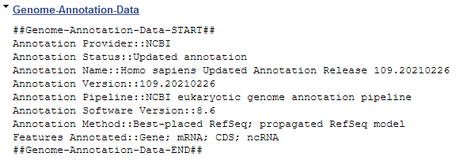
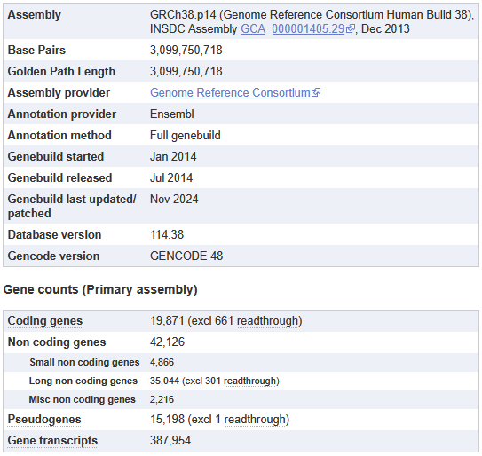
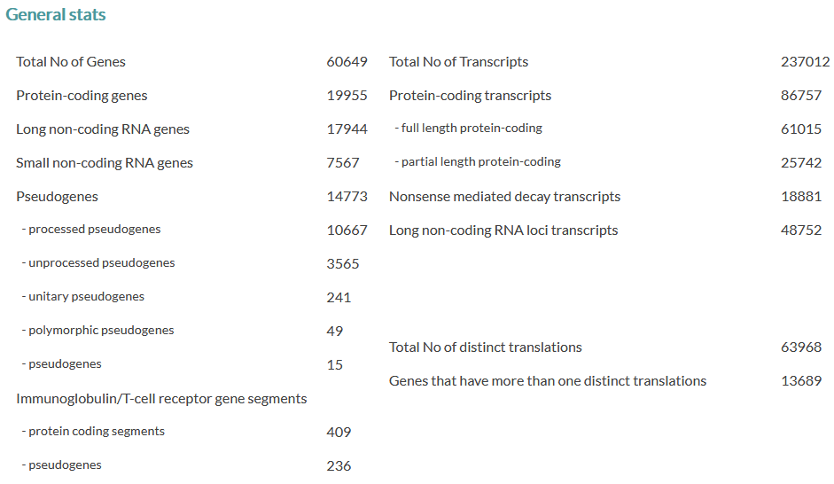
Genome Annotation Details

Slide 11
Viewing Annotated Genomes
Mostly web based
  Species specific sites
  Generic multi-species sites
Often adds more information
  Regulation, conservation, repeats
  Experimental datasets
  Upload your own

Slide 12



Species specific genome viewer sites
Arabidopsis
https://www.arabidopsis.org
Drosophila
https://flybase.org/
Nematode worms
https://wormbase.org

Slide 13


Generic genome viewer sites
Ensembl
https://www.ensembl.org
UCSC Browser
https://genome.ucsc.edu
WashU Browser
https://epigenomegateway.wustl.edu/

Slide 14
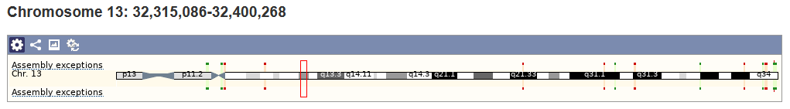
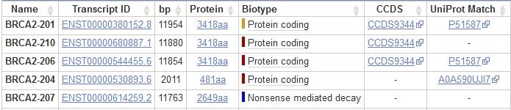
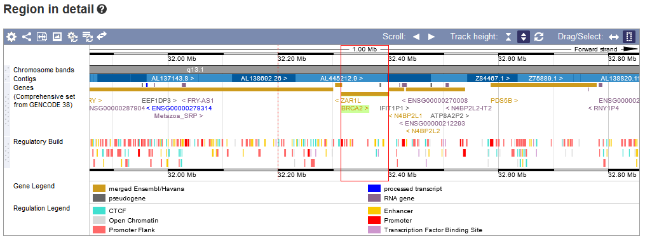
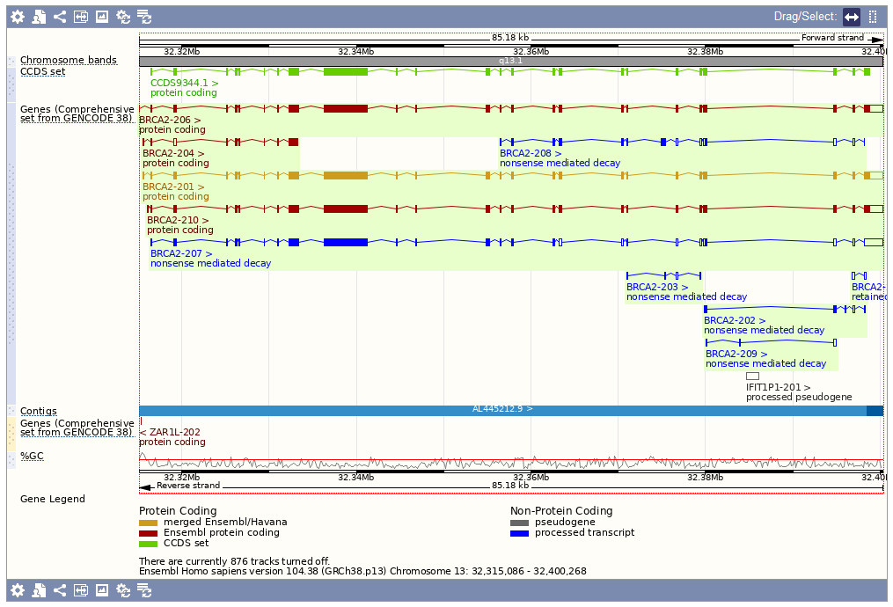
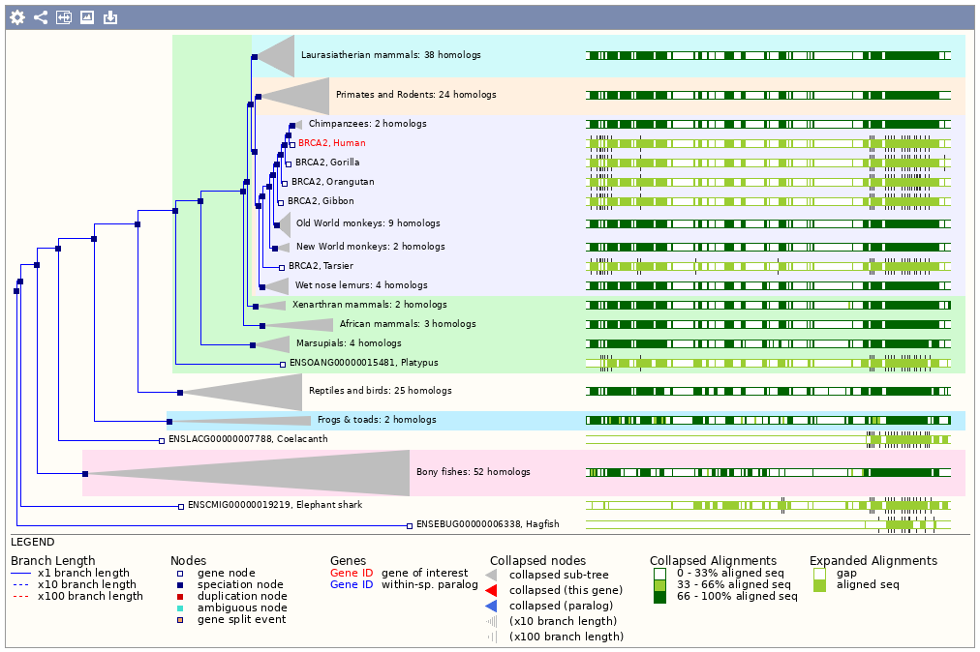

Slide 15
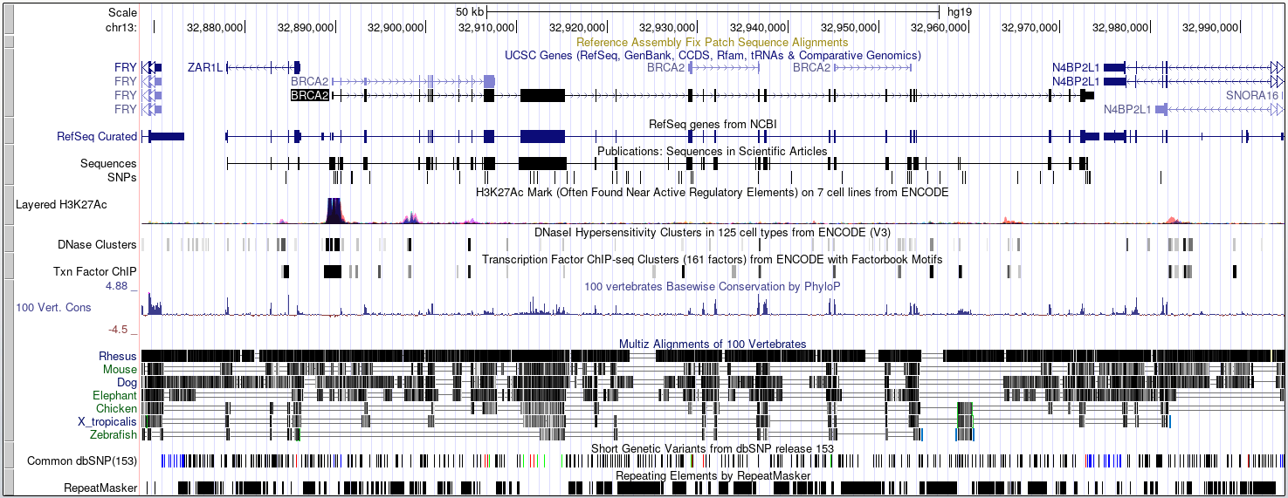
Track Based Displays

Slide 16


Large Scale Queries
Large scale querying and export of genomic data
Annotations, Sequences, Variants etc.
  Select data type (eg genes)
  Select genome species
  Select genes / regions / identifiers
  Select attributes to export
  Generate report

Slide 17
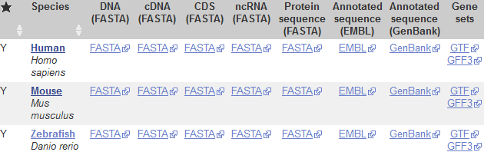
Genome File Formats
Genome Assemblies
  Chr sequence, FastA format
  A small header plus DNA bases
  Also used for RNA / protein
Gene Annotations
  GFF or GTF format (both very similar)
  Hierarchical format linking exons to transcripts to genes
https://www.ensembl.org/info/data/ftp/index.html

Slide 18
FastA Format Data
>I dna:chromosome chromosome:R64-1-1:I:1:230218:1 REF
CCACACCACACCCACACACCCACACACCACACCACACACCACACCACACCCACACACACA
CATCCTAACACTACCCTAACACAGCCCTAATCTAACCCTGGCCAACCTGTCTCTCAACTT
ACCCTCCATTACCCTGCCTCCACTCGTTACCCTGTCCCATTCAACCATACCACTCCGAAC
CACCATCCATCCCTCTACTTACTACCACTCACCCACCGTTACCCTCCAATTACCCATATC
>II dna:chromosome chromosome:R64-1-1:II:1:813184:1 REF
AAATAGCCCTCATGTACGTCTCCTCCAAGCCCTGTTGTCTCTTACCCGGATGTTCAACCA
AAAGCTACTTACTACCTTTATTTTATGTTTACTTTTTATAGGTTGTCTTTTTATCCCACT
TCTTCGCACTTGTCTCTCGCTACTGCCGTGCAACAAACACTAAATCAAAACAATGAAATA
CTACTACATCAAAACGCATTTTCCCTAGAAAAAAAATTTTCTTACAATATACTATACTAC

Slide 19
Annotation Descriptions
Gene
Exon (combined into transcript)
Coding Exon

Slide 20
GTF
GTF File Fields
Chromosome
Source
Feature Type
Start
End
Score
Strand (+/-)
Frame (1,2,3)
Group/Attributes
Targeted at gene structure definition
Tab delimited text file
Multi-level structure
  Genes > Transcripts > Exons
1 havana gene 11869 14409 . + . gene_id "ENSG223972"; gene_name "DDX11L1";
1 havana transcript 11869 14409 . + . gene_id "ENSG223972"; transcript_id "ENST456328"; transcript_name "DDX11L1-202";
1 havana exon 11869 12227 . + . gene_id "ENSG223972"; transcript_id "ENST456328"; exon_number "1"; exon_id "ENSE2234944";
1 havana exon 12613 12721 . + . gene_id "ENSG223972"; transcript_id "ENST456328"; exon_number "2"; exon_id "ENSE3582793";
1 havana exon 13221 14409 . + . gene_id "ENSG223972"; transcript_id "ENST456328“; exon_number "3"; exon_id "ENSE2312635";

Slide 21
Genome Exploration Exercise

Slide 22
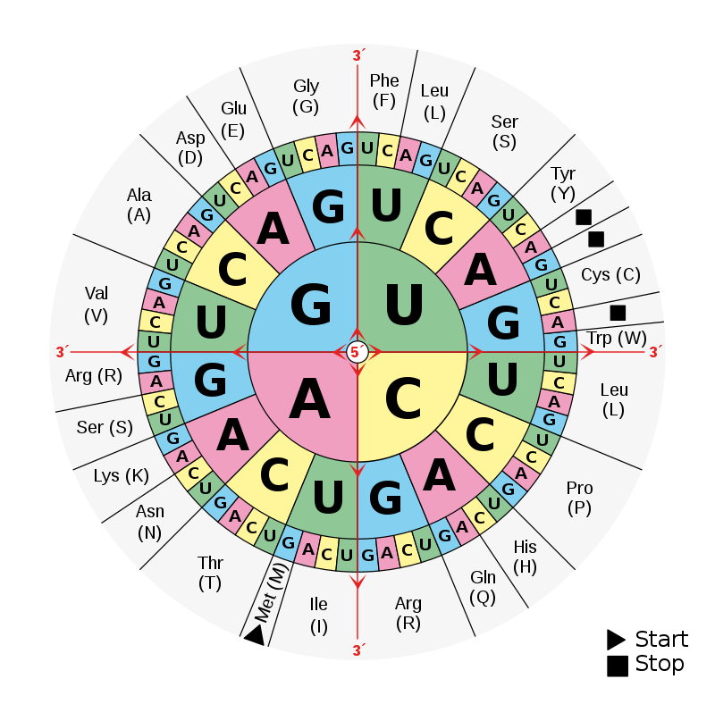
mRNA Translation into Protein
Start Codon
Stop Codon
GACACC ATG AGC ACT GAA ... CTG TGA
Met Ser Thr Glu Arg Stp
UTR
Most species use the same code
Some have minor differences
https://www.ncbi.nlm.nih.gov/Taxonomy/Utils/wprintgc.cgi

Slide 23
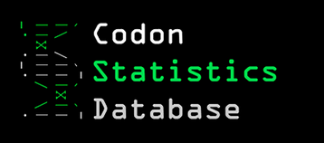
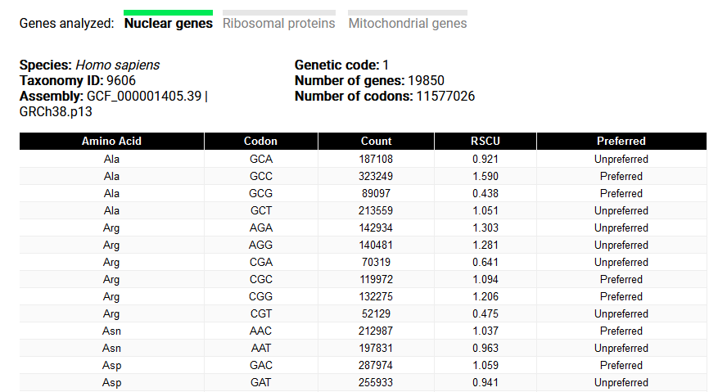
Codon Usage

Slide 24
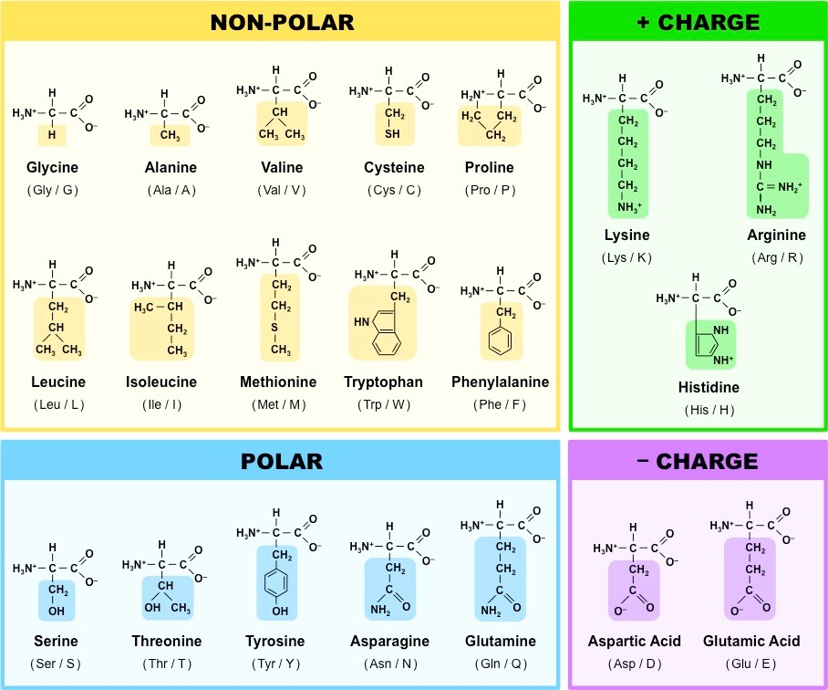
Often
internal
Often
Binding or catalytic sites
Often
surface

Slide 25

Protein Domain Information
A single protein can have more than one functional unit
  Proteins are annotated with functional ‘domains’
  A domain is normally linked with a globular folded structure
Domain structures are re-used to provide modular functionality across multiple proteins.
  Often linked to exon structures or splice variation
It can be useful to know the key functional amino acids
  Binding pockets
  Active sites

Slide 26


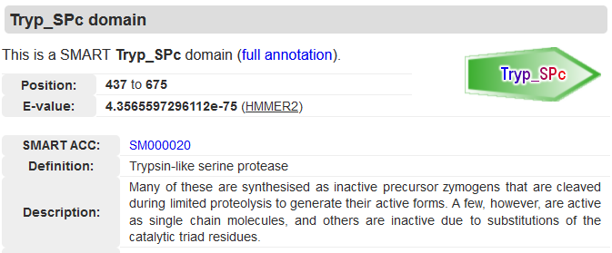

Protein Domain Databases
http://smart.embl-heidelberg.de/
https://www.ebi.ac.uk/interpro/

Slide 27
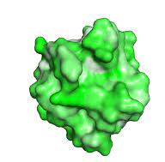
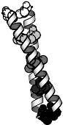
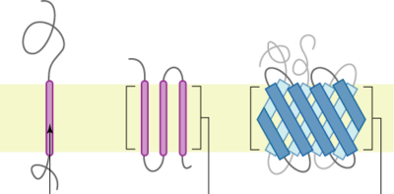
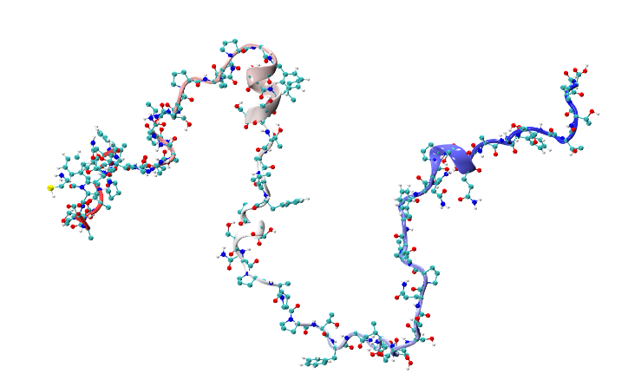
Types of domain
Globular
  Forms a concerted 3D structure
  Most catalytic and some binding domains
Semi-ordered
  Coiled coil
  Many binding domains
Transmembrane
  Threaded through a membrane
  Transmembrane regions, then internal and external segments
Disordered / Low Complexity
  Linker regions
  Intrinsically disordered proteins

Slide 28


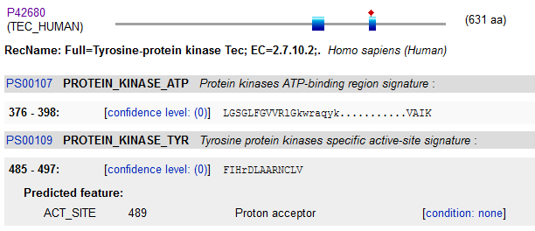
Key Residue Databases

Slide 29
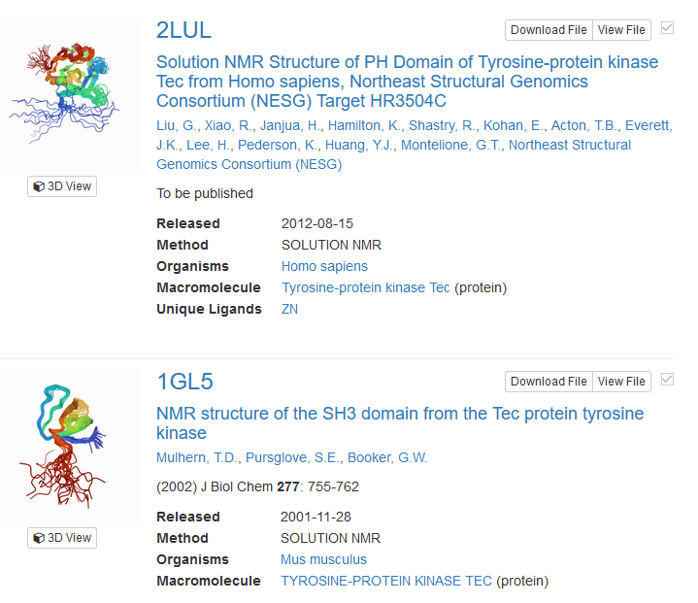
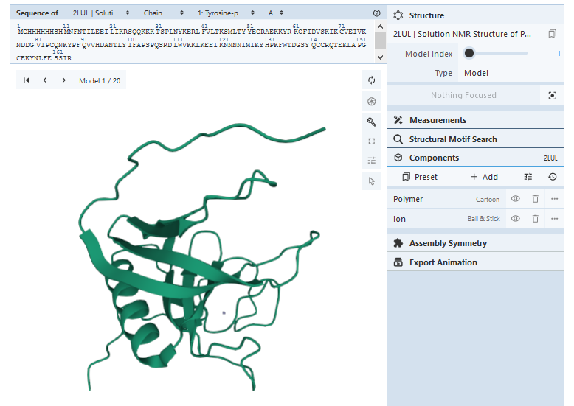
Protein Structure Databases

Slide 30


Protein Structure Classification Databases
https://scop.mrc-lmb.cam.ac.uk/
https://www.cathdb.info/

Slide 31
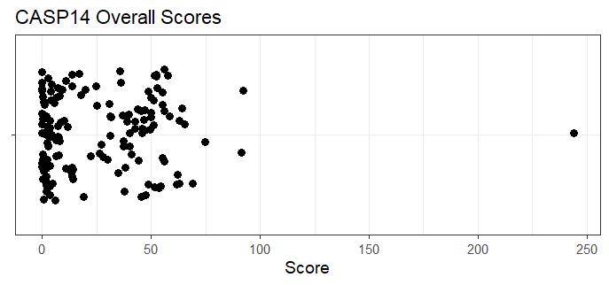
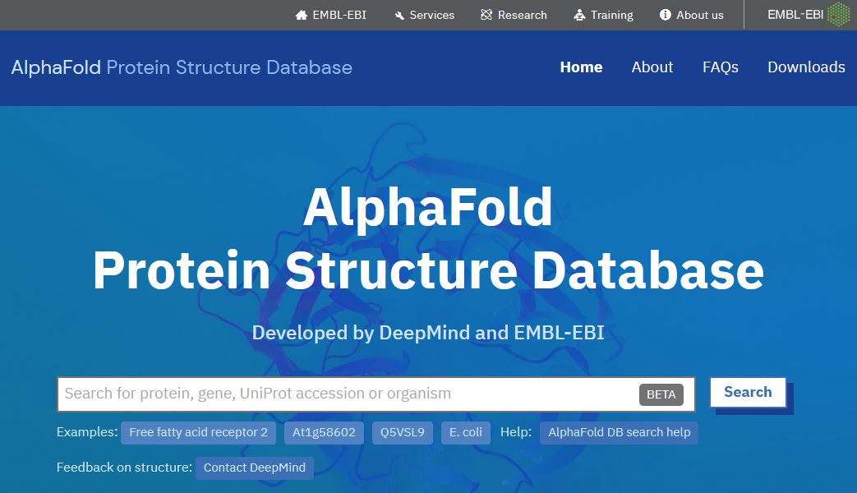

Predicted Structure Database
Currently (Mar 2022), only 7914/22818 protein coding genes have an experimental 3D structure available
https://alphafold.ebi.ac.uk/

Slide 32
Protein Annotation Exercise

Slide 33
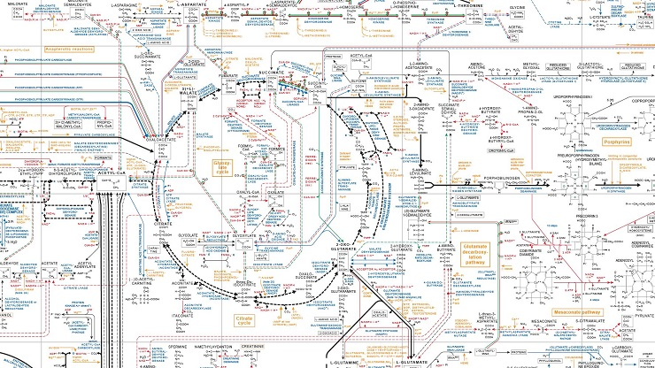
Pathways

Slide 34
Hierarchy of Reaction Annotations
Components (Reactants / Products)
Proteins (Enzymes)
Reactions
Pathways
Processes
X
A + B C + D
Y
D + E F + G

Slide 35

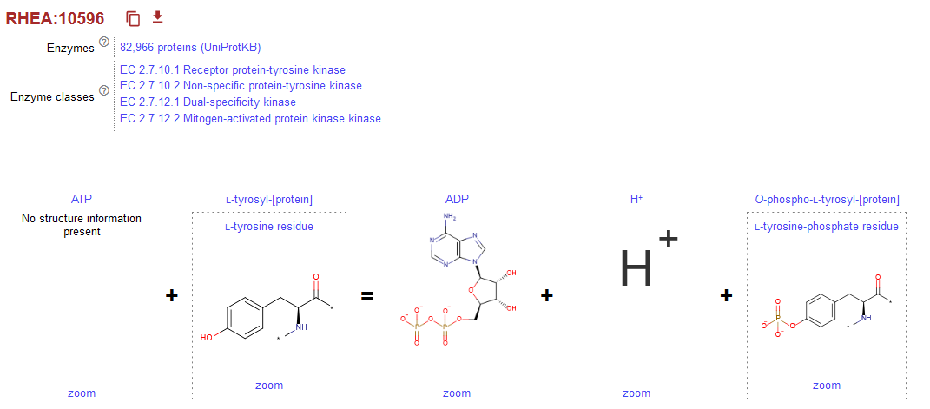
Reactions

Slide 36
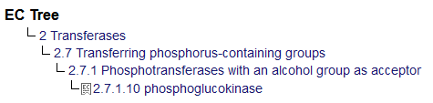

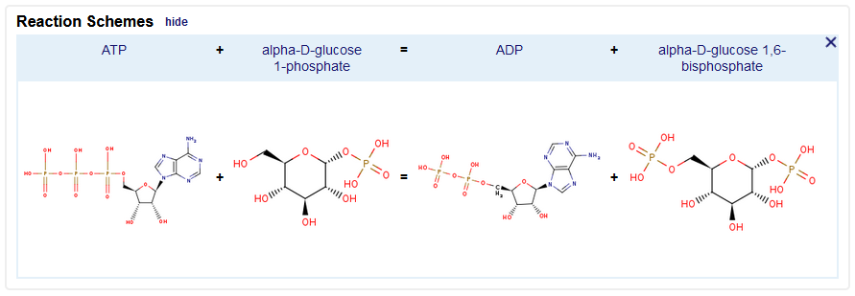

Enzyme Databases
Enzymes are described by an Enzyme Commission (EC) number
  EC 2.7.1.10 is phosphoglucokinase
  Hierarchical structure
Main Enzyme databases
  Expasy Enzyme

Slide 37

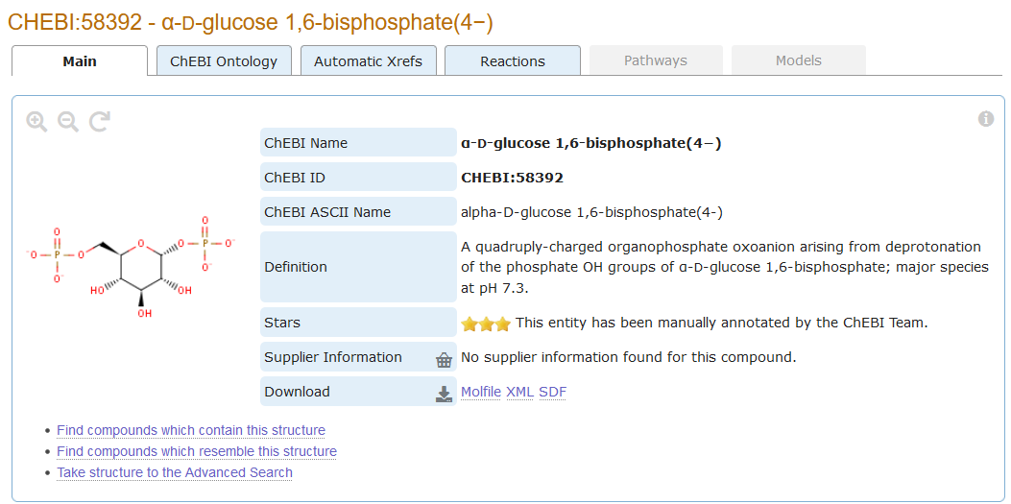
Chemical entities of biological interest
A database of "small" molecules with biological relevance
Natural or synthetic products which intervene in the processes of living organisms

Slide 38
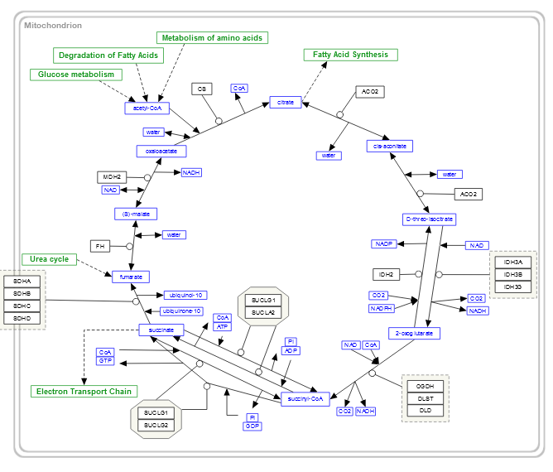



Pathways

Slide 39
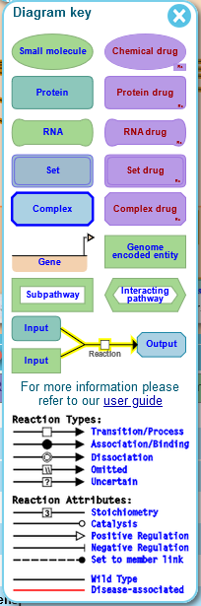
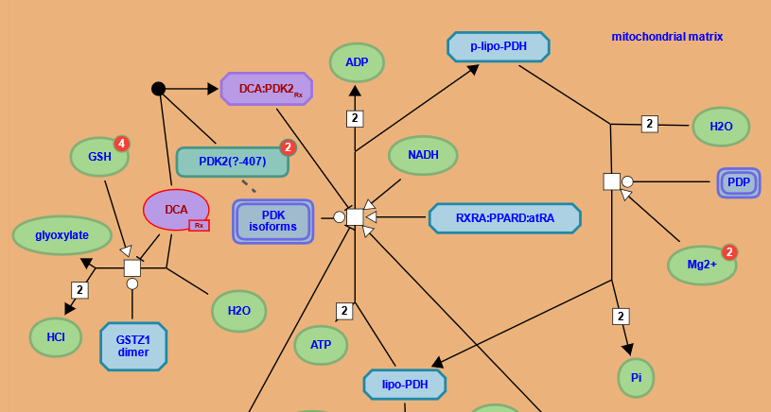
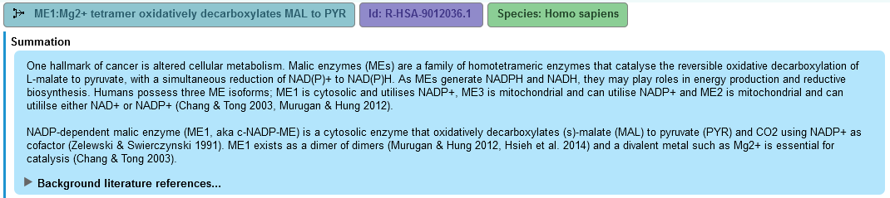
Reactome

Slide 40
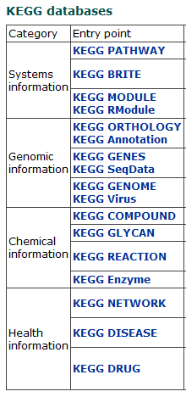
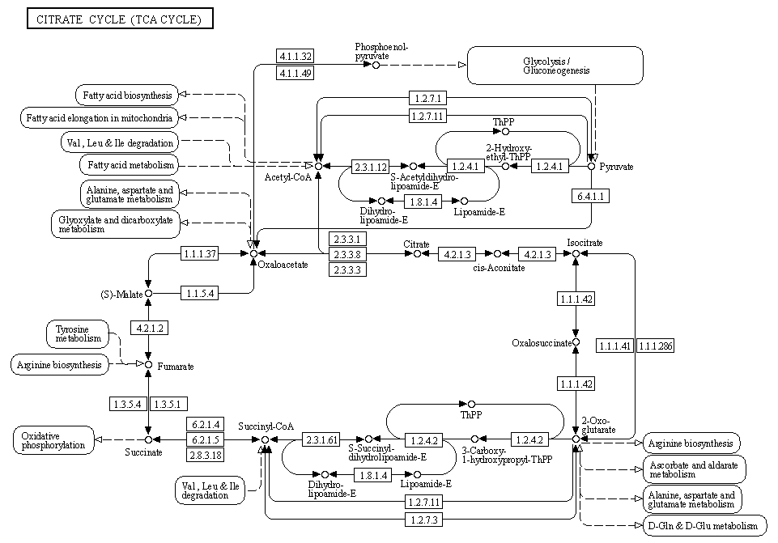
KEGG

Slide 41
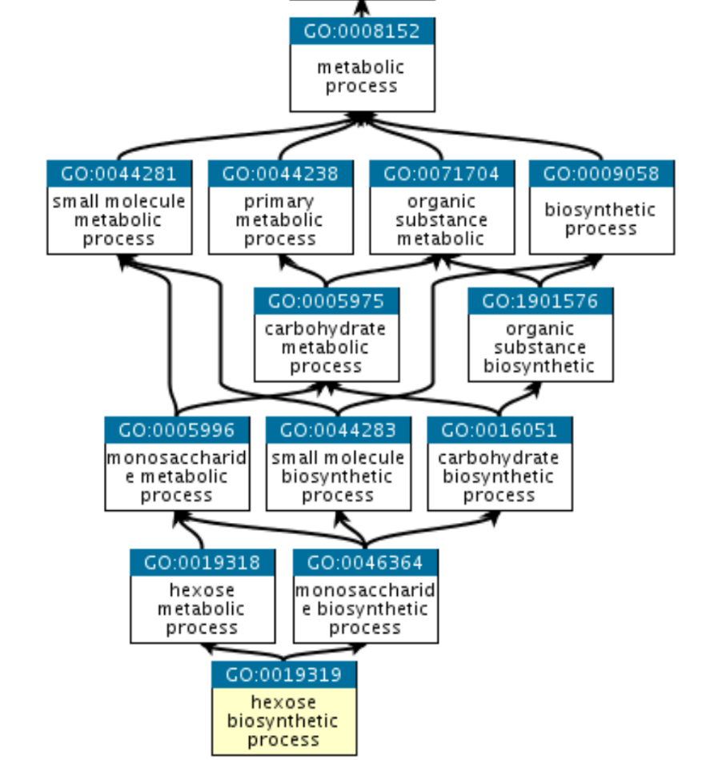
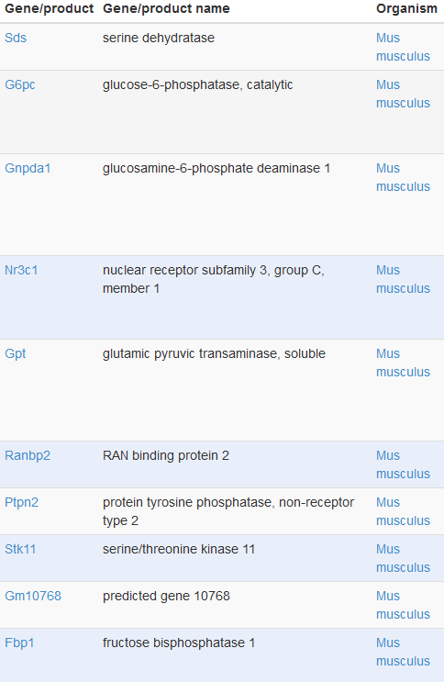
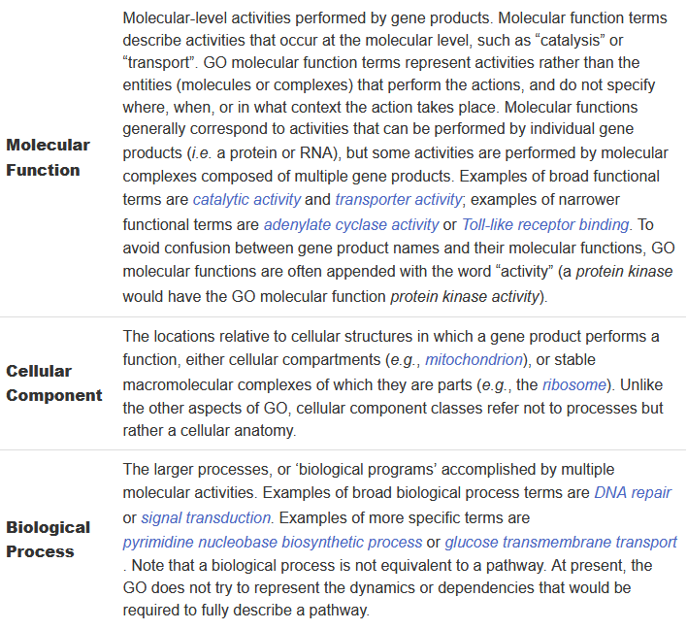
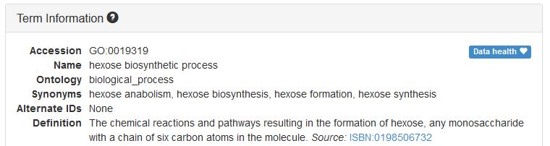
Functional Gene Sets

Slide 42
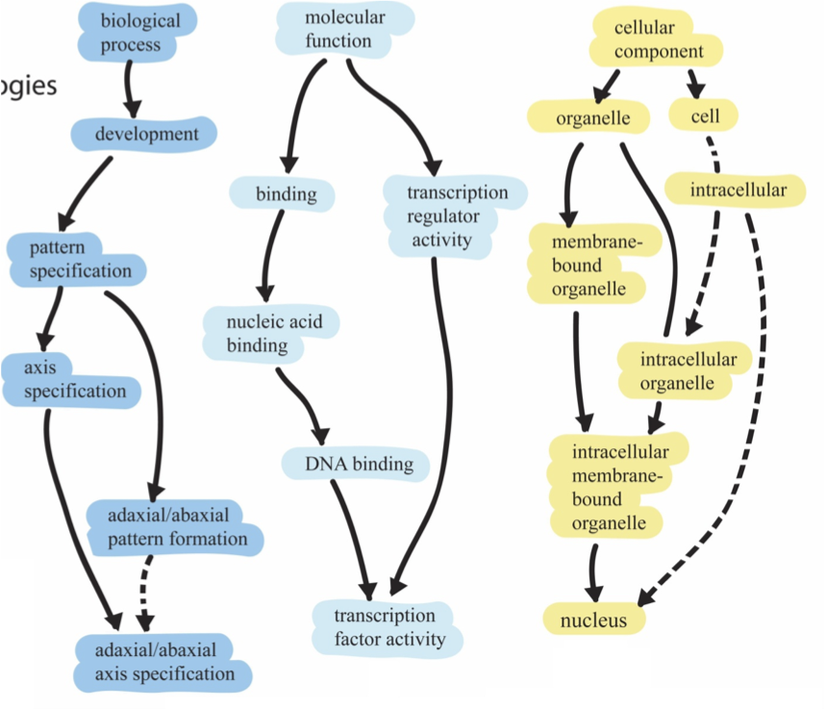
1
2
3
Root ontology terms
big
general
Parent
small
Child
specific

Slide 43
Genes assigned to ontology terms
Nanog homeobox [Source:HGNC Symbol;Acc:HGNC:20857]
Cellular Component
  GO:0005634 nucleus
  GO:0005654 nucleoplasm
  GO:0005730 nucleolus
Molecular Function
  GO:0003677 DNA binding
  GO:0003700 transcription factor activity, sequence-specific DNA binding
  GO:0003714 transcription corepressor activity
  GO:0005515 protein binding
  GO:0043565 sequence-specific DNA binding
Biological Process
  GO:0001714 endodermal cell fate specification
  GO:0006351 transcription, DNA-templated
  GO:0006355 regulation of transcription, DNA- templated
  GO:0007275 multicellular organism development
  GO:0008283 cell proliferation
  GO:0019827 stem cell population maintenance
  GO:0030154 cell differentiation
  GO:0035019 somatic stem cell population maintenance
  GO:0045595 regulation of cell differentiation
  GO:0045944 positive regulation of transcription from RNA polymerase II promoter
  GO:1903507 negative regulation of nucleic acid-templated transcription

Slide 44
Reactions and Pathways Exercise

Slide 45
Regulation and Interactions
The regulation of genes is as important as their structure or function
Several sources of useful information
  Regulatory binding proteins, mostly transcription factors
  Interactions with other proteins to form complexes
  Composition of known complexes

Slide 46

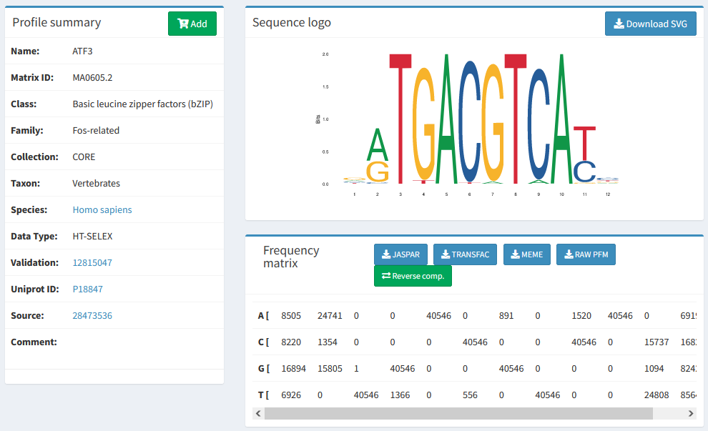
Transcription Factor Information

Slide 47

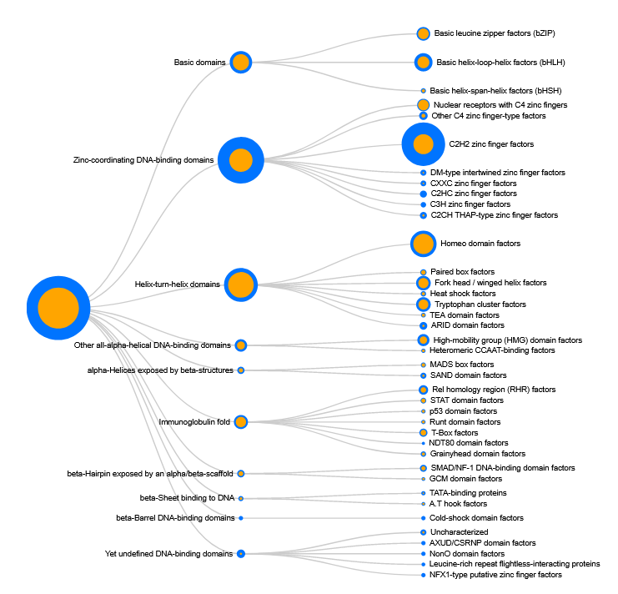
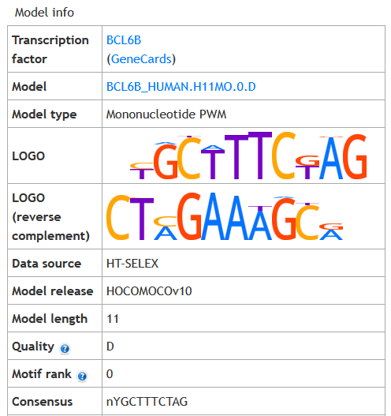
Transcription Factor Information

Slide 48

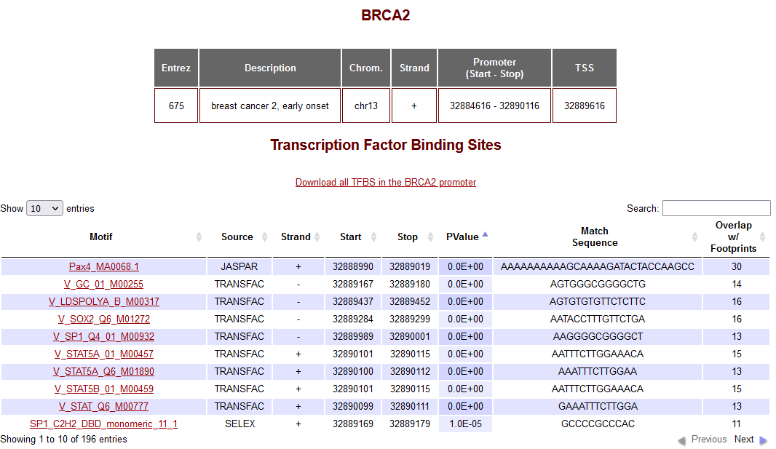


Genes Regulated by a Transcription Factor
Difficult to predict - lots of false positives
  Swiss Regulon

Slide 49
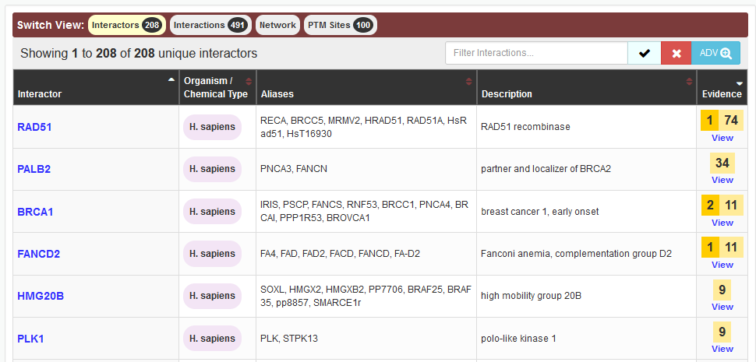

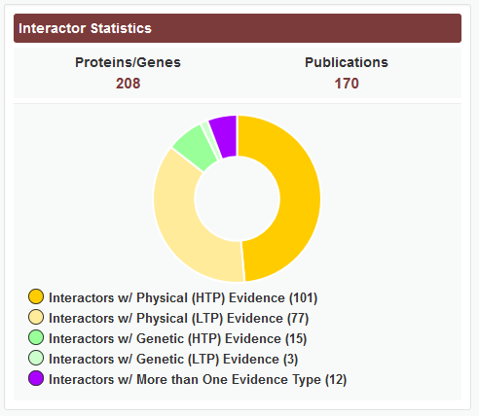

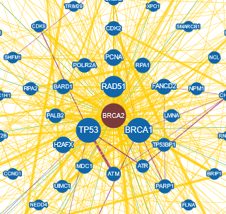

Gene Interactions
Many genes form stable or transitory interactions with others
Knowing the genes that interact helps understand biology

Slide 50
Types of Interaction
Physical
  Two proteins directly interact, either stably or transiently
Genetic
  One gene influences another, normally after modification
    Co-expression
    Knockout compensation

Slide 51
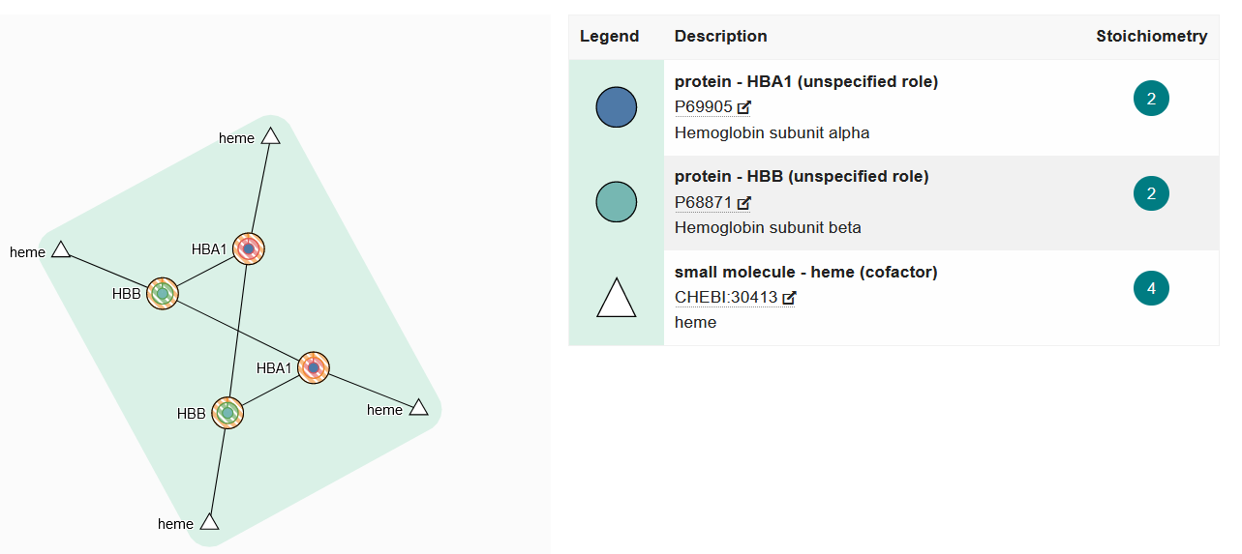

Complex Prediction
Many proteins interact with several others, but at different times
Complexes suggest that multiple proteins directly associate
  Can't always be clearly predicted from pairwise interactions
  Other experimental methods are required

Slide 52
Regulatory Information Exercise

Slide 53
Sequence Variants

Slide 54
Sequence Variants
Reference GATCTTAGCTGA
Variant GATCTTACCTGA
Germline variants
  Happen in sperm or eggs
  Completely inherited into the next generation
  Can cause genetic disease
Somatic variants
  Happen in other tissues
  Partially penetrant
  Common cause of cancer

Slide 55
Types of Variant
Ref GATCTTAGCTGA
Var GATCTTACCTGA
Substitution
Single Nucleotide Polymorphism
SNP
Ref GATCTTAG..CTGA
Var GATCTTACAA CTGA
Insertion
InDel
Ref GATCTTAGCTGA
Var GATCTTAC..GA
Deletion

Slide 56
Functional Variant Consequences
Within Coding Region
  Silent (codon changes, but same translation)
  Missense (change translation from one amino acid to another)
  Nonsense (change translation from one amino acid to STOP)
  Frameshift (InDel changing the translation frame)
Outside CDS
  Breaks or adds splice junction
  Changes functional binding site

Slide 57
Structural variants
Chromosomal copy number change
  Gain or loss of a chromosome
  Leads to serious genetic disease
Segmental Deletion / Duplication
  Large parts of chromosomes deleted, duplicated, inverted, translocated
  1kb to 3Mbp
  Affects many genes, can lead to gene fusions

Slide 58
Databases of Variants
Common genomic variants
  Measured across a large population
  Shows natural variation
  Not necessarily linked to disease
  Used for studying populations and families
Functional variants
  Variants with an associated phenotype
  Often disease related but can be any measurable phenotype

Slide 59
Variant Databases
Single Variants
  dbSNP (https://www.ncbi.nlm.nih.gov/snp/)
    Full reference for any reported SNPs, mix of functional and non-functional
  HGMD (http://www.hgmd.cf.ac.uk)
    Human genetic disease focussed database
  COSMIC (https://cancer.sanger.ac.uk/cosmic)
    Mutations observed in Cancer
    Also has details of mutations in immortalised cell lines
Larger Regions
  dbVar (https://www.ncbi.nlm.nih.gov/dbvar/)
    Counterpart to dbSNP for larger variants
  ClinVar (https://www.ncbi.nlm.nih.gov/clinvar/)
    Larger variants with clinical relevance
  OMIM (https://www.ncbi.nlm.nih.gov/omim)
    A more wide ranging collection of the phenotypic variation linked to genes

Slide 60
Variant Terminology
Minor Allele Frequency (MAF)
  How prevalent the variant is in the population
Impact scores (SIFT / PolyPhen etc)
  A quantitative value assessing the likely biological impact of a variant

Slide 61
Variant Exercise

Slide 62
Other Information and Data Sources

Slide 63

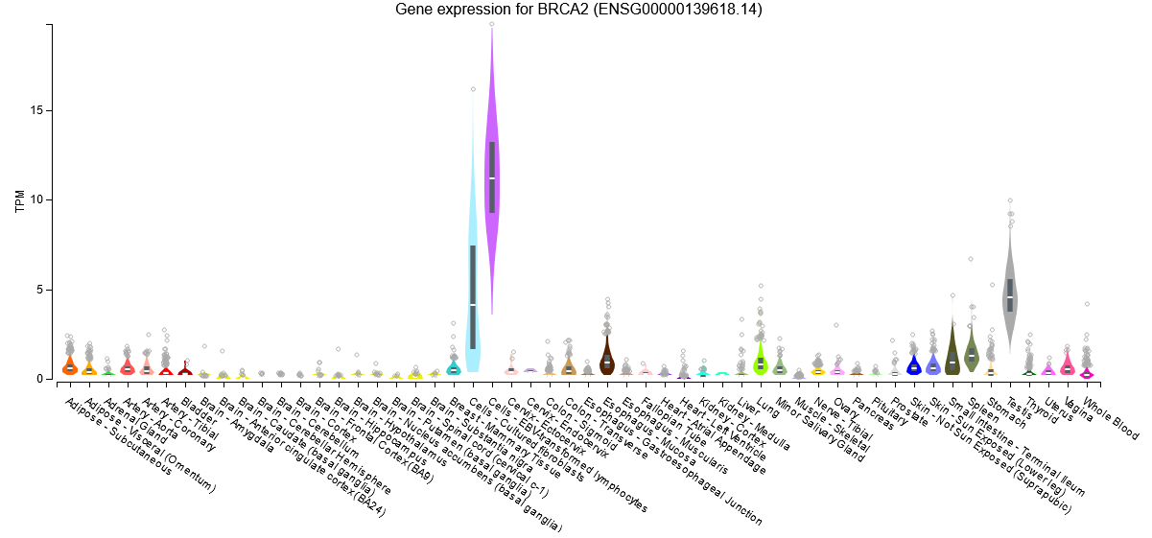
Gene Expression Information

Slide 64

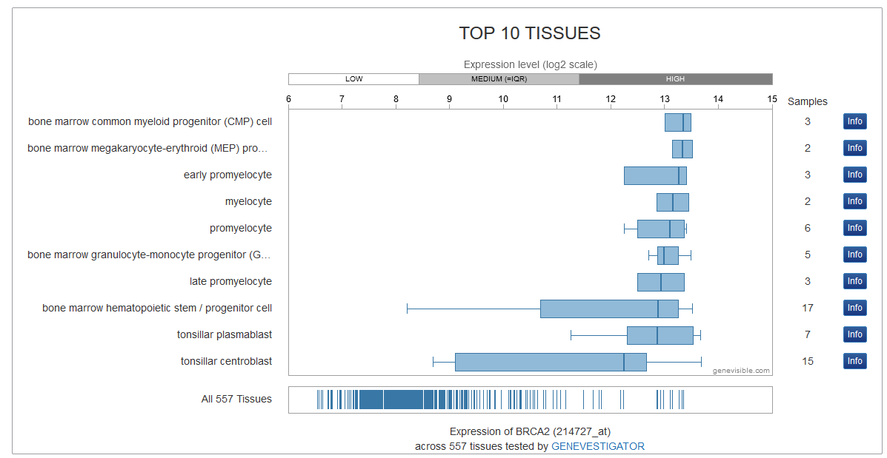
Gene Expression Information

Slide 65



Gene Expression Information

Slide 66

Post translational Modifications
Many proteins are modified after they have been translated
  Phosphorylation
  Glycosylation
  Ubiquitination
  Nitrosylation
  Methylation
  Acetylation
  Lipidation
  Proteolysis
Both PTMs observed on a protein and proteins modified by a query gene.

Slide 67



Combined Gene/Protein Centric Datasources
https://www.uniprot.org/
https://www.genecards.org
Gene
https://www.ncbi.nlm.nih.gov/gene/
https://www.wikigenes.org/

Slide 68



Disease Relevance
High Impact publication summaries
Biological Context
Anatomical Context
Chemical Compound Associations
Physical Interactions
Enzymatic Interactions
Regulatory relationships
Analytical, diagnostic and therapeutic context
References

Slide 69
Experimental Data Types and Repositories
Simon Andrews, Chris Hall, Judith Webster, Eoin Fahy, Laura Biggins, Hanneke Okkenhaug, Simon Walker

Slide 70
Big Data Generation
High throughput sequencing
  Genomics, Transcriptomics, Epigenetics
Multi-channel Flow Cytometry
  Cell surface proteomics
Mass Spectrometry
  Proteomics, Metabolomics
Biological Imaging
  Cell / Tissue structure, Proteomics, Metabolomics

Slide 71

Data Repositories
For many techniques deposition of data in a suitable repository is a condition of publication
Repositories are more developed and complete for some techniques than others
Still a growing area

Slide 72
FAIR Data Principles
Designed to make data as useful as possible to future researchers
  Findable
    Unique accession code
    Rich metadata
  Accessible
    Automated query and download API
  Iteroperable
    Use of open formats
    Standard Ontologies for descriptions
  Reusable
    Clear licensing
    Annotated to common community standards

Slide 73




High Throughput Sequencing
ONT MinION
PacBio Revio
Illumina NovaseqX
Element Aviti

Slide 74
Data Generation Capacity

Slide 75
What can you measure?
Genomics
  Whole genome sequencing, Targeted Sequencing
Transcriptomics
  RNA-Sequencing
Regulation
  Accessible DNA (ATAC-Seq), Histone Modifications, Transcription Factor binding sites
Epigenetics
  DNA Methylation, Chromatin Structure

Slide 76
Types of Sequencing Library
DNA-Based
  Genome-Seq: Variants
  Exome-Seq: Variants
  ATAC-Seq: Accessible DNA
  ChIP, Cut n Run:
    DNA binding sites
    Epigenetic Marks
    Polymerase Attachment
  BS-Seq, EM-Seq: DNA Methylation
  3C, 4C, Hi-C: Genome Structure
  TrAEL-Seq: DNA-replication
RNA Based
  RNA-Seq: RNA transcription
  Ribo-Seq: Ribosome attachment
  CAGE-Seq: Transcription start sites
  VDJ-Seq: Antibody repertoires
  CLIP-Seq: RNA-binding protein sites
  sRNA-Seq: Small RNA abundance
  SLAM-Seq: RNA dynamics

Slide 77
Genome Sequencing
DNA
Fragment DNA (Sonnication, Tagmentation)
Size Select
Hybridise to Capture Baits for Exons
Sequence Everything
Whole Genome Sequencing (WGS)
Shotgun sequencing
Sequence Captured Material
Whole Exome Sequencing (WES)

Slide 78
RNA-Sequencing
rRNA depleted mRNA
Fragment
Random prime + RT
2nd strand synthesis (+ U)
A-tailing
Adapter Ligation
(U strand degradation)
Sequencing
NNNN
u
u
u
u
u
u
u
u
A
A
T
u
u
u
u
A
A
T
A
T
Notes:
Point out parts in library prep which are relevant later on.
Start with single strand RNA.
Can't sequence because it's RNA and too long
Must fragment to make short bits
Must convert to DNA, but that loses directionality - which is bad.
Random priming and RT (causes biases later)
Normal Illumina library prep once double stranded.
Can retain strand information by tagging and degrading one of the stands. Which one determines same strand or opposing strand specific libraries.

Slide 79
Enrichment Sequencing
DNA
Cross-link proteins to DNA
DNA
Fragment DNA (sonication, MNase etc)
Capture
Y
Y
Y
Y
Y
Y
Y
Y
Elute
Remove Crosslinks
Size Select
Add Adapters
Sequence

Slide 80

Bisulphite/EM Sequencing
me
me
CCAGTCGCTATAGCGCGATATCGTA
Convert
TTAGTTGCTATAGTGCGATATTGTA
Map
TTAGTTGCTATAGTGCGATATTGTA
|||||||||||||||||||||||||
...CCAGTCGCTATAGCGCGATATCGTA...

Slide 81

10X Single Cell RNA-Seq
RT Reagents
Oil
Cells
Barcoded Beads
Gel Beads in Emulsion (GEMs)

Slide 82
10X Single Cell RNA-Seq Adapter System
Oligo dT
UMI (all different)
Cell barcode (same within GEM)
Priming site

Slide 83



Multi-measure single cell

Slide 84

Spatial Transcriptomics
10X Visium
Nanostring CosMX
Vizgen Merscope

Slide 85
FastQ Format Data
@HWUSI-EAS611:34:6669YAAXX:1:1:5069:1159 1:N:0:
TCGATAATACCGTTTTTTTCCGTTTGATGTTGATACCATT
+
IIHIIHIIIIIIIIIIIIIIIIIIIIIIIHIIIIHIIIII
@HWUSI-EAS611:34:6669YAAXX:1:1:5243:1158 1:N:0:
TATCTGTAGATTTCACAGACTCAAATGTAAATATGCAGAG
+
DF=DBD<BBFGGGGGGGBD@GGGD4@CA3CGG>DDD:D,B
@HWUSI-EAS611:34:6669YAAXX:1:1:5266:1162 1:N:0:
GGAGGAAGTATCACTTCCTTGCCTGCCTCCTCTGGGGCCT
+
:GBGGGGGGGGGDGGDEDGGDGGGGDHHDHGHHGBGG:GG

Slide 86




Public Sequencing Databases
GEO (NCBI)
Array Express (EBI)
  Databases for quantitated sequencing data. Provide experimental annotation and metadata and processed quantitated data
SRA (NCBI)
ENA (EBI)
  Provide raw sequencing data as fastq files

Slide 87


Accession Codes
GSExxxx
GEO Study
GSMxxxx
GEO Sample
Sequence Data
SRPxxxx
SRA Study
SRXxxxx
SRA Experiment
SRRxxxx
SRA Run

Slide 88





Slide 89



Slide 90



sradownloader SRR9924120

Slide 91
Sequencing Data Exercise

Slide 92

Flow Cytometry

Slide 93
Flow Cytometry

Slide 94

Small Scale Measurement
https://flowjo.com

Slide 95
Using Flow for Sorting Cells
Cell subpopulations
CRISPR screens
Cow sexing!

Slide 96

Large Scale Measurement
https://doi.org/10.3389/fimmu.2019.01194

Slide 97


Problems with multiple fluorescent markers
Traditionally filters measure one wavelength per fluor
Spectral Flow Cytometry measures the whole spectrum and can deconvolve overlapping emissions spectra
Allows for 40+ markers to be used simultaneously.
Nd
Tb
Ba
Lu

Slide 98

Public Flow Data Repository
Deposition of FCS files
  Instrument details
  Raw data
  Analysis details
Basic description of experiment structure

Slide 99



Slide 100
Flow Exercise

Slide 101
Mass Spec
General purpose method to measure the accurate masses of small molecules
Can be used to identify
  Proteins (plus modifications)
  Metabolites
    Sugars
    Nucleotides
    Amino Acids
    Lipids

Slide 102




Protein Mass Spec
Proteins
Peptides
A peptide
Digest
Separate
Too Big
Too Many
Non-specific

Slide 103
Protein Mass Spec Workflow
Digestion
Separation
Protein Mix
Peptide Mix
Chromatography
Column (s)
Fragmentation
Peptide Masses
Plus Retention
Identification
Mass Spec

Slide 104

Protein Mass Spec Results
https://www.maxquant.org/

Slide 105

Protein Identification
http://www.ohri.ca/proteomics/

Slide 106
Post Translational Modifications
When doing tandem mass spectrometry you can also identify modified peptides
Phosphorylation
Acetylation
Methylation
Palmitylation
Acylation
Ubiquitination
etc.

Slide 107



High throughput proteomics
30 samples per day Evosep workflow, >12 000 proteins were identified in 48 h of mass spectrometry time
10,000 proteins per sample
37,000 phosphosites per sample

Slide 108


Expanding Mass Spec Technology
1,400 proteins measured from a single cell
Mass Spectral Imaging
Fix a sample to a surface and then do scanning
Ionisation over it to get a spectrum for each point.
You can then pick any fragment and image its
distribution over the original sample

Slide 109

Data Repositories for Proteomics Mass Spec

Slide 110
Data Repositories for Proteomics Mass Spec
Varying amounts of experimental annotation
Good description of processing and preparation
Raw data files available
  Mass spec still uses a lot of proprietary vendor file formats
  Open mzML format is defined but often not used
  Converters exist but often lose information.

Slide 111






Slide 112
Metabolite Mass Spectrometry
Similar concepts to protein mass spec
Range of starting material
  Serum
  Urine
  Cerebrospinal fluid
  Saliva
Different separations
Up to 5000 different metabolites to find

Slide 113

Data Repository for Metabolomics Data
Reference spectra for biological molecules
  Used for searching and quantitation
Experimental datasets of MassSpec Studies
  Used to answer biological questions
  Also provides visualisations and tools

Slide 114



Metabolomics Workbench

Slide 115
Mass Spec Data Exercise

Slide 116


Imaging Analysis
What can you measure with imaging?
Cell structure and morphology
  In both live and fixed cells
Targeted molecules (fluorescence microscopy)
  Antibodies to proteins
  Fluorescent fusion proteins
Functional readouts
  Redox state
  pH

Slide 117

Types of Microscopy
Light Microscopy
  Sample is illuminated, some light goes to the viewer
  Biological samples are generally clear, so hard to see
  Can use stains (often toxic) or reflection or phase shift to see better
https://zeiss-campus.magnet.fsu.edu/articles/basics/contrast.html

Slide 118

Types of Microscopy
Fluorescence Microscopy
  Uses molecules which excite at one wavelength and emit at another
  Allow the tagging of specific biological molecules
  Confocal microscopes allow clear views of a single plane in the sample
DOI:10.3390/ijms20082033

Slide 119

Ultra-plex fluorescence imaging
Simon Walker – BI Imaging Facility

Slide 120


Types of Microscopy
Electron Microscopy
  Fixed and processed samples only (not live)
  Very high resolution
https://www.ncl.ac.uk/emrs/

Slide 121


High Content Imaging
Microscopy traditionally operated on small numbers of individual samples
Improved equipment and automation now allows for more ambitious studies
  384 well plates
  30 images per well
  5 different markers
  Thousands of images
  Hundreds of measured features per cell

Slide 122


Imaging Flow Cytometry
High Content Imaging from Flowed Cells
Up to 5000 cells per second
Automated real-time feature extraction

Slide 123
High Content Applications
Screening for drugs with specific phenotypic effects
Measuring CRISPR library phenotypes
Measuring RNAi library phenotypes

Slide 124




Slide 125




Image Data Resource

Slide 126
Imaging Data Exercise

Slide 127
Computational Environments for Processing and Analysing Big Data
Simon Andrews

Slide 128
Computation for Big Data
Physical
  What sort of machine / storage can I use?
  What will I need?
Software
  What programs exist to process / analyse my data?
  What operating system will they run under?
Programming / Analysis
  How can I write new analysis tools or perform programmatic analyses?

Slide 129
Topics for Today
Running programs in a command line environment
How to select which programs / methods to use?
Programmatic analysis with R and Tidyverse
Developing new analysis tools with python

Slide 130
Big Data Operating Systems

Slide 131







What (exactly) is Linux?

Slide 132


Why Linux?
Programs are long running and require automation
  Need a command line driven operating system
  Easy text based remote access
Computers need to operate at scale
  Free and open source are a real benefit
  Can tinker with everything to tune performance

Slide 133
Types of Linux installation
Bare metal
  Physical hardware
  CD / DVD / USB / Network installation
  Can be physically accessible (desktop) or remote (server / cluster)
Virtual Machine
  Runs within another operating system
  Portable / disposable
  Install from ISO / Network
Cloud
  Virtual machine on someone else's hardware
  Amazon / Google are the main providers
  Range of available hardware and OS images available
  Pay by the hour

Slide 134


Single Machines vs Clusters
1 physical box
28 CPU cores
512GB RAM
20 physical boxes
~700 CPU cores
7TB RAM

Slide 135

Cluster Queues
fastqc data.fq.gz
ssub
-o f.log
--cores=2
--mem=5G
fastqc data.fq.gz

Slide 136


Workflows
Larger Scale Automation
Multiple Programs
Multiple Files
Integrates with Clusters
nf_rnaseq --genome GRCh38 *fastq.gz

Slide 137



executor > slurm (21)
[15/929bd5] process > FASTQC (lane8_DD_P9_TGACCA_L008) [100%] 4 of 4 ✔
[b9/674ced] process > FASTQ_SCREEN (lane8_FF_P4_ATCACG_L008) [100%] 4 of 4 ✔
[ca/b39d14] process > TRIM_GALORE (lane8_FF_P9_CGATGT_L008) [100%] 4 of 4 ✔
[c0/4dcaf9] process > FASTQC2 (lane8_FF_P9_CGATGT_L008) [100%] 4 of 4 ✔
[58/879cf5] process > HISAT2 (lane8_FF_P9_CGATGT_L008) [100%] 4 of 4 ✔
[c4/cfe1f1] process > MULTIQC [100%] 1 of 1 ✔
Completed at: 05-Feb-2021 08:47:47
Duration : 4m 2s
CPU hours : 1.9
Succeeded : 21

Slide 138

Running programs in the BASH shell

Slide 139
Running programs in Linux
Two major methods
  Graphical
  Command line
Graphical launches only work for graphical programs accessed through a graphical environment
Most data processing will be command line based, as will most remote access
  Graphical programs can still be launched from the command line

Slide 140
Shells
A shell is a command line interpreter, used to launch software in Linux
Text commands are used to launch programs
We will use the most popular shell, BASH

Slide 141
What does a shell provide
Command line editing and construction tools
History
Job control
Automation
  Scripting language
  Variables, functions etc

Slide 142


Slide 143
Running programs
Type the name of the program you want to run
  Add on any options the program needs
  Press return - the program will run
When the program ends control will return to the shell
Run the next program!

Slide 144
Running programs
student@ip1-2-3-4:~$ ls
Desktop Documents Downloads examples.desktop Music Pictures Public Templates Videos
student@ip1-2-3-4:~$
Command prompt - you can't enter a command unless you can see this
The command we're going to run (ls in this case, to list files)
The output of the command - just text in this case

Slide 145

Running graphical programs
student@ip1-2-3-4:~$ xeyes
student@ip1-2-3-4:~$
Note that you can't enter another command
until you close the program you launched

Slide 146
The structure of a unix command
ls -ltd --reverse Downloads/ Desktop/ Documents/
Program
name
Switches
Data
(normally files)
Each option or section is separated by spaces. Options or files with spaces in must be put in quotes.

Slide 147
Command line switches
Change the behaviour of the program
Come in two flavours (each option usually has both types available)
  Minus plus single letter (eg -x -c -z)
    Can be combined (eg -xcz)
  Two minuses plus a word (eg --extract --gzip)
    Can't be combined
Some take an additional value, this can be an additional option, or use an = to separate (it's up to the program)
  -f somfile.txt (specify a filename)
  --width=30 (specify a value)

Slide 148
Manual pages
All core programs will have a manual page to document the options for the command
Manual pages are accessible using the man program followed by the program name you want to look up.
All manual pages have a common structure

Slide 149
Manual Pages (man cat)
CAT(1) User Commands CAT(1)
NAME
cat - concatenate files and print on the standard output
SYNOPSIS
cat [OPTION]... [FILE]...
DESCRIPTION
Concatenate FILE(s) to standard output.
With no FILE, or when FILE is -, read standard input.
-A, --show-all
equivalent to -vET
-n, --number
number all output lines
-T, --show-tabs
display TAB characters as ^I
--help display this help and exit
EXAMPLES
cat f - g
Output f's contents, then standard input, then g's contents.
cat Copy standard input to standard output.

Slide 150
Help Pages
For non core programs (ie analysis / processing) you won't have a man page
Instead use --help to get the help page
$ hisat2 --help
HISAT2 version 2.1.0 by Daehwan Kim (infphilo@gmail.com, www.ccb.jhu.edu/people/infphilo)
Usage:
hisat2 [options]* -x <ht2-idx> {-1 <m1> -2 <m2> | -U <r> | --sra-acc <SRA accession number>} [-S <sam>]
<ht2-idx> Index filename prefix (minus trailing .X.ht2).
<m1> Files with #1 mates, paired with files in <m2>.
Could be gzip'ed (extension: .gz) or bzip2'ed (extension: .bz2).
<m2> Files with #2 mates, paired with files in <m1>.
Could be gzip'ed (extension: .gz) or bzip2'ed (extension: .bz2).
<r> Files with unpaired reads.
Could be gzip'ed (extension: .gz) or bzip2'ed (extension: .bz2).
<SRA accession number> Comma-separated list of SRA accession numbers, e.g. --sra-acc SRR353653,SRR353654.
<sam> File for SAM output (default: stdout)
<m1>, <m2>, <r> can be comma-separated lists (no whitespace) and can be
specified many times. E.g. '-U file1.fq,file2.fq -U file3.fq'.
Options (defaults in parentheses):

Slide 151
Exercise 12
Running Programs in Bash

Slide 152
Understanding Unix File Systems

Slide 153
Unix File Systems
Consists of a hierarchical set of directories (folders)
Each directory can contain files
No drive letters (drives can appear at arbitrary points in the file system)
No file extensions (you can add them, but they're not required)

Slide 154
A simple unix filesystem
/ (Always the top of the file system)
home/ (Directory containing all home directories)
anne/
simon/
Documents/ (All names are case sensitive)
test.txt (A file we want to work with)
/home/simon/Documents/test.txt
media/
myusb/ (A USB stick added to the system)

Slide 155
Creating and moving into directories
Every Unix session has a ‘working directory’ which is a folder where the shell looks for file paths
You can see your current working directory with pwd
Your initial working directory will be your home directory (/home/user)
You can change your working directory with cd [new working directory]
Running cd on its own takes you back home
You can create a new directory with mkdir [new directory name]

Slide 156

Specifying file paths
Some shortcuts
  ~ (tilde, just left of the return key) - the current user's home directory
  . (single dot) - the current directory
  .. (double dot) - the directory immediately above the current directory

Slide 157
Specifying file paths
Absolute paths from the top of the file system
  /home/simon/Documents/Course/some_file.txt
Relative paths from whichever directory you are currently in
  If I'm working in /home/simon/Course/
  big_data.csv = /home/simon/Course/big_data.csv
Paths using the home shortcut
  ~/Documents/Course/some_file.txt will work for user simon anywhere on the system

Slide 158
Command line completion
Most errors in commands are typing errors in either program names or file paths
Shells (ie BASH) can help with this by offering to complete path names for you
Command line completion is achieved by typing a partial path and then pressing the TAB key (to the left of Q)

Slide 159
Command line completion
Actual files in a folder:
Desktop
Documents
Downloads
examples.desktop
Music
Pictures
Public
Templates
Videos
If I type the following and press tab:
De [TAB] will complete to Desktop as it is the only option
T [TAB] will complete to Templates as it is the only option
Do [TAB] will no nothing (just beep) as it is ambiguous
Do [TAB] [TAB] will show Documents and Downloads since
those are the only options
Do [TAB] [TAB] c [TAB] will complete to Documents
You should ALWAYS use TAB completion to fill in paths for
locations which exist so you can't make typing mistakes
(it obviously won't work for output files though)

Slide 160
Wildcards
Another function provided by your shell (not your application)
A quick way to be able to specify multiple related file paths in a single operation
There are two main wildcards
  * = Any number of any characters
  ? = One of any character
You can include them at any point in a file path and the shell will expand them before passing them on to the program
Multiple wildcards can be in the same path.
Command line completion won't work after the first wildcard

Slide 161
Wildcard examples
$ ls Monday/*txt
Monday/mon_1.txt Monday/mon_2.txt Monday/mon_3.txt Monday/mon_500.txt
$ ls Monday/mon_?.txt
Monday/mon_1.txt Monday/mon_2.txt Monday/mon_3.txt
$ ls */*txt
Friday/fri_1.txt Monday/mon_1.txt Monday/mon_3.txt Tuesday/tue_1.txt
Friday/fri_2.txt Monday/mon_2.txt Monday/mon_500.txt Tuesday/tue_2.txt
$ ls */*1.txt
Friday/fri_1.txt Monday/mon_1.txt Tuesday/tue_1.txt

Slide 162
The structure of a Unix command
D*
ls -ltd --reverse Downloads/ Desktop/ Documents/
Program
name
Switches
Data
(normally files)
Each option or section is separated by spaces. Options or files with spaces in must be put in quotes.

Slide 163
Manipulating files
You will spend a lot of time managing files on a Linux system.
  Viewing files (normally text files)
  Editing text files
  Moving or renaming files
  Copying files
  Deleting files
  Finding files

Slide 164
Viewing Files
Simplest solution
  cat [file] Sends the entire contents of a file (or multiple files) to the screen.
Quick look
  head or tail will look at the start/end of a file
    head -10 [file]
    tail -20 [file]
More scalable solution
  less is a 'pager' program, sends output to the screen one page at a time
    Return / j = move down one line
    k = move up one line
    Space = move down one page
    b = go back one page
    /[term] = search for [term] in the file
    q = quit back to the command prompt
less -S (no wrapping)

Slide 165
Editing files
Lots of text editors exist, both graphical and command line
Many have special functionality for specific content (C, HTML etc)
nano is a simple command line editor which is always present

Slide 166

Using nano to edit text files
nano [filename] (edits if file exists, creates if it doesn't)

Slide 167
Moving / Renaming files
Uses the mv command for both (renaming is just moving from one name to another)
mv [file or directory] [new name/location]
If new name is a directory then the file is moved there with its existing name
Moving a directory moves all of its contents as well
Examples
  mv old.txt new.txt
  mv old.txt ../Saved/
  mv old.txt ../Saved/new.txt
  mv ../Saved/old.txt .

Slide 168
Copying files
Uses the cp command
cp [file] [new file]
Operates on a single file
Can copy directories using recursive copy (cp -r)
Examples
  cp old.txt new.txt
  cp old.txt ../Saved/
  cp old.txt ../Saved/new.txt
  cp ../Saved/old.txt .
  cp -r ../Saved ./NewDir
  cp -r ../Saved ./ExistingDir/ (only if ExistingDir exists)

Slide 169
Deleting files
Linux has no undo.
Deleting files has no recycle bin.
Linux will not ask you "are you sure"
Files can be deleted with the rm command
Directories (and all of their contents) can be deleted with rm -r
Examples
  rm test_file.txt test_file2.txt
  rm *.txt (be VERY careful using wildcards. Always run ls first to see what will go)
  rm -r Old_directory/

Slide 170
Exercise 13:
Using the filesystem

Slide 171

More clever BASH usage

Slide 172
What we know already
How to run programs
How to modify the options for a program using switches
How to supply data to programs using file paths and wildcards

Slide 173
What else can we do
Record the output of programs
Check for errors in programs which are running
Link programs together into small pipelines
Automate the running of programs over batches of files
All of these are possible with some simple BASH scripting

Slide 174
Recording the output of programs
One of the aspects of POSIX is a standard system for sending data to and from programs.
Three data streams exist for all Linux programs (though they don't have to use them all)
  STDIN (Standard Input - a way to send data into the program)
  STDOUT (Standard Output - a way to send expected data out of the program)
  STDERR (Standard Error - a way to send errors or warnings out of the program)
By default STDOUT and STDERR are connected to your shell, so when you see text coming from a program, it's coming from these streams.

Slide 175
Recording the output of programs
STDOUT
STDIN
program
STDERR
Rather than leaving these streams connected to the screen, you can link them to either files, or other programs to either create logs, or to build small pipelines

Slide 176
Redirecting standard streams
You can redirect using arrows at the end of your command
  > [file] Redirects STDOUT
  < [file] Redirects STDIN
  2> [file] Redirects STDERR
  2>&1 Sends STDERR to STDOUT so you only have one output stream
$ find . -print > file_list.txt 2> errors.txt
$ ls
Data Desktop Documents Downloads errors.txt examples.desktop file_list.txt Music Pictures Public Templates Videos
$ head file_list.txt
.
./Downloads
./Pictures
./Public
./Music
./.bash_logout
./.local
./.local/share
./.local/share/icc
./.local/share/icc/edid-33d524c378824a7b78c6c679234da6b1.icc

Slide 177
Throwing stuff away
Sometimes you want to be able to hide output
  STDOUT - I just want to test whether something worked
  STDERR - I want to hide progress / error messages
Linux defines a special file /dev/null which you can write to but just discards all data sent to it
  might_fail > /dev/null
  chatty_app 2> /dev/null

Slide 178
Linking programs together with pipes
Part of the original UNIX design was to have lots of small programs doing specific jobs, and then to link them together to perform more advanced tasks.
Pipes are designed to do this by connecting STDOUT from one program to STDIN on another

Slide 179
Linking programs together using pipes
Pipes are a mechanism to connect the STDOUT of one program to the STDIN of another. You can use them to build small pipelines
To create a pipe just use a pipe character | between programs
$ ls | head -2
Data
Desktop

Slide 180
Useful programs for pipes
Whilst you can theoretically use pipes to link any programs, there are some which are particularly useful, these are things like:
  wc to do word and line counting
  grep to do pattern searching
  sort to sort things
  uniq to deduplicate things
  less to read large amounts of output
  zcat/gunzip/gzip - to do decompression or compression

Slide 181
Small example pipeline
Take a compressed fastq sequence file, extract from it all of the entries containing the telomere repeat sequence (TTAGGG) and count them
zcat file.fq.gz | grep TTAGGGTTAGGG | wc -l
$ zcat file.fq.gz | wc -l
179536960
$ zcat file.fq.gz | grep TTAGGGTTAGGG | wc -l
3925

Slide 182
Iterating over files
When processing data it is common to need to re-run the same command multiple times for different input/output files.
Some programs will support being provided with multiple input files, but many will not.
You can use the automation features of the BASH shell to automate the running of these types of programs

Slide 183
The BASH for loop
Simple looping construct
  Loop over a set of files
  Loop over a set of values
Creates a temporary environment variable which you can use when creating commands

Slide 184
Examples of for loops
for file in *txt
do
echo $file
grep .sam $file | wc -l
done

Slide 185
Job Control
By default you run one job at a time in a shell
  Shells support multiple running jobs
States of job
  Running - foreground (shell has the attention of the job)
  Running - background (output goes to the shell but other jobs can run)
  Suspended - background (job exists but is paused, consumes no CPU)
  Running - disconnected (output is no longer attached to the shell)

Slide 186
Job Control
prog_to_run (starts in foreground)
prog_to_run & (starts in background)
nohup prog_to_run & (disconnects, logs to nohup.out)
nohup prog_to_run > log.txt &

Slide 187
Exercise 14: Automation in BASH

Slide 188
Selecting Analysis Tools

Slide 189

RNA-Seq Aligner Selection
PASSion
PASTA
QPALMA
RAZER
SeeSaw
SoapSplice
SpliceMap
SplitSeq
STAR
Subjunc
SuperSplat
TopHat
ABMapper
BBMap
ContextMap
CRAC
GSNAP
GMAP
Hisat
Hisat2
HMMSplicer
MapSplice
MapNext
Olego
PALMapper
Pass
Local Knowledge
Relevant increases in sensible metrics
Ease of installation / use / defaults
Documentation
Longevity and support

Slide 190
Installing New Software

Slide 191
Different Options
Ask someone to do it for you
  Best option if you're on a managed system
Manual Installation
  Look for install instructions - sometimes trivial, sometimes horrific
Containerised Applications
  Docker or Singularity
Automated Installation
  BioConda

Slide 192



Containers
Single applications or pipelines in a VM
Lighter than normal virtual machines
Every app operates in an isolated environment
All dependencies handled for you
Not easy to modify or debug
Software black box

Slide 193

Collection of recipes to install applications on different systems
Handles dependencies and versioning
Local installation per user
Options to install mutually incompatible software
Great when it works
  Users love it
A nightmare when it doesn't work
  Debugging is really complex

Slide 194


Slide 195

Miniconda installer is free
BioConda is free
CondaForge is freed
The “defaults” channel is NOT free (and not needed)
conda config --remove channels defaults
conda config --add channels conda-forge

Slide 196
[Optional BioConda Exercise]

Slide 197
Programmatic Environments

Slide 198


Different Types of Programmatic Environment
Data Analysis
Application Development
Alternative to GUI exploration/analysis
Interactive Environment
Graphing and Statistics
Report Generation
Reproducible
Automatable
Flexible
Often one-off
Data processing and extraction
Automation and pipelining
Use of remote resources
Interaction with users
Non-interactive use
Advanced command line options
Longer term development

Slide 199
Programmatic Analysis
Alternative and complement to exploratory graphical tools
Positives
  Reproducible and automatable
  Completely flexible and scalable
Negatives
  Tends to encourage repetition without exploration
  Can be difficult to spot unusual behaviour / bugs

Slide 200



R, Rstudio, Tidyverse, Notebooks

Slide 201
Notebook Structure
Single overall text document, split into sections
  Header (mostly preferences)
  Body
    Commentary (default)
    R Code
    Output (graphical and text)

Slide 202


Code
Output

Slide 203


Creating a Notebook in RStudio
You may need to install some packages (Rstudio will prompt you if you do)
Opens a default template which you can then edit

Slide 204

Notebook sections
Header
Commentary
Code
Sections are marked by special quotes
---
--- for header
```{r}
``` for R code
Default for unquoted text is commentary

Slide 205


Notebook workflow
Create new notebook document
Save it straight away (use a .Rmd extension)
Add commentary in Markdown format
Add R sections using Insert > R
Run code blocks to generate output
Knit document to HTML / PDF / Word

Slide 206

Commentary sections use ‘Markdown’
Simple markup language
Designed to be nicely readable as plain text
Compiles to properly formatted text
Simple syntax

Slide 207

Markdown basics
Headings
  Heading 1
  =========
  Heading 2
  ---------
Lists (need a blank line first)
* Bullet 1
* Sub-bullet 1
* Bullet 2
1. Numbered 1
2. Numbered 2
[Tab]
Headings also give you navigation for your document, so they’re worth using!

Slide 208
Data Processing with Tidyverse

Slide 209
Basic Structures in R
myfunc(x, value=y) Runs myfunc using data x and y
100 -> saveme Saves a value under a name
myfunc(x,y) -> saveme Saves the output of myfunc
saveme Shows the contents of saveme
funca() %>% funcb() Passes data from funca to funcb

Slide 210

Reading Files
Tidyverse functions for reading text files into data structures
  read_delim("file.csv") -> data
  read_tsv("file.tsv") -> data

Slide 211
Reading files with readr
> read_delim("trumpton.txt") -> trumpton
Rows: 7 Columns: 5
-- Column specification ----------------
Delimiter: "\t"
chr (2): LastName, FirstName
dbl (3): Age, Weight, Height
> trumpton
# A tibble: 7 x 5
LastName FirstName Age Weight Height
<chr> <chr> <dbl> <dbl> <dbl>
1 Hugh Chris 26 90 175
2 Pew Adam 32 102 183
3 Barney Daniel 18 88 168
4 McGrew Chris 48 97 155
5 Cuthbert Carl 28 91 188
6 Dibble Liam 35 94 145
7 Grub Doug 31 89 164

Slide 212

Tidyverse Data Processing
select pick columns by name/position
filter pick rows based on the data
arrange sort rows

Slide 213
Combining multiple operations
trumpton %>%
filter(Age > 30) %>%
arrange(Height)
# A tibble: 4 x 5
LastName FirstName Age Weight Height
<chr> <chr> <dbl> <dbl> <dbl>
1 Dibble Liam 35 94 145
2 McGrew Chris 48 97 155
3 Grub Doug 31 89 164
4 Pew Adam 32 102 183

Slide 214

Running R code in a notebook
Run Button
Code Block
Inserted Output

Slide 215

Plotting Graphs with GGPlot
Say what data you want to use
Say what graph type you want to use
Say how you want the data to affect the graph
Plot the graph

Slide 216
Geometries and Aesthetics
Geometries are types of plot
  geom_point() Scatterplots
  geom_jitter() Stripcharts
  geom_boxplot() Box plots
  geom_col() Barplots
Aesthetics are graphical parameters in a given geometry
  Size
  Colour
  Fill
  X/Y position

Slide 217
Setting Aesthetics
Aesthetic Mappings
  A column in your data defines the value for the aesthetic
    Height is the position on the x, Weight is the position on the y
    Colour the graph by experimental condition
  Set an aesthetic to a fixed value
    Fill all bars with yellow
    Make all of the points size 5

Slide 218

An Example GGplot
Set the data to use
expression %>%
ggplot (aes(x=WT, y=KO)) +
geom_point(color="red2", size=5)
Set the aesthetic mappings
Set the plot type and fixed aesthetics

Slide 219
Statistics in Tidyverse
Just more functions
  anova_test Comparison of multiple means
  tukey_hsd Multiple pairwise comparisons
  data %>% anova_test (x~y)
  x is a quantitative column
  y is a categorical column
  Test how well we can predict x if we know y

Slide 220
R / Tidyverse / GGPlot / Notebook Exercise
Create a Notebook
Write some commentary in markdown
Load in a dataset
Plot out the data
Calculate some summaries
Run some statistics

Slide 221
Exercise 15: Interactive Data Analysis in R

Slide 222
Application Development in Python

Slide 223




Python is a ‘scripting’ language
#!/usr/bin/env python
print("I am a python program")
python
python.exe
python3
python3.exe
https://www.python.org/
C:\Introduction to Python>python example.py
I am a python program

Slide 224

Different environments for writing python
#!/usr/bin/env python
print("I am a python program")
Scripted: code in text file, output in console
C:\Users\andrewss\>python
Python 3.9.1 (tags/v3.9.1:1e5d33e, Dec 7 2020, 17:08:21) [MSC v.1927 64 bit (AMD64)] on win32
Type "help", "copyright", "credits" or "license" for more information.
>>>
>>> print("I am an interactive session")
I am an interactive session
>>>
Notebook: code, commentary and output in a single file
Interactive: code and output in console

Slide 225
Python script basics
Where to find an interpreter
(optional)
#!/usr/bin/env python
my_name = "Simon"
print (my_name,"wrote his first python program")
print ("He is very proud")
Series of python ‘statements’. One per line (generally). These are executed in order, from the top of the file to the bottom.
Your program finishes at the end of the file

Slide 226

Thonny
Simple python editor
Editor at the top
Interaction at the bottom
Write
Save
Run
  Debug!

Slide 227
Functions vs Methods
Functions
  Named pieces of code. All data must be passed in to them.
Methods
  Functions which are associated with a piece of data. Called via the data, you don’t need to pass the data in to the method
len("Simon")
5
"Simon".upper()
'SIMON'

Slide 228
Text manipulation
string — Common string operations
re — Regular expression operations
Data Types
datetime — Basic date and time types
zoneinfo — IANA time zone support
calendar — General calendar-related functions
array — Efficient arrays of numeric values
copy — Shallow and deep copy operations
pprint — Data pretty printer
graphlib — Operate with graph-like structures
Numeric and Mathematical Modules
math — Mathematical functions
random — Generate pseudo-random numbers
statistics — Mathematical statistics functions
File and Directory Access
os.path — Common pathname manipulations
stat — Interpreting stat() results
tempfile — Generate temporary files and directories
glob — Unix style pathname pattern expansion
shutil — High-level file operations
Data Persistence
pickle — Python object serialization
sqlite3 — DB-API 2.0 interface for SQLite databases
Data Compression and Archiving
gzip — Support for gzip files
bz2 — Support for bzip2 compression
zipfile — Work with ZIP archives
csv — CSV File Reading and Writing
Generic Operating System Services
os — Miscellaneous operating system interfaces
io — Core tools for working with streams
time — Time access and conversions
argparse — Parser for command-line options
Internet Data Handling
email — An email and MIME handling package
json — JSON encoder and decoder
Graphical User Interfaces with Tk
tkinter — Python interface to Tcl/Tk
Software Packaging and Distribution
distutils — Building and installing Python modules
venv — Creation of virtual environments

Slide 229

Packages we're going to use
requests - fetches data from a web resource and saves it into your program
biopython - lots of functionality related to bioinformatics. We're using it to parse a sequence file, but there's lots of stuff in there

Slide 230
Using functions from packages
Use functions via the package
Import individual functions
import math
math.sqrt(10)
3.162277
from math import sqrt
sqrt(10)
3.162277

Slide 231




APIs
Lots of resources make their data available programmatically
An API describes how to query and access the data

Slide 232

Using APIs

Slide 233
Code Blocks in Python
animals = ["dog","cat","mouse","elephant"]
for animal in animals:
print(animal.lower())
print(animal.upper())
print("Finished listing animals")
Block starts
Block finished
4 space indent

Slide 234
Exercise 16
Application Development in Python Exercise
Ask the user for the name of a gene
Use the Ensembl API to get the Ensembl ID for that gene
Use the Ensembl API to get the transcript sequences
Use BioPython to parse the sequences
Write out a list of the transcripts and their lengths

