Slide 1

Introduction to Biological Big Data
Simon Andrews
simon.andrews@babraham.ac.uk
v2025-05

Slide 2












Slide 3
Course Structure
Central Dogma Data Sources
  Genomes and Annotations
  Protein Domains and Structures
  Reactions, Pathways and Interactions
Experimental Techniques, Datatypes and Repositories
  Sequencing and Variants
  Proteomics and Metabolites
  Flow and Imaging

Slide 4
Central Dogma Data Resources

Slide 5
DNA
(Genome)
SNPs
Epigenetics
Transcription Factors
RNA
(Transcriptome)
Non-coding RNA
Splicing
Post-translational modifications
Pathways
Protein
(Proteome)
Domains
Metabolites
Structures

Slide 6
Genomes and Annotations
Genome Assemblies
  Underlying sequence of the organism’s chromosomes
  Often starts as scaffolds / contigs
  Eventually assembled into chromosomes (still with holes)
    Only one chromosome sequence per chromosome
  Represents an ‘average’ individual (unless backcrossed)
  Variations (natural or clinical) are stored separately)
  Assembly is refined and improved over time, new releases get new names

Slide 7
Genome Assembly Nomenclature
Chromosome / Scaffold sequences
  Originally deposited with ENA / NCBI as sequence records
Genome Assembly
  Given an official name by a supervising group (sometimes two!)
  Fixed coordinates at that point

Slide 8
Current Human Genome
Assembly Name: GRCh38
Current Patch: GRCh38.p16
Managed by: Genome Reference Consortium
Assembly type: Chromosomal
Chromosome: Chr1 = CM000663.2 = NC_000001.11
Genome: GCF_000001405.40 (Assembly Refseq)
GCA_000001405.29 (Assembly Genbank)

Slide 9
Genome Annotation Sets
Built on top of a specific assembly
Combination of prediction tools and real data
Main annotation is Genes, Transcripts, Coding Sequences
Many other tracks often added
Different sites will have different annotations
Annotations updated more frequently than assemblies

Slide 10
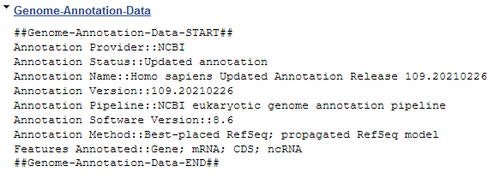
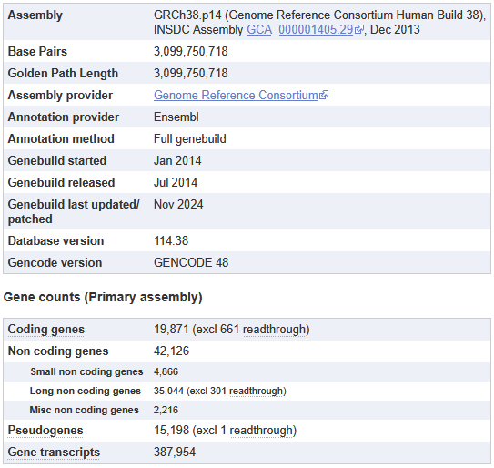
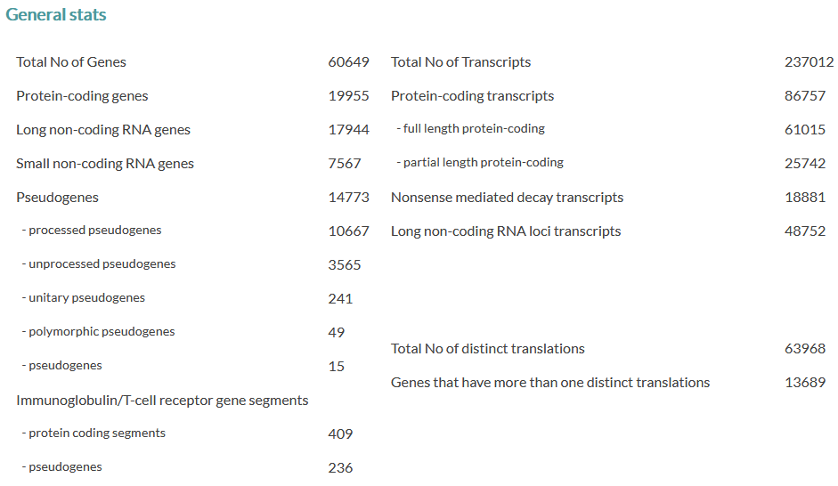
Genome Annotation Details

Slide 11
Viewing Annotated Genomes
Mostly web based
  Species specific sites
  Generic multi-species sites
Often adds more information
  Regulation, conservation, repeats
  Experimental datasets
  Upload your own

Slide 12



Species specific genome viewer sites
Arabidopsis
https://www.arabidopsis.org
Drosophila
https://flybase.org/
Nematode worms
https://wormbase.org

Slide 13


Generic genome viewer sites
Ensembl
https://www.ensembl.org
UCSC Browser
https://genome.ucsc.edu
WashU Browser
https://epigenomegateway.wustl.edu/

Slide 14
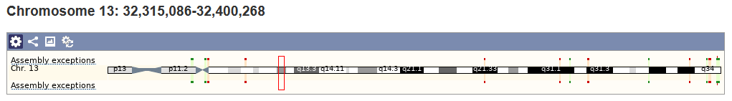
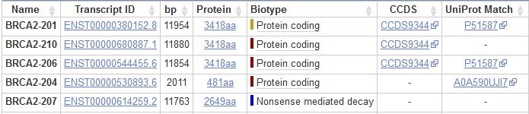
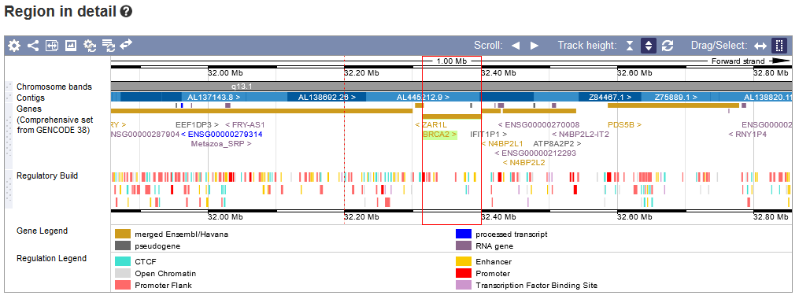
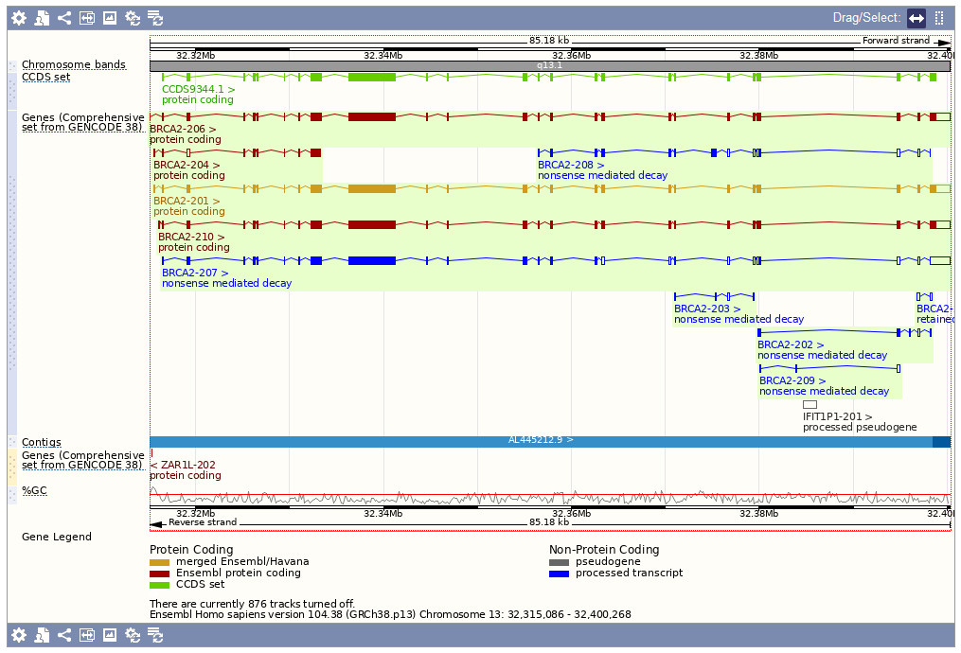
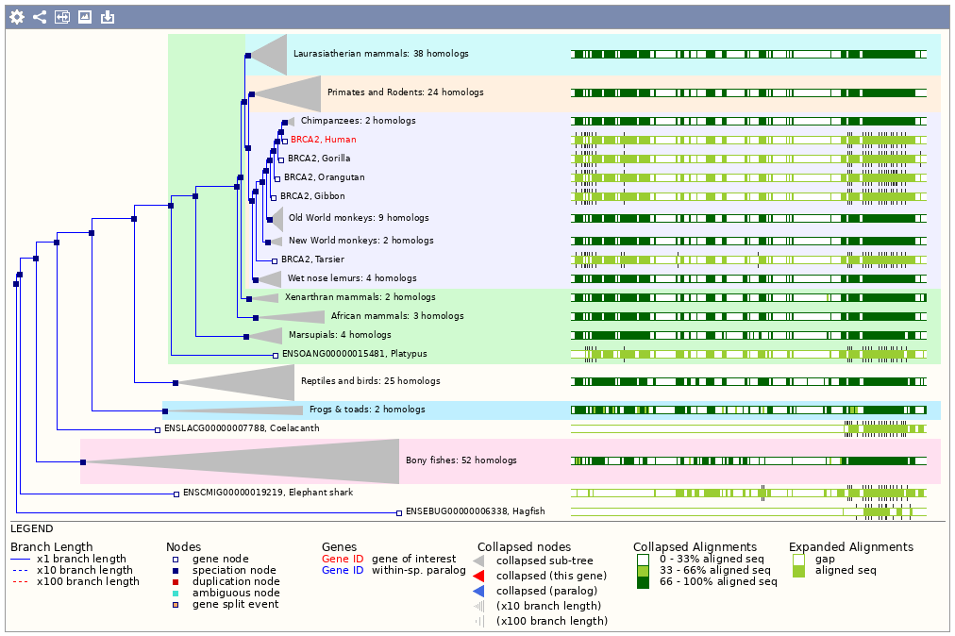

Slide 15
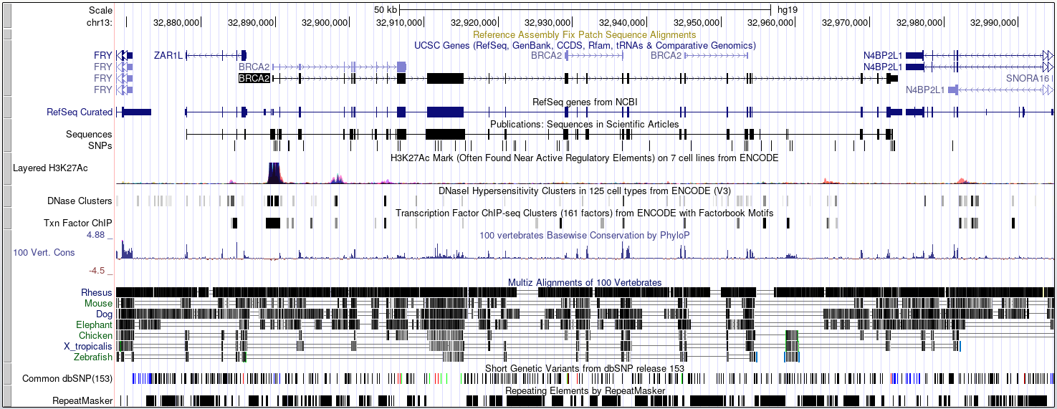
Track Based Displays

Slide 16


Large Scale Queries
Large scale querying and export of genomic data
Annotations, Sequences, Variants etc.
  Select data type (eg genes)
  Select genome species
  Select genes / regions / identifiers
  Select attributes to export
  Generate report

Slide 17
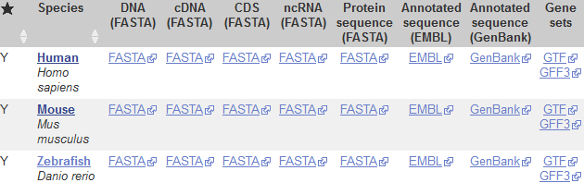
Genome File Formats
Genome Assemblies
  Chr sequence, FastA format
  A small header plus DNA bases
  Also used for RNA / protein
Gene Annotations
  GFF or GTF format (both very similar)
  Hierarchical format linking exons to transcripts to genes
https://www.ensembl.org/info/data/ftp/index.html

Slide 18
FastA Format Data
>I dna:chromosome chromosome:R64-1-1:I:1:230218:1 REF
CCACACCACACCCACACACCCACACACCACACCACACACCACACCACACCCACACACACA
CATCCTAACACTACCCTAACACAGCCCTAATCTAACCCTGGCCAACCTGTCTCTCAACTT
ACCCTCCATTACCCTGCCTCCACTCGTTACCCTGTCCCATTCAACCATACCACTCCGAAC
CACCATCCATCCCTCTACTTACTACCACTCACCCACCGTTACCCTCCAATTACCCATATC
>II dna:chromosome chromosome:R64-1-1:II:1:813184:1 REF
AAATAGCCCTCATGTACGTCTCCTCCAAGCCCTGTTGTCTCTTACCCGGATGTTCAACCA
AAAGCTACTTACTACCTTTATTTTATGTTTACTTTTTATAGGTTGTCTTTTTATCCCACT
TCTTCGCACTTGTCTCTCGCTACTGCCGTGCAACAAACACTAAATCAAAACAATGAAATA
CTACTACATCAAAACGCATTTTCCCTAGAAAAAAAATTTTCTTACAATATACTATACTAC

Slide 19
Annotation Descriptions
Gene
Exon (combined into transcript)
Coding Exon

Slide 20
GTF
GTF File Fields
Chromosome
Source
Feature Type
Start
End
Score
Strand (+/-)
Frame (1,2,3)
Group/Attributes
Targeted at gene structure definition
Tab delimited text file
Multi-level structure
  Genes > Transcripts > Exons
1 havana gene 11869 14409 . + . gene_id "ENSG223972"; gene_name "DDX11L1";
1 havana transcript 11869 14409 . + . gene_id "ENSG223972"; transcript_id "ENST456328"; transcript_name "DDX11L1-202";
1 havana exon 11869 12227 . + . gene_id "ENSG223972"; transcript_id "ENST456328"; exon_number "1"; exon_id "ENSE2234944";
1 havana exon 12613 12721 . + . gene_id "ENSG223972"; transcript_id "ENST456328"; exon_number "2"; exon_id "ENSE3582793";
1 havana exon 13221 14409 . + . gene_id "ENSG223972"; transcript_id "ENST456328“; exon_number "3"; exon_id "ENSE2312635";

Slide 21
Genome Exploration Exercise

Slide 22
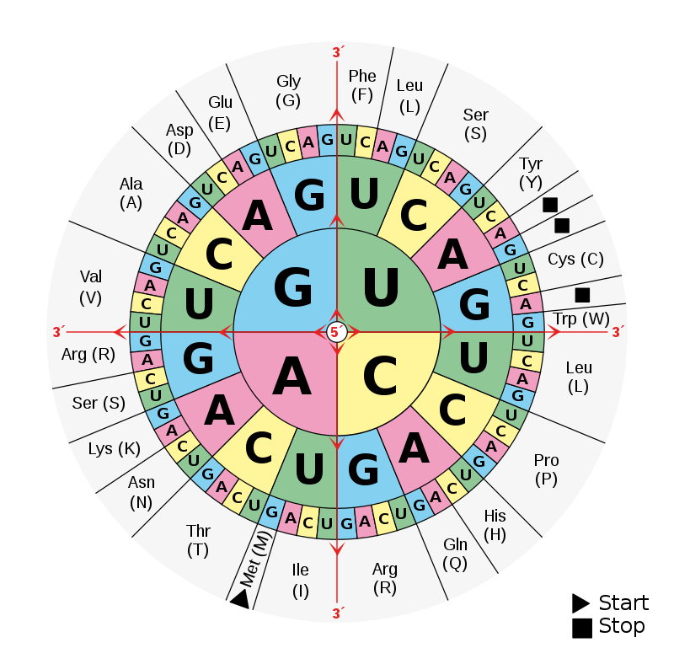
mRNA Translation into Protein
Start Codon
Stop Codon
GACACC ATG AGC ACT GAA ... CTG TGA
Met Ser Thr Glu Arg Stp
UTR
Most species use the same code
Some have minor differences
https://www.ncbi.nlm.nih.gov/Taxonomy/Utils/wprintgc.cgi

Slide 23
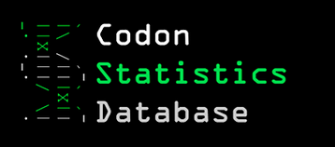
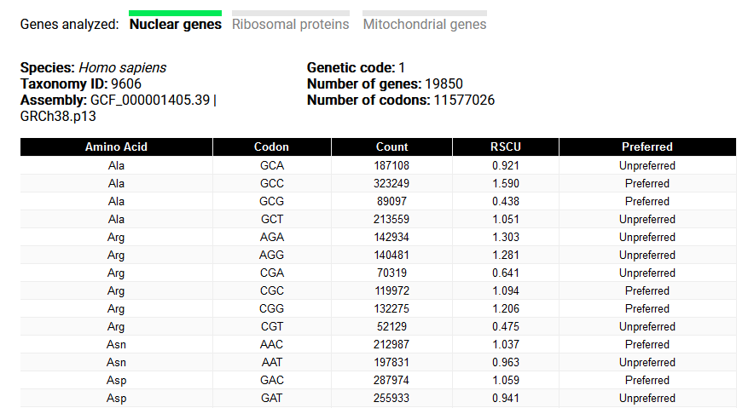
Codon Usage

Slide 24
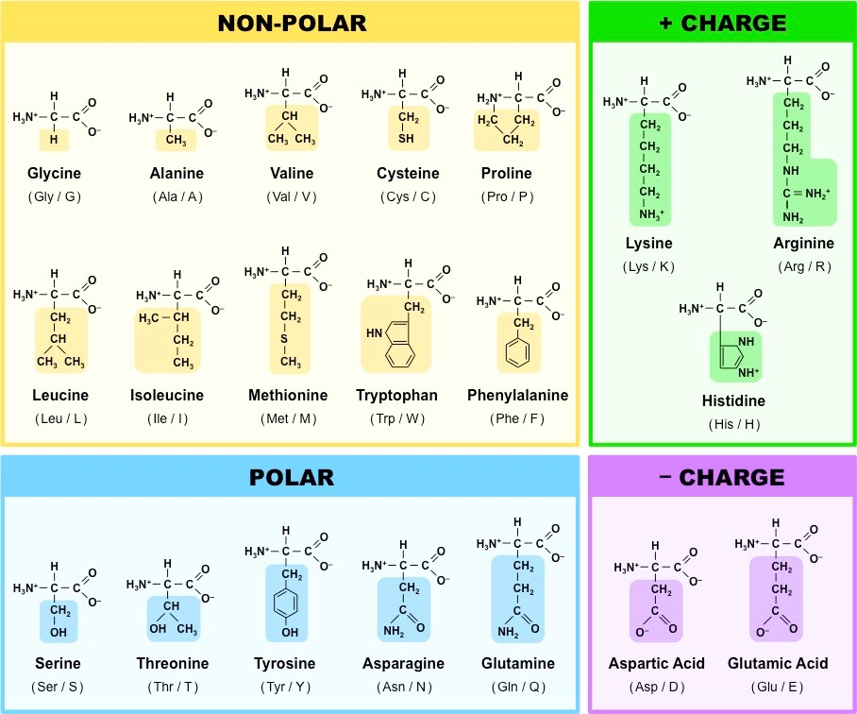
Often
internal
Often
Binding or catalytic sites
Often
surface

Slide 25

Protein Domain Information
A single protein can have more than one functional unit
  Proteins are annotated with functional ‘domains’
  A domain is normally linked with a globular folded structure
Domain structures are re-used to provide modular functionality across multiple proteins.
  Often linked to exon structures or splice variation
It can be useful to know the key functional amino acids
  Binding pockets
  Active sites

Slide 26


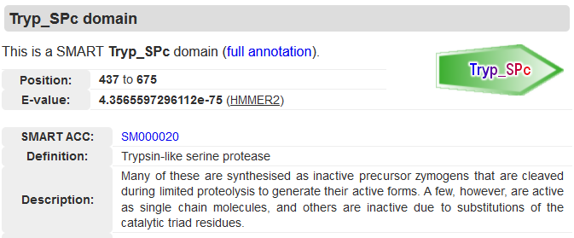

Protein Domain Databases
http://smart.embl-heidelberg.de/
https://www.ebi.ac.uk/interpro/

Slide 27
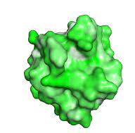
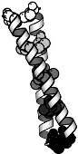
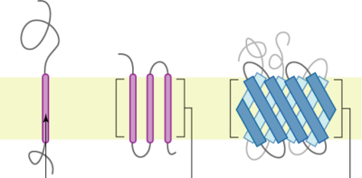
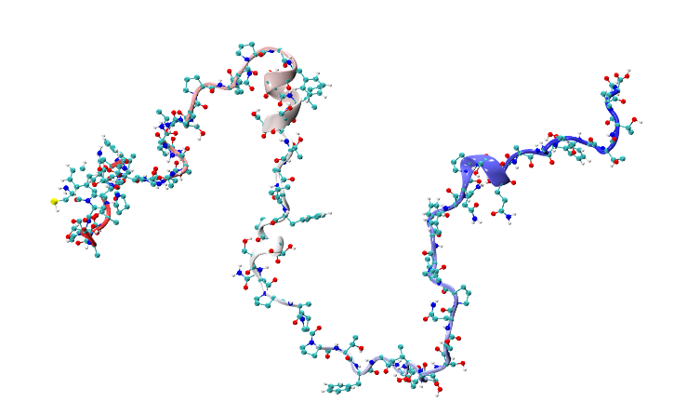
Types of domain
Globular
  Forms a concerted 3D structure
  Most catalytic and some binding domains
Semi-ordered
  Coiled coil
  Many binding domains
Transmembrane
  Threaded through a membrane
  Transmembrane regions, then internal and external segments
Disordered / Low Complexity
  Linker regions
  Intrinsically disordered proteins

Slide 28


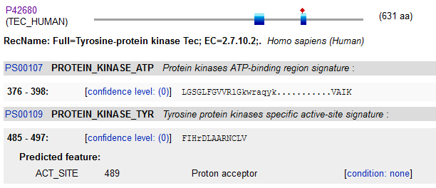
Key Residue Databases

Slide 29
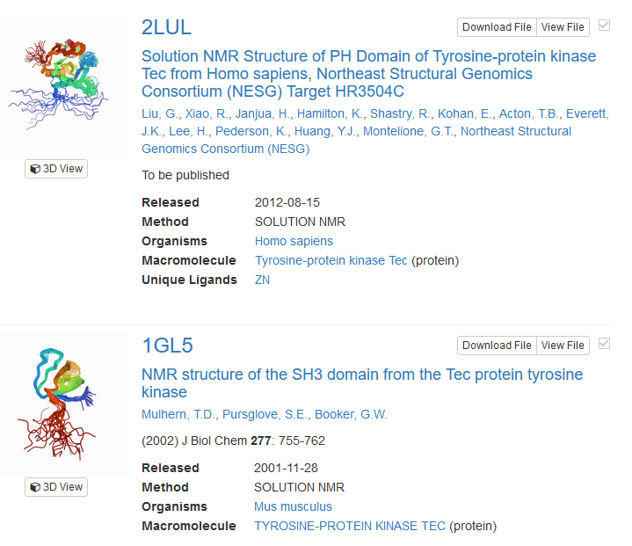
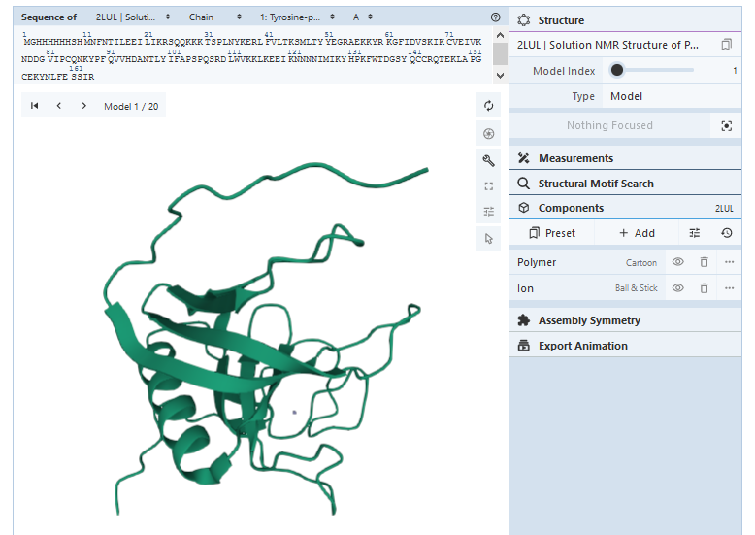
Protein Structure Databases

Slide 30
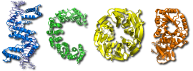

Protein Structure Classification Databases
https://scop.mrc-lmb.cam.ac.uk/
https://www.cathdb.info/

Slide 31
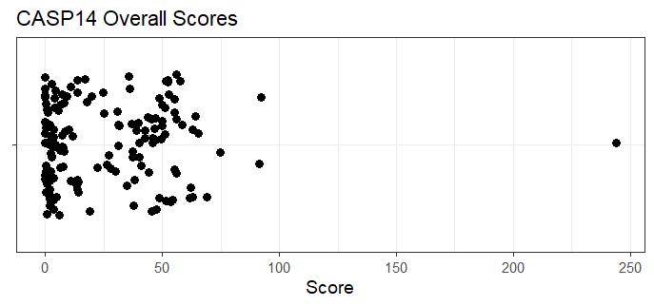
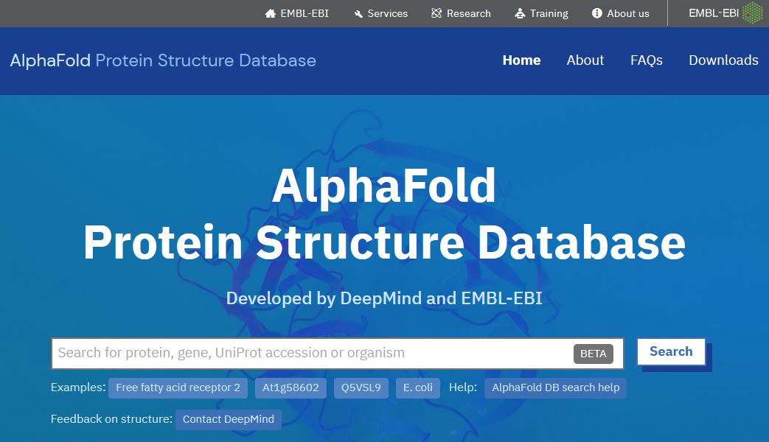
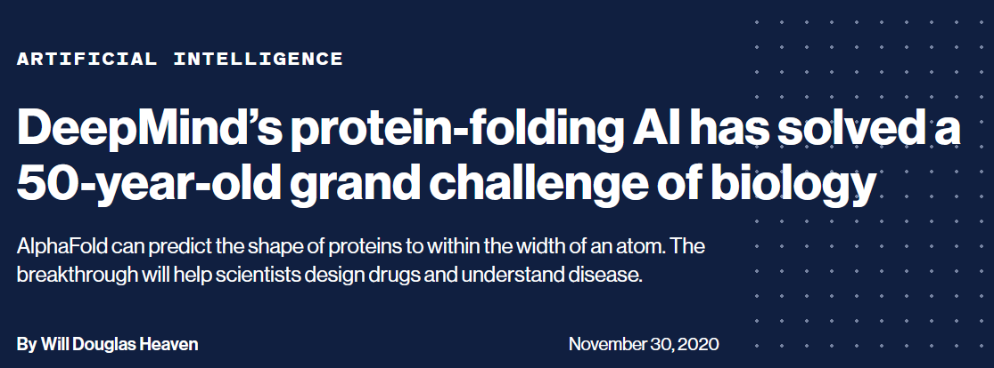
Predicted Structure Database
Currently (Mar 2022), only 7914/22818 protein coding genes have an experimental 3D structure available
https://alphafold.ebi.ac.uk/

Slide 32
Protein Annotation Exercise

Slide 33
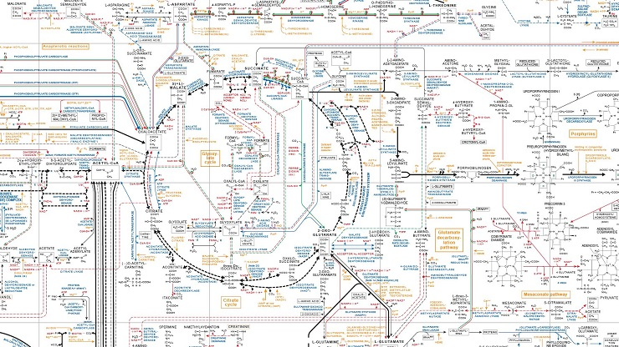
Pathways

Slide 34
Hierarchy of Reaction Annotations
Components (Reactants / Products)
Proteins (Enzymes)
Reactions
Pathways
Processes
X
A + B C + D
Y
D + E F + G

Slide 35

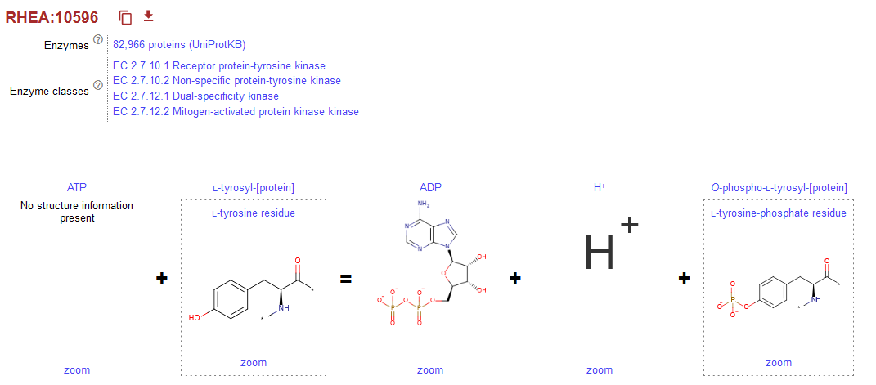
Reactions

Slide 36
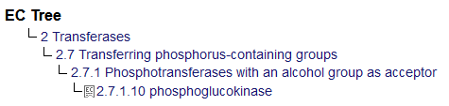

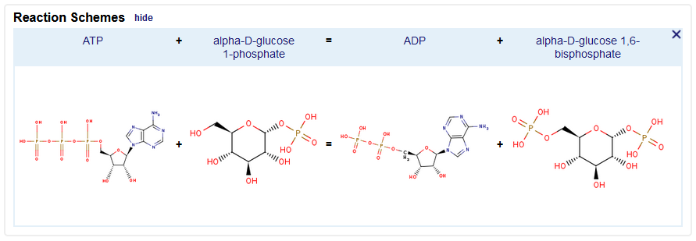

Enzyme Databases
Enzymes are described by an Enzyme Commission (EC) number
  EC 2.7.1.10 is phosphoglucokinase
  Hierarchical structure
Main Enzyme databases
  Expasy Enzyme

Slide 37

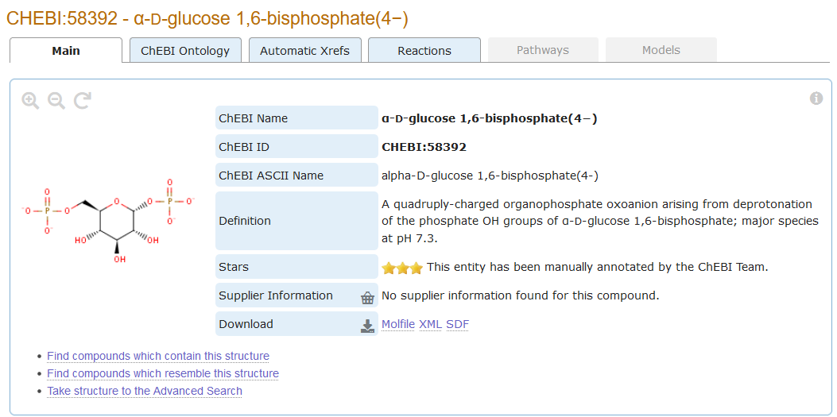
Chemical entities of biological interest
A database of "small" molecules with biological relevance
Natural or synthetic products which intervene in the processes of living organisms

Slide 38
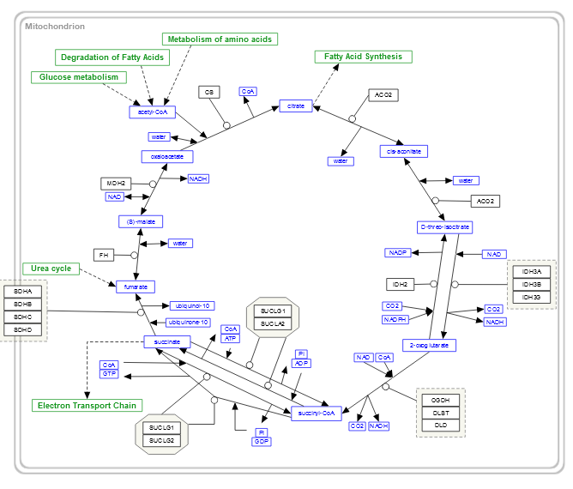


Pathways

Slide 39
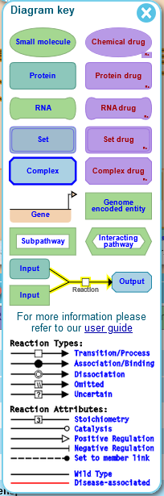
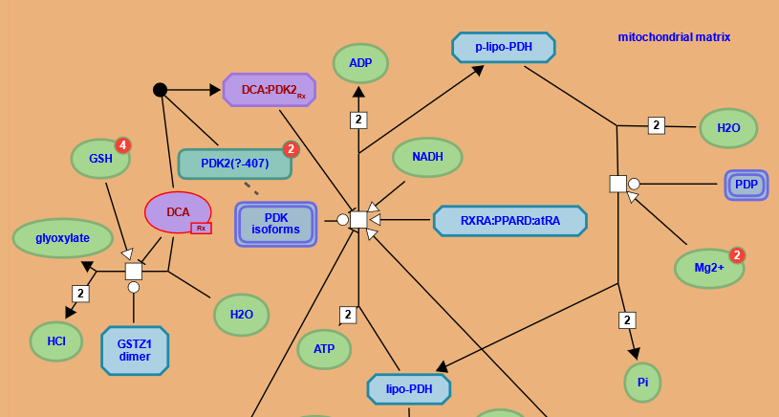
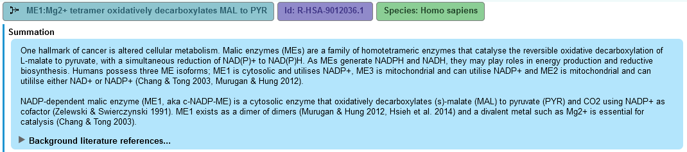
Reactome

Slide 40
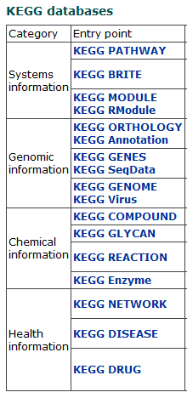
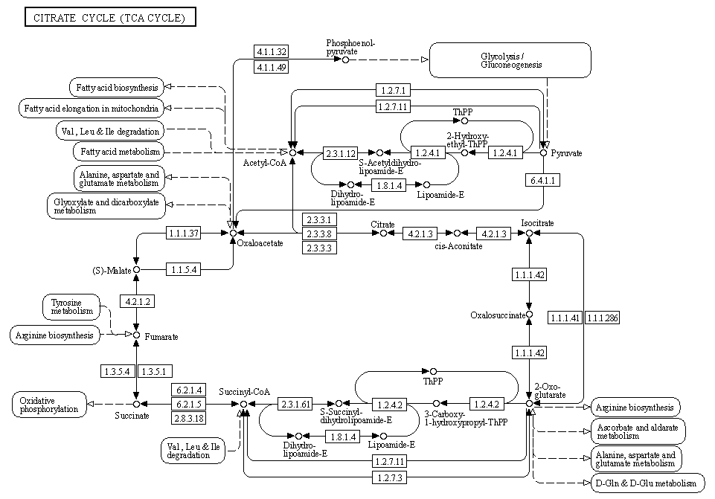
KEGG

Slide 41
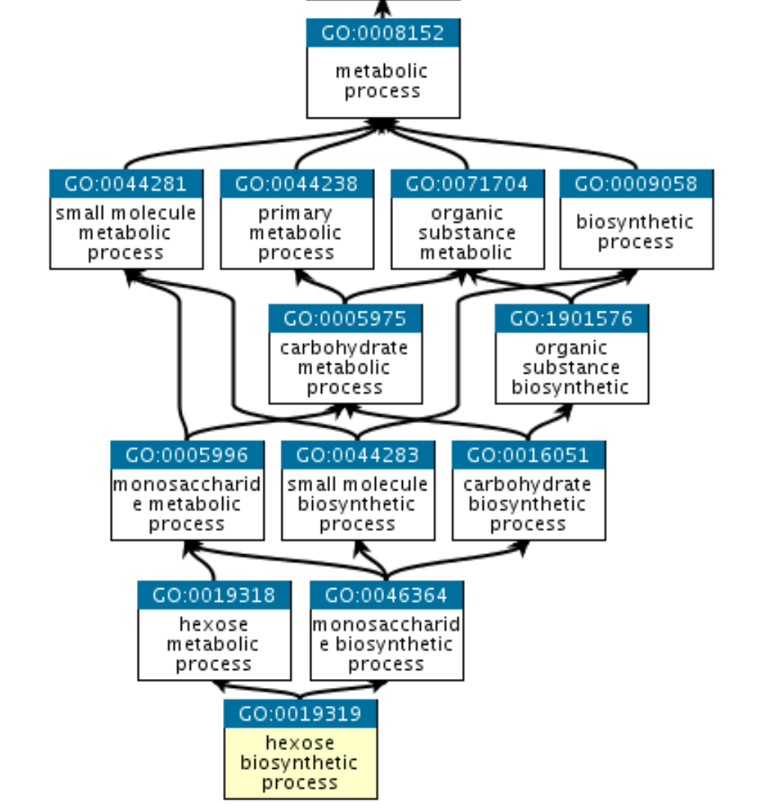
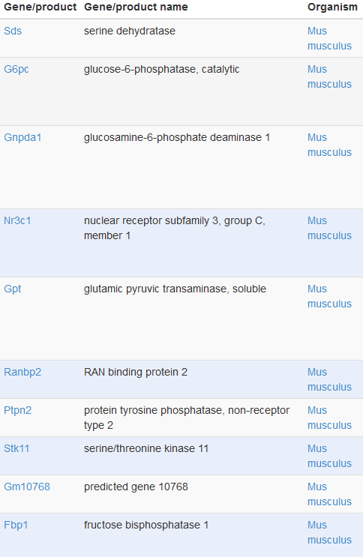
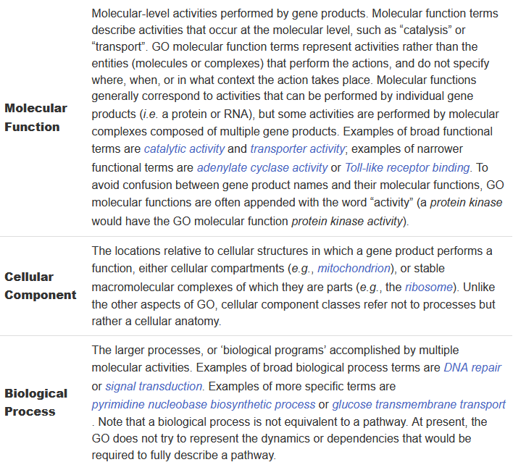
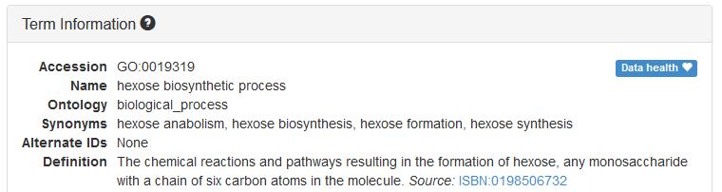
Functional Gene Sets

Slide 42
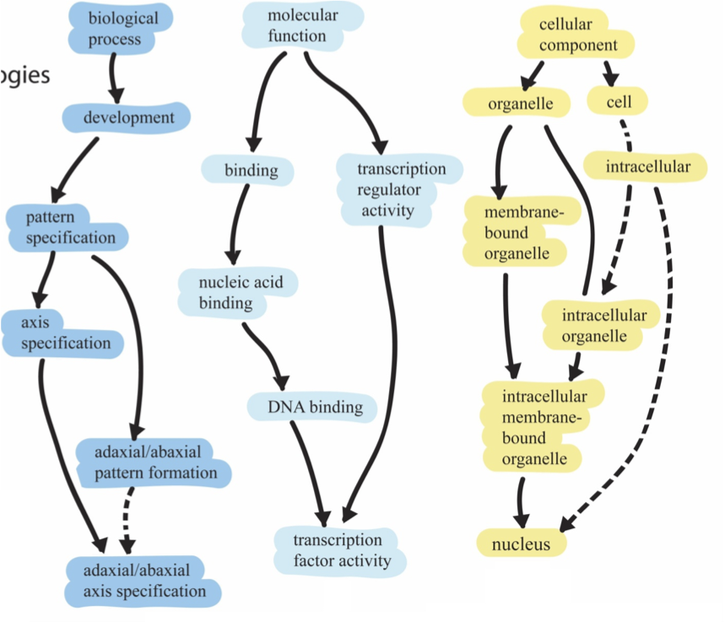
1
2
3
Root ontology terms
big
general
Parent
small
Child
specific

Slide 43
Genes assigned to ontology terms
Nanog homeobox [Source:HGNC Symbol;Acc:HGNC:20857]
Cellular Component
  GO:0005634 nucleus
  GO:0005654 nucleoplasm
  GO:0005730 nucleolus
Molecular Function
  GO:0003677 DNA binding
  GO:0003700 transcription factor activity, sequence-specific DNA binding
  GO:0003714 transcription corepressor activity
  GO:0005515 protein binding
  GO:0043565 sequence-specific DNA binding
Biological Process
  GO:0001714 endodermal cell fate specification
  GO:0006351 transcription, DNA-templated
  GO:0006355 regulation of transcription, DNA- templated
  GO:0007275 multicellular organism development
  GO:0008283 cell proliferation
  GO:0019827 stem cell population maintenance
  GO:0030154 cell differentiation
  GO:0035019 somatic stem cell population maintenance
  GO:0045595 regulation of cell differentiation
  GO:0045944 positive regulation of transcription from RNA polymerase II promoter
  GO:1903507 negative regulation of nucleic acid-templated transcription

Slide 44
Reactions and Pathways Exercise

Slide 45
Regulation and Interactions
The regulation of genes is as important as their structure or function
Several sources of useful information
  Regulatory binding proteins, mostly transcription factors
  Interactions with other proteins to form complexes
  Composition of known complexes

Slide 46

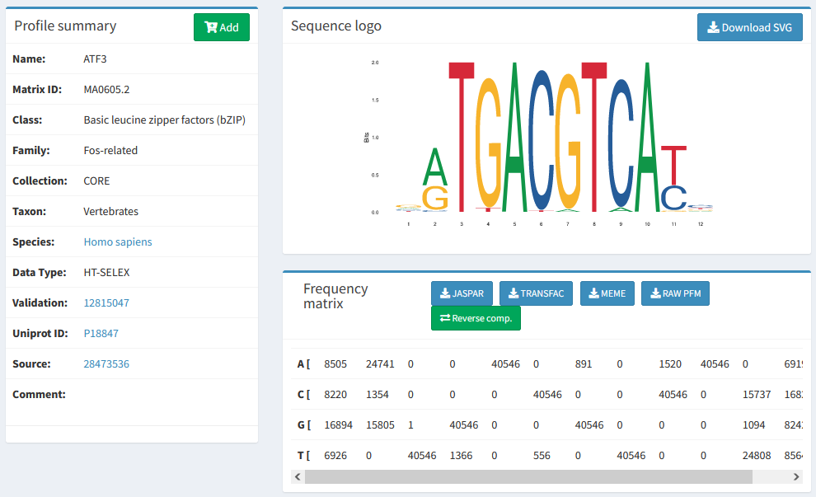
Transcription Factor Information

Slide 47

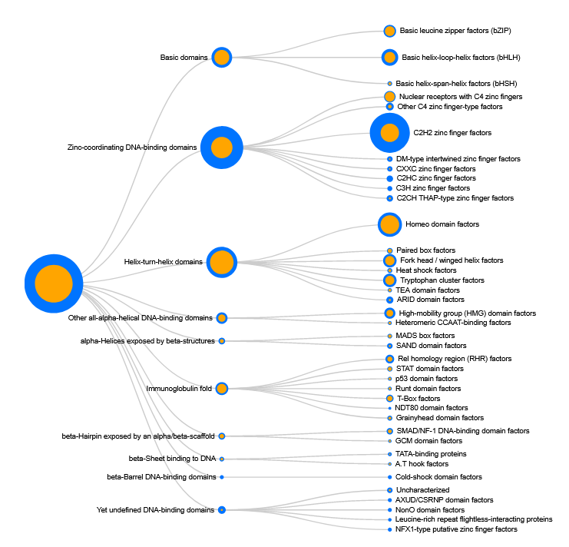
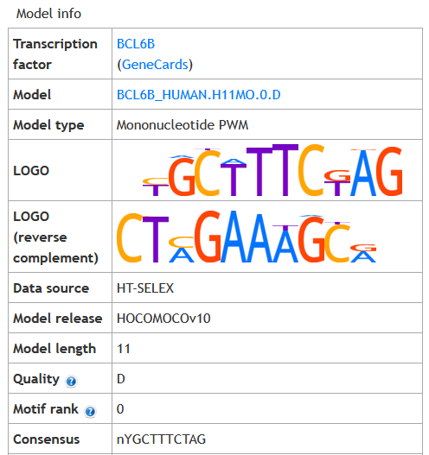
Transcription Factor Information

Slide 48
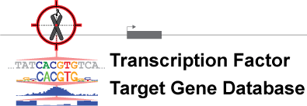
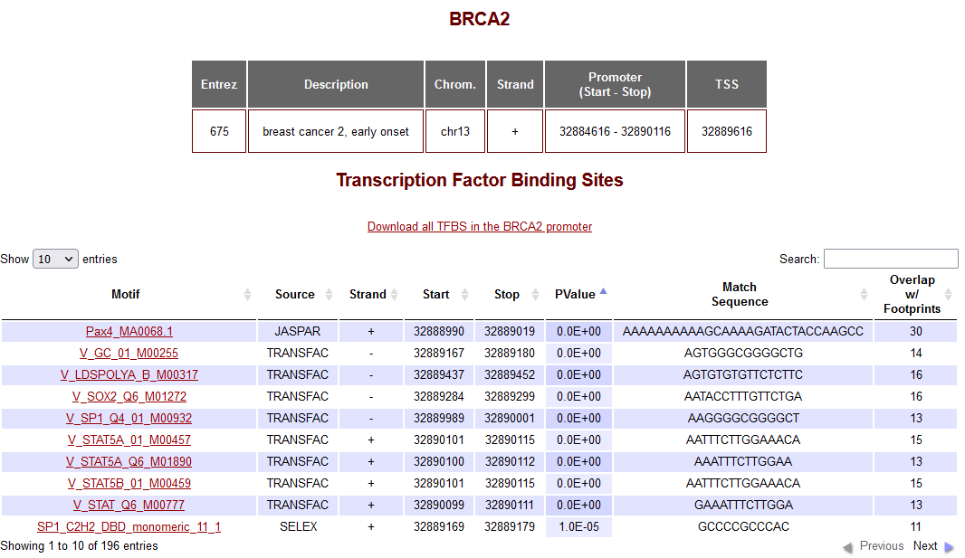


Genes Regulated by a Transcription Factor
Difficult to predict - lots of false positives
  Swiss Regulon

Slide 49
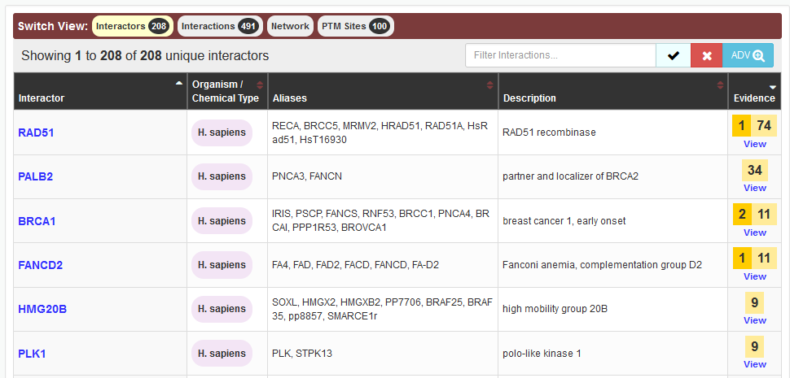

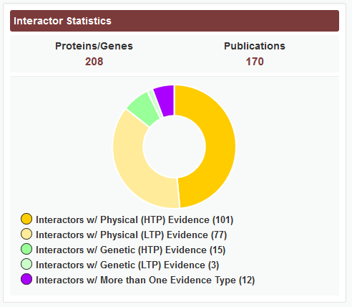

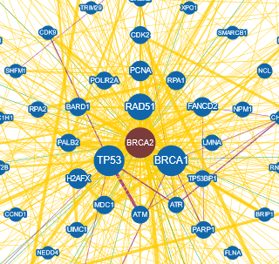

Gene Interactions
Many genes form stable or transitory interactions with others
Knowing the genes that interact helps understand biology

Slide 50
Types of Interaction
Physical
  Two proteins directly interact, either stably or transiently
Genetic
  One gene influences another, normally after modification
    Co-expression
    Knockout compensation

Slide 51


Complex Prediction
Many proteins interact with several others, but at different times
Complexes suggest that multiple proteins directly associate
  Can't always be clearly predicted from pairwise interactions
  Other experimental methods are required

Slide 52
Regulatory Information Exercise

Slide 53
Sequence Variants

Slide 54
Sequence Variants
Reference GATCTTAGCTGA
Variant GATCTTACCTGA
Germline variants
  Happen in sperm or eggs
  Completely inherited into the next generation
  Can cause genetic disease
Somatic variants
  Happen in other tissues
  Partially penetrant
  Common cause of cancer

Slide 55
Types of Variant
Ref GATCTTAGCTGA
Var GATCTTACCTGA
Substitution
Single Nucleotide Polymorphism
SNP
Ref GATCTTAG..CTGA
Var GATCTTACAA CTGA
Insertion
InDel
Ref GATCTTAGCTGA
Var GATCTTAC..GA
Deletion

Slide 56
Functional Variant Consequences
Within Coding Region
  Silent (codon changes, but same translation)
  Missense (change translation from one amino acid to another)
  Nonsense (change translation from one amino acid to STOP)
  Frameshift (InDel changing the translation frame)
Outside CDS
  Breaks or adds splice junction
  Changes functional binding site

Slide 57
Structural variants
Chromosomal copy number change
  Gain or loss of a chromosome
  Leads to serious genetic disease
Segmental Deletion / Duplication
  Large parts of chromosomes deleted, duplicated, inverted, translocated
  1kb to 3Mbp
  Affects many genes, can lead to gene fusions

Slide 58
Databases of Variants
Common genomic variants
  Measured across a large population
  Shows natural variation
  Not necessarily linked to disease
  Used for studying populations and families
Functional variants
  Variants with an associated phenotype
  Often disease related but can be any measurable phenotype

Slide 59
Variant Databases
Single Variants
  dbSNP (https://www.ncbi.nlm.nih.gov/snp/)
    Full reference for any reported SNPs, mix of functional and non-functional
  HGMD (http://www.hgmd.cf.ac.uk)
    Human genetic disease focussed database
  COSMIC (https://cancer.sanger.ac.uk/cosmic)
    Mutations observed in Cancer
    Also has details of mutations in immortalised cell lines
Larger Regions
  dbVar (https://www.ncbi.nlm.nih.gov/dbvar/)
    Counterpart to dbSNP for larger variants
  ClinVar (https://www.ncbi.nlm.nih.gov/clinvar/)
    Larger variants with clinical relevance
  OMIM (https://www.ncbi.nlm.nih.gov/omim)
    A more wide ranging collection of the phenotypic variation linked to genes

Slide 60
Variant Terminology
Minor Allele Frequency (MAF)
  How prevalent the variant is in the population
Impact scores (SIFT / PolyPhen etc)
  A quantitative value assessing the likely biological impact of a variant

Slide 61
Variant Exercise

Slide 62
Other Information and Data Sources

Slide 63


Gene Expression Information

Slide 64


Gene Expression Information

Slide 65



Gene Expression Information

Slide 66

Post translational Modifications
Many proteins are modified after they have been translated
  Phosphorylation
  Glycosylation
  Ubiquitination
  Nitrosylation
  Methylation
  Acetylation
  Lipidation
  Proteolysis
Both PTMs observed on a protein and proteins modified by a query gene.

Slide 67



Combined Gene/Protein Centric Datasources
https://www.uniprot.org/
https://www.genecards.org
Gene
https://www.ncbi.nlm.nih.gov/gene/
https://www.wikigenes.org/

Slide 68



Disease Relevance
High Impact publication summaries
Biological Context
Anatomical Context
Chemical Compound Associations
Physical Interactions
Enzymatic Interactions
Regulatory relationships
Analytical, diagnostic and therapeutic context
References

Slide 69
Experimental Data Types and Repositories
Simon Andrews, Chris Hall, Judith Webster, Eoin Fahy, Laura Biggins, Hanneke Okkenhaug, Simon Walker

Slide 70
Big Data Generation
High throughput sequencing
  Genomics, Transcriptomics, Epigenetics
Multi-channel Flow Cytometry
  Cell surface proteomics
Mass Spectrometry
  Proteomics, Metabolomics
Biological Imaging
  Cell / Tissue structure, Proteomics, Metabolomics

Slide 71

Data Repositories
For many techniques deposition of data in a suitable repository is a condition of publication
Repositories are more developed and complete for some techniques than others
Still a growing area

Slide 72
FAIR Data Principles
Designed to make data as useful as possible to future researchers
  Findable
    Unique accession code
    Rich metadata
  Accessible
    Automated query and download API
  Iteroperable
    Use of open formats
    Standard Ontologies for descriptions
  Reusable
    Clear licensing
    Annotated to common community standards

Slide 73




High Throughput Sequencing
ONT MinION
PacBio Revio
Illumina NovaseqX
Element Aviti

Slide 74
Data Generation Capacity

Slide 75
What can you measure?
Genomics
  Whole genome sequencing, Targeted Sequencing
Transcriptomics
  RNA-Sequencing
Regulation
  Accessible DNA (ATAC-Seq), Histone Modifications, Transcription Factor binding sites
Epigenetics
  DNA Methylation, Chromatin Structure

Slide 76
Types of Sequencing Library
DNA-Based
  Genome-Seq: Variants
  Exome-Seq: Variants
  ATAC-Seq: Accessible DNA
  ChIP, Cut n Run:
    DNA binding sites
    Epigenetic Marks
    Polymerase Attachment
  BS-Seq, EM-Seq: DNA Methylation
  3C, 4C, Hi-C: Genome Structure
  TrAEL-Seq: DNA-replication
RNA Based
  RNA-Seq: RNA transcription
  Ribo-Seq: Ribosome attachment
  CAGE-Seq: Transcription start sites
  VDJ-Seq: Antibody repertoires
  CLIP-Seq: RNA-binding protein sites
  sRNA-Seq: Small RNA abundance
  SLAM-Seq: RNA dynamics

Slide 77
Genome Sequencing
DNA
Fragment DNA (Sonnication, Tagmentation)
Size Select
Hybridise to Capture Baits for Exons
Sequence Everything
Whole Genome Sequencing (WGS)
Shotgun sequencing
Sequence Captured Material
Whole Exome Sequencing (WES)

Slide 78
RNA-Sequencing
rRNA depleted mRNA
Fragment
Random prime + RT
2nd strand synthesis (+ U)
A-tailing
Adapter Ligation
(U strand degradation)
Sequencing
NNNN
u
u
u
u
u
u
u
u
A
A
T
u
u
u
u
A
A
T
A
T
Notes:
Point out parts in library prep which are relevant later on.
Start with single strand RNA.
Can't sequence because it's RNA and too long
Must fragment to make short bits
Must convert to DNA, but that loses directionality - which is bad.
Random priming and RT (causes biases later)
Normal Illumina library prep once double stranded.
Can retain strand information by tagging and degrading one of the stands. Which one determines same strand or opposing strand specific libraries.

Slide 79
Enrichment Sequencing
DNA
Cross-link proteins to DNA
DNA
Fragment DNA (sonication, MNase etc)
Capture
Y
Y
Y
Y
Y
Y
Y
Y
Elute
Remove Crosslinks
Size Select
Add Adapters
Sequence

Slide 80

Bisulphite/EM Sequencing
me
me
CCAGTCGCTATAGCGCGATATCGTA
Convert
TTAGTTGCTATAGTGCGATATTGTA
Map
TTAGTTGCTATAGTGCGATATTGTA
|||||||||||||||||||||||||
...CCAGTCGCTATAGCGCGATATCGTA...

Slide 81

10X Single Cell RNA-Seq
RT Reagents
Oil
Cells
Barcoded Beads
Gel Beads in Emulsion (GEMs)

Slide 82
10X Single Cell RNA-Seq Adapter System
Oligo dT
UMI (all different)
Cell barcode (same within GEM)
Priming site

Slide 83



Multi-measure single cell

Slide 84

Spatial Transcriptomics
10X Visium
Nanostring CosMX
Vizgen Merscope

Slide 85
FastQ Format Data
@HWUSI-EAS611:34:6669YAAXX:1:1:5069:1159 1:N:0:
TCGATAATACCGTTTTTTTCCGTTTGATGTTGATACCATT
+
IIHIIHIIIIIIIIIIIIIIIIIIIIIIIHIIIIHIIIII
@HWUSI-EAS611:34:6669YAAXX:1:1:5243:1158 1:N:0:
TATCTGTAGATTTCACAGACTCAAATGTAAATATGCAGAG
+
DF=DBD<BBFGGGGGGGBD@GGGD4@CA3CGG>DDD:D,B
@HWUSI-EAS611:34:6669YAAXX:1:1:5266:1162 1:N:0:
GGAGGAAGTATCACTTCCTTGCCTGCCTCCTCTGGGGCCT
+
:GBGGGGGGGGGDGGDEDGGDGGGGDHHDHGHHGBGG:GG

Slide 86




Public Sequencing Databases
GEO (NCBI)
Array Express (EBI)
  Databases for quantitated sequencing data. Provide experimental annotation and metadata and processed quantitated data
SRA (NCBI)
ENA (EBI)
  Provide raw sequencing data as fastq files

Slide 87


Accession Codes
GSExxxx
GEO Study
GSMxxxx
GEO Sample
Sequence Data
SRPxxxx
SRA Study
SRXxxxx
SRA Experiment
SRRxxxx
SRA Run

Slide 88





Slide 89



Slide 90



sradownloader SRR9924120

Slide 91
Sequencing Data Exercise

Slide 92

Flow Cytometry

Slide 93
Flow Cytometry

Slide 94

Small Scale Measurement
https://flowjo.com

Slide 95
Using Flow for Sorting Cells
Cell subpopulations
CRISPR screens
Cow sexing!

Slide 96

Large Scale Measurement
https://doi.org/10.3389/fimmu.2019.01194

Slide 97


Problems with multiple fluorescent markers
Traditionally filters measure one wavelength per fluor
Spectral Flow Cytometry measures the whole spectrum and can deconvolve overlapping emissions spectra
Allows for 40+ markers to be used simultaneously.
Nd
Tb
Ba
Lu

Slide 98

Public Flow Data Repository
Deposition of FCS files
  Instrument details
  Raw data
  Analysis details
Basic description of experiment structure

Slide 99



Slide 100
Flow Exercise

Slide 101
Mass Spec
General purpose method to measure the accurate masses of small molecules
Can be used to identify
  Proteins (plus modifications)
  Metabolites
    Sugars
    Nucleotides
    Amino Acids
    Lipids

Slide 102




Protein Mass Spec
Proteins
Peptides
A peptide
Digest
Separate
Too Big
Too Many
Non-specific

Slide 103
Protein Mass Spec Workflow
Digestion
Separation
Protein Mix
Peptide Mix
Chromatography
Column (s)
Fragmentation
Peptide Masses
Plus Retention
Identification
Mass Spec

Slide 104

Protein Mass Spec Results
https://www.maxquant.org/

Slide 105

Protein Identification
http://www.ohri.ca/proteomics/

Slide 106
Post Translational Modifications
When doing tandem mass spectrometry you can also identify modified peptides
Phosphorylation
Acetylation
Methylation
Palmitylation
Acylation
Ubiquitination
etc.

Slide 107



High throughput proteomics
30 samples per day Evosep workflow, >12 000 proteins were identified in 48 h of mass spectrometry time
10,000 proteins per sample
37,000 phosphosites per sample

Slide 108


Expanding Mass Spec Technology
1,400 proteins measured from a single cell
Mass Spectral Imaging
Fix a sample to a surface and then do scanning
Ionisation over it to get a spectrum for each point.
You can then pick any fragment and image its
distribution over the original sample

Slide 109

Data Repositories for Proteomics Mass Spec

Slide 110
Data Repositories for Proteomics Mass Spec
Varying amounts of experimental annotation
Good description of processing and preparation
Raw data files available
  Mass spec still uses a lot of proprietary vendor file formats
  Open mzML format is defined but often not used
  Converters exist but often lose information.

Slide 111






Slide 112
Metabolite Mass Spectrometry
Similar concepts to protein mass spec
Range of starting material
  Serum
  Urine
  Cerebrospinal fluid
  Saliva
Different separations
Up to 5000 different metabolites to find

Slide 113

Data Repository for Metabolomics Data
Reference spectra for biological molecules
  Used for searching and quantitation
Experimental datasets of MassSpec Studies
  Used to answer biological questions
  Also provides visualisations and tools

Slide 114



Metabolomics Workbench

Slide 115
Mass Spec Data Exercise

Slide 116


Imaging Analysis
What can you measure with imaging?
Cell structure and morphology
  In both live and fixed cells
Targeted molecules (fluorescence microscopy)
  Antibodies to proteins
  Fluorescent fusion proteins
Functional readouts
  Redox state
  pH

Slide 117

Types of Microscopy
Light Microscopy
  Sample is illuminated, some light goes to the viewer
  Biological samples are generally clear, so hard to see
  Can use stains (often toxic) or reflection or phase shift to see better
https://zeiss-campus.magnet.fsu.edu/articles/basics/contrast.html

Slide 118

Types of Microscopy
Fluorescence Microscopy
  Uses molecules which excite at one wavelength and emit at another
  Allow the tagging of specific biological molecules
  Confocal microscopes allow clear views of a single plane in the sample
DOI:10.3390/ijms20082033

Slide 119

Ultra-plex fluorescence imaging
Simon Walker – BI Imaging Facility

Slide 120


Types of Microscopy
Electron Microscopy
  Fixed and processed samples only (not live)
  Very high resolution
https://www.ncl.ac.uk/emrs/

Slide 121


High Content Imaging
Microscopy traditionally operated on small numbers of individual samples
Improved equipment and automation now allows for more ambitious studies
  384 well plates
  30 images per well
  5 different markers
  Thousands of images
  Hundreds of measured features per cell

Slide 122


Imaging Flow Cytometry
High Content Imaging from Flowed Cells
Up to 5000 cells per second
Automated real-time feature extraction

Slide 123
High Content Applications
Screening for drugs with specific phenotypic effects
Measuring CRISPR library phenotypes
Measuring RNAi library phenotypes

Slide 124




Slide 125




Image Data Resource

Slide 126
Imaging Data Exercise

