Slide 1
Quality Control for Sequencing Experiments
v2024-11
Simon Andrews, Sarah Inglesfield
simon.andrews@babraham.ac.uk
sarah.inglesfield@babraham.ac.uk

Slide 2
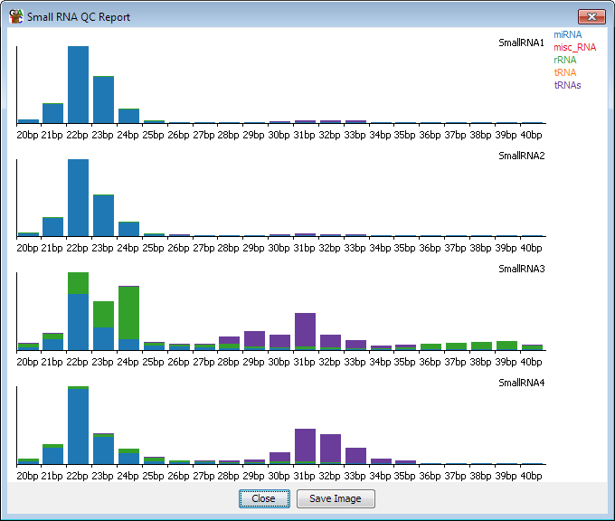
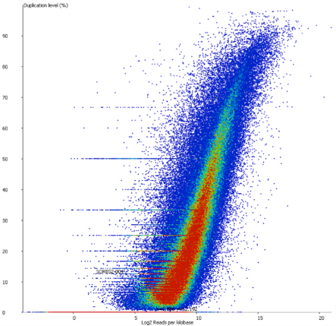
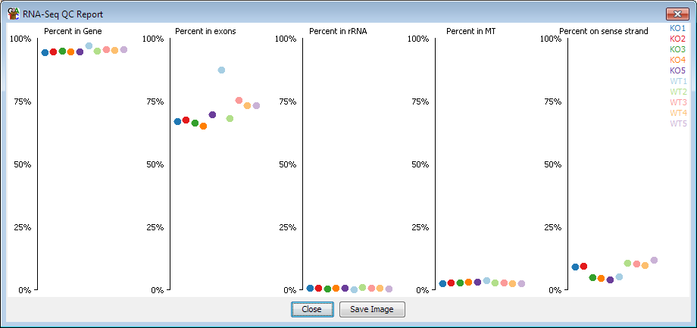
Interests in QC
QC packages
Application specific QC
Data visualisation QC

Slide 3
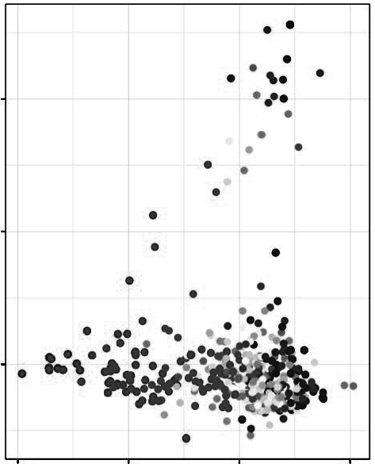
What is the Point of QC? An Example…
PC2 Genes (85 total)
No clear biological theme
No clear connection to system
PC2
What is going on?
PC1

Slide 4
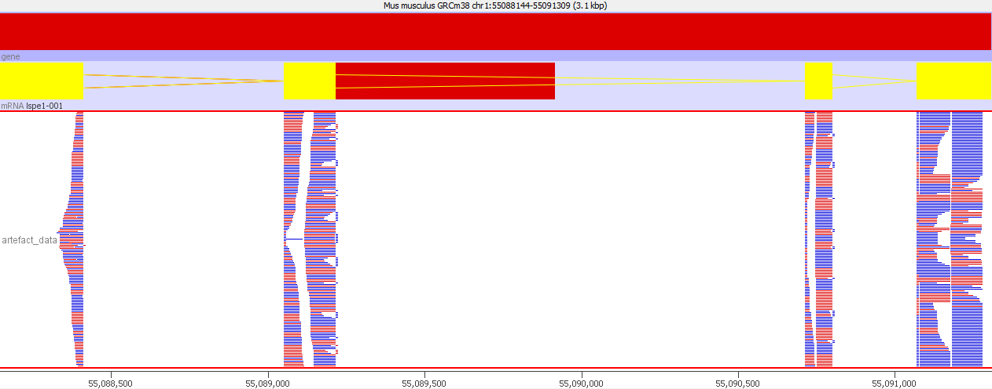
What is the Point of QC? An Example…
Expectations
Observations
Normal RNA-seq Data for a Gene
RNA-seq Data for a PCA Gene
Different aligner
Conclusion:
The original separation was a technical artefact of no biological interest

Slide 5
What is the Point of QC?
Technical Problems …
Don’t always cause pipelines to fail
Don’t prevent hits being generated
These hits can look biologically real
Real biology…
Can cause unexpected, interesting behaviour of data
Set Pipelines can miss things….
QC Saves Time, Effort and Money!!
Better to know asap what you’re dealing with
Want to be sure any follow-up work will be worth it

Slide 6
Course Structure
How Does Sequencing Work?
What can QC tell us?
Fundamentals of Illumina Sequencing
The Format of Sequencing Data
How QC Programmes Fit In
Universal metrics
Library Dependent metrics
Consistency

Slide 7
How Does (Illumina) Sequencing Work?

Slide 8
Processing Sequencing Data
Sequence
Clean-up
Mapping
Trimmed Reads
Mapped Reads
Downstream Quantitation
Library
Reads
QC
QC
QC
QC
Focus for Today

Slide 9
Illumina Sequencing: An Overview
Library Generation
Attach to Flow Cell
Sequence by Synthesis (SBS)
Sequencing Reads
DNAP

Slide 10
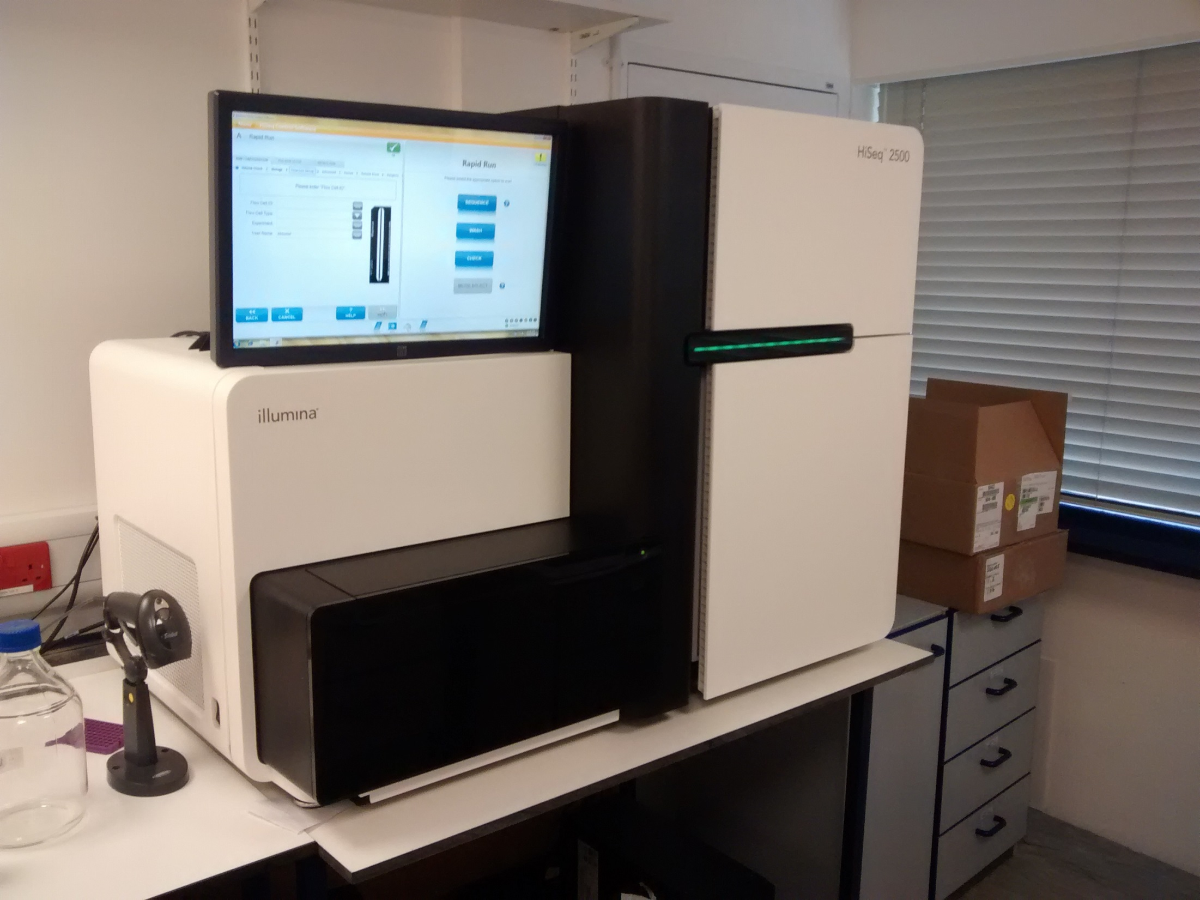
Microscope
Fridge
Pumps
Compartment

Slide 11
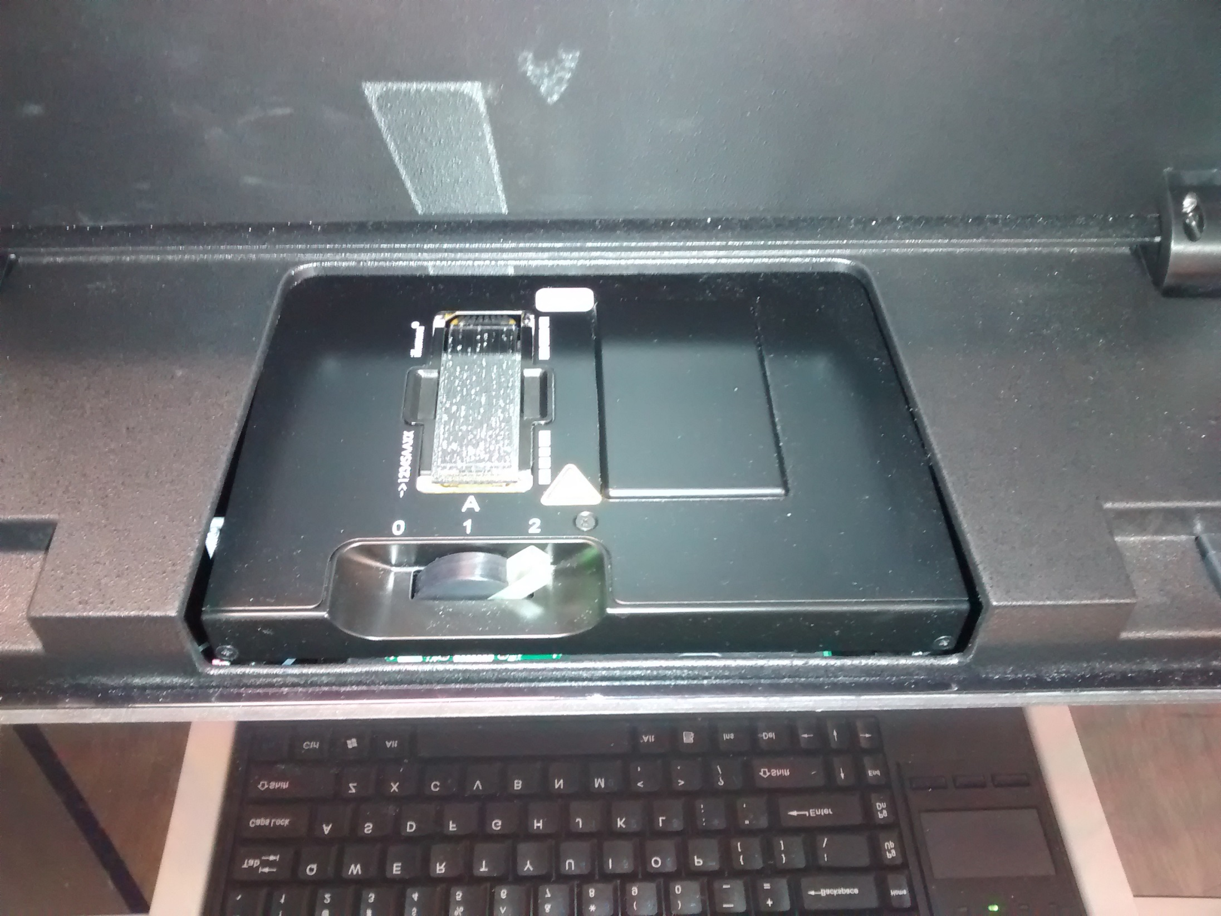
Flow Cell

Slide 12
Illumina Sequencing: An Overview
Library Generation
Attach to Flow Cell
Sequence by Synthesis (SBS)
Sequencing Reads
DNAP

Slide 13
SBS For a Single Molecule
T
A
G
C
G A T T C A G

Slide 14
SBS For a Single Molecule
C
G A T T C A G

Slide 15
SBS For a Single Molecule
T
A
G
C
C
G A T T C A G
1 Cycle

Slide 16
SBS For a Single Molecule
C
T
A
A
G
T
C
ect...
G A T T C A G
5 Cycles
3 Cycles
2 Cycles
4 Cycles
... Read length
6 Cycles
7 Cycles

Slide 17
Comparing Chemistry
Signal
Image
Base Call
4 Channel Chemistry
2 Channel Chemistry
1 Channel Chemistry
T
C
A
G
T
C
A
G
T
C
A
G
T
C
A
G
No Signal is interpreted as G

Slide 18
Detecting a Signal
One Molecule isn’t Enough
Cycle 3
Amplify to generate Cluster
Cycle 2
Cluster Molecules sequenced
Cycle 1
Multiple Clusters on a Flow Cell

Slide 19
Flow Cell Imaging
Image
Flow out
Lanes
Flow in
Tiles
Swaths
Flow Cell
Image
Glass Slide

Slide 20
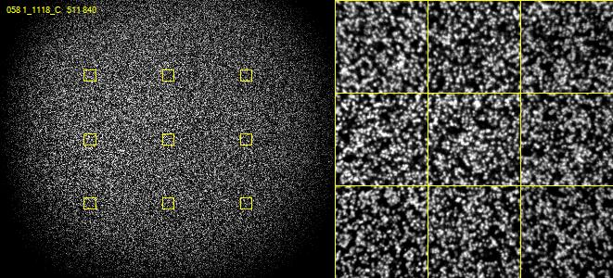
Real Illumina Sequence Data

Slide 21
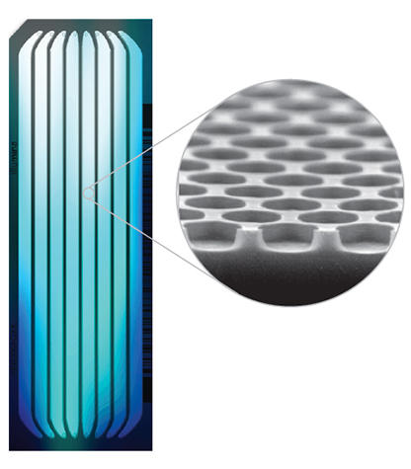
Creating Clusters
Non Patterned Flow Cell
Patterned Flow Cell
Random Clusters
Pre-defined Clusters

Slide 22
Creating Clusters: Patterned Flow Cells
Single molecule attaches in a nano well
Recombinase Polymerase
Bridge Amplification
Cluster of identical (ish) molecules created in a nanowell
Amplification is faster than seeding

Slide 23
Good and Bad things about Clusters
Good
Bad
Generates large signal
Is robust to random mistakes
Small amount of starting material
Bridging limits length
Molecules in a cluster get out of sync
2 bases added
No bases added
Reaction stalls
Can get mixed signals if clusters overlap (non-patterned)
Can get re-seeding (patterned)
Can get index hopping (patterned)

Slide 24
Different Sequencers, Same Chemistry
Sequencer | Number of lanes | Reads per lane | Max read length | Dyes
iSeq 100 | 1 | ~4 million | 150bp | 1
MiniSeq | 1 | ~7 million | 150bp | 2
MiSeq | 1 | ~20 million | 300bp | 4
NextSeq | 1 | ~400 million | 150bp | 2
HiSeq 2xxx | 16 | ~200 million | 150bp | 4
HiSeq 4xxx | 16 | ~300 million | 150bp | 4
NovaSeq | 8 | ~2.5 billion | 150bp | 2

Slide 25
Illumina Sequencing: An Overview
Library Generation
Attach to Flow Cell
Sequence by Synthesis (SBS)
Sequencing Reads
DNAP

Slide 26
What Reads Do You Get: Single or Paired?
Barcode
Adapter
Insert
Adapter
Barcode
Insert R1
Read 1
Primer
Single End
(1 file)
Adapter
Insert
+
Read 2
Primer
Paired End
(2 files)
Insert
Adapter
Insert R2

Slide 27
What Reads Do You Get: Multiplexed?
Sequence
De-multiplex
Pooled
Library
Reads
Reads
Sample 1
Sample 2
Barcode 1 Read
Barcode Read

Slide 28
So For a Paired End, Single Index Multiplexed Library….
Insert R1
Insert R2
Insert R1
Insert R2
Sample 1
Sequence
Library
Sample 2
Barcode 1
ect.
So what is actually in these files?

Slide 29
FastQ Format Data
@HWUSI-EAS611:34:6669YAAXX:1:1:5069:1159 1:N:0:
TCGATAATACCGTTTTTTTCCGTTTGATGTTGATACCATT
+
IIHIIHIIIIIIIIIIIIIIIIIIIIIIIHIIIIHIIIII
@HWUSI-EAS611:34:6669YAAXX:1:1:5243:1158 1:N:0:
TATCTGTAGATTTCACAGACTCAAATGTAAATATGCAGAG
+
DF=DBD<BBFGGGGGGGBD@GGGD4@CA3CGG>DDD:D,B
@HWUSI-EAS611:34:6669YAAXX:1:1:5266:1162 1:N:0:
GGAGGAAGTATCACTTCCTTGCCTGCCTCCTCTGGGGCCT
+
:GBGGGGGGGGGDGGDEDGGDGGGGDHHDHGHHGBGG:GG
Sequence 1
Sequence 2
Sequence 3

Slide 30
A Single FastQ Entry
1.
@HWUSI-EAS611:34:6669YAAXX:1:1:5266:1162 1:N:0:
GGAGGAAGTATCACTTCCTTGCCTGCCTCCTCTGGGGCCT
+
:GBGGGGGGGGGDGGDEDGGDGGGGDHHDHGHHGBGG:GG
2.
3.
4.
Header - starts with @
Base calls (can include N or IUPAC codes)
Mid-line - starts with + usually empty
Quality scores (= Phred Scores)

Slide 31
Illumina Header Sections (Line 1)
@HWUSI-EAS611:34:6669YAAXX:5:1:5069:1159 1:N:0:
Starts with @ (required by fastq spec)
Instrument ID (HWUSI-EAS611)
Run number (34)
Flowcell ID (6669YAAXX)
Lane (5)
Tile (1)
X-position (5069)
Y-position (1159)
[space]
Read number (1)
Was filtered (Y/N) (N) - You wouldn't normally see the Ys
Control number (0 = no control)
Sample number (only if demultiplexed using Illumina's software)

Slide 32
Phred Scores (Line 4)
@HWUSI-EAS611:34:6669YAAXX:1:1:5266:1162 1:N:0:
GGAGGAAGTATCACTTCCTTGCCTGCCTCCTCTGGGGCCT
+
:GBGGGGGGGGGDGGDEDGGDGGGGDHHDHGHHGBGG:GG
Base Calls
Phred Scores
How it’s calculated:
Start from (p) - the probability that the reported call is incorrect
Transformation to a Phred score = positive integer from floating point
Phred = -10 * (int)log₁₀(p)
p=0.1 Phred = 10
p=0.01 Phred = 20
p=0.001 Phred = 30
Higher Phred Score
Higher Confidence

Slide 33
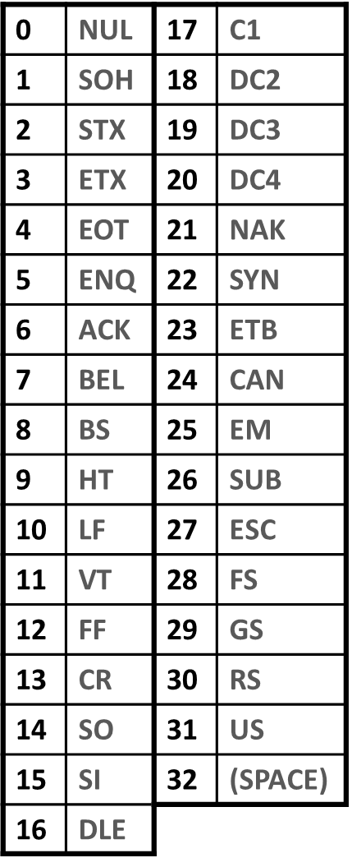
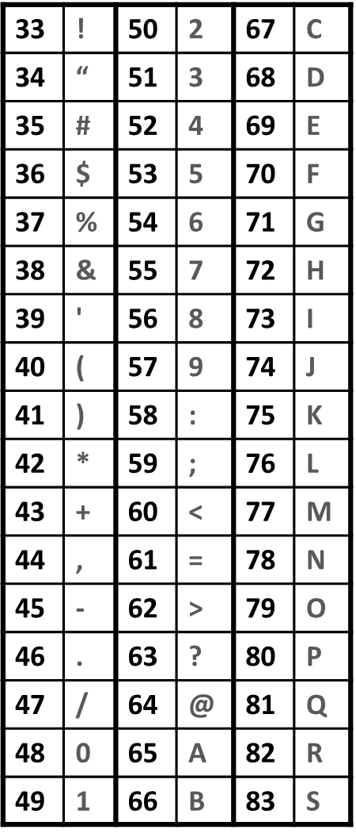
Phred Score Encoding
Translation of Phred score to single ASCII letter
Based on standard ASCII table
Can't translate directly
low values are non-printing
Encode with Sanger System*
Phred+33
*Historically also had Illumina = Phred+64

Slide 34
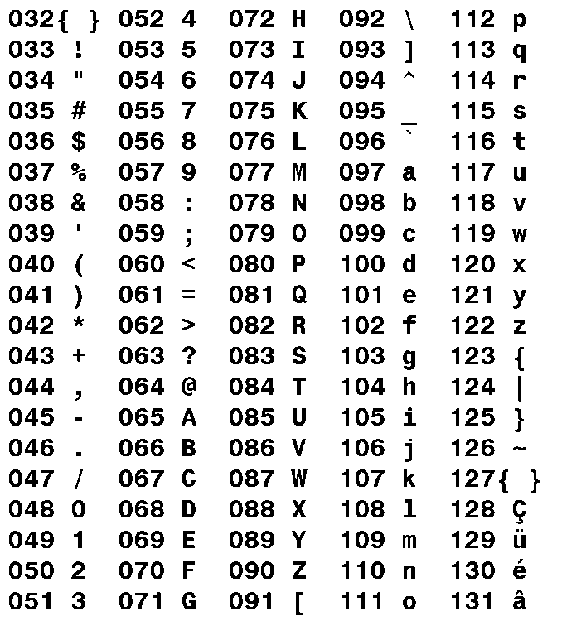
Interpreting Phred Scores
:GBGGGGGGGGGDGGDEDGGDGGGGDHHDHGHHGBGG:GG
: = ASCII 58
Phred33 encoding so Phred = 25
p = 10^^{(25/-10)}
p = 0.003

Slide 35
Interpreting Phred Scores
:GBGGGGGGGGGDGGDEDGGDGGGGDHHDHGHHGBGG:GG
Symbol | ASCII | Phred | Probability of miscall
: | 58 | 25 | p = 10^{^(25/-10)} = 0.003
G | 71 | ? | ?
BETTER
or
WORSE

Slide 36
Interpreting Phred Scores
:GBGGGGGGGGGDGGDEDGGDGGGGDHHDHGHHGBGG:GG
Symbol | ASCII | Phred | Probability of miscall
: | 58 | 25 | p = 10^{^(25/-10)} = 0.003
G | 71 | 38 | p = 10^^{(38/-10)} = 0.00016
BETTER

Slide 37
Interpreting Phred Scores
:GBGGGGGGGGGDGGDEDGGDGGGGDHHDHGHHGBGG:GG
Symbol | ASCII | Phred | Probability of miscall
G | 71 | 38 | p = 10^^{(38/-10)} = 0.00016
B | 66 | ? | ?
BETTER
or
WORSE

Slide 38
Interpreting Phred Scores
:GBGGGGGGGGGDGGDEDGGDGGGGDHHDHGHHGBGG:GG
Symbol | ASCII | Phred | Probability of miscall
G | 71 | 38 | p = 10^^{(38/-10)} = 0.00016
B | 66 | 33 | p = 10^^{(33/-10)} = 0.0005
WORSE

Slide 39
Further Processing: Beyond Raw FastQ Files
Sequence
Clean-up
Mapping
Library
Reads
Trimmed Reads
Mapped Reads
Downstream Quantitation
Fastq files
Bam file

Slide 40
Aligned Data – BAM Files
Expanded file containing alignment data (+ FastQ file details), in 2 Sections:
Header Section
Alignments Section
samtools view –H filename.bam
samtools view filename.bam | less
Details of sequence alignments:
One line per read
11 required columns (tab separated)
Information on:
Sequence
Where alignments and how it aligns
General Metadata
Information on:
Technical details of File
Reference
Programmes Involved
Each line begins with @ + 2 letter code
Need special programs to read, normally 'samtools’

Slide 41
BAM Header Section: Example
@HD VN:1.0 SO:unsorted
@SQ SN:1 LN:195471971
@SQ SN:10 LN:130694993
@SQ SN:11 LN:122082543
@SQ SN:12 LN:120129022
@SQ SN:13 LN:120421639
…etc…
@PG ID:hisat2 PN:hisat2 VN:2.1.0 CL:"/bi/apps/hisat2/2.1.0/hisat2-align-s --wrapper basic-0 --dta --sp 1000,1000 -p 7 -t --phred33-quals -x /bi/scratch/Genomes/Mouse/GRCm38/Mus_musculus.GRCm38 --known-splicesite-infile /bi/scratch/Genomes/Mouse/GRCm38/Mus_musculus.GRCm38.90.hisat2_splices.txt -U /tmp/17469.unp"
Header line
Format Version
Sorting Order
Reference Sequence
Name
Length
Program Information
ID
Name
Version
Command

Slide 42
BAM Alignments Section: Example
HWI-D00436:394:CBGLBANXX:1:1101:1222:1861 16 chr18 57944851 60 50M * 0 0 AAAAGATCTCTTGATTTAGAATTTTCTCTCAAATGTGAGGGACTTTTATN GGGGGGGGGGGGGGGGGGGGGGGGGGGGGGGGGGGGGGGGGGGGGBA<=# AS:i:-2 XN:i:0 XM:i:1 XO:i:0 XG:i:0 NM:i:1 MD:Z:49G0 YT:Z:UU NH:i:1
Sections
Sequence name HWI-D00436:394:CBGLBANXX:1:1101:1222:1861
Alignment Flags 16
Reference sequence name chr18
Start position 5794485
Mapping Quality (Phred) 60
Alignment (CIGAR) string 50M
Paired sequence name *
Paired sequence position 0
Total insert length 0
Called Bases AAAAGATCTCTTGATTTAGAATTTTCTCTCAAATGTGAGGGACTTTTATN
Base Quality String (Phred 33) GGGGGGGGGGGGGGGGGGGGGGGGGGGGGGGGGGGGGGGGGGGGGBA<=#
Other Tags

Slide 43
How QC Programmes Fit Into Processing Pipelines

Slide 44
QC metrics can we work with
Phred Scores
How the Sequencer Performed
At different cycles
Across different locations
For different reads
The Nature of our Sequenced Reads
Library Composition
Biases
Contaminants
Duplication
Mapping
Where our Sequencing Reads Come From
Species (plural or singular!)
Region (repetitive or unique)

Slide 45
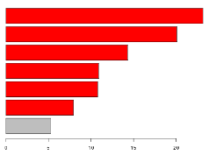
QC Programmes in Data Processing
Demultiplexed
QC
Sequence
Clean-up
Mapping
Trimmed Reads
Mapped Reads
Library
Reads
QC
QC
QC

Slide 46
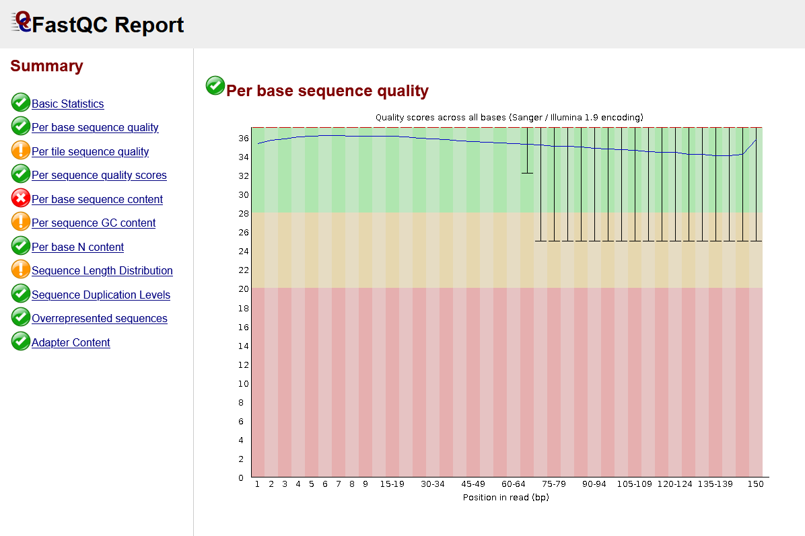
FastQC
fastqc seqfile1 seqfileN
fastqc *.fastq.gz
Reads raw fastq file(s)
Performs multiple checks
Pass/warn/fail
Compares to genomic library
Generates a HTML Report
https://www.bioinformatics.babraham.ac.uk/projects/fastqc/

Slide 47
FastQ Screen
fastq_screen seqfile1 seqfileN
fastq_screen *.fastq.gz
Reads fastq file(s)
Maps against a range of species / contaminants
Identifies unexpected sequences in your library
Generates a HTML Report
https://www.bioinformatics.babraham.ac.uk/projects/fastq_screen/

Slide 48
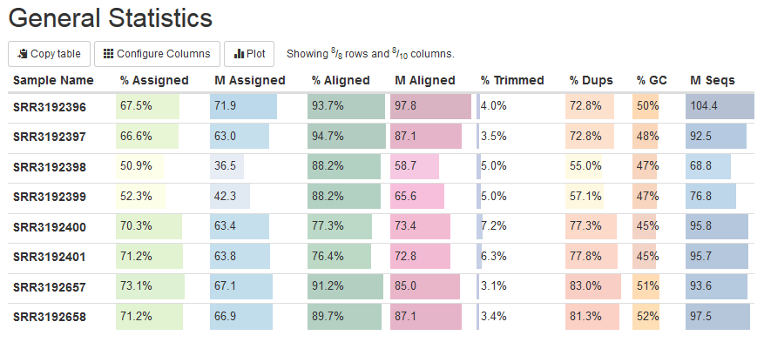
MultiQC
multiqc directory_with_reports
multiqc .
Reads in all QC files in a directory
Aggregates QC information from multiple samples
Large number of programs supported
Generates a combined HTML report
https://multiqc.info/

Slide 49
What can QC tell us?

Slide 50
Context is Key for QC
Expectations
Observations
Critical Analysis
Understanding & Confidence
QC should be about what you expect and what you see

Slide 51
Context is Key for QC
Expectations
Individual Library:
Universal
Library Dependent
Replicate Libraries:
Consistency

Slide 52
Assessing Universal Metrics

Slide 53
Context is Key for QC
Expectations
Observations
Expected
Universal
Concern
QC metrics that behave the same for all libraries
What Does it Mean?

Slide 54
Universal QC Metrics
Demultiplexing
Base Call Quality
Adapter Content
Mapping Quality

Slide 55
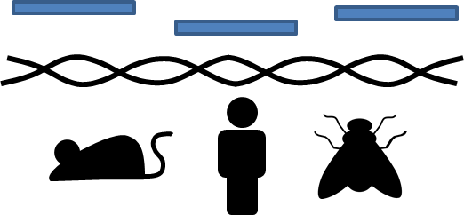
Universal QC Metrics
Demultiplexing
Base Call Quality
Adapter Content
Mapping Quality

Slide 56
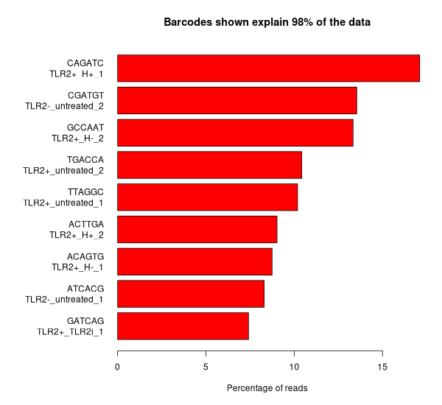
Demultiplexing: Expectations
Only the barcodes we assigned to samples should be present—no others
Sample 1
Sample 2
Sample 3
ect…
What barcode sequences have we found?
Expected Barcode
Unknown Sequence
What could unknown barcode sequences mean?

Slide 57
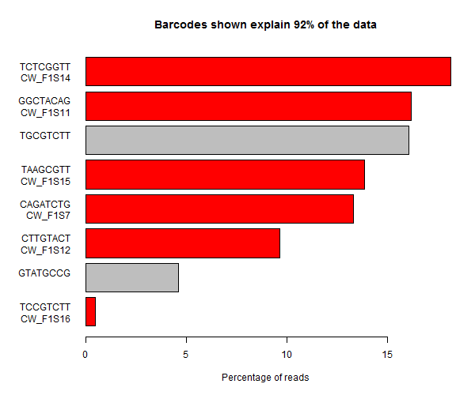
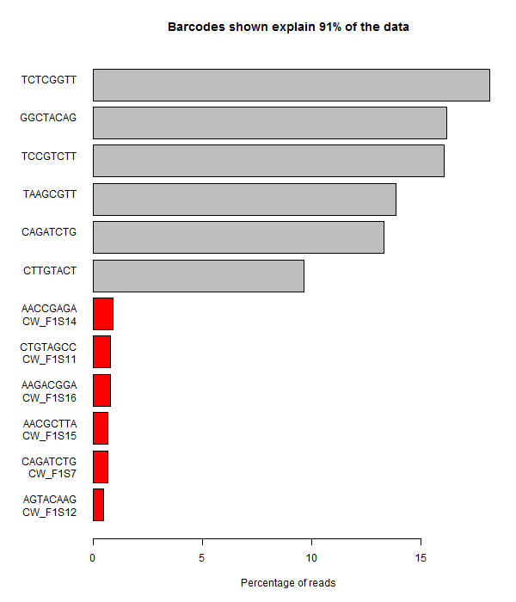
Demultiplexing: Unknown Barcode Sequences
Expected Barcode
Unknown Sequence
Typo
Reverse Complement
Human Error is a really common source of barcode issues

Slide 58
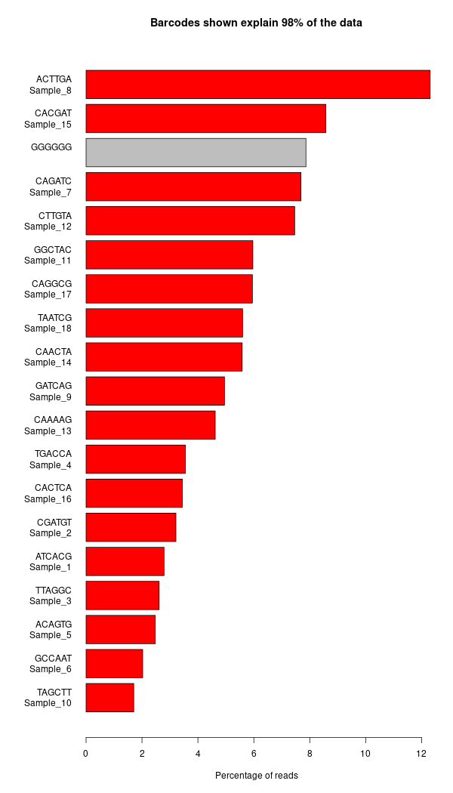
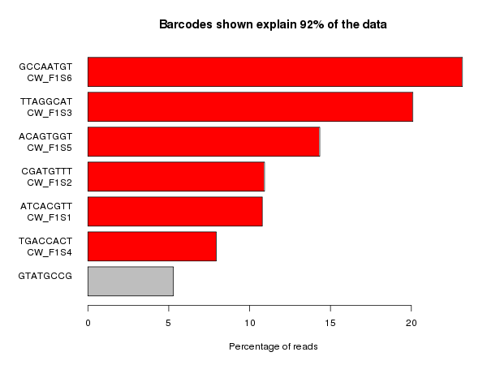
Demultiplexing: Unknown Barcode Sequences
Expected Barcode
Unknown Sequence
Failure in Priming site
PhiX Spike
Sometimes more technical in nature…

Slide 59
Universal QC Metrics
Demultiplexing
Base Call Quality
Adapter Content
Mapping Quality

Slide 60
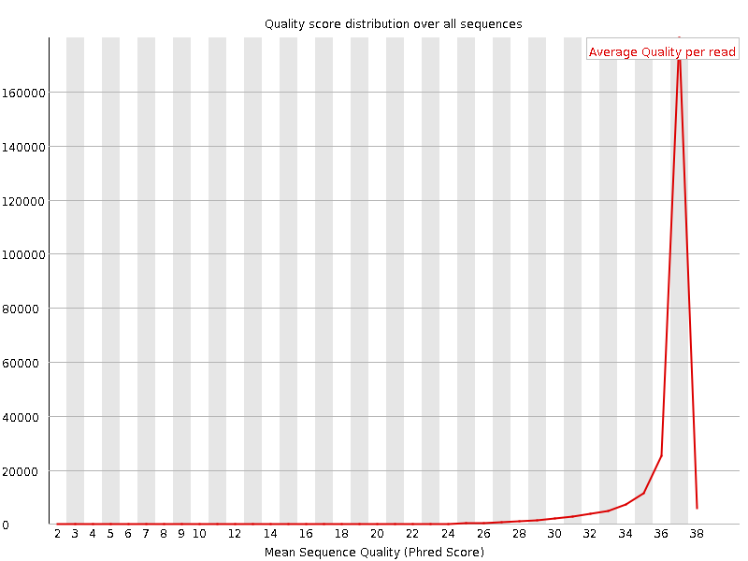
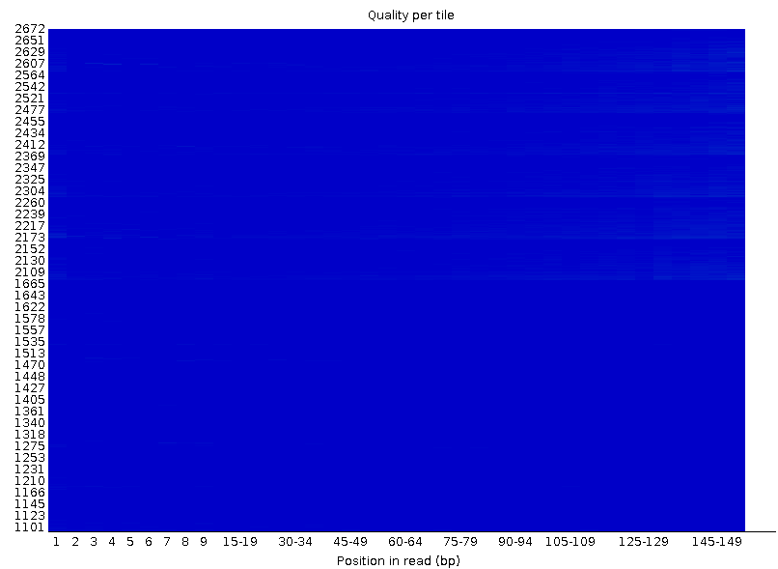
Base Call Quality: Expectations
Illumina Sequencers are technically reliable, so we expect confident calls
Phred scores
Per base/cycle
Per Read
Location

Slide 61
Per Base Sequence Quality Plot
Phred Score
Read Position / Cycles of Chemistry

Slide 62
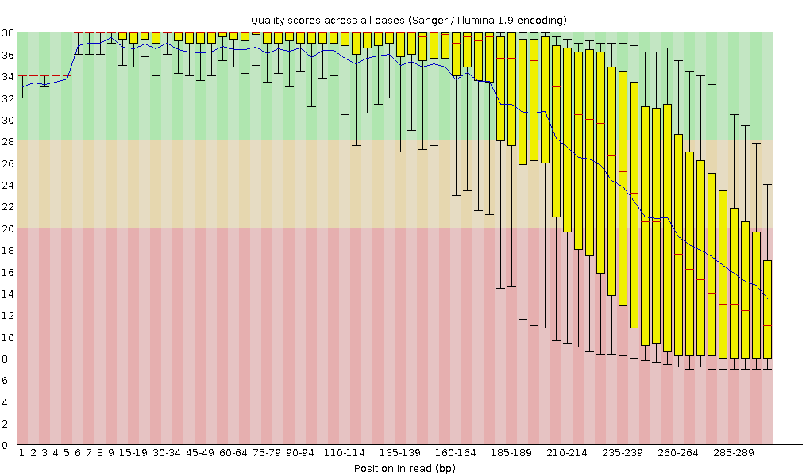
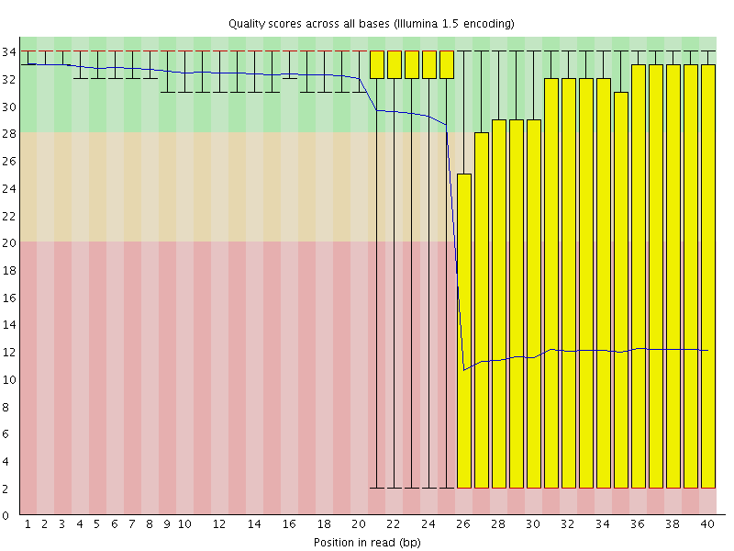
Base Call Qualities – Problems At Given Cycles
Clusters get out of sync over long read length
Technical problem with the sequencer

Slide 63
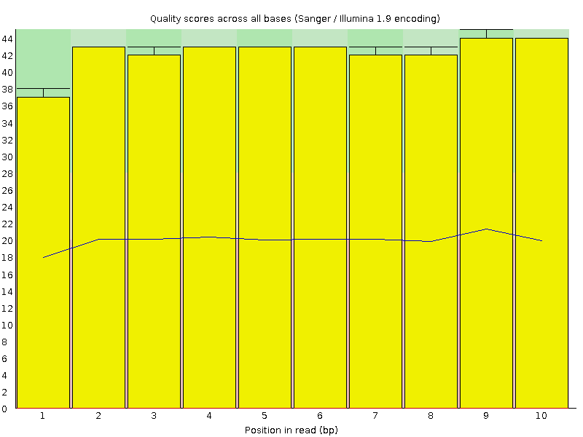
Diagnosing Less Clear Cut Base Call Problems
Not everything is bad
Why are some calls bad and not others?
What can we learn
Salvage this run
Fix future runs

Slide 64
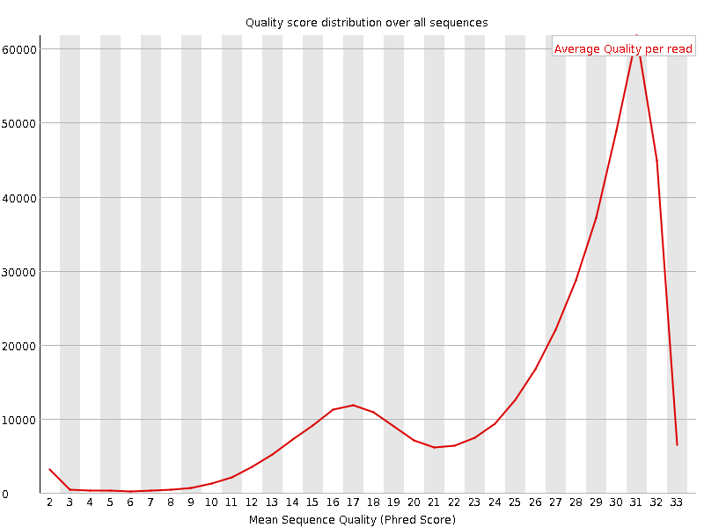
Per Sequence Quality Score Plot
Reads have Similar High Average Quality
Count
Poorer Quality Read Subsets
Mean Sequence Phred Score

Slide 65
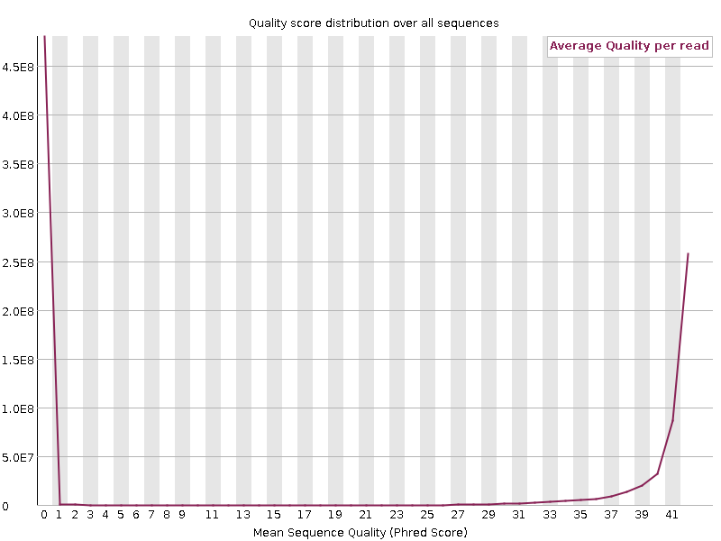
Diagnosing Less Clear Cut Base Call Problems
Lot of Reads with really low Scores

Slide 66
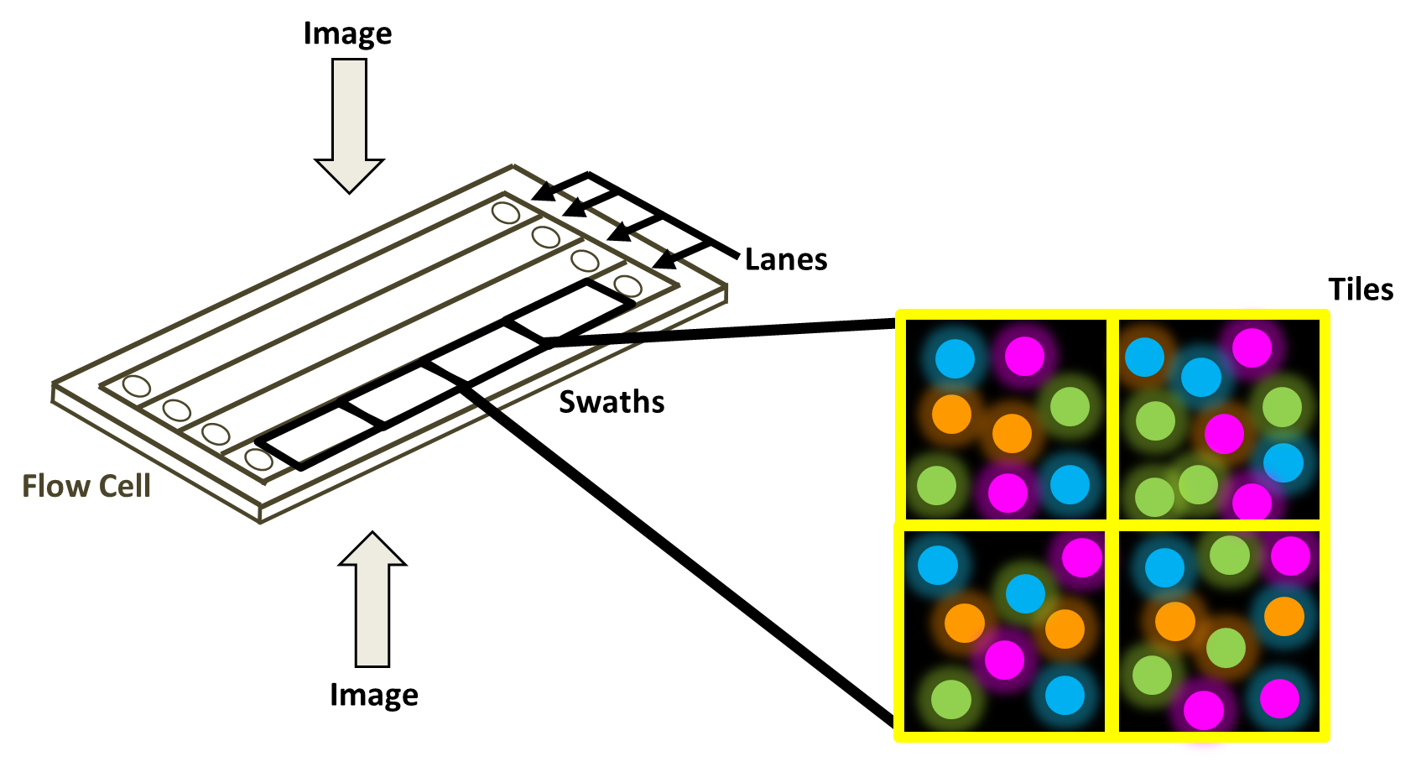
Positional Quality
Quality >= Average
Quality < Average
Bottom
Tile
Top
A good tile plot is a blue square
Read Position / Cycles of Chemistry

Slide 67
Diagnosing Less Clear Cut Base Call Problems
Focusing Fail!

Slide 68
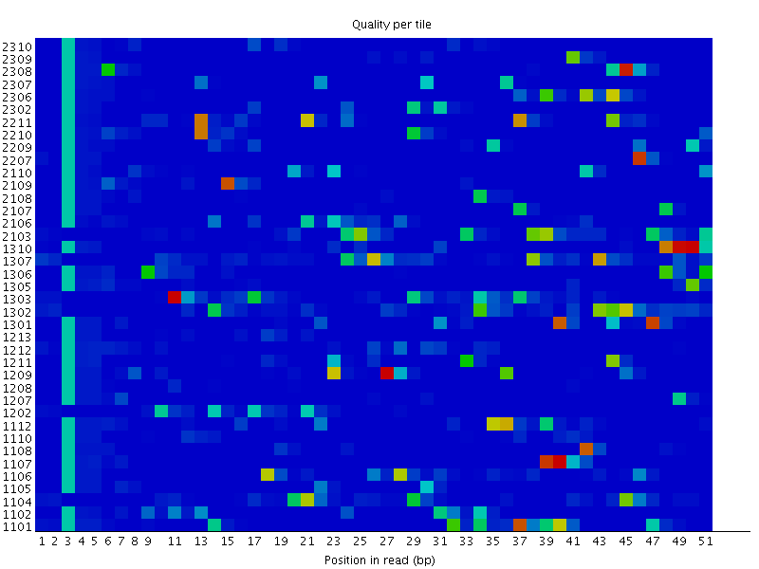
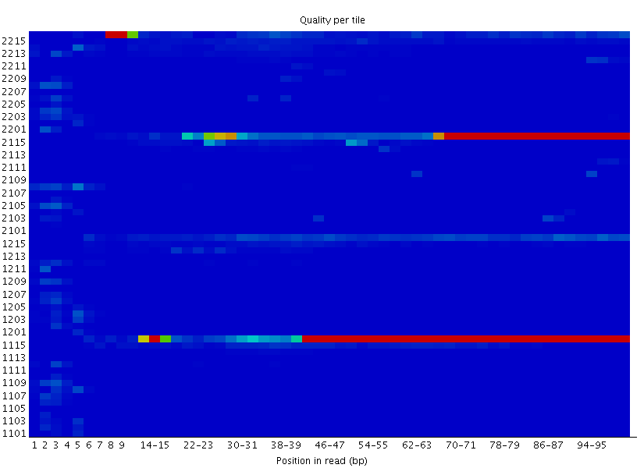
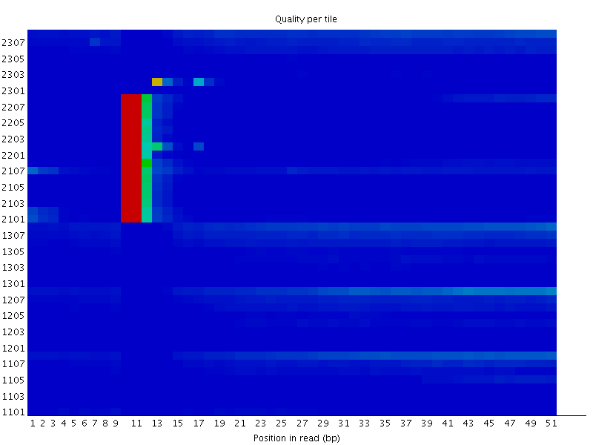
More Examples of Positional Fails
Position Specific Patterning
Random Pattern
Permanent
Transient
Overloading of Flow Cell
Obstruction
Bubble

Slide 69
Universal QC Metrics
Demultiplexing
Base Call Quality
Adapter Content
Mapping Quality

Slide 70
Adapters Content: Expectations
Read 1
Primer
Adapter
Insert
Adapter
Read 1
Primer
Adapter
Insert
Adapter
Due to variable insert and read length, we may sequence adapter at the end of our reads

Slide 71
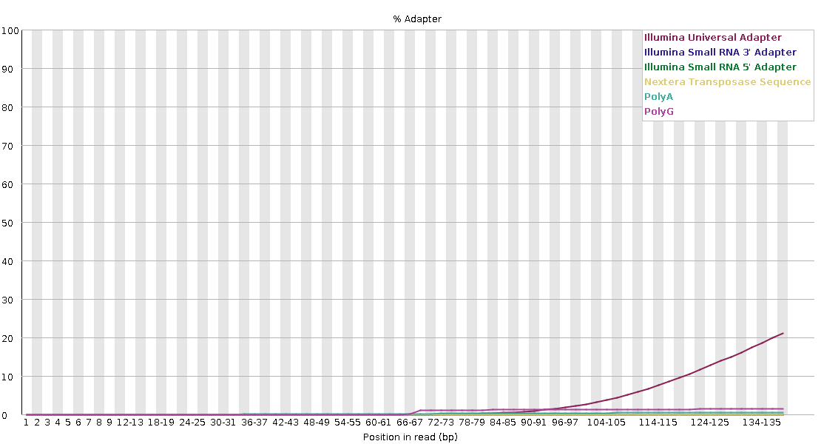
Measuring Read-though Adapters
Read 1
Primer
Adapter
Insert
Adapter

Slide 72
Clean-Up Options (Adapters & Poor Calls)
Trimming 3’ end:
Remove adapter read through
Remove poor quality bases
Read 1
Primer
Adapter
Insert
Adapter
Remove Specific Reads
Average Quality
Location on Flow Cell
Live with it:
Sometimes it’s good enough e.g. mapping

Slide 73
Universal QC Metrics
Demultiplexing
Base Call Quality
Adapter Content
Mapping Quality

Slide 74
Mapping: Expectations
We Expect Reads to Align to the Species Sequenced
QC
Time loading forward index: 00:01:10
Time loading reference: 00:00:05
Multiseed full-index search: 00:20:47
24548251 reads; of these:
24548251 (100.00%) were paired; of these:
1472534 (6.00%) aligned concordantly 0 times
21491188 (87.55%) aligned concordantly exactly 1 time
1584529 (6.45%) aligned concordantly >1 times
94.00% overall alignment rate
Time searching: 00:20:52
Overall time: 00:22:02
Sample1
Number or Percentage
Did Not Align
Mapped Uniquely
Multi-mapped
Alignment Will Vary!
But if many reads do not align as expected… Where are they from?

Slide 75
Checking Mapping issues: Library Screening
Map reads against a range of reference genomes
Classify matches as: unique to one species & single or multiple mapping
One Genome Hits Should Match The Species Sequenced

Slide 76
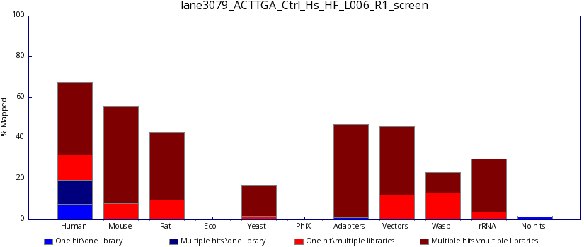
Library Screening
One Genome Hits Should Match The Species Sequenced

Slide 77
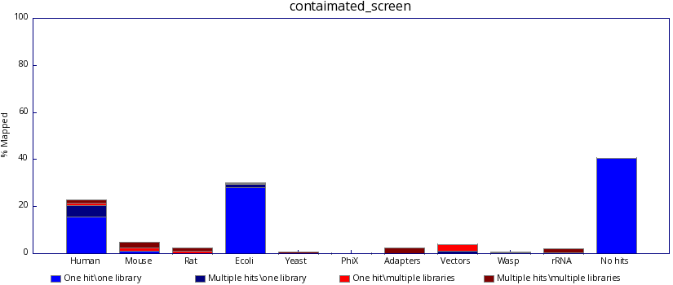
Library Screening

Slide 78
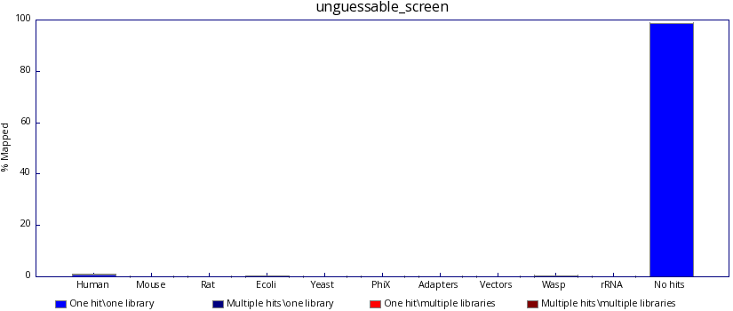
Library Screening

Slide 79
Exercise Part 1: Assessing Universal Metrics
Concern?
Per base sequence quality
Per tile sequence quality
Per sequence quality scores
Adapter Content
Dataset 1
one for each read
Dataset 2
Dataset 3
Expected Genome?
There are QC problems with all of these libraries, can you spot them?

Slide 80
Assessing Library Dependent Metrics

Slide 81
Context is Key for QC
Expectations
Observations
Library Dependent
Concern or Expected?
Metrics which vary with type of Library
What Does it Mean?
FastQC expects a Genomic Library: Do you?

Slide 82
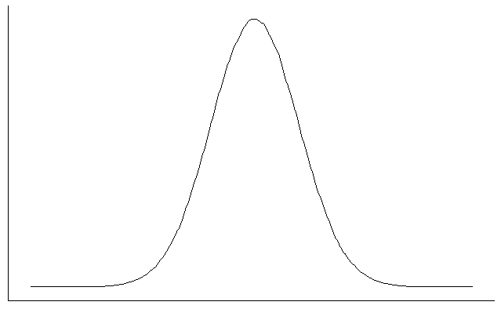
Library Dependent QC Metrics
From the Base Sequence:
GC Content
GC
Base Composition
GATC
GATCTACGAGTTACGATCAGT
Duplication
GATCTACGAGTTACGATCAGT
GATCTACGAGTTACGATCAGT
GATCTACGAGTTACGATCAGT

Slide 83
Library Dependent QC Metrics
From the Base Sequence:
GC Content
GC
Base Composition
GATC
GATCTACGAGTTACGATCAGT
Duplication
GATCTACGAGTTACGATCAGT
GATCTACGAGTTACGATCAGT
GATCTACGAGTTACGATCAGT

Slide 84
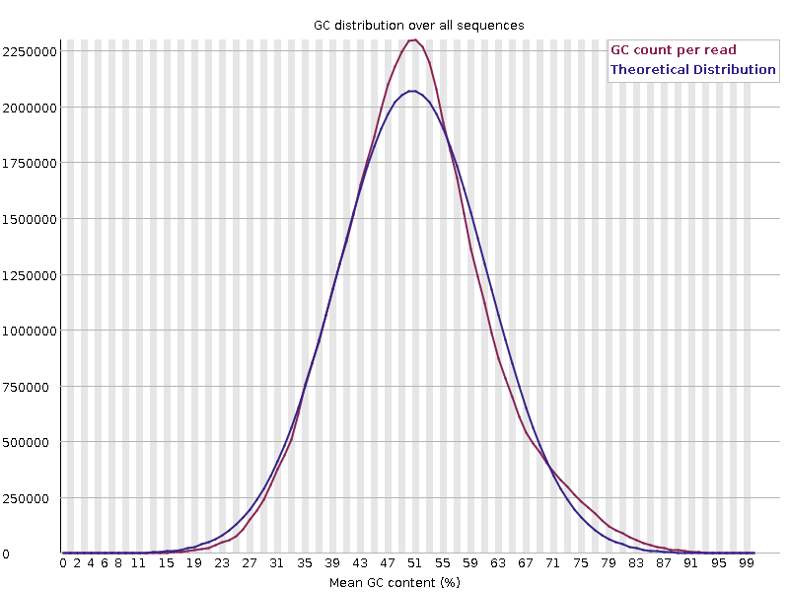
Library GC Content
Generic summary of library composition at a read level
Expect a normally distributed set of values centred on the overall GC content

Slide 85
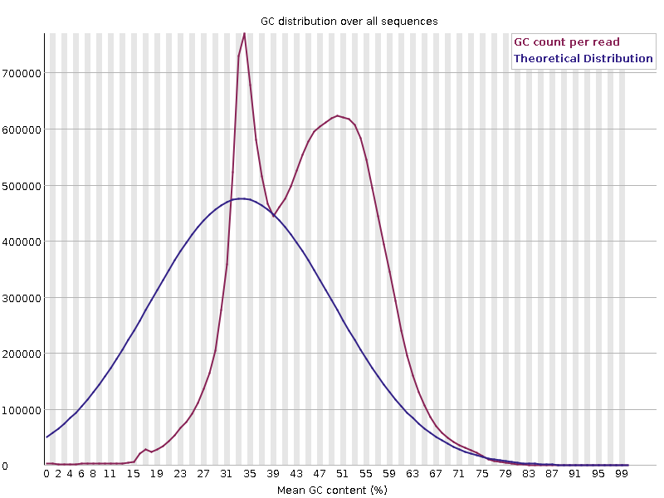
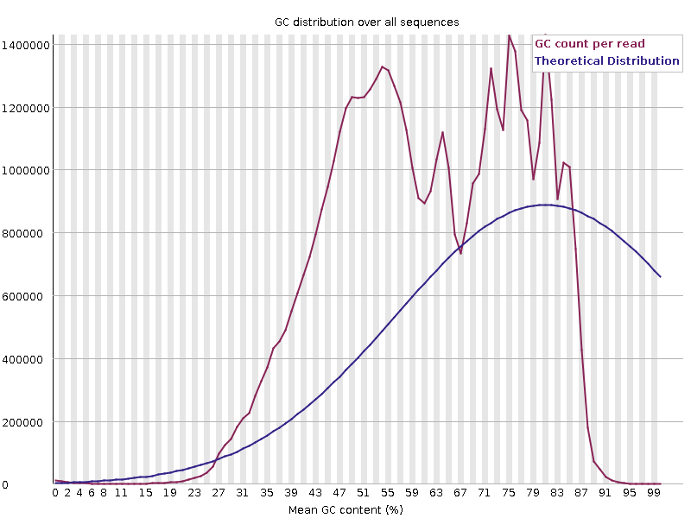
Sharp Peaks in GC
Concern or Expected
Specific Contamination with single sequence or closely related sequences
Artificial sequences, ribosomal RNA, contaminants

Slide 86
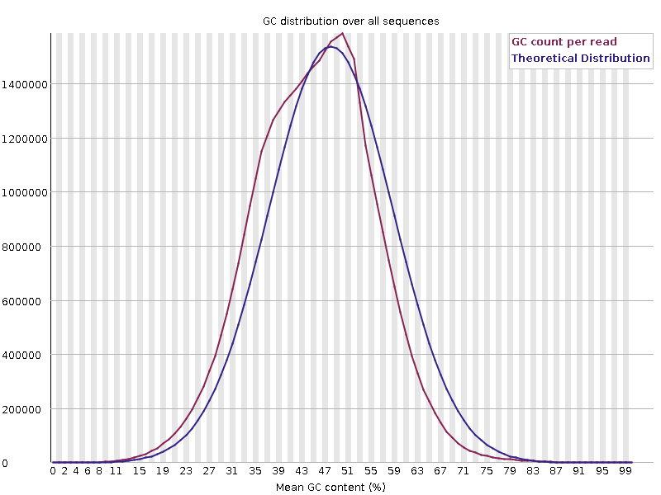
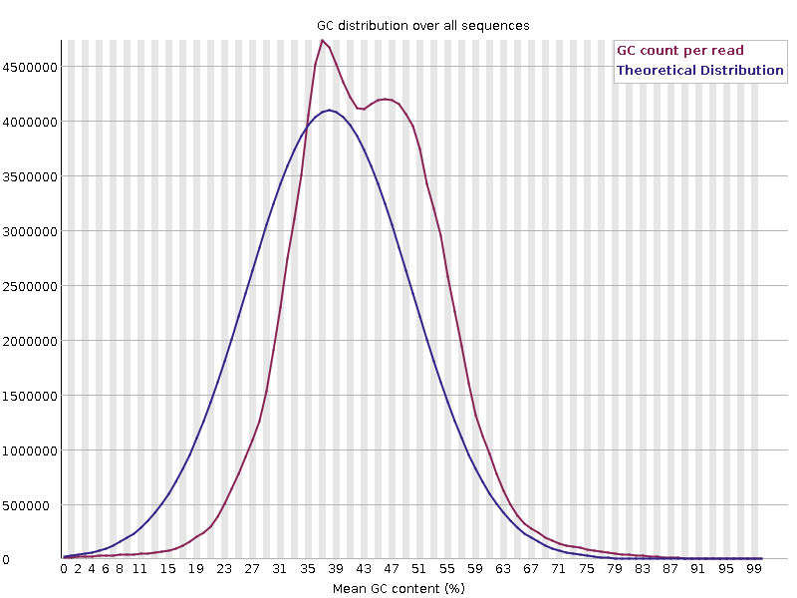
Broader Peaks in GC
Concern or Expected
Mouse
Drosophila
H3K4me1 ChIP: enrich for regions rich in GC
More extensive mixture of reads with different GC content

Slide 87
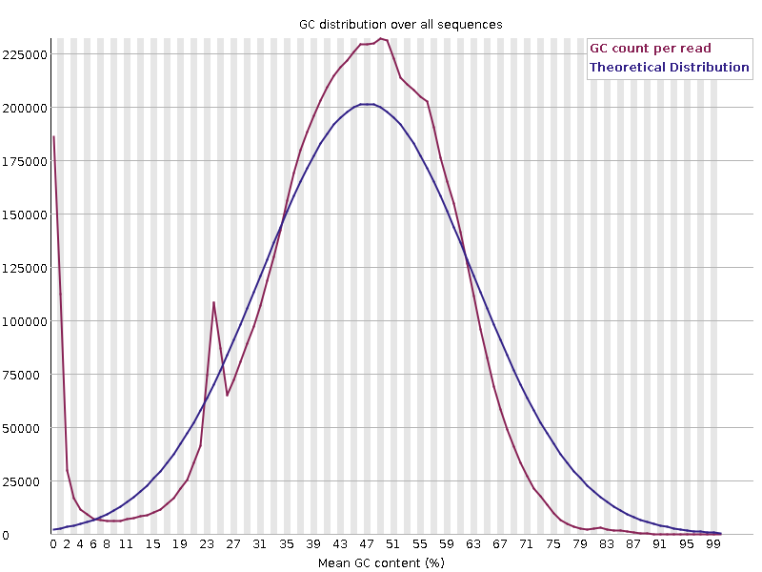
GC Skew
Concern or Expected
PolyA’s
PolyG’s
More extensive subset of reads with extreme differences in GC

Slide 88
Library Dependent QC Metrics
From the Base Sequence:
GC Content
GC
Base Composition
GATC
GATCTACGAGTTACGATCAGT
Duplication
GATCTACGAGTTACGATCAGT
GATCTACGAGTTACGATCAGT
GATCTACGAGTTACGATCAGT

Slide 89
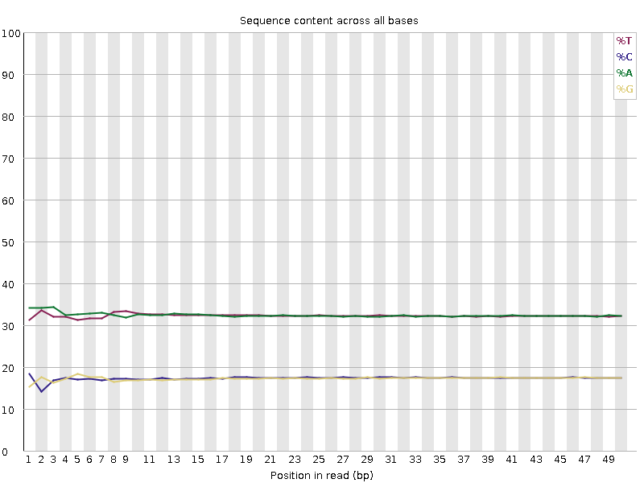
Library Base Composition
For every chemistry cycle we can look at the number of ATGC we call
For Libraries with random start positions the composition should be the same for all cycles

Slide 90
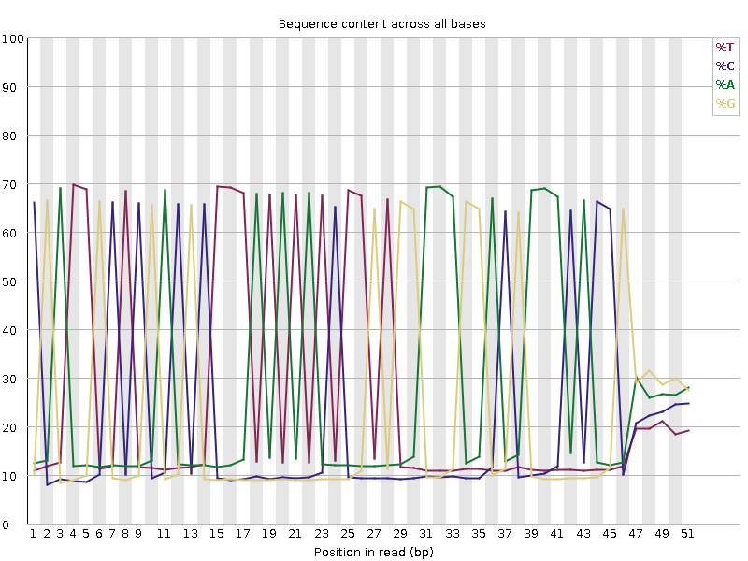
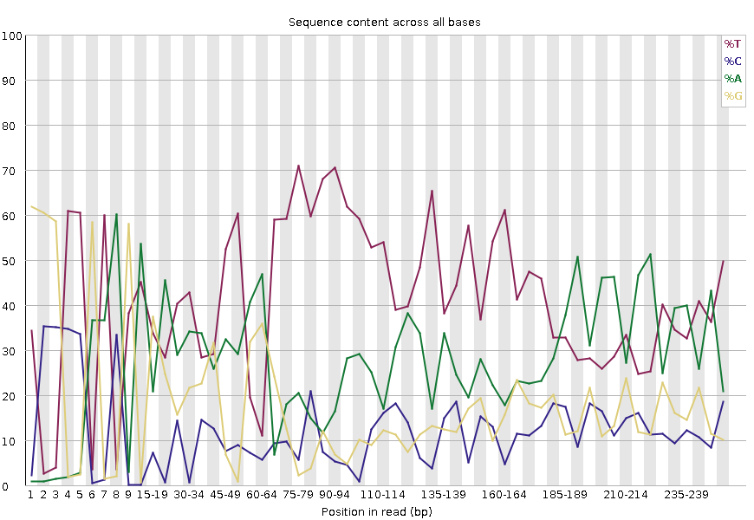
Bias Composition Throughout
Concern or Expected
Wrong Sequence
Amplicon
Proportional biases of bases at specific positions:
Very low diversity

Slide 91
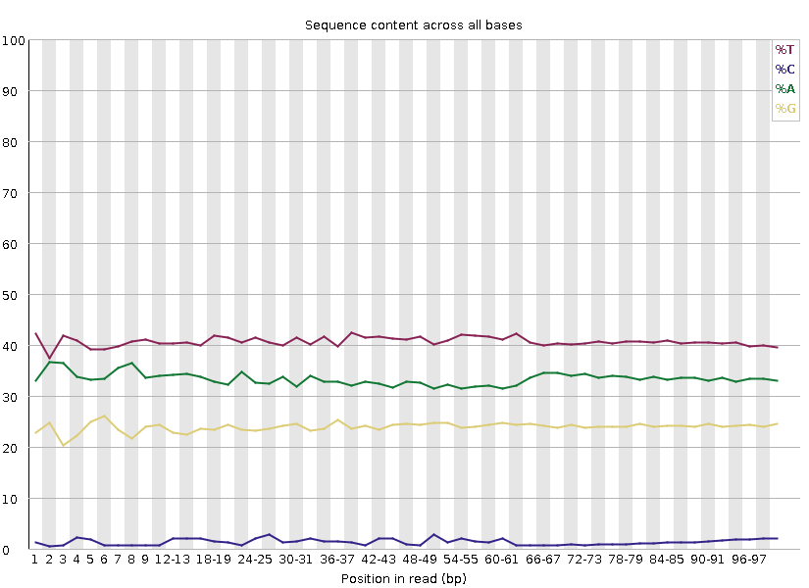
Bias Composition Throughout
Concern or Expected
WGBS
Consistent disproportional expression of bases

Slide 92
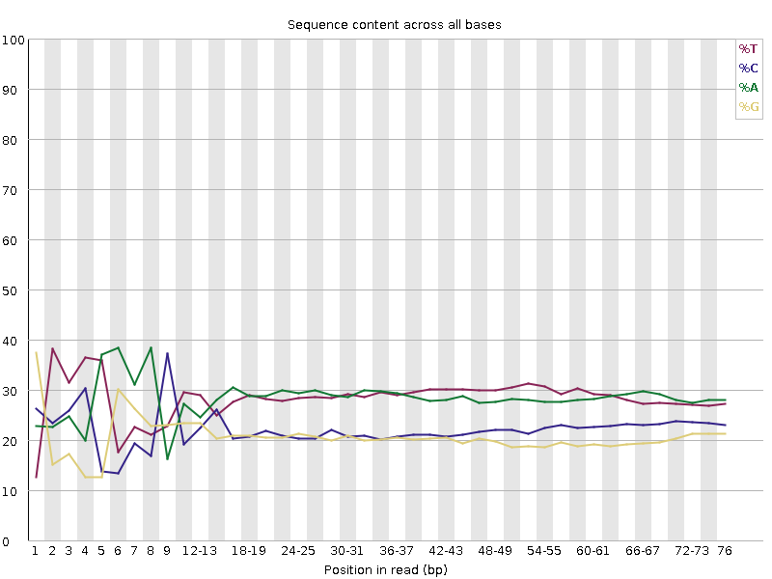
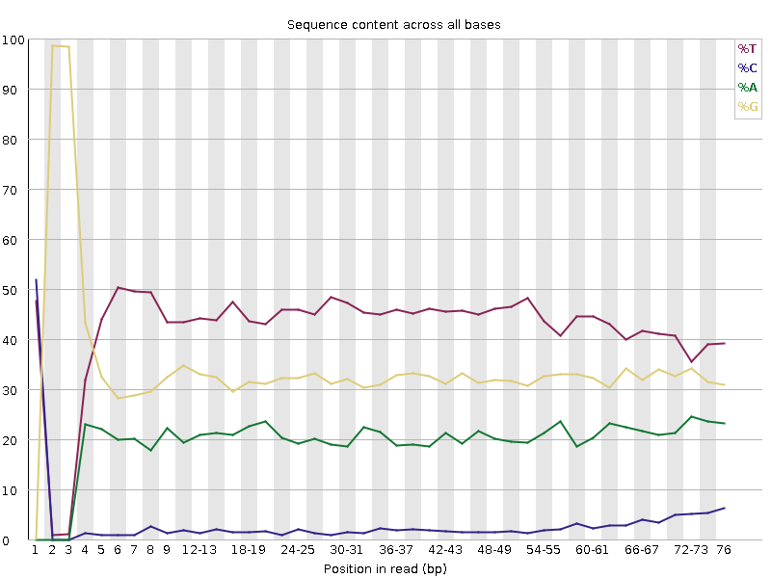
Bias Composition at 5’ end
Concern or Expected
ATAC – Transposases
RRBS – Restriction Start Site
Proportional biases of bases at the start of a read: A preferred start site

Slide 93
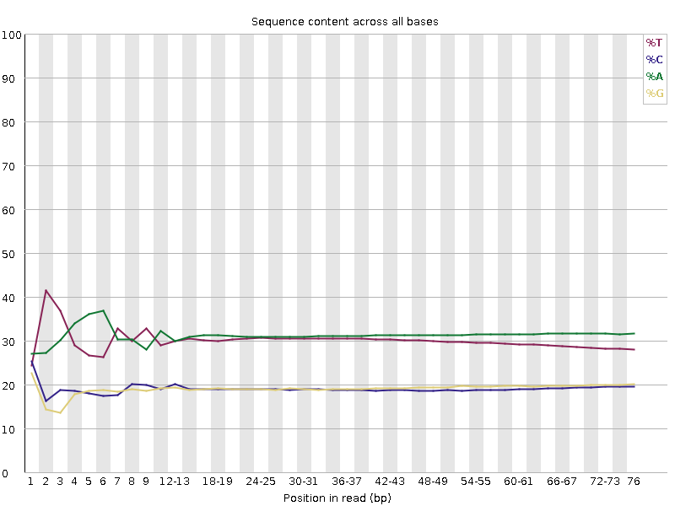
Bias Composition at 3’ end
Concern or Expected
Proportional biases of bases at the end of a read: consistent closing sequence

Slide 94
Bias Composition at 3’ end
Concern or Expected
Proportional biases of bases at the end of a read: consistent closing sequence
Bioinformatics processing can also influence QC metrics!

Slide 95
Library Dependent QC Metrics
From the Base Sequence:
GC Content
GC
Base Composition
GATC
GATCTACGAGTTACGATCAGT
Duplication
GATCTACGAGTTACGATCAGT
GATCTACGAGTTACGATCAGT
GATCTACGAGTTACGATCAGT

Slide 96
Duplication
How frequently the exact same sequence appears in your library
For WGS expect most sequences to be unique

Slide 97
Duplication
If the exact same sequence appears more than once it could be…
Technical:
Coincidental:
ATCCGAGCTATTCGGCGAGCTCGCCAGTTACG
ATCCGAGCTATTCGGCGAGCTCGCCAGTTACG
ATCCGAGCTATTCGGCGAGCTCGCCAGTTACG
ATCCGAGCTATTCGGCGAGCTCGCCAGTTACG
ATCCGAGCTATTCGGCGAGCTCGCCAGTTACG
ATCCGAGCTATTCGGCGAGCTCGCCAGTTACG
PCR duplicates
Deep sequencing
Highly present sequences
Restricted diversity libraries

Slide 98
Duplication
Concern or Expected
RNA-Seq
Amplicon
BUT could have technical duplication with expected coincidental duplication!

Slide 99
Overrepresented Sequences
Extreme duplication
The exact same sequence is a significant proportion of the whole library (which might not be duplicated overall)
Poly Sequences
Specific Sequences

Slide 100
Sources of Poly Sequences
PolyN – Quality too poor to make any calls
PolyG – Empty space in 2 colour chemistry, can be technically “high quality” calls

Slide 101
Sources of Poly Sequences
PolyA (or PolyT) – Common in RNA-Seq

Slide 102
Overrepresented Specific Sequences
Normally artificial sequences (primers, adapters, vectors etc)
Can search a database of known sequences to find matches
Example of an Adapter dimer:
Barcode
Adapter
Insert
Adapter
Barcode
Barcode
Adapter
Adapter
Barcode

Slide 103
Overrepresented Specific Sequences
Other potential sources…
Ribosomal
Contaminant

Slide 104
Exercise Part 2: Assessing Library Dependent Metrics
Dataset 4
RNA-Seq Library
Concern or Expected?
E14_D0
Per base sequence content
Per sequence GC content
Sequence Duplication Levels
Overrepresented sequences
E14_D4
One of these samples is normal for an RNA-Seq library, the other is not. Which is which?

Slide 105
Assessing Consistency

Slide 106
Context is Key for QC
Expectations
Individual Library:
Universal
Library Dependent
Replicate Libraries:
Consistency

Slide 107
Aggregated Statistics
Individual QC reports are useful but helpful to have a wider picture
Sample 1
Sample 2
Aggregate and plot range of QC stats together
https://multiqc.info/modules/

Slide 108
Sample1
Sample2
Sample3
Sample4
Sample5
Sample6
6 Samples, 24 files:
Paired end
Pre/post trimming

Slide 109
Aggregated Mapping Stats
Identify local QC problems by spotting samples that behave differently
FastQ Screen

Slide 110
Exercise Part 3: Putting it All Together with MultiQC
Consider Expectations
Fastq File
Review Observations
QC Metrics:
FastQC
Dataset 5
ATAC-Seq Library
mESC_rep1
Trimmed Fastq File
mESC_rep2
QC Metrics:
FastQC
FastQ Screen
NPC_rep1
NPC_rep2
Aligned File
e.g. bam file
QC Metrics:
Aligner programme dependent QC stats
e.g. mapping statistics
There is a QC problem, can you tell what it is and whether the data is usable?

Slide 111
Final Thoughts

Slide 112
Expectations and Observations are Key
Can you tell if these libraries are any good?

Slide 113
QC In A Nut-Shell
Expectations
Observations
Critical Analysis
Understanding & Confidence
Good Science ☺

Slide 114
Useful Links
https://sequencing.qcfail.com/
FastQC http://www.bioinformatics.babraham.ac.uk/projects/fastqc/
FastQ Screen https://www.bioinformatics.babraham.ac.uk/projects/fastq_screen/
MultiQC https://multiqc.info/

