Slide 1

An Introduction to SeqMonk
Simon Andrews
simon.andrews@babraham.ac.uk
v2023-06
Notes:
The format of the course will be…
Firstly – theory
Steps involved in an RNA-seq analysis
Practical session

Slide 2
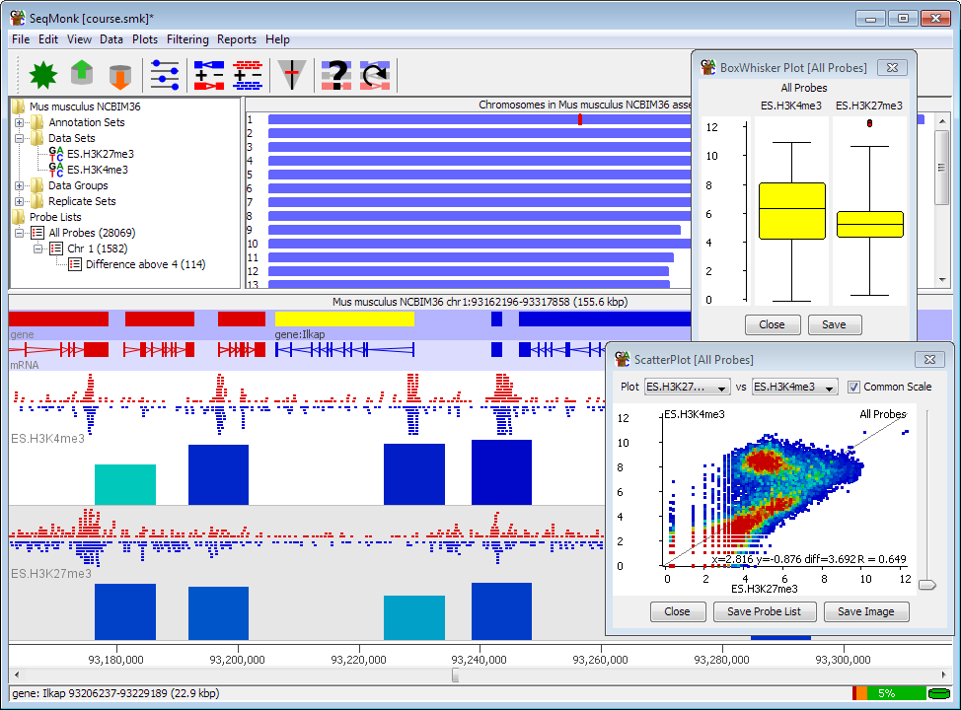

Slide 3
Course Programme
Installing SeqMonk and Dependencies
Creating a Project and Importing Data
UI layout and basic controls
Probes and Quantitation
Plotting Figures
Filtering Probes
Saving, Reporting and Vistories

Slide 4
Installing SeqMonk and Dependencies

Slide 5
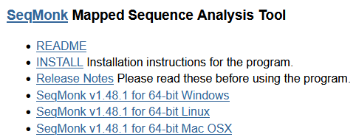
https://www.bioinformatics.babraham.ac.uk/projects/seqmonk/

Slide 6
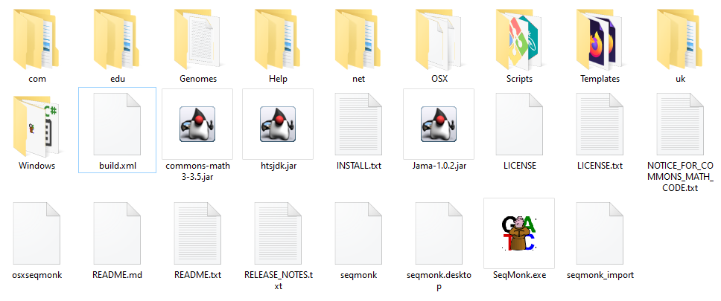
Windows
Unzip zip file

Slide 7
Mac OSX
Download and run the DMG file
Copy App to the Applications folder

Slide 8
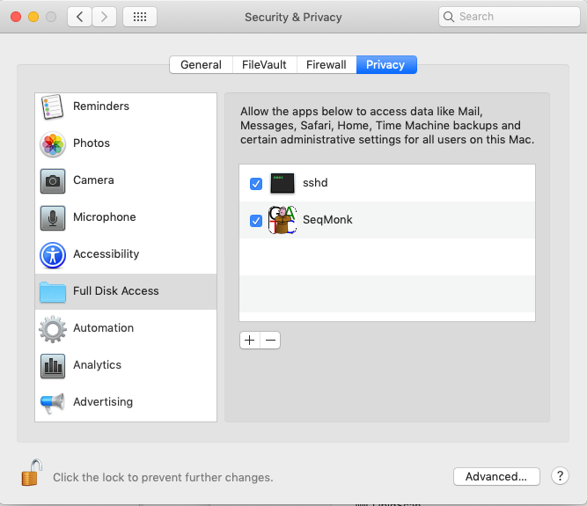
Mac OSX

Slide 9
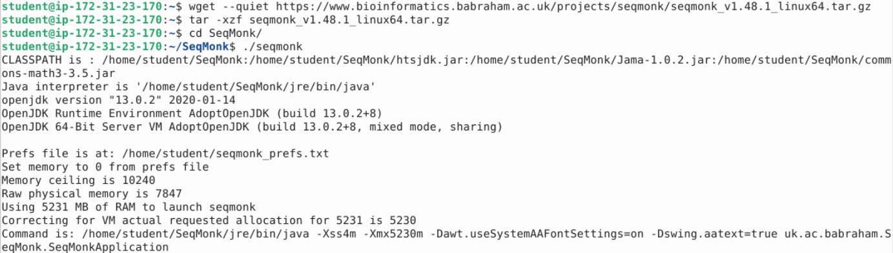
Linux
Download tar file
Run the launcher

Slide 10
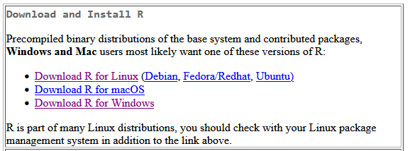
Installing R
https://cran.r-project.org/
Linux users need to install development versions of libssl, libcurl4, libxml2

Slide 11
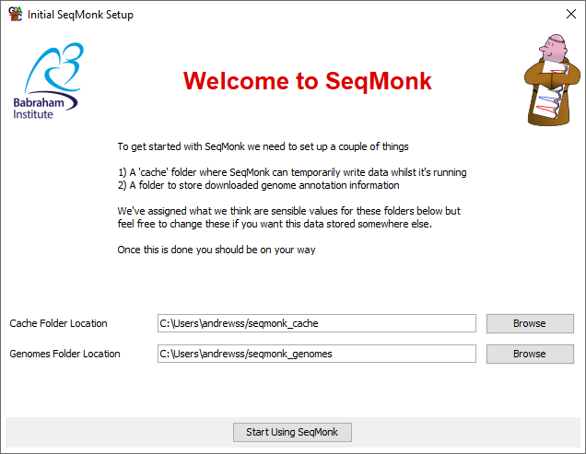
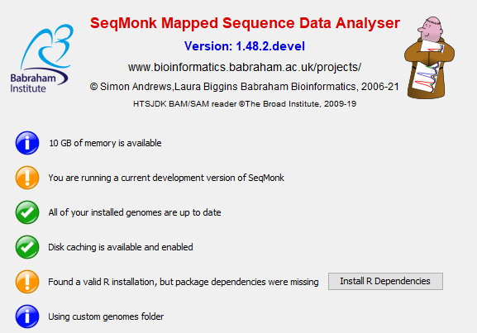
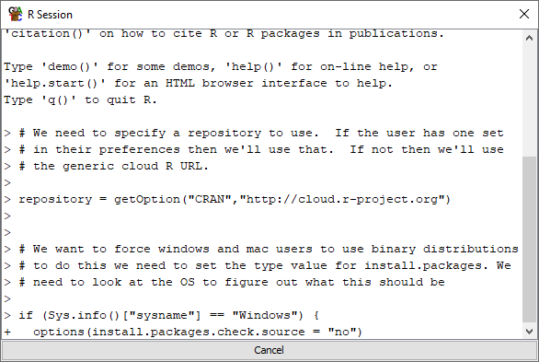
First Launch

Slide 12
Creating a Project and Importing Data

Slide 13
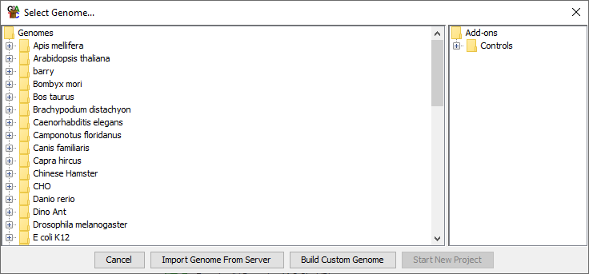
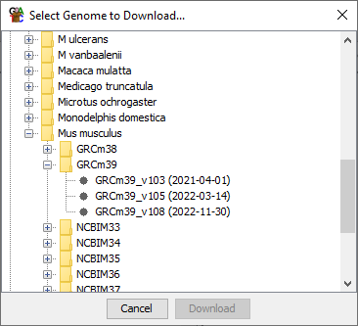
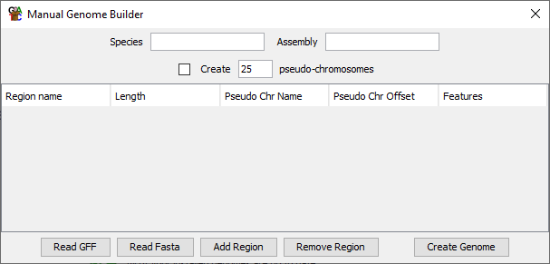
File > New Project

Slide 14
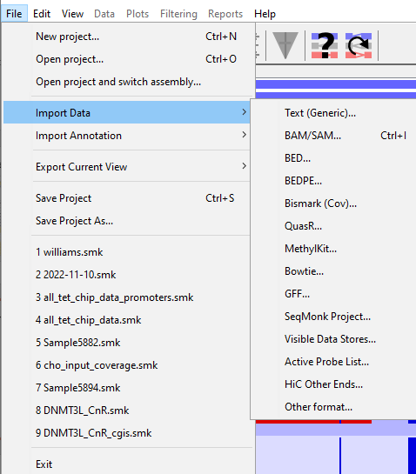
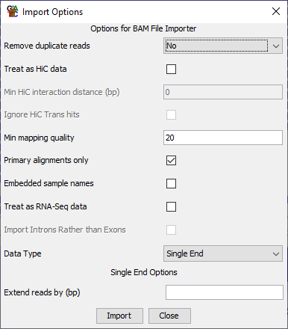
File > Import Data

Slide 15
UI Layout and Basic Controls

Slide 16
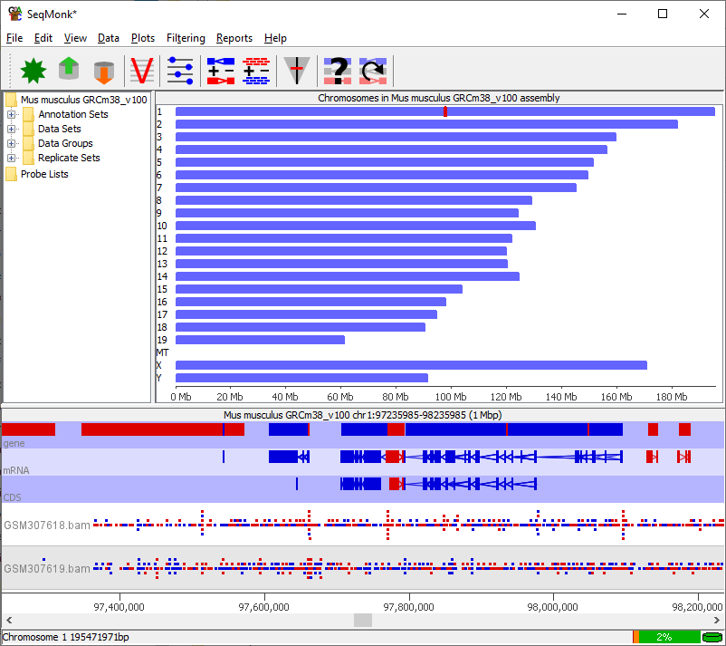
Data View
Genome View
Chromosome
View

Slide 17
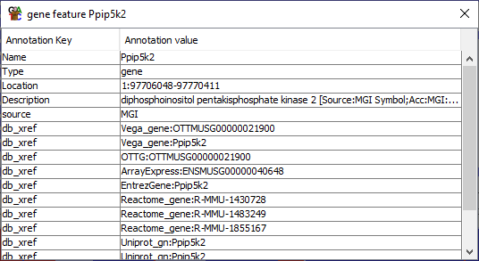
Annotation
Data
Reads
Exon
Intron
Top strand – features run left to right
Bottom strand – features run right to left

Slide 18
Data Types
Annotation
Reads
Annotation collection
  All of the annotation in the project
Annotation set
  A collection of features of varying types which came from the same source
Annotation track
  A set of features of the same type which might be drawn from several annotation sets
Data Set
  A set of reads which came from one source (usually file)
Data Group
  A set of reads merged together from multiple datasets.
Replicate Set
  A collection of data sets / groups which come from the same biological condition

Slide 19
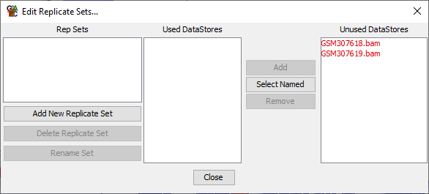
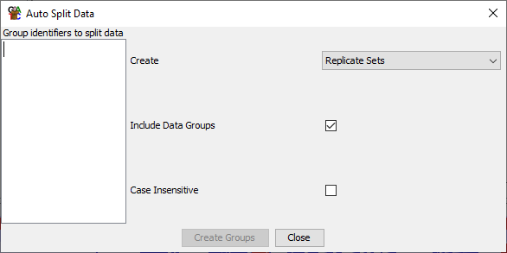
Creating Data Groups / Replicate Sets
Data > Edit Replicate Sets
Data > Auto Create Groups/Sets

Slide 20
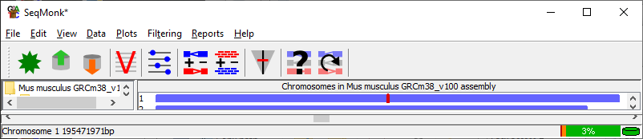
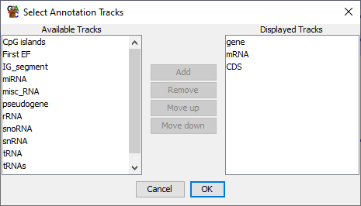
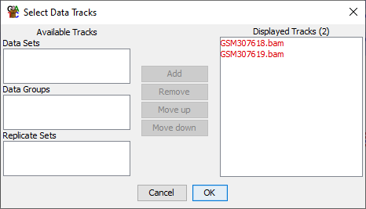
Changing Chromosome Tracks

Slide 21
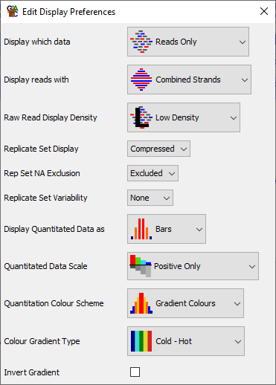
Changing Display Preferences

Slide 22
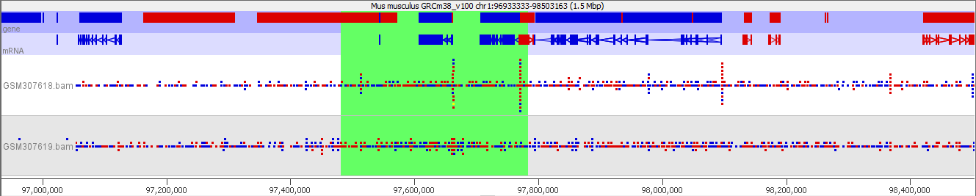
Movement Controls
Mouse
Keyboard
Scroll Wheel to move left / right
Click and drag to zoom in
Right click to zoom out
Double click for feature details
Up arrow to zoom in
Down arrow to zoom out
Left / Right arrows to move along
Control +F to search (find)
Control +G to jump to position (goto)

Slide 23
Probes and Quantitation

Slide 24
Terminology for Quantitation
Probe
  A region of the genome where a measurement will be made. Has a start and end, and optionally a strand
Probe Set
  The full set of probes currently being used for quantitation (eg all the promoters in the genome)
Probe List
  A subset of probes drawn from within the current Probe set (eg all of the promoters on chromosome 1)

Slide 25
Quantitation Rules
A project can only have a single probe set, and the same probe set is used to quantitate all data
Each probe has a quantitative value associated with it in every Data Set and Data Group
Replicate Sets show the mean quantitation of the Data Sets within them
The chromosome view will show only the currently selected probe list, and most plots only use data from the current probe list

Slide 26
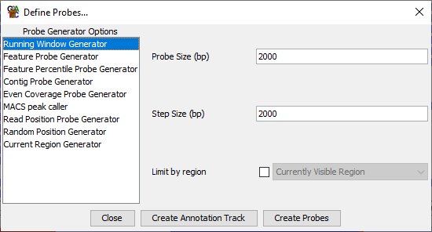
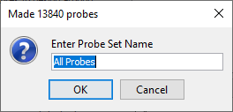
Data > Define Probes
Probe Generators
Different ways of defining a probe set
Generator Options
Options specific to the currently selected generator

Slide 27
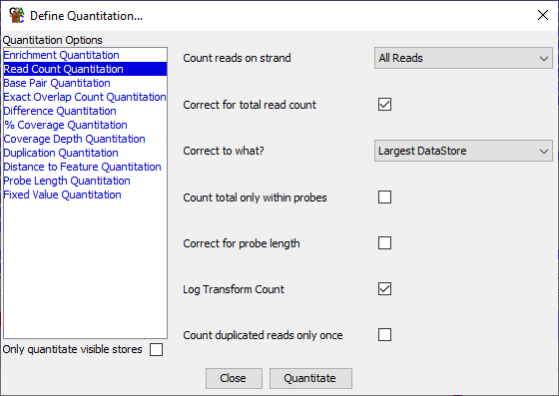
Data > Quantitate Existing Probes
Opens automatically after defining new probes
Can be rerun on existing probes without changing them
Quantitation Methods
Different ways of assigning a value to a probe
Quantitation Options
Options specific to the currently selected quantitation method

Slide 28
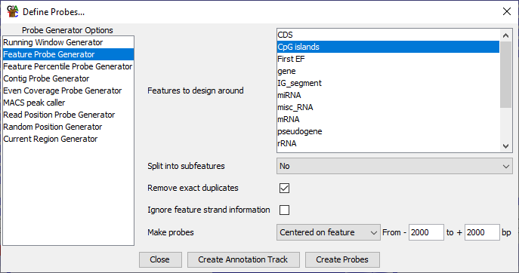
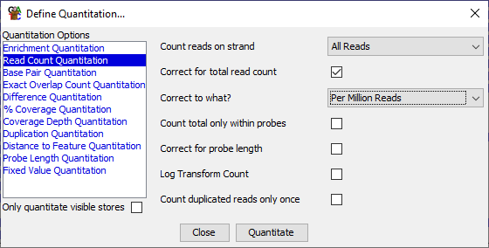
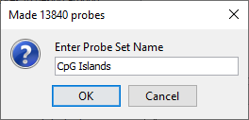
Quantitation Example
2000bp
2000bp
New Probe
CpG Island

Slide 29

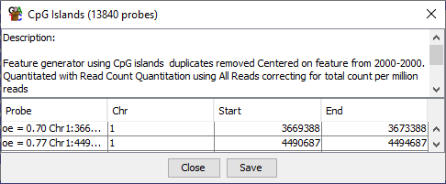
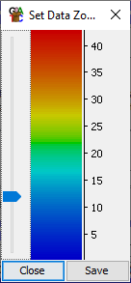
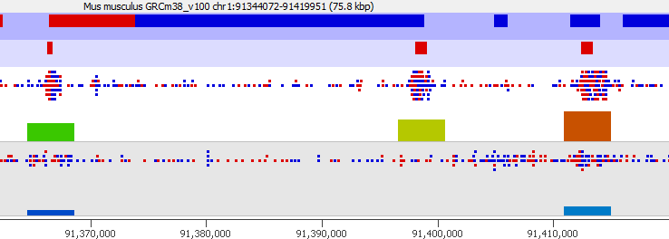
Quantitation Example
Bars = Probes
Check the positions match with what you expect
Height = Value = Colour
Capped at 95th Percentile by default

Slide 30
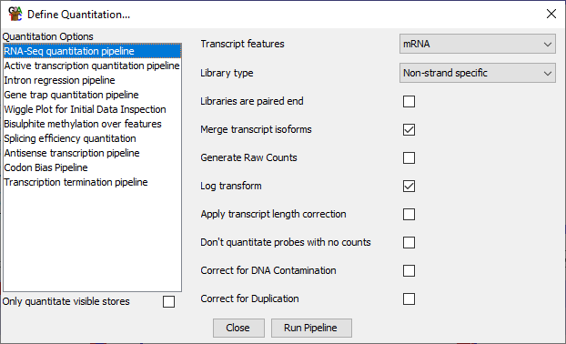
Quantitation Pipelines
Data > Quantitation Pipelines
Combine Probe Generation and Quantitation
Pipeline
Pipeline Options

Slide 31
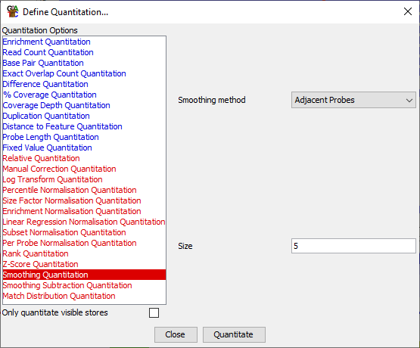
Quantitation Adjustment
Additional Options once you have a quantitation
Blue
Fresh quantitation from the raw read data
Red
Methods to normalise / scale / adjust the existing quantitation

Slide 32
Plotting Figures

Slide 33
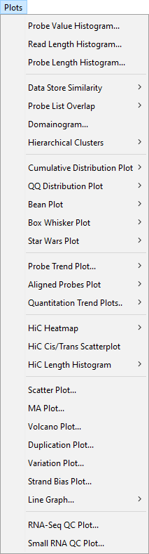

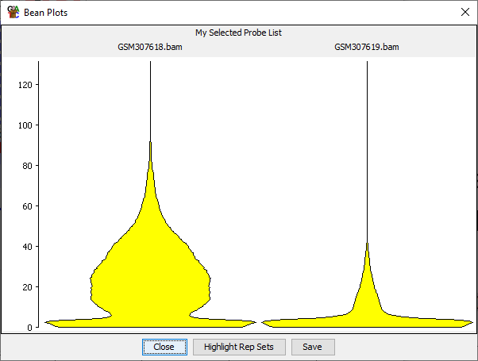
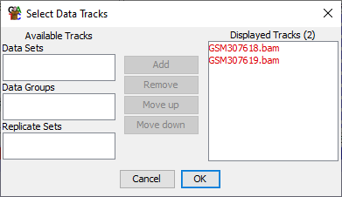
Plotting
By Default
  Uses the data stores shown in the chromosome view
  Uses the probes in the selected probe list

Slide 34
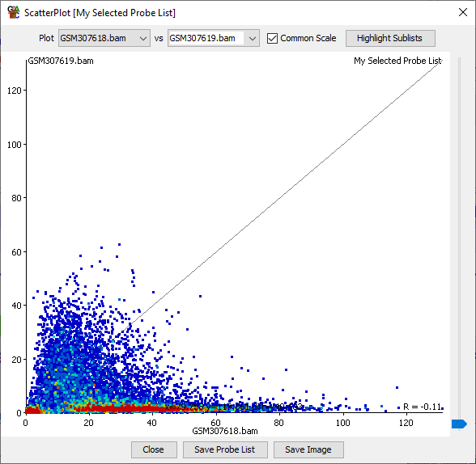
Some Plots are Interactive
Hover to see label
Click to fix label
Double click to show probe in Chromosome View
Triple Click to clear labels

Slide 35

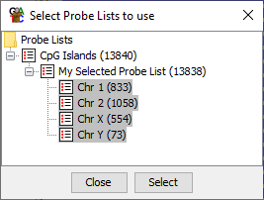
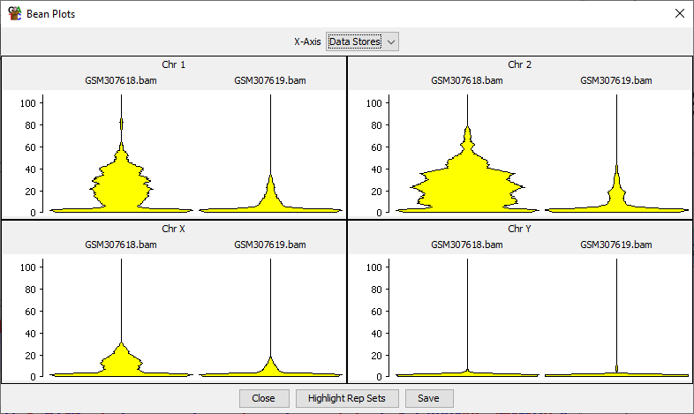
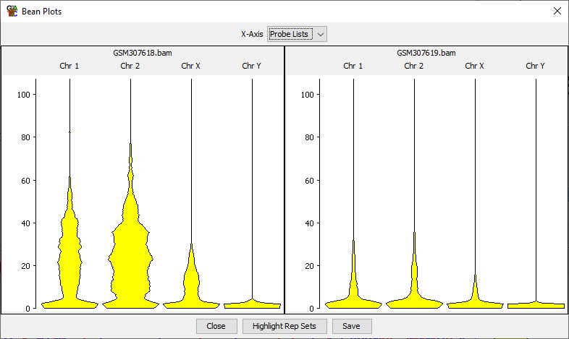
Some Plots can be Duplicated

Slide 36
Filtering Probes

Slide 37
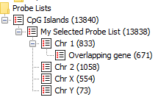
Filtering Concepts
Start from an existing Probe List
Run a Filter to select a subset of those probes
Create a new Probe List as a child of the original list
Build up a tree of filtered Probe Lists

Slide 38
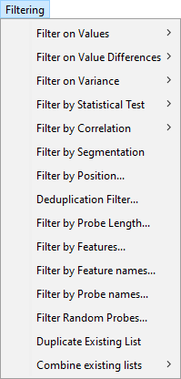
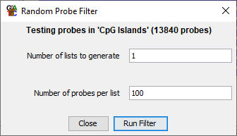
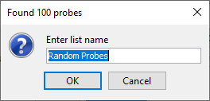
Filters
Starting List
Check this is what you expect
Number of passed probes
New List Name

Slide 39
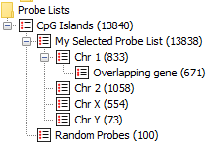
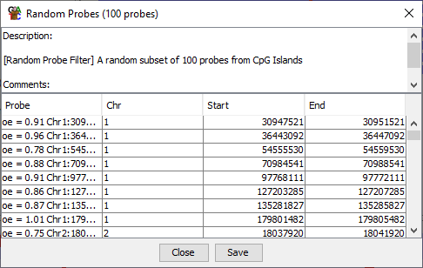
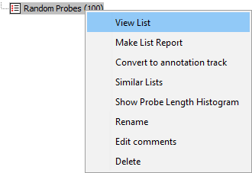
Filter Details
Rename list (doesn't change contents)
Delete list (and any children)
View list (shows options used)

Slide 40
Saving, Reporting and Vistories

Slide 41
Saving SeqMonk Projects
File > Save Project
Saves Everything
  Data
  Quantitations
  Probes / Filters
  Current View
Single file with .smk file extension
Can be moved to another machine and opened*
*Unless using a custom genome – you need to copy that separately

Slide 42
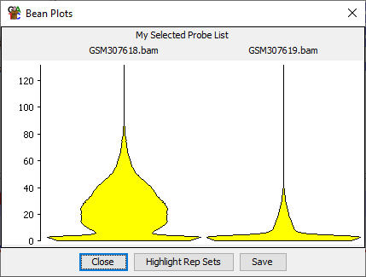
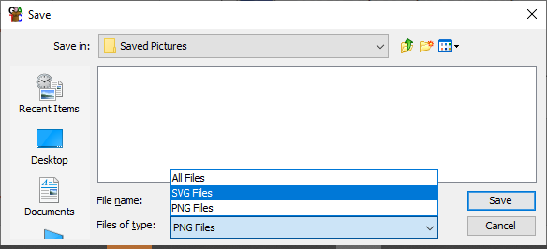

Saving Images
PNG – Bitmap – Screenshot
SVG – Vector – Editable

Slide 43

Editing SVG Images

Slide 44
Creating Reports
Annotated Probe Report
  Generates a report for every probe in a probe list. Can annotate it with a feature from a chosen annotation track
Probe Group Report
  Generates a report from a probe list but can group together probes which are close to each other
Feature Report
  Generates a report for all features in an annotation track. Relates them to probes in a probe list
Data Store Summary
  Gives statistics about the data and quantitation in the currently selected probe list.

Slide 45


Creating Reports
Sort by clicking headers
Double click to change view
Save to file (tab delimited text)

Slide 46
Vistories
A way to formally record your activities in SeqMonk
Generates an HTML report
Created automatically
You can add commentary, images, reports and summaries
Easy way to record and share your analysis

Slide 47


Vistories

Slide 48


Vistories
Save as .smv file (editable)
Save as HTML (report)

Slide 49

https://www.bioinformatics.babraham.ac.uk/vistorydb/

