Slide 1


Sample size estimation
v. 2018-02

Slide 2
Outline
Definition of Power
Variables of a power analysis
Difference between technical and biological replicates
Power analysis for:
  Comparing 2 proportions
  Comparing 2 means
  Comparing more than 2 means
  Correlation

Slide 3
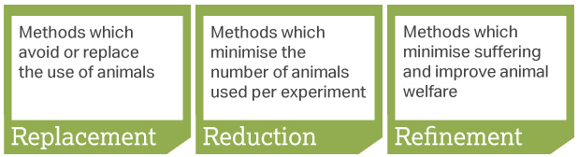
Power analysis
Definition of power: probability that a statistical test will reject a false null hypothesis (H₀) when the alternative hypothesis (H₁) is true.
  Plain English: statistical power is the likelihood that a test will detect an effect when there is an effect to be detected.
Main output of a power analysis:
  Estimation of an appropriate sample size
  Very important for several reasons:
    Too big: waste of resources,
    Too small: may miss the effect (p>0.05)+ waste of resources,
    Grants: justification of sample size,
    Publications: reviewers ask for power calculation evidence,
    The 3 Rs: Replacement, Reduction and Refinement

Slide 4
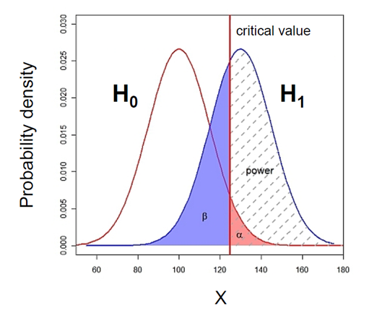
What does Power look like?

Slide 5
What does Power look like?
Probability that the observed result occurs if H₀ is true
  H₀ : Null hypothesis = absence of effect
  H₁: Alternative hypothesis = presence of an effect

Slide 6
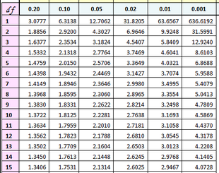
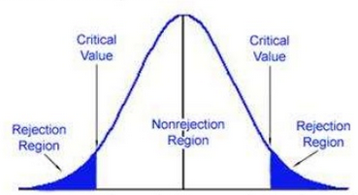
What does Power look like?
Example: 2-tailed t-test with n=15 (df=14)
T Distribution
0.95
0.025
0.025
t(14)
t=-2.1448
t=2.1448
In hypothesis testing, a critical value is a point on the test distribution that is compared to the test statistic to determine whether to reject the null hypothesis
  Example of test statistic: t-value
If the absolute value of your test statistic is greater than the critical value, you can declare statistical significance and reject the null hypothesis
  Example: t-value > critical t-value

Slide 7
What does Power look like?
α : the threshold value that we measure p-values against.
  For results with 95% level of confidence: α = 0.05
  = probability of type I error
p-value: probability that the observed statistic occurred by chance alone
Statistical significance: comparison between α and the p-value
  p-value < 0.05: reject H₀ and p-value > 0.05: fail to reject H₀

Slide 8
What does Power look like?
Type II error (β) is the failure to reject a false H₀
  Direct relationship between Power and type II error:
    β = 0.2 and Power = 1 – β = 0.8 (80%)

Slide 9
The desired power of the experiment: 80%
Type II error (β) is the failure to reject a false H₀
  Direct relationship between Power and type II error:
    if β = 0.2 and Power = 1 – β = 0.8 (80%)
  Hence a true difference will be missed 20% of the time
  General convention: 80% but could be more or less
  Cohen (1988):
      For most researchers: Type I errors are four times
      more serious than Type II errors: 0.05 * 4 = 0.2
      Compromise: 2 groups comparisons: 90% = +30% sample size,
      95% = +60%

Slide 10
To recapitulate:
The null hypothesis (H₀): H₀ = no effect
The aim of a statistical test is to reject or not H_{0.}
Traditionally, a test or a difference are said to be “significant” if the probability of type I error is: α =< 0.05
High specificity = low False Positives = low Type I error
High sensitivity = low False Negatives = low Type II error
Statistical decision | True state of H₀
 | H₀ True (no effect) | H₀ False (effect)
Reject H₀ | Type I error α False Positive | Correct True Positive
Do not reject H₀ | Correct True Negative | Type II error β False Negative

Slide 11
Power Analysis
The power analysis depends on the relationship between 6 variables:
the difference of biological interest
the standard deviation
the significance level (5%)
the desired power of the experiment (80%)
the sample size
the alternative hypothesis (ie one or two-sided test)
Effect size

Slide 12
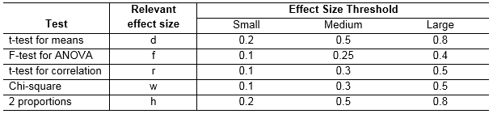
The effect size: what is it?
The effect size: minimum meaningful effect of biological relevance.
  Absolute difference + variability
How to determine it?
  Substantive knowledge
  Previous research
  Conventions
Jacob Cohen
  Author of several books and articles on power
  Defined small, medium and large effects for different tests

Slide 13

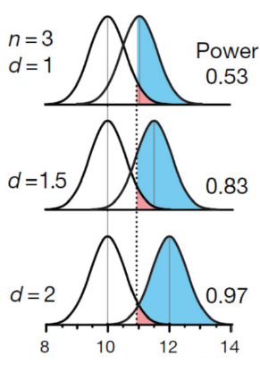
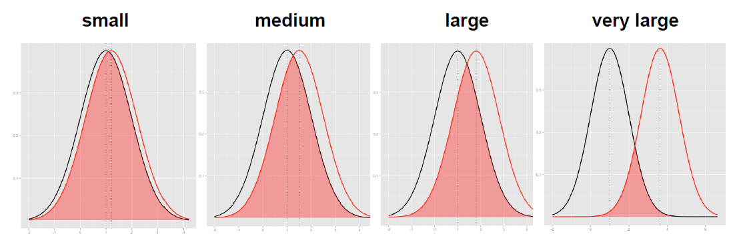
The effect size: how is it calculated?
The absolute difference
It depends on the type of difference and the data
  Easy example: comparison between 2 means
The bigger the effect (the absolute difference), the bigger the power
  = the bigger the probability of picking up the difference
Absolute difference
http://rpsychologist.com/d3/cohend/

Slide 14
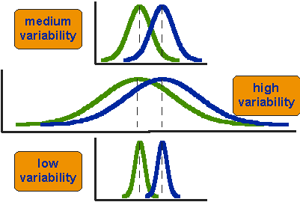
The effect size: how is it calculated?
The standard deviation
The bigger the variability of the data, the smaller the power
H₀
H₁

Slide 15
Power Analysis
The power analysis depends on the relationship between 6 variables:
the difference of biological interest
the standard deviation
the significance level (5%) (p< 0.05) α
the desired power of the experiment (80%) β
the sample size
the alternative hypothesis (ie one or two-sided test)

Slide 16
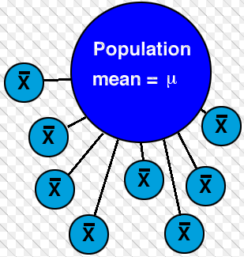
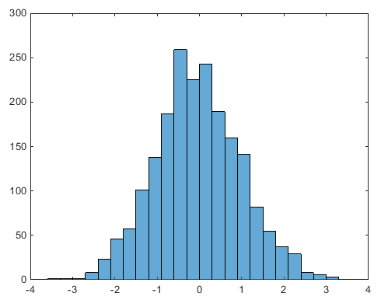
The sample size
Most of the time, the output of a power calculation
The bigger the sample, the bigger the power
  but how does it work actually?
In reality it is difficult to reduce the variability in data, or the contrast between means,
  most effective way of improving power:
    increase the sample size.
The standard deviation of the sample distribution
  = Standard Error of the Mean: SEM = SD/√N
    SEM decreases as sample size increases
Sample
Standard deviation
SEM: standard deviation of the sample distribution

Slide 17
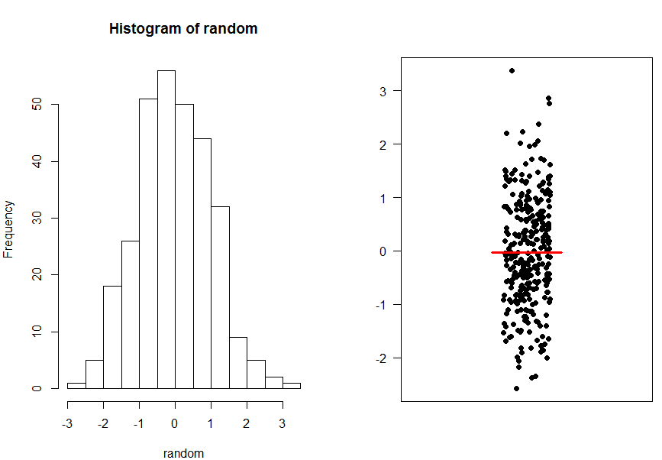
The sample size
A population

Slide 18
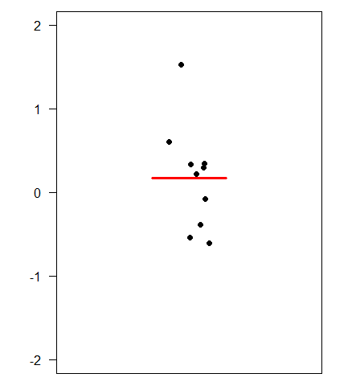
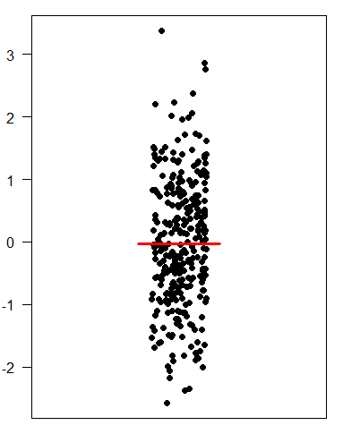
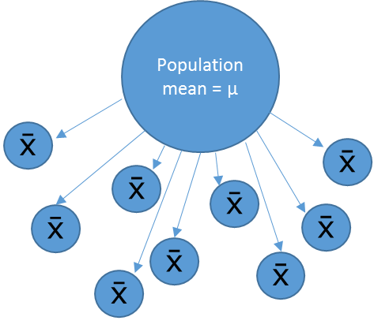
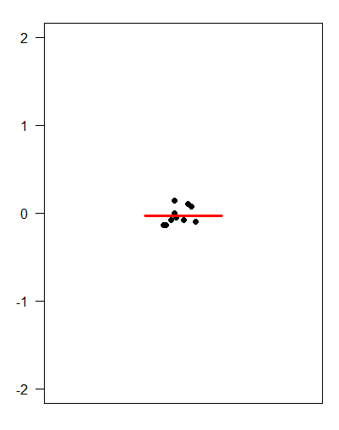
The sample size
Small samples (n=3)
Sample means
Big samples (n=30)
‘Infinite’ number of samples
Samples means = 
Sample means

Slide 19
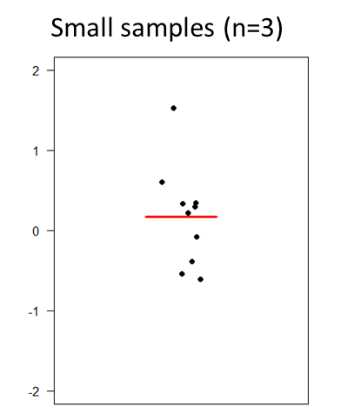
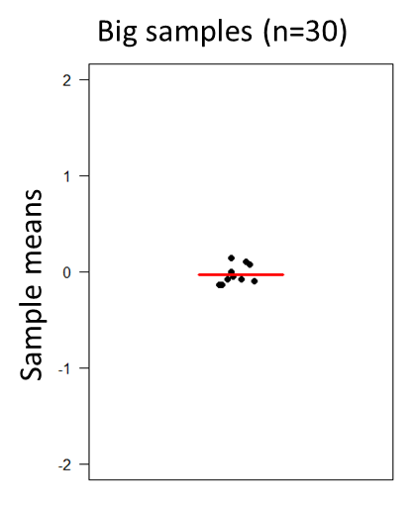
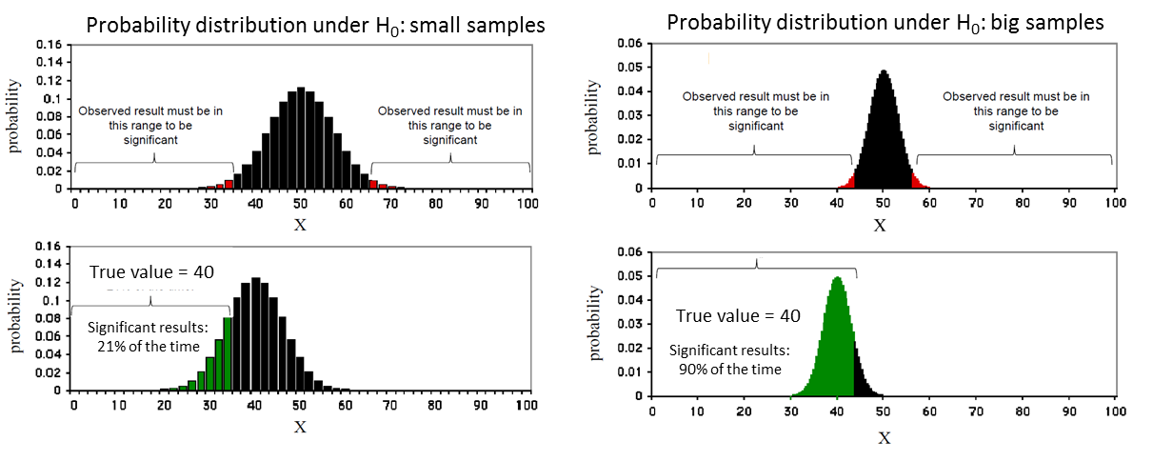
The sample size

Slide 20

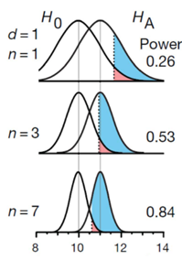
The sample size

Slide 21
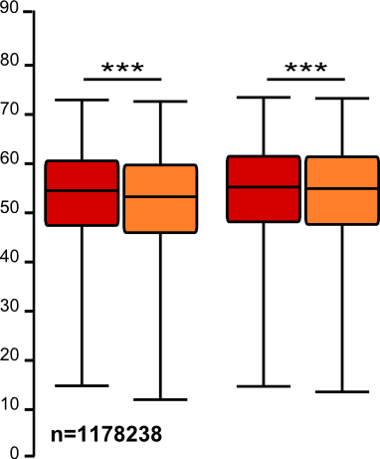
The sample size: the bigger the better?
It takes huge samples to detect tiny differences but tiny samples to detect huge differences.
What if the tiny difference is meaningless?
  Beware of overpower
  Nothing wrong with the stats: it is all about interpretation of the results of the test.
Remember the important first step of power analysis
  What is the effect size of biological interest?

Slide 22
Power Analysis
The power analysis depends on the relationship between 6 variables:
the effect size of biological interest
the standard deviation
the significance level (5%)
the desired power of the experiment (80%)
the sample size
the alternative hypothesis (ie one or two-sided test)

Slide 23
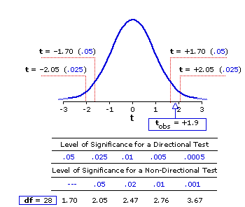
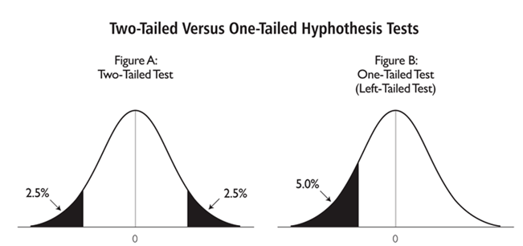
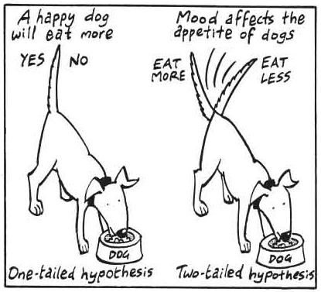
The alternative hypothesis: what is it?
One-tailed or 2-tailed test? One-sided or 2-sided tests?
Is the question:
  Is the there a difference?
  Is it bigger than or smaller than?
Can rarely justify the use of a one-tailed test
Two times easier to reach significance
with a one-tailed than a two-tailed
  Suspicious reviewer!
T Distribution

Slide 24
Fix any five of the variables and a mathematical relationship can be used to estimate the sixth.
e.g. What sample size do I need to have a 80% probability (power) to detect this particular effect (difference and standard deviation) at a 5% significance level using a 2-sided test?
Difference Standard deviation
Sample size
Significance level Power 2-sided test ( )

Slide 25
Technical and biological replicates
Definition of technical and biological depends on the model and the question
  e.g. mouse, cells …
  Question: Why replicates at all?
    To make proper inference from sample to general population we need biological samples.
    Example: difference on weight between grey mice and white mice:
      cannot conclude anything from one grey mouse and one white mouse randomly selected
        only 2 biological samples
      need to repeat the measurements:
        measure 5 times each mouse: technical replicates
        measure 5 white and 5 grey mice: biological replicates
Answer: Biological replicates are needed to infer to the general population

Slide 26
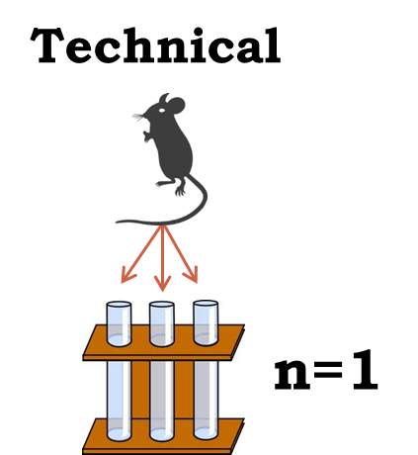
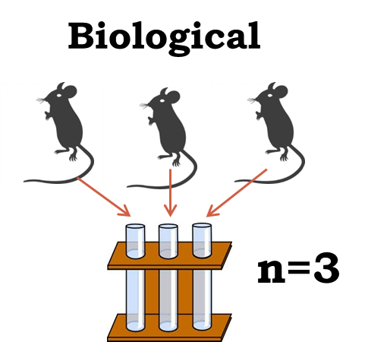
Technical and biological replicates
Always easy to tell the difference?
Definition of technical and biological depends on the model
and the question.
The model: mouse, rat … mammals in general.
  Easy: one value per individual
    e.g. weight, neutrophils counts …
What to do? Mean of technical replicates = 1 biological replicate

Slide 27

Technical and biological replicates
Always easy to tell the difference?
The model is still: mouse, rat … mammals in general.
  Less easy: more than one value per individual
    e.g. axon degeneration
What to do? Not one good answer.
  In this case: mouse = experiment unit
    axons = technical replicates, nerve segments = biological replicates
One measure
…
…
One mouse
Several segments
per mouse
Several axons
per segment
Tens of values
per mouse

Slide 28


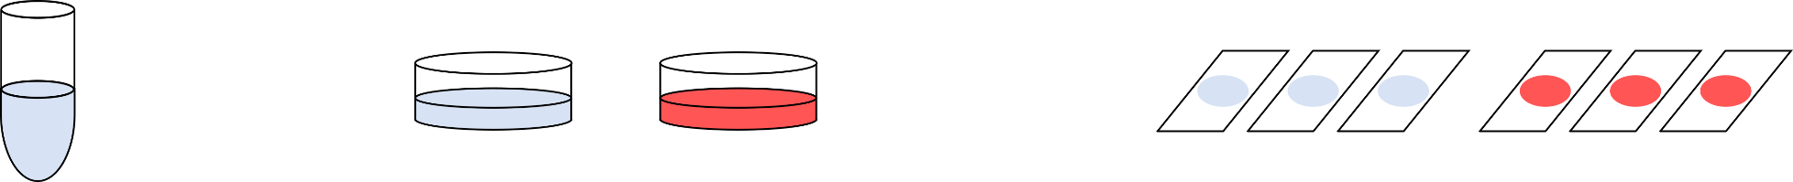

Technical and biological replicates
Always easy to tell the difference?
The model is : worms, cells …
  Less and less easy: many ‘individuals’
    What is ‘n’ in cell culture experiments?
Cell lines: no biological replication, only technical replication
To make valid inference: valid design
Control
Treatment
Glass slides
microarrays
lanes in gel
wells in plate
…
Point of Measurements
Vial of frozen cells
Dishes, flasks, wells …
Cells in culture
Point of Treatment

Slide 29
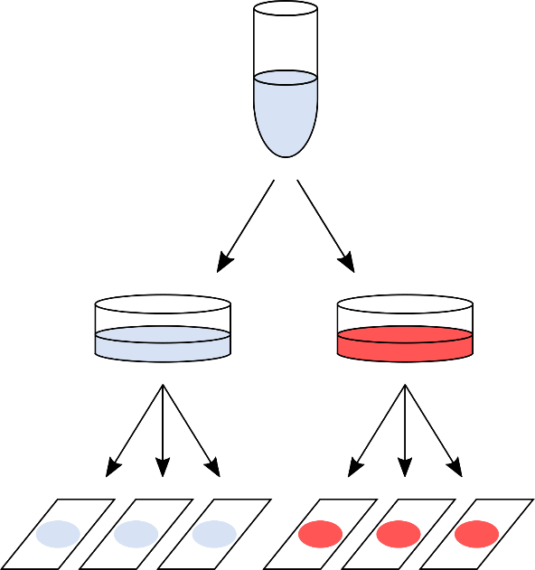
Technical and biological replicates
Cell cultures
Design 1: As bad as it can get
One value per glass slide
e.g. cell count
After quantification: 6 values
  But what is the sample size?
    n = 1
      no independence between the slides
      variability = pipetting error

Slide 30
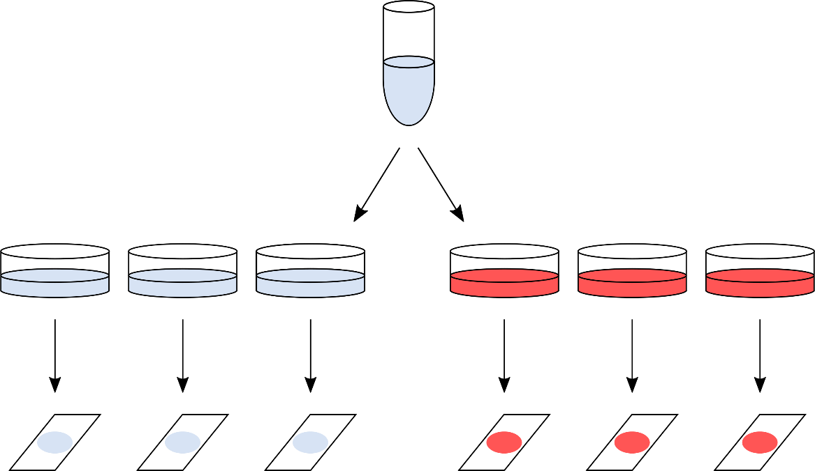
Technical and biological replicates
Cell cultures
Design 2: Marginally better, but still not good enough
Everything processed
on the same day
After quantification: 6 values
  But what is the sample size?
    n = 1
      no independence between the plates
      variability = a bit better as sample split higher up in the hierarchy

Slide 31
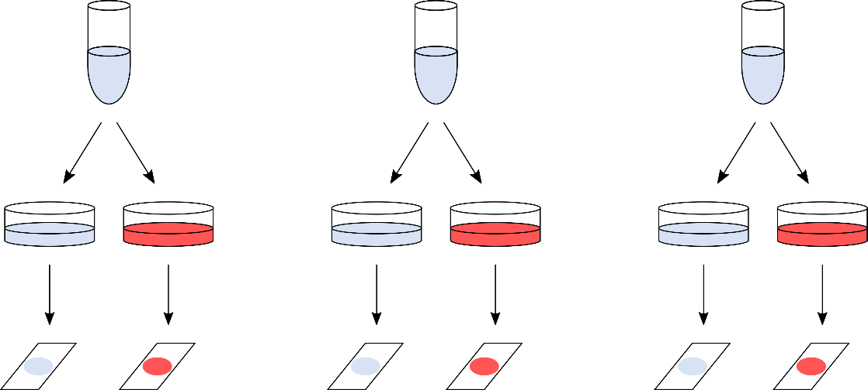
Technical and biological replicates
Cell cultures
Design 3: Often, as good as it can get
Day 1
Day 2
Day 3
After quantification: 6 values
  But what is the sample size?
    n = 3
      Key difference: the whole procedure is repeated 3 separate times
      Still technical variability but done at the highest hierarchical level
      Results from 3 days are (mostly) independent
      Values from 2 glass slides: paired observations

Slide 32
Technical and biological replicates
Cell cultures
Design 4: The ideal design
person/animal 1
person/animal 2
person/animal 3
After quantification: 6 values
  But what is the sample size?
    n = 3
      Real biological replicates

Slide 33
Technical and biological replicates
What to remember
Key things to remember:
  Take the time to identify technical and biological replicates
  Try to make the replications as independent as possible
  Never ever mix technical and biological replicates
  The hierarchical structure of the experiment needs
  to be respected in the statistical analysis.

Slide 34
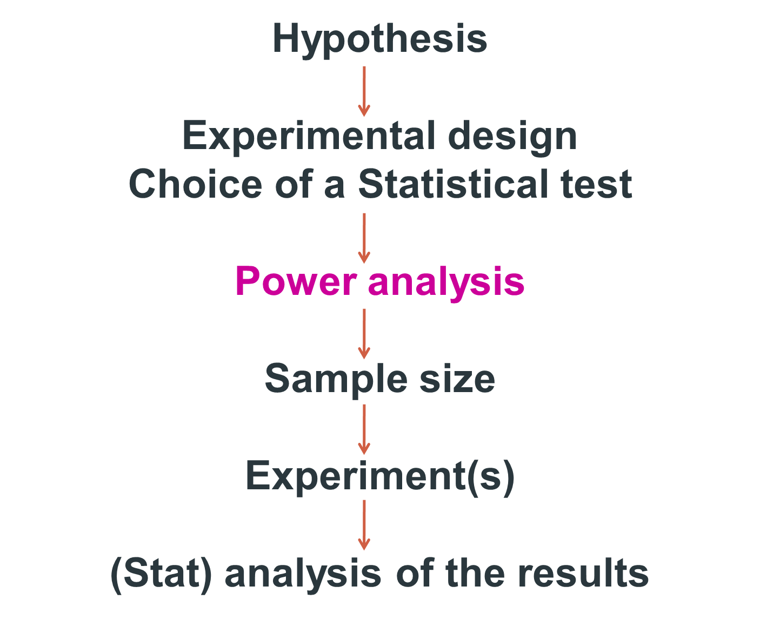

Slide 35
Good news:
there are packages that can do the power analysis for you ... providing you have some prior knowledge of the key parameters!
difference + standard deviation = effect size
Free packages:
  G*Power and InVivoStat
  Russ Lenth's power and sample-size page:
    http://www.divms.uiowa.edu/~rlenth/Power/
  R
Cheap package: StatMate (~ $95)
Not so cheap package: MedCalc (~ $495)

Slide 36
Power Analysis
Let’s do it
Examples of power calculations:
  Comparing 2 proportions
  Comparing 2 means
  Comparing more than 2 means
  Correlation
Package: G*Power

Slide 37
Power Analysis
Comparing 2 proportions
Research example:
  A scientist is looking at a new treatment to reduce the development
  of tumours in mice.
    Control group: 40% of mice develop tumours
    Aim: reduction to 10%
    Power: 80%, 5% significance
Effect size: measure of distance between 2 proportions or probabilities
Comparison between 2 proportions: Fisher’s exact test

Slide 38
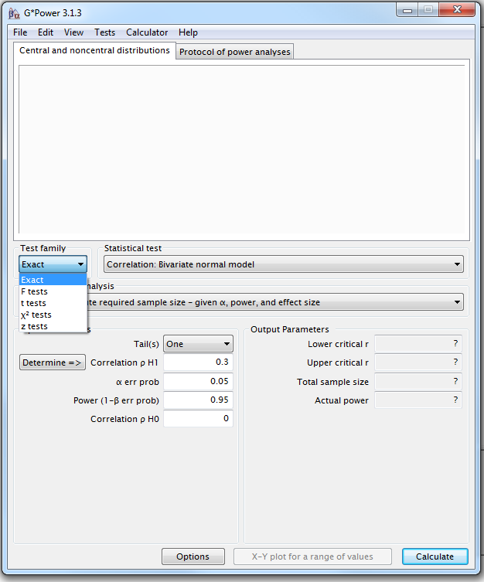
Power Analysis
Comparing 2 proportions
Four steps to Power
Example case:
Decrease of tumour development from 40% to 10%.
Step1: choice of Test family

Slide 39
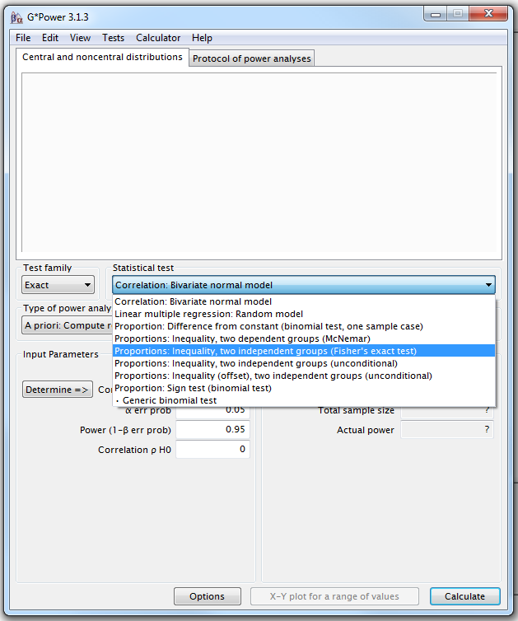
G*Power
Step 2 : choice of Statistical test
Fisher’s exact test or Chi-square for 2x2 tables

Slide 40
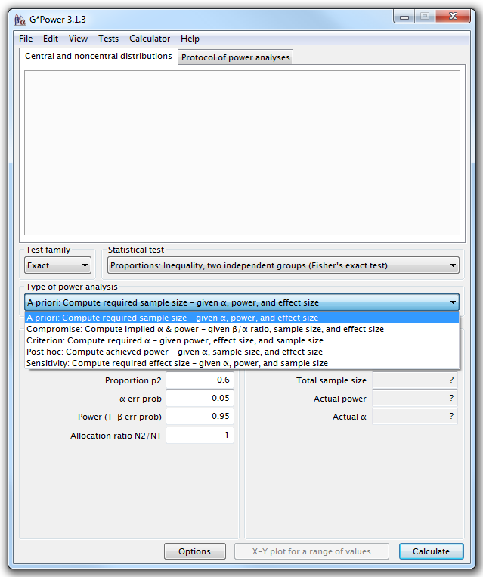
G*Power
Step 3: Type of power analysis

Slide 41
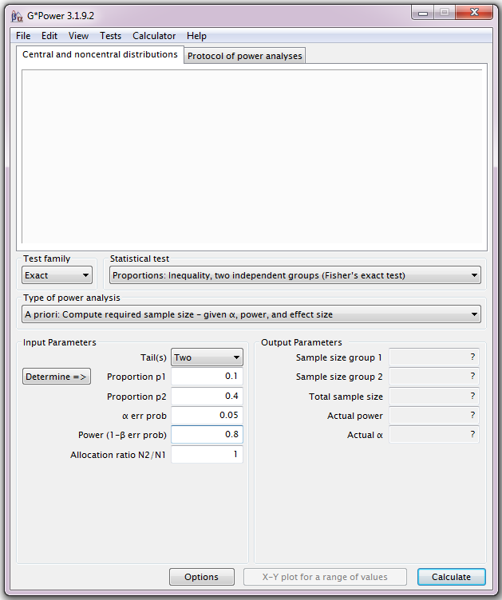
G*Power
Step 4: Choice of Parameters
Tricky bit: need information on the size of the difference and the variability.

Slide 42
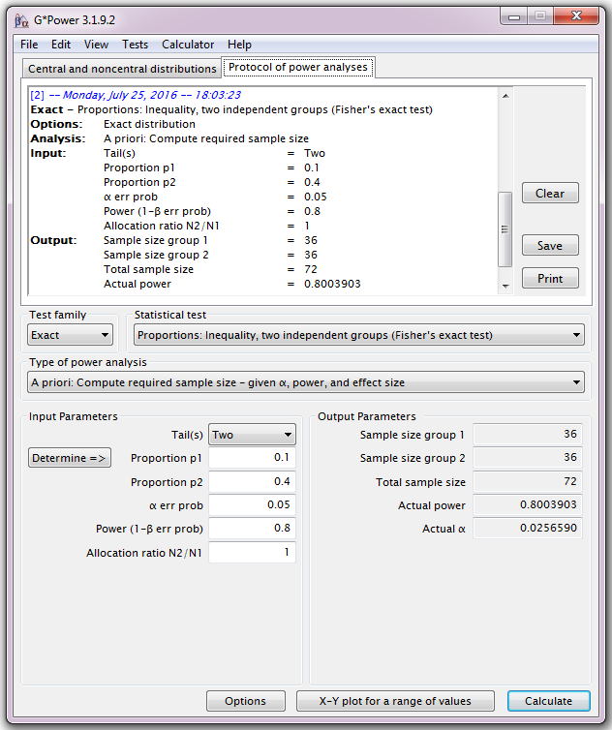
G*Power
If aiming for a decrease from 40% to 10% for tumour development, we will need 2 samples of about 36 mice to reach significance (p<0.05) with 80% power.

Slide 43
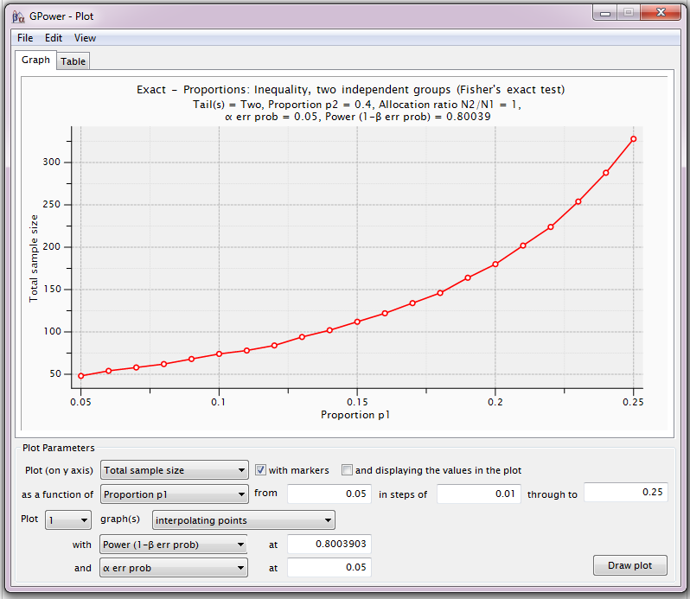
G*Power
For a range of sample sizes:

Slide 44
Power Analysis
Comparing 2 means
Research example:
  A scientist is looking at the effect of caffeine on muscle metabolism.
    Metabolism measured via Respiratory Exchange Ratio (RER)
    Pilot study:
      Placebo: Mean=100.56, SD=7.70 and Caffeine: Mean=94.22, SD=5.61
    Power: 80%, 5% significance
Effect size: difference between the 2 means accounting
for the variability (Cohen’s d).
Comparison between 2 means: t-test

Slide 45
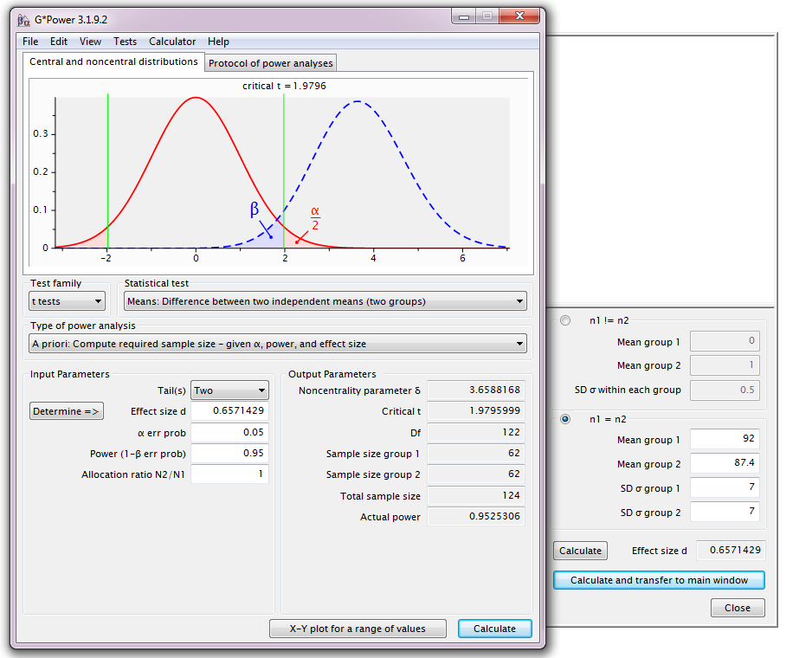
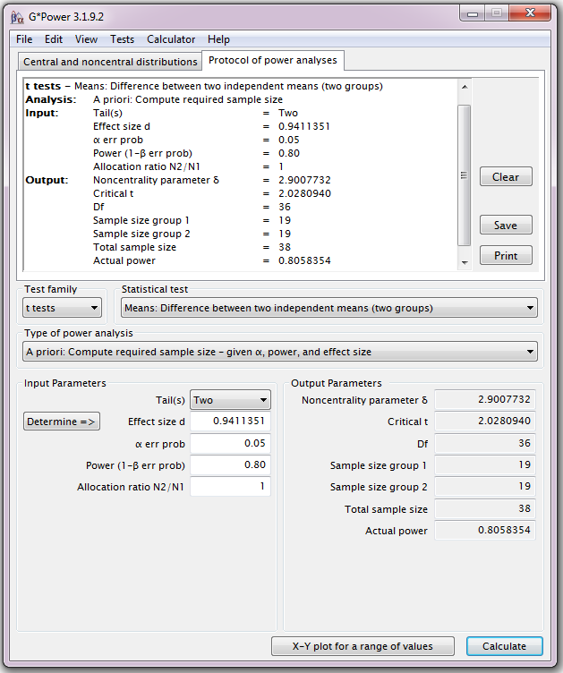
Power Analysis
Providing the difference observed in the pilot study is a good estimation
of the real effect size, we need a sample size of n=38 (2*19).

Slide 46
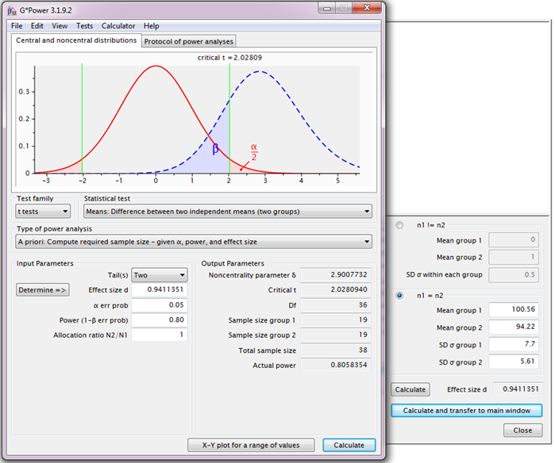
Power Analysis
H₀
H₁

Slide 47
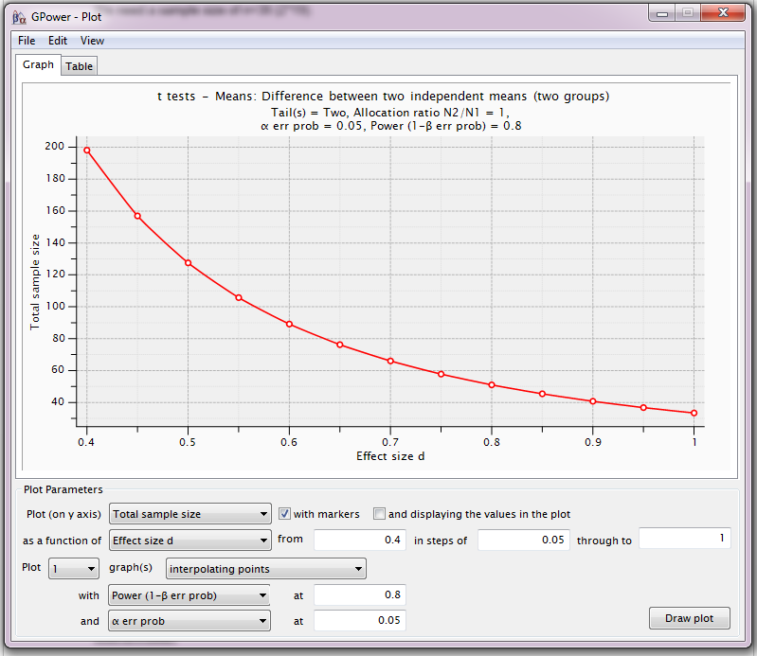
Power Analysis
For a range of sample sizes:

Slide 48
Comparison of more than 2 means
ANOVA
Extension of the t-test as in it compares means accounting for groups variability but because there are more than 2 means, it actually compares the variance between groups with the one within groups (hence ANalysis Of VAriance).
Output of an ANOVA is 2-fold:
  first, the omnibus part quantifying the overall difference between the groups and
  second, the pairwise comparisons of interest via post-hoc tests.
Most of the time, it’s the second bit which is really interesting
  An adjustment needs to be applied to account for multiple comparisons.
Notes:
Compare many groups to each other, wrong to use multiple t-tests, It increases the error

Slide 49
Comparison of more than 2 means
Different ways to go about power analysis in the context of ANOVA:
  η² : explained proportion variance of the total variance.
    Can be translated into effect size d.
    Not very useful: only looking at the omnibus part of the test
  Minimum power specification: looks at the difference between the smallest and the biggest means.
    All means other than the 2 extreme one are equal to the grand mean.
  Smallest meaningful difference
    Works like a post-hoc test.

Slide 50
Power Analysis
Comparing more than 2 means
Minimum power specification
Research example:
  A researcher is interested in 4 different teaching methods in the area of mathematics education.
    Effect of these methods on standardized math scores.
  Group 1: the traditional teaching method,
  Group 2: the intensive practice method,
  Group 3: the computer assisted method and,
  Group 4: the peer assistance learning method.
Standardized test: mean score = 550, SD = 80
    Power: 80%, 5% significance

Slide 51
Power Analysis
Comparing more than 2 means
Research example: Comparison between 4 teaching methods
  Assumptions:
    Equal group sizes and equal variability (SD = 80)
    Prior research:
      Traditional teaching (Group 1): lowest mean score
      Peer assistance (Group 4): highest mean score
    Group 1: mean = 550 (SD = 80)
    Group 4: Difference of interest> +1.2 SD: 550+80*1.2 = 646
    Other 2 groups: mean = grand mean = 598 (= 646+550/2)

Slide 52
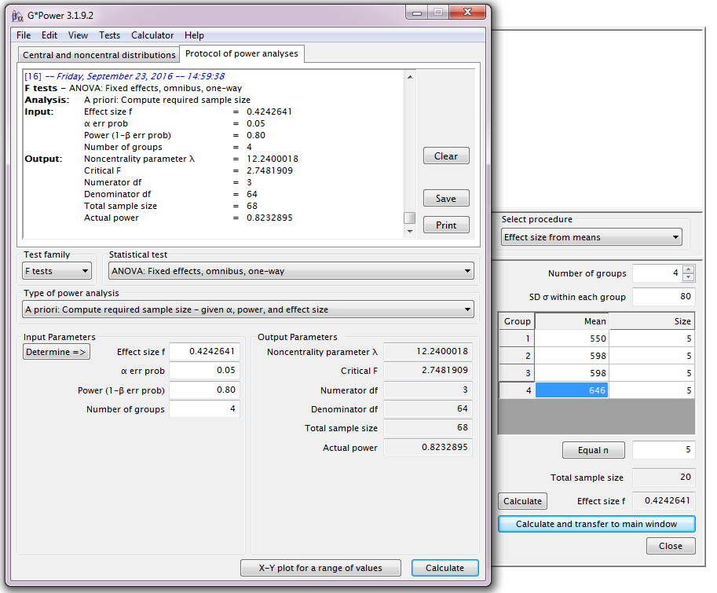
Power Analysis
Minimum power specification
Each group: n=17

Slide 53
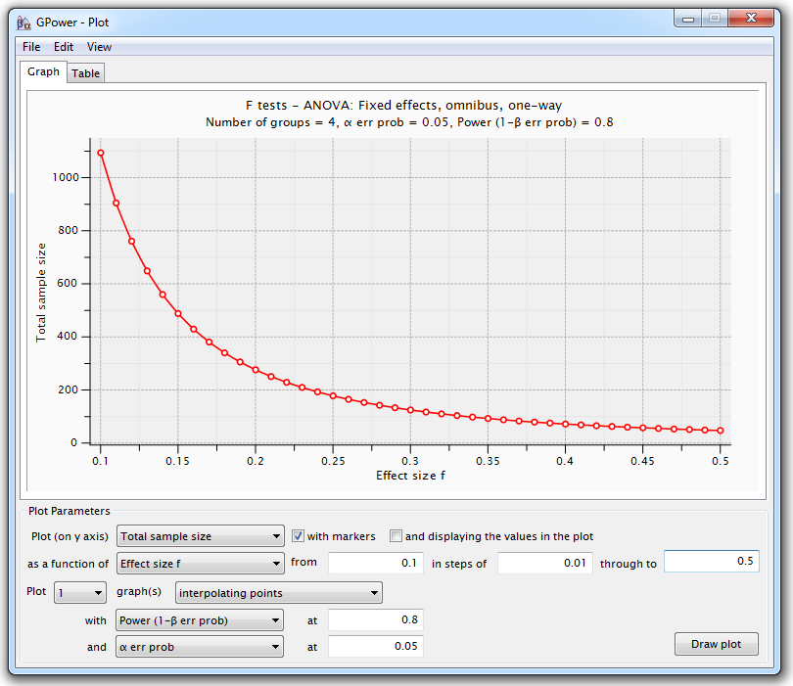
Power Analysis
Minimum power specification
If the other 2 means are known, better to use them:
  if more polarized towards the two extreme ends:
    easier to detect the group effect: smaller samples.

Slide 54
Comparison of more than 2 means
Different ways to go about power analysis in the context of ANOVA:
  η² : explained proportion variance of the total variance.
    Can be translated into effect size d.
  Minimum power specification: looks at the difference between the smallest and the biggest means.
    All means other than the 2 extreme one are equal to the grand mean.
  Smallest meaningful difference
    Works like a post-hoc test.

Slide 55
Power Analysis
Comparing more than 2 means
Research example: Comparison between 4 teaching methods
Smallest meaningful difference
  Same assumptions:
    Equal group sizes and equal variability (SD = 80)
  3 comparisons of interest: vs. Group 1
  Smallest meaningful difference: group 1 vs. Group 2
    t-test: Mean 1 = 550, SD = 80 and mean 2 = 598, SD = 80
    Power calculation like for a t-test but with a Bonferroni correction (adjustment for multiple comparisons)

Slide 56
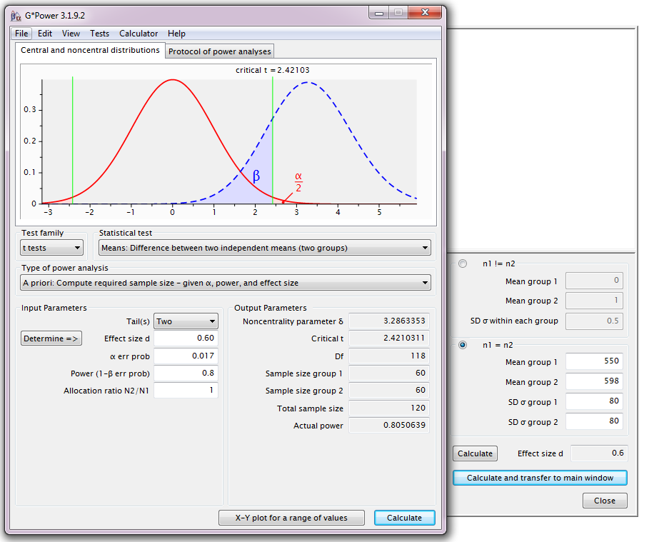
Power Analysis
Comparing more than 2 means
Smallest meaningful difference
Bonferroni correction
3 comparisons: 0.05/3 = 0.017

Slide 57
Power Analysis
Correlation
Research example:
  A ecologist is looking at the host-parasite relationship in roe deers.
  Measures of body weight and parasite load will be collected
  from a group of females: Body weight = f(parasite load).
    Pilot study on a small group: r = 0.3
    Power: 80%, 5% significance
Effect size: Cohen’s r: effect size in correlation

Slide 58
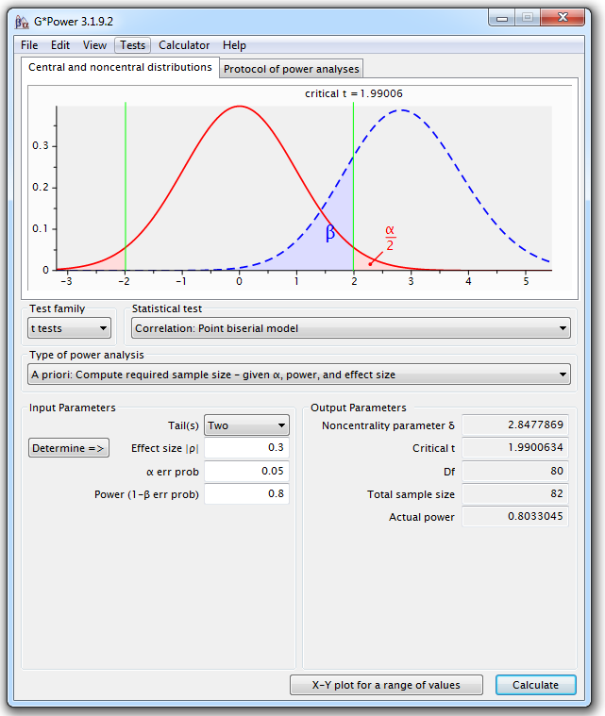
Power Analysis
Correlation

Slide 59
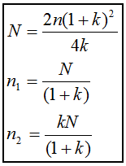
Power Analysis
Unequal sample sizes
Scientists often deal with unequal sample sizes
  No simple trade-off:
    if one needs 2 groups of 30, going for 20 and 40
    will be associated with decreased power.
    Unbalanced design = bigger total sample
    Solution:
    Step 1: power calculation for equal sample size
    Step 2: adjustment
Caffeine example but this time:
placebo group: 2 times smaller than caffeine one:
k=2. Using the formula, we get a total:
N=2*19*(1+2)²/4*2=43
Placebo (n₁)=14 and caffeine (n₂)=29

Slide 60
Power Analysis
Non-parametric tests
Non-parametric tests: do not assume data come from a Gaussian distribution.
  Non-parametric tests are based on ranking values from low to high
  Non-parametric tests not always less powerful
Proper power calculation for non-parametric tests:
  Need to specify which kind of distribution we are dealing with
    Not always easy
Non-parametric tests never require more than 15% additional subjects
providing 2 assumptions:
  n>=30
  the distribution is not too unusual
Very crude rule of thumb for non-parametric tests:
  Compute the sample size required for a parametric test and add 15%.

