Slide 1
Research Integrity or How to be a Good Scientist Jo Montgomery, Sarah Inglesfield, Anne Segonds-Pichon, Laura Biggins and Simon Andrews v2024-10

Slide 2
A
B
C
D

Slide 3
An illustration

Slide 4
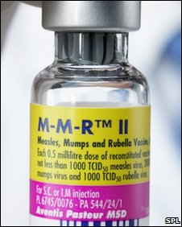
Research Integrity
MMR = Measles, Mumps and Rubella
Autism

Slide 5
2010
Retraction of the Wakefield et al. paper
https://www.ncbi.nlm.nih.gov/pmc/articles/PMC2831678/
2010
Andrew Wakefield found guilty of serious professional misconduct
https://www.bmj.com/content/340/bmj.c593
2002-2005: No link MMR autism
Many more studies
https://pubmed.ncbi.nlm.nih.gov/15366972/
https://pubmed.ncbi.nlm.nih.gov/15877763/
1999 No link MMR autism
Taylor et al.
n=498 children
https://pubmed.ncbi.nlm.nih.gov/10376617
2001: No link MMR autism
Dales et al.
n=600-1900 children each year over 14 years
https://pubmed.ncbi.nlm.nih.gov/11231748/
1998 Link MMR autism
Wakefield et al.
n=12 children
https://pubmed.ncbi.nlm.nih.gov/9500320/

Slide 6
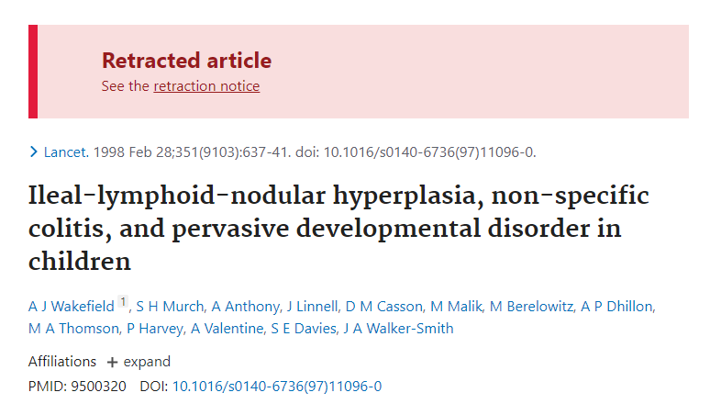
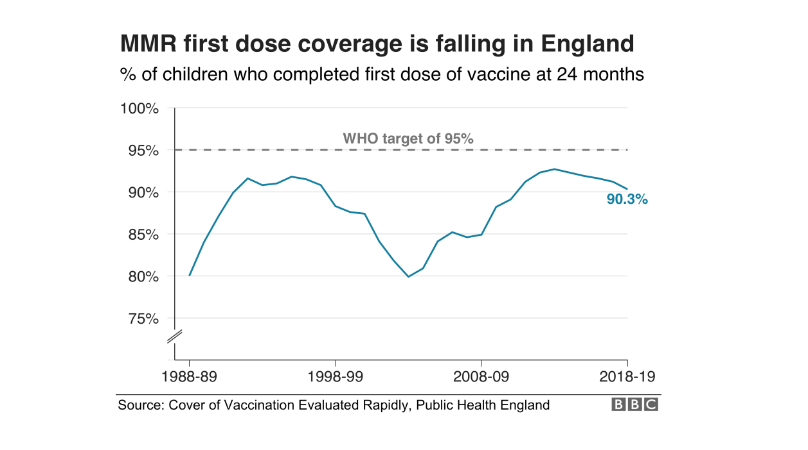
Research Integrity
Scientists and organisations across the world spent a great deal of time and money refuting the results of a minor paper in the Lancet .
MMR vaccination: 1995: 95% to 2002: 81 %
Measles outbreaks in the UK in 2008 and 2009
2020: Uptake of MMR vaccine: 91% (still below herd immunity)
2010
12 years
84%
2022-23

Slide 7
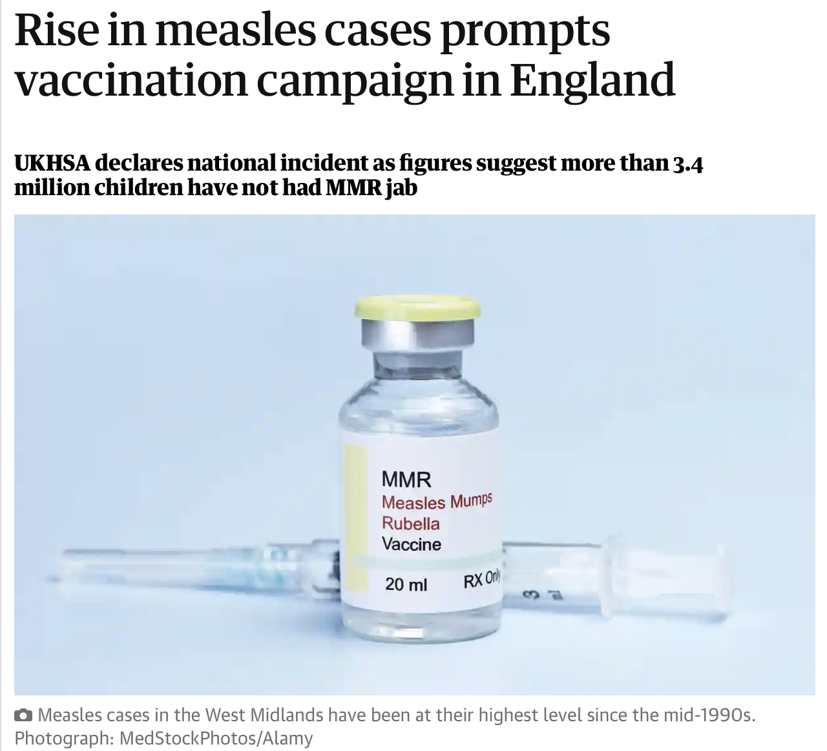
Research Integrity
2016: UK declared measles free
Now lost this status
Increases in number of measles cases
2022-23: : 84% children in England
(74% in London, vs 90% South West)
Need vaccination rate of 95%
Current decline due to:
Vaccine misinformation
Not serious?
Difficulty accessing appointments
Impact of covid pandemic

Slide 8
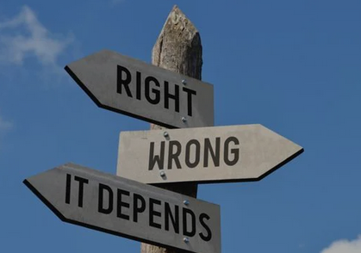
Obvious examples are obvious, but…

Slide 9
Outline of the course

Slide 10
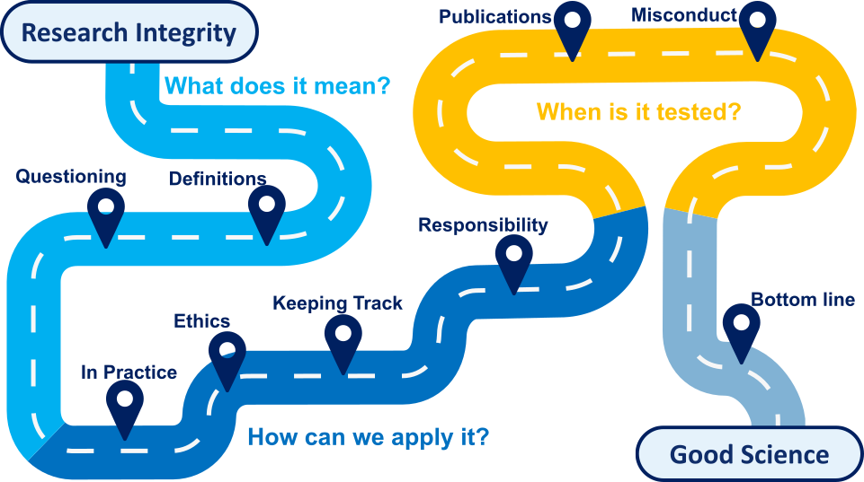

Slide 11
What is Research Integrity?

Slide 12
Research Integrity
a.k.a. Scientific Integrity
Scientific integrity (From Wikipedia):
Scientific integrity deals with ‘best practices’ or rules of professional practice of researchers.
Organisation for Economic Co-operation and
Development (OECD) report, 2007 replication (or reproducibility) crisis and the fight against scientific misconduct.

Slide 13
Research Integrity
a.k.a. Scientific Integrity
The replication crisis - scientific studies are difficult or impossible to replicate or reproduce.
Psychology:
Open Science Collaboration
(100 papers from 2012)
36% of the replications yielded significant findings vs 97% in the original studies.
Cancer Research:
Reproducibility Project: Cancer Biology (53 papers from 2010 to 2012)
25% experiments could be reproduced.
Replication effect sizes were 85% smaller on average than the original findings.
https://osf.io/82fth/
https://www.sciencenews.org/article/cancer-biology-studies-research-replication-reproducibility

Slide 14
Which words are
most important/synonymous with integrity?
Exercise

Slide 15
Research Integrity
Many words
Responsibility
Accountability
Honesty
Fair
Objectivity
Respect
Scientific integrity
Rigor
Care
Reproducibility
Openness
Ethics
Transparency
Accurate
Reliability
Cooperation
Collegiality
Quality

Slide 16
Research Integrity
More than words
Accountability
Accurate
Care
Collegiality
Cooperation
Ethics
Fair
Honesty
Objectivity
Openness
Quality
Reliability
Reproducibility
Respect
Responsibility
Rigor
Transparency
Scientific integrity

Slide 17
Research Integrity
Research Integrity means conducting, reviewing and reporting research in a responsible way that allows ourselves and others to have confidence that our research is trustworthy and of the highest quality.
It also sets the culture of the Institute as an inclusive, respectful, open and outstanding place to work.
BI-RES-005 RESEARCH INTEGRITY POLICY

Slide 18
Research Integrity in practice

Slide 19
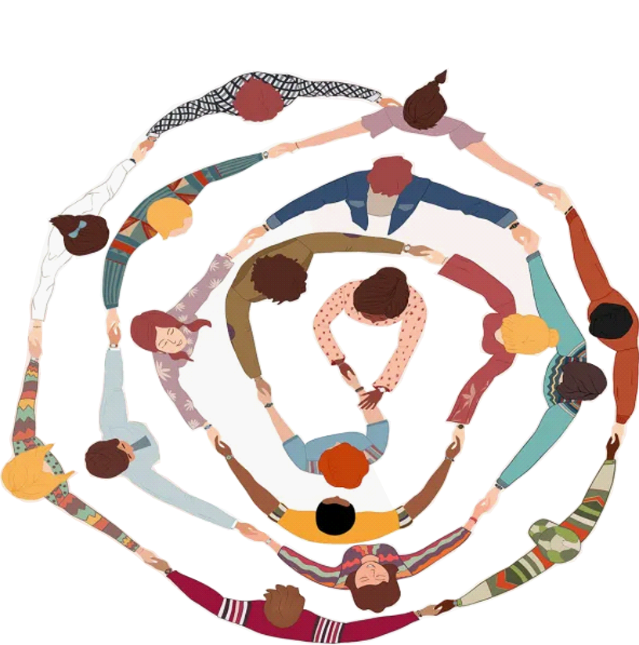
Research Integrity: In Practice
Accountability
Accurate
Care
Collegiality
Cooperation
Ethics
Fair
Honesty
Objectivity
Openness
Quality
Reliability
Reproducibility
Respect
Responsibility
Rigor
Transparency
Question
Results
Experiment
Experimental Design
Data Analysis
Sample Size
Data Exploration
Credit: Getty Images/melitas

Slide 20
Research Integrity in practice
Experimental design

Slide 21
Question
Data Exploration
Data Analysis
Results
Experiment
Experimental Design
Sample Size
Accountability
Accurate
Care
Collegiality
Cooperation
Ethics
Fair
Honesty
Objectivity
Openness
Quality
Reliability
Reproducibility
Respect
Responsibility
Rigor
Transparency
A Practical Translation of the Question
Communicating Ideas
Types of Design
Avoiding Bias

Slide 22
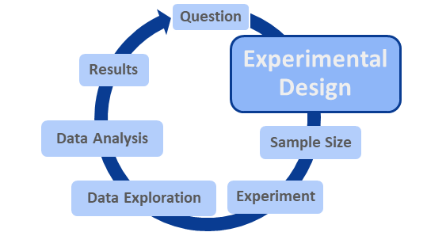
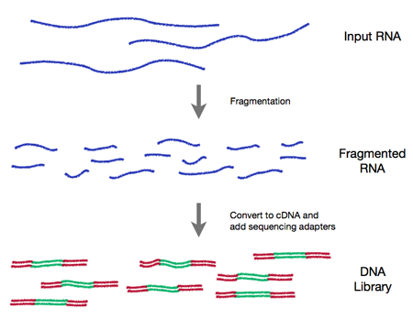
Clear Communication
Library
Accountability
Accurate
Care
Collegiality
Cooperation
Ethics
Fair
Honesty
Objectivity
Openness
Quality
Reliability
Reproducibility
Respect
Responsibility
Rigor
Transparency
Library, Cambridge
RNA seq Library

Slide 23
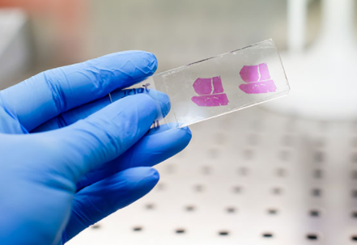
Clear Communication
Sample
Accountability
Accurate
Care
Collegiality
Cooperation
Ethics
Fair
Honesty
Objectivity
Openness
Quality
Reliability
Reproducibility
Respect
Responsibility
Rigor
Transparency
Tissue Sample
Sample of mice
Different words to describe the same data/graphs
Different traditions in different labs, areas of science

Slide 24
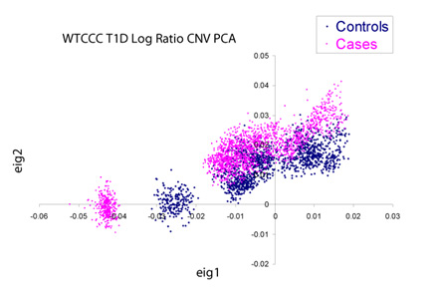
Appropriate Type of Design
Distinguish real differences from experimental artefacts…
…But experiments can be big and complicated
Accountability
Accurate
Care
Collegiality
Cooperation
Ethics
Fair
Honesty
Objectivity
Openness
Quality
Reliability
Reproducibility
Respect
Responsibility
Rigor
Transparency
Seminal Wellcome Trust GWAS Study:
14000 cases of 7 diseases & 3000 shared controls
Each processed at different sites and genotyped on distinct series of plates
Condition 1
Condition 2
Condition 3 etc…
A
Good Design
B
Bad Design
Plate 1
Plate 2
Plate 3
Differences between control and cases are confounded by plate

Slide 25
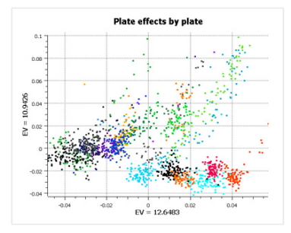
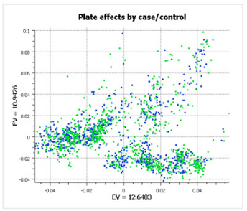
Appropriate Type of Design
GenADA multi-site collaborative study:
Plate 1
Plate 2 etc…
875 Alzheimers patients, 850 controls, 9 sites
Randomised Block Design
Accountability
Accurate
Care
Collegiality
Cooperation
Ethics
Fair
Honesty
Objectivity
Openness
Quality
Reliability
Reproducibility
Respect
Responsibility
Rigor
Transparency
Accountability
Accurate
Care
Collegiality
Cooperation
Ethics
Fair
Honesty
Objectivity
Openness
Quality
Reliability
Reproducibility
Respect
Responsibility
Rigor
Transparency
Still have differences between plates
Doesn’t confound the experiment
https://blog.goldenhelix.com/stop-ignoring-experimental-design-or-my-head-will-explode/

Slide 26
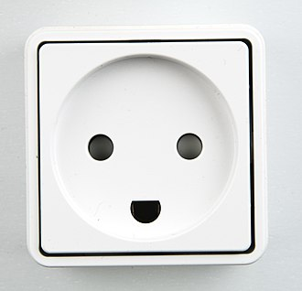
Avoiding Bias
Humans are not always good at remaining objective…
Accountability
Accurate
Care
Collegiality
Cooperation
Ethics
Fair
Honesty
Objectivity
Openness
Quality
Reliability
Reproducibility
Respect
Responsibility
Rigor
Transparency
Cognitive Bias = Pareidolia
Biases can also impact our experiments

Slide 27
Confirmation bias
Exercise

Slide 28
A Quick Exercise on Confirmation Bias and Hypothesis Testing
You will be presented with 3 numbers in a sequence.
You need to guess the rule that governs the sequence.
You can suggest any 3 numbers you like, and we will tell you whether or not your sequence follows the rule.

Slide 29
A Quick Exercise on Confirmation Bias and Hypothesis Testing
2
4
8

Slide 30
A Quick Exercise on Confirmation Bias and Hypothesis Testing
What’s the rule?

Slide 31
Confirmation bias
Objective facts
What confirms your beliefs
What you see

Slide 32
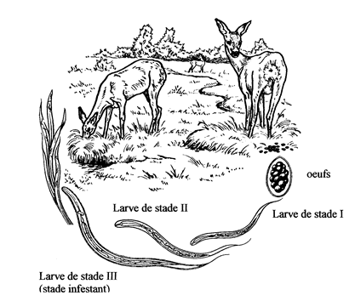
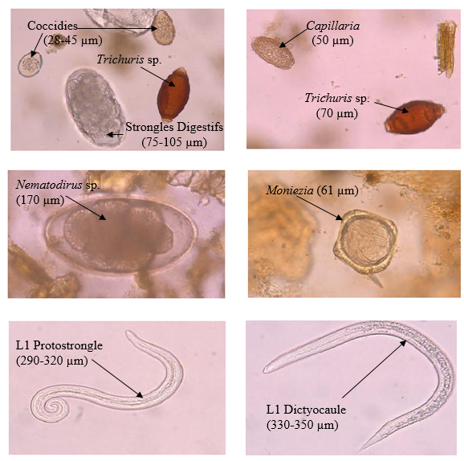
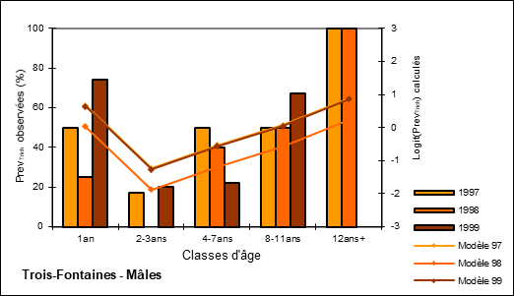
Experimenter Bias
Accountability
Accurate
Care
Collegiality
Cooperation
Ethics
Fair
Honesty
Objectivity
Openness
Quality
Reliability
Reproducibility
Respect
Responsibility
Rigor
Transparency
Scientists should be blind … if they want to be objective!
Wetzer and Rieck, 1960

Slide 33
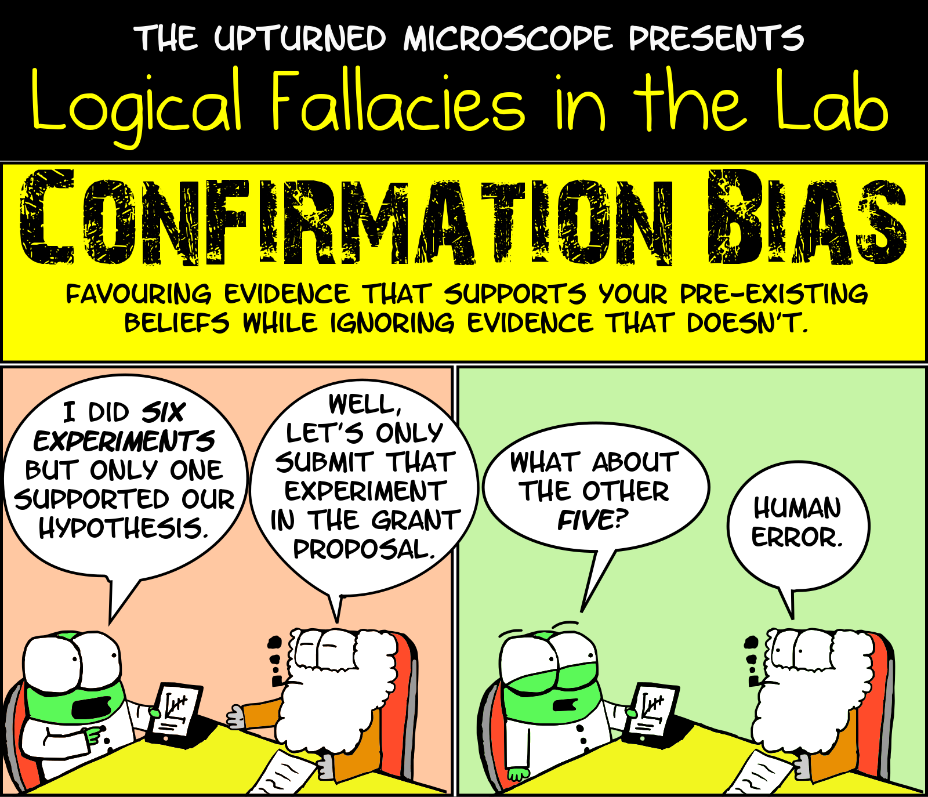
Blinding
is important to avoid
Confirmation bias
Accountability
Accurate
Care
Collegiality
Cooperation
Ethics
Fair
Honesty
Objectivity
Openness
Quality
Reliability
Reproducibility
Respect
Responsibility
Rigor
Transparency

Slide 34
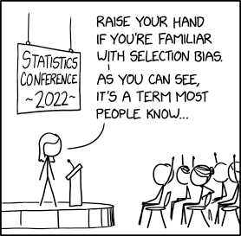
Selection Bias
Accountability
Accurate
Care
Collegiality
Cooperation
Ethics
Fair
Honesty
Objectivity
Openness
Quality
Reliability
Reproducibility
Respect
Responsibility
Rigor
Transparency
Biases in our sample populations can impact on our conclusions too

Slide 35
Randomisation
Control Group
Pooled starting group
Accountability
Accurate
Care
Collegiality
Cooperation
Ethics
Fair
Honesty
Objectivity
Openness
Quality
Reliability
Reproducibility
Respect
Responsibility
Rigor
Transparency
Random Allocation
Treatment Group
Each experimental unit has equal probability of receiving a treatment
Minimises Selection Bias
Reduces systematic differences between groups

Slide 36
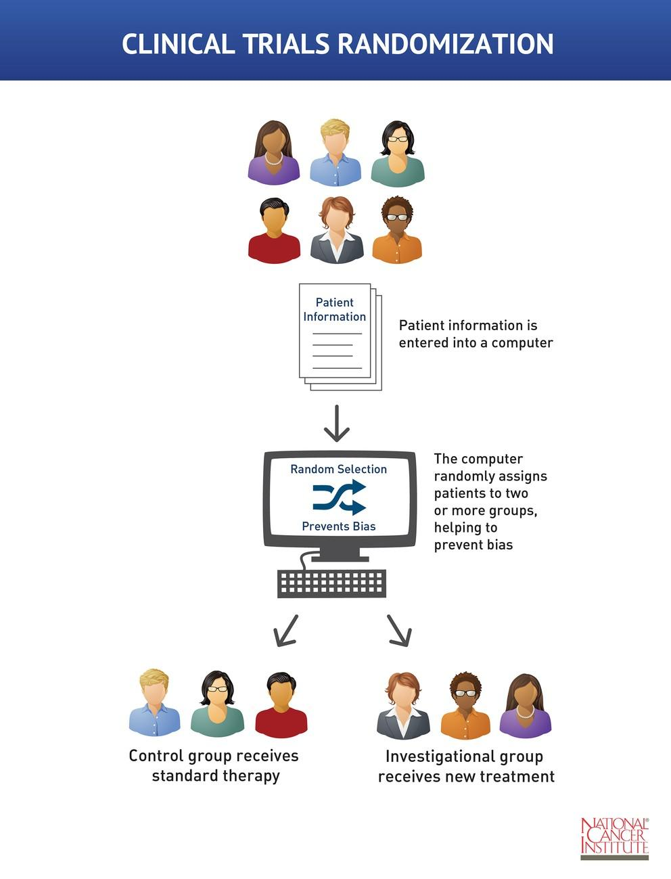
Random Allocation
Accountability
Accurate
Care
Collegiality
Cooperation
Ethics
Fair
Honesty
Objectivity
Openness
Quality
Reliability
Reproducibility
Respect
Responsibility
Rigor
Transparency

Slide 37
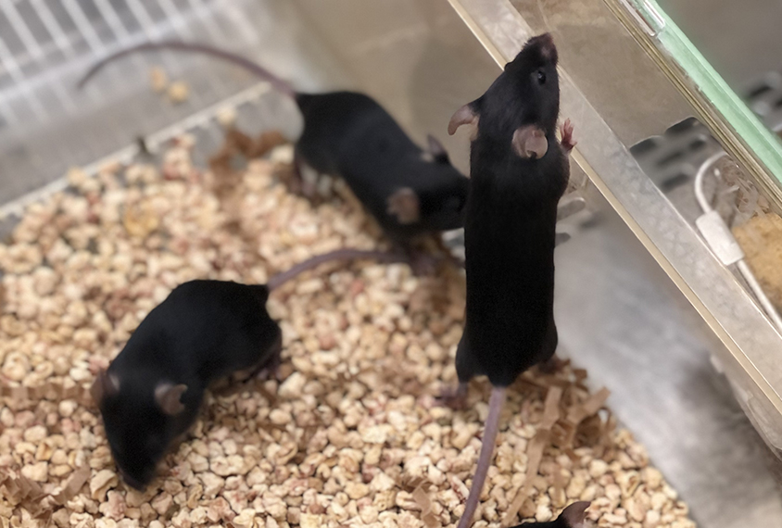
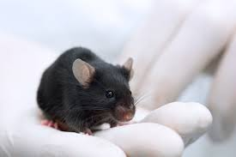
Random Allocation
Accountability
Accurate
Care
Collegiality
Cooperation
Ethics
Fair
Honesty
Objectivity
Openness
Quality
Reliability
Reproducibility
Respect
Responsibility
Rigor
Transparency
Pick out a mouse at random, first 3 get the treatment
Is this random?
Does it have the potential to introduce bias?
A
Biased
B
Not Biased

Slide 38
Randomisation More Broadly
Consider Nuisance Factors
Accountability
Accurate
Care
Collegiality
Cooperation
Ethics
Fair
Honesty
Objectivity
Openness
Quality
Reliability
Reproducibility
Respect
Responsibility
Rigor
Transparency
Random Allocation
Also consider randomisation throughout the experiment
https://eda.nc3rs.org.uk/experimental-design-allocation#randomisationstrategy

Slide 39
In a nutshell
Accountability
Accurate
Care
Collegiality
Cooperation
Ethics
Fair
Honesty
Objectivity
Openness
Quality
Reliability
Reproducibility
Respect
Responsibility
Rigor
Transparency
Good experimental design…
Translates the scientific question into lab work
Prevents subjectivity
Reduces effects of nuisance variables
…Is a fair way to do science

Slide 40
Research Integrity in practice
Sample size

Slide 41
Question
Data Exploration
Data Analysis
Results
Experiment
Experimental Design
Sample Size
Accountability
Accurate
Care
Collegiality
Cooperation
Ethics
Fair
Honesty
Objectivity
Openness
Quality
Reliability
Reproducibility
Respect
Responsibility
Rigor
Transparency
The Right Size to be Confident in Our Results
Statistical Power
Replicates

Slide 42
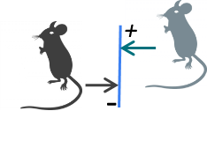
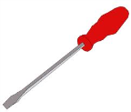
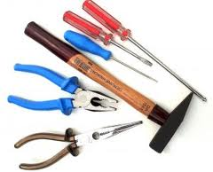
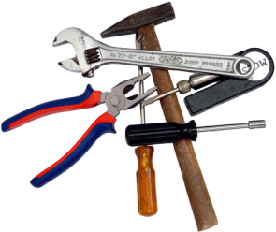
Statistical power: an analogy
Accountability
Accurate
Care
Collegiality
Cooperation
Ethics
Fair
Honesty
Objectivity
Openness
Quality
Reliability
Reproducibility
Respect
Responsibility
Rigor
Transparency
You send your child into the basement to find a tool. The child comes back and says "it isn't there". What do you conclude?
In the house
In the lab
"If the tool really is in the basement, what are the chances that your child would have found it?”
“If there is a difference between 2 conditions, what are the chances that your experiment will pick it up (p<0.05)?”
How long did the child spend looking?
How many mice do you look at? Sample size
How big is the tool?
How big is the difference? The absolute effect
or
How messy is the basement?
How messy the data are? Variability
or

Slide 43
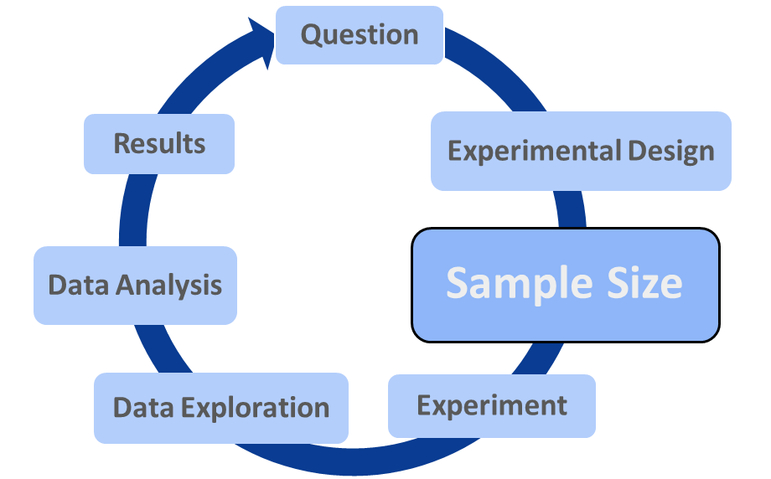
The Importance of Statistical Power
“If there is a difference between 2 conditions, what are the chances that your experiment will pick it up (p<0.05)?”
Accountability
Accurate
Care
Collegiality
Cooperation
Ethics
Fair
Honesty
Objectivity
Openness
Quality
Reliability
Reproducibility
Respect
Responsibility
Rigor
Transparency
Increase Sample size to increase Power
How many mice do you look at? Sample size
How big is the difference? The absolute effect
Little to no control
How messy the data are? Variability

Slide 44
The Importance of Statistical Power
Low Powered Studies have a greater chance of failing to detect a real effect
Accountability
Accurate
Care
Collegiality
Cooperation
Ethics
Fair
Honesty
Objectivity
Openness
Quality
Reliability
Reproducibility
Respect
Responsibility
Rigor
Transparency
BUT that’s all probability…
So some underpowered studies will detect a real effect
Are these results trustworthy?
A
Yes
B
No
https://www.taconic.com/taconic-insights/quality/animal-research-sample-size-calculation.html

Slide 45
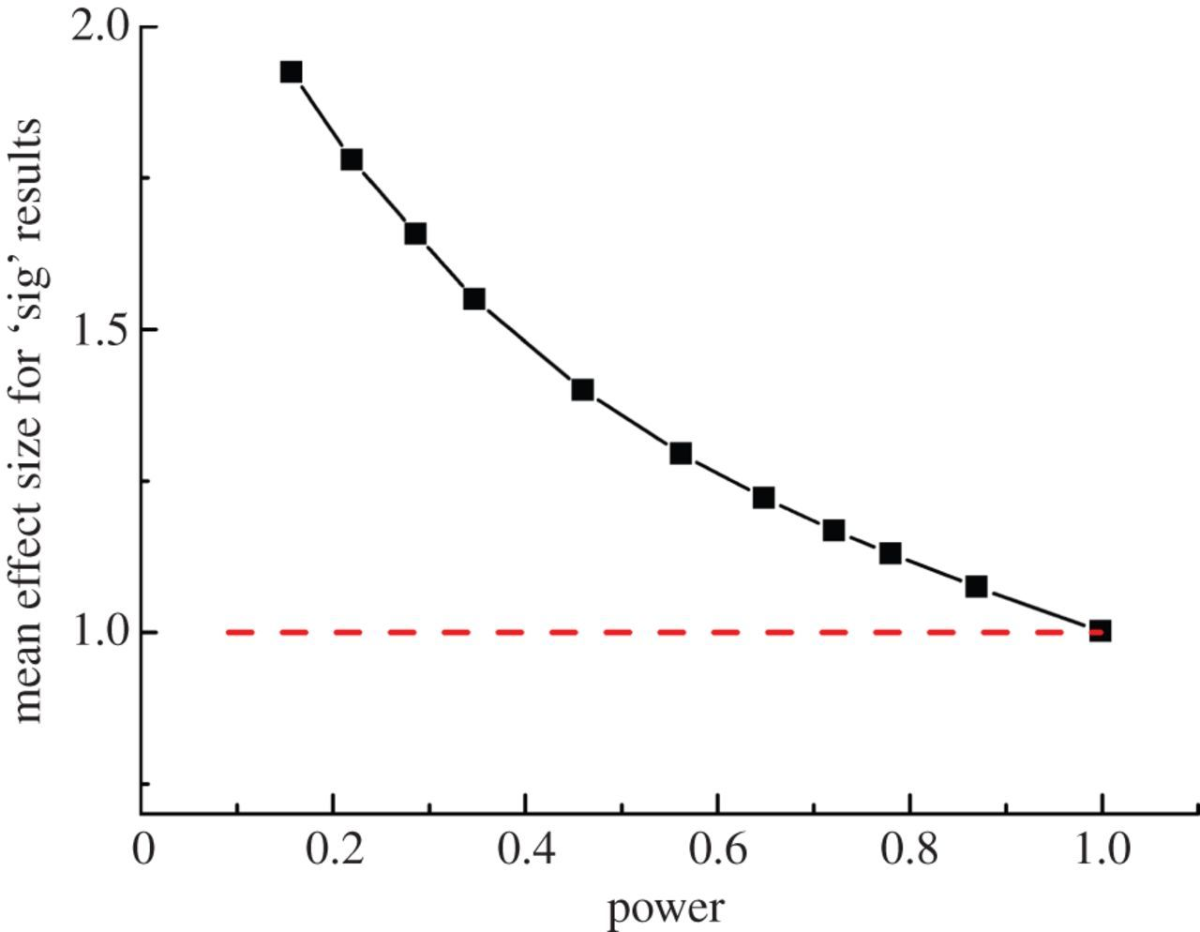
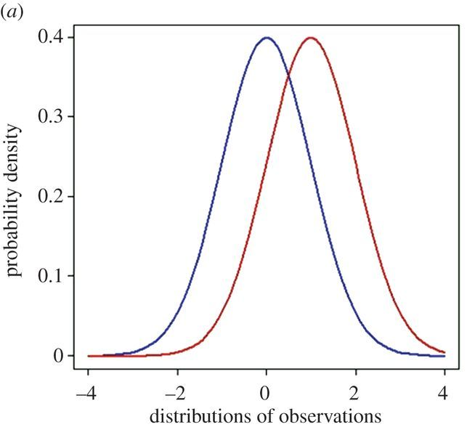
The Importance of Statistical Power
The Problem of the “Inflation Effect”…
Accountability
Accurate
Care
Collegiality
Cooperation
Ethics
Fair
Honesty
Objectivity
Openness
Quality
Reliability
Reproducibility
Respect
Responsibility
Rigor
Transparency
The TRUE effect size = 1
n=3
power = 0.157
n=50
power = 0.999
https://royalsocietypublishing.org/doi/10.1098/rsos.140216

Slide 46
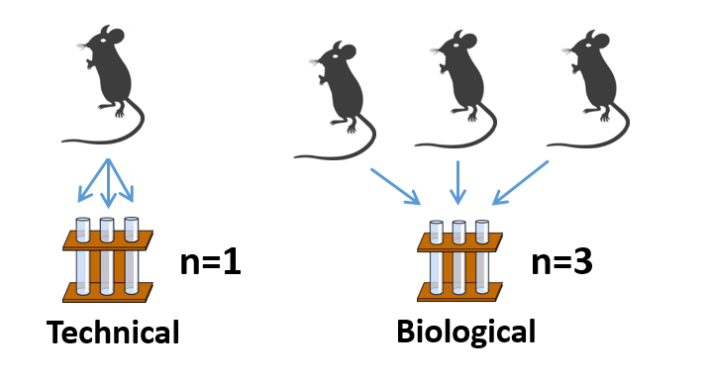
Defining Replicates
By the way: replicates = repeat = sample = library
Technical versus biological replicates
Accountability
Accurate
Care
Collegiality
Cooperation
Ethics
Fair
Honesty
Objectivity
Openness
Quality
Reliability
Reproducibility
Respect
Responsibility
Rigor
Transparency

Slide 47
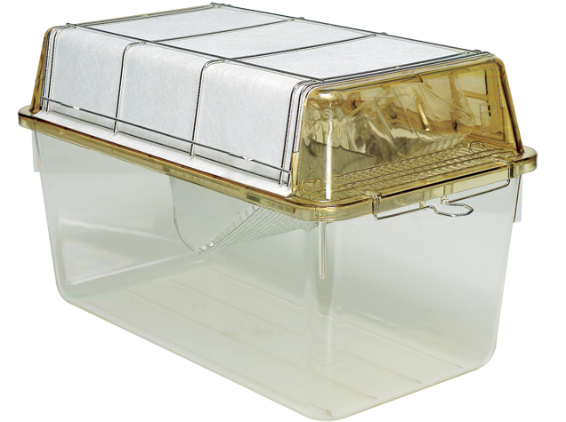
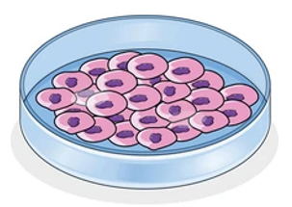
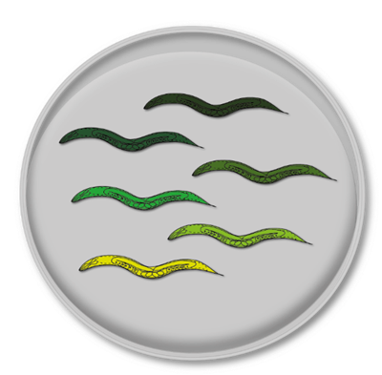
What is a Biological Replicate in Practice?
1 biological replicate:
A
1 mouse
B
1 cage
Accountability
Accurate
Care
Collegiality
Cooperation
Ethics
Fair
Honesty
Objectivity
Openness
Quality
Reliability
Reproducibility
Respect
Responsibility
Rigor
Transparency
1 biological replicate:
A
1 cell
B
1 petri dish
1 biological replicate:
A
1 worm
B
1 petri dish

Slide 48
In a nutshell
Accountability
Accurate
Care
Collegiality
Cooperation
Ethics
Fair
Honesty
Objectivity
Openness
Quality
Reliability
Reproducibility
Respect
Responsibility
Rigor
Transparency
Sample Size & Power are key to confident results
Underpowered Studies are more likely to:
- Fail to detect real effects
- Overestimate the effect size of detected effects
More biological replicates increase our evidence
How Many?
Formalise with power calculations….

Slide 50
Research Integrity in practice
Data Exploration & Data Analysis

Slide 51
Question
Data Exploration
Data Analysis
Results
Experiment
Experimental Design
Sample Size
Accountability
Accurate
Care
Collegiality
Cooperation
Ethics
Fair
Honesty
Objectivity
Openness
Quality
Reliability
Reproducibility
Respect
Responsibility
Rigor
Transparency
A Faithful and Informative View of Our Data
Understanding Our Data
Presenting Our Data Honestly

Slide 52
Data Exploration
Accountability
Accurate
Care
Collegiality
Cooperation
Ethics
Fair
Honesty
Objectivity
Openness
Quality
Reliability
Reproducibility
Respect
Responsibility
Rigor
Transparency
Understanding Our Data:
- The Biology
- The Quality
Builds Our Understanding and Confidence

Slide 53
Data Exploration: Understanding Our Data
Accountability
Accurate
Care
Collegiality
Cooperation
Ethics
Fair
Honesty
Objectivity
Openness
Quality
Reliability
Reproducibility
Respect
Responsibility
Rigor
Transparency
Often we summarise our data to key values
N | 182
X Mean | 54.26
Y Mean | 47.83
X SD | 16.76
Y SD | 26.93
Correlation | -0.06
Can be really useful…
…And also really not!

Slide 54
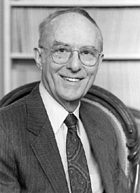
Data Exploration: Anscombe’s Quartet
Accountability
Accurate
Care
Collegiality
Cooperation
Ethics
Fair
Honesty
Objectivity
Openness
Quality
Reliability
Reproducibility
Respect
Responsibility
Rigor
Transparency
“A computer should make both calculations and graphs"
Dataset 1 |  | Dataset 2 |  | Dataset 3 |  | Dataset 4
X1 | Y1 | X2 | Y2 | X3 | Y3 | X4 | Y4
10.00 | 8.04 | 10.00 | 9.14 | 10.00 | 7.46 | 8.00 | 6.58
8.00 | 6.95 | 8.00 | 8.14 | 8.00 | 6.77 | 8.00 | 5.76
13.00 | 7.58 | 13.00 | 8.74 | 13.00 | 12.74 | 8.00 | 7.71
9.00 | 8.81 | 9.00 | 8.77 | 9.00 | 7.11 | 8.00 | 8.84
11.00 | 8.33 | 11.00 | 9.26 | 11.00 | 7.81 | 8.00 | 8.47
14.00 | 9.96 | 14.00 | 8.10 | 14.00 | 8.84 | 8.00 | 7.04
6.00 | 7.24 | 6.00 | 6.13 | 6.00 | 6.08 | 8.00 | 5.25
4.00 | 4.26 | 4.00 | 3.10 | 4.00 | 5.39 | 19.00 | 12.50
12.00 | 10.84 | 12.00 | 9.13 | 12.00 | 8.15 | 8.00 | 5.56
7.00 | 4.82 | 7.00 | 7.26 | 7.00 | 6.42 | 8.00 | 7.91
5.00 | 5.68 | 5.00 | 4.74 | 5.00 | 5.73 | 8.00 | 6.89
Francis Anscombe
4 datasets
Each consisting of X and Y variable
All 4 datasets have the same summary statistics...

Slide 55
Data Exploration: Anscombe’s Quartet
Accountability
Accurate
Care
Collegiality
Cooperation
Ethics
Fair
Honesty
Objectivity
Openness
Quality
Reliability
Reproducibility
Respect
Responsibility
Rigor
Transparency
The average and spread of the conditions appears the same
 | Dataset 1 |  | Dataset 2 |  | Dataset 3 |  | Dataset 4
 | X1 | Y1 | X2 | Y2 | X3 | Y3 | X4 | Y4
N | 11 | 11 | 11 | 11 | 11 | 11 | 11 | 11
Mean | 9.00 | 7.50 | 9.00 | 7.50 | 9.00 | 7.50 | 9.00 | 7.50
STD | 3.31 | 2.03 | 3.31 | 2.03 | 3.31 | 2.03 | 3.31 | 2.03
SEM | 1.00 | 0.612 | 1.00 | 0.612 | 1.00 | 0.612 | 1.00 | 0.612
The relationship between X & Y can be described the same
 | Correlation (r) | Line of Best Fit
x1 vs. y1 | r = 0.8164 | Y = 0.5001*X + 3.000
x2 vs. y2 | r = 0.8162 | Y = 0.5000*X + 3.001
x3 vs. y3 | r = 0.8163 | Y = 0.4997*X + 3.002
x4 vs. y4 | r = 0.8165 | Y = 0.4999*X + 3.002

Slide 56
Data Exploration: Anscombe’s Quartet
Accountability
Accurate
Care
Collegiality
Cooperation
Ethics
Fair
Honesty
Objectivity
Openness
Quality
Reliability
Reproducibility
Respect
Responsibility
Rigor
Transparency
How does the data behave within the groups?
We’re still not getting a complete view of the data
What about the relationship between X & Y?

Slide 57
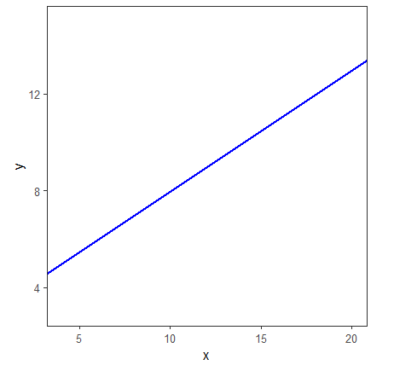
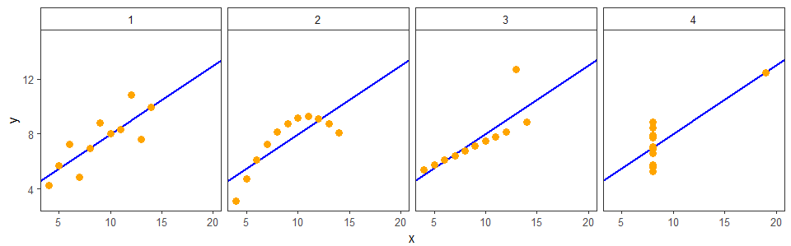
Data Exploration: Anscombe’s Quartet
Accountability
Accurate
Care
Collegiality
Cooperation
Ethics
Fair
Honesty
Objectivity
Openness
Quality
Reliability
Reproducibility
Respect
Responsibility
Rigor
Transparency
What about the relationship between X & Y?
r = 0.816 | Y = 0.500*X + 3.00

Slide 58
Can You Predict The Data Structure?
Accountability
Accurate
Care
Collegiality
Cooperation
Ethics
Fair
Honesty
Objectivity
Openness
Quality
Reliability
Reproducibility
Respect
Responsibility
Rigor
Transparency
We already know what the data will look like…
A
N | 182
X Mean | 54.26
Y Mean | 47.83
X SD | 16.76
Y SD | 26.93
Correlation | -0.06
C
Line
Unstructured
B
D
Circle
I Don’t Know…
A Dinosaur!

Slide 59
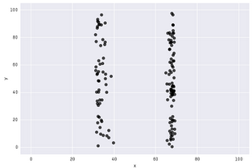
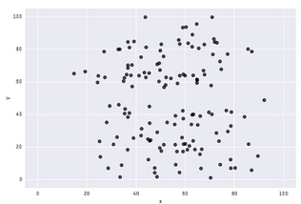
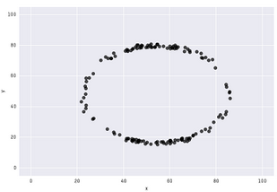
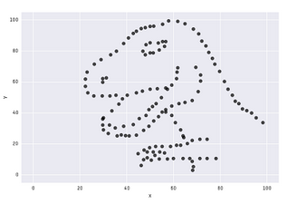
The Datasaurus Dozen
A
N | 182
X Mean | 54.26
Y Mean | 47.83
X SD | 16.76
Y SD | 26.93
Correlation | -0.06
C
B
D
And More!
https://www.research.autodesk.com/publications/same-stats-different-graphs/

Slide 60
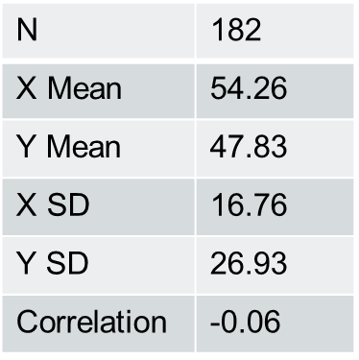
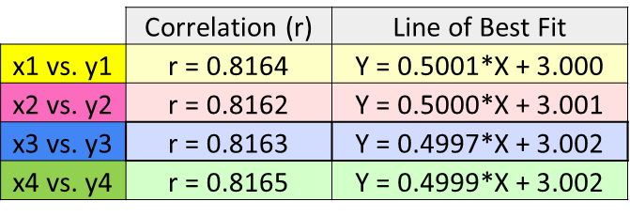
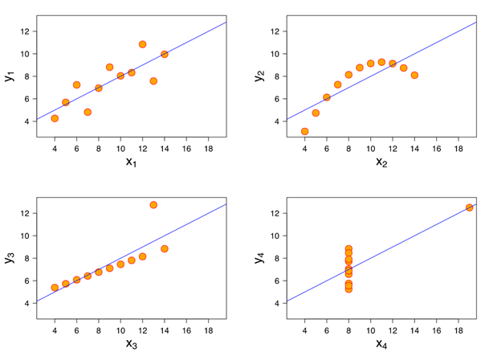
Data Exploration: Seeing is Believing!
Accountability
Accurate
Care
Collegiality
Cooperation
Ethics
Fair
Honesty
Objectivity
Openness
Quality
Reliability
Reproducibility
Respect
Responsibility
Rigor
Transparency
Beware of statistical or graphical summaries…
…without proper exploration & visualisation!

Slide 61
Data Exploration
Exercise

Slide 62
What do you think of this graph?
Values from 3 conditions from one experiment

Slide 63
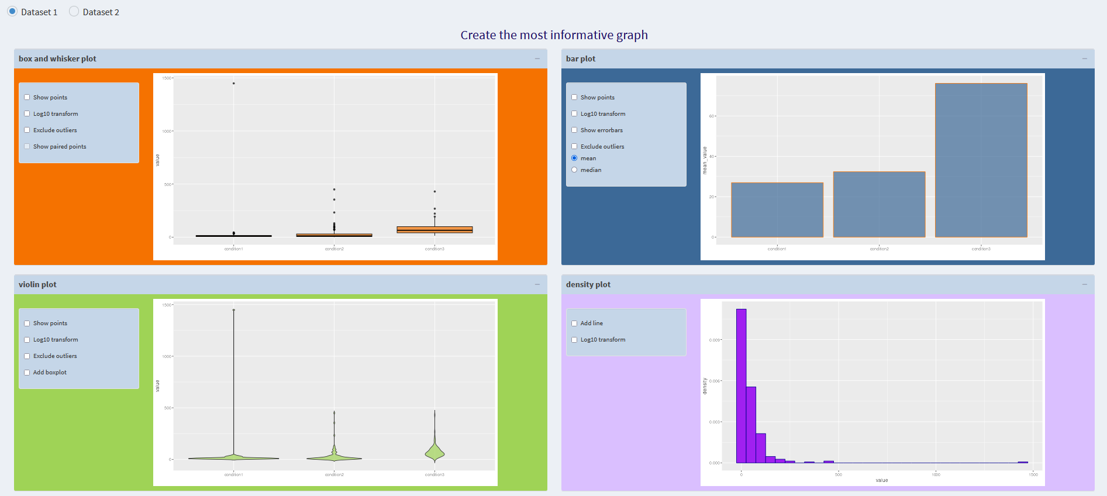
Representing Dataset 1:
Create the most informative graph
https://tinyurl.com/RIdataExp
Make sure you are looking at Dataset 1
Plot for initial exploration of the data?
Plot for presentation/ publication?

Slide 64
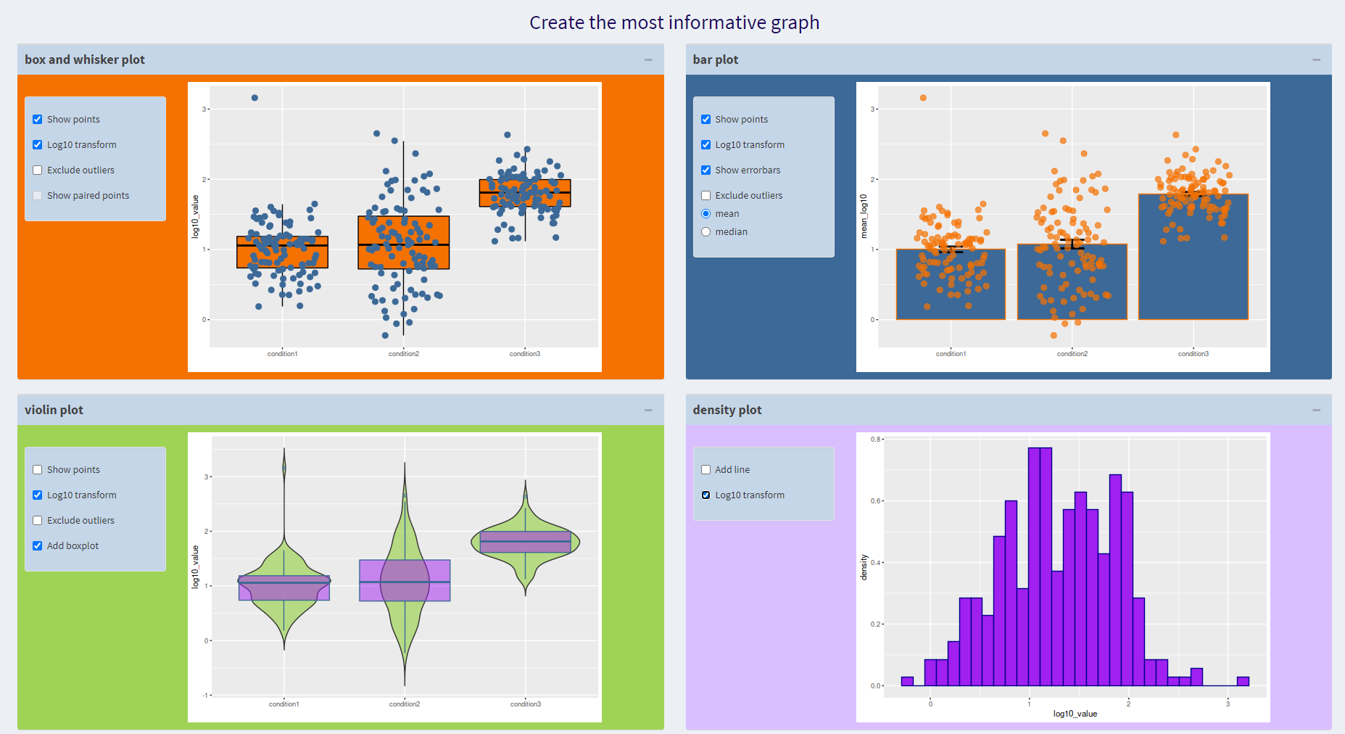
Representing Dataset 1:
Create the most informative graph
Which plots did we choose and why?
Any differences between initial exploration and presentation?

Slide 65
What do you think of this graph?
Before
After
Values for before-after treatment from 4 experiments.

Slide 66
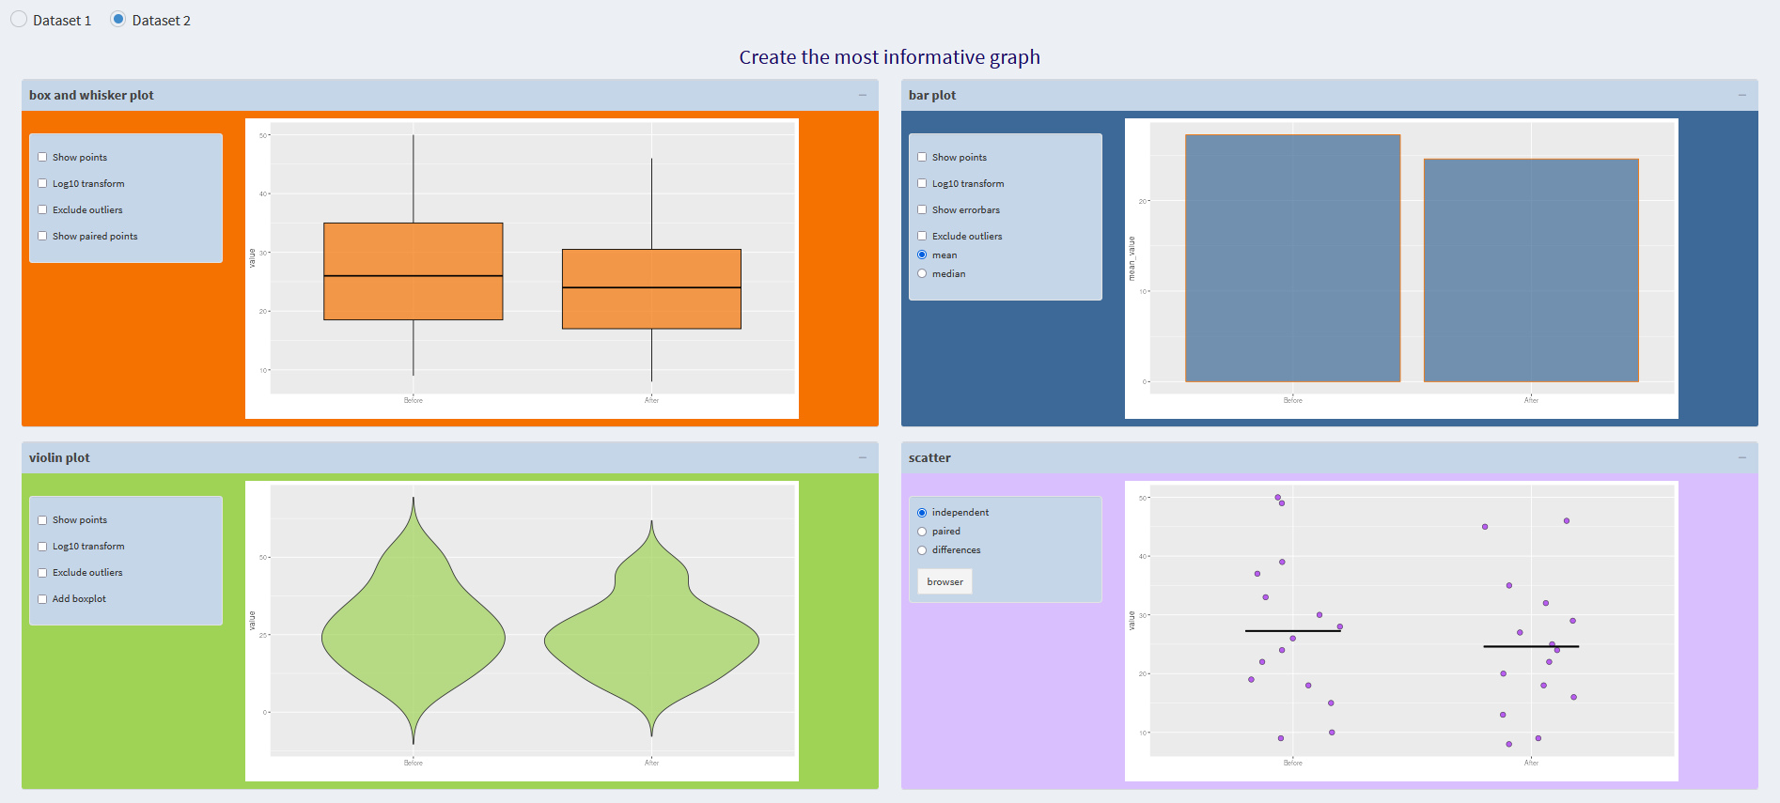
Representing Dataset 2:
Create the most informative graph
https://tinyurl.com/RIDataExp
Make sure you are looking at Dataset 2
Create a plot to best represent dataset 2
Think about experimental design and statistics

Slide 67
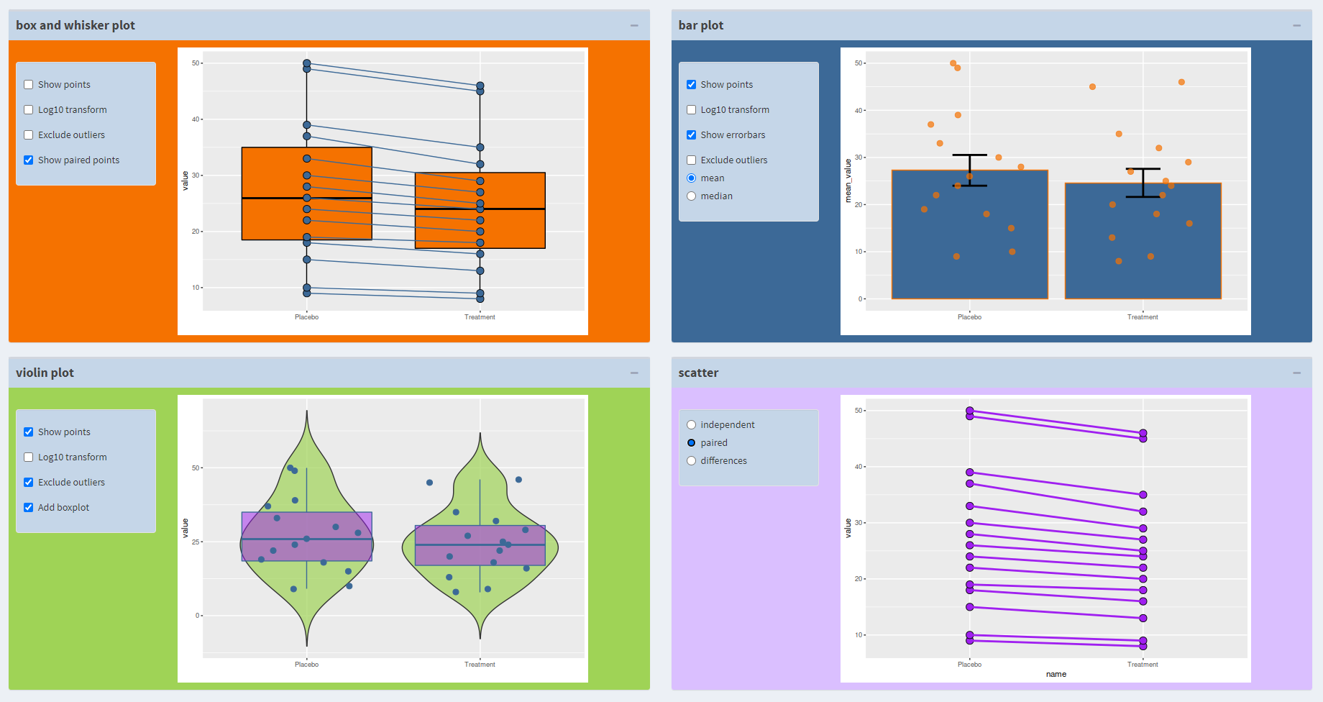
Representing Dataset 2:
Create the most informative graph
Which plots did we choose and why?
What do you think about the stats now?

Slide 68
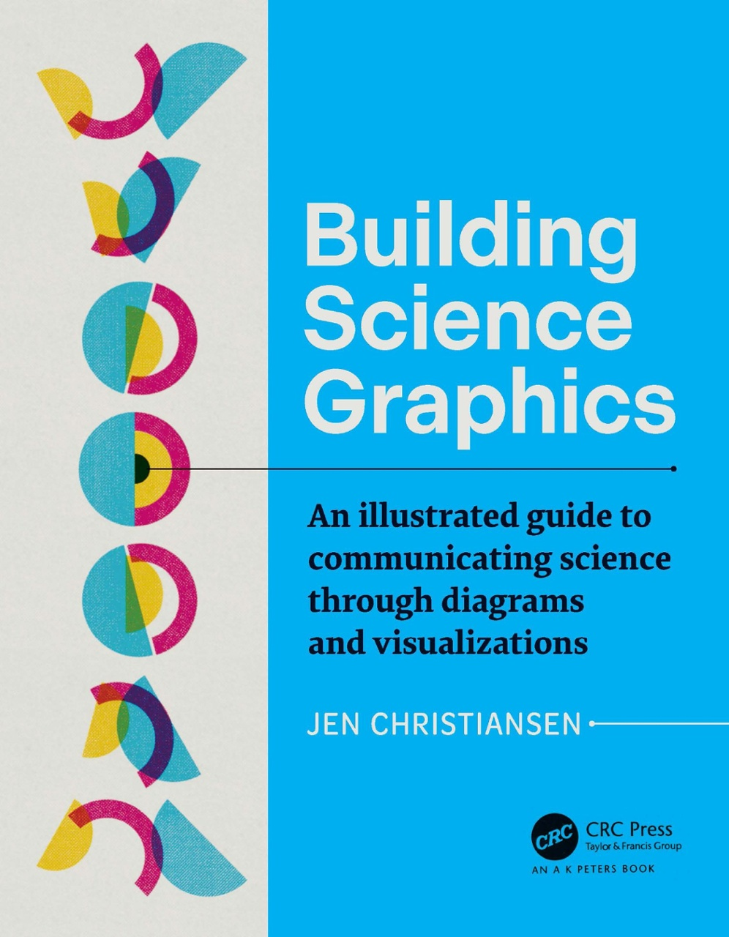
An Aside to Help with Better Figure Design…
Scientific Figure Design

Slide 69
Data exploration
What can go wrong if we don’t do it?!

Slide 70
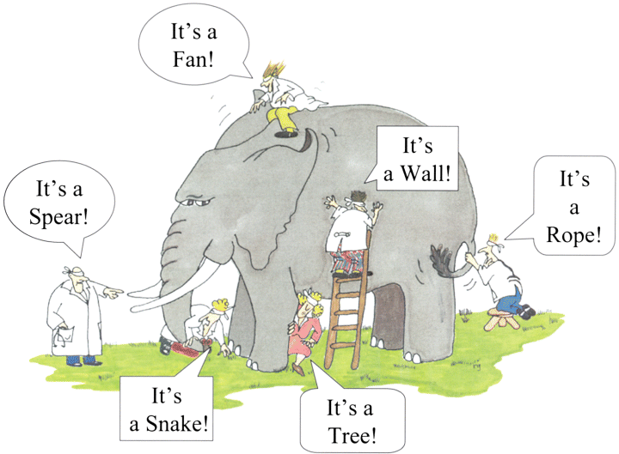
Risk missing the actual story the data is telling…
Data exploration
Less Exploring more Assuming!
Image from https://link.springer.com/article/10.1007/s00246-017-1742-2

Slide 71
…Suspicious Summaries
Data Exploration…

Slide 72
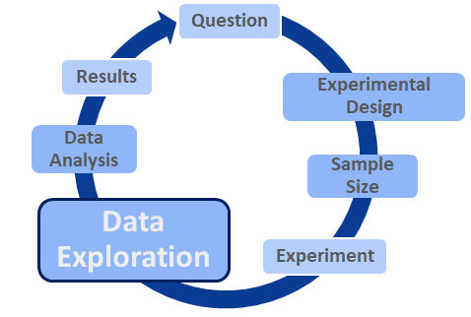
Example 1
Four experiments: Before-After treatment effect on a variable of interest.
Hypothesis: Treatment will decrease the levels of the variable of interest
Accountability
Accurate
Care
Collegiality
Cooperation
Ethics
Fair
Honesty
Objectivity
Openness
Quality
Reliability
Reproducibility
Respect
Responsibility
Rigor
Transparency

Slide 73
Example 2
Accountability
Accurate
Care
Collegiality
Cooperation
Ethics
Fair
Honesty
Objectivity
Openness
Quality
Reliability
Reproducibility
Respect
Responsibility
Rigor
Transparency

Slide 74
Example 3
Accountability
Accurate
Care
Collegiality
Cooperation
Ethics
Fair
Honesty
Objectivity
Openness
Quality
Reliability
Reproducibility
Respect
Responsibility
Rigor
Transparency

Slide 75
…Dubious Datasets
Data Exploration…

Slide 76
Example 1: A Knockout?
Accountability
Accurate
Care
Collegiality
Cooperation
Ethics
Fair
Honesty
Objectivity
Openness
Quality
Reliability
Reproducibility
Respect
Responsibility
Rigor
Transparency

Slide 77
Example 2: A Case of Mistaken Identity
Accountability
Accurate
Care
Collegiality
Cooperation
Ethics
Fair
Honesty
Objectivity
Openness
Quality
Reliability
Reproducibility
Respect
Responsibility
Rigor
Transparency
WT
KO

Slide 78
Example 3: Of Mice and Mycoplasma!
Accountability
Accurate
Care
Collegiality
Cooperation
Ethics
Fair
Honesty
Objectivity
Openness
Quality
Reliability
Reproducibility
Respect
Responsibility
Rigor
Transparency
% Alignment to Mouse
50%
Condition 1
Condition 2
% Alignment to Mycoplasma
Condition 1
Condition 2
50%

Slide 79
…Is it okay if you don’t know there’s a problem?
All highlight the perils of assuming and not exploring….
Accountability
Accurate
Care
Collegiality
Cooperation
Ethics
Fair
Honesty
Objectivity
Openness
Quality
Reliability
Reproducibility
Respect
Responsibility
Rigor
Transparency

Slide 80
Analytical Tools
The right tools for the job!
Accountability
Accurate
Care
Collegiality
Cooperation
Ethics
Fair
Honesty
Objectivity
Openness
Quality
Reliability
Reproducibility
Respect
Responsibility
Rigor
Transparency
- Know what's out there
- Learn how to use it

Slide 81
Help With Analytical Tools
Accountability
Accurate
Care
Collegiality
Cooperation
Ethics
Fair
Honesty
Objectivity
Openness
Quality
Reliability
Reproducibility
Respect
Responsibility
Rigor
Transparency
Application Specific Courses
Core Skills Courses
e.g. R Programming
e.g. NGS Analysis
https://www.bioinformatics.babraham.ac.uk/training.html

Slide 82
In a nutshell
Accountability
Accurate
Care
Collegiality
Cooperation
Ethics
Fair
Honesty
Objectivity
Openness
Quality
Reliability
Reproducibility
Respect
Responsibility
Rigor
Transparency
Data exploration is CRITICAL to:
Understand our data
Be confident in our findings
Ensure our results are quality and reliable
… Good for everyone!

Slide 83
Question
Data Exploration
Data Analysis
Results
Experiment
Experimental Design
Sample Size
Accountability
Accurate
Care
Collegiality
Cooperation
Ethics
Fair
Honesty
Objectivity
Openness
Quality
Reliability
Reproducibility
Respect
Responsibility
Rigor
Transparency
Formalise Our Findings with Statistics
Understanding Our Data
Understanding Our Question

Slide 84
Statistical Analysis
Translate the hypothesis/question into statistical questions
By choosing the right test!
Accountability
Accurate
Care
Collegiality
Cooperation
Ethics
Fair
Honesty
Objectivity
Openness
Quality
Reliability
Reproducibility
Respect
Responsibility
Rigor
Transparency
Healthy approach:
“It’s not about knowing the name of the test…
…It’s knowing what the test should do”
Anne Segonds-Pichon

Slide 85
Knowing what the Test should do…
Statistics Decision tree
Accountability
Accurate
Care
Collegiality
Cooperation
Ethics
Fair
Honesty
Objectivity
Openness
Quality
Reliability
Reproducibility
Respect
Responsibility
Rigor
Transparency

Slide 86
Knowing what the Test should do…
Accountability
Accurate
Care
Collegiality
Cooperation
Ethics
Fair
Honesty
Objectivity
Openness
Quality
Reliability
Reproducibility
Respect
Responsibility
Rigor
Transparency
Statistics Using GraphPad Prism
Statistics Using R
https://www.bioinformatics.babraham.ac.uk/training.html

Slide 87
Research Integrity
More than 1 way to Investigate!
Accountability
Accurate
Care
Collegiality
Cooperation
Ethics
Fair
Honesty
Objectivity
Openness
Quality
Reliability
Reproducibility
Respect
Responsibility
Rigor
Transparency
Data Exploration
Data Analysis
Results
Experiment
Experimental Design
Sample Size
Question
Question
Data Analysis
Data Exploration
Exploratory data analysis

Slide 88
Accountability
Accurate
Care
Collegiality
Cooperation
Ethics
Fair
Honesty
Objectivity
Openness
Quality
Reliability
Reproducibility
Respect
Responsibility
Rigor
Transparency
In a nutshell
Question
Data Exploration
Data Analysis
Data exploration should always be a pivotal step of analysis
Stats helps us formalise our findings

Slide 90
Research Integrity
What does Ethics mean?

Slide 91
Research Integrity
Ethics and Animal Welfare
Accountability
Accurate
Care
Collegiality
Cooperation
Ethics
Fair
Honesty
Objectivity
Openness
Quality
Reliability
Reproducibility
Respect
Responsibility
Rigor
Transparency
If we need biological replicates to be confident in our results, why not have as many as we can?
And what does it have to do with integrity?
Time to talk about the Home Office, ASPA and the 3 Rs

Slide 92
Research Integrity
Home Office
The Home Office (HO) is a ministerial department of the Government of the UK, responsible for immigration, security and law and order.
- But more importantly: animal welfare
By Steph Gray, CC BY-SA 2.0, https://commons.wikimedia.org/w/index.php?curid=31387711

Slide 93
Research Integrity
The 3 Rs
Accountability
Accurate
Care
Collegiality
Cooperation
Ethics
Fair
Honesty
Objectivity
Openness
Quality
Reliability
Reproducibility
Respect
Responsibility
Rigor
Transparency
Replace
Reduce
Refine
https://wellcome.org/sites/default/files/wtp057673_0.pdf

Slide 94
Research Integrity
The 3Rs: about animal welfare
Replace
Avoiding or replacing the use of animals in areas where they otherwise would have been used.

Slide 95
Research Integrity
The 3Rs: about animal welfare
Reduce
Minimising the number of animals used consistent with scientific aims.

Slide 96
Research Integrity
The 3Rs: about animal welfare
Refine
Minimising the pain, suffering, distress or lasting harm that research animals might experience.
3Rs resource library | NC3Rs

Slide 97
Research Integrity
The 3 Rs at Babraham: AWERB
Remit
To provide the campus with independent ethical advice on the balance of harms to benefits within scientific projects using animals. To monitor standards of animal care and welfare, to support and advise named persons and licensees working under the Animals (Scientific Procedures) Act and to advise the Establishment Licence Holder on the suitability of Project Licence applications. To develop initiatives and guidelines leading to the widest possible application of the 3Rs (refinement, reduction and replacement) both on the campus and amongst the wider scientific community. In accordance with our commitments to the Concordat on Openness in animal research, any staff member with a concern that falls within the AWERB remit is encouraged to speak to the AWERB chair or any other committee member.

Slide 98
Good Research in Practice

Slide 99
Good Research in Practice
Accountability
Accurate
Care
Collegiality
Cooperation
Ethics
Fair
Honesty
Objectivity
Openness
Quality
Reliability
Reproducibility
Respect
Responsibility
Rigor
Transparency
The Research Process
Responsibilities
Competence
Project planning
Quality Control
Laboratory Practice
Health and safety
Handling of samples and materials
Facilities and equipment
Documentation of procedures and methods
Research/work records

Slide 100
Keeping track of the research
How?

Slide 101
Research Integrity Laboratory Notebooks
Accountability
Accuracy
Care
Collegiality
Cooperation
Ethics
Fair
Honesty
Objectivity
Openness
Quality
Reliability
Reproducibility
Respect
Responsibility
Rigor
Transparency
Reporting
Defend data
Trace
Find it
Share it
Describe
Protect IP
Legal protection
GLP++
Safe and secure
Compliant

Slide 102
Research Integrity Laboratory Notebooks
Accountability
Accuracy
Care
Collegiality
Cooperation
Ethics
Fair
Honesty
Objectivity
Openness
Quality
Reliability
Reproducibility
Respect
Responsibility
Rigor
Transparency
This Photo by Unknown Author is licensed under CC BY

Slide 103
Research Integrity Laboratory Notebooks
Accountability
Accuracy
Care
Collegiality
Cooperation
Ethics
Fair
Honesty
Objectivity
Openness
Quality
Reliability
Reproducibility
Respect
Responsibility
Rigor
Transparency
This Photo by Unknown Author is licensed under CC BY-ND
This Photo by Unknown Author is licensed under CC BY-ND

Slide 104
Research Data Data Storage
Accountability
Accuracy
Care
Collegiality
Cooperation
Ethics
Fair
Honesty
Objectivity
Openness
Quality
Reliability
Reproducibility
Respect
Responsibility
Rigor
Transparency
Legal Requirements
Practicalities
Image: cleanpng.com

Slide 105
Research Data Data Storage
Accountability
Accuracy
Care
Collegiality
Cooperation
Ethics
Fair
Honesty
Objectivity
Openness
Quality
Reliability
Reproducibility
Respect
Responsibility
Rigor
Transparency
Interruption in the supply of liquid nitrogen leading to the destruction of samples from multiple institutions.
Valued in the millions.
“Those worst affected are those researching leukaemia, they have gathered samples from patients over as much as 30 years,”

Slide 106
What should we be doing? Expectations and Responsibilities

Slide 107
Research Data OneNote
Accountability
Accuracy
Care
Collegiality
Cooperation
Ethics
Fair
Honesty
Objectivity
Openness
Quality
Reliability
Reproducibility
Respect
Responsibility
Rigor
Transparency

Slide 108
Responsibility

Slide 109
Research Integrity
Wider Responsibility
Accountability
Accurate
Care
Collegiality
Cooperation
Ethics
Fair
Honesty
Objectivity
Openness
Quality
Reliability
Reproducibility
Respect
Responsibility
Rigor
Transparency
Question
Experimental Design
Results
Data Analysis
Data Exploration
Experiment
Sample Size

Slide 110
Research Integrity
Accountability
Accuracy
Care
Collegiality
Cooperation
Ethics
Fair
Honesty
Objectivity
Openness
Quality
Reliability
Reproducibility
Respect
Responsibility
Rigor
Transparency
Photo by Miguel Henriques Unsplash

Slide 111
Research Integrity Questioning
Accountability
Accuracy
Care
Collegiality
Cooperation
Ethics
Fair
Honesty
Objectivity
Openness
Quality
Reliability
Reproducibility
Respect
Responsibility
Rigor
Transparency
Photo by Ana Municio on Unsplash

Slide 112
Research Integrity Collaboration and Competition
Accountability
Accuracy
Care
Collegiality
Cooperation
Ethics
Fair
Honesty
Objectivity
Openness
Quality
Reliability
Reproducibility
Respect
Responsibility
Rigor
Transparency
Photo by Natalie Pedigo on Unsplash

Slide 113
Research Integrity The Game
Accountability
Accuracy
Care
Collegiality
Cooperation
Ethics
Fair
Honesty
Objectivity
Openness
Quality
Reliability
Reproducibility
Respect
Responsibility
Rigor
Transparency
Photo by Karthik Balakrishnan on Unsplash

Slide 114
Research Integrity Wider Responsibility and Scientific Community
Accountability
Accuracy
Care
Collegiality
Cooperation
Ethics
Fair
Honesty
Objectivity
Openness
Quality
Reliability
Reproducibility
Respect
Responsibility
Rigor
Transparency

Slide 115
Research Integrity

Slide 116
Research Integrity
Accountability
Accuracy
Care
Collegiality
Cooperation
Ethics
Fair
Honesty
Objectivity
Openness
Quality
Reliability
Reproducibility
Respect
Responsibility
Rigor
Transparency
“Academia is at its best a meritocracy and at its worst a pit of vipers. A grown-up version of the children’s game snakes and ladders. The quest for knowledge and the pushing back of frontiers has created a hierarchal system with super demanding and, at times, conflicting metrics (postdocs must publish, publish, publish but to apply for a lectureship position you need to have a teaching track record).”

Slide 117
Research Integrity
In a nutshell
Accountability
Accurate
Care
Collegiality
Cooperation
Ethics
Fair
Honesty
Objectivity
Openness
Quality
Reliability
Reproducibility
Respect
Responsibility
Rigor
Transparency
Applying research integrity principles is our responsibility as scientists

Slide 118
Research Integrity
In the lab
Accountability
Accurate
Care
Collegiality
Cooperation
Ethics
Fair
Honesty
Objectivity
Openness
Quality
Reliability
Reproducibility
Respect
Responsibility
Rigor
Transparency
https://www.nature.com/articles/nj7593-263a

Slide 119
Research Integrity
Work culture
Accountability
Accurate
Care
Collegiality
Cooperation
Ethics
Fair
Honesty
Objectivity
Openness
Quality
Reliability
Reproducibility
Respect
Responsibility
Rigor
Transparency

Slide 120
Research Integrity
PhD Students
Accountability
Accurate
Care
Collegiality
Cooperation
Ethics
Fair
Honesty
Objectivity
Openness
Quality
Reliability
Reproducibility
Respect
Responsibility
Rigor
Transparency
It doesn’t matter if it ‘doesn’t work’

Slide 121
Research Integrity
Accountability
Accurate
Care
Collegiality
Cooperation
Ethics
Fair
Honesty
Objectivity
Openness
Quality
Reliability
Reproducibility
Respect
Responsibility
Rigor
Transparency
Work hard…
…but what if it is too hard?

Slide 122
Research Integrity
Accountability
Accurate
Care
Collegiality
Cooperation
Ethics
Fair
Honesty
Objectivity
Openness
Quality
Reliability
Reproducibility
Respect
Responsibility
Rigor
Transparency
EAP
Mental Health First Aiders
Graduate Studies
HR
Pastoral Mentors
The Hub

Slide 123
Research Integrity
Accountability
Accurate
Care
Collegiality
Cooperation
Ethics
Fair
Honesty
Objectivity
Openness
Quality
Reliability
Reproducibility
Respect
Responsibility
Rigor
Transparency
https://forbetterscience.com/2020/07/07/science-misconduct/

Slide 124
Research Integrity
Accountability
Accurate
Care
Collegiality
Cooperation
Ethics
Fair
Honesty
Objectivity
Openness
Quality
Reliability
Reproducibility
Respect
Responsibility
Rigor
Transparency
PhD
PostDoc
Tenure
Group Leader

Slide 125
Research Integrity
Accountability
Accurate
Care
Collegiality
Cooperation
Ethics
Fair
Honesty
Objectivity
Openness
Quality
Reliability
Reproducibility
Respect
Responsibility
Rigor
Transparency

Slide 126
How our integrity may be tested

Slide 127
Publications

Slide 128
Publish or Perish?

Slide 129
Publications: the good
Accountability
Accurate
Care
Collegiality
Cooperation
Ethics
Fair
Honesty
Objectivity
Openness
Quality
Reliability
Reproducibility
Respect
Responsibility
Rigor
Transparency
Paper published
Dissemination of knowledge
Peer review
Need to publish
Career advancement
More jobs in research
Grant, Job
More research, more grants, more papers
More research

Slide 130
Publications: the bad
Accountability
Accurate
Care
Collegiality
Cooperation
Ethics
Fair
Honesty
Objectivity
Openness
Quality
Reliability
Reproducibility
Respect
Responsibility
Rigor
Transparency
Random sample of 1,000 Medline abstracts:
96% reported significant p-values
Dissemination of knowledge
Peer review
Need to publish
Career advancement
More jobs in research
Grant, Job
More research, more grants, more papers
More research
Paper published
Dissemination of knowledge
Peer review
Need to publish
Career advancement
More jobs in research
Grant, Job
More research, more grants, more papers
More research
Novel Significant Results
Rules are ignored, bent, broken
Paper published
Amgen attempted to replicate 53 high-impact
cancer research studies: able to replicate only six.
Replication crisis

Slide 131
Publications: the bad
Accountability
Accurate
Care
Collegiality
Cooperation
Ethics
Fair
Honesty
Objectivity
Openness
Quality
Reliability
Reproducibility
Respect
Responsibility
Rigor
Transparency
The most cited paper to be retracted
Pluripotency of mesenchymal stem cells derived from adult marrow
June 2002
Paper published in Nature
June 2024
Retraction of the paper
Concerns about reproducibility and duplicated images
Primarily by New Scientist
22 years!
December 2019
New concerns raised by Elisabeth Bik https://pubpeer.com/publications/DF95522E3585E37663CAD1972E70BD#
Investigation by University
Retraction of related paper
June 2007 Erratum published

Slide 132
Publications: the bad
Accountability
Accurate
Care
Collegiality
Cooperation
Ethics
Fair
Honesty
Objectivity
Openness
Quality
Reliability
Reproducibility
Respect
Responsibility
Rigor
Transparency
The most cited paper to be retracted
Pluripotency of mesenchymal stem cells derived from adult marrow
 | Published | Accesses | Citations
Original Article | 20 June 2002 | 27k | 4492
Erratum Note | 14 June 2007 | 6289 | 39
Retraction Note | 17 June 2024 | 19k | 1
(Numbers as of Oct. 2024)
Most authors agree with the retraction*
https://retractionwatch.com/the-retraction-watch-leaderboard/top-10-most-highly-cited-retracted-papers/
No. 7 is Andrew Wakefield original MMR paper

Slide 133
Publications: the ugly
Accountability
Accurate
Care
Collegiality
Cooperation
Ethics
Fair
Honesty
Objectivity
Openness
Quality
Reliability
Reproducibility
Respect
Responsibility
Rigor
Transparency
Paper Mills
Estimated Prevalence
2 – 3%¹
11%²
In 2023 Hindawi closed 4 journals because they were
“heavily compromised by paper mills”
2 – 46%³
1. https://www.nature.com/articles/d41586-023-03464-x
2. https://www.medrxiv.org/content/10.1101/2023.05.06.23289563v2
3. https://publicationethics.org/node/55256

Slide 134
Publications: the balance
Accountability
Accurate
Care
Collegiality
Cooperation
Ethics
Fair
Honesty
Objectivity
Openness
Quality
Reliability
Reproducibility
Respect
Responsibility
Rigor
Transparency

Slide 135
Misconduct

Slide 136
Research Integrity
Misconduct
Accountability
Accurate
Care
Collegiality
Cooperation
Ethics
Fair
Honesty
Objectivity
Openness
Quality
Reliability
Reproducibility
Respect
Responsibility
Rigor
Transparency

Slide 137
Misconduct: How?
Accountability
Accurate
Care
Collegiality
Cooperation
Ethics
Fair
Honesty
Objectivity
Openness
Quality
Reliability
Reproducibility
Respect
Responsibility
Rigor
Transparency
There are many ways to misbehave when it comes to research
Plagiarism
Fabrication and falsification
Inappropriate image manipulation
Non-publication of data
Faulty data-gathering procedures
Poor data storage and retention
Misleading authorship
Sneaky publication practices
https://undsci.berkeley.edu/article/socialsideofscience_06

Slide 138
Misconduct: Why?
Accountability
Accurate
Care
Collegiality
Cooperation
Ethics
Fair
Honesty
Objectivity
Openness
Quality
Reliability
Reproducibility
Respect
Responsibility
Rigor
Transparency
Temptation
Rationalization
Ambition
Tina Gunsalus
Group and authority pressure
Entitlement
Deception
Incrementalism
Embarrassment
Stupid systems
https://www.nature.com/articles/d41586-018-05145-6

Slide 139
Misconduct: Spot the TRAGEDIES
Group and authority pressure
Entitlement
Deception
Ambition
Incrementalism
A Simple Request from their Professor
Verify the numbers in a figure matched the spreadsheet
Rationalisation
A Questionable Outcome
Embarrassment
Paper published with the new student as a co-author
They accept the credit
Temptation
Stupid systems
Why?
A real case from Tina Gunsalus
https://www.nature.com/articles/d41586-018-05145-6
The New Student
The Professor

Slide 140
Misconduct: In a nutshell
Accountability
Accurate
Care
Collegiality
Cooperation
Ethics
Fair
Honesty
Objectivity
Openness
Quality
Reliability
Reproducibility
Respect
Responsibility
Rigor
Transparency
“I never met anyone who said, yeah, you know, that was the day I woke up and decided to you know, put my career at risk, potentially go to jail, embarrass my family, lose my job.”
Tina Gunsalus
We need to be aware of our feelings and circumstances
And acknowledge how they might influence us

Slide 141
The Only Acceptable Tragedy!*
https://www.youtube.com/watch?v=OiwDHHcHPh0
*To be fully transparent we should note the Bee Gees did it first!

Slide 142
Research misconduct
Research misconduct can take many forms, including:
fabrication; falsification; plagiarism; failure to meet legal, ethical and professional obligations; misrepresentation; and dealing with allegations of misconduct inappropriately.
Honest errors and differences in, e.g., research methodology or interpretations, do not constitute research misconduct.
BI-RES-004 RESEARCH MISCONDUCT POLICY.
Should be read in conjunction with
BI-HR-001 Code of Conduct
BI-HR-005 Disciplinary Policy
BI-COR-010 Whistleblowing Policy
BI-RES-001 Authorship Policy
BI-RES-005 Research Integrity Policy
Record Retention Policy

Slide 143
The bottom line

Slide 144
Research Integrity
It’s about being a good scientist
Research integrity
is about owning every step of our research, and
benefits everyone.
https://penntoday.upenn.edu/news/pursuit-scientific-truth-adversarial-collaboration-Tetlock-Clark

Slide 146
What do you think now?
Which words are
most important/synonymous with integrity?

Slide 147
Research Integrity
More than words
Responsibility
Accountability
Honesty
Fair
Objectivity
Respect
Scientific integrity
Rigor
Care
Reproducibility
Openness
Ethics
Transparency
Accurate
Reliability
Cooperation
Collegiality
Quality

Slide 148
Research Integrity
Useful resources
BI-HR-001 Code of Conduct
BI-HR-005 Disciplinary Policy
BI-COR-010 Whistleblowing Policy
BI-RES-001 Authorship Policy
BI-RES-004 Research Misconduct Policy
BI-RES-005 Research Integrity Policy
Record Retention Policy
Data Management Guidance

Slide 149
Research Integrity
Useful resources
MS Teams channel and mailing list. Contact Richard.Acton@babraham.ac.uk
www.bioinformatics.babraham.ac.uk

Slide 150
Research Integrity
Useful resources

Slide 153
“Integrity is doing the right thing when you don’t have to—when no one else is looking or will ever know—when there will be no congratulations or recognition for having done so.”
Excerpted from Shattering the Glass Slipper: Destroying Fairy-tale Thinking Before It Destroys You.
© 2003 Charles Marshall

