Slide 1
Developing R Packages
Simon Andrews
simon.andrews@babraham.ac.uk
@simon_andrews
V2022-03

Slide 2
Writing R Functions
Function name
Function Arguments
bmi <- function(weight, height) {
height/100 -> height
height^2 -> height
return(weight/height)
}
Code Block
Return value
> bmi(90,175)
[1] 29.38776
> bmi(c(90,102), c(175,183))
[1] 29.38776 30.45776

Slide 3
Making functions robust
More important when your function will be run by people other than you!
Two main changes:
Make sure your function isn’t affected by the environment in the script in which it’s run
Validate the input data and provide helpful error messages if anything is wrong

Slide 4
Encapsulation
A function should only refer to data passed in as an argument.
It shouldn’t read or modify data in the users environment
It should only send data back via the return statement and let the user decide how to use it

Slide 5
The wrong way to do it…
read_delim("Child_Variants.csv") -> variants
how_many_genes <- function() {
variants %>%
distinct(GENE) %>%
nrow() -> gene_count
print(paste0("There are ",gene_count," genes"))
}
how_many_genes()
[1] "There are 10321 genes"

Slide 6
The right way to do it…
read_delim("Child_Variants.csv") -> variants
how_many_genes <- function(variant_data) {
variant_data %>%
distinct(GENE) %>%
nrow() -> gene_count
return(gene_count)
}
print(paste0("There are ",how_many_genes(variants)," genes"))
[1] "There are 10321 genes"

Slide 7
Data Guarantees
how_many_genes <- function(variant_data, chr=NULL) {
if (! is.null(chr)) {
variant_data %>%
filter(CHR==chr) -> variant_data
}
variant_data %>%
distinct(GENE) %>%
nrow() -> gene_count
return(gene_count)
}
print(paste0("There are ",how_many_genes(variants)," genes"))
[1] "There are 10321 genes"
print(paste0("There are ",how_many_genes(variants,2)," genes on chr 2"))
[1] "There are 647 genes on chr 2"

Slide 8
Data Guarantees
function(variant_data, chr=NULL)
variant should be a tibble (or data frame)
chr should be either text or integer
Could get the wrong data type
Could get multiple values when only one is required
Could have an empty dataset
Could get an invalid value
Non-existent chromosome
NA, negative or infinite value
R provides no guarantees – it’s all up to the function author

Slide 9
Actions upon problems
message(): print a message to inform the user about something
warning(): print a warning message but keep going
stop(): print an error message and stop the script execution
> message("This is a message")
This is a message
> warning("This is a warning")
Warning message:
This is a warning
> stop("I will go no further")
Error: I will go no further

Slide 10
Conditional Statements
value <- -10
if (value < 0) {
warning(paste("Values should be positive, yours was",value))
} else {
message(paste("The value",value,"was fine"))
}
Warning message:
Values should be positive, yours was -10
value <- c(1,2,-10)
Warning message:
In if (value < 0) { :
the condition has length > 1 and only the first element will be used

Slide 11
Collapsing logical vectors
c(1,5,-10) > 0
[1] TRUE TRUE FALSE
any(c(1,5,-10) > 0)
[1] TRUE
all(c(1,5,-10) > 0)
[1] FALSE
value <- c(1,2,-10)
if (any(value < 0)) {
warning("Values should be positive, one of yours wasn't")
}

Slide 12
Argument checking
how_many_genes <- function(variant_data, chr=NULL) {
if (length(chr) != 1) {
stop("You can only analyse one chromosome")
}
if (!is.null(chr) & !chr %in% variant_data$CHR) {
warning(paste("No data for chr",chr))
}
}
how_many_genes(variants,"Z")
Warning message:
In how_many_genes(variants, "Z") : No data for chr Z
how_many_genes(variants,c(1,2,"X"))
Error in how_many_genes(variants, c(1, 2, "X")) :
You can only analyse one chromosome

Slide 13
Argument Checking (with assertthat package)
Raw Data Types and Values
Data structure checks
is.scalar a single value
is.number a single number
is.numeric a numeric vector
is.count a positive integer
is.string a single text value
is.character a text vector
is.flag a single logical
is.logical a logical vector
is.date a date
noNA no NA values
not_empty some data in it
is.tibble a tibble
is.data.frame a data frame
is.list a list
File operations
is.dir a directory
is.readable a readable file
is.writeable a writeable file
has.extension correct extension

Slide 14
Simpler checking with assert_that()
assert_that(x) is equivalent to if(x){stop()}
Constructs nice messages (or make your own)
> assert_that(is.number("X"))
Error: "X" is not a number (a length one numeric vector).
> assert_that(is.readable("missing.txt"))
Error: Path 'missing.txt' does not exist
> assert_that(is_tibble(4))
Error: is_tibble(x = 4) is not TRUE
> assert_that(is_tibble(4), msg = "This was not a tibble")
Error: This was not a tibble

Slide 15
Easier Checking with assertthat
library(assertthat)
how_many_genes <- function(variant_data, chr=NULL) {
assert_that(is.data.frame(variant_data), msg="Not a data frame")
assert_that("GENE" %in% colnames(variant_data), msg="No GENE column")
if(!is.null(chr) {
assert_that(is.scalar(chr))
assert_that(is.count(chr)|is.string(chr), msg="chr must be text or int")
}
}
how_many_genes(variants)
how_many_genes("variants")
how_many_genes(variants,c(1,2,3))
how_many_genes(variants,TRUE)

Slide 16
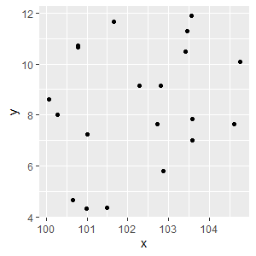
Writing Functions
xvalues <- positions$x
yvalues <- positions$y
mean(xvalues) -> centrex
mean(yvalues) -> centrey
xvalues-centrex ** 2 -> xdiff2
yvalues-centrey ** 2 -> ydiff2
sqrt(xdiff2+ydiff2) -> distance
> head(xdiff2)
[1] -10355.55 -10358.47 -10356.25 -10355.67 -10358.12 -10357.46

Slide 17
Writing Functions
xvalues <- positions$x
yvalues <- positions$y
mean_center_distance <- function(xvalues, yvalues) {
mean(xvalues) -> centrex
mean(yvalues) -> centrey
(xvalues-centrex) ** 2 -> xdiff2
(yvalues-centrey) ** 2 -> ydiff2
sqrt(xdiff2+ydiff2) -> distance
return(distance)
}

Slide 18
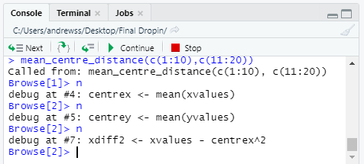
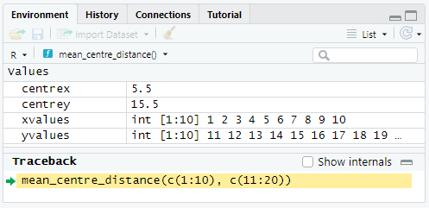
Debugging Functions
You can add browser() to any point if your code
Stops execution at that point
Opens an interactive debugger
Current variables are shown in Environment
Controls allow you to step through the code one line at a time to see changes

Slide 19
Exercise 1 – Writing Robust Functions

Slide 20
Putting functions into packages

Slide 21
Toolchain
Operating system packages
Rtools
Compiler
Make system
R helper packages
devtools (many convenience methods)
roxygen2 (documentation)
testthat (test suite)
knitr (vignettes)

Slide 22
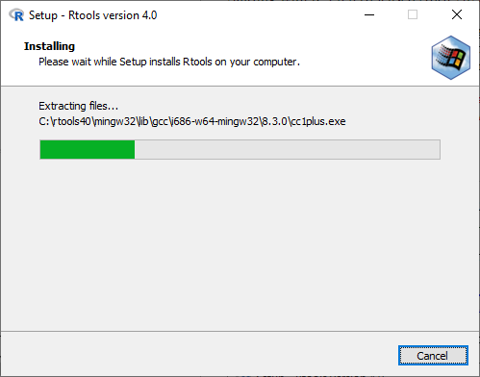
Rtools
OSX
Command line developer tools
xcode-select --install
Linux
R development package
sudo apt -y install r-base-dev
Windows
Rtools40
Install from https://cran.r-project.org/bin/windows/Rtools/

Slide 23
R helper packages
install.packages(c(
"devtools", # Development helpers
"roxygen2", # Documentation
"testthat", # Testing
"knitr")) # Writing vignettes

Slide 24
Starting a package - naming
Rules!
Only letters, numbers and dots (not hyphens or underscores)
Can’t start with a number
Can’t end with a dot
Guidelines
Don’t use dots
All lowercase is best
Don’t use a name already in CRAN or Bioconductor

Slide 25
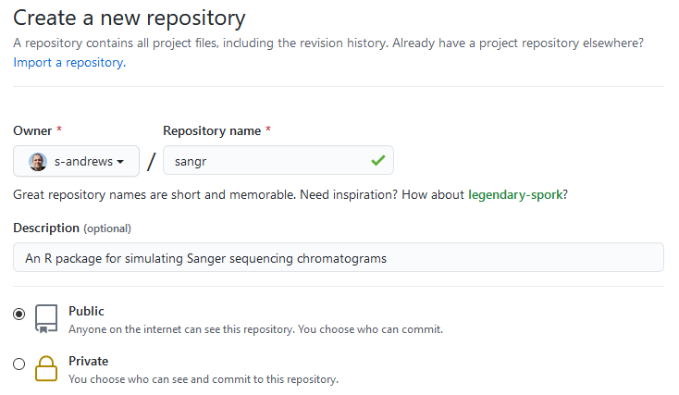
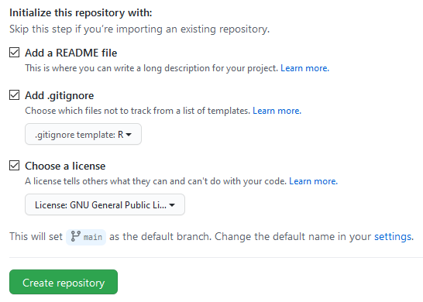
Starting a package – create git repository
It’s easiest to create a new git repository first rather than creating a package and adding the repository later.

Slide 26
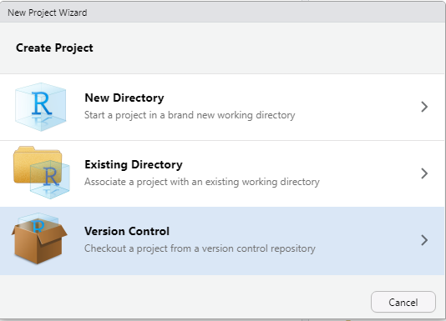
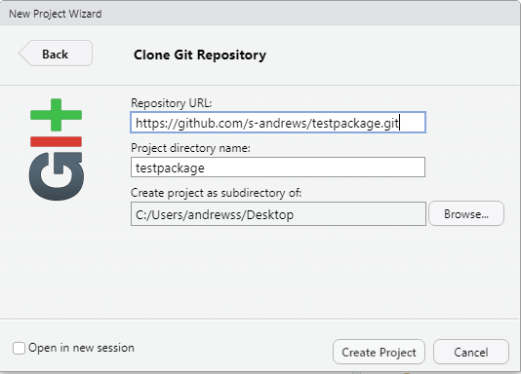
Bring your package into RStudio
Or…
git clone https://github.com/s-andrews/sangr.git

Slide 27
Starting a package – create_package()
Check out your git repository
Load devtools (library(devtools))
Use create_package() to make the basic file structure*
The newly created project should automatically open
library(devtools)
create_package("C:/Users/andrewss/git/sangr/")
Commit and Push to github (R folder won’t add until something is in it)
* If you use the GUI to import your repository you'll get a warning when running create_package

Slide 28
> create_package("C:/Users/andrewss/git/sangr/")
√ Setting active project to 'C:/Users/andrewss/git/sangr'
√ Creating 'R/'
√ Writing 'DESCRIPTION'
Package: sangr
Title: What the Package Does (One Line, Title Case)
Version: 0.0.0.9000
Authors@R (parsed):
* First Last <first.last@example.com> [aut, cre] (YOUR-ORCID-ID)
Description: What the package does (one paragraph).
License: `use_mit_license()`, `use_gpl3_license()` or friends to
pick a license
Encoding: UTF-8
LazyData: true
Roxygen: list(markdown = TRUE)
RoxygenNote: 7.1.1
√ Writing 'NAMESPACE'
√ Writing 'sangr.Rproj'
√ Adding '.Rproj.user' to '.gitignore'
√ Adding '^sangr\\.Rproj$', '^\\.Rproj\\.user$' to '.Rbuildignore'
√ Opening 'C:/Users/andrewss/git/sangr/' in new RStudio session
√ Setting active project to '<no active project>'

Slide 29
Configuring your package
Package metadata is in the DESCRIPTION file
Edit this file to specify suitable values for the metadata
Just do the Title, Authors and Description to start with
Package: sangr
Title: Simulate Sanger Sequencing Chromatograms
Version: 0.0.0.9000
Authors@R:
person(given = "Simon",
family = "Andrews",
role = c("aut", "cre"),
email = "simon.andrews@babraham.ac.uk",
comment = c(ORCID = "0000-0002-5006-3507"))
Description: Generates either per base density data for simulated sanger Sequences
License: `use_mit_license()`, `use_gpl3_license()` or friends to
pick a license
Encoding: UTF-8
LazyData: true
Roxygen: list(markdown = TRUE)
RoxygenNote: 7.1.1
Package: sangr
Title: What the Package Does (One Line, Title Case)
Version: 0.0.0.9000
Authors@R:
person(given = "First",
family = "Last",
role = c("aut", "cre"),
email = "first.last@example.com",
comment = c(ORCID = "YOUR-ORCID-ID"))
Description: What the package does (one paragraph).
License: `use_mit_license()`, `use_gpl3_license()` or friends to
pick a license
Encoding: UTF-8
LazyData: true
Roxygen: list(markdown = TRUE)
RoxygenNote: 7.1.1

Slide 30
Exercise 2: Creating your package

Slide 31
Importing and Modifying Functions

Slide 32
Package development workflow
Write R code
Editing .R files under the R folder in the package
Reload the package to test the new code
Call load_all() to bring the new code into your environment
Update Tests
Write code to test the new or updated functionality

Slide 33
Writing R Code
Create a new .R file under the R directory
Best to use the use_r()function to create the file
Write one or more functions within the newly created file
> use_r("simulate_sanger_data")
√ Setting active project to 'C:/Users/andrewss/git/sangr'
* Modify 'R/simulate_sanger_data.R'
* Call `use_test()` to create a matching test file

Slide 34
Functions and Files
How many R files do you make?
How do you divide your functions between them?
Put each public function in its own file
Name the file after the function (foo() goes in foo.R)
Helper functions can either go alongside the main ones or be in a separate file of their own (eg utils.R)

Slide 35
Functions and Files
simulate_sanger_data.R
draw_chromatogram.R
simulate_sanger_data()
add_base()
add_noise()
degrade_signal()
draw_chromatogram()
merge_sanger_data.R
merge_sanger_data()

Slide 36
library(tidyverse)
theme_set(theme_classic(base_size = 16))
simulate_sanger_data <- function(sequence, sd=5, noise=0.2, degrade=0.8) {
trace_length <- 20*(nchar(sequence)+2)
start_signal <- rep(0,trace_length)
tibble(
POS=1:trace_length,
G=start_signal,A=start_signal,T=start_signal,C=start_signal
) -> base_data
for (i in 1:nchar(sequence)) {
base <- substr(sequence,i,i)
position <- 20 * (i+1)
add_base(base_data,base,position,sd) -> base_data
}
add_noise(base_data,noise) -> base_data
degrade_signal(base_data, degrade) -> base_data
return(base_data)
}

Slide 37
Making functions robust
More important when your function will be run by people other than you!
Two main changes:
Make sure your function isn’t affected by the environment in the script in which it’s run
Validate the input data and provide helpful error messages if anything is wrong

Slide 38
Making functions robust
More important when your function will be run by people other than you!
Two main changes:
Make sure your function isn’t affected by the environment in the script in which it’s run
Validate the input data and provide helpful error messages if anything is wrong

Slide 39
Being a good citizen
We should ensure our function can’t be broken by the environment in which it’s run (ie what the user has already done in their R session)
We should ensure that nothing our function does could break other code in the users R session

Slide 40
How R finds functions
tibble(x=1:10,y=21:30) -> data
how_many_rows <- function(x) {
return(nrow(x))
}
nrow <- function(x) {
return(5)
}
how_many_rows(data)
[1] 5
> library(MASS)
Attaching package: ‘MASS’
The following object is masked from ‘package:dplyr’:
select
> search()
[1] ".GlobalEnv" "package:MASS"
[3] "package:dplyr" "tools:rstudio"
[5] "package:stats" "package:graphics"
[7] "package:grDevices" "package:utils"
[9] "package:datasets" "package:methods"
[11] "Autoloads" "package:base"

Slide 41
Stop Relying on .GlobalEnv
tibble(x=1:10,y=21:30) -> data
how_many_rows <- function(x) {
return(nrow(x))
}
nrow <- function(x) {
return(5)
}
how_many_rows(data)
[1] 5
tibble(x=1:10,y=21:30) -> data
how_many_rows <- function(x) {
return(base::nrow(x))
}
nrow <- function(x) {
return(5)
}
how_many_rows(data)
[1] 10

Slide 42
Don’t modify .GlobalEnv
User’s Code
Your Package’s Code
library(MASS)
library(your_package)
select(some_data)
library(dplyr)
myfunc <- function(x){
select(x,1:5)
}
You just broke their script!

Slide 43
Things your package code shouldn’t do!
Use library to load other packages
Rely on .GlobalEnv to find functions that it uses
Change or rely on the working directory
Create or rely on any global variables
Change or rely on any global options
Graphics parameters (eg ggplot theme or par)
System options (eg locale)
Random number generator seed (restore it if used)

Slide 44
Using other packages in your R code
Add the package as a dependency in your metadata
Call functions with explicit package names
Core functions mostly come from the base:: package, but there are other default packages (eg stats::)
tibble::tibble(
POS=1:trace_length,
G=start_signal,A=start_signal,T=start_signal,C=start_signal
)

Slide 45
Which package is a function from?
> dnorm
function (x, mean = 0, sd = 1, log = FALSE)
.Call(C_dnorm, x, mean, sd, log)
<bytecode: 0x00000210017f5ae8>
<environment: namespace:stats>
> nrow
function (x)
dim(x)[1L]
<bytecode: 0x0000021000399240>
<environment: namespace:base>
* If the function says "Primitive" then it's not in a package and you don't need to change it

Slide 46
Adding Dependencies
You need to tell R if your code relies on functions from other packages. Dependencies are recorded in the DESCRIPTION file
The easiest way to add dependencies to your project is with use_package()
use_package("readr")
use_package("readr",min_version="2.0.0")

Slide 47
Adding Dependencies
The easiest way to add dependencies to your project is with use_package()
use_package("tibble")
use_package("tibble","Suggests")
use_package("tibble","Suggests",min_version="3.0.0")
use_package("tibble")
√ Adding 'tibble' to Imports field in DESCRIPTION
* Refer to functions with `tibble::fun()`
LazyData: true
Roxygen: list(markdown = TRUE)
RoxygenNote: 7.1.1
Imports:
tibble

Slide 48
Unusual dependencies
If you use the %>% pipe then you need to add that as a dependency. It’s not a function so you do need to import it into the environment with
use_pipe()

Slide 49
Example Modification
assert_that(is.character(seq))
Two functions, assert_that and is.character. Find where they come from
> assert_that
function (..., env = parent.frame(), msg = NULL)
{
res <- see_if(..., env = env, msg = msg)
if (res)
return(TRUE)
stop(assertError(attr(res, "msg")))
}
<bytecode: 0x0000017e3c20d728>
<environment: namespace:assertthat>
> is.character
function (x) .Primitive("is.character")
No action required
Need to modify this code to add package name
assertthat::assert_that(is.character(seq))
use_package("assertthat")

Slide 50
Trying out new code
You can simulate updating and loading a modified package using the load_all()function
Functions from the package will be imported into your environment similar to if you’d used library()
> load_all()
Loading sangr
> packageVersion("sangr")
[1] ‘0.0.0.9000’

Slide 51
More thorough testing
To do a more complete check of the structure, code and metadata in your package you can do a full build using the check() function.
This is a more complete (and slower) option than load_all() it does much more than just re-import your functions.

Slide 52
-- R CMD check results ----------------------------- sangr 0.0.0.9000 ----
Duration: 23s
> checking DESCRIPTION meta-information ... WARNING
Non-standard license specification:
`use_mit_license()`, `use_gpl3_license()` or friends to pick a license
Standardizable: FALSE
> checking top-level files ... NOTE
File LICENSE is not mentioned in the DESCRIPTION file.
> checking R code for possible problems ... NOTE
add_base: no visible global function definition for ':='
add_base: no visible global function definition for 'sym'
add_base: no visible global function definition for 'dnorm'
Undefined global functions or variables:
:= dnorm sym
Consider adding
importFrom("stats", "dnorm")
to your NAMESPACE file.
0 errors √ | 1 warning x | 2 notes x

Slide 53
Exercise 3: Importing and Modifying your Functions

Slide 54
Metadata and Documentation

Slide 55
Package Versions
Package versions are generally split into numeric sections, separated by dots eg (2.10.5)
Major version (2)
Minor version (10)
Patch version (5)
Sometimes the version will be followed by a dev version – always above 9000 for development (never releases) eg 2.10.5.9000

Slide 56
Package versions
Major
Starts at 0 and moves to 1 when all basic functionality is complete.
Increments when adding significant new functionality, or breaking backwards compatibility
Minor
Starts at 0 and increases within the same major version any time any functionality is added or changed
Patch
Starts at 0 and increases every time a bug is fixed within the same minor version

Slide 57
Package Version Examples
1.0.0 to 1.0.1 – Bug fix in a function or documentation update
1.0.0 to 1.1.0 – Added a new function or improved the functionality of an existing function
1.0.0 to 2.0.0 – Made a major change in the way that something works – possibly breaking existing code

Slide 58
Choosing a License
The DESCRIPTION file specifies the license under which your code is to be made available
You need to use a standard license if you want to submit to CRAN
Private code stored on github can use any license (including none)

Slide 59
Standard CRAN licenses (for code)
MIT (use_mit_license())
Very simple and permissive
Anyone can use the code in any way they like with no conditions
Standard disclaimer to protect you from litigation
Apache2 (use_apl2_license())
Very similar to MIT, very permissive
Provides some protection against the use of software patents
GNU Public License (use_gpl3_license())
Permissive in that people can *use* the code without restriction
Restrictive in that if others modify and distribute the code they must share their changes under the same license

Slide 60
Applying a license
> use_gpl3_license(name="Simon Andrews")
√ Setting License field in DESCRIPTION to 'GPL-3'
√ Writing 'LICENSE.md'
√ Adding '^LICENSE\\.md$' to '.Rbuildignore'
License: GPL-3
You need to set the name of the code’s copyright holder (who wrote it)
Multiple people can be added by separating names with semi-colons

Slide 61
Adding Function Documentation
Use the roxygen2 package to add and edit documentation
Adds both text documentation and additional metadata
Documentation is added to the source files as comments above each function
Rstudio can generate a template for each function

Slide 62
Adding Function Documentation
#' Title
#'
#' @param sequence
#' @param sd
#' @param noise
#' @param degrade
#'
#' @return
#' @export
#'
#' @examples
simulate_sanger_data <- function(sequence, sd=5, noise=0.2, degrade=0.8) {

Slide 63
Adding Function Documentation
#' Simulate sanger chromatogram density data
#'
#' @param sequence A string of nucleotides to use (GATC)
#' @param sd The standard deviation of the peak width
#' @param noise What proportion of the signal to make from random noise
#' @param degrade What proportion of the signal should be lost by the end
#'
#' @return A tibble with positions (20 per base) and G/A/T/C signal
#' @export
#'
#' @examples
#' simulate_sanger_data("GAATTC")
simulate_sanger_data <- function(sequence, sd=5, noise=0.2, degrade=0.8) {

Slide 64
Using data in examples
You can add data files to your package
Data designed to be accessed directly
Example data to show how to parse for example
R Example data should go in a folder called ‘inst’
Can access using system.file("good.fq", package = "fastqR")
Data should be put into a folder called ‘data’ in Rda format

Slide 65
Checking Function Documentation
Update documentation using the document() function
Read the compiled version using ?function_name

Slide 66
Documenting the package as a whole
It can be useful to add package level documentation rather than just documenting functions
Still use roxygen2 to do this, but you have to document NULL which then flags this as package level documentation
Can read with package?sangr (doesn’t work from devtools though)
Probably best to put this into a fresh R file

Slide 67
Documenting the package as a whole
#' sangr: A package for simulating sanger sequencing chromatograms
#'
#' The sangr package provides three main functions which you might
#' want to use.
#'
#' @section sangr functions:
#' simulate_sanger_data
#'
#' draw_chromatogram
#'
#' merge_sanger_data
#'
#' @docType package
#' @name sangr
NULL

Slide 68
Writing Vignettes
Longer form documentation – not just function documents, but a description of how to use the package
Created similarly to R notebooks using Markdown.
> usethis::use_vignette("sangr_usage")
√ Adding 'knitr' to Suggests field in DESCRIPTION
√ Setting VignetteBuilder field in DESCRIPTION to 'knitr'
√ Adding 'inst/doc' to '.gitignore'
√ Creating 'vignettes/'
√ Adding '*.html', '*.R' to 'vignettes/.gitignore'
√ Adding 'rmarkdown' to Suggests field in DESCRIPTION
√ Writing 'vignettes/sangr_usage.Rmd'
* Modify 'vignettes/sangr_usage.Rmd'

Slide 69
Writing Vignettes
---
title: "sangr_usage"
output: rmarkdown::html_vignette
vignette: >
%\VignetteIndexEntry{sangr_usage}
%\VignetteEngine{knitr::rmarkdown}
%\VignetteEncoding{UTF-8}
---
```{r, include = FALSE}
knitr::opts_chunk$set(
collapse = TRUE,
comment = "#>"
)
```
```{r setup}
library(sangr)
```

Slide 70
Exercise 4: Licensing and Documentation

Slide 71
Testing and Installation

Slide 72
Writing a Test Suite
R packages can integrate with the testthat package to create a test suite for your code
The test suite is automatically run whenever someone builds your package to check that the code is working on their machine
You can also use the test suite to check that any changes you make don’t break the code

Slide 73
Creating a Test Suite
Run use_testthat() to create the basic structure
> use_testthat()
√ Adding 'testthat' to Suggests field in DESCRIPTION
√ Creating 'tests/testthat/'
√ Writing 'tests/testthat.R'
* Call `use_test()` to initialize a basic test file and open it for editing.

Slide 74
Adding tests
Good idea to group tests by either function or type (parameters, errors etc)
Running use_test("simulate_sanger_data") creates test-simulate_sanger_data.R in the testthat directory
Write tests in the newly created file

Slide 75
Test Code Structure
library(sangr)
test_that("Simulation Parameters", {
good_sequence <- "GATC"
expect_equal(ncol(simulate_sanger_data(good_sequence)),5)
expect_equal(nrow(simulate_sanger_data(good_sequence)),120)
expect_equal(nrow(simulate_sanger_data(good_sequence,sd = 10)),120)
expect_equal(nrow(simulate_sanger_data(good_sequence,degrade = 0.1)),120)
expect_equal(nrow(simulate_sanger_data(good_sequence,noise = 0.5)),120)
})
test_that("Invalid Parameters", {
expect_error(simulate_sanger_data("gatc"))
expect_error(simulate_sanger_data("jeyc"))
expect_error(simulate_sanger_data(1234))
expect_error(simulate_sanger_data("GATC",sd=-1))
expect_error(simulate_sanger_data("GATC",degrade=2))
expect_error(simulate_sanger_data("GATC",noise=-1))
})

Slide 76
Expectations
expect_equal(10,10.0)
expect_gt(20,10)
expect_lt(10,20)
expect_true()
expect_false()
expect_match("GGATCC", "GATC")
expect_output(print("Hi world"))
expect_output(print("Hi world"), "wor")
expect_is(1:10,"integer")
expect_is(variants,"tbl")
expect_error()
expect_warning()

Slide 77
Running tests
Explicitly with test()
Automatically as part of check()
> test()
Loading sangr
Testing sangr
√ | OK F W S | Context
√ | 6 | simulate_sanger_data [0.3 s]
== Results =================================
Duration: 0.3 s
[ FAIL 0 | WARN 0 | SKIP 0 | PASS 6 ]

Slide 78
Fixing tests
expect_error(simulate_sanger_data("GATC",sd=-1))
Warning (test-simulate_sanger_data.R:22:3): Invalid Parameters
NAs produced
Backtrace:
1. testthat::expect_error(simulate_sanger_data("GATC", sd = -1)) test-simulate_sanger_data.R:22:2
22. stats::runif(nrow(data), min = 0, max = biggest_signal * noise)
-------------------------------------------------------------------------------------
== Results ==========================================================================
Duration: 0.4 s
[ FAIL 0 | WARN 10 | SKIP 0 | PASS 10 ]

Slide 79
Fixing tests
expect_error(simulate_sanger_data("GATC",sd=-1))
simulate_sanger_data <- function(sequence, sd=5, noise=0.1, degrade=0.8) {
if (sd<=0) {
stop("SD must be more than zero")
}
> test()
Loading sangr
Testing sangr
√ | OK F W S | Context
√ | 10 | simulate_sanger_data [0.3 s]
== Results =========================
Duration: 0.3 s
[ FAIL 0 | WARN 0 | SKIP 0 | PASS 10 ]

Slide 80
Installing the Package
From github
library(devtools)
install_github("s-andrews/sangr", build_vignettes=TRUE)
From source
R CMD build sangr
R CMD install sangr_0.1.tar.gz

Slide 81
> install_github("s-andrews/sangr", build_vignettes = TRUE)
Downloading GitHub repo s-andrews/sangr@HEAD
✓ checking for file ‘/tmp/RtmpDsGoRv/remotesac27c16a136/s-andrews-sangr-62f3fb3/DESCRIPTION’ ...
─ preparing ‘sangr’:
✓ checking DESCRIPTION meta-information ...
─ installing the package to build vignettes
✓ creating vignettes (9.7s)
─ checking for LF line-endings in source and make files and shell scripts
─ checking for empty or unneeded directories
─ building ‘sangr_0.0.0.9000.tar.gz’
Installing package into ‘/home/student/R/x86_64-pc-linux-gnu-library/4.0’
(as ‘lib’ is unspecified)
* installing *source* package ‘sangr’ ...
** using staged installation
** R
** inst
** byte-compile and prepare package for lazy loading
** help
*** installing help indices
converting help for package ‘sangr’
finding HTML links ... done
draw_chromatogram html
merge_sanger_data html
sangr html
simulate_sanger_data html
** building package indices
** installing vignettes
** testing if installed package can be loaded from temporary location
** testing if installed package can be loaded from final location
** testing if installed package keeps a record of temporary installation path
* DONE (sangr)

Slide 82
Exercise 5: Testing and Installation

