Slide 1

Using R Notebooks
Simon Andrews
v2022-03

Slide 2
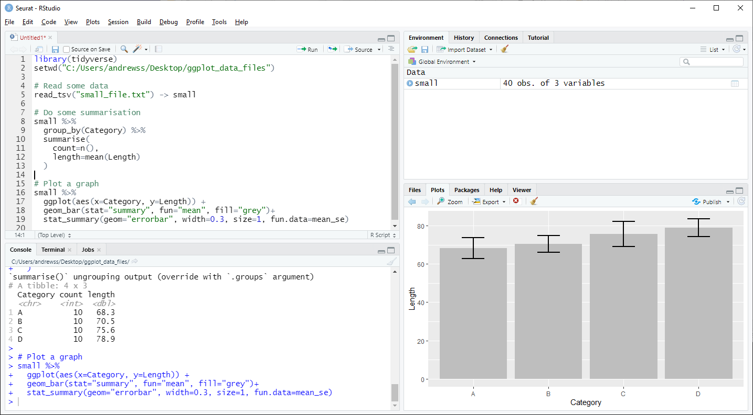
Code
Comments
Text output
Graphical output

Slide 3
Problems with conventional scripts
Only the code is generally distributed
  Output not included – users have to run it again
No collation of output
  Can’t see which bit of code generated what output
  No automated saving of results
Limited commenting
  Text comments, no formatting or structure

Slide 4
R Notebooks
Alternative document format to conventional scripts
Collates into a single document
  Code
  Formatted commentary
  Output (text and graphical)
Exported to HTML, PDF or Word

Slide 5
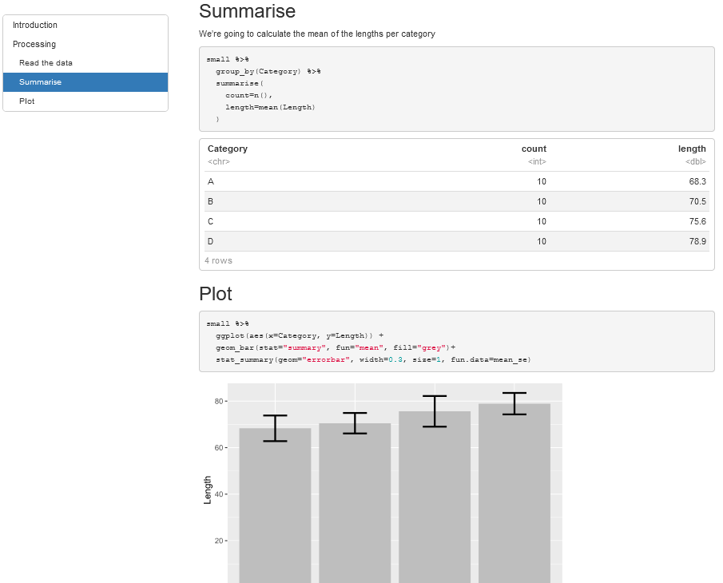
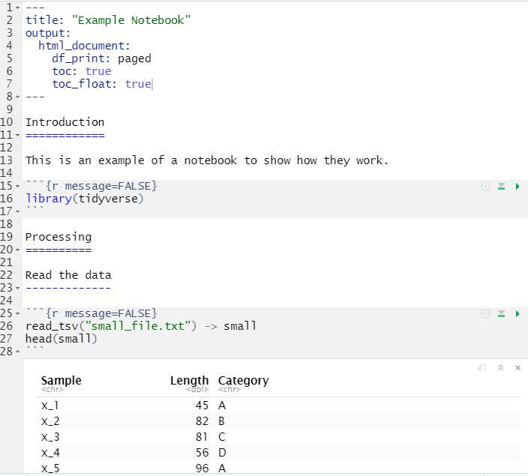
Code
Output

Slide 6
Notebook Structure
Single overall text document, split into sections
  Header (mostly preferences)
  Body
    Commentary (default)
    R Code
    Output (graphical and text)

Slide 7

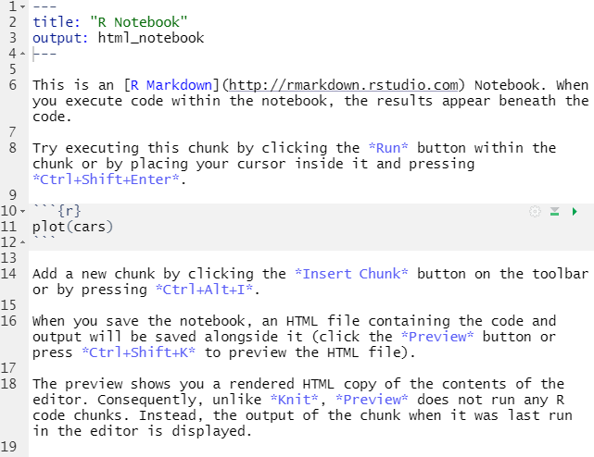
Creating a Notebook in RStudio
You may need to install some packages (Rstudio will prompt you if you do)
Opens a default template which you can then edit

Slide 8
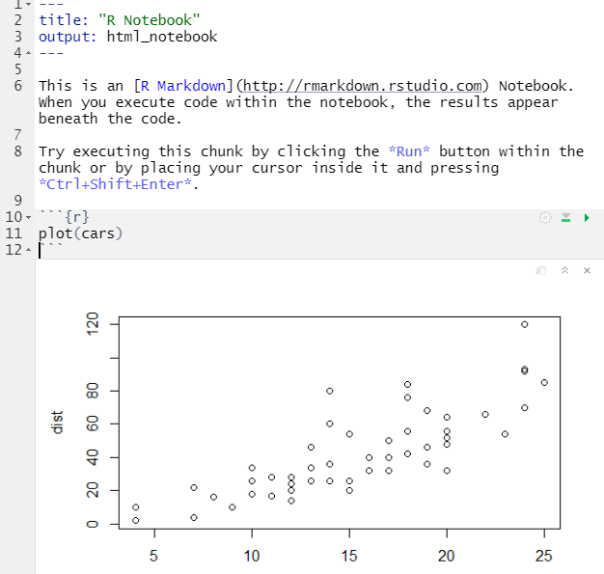
Notebook sections
Header
Commentary
Code
Sections are marked by special quotes
---
--- for header
```{r}
``` for R code
Default for unquoted text is commentary

Slide 9

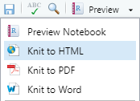

Notebook workflow
Create new notebook document
Save it straight away (use a .Rmd extension)
Add commentary in Markdown format
Add R sections using Insert > R
Run code blocks to generate output
Knit document to HTML / PDF / Word
Be careful not to delete any of the section markers added by ‘insert’ or the header

Slide 10
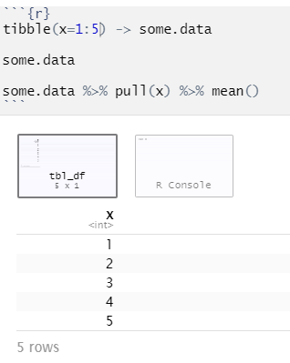
Running R code in a notebook
Control + Return runs one line
  Output goes below
  Output replaces any previous block output
Control + Shift + Return runs the block
  Multiple outputs put into clickable windows
  Will be interspersed in compiled document
  Can also press the ‘play’ button at top right

Slide 11
Exercise 1

Slide 12
Using Markdown

Slide 13

Commentary sections use ‘Markdown’
Simple markup language
Designed to be nicely readable as plain text
Compiles to properly formatted text
Simple syntax

Slide 14
Markdown basics
Headings
  # Heading1
  ## Heading 2
  ### Heading 3 etc.
  Heading 1
  =========
  Heading 2
  ---------
Lists (need a blank line first)
* Bullet 1
* Sub-bullet 1
* Bullet 2
1. Numbered 1
2. Numbered 2
[Tab]
Headings also give you navigation for your document, so they’re worth using!

Slide 15
Markdown basics
Emphasis
  *italics*
  _italics_
  **bold**
  __bold__
  ***bold italics***
  ___bold italics___
  vol=width\*depth\*height
Other formatting
```fixed width code etc```
> quoted text
super^script^
sub~script~
********* or -------- page break
NOT bold (escaped)
Needs blank line above and below

Slide 16
Markdown basics
Tables
| Name | Quest | Success |
| :------- | :------------------------: | ------------: |
| Simon | To teach R | Sometimes |
| Emma | To teach the world to sing | Always |
| Libby | To pass her GCSEs | Unknown |
:--- Left Justified
:--: Centred
---: Right Justified

Slide 17




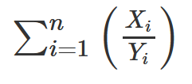
Markdown basics
$e=mc^2$
Markdown supports Latex equations.
  $equation$ is inline with text
  $$equation$$ is as a separate block
$\sum_{i=1}^n X_i$
$F_{i,j}$
$\sqrt{x^2 - 5y}$
$\sum_{i=1}^{n}\left( \frac{X_i}{Y_i} \right)$

Slide 18
Exercise 2

Slide 19
R code block details

Slide 20
Working directories
Working directories
  Working directory is automatically set to directory with Rmd file
  That’s why we immediately save
  Designed so that data and code all go together
  Can run setwd but get a warning, and only lasts for 1 block

Slide 21
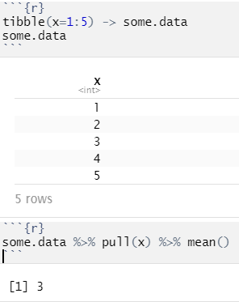
Good code block practices
Break code into short chunks
All chunks are part of the same session
Stop the block as soon as any output is generated

Slide 22

Good code block practices
Names are cool
--------------
```{r "create data"}
tibble(x=1:5) -> some.data
some.data
```
```{r "calculate mean"}
some.data %>% pull(x) %>% mean()
```
Name your chunks
Name appears in the navigation along with headings you’ve created

Slide 23
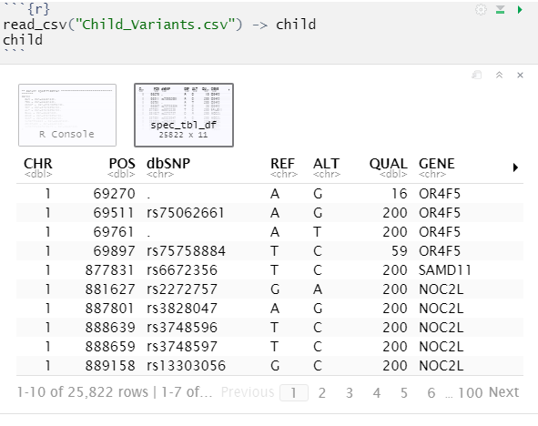
Displaying tibbles
By default you don’t see the text form of tibbles/dataframes
You get a nice interactive table
  Not in all output formats
Buttons to see more columns/rows

Slide 24
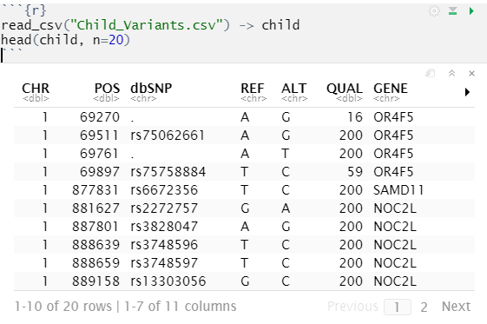
Displaying tibbles
Although you only see 10 rows, all of the data goes into your document
When rendered to HTML / PDF this can make your document BIG
Use the head() function to only show a few example rows

Slide 25
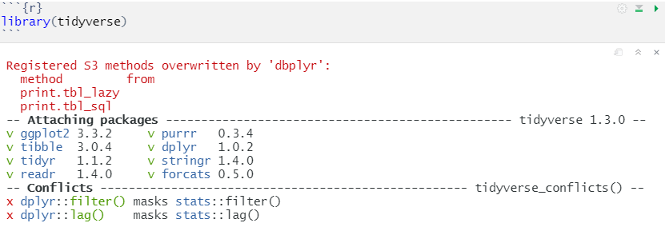
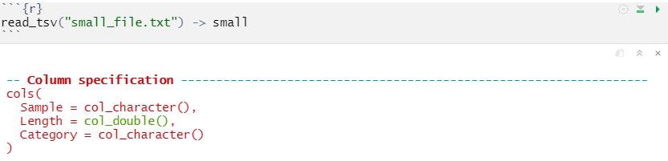
Controlling warnings / errors / messages

Slide 26
Controlling warnings / errors / messages
Can select which output you want to see using the block header
```{r "Block name", warnings=FALSE}
Can remove
  Warnings {r warnings=FALSE}
  Errors {r error=TRUE} means that script doesn’t stop on error
  Messages {r message=FALSE}
  Code {r echo=FALSE}
  Code + output {r include=FALSE}

Slide 27
Changing graphics options
You can change the way that figures / graphs are displayed by changing R code block options
Change the file format (default is PNG)
  ```{r dev="svg"}
Change the size
  ```{r fig.height=5, fig.width=8}
Change the alignment (only affected compiled document)
  ```{r fig.align="center"}
Add a legend
  ```{r fig.cap="This is a great picture"}

Slide 28
Exercise 3

Slide 29
Changing document appearance

Slide 30
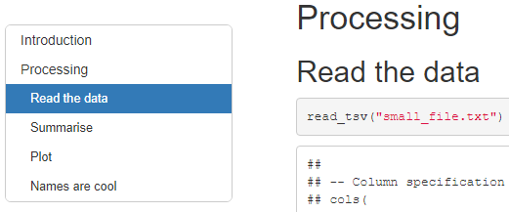
Table of Contents
If you have used headings in your document then you can auto-create a table of contents
This can be a fixed set of links at the top of your document, or a floating table on the left
This is set in the header section
---
title: "Example Notebook"
output:
html_document:
df_print: paged
toc: yes
toc_float: yes
---

Slide 31
Document themes
---
title: "Themes"
output:
html_document:
df_print: paged
toc: true
toc_float: true
theme: yeti
highlight: kate
---
HTML documents are based on the bootswatch theme collection (https://bootswatch.com)
You can change the theme by adding to the header

Slide 32
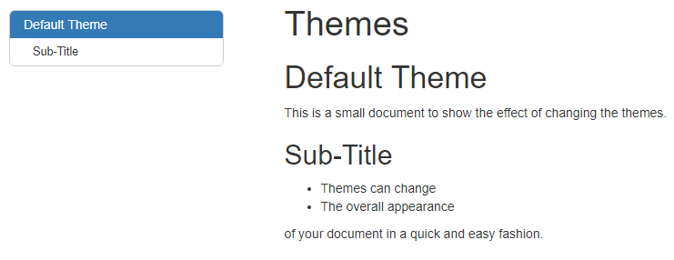
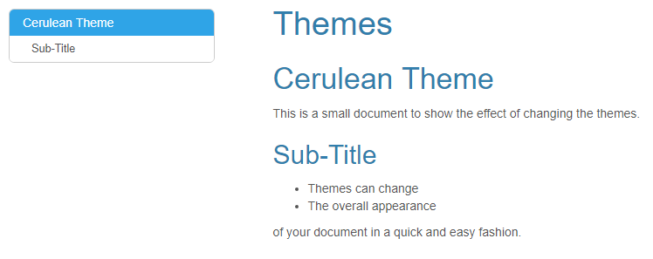
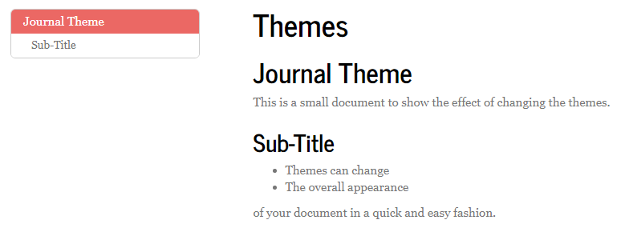
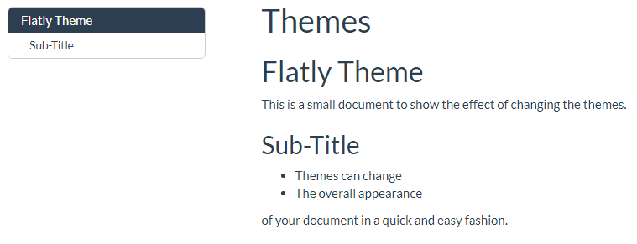
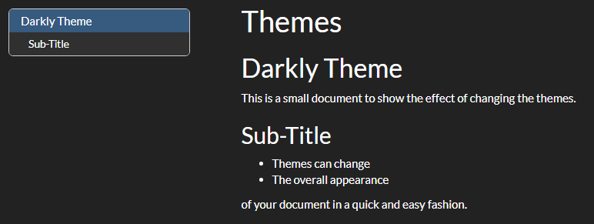
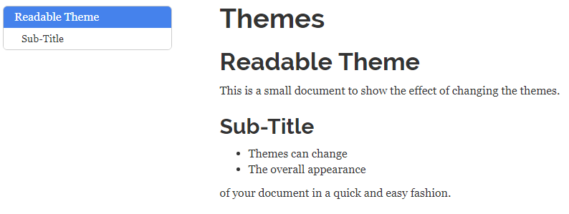
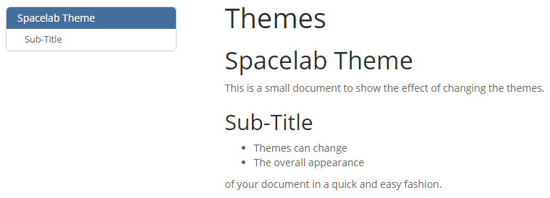
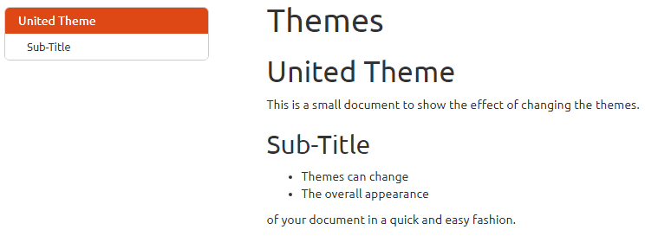
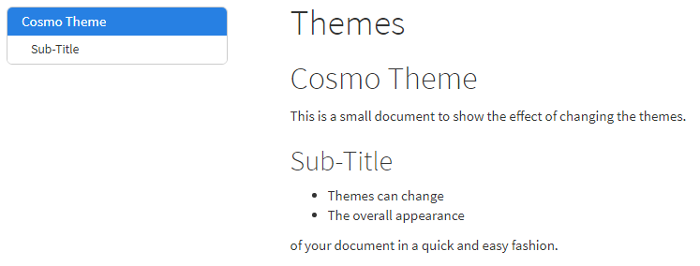
Document themes
(there are more than this)

Slide 33
Highlighting themes
---
title: "Themes"
output:
html_document:
df_print: paged
toc: true
toc_float: true
theme: yeti
highlight: kate
---
Similarly to the document themes you can also change the colouring / style used to highlight R code in your document

Slide 34
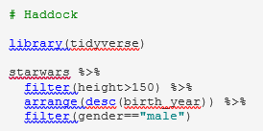
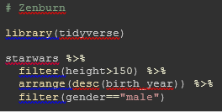
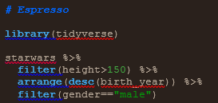
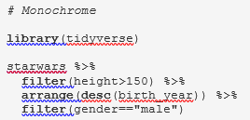
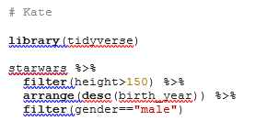
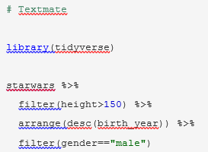
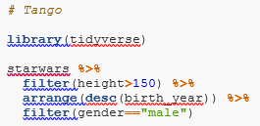
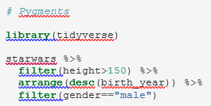
Highlighting themes

Slide 35
Tibble / DataFrame display options
Rather than text output you see an interactive HTML version of tibbles
  This will vary by output document type
A few options exist for how they are displayed these are set in the header, and are specific to the HTML output type:
html_document:
df_print: paged

Slide 36
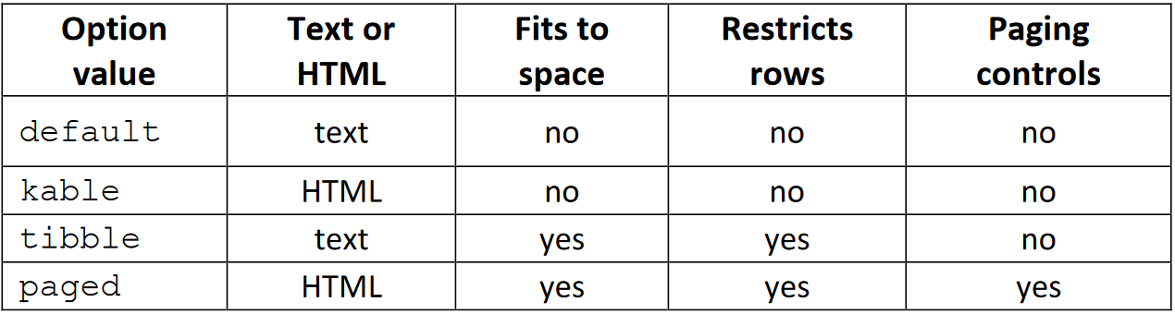
Tibble / DataFrame display options
Only works on data frames
This is the default

Slide 37
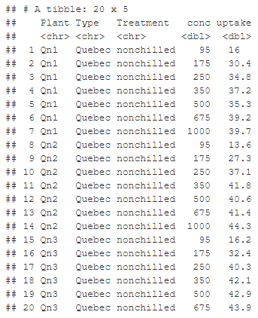
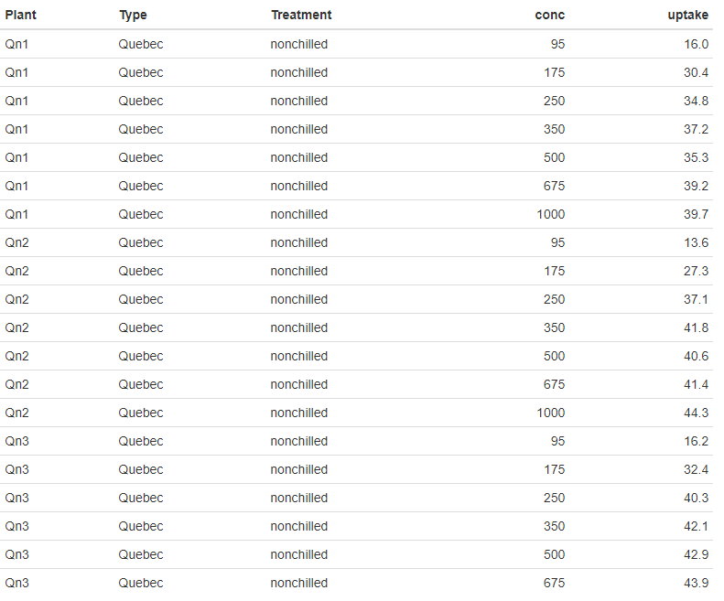
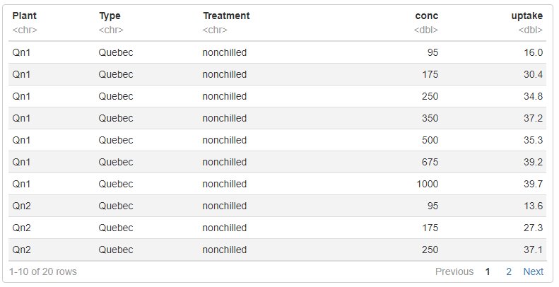
Tibble / DataFrame display options
Tibble
Kable
Paged

Slide 38
Automating Notebook Rendering

Slide 39
Generating a notebook programatically
Rscript -e "rmarkdown::render('example.Rmd')"

Slide 40
Adding notebook parameters
---
title: My Document
output: html_document
params:
year: 2018
region: Europe
printcode: TRUE
data: "file.csv"
---
Parameters are collected in a list called params
print(params$year)
[1] 2018

Slide 41
Parameters can be R code
---
title: My Document
output: html_document
params:
date: !r Sys.Date()
today: !r lubridate::today()
---
You can use code from packages but need to supply the full function name, including package name

Slide 42
Parameters can be supplied at runtime
---
title: My Document
output: html_document
params:
year: 2018
printcode: TRUE
data: "file.csv"
---
Rscript -e "rmarkdown::render(
'example.Rmd',
params=list(data="data.csv")
)"
read_csv(params$data)

Slide 43
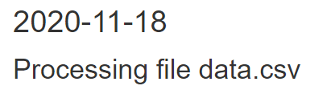
Parameters can also be used in Markdown
---
output:
html_document:
df_print: paged
params:
file: "test.csv"
date: !r Sys.Date()
---
---
title: `r params$date`
---
```{r results='asis', echo=FALSE}
cat("# Processing file ",params$file)
```
Rscript -e "rmarkdown::render(
'example.Rmd',
params=list(data="data.csv")
)"

Slide 44
Exercise 4

