Slide 1

RNA-Seq Analysis
Simon Andrews, Laura Biggins, Sarah Inglesfield
simon.andrews@babraham.ac.uk
v2023-11
Notes:
The format of the course will be…
Firstly – theory
Steps involved in an RNA-seq analysis
Practical session

Slide 2
RNA-Seq Libraries
rRNA depleted mRNA
Fragment
Random prime + RT
2nd strand synthesis (+ U)
A-tailing
Adapter Ligation
(U strand degradation)
Sequencing
NNNN
u
u
u
u
u
u
u
u
A
A
T
u
u
u
u
A
A
T
A
T
Notes:
Point out parts in library prep which are relevant later on.
Start with single strand RNA.
Can't sequence because it's RNA and too long
Must fragment to make short bits
Must convert to DNA, but that loses directionality - which is bad.
Random priming and RT (causes biases later)
Normal Illumina library prep once double stranded.
Can retain strand information by tagging and degrading one of the stands. Which one determines same strand or opposing strand specific libraries.

Slide 3
Reference based RNA-Seq Analysis
QC
Trimming
Mapping
Statistical Analysis
Exploration
and
Quantitation
Mapped QC
Notes:
Focus on experiment types where you have a reference.
Mention transcriptome assembly.

Slide 4
Sequence Data Processing

Slide 5
Raw Sequence Quality Control

Slide 6
FastQ Format Data
@HWUSI-EAS611:34:6669YAAXX:1:1:5069:1159 1:N:0:
TCGATAATACCGTTTTTTTCCGTTTGATGTTGATACCATT
+
IIHIIHIIIIIIIIIIIIIIIIIIIIIIIHIIIIHIIIII
@HWUSI-EAS611:34:6669YAAXX:1:1:5243:1158 1:N:0:
TATCTGTAGATTTCACAGACTCAAATGTAAATATGCAGAG
+
DF=DBD<BBFGGGGGGGBD@GGGD4@CA3CGG>DDD:D,B
@HWUSI-EAS611:34:6669YAAXX:1:1:5266:1162 1:N:0:
GGAGGAAGTATCACTTCCTTGCCTGCCTCCTCTGGGGCCT
+
:GBGGGGGGGGGDGGDEDGGDGGGGDHHDHGHHGBGG:GG

Slide 7
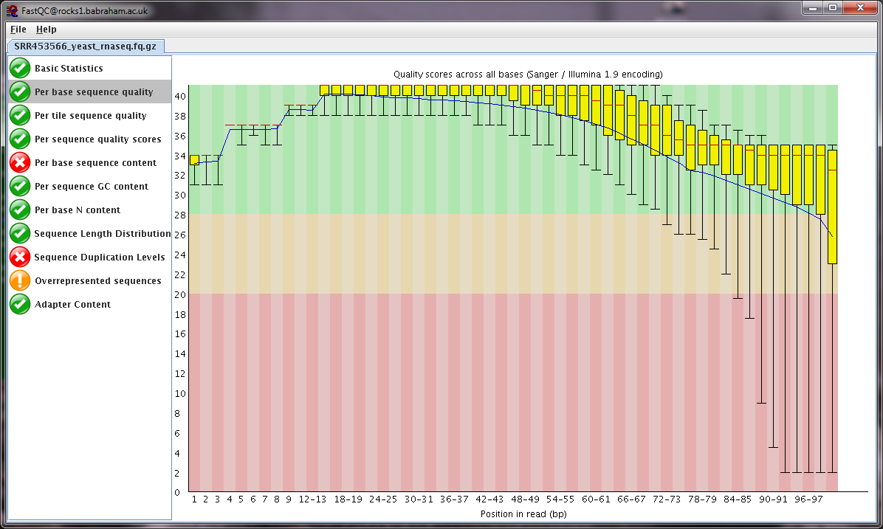
FastQC
Base call quality
Composition
Duplication
Contamination

Slide 8
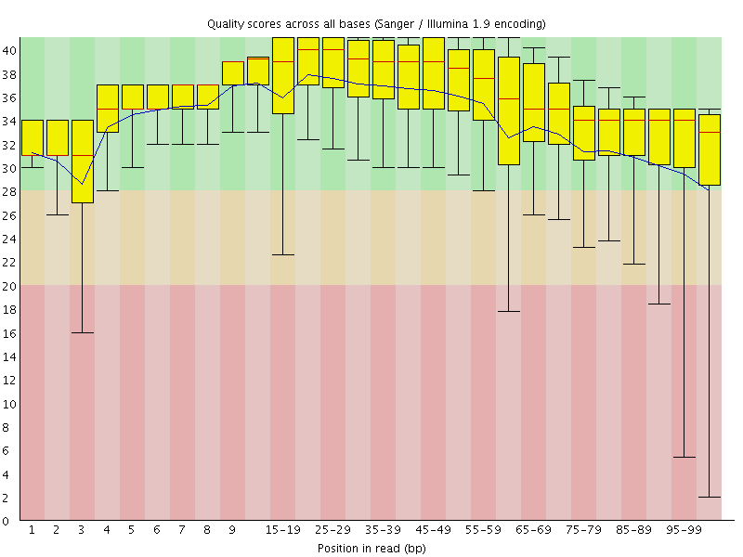
QC: Base Call Quality
Call Quality
(Phred score)
Read Position
Notes:
Some QC looks very similar for different types of sequencing

Slide 9
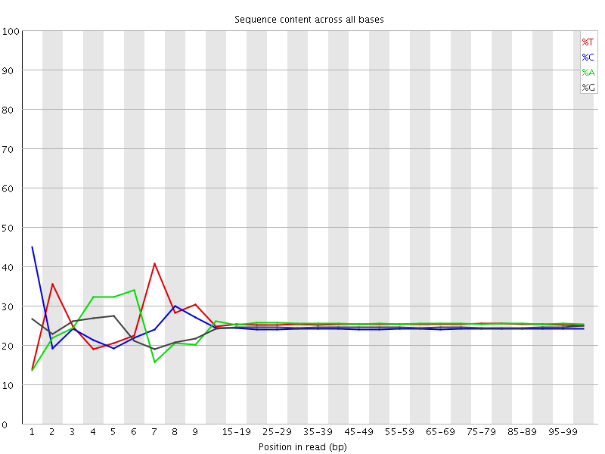
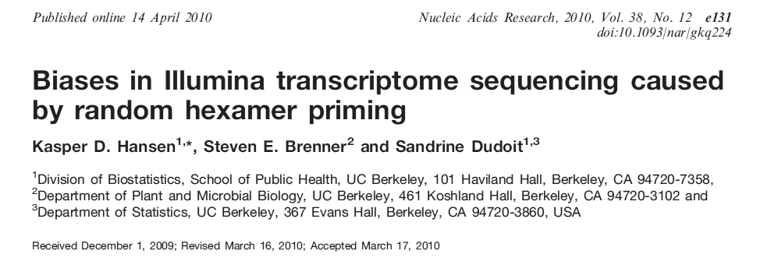
QC: Composition
Read Position
Notes:
Random primed so no positional bias is expected.
Expect to see 4 horizontal lines, not always all 25%, GC and AT might be different
Will see biases in the actual data. Will be flagged as a problem.
Assume hexamer libraries have all possible hexamers in equal proportion
Assume that all possible hexamers bind and extend with equal efficiency.
Should worry if you don't see this.
Any slight biases in the analysis will be similar over all samples.

Slide 10
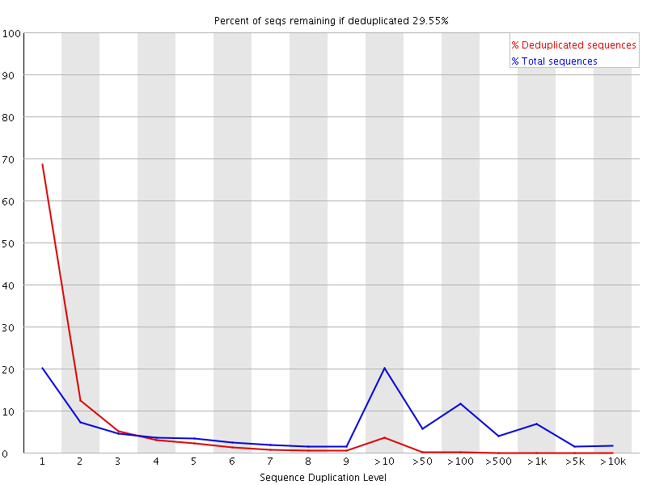
QC: Duplication (blue trace)
Percentage
of library
Level of duplication
Notes:
Definitely a problem.
Hard to assess from raw sequence.
Shouldn't expect that all sequence are present equally – measuring expression levels
You will see high duplication levels, this isn't necessarily a problem.
Can look much more sensitively after mapping.

Slide 11
Adapters and Trimming

Slide 12
Library Structure
Read 1
Primer
Adapter
Insert
Adapter
Read 2
Primer
Read 1
Primer
Adapter
Insert
Adapter

Slide 13
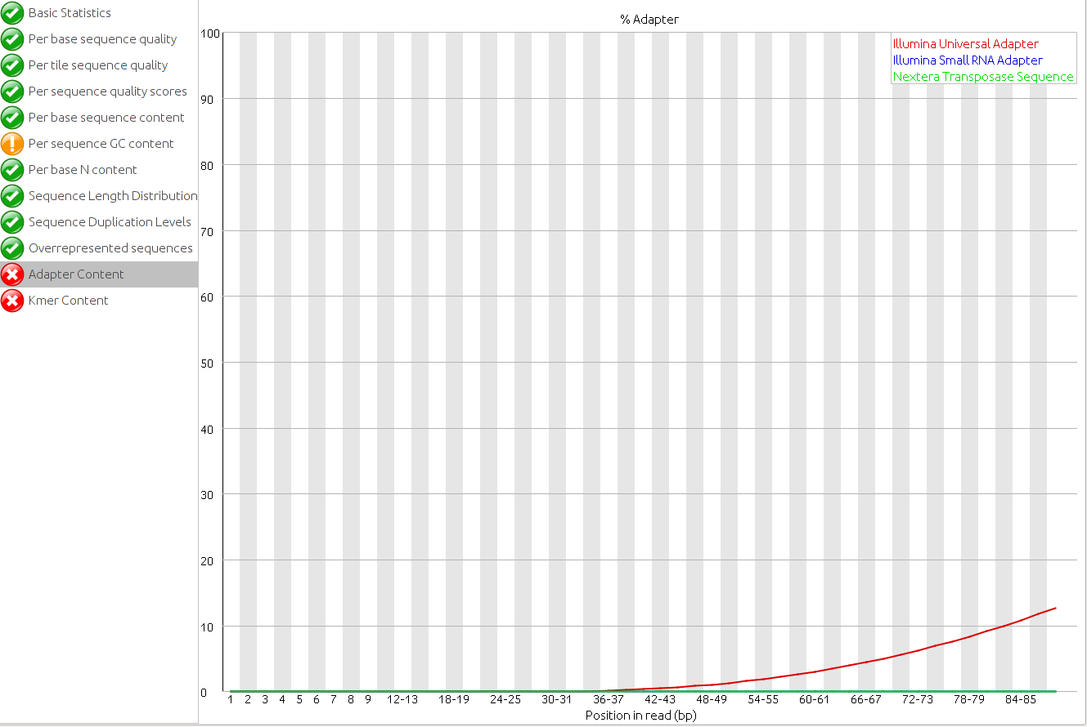
Trimming Adapters
Read 1
Primer
Adapter
Insert
Adapter

Slide 14
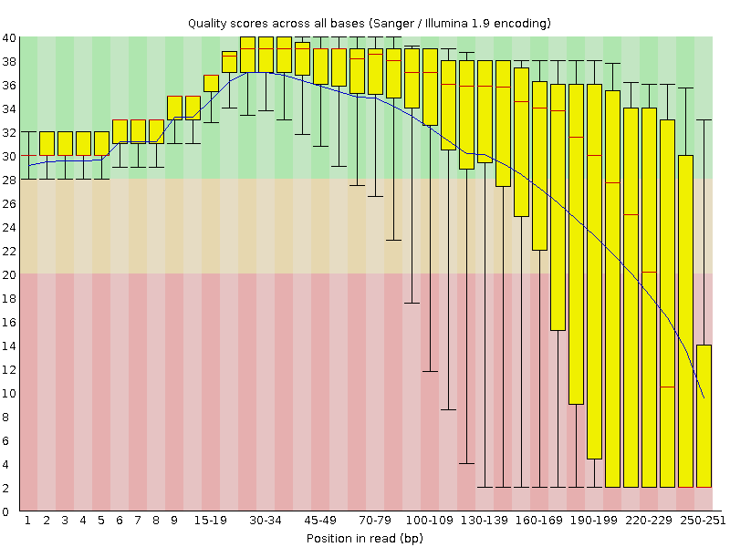
Trimming Quality
Poor quality data tends to be at the 3’ end

Slide 15
Mapping to a reference

Slide 16
Mapping
Exon 1
Exon 2
Exon 3
Genome
Simple mapping within exons
Mapping between exons
Spliced mapping
Notes:
Explain paired end sequence and colours.
Must use a splicing aware read mapper.

Slide 17
RNA-Seq Mapping Software
HiSat2 (https://ccb.jhu.edu/software/hisat2/)
Star (http://code.google.com/p/rna-star/)
Tophat (http://tophat.cbcb.umd.edu/)
Notes:
TopHat was original. Mapped to transcriptome first, then to genome if no hit.
STAR and HiSat are very similar. Map directly to genome but with knowledge of splice sites.
We're using Hisat as it uses less memory.
Pick one and stick to it.

Slide 18
HiSat2 pipeline
Reference FastA files
Indexed Genome
Reference GTF Models
Reads
(fastq)
Yes
Maps with known junctions
Report
Pool of known splice junctions
Yes
Add
Maps convincingly with novel junction?
Report
No
Discard
Notes:
Discovery of new junctions depends a lot on where the junction is in the read.
50/50 easy to discover
90/10 probably impossible
Can do 1 or 2 pass processing. 2 pass is more complete - uses first pass just to find junctions but is slow.
In practise 1 pass is fine and you hardly lose anything.

Slide 19
Mapped Data QC

Slide 20
Mapping Statistics
Time loading forward index: 00:01:10
Time loading reference: 00:00:05
Multiseed full-index search: 00:20:47
24548251 reads; of these:
24548251 (100.00%) were paired; of these:
1472534 (6.00%) aligned concordantly 0 times
21491188 (87.55%) aligned concordantly exactly 1 time
1584529 (6.45%) aligned concordantly >1 times
94.00% overall alignment rate
Time searching: 00:20:52
Overall time: 00:22:02

Slide 21
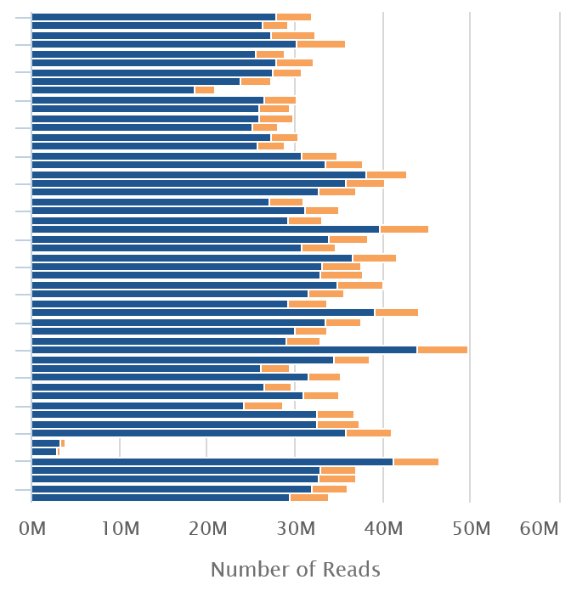

Mapping Statistics
Notes:
Important thing to check is consistency
MultiQC

Slide 22
Exercise: RNA-Seq QC and Data Processing

Slide 23
Running programs in Linux
Open a shell (text based OS interface)
Type the name of the program you want to run
  Add on any options the program needs
  Press return - the program will run
  When the program ends control will return to the shell
Run the next program!

Slide 24
Running programs
user@server:~$ ls
Desktop Documents Downloads examples.desktop Music Pictures Public Templates Videos
user@server:~$
Command prompt - you can't enter a command unless you can see this
The command we're going to run (ls in this case, to list files)
The output of the command - just text in this case

Slide 25
The structure of a unix command
ls -ltd --reverse Downloads/ Desktop/ Documents/
Program
name
Switches
Data
(normally files)
Each option or section is separated by spaces. Options or files with spaces in must be put in quotes.

Slide 26
Command line switches
Change the behaviour of the program
Come in two flavours (each option often has both types available)
  Minus plus single letter (eg -x -c -z)
    Can be combined (eg -xcz)
  Two minuses plus a word (eg --extract --gzip)
    Can't be combined
Some take an additional value
  -f somfile.txt (specify a filename)
  --width=30 (specify a value)

Slide 27


Specifying file paths
home
simon
Data
big_data.fq.gz
Specify names from whichever directory you are currently in
  If I'm in /home/simon
  Data/big_data.fq.gz
    is the same as /home/simon/Data/big_data.fq.gz
Move to the directory with the data and just use file names
  cd Data
  big_data.fq.gz

Slide 28
Command line completion
Most errors in commands are typing errors in either program names or file paths
Shells (ie BASH) can help with this by offering to complete path names for you
Command line completion is achieved by typing a partial path and then pressing the TAB key (to the left of Q)

Slide 29
Command line completion
List of files / folders:
Desktop
Documents
Downloads
Music
Public
Published
Templates
Videos
T [TAB] → Templates
P [TAB] → Publ
Do [TAB] → [beep]
Do [TAB] [TAB] → Documents Downloads
Doc [TAB] → Documents
You should ALWAYS use TAB completion to fill in paths for
locations which exist so you can't make typing mistakes
(it obviously won't work for output files though)

Slide 30
Debugging Tips
If anything (except the splice site extraction) completes almost immediately then it didn't work!
Look for errors before asking for help. They will either be
  The last piece of text before the program exited
  The first piece of text produced after it started (followed by the help file)
To see if a program is running go to another shell and look at the last file produced to see if it's growing
Programs which are stuck can be cancelled with Control+C

Slide 31
Some useful commands
cd mydir Change directory to mydir
ls -ltrh List files in the current directory, show details and put the newest files at the bottom
less x.txt View the x.txt text file
Return = down one line
Space = down one page
q = quit

Slide 32
Data Visualisation and Exploration

Slide 33
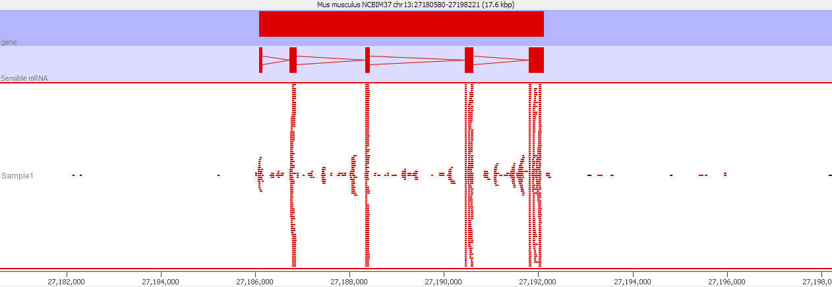
Viewing Mapped Data
Reads over exons
Reads over introns
Reads in intergenic regions
Strand specificity
Notes:
Zoomed right in on one gene

Slide 34
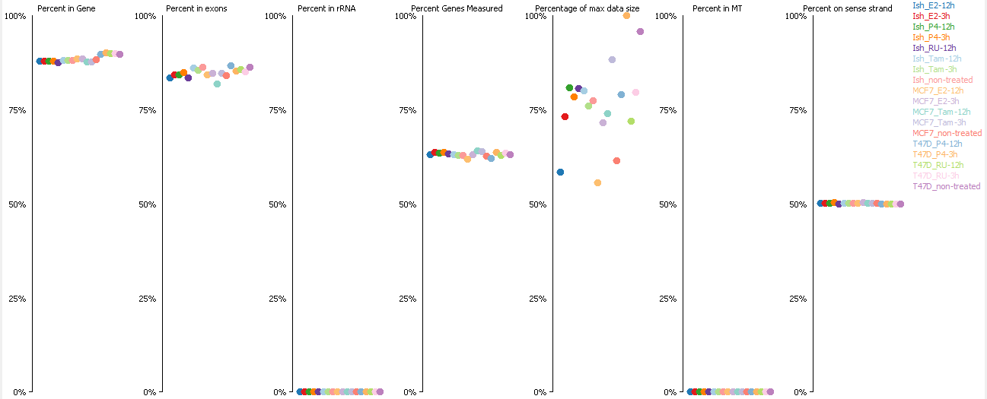
SeqMonk RNA-Seq QC (good)
Notes:
To get a broader overview – RNA-seq QC report examines all the data

Slide 35
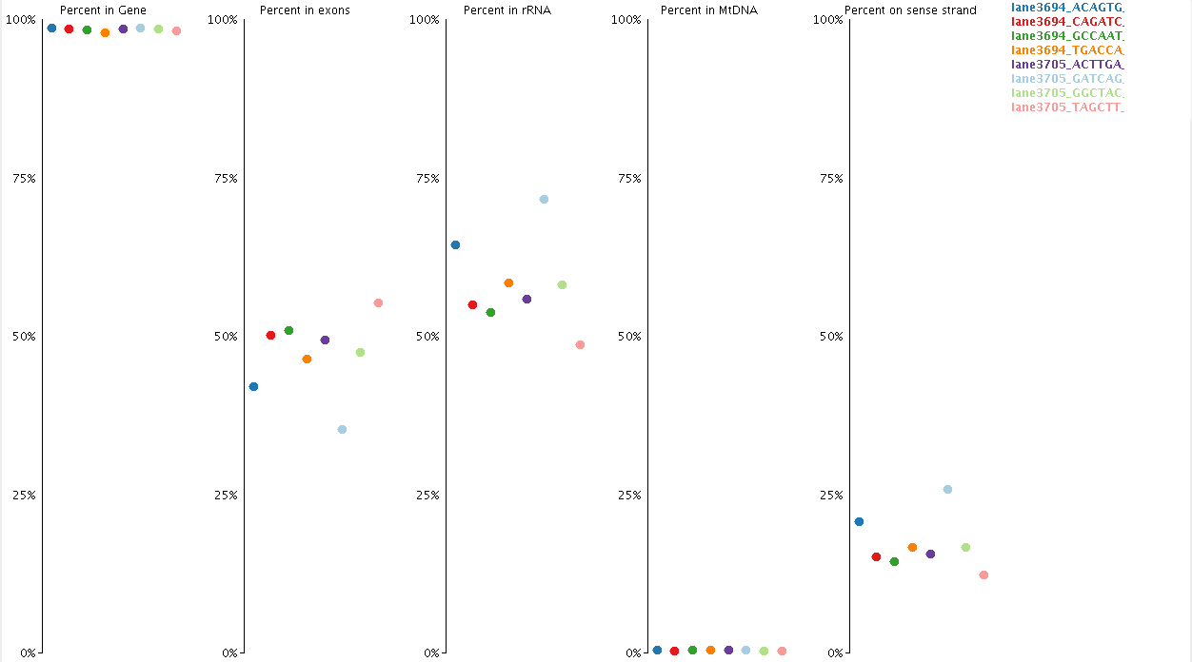
SeqMonk RNA-Seq QC (bad)

Slide 36
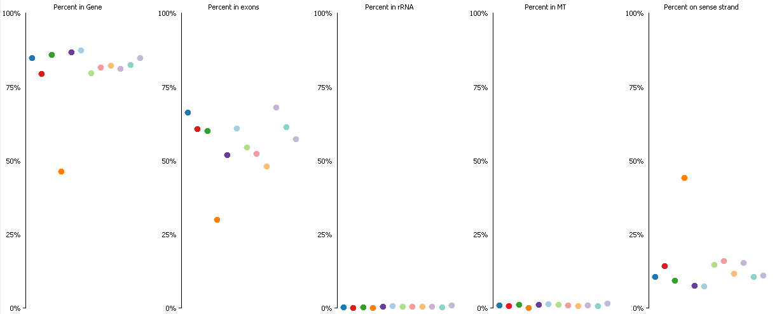
SeqMonk RNA-Seq QC (bad)

Slide 37
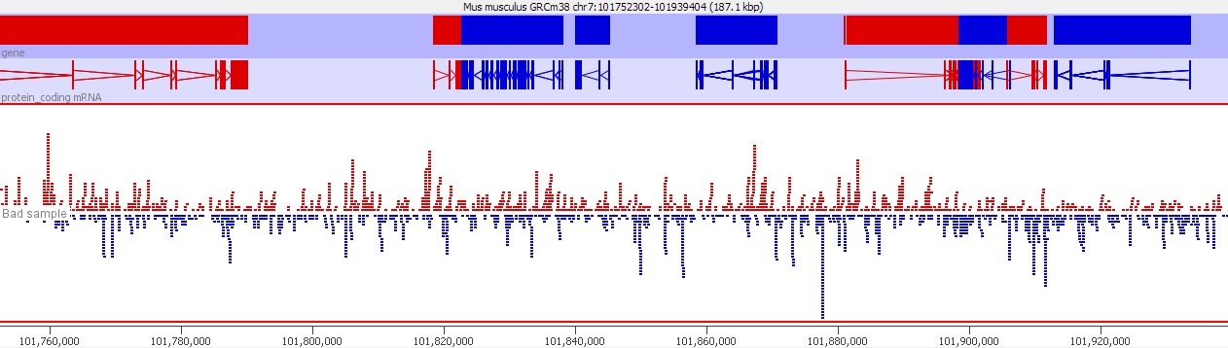
Look at poor QC samples

Slide 38
Duplication (again)
Exon
Exon

Slide 39
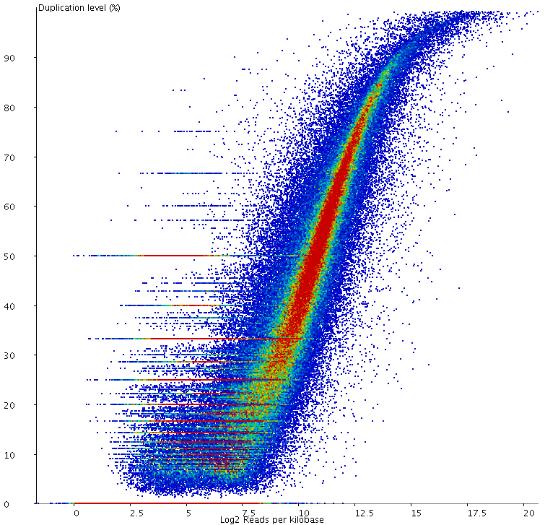
Duplication (good)
Notes:
Coincidental vs technical (PCR) duplication.
Anything that isn’t a smooth distribution is more worrying

Slide 40
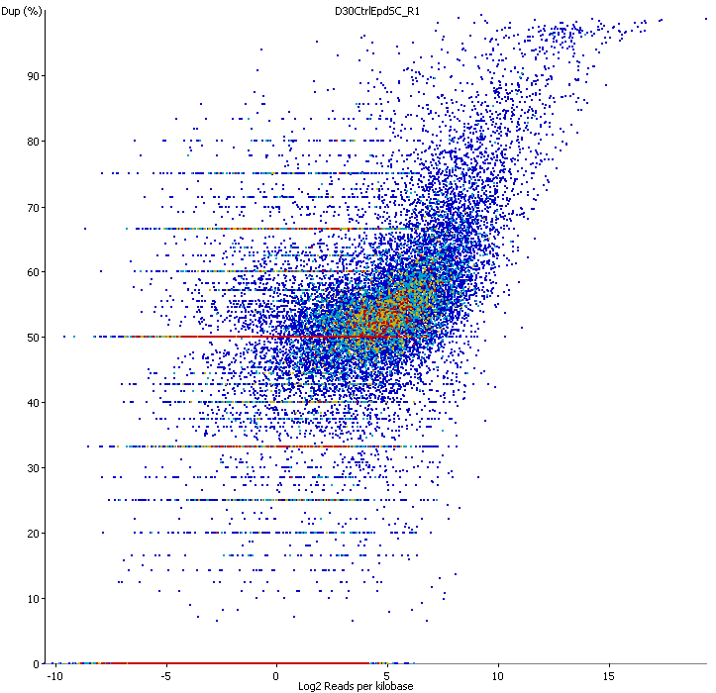
Duplication (moderate)

Slide 41
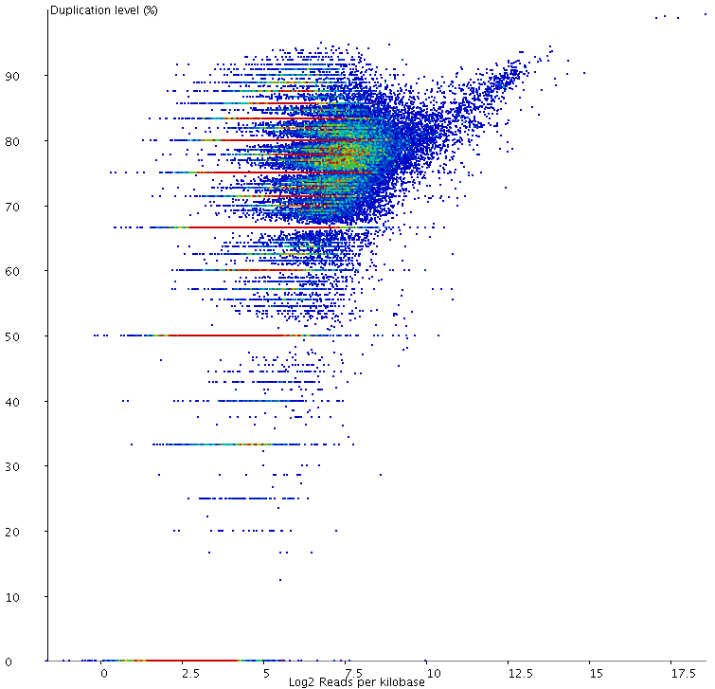
Duplication (bad)
Notes:
What to do about bad duplication;
Duplication doesn't affect corrected quantitation.
Mainly affects count based statistics.
Can estimate basal level of duplication and divide raw counts. Only matters for statistical tests. Don't use unless there is a problem.

Slide 42
Fixing Duplication?
If duplication is biased (some genes more than others)
  Can’t be ‘fixed’ – can still analyse but be cautious
If it’s unbiased (everything is duplicated)
  Doesn’t affect quantitation
  Will affect statistics
  Can estimate global level and correct raw counts

Slide 43
Quantitation
Exon 1
Exon 2
Exon 3
Splice form 1
Exon 1
Exon 3
Splice form 2
Definitely splice form 1
Definitely splice form 2
Ambiguous
Notes:
This is a simple example – about as simple as you get.
Paired end mapping as before.
Get a lot of ambiguous reads.

Slide 44
Simple Quantitation - Forget splicing
Count read overlaps with exons of each gene
  Consider library directionality
  Simple
  Gene level quantitation
  Many programs
    Seqmonk (graphical)
    Feature Counts (subread)
    BEDTools
    HTSeq

Slide 45
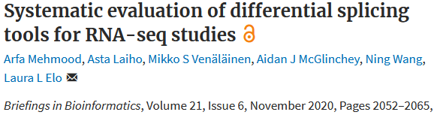
Analysing Splicing
Try to quantitate transcripts (cufflinks, RSEM, bitSeq)
Quantitate exons and compare to gene (EdgeR, DEXSeq)
Quantitate splicing events (rMATS, MAJIQ)
Notes:
Not going to do any of this today.
Transcript level expression: Expectation maximisation model to create the mostly likely redistribution of counts between different splice forms.
Can work well in some cases. Can be *very* wrong in others.
Very difficult to evaluate.
Counting junctions is much less complex. Set of counts which you can treat the same as expression levels.
Splicing decisions is nice - ratio test.

Slide 46
Normalisation: RPKM / FPKM / TPM
RPKM (Reads per kilobase of transcript per million reads of library)
  Corrects for total library coverage
  Corrects for gene length
  Comparable between different genes within the same dataset
FPKM (Fragments per kilobase of transcript per million fragments of library)
  Only relevant for paired end libraries
  Pairs are not independent observation
  Effectively halves raw counts
TPM (transcripts per million)
  Normalises to transcript copies instead of reads
  Corrects for cases where the average transcript length differs between samples
Notes:
RPKM and TPM are very functionally equivalent.
Main thing is the scale - TPM values are much higher. Can be an issue when you log transform. Very common to get negative logRPKM values which is fine, but people don't like.

Slide 47
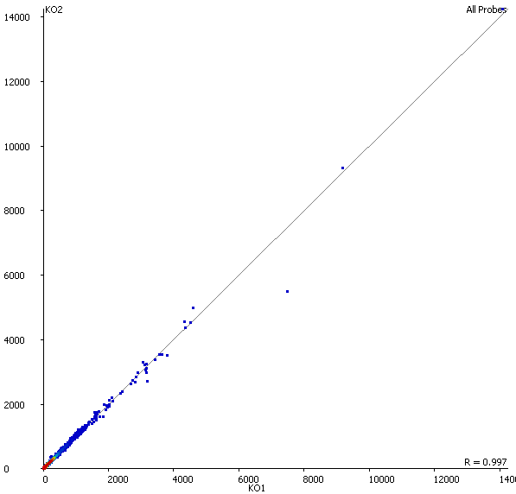
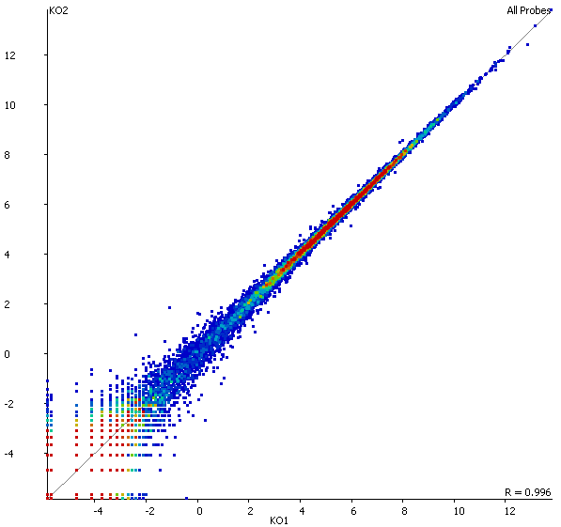
Visualising Expression and Normalisation
Linear
Log2
CD74
Eef1a1
Actb
Lars2
Eef2

Slide 48
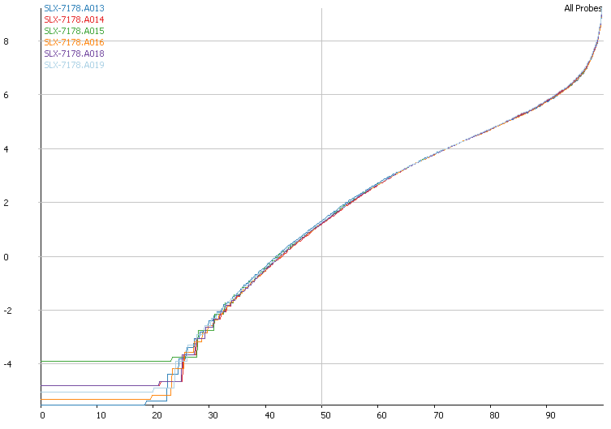
Visualising Normalisation
Notes:
Point out the upper scoop on a log scale.
Changes in high expressed genes can mess up the normalisation. Particularly rRNA but there are others too.
If normalisation is messed up then apply additional correction.
Percentile normalisation - pick a nicely behaving part of the distribution.
Size factor normalisation - take the median difference between all genes of two sets.
Most of the time it's fine. Don't do additional correction if you don't need to.

Slide 49
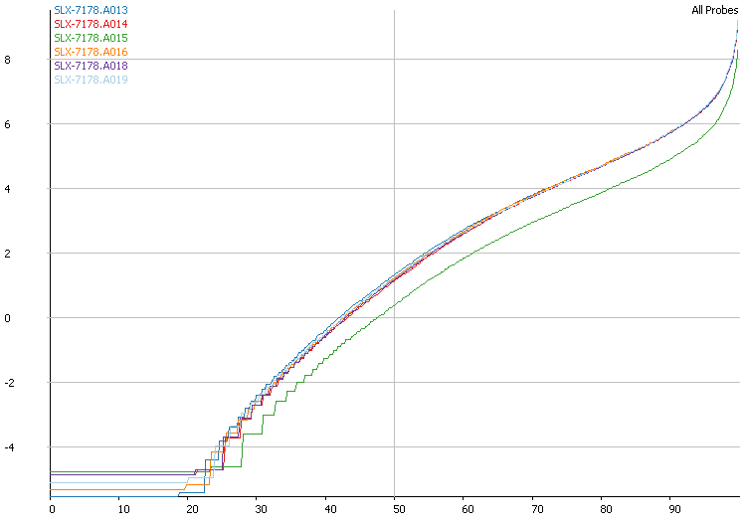
Visualising Normalisation
Notes:
Point out the upper scoop on a log scale.
Changes in high expressed genes can mess up the normalisation. Particularly rRNA but there are others too.
If normalisation is messed up then apply additional correction.
Percentile normalisation - pick a nicely behaving part of the distribution.
Size factor normalisation - take the median difference between all genes of two sets.
Most of the time it's fine. Don't do additional correction if you don't need to.

Slide 50
Size Factor Normalisation
Make an ‘average’ sample from the mean of expression for each gene across all samples
For each sample calculate the distribution of differences between the data in that sample and the equivalent in the ‘average’ sample
Use the median of the difference distribution to normalise the data

Slide 51
Normalisation – Coverage Outliers
Notes:
Point out the upper scoop on a log scale.
Changes in high expressed genes can mess up the normalisation. Particularly rRNA but there are others too.
If normalisation is messed up then apply additional correction.
Percentile normalisation - pick a nicely behaving part of the distribution.
Size factor normalisation - take the median difference between all genes of two sets.
Most of the time it's fine. Don't do additional correction if you don't need to.

Slide 52
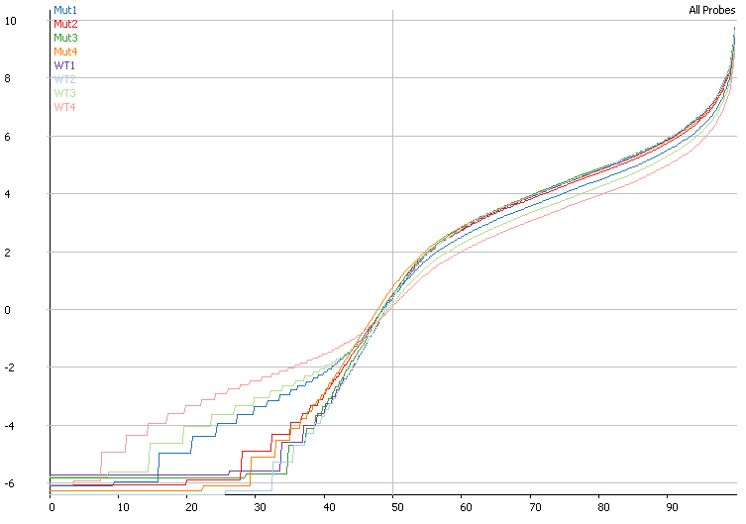
Normalisation – DNA Contamination
Notes:
Apply DNA contamination estimation and subtraction only if you know you have a problem. Can fix problems which a mathematical transformation can't.

Slide 53
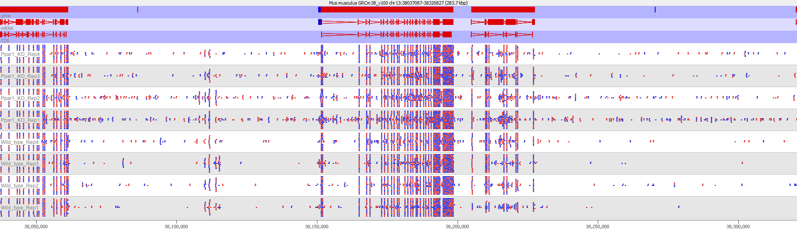
Normalisation – DNA Contamination

Slide 54
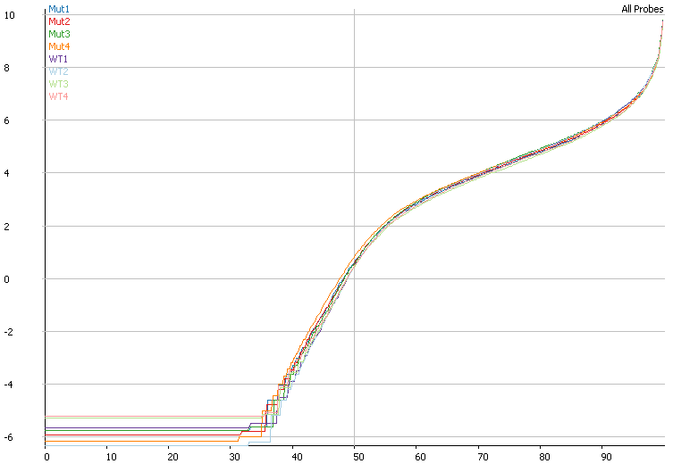
Normalisation – DNA Contamination
Notes:
Apply DNA contamination estimation and subtraction only if you know you have a problem. Can fix problems which a mathematical transformation can't.

Slide 55
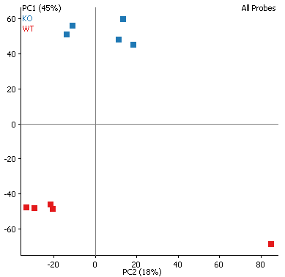
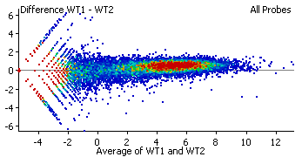
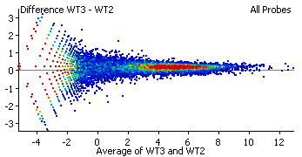
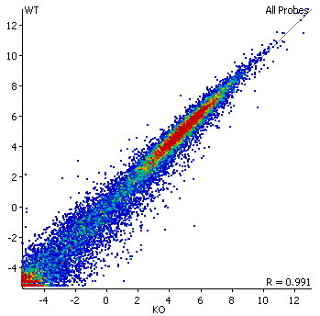
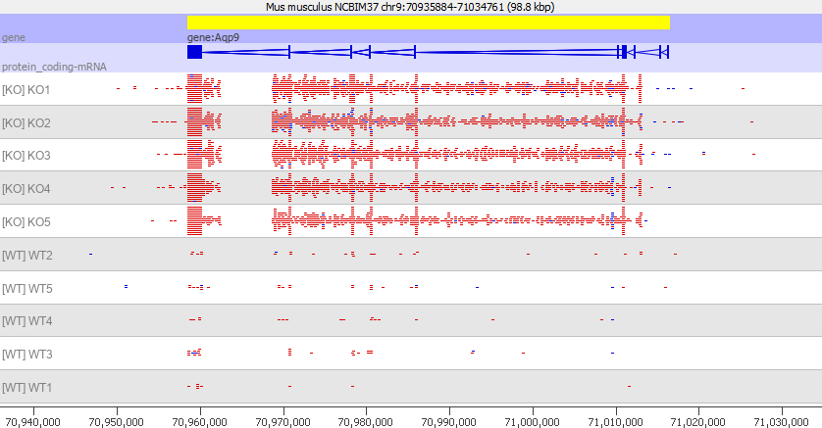
Exploratory Analyses
Time to understand your data
  Behaviour of raw data and annotation
  Clustering of samples (PCA / tSNE etc)
  Pairwise comparisons of samples and groups
  Are expected effects present (eg KO)?
  Can I validate other aspects of the samples (eg sex)
  Can I see obvious changes?
  Are the changes convincing?

Slide 56
Differential Expression Statistics

Slide 57
Differential Expression
Mapped data
Normalised expression
(+ confidence)
Raw counts
Continuous stats
Binomial stats
Notes:
Count based is natural fit for raw count quantitation
Continuous would work with cufflinks or other transcript level quantitation.
Binomial stats are very powerful with good power to detect changes.

Slide 58
DE-Seq2 binomial Stats
Are the counts we see for gene X in condition 1 consistent with those for gene X in condition 2?
Size factors
  Estimator of library sampling depth
  More stable measure than total coverage
  Based on median ratio between conditions
Variance – required for Negative Binomial distribution
  Insufficient observations to allow direct measure
  Custom variance distribution fitted to real data
  Smooth distribution assumed to allow fitting
Notes:
Talk about DESeq but others are very similar (EdgeR, BaySeq etc).
Big problem is that people don't do enough replicates. Need a statistical kludge to work around this.
We don’t get enough observations for an individual gene to get a good measure of variance. Need to share information between genes.

Slide 59
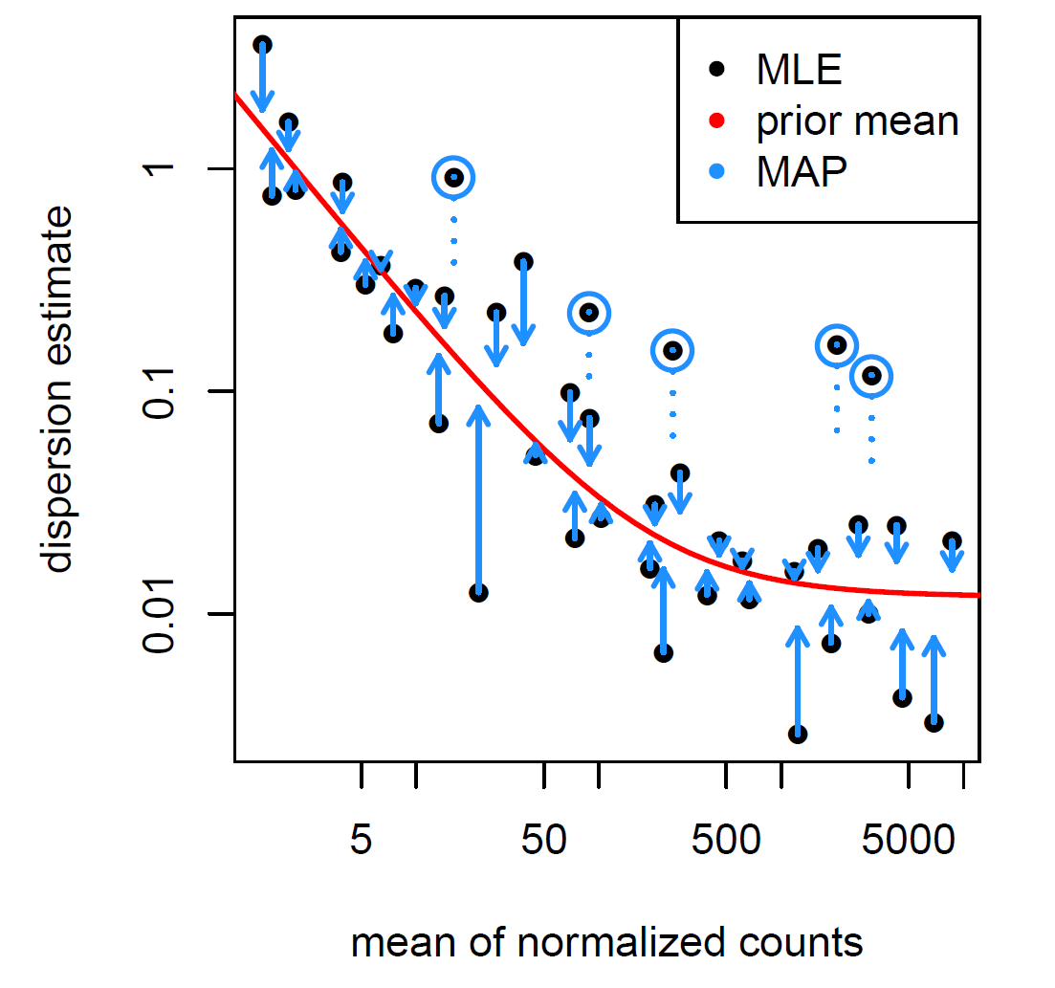
Dispersion shrinkage
Plot observed per gene dispersion
Calculate average dispersion for genes with similar observation
Individual dispersions regressed towards the mean. Weighted by
  Distance from mean
  Number of observations
Points more than 2SD above the mean are not regressed
Notes:
There is a global relationship between variance and observation level.
Makes sense - low observed is very variable, high observed is more stable.
Can construct a global regression line of the relationship.
In the test we don't use the observed variance but a 'shrunken' version of this where it is moved towards the global line.
Amount it moves dependent on
Number of replicates
Distance from line
For most genes this is fine and improves the analysis. For some hyper-variable genes though it's *bad*
Worst offenders removed by not shrinking any points more than 2SD above the mean. Nothing statistical or magical about 2SD. Other points won't hit that limit.
Bottom line is that the fewer replicates you have the more you rely on the global model.

Slide 60
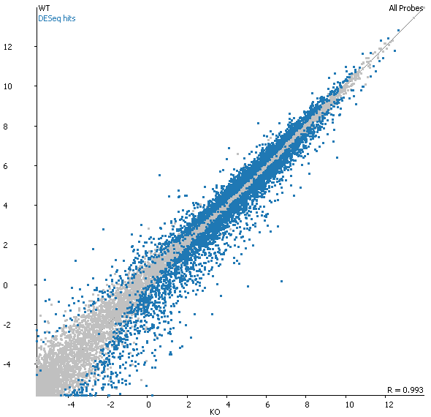
Visualising Differential Expression Results
5x5 Replicates
8,022 out of 18,570 genes (43%) identified as DE using DESeq (p<0.05)
Needs further filtering
Two options:
  Decrease the p-value cutoff
  Filter on magnitude of change
  (both are a bit rubbish)
Notes:
Always look at your results. Spots obvious errors in calculation.

Slide 61
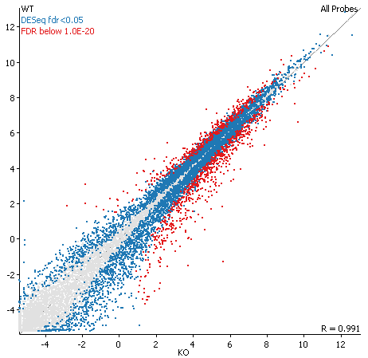
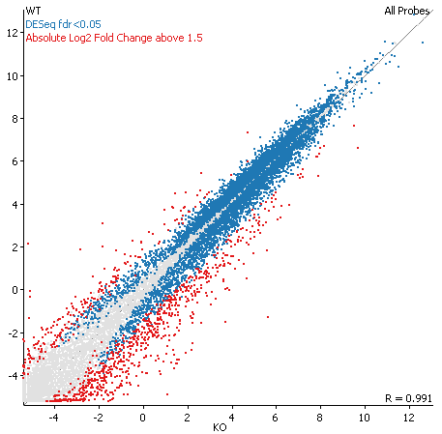
Visualising Differential Expression Results
Filter by p-value (fdr < 10⁻²⁰)
Filter by fold change (abs log2 change > 1.5)

Slide 62
Fold Change Shrinkage
Aims to make the log2 Fold change a more useful value
Tries to remove systematic biases
Two types:
  Fold Change Shrinkage – removes bias from both expression level and variance, produces a modified fold change
  Intensity difference – removes bias from just expression level, produces a p-value

Slide 63
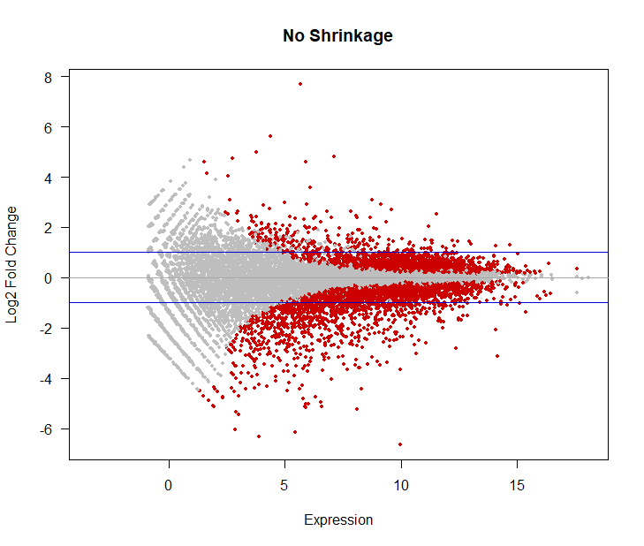
Fold Change Shrinkage

Slide 64
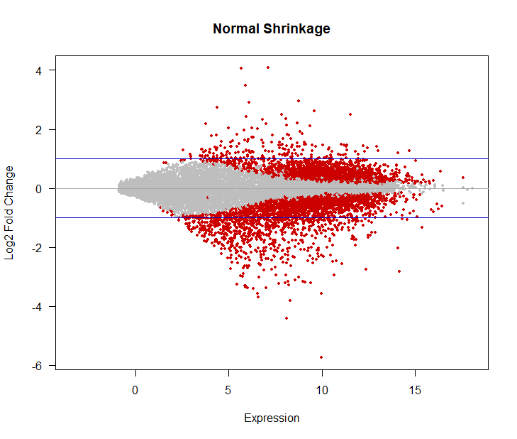
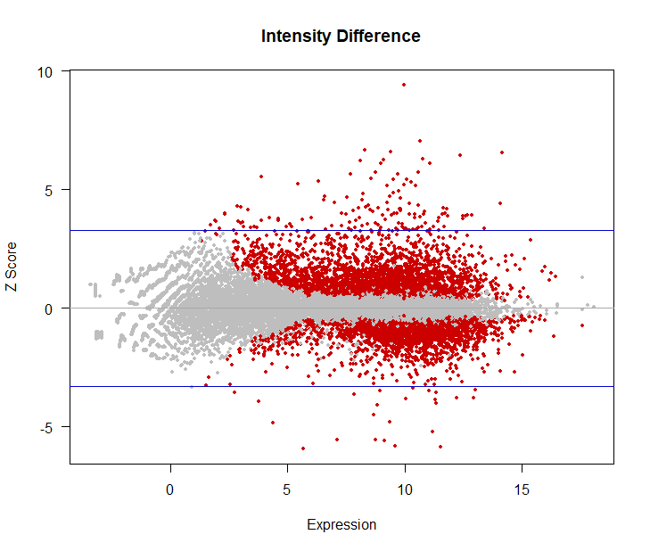
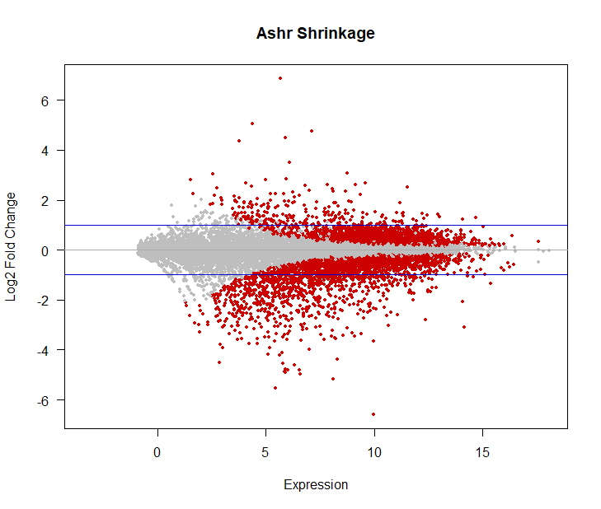
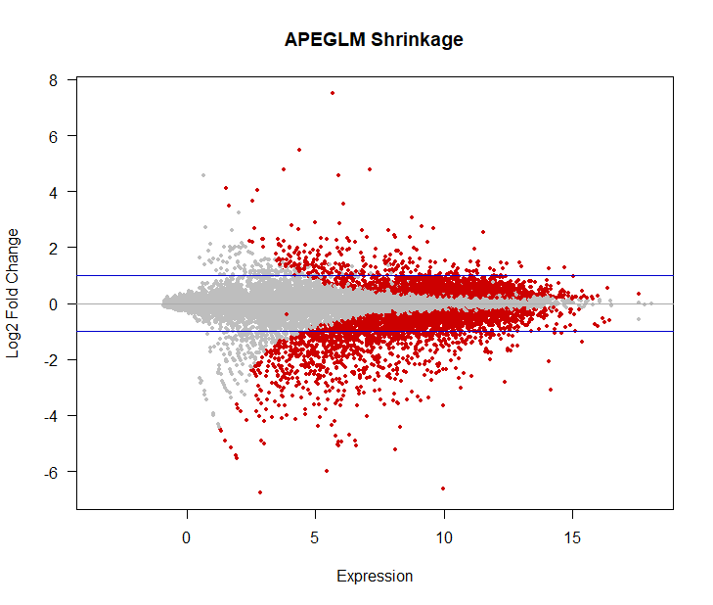

Slide 65
Result Validation
(Can I believe the hits?)

Slide 66
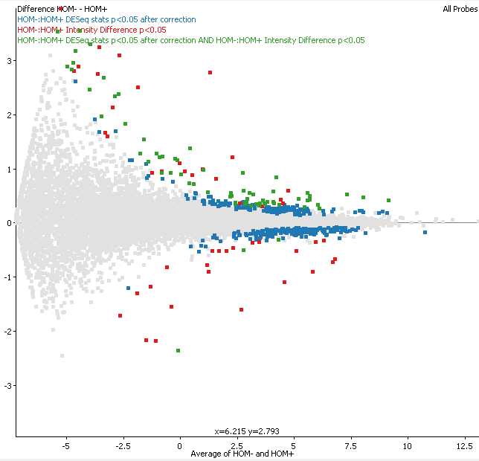
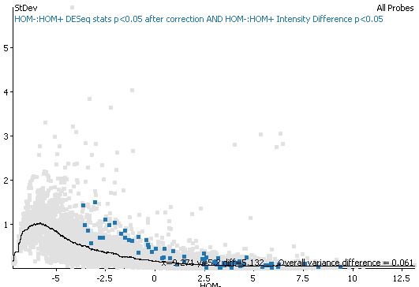
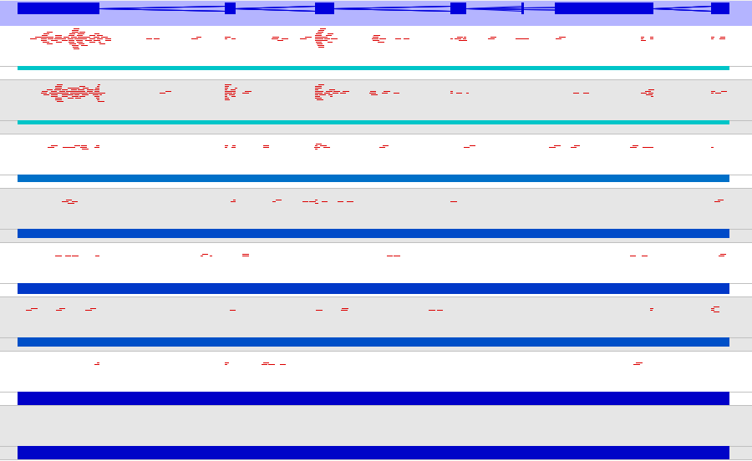
Validation
2900097C17Rik RIKEN cDNA 2900097C17 gene
Hbb-b1 hemoglobin, beta adult major chain
Rps27a-ps2 ribosomal protein S27A, pseudogene 2
C230073G13Rik RIKEN cDNA C230073G13 gene
mt-Atp8 mitochondrially encoded ATP synthase 8
mt-Nd4l mitochondrially encoded NADH dehydrogenase
AC151712.4 erythroid differentiation regulator 1
Gm5641 predicted gene 5641

Slide 67
Data Exploration and Analysis Practical

Slide 68
Experimental Design for RNA-Seq

Slide 69
Practical Experiment Design
What type of library?
What type of sequencing?
How many reads?
How many replicates?

Slide 70
What type of library?
Directional libraries if possible
  Easier to spot contamination
  No mixed signals from antisense transcription
  May be difficult for low input samples
mRNA vs total vs depletion etc.
  Down to experimental questions
  Remember LINC RNA may not have polyA tail
  Active transcription vs standing mRNA pool

Slide 71
What type of sequencing
Depends on your interest
  Expression quantitation of known genes
    50bp single end is fine, but lots of places don’t offer anything that short!
  Expression plus splice junction usage
    100-150bp single end
  Novel transcript discovery or per transcript expression
    150bp paired end

Slide 72
How many reads
Typically aim for 20-50 million reads per sample for human or mouse sized genome
More reads:
  De-novo discovery
  Low expressed transcripts
More replicates more useful than more reads

Slide 73
Replicates
Compared to arrays, RNA-Seq is a very clean technical measure of expression
  Generally don’t run technical replicates
  Must run biological replicates
For clean systems (eg cell lines) 3x3 or 4x4 is common
Higher numbers required as the system gets more variable
Always plan for at least one sample to fail
Randomise across sample groups
Notes:
Example cell lines in a dish with a compound added.
Samples collected in the wild, dissected, extracted, posted, processed at different times.

Slide 74
Power Analysis
Power Analysis is not simple for RNA-Seq data
  Not a single test – one test per gene
  Need to apply multiple testing correction
  Each gene will have different power
    Power correlates with observation level
    Variations in variance per gene
Several tools exist to automate power analysis
  All require parameters which are difficult to estimate, and have dramatic effects on the outcome

Slide 75
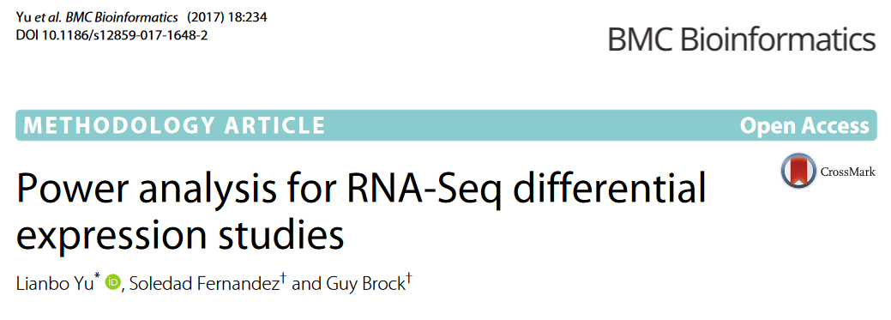
Power Analysis

Slide 76
Tools available
RnaSeqSampleSize https://cqs-vumc.shinyapps.io/rnaseqsamplesizeweb/
Scotty http://scotty.genetics.utah.edu/
All require an estimate of count vs variance
  Pilot data (if only!)
  “Similar” studies
We are planning a RNA sequencing experiment to identify differential gene expression between two groups. Prior data indicates that the minimum average read counts among the prognostic genes in the control group is 500, the maximum dispersion is 0.1, and the ratio of the geometric mean of normalization factors is 1. Suppose that the total number of genes for testing is 10000 and the top 100 genes are prognostic. If the desired minimum fold change is 3, we will need to study 4 subjects in each group to be able to reject the null hypothesis that the population means of the two groups are equal with probability (power) 0.8 using exact test. The FDR associated with this test of this null hypothesis is 0.05.

Slide 77

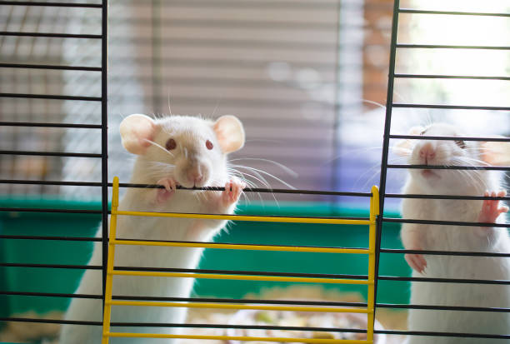
Predicting variability
Simple = clean
Complex = noisy
Umar Hashim

Slide 78
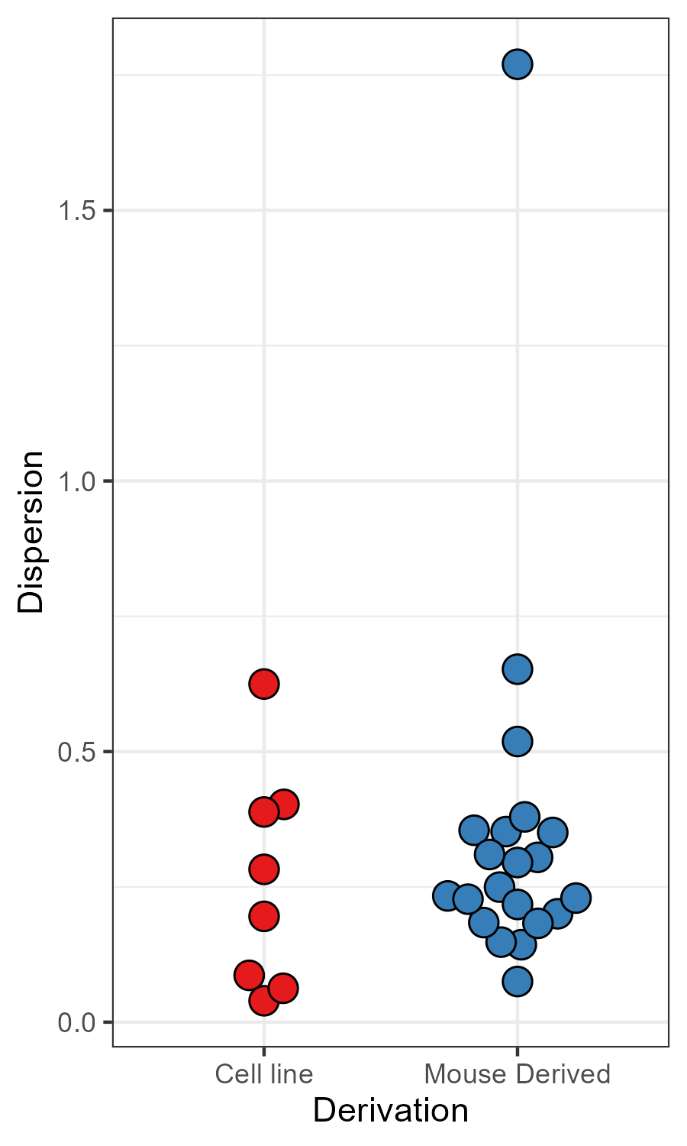
Predicting Variability
No clear difference in the variability of replicates coming from cell lines vs animal samples
Knowing the sample preparation doesn't help you predict how many replicates you need
Umar Hashim

Slide 79
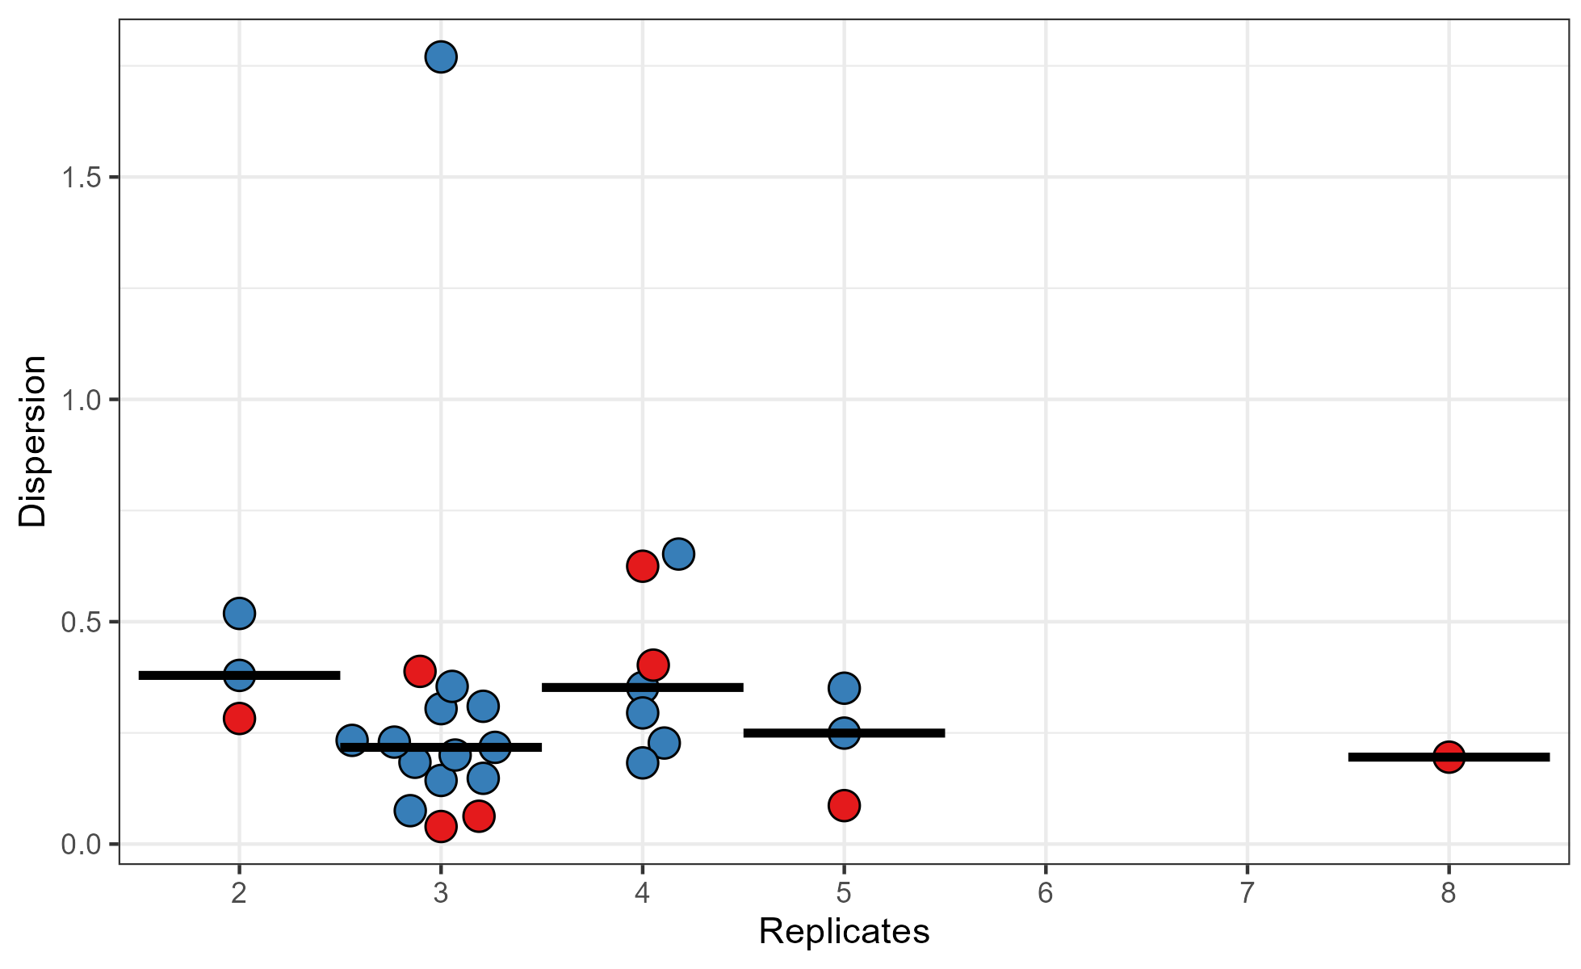
Predicting Variability
Most groups just do 3 replicates
Those that do more, didn't have noisier data
People are bad at estimating
Umar Hashim

Slide 80
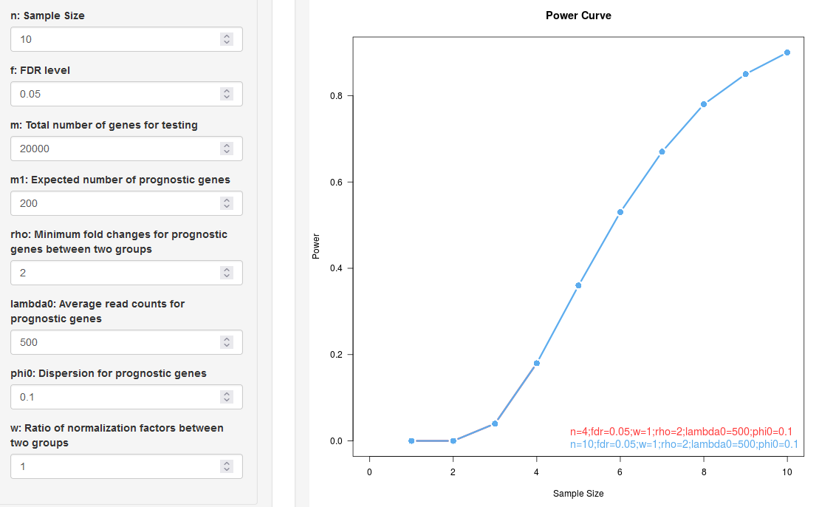
Power Curves

Slide 81
Useful links
FastQC http://www.bioinformatics.babraham.ac.uk/projects/fastqc/
HiSat2 https://ccb.jhu.edu/software/hisat2/
SeqMonk http://www.bioinformatics.babraham.ac.uk/projects/seqmonk/
Cufflinks http://cufflinks.cbcb.umd.edu/
DESeq2 https://bioconductor.org/packages/release/bioc/html/DESeq2.html
Bioconductor http://www.bioconductor.org/
DupRadar http://sourceforge.net/projects/dupradar/

