Slide 1
Additional Cytosine Modifications – analysing hydroxymethylcytosine (5hmC) with oxidative BS-Seq (oxBS)
Felix Krueger
felix.krueger@babraham.ac.uk
January 2015

Slide 2
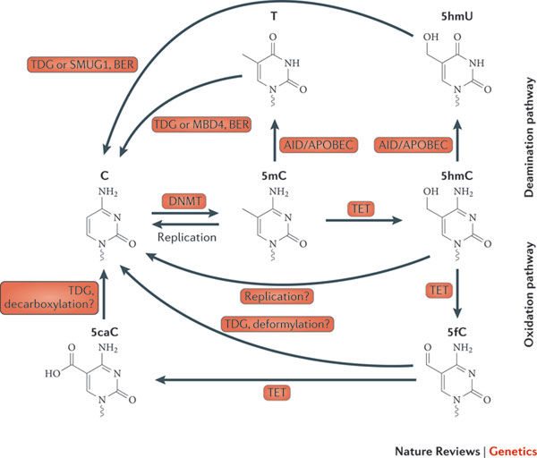
Cytosine modifications
Miguel R. Branco, Gabriella Ficz & Wolf Reik
Nature Reviews Genetics 13, 7-13 (January 2012)

Slide 3
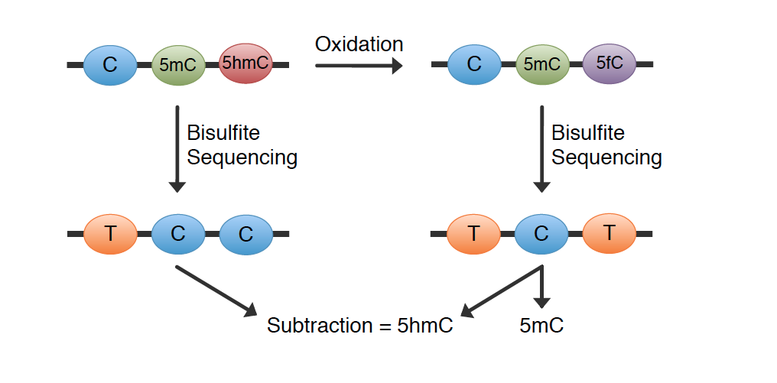
Detecting 5-hydroxymethylcytosine using Oxidative Bisulfite-Seq (oxBS)
Quantitative sequencing of 5-methylcytosine and 5-hydroxymethylcytosine at single-base resolution
Science, 2012 May 18;336(6083):934-7

Slide 4
Detecting 5-formylcytosine using Reduced Bisulfite-Seq (redBS)
M.j. Booth, NATURE CHEMISTRY Quantitative sequencing of 5-formylcytosine in DNA at single-base resolution

Slide 5
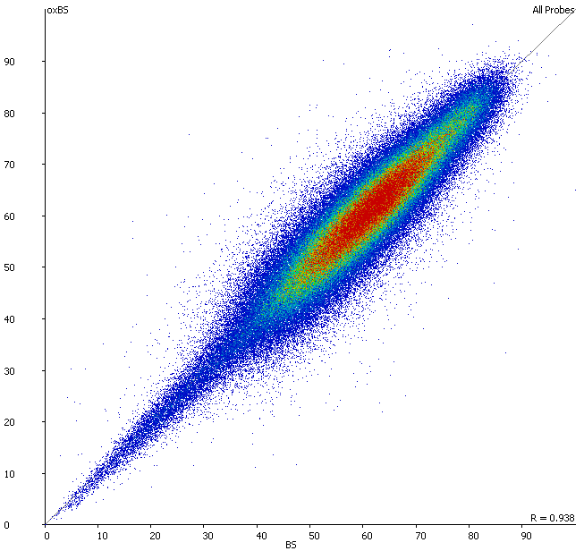

Slide 6
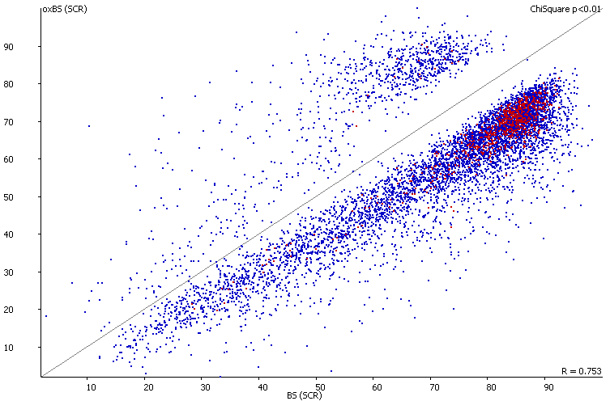
oxBS: identifying target regions
Gives an idea about false positive rate
Analysis options to gain more power:
- larger running windows
- looking for sets/functional sets

Slide 7
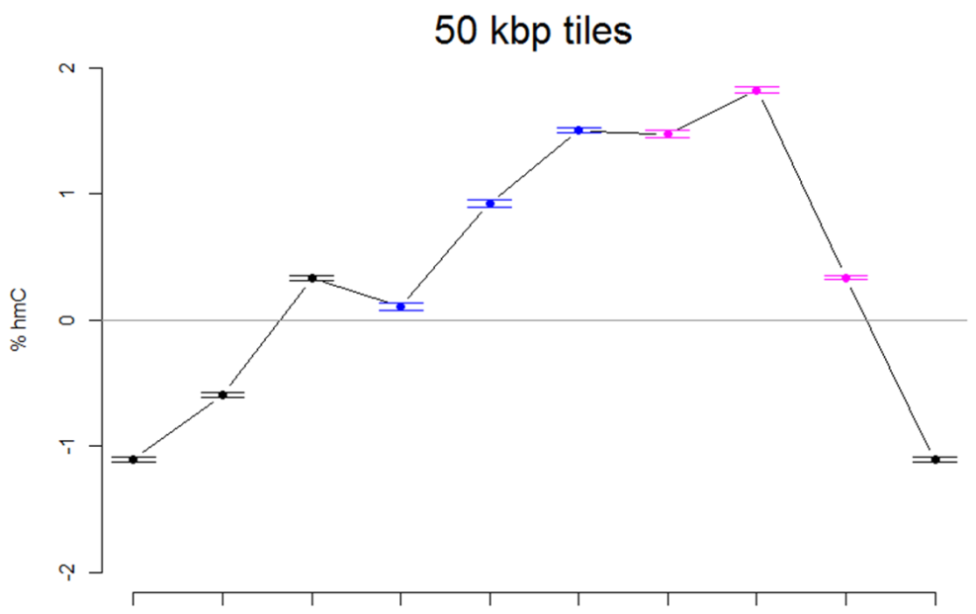
hmC as difference BS – oxBS
genome-wide difference:
sometimes negative values…
relative differences

