Slide 1

Visualising and Exploring
BS-Seq Data
Simon Andrews
simon.andrews@babraham.ac.uk
@simon_andrews
v2021-04

Slide 2
Starting Data
Read 1
Read 2
Read 3
Genome
L001_bismark_bt2_pe.deduplicated.bam
CHG_OB_L001_bismark_bt2_pe.deduplicated.txt.gz
CHG_OT_L001_bismark_bt2_pe.deduplicated.txt.gz
CHH_OB_L001_bismark_bt2_pe.deduplicated.txt.gz
CHH_OT_L001_bismark_bt2_pe.deduplicated.txt.gz
CpG_OB_L001_bismark_bt2_pe.deduplicated.txt.gz
CpG_OT_L001_bismark_bt2_pe.deduplicated.txt.gz
L001_bismark_bt2_pe.deduplicated.cov.gz

Slide 3
Decide early on which data to use
Methylation contexts
  CpG: Only generally relevant context for mammals
  CHG: Only known to be relevant in plants
  CHH: Generally unmethylated
Methylation strands
  CpG methylation is generally symmetric
  Normally makes sense to merge OT / OB strands

Slide 4
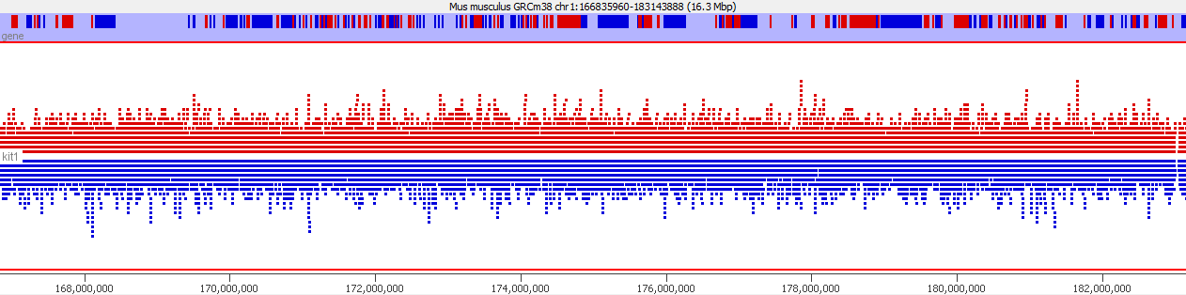
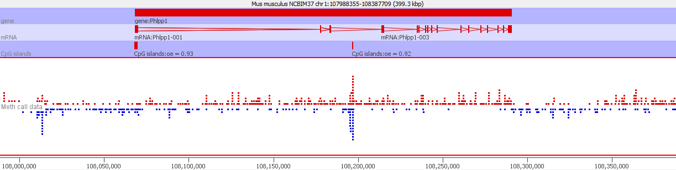
Always start by looking at your data. Think about what you expect
Reads (red=for blue=rev)
Calls (red=meth blue=unmeth)

Slide 5
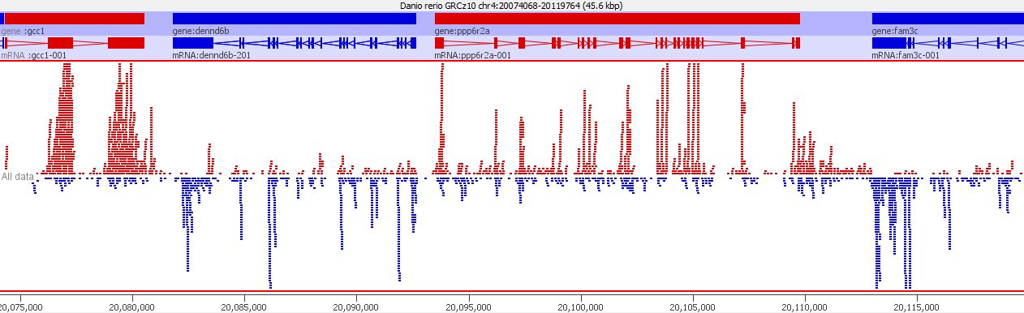
Try to understand anything unusual
Very messed up cDNA contaminated library

Slide 6
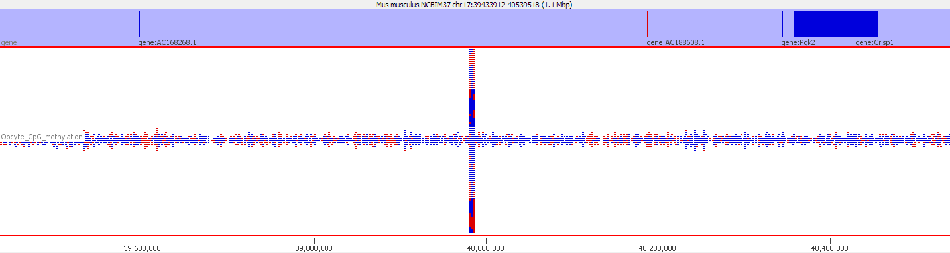
Try to understand anything unusual
Around 600x average genome density
Coverage Outliers

Slide 7
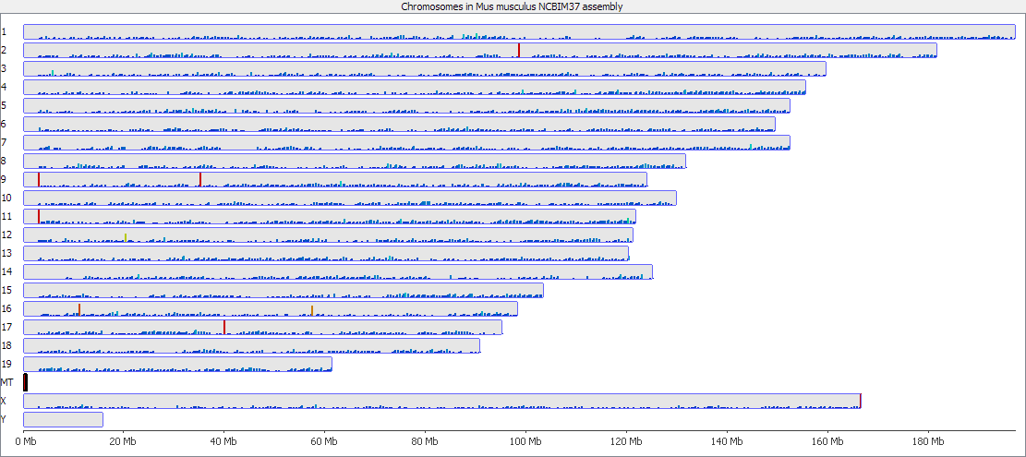
Coverage Outliers

Slide 8
Coverage Outliers
Normally the result of mis-mapping repetitive sequences not in the genome assembly
Centromeric / telomeric sequences are common
Can be a significant proportion of all data
Can throw off calculations of overall methylation
Should be flagged and hits in those regions ignored

Slide 9
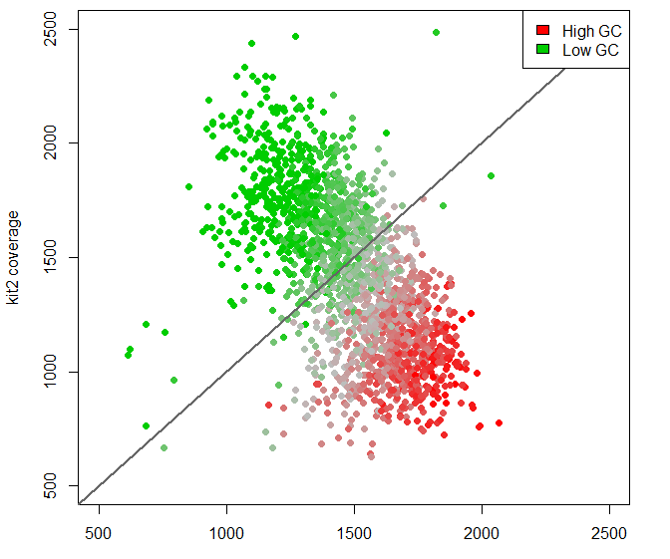
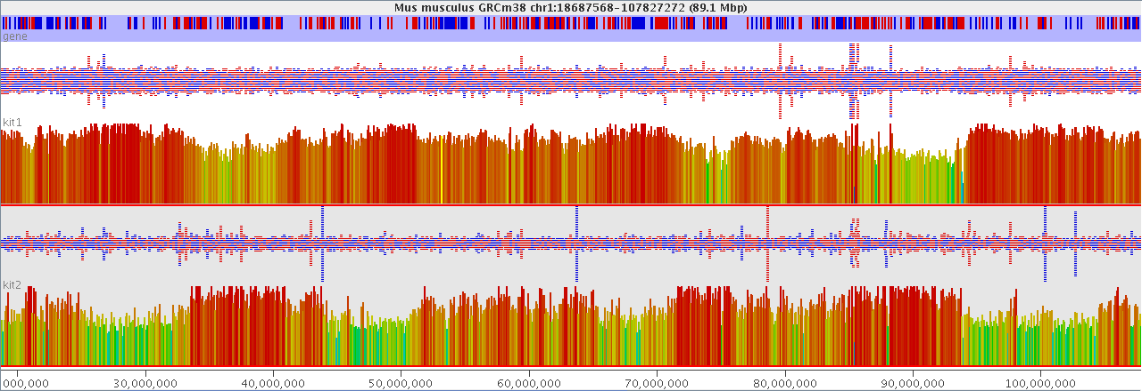
Coverage Bias
GC Content is most likely but
others could exist

Slide 10
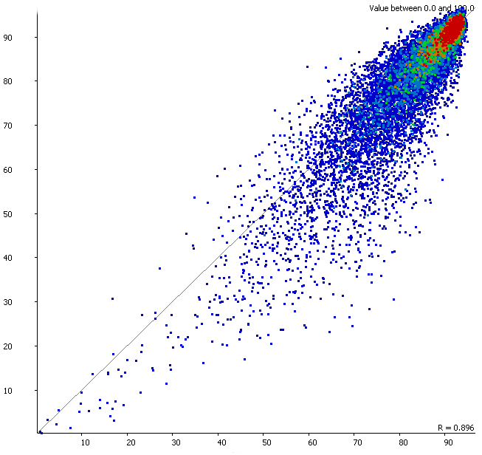
Coverage bias can lead to apparent methylation bias

Slide 11
Quantitating your methylation data

Slide 12
Where to make measures
Per base
  Very large number of measures
  Poor accuracy for individual bases
Unbiased windows
  Tiled over whole genome
  Need to decide how they will be defined
Targeted regions
  Which regions
  What context

Slide 13
Accuracy and Power
Region A
Region B
50% Methylation
50% Methylation
Variation in CpG density
Variation in coverage depth

Slide 14
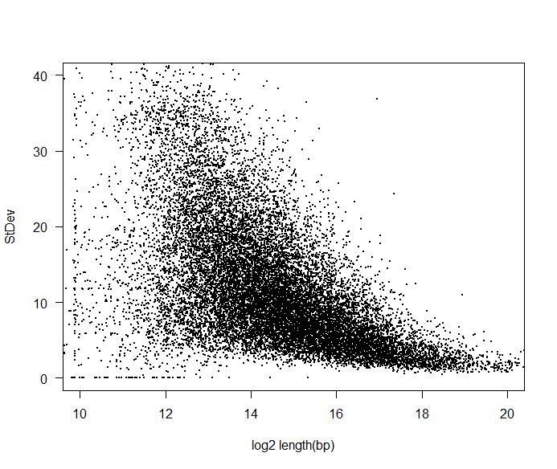
Try to make comparable measures
Observation level correlates with stability.
Want to try to have similar amounts of data in each measurement window.
Equalises noise for visualisation and power for analysis.

Slide 15
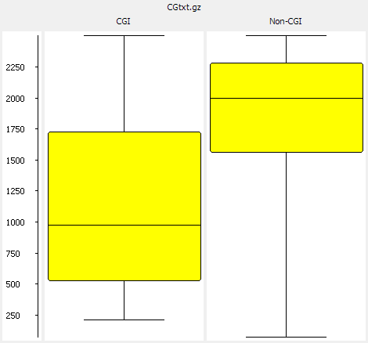
Unbiased Analysis
Fix the amount of data in each window
  Fixed number of CpGs per window
  Allow the resolution to vary
50 CpG window lengths

Slide 16
Targeted Quantitation
Measure over features
  CpG islands
    Be careful where you get your locations
    Try to fix sizes
  Promoters
    Should probably split into CpG island and non-CpG island
    Try to fix sizes
  Gene bodies
    Filter by biotype to remove small RNA genes?

Slide 17
How to Quantitate methylation calls
Percentage methylation
  (Methylated calls / Total Calls) * 100
= meth
= unmeth
(6/10) * 100 = 60% methylated

Slide 18
Assigning a % methylation value to a region can be difficult.
Total methylated calls = 15
Total unmethylated calls = 10
Methylation level = (15/(15+10))*100 = 60%

Slide 19
You get different answers quantitating per base or per region
Percentage methylation from all calls independently = 46%
Percentage methylation from mean methylation per base = 80%

Slide 20
Coverage differences can look like methylation differences
67%
43%
Common = 60% in both

Slide 21
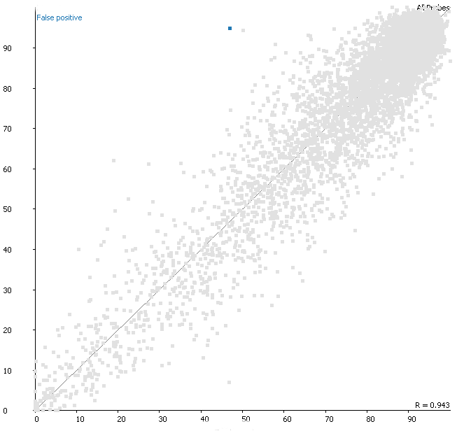
Coverage differences aren’t just a theoretical concern – they affect real data
p=3.2⁻⁷

Slide 22
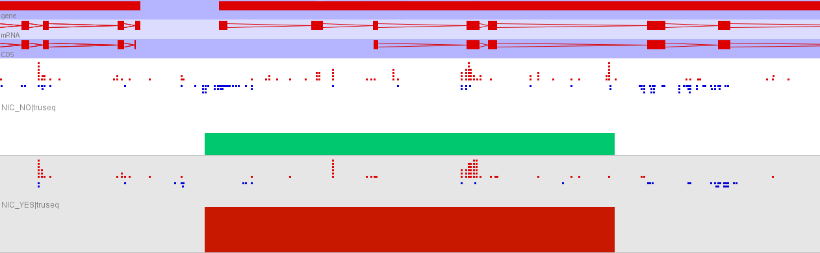
Coverage differences aren’t just a theoretical concern – they affect real data
47%
94%

Slide 23
Levels of Complexity
Percentage of all calls which are methylated
Per base methylation, averaged over a region
  Bases excluded because of low coverage
As above, but requiring the same bases to be used in each sample
  Doesn't scale well
Simple
Complex

Slide 24
(Even) More Complex Methods
Smoothing or regression of actual measures along a chromosome.
  Aims to reduce noise from sampling variation
  Relies on consistent linear patterns
Imputation of missing values
  Relies on consistent linear patterns
Additional normalisation or correction
  Will be discussed later…

Slide 25
Visualisation and Exploration

Slide 26
Use visualisation to understand the basic structure of your data before asking questions
Patterning
  What sorts of changes in methylation do I observe along a chromosome
Distributions
  What are the overall levels and distributions of methylation values in my samples
Relationships
  On a global scale what is the overall relationship between methylation levels in different conditions

Slide 27
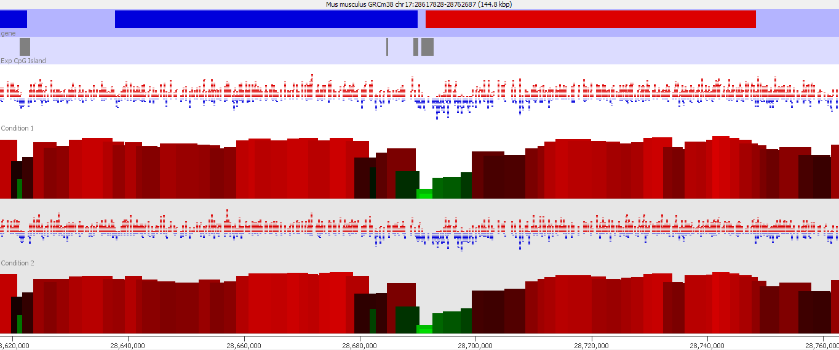
Visualise your quantitated data alongside the raw methylation calls.

Slide 28
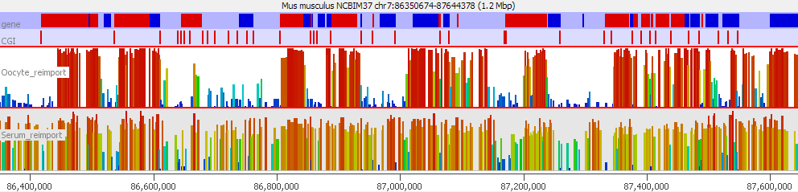
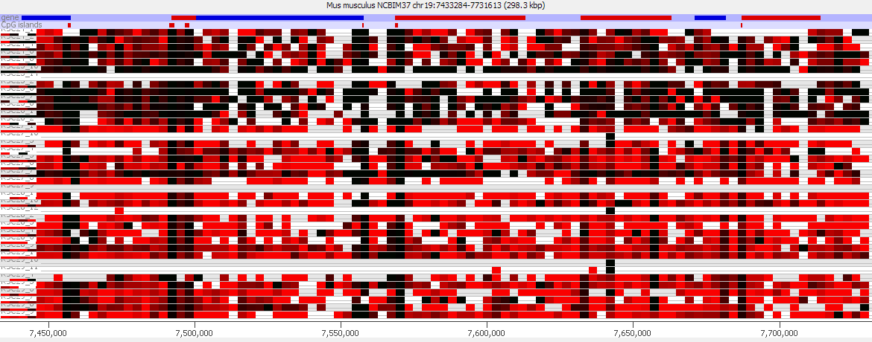
Different representations scale to different numbers of samples.

Slide 29
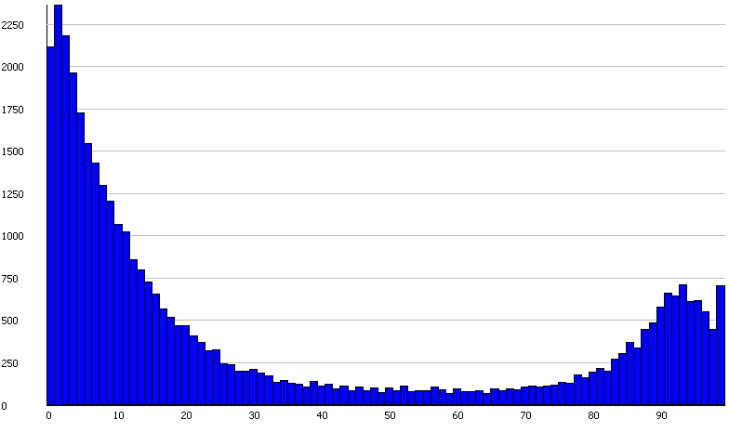
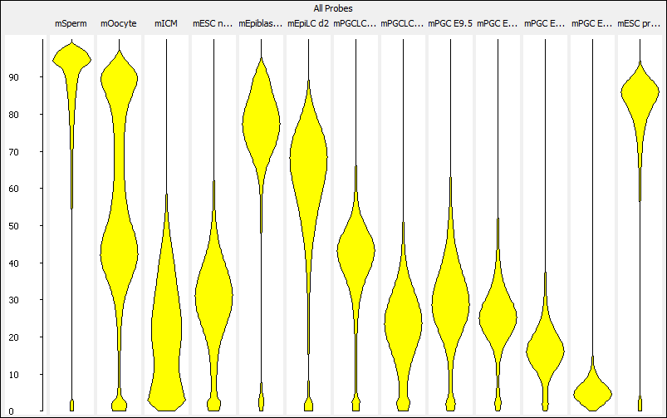
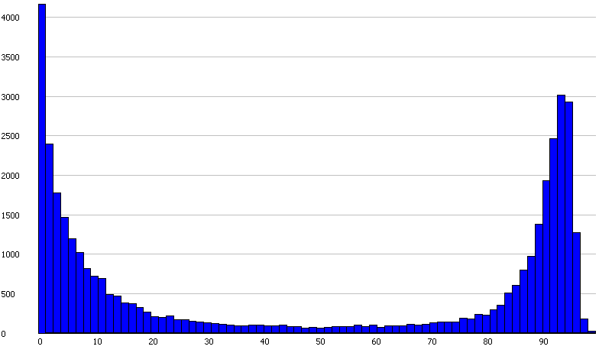
Understand and compare your methylation distributions before formulating a question.

Slide 30
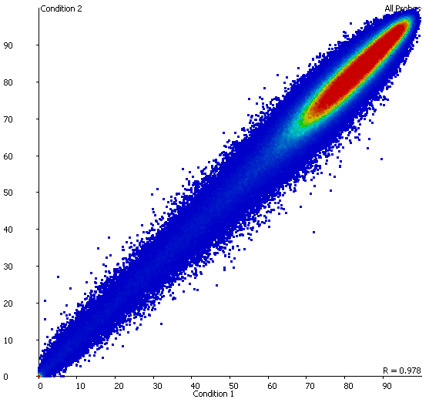
Plotting comparisons will identify global differences which might be interesting

Slide 31
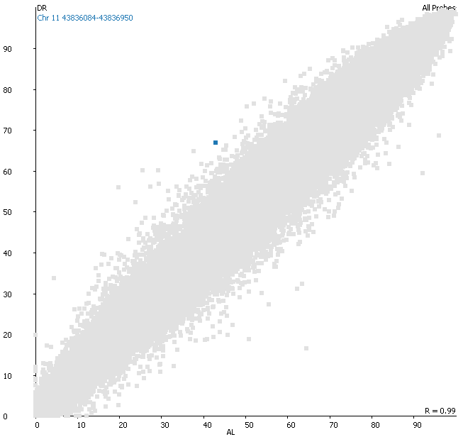
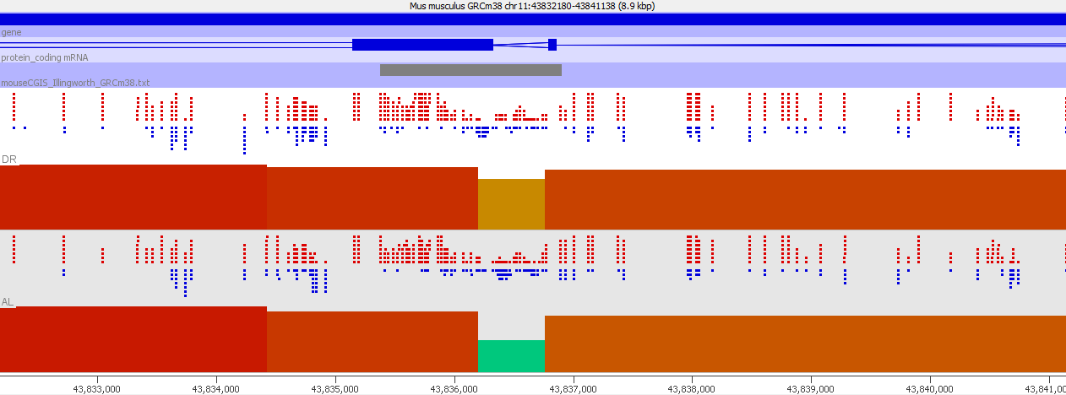
Look at the data underneath and around potentially interesting points

Slide 32
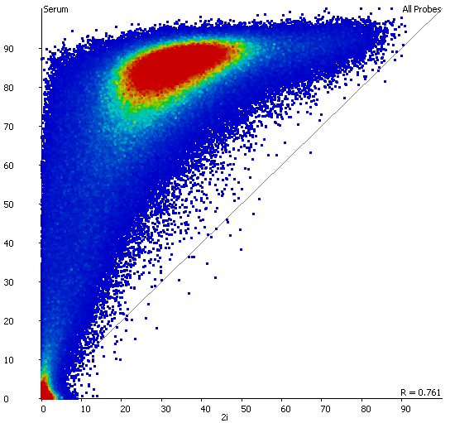
Large global changes might mean that local analysis is no longer relevant

Slide 33
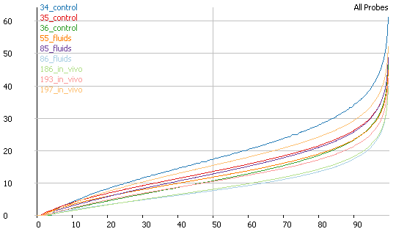
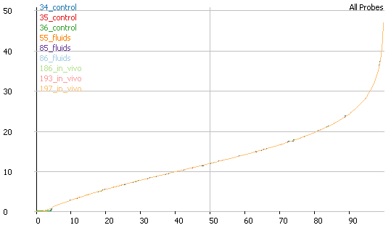
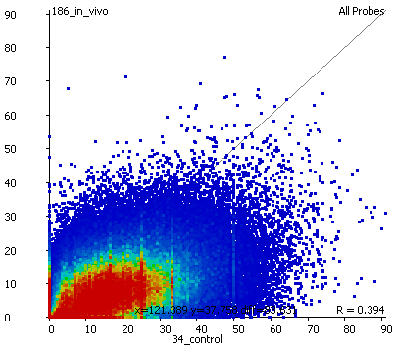
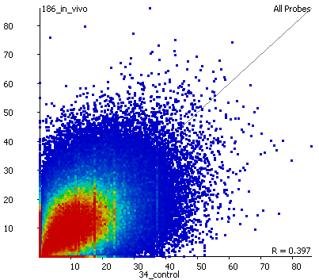
Small differences in distribution can be normalised to improve comparisons

Slide 34
Summary Visualisations

Slide 35
Trend Plots
Effects at individual loci can be subtle
Want to find more generalised effect
Collate information across whole genome
Look at the general trends
Relies on the effect being consistent

Slide 36
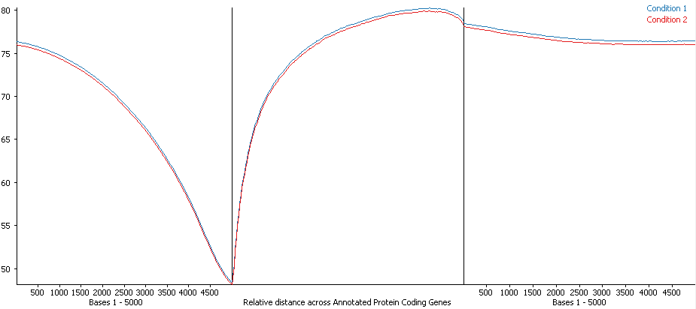
Trend plot considerations
Axis Scaling
What measures
How much context
Features to use
How much context

Slide 37
Clustering
Correlation Clustering
  Focusses on the differences between conditions
  Absolute values not important
  Look for similar trends
  Show median normalised values
Euclidean Clustering
  Focusses on absolute differences between conditions
  Look for similar levels
  Show raw values

Slide 38
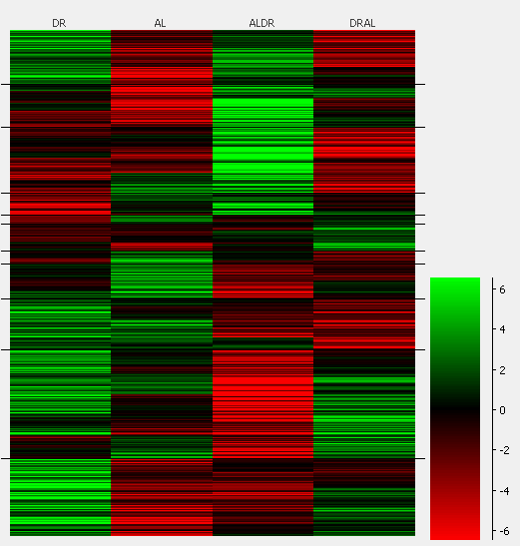
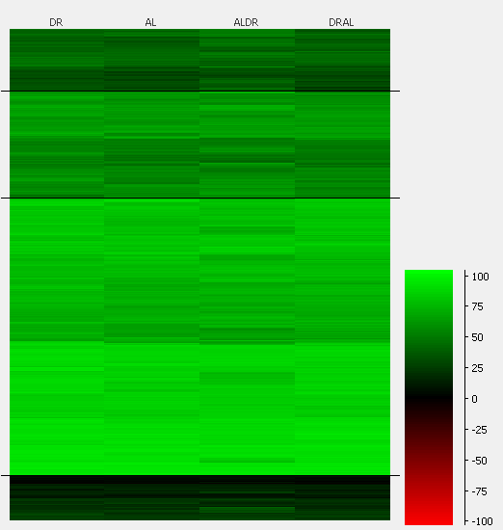
Clustering
Correlation Clustering
Euclidean Clustering

Slide 39
Exploration Summary (1)
Look at the distribution of your raw reads/calls
  Do they match what you expect from the library type?
Always start with an unbiased quantitation
  Fix the amount of data in each window
  Think about how to best quantitate
Check the quantitation matches the raw data

Slide 40
Exploration Summary (2)
Check the distributions of methylation values in your samples
  Are there big differences between your samples?
Directly compare your values to look for global differences
  They might be the source of the interesting biology
  Might spot small global differences which require normalisation
Summarise trends around features
  Might justify targeted quantitation

