Slide 1

Analysing DNA Methylation Data
Simon Andrews, Felix Krueger
v2026-06

Slide 2
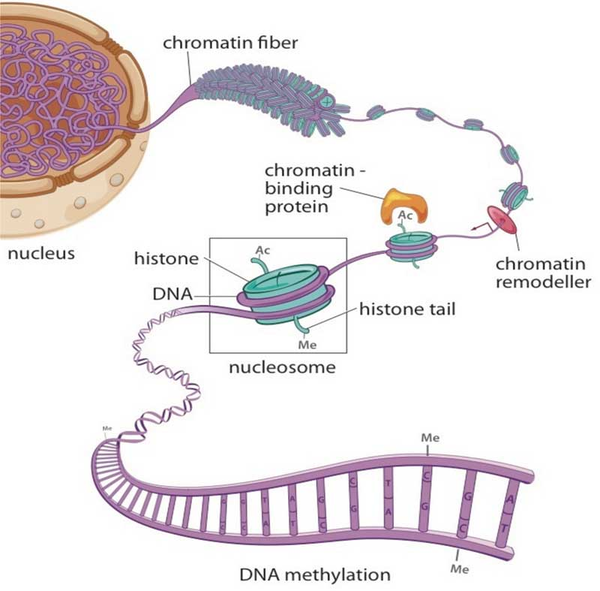
Epigenetics
Studies changes in gene expression which are not encoded by the underlying DNA sequence
Chromatin
histone modification
non-coding RNAs
higher order structure (accessibility/compaction)
DNA cytosine methylation
From The Cell Biology of Stem Cells (2010)

Slide 3
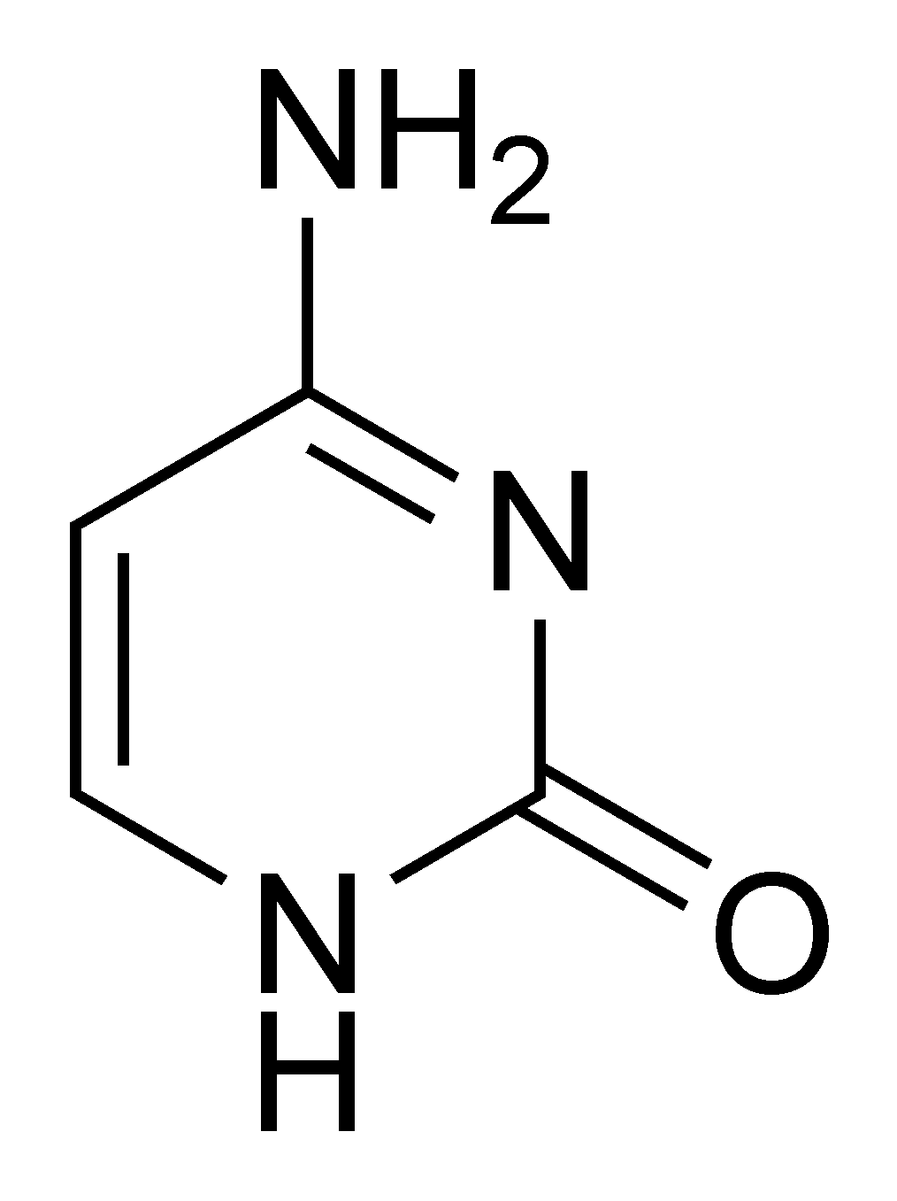
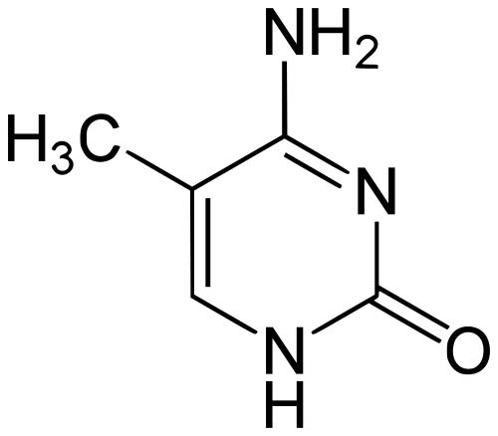
DNA Methylation
DNA methyl-transferases
Active Demethylation
Passive demethylation
Cytosine
5-methyl Cytosine

Slide 4
Context of DNA methylation
CG context
non-CG context
me
me
T
C
G
T
A
T
C
A
T
A
5’
5’
5’
5’
3’
3’
3’
3’
A
G
C
A
T
A
G
T
A
T
me
 | Mammals | Plants
CG | present | present
CHG | (mostly) absent | present
CHH | (mostly) absent | (mostly) absent
H = T/A/C

Slide 5
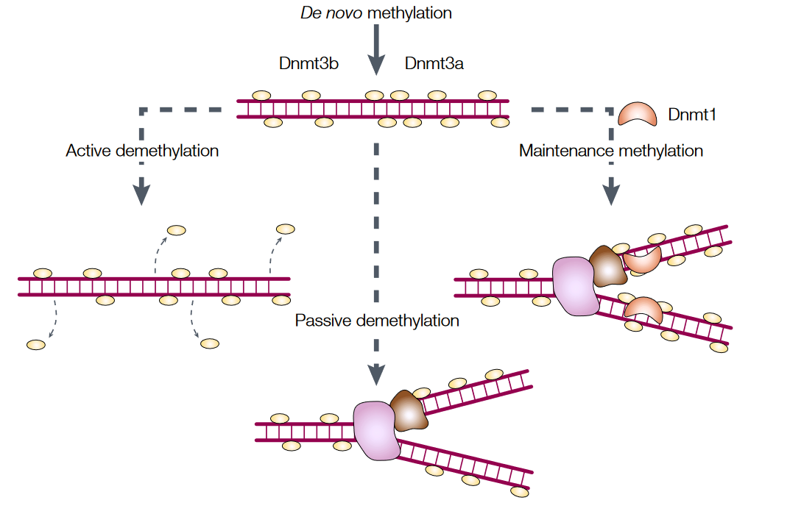
Methylation Maintenance
Passive Demethylation
from W. Reik & J. Walter, Nat. Rev. Genet. 2001

Slide 6
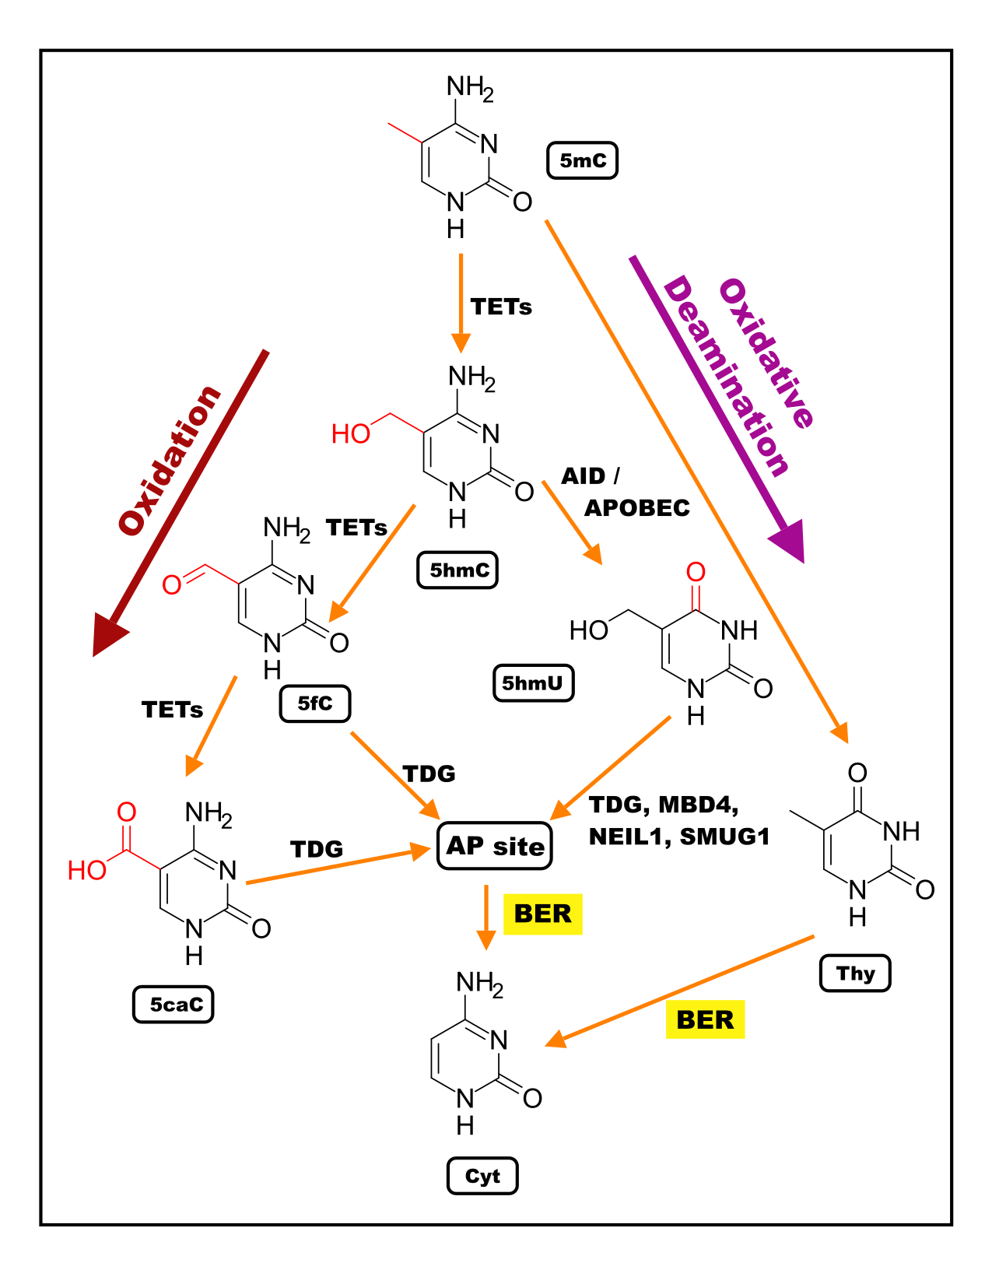
Active Demethylation
C to mC is a direct reaction
mC to C is indirect
  mC to 5fC
  mC to 5hmU
Base Excision Repair then converts back to Cytosine

Slide 7
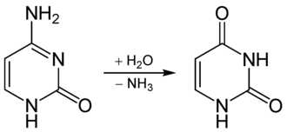
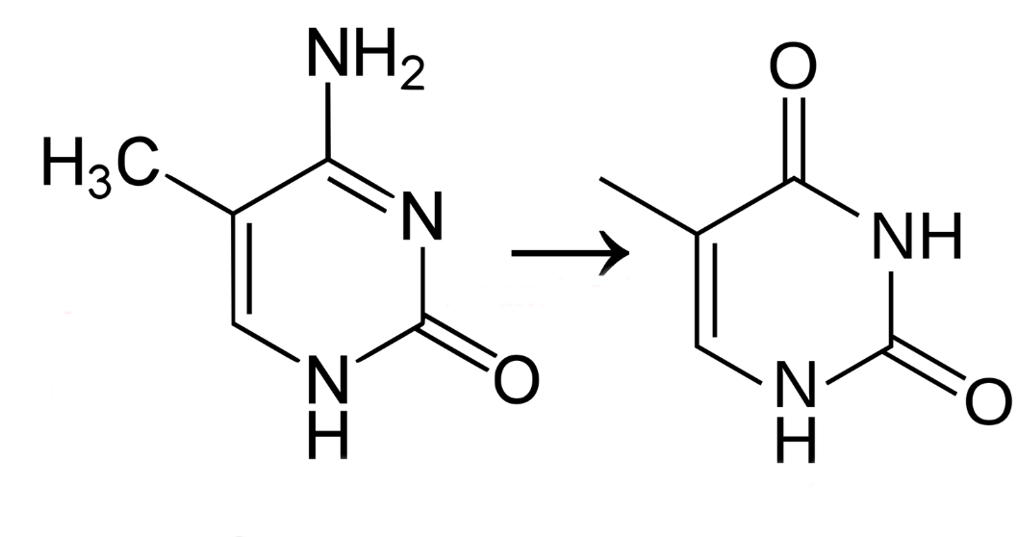
Cytosine Mutation
Spontaneous Deamidation
Cytosine
Uracil
5m-Cytosine
Thymine
Common occurrence
Uracil is non-natural base
Fixed by Uracil Degylcosylase
Less common occurrence
Thymine is a natural base
Often leads to C to T Mutation

Slide 8
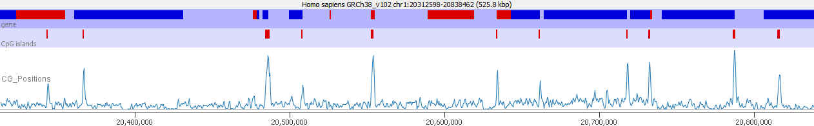
Bringing Things Together
Methylation only persists on CpG dinucleotides
Methylated Cytosines tend to mutate to Thymine (CpG > CpT)
CpGs are rare in the genome – concentrate at CpG islands
CpGs inside islands are mostly unmethylated
CpGs outside islands are mostly methylated

Slide 9
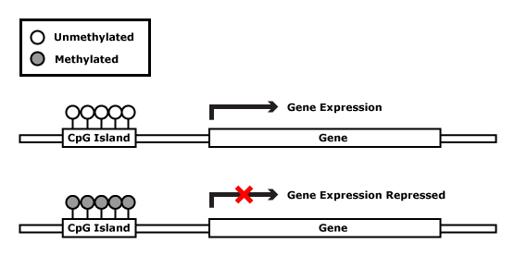
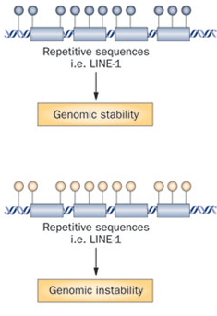
Regulation by DNA methylation
Silencing of gene expression
Tissue differentiation and embryonic development
Faults in correct DNA methylation may result in
early development failure
epigenetic syndromes
cancer
Repeat activity
Genomic stability

Slide 10
Genomic Imprinting mono-allelic expression
Differential allelic
DNA methylation
CGI (CpG island)
X
methylated CpG
unmethylated CpG
Imprinted Genes: Mono-allelic expression with parent-of-origin specificity. Have key roles in energy metabolism, placenta functions.

Slide 11
Measuring Cytosine Methylation by Sequencing
Short Read Sequencing
(Illumina, Aviti etc)
Long Read Sequencing
(Oxford Nanopore)
Based on DNA Polymerase
C and mC both pair to G
Can’t directly sequence mC
Need a chemical trick to make mC look different to C
Based on electrical signal as DNA passes through a pore
C and mC give different signals
Can sequence methylation directly
Need a base caller trained for this

Slide 12
Bisulphite-Seq or EM-Seq
Unmethylated
Cytosine
Uracil
(Recognised as Thymine)
Methylated Cytosines are NOT affected
Chemical (Sodium Bisulphite): Easy, cheap, harsh
Enzymatic (TET, T4BGT, APOBEC3A): Efficient, more expensive!

Slide 13
Bisulfite Sequencing
me
me
CCAGTCGCTATAGCGCGATATCGTA
Convert
TTAGTTGCTATAGTGCGATATTGTA
Map
TTAGTTGCTATAGTGCGATATTGTA
|||||||||||||||||||||||||
...CCAGTCGCTATAGCGCGATATCGTA...

Slide 14
Sequencing Double Stranded DNA
mC
|
mC
|
>>CCGGCATGTTTAAACGCT>>
<<GGCCGTACAAATTTGCGA<<
Top strand
|
mC
|
hmC
|
mC
Bottom strand
Bisulfite conversion
>>UCGGUATGTTTAAACGUT>>
<<GGUCGTACAAATTTGCGA<<
PCR amplification
OT
>>TCGGTATGTTTAAACGTT>>
>>CCAGCATGTTTAAACGCT>>
CTOB
CTOT
<<AGCCATACAAATTTGCAA<<
<<GGTCGTACAAATTTGCGA<<
OB
FOUR possible sequences from the same original region

Slide 15

Sequence Reads
Reference Genome
CT Converted
Reads
GA Converted
Reads
CT Converted
Genome
GA Converted
Genome
All vs All Alignment
Best Alignment
Infer Methylation
Bismark

Slide 16

Raw Sequence Reads
Sequence QC Checks
Bismark Alignment
PCR Duplicate Removal
Extract Methylation Calls
Create Report
Bismark

Slide 17
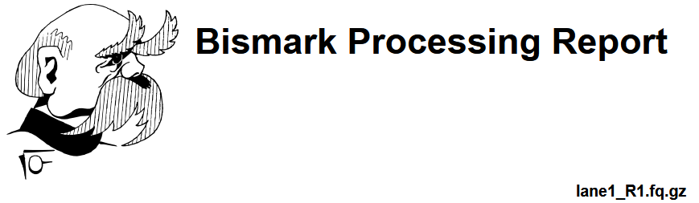
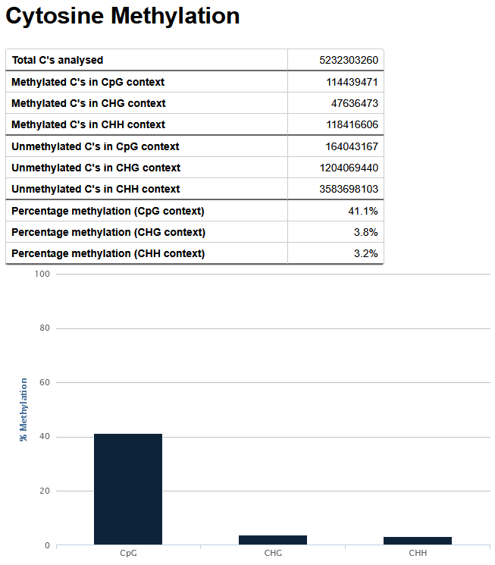
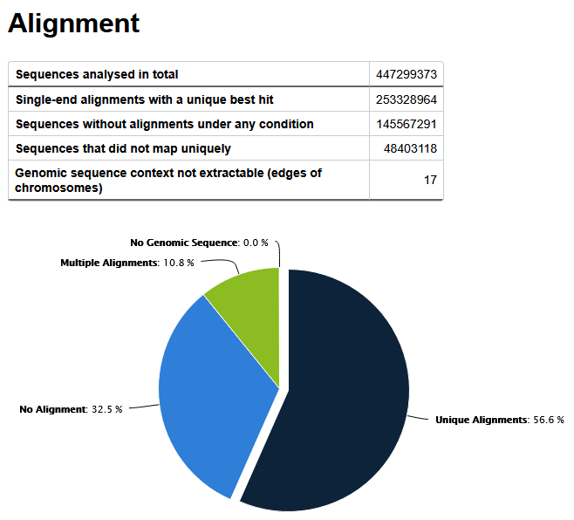

Slide 18
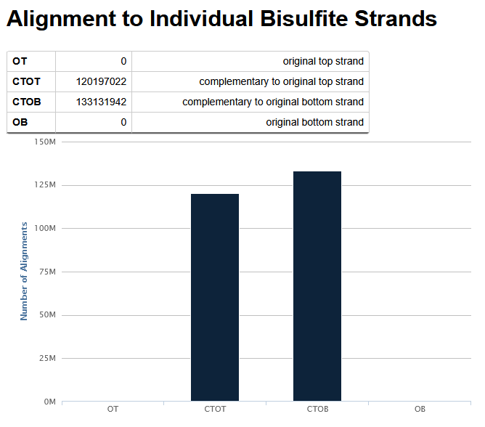
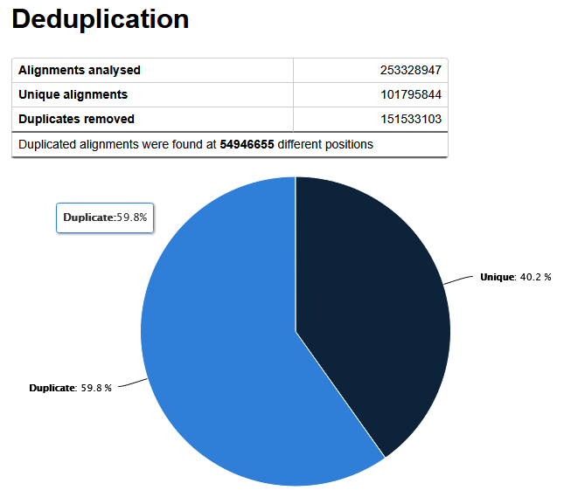

Slide 19
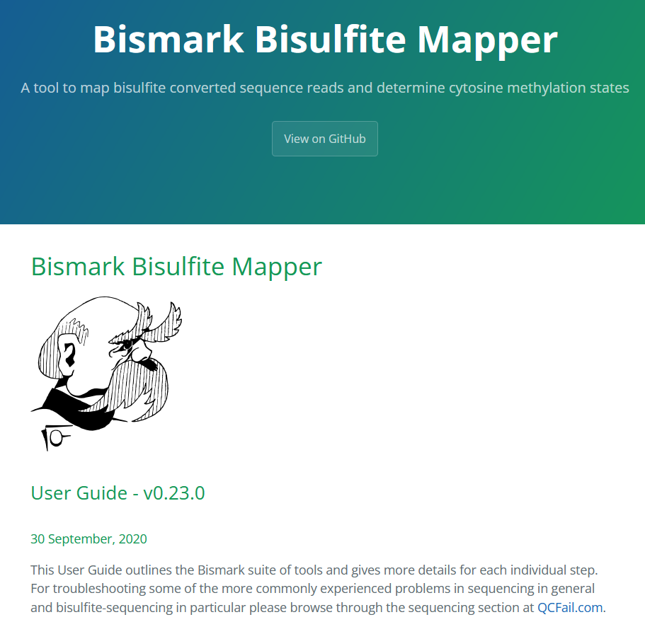
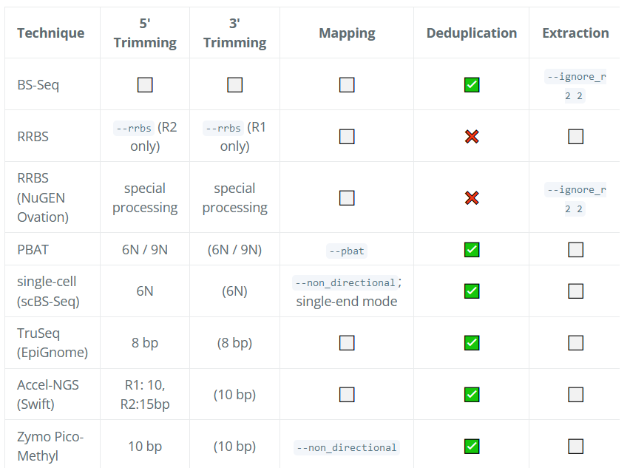
http://felixkrueger.github.io/Bismark/Docs/

Slide 20
Bismark Coverage Files
Unmeth Count
Meth Count
Chromosome
Start
End
%Meth
18 6638214 6638214 0 0 3
18 6638233 6638233 0 0 5
18 6638291 6638291 0 0 7
18 6638303 6638303 0 0 6
18 6638322 6638322 0 0 8
18 6638339 6638339 40 2 3
18 6638765 6638765 0 0 1

Slide 21
Visualising and Exploring Methylation Data
Simon Andrews

Slide 22
Which Data do you use?
Methylation contexts
  CpG: Only generally relevant context for mammals
  CHG: Only known to be relevant in plants
  CHH: Generally unmethylated
Methylation strands
  CpG methylation is generally symmetric
  Normally makes sense to merge OT / OB strands

Slide 23
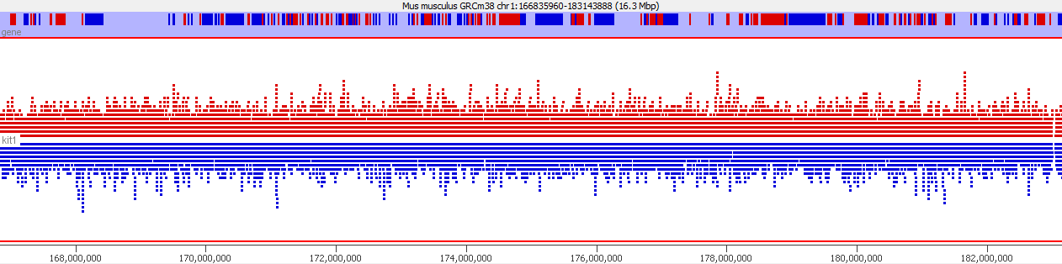
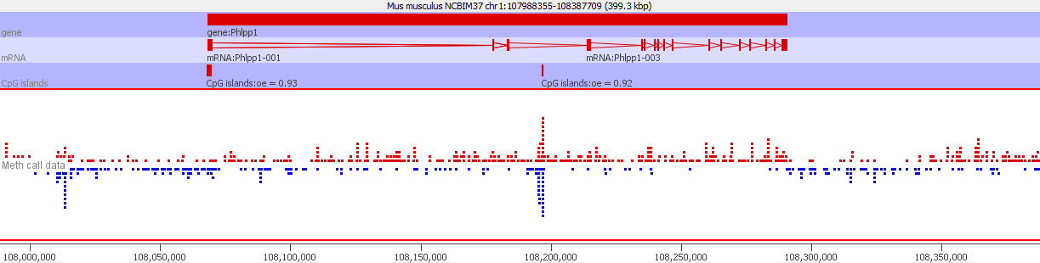
Looking at your data
Reads (red=for blue=rev)
Calls (red=meth blue=unmeth)

Slide 24
Quantitating your Data (Percent Methylation)
Per Base
  Is possible, but generally not enough data to be practical
In Windows
  Windows Tiled over the genome
  Puts more data into each measurement
Over Features
  CpG Islands
  Gene Bodies

Slide 25
Building Measurement Windows
Fixed Size
Region A
Region B
50% Methylation
50% Methylation
Fixed Data
Region A
Region B

Slide 26
Calculating Percentage Methylation
= meth
= unmeth
(6/10) * 100 = 60% methylated

Slide 27
Calculating Percentage Methylation
Total methylated calls = 15
Total unmethylated calls = 10
Methylation level = (15/(15+10))*100 = 60%

Slide 28
Calculating Percentage Methylation
Percentage methylation from all calls independently = 46%
Percentage methylation from mean methylation per base = 80%

Slide 29
Calculating Percentage Methylation
67%
43%
Common = 60% in both

Slide 30
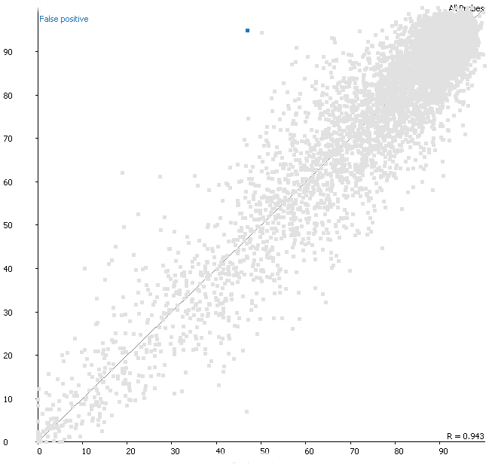
This affects real data
p=3.2⁻⁷

Slide 31
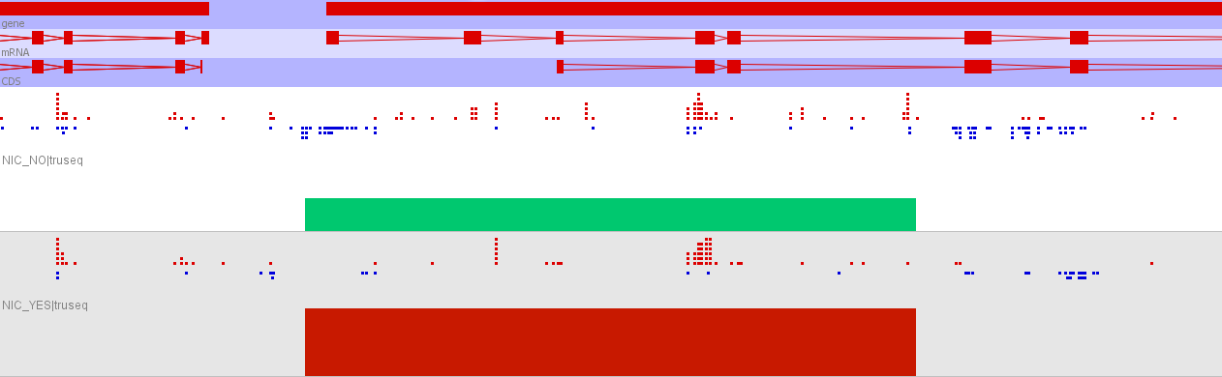
This affects real data
47%
94%

Slide 32
Answering Basic Questions
Patterning
  What sorts of changes in methylation do I observe along a chromosome
Distributions
  What are the overall levels and distributions of methylation values in my samples
Comparisons
  On a global scale what is the overall relationship between methylation levels in different samples

Slide 33
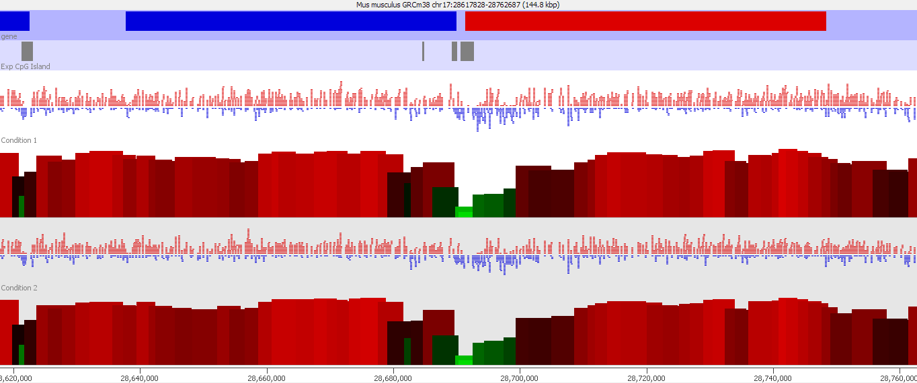
Patterning

Slide 34
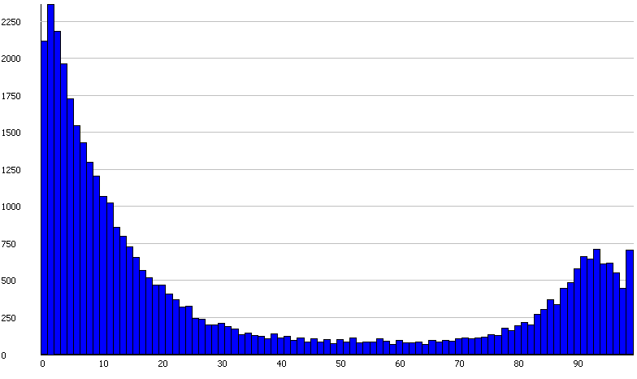
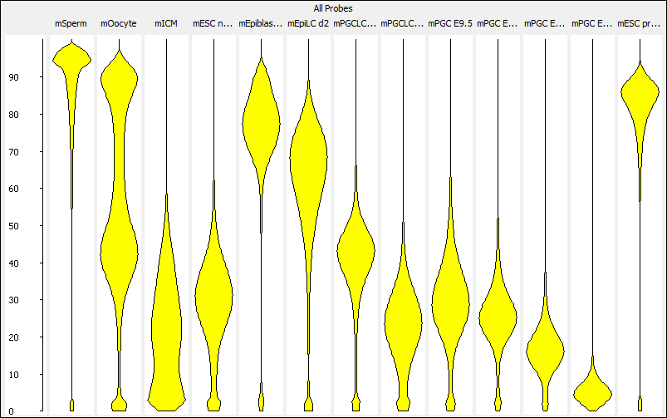
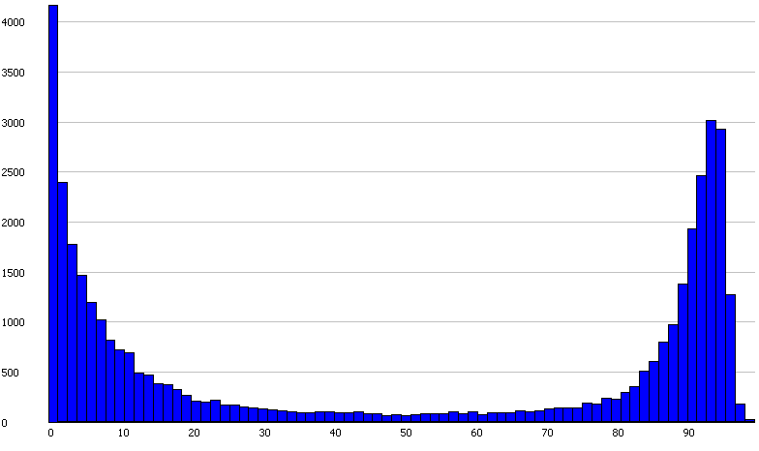
Distributions

Slide 35
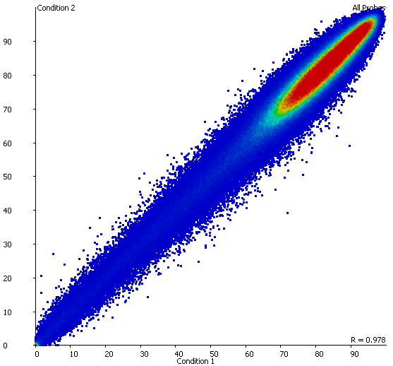
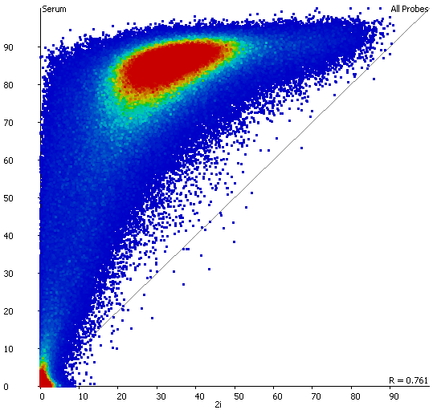
Comparisons

Slide 36
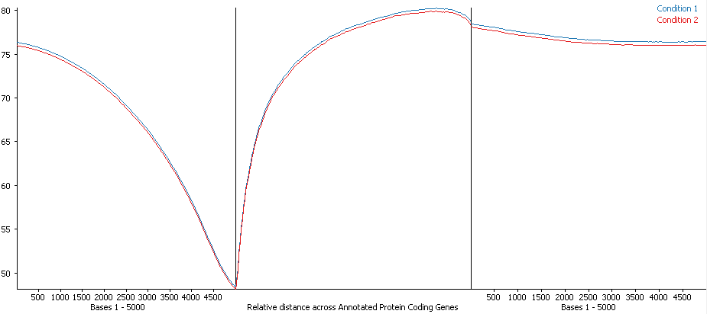
MetaGene Summaries
Upstream Region
Gene Body
Downstream Region

Slide 37
Exercise
Visualising and Exploring Methylation Data in SeqMonk

Slide 38
Differential Methylation Statistics
Simon Andrews

Slide 39
A simple question…

Slide 40
Two Strategies
Raw Data
Reverse
Counting
Normalised %methylation
Counts of Meth/Unmeth
Continuous value statistics
Count based statistics

Slide 41
Sensible Questions
Which regions show a significant change in methylation level between the two conditions?

Slide 42
Sensible Questions
Which regions show a significant change in methylation level between the two conditions?
Which regions show a change in methylation which is larger or smaller than the global change beteen the samples overall?

Slide 43
The problem of power…
Ideally we’d like to analyse every Cytosine (CpG) individually
It’s unlikely we’ll have enough data to identify significantly changing bases per base
Analysing in windows provides higher counts and more power

Slide 44
Power Analysis
(Assuming a human genome with p<0.05 and power of detection of 0.8)
Window Size (# CpG cytosines)
Absolute
methylation
change
(from 80%)
Required Fold Genome Coverage

Slide 45
Count Based Statistics

Slide 46
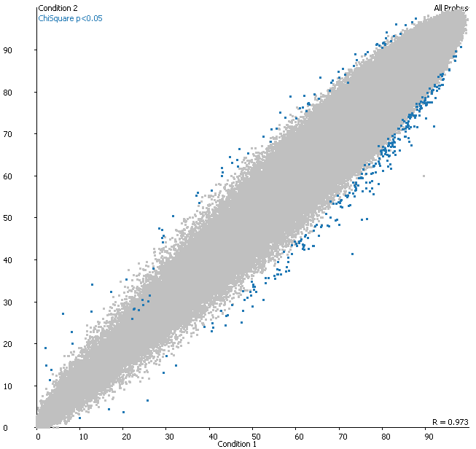
Contingency Statistics
Count Based Stats
Unreplicated design
  Chi-Square
  Fisher’s Exact
Replicated Design
  Logistic Regression
  Binomial Linear Model

Slide 47
Contingency Stats Example
51% Methylated
36% Methylated
fisher.test(
matrix(
c(51,32,48,58),
nrow = 2
)
)
Fisher's Exact Test for Count Data
data: matrix(c(51, 32, 48, 58), nrow = 2)
p-value = 0.02897
*NB: This takes no account of running multiple tests

Slide 48
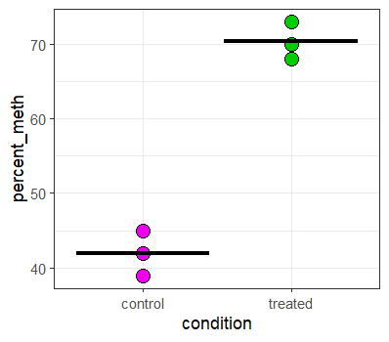
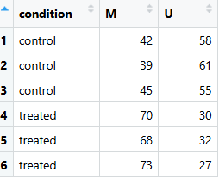
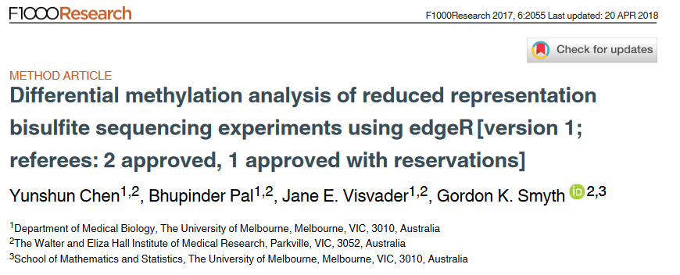
Samples with Replicates
glm(
cbind(M, U) ~ condition,
data = dat,
family = binomial()
) -> fit
summary(fit)
Call:
glm(formula = cbind(M, U) ~ condition,
family = binomial(), data = dat)
Coefficients:
Estimate Std. Error z value Pr(>|z|)
(Intercept) -0.3228 0.1170 -2.759 0.00579 **
conditiontreated 1.1860 0.1722 6.887 5.71e-12 ***

Slide 49
Continuous Statistics

Slide 50
Statistics on Continuous Values
Simple Models
Must have replicates
  T-Test
  ANOVA
Can’t use technical significance
Less Powerful than count based
Make assumptions about data behaviour
Continuous value linear models
More flexible – allow more complex designs
LIMMA – allows better variance estimates
Still less powerful than count stats

Slide 51
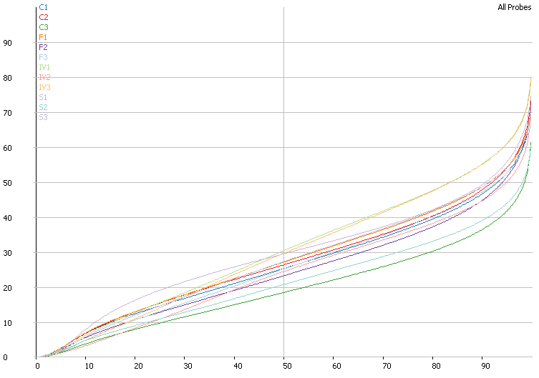
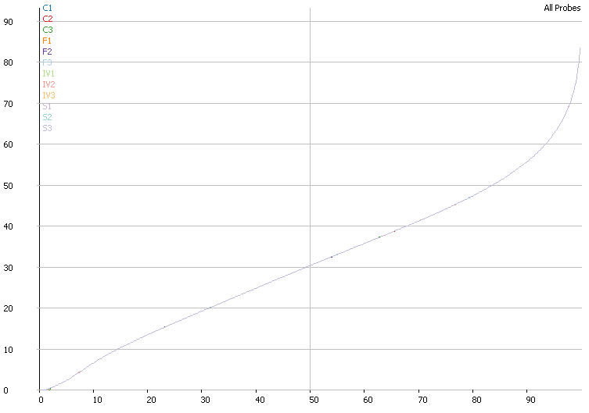
Global vs Local Effects
Original Methylation Levels
After Quantile Normalisation

Slide 52
Reverse counting
Some packages offer a conversion from normalised methylation back to counts
Allows count based statistics – regains the lost power from normalisation
Retains information about noise from the true observation level
True observations: Meth = 20 Umeth=30 (40% meth)
Corrected % methylation = 50%
Reversed counts: Meth = 25 Unmeth=25

Slide 53
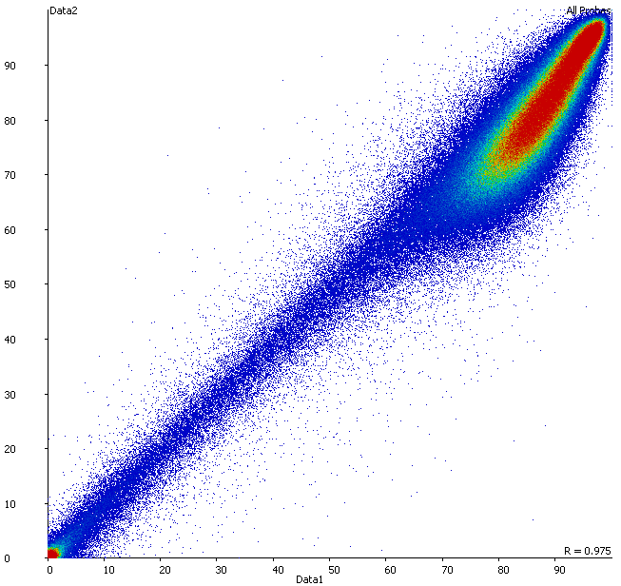
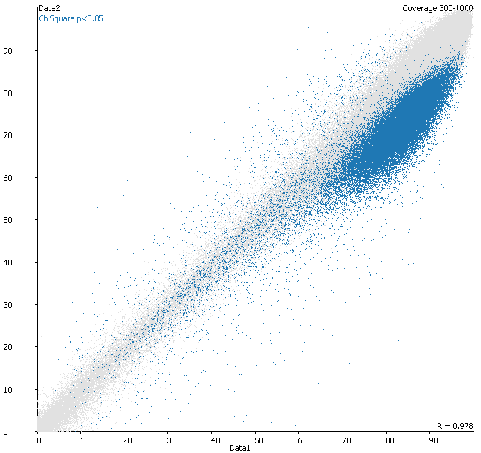
Correction can have a big effect

Slide 54
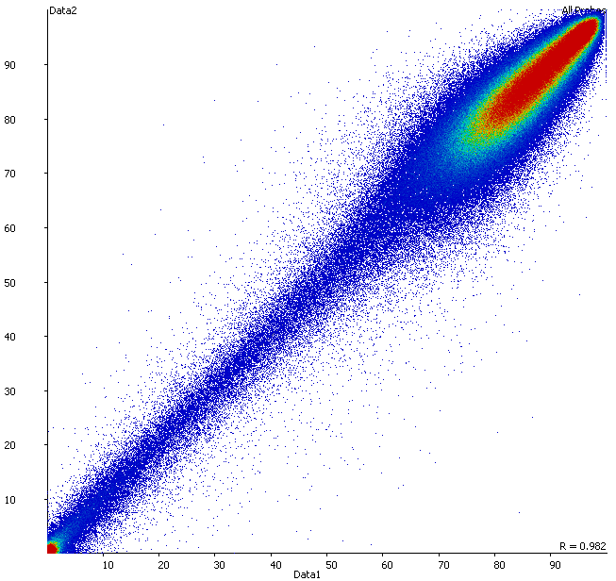
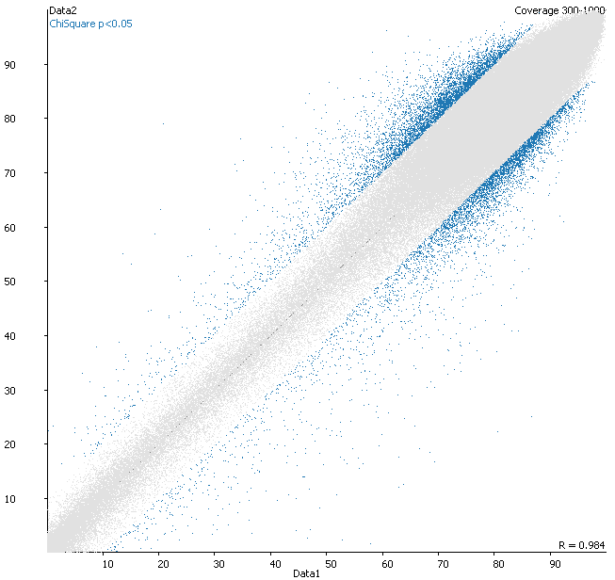
Correction can have a big effect

Slide 55
Exercise
Differential Methylation Statistics in SeqMonk

