Slide 1

Differential Methylation Analysis
Simon Andrews
simon.andrews@babraham.ac.uk
@simon_andrews
v2021-04

Slide 2
A basic question…

Slide 3
Two Strategies
Raw Data
Reverse
Counting
Normalised %methylation
Counts of Meth/Unmeth
Continuous value statistics
Count based statistics

Slide 4
Factors to consider
Formulating a sensible question
Applying corrections if needed
Assessing statistical power
Relating hits to biology

Slide 5
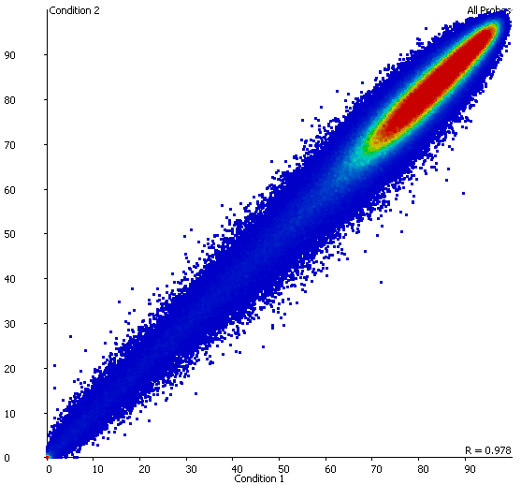
Question
Which areas show a significant change in methylation level between the two conditions?

Slide 6
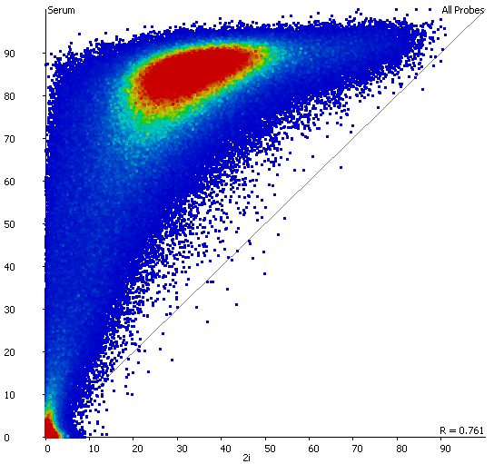
Question
Which areas show a change in methylation which is larger or smaller than the global change in the samples overall?

Slide 7
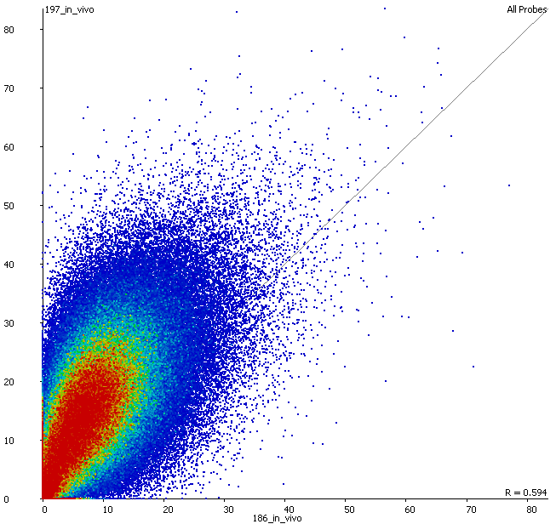
Question
Which areas show a change in methylation after correcting for the small global differences?

Slide 8
Count based statistics

Slide 9
Count Data
Is the difference in ratios significant given the
observation levels of the samples

Slide 10
The problem of power…
Ideally want to cover every Cytosine (CpG)
Should correct for the number of tests
It’s unlikely you’ll collect enough data to analyse each C and have p-values which survive multiple testing correction
Generally need to analyse in windows

Slide 11
Window sizes
Effect size
Small
Large
Good resolution
Specific biological effects
High MTC burden
Small observations
High p-values
Lots of data
High statistical power
Low MTC burden
Low p-values
Effect averaging

Slide 12
Power Analysis
(Assuming a human genome with p<0.05 and power of detection of 0.8)
Window Size (# CpG cytosines)
Absolute
methylation
change
(from 80%)
Required Fold Genome Coverage
Without Multiple
Testing Correction

Slide 13
Applicable Statistics

Slide 14
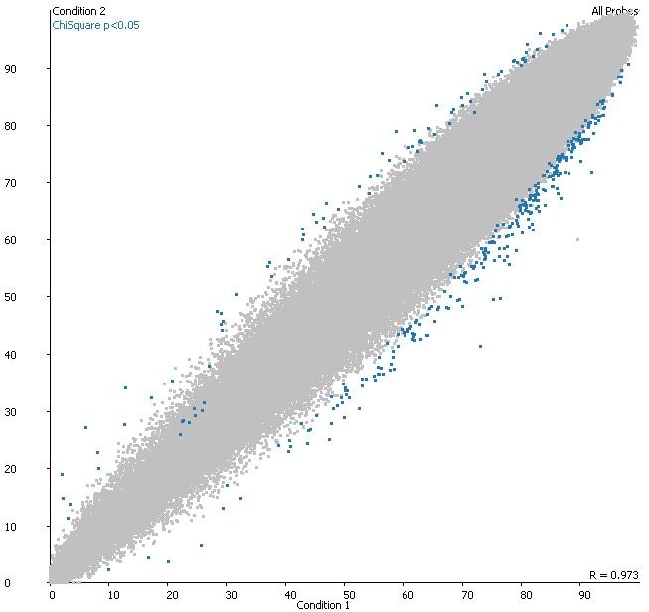
Contingency Statistics are simple to use for differential methylation in well behaved data
Unreplicated
  Chi-Square
  Fisher’s Exact

Slide 15
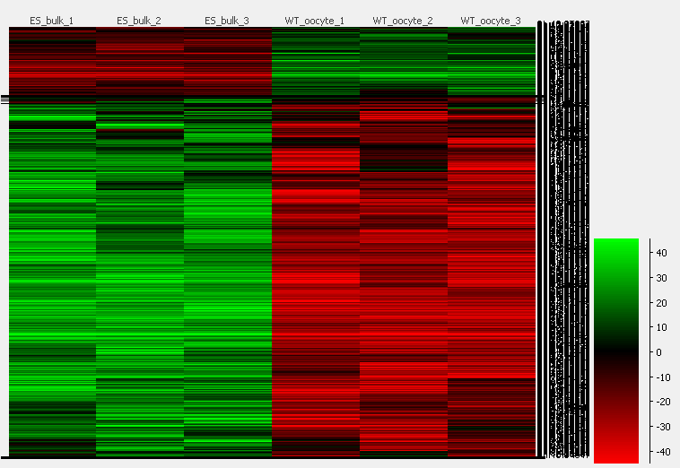
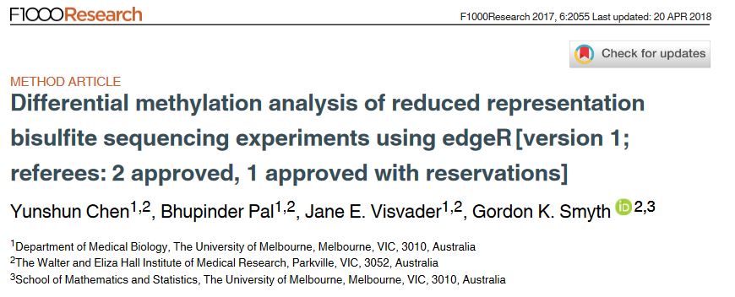
Contingency Statistics are simple to use for differential methylation in well behaved data
Replicated Contingency
Logistic Regression
Linear Modelling of counts
EdgeR

Slide 16
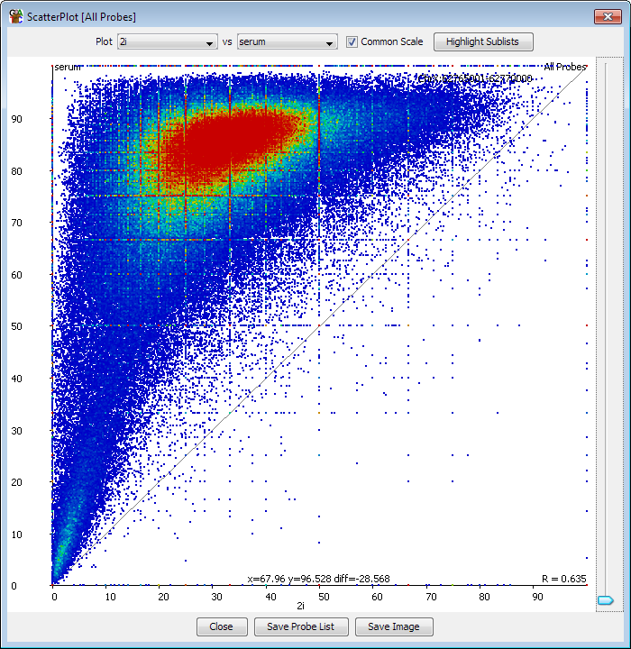
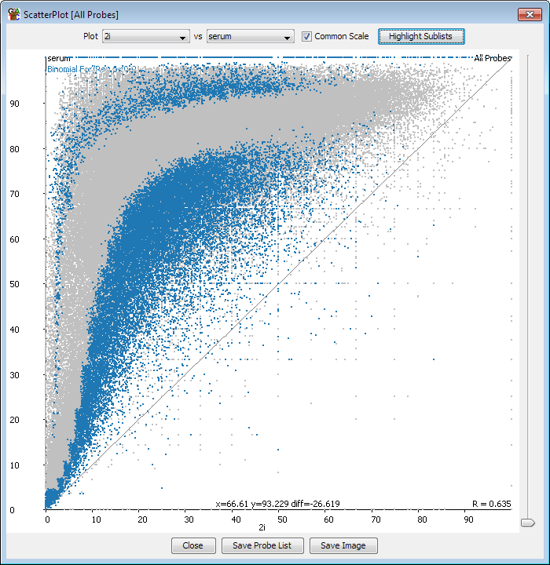
Binomial statistics can find interesting points in globally changing datasets
Changes the default expectation
Find average difference for each starting point
Select points which exhibit unusual change

Slide 17
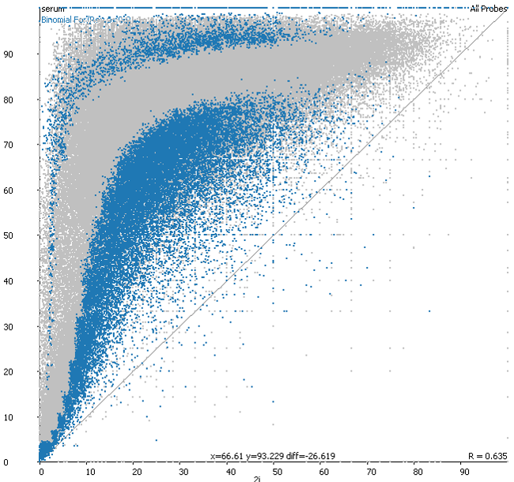
Globally changing example
Starting level = 30%
Observations = 14 meth 6 unmeth
Expected End level = 85%
Binomial test, p=0.85, trials=20, successes=14
Raw p=0.106

Slide 18
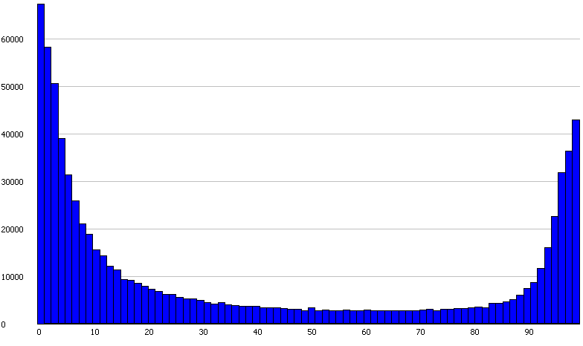
Beta Binomial Models
What is the probability distribution for the true methylation level?
Simple model: Binomial stats to estimate confidence
Can we do better?
Genome-wide methylation profile.
All levels are not equally likely
Can inform the construction of a
Custom beta binomial distribution

Slide 19
Beta-binomial model
Measure 3/20 observations as methylated
The binomial distribution would be defined by the mean and observations
Using the whole genome prior a beta-binomial model would upweight the
lower methylation levels, since these are more common.
Provides increased power in comparisons between major groups
Often computationally intensive

Slide 20
Limitations of count based stats
No subdivision of calls – all calls are equal even when coverage isn’t
  Supplement with differences based on better quantitation
Potential biased by power
  Can alleviate with CpG window based analysis
  Easy to bias data otherwise
  Problem of interpretation, not statistics

Slide 21
Methylation Level Statistics

Slide 22
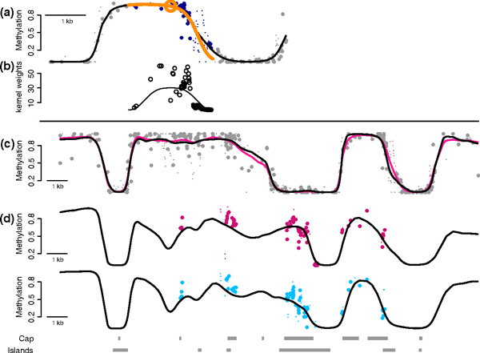
BSmooth algorithm for methylation correction
black: 25x (Lister)
pink: 4x (Lister)

Slide 23
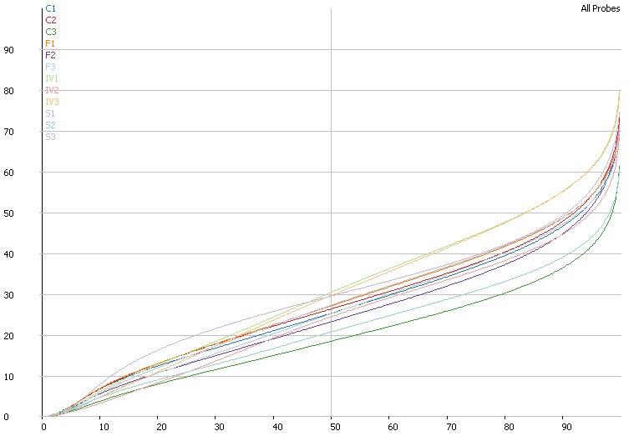
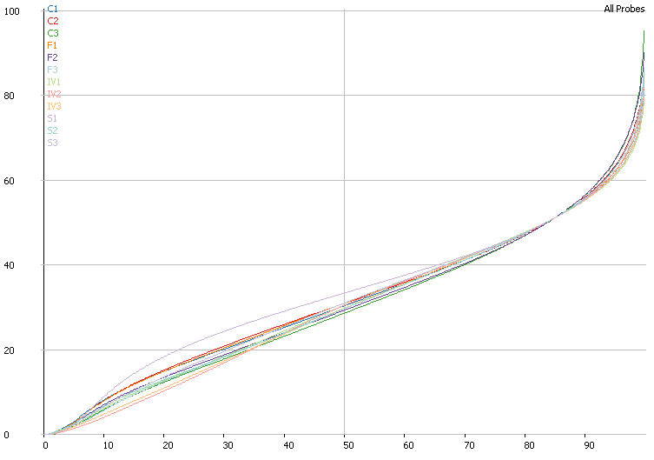
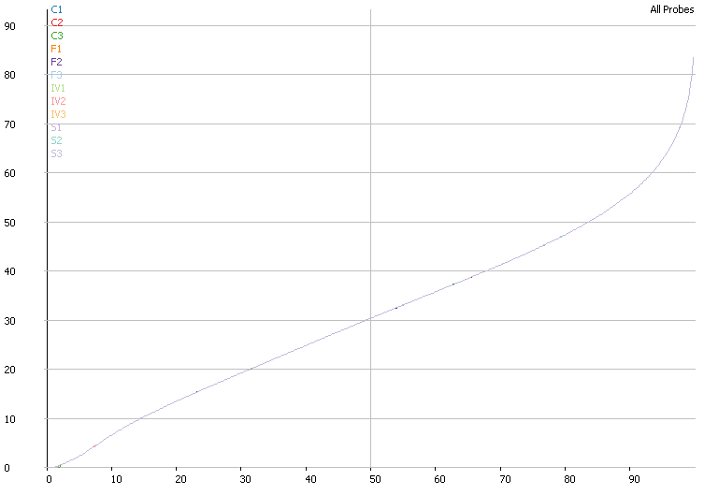
Normalisation for methylation levels
Original Levels
Single Correction
Quantile Normalisation

Slide 24
Statistics
Standard continuous statistics
  T-Test
  ANOVA
Information sharing continuous stats
  LIMMA
Reduced power – one value per replicate

Slide 25
Reverse counting
Some packages offer a conversion from normalised methylation back to counts
Allows count based statistics – regains the lost power from normalisation
Retains information about noise from the true observation level
True observations: Meth=20 Umeth=30 (40% meth)
Corrected % methylation = 50%
Reversed counts: Meth=25 Unmeth=25

Slide 26
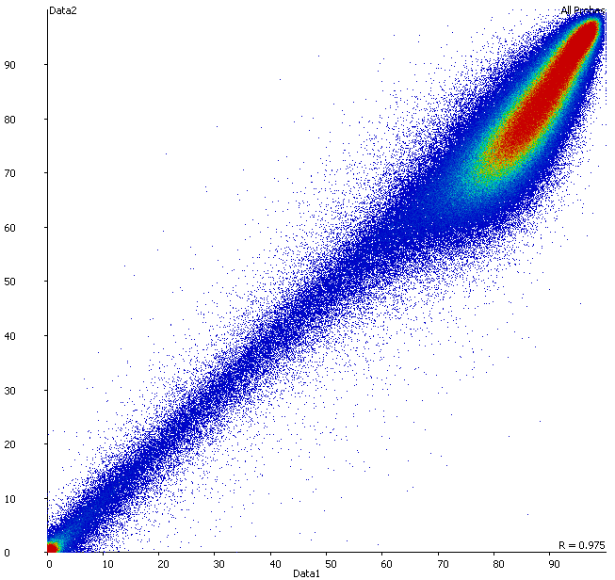
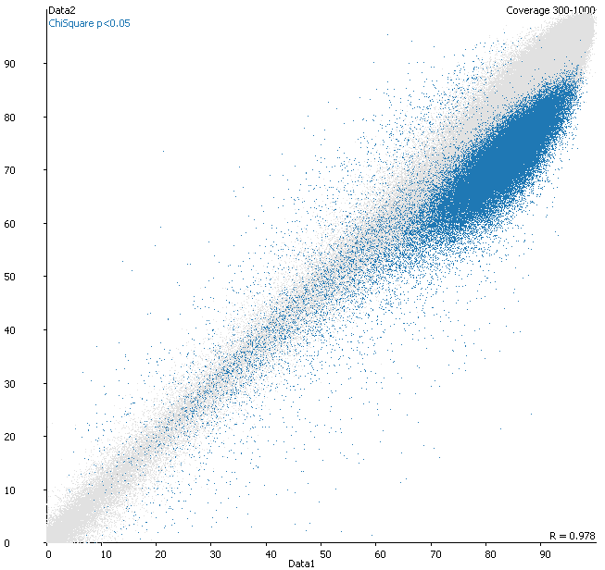
Reverse counting of normalised data can give very different results

Slide 27
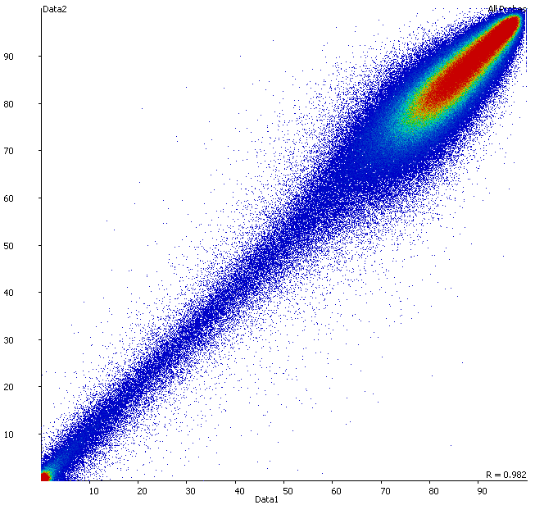
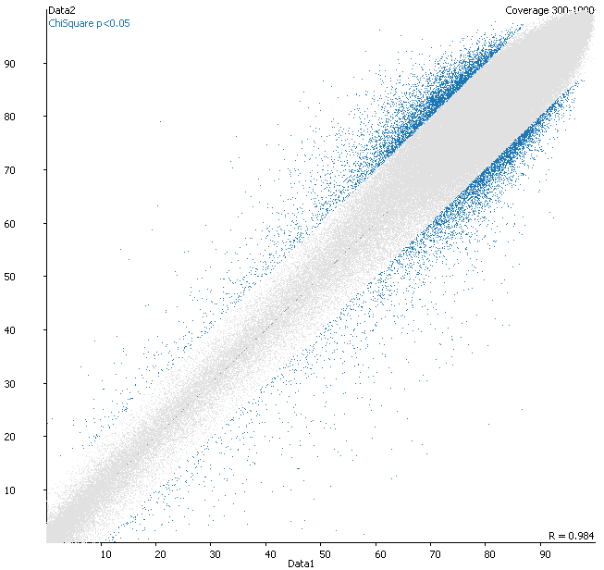
Reverse counting of normalised data can give very different results

Slide 28
Reviewing Hits

Slide 29
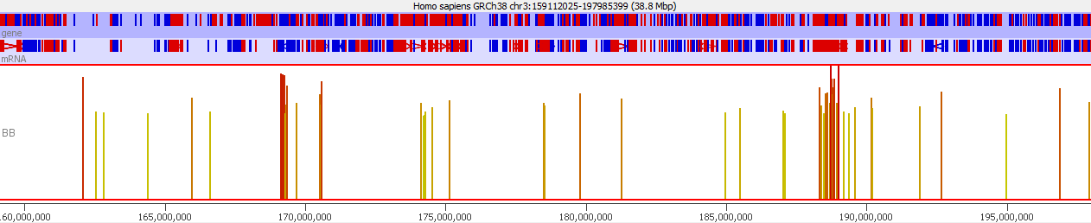
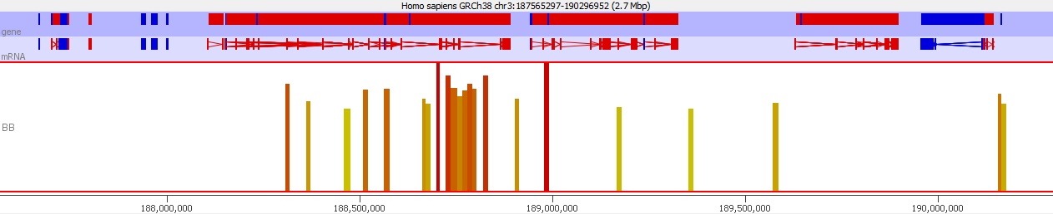
Look for hit clusters
Grouping to create larger candidate regions
Check intermediate regions for consistency

Slide 30
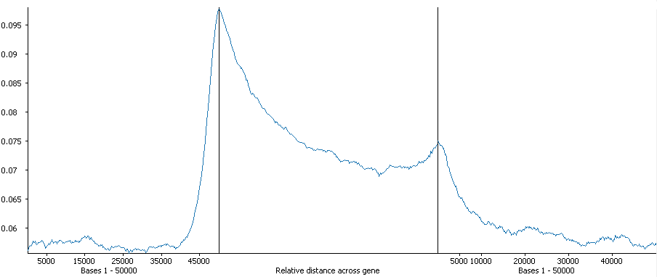
Patterning of hits may suggest more specific ways to quantitate and analyse.

Slide 31
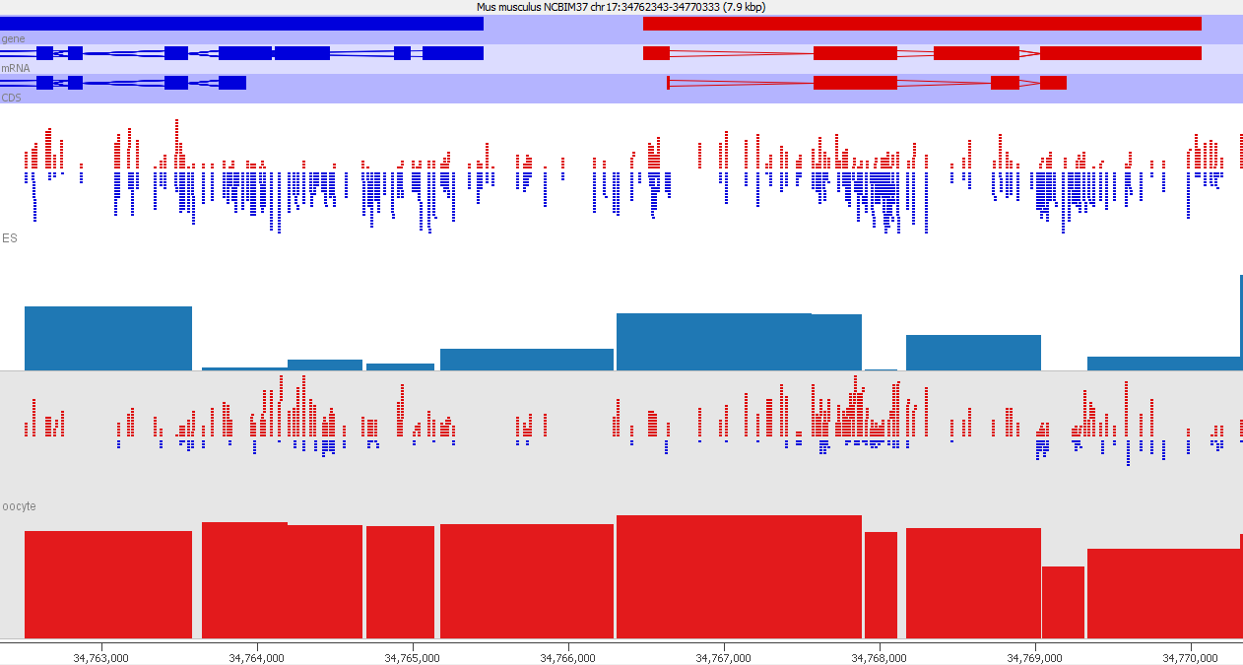
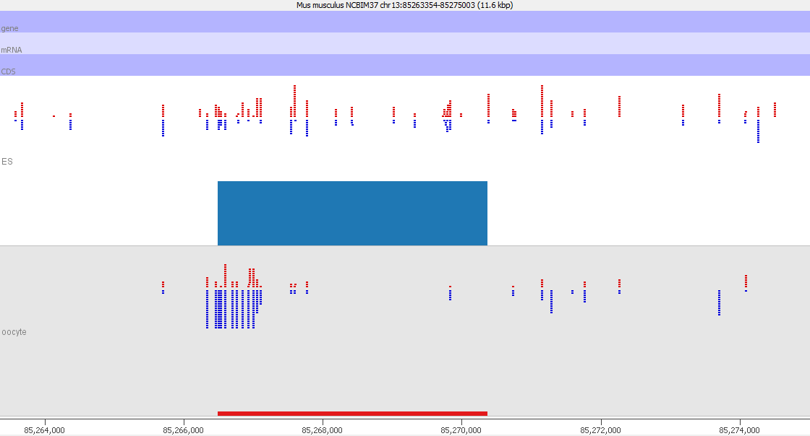
Look at underlying data for artefacts

Slide 32
Biological considerations
Minimum relevant effect size?
  Balance power vs change
  What makes biological sense
  (what would you follow up?)
Position relative to features
Consistent change over adjacent regions

Slide 33
Methylation statistics packages
SeqMonk (Graphical Analysis Package)
  Flexible measurement based on fixed windows, fixed calls or features. Complex corrected methylation calculation and several optional post-calculation normalization options. Chi-Square with optional resampling for unreplicated data, logistic regression with optional resampling for replicated data.
EdgeR (R-package by Gordon Smyth)
  Originally designed for count data (RNA-Seq mostly), there is now a mode which models paired counts for meth/unmeth to provide differential methylation statistics. Stats are based around negative binomial linear models.
methylKit (R-package by A. Akalin et al.)
  Sliding window, Fisher’s exact test or logistic regression. Adjusts p-values to q-values using SLIM method.
bsseq (R/Bioconductor by K.D. Hansen)
  Implements the BSmooth smoothing algorithm. Numerous CpG-wise t-tests and p-value cutoff to define DMRs. Outperforms Fisher’s exact test. Requires biological replicates for DMR detection
BiSeq (R/Bioconductor by K. Hebestreit et al.)
  Beta regression model, impractical for very large data other than RRBS or targeted BS-Seq
MOABS (C++ command line tool by D. Sun et al.)
  Beta binomial hierarchical model to capture sampling and biological variation, Credible Methylation Difference (CDIF) single metric that combines biological and statistical significance

