Slide 1

Introduction to Machine Learning
Hayley Carr, Simon Andrews, Laura Biggins
hayley.carr@babraham.ac.uk
v2026-03

Slide 2
Agenda for the session
What is machine learning
Different types of machine learning model
Running Models with tidymodels
[Exercise] Building your first model
How to evaluate models
Preparing Input Data
[Exercise] Evaluating Models

Slide 3
What is Machine Learning?

Slide 4
Data Analysis Workflow
Raw Data
Visualisation
Exploration
Modelling
Prediction
Filtering Cleaning
Statistics
Reporting
Collection
Preparation
Formalisation
Outcome
Notes:
Usual set up for data analysis
Machine learning starts same as stats, explore, understand, filter, etc.
But formalise by building model = mathematical representation for our data, summarises main characteristics, that might be more complex than those tested with statistical analysis.
Sometimes point is to build a model- show that you can successfully do this, data is amenable to modelling, can report on this.
Mostly want to build model to make new predictions → apply to new data in the future.

Slide 5
Machine Learning Builds a Model to make Predictions
Data
Model
Prediction
Classification
Regression
Notes:
2 types of predictions can make – type of prediction want to make feedback into what model build, and also what data collect.
Classification – simplest, assign to a category. Can be >2 categories.
Quantitative prediction = regression model. Numerical output.
Some models are classification, sometimes regression, sometimes both. Mostly focus on classification.

Slide 6
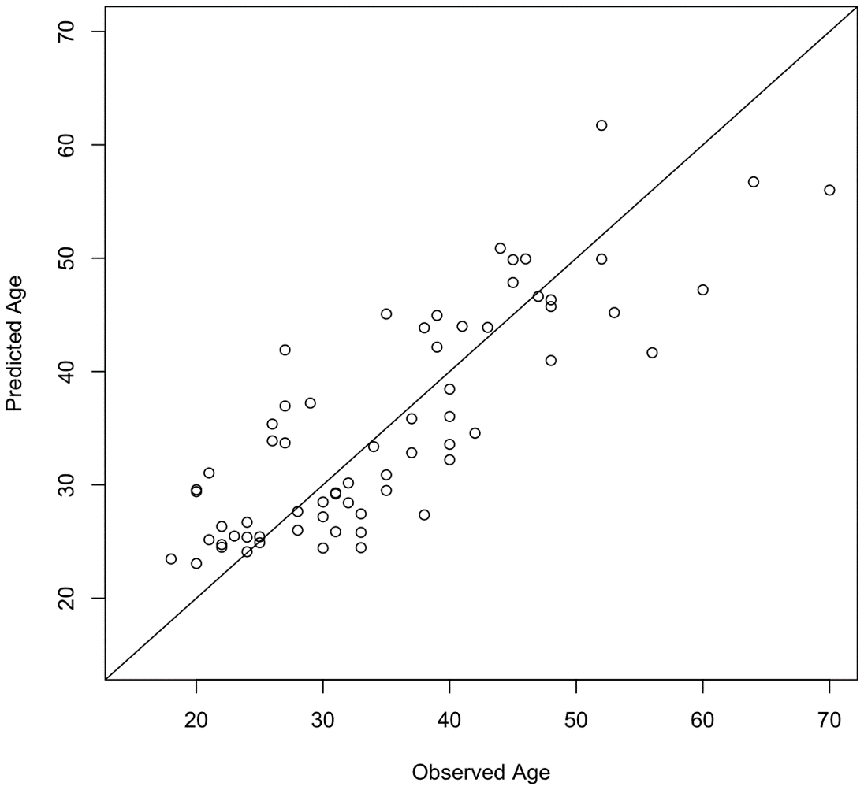
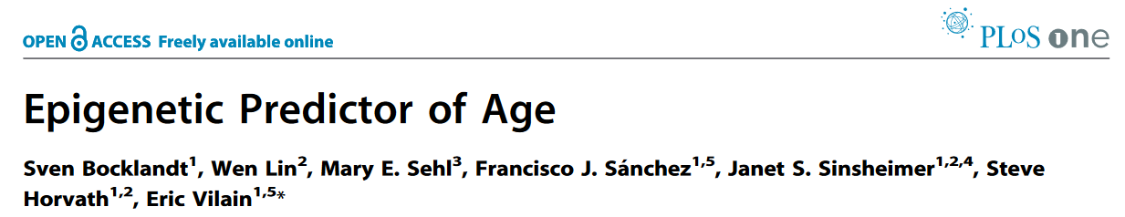
Biological Examples
Input: DNA Methylation from genomic CpGs
Output: Estimated biological age
Notes:
Regression model
Predict biological age of the sample from DNA methylation.

Slide 7
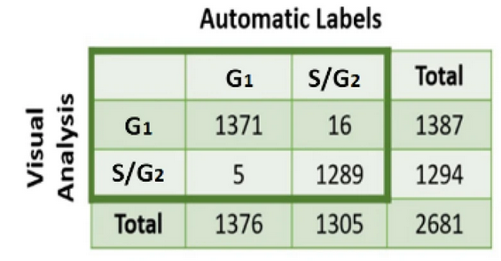
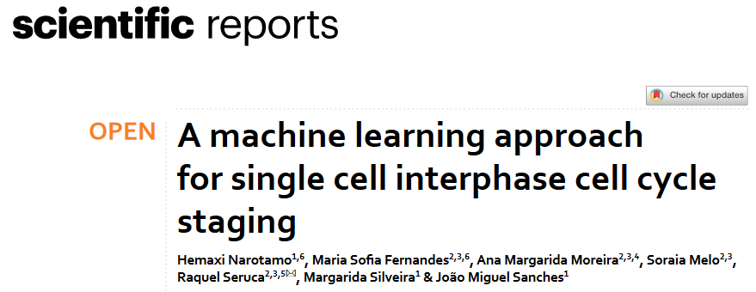
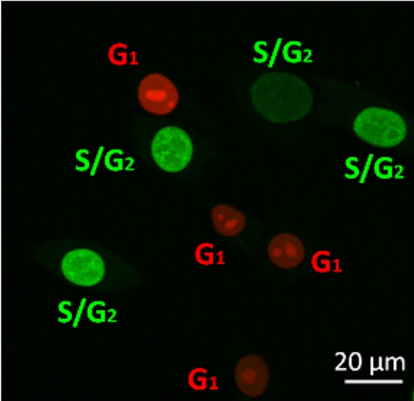
Biological Examples
Input: DAPI stained cell images
Output: Predicted Cell Cycle Stage
Notes:
Classification model
Image stained with DAPI, predicts cell cycle stage.

Slide 8
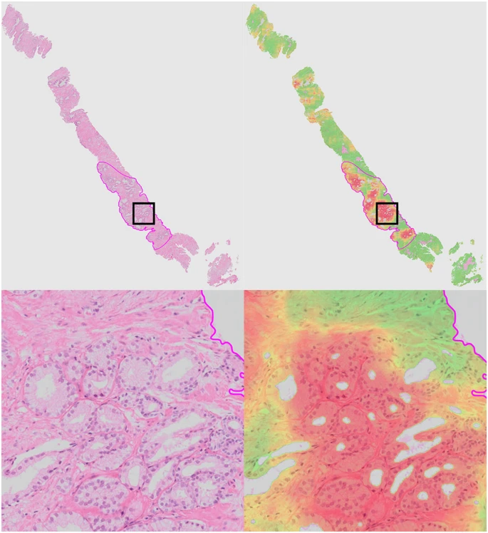
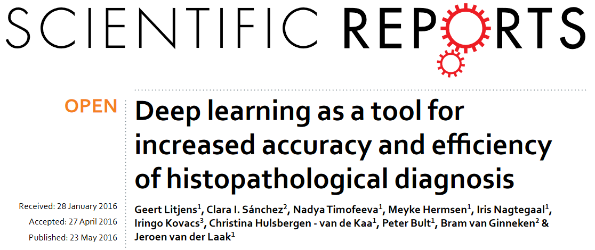
Biological Examples
Input: Histopathology slide images
Output: Cancer likelihood score
Notes:
Assisting clinical diagnoses. Regression model – quantitative score. Could be classification (high/low) but did regression.
Prediction of data not seen before is aim.

Slide 9
Steps in Machine Learning
Refine the model
Generate data for samples where the outcome is known
Pick a modelling method and build a model
Evaluate the model
Test the predictions
Make predictions where the outcome is not known
Notes:
Generate as large dataset as possible, with outcomes covering full range that want to predict.
High quality and large enough data often a challenge.
Don’t have to make definitive choice, but try different options, see what works best. Try several different models.
Refinement – different model approach, tuning parameters (different things can tweak to try to improve for different models)

Slide 10
Different machine learning models

Slide 11
Notes:
Selection of more common models.

Slide 12
Differences between models
Regression
Outcome type
Regression models for quantitative predictions
Classification models for categorical predictions
Some model types can do both
Input type
Some models require all of their variables to be numeric
May need to convert categorical values to numbers
Expected behaviour of input data
Variation in the number of viable measures
Classification
Notes:
Type of prediction want to do, but also type of data going to collect.
Amount of input data also varies, some models. amount of data needed to work efficiently. Some 100s or 1000s, others work with smaller. Some don’t scale well to enormous datasets.

Slide 13
K-Nearest Neighbours (KNN) models
Notes:
Start with simple model, more complex not always better, be pragmatic, want something that works. If simple, quick model works well then that’s ideal.

Slide 14
K-nearest neighbours
Add a new point
Find the K (5 in this case) closest points
Count the categories in the closest points
The highest vote wins
= 4 votes
= 1 vote
Notes:
Data in 2D, could be PCA or something else, 2 groups, either blue or red, want to predict with model.
To predict new data, plot into dataset (green), find 5 nearest neighbours to that point, look at categories and highest vote wins.
So green would be predicted to be blue.
Degrees of complexity sit on top of basic structure. How decide which are 5 nearest points. In this case could measure linear distance but could try different metrics for calculating distances. Can tune in construction of model

Slide 15
Distance Measures
Quantitative:
Euclidean Distance (straight line)
Manhattan Distance (along each axis)
Categorical:
Hamming Distance (how many categories need to switch to make match)
Jaccard Distance
…
Euclidean
Manhattan
A
B
C
D
E
F
Sample 1
Sample 2
Hamming = 2 differences

Slide 16
Naïve Bayes Models
Notes:
Naïve because makes some fairly simple assumptions about your data. Bayes because uses rules defined in Bayes theorem – used for conventional stats, but also used in modelling.

Slide 17
Naïve Bayesian
Bayes' Theorem states that the conditional probability of an event, based on the occurrence of another event, is equal to the likelihood of the second event given the first event multiplied by the probability of the first event.
We calculate a set of probabilities for each variable, based on the "Disease Linked Classification"
Notes:
Simple example, but same principle for more complex.
Look at each parameter separately, probabilities of values that see – focus on chromosome (categorical) and GC content (quantitative).

Slide 18
Categorical Probabilities
p Chr1 | Disease = 5 / 8 = 0.625
p Chr2 | Disease = 2 / 8 = 0.250
p ChrX | Disease = 1 / 8 = 0.125
p Chr1 | Non Disease = 6 / 76 = 0.079
p Chr2 | Non Disease = 20 / 76 = 0.263
p ChrX | Non Disease = 50 / 76 = 0.658
Disease genes are more likely to be on Chr1 and Non Disease genes are more likely to be on ChrX
Notes:
Summarisation – genes fall onto 1, 2 or X chromosome. Disease and non-diseased can see how many on each chromosome.
Probability of one event given probability of second. Probability of gene falling onto each chromosome, separate depending on disease linked or non-disease linked genes.

Slide 19
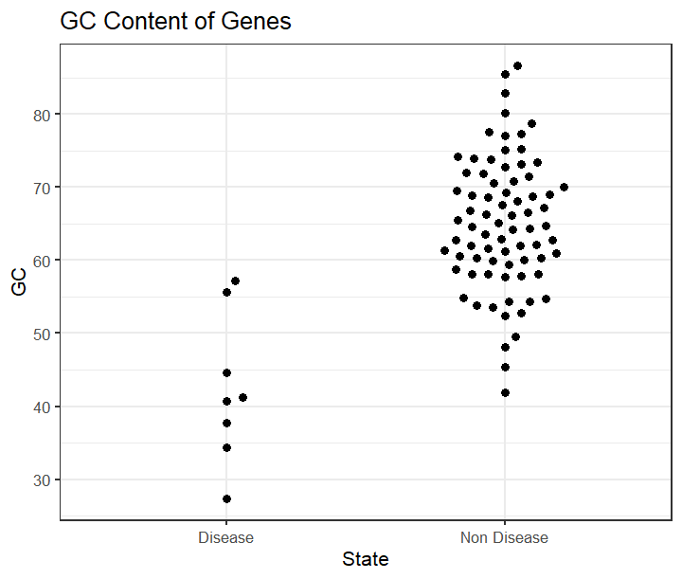
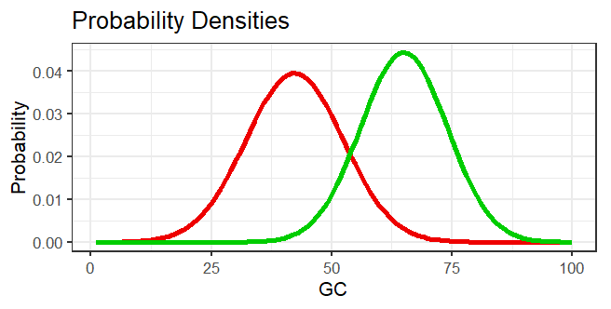
Quantitative Probabilities
State mean stdev
Disease 42.3 10.10
Non Disease 65.0 8.99
Disease
Non-Disease
40
Assumption: quantitative values are normally distributed
Notes:
Distribution of values not the same between the two, lower GC content in disease than non-disease genes.
Assumptions associated with Bayes = normally distributed values for quantitative.
Summarise disease and non-disease genes using mean and sd. Use these to create theoretical probability density – probability for disease or non-disease for a particular GC value. E.g. at 40% GC compare probability in disease vs non-disease – quite likely to be disease, not very likely to be non-disease.
How combine all this together?

Slide 20
Naïve Bayes Predictions
Predict the state for a new datapoint
Chromosome is 1
GC content is 40%
Disease
Non
-
Disease
Prior
(8/84) = 0.095
(76/84) = 0.905
(starting assumption)
Probability Chr1
0.625
0.079
Probability 40% GC
0.038
0.001
Total
0.0022
0.00007
New data is predicted to be Disease
Notes:
Build up a set of probabilities.
Start with prior assumption – if know nothing about gene, what is best guess about being disease or non-disease gene. Look at proportions of disease or non-disease genes overall
Multiply down column, gives total probability for disease and non-disease. See which is higher to predict category.
Fairly simple probabilistic model.

Slide 21
Decision Trees
Notes:
Different approach to predictions = decisions trees, really simple to explain, work nicely generally.

Slide 22
Predict Cancer Risk with a Decision Tree
Smokes?
Smokes?
Yes
No
Age <50?
Age <50?
Obese?
Yes
No
Yes
No
Exercises?
Exercises?
High
Exercises
Low
Yes
No
Yes
No
High
Low
High
Low
High
Notes:
Hierarchical system of questions. Answer in turn to refine decision to ultimately give prediction for sample not seen before.
Where quantitative value picks some cut-off

Slide 23
How do you build a tree?
From a population of observations
Which variable do you use when?
[If quantitative] which cutoff do you use?
Answer: you calculate an ‘impurity’ score and pick the least ‘impure’ variable to split the remaining data
Want to use the most cleanly predictive question to improve the tree

Slide 24
Calculating Categorical Impurity
Gini gain compares the weighted average of the new nodes with the impurity of the parent node
30
70
Repeat for each question & select lowest impurity
Smoker?
0.42-0.24 = 0.18
1 – (18/20)² – (2/20)²
0.180
1 – (12/80)² – (68/80)²
0.255
Yes
Outcome is ‘impure’ because there are a mix of high and low risk individuals in each node.
No
18
2
12
68
Node impurity = 1 – (p High)² – (p Low)²
= Gini impurity
Weighted Average of Node Impurities = 0.18 * (20/100) + 0.255 * (80/100) = 0.24
Notes:
Start with 100 in our starting data, 30 high risk and 70 low risk.
Pick a variable that could split, choose whether smoker or not. Then split into proportions within each category.
Want quantitative value for how ‘impure’ the result is.
Node impurity=Gini impurity number
Want to know how good question is, so want single value. Calculate weighted average of both impurity scores.
Work this out for each question, then select question with lowest impurity, because gives best division of high vs low risk (category separating out).
Straightforward with categorical, more complex with quantitative.

Slide 25
Calculating Quantitative Impurity
Take mid-point between 34 and 58
Age <= 25 = 1 Low 0 High, Age >25 = 3 Low 2 High, Impurity = 0.40
Age <= 32 = 2 Low 0 High, Age >32 = 2 Low 2 High, Impurity = 0.33
Age <= 34 = 3 Low 0 High, Age >34 = 1 Low 2 High, Impurity = 0.22
Age <= 58 = 3 Low 1 High, Age >58 = 1 Low 1 High, Impurity = 0.42
Age <= 64 = 3 Low 2 High, Age >64 = 1 Low 0 High, Impurity = 0.40
Notes:
Straightforward with categorical, more complex with quantitative. Have to turn to categorical values, can divide at any point between each 2 data points.
Pick mid point between scores with lowest impurity – so mid-point between 34 and 58.
Repeat process to ultimately end up with nodes that are pure, answer is always either high risk or low risk.

Slide 26
Pruning Trees
Lower branches may provide minimal additional information
Leaves don’t need to be completely pure
Can terminate the tree early and pick the majority answer
When to stop can be determined by node size
8
1
Swims
0
1
8
0
Yes
No
Notes:
Need to be wary of making models which are too complex. Level of complexity in this case can be removed at the end of the tree, when separating nodes with basically no-one in them.
Going into level of detail more then actually need in model, not relevant biologically.
Tune how many individuals need in a node before stop subdiving further. E.g. if <10 not enough data to bother splitting. If make to this point, classify as high risk.
Can tune how pure final node needs to be to stop.

Slide 27
Random Forests
Notes:
Better than a tree = many trees. Extension of principle of decision trees. Very powerful way of doing machine learning, flexible, etc.

Slide 28
Random Forest
Decision trees can be fragile
Prone to overfitting – too specific to training data
Deterministic – same result every time
Many trees are better than one!
Bagging
Bootstrapping
Selecting multiple random subsets of data
+
Aggregating
Making many predictions and voting
Notes:
Overfitting – too specific to specific training data, not extracting biological principles within that data.
Decision trees are deterministic, will get exactly the same answer every time because impurity scores based on same probabilities, etc.
Random forest tried to make more robust.

Slide 29
Bootstrapping Two Levels of Randomisation
Original
Random
x
x
x
“Out of Bag”
Smoker | Exercises
Age | Exercises
Age | Smoker
Build tree with random selection of variables at each branch point
Notes:
Random dataset = same size, randomly sample from original dataset but don’t remove case when select.
Out of bag – don’t appear in random dataset.
2 levels of randomisation – random selection of samples, and random subset of variables included in tree at each branch. Most pure answer, just from subset of data
Select random subset of variables, to only test, e,g. smoker & exercises in first node. Most pure from subset of variables.

Slide 30
Build a Forest (hundreds of trees)
Evaluate
Run the “out of bag” data through the trees
See how often they predict correctly
Random variable number and
number of trees can be optimised
Predict
Run new data down all trees
Count the predicted outcomes
Most frequent outcome wins
Notes:
Easy way to tell how well model is doing. Use out of bag data for each tree – take samples not used, run through tree and see how well they do.
Evaluate all trees based on data didn’t use, get value for forest.
Once built tree and tuned, can predict on new data - e.g. 80/100 trees predicted high, 20/100 predicted low, so predict high based on 80% of trees. More robust than individual tree

Slide 31
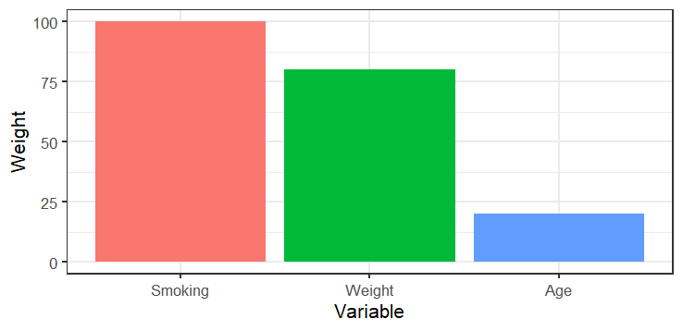
Feature Selection
Smoker | Exercises
Age | Exercises
Age | Smoker
Smoker | Exercises
Age | Exercises
Age | Smoker
More informative features will appear higher up the tree.
Can aggregate this information across the forest
Notes:
Have nice secondary feature. When build tree, get impurity to make decision for each node. On larger scale, variable alone good at predicting will tend to get used higher up the tree, than those that are less useful. From forest can pull out which level of tree variables are used at, then aggregate across all trees in forest.
Gives measure for how predictive/useful each variable is. Rank variables to identify most and least important.
From forest pull out which variables used at which level → how predictive/useful each variable was

Slide 32
Neural Networks
Notes:
Deep learning essentially built off neural networks, not always necessary. There are alternatives, often do not need this level of complexity. Often viewed as big black box, but principles behind mathematics not too difficult to understand.

Slide 33
Neural Network Structure
Node
Predictor 1
Predictor 2
Predictor 3
Predictor 4
Predictor 5
Layer
Input
Notes:
Some layers always going to be present – first is input layer, one node for each measurement you have made from a sample you are trying to classify.
Other end of the model, have output layer – gives node for each category to predict.
In between have set of intermediate, hidden layers. Nodes data passes through from input to output. Connect all layers to each other in sequential fashion.
Hidden = passes through from input to output, don’t make predictions themselves.

Slide 34
Neural Network Structure
Predictor 1
Predictor 2
Outcome 1
Predictor 3
Outcome 2
Predictor 4
Predictor 5
Input
Hidden
Output
Notes:
In paper only 0 or 1 hidden layers – number of hidden layers decides how complex relationships can establish – 0 = linear model, 1 = non-linear relationships, 2 = non-linear with inflections
In paper, has either no hidden layer or one hidden layer, with 32 ReLU units – decided as part of training

Slide 35
Neural Network Structure
Weight
Height
Age
Disease
Smokes
No Disease
Exercises
Diet
History
Input
Hidden
Output
Notes:
Some layers always going to be present – first is input layer, one node for each measurement you have made from a sample you are trying to classify.
Other end of the model, have output layer – gives node for each category to predict.
In between have set of intermediate, hidden layers. Nodes data passes through from input to output. Connect all layers to each other in sequential fashion.
Hidden = passes through from input to output, don’t make predictions themselves.

Slide 36
Using the network
Weight
Height
Age
Disease
Smokes
No Disease
Exercises
Diet
History
Input
Hidden
Output
Notes:
Done as binary but would be low and high values, looks at activation value of disease and no disease, whichever is higher gets chosen as prediction.
When train, decide on weight and activation values – how do we do that? Couple of decisions – weights and hidden layers, how many hidden layers and how many nodes should be in them?
Higher activation value in output node = prediction of sample
Decisions when training = Training weights, how many hidden layers, how many nodes in them?

Slide 37
Neural Networks
Node
Activation Value
0.1
0.6
0.9
0.2
0.5
0.9
Layer
Notes:
Built out of components – nodes with quantitative value (activation, 0-1). Nodes come in sets a collection of nodes is called a layer. Neural networks contain multiple layers. All nodes tied across layers – all nodes in first layer connect with all nodes in the second layer. Values in second later calculated from combined set of values in the first layer via mathematical transformation.

Slide 38
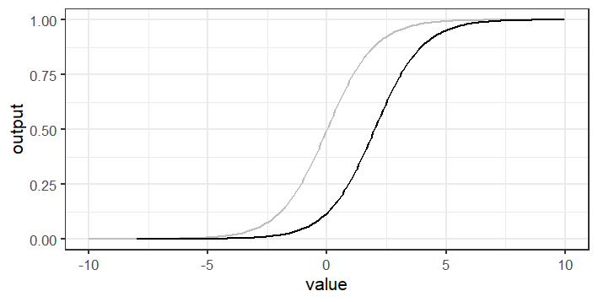
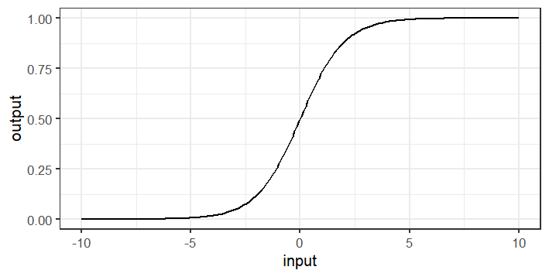
Calculating Node Values
∑(activation x weight)
(0.1 x 0.5) + (0.9 x 3.1) + (0.5 x -1.9) = 1.89
0.1
Weight
Sigmoid output = 0.87
+0.5
Sigmoid output (bias 2) = 0.47
0.9
+3.1
?
0.5
-1.9
Training = Calculating Weights and Biases and optimising
Notes:
Have activation values for each nodes, and add a second value = weight value. Weights are on every connection, can be positive or negative. Need activation value between 0 and 1 (can’t be 1.89).
Second layer in calculation – pass through sigmoid function (mathematical transformation that will guarantee get value between 0 and 1). Input runs from –infinity to +infinity, output between 0 and 1.
Here centre on 0 but can shift left and right to get different output values – added a bias to our curve
For each connection, calculating weight and for each activation value calculating the bias. So when training model optimising to get the best weight for each connection and bias value for each node.
E[Value*weight] → pass through sigmoid function to get between 0&1. Doesn’t have to centre on 0 – bias on curve, how far moved from mean 0.
When train finding best value for weights and best bias in the curve.
Other activation functions exist, e.g. ReLU only allows for positive activation values.

Slide 39
Neural Network Structure
Weight
Height
Age
Disease
Smokes
No Disease
Exercises
Diet
History
Input
Hidden
Output
Notes:
Some layers always going to be present – first is input layer, one node for each measurement you have made from a sample you are trying to classify.
Other end of the model, have output layer – gives node for each category to predict.
In between have set of intermediate, hidden layers. Nodes data passes through from input to output. Connect all layers to each other in sequential fashion.
Hidden = passes through from input to output, don’t make predictions themselves.

Slide 40
Training the network Selecting the number of hidden layers
Number of layers changes the type of relationships modelled
0 hidden layers = linear relationship, similar to linear modelling
1 hidden layer = nonlinear relationships
2 hidden layers = nonlinear relationships with arbitrary boundaries
Most problems only require 1 hidden layer. More complex data can benefit from 2. Virtually nothing requires more than two.
Notes:
2 hidden layers = Nonlinear with inflection points, where they change direction at certain point/do something different
If 0, probably don’t need a neural network, just use a linear model. 1 will be enough for most purposes (non-linear relationship). 2 if really complex and have a lot of variables. Basically nothing needs more than 2.

Slide 41
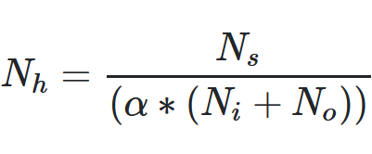
Training the network Selecting the number of nodes in hidden layers
Too few nodes will not allow enough complexity to model the system effectively
Too many nodes will overfit – essentially "memorising" the training data
Number of hidden layer nodes should be between the input number and the output number
Gives starting point, then can optimise
Simple
Try 2/3 input number plus output number
Complex
Nh = number of hidden nodes
Ni = number of input nodes
No = number of output nodes
Ns = size of training set
α = scaling factor (normally 2)
Notes:
How many nodes in middle hidden layers. Input fixed because is no. of inputs, output fixes as number of outcomes trying to predict.
Overfitting - essentially memorise a path for each samples, not give summary of principles, just memorise.
Or iterative testing
Rules of thumb, then when optimising look at iterative.

Slide 42
Training the network Selecting weights and biases
Generate a "cost function" – a numerical value which says how well the model performed on the training data (high = bad, low = good)
Could just be how good the predictions are, but often good to include how complex the connections are
Start by initialising the weights / biases to random numbers
Shuffle the values to gradually minimise the cost function value
Notes:
Need to come up with a way to evaluate how well the model has done – means need to come up with equation, called cost function.
Simple level = what percentage got wrong? More complex = How clear separation between output nodes? How complex connections were (that were required)? Level of detail not needed today – just a value that if high is bad, if low is good.
Start by making random model (random weights and biases). Shuffle weights and biases to come up with combination of weights and biases to minimise cost function.
Shuffling is cleverer than just random – something called ‘back propagation’

Slide 43
Training the network Back Propagation
0.8
How do you increase a value?
Increase positive weights
Tied to high activations upstream
Decrease negative weights
Tied to high activations upstream
What doesn't matter?
Anything with a low weight
Anything with a low upstream activation
Should be higher
0.9
Should be higher
0.6
Disease
0.1
0.7
No Disease
0.1
Should be lower
0.9
Should be lower
Prediction for a single disease sample
Average across all samples and then adjust
Notes:
How know which weights want to change to get outcome that want?
Part of a model, not doing very well – weights and biases for output layer, prediction for disease but got it wrong, need to make disease higher.
Can increase or decrease negative weights – but some things matter, and some things don’t. Anything with low weight and low upstream activation not much influence.
Repeat for all samples to get average direction that should push. Do many times, go round and round to optimise the model.
Repeat for all samples to get average direction need to move all weights, then run many times to optimise the model

Slide 44
Cleaning the network
Weight
Good idea to minimise the network
Remove nodes where all output weights are low
Having little effect on the rest of the network
Height
Age
Smokes
Exercises
Diet
History
Notes:
Final thing can do – don’t want to build overly complex model. Once optimised, can see that certain values have low weights coming off them – height and medical history. If nodes have all low weights, then take out to simplify.
Start looking at everything, but weights coming off some nodes all really low – means information not going anywhere → remove those with low weights to reduce complexity.

Slide 45
Practical Machine Learning using R and tidymodels
Notes:
There are a lot of frameworks in multiple languages – lot of stuff done in Python, had a lot of original frameworks. But pretty much every language has frameworks now. Which one you choose is preference of language and capabilities/maturity of environments

Slide 46
Baseline R Come on an R Course!
Introduction to R: https://biotrain.tv/courses/r_intro
Advanced R: https://biotrain.tv/courses/r_advanced
Plotting with GGPlot: https://biotrain.tv/courses/r_ggplot
Notes:
If have been on course, should be familiar. Otherwise show essential part of modelling part, but happens after data manipulation, exploration/formatting/cleaning/etc. so should go on an R course!

Slide 47
Data Analysis Workflow
Raw Data
Visualisation
Exploration
Modelling
Prediction
Filtering Cleaning
Statistics
Reporting
Collection
Preparation
Formalisation
Outcome
Notes:
Will go through coding for modelling but need to remember prep stages to explore and understand data

Slide 48
R Syntax
A 'pipe'
Passes data from left to right
forest_fit %>%
predict(data) %>%
bind_cols(data) -> prediction_results
Function 'arguments'
Options for the function
Assignment arrow
Saves data to a variable
Variables (data structures)
Functions (do stuff and give something back)
Notes:
Compound R statement – 3 separate parts on separate lines.
Coloured to explain what they are.
Variables – names of data working with. Forest fit = model starting from. Data = name of data. Save to prediction results.
Run model to predict new values based on already constructed. Then link predictions to original data to join together.
Read code top to bottom and left to right, execution also happens in that order. Pipe passes output to next thing to right or down.
Function has brackets, inside is data that sees – either within bracket or piped from previous. Bind_cols sees predict output plus data.

Slide 49
Packages for machine learning in R
lm
nnet
rpart
brulee
kknn
ranger
h2o
mboost
spark
glmnet
keras
partykit
aorsf
stan
kernlab
thief
tbats
survival
xrf
hurdle
aorsf
gee
lmer
mgcv
Different model types
Sometimes same model but with slight differences (tuneable factors, input data format, etc)
Want to be able to easily try different model types
All have their own conventions for preparing data and building models
Notes:
All packages for implementing machine learning
Many for different models. Some do same model but slight differences, e.g. different random forest might be 3-4 in different ways/tunable parameters. Don’t want to learn conventions and structure of all packages to try different types of models. Want to try different models, e.g. decision tree, random forest, etc.

Slide 50
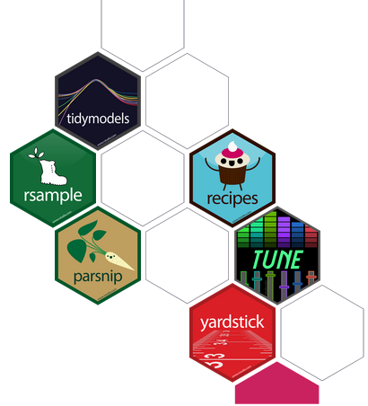

TidyModels
https://www.tidymodels.org/
Provides a consistent interface to prepare data, construct models and evaluate results.
Easy to move between different modelling packages with minimal code changes.
Notes:
Part of tidyverse project (clean, scalable, readable R code). Provides consistent interface. Layer between code and packages that do work – translation layer between you and packages that do the actual modelling.
Are subprojects within tidymodels, which will mention (e.g. parsnip, recipes, TUNE, etc.) – don’t really need to know distinction but will point out.

Slide 51
Input Data
Tibble of data (2D Spreadsheet)
Read in as e.g. tsv, csv, excel spreadsheet
Rows are observations (cases) columns are variables
Classification variables must be factors (not text)
Standard exploration / plotting should happen before modelling (not covered today)
Notes:
Start at the top – need input data = tibble
Row could be animal (cases), column is something measured about it.

Slide 52
Code Structure
Create a model
No data yet, just the type of model and the settings to use
Create your data
Prepare and filter the input data (e.g. filtering/scaling/etc.)
Split off training / testing data
Train the model
Pass the data to the model and define the variable to predict
Test / Use the model
Use the trained model to predict new values
Notes:
k-nearest neighbours, how many neighbours, distance measure. Neural network – how many hidden layers, how many nodes, etc. If want to alter later on, can just change the first step and carry on.
E.g. converting to categorical variables, scaling, other prep. Filter out not useful variables.
Train, tell the model what want to predict
Use the model, initially for testing to calculate specificity, sensitivity, accuracy, kappa, SSD, etc. When happy with model, do the same process with data in the same format where don’t have prediction column, so get model to predict.

Slide 53
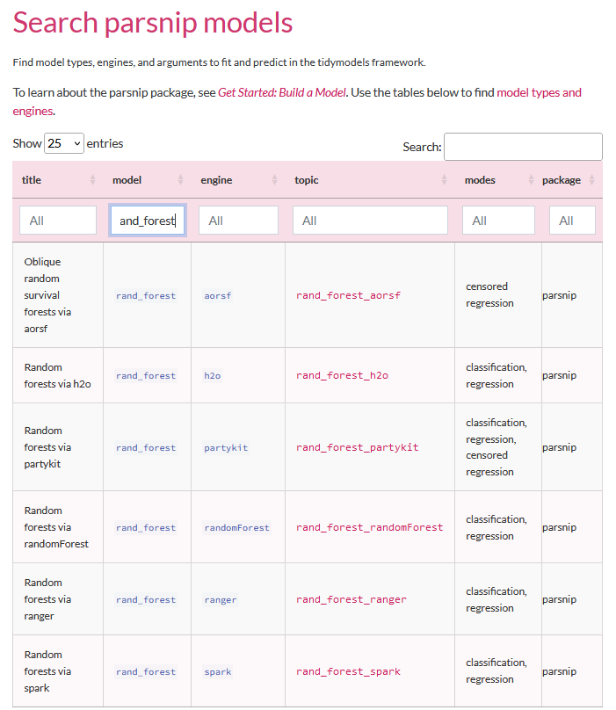

Create a Model
parsnip = translation layer
You need
A model type
An engine
A mode
Options
https://www.tidymodels.org/find/parsnip/
Notes:
Sub-part of tidyModels – parsnip = interface to package that does model.
Engine = pack end package that want to use.
Mode = classification or regression
Options relevant to type of model using.
Comprehensive list at url – plug into, e.g. search for random forests.
No real shortcut for which to use, can find ones that people run most of the time, can click through to see documentation, some specific purposes others more generic.

Slide 54
Create a Model
library(tidymodels)
tidymodels_prefer()
rand_forest(trees=100, min_n=5) %>%
set_mode("classification") %>%
set_engine("ranger") -> model
Model Options
The model
function
Model Type
The back end engine
Notes:
Tidymodels_prefer not necessary but helps to avoid weirdness. Loads in functions – not controlled by R in any way. Multiple packages have functions with the same name. prefer = use tidymodels function in preference to anything else.
Don’t have to put preferences within model function, will have defaults, but to alter do that here.
Builds basic, untrained model.

Slide 55

Creating Data
read_delim("development_gene_expression.txt") -> data
data %>%
mutate(Development=factor(Development)) -> data
Basic R data manipulation – convert text column to factor
set.seed(123)
data %>%
sample_frac() -> data
Control random element to make reproducible by setting the random seed
Shuffle data – random reordering to remove any structure
Notes:
If text either text or factor, which has categories.
When have random elements, want these to not be completely random, need to be able to reproduce the same model when run again. Set.seed() means that computer pseudorandom numbers will always start at the same point, so same numbers each time. Number doesn’t matter. ‘Random numbers’ from computer might start off from, e.g. the time, so when run at different time will be different.
Sample_frac() samples random subset of data – but no fraction, so randomly shuffles all rows in the data.

Slide 56

Splitting Data
data %>%
initial_split(prop=0.8) -> split_data
training(split_data)
# A tibble: 992 × 93
Convention = 80-90%
Consider how much data you have and frequency of cases
testing(split_data)
# A tibble: 249 × 93
Notes:
Split data into test and training data.
Initial_split – give proportion, so 80% training, 20% to testing. 80-90% usual convention but depends on frequency of cases, how much data, etc.
Split_data = single data structure holds both, call training() or test() to pull out data.

Slide 57
Training the Model Create a formula
Variable to predict ~ Variables to use
Variable to predict ~ VarA + VarB + VarC
Variable to predict ~ .
(dot = everything else)
Notes:
Need to give model the variable that we want to predict.
Pretty much always when have tidied up your data to input to the model, will have taken out any variables that you do not want to use for the prediction, so you just have what you want to predict and variables to use.

Slide 58
Training the Model Performing a single fit
model %>%
fit(Development ~ ., data=training(split_data)) -> model_fit
model_fit
parsnip model object
Ranger result
Call:
ranger::ranger(x = maybe_data_frame(x), y = y, num.trees = ~100, min.node.size = min_rows(~5, x), num.threads = 1, verbose = FALSE,seed = sample.int(10^5, 1), probability = TRUE)
Type: Probability estimation
Number of trees: 100
Sample size: 992
Number of independent variables: 92
Mtry: 9
Target node size: 5
Variable importance mode: none
Splitrule: gini
OOB prediction error (Brier s.): 0.2412714
24% of out of bag predictions wrong
Notes:
Fit = training function, essentially.
Get back and save a fitted model - now has filled out the values to show exactly what did in the call.
OOB = out of bag prediction error, the predictions thrown out, got 24% of those thrown out wrong.

Slide 59
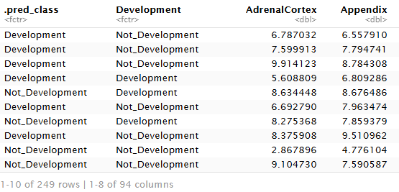
Evaluating / Using the Model
model_fit %>%
predict(new_data=testing(split_data))
%>%
bind_cols(testing(split_data))
Notes:
Predict() gives back one column tibble saying if it predicted it to be development or not development. Then bind with the rest of the testing data – join prediction to rest of columns.
Count how many times gets dev correct or incorrect or non_dev correct or incorrect…

Slide 60
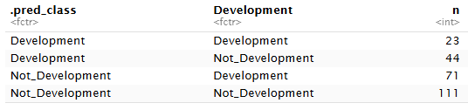
Evaluating / Using the Model
model_fit %>% predict(new_data=testing(split_data)) %>% bind_cols(testing(split_data)) %>% group_by(.pred_class, Development) %>%
count()
Notes:
Just R, not tidymodels – group_by predicted and development and then count
Manually looking at the results, but can look automatically.

Slide 61
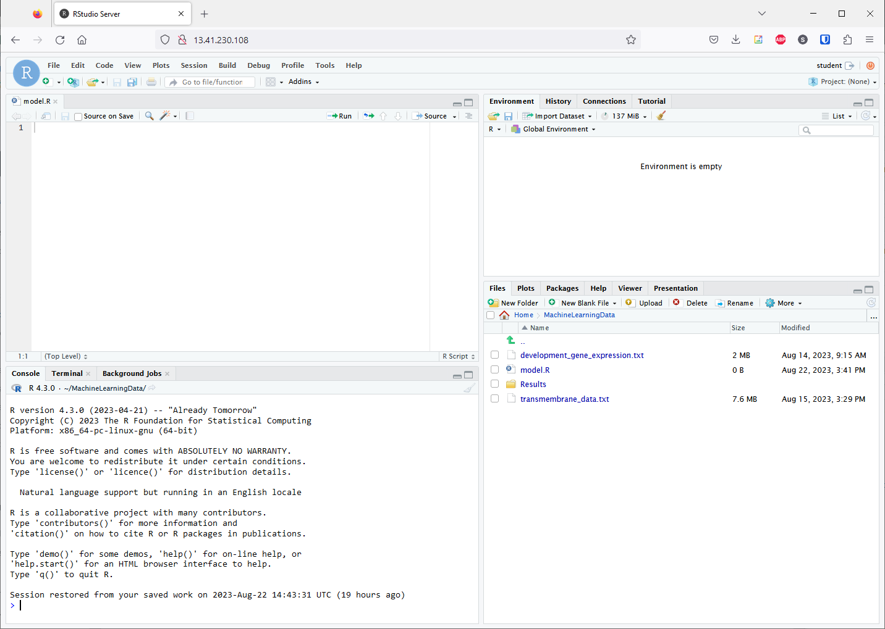
Environment
Data Appears Here
Click name to view it
Script Editor
Code Goes Here
Control + Return to run a line
R Console
Code Runs Here
Output Appears Here

Slide 62
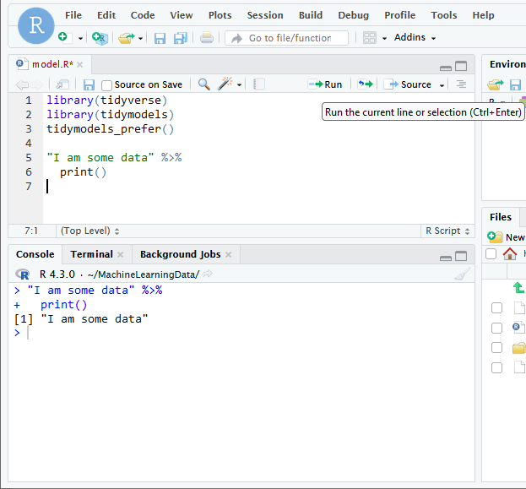
Write Code
Often multi-line statements joined with pipes
Run Code
Cursor on last line
Control + Run or Run button
Examine Output
You should see a copy of the code, along with the output it generated

Slide 63
Exercise: Building a model in tidymodels
Notes:
Half an hour?

Slide 64
Evaluating Models
Notes:
Get high level statements in publications/from companies – what do these things mean?

Slide 65
A good model?
DC
Disease Corp
In a recent study our new AI model correctly predicted the disease status of 980 out of 1000 patients – that’s a 98% success rate!
Non diseased, predicted correctly (980)
Non diseased, predicted incorrectly (10)
Diseased, predicted incorrectly (10)
Notes:
98% success rate sounds great, but is it actually a good result?
Want robust ways to assess how well a model is doing, and how much value it’s adding.
Predicted 980 people correctly, all who had the disease. But also incorrectly identified 10 people who had the disease, and 10 people who did not

Slide 66
Baseline for comparison
1000 patients, 10 have disease
Assign most common category (healthy) to everyone
990 correct = 99% success!
A good model must do better than this.

Slide 67
Evaluating Qualitative Models
Rather than overall success rate, break down by category
Confusion matrix
False Negative
False Positive
Notes:
Break down by category, rather than overall success rate → confusion matrix

Slide 68
Evaluating Qualitative Models
(88+24) = 112 correct
(4+6) = 10 incorrect
Overall = 92% correct
(88+4) = 92 correct
(4+1) = 5 incorrect
Overall = 95% correct
(78+28) = 106 correct
(0+16) = 16 incorrect
Overall = 91% correct

Slide 69
Sensitivity vs Specificity
Sensitivity: How likely is the model to identify diseased patients correctly
Specificity: How likely is the model to identify healthy patients correctly
Overall = 92% correct
Sensitivity = 24/28 = 86%
Specificity = 88/94 = 94%
Overall = 95% correct
Sensitivity = 4/8 = 50%
Specificity = 88/89 = 99%
Overall = 91% correct
Sensitivity = 28/28 = 100%
Specificity = 78/94 = 83%

Slide 70
Sensitivity vs Specificity
What matters more?
Overall = 92% correct
Sensitivity = 24/28 = 86%
Specificity = 88/94 = 94%
Overall = 95% correct
Sensitivity = 4/8 = 50%
Specificity = 88/89 = 99%
Overall = 91% correct
Sensitivity = 28/28 = 100%
Specificity = 78/94 = 83%
Getting both is ideal – obviously!
If never missing disease is the main concern favour sensitivity
If not incorrectly false predictions is important favour specificity
Need to consider the frequency of true positives

Slide 71
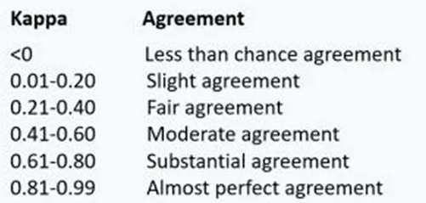
Cohen's Kappa Score
Measures whether the predictions are correct more often that you'd expect if the model was just guessing
Takes into account the proportion of predictions and observations in each class
Notes:
Single score, rather than having to look at both specificity and sensitivity.
Tells you how well did overall – runs between -1 and +1.
0 is random guessing, in line with proportion of input data (so if 99% id majority, will be 99% correct).
Less than 0 is worse than random.

Slide 72
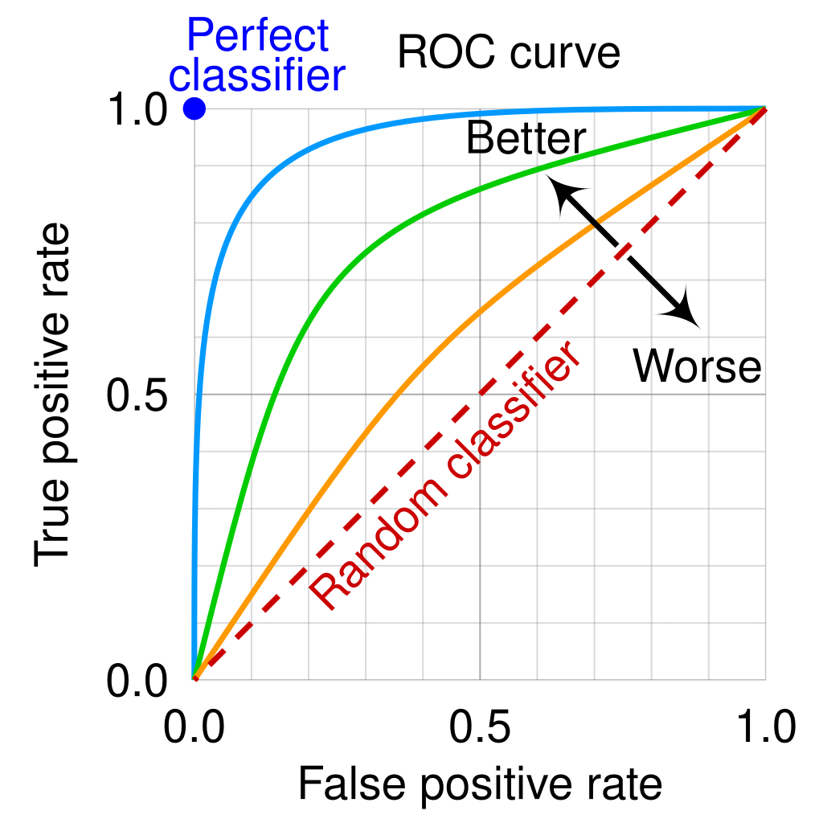
Area Under the ROC Curve (AUC)
ROC curves plot the model’s True Positive Rate (TPR) as a function of its False Positive Rate (FPR)
AUROC values of:
1.0 = a perfect classifier
0.5 = a classifier with random guessing performance
0 = the worst possible classifier
If not a binary classifier then it can be calculated for each class in turn and take a weighted average (e.g. by number of instances in each class)
By cmglee, MartinThoma - Roc-draft-xkcd-style.svg, CC BY-SA 4.0, https://commons.wikimedia.org/w/index.php?curid=109730045
Notes:
ROC = Receiver Operating Characteristic

Slide 73
Evaluating Quantitative Models
Correlation/association between predictions and true values (R or R²)
How close are the predictions to the true values?
Doesn’t matter if the mistake is high or low
Need a single value to summarise the total error
Notes:
Total error across all training or test data put into model

Slide 74
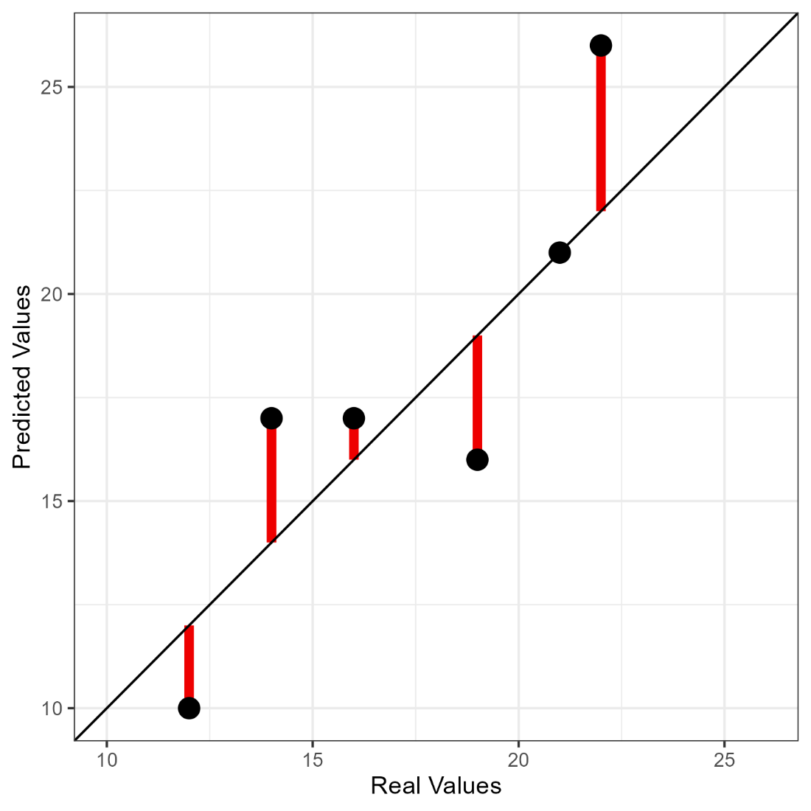
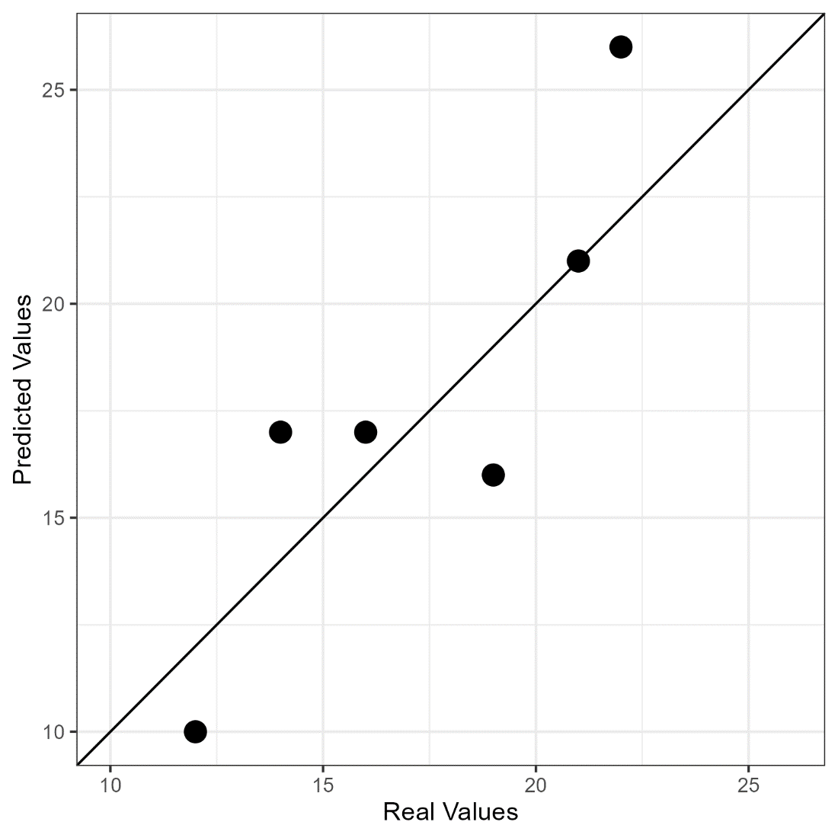
Evaluating Quantitative Models
Differences (+ and -)
Square differences (all positive)
Sum differences = single value
Sum of Squared Differences
SSD
Line of perfect fit
Notes:
Measure residuals for perfect fit. Are other measures – e.g. look at correlation, R², MSE
5 minutes to go back to original models from exercise, see if the evaluation metrics make sense.

Slide 75




Evaluating / Using the Model
model_fit %>% predict(new_data=testing(split_data)) %>% bind_cols(testing(split_data)) %>%
sens(Development,.pred_class)
spec(Development,.pred_class)
metrics(Development,.pred_class)
Notes:
Automatically calculating evaluation parameters – everything saw before. Each step relatively straight forward, work through process
15 min BREAK (2.45)

Slide 76
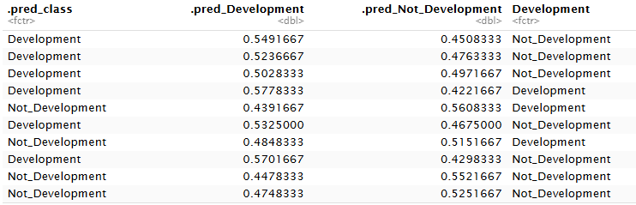
Evaluating / Using the Model
Alternative is to use augment:
model_fit %>%
augment(new_data=testing(split_data))
Notes:
Depends on model type as to what outputs but gives probabilities in this case.

Slide 77
Input Data
Notes:
Lunch break at this point, then more practical considerations after lunch
Modelling is not magic – if have bad/noisy/contaminated data, will get bad model – will not fix it for you

Slide 78
Garbage in = Garbage out
Noisy Variables
Outliers
Poorly Scaled Variables
Duplicates
Conflated Signals
Poorly Constructed Features
Missing Data
Data Leakage
Data Cleaning, Filtering, Scaling and Feature Construction
Notes:
Poorly scaled variables depends on the model – decision tree fairly robust but naïve bayes more sensitive because quantitative
Model doesn’t understand data so if have duplicates, replicated data, then think great consistency.
Conflated = if have 10 things going in but 5 of them are highly correlated, not really new information
Data leakage – look in more detail

Slide 79

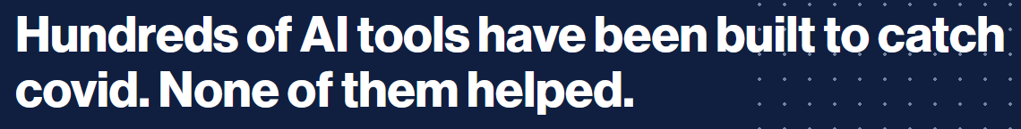
Common Data Problems Data Leakage
Accidentally including something unintentional which reveals the true prediction for the case
Audio clips from right whales were shorter than those from other species.
The right whale clips were next to each other in the dataset
Healthy scans came from children
COVID scans came from people lying down
Models recognised the font on the scan pictures
Notes:
Aspect of the data that allows model to predict that has nothing to do with biology that you are interested in.
Models looks like they work really well, incl. on reserved test data, but introduce data outside of study and works terribly. Sometimes don’t know why, but sometimes you do.
Whale challenge – competition, someone collected recordings of whales, build models to predict what type of whale from the recording. Worked well on the data, out in the wild were terrible. Found signals in the data models were picking up on that were essentially meaningless.
Randomise signals before enter data to model – if already random, makes no difference, if sorted then removes problem.
Build ML models to detect cases of covid from healthy patients. Lots done from lung/chest x-rays. Lots of people published, but not clinically useful. Retrospective analysis done to look at confounding signals models were picking up on. In one had set of scans that were healthy and set that were diseased, but healthy were children, adults were diseased. Ill people couldn’t stand up in the x-ray so for those with disease were lying down, heathy were standing up.
Healthy and diseased from different hospitals, had logos on the scan which were recognised instead of the actual disease.
Models are thick, there to solve a problem will pick up on anything that you give them. If lucky, prepared data well, no confounders, will pick up on real biological signals that are too complex to pick up on usually. But if anything else allows for prediction not linked to biology will use that.

Slide 80
Common Data Problems
Outliers
Extreme values, or just mistakes, will skew summary metrics
Missing values
Handled poorly by many models, either remove, or impute (with care)
Noisy variables
Variables with no connection to the question. Slow modelling and make results worse
Different scales
Quantitative models benefit from having variables with similar ranges of values
Notes:
Imputation – assumptions you make for this will go into the model. May pick up the signal from the imputation. If missing values in one column and know high are diseased and low are healthy then it will pick up on those imputed differences. Might not work on real data.
Very big datasets can be problem – doing some kind of selection before running the model can be better. If most variables have no connection then just add noise, don’t improve quality, don’t make better, just slower.

Slide 81
Preprocessing Converting to Numbers
Some models require all data to be numeric
Linear Models, SVM, Neural Nets
Create ‘dummy variables’
Some don’t care
Decision trees, Random Forest
Blue
Red
Purple
Orange
Green
1
0
0
0
0
Blue
Red
Purple
Orange
Green
0
0
1
0
0
0
1
0
0
0
0
1
2
3
4
0
0
0
0
1
Notes:
If assign number, will think orange is closer to purple and green than it is to blue and red – more likely to mis-predict to next category so introduces bias.
Each category to separate variable – is it blue? Get 1 if yes and 0 if no. increasing number of variables but makes more complex and more sparse, all are completely independent from each other.
Are different ways to achieve each step – choice can influence way model works in the end.

Slide 82
Preprocessing Scaling and Normalising
Some models expect numerical data which behaves in a roughly normal manner
Naïve Bayes, Linear Modelling, Neural Nets
Transformations make data more usable
Log transformation
Mean centering
Z-score normalisation
Converting to ranks
Often dealing with high-dimensional data → More advanced transformations
PCA to remove noise (e.g. single cell data)
Notes:
Z-score = SDs above or below a mean
Often dealing with high dimensional data (simple, don’t need machine learning) – when have 1000s of genes, too much data to run the model + super noisy. Dimensionality reduction techniques, e.g. PCA.
Single cell data run through PCA before machine learning

Slide 83
Preprocessing Data Filtering
Good idea to reduce the data complexity
Remove noise
Reduce size (runs quicker)
Remove variables or cases which aren't helpful
Outlier values
Poorly measured features
Redundant features, e.g. highly correlated variables
Features with no variability
Notes:
Redundant = highly correlated, do all versus all correlation of features – if whole load of variables co-vary no point including all in the model.
Genes that stay the same across all cases – don’t vary, so no information content

Slide 84
Exercise: Evaluating Models
Notes:
Exercise 4 = ~15mins
Run through = ~5mins

Slide 85
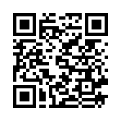
That’s it! - What Next?
Scan or Click to tell us what you thought
Other relevant courses?
Introduction to R (with tidyverse): TBC
Advanced R (with tidyverse): TBC
Creating Complex Figures with GGPlot: TBC
Stay in touch: contact@biotrain.tv

Slide 86

Automation with Recipes and Workflows
Preprocessing often has multiple steps
Need to apply these to training, testing and future data
Manually preprocessing is tedious and potentially inconsistent
Recipes let you automate this
More work initially but more reproducible
Workflows bring everything together
Notes:
More work initially but pays off later on in reproducibility
For cross-validation doing it 10 times, for training and testing need the same things.

Slide 87
Automation with Recipes and Workflows
Create a recipe
Specify formula and optionally data (shows what looks like)
Add processing steps
Filtering, Transformation etc.
Create a model
Same as we did before
Create a workflow
Combine the recipe and model together
Notes:
Create recipe: Not really putting data in, showing what is going to look like so it knows names of variables and type of data in them.

Slide 88
Creating a Recipe
recipe(
var_to_predict ~ .,
data=training(split_data)
) -> my_recipe
You add data here but it's only used to list and type the variables. You still need to provide it when you train or use the model
Notes:
Recipe based around formula want to create.
Not actually putting data into recipe, have to feed it when want to run it, but tells it names and types of data that are going to use.

Slide 89
Recipe Preprocessing Steps
step_rm : Remove one or more variables
step_log: Log transform variables
step_normalize: Convert values to z-scores
step_dummy: Create numerical dummy variables from text
step_other: Combine infrequent categories into an 'other'
step_corr: Remove variables which are highly correlated
step_naomit: Remove rows/columns with missing values
Full list of steps at https://recipes.tidymodels.org/reference/index.html
Notes:
url = reference page for the recipe package, has full list of things recipe knows what to do with data.
Example ones on slide
Step_dummy = category → quantitative variables, split each option to own column and give 0 or 1.
Are imputation steps included, various different methods (on the website).
Easy to try things out – just change one step in the recipe and rerun everything else!

Slide 90
Applying Steps to Variables
Individually named variables
step_rm(Unsued1, Unused2)
Role selectors
step_normalize(all_numeric_predictors())
step_dummy(all_nominal_predictors())
Notes:
Have to tell which columns to apply to – can name them individually.
Role selectors – apply to all columns that fit these roles.

Slide 91
Adding Preprocessing Steps
my_recipe %>%
step_rm(Unsued1, Unused2) %>%
step_log(expression, gene_length) %>%
step_normalize(all_numeric_predictors()) %>%
step_dummy(all_nominal_predictors()) -> my_recipe
Notes:
Sequentially add steps that you want to apply to data

Slide 92

Creating a workflow
Workflows bring together
Recipe (training data, preprocessing, formula)
Model
workflow() %>%
add_recipe(my_recipe) %>%
add_model(my_model) -> my_workflow
Notes:
Once set up, work with the workflow for the training and prediction.

Slide 93
Training via a workflow
my_workflow %>%
fit(training(my_data)) -> my_workflow
Fits the model, but also finalises choices in the recipe inside the workflow
Notes:
If had cross validation, could fit cross validation set and it would run everything all in one go. Just single split in here.
Add to workflow, then fitted data also part of workflow

Slide 94
Testing via a workflow
my_workflow %>%
predict(new_data=testing(my_data)) %>%
bind_cols(testing(my_data)) %>%
select(.pred_class, var_to_predict)
Predict will automatically pull the trained model out of the workflow and will run the recipe on the new data
Notes:
From workflow, fit to new data, then pull out predictions.
Gives more automation and consistency, means we don’t have to remember all pre-processing steps.
When distribute the model, can distribute the whole workflow, rather than just the model – incorporates trained model and pre-processing required.

Slide 95
Exercise: Automating models with workflows
Notes:
Exercise 4 = ~15mins
Run through = ~5mins

