Slide 1
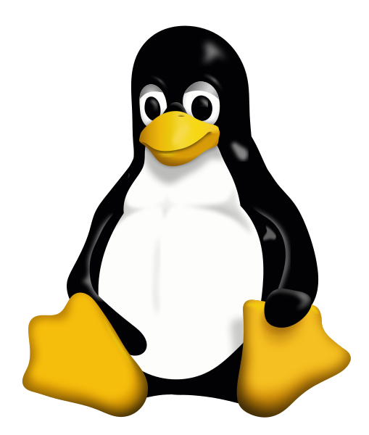
Automated installers and Containers

Slide 2
Automated Installers
Like a package manager, but independent of Operating System
Some will operate from source, distributing recipes
Some will distribute pre-compiled binaries
Most common examples
Conda (https://conda.io)
Easy Build (https://easybuild.readthedocs.io)

Slide 3
Conda
Package management system
Originally for python packages, but now covers all types of software
Several Implementations
Anaconda (original distribution, with a full python environment)
Miniconda (small distribution, just for running conda)
Add-in repositories for more packages
BioConda (https://bioconda.github.io/)

Slide 4
Using conda
Install a conda providing environment (probably miniconda)
Set up some channels (bioconda)
Install some packages
Use the packages

Slide 5
Installing miniconda
Go to https://conda.io/miniconda.html
Download the shell script for your platform
Run it
Will install into your home directory - each user gets a separate install
Will offer to modify your PATH to include the miniconda bin directory*
*Be careful about this!!

Slide 6
Adding bioconda channels
conda config --add channels bioconda
conda config --add channels conda-forge
Bioconda will now be searched for new installs

Slide 7
Installing packages with conda
Simple installs [but don't do this]
conda install bwa
conda install bwa=0.7.4
Custom environments
conda create -n aligners
source activate aligners
conda install bwa bowtie2 hisat2
source deactivate

Slide 8
Problems with conda?
Only software available in the repositories
Pretty comprehensive these days
Closed environment
Can't mix and match with things from the base OS (well you can, but stuff will break!)
Duplication
Every user (and every environment) gets their own copy of everything
Duplication (again)
Will install its own R / perl / python etc and will put it first in the path
Can break non-conda applications in odd ways
Always use a named environment

Slide 9
Containers

Slide 10
Containers
A method for bundling software and data together into a single item which can be ported easily between users/computers
Can provide an isolated environment - similar to a VM or a conda environment, or make a suite of programs/data look like an application
Main systems
Docker* (https://www.docker.com/)
Singularity* (https://www.sylabs.io/singularity/)
*They play nicely together

Slide 11
Finding a container
DockerHub (https://hub.docker.com)
SingularityHub (https://singularity-hub.org)
Search for the application / user / container you want
Find the address (user/name) eg vsoch/hello-world

Slide 12
Installing singularity
Available from apt in Debian/Ubuntu
sudo apt install singularity-container
Note that just "singularity" is a game!
Compile from source (https://github.com/sylabs/singularity/releases)
v2.6.0 is autotools based - similar install to previous apps
v3.0.0 is re-written in GOLang so has a custom install procedure

Slide 13
Installing a container
Download from a repository and install onto your machine
singularity pull shub://dleehr/qiime2-singularity
singularity pull docker://qiime2/core
File names can get a bit long, so:
singularity pull --name qiime.simg docker://qiime2/core
Produces a .simg file on your machine

Slide 14
Using a container
Different options. You can start a shell in the environment of the container
singularity shell qiime.simg
You can run a script which the image provides
singularity run qiime.simg
./qiime.simg

