Slide 1


Running programs in the BASH shell
v2018-11

Slide 2
Running programs in Linux
Two major methods
  Graphical
  Command line
Graphical launches only work for graphical programs accessed through a graphical environment
Most data processing will be command line based, as will most remote access
  Graphical programs can still be launched from the command line

Slide 3
Shells
A shell is a command line interpreter, used to launch software in Linux
There are many different shells available:
  BASH
  CSH
  ZSH etc.
Most software will work the same in all shells
Some functions and automation are different between shells
We will use the most popular shell, BASH

Slide 4
What does a shell provide
Command line editing and construction tools (eg auto complete)
History
Job control
Configuration management (startup scripts)
Aliases
Automation
  Scripting language
  Variables, functions etc

Slide 5
Running programs in BASH
We will be using a graphical terminal running BASH
Right click and select "Open terminal"
..or, from Applications menu find Terminal
Once running, right click on icon and select "Add to favourites"

Slide 6
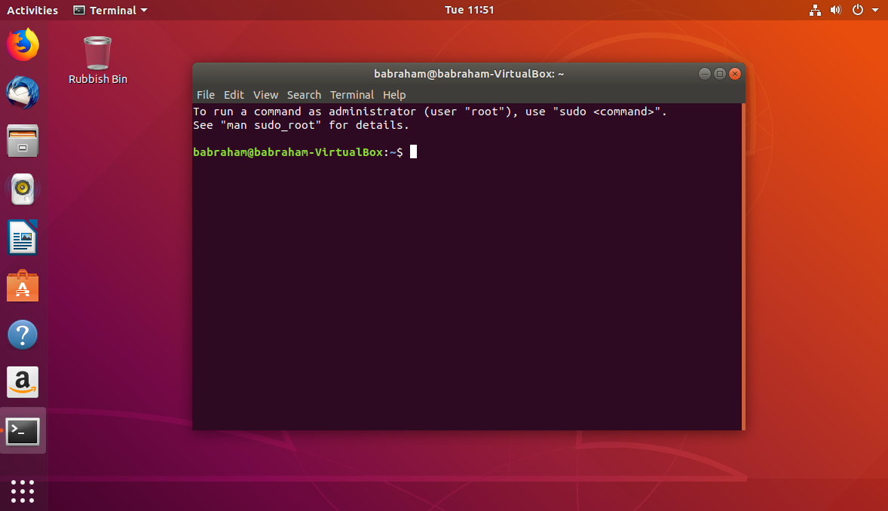

Slide 7
Running programs
Type the name of the program you want to run
Add on any options the program needs
Press return - the program will run
When the program ends control will return to the shell
Run the next program!

Slide 8
Running programs
babraham@babraham-VirtualBox:~$ ls
Desktop Documents Downloads examples.desktop Music Pictures Public Templates Videos
babraham@babraham-VirtualBox:~$
Command prompt - you can't enter a command unless you can see this
The command we're going to run (ls in this case, to list files)
The output of the command - just text in this case

Slide 9
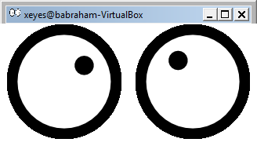
Running graphical programs
babraham@babraham-VirtualBox:~$ xeyes
babraham@babraham-VirtualBox:~$
Note that you can't enter another command
until you close the program you launched

Slide 10
The structure of a unix command
ls -ltd --reverse Downloads/ Desktop/ Documents/
Program
name
Switches
Data
(normally files)
Each option or section is separated by spaces. Options or files with spaces in must be put in quotes.

Slide 11
Command line switches
Change the behaviour of the program
Come in two flavours (each option usually has both types available)
  Minus plus single letter (eg -x -c -z)
    Can be combined (eg -xcz)
  Two minuses plus a word (eg --extract --gzip)
    Can't be combined
Some take an additional value, this can be an additional option, or use an = to separate (it's up to the program)
  -f somfile.txt (specify a filename)
  --width=30 (specify a value)

Slide 12
Manual pages
All core programs will have a manual page to document the options for the command
Manual pages are accessible using the man program followed by the program name you want to look up.
All manual pages have a common structure

Slide 13
Manual Pages (man cat)
CAT(1) User Commands CAT(1)
NAME
cat - concatenate files and print on the standard output
SYNOPSIS
cat [OPTION]... [FILE]...
DESCRIPTION
Concatenate FILE(s) to standard output.
With no FILE, or when FILE is -, read standard input.
-A, --show-all
equivalent to -vET
-n, --number
number all output lines
-T, --show-tabs
display TAB characters as ^I
--help display this help and exit
EXAMPLES
cat f - g
Output f's contents, then standard input, then g's contents.
cat Copy standard input to standard output.

Slide 14
Exercise 1

Slide 15
Understanding Unix File Systems

Slide 16
Unix File Systems
Consists of a hierarchical set of directories (folders)
Each directory can contain files
No drive letters (drives can appear at arbitrary points in the file system)
No file extensions (you can add them, but they're not required)

Slide 17
A simple unix filesystem
/ (Always the top of the file system)
home/ (Directory containing all home directories)
anne/
simon/
Documents/ (All names are case sensitive)
test.txt (A file we want to work with)
/home/simon/Documents/test.txt
media/
myusb/ (A USB stick added to the system)

Slide 18
Drives in a Linux file system
$ mount
/dev/sda1 on / type ext4 (rw)
/dev/sda5 on /state/partition1 type ext4 (rw)
/dev/sda2 on /var type ext4 (rw)
Private-Cluster.local:/ifs/homes on /bi/home type nfs (rw,addr=10.99.101.5)
Private-Cluster.local:/ifs/Scratch/Scratch on /bi/scratch type nfs (rw, addr=10.99.101.5)
Private-Cluster.local:/ifs/Group on /bi/group type nfs (rw, addr=10.99.101.4)
Private-Cluster.local:/ifs/apps-nfs on /bi/apps type nfs (rw, addr=10.99.101.5)
central-cluster.local:/ifs/bioinformatics/pubcache on /bi/pubcache type nfs (rw, addr=10.99.102.7)
central-cluster.local:/ifs/bioinformatics/seqfac on /bi/seqfac/seqfac type nfs (ro, addr=10.99.102.6)
/dev/fuse on /bi/sequencing type fuse (ro,nosuid,nodev,allow_other)

Slide 19

Specifying file paths
Some shortcuts
  ~ (tilde, just left of the return key) - the current user's home directory
  . (single dot) - the current directory
  .. (double dot) - the directory immediately above the current directory

Slide 20
Specifying file paths
Absolute paths from the top of the file system
  /home/simon/Documents/Course/some_file.txt
Relative paths from whichever directory you are currently in
  If I'm in /home/simon/Documents/Course/
  ../../Data/big_data.csv
    is the same as /home/simon/Data/big_data.csv
Paths using the home shortcut
  ~/Documents/Course/some_file.txt will work for user simon anywhere on the system

Slide 21
Command line completion
Most errors in commands are typing errors in either program names or file paths
Shells (ie BASH) can help with this by offering to complete path names for you
Command line completion is achieved by typing a partial path and then pressing the TAB key (to the left of Q)

Slide 22
Command line completion
Actual files in a folder:
Desktop
Documents
Downloads
examples.desktop
Music
Pictures
Public
Templates
Videos
If I type the following and press tab:
De [TAB] will complete to Desktop as it is the only option
T [TAB] will complete to Templates as it is the only option
Do [TAB] will no nothing (just beep) as it is ambiguous
Do [TAB] [TAB] will show Documents and Downloads since
those are the only options
Do [TAB] [TAB] c [TAB] will complete to Documents
You should ALWAYS use TAB completion to fill in paths for
locations which exist so you can't make typing mistakes
(it obviously won't work for output files though)

Slide 23
Wildcards
Another function provided by your shell (not your application)
A quick way to be able to specify multiple related file paths in a single operation
There are two main wildcards
  * = Any number of any characters
  ? = One of any character
You can include them at any point in a file path and the shell will expand them before passing them on to the program
Multiple wildcards can be in the same path.
Command line completion won't work after the first wildcard

Slide 24
Wildcard examples
$ ls Monday/*txt
Monday/mon_1.txt Monday/mon_2.txt Monday/mon_3.txt Monday/mon_500.txt
$ ls Monday/mon_?.txt
Monday/mon_1.txt Monday/mon_2.txt Monday/mon_3.txt
$ ls */*txt
Friday/fri_1.txt Monday/mon_1.txt Monday/mon_3.txt Tuesday/tue_1.txt
Friday/fri_2.txt Monday/mon_2.txt Monday/mon_500.txt Tuesday/tue_2.txt
$ ls */*1.txt
Friday/fri_1.txt Monday/mon_1.txt Tuesday/tue_1.txt

Slide 25
The structure of a Unix command
D*
ls -ltd --reverse Downloads/ Desktop/ Documents/
Program
name
Switches
Data
(normally files)
Each option or section is separated by spaces. Options or files with spaces in must be put in quotes.

Slide 26
Programs for manipulating files

Slide 27
Manipulating files
You will spend a lot of time managing files on a Linux system.
  Viewing files (normally text files)
  Editing text files
  Moving or renaming files
  Copying files
  Deleting files
  Finding files

Slide 28
Viewing Files
Simplest solution
  cat Sends the entire contents of a file (or multiple files) to the screen.
Quick look
  head or tail will look at the start/end of a file
    head -10 [file]
    tail -20 [file]
More scalable solution
  less is a 'pager' program, sends output to the screen one page at a time
    Return / j = move down one line
    k = move up one line
    Space = move down one page
    b = go back one page
    /[term] = search for [term] in the file
    q = quit back to the command prompt
less -S (no wrapping)

Slide 29
Editing files
Lots of text editors exist, both graphical and command line
Many have special functionality for specific content (C, HTML etc)
Technically, only the vi editor is required to be present in POSIX
nano is a simple command line editor which is nearly always present
You can try several until you find one you like

Slide 30
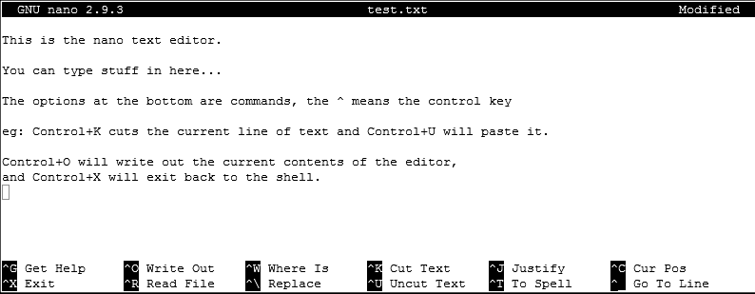
Using nano to edit text files
nano [filename] (edits if file exists, creates if it doesn't)

Slide 31
Moving / Renaming files
Uses the mv command for both (renaming is just moving from one name to another)
mv [file or directory] [new name/location]
If new name is a directory then the file is moved there with its existing name
Moving a directory moves all of its contents as well
Examples
  mv old.txt new.txt
  mv old.txt ../Saved/
  mv old.txt ../Saved/new.txt
  mv ../Saved/old.txt .

Slide 32
Copying files
Uses the cp command
cp [file] [new file]
Operates on a single file
Can copy directories using recursive copy (cp -r)
Examples
  cp old.txt new.txt
  cp old.txt ../Saved/
  cp old.txt ../Saved/new.txt
  cp ../Saved/old.txt .
  cp -R ../Saved ./NewDir
  cp -R ../Saved ./ExistingDir/ (only if ExistingDir exists)

Slide 33
Linking rather than copying
Copy duplicates the data in a file
  Can be a problem with big data files
  Can be a problem if you want edits to propagate
Links are a way to do 'virtual' copies. You can make the same file appear in more than one place.
Two types of link
  Hard link - completely indistinguishable from a copied file
    Only works on the same disk (can't span file systems)
    Only works for files (not directories)
  Symbolic (or soft) link
    Is visible as a link, but can still be used as if it is a file
    Can work across file systems
    Can be used for directories as well as files
    Normally the safe option to use

Slide 34
Creating symbolic links
Use the ln command with the -s modifier
Usage ln -s [from] [to]
Exactly the same structure as mv
When you list a link you can see where it points, but you can use it like a file
$ cat test.txt
This is a test file
$ ln -s test.txt test2.txt
$ ls -l test2.txt
lrwxrwxrwx 1 babraham babraham 8 Sep 11 16:27 test2.txt -> test.txt
$ cat test2.txt
This is a test file

Slide 35
Deleting files
Linux has no undo.
Deleting files has no recycle bin.
Linux will not ask you "are you sure"
Files can be deleted with the rm command
Directories (and all of their contents) can be deleted with rm -r
Examples
  rm test_file.txt test_file2.txt
  rm *.txt (be VERY careful using wildcards. Always run ls first to see what will go)
  rm -r Old_directory/

Slide 36
Finding files
From the command line there are two main mechanisms
  Using locate
    Uses a pre-built index, so is *VERY* quick
    Needs to be installed and configured (isn't on all distributions)
    Only works on local drives - not network shares
  Using find
    Searches fresh each time
    Can be slow if you're searching large numbers of files
    Requires no pre-processing

Slide 37
Using find
find [options/filters] [place to start] [action]
Options / Filters
  -name thisfile.txt
  -name *txt
  -type f -empty
Action
  -print
  -exec (any command - include {} for filename - need to finish with \;)

Slide 38
Find examples
find ~ -name *fastq.gz -print
find /etc/ -name *conf -exec wc -l '{}' \;
find ~ -type l -print

Slide 39
Exercise 2

Slide 40
Finding programs to run
ls -ltd --reverse Downloads/ Desktop/ Documents/
Program
name
Switches
Data
(normally files)
How does the system know which executable file to run when you just supply a name (like ls in this example) rather than a file path?
What happens when you have two different programs with the same name?

Slide 41
The PATH environment variable
Two new concepts which will be reused a lot:
  A search path is a list of directories which the shell will iterate over to try to find something (a program in this case). It is an ordered list and the first hit will be returned.
  Shells use "environment variables" as a small scale storage and configuration system. They are a set of key/value pairs which provide named pieces of data which influence the behaviour of the shell or programs which it runs. Some environment variables are created by default, but you can modify these, or add your own.

Slide 42
The PATH environment variable
You can see the current PATH contents by running:
  echo $PATH
  /usr/local/sbin:/usr/local/bin:/usr/sbin:/usr/bin:/sbin:/bin:/usr/games:/usr/local/games:/snap/bin
These are the directories which are trusted to contain good programs which you can launch just using their name
Other programs can be launched using their location (rather than name)
You can find the location of a named program using which
  which ls (produces /bin/ls which is where the ls program is)

Slide 43
Setting the PATH
PATH is an environment variable, you can set it the same as any other variable, using the export function
export PATH=/one/folder:/another/folder
Normally you want to just add to the existing PATH, so you can include the current $PATH in the definition
export PATH=/new/folder/:$PATH
You can write this into ~/.bashrc to make the change permanent.

Slide 44
Exercise 3

