Slide 1
Linux Basics
Understanding Linux and the BASH shell
v2018-11

Slide 2
What (exactly) is Linux?

Slide 3
Unix, Posix and Linux
Unix was a set of concepts which defined a number of early operating systems developed in the 1970s.
These concepts allowed for interoperability of software written based on them.
The original Unix concepts developed into POSIX, a more formal standard defining
The way that devices, configuration, memory and libraries are handled
A standardised development environment based on C and make
A core set of commands and a command interpreter (shell) in which to run them
A standard set of documentation

Slide 5
Linux - what most people now use (apart from OSX!)
Linux is more correctly called GNU/Linux
Linux is the kernel
GNU is a collection of applications and libraries
POSIX
The way that devices, configuration, memory and libraries are handled
A standardised development environment based on C and make
A core set of commands and a shell in which to run them
A standard set of documentation

Slide 6
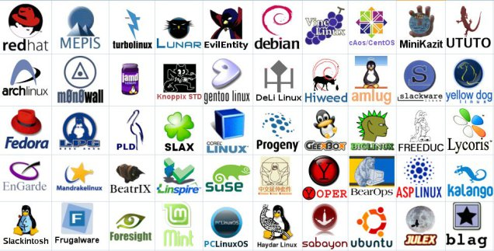
Linux comes in different distributions
They vary in
Their choice of (non-core) software
Their support packages (the way software is installed for example)
How much non-core software they provide
Their frequency of update and length of support

Slide 7
Most Popular Distributions
Ubuntu
Mostly aimed at desktop users
Friendly and well supported
Regular updates (some with long term support)
Based on Debian
Other offshoots such as Mint
CentOS
Free version of the RedHat commercial distro
Mostly aimed at servers
Stable software and long term support
Used in many large environments

Slide 8
Specialised Distributions
Bio Linux
Many pre-built scientific programs
Based on Ubuntu
ROCKS
Linux distribution to run on clusters
Includes automated building and management
Based on CentOS

