Slide 1
Introduction to R
v2019-01

Slide 2
R can just be a calculator
> 3+2
[1] 5
> 2/7
[1] 0.2857143
> 5^10
[1] 9765625

Slide 3
Storing numerical data in variables
10 -> x
y <- 20
x
[1] 10
x/y
[1] 0.5
x/y -> z
Notes:
Naming conventions - lower case, separate words with dots.
Meaningful names
Must start with a letter

Slide 4
Storing text in variables
my.name <- "laura"
my.other.name <- 'biggins'
Notes:
Can use single or double quotes but must do the same at the start and end

Slide 5
Running a simple function
sqrt(10)
[1] 3.162278

Slide 6
Looking up help
?sqrt

Slide 7
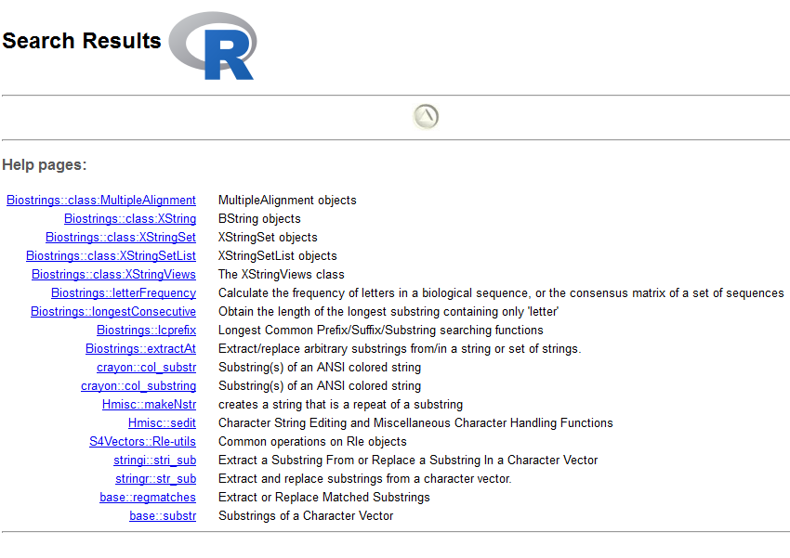
Searching Help
??substring
Notes:
Refer to the cheat sheet
Google is also an option.

Slide 8
Searching Help
Notes:
Multiple options separated by commas
Optional arguments

Slide 9
Passing arguments to functions
substr(my.name,2,4)
[1] "aur"
substr(x=my.name,start=2,stop=4)
[1] "aur"
substr(
start=2,
stop=4,
x=my.name
)
[1] "aur"

Slide 10
Exercise 1

Slide 11
Everything is a vector
Vectors are the most basic unit of storage in R
Vectors are ordered sets of values of the same type
Numeric
Character (text)
Factor
Logical
Date etc…
10 -> x
x is a vector of length 1 with 10 as its first value

Slide 12
Creating vectors manually
Use the "c" (combine) function
Data should be of the same type
c(1,2,4,6,3) -> simple.vector
c("simon","laura","anne","jo","steven") -> some.names
c(1,2,3,"fred")
[1] "1" "2" "3" "fred"
Notes:
Single value is equivalent to c(value)

Slide 13
Functions for creating vectors
rep - repeat values
rep(2,10)
[1] 2 2 2 2 2 2 2 2 2 2
rep("hello",5)
[1] "hello" "hello" "hello" "hello" "hello"
rep(c("dog","cat"),times=3)
[1] "dog" "cat" "dog" "cat" "dog" "cat"
rep(c("dog","cat"),each=3)
[1] "dog" "dog" "dog" "cat" "cat" "cat"

Slide 14
Functions for creating vectors
seq - create numerical sequences
No required arguments!
from
to
by
length.out
Specify enough that the series is unique

Slide 15
Functions for creating vectors
seq - create numerical sequences
seq(from=2,by=3,to=14)
[1] 2 5 8 11 14
seq(from=3,by=10,to=40)
[1] 3 13 23 33
seq(from=5,by=3.6,length.out=5)
[1] 5.0 8.6 12.2 15.8 19.4

Slide 16
Functions for creating vectors
Sampling from statistical distributions
rnorm
runif
rpois
rbeta
rbinom
rnorm(10000)

Slide 17
Language shortcuts for vector creation
Single elements
"simon"
c("simon")
Integer series
seq(from=4,to=20,by=1)
4:20

Slide 18
Viewing large variables
In the console
head(data)
tail(data,n=10)
Graphically
View(data) ^{[Note capital V!]}
Click in Environment tab

Slide 19
What can we do with Vectors?
Extract subsets
Perform vectorised operations
Both are *really* useful!

Slide 20
Extracting from a vector
Always two ways to retrieve data from an R data structure
Based on its position (give me the third value)
Based on a name (give me the BRCA1 value)
True for all of the main R structures

Slide 21
Extracting by position
simple.vector
[1] 1 2 4 6 3
simple.vector[5]
[1] 3
simple.vector[c(5,2,3)]
[1] 3 2 4
simple.vector[2:4]
[1] 2 4 6

Slide 22
Assigning names to vector slots
simple.vector
[1] 1 2 4 6 3
some.names
[1] "simon" "laura" "anne" "jo" "steven"
names(simple.vector)
NULL
names(simple.vector) <- some.names
simple.vector
simon laura anne jo steven
1 2 4 6 3

Slide 23
Extracting by name
simple.vector
simon laura anne jo steven
1 2 4 6 3
simple.vector["anne"]
anne
4
simple.vector[c("anne","simon","laura")]
anne simon laura
4 1 2

Slide 24
Vectorised Operations
2+3
[1] 5
c(2,4) + c(3,5)
[1] 5 9
simple.vector
simon laura anne jo steven
1 2 4 6 3
simple.vector * 100
simon laura anne jo steven
100 200 400 600 300

Slide 25
Rules for vectorised operations
Equivalent positions are matched
Vector 1
3
4
5
6
7
8
9
10
+
Vector 2
11
12
13
14
15
16
17
18
14
16
18
20
22
24
26
28

Slide 26
Rules for vectorised operations
Shorter vectors are recycled
Vector 1
3
4
5
6
7
8
9
10
+
Vector 2
11
12
13
14
14
16
18
20
18
20
22
24

Slide 27
Rules for vectorised operations
Incomplete vectors generate a warning
Vector 1
3
4
5
6
7
8
9
10
+
Warning message:
In 3:10 + 11:13 :
longer object length is not a multiple of shorter object length
Vector 2
11
12
13
14
16
18
17
19
21
20
22

Slide 28
Vectorised Operations
c(2,4) + c(3,5)
[1] 5 9
simple.vector
simon laura anne jo steven
1 2 4 6 3
simple.vector * 100
simon laura anne jo steven
100 200 400 600 300

Slide 29
Updating vectors
Overwrite the existing vector
simple.vector
simon laura anne jo steven
1 2 4 6 3
simple.vector[2:4] -> simple.vector
simple.vector
laura anne jo
2 4 6

Slide 30
Updating vectors
Replace contents based on a selection
simple.vector
simon laura anne jo steven
1 2 4 6 3
simple.vector[c("jo","laura")] <- c(200,500)
simple.vector
simon laura anne jo steven
1 500 4 200 3

Slide 31
Exercise 2

Slide 32
R Data Structures

Slide 33
Vector
1D Data Structure of fixed type
scores
1
0.8
“bob”
scores[2]
scores[c(2,4,3)]
scores[3:5]
scores[“mary”]
scores[c(“mary”,”sue”)]
1.2
2
“dave”
3.3
3
“mary”
1.8
4
“sue”
2.7
5
“alan”

Slide 34
List
Collection of vectors
results
“names”
“days”
results[[1]]
results[[“days”]]
results$days
results$days[2:3]
results[[1]][“sue”]
1
2
1
0.8
“bob”
1
100
“mon”
1.2
300
2
“dave”
2
“tue”
3.3
200
3
“mary”
3
“wed”
1.8
4
“sue”
2.7
5
“alan”

Slide 35
Data Frame
Collection of vectors with same lengths
all.results
all.results[[1]]
all.results[[“tue”]]
all.results$wed
all.results[5,2]
all.results[1:3,c(2,4)]
all.results[c(“bob”,“dave”),]
all.results[,2:3]
“mon”
“tue”
“wed”
“pass”
1
2
3
4
“bob”
1
0.8
0.9
0.8
T
0.6
0.7
0.5
F
“dave”
2
0.2
0.3
0.3
F
“mary”
3
0.8
0.8
0.9
T
“sue”
4
0.6
1.0
0.9
T
“alan”
5

Slide 36
Creating lists / data frames
list(vector1,vector2,vector3)
data.frame(vector1,vector2,vector3)
list(names=vector1,values=vector2)
data.frame(names=vector1,values=vector2)
names(my.list) <- c(“age”,“height”,“score”)
colnames(my.df) <- c(“age”,“height”,“score”)
rownames(my.df) <- c(“bob”,“dave”,“mary”,“sue”)

Slide 37
Exercise 3

Slide 38
Spot the mistakes
vec1 <- c(31,47,15 52,13)
vec2 <- c("Alfie","Bob","Chris",Dave,"Ed")
vec3 <- (TRUE,TRUE,FALSE, TRUE ,FALSE)
vec4 <- c[41, 67]
vec5 <- c("Alfie","Bob,"Chris","Dave")
Error: unexpected numeric constant in "vec1 <- c(31,47,15 52“
Error: object 'Dave' not found
Error: unexpected ',' in "vec3 <- (TRUE,"
Error in c[41, 67] : object of type 'builtin' is not subsettable```
Error: unexpected symbol in "vec5 <- c("Alfie","Bob,"Chris"

Slide 39
Spot the mistakes
my.vector(1:5)
my.vector[2,3,4]
my.list[2]
my.data.frame[2:4]
nrow(my.data.frame)
[1] 10
my.data.frame[300,]
Error: could not find function "my.vector"
Error in my.vector[2, 3, 4] : incorrect number of dimensions
[No error! Works – but don’t do this]
Error in `[.data.frame`(my.data.frame, 2:4) : undefined columns selected
a b c
NA NA NA NA

Slide 40
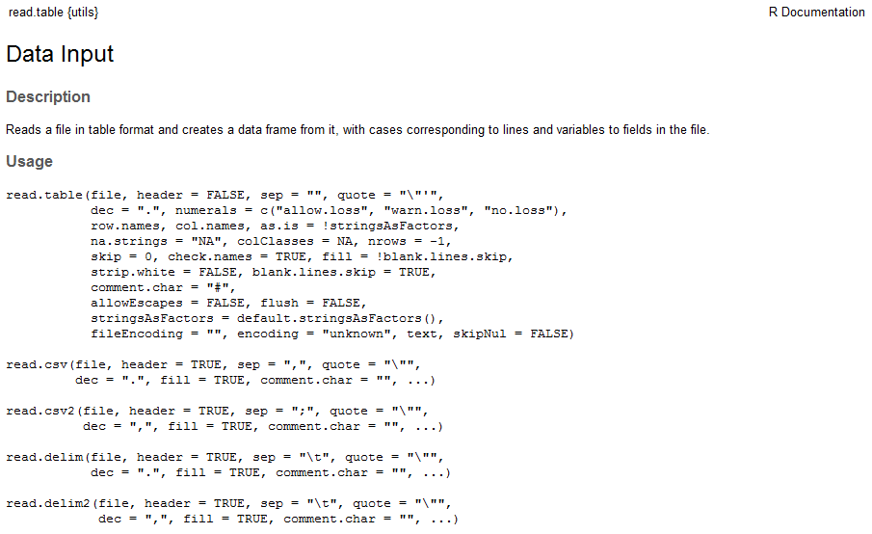
Reading data from files

Slide 41
Using read.table
Only required parameter is the file name (path)
Other parameters are optional
You hardly ever call read.table directly
read.delim for tab delimited files
read.csv for comma separated value files
The function returns a data frame - it *doesn't* save it. You need to do that

Slide 42
Specifying file paths
You can use full file paths, but it's a pain
Easier to set the 'working directory' and then just provide a file name
getwd()
setwd(path)
Session > Set Working Directory > Choose Directory
Use [Tab] to fill in file paths in the editor
read.csv("O:/Training/Introduction to R/R_intro_data_files/neutrophils.csv")

Slide 43
Being clear about names
File names only matter when loading.
After that the variable name is used
read.delim("data_file.txt") -> my.data
head(my.data)

Slide 44
Exercise 4

Slide 45
Logical Selection
> simple.vector
simon laura anne jo steven
1 2 4 6 3
simple.vector[c(...)]
Numbers (index positions)
Text (names)
Logicals (TRUE/FALSE)

Slide 46
Logical Selection
simple.vector
simon laura anne jo steven
1 2 4 6 3
c(TRUE,FALSE,FALSE,TRUE,FALSE)
simple.vector[c(TRUE,FALSE,FALSE,TRUE,FALSE)]
simon jo
1 6

Slide 47
Logical Vectors are created by logical tests
simple.vector
1 2 4 6 3
simple.vector > 3
FALSE FALSE TRUE TRUE FALSE
simple.vector == 2
FALSE TRUE FALSE FALSE FALSE
simple.vector <= 4
TRUE TRUE TRUE FALSE TRUE

Slide 48
Combine the two concepts to make logical selections
simple.vector
1 2 4 6 3
simple.vector > 3
FALSE FALSE TRUE TRUE FALSE
simple.vector > 3 -> logical.result
simple.vector[logical.result]
4 6
simple.vector[simple.vector > 3]
4 6

Slide 49
Extension to data frames
Select the people with heights over 170
trumpton
LastName FirstName Age Weight Height
1 Hugh Chris 26 90 175
2 Pew Adam 32 102 183
3 Barney Daniel 18 88 168
4 McGrew Chris 48 97 155
5 Cuthbert Carl 28 91 188
6 Dibble Liam 35 94 145
7 Grub Doug 31 89 164

Slide 50
3 Steps to Success!
Extract the column containing the data you want to filter against
Perform the logical test to get a logical vector
Use the logical vector to select the rows from the original data frame

Slide 51
Select people over 170 tall
Extract the column containing the data you want to filter against
trumpton
LastName FirstName Age Weight Height
1 Hugh Chris 26 90 175
2 Pew Adam 32 102 183
3 Barney Daniel 18 88 168
4 McGrew Chris 48 97 155
5 Cuthbert Carl 28 91 188
6 Dibble Liam 35 94 145
Grub Doug 31 89 164
trumpton$Height

Slide 52
Select people over 170 tall
Perform the logical test to get a logical vector
trumpton
LastName FirstName Age Weight Height
1 Hugh Chris 26 90 175
2 Pew Adam 32 102 183
3 Barney Daniel 18 88 168
4 McGrew Chris 48 97 155
5 Cuthbert Carl 28 91 188
6 Dibble Liam 35 94 145
Grub Doug 31 89 164
trumpton$Height > 170

Slide 53
Select people over 170 tall
Use the logical vector to select the rows from the original data frame
trumpton
LastName FirstName Age Weight Height
1 Hugh Chris 26 90 175
2 Pew Adam 32 102 183
3 Barney Daniel 18 88 168
4 McGrew Chris 48 97 155
5 Cuthbert Carl 28 91 188
6 Dibble Liam 35 94 145
Grub Doug 31 89 164
trumpton$Height > 170
trumpton[rows,columns]
trumpton[trumpton$Height > 170,]

Slide 54
Select people over 170 tall
trumpton[trumpton$Height > 170,]
LastName FirstName Age Weight Height
1 Hugh Chris 26 90 175
2 Pew Adam 32 102 183
5 Cuthbert Carl 28 91 188

Slide 55
It's not just selections…
Sometimes you just want to know how many times something is true, rather than getting the values
You can take the sum() of a logical vector to get the count of TRUE values

Slide 56
3.5 Steps to Success!
Extract the column containing the data you want to filter against
Perform the logical test to get a logical vector
Use the logical vector to select the rows from the original data frame
Take the sum() of the logical vector to count hits

Slide 57
How many people are over 170 tall
sum(trumpton$Height > 170)
[1] 3

Slide 58
Using subset function for selections
Select the people with heights over 170
subset(trumpton, Height>170)
LastName FirstName Age Weight Height
1 Hugh Chris 26 90 175
2 Pew Adam 32 102 183
5 Cuthbert Carl 28 91 188

Slide 59
Exercise 5

