Slide 1


Day 1
Experimental design
Anne Segonds-Pichon v2019-11
Notes:
Basics necessary for what simon will talk about: when things go wrong, what to look for, what questions to ask
Key basic principles necessary to check the results
Uncool things to do cool science

Slide 2
Question
Data Collection/Storage
Data Exploration
Data Analysis
Results
Experiment
Experimental Design
Sample Size
Notes:
We all know the steps from hyp to results
But more and more it seems we focus on the results and skip ignore the steps before
Especially an issue when using complex pipeline we don’t know how they work
Student, heap of data, what is the question?
Emphasis is on the results but they cannot be trusted if poor design wrong sample size wrong stat test chosen or just something went wrong which could have been seen with proper data exploration
We will cover 3 steps today and remind ourselves how universal they are no matter what our area of science is

Slide 3
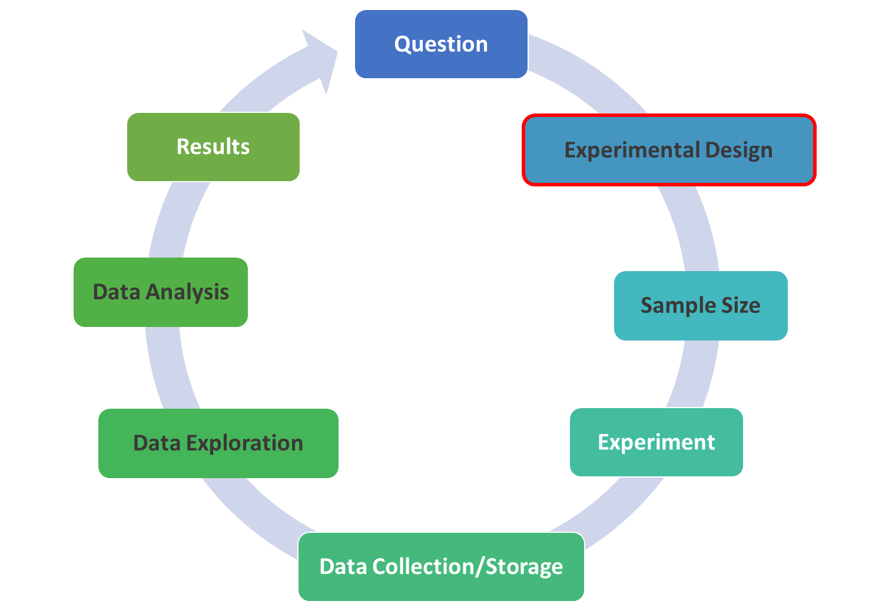
Universal principles
  The same-ish questions should always be asked
    What is the question?
    What measurements will be made?
    What factors could influence these measurements?
  But the answers/solutions will differ between areas
Examples:
  Experimental design will be affected by the question
    but also by practical feasibility, factors that may affect causal interpretation …
    e.g. number of treatments, litter size, number plants per bench …
  Sample size will be affected by ethics, money, model …
    e.g. mouse/plant vs. cell, clinical trials vs. lab experiment …
  Data exploration will be affected by sample size, access to raw data …
    e.g. >20.000 genes vs. weight of a small sample of mice
Notes:
N=20 not worth doing any stats for some

Slide 4
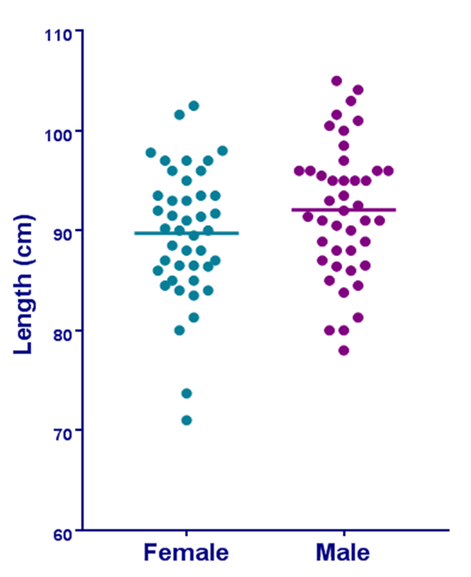
Vocabulary, tradition and software
People use different words to describe the same data/graphs …
There are different traditions in different labs, areas of science …
Different software mean different approaches: R, SPSS, GraphPad, Stata, Minitab …
Examples:
    Variable names: qualitative data = attribute
    Scatterplots in GraphPad Prism = stripchart in R
    2 treatment groups in an experiment = 2 arms of a clinical trial
    Replicate = repeat = sample
    QQ plots in SPSS versus D’Agostino-Pearson test …
    Sample sizes
Very different biological questions, very different designs, sophisticated scientific approach or very simple
  Similar statistical approach
  Example:
    Data: Gene expression values from The Cancer Genome Atlas for samples from tumour and normal tissue, question: which genes are showing a significant difference? t-test
    Data: weight from WT and KO mice, question: difference between genotypes? t-test
Notes:
Now what is not universal is the language used to describe data
Stata used by MRC labs around the world, SPSS in a lot of universities, minitab not gone, R more and more but not really, GraphPad very popular, excel … important not to go for a package because it is cool
One reason to choose a package is because it is used in your lab
It all leads to different approaches to data
N=20 not worth doing any stats for some

Slide 5
Statistical Analysis
Common Sense
Experimental Design
Type of Design
Technical vs. Biological

Slide 6
Experimental Design
Statistical Analysis
Translate the hypothesis into statistical questions
  Think about the statistical analyses before you collect any data
What data will I collect?
How will it be recorded/produced?
Will I have access to the raw data?
I have been told to do this test/use that template, is that right?
Do I know enough stats to analyse my data?
  If not: ask for help!
Notes:
Classic GraphPad stuff: template or package in R

Slide 7
Experimental Design
Statistical Analysis
Example:
  Hypothesis: exercise has an effect on neuronal density in the hippocampus.
  Experiment: 2 groups of mice on 2 different levels of activity:
    No running or running for 30 minutes per day
    After 3 weeks: mice are euthanized and histological brain sections are prepared
      Neuronal density by counting the number of neurons per slide
  Stats: one factor: activity and one outcome: number of neurons
Bate and Clark, 2014

Slide 8
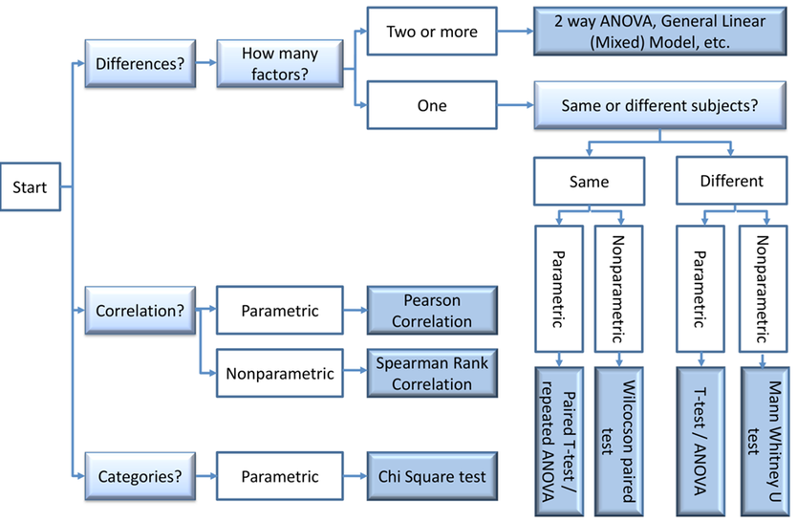
Experimental Design
Statistical Analysis
Experiment: exercise has an effect on neuronal density in the hippocampus
Difference between the groups
2 different groups of mice
One factor: Activity (2 levels)
Neurons counts:
Normality
Homogeneity of variance
That’s the one!

Slide 9
Statistical Analysis
Common Sense
Experimental Design
Type of Design
Technical vs. Biological

Slide 10
Experimental Design
Type of design
Experimental unit: cell, tissue sample, leaf, mouse, plant, litter …
  Neuronal density experiment: experimental unit: mouse
Factor:
  Fixed factor: factor of interest, predictor, grouping factor, arm in controlled trial, independent variable …
    e.g. : treatment, gender, genotype …
    Neuronal density experiment: fixed factor: running
  Random factor: factor we need to account for, blocking factor, nuisance factor …
    e.g. : experiment, batch, plate, lanes …
    Neuronal density experiment: uh oh
Key concepts:
  Blinding: not always possible, single and double-blinding
  Randomisation

Slide 11
Experimental Design
Type of design
Completely random
CRD
Complete Randomised block
CRBD
Split-plot
Simplest:
experimental units randomly
allocated to groups
e.g. : treatment …
Accounting for random factors,
nuisance variables
e.g. : batch effect, experimental effect,
day-to-day variation …
Also nested design,
repeated measures
e.g. : several measures per animal,
several treatments per plot,
pups in a litter…

Slide 12
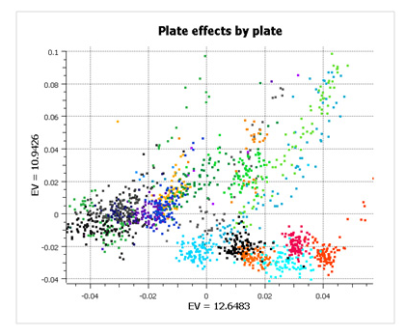
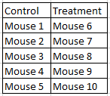
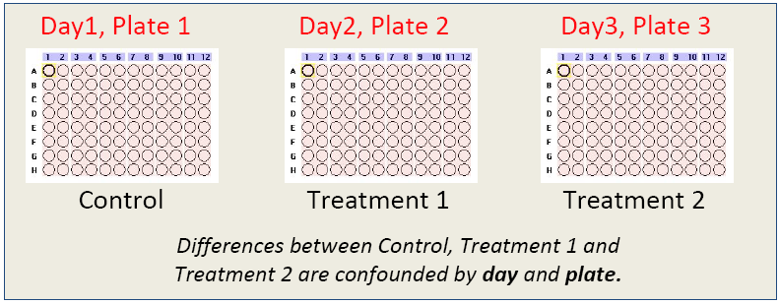
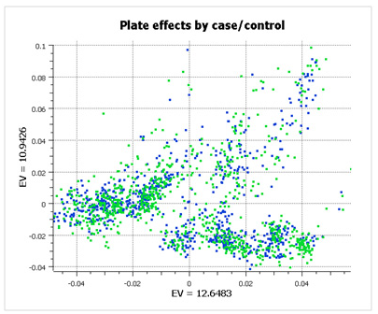
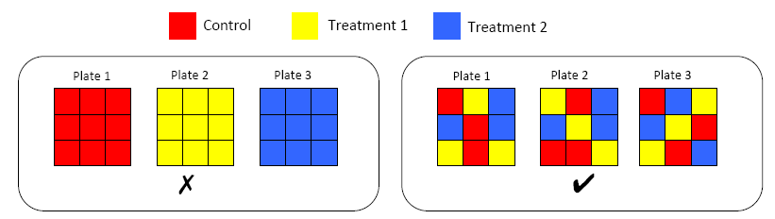
Experimental Design
Type of design
Good design:
GenADA multi-site collaborative study 2010
Alzheimer’s study on 875 patients
Completely random
CRD
Complete Randomised block
CRBD
Bad design
Controls and Cases

Slide 13
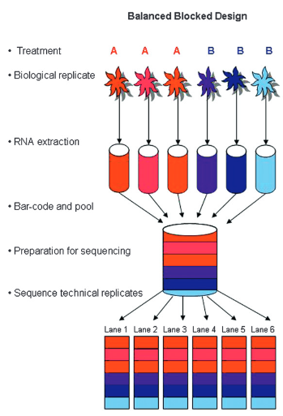
Experimental Design
Type of design
Complete Randomised block
Biological variability:
not noise really
RNA-Seq experiments: multiplexing allows for randomization
  Multiplexing: barcodes attached to fragments
  Barcodes: distinct between libraries (samples)
  Important: identify the sources of noise (nuisance variable)
    Library preparation: big day-to-day variability
      Batch effect
    Big variability between runs
    Lane effect
One library
Library preparation:
Often big noise
Batch effect
Lane = block
Auer and Doerge, 2010

Slide 14
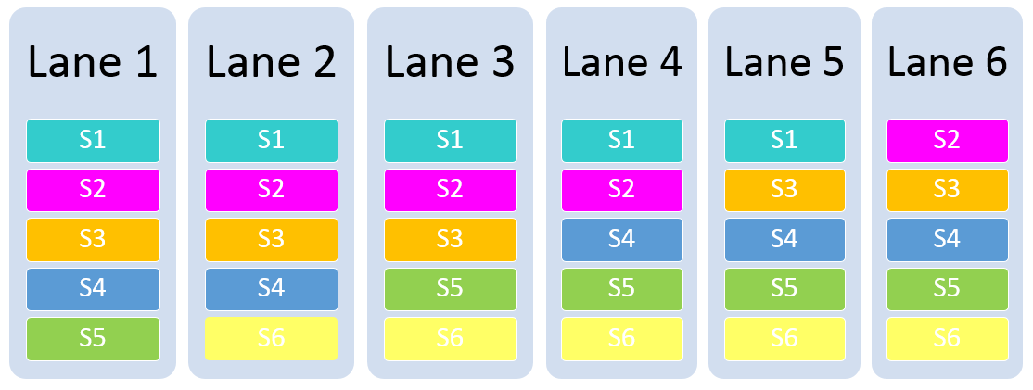
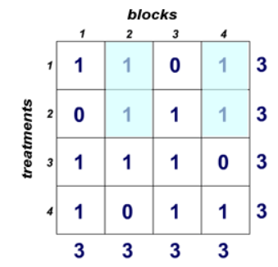
Experimental Design
Type of design
Incomplete Randomised block
Six samples
RNA-Seq experiments:
  Incomplete block design:
    All treatments/samples are not present in each block
  Balanced Incomplete Block Design (BIBD):
    where all pairs of treatments/samples occur together
    within a block an equal number of times
Five samples per lanes
Statistical analysis:
  account for missing values
  e.g.: a model fits blocks then samples
Notes:
Plant Example: You are working in a greenhouse, and want to compare 9 varieties of flowers. The benches in this greenhouse are only large enough to hold 6 pots, and you know benches differ and so must be blocked on. Here the block size of 6 is too small to hold all 9 treatments, making the blocks "incomplete".

Slide 15
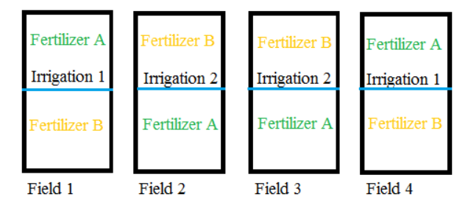
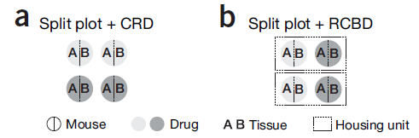
Experimental Design
Type of design
Split-plot
: from agriculture: fields are split into plots and subplots.
Example: in vivo effect of a drug on gene expression on 2 tissues.
Mouse/Plant = plot
= random factor
Housing unit/Bench = blocking factor
= nuisance factor
Tissue = subplot (split-plots)
= nested factor
Krzywinski and Altman, 2015

Slide 16
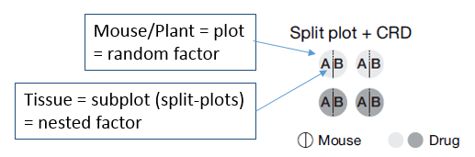
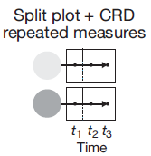
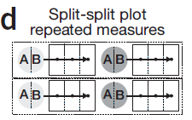
Experimental Design
Type of design
Split-plot
One-factor design: drug
More complex design:
  Split-plot + Completely Random Design: commonly used for repeated measures designs
Two-factor design: drug+time
Three-factor design: drug+time+tissue
Mouse/Plant = plot
Mouse/Plant = plot
Tissue = subplot
Time = sub-subplot
Time = nested within mouse/plant
= repeated measures = subplot
Krzywinski and Altman, 2015

Slide 17

Experimental Design
Type of design
Other designs: crossover, sequential ….
Factorial designs: : more an arrangement of factors than a design
  When considering more than one factor
Back to our neuronal density experiment: exercise has an effect on neuronal density in the hippocampus
Not enough: we want to account for:
  Sex: factor of interest: factorial design (2 factors: running and sex)
  Experimental variability: random factor: blocking factor (one experiment = one block)
  Several histological slides: nested variable
Factorial Design
Completely random
Notes:
Crossover: A crossover design is a repeated measurements design such that each experimental unit (patient) receives different treatments during the different time periods
Incomplete design: This means we would not see all treatments in each block. In some situations this is not possible because (physical) block size is too small, too expensive or not advisable (think of rater having to rate 7 champagne brands)
A cross-sequential design is a research method that combines both a longitudinal design and a cross-sectional design. It aims to correct for some of the problems inherent in the cross-sectional and longitudinal designs.^{[1]}
In a cross-sequential design (also called an "accelerated longitudinal" or "convergence" design), a researcher wants to study development over some large period of time within the lifespan. Rather than studying particular individuals across that whole period of time (e.g. 20–60 years) as in a longitudinal design, or multiple individuals of different ages at one time (e.g. 20, 25, 30, 35, 40, 45, 50, 55, and 60 years) as in a cross-sectional design, the researcher chooses a smaller time window (e.g. 20 years) to study multiple individuals of different starting ages. An example of a cross-sequential design is shown in the table below.

Slide 18
Experiment 1
Running
Male
Female
Not running
Male
Experiment
Treatment
Sex
Female
Mouse 1
S1
Mouse 2
Mouse 3
Mouse 4
Mouse 5
Mouse 6
Mouse 7
Mouse 8
Mouse
Histological slides
S2
S3
S4
S5
S6
S7
S8
S9
S10
S11
S12
S13
S14
S15
S16
Experimental Design
Type of design
Neuronal density experiment: Complete Randomised block design
+ Split-plot
Random factor
Blocks
Fixed factor
Interest
Fixed factor
Interest
Experiment Unit
Biological
Fixed factor
Nested variable
Technical
Biological
S1
S2
If samples from 2 different tissues
Rule of thumb: Block what you can, randomize what you cannot
  Blocking is used to remove the effects of a few of the most important nuisance variables (known/controllable)
  Randomisation is then used to reduce the contaminating effects of the remaining nuisance variables (unknown/uncontrollable, lurking).
Drawing the experimental design can help!

Slide 19
Experimental Design
Statistical Analysis
Experiment: exercise has an effect on neuronal density in the hippocampus
Two factors of interest per experiment:
Activity and Sex
That’s the one!

Slide 20
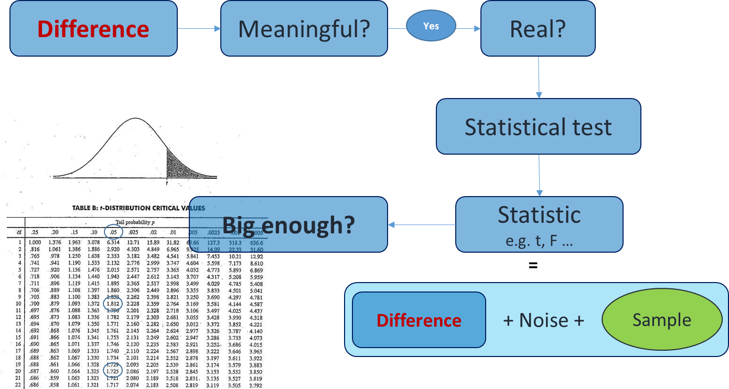
Statistical Analysis
Sample
Statistical inference
Population
Statistical tests are tools used to quantify our level of confidence in what we see.
Notes:
Sample = 20 not worth doing stats

Slide 21
Statistical Analysis
The ‘job’ = the question(s)
  The main one: cause effect
  What (can) affects that relationship?
    Both technical and biological
Data
Nature and behaviour of the data:
  All statistical tests are associated with assumptions
    e.g. normality and homogeneity of variance
  If assumptions not met: bad p-values
Running a statistical test is easy
  but making sure it’s the right test is not.
Getting to know the data:
  Data exploration
  But also if not one’s data:
    raw or not raw?
    If normalised/standardised, how?
    e.g raw counts (qualitative data) vs. normalised (quantitative)
Statistical tests are tools
  How do we choose the right tool?

Slide 22
Statistical Analysis
Common Sense
Experimental Design
Type of Design
Technical vs. Biological

Slide 23
Experimental Design
Technical vs. Biological
Definition of technical and biological depends on the model and the question
  e.g. mouse, cells …
  Question: Why replicates at all?
    To make proper inference from sample to general population we need biological samples.
    Example: difference on weight between grey mice and white mice:
      cannot conclude anything from one grey mouse and one white mouse randomly selected
        only 2 biological samples
      need to repeat the measurements:
        measure 5 times each mouse: technical replicates
        measure 5 white and 5 grey mice: biological replicates
Answer: Biological replicates are needed to infer to the general population

Slide 24

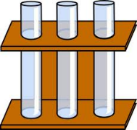
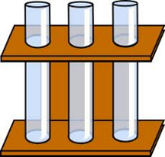
Technical vs. Biological
Always easy to tell the difference?
Definition of technical and biological depends on the model and the question.
The model: mouse, plant … complex organisms in general.
  Easy: one value per individual organism
    e.g. weight, neutrophils counts …
What to do? Mean of technical replicates = 1 biological replicate
n=1
n=3
Technical
Biological

Slide 25
Technical vs. Biological
Always easy to tell the difference?
The model is still: mouse, plant … complex organisms in general.
  Less easy: more than one value per individual
    e.g. axon degeneration
What to do? Not one good answer.
  In this case: mouse = experiment unit (block, split-plot)
    axons = technical replicates, nerve segments = biological replicates
One measure or more
…
…
One mouse
Several segments
per mouse
Several axons
per segment
Tens of values
per mouse

Slide 26


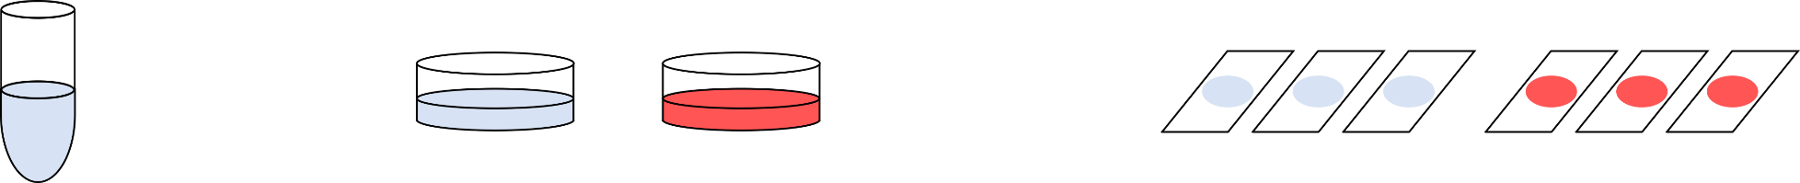

Technical vs. Biological
Always easy to tell the difference?
The model is : worms, cells …
  Less and less easy: many ‘individuals’
    What is ‘n’ in cell culture experiments?
Cell lines: no biological replication, only technical replication
To make valid inference: valid design
Control
Treatment
Glass slides
microarrays
lanes in gel
wells in plate
…
Point of Measurements
Dishes, flasks, wells …
Cells in culture
Point of Treatment
Vial of frozen cells

Slide 27
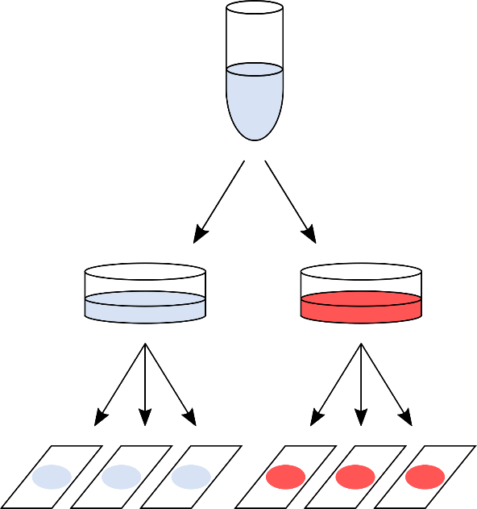
Technical vs. Biological
Always easy to tell the difference?
Design 1: As bad as it can get
One value per glass slide
e.g. cell count
After quantification: 6 values
  But what is the sample size?
    n = 1
      no independence between the slides
      variability = pipetting error

Slide 28
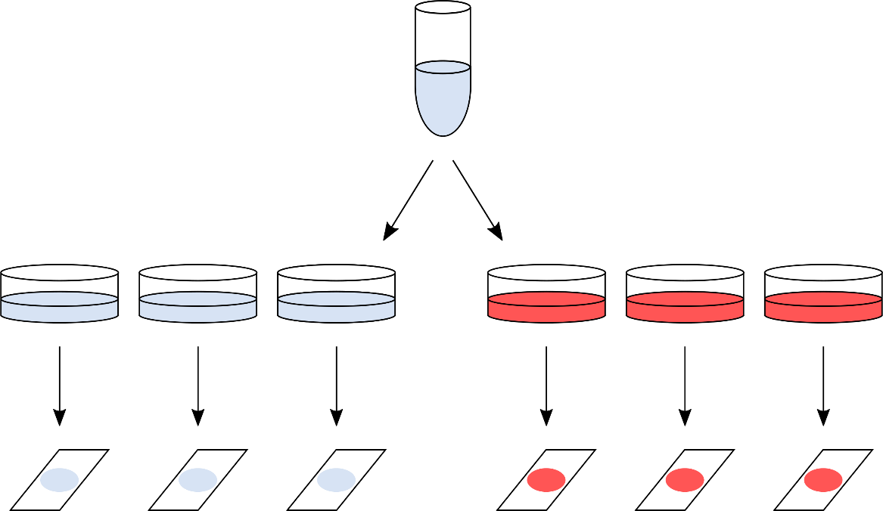
Technical vs. Biological
Always easy to tell the difference?
Design 2: Marginally better, but still not good enough
Everything processed
on the same day
After quantification: 6 values
  But what is the sample size?
    n = 1
      no independence between the plates
      variability = a bit better as sample split higher up in the hierarchy

Slide 29
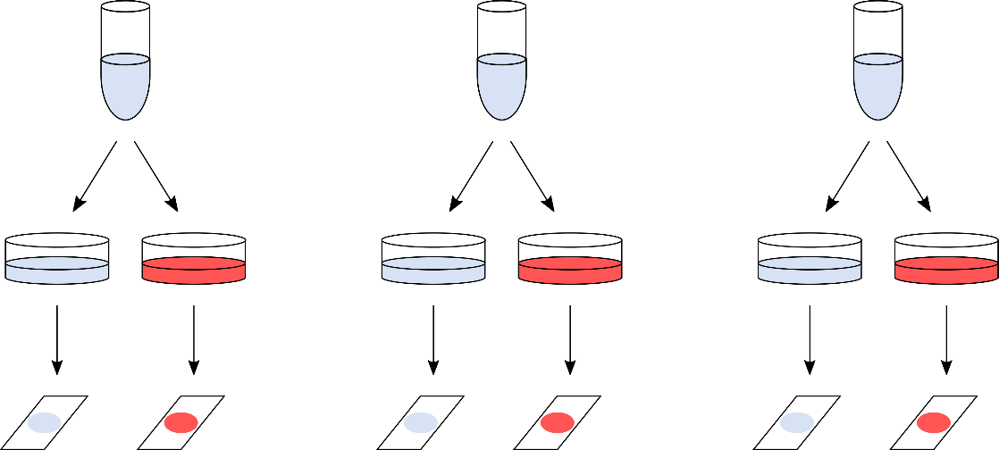
Technical vs. Biological
Always easy to tell the difference?
Design 3: Often, as good as it can get
Day 1
Day 2
Day 3
After quantification: 6 values
  But what is the sample size?
    n = 3
      Key difference: the whole procedure is repeated 3 separate times
      Still technical variability but done at the highest hierarchical level
      Results from 3 days are (mostly) independent
      Values from 2 glass slides: paired observations

Slide 30
Technical vs. Biological
Always easy to tell the difference?
Design 4: The ideal design
person/animal/plant 1
person/animal/plant 2
person/animal/plant 3
After quantification: 6 values
  But what is the sample size?
    n = 3
      Real biological replicates

Slide 31
Technical vs. Biological
Technical and biological replicates
What to remember
Take the time to identify technical and biological replicates
Try to make the replications as independent as possible
Never ever mix technical and biological replicates
The hierarchical structure of the experiment needs to be respected in the statistical analysis (nested, blocks …).

Slide 32
Statistical Analysis
Common Sense
Experimental Design
Type of Design
Technical vs. Biological

Slide 33
Experimental Design
Common Sense
Design your experiment to be analysable
The gathering of results or carrying out of a procedure is not the end goal
  Think about the analysis of the data and design the experiment accordingly
Imagine how your results will look
Ask yourself whether these results will address your hypothesis
Don’t get fixated on being able to perform a cool technique or experimental protocol.
Don’t be overwhelmed (or try not to be).
Draw your experiment and imagine all that can go wrong at each step

Slide 36
Day 1
Power Analysis
Anne Segonds-Pichon v2019-11

Slide 37
Question
Data Collection/Storage
Data Exploration
Data Analysis
Results
Experiment
Sample Size
Experimental Design

Slide 38
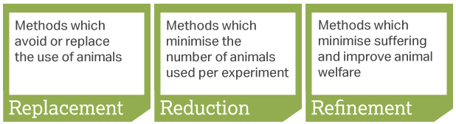
Sample Size: Power Analysis
Definition of power: probability that a statistical test will reject a false null hypothesis (H₀).
  Translation: the probability of detecting an effect, given that the effect is really there.
In a nutshell: the bigger the experiment (big sample size), the bigger the power (more likely to pick up a difference).
Main output of a power analysis:
  Estimation of an appropriate sample size
    Too big: waste of resources,
    Too small: may miss the effect (p>0.05)+ waste of resources,
    Grants: justification of sample size,
    Publications: reviewers ask for power calculation evidence,
    Home office: the 3 Rs: Replacement, Reduction and Refinement.

Slide 39
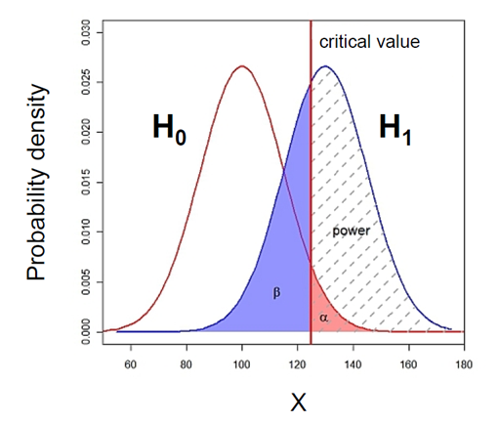
What does Power look like?

Slide 40
What does Power look like? Null and alternative hypotheses
Probability that the observed result occurs if H₀ is true
  H₀ : Null hypothesis = absence of effect
  H₁: Alternative hypothesis = presence of an effect

Slide 41
What does Power look like? Type I error α
  α : = probability of type I error (α = 0.05)
p-value: probability that the observed statistic occurred by chance alone
Statistical significance: comparison between α and the p-value
  p-value < 0.05: reject H₀
  p-value > 0.05: fail to reject H₀

Slide 42
What does Power look like? Power and Type II error β
Area = 1
Type II error (β) is the failure to reject a false H₀
  Probability of missing an effect which is really there.
  Power: probability of detecting an real effect
  Direct relationship between Power and type II error:
    Power = 1 – β

Slide 43

What does Power look like? Power = 80%
General convention: 80% but could be more
    if Power = 0.8 then β = 1- Power = 0.2 (20%)
Hence a true difference will be missed 20% of the time
Jacob Cohen (1988):
    For most researchers: Type I errors are four times more serious than Type II errors so: 0.05 * 4 = 0.2
      Compromise: 2 groups comparisons:
        90% = +30% sample size
        95% = +60%s sample size

Slide 44
The critical value
Critical value
Small difference
Big difference
Not significant: p>0.05
Significant: p<0.05
Critical value = size of difference + sample size + significance

Slide 45
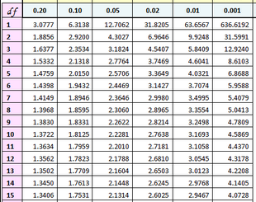
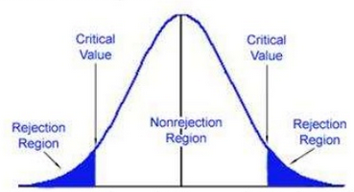
The critical value: size of difference + sample size + significance
Example: 2-tailed t-test with n=15 (df=14)
T Distribution
0.95
0.025
0.025
t(14)
t=-2.1448
t=2.1448
In hypothesis testing:
  critical value is compared to the test statistic to determine significance
  Example of test statistic: t-value
If test statistic > critical value: statistical significance and rejection of the null hypothesis
  Example: t-value > critical t-value

Slide 46
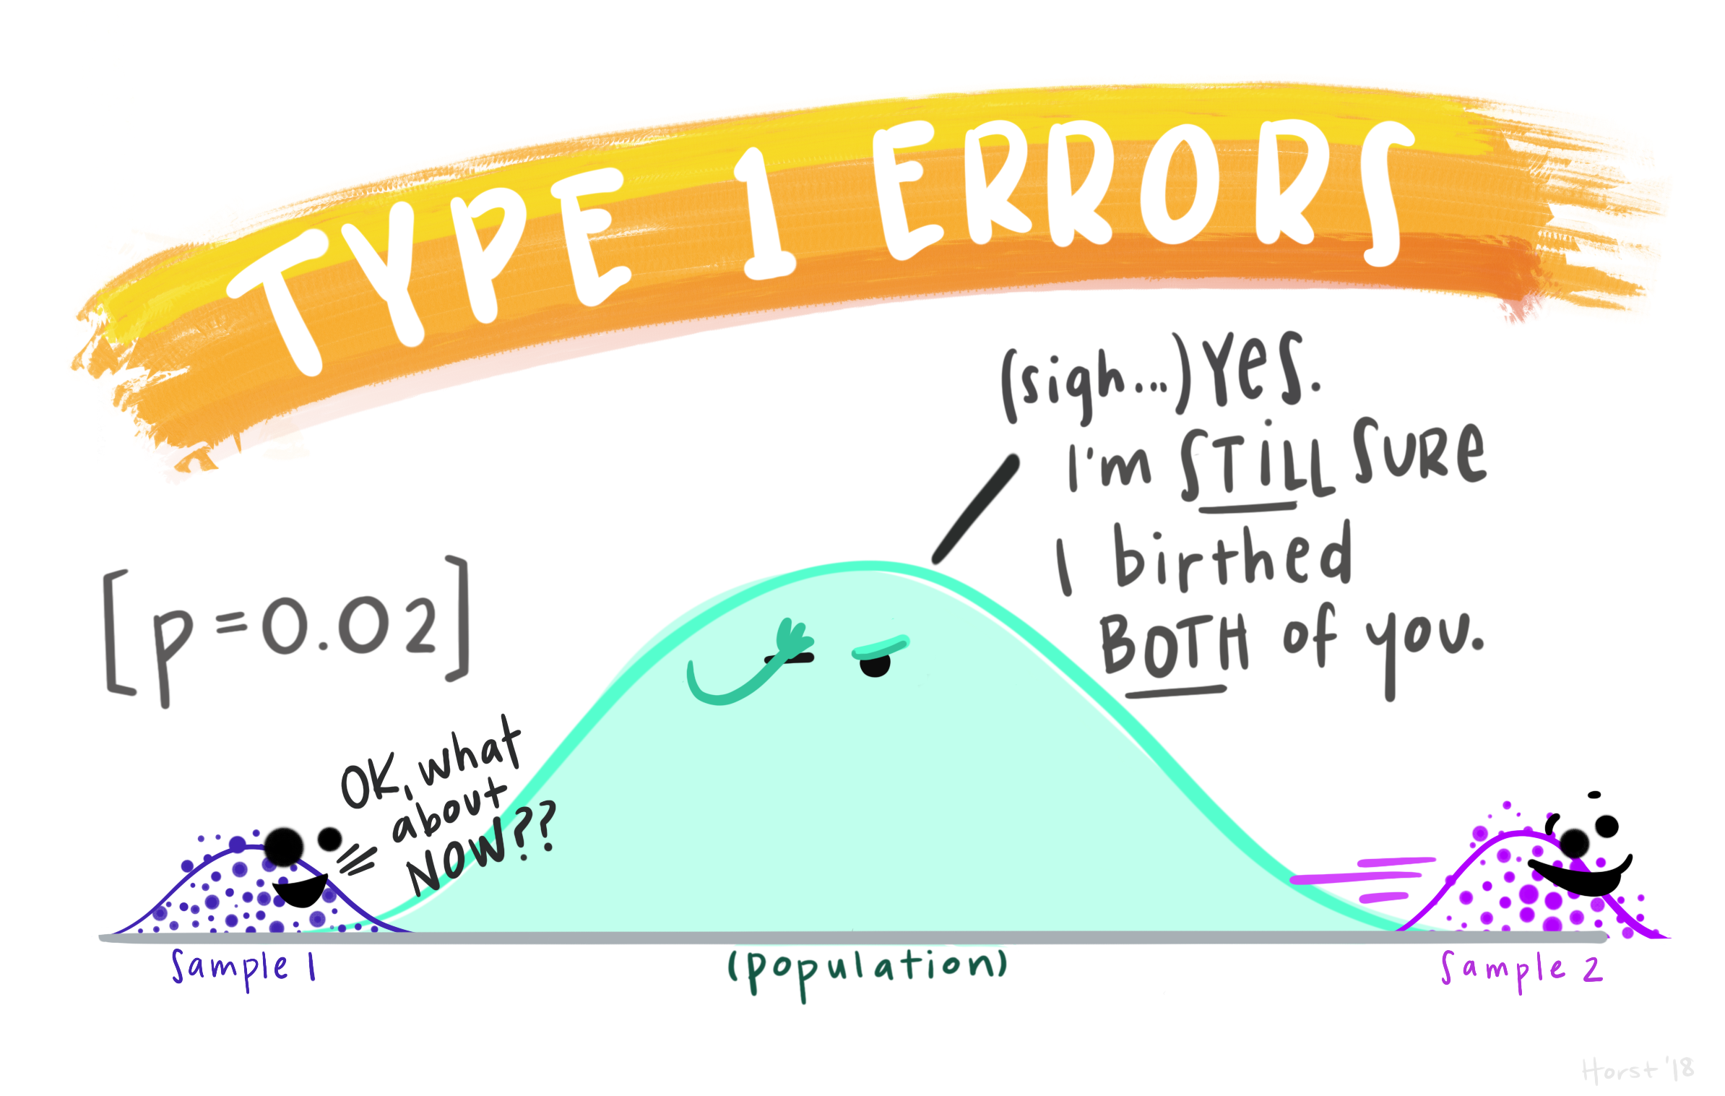
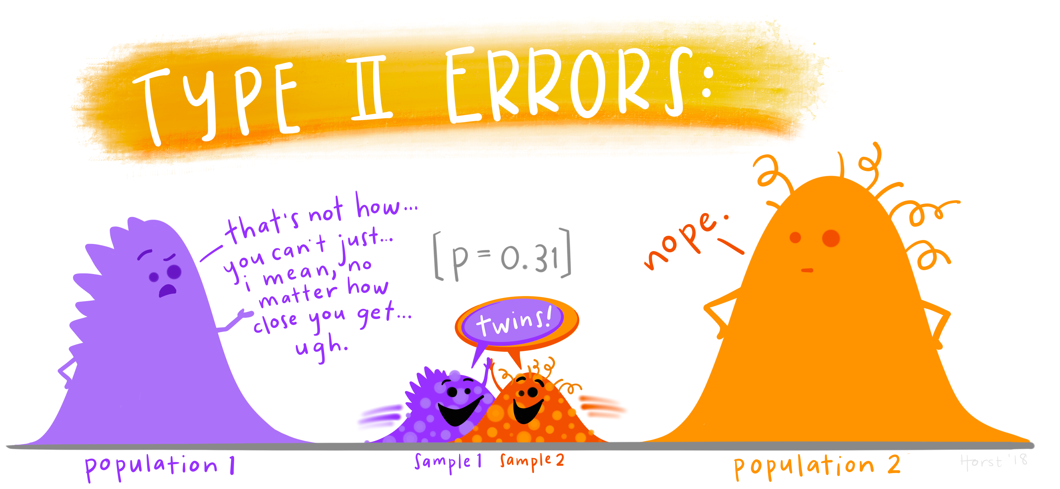
To recapitulate:
The null hypothesis (H₀): H₀ = no effect
The aim of a statistical test is to reject or not H_{0.}
High specificity = low False Positives = low Type I error
High sensitivity = low False Negatives = low Type II error
Statistical decision | True state of H₀
 | H₀ True (no effect) | H₀ False (effect)
Reject H₀ | Type I error α False Positive | Correct True Positive
Do not reject H₀ | Correct True Negative | Type II error β False Negative
https://github.com/allisonhorst/stats-illustrations#other-stats-artwork

Slide 47
Sample Size: Power Analysis
The power analysis depends on the relationship between 6 variables:
the difference of biological interest
the variability in the data (standard deviation)
the significance level (5%)
the desired power of the experiment (80%)
the sample size
the alternative hypothesis (ie one or two-sided test)
Effect size

Slide 48
The difference of biological interest
  This is to be determined scientifically, not statistically.
    minimum meaningful effect of biological relevance
    the larger the effect size, the smaller the experiment will need to be to detect it.
  How to determine it?
    Previous research, pilot study …
The Standard Deviation (SD)
  Variability of the data
  How to determine it?
    Data from previous research on WT or baseline …

Slide 49
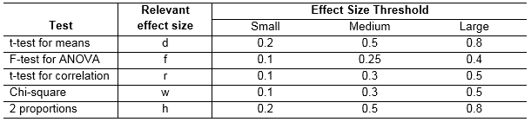
The effect size: what is it?
The effect size: minimum meaningful effect of biological relevance.
  Absolute difference + variability
How to determine it?
  Substantive knowledge
  Previous research
  Conventions
Jacob Cohen
  Author of several books and articles on power
  Defined small, medium and large effects for different tests

Slide 50

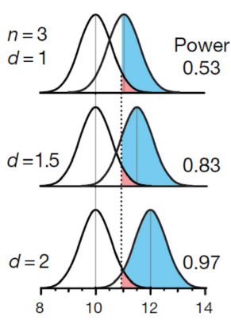
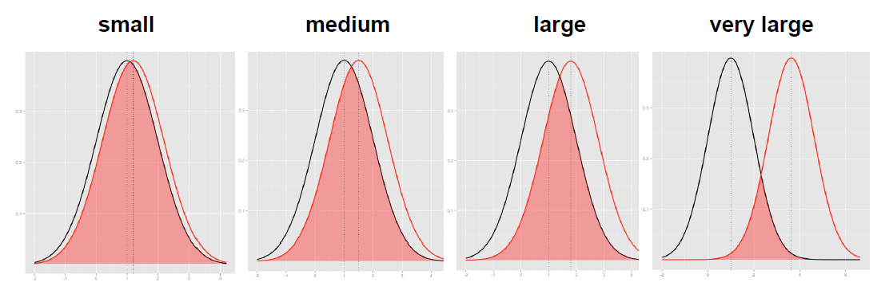
The effect size: how is it calculated?
The absolute difference
It depends on the type of difference and the data
  Easy example: comparison between 2 means
The bigger the effect (the absolute difference), the bigger the power
  = the bigger the probability of picking up the difference
Absolute difference
http://rpsychologist.com/d3/cohend/

Slide 51
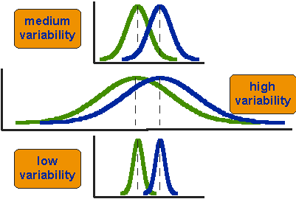
The effect size: how is it calculated?
The standard deviation
The bigger the variability of the data, the smaller the power
critical value
H₀
H₁

Slide 52
Power Analysis
The power analysis depends on the relationship between 6 variables:
the difference of biological interest
the standard deviation
the significance level (5%) (p< 0.05) α
the desired power of the experiment (80%) β
the sample size
the alternative hypothesis (ie one or two-sided test)

Slide 53
The sample size
Most of the time, the output of a power calculation.
The bigger the sample, the bigger the power
  but how does it work actually?
In reality it is difficult to reduce the variability in data, or the contrast between means,
  most effective way of improving power:
    increase the sample size.

Slide 54
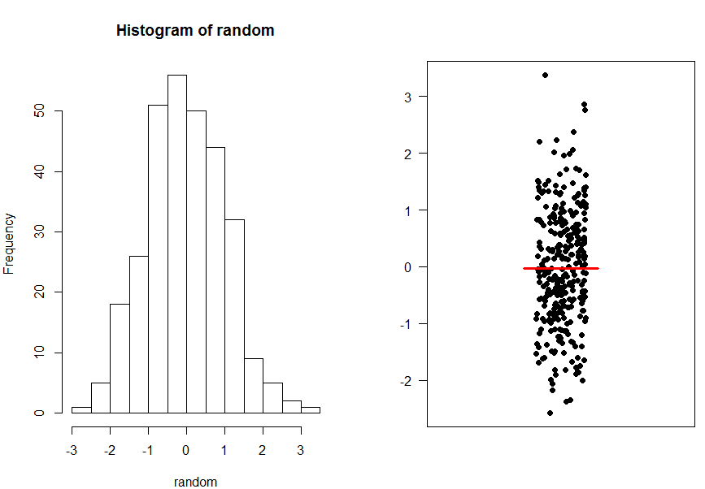
The sample size
A population

Slide 55
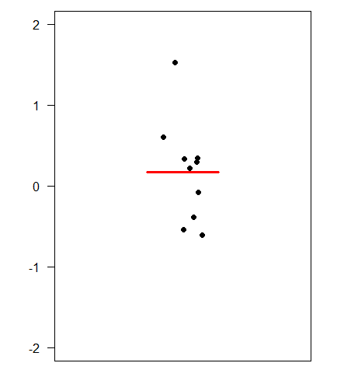
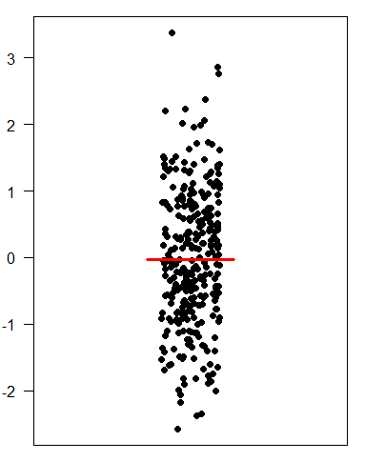
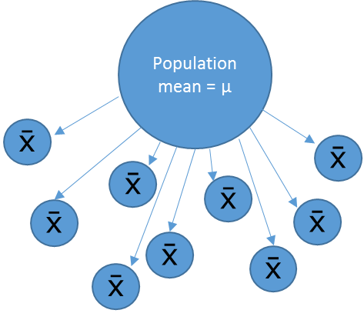
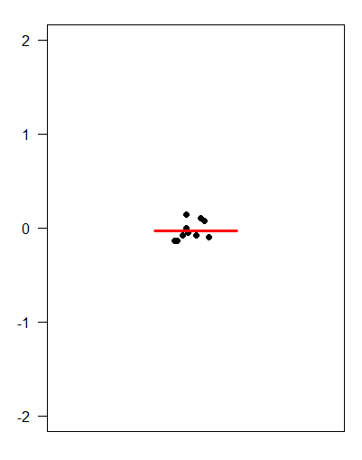
The sample size
Small samples (n=3)
Sample means
Big samples (n=30)
‘Infinite’ number of samples
Samples means = 
Sample means

Slide 56
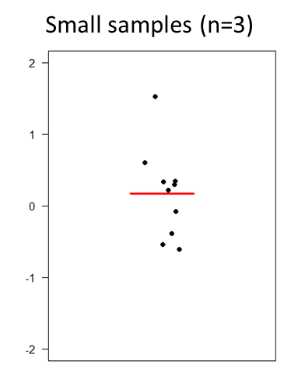
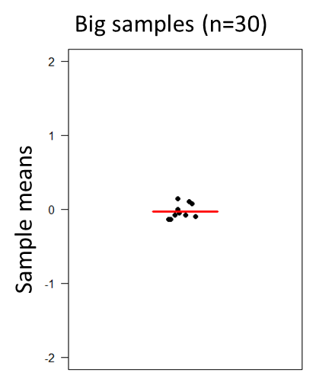


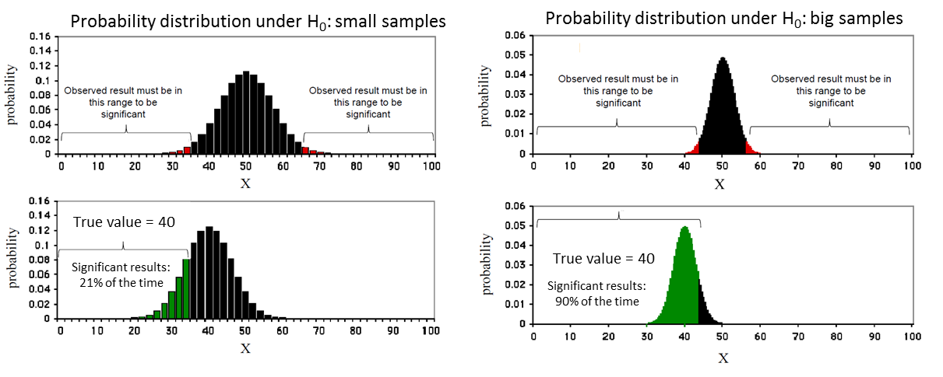
The sample size

Slide 57
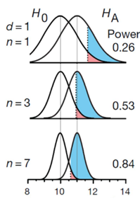
The sample size

Slide 58
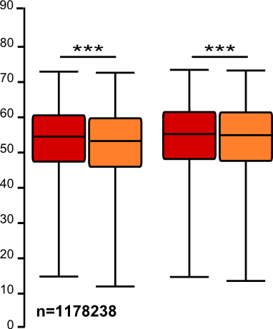
The sample size: the bigger the better?
It takes huge samples to detect tiny differences but tiny samples to detect huge differences.
What if the tiny difference is meaningless?
  Beware of overpower
  Nothing wrong with the stats: it is all about interpretation of the results of the test.
Remember the important first step of power analysis
  What is the effect size of biological interest?

Slide 59
Power Analysis
The power analysis depends on the relationship between 6 variables:
the effect size of biological interest
the standard deviation
the significance level (5%)
the desired power of the experiment (80%)
the sample size
the alternative hypothesis (ie one or two-sided test)

Slide 60
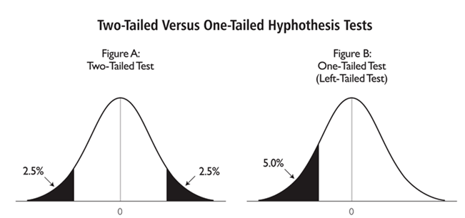
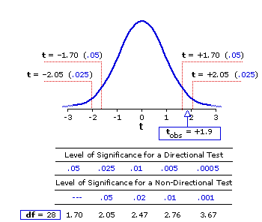
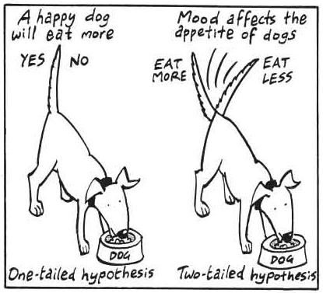
The alternative hypothesis: what is it?
One-tailed or 2-tailed test? One-sided or 2-sided tests?
Is the question:
  Is the there a difference?
  Is it bigger than or smaller than?
Can rarely justify the use of a one-tailed test
Two times easier to reach significance with a one-tailed than a two-tailed
  Suspicious reviewer!

Slide 61
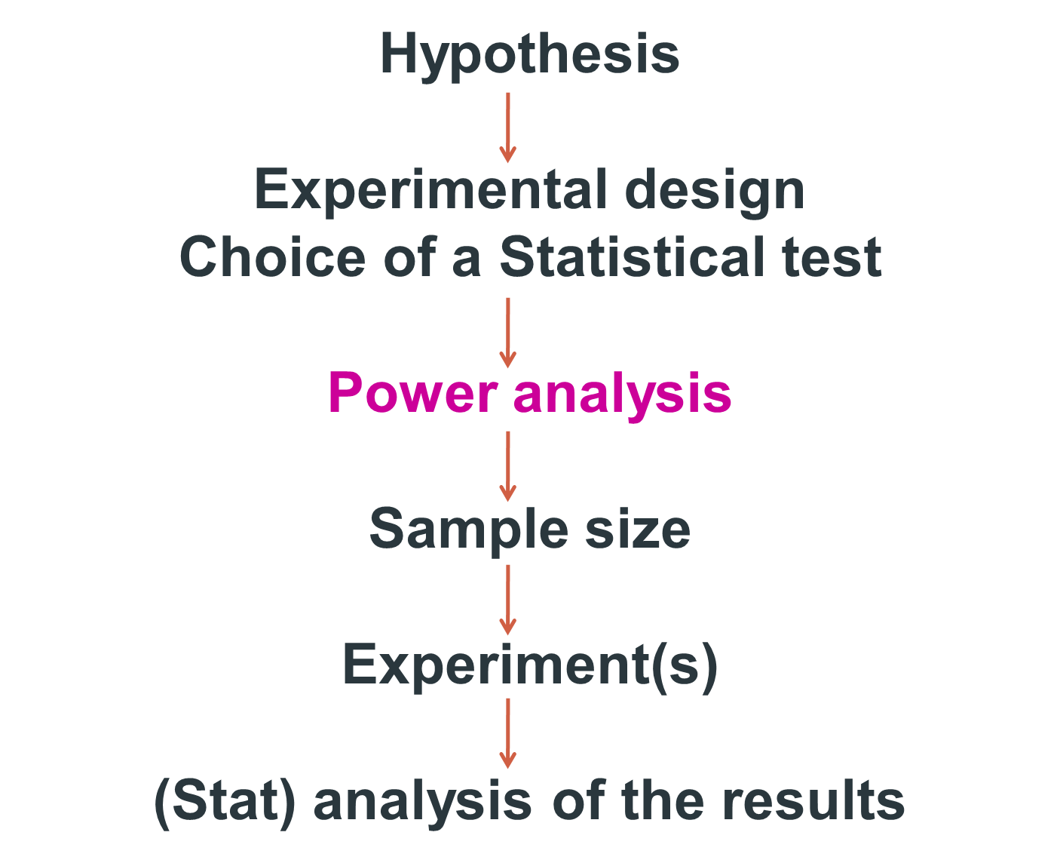

Slide 62
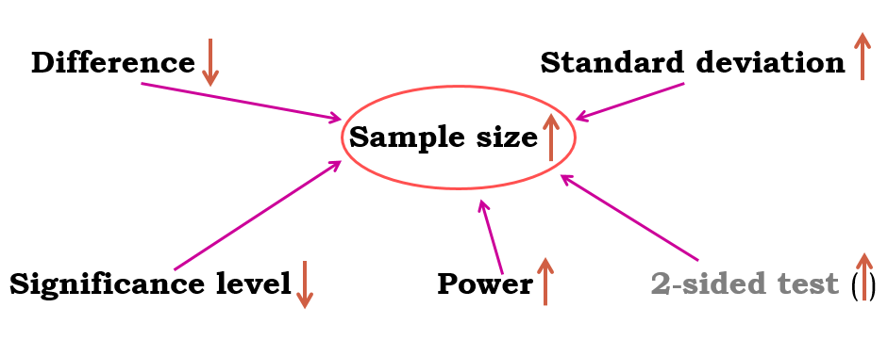
Fix any five of the variables and a mathematical relationship can be used to estimate the sixth.
e.g. What sample size do I need to have a 80% probability (power) to detect this particular effect (difference and standard deviation) at a 5% significance level using a 2-sided test?

Slide 63
Good news:
there are packages that can do the power analysis for you ... providing you have some prior knowledge of the key parameters!
difference + standard deviation = effect size
Free packages:
  R
  G*Power and InVivoStat
  Russ Lenth's power and sample-size page:
    http://www.divms.uiowa.edu/~rlenth/Power/
Cheap package: StatMate (~ $95)
Not so cheap package: MedCalc (~ $495)

Slide 64
Power Analysis
Let’s do it
Examples of power calculations:
  Comparing 2 proportions: Exercise 1
  Comparing 2 means: Exercise 2

Slide 65
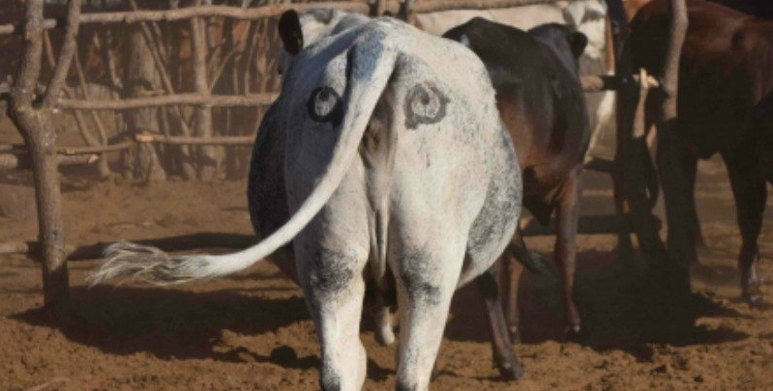
Sample Size: Power Analysis
Exercise 1:
Scientists have come up with a solution that will reduce the number of lions being shot by farmers in Africa:
painting eyes on cows’ bottoms.
Early trials suggest that lions are less likely to attack livestock when they think they’re being watched
  Fewer livestock attacks could help farmers and lions co-exist more peacefully.
Pilot study over 6 weeks:
  3 out of 39 unpainted cows were killed by lions, none of the 23 painted cows from the same herd were killed.
Questions:
  Do you think the observed effect is meaningful to the extent that such a ‘treatment’ should be applied?
Consider ethics, economics, conservation …
  Run a power calculation to find out how many cows should be included in the study.
Effect size: measure of distance between 2 proportions or probabilities
Comparison between 2 proportions: Fisher’s exact test
http://www.sciencealert.com/scientists-are-painting-eyes-on-cows-butts-to-stop-lions-getting-shot

Slide 66
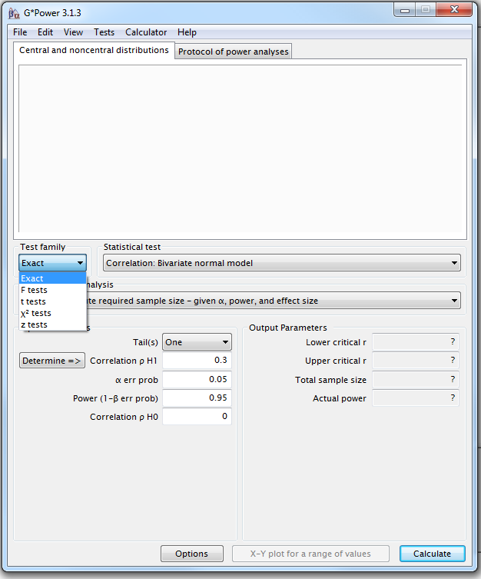
Power Analysis
Comparing 2 proportions
Four steps to Power
Example case:
0 cows killed in the painted group versus 3 out 39.
Step1: choice of Test family

Slide 67

G*Power
Step 2 : choice of Statistical test
Fisher’s exact test or Chi-square for 2x2 tables

Slide 68

G*Power
Step 3: Type of power analysis

Slide 69

G*Power
Step 4: Choice of Parameters
Tricky bit: need information on the size of the difference and the variability.

Slide 70

G*Power
To be able to pick up such a difference, we will need 2 samples of about 102 cows to reach significance (p<0.05) with 80% power.

Slide 71


Sample Size: Power Analysis
Exercise 2:
Pilot study: 10 arachnophobes were asked to perform 2 tasks:
Task 1: Group1 (n=5): to play with a big hairy tarantula spider with big fangs and an evil look in its eight eyes.
Task 2: Group 2 (n=5): to look at pictures of the same hairy tarantula.
Anxiety scores were measured for each group (0 to 100).
Use the data to calculate the values for a power calculation
Run a power calculation

Slide 72


Power Analysis
To reach significance with a t-test, providing the preliminary results are to be trusted, and be confident about the difference between the 2 groups, we need about 20 arachnophobes (2*10).

Slide 73
Power Analysis
H₀
H₁

Slide 74

Power Analysis
For a range of sample sizes:

Slide 75

Sample Size: Power Analysis
Unequal sample sizes
Scientists often deal with unequal sample sizes
  No simple trade-off:
    if one needs 2 groups of 30, going for 20 and 40 will be associated with decreased power.
  Unbalanced design = bigger total sample
  Solution:
    Step 1: power calculation for equal sample size
    Step 2: adjustment
Cow example: balanced design: n = 102
but this time: unpainted group: 2 times bigger than painted one (k=2):
Using the formula, we get a total:
N=2*102*(1+2)²/4*2 = 230
Painted butts (n₁)=77 Unpainted butts (n₂)=153
Balanced design: n = 2*102 = 204
Unbalanced design: n= 77+153 = 230

Slide 76
Sample Size: Power Analysis
Non-parametric tests
Non-parametric tests: do not assume data come from a Gaussian distribution.
  Non-parametric tests are based on ranking values from low to high
  Non-parametric tests not always less powerful
Proper power calculation for non-parametric tests:
  Need to specify which kind of distribution we are dealing with
    Not always easy
Non-parametric tests never require more than 15% additional subjects
providing that the distribution is not too unusual.
Very crude rule of thumb for non-parametric tests:
  Compute the sample size required for a parametric test and add 15%.

Slide 77
Sample Size: Power Analysis
What happens if we ignore the power of a test?
  Misinterpretation of the results
p-values: never ever interpreted without context:
  Significant p-value (<0.05): exciting! Wait: what is the difference?
    >= smallest meaningful difference: exciting
    < smallest meaningful difference: not exciting
      very big sample, too much power
  Not significant p-value (>0.05): no effect! Wait: how big was the sample?
    Big enough = enough power: no effect means no effect
    Not big enough = not enough power
      Possible meaningful difference but we miss it

Slide 80
Day 1
Descriptive statistics and data exploration
Anne Segonds-Pichon v2019-11
Notes:
Basics necessary for what simon will talk about: when things go wrong, what to look for, what questions to ask
Key basic principles necessary to check the results
Uncool things to do cool science

Slide 81
Variable
Quantitative
Qualitative
Discrete
Continuous
Nominal
Ordinal
Ratio
Interval

Slide 82

Quantitative data
They take numerical values (units of measurement)
Discrete: obtained by counting
  Example: number of students in a class
  values vary by finite specific steps
or continuous: obtained by measuring
  Example: height of students in a class
  any values
They can be described by a series of parameters:
  Mean, variance, standard deviation, standard error and confidence interval
https://github.com/allisonhorst/stats-illustrations#other-stats-artwork
Notes:
Discrete numb pups in a litter ; continous height, weight, different scale
Data can be messy so then you go back to qualitative data.
Describe them: Mean, variance, standard deviation, standard error and confidence interval

Slide 83


Measures of central tendency
Mode and Median
Mode: most commonly occurring value in a distribution
Median: value exactly in the middle of an ordered set of numbers
Notes:
Discrete numb pups in a litter continous hight, weitght, different scale
Data can be messy so then you go back to qualitative data.
Describe them: Mean, variance, standard deviation, standard error and confidence interval

Slide 84
Measures of central tendency
Mean
Definition: average of all values in a column
It can be considered as a model because it summaries the data
  Example: a group of 5 lecturers: number of friends of each members of the group: 1, 2, 3, 3 and 4
    Mean: (1+2+3+3+4)/5 = 2.6 friends per person
      Clearly an hypothetical value
How can we know that it is an accurate model?
  Difference between the real data and the model created

Slide 85

Measures of dispersion
Calculate the magnitude of the differences between each data and the mean:
  Total error = sum of differences
  $=0=Σ(x_{i}−\overline{x}$) = (-1.6)+(-0.6)+(0.4)+(0.4)+(1.4) = 0
  No errors !
      Positive and negative: they cancel each other out.
From Field, 2000

Slide 86
Sum of Squared errors (SS)
To avoid the problem of the direction of the errors: we square them
  Instead of sum of errors: sum of squared errors (SS):
$\left(SS\right)= Σ\left(x_{i} − \overline{x}\right)\left(x_{i} − \overline{x}\right)$
= (1.6) ² + (-0.6)² + (0.4)² +(0.4)² + (1.4)²
= 2.56 + 0.36 + 0.16 + 0.16 +1.96
= 5.20
SS gives a good measure of the accuracy of the model
  But: dependent upon the amount of data: the more data, the higher the SS.
  Solution: to divide the SS by the number of observations (N)
    As we are interested in measuring the error in the sample to estimate the one in the population we divide the SS by N-1 instead of N and we get the variance (S²) = SS/N-1

Slide 87
Variance and standard deviation
$variance \left(s^{2}\right)=\frac{SS}{N−1}= \frac{Σ \left(x_{i}− \overline{x}\right)2}{N−1}= \frac{5.20}{4}=1.3$
Problem with variance: measure in squared units
  For more convenience, the square root of the variance is taken to obtain a measure in the same unit as the original measure:
    the standard deviation
      S.D. = √(SS/N-1) = √(s²) = s $= \sqrt{1.3}=1.14$
    The standard deviation is a measure of how well the mean represents the data.

Slide 88

Standard deviation
Small S.D.:
data close to the mean:
mean is a good fit of the data
Large S.D.:
data distant from the mean:
mean is not an accurate representation

Slide 89
SD and SEM (SEM = SD/√N)
What are they about?
  The SD quantifies how much the values vary from one another: scatter or spread
    The SD does not change predictably as you acquire more data.
  The SEM quantifies how accurately you know the true mean of the population.
    Why? Because it takes into account: SD + sample size
    The SEM gets smaller as your sample gets larger
      Why? Because the mean of a large sample is likely to be closer to the true mean than is the mean of a small sample.

Slide 90
The SEM and the sample size
Small samples (n=3)
Sample means
Big samples (n=30)
‘Infinite’ number of samples
Samples means = 
Sample means

Slide 91


SD and SEM
The SD quantifies the scatter of the data.
The SEM quantifies the distribution
of the sample means.

Slide 92
SD or SEM ?
If the scatter is caused by biological variability, it is important to show the variation.
  Report the SD rather than the SEM.
    Better even: show a graph of all data points.
If you are using an in vitro system with no biological variability, the scatter is about experimental imprecision (no biological meaning).
  Report the SEM to show how well you have determined the mean.
Notes:
SD how much data differ from one to another. Scattered.
SEM how accurately you know the real mean of the true population
SD is the biological variability meaningful? If you have meaningful biological variability you have to put SD

Slide 93



Confidence interval
Range of values that we can be 95% confident contains the true mean of the population.
  - So limits of 95% CI: [Mean - 1.96 SEM; Mean + 1.96 SEM] (SEM = SD/√N)
Error bars | Type | Description
Standard deviation | Descriptive | Typical or average difference between the data points and their mean.
Standard error | Inferential | A measure of how variable the mean will be, if you repeat the whole study many times.
Confidence interval usually 95% CI | Inferential | A range of values you can be 95% confident contains the true mean.
Notes:
If you polt that it tells you that 95% of the time the SD will be in this interval if you have a small overlap you can still have significance it’s the best to use

Slide 94



Z-score
Standardisation of normal data with mean µ and standard deviation σ
Example: µ=50 and σ=1.
  A variable with value x=60 has a z-score=1

Slide 95


Z-score
Probability that a given value is found in a normally distributed sample with known µ and σ.
Beyond a threshold, values ‘do not belong’ or are very unlikely to be found in such a sample.
  Threshold = 1.96
  Normal distribution: 95% of observations lie within μ ± 1.96σ (Z=1.96)
  Probability to find values beyond ± 1.96σ is =<5% (p<0.05)

Slide 96

Z-score application
RNA-seq analysis
Differential gene expression: Noise
    Length of gene and level of expression
  Lowly expressed genes = highest fold changes
    Often biologically meaningless

Slide 97
Graphical exploration of data

Slide 98
Question
Data Collection/Storage
Data Exploration
Data Analysis
Results
Experiment
Sample Size
Experimental Design

Slide 99



Data Exploration
Categorical data

Slide 100


Data Exploration
Quantitative data: Scatterplot

Slide 101


Data Exploration
Quantitative data:
Scatterplot/stripchart
Small sample
Big sample

Slide 102


Data Exploration
Quantitative data: Boxplot

Slide 103


Data Exploration
Quantitative data:
Boxplot or Beanplot
Scatterplot shows individual data
A bean= a ‘batch’ of data
Bimodal
Uniform
Normal
Distributions
Data density mirrored by the shape of the polygon

Slide 104


Data Exploration
Quantitative data:
Boxplot and Beanplot and Scatterplot
****

Slide 105


Data Exploration
Quantitative data: Histogram
Big sample
Small sample

Slide 106


Data Exploration
Quantitative data: Histogram (distribution)

Slide 107
Data exploration $≠$ plotting data

Slide 108
Data Exploration
Plotting is not the same thing as exploring
One experiment: change in the variable of interest between CondA to CondB.
  Data plotted as a bar chart.
The truth
The fiction

Slide 109
Data Exploration
Plotting (and summarising) is (so) not
the same thing as exploring
Five experiments: change in the variable of interest between 3 treatments and a control.
  Data plotted as a bar chart.
The truth (if you are into bar charts)
Comparisons:
Treatments vs. Control
p=0.001
p=0.04
Exp5
Exp4
p=0.32
Exp3
Exp1
Exp2

Slide 112
Days 2 and 3
Analysis of Quantitative data
Anne Segonds-Pichon v2019-11

Slide 113
Outline of this section
Assumptions for parametric data
Comparing two means: Student’s t-test
Comparing more than 2 means
  One factor: One-way ANOVA
  Two factors: Two-way ANOVA
Relationship between 2 continuous variables:
  Linear: Correlation
  Non-linear: Curve fitting
Non-parametric tests

Slide 114
Introduction
Key concepts to always keep in mind
  Null hypothesis and error types
  Statistics inference
  Signal-to-noise ratio

Slide 115
The null hypothesis and the error types
The null hypothesis (H₀): H₀ = no effect
  e.g. no difference between 2 genotypes
The aim of a statistical test is to reject or not H_{0.}
Traditionally, a test or a difference is said to be “significant” if the probability of type I error is: α =< 0.05
High specificity = low False Positives = low Type I error
High sensitivity = low False Negatives = low Type II error
Statistical decision | True state of H₀
 | H₀ True (no effect) | H₀ False (effect)
Reject H₀ | Type I error α False Positive | Correct True Positive
Do not reject H₀ | Correct True Negative | Type II error β False Negative

Slide 116

Sample
Statistical inference
Population
Difference
Meaningful?
Yes
Real?
Statistical test
Big enough?
Statistic
e.g. t, F …
=
+ Noise +
Difference
Sample

Slide 117

Signal-to-noise ratio
Stats are all about understanding and controlling variation.
signal
noise
signal
noise
Difference
+ Noise
Difference
Noise
If the noise is low then the signal is detectable …
= statistical significance
… but if the noise (i.e. interindividual variation) is large
then the same signal will not be detected
= no statistical significance
In a statistical test, the ratio of signal to noise determines the significance.

Slide 118
Analysis of Quantitative Data
Choose the correct statistical test to answer your question:
  They are 2 types of statistical tests:
    Parametric tests with 4 assumptions to be met by the data,
    Non-parametric tests with no or few assumptions (e.g. Mann-Whitney test) and/or for qualitative data (e.g. Fisher’s exact and χ² tests).

Slide 119

Assumptions of Parametric Data
All parametric tests have 4 basic assumptions that must be met for the test to be accurate.
  1) Normally distributed data
  Normal shape, bell shape, Gaussian shape
    Transformations can be made to make data suitable for parametric analysis.
Notes:
Small sample no worth check for normality
Parametric only when it’s big sample go for non parametric if you are unsure do both the non parametric is more efficient to find a difference
Can ask to run a test if there is a departure from normality

Slide 120




Assumptions of Parametric Data
Frequent departures from normality:
  Skewness: lack of symmetry of a distribution
  Kurtosis: measure of the degree of ‘peakedness’ in the distribution
    The two distributions below have the same variance approximately the same skew, but differ markedly in kurtosis.
Skewness < 0
Skewness = 0
Skewness > 0
More peaked distribution: kurtosis > 0
Flatter distribution: kurtosis < 0
Notes:
Departure from normality +vely skewd most common

Slide 121
Assumptions of Parametric Data
  2) Homogeneity in variance
    The variance should not change systematically throughout the data
  3) Interval data (linearity)
    The distance between points of the scale should be equal at all parts along the scale.
  4) Independence
    Data from different subjects are independent
      Values corresponding to one subject do not influence the values corresponding to another subject.
      Important in repeated measures experiments
Notes:
Variance must be same in the groups or similar
Interval data: in all group ypu measure data in the same way
Independence you have to know if it is or not tests are different in this case

Slide 122
Analysis of Quantitative Data
Is there a difference between my groups regarding the variable I am measuring?
  e.g. are the mice in the group A heavier than those in group B?
    Tests with 2 groups:
      Parametric: Student’s t-test
      Non parametric: Mann-Whitney/Wilcoxon rank sum test
    Tests with more than 2 groups:
      Parametric: Analysis of variance (one-way and two-way ANOVA)
      Non parametric: Kruskal Wallis (one-way ANOVA equivalent)
Is there a relationship between my 2 (continuous) variables?
  e.g. is there a relationship between the daily intake in calories and an increase in body weight?
    Test: Correlation (parametric or non-parametric) and Curve fitting

Slide 123
Comparison between 2 groups
Parametric data

Slide 124

Comparison between 2 groups:
Student’s t-test
Basic idea:
  When we are looking at the differences between scores for 2 groups, we have to judge the difference between their means relative to the spread or variability of their scores.
    Eg: comparison of 2 groups: control and treatment

Slide 125
Student’s t-test
Notes:
Smaller variability more likely that the difference is significant case b it’s going to be difficult you nee A LOT of data

Slide 126


Student’s t-test

Slide 127
****
~ 2 x SE: p~0.05
~ 4.5 x SE: p~0.01
~ 1 x SE: p~0.05
~ 2 x SE: p~0.01

Slide 128
Student’s t-test
3 types:
  Independent t-test
    Difference between 2 means of one variable for two independent groups
      Example: difference in weight between WT and KO mice
  Paired t-test
    difference between two measures of one variable for one group:
      Example: before-after measurements
    Importance of experimental design!
  One-Sample t-test
    tests whether the mean of a single variable differs from a specified constant
Notes:
WT vs mutant, totally independent
Time 0 then treatment and look at time 1: look difference in one group in difference condition

Slide 129

Example: coyotes.xlsx
Question: do male and female coyotes differ in size?
Sample size
Data exploration
Check the assumptions for parametric test
Statistical analysis: Independent t-test

Slide 130
Exercise 3: Power analysis
Example case:
No data from a pilot study but we have found some information in the literature.
In a study run in similar conditions as in the one we intend to run, male coyotes were found to measure: 92cm+/- 7cm (SD).
We expect a 5% difference between genders.
smallest biologically meaningful difference

Slide 131

G*Power
Independent t-test
A priori Power analysis
Example case:
You don’t have data from a pilot study but you have found some information in the literature.
In a study run in similar conditions to the one you intend to run, male coyotes were found to measure:
92cm+/- 7cm (SD)
You expect a 5% difference between genders with a similar variability in the female sample.
You need a sample size of n=76 (2*38)

Slide 132

Power Analysis
H₀
H₁

Slide 133

Power Analysis
For a range of sample sizes:

Slide 134
Data exploration $≠$ plotting data

Slide 135
Exercise 4: Data exploration
The file contains individual body length of male and female coyotes.
Question: do male and female coyotes differ in size?
  Plot the data as stripchart, boxplot and violinplot

Slide 136
Maximum
Upper Quartile (Q3) 75th percentile
Interquartile Range (IQR)
Median
Lower Quartile (Q1) 25th percentile
Smallest data value
> lower cutoff
Cutoff = Q1 – 1.5*IQR
Outlier

Slide 137


Slide 138
Exercise 4: Exploring data - Answers

Slide 139

Assumptions for parametric tests
Normality ☑

Slide 140
Normality assumption
Same mean
Same SD
Same sample size
BUT
perfectly normal distribution
= Quantile – Quantile plot
Fake coyotes
Our coyotes

Slide 141

Independent t-test: results
Males tend to be longer than females
but not significantly so (p=0.1045)
Homogeneity in variance ☑
What about the power of the analysis?

Slide 142


Power analysis
You would need a sample 3 times bigger to reach the accepted power of 80%.
But is a 2.3 cm difference between genders biologically relevant (<3%) ?

Slide 143
Sample size: the bigger the better?
It takes huge samples to detect tiny differences but tiny samples to detect huge differences.
What if the tiny difference is meaningless?
  Beware of overpower
  Nothing wrong with the stats: it is all about interpretation of the results of the test.
Remember the important first step of power analysis
  What is the effect size of biological interest?

Slide 144
Coyotes

Slide 145

Exercise 5: Dependent or Paired t-test
working memory.xlsx
A group of rhesus monkeys (n=15) performs a task involving memory after having received a placebo. Their performance is graded on a scale from 0 to 100. They are then asked to perform the same task after having received a dopamine depleting agent.
Is there an effect of treatment on the monkeys' performance?

Slide 146
Another example of t-test:
working memory.xlsx
Normaliy ☑

Slide 147

Another example of t-test:
working memory.xlsx

Slide 148

Paired t-test: Results
working memory.xlsx

Slide 149
Comparison between 2 groups
Non-Parametric data

Slide 150
Non-parametric test:
Mann-Whitney = Wilcoxon rank test
Non-parametric equivalent of the t-test.
What if the data do not meet the assumptions for parametric tests?
  The outcome is a rank or a score with limited amount of possible values: non-parametric approach.
How does the Mann-Whitney test work?
Real values | Ranks
3 | 1
5 | 2
6 | 3
7 | 4
8 | 5
9 | 6
Mean | 3.5
 | Group 1 | Group 2
 | 2 | 5
 | 4 | 6
 | 1 | 3
Sum | 7 | 14
Group 1 | Group 2
5 | 8
7 | 9
3 | 6
Statistic of the Mann-Whitney test: W (U)
  W = sum of ranks – mean rank: W₁=3.5 and W₂=10.5
  Smallest of the 2 Ws: W₁ + sample size p-value

Slide 151


Exercise 6: smelly teeshirt.xlsx
Hypothesis: Group body odour is less disgusting when associated with an in-group member versus an out-group member.
Study: Two groups of Cambridge University students are presented with one of two smelly, worn t-shirts with university logos.
Question: are Cambridge students more disgusted by worn smelly T-shirts
from Oxford or Cambridge? Disgust score: 1 to 7, with 7 the most disgusting
  Explore the data with an appropriate combination of 2 graphs
  Answer the question with a non-parametric approach
  What do you think about the design?

Slide 152


Exercise 6: smelly teeshirt.xlsx
Question: are Cambridge students more disgusted by worn smelly T-shirts from Oxford or Cambridge?
Disgust score: 1 to 7, with 7 the most disgusting
A paired design would have been better.

Slide 153
Non-parametric test:
Wilcoxon’s signed-rank
Non-parametric equivalent of the paired t-test
How does the test work?
Before | After | Differences
9 | 3 | -6
7 | 4 | -3
10 | 4 | -6
8 | 5 | -3
5 | 6 | 1
8 | 2 | -6
7 | 7 | 0
9 | 4 | -5
10 | 5 | -5
Ranking | Ranks
0
1 | 1
3 | 2.5
3 | 2.5
5 | 4.5
5 | 4.5
6 | 7
6 | 7
6 | 7
 | Negative rank | Positive rank
 | -1
 | -2.5
 | -2.5
 |  | 4.5
 | -4.5
 | -7
 | -7
 | -7
Sum | -31.5 | 4.5
Statistic of the Wilcoxon’s signed-rank test: T (W)
  Here: Wilcoxon’s T = 4.5 (smallest of the 2 (absolute value))
  Sample size N = 9 (we ignore the 0 difference): T + N p-value

Slide 154


Exercise 7: botulinum.xlsx
A group of 9 disabled children with muscle spasticity (or extreme muscle tightness limiting movement) in their right upper limb underwent a course of injections with botulinum toxin to reduce spasticity levels.
A neurologist (blind to group membership) assessed levels of spasticity pre- and post-treatment for all 9 children using a 10-point ordinal scale.
Higher ratings indicated higher levels of spasticity.
Question: do botulinum toxin injections reduce muscle spasticity levels?
  Score: 1 to 10, with 10 the highest spasticity

Slide 155


Exercise 7: botulinum.xlsx
Question: do botulinum toxin injections reduce muscle spasticity levels?
Answer: There was a significant difference pre- and post- treatment in ratings of muscle spasticity. (T=-45, p=0.004).
Note: T=W

Slide 156
Comparison between more than 2 groups
One factor

Slide 157

Comparison of more than 2 means
Running multiple tests on the same data increases the familywise error rate.
What is the familywise error rate?
  The error rate across tests conducted on the same experimental data.
One of the basic rules (‘laws’) of probability:
  The Multiplicative Rule: The probability of the joint occurrence of 2 or more independent events is the product of the individual probabilities.
Notes:
Compare many groups to each other, wrong to use multiple t-tests, It increases the error

Slide 158
Familywise error rate
Example: All pairwise comparisons between 3 groups A, B and C:
  A-B, A-C and B-C
Probability of making the Type I Error: 5%
  The probability of not making the Type I Error is 95% (=1 – 0.05)
Multiplicative Rule:
  Overall probability of no Type I errors is: 0.95 * 0.95 * 0.95 = 0.857
So the probability of making at least one Type I Error is 1-0.857 = 0.143 or 14.3%
    The probability has increased from 5% to 14.3%
Comparisons between 5 groups instead of 3, the familywise error rate is 40% (=1-(0.95)^{n})

Slide 159
Familywise error rate
Solution to the increase of familywise error rate: correction for multiple comparisons
  Post-hoc tests
Many different ways to correct for multiple comparisons:
  Different statisticians have designed corrections addressing different issues
    e.g. unbalanced design, heterogeneity of variance, liberal vs conservative
However, they all have one thing in common:
  the more tests, the higher the familywise error rate: the more stringent the correction
Tukey, Bonferroni, Sidak, Benjamini-Hochberg …
  Two ways to address the multiple testing problem
    Familywise Error Rate (FWER) vs. False Discovery Rate (FDR)

Slide 160
Multiple testing problem
FWER: Bonferroni: α_{adjust} = 0.05/n comparisons e.g. 3 comparisons: 0.05/3=0.016
  Problem: very conservative leading to loss of power (lots of false negative)
  10 comparisons: threshold for significance: 0.05/10: 0.005
  Pairwise comparisons across 20.000 genes ☹
FDR: Benjamini-Hochberg: the procedure controls the expected proportion of “discoveries” (significant tests) that are false (false positive).
  Less stringent control of Type I Error than FWER procedures which control the probability of at least one Type I Error
  More power at the cost of increased numbers of Type I Errors.
Difference between FWER and FDR:
  a p-value of 0.05 implies that 5% of all tests will result in false positives.
  a FDR adjusted p-value (or q-value) of 0.05 implies that 5% of significant tests will result in false positives.

Slide 161
Analysis of variance
Extension of the 2 groups comparison of a t-test but with a slightly different logic:
t-test = mean1 – mean2
      Pooled SEM
ANOVA = variance between means
  Pooled SEM
ANOVA compares variances:
  If variance between the several means > variance within the groups (random error) then the means must be more spread out than it would have been by chance.
Pooled SEM
Pooled SEM

Slide 162
Analysis of variance
The statistic for ANOVA is the F ratio.
F =
F =
If the variance amongst sample means is greater than the error/random variance, then F>1
  In an ANOVA, we test whether F is significantly higher than 1 or not.
Variance between the groups
Variance within the groups (individual variability)
Variation explained by the model (= systematic)
Variation explained by unsystematic factors (= random variation)

Slide 163
Analysis of variance
Source of variation | Sum of Squares | df | Mean Square | F | p-value
Between Groups | 2.665 | 4 | 0.6663 | 8.423 | <0.0001
Within Groups | 5.775 | 73 | 0.0791
Total | 8.44 | 77
Variance (= SS / N-1) is the mean square
  df: degree of freedom with df = N-1
In Power Analysis:
Pooled SD=$√$MS(Residual)
Between groups variability
Within groups variability
Total sum of squares

Slide 164
Exercise 8: One-way ANOVA
protein expression.xlsx
Question: is there a difference in protein expression between the 5 cell lines?
1 Plot the data
2 Check the assumptions for parametric test

Slide 166

Parametric tests assumptions

Slide 168

Parametric tests assumptions

Slide 169
Analysis of variance: Post hoc tests
The ANOVA is an “omnibus” test: it tells you that there is (or not) a difference between your means but not exactly which means are significantly different from which other ones.
  To find out, you need to apply post hoc tests.
  These post hoc tests should only be used when the ANOVA finds a significant effect.

Slide 170




One-Way Analysis of variance

Slide 171


Analysis of variance: results
Homogeneity of variance ☑
F=0.6727/0.08278=8.13

Slide 172

Exercise 9: neutrophils.xlsx
A researcher is looking at the difference between 4 cell groups. He has run the experiment 5 times. Within each experiment, he has neutrophils from a WT (control), a KO, a KO+Treatment 1 and a KO+Treatment2.
Question: Is there a difference between KO with/without treatment and WT?

Slide 173




Exercise 9: neutrophils.xlsx
Answer: There is a significant difference from WT for the first and third groups.

Slide 174
Comparison between more than 2 groups
One factor
What about power analysis?

Slide 175
Comparison of more than 2 means
Different ways to go about power analysis in the context of ANOVA:
  η² : explained proportion variance of the total variance.
    Can be translated into effect size d.
    Not very useful: only looking at the omnibus part of the test
  Minimum power specification: looks at the difference between the smallest and the biggest means.
    All means other than the 2 extreme one are equal to the grand mean.
  Smallest meaningful difference
    Works like a post-hoc test.

Slide 176
Power Analysis
Comparing more than 2 means
Research example: Comparison between 4 teaching methods
Smallest meaningful difference
  Same assumptions:
    Equal group sizes and equal variability (SD = 80)
  3 comparisons of interest: vs. Group 1
  Smallest meaningful difference: group 1 vs. Group 2
    t-test: Mean 1 = 550, SD = 80 and mean 2 = 598, SD = 80
    Power calculation like for a t-test but with a Bonferroni correction (adjustment for multiple comparisons)

Slide 177

Power Analysis
Comparing more than 2 means
Smallest meaningful difference
  Power calculation like for a t-test but with a Bonferroni correction.
  Protein expression example:
    Comparisons vs. cell line A.
    Meaningful difference: D vs. A
Bonferroni correction
3 comparisons: 0.05/4 = 0.0125

Slide 178
Comparison between more than 2 groups
One factor
Non-Parametric data

Slide 179
Non Parametric approach:
Kruskal-Wallis
Non-parametric equivalent of the one-way ANOVA
It is a test based on ranks
kruskal.wallis() produces omnibus part of the analysis
Post-hoc test associated with Kruskal-Wallis: Dunn test
dunn.test() gives both Kruskall-Wallis and pairwise comparisons results ## dunn.test package ##
Statistic associated with Kruskal-Wallis is H and it has a Chi² distribution
The Dunn test works pretty much like the Mann-Whitney test.

Slide 180

Exercise 10: creatine.xlsx
Creatine, a supplement popular among body builders
Three groups: No creatine; Once a day; and Twice a day.
Question: does the average weight gain depend on the creatine group to which people were assigned?

Slide 181

Exercise 10: creatine.xlsx

Slide 182
Comparison between more than 2 groups
Two factors

Slide 183
Two-way Analysis of Variance
(Factorial ANOVA)
Source of variation | Sum of Squares | Df | Mean Square | F | p-value
Variable A * Variable B | 1978 | 2 | 989.1 | F (2, 42) = 11.91 | P < 0.0001
Variable B (Between groups) | 3332 | 2 | 1666 | F (2, 42) = 20.07 | P < 0.0001
Variable A (Between groups) | 168.8 | 1 | 168.8 | F (1, 42) = 2.032 | P = 0.1614
Residuals | 3488 | 42 | 83.04
Source of variation | Sum of Squares | Df | Mean Square | F | p-value
Variable A (Between Groups) | 2.665 | 4 | 0.6663 | 8.42 | <0.0001
Within Groups (Residual) | 5.775 | 73 | 0.0791
Total | 8.44 | 77
One-way ANOVA= 1 predictor variable
2-way ANOVA= 2 predictor variables: A and B
SST
Total variance in the Data
SST
Total variance in the Data
Total
SSM
Variance Explained by the Model
SSR
Unexplained Variance
SSM
Variance Explained by the Model
Between Groups
SSR
Unexplained Variance
Within Groups
SSA
Variance Explained by Variable A
SSB
Variance Explained by Variable B
SSAxB
Variance Explained by the Interaction of A and B

Slide 184

Two-way Analysis of Variance
Example: goggles.xlsx
  The ‘beer-goggle’ effect
    The term refers to finding people more attractive after you’ve had a few beers. Drinking beer provides a warm, friendly sensation, lowers your inhibitions, and helps you relax.
  Study: effects of alcohol on mate selection in night-clubs.
  Pool of independent judges scored the levels of attractiveness of the person that the participant was chatting up at the end of the evening.
  Question: is subjective perception of physical attractiveness affected by alcohol consumption?
    Attractiveness on a scale from 0 to 100

Slide 185
Two-way Analysis of Variance
Interaction
between Alcohol and Gender
Main effect of Alcohol
Main effect of Gender

Slide 186
Two-way Analysis of Variance
Interaction plots: Examples
  Fake dataset:
    2 factors: Genotype (2 levels) and Condition (2 levels)

Slide 187


Two-way Analysis of Variance
Interaction plots: Examples
  2 factors: Genotype (2 levels) and Condition (2 levels)
Single Effect
Genotype Effect
Condition Effect

Slide 188


Two-way Analysis of Variance
Interaction plots: Examples
  2 factors: Genotype (2 levels) and Condition (2 levels)
Zero or Both Effect
Zero Effect
Both Effect

Slide 189


Two-way Analysis of Variance
Interaction plots: Examples
  2 factors: Genotype (2 levels) and Condition (2 levels)
Interaction

Slide 190
Two-way Analysis of Variance
With significant interaction (real data)
ANOVA table | SS | DF | MS | F (DFn, DFd) | P value
Interaction | 1978 | 2 | 989.1 | F (2, 42) = 11.91 | < 0.0001
Alcohol Consumption | 3332 | 2 | 1666 | F (2, 42) = 20.07 | < 0.0001
Gender | 168.8 | 1 | 168.8 | F (1, 42) = 2.032 | 0.1614
Residual | 3488 | 42 | 83.04
Without significant interaction (fake data)
ANOVA table | SS | DF | MS | F (DFn, DFd) | P value
Interaction | 7.292 | 2 | 3.646 | F (2, 42) = 0.06872 | 0.9337
Alcohol Consumption | 5026 | 2 | 2513 | F (2, 42) = 47.37 | < 0.0001
Gender | 438.0 | 1 | 438.0 | F (1, 42) = 8.257 | 0.0063
Residual | 2228 | 42 | 53.05

Slide 191





Two-way Analysis of Variance

Slide 192


Two-way Analysis of Variance

Slide 193
Other example with multiple t-tests

Slide 194
Association between 2 continuous variables
Linear relationship

Slide 195


Correlation
A correlation coefficient is an index number that measures:
  The magnitude and the direction of the relation between 2 variables
  It is designed to range in value between -1 and +1
Notes:
No biological basis, could be just coincidence

Slide 196
Correlation
Assumptions for correlation
  Regression and linear Model (lm)
Linearity: The relationship between X and the mean of Y is linear.
Homoscedasticity: The variance of residual is the same for any value of X.
Independence: Observations are independent of each other.
Normality: For any fixed value of X, Y is normally distributed.

Slide 197
Correlation
Assumptions for correlation
  Regression and linear Model (lm)
Outliers: the observed value for the point is very different from that predicted by the regression model.
Leverage points: A leverage point is defined as an observation that has a value of x that is far away from the mean of x.
Influential observations: change the slope of the line. Thus, have a large influence on the fit of the model.
One method to find influential points is to compare the fit of the model with and without each observation.
Bottom line: influential outliers are problematic.

Slide 198

Correlation
Most widely-used correlation coefficient:
  Pearson product-moment correlation coefficient “r”
    The 2 variables do not have to be measured in the same units but they have to be proportional (meaning linearly related)
  Coefficient of determination:
    r is the correlation between X and Y
    r² is the coefficient of determination:
      It gives you the proportion of variance in Y that can be explained by X, in percentage.

Slide 199

Correlation
Example: roe deer.xlsx
Is there a relationship between parasite burden and body mass in roe deer?

Slide 200



Correlation
Example: roe deer.xlsx
There is a negative correlation between parasite load and fitness but this relationship is only significant for the males(p=0.0049 vs. females: p=0.2940).

Slide 201
Association between 2 continuous variables
Linear relationship
Non-parametric

Slide 202


Non-Parametric:
Spearman Correlation Coefficient
Only really useful for ranks (either one or both variables)
ρ (rho) is the equivalent of r and calculated in a similar way
Example: dominance.xslx
  Six male colobus monkeys ranked for dominance
  Question: is social dominance associated with parasitism?
    Eggs of Trichirus nematode per gram of monkey faeces

Slide 203

Non-Parametric:
Spearman Correlation Coefficient
Answer: the relationship between dominance and parasitism is significant (ρ =-0.94, p=0.017) with high ranking males harbouring a heavier burden.

Slide 204
Association between 2 continuous variables
Non-linear relationship

Slide 205


Curve fitting
Dose-response curves
  Nonlinear regression
  Dose-response experiments typically use around 5-10 doses of agonist, equally spaced on a logarithmic scale
  Y values are responses
The aim is often to determine the IC50 or the EC50
  IC50 (I=Inhibition): concentration of an agonist that provokes a response half way between the maximal (Top) response and the maximally inhibited (Bottom) response.
  EC50 (E=Effective): concentration that gives half-maximal response
Stimulation:
Y=Bottom + (Top-Bottom)/(1+10^((LogEC50-X)*HillSlope))
Inhibition:
Y=Bottom + (Top-Bottom)/(1+10^((X-LogIC50)))

Slide 206


Curve fitting
Example: inhibition data.xlsx
Step by step analysis and considerations:
1- Choose a Model:
not necessary to normalise
should choose it when values defining 0 and 100 are precise
variable slope better if plenty of data points (variable slope or 4 parameters)
2- Choose a Method: outliers, fitting method, weighting method and replicates
3- Compare different conditions:
4- Constrain:
depends on your experiment
depends if your data don’t define the top or the bottom of the curve
Diff in parameters
Diff between conditions for one or more parameters
Constraint vs no constraint
Diff between conditions for one or more parameters

Slide 207
Curve fitting
Example: inhibition data.xlsx
Step by step analysis and considerations:
5- Initial values:
defaults usually OK unless the fit looks funny
6- Range:
defaults usually OK unless you are not interested in the x-variable full range (ie time)
7- Output:
summary table presents same results in a … summarized way.
8 – Confidence: calculate and plot confidence intervals
9- Diagnostics:
check for normality (weights) and outliers (but keep them in the analysis)
check Replicates test
residual plots

Slide 208








Curve fitting
Example: inhibition data.xlsx
revisit

Slide 209
Curve fitting
Example: inhibition data.xlsx
No inhibitor | Inhibitor
No inhibitor | Inhibitor
Replicates test for lack of fit
SD replicates | 22.71 | 25.52
SD lack of fit | 41.84 | 32.38
Discrepancy (F) | 3.393 | 1.610
P value | 0.0247 | 0.1989
Evidence of inadequate model? | Yes | No
-7.158 | -6.011
Replicates test for lack of fit
SD replicates | 22.71 | 25.52
SD lack of fit | 39.22 | 30.61
Discrepancy (F) | 2.982 | 1.438
P value | 0.0334 | 0.2478
Evidence of inadequate model? | Yes | No
-7.159 | -6.017
Replicates test for lack of fit
SD replicates | 5.755 | 7.100
SD lack of fit | 11.00 | 8.379
Discrepancy (F) | 3.656 | 1.393
P value | 0.0125 | 0.2618
Evidence of inadequate model? | Yes | No
-7.017 | -5.943
Replicates test for lack of fit
SD replicates | 5.755 | 7.100
SD lack of fit | 12.28 | 9.649
Discrepancy (F) | 4.553 | 1.847
P value | 0.0036 | 0.1246
Evidence of inadequate model? | Yes | No
-7.031 | -5.956

Slide 210
Association between 2 continuous variables
Linear relationship
Diagnostics

Slide 211

Correlation
exam anxiety.xlsx
Question: Is there a relationship between time spent revising and exam anxiety?
And, if yes, are boys and girls different?
Focus: how good is the model?

Slide 212




Correlation
exam anxiety.xlsx
Question: Is there a relationship between time spent revising and exam anxiety?
And, if yes, are boys and girls different?
Focus: how good is the model?

Slide 213

Correlation
exam anxiety.xlsx
Question: Is there a relationship between time spent revising and exam anxiety?
And, if yes, are boys and girls different?
Focus: how good is the model? Diagnostic: we don’t like students 24, 87 and 78

Slide 214




Correlation
exam anxiety.xlsx

Slide 217
Day 3
Analysis of Qualitative data
Anne Segonds-Pichon v2019-06

Slide 218
Variable
Quantitative
Qualitative
Discrete
Continuous
Nominal
Ordinal
Ratio
Interval

Slide 219

Qualitative data
= not numerical
= values taken = usually names (also nominal)
    e.g. causes of death in hospital
Values can be numbers but not numerical
    e.g. group number = numerical label but not unit of measurement
Qualitative variable with intrinsic order in their categories = ordinal
Particular case: qualitative variable with 2 categories: binary or dichotomous
    e.g. alive/dead or presence/absence
https://github.com/allisonhorst/stats-illustrations#other-stats-artwork
Notes:
Can be good or horrible data qualitative data do not use many stats, one is chi square
Cats and dogs, first plot it

Slide 220


  Fisher’s exact and Chi²
Example: cats and dogs.xlsx
Cats and dogs trained to line dance
2 different rewards: food or affection
Question: Is there a difference between the rewards?
Is there a significant relationship between the 2 variables?
  does the reward significantly affect the likelihood of dancing?
To answer this type of question:
  Contingency table
  Fisher’s exact or Chi² tests
 | Food | Affection
Dance | ? | ?
No dance | ? | ?
But first: how many cats do we need?
Notes:
Is there a difference between the rewards?
Dogs more happy, cats more picky (on demonstration is the other way around, so cats more picky

Slide 221
Exercise 11: Power calculation
Preliminary results from a pilot study: 25% line-danced after having received affection as a reward vs. 70% after having received food.
  How many cats do we need?

Slide 222

Exercise 11: Power calculation
Output:
If the values from the pilot study are good predictors and if we use a sample of n=23 for each group, we will achieve a power of 83%.

Slide 223
Chi-square and Fisher’s tests
Chi² test very easy to calculate by hand but Fisher’s very hard
Many software will not perform a Fisher’s test on tables > 2x2
Fisher’s test more accurate than Chi² test on small samples
Chi² test more accurate than Fisher’s test on large samples
Chi² test assumptions:
  2x2 table: no expected count <5
  Bigger tables: all expected > 1 and no more than 20% < 5
Yates’s continuity correction
  All statistical tests work well when their assumptions are met
  When not: probability Type 1 error increases
  Solution: corrections that increase p-values
    Corrections are dangerous: no magic
    Probably best to avoid them

Slide 224

Chi-square test
In a chi-square test, the observed frequencies for two or more groups are compared with expected frequencies by chance.
  With observed frequency = collected data
Example with ‘cats and dogs’
Notes:
Your frequency, compare the frequencies with the expected ones observed by chance. HOW DIFFERENT IS WHAT I observe from what I expect? THIS DIFFERENCE CAN BE BIG SO SIGNOFICANT OR NOT

Slide 225
Chi-square test
Example: expected frequency of cats line dancing after having received food as a reward:
Direct counts approach:
Expected frequency=(row total)*(column total)/grand total
= 32*32/68 = 15.1
Probability approach:
Probability of line dancing: 32/68
Probability of receiving food: 32/68
Expected frequency:(32/68)*(32/68)=0.22: 22% of 68 = 15.1
For the cats:
Chi² = (26-15.1)²/15.1 + (6-16.9)²/16.9 + (6-16.9)² /16.9 + (30-19.1)²/19.1 = 28.4
Is 28.4 big enough for the test to be significant?
Notes:
Distance between expected and observed

Slide 226


Is 28.4 big enough for the test to be significant?
Student’s t-test
χ² test

Slide 227




Results

Slide 228
Fisher’s exact test: results
In our example:
cats are more likely to line dance if they are given food as reward than affection (p<0.0001) whereas dogs don’t mind (p>0.99).

Slide 229

Exercise 12: Cane toads
 | Infected | Uninfected
Rockhampton | 12 | 8
Bowen | 4 | 16
Mackay | 15 | 5
A researcher decided to check the hypothesis that the proportion of cane toads with intestinal parasites was the same in 3 different areas of Queensland.
From Statistics Explained by Steve McKillup
Question: Is the proportion of cane toads infected by intestinal parasites the same in 3 different areas of Queensland?

Slide 230


Exercise 12: Cane toads
Answer:
The proportion of cane toads infected by intestinal parasites varies significantly between the 3 different areas of Queensland (p=0.0015), the animals being more likely to be parasitized in Rockhampton and Mackay than in Bowen.

Slide 231
Exercise 12: Cane toads
New question:
Is the proportion of infected cane toads lower in Bowen than in the other 2 areas?

Slide 232


Exercise 12: Cane toads
p=0.045
p=0.0024

