Slide 1


Survival analysis
Anne Segonds-Pichon v2020-07

Slide 2
Survival analysis
Time to event data.
Censoring.
Survivor function – Kaplan-Meier plot.
Log-rank test.
Hazard function and Hazard ratio .

Slide 3
Time to event data: examples
Time to death.
Time to progression of cancer.
Time to development of diabetes.
Time to recovery from diarrhea.
Time to event data typically collected in
  cohort studies (time between study baseline and event of interest).
  clinical trials (time between randomisation and event of interest).
Also known as survival data.

Slide 4
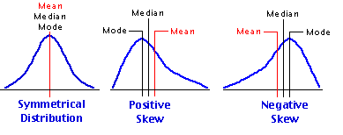
Features of time to event data
Non-negative values.
Not normally distributed (usually positively skewed).
Event not usually observed for all individuals during the study.
An observation is censored if individual does not experience event during the study.
Censoring time: time from baseline/randomisation until latest date at which individual is known to be still alive and event-free.

Slide 5
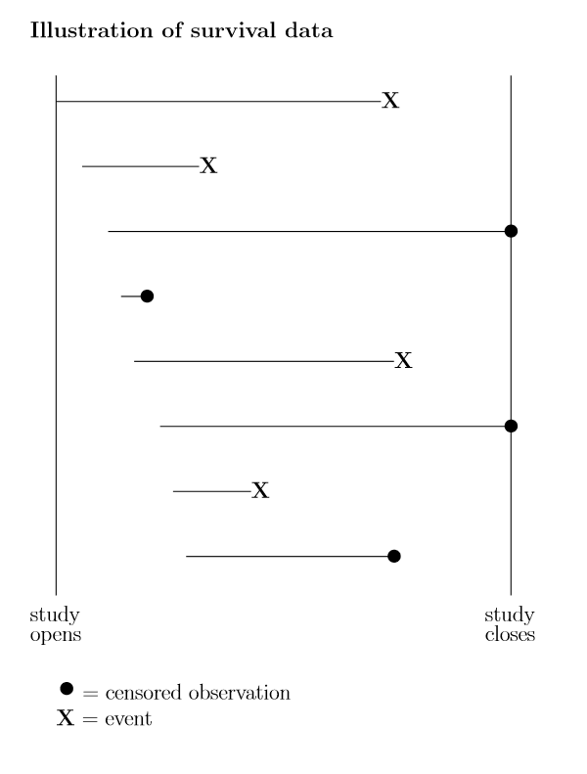
Censoring
Definition: Event of interest not observed for all individuals.
Fixed censoring: event has not occurred when study has ended or data analysis is performed.
Loss to follow-up: individual has been lost to follow-up (e.g. he/she no longer wishes to take part in study).
Survival analysis methods make use of information from censored observations.
Assume censoring is non-informative, i.e. if an individual is censored, his/her subsequent risk of the event of interest is unaffected.

Slide 6
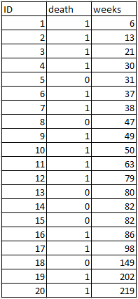

Example of time to event data
Weeks to death or censoring (*) in 20 adults
with recurrent astrocytoma:
Data reproduced from BMJ 2004; 328:1073.

Slide 7
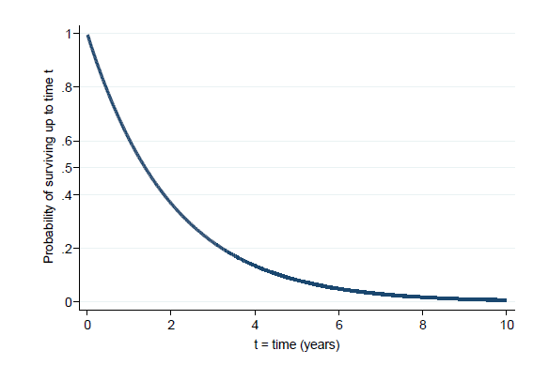
Aims of survival analysis
To estimate probability of not experiencing event of interest (not dying = “surviving”) over any given time period (e.g. 5 year survival rate).
To compare overall survival experience between different groups of individuals (e.g. between groups in a randomised clinical trial).
Survivor function: Probability of not experiencing event of interest (“surviving”) up to time t.
Example:

Slide 8
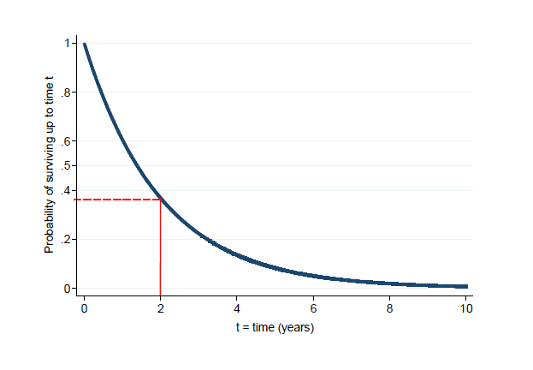
Estimating a survival rate
Probability of surviving up to 2 years = 0.37.

Slide 9
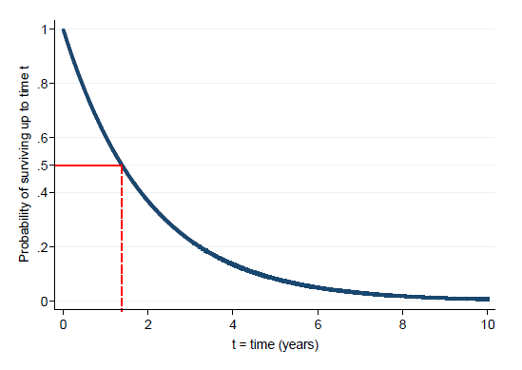
Median survival time
It is the time (expressed in months or years) when half the patients are expected to be alive. It means that the chance of surviving beyond that time is 50%.
Median survival time = 1.4 years, since the probability of surviving up to 1.4 years is 0.5.
50% survival
1.4 years

Slide 10

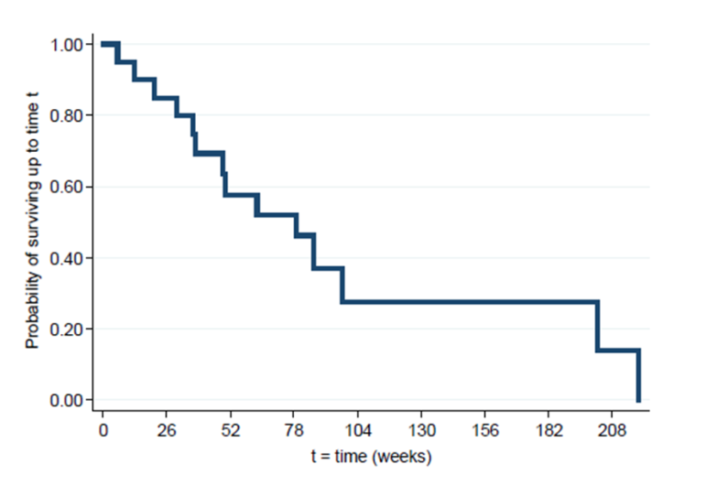
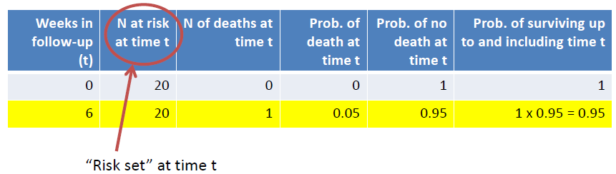
Kaplan-Meier (KM) estimation of survivor function
First death
20 individuals in study at t=0.
First death at t=6 weeks.
No individuals censored before t=6.
Probability of death for each individual: 1/20=0.05
Therefore probability of surviving beyond t=6 is (1-0.05)=0.95=19/20.
1/20
19/20

Slide 11

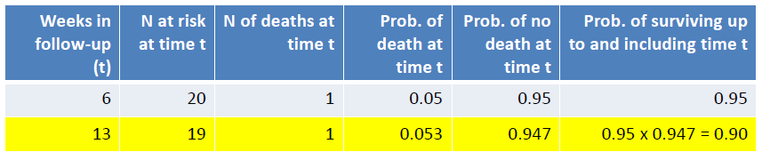
K-M estimation of survivor function
Second death
19 individuals in study between t=6 and t=13.
Second death at t=13.
No individuals censored between t=6 and t=13.
Probability of death for each individual: 1/19=0.053
Therefore probability of surviving beyond t=13 is 0.95 x 0.947 =0.90.
  with 0.95=(1-(1/20)) and 0.947=(1-(1/19))
19/20
18/19
1/19
1-(1/19)=18/19

Slide 12

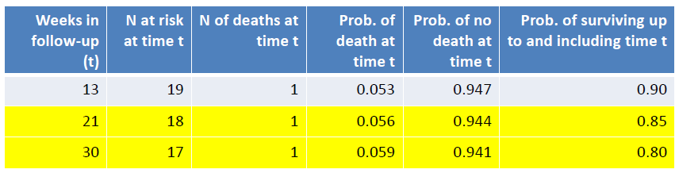
K-M estimation of survivor function
Third and fourth death
18 individuals in study between t=13 and t=21.
Probability of death for each individual: 1/18=0.056
Probability of surviving beyond t=21 is 0.90 x (1-(1/18)) =0.85.
17 individuals in study between t=21 and t=30.
Probability of death for each individual: 1/17=0.059
Probability of surviving beyond t=30 is 0.85 x (1-(1/17)) =0.80.
From t=13: 0.95*0.947
1/19=
1/18=
1/17=

Slide 13

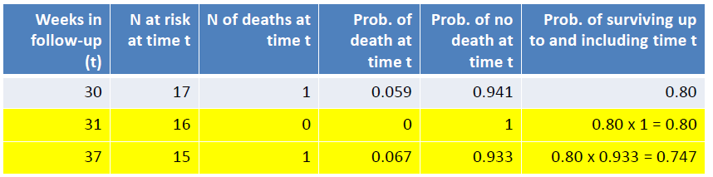
K-M estimation of survivor function
Fifth and sixth death
16 individuals in study between t=30 and t=31.
1 individual censored at t=31.
Probability of surviving beyond t=31 remains at 0.80.
15 individuals in study between t=31 and t=37.
Probability of surviving beyond t=37 is 0.80 x (1-(1/15)) =0.747.
1/15=

Slide 14
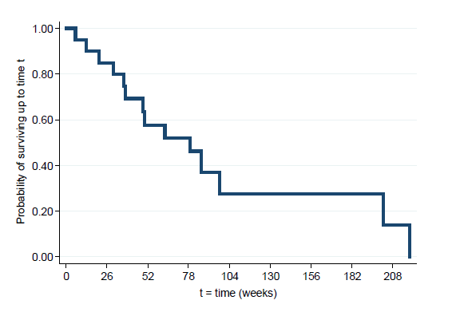
K-M plot of survivor function
Continue these calculations until reaching the longest event time.
K-M plot drawn as a step function:
First death: t=6, survival probability=0.95
Second death: t=13, survival probability=0.90
Third death: t=21, survival probability=0.85

Slide 15
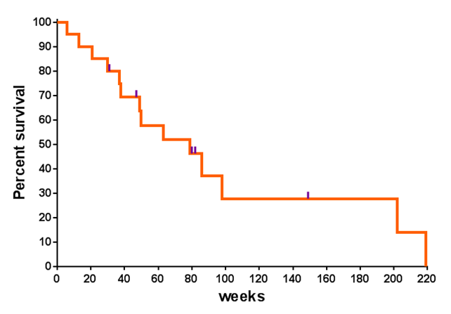
K-M plot of survivor function
Add ticks to indicate where censoring occurred.
Data: tumours.slsx
(astro data only)

Slide 16

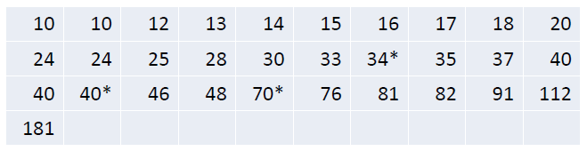
Comparing 2 groups
Weeks to death or censoring (*) in 20 adults with recurrent astrocytoma:
Weeks to death or censoring (*) in 31 adults with recurrent glioblastoma:
Data reproduced from BMJ 2004; 328:1073.

Slide 17
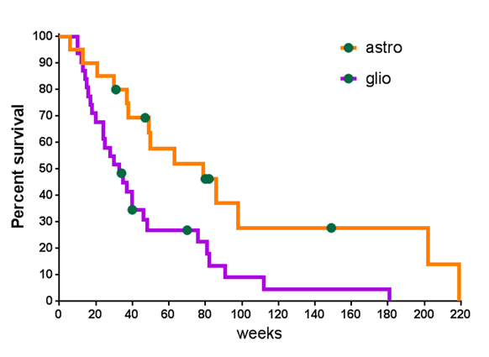
K-M plot of survivor function
by tumour type
Survival chances appear better in individuals with astrocytoma than with glioblastoma, but is the difference between groups statistically significant?

Slide 18
Comparing 2 samples
Could compare median survival time, or probability of surviving up to any particular time.
Better to use a test which compares survivor functions over whole follow-up period.
Log rank test: tests null hypothesis of no difference between samples in probability of an event (death in this example) at any time point during follow-up.
Log rank test statistic:
  based on calculating expected number of events that would occur under null hypothesis at each event time, and comparing to observed number of events.
  under null hypothesis has a Chi² distribution with 1 degree of freedom.

Slide 19
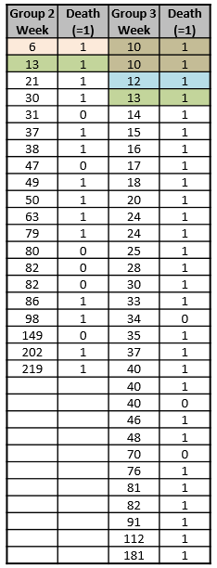
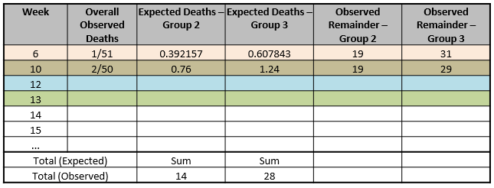



Log rank test to compare 2 groups
20/51
31/51
Astro
Glio
Astro
(19/50)*2
(31/50)*2
Log rank test statistic has a Chi² distribution:
=14 deaths
=28 deaths

Slide 20
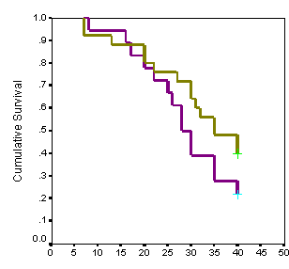
Log rank test
Unlikely to detect a difference between Groups if survivor
functions cross over during follow-up.
Assumes non-informative censoring
Can be extended to compare more than 2 groups.
But
Only provides a p-value, not an estimate of size of difference between groups or a confidence interval.
  Estimate of size of difference = Hazard Ratio

Slide 21
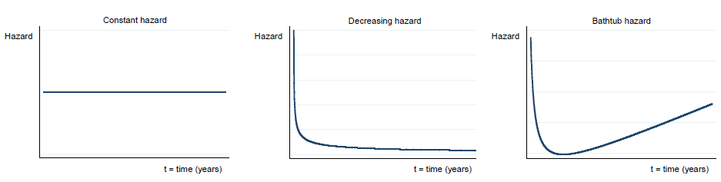
Hazard function
Hazard is defined as the slope of the survival curve :a measure of how rapidly subjects are dying.
Hazard function describes how hazard varies over time.

Slide 22
Hazard Ratio (HR)
for comparing 2 samples
Hazards may vary over time, but assume that HR is constant over time.
The hazard ratio is not directly related to the ratio of median survival times.
When comparing 2 groups (a and b):
  observed events (deaths) in each group: Oa and Ob,
  expected events (deaths) in each group: Ea and Eb,
    assuming a null hypothesis of no difference in survival.
HR= (Oa/Ea)/(Ob/Eb)
No assumption is needed about shape of hazard functions or underlying distribution of time to event data.
HR is obtained from Cox regression

Slide 23
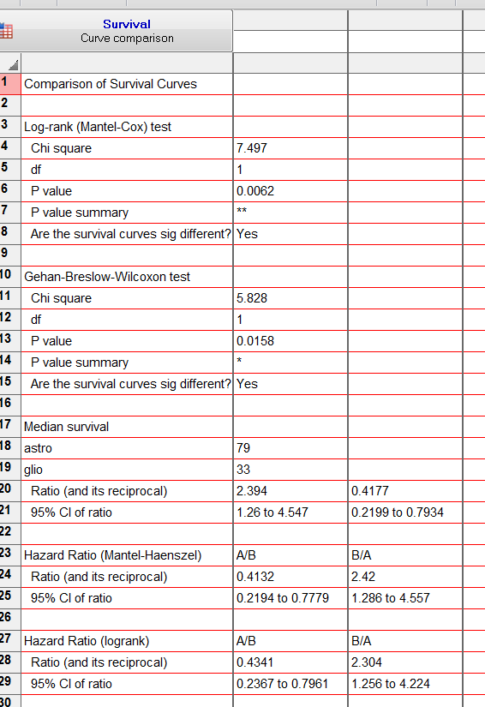

Hazard Ratio (HR)
Data: tumours.xlsx
HR = 2.3 (95% CI [1.32;4.44])
At any point in time, hazard (i.e. instantaneous rate) of dying in individuals
with recurrent glioblastoma is 2.3 times higher than in individuals with recurrent astrocytoma.

Slide 24
Comparing more than 2 samples
Issue with GraphPad: cannot compare more than 2 groups directly
  As in: does not run post-hoc pairwise comparisons
So how do we do it?
  Step 1: All groups comparisons (equivalent omnibus step in ANOVA)
  Step 2: Make all pairwise comparisons of interest
  Step 3: Apply Bonferroni correction
Example dataset: Lung infection
  Mice are infected with Streptococcus pneumoniae
    3 groups: Control, treatment 1 and treatment 2

Slide 25
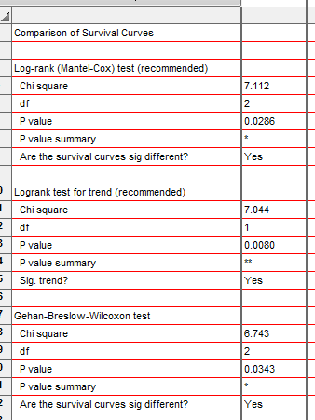
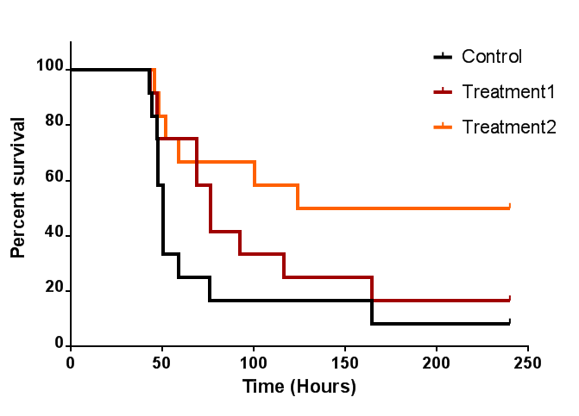
Comparing more than 2 groups
  Step 1: All groups comparisons
There is an overall difference in survival between the 3 groups but which group is different from which?

Slide 26
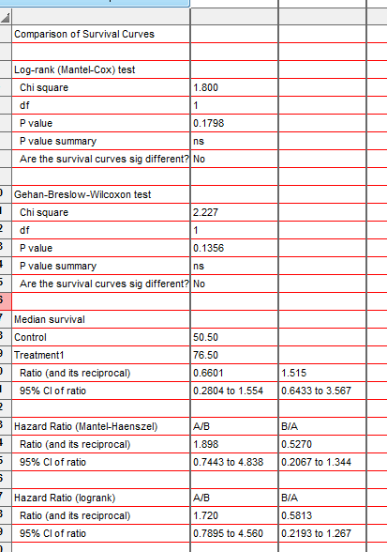
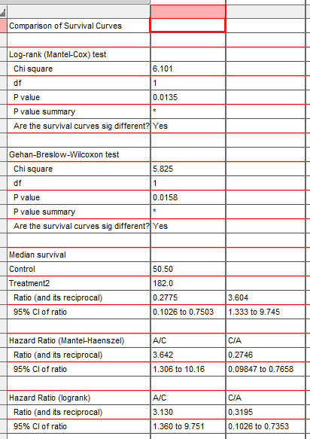
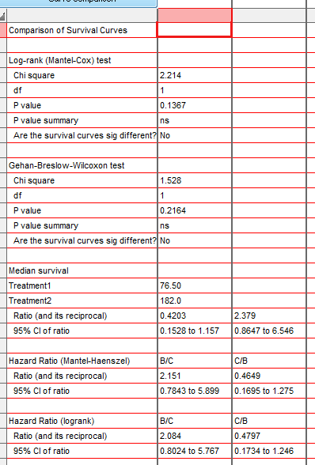
Comparing more than 2 groups
  Step 2: Make all pairwise comparisons of interest
Control vs. T1
Control vs. T2
T1 vs. T2
Adjusted p-value = 0.5394
Adjusted p-value = 0.0405
Adjusted p-value = 0.4101
  Step 3: Apply Bonferroni correction: 0.05/3=0.06 or initial p-values*3

Slide 27
Comparing more than 2 groups
At any point in time, hazard of dying in mice with lung infection is:
  almost 2 times higher in the control than in the treatment 1 group (p=0.54)
  3.6 times higher in the control than in the treatment 1 group (p=0.04)

