Slide 1


Power Analysis
Anne Segonds-Pichon v2020-09

Slide 2
Question
Data Collection/Storage
Data Exploration
Data Analysis
Results
Experiment
Sample Size
Choice of statistical tests
Experimental design

Slide 3
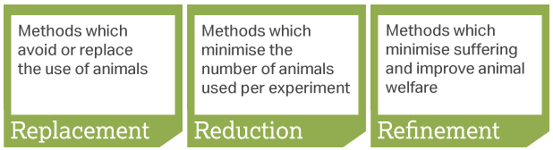
Sample Size: Power Analysis
Definition of power: probability that a statistical test will reject a false null hypothesis (H₀).
  Translation: the probability of detecting an effect, given that the effect is really there.
In a nutshell: the bigger the experiment (big sample size), the bigger the power (more likely to pick up a difference).
Main output of a power analysis:
  Estimation of an appropriate sample size
    Too big: waste of resources,
    Too small: may miss the effect (p>0.05)+ waste of resources,
    Grants: justification of sample size,
    Publications: reviewers ask for power calculation evidence,
    Home office: the 3 Rs: Replacement, Reduction and Refinement.

Slide 4
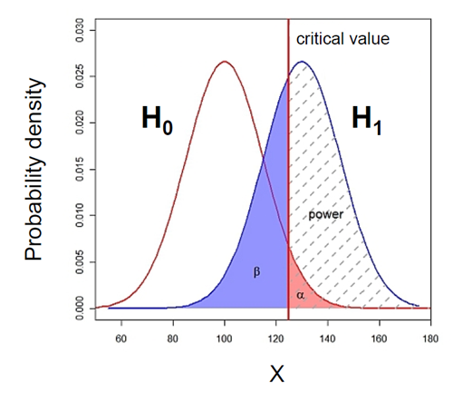
What does Power look like?

Slide 5
What does Power look like? Null and alternative hypotheses
Control
Treatment
Probability that the observed result occurs if H₀ is true
  H₀ : Null hypothesis = absence of effect
  H₁: Alternative hypothesis = presence of an effect

Slide 6
What does Power look like? Type I error (α)
Type I error is the failure to reject a true H₀
  α : probability of claiming an effect which is not there.
p-value: probability that the observed statistic occurred by chance alone
  probability that a difference as big as the one observed could be found even if there is no effect.
Statistical significance: comparison between α and the p-value
  p-value < 0.05: there is a difference ☺ (reject H₀)
  p-value > 0.05: there is no difference ☹ (fail to reject H₀)

Slide 7
What does Power look like? Type II error (β) and Power
Area = 1
Type II error (β) is the failure to reject a false H₀
  β : Probability of missing an effect which is really there.
  Power: probability of detecting an effect which is really there.
  Direct relationship between Power and type II error:
    Power = 1 – β

Slide 8

What does Power look like? Power = 80%
General convention: 80% but could be more
    if Power = 0.8 then β = 1- Power = 0.2 (20%)
Hence a true difference will be missed 20% of the time
Jacob Cohen (1962):
    For most researchers: Type I errors are four times more serious than Type II errors so: 0.05 * 4 = 0.2
      Compromise: 2 groups comparisons:
        90% = +30% sample size
        95% = +60% sample size

Slide 9
The critical value
Critical value
Small difference
Big difference
Not significant: p>0.05
Significant: p<0.05
Critical value = size of difference + sample size + significance

Slide 10
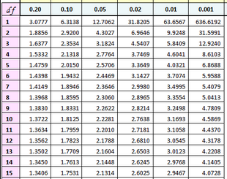
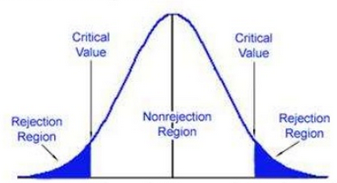
The critical value: size of difference + sample size + significance
Example: 2-tailed t-test with n=15 (df=14)
T Distribution
0.95
0.025
0.025
t(14)
t=-2.1448
t=2.1448
In hypothesis testing:
  critical value is compared to the test statistic to determine significance
  Example of test statistic: t-value
If test statistic > critical value: statistical significance and rejection of the null hypothesis
  Example: t-value > critical t-value

Slide 11
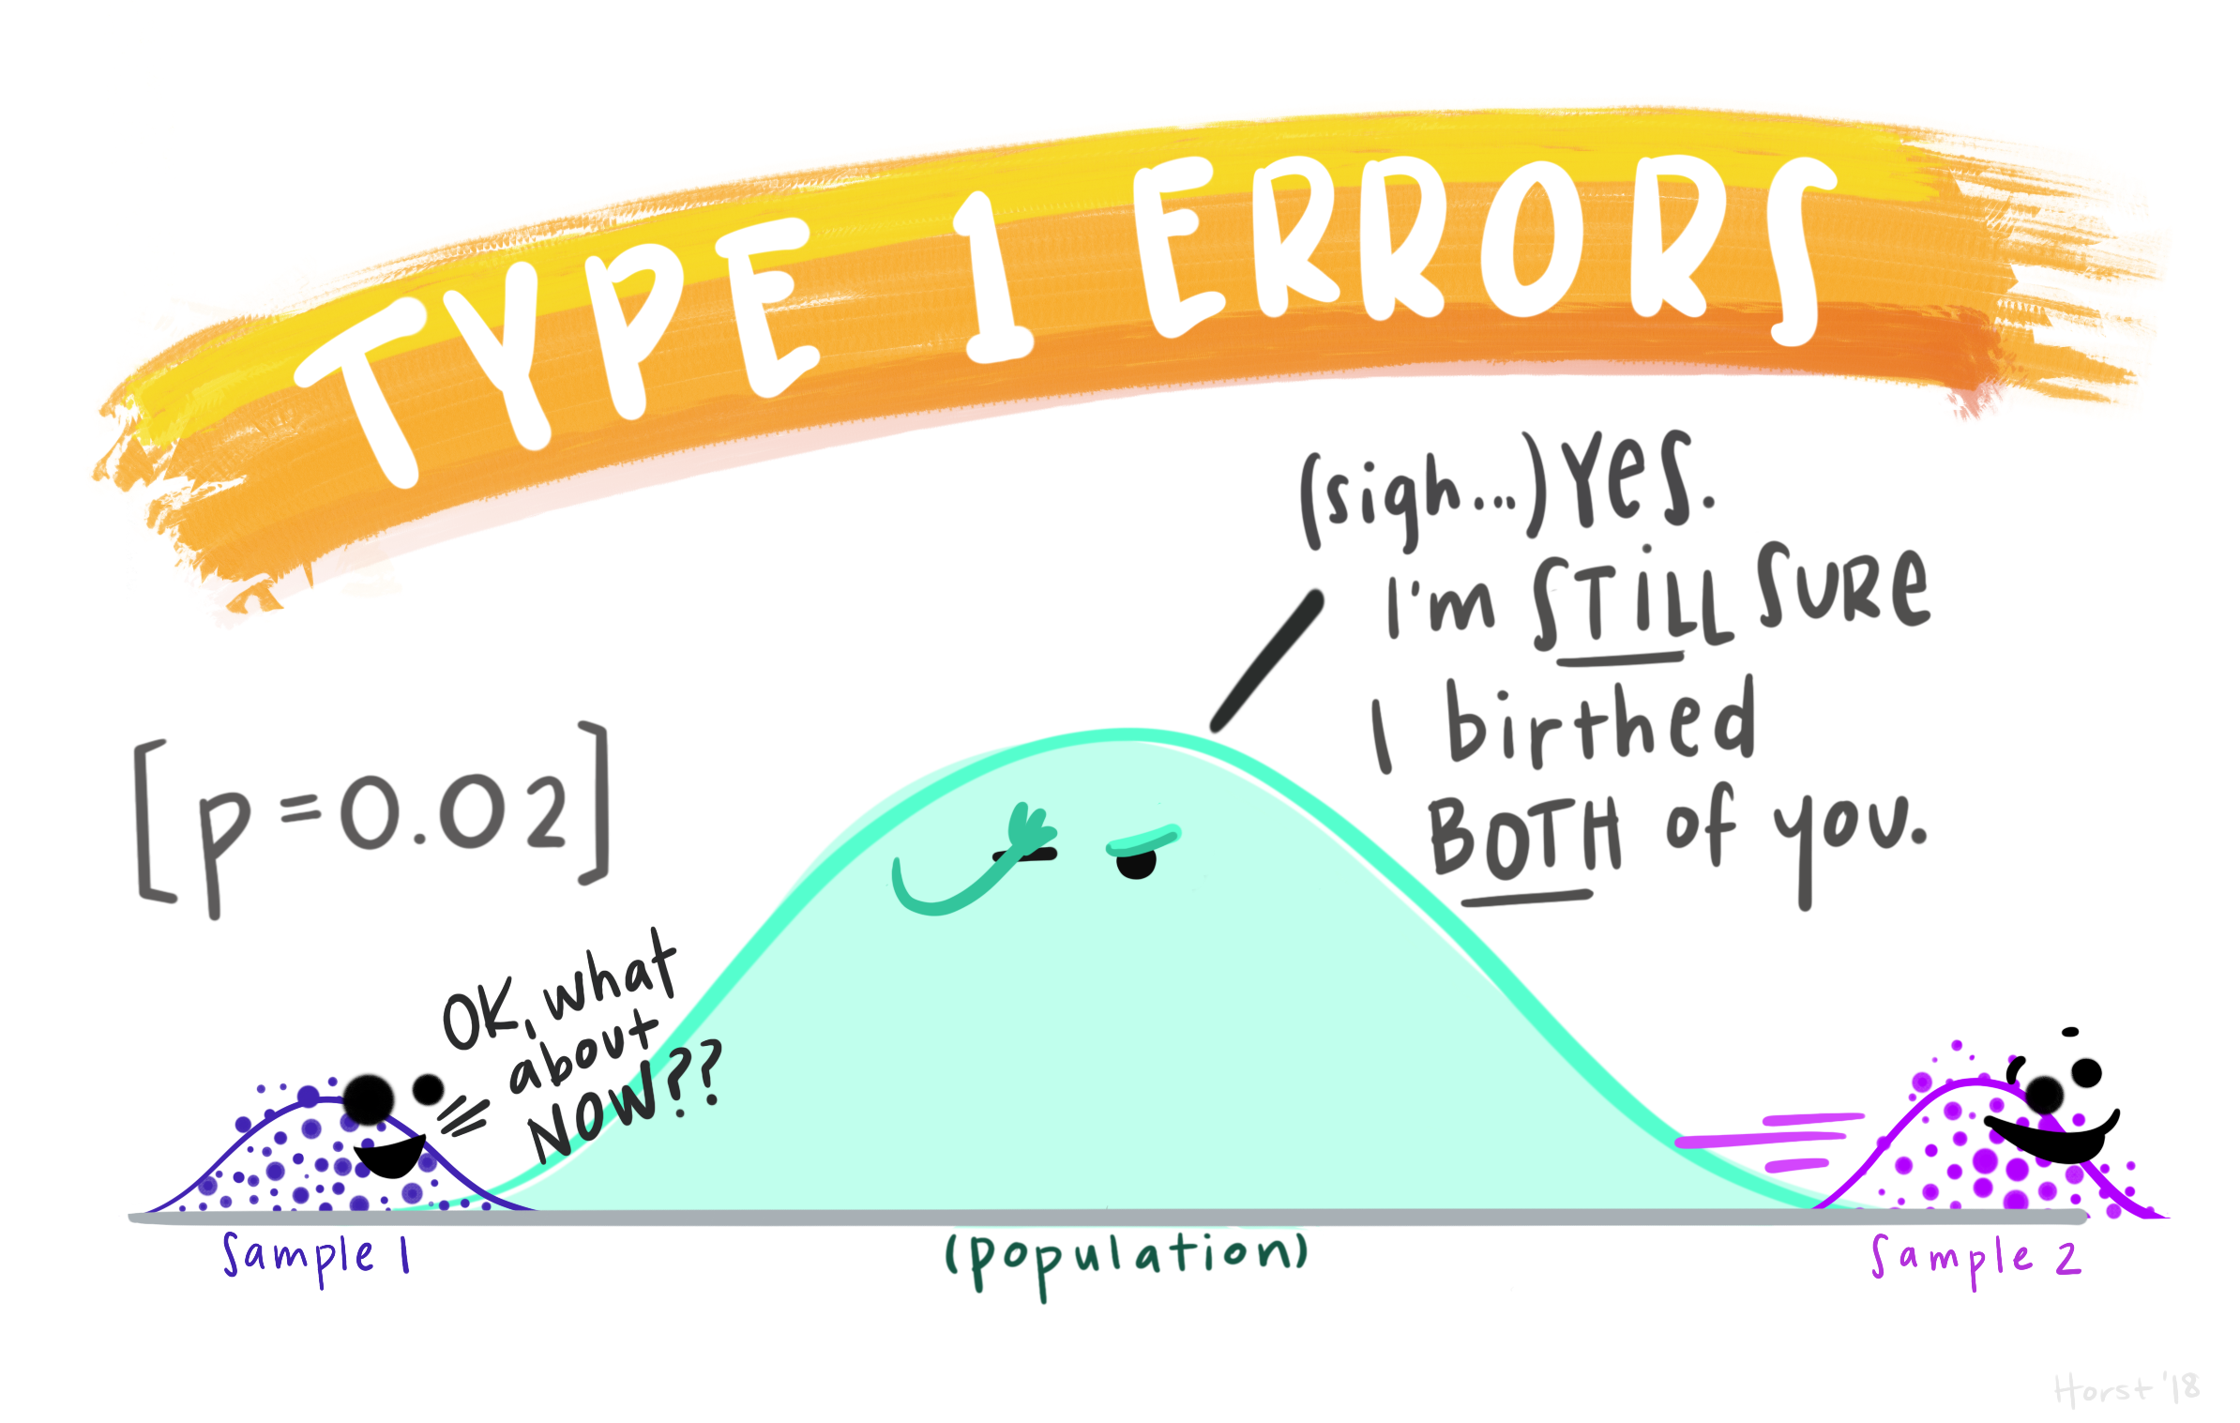
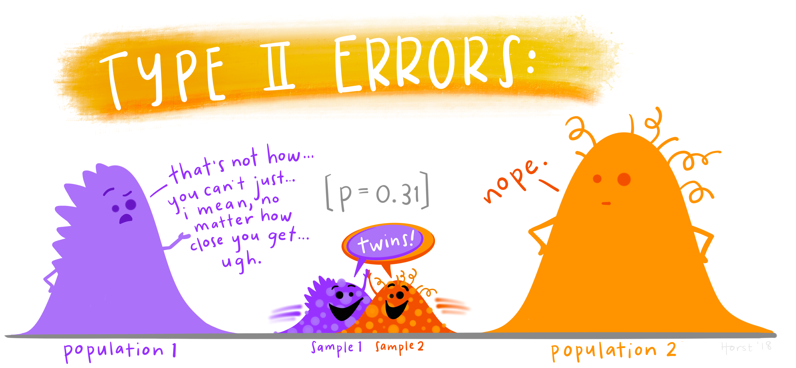
To recapitulate:
The null hypothesis (H₀): H₀ = no effect
The aim of a statistical test is to reject or not H_{0.}
High specificity = low False Positives = low Type I error
High sensitivity = low False Negatives = low Type II error
Statistical decision | True state of H₀
 | H₀ True (no effect) | H₀ False (effect)
Reject H₀ | Type I error α False Positive | Correct True Positive
Do not reject H₀ | Correct True Negative | Type II error β False Negative
https://github.com/allisonhorst/stats-illustrations#other-stats-artwork

Slide 12
Sample Size: Power Analysis
The power analysis depends on the relationship between 6 variables:
the difference of biological interest
the variability in the data (standard deviation)
the significance level (5%)
the desired power of the experiment (80%)
the sample size
the alternative hypothesis (ie one or two-sided test)
Effect size

Slide 13
The difference of biological interest
  This is to be determined scientifically, not statistically.
    minimum meaningful effect of biological relevance
    the larger the effect size, the smaller the experiment will need to be to detect it.
  How to determine it?
    Previous research, pilot study …
The Standard Deviation (SD)
  Variability of the data
  How to determine it?
    Data from previous research on WT or baseline …

Slide 14
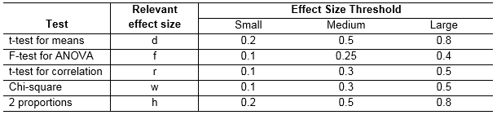
The effect size: what is it?
The effect size: minimum meaningful effect of biological relevance.
  Absolute difference + variability
How to determine it?
  Substantive knowledge
  Previous research
  Conventions
Jacob Cohen
  Defined small, medium and large effects for different tests

Slide 15

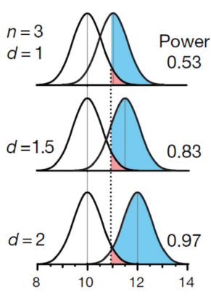
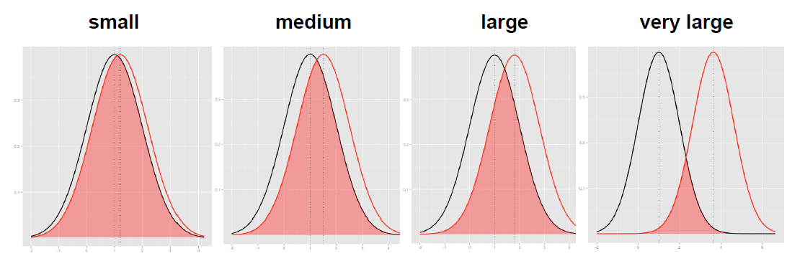
The effect size: how is it calculated?
The absolute difference
It depends on the type of difference and the data
  Easy example: comparison between 2 means
The bigger the effect (the absolute difference), the bigger the power
  = the bigger the probability of picking up the difference
Absolute difference
http://rpsychologist.com/d3/cohend/

Slide 16
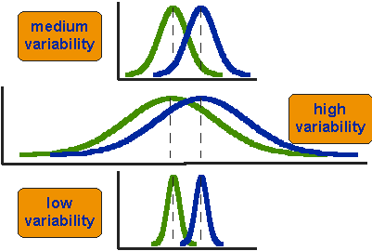
The effect size: how is it calculated?
The standard deviation
The bigger the variability of the data, the smaller the power
critical value
H₀
H₁

Slide 17
Power Analysis
The power analysis depends on the relationship between 6 variables:
the difference of biological interest
the standard deviation
the significance level (5%) (p< 0.05) α
the desired power of the experiment (80%) β
the sample size
the alternative hypothesis (ie one or two-sided test)

Slide 18
The sample size
Most of the time, the output of a power calculation.
The bigger the sample, the bigger the power
  but how does it work actually?
In reality it is difficult to reduce the variability in data, or the contrast between means.
  most effective way of improving power:
    increase the sample size.

Slide 19
The sample size
n=3
Small samples (n=3)
‘Infinite’ number of samples
Samples means = $\overline{x}$
Sample
n=30
Big samples (n=30)
Population
Sample

Slide 20


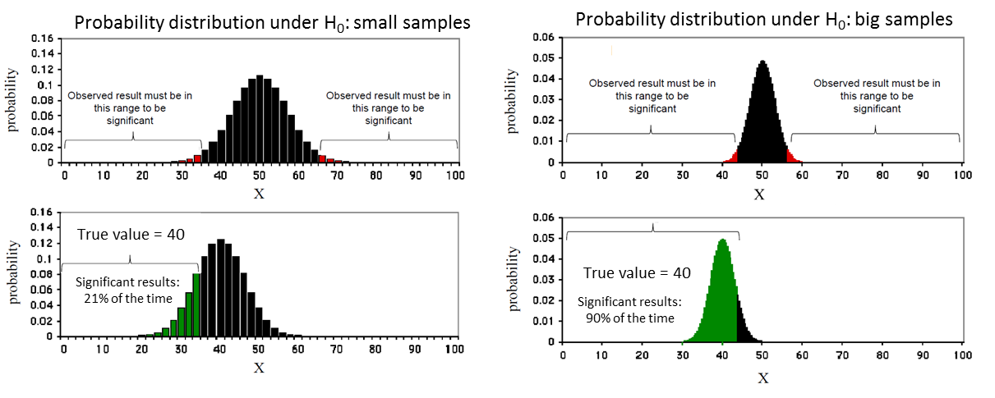
The sample size
Control
Treatment

Slide 21
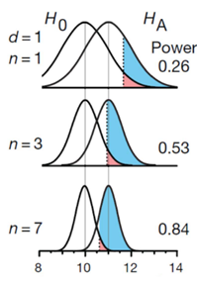
The sample size
Control
Treatment

Slide 22
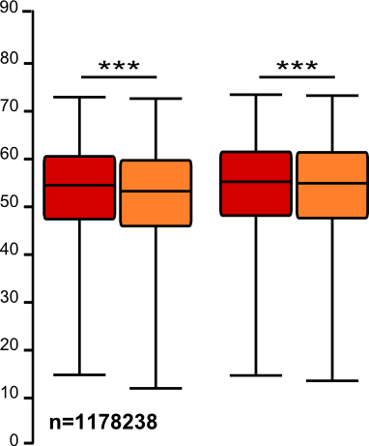
The sample size: the bigger the better?
It takes huge samples to detect tiny differences but tiny samples to detect huge differences.
What if the tiny difference is meaningless?
  Beware of overpower
  Nothing wrong with the stats: it is all about interpretation of the results of the test.
Remember the important first step of power analysis
  What is the effect size of biological interest?

Slide 23
Power Analysis
The power analysis depends on the relationship between 6 variables:
the effect size of biological interest
the standard deviation
the significance level (5%)
the desired power of the experiment (80%)
the sample size
the alternative hypothesis (ie one or two-sided test)

Slide 24
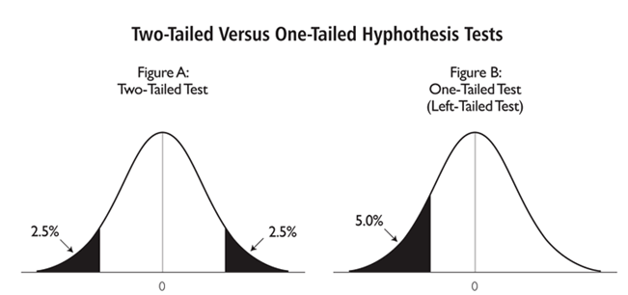
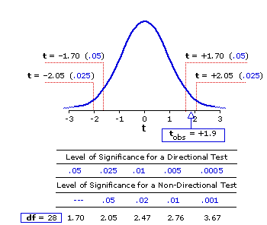
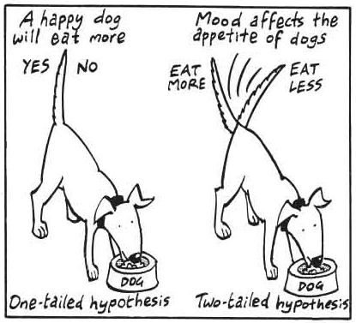
The alternative hypothesis: what is it?
One-tailed or 2-tailed test? One-sided or 2-sided tests?
Is the question:
  Is the there a difference?
  Is it bigger than or smaller than?
Can rarely justify the use of a one-tailed test
Two times easier to reach significance with a one-tailed than a two-tailed
  Suspicious reviewer!

Slide 25
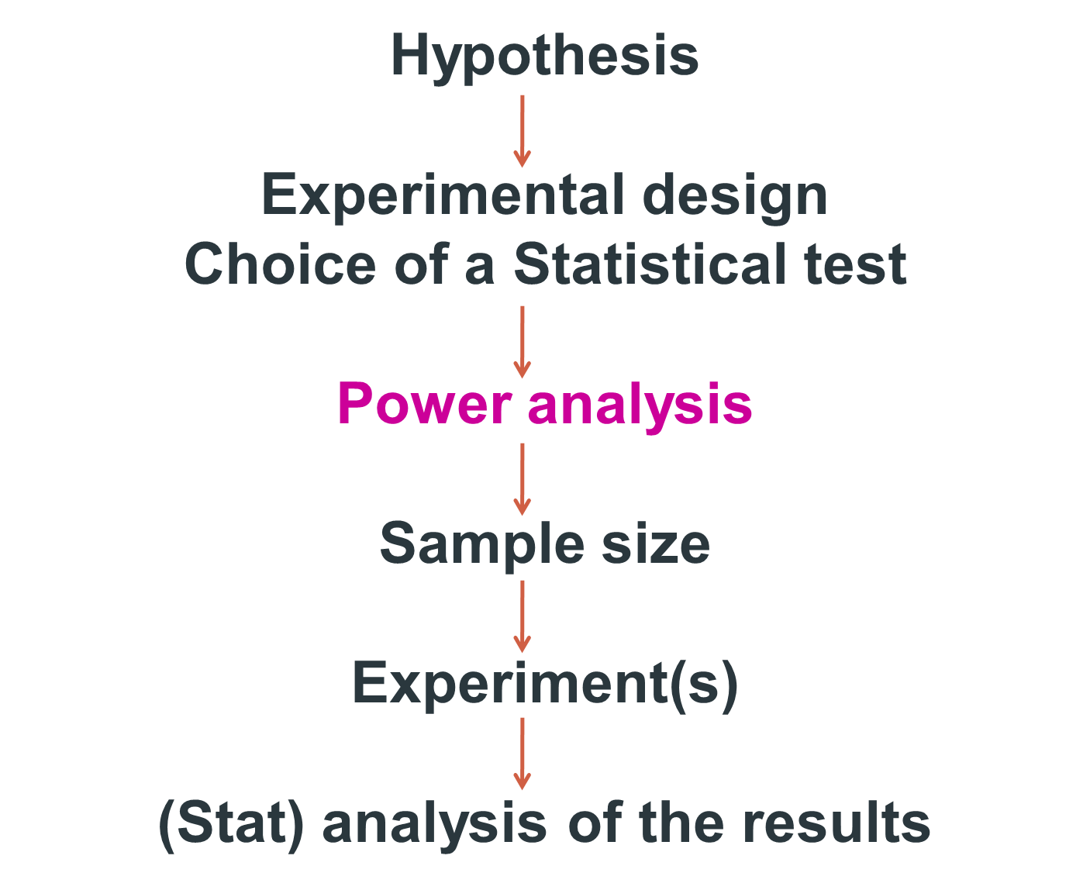

Slide 26
Power analysis
Fix any five of the variables, a mathematical relationship is used to estimate the sixth
Difference of biological interest
+ Variability in the data (standard deviation)
+ Desired power of the experiment (80%)
+ Significance level (5%)
+ Alternative hypothesis (ie one or two-sided test)
Appropriate sample size

Slide 27
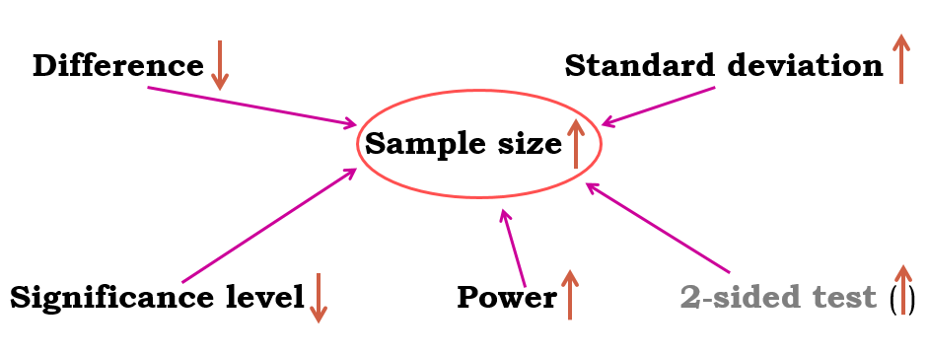
Fix any five of the variables and a mathematical relationship can be used to estimate the sixth.
e.g. What sample size do I need to have a 80% probability (power) to detect this particular effect (difference and standard deviation) at a 5% significance level using a 2-sided test?

Slide 28
Good news:
there are packages that can do the power analysis for you ... providing you have some prior knowledge of the key parameters!
difference + standard deviation = effect size
Free packages:
  R
  G*Power and InVivoStat
  Russ Lenth's power and sample-size page:
    http://www.divms.uiowa.edu/~rlenth/Power/
Cheap package: StatMate (~ $95)
Not so cheap package: MedCalc (~ $495)

Slide 29
Power Analysis
Let’s do it
Examples of power calculations:
  Comparing 2 proportions: Exercise 1
  Comparing 2 means: Exercise 2

Slide 30

Exercise 1:
Scientists have come up with a solution that will reduce the number of lions being shot by farmers in Africa:
painting eyes on cows’ bottoms.
Early trials suggest that lions are less likely to attack livestock when they think they’re being watched
  Fewer livestock attacks could help farmers and lions co-exist more peacefully.
Pilot study over 6 weeks:
  3 out of 39 unpainted cows were killed by lions, none of the 23 painted cows from the same herd were killed.
Tasks:
  Do you think the observed effect is meaningful to the extent that such a ‘treatment’ should be applied?
Consider ethics, economics, conservation …
  Run a power calculation to find out how many cows should be included in the study.
Effect size: measure of distance between 2 proportions or probabilities
Comparison between 2 proportions: Fisher’s exact test
http://www.sciencealert.com/scientists-are-painting-eyes-on-cows-butts-to-stop-lions-getting-shot

Slide 31
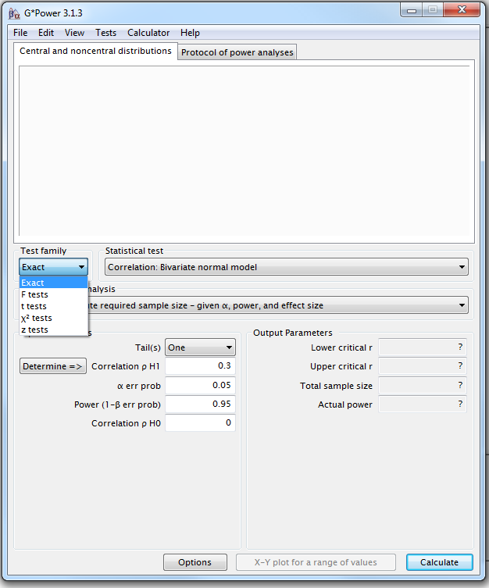
Power Analysis
Comparing 2 proportions
Four steps to Power
Example case:
0 cows killed in the painted group versus 3 out 39.
Step1: choice of Test family

Slide 32
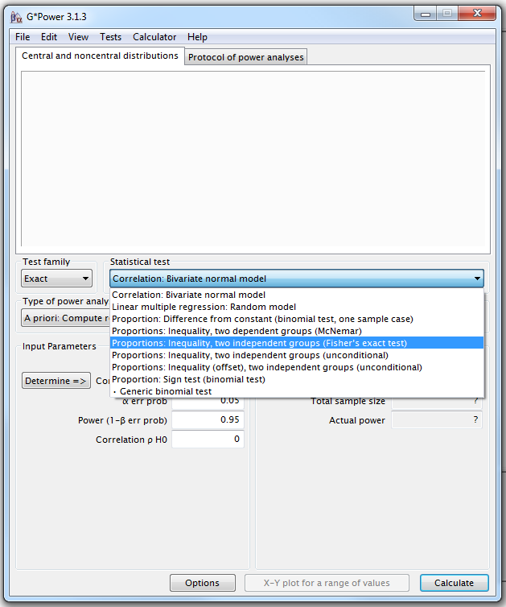
G*Power
Step 2 : choice of Statistical test
Fisher’s exact test or Chi-square for 2x2 tables

Slide 33
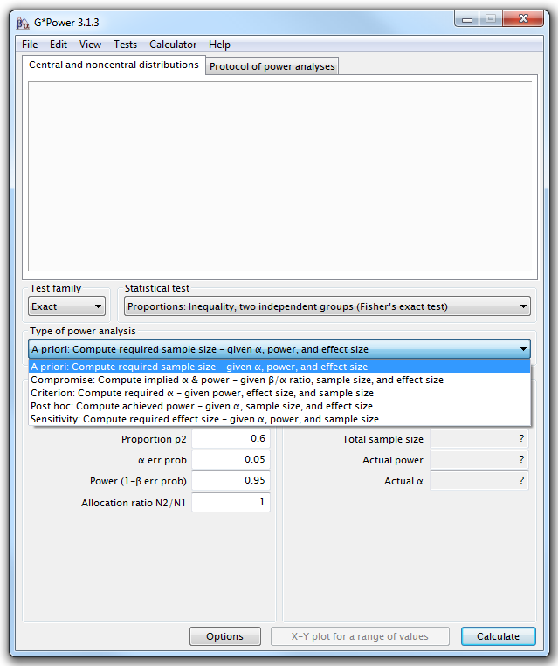
G*Power
Step 3: Type of power analysis

Slide 34
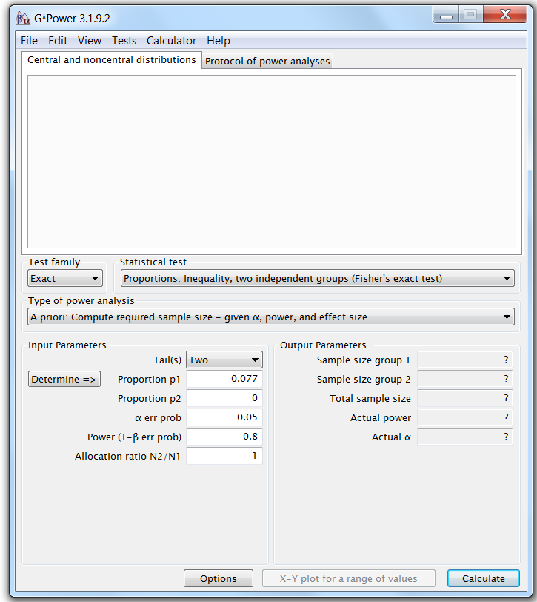
G*Power
Step 4: Choice of Parameters
Tricky bit: need information on the size of the difference and the variability.

Slide 35
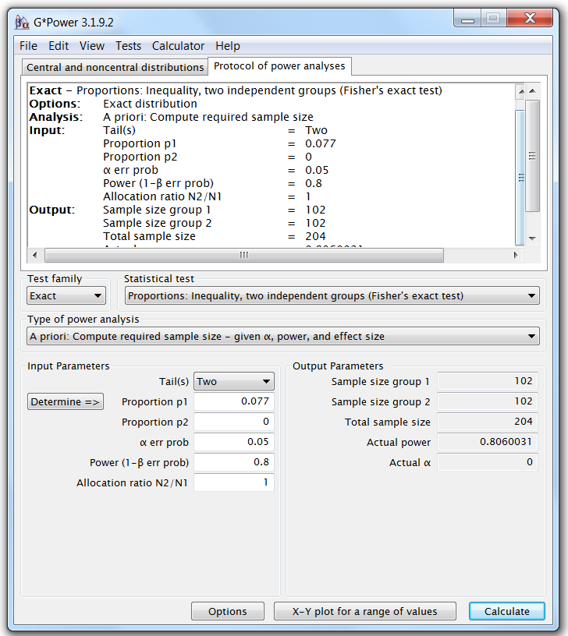
G*Power
To be able to pick up such a difference, we will need 2 samples of about 102 cows to reach significance (p<0.05) with 80% power.

Slide 36
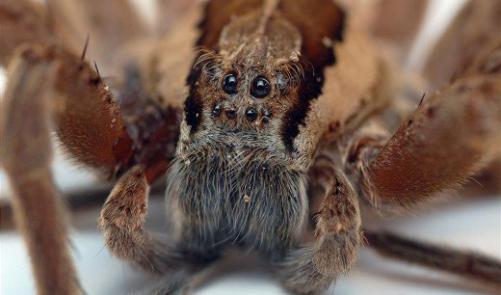
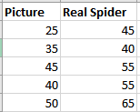
Exercise 2:
Pilot study: 10 arachnophobes were asked to perform 2 tasks:
Task 1: Group1 (n=5): to play with a big hairy tarantula spider with big fangs and an evil look in its eight eyes.
Task 2: Group 2 (n=5): to look at pictures of the same hairy tarantula.
Anxiety scores were measured for each group (0 to 100).
Tasks:
Use the data to calculate the values for a power calculation
Run a power calculation
  Hint: in Excel: function STDEV.S
  Comparison between 2 means: Student’s t test

Slide 37
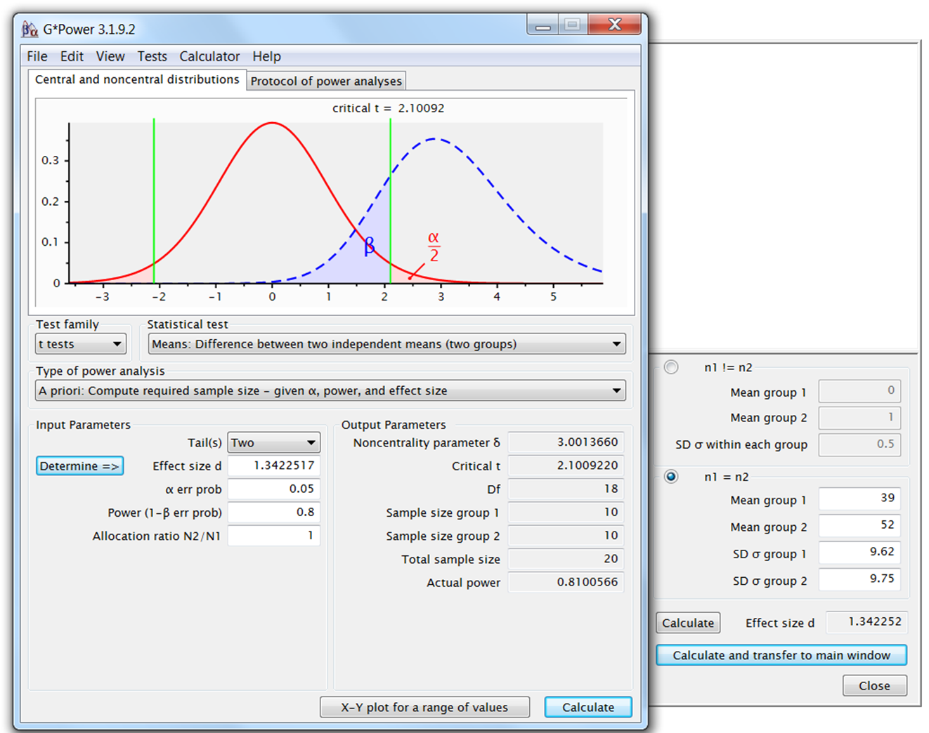
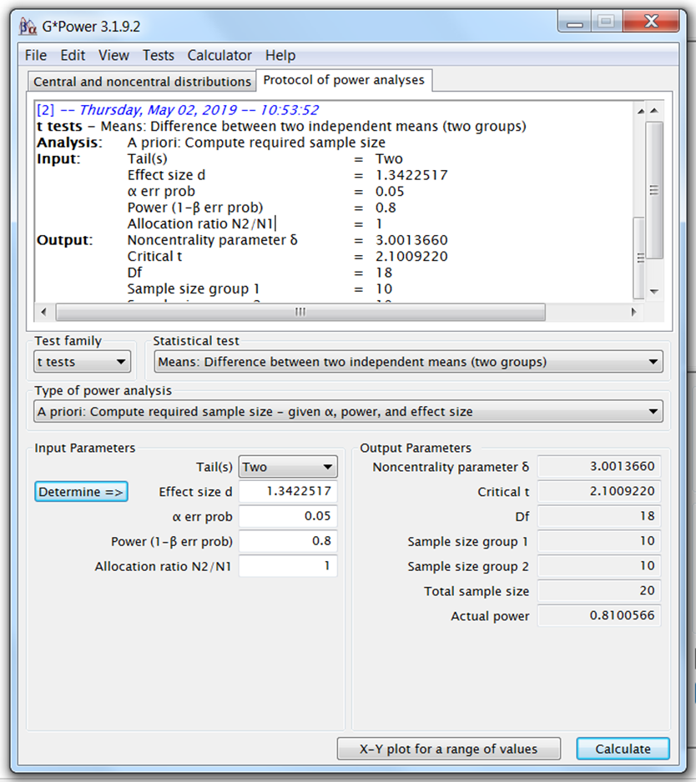
Power Analysis
To reach significance with a t-test, providing the preliminary results are to be trusted, and be confident about the difference between the 2 groups, we need about 20 arachnophobes (2*10).

Slide 38
Power Analysis
H₀
H₁

Slide 39
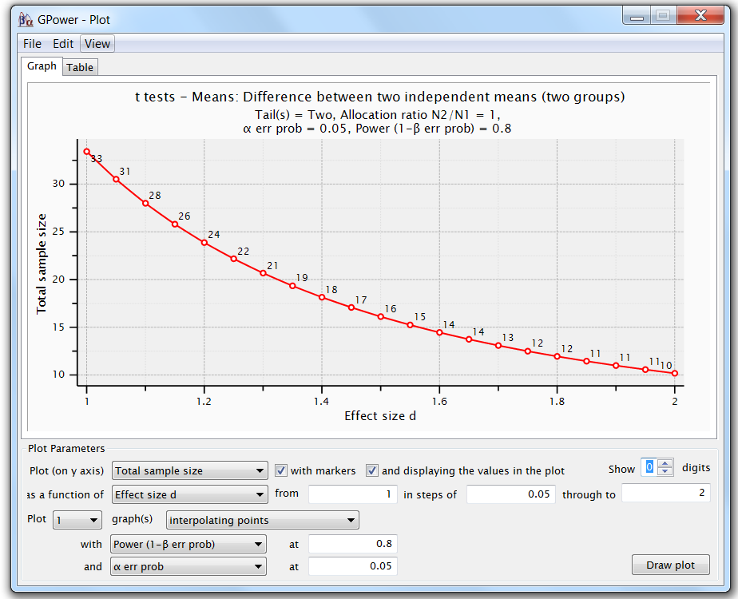
Power Analysis
For a range of sample sizes:

Slide 40
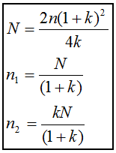
Unequal sample sizes
Scientists often deal with unequal sample sizes
  No simple trade-off:
    if one needs 2 groups of 30, going for 20 and 40 will be associated with decreased power.
  Unbalanced design = bigger total sample
  Solution:
    Step 1: power calculation for equal sample size
    Step 2: adjustment
Cow example: balanced design: n = 102
but this time: unpainted group: 2 times bigger than painted one (k=2):
Using the formula, we get a total:
N=2*102*(1+2)²/4*2 = 229.5 ~ 230
Painted butts (n₁)=77 Unpainted butts (n₂)=153
Balanced design: n = 2*93 = 204
Unbalanced design: n= 70+140 = 230

Slide 41
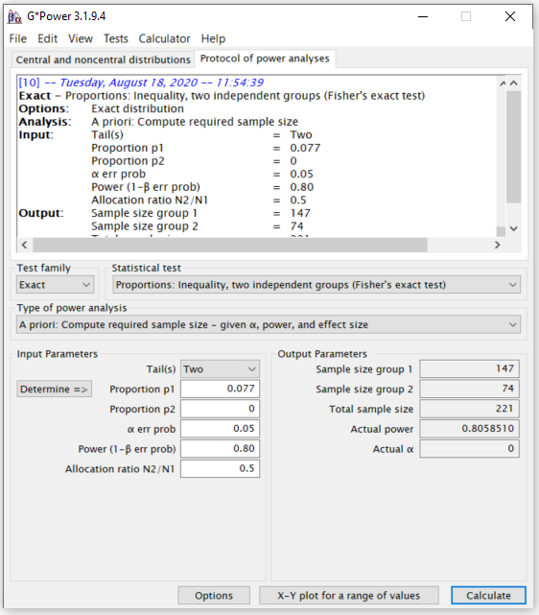
Unequal sample sizes
Cow example: balanced design: n = 102
but this time: unpainted group: 2 times bigger than painted one (k=2):
Using the formula, we get a total:
N=2*102*(1+2)²/4*2 = 229.5 ~ 230
Painted butts (n₁)=77 Unpainted butts (n₂)=153
Balanced design: n = 2*93 = 204
Unbalanced design: n= 70+140 = 230

Slide 42
Non-parametric tests
Non-parametric tests: do not assume data come from a Gaussian distribution.
  Non-parametric tests are based on ranking values from low to high
  Non-parametric tests almost always less powerful
Proper power calculation for non-parametric tests:
  Need to specify which kind of distribution we are dealing with
    Not always easy
Non-parametric tests never require more than 15% additional subjects providing that the distribution is not too unusual.
Very crude rule of thumb for non-parametric tests:
  Compute the sample size required for a parametric test and add 15%.

Slide 43
Sample Size: Power Analysis
What happens if we ignore the power of a test?
  Misinterpretation of the results
p-values: never ever interpreted without context:
  Significant p-value (<0.05): exciting! Wait: what is the difference?
    >= smallest meaningful difference: exciting
    < smallest meaningful difference: not exciting
      very big sample, too much power
  Not significant p-value (>0.05): no effect! Wait: how big was the sample?
    Big enough = enough power: no effect means no effect
    Not big enough = not enough power
      Possible meaningful difference but we miss it

