Slide 1


Introduction to Statistics with GraphPad Prism 8
Anne Segonds-Pichon v2019-03

Slide 2
Outline of the course
Power analysis with G*Power
Basic structure of a GraphPad Prism project
Analysis of qualitative data:
  Chi-square test
Analysis of quantitative data:
  Student’s t-test, One-way ANOVA, correlation and curve fitting

Slide 3
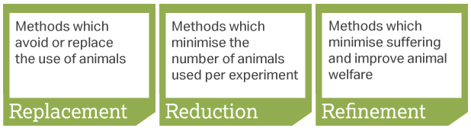
Power analysis
Definition of power: probability that a statistical test will reject a false null hypothesis (H₀).
  Translation: the probability of detecting an effect, given that the effect is really there.
In a nutshell: the bigger the experiment (big sample size), the bigger the power (more likely to pick up a difference).
Main output of a power analysis:
  Estimation of an appropriate sample size
    Too big: waste of resources,
    Too small: may miss the effect (p>0.05)+ waste of resources,
    Grants: justification of sample size,
    Publications: reviewers ask for power calculation evidence,
    Home office: the 3 Rs: Replacement, Reduction and Refinement.

Slide 4

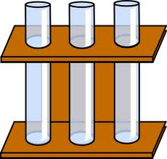
Experimental design
Think stats!!
Translate the hypothesis into statistical questions:
  What type of data?
  What statistical test ?
  What sample size?
Very important: Difference between technical and biological replicates.
Technical
Biological
n=1
n=3

Slide 5
Power analysis
A power analysis depends on the relationship between 6 variables:
the difference of biological interest
the variability in the data (standard deviation)
the significance level (5%)
the desired power of the experiment (80%)
the sample size
the alternative hypothesis (ie one or two-sided test)
Effect size

Slide 6
1 The difference of biological interest
  This is to be determined scientifically, not statistically.
    minimum meaningful effect of biological relevance
    the larger the effect size, the smaller the experiment will need to be to detect it.
  How to determine it?
    Substantive knowledge, previous research, pilot study …
2 The Standard Deviation (SD)
  Variability of the data
  How to determine it?
    Substantive knowledge, previous research, pilot study …
  In ‘power context’: effect size: combination of both:
  e.g.: Cohen’s d = (Mean 1 – Mean 2)/Pooled SD

Slide 7
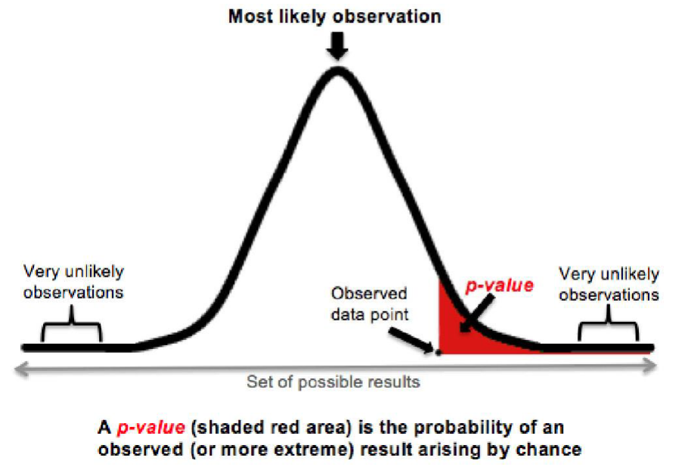
3 The significance level
usually 5% (p<0.05), probability of the Type I error α
p-value is the probability that a difference as big as the one observed could be found even
if there is no effect.
  Probability that an effect occurs by chance alone
Don’t throw away a p-value=0.051 !

Slide 8
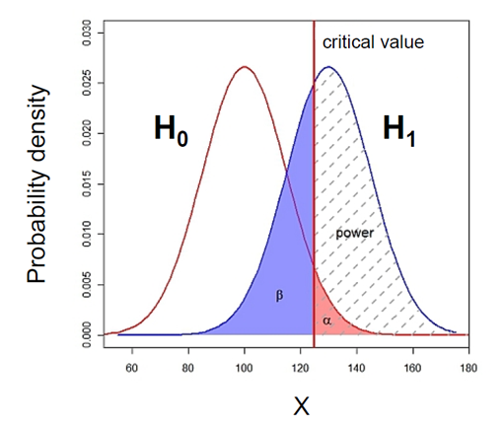
The significance level, critical value, α and β
α : the threshold value that we measure p-values against.
  For results with 95% level of confidence: α = 0.05
  = probability of type I error
p-value: probability that the observed statistic occurred by chance alone
Statistical significance: comparison between α and the p-value
  p-value < 0.05: reject H₀ and p-value > 0.05: fail to reject H₀

Slide 9
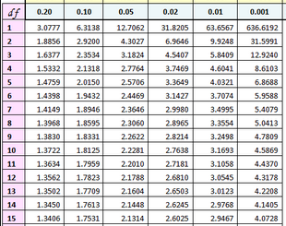
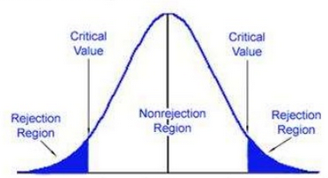
The critical value
Example: 2-tailed t-test with n=15 (df=14)
T Distribution
0.95
0.025
0.025
t(14)
t=-2.1448
t=2.1448
In hypothesis testing, a critical value is a point on the test distribution that is compared to the test statistic to determine whether to reject the null hypothesis
  Example of test statistic: t-value
If the absolute value of your test statistic is greater than the critical value, you can declare statistical significance and reject the null hypothesis
  Example: t-value > critical t-value

Slide 10

4 The desired power: 80%
Type II error (β) is the failure to reject a false H₀
  Direct relationship between Power and type II error:
    if β = 0.2 and Power = 1 – β = 0.8 (80%)
  Hence a true difference will be missed 20% of the time
  General convention: 80% but could be more or less
  Cohen (1988):
      For most researchers: Type I errors are four times
      more serious than Type II errors: 0.05 * 4 = 0.2
      Compromise: 2 groups comparisons: 90% = +30% sample size, 95% = +60%

Slide 11
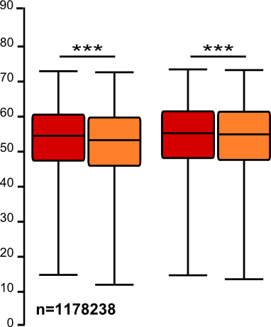
5 The sample size: the bigger the better?
It takes huge samples to detect tiny differences but tiny samples to detect huge differences.
What if the tiny difference is meaningless?
  Beware of overpower
  Nothing wrong with the stats: it is all about interpretation of the results of the test.
Remember the important first step of power analysis
  What is the effect size of biological interest?

Slide 12
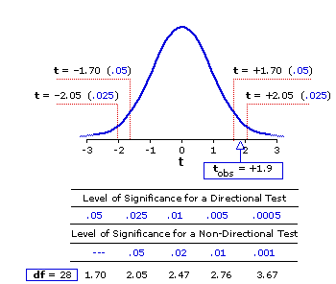
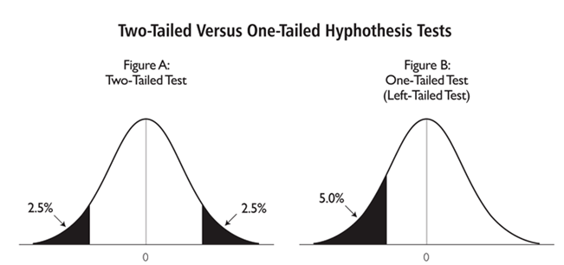
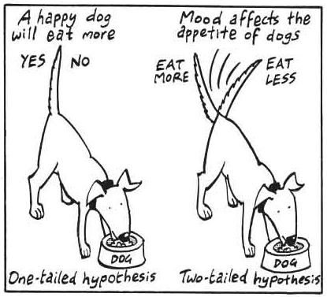
6 The alternative hypothesis
One-tailed or 2-tailed test? One-sided or 2-sided tests?
Is the question:
  Is the there a difference?
  Is it bigger than or smaller than?
Can rarely justify the use of a one-tailed test
Two times easier to reach significance with a one-tailed than a two-tailed
  Suspicious reviewer!

Slide 13
To recapitulate:
The null hypothesis (H₀): H₀ = no effect
The aim of a statistical test is to reject or not H_{0.}
Traditionally, a test or a difference are said to be “significant” if the probability of type I error is: α =< 0.05
High specificity = low False Positives = low Type I error
High sensitivity = low False Negatives = low Type II error
Statistical decision | True state of H₀
 | H₀ True (no effect) | H₀ False (effect)
Reject H₀ | Type I error α False Positive | Correct True Positive
Do not reject H₀ | Correct True Negative | Type II error β False Negative

Slide 14
Hypothesis
Experimental design
Choice of a Statistical test
Power analysis: Sample size
Experiment(s)
Data exploration
Statistical analysis of the results

Slide 15
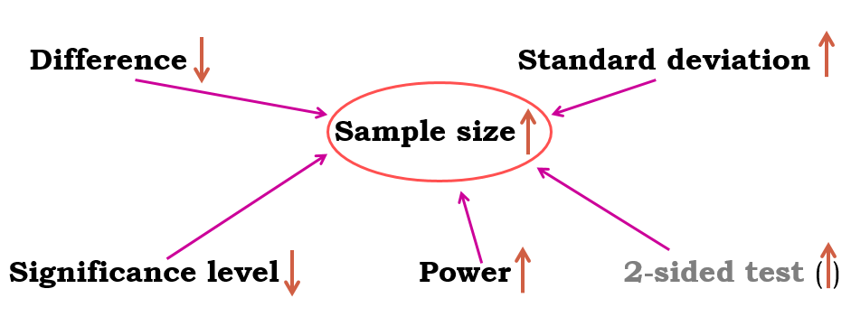
Fix any five of the variables and a mathematical relationship can be used to estimate the sixth.
e.g. What sample size do I need to have a 80% probability (power) to detect this particular effect (difference and standard deviation) at a 5% significance level using a 2-sided test?

Slide 16
Good news:
there are packages that can do the power analysis for you ... providing you have some prior knowledge of the key parameters!
difference + standard deviation = effect size
Free packages:
  R
  G*Power and InVivoStat
  Russ Lenth's power and sample-size page:
    http://www.divms.uiowa.edu/~rlenth/Power/
Cheap package: StatMate (~ $95)
Not so cheap package: MedCalc (~ $495)

Slide 17
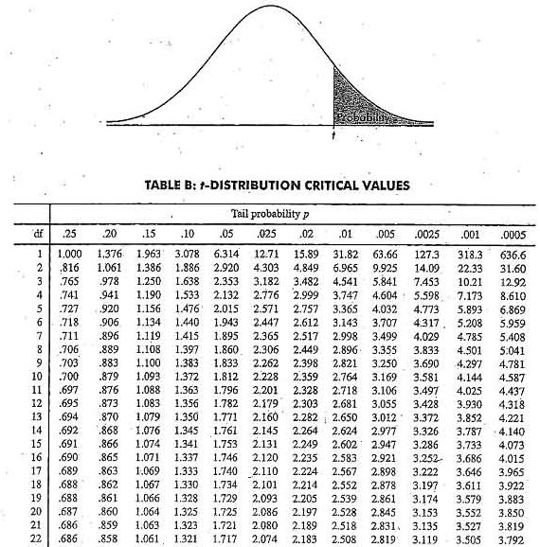
Sample
Statistical inference
Population
Difference
Meaningful?
Yes
Real?
Statistical test
Big enough?
Statistic
e.g. t, F …
=
+ Noise +
Difference
Sample

Slide 18
Qualitative data

Slide 19
Qualitative data
= not numerical
= values taken = usually names (also nominal)
    e.g. causes of death in hospital
Values can be numbers but not numerical
    e.g. group number = numerical label but not unit of measurement
Qualitative variable with intrinsic order in their categories = ordinal
Particular case: qualitative variable with 2 categories: binary or dichotomous
    e.g. alive/dead or presence/absence
Notes:
Can be good or horrible data qualitative data do not use many stats, one is chi square
Cats and dogs, first plot it

Slide 20
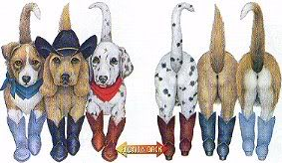

  Fisher’s exact and Chi²
Example: cats and dogs.xlsx
Cats and dogs trained to line dance
2 different rewards: food or affection
Question: Is there a difference between the rewards?
Is there a significant relationship between the 2 variables?
  does the reward significantly affect the likelihood of dancing?
To answer this type of question:
  Contingency table
  Fisher’s exact or Chi² tests
 | Food | Affection
Dance | ? | ?
No dance | ? | ?
But first: how many cats do we need?
Notes:
Is there a difference between the rewards?
Dogs more happy, cats more picky (on demonstration is the other way around, so cats more picky

Slide 21
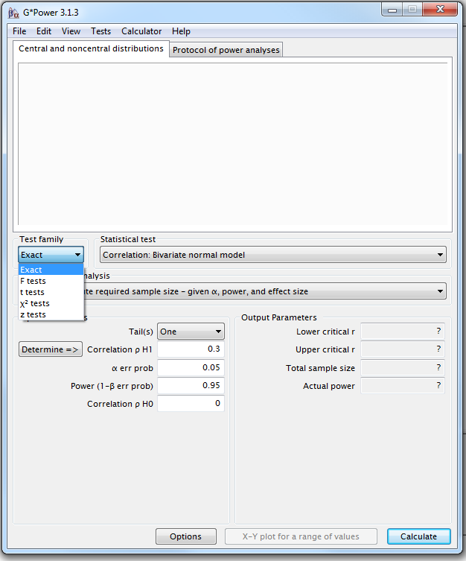
G*Power
A priori Power Analysis
Example case:
Preliminary results from a pilot study on cats: 25% line-danced after having received affection as a reward vs. 70% after having received food.
Power analysis with G*Power = 4 steps
Step1: choice of Test family

Slide 22
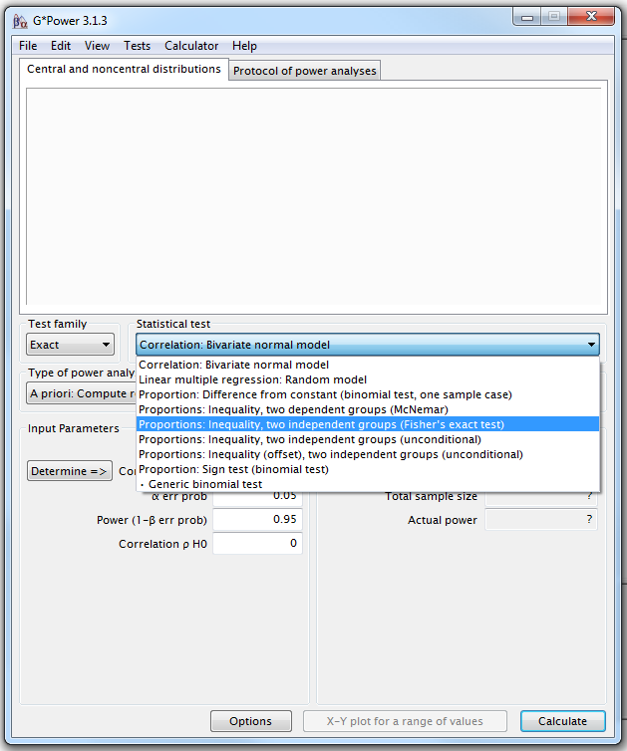
G*Power
Step 2 : choice of Statistical test
Fisher’s exact test or Chi-square for 2x2 tables

Slide 23
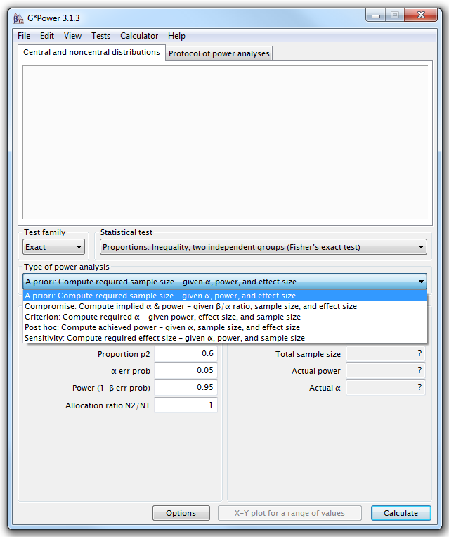
G*Power
Step 3: Type of power analysis

Slide 24
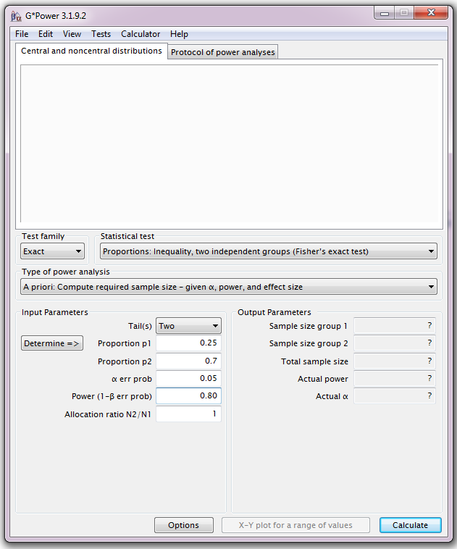
G*Power
Step 4: Choice of Parameters
Tricky bit: need information on the size of the difference and the variability.

Slide 25
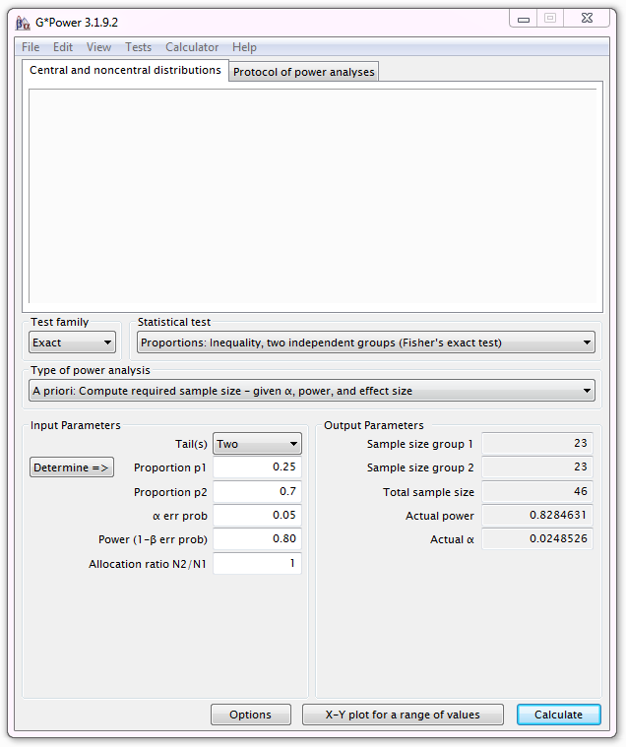
G*Power
Output:
If the values from the pilot study are good predictors and if you use a sample of n=23 for each group, you will achieve a power of 83%.

Slide 26
Chi-square and Fisher’s tests
Chi² test very easy to calculate by hand but Fisher’s very hard
Many software will not perform a Fisher’s test on tables > 2x2
Fisher’s test more accurate than Chi² test on small samples
Chi² test more accurate than Fisher’s test on large samples
Chi² test assumptions:
  2x2 table: no expected count <5
  Bigger tables: all expected > 1 and no more than 20% < 5
Yates’s continuity correction
  All statistical tests work well when their assumptions are met
  When not: probability Type 1 error increases
  Solution: corrections that increase p-values
    Corrections are dangerous: no magic
    Probably best to avoid them

Slide 27
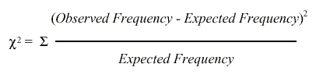
Chi-square test
In a chi-square test, the observed frequencies for two or more groups are compared with expected frequencies by chance.
  With observed frequency = collected data
Example with ‘cats and dogs’
Notes:
Your frequency, compare the frequencies with the expected ones observed by chance. HOW DIFFERENT IS WHAT I observe from what I expect? THIS DIFFERENCE CAN BE BIG SO SIGNOFICANT OR NOT

Slide 28
Chi-square test
Example: expected frequency of cats line dancing after having received food as a reward:
Direct counts approach:
Expected frequency=(row total)*(column total)/grand total
= 32*32/68 = 15.1
Probability approach:
Probability of line dancing: 32/68
Probability of receiving food: 32/68
Expected frequency:(32/68)*(32/68)=0.22: 22% of 68 = 15.1
For the cats:
Chi² = (26-15.1)²/15.1 + (6-16.9)²/16.9 + (6-16.9)² /16.9 + (30-19.1)²/19.1 = 28.4
Is 28.4 big enough for the test to be significant?
Notes:
Distance between expected and observed

Slide 29
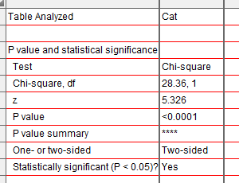
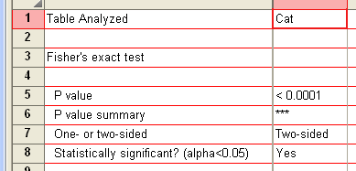
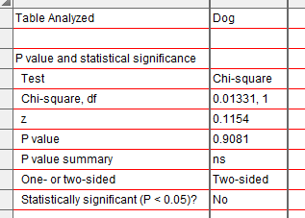
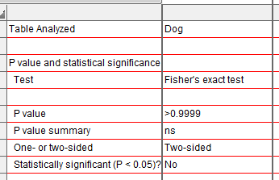
Results

Slide 30
Fisher’s exact test: results
In our example:
cats are more likely to line dance if they are given food as reward than affection (p<0.0001) whereas dogs don’t mind (p>0.99).

Slide 31
Quantitative data

Slide 32
Quantitative data
They take numerical values (units of measurement)
Discrete: obtained by counting
  Example: number of students in a class
  values vary by finite specific steps
or continuous: obtained by measuring
  Example: height of students in a class
  any values
They can be described by a series of parameters:
  Mean, variance, standard deviation, standard error and confidence interval
Notes:
Discrete numb pups in a litter ; continous height, weight, different scale
Data can be messy so then you go back to qualitative data.
Describe them: Mean, variance, standard deviation, standard error and confidence interval

Slide 33
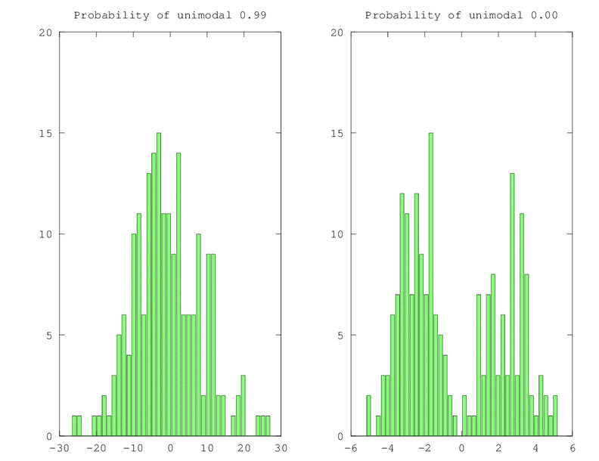

Measures of central tendency
Mode and Median
Mode: most commonly occurring value in a distribution
Median: value exactly in the middle of an ordered set of numbers
Notes:
Discrete numb pups in a litter continous hight, weitght, different scale
Data can be messy so then you go back to qualitative data.
Describe them: Mean, variance, standard deviation, standard error and confidence interval

Slide 34
Measures of central tendency
Mean
Definition: average of all values in a column
It can be considered as a model because it summaries the data
  Example: a group of 5 lecturers: number of friends of each members of the group: 1, 2, 3, 3 and 4
    Mean: (1+2+3+3+4)/5 = 2.6 friends per person
      Clearly an hypothetical value
How can we know that it is an accurate model?
  Difference between the real data and the model created

Slide 35

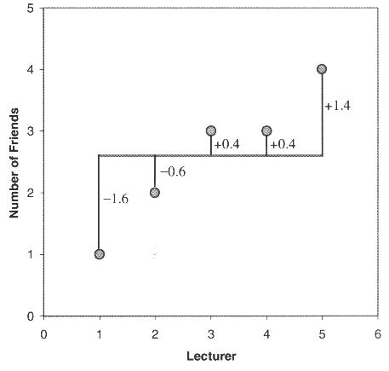
Measures of dispersion
Calculate the magnitude of the differences between each data and the mean:
  Total error = sum of differences
  $=0=Σ(x_{i}−\overline{x}$) = (-1.6)+(-0.6)+(0.4)+(1.4) = 0
  No errors !
      Positive and negative: they cancel each other out.
From Field, 2000

Slide 36
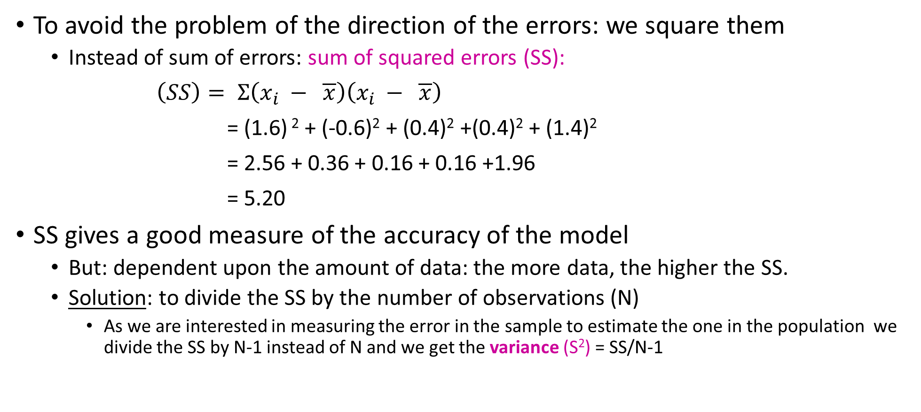
Sum of Squared errors (SS)
To avoid the problem of the direction of the errors: we square them
  Instead of sum of errors: sum of squared errors (SS):
$\left(SS\right)= Σ\left(x_{i} − \overline{x}\right)\left(x_{i} − \overline{x}\right)$
= (1.6) ² + (-0.6)² + (0.4)² +(0.4)² + (1.4)²
= 2.56 + 0.36 + 0.16 + 0.16 +1.96
= 5.20
SS gives a good measure of the accuracy of the model
  But: dependent upon the amount of data: the more data, the higher the SS.
  Solution: to divide the SS by the number of observations (N)
    As we are interested in measuring the error in the sample to estimate the one in the population we divide the SS by N-1 instead of N and we get the variance (S²) = SS/N-1

Slide 37
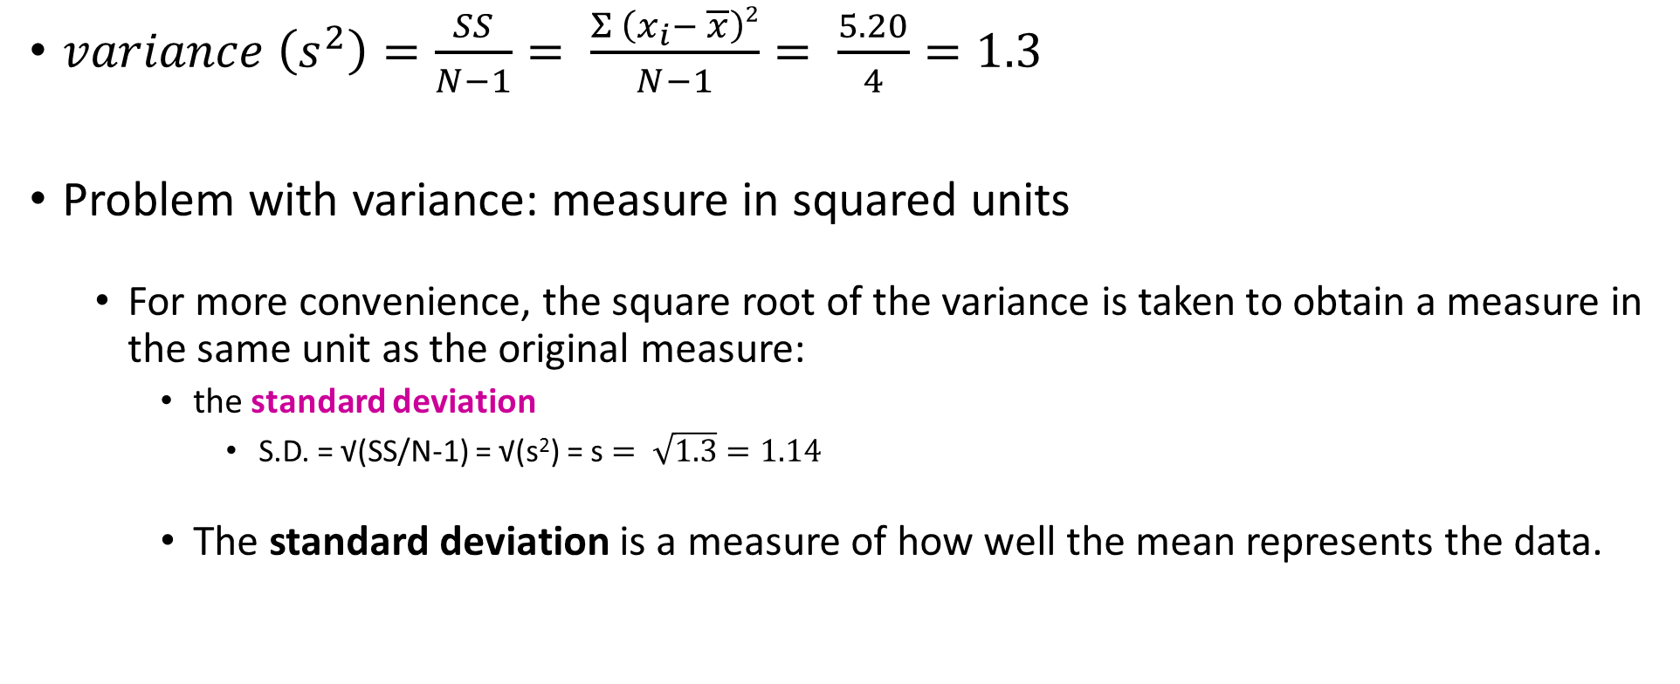
Variance and standard deviation
$variance \left(s^{2}\right)=\frac{SS}{N−1}= \frac{Σ \left(x_{i}− \overline{x}\right)2}{N−1}= \frac{5.20}{4}=1.3$
Problem with variance: measure in squared units
  For more convenience, the square root of the variance is taken to obtain a measure in the same unit as the original measure:
    the standard deviation
      S.D. = √(SS/N-1) = √(s²) = s $= \sqrt{1.3}=1.14$
    The standard deviation is a measure of how well the mean represents the data.

Slide 38
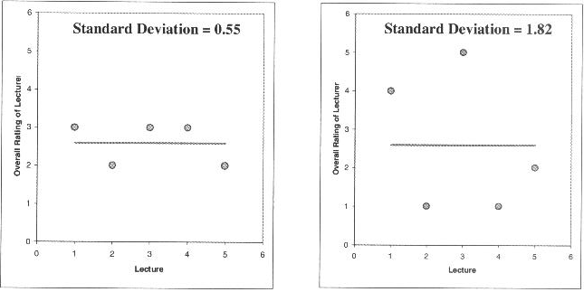
Standard deviation
Small S.D.:
data close to the mean:
mean is a good fit of the data
Large S.D.:
data distant from the mean:
mean is not an accurate representation

Slide 39
SD and SEM (SEM = SD/√N)
What are they about?
  The SD quantifies how much the values vary from one another: scatter or spread
    The SD does not change predictably as you acquire more data.
  The SEM quantifies how accurately you know the true mean of the population.
    Why? Because it takes into account: SD + sample size
    The SEM gets smaller as your sample gets larger
      Why? Because the mean of a large sample is likely to be closer to the true mean than is the mean of a small sample.

Slide 40
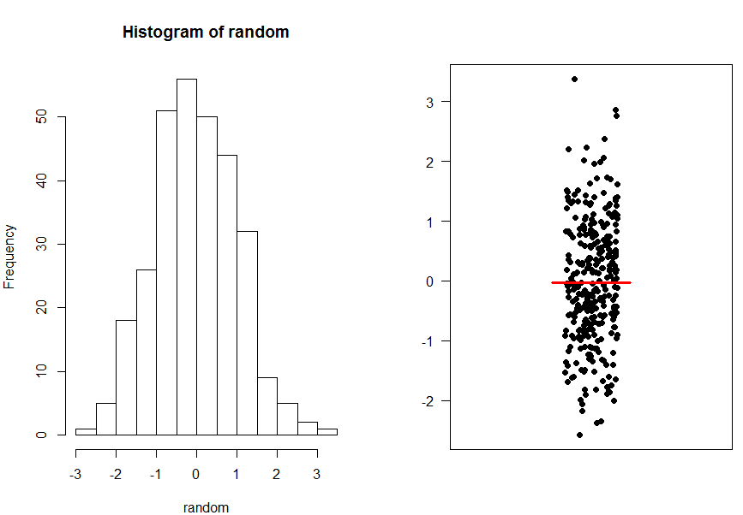
The SEM and the sample size
A population

Slide 41
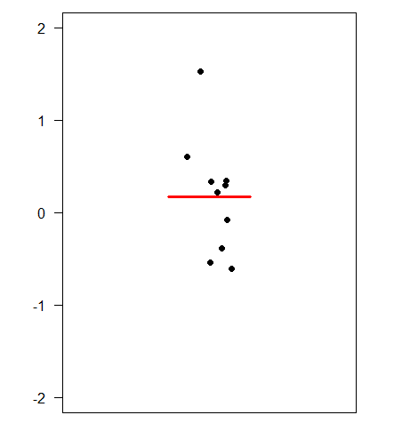
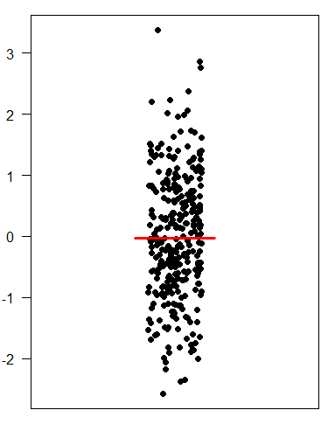
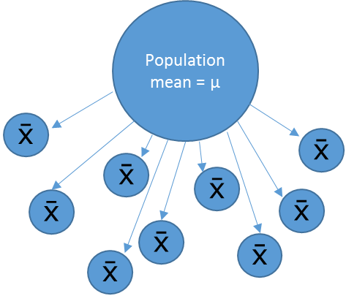
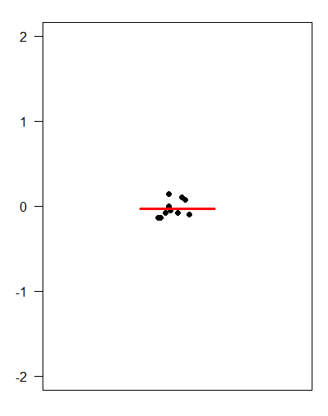
The SEM and the sample size
Small samples (n=3)
Sample means
Big samples (n=30)
‘Infinite’ number of samples
Samples means = 
Sample means

Slide 42
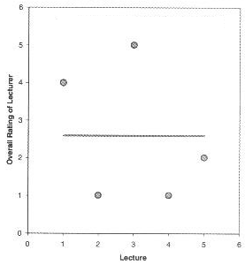
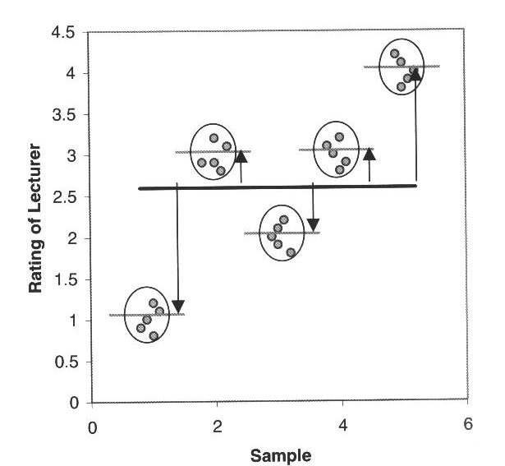
SD and SEM
The SD quantifies the scatter of the data.
The SEM quantifies the distribution
of the sample means.

Slide 43
SD or SEM ?
If the scatter is caused by biological variability, it is important to show the variation.
  Report the SD rather than the SEM.
    Better even: show a graph of all data points.
If you are using an in vitro system with no biological variability, the scatter is about experimental imprecision (no biological meaning).
  Report the SEM to show how well you have determined the mean.
Notes:
SD how much data differ from one to another. Scattered.
SEM how accurately you know the real mean of the true population
SD is the biological variability meaningful? If you have meaningful biological variability you have to put SD

Slide 44
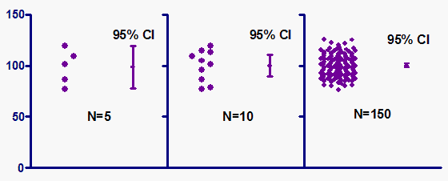
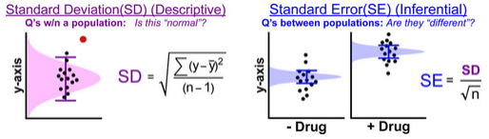
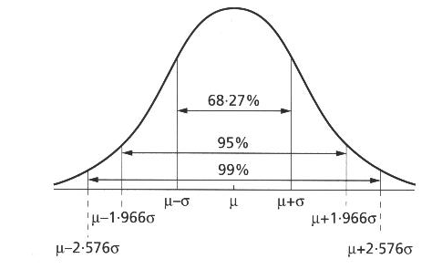
Confidence interval
Range of values that we can be 95% confident contains the true mean of the population.
  - So limits of 95% CI: [Mean - 1.96 SEM; Mean + 1.96 SEM] (SEM = SD/√N)
Error bars | Type | Description
Standard deviation | Descriptive | Typical or average difference between the data points and their mean.
Standard error | Inferential | A measure of how variable the mean will be, if you repeat the whole study many times.
Confidence interval usually 95% CI | Inferential | A range of values you can be 95% confident contains the true mean.
Notes:
If you polt that it tells you that 95% of the time the SD will be in this interval if you have a small overlap you can still have significance it’s the best to use

Slide 45
Analysis of Quantitative Data
Choose the correct statistical test to answer your question:
  They are 2 types of statistical tests:
    Parametric tests with 4 assumptions to be met by the data,
    Non-parametric tests with no or few assumptions (e.g. Mann-Whitney test) and/or for qualitative data (e.g. Fisher’s exact and χ² tests).

Slide 46
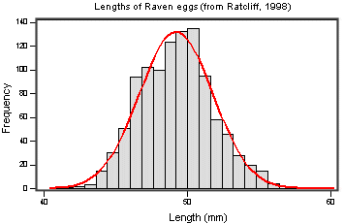
Assumptions of Parametric Data
All parametric tests have 4 basic assumptions that must be met for the test to be accurate.
  1) Normally distributed data
  Normal shape, bell shape, Gaussian shape
    Transformations can be made to make data suitable for parametric analysis.
Notes:
Small sample no worth check for normality
Parametric only when it’s big sample go for non parametric if you are unsure do both the non parametric is more efficient to find a difference
Can ask to run a test if there is a departure from normality

Slide 47
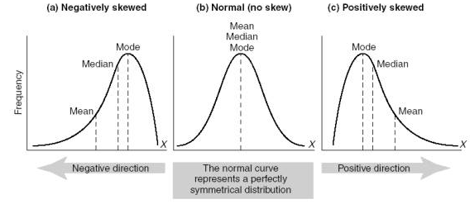

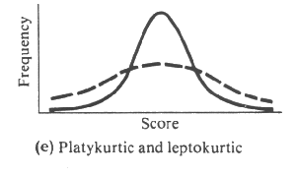

Assumptions of Parametric Data
Frequent departures from normality:
  Skewness: lack of symmetry of a distribution
  Kurtosis: measure of the degree of ‘peakedness’ in the distribution
    The two distributions below have the same variance approximately the same skew, but differ markedly in kurtosis.
Skewness < 0
Skewness = 0
Skewness > 0
More peaked distribution: kurtosis > 0
Flatter distribution: kurtosis < 0
Notes:
Departure from normality +vely skewd most common

Slide 48
Assumptions of Parametric Data
  2) Homogeneity in variance
    The variance should not change systematically throughout the data
  3) Interval data (linearity)
    The distance between points of the scale should be equal at all parts along the scale.
  4) Independence
    Data from different subjects are independent
      Values corresponding to one subject do not influence the values corresponding to another subject.
      Important in repeated measures experiments
Notes:
Variance must be same in the groups or similar
Interval data: in all group ypu measure data in the same way
Independence you have to know if it is or not tests are different in this case

Slide 49
Analysis of Quantitative Data
Is there a difference between my groups regarding the variable I am measuring?
  e.g. are the mice in the group A heavier than those in group B?
    Tests with 2 groups:
      Parametric: Student’s t-test
      Non parametric: Mann-Whitney/Wilcoxon rank sum test
    Tests with more than 2 groups:
      Parametric: Analysis of variance (one-way ANOVA)
      Non parametric: Kruskal Wallis
Is there a relationship between my 2 (continuous) variables?
  e.g. is there a relationship between the daily intake in calories and an increase in body weight?
    Test: Correlation (parametric) and curve fitting

Slide 50
Sample
Statistical inference
Population
Difference
Meaningful?
Yes
Real?
Statistical test
Big enough?
Statistic
e.g. t, F …
=
+ Noise +
Difference
Sample

Slide 51
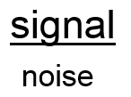
Signal-to-noise ratio
Stats are all about understanding and controlling variation.
signal
noise
signal
noise
Difference
+ Noise
Difference
Noise
If the noise is low then the signal is detectable …
= statistical significance
… but if the noise (i.e. interindividual variation) is large
then the same signal will not be detected
= no statistical significance
In a statistical test, the ratio of signal to noise determines the significance.

Slide 52
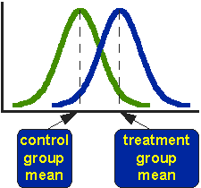
Comparison between 2 groups:
Student’s t-test
Basic idea:
  When we are looking at the differences between scores for 2 groups, we have to judge the difference between their means relative to the spread or variability of their scores.
    Eg: comparison of 2 groups: control and treatment

Slide 53
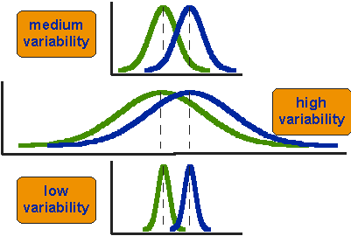
Student’s t-test
Notes:
Smaller variability more likely that the difference is significant case b it’s going to be difficult you nee A LOT of data

Slide 54
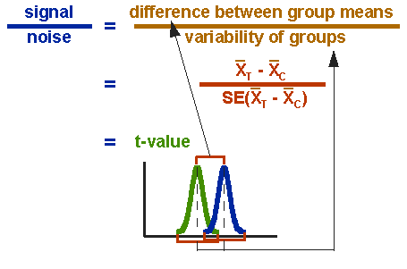
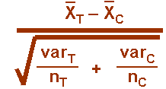
Student’s t-test

Slide 55
~ 2 x SE: p~0.05
~ 4.5 x SE: p~0.01
~ 1 x SE: p~0.05
~ 2 x SE: p~0.01

Slide 56
~ 1 x CI: p~0.05
~ 0.5 x CI: p~0.01
~ 0.5 x CI: p~0.05
~ 0 x CI: p~0.01

Slide 57
Student’s t-test
3 types:
  Independent t-test
    compares means for two independent groups of cases.
  Paired t-test
    looks at the difference between two variables for a single group:
      the second ‘sample’ of values comes from the same subjects (mouse, petri dish …).
  One-Sample t-test
    tests whether the mean of a single variable differs from a specified constant (often 0)
Notes:
WT vs mutant, totally independent
Time 0 then treatment and look at time 1: look difference in one group in difference condition

Slide 58

Example: coyotes.xlsx
Question: do male and female coyotes differ in size?
Sample size
Data exploration
Check the assumptions for parametric test
Statistical analysis: Independent t-test

Slide 59
Power analysis
Example case:
No data from a pilot study but we have found some information in the literature.
In a study run in similar conditions as in the one we intend to run, male coyotes were found to measure: 92cm+/- 7cm (SD).
We expect a 5% difference between genders.
smallest biologically meaningful difference

Slide 60
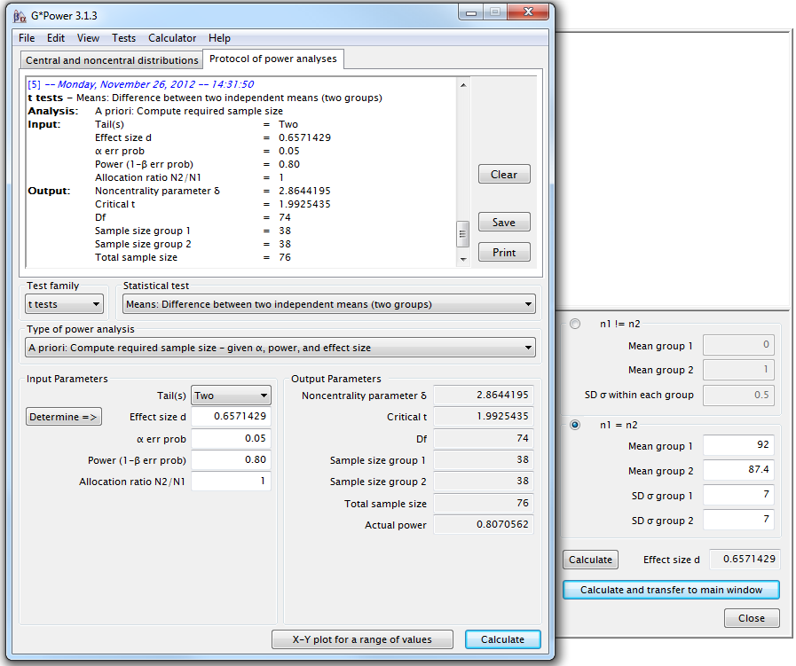
G*Power
Independent t-test
A priori Power analysis
Example case:
You don’t have data from a pilot study but you have found some information in the literature.
In a study run in similar conditions to the one you intend to run, male coyotes were found to measure:
92cm+/- 7cm (SD)
You expect a 5% difference between genders with a similar variability in the female sample.
You need a sample size of n=76 (2*38)

Slide 61
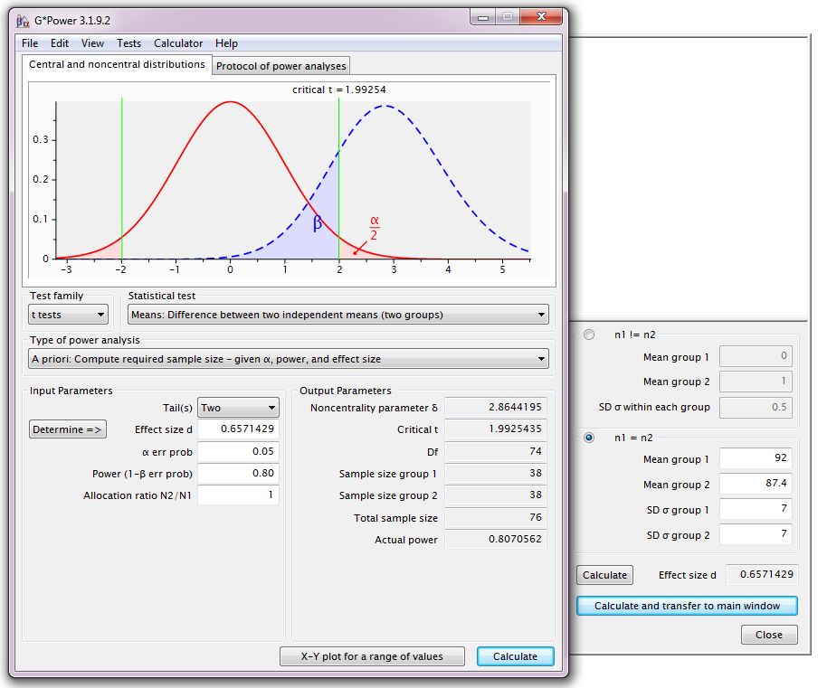
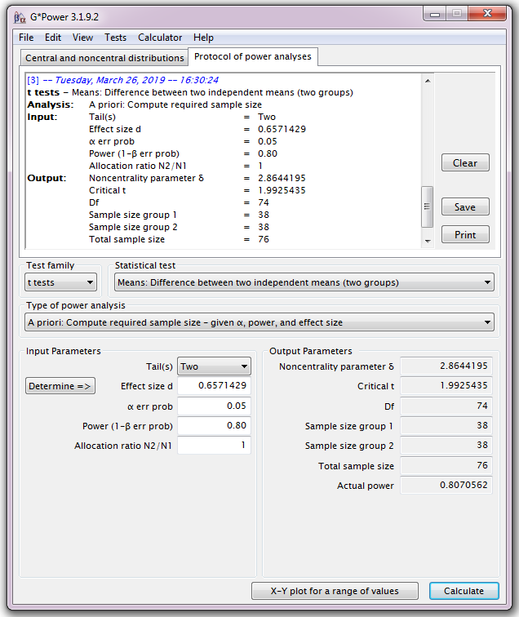
Power Analysis

Slide 62

Power Analysis
H₀
H₁

Slide 63

Power Analysis
For a range of sample sizes:

Slide 64

Data exploration $≠$ plotting data

Slide 65
Maximum
Upper Quartile (Q3) 75th percentile
Interquartile Range (IQR)
Median
Lower Quartile (Q1) 25th percentile
Smallest data value
> lower cutoff
Cutoff = Q1 – 1.5*IQR
Outlier

Slide 66


Slide 67

Assumptions for parametric tests
Normality ☑

Slide 68


Coyotes

Slide 69

Independent t-test: results
Males tend to be longer than females
but not significantly so (p=0.1045)
Homogeneity in variance ☑
What about the power of the analysis?

Slide 70


Power analysis
You would need a sample 3 times bigger to reach the accepted power of 80%.
But is a 2.3 cm difference between genders biologically relevant (<3%) ?

Slide 71
The sample size: the bigger the better?
It takes huge samples to detect tiny differences but tiny samples to detect huge differences.
What if the tiny difference is meaningless?
  Beware of overpower
  Nothing wrong with the stats: it is all about interpretation of the results of the test.
Remember the important first step of power analysis
  What is the effect size of biological interest?

Slide 72

Another example of t-test:
working memory.xlsx
A group of rhesus monkeys (n=15) performs a task involving memory after having received a placebo. Their performance is graded on a scale from 0 to 100. They are then asked to perform the same task after having received a dopamine depleting agent.
Is there an effect of treatment on the monkeys' performance?

Slide 73


Another example of t-test:
working memory.xlsx
Normality ☑

Slide 74

Another example of t-test:
working memory.xlsx

Slide 75

Paired t-test: Results
working memory.xlsx

Slide 76

Comparison of more than 2 means
Running multiple tests on the same data increases the familywise error rate.
What is the familywise error rate?
  The error rate across tests conducted on the same experimental data.
One of the basic rules (‘laws’) of probability:
  The Multiplicative Rule: The probability of the joint occurrence of 2 or more independent events is the product of the individual probabilities.
Notes:
Compare many groups to each other, wrong to use multiple t-tests, It increases the error

Slide 77
Familywise error rate
Example: All pairwise comparisons between 3 groups A, B and C:
  A-B, A-C and B-C
Probability of making the Type I Error: 5%
  The probability of not making the Type I Error is 95% (=1 – 0.05)
Multiplicative Rule:
  Overall probability of no Type I errors is: 0.95 * 0.95 * 0.95 = 0.857
So the probability of making at least one Type I Error is 1-0.857 = 0.143 or 14.3%
    The probability has increased from 5% to 14.3%
Comparisons between 5 groups instead of 3, the familywise error rate is 40% (=1-(0.95)^{n})

Slide 78
Familywise error rate
Solution to the increase of familywise error rate: correction for multiple comparisons
  Post-hoc tests
Many different ways to correct for multiple comparisons:
  Different statisticians have designed corrections addressing different issues
    e.g. unbalanced design, heterogeneity of variance, liberal vs conservative
However, they all have one thing in common:
  the more tests, the higher the familywise error rate: the more stringent the correction
Tukey, Bonferroni, Sidak, Benjamini-Hochberg …
  Two ways to address the multiple testing problem
    Familywise Error Rate (FWER) vs. False Discovery Rate (FDR)

Slide 79
Multiple testing problem
FWER: Bonferroni: α_{adjust} = 0.05/n comparisons e.g. 3 comparisons: 0.05/3=0.016
  Problem: very conservative leading to loss of power (lots of false negative)
  10 comparisons: threshold for significance: 0.05/10: 0.005
  Pairwise comparisons across 20.000 genes ☹
FDR: Benjamini-Hochberg: the procedure controls the expected proportion of “discoveries” (significant tests) that are false (false positive).
  Less stringent control of Type I Error than FWER procedures which control the probability of at least one Type I Error
  More power at the cost of increased numbers of Type I Errors.
Difference between FWER and FDR:
  a p-value of 0.05 implies that 5% of all tests will result in false positives.
  a FDR adjusted p-value (or q-value) of 0.05 implies that 5% of significant tests will result in false positives.

Slide 80
Analysis of variance
Extension of the 2 groups comparison of a t-test but with a slightly different logic:
t-test = mean1 – mean2
      Pooled SEM
ANOVA = variance between means
  Pooled SEM
ANOVA compares variances:
  If variance between the several means > variance within the groups (random error) then the means must be more spread out than it would have been by chance.
Pooled SEM
Pooled SEM

Slide 81
Analysis of variance
The statistic for ANOVA is the F ratio.
F =
F =
If the variance amongst sample means is greater than the error/random variance, then F>1
  In an ANOVA, we test whether F is significantly higher than 1 or not.
Variance between the groups
Variance within the groups (individual variability)
Variation explained by the model (= systematic)
Variation explained by unsystematic factors (= random variation)

Slide 82

Analysis of variance
Source of variation | Sum of Squares | df | Mean Square | F | p-value
Between Groups | 2.665 | 4 | 0.6663 | 8.423 | <0.0001
Within Groups | 5.775 | 73 | 0.0791
Total | 8.44 | 77
Variance (= SS / N-1) is the mean square
  df: degree of freedom with df = N-1
In Power Analysis:
Pooled SD=$√$MS(Residual)
Between groups variability
Within groups variability
Total sum of squares

Slide 83
Example: protein.expression.csv
Question: is there a difference in protein expression between the 5 cell lines?
1 Plot the data
2 Check the assumptions for parametric test
3 Statistical analysis: ANOVA

Slide 85

Parametric tests assumptions

Slide 87

Parametric tests assumptions

Slide 88
Analysis of variance: Post hoc tests
The ANOVA is an “omnibus” test: it tells you that there is (or not) a difference between your means but not exactly which means are significantly different from which other ones.
  To find out, you need to apply post hoc tests.
  These post hoc tests should only be used when the ANOVA finds a significant effect.

Slide 89




Analysis of variancec

Slide 90


Analysis of variance: results
Homogeneity of variance ☑
F=0.6727/0.08278=8.13

Slide 91


Correlation
A correlation coefficient is an index number that measures:
  The magnitude and the direction of the relation between 2 variables
  It is designed to range in value between -1 and +1
Notes:
No biological basis, could be just coincidence

Slide 92

Correlation
Most widely-used correlation coefficient:
  Pearson product-moment correlation coefficient “r”
    The 2 variables do not have to be measured in the same units but they have to be proportional (meaning linearly related)
  Coefficient of determination:
    r is the correlation between X and Y
    r² is the coefficient of determination:
      It gives you the proportion of variance in Y that can be explained by X, in percentage.

Slide 93

Correlation
Example: roe deer.xlsx
Is there a relationship between parasite burden and body mass in roe deer?

Slide 94



Correlation
Example: roe deer.xlsx
There is a negative correlation between parasite load and fitness but this relationship is only significant for the males(p=0.0049 vs. females: p=0.2940).

Slide 95


Curve fitting
Dose-response curves
  Nonlinear regression
  Dose-response experiments typically use around 5-10 doses of agonist, equally spaced on a logarithmic scale
  Y values are responses
The aim is often to determine the IC50 or the EC50
  IC50 (I=Inhibition): concentration of an agonist that provokes a response half way between the maximal (Top) response and the maximally inhibited (Bottom) response.
  EC50 (E=Effective): concentration that gives half-maximal response
Stimulation:
Y=Bottom + (Top-Bottom)/(1+10^((LogEC50-X)*HillSlope))
Inhibition:
Y=Bottom + (Top-Bottom)/(1+10^((X-LogIC50)))

Slide 96


Curve fitting
Example: Inhibition data.xlsx
Step by step analysis and considerations:
1- Choose a Model:
not necessary to normalise
should choose it when values defining 0 and 100 are precise
variable slope better if plenty of data points (variable slope or 4 parameters)
2- Choose a Method: outliers, fitting method, weighting method and replicates
3- Compare different conditions:
4- Constrain:
depends on your experiment
depends if your data don’t define the top or the bottom of the curve
Diff in parameters
Diff between conditions for one or more parameters
Constraint vs no constraint
Diff between conditions for one or more parameters

Slide 97
Curve fitting
Example: Inhibition data.xlsx
Step by step analysis and considerations:
5- Initial values:
defaults usually OK unless the fit looks funny
6- Range:
defaults usually OK unless you are not interested in the x-variable full range (ie time)
7- Output:
summary table presents same results in a … summarized way.
8 – Confidence: calculate and plot confidence intervals
9- Diagnostics:
check for normality (weights) and outliers (but keep them in the analysis)
check Replicates test
residual plots

Slide 98








Curve fitting
Example: Inhibition data.xlsx

Slide 99
Curve fitting
Example: Inhibition data.xlsx
No inhibitor | Inhibitor
No inhibitor | Inhibitor
Replicates test for lack of fit
SD replicates | 22.71 | 25.52
SD lack of fit | 41.84 | 32.38
Discrepancy (F) | 3.393 | 1.610
P value | 0.0247 | 0.1989
Evidence of inadequate model? | Yes | No
-7.158 | -6.011
Replicates test for lack of fit
SD replicates | 22.71 | 25.52
SD lack of fit | 39.22 | 30.61
Discrepancy (F) | 2.982 | 1.438
P value | 0.0334 | 0.2478
Evidence of inadequate model? | Yes | No
-7.159 | -6.017
Replicates test for lack of fit
SD replicates | 5.755 | 7.100
SD lack of fit | 11.00 | 8.379
Discrepancy (F) | 3.656 | 1.393
P value | 0.0125 | 0.2618
Evidence of inadequate model? | Yes | No
-7.017 | -5.943
Replicates test for lack of fit
SD replicates | 5.755 | 7.100
SD lack of fit | 12.28 | 9.649
Discrepancy (F) | 4.553 | 1.847
P value | 0.0036 | 0.1246
Evidence of inadequate model? | Yes | No
-7.031 | -5.956

Slide 100
My email address if you need some help with GraphPad:
anne.segonds-pichon@babraham.ac.uk
Slides and manual available on:
https://www.bioinformatics.babraham.ac.uk/training.html

