Slide 1
Exercises
Activated T cells
Providing the observed difference between WT and KO cells is of scientific interest, what sample size is needed to achieve a 80% power?
Mice weight
What sample size is needed to be able to spot a 10% difference with 80% power?

Slide 2
Exercises
Arachnophobia
Is it as scary to look at the picture of a spider than at a real one?
Cane toad
Is the proportion of cane toads infected by intestinal parasites the same in 3 different areas of Queensland?
Neutrophils
Is there a difference between KO with/without treatment and WT?

Slide 3
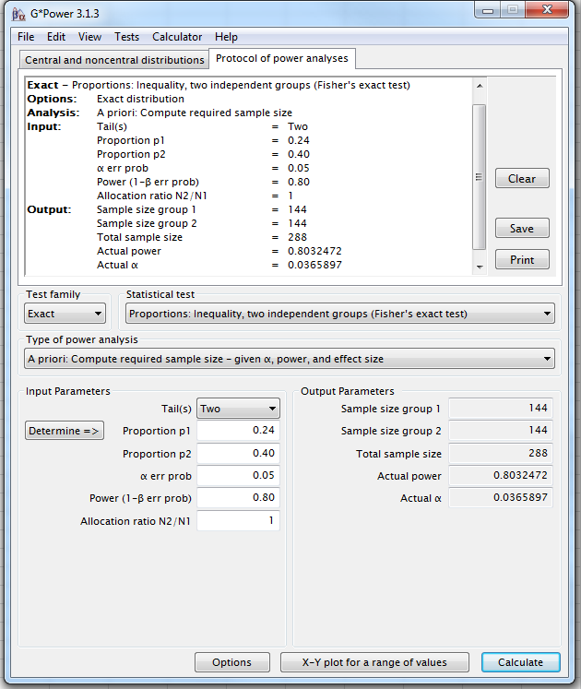
Activated T cells
Answer:
To achieve a power of 80%,
you will need a total sample of 288 cells.

Slide 4
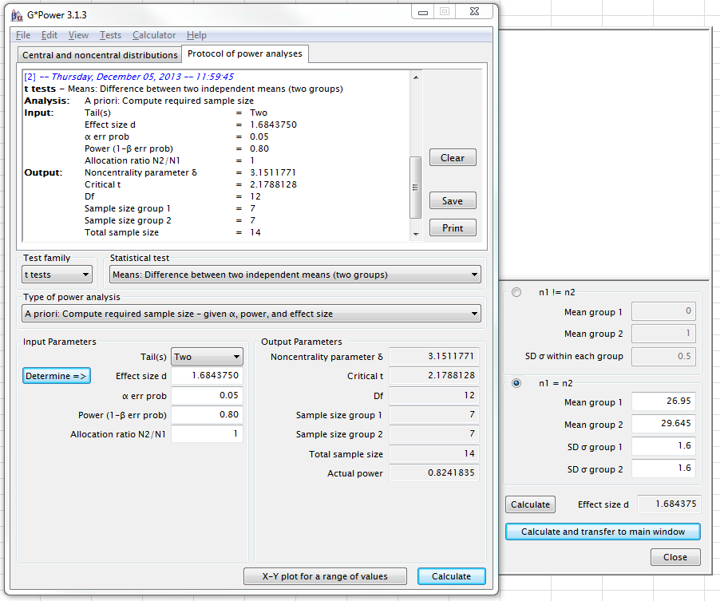
Mice weight
Answer:
To be able to spot a 10% difference in the mice weight,
at 80% power, you will need a sample n=7.

Slide 5
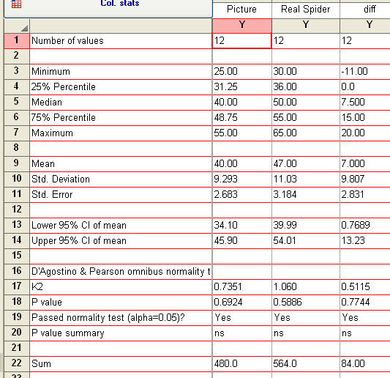
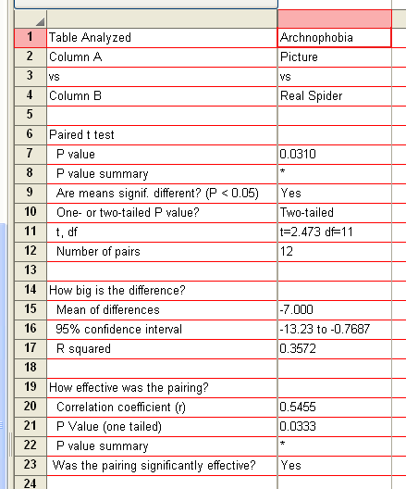
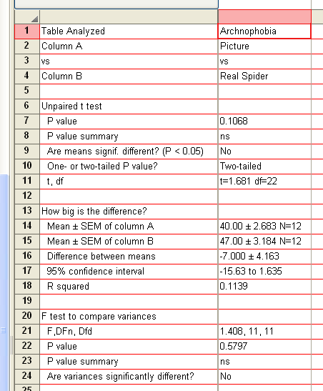
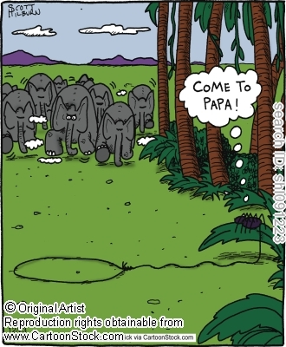
Arachnophobia
Answer:
If you are arachnophobe, it is scarier to look at a real spider than at the picture of one
(p=0.0310).

Slide 6
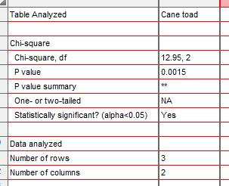
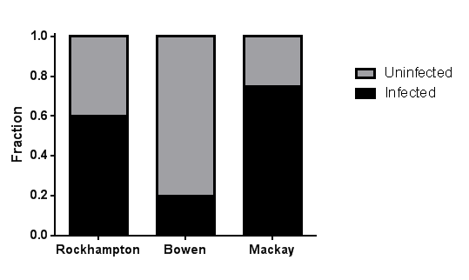
Cane toad
Answer:
The proportion of cane toads infected by intestinal parasites varies significantly between the 3 different areas of Queensland (p=0.0015), the animals being more likely to be parasitized in Rockhampton and Mackay than in Bowen.

Slide 7
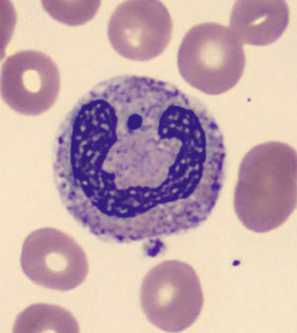
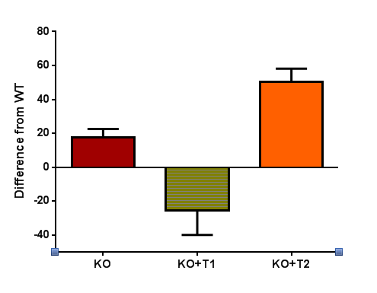
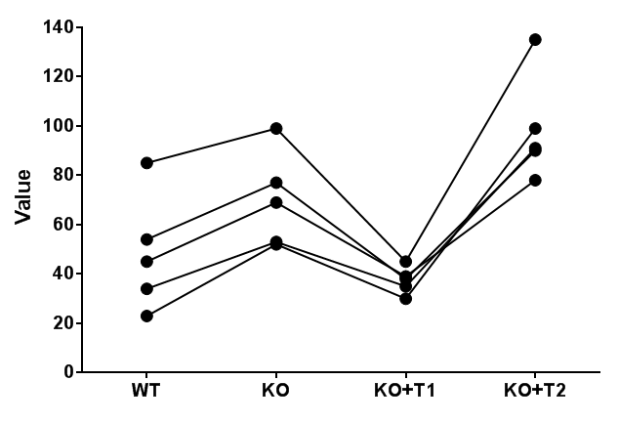
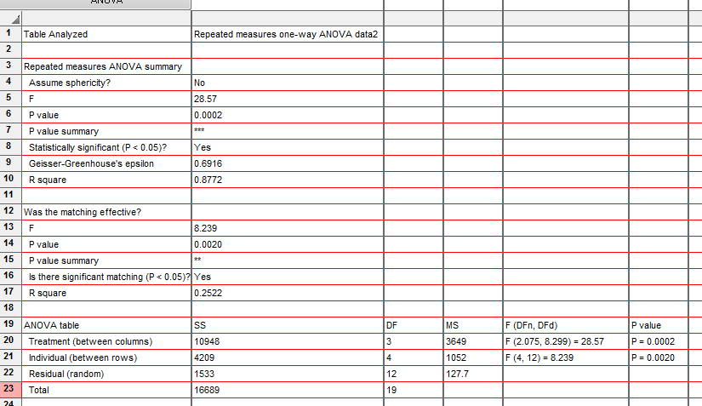
Neutrophils
Answer:
There is a significant difference from WT for the first and third groups.

