Slide 1


Experimental design Hayley Carr & Anne Segonds-Pichon v2025-01

Slide 2
Question
Data Collection/Storage
Data Exploration
Data Analysis
Results
Experiment
Experimental Design
Sample Size

Slide 3






Statistical Analysis
Common Sense
Experimental Design
Type of Design
Technical vs. Biological

Slide 4





Statistical Analysis
Common Sense
Experimental Design
Type of Design
Technical vs. Biological

Slide 5
Experimental design Independent versus matched design

Slide 6


Experimental design
Independent design
2 or more groups in an experiment with independent subjects
Example: 3 groups with n=4 in the control group and n=4 in each treated group
Control
Treatment 1
Treatment 2
One experiment
4 different mice
4 different mice
4 different mice

Slide 7


Experimental design
Matched design
Also called repeated = dependent = paired (2 groups)
Design 1: ≥2 measures per animal/subject/petri dish
Example 1: before/after treatment measures
Example 2: 3 time points
Time 1
Time 2
Time 3
Same mouse
Before
After
Paired/Matched values
Difference or ratio possible
for each mouse
Mouse 1
Mouse 1
Mouse 2
Same mouse
Mouse 2
Matched/Repeated values
Ex: Difference or ratio vs. Time 1
for each mouse
Mouse 3
Mouse 3

Slide 8
Experimental design
Matched design
Design 2: experiment repeated independently
Example 1: 3 independent experiments
2 mice within each: WT and KO
Example 2: 3 independent experiments
3 mice within each: control and 2 treatments
2 different mice
Matched/Paired values
Each KO mouse is matched with a WT
Difference or ratio possible
for each experiment
WT
KO
Ctrl
Treat 1
Treat 2
Experiment 1
Experiment 1
Experiment 2
Matched values
Ex: Difference or ratio vs. Time 1
for each experiment
Experiment 2
3 different
mice
Experiment 3
Experiment 3

Slide 9
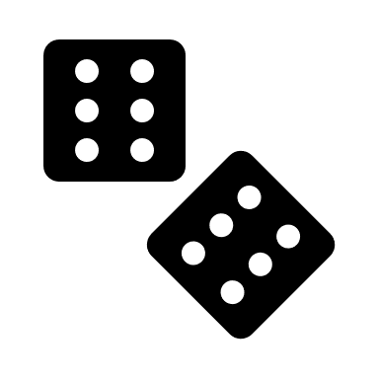



Experimental design
Other design considerations: bias
The lack of bias-reducing measures such as randomisation and blinding can contribute to as much as 30-45% inflation of effect sizes
Simple randomisation or randomisation within blocks
Example nuisance variables for blocking:
Time or day of experiment
Litter, cage, etc.
Person carrying out experiment
Sex, age, body weight, etc.
Another related measure (e.g. starting cell numbers, level of cytokine, or similar)
Use random number generator, flip a coin, roll a dice
Blinding should be thought about:
When allocating groups
When doing the experiment
The ARRIVE guidelines 2.0
Study design
Sample size
Inclusion and exclusion criteria
Randomisation
Blinding/Masking
Outcome measures
Statistical methods
Experimental animals
Results
When measuring outcomes
When doing the analysis
https://arriveguidelines.org/arrive-guidelines

Slide 10

Statistical Analysis
Common Sense
Experimental Design
Type of Design
Technical vs. Biological

Slide 11
Technical/biological replicates Not always easy

Slide 12

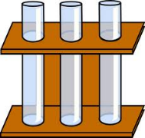
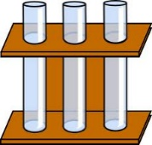
Technical versus biological replicates
Technical: repeated measures of the same sample → variability in the protocol
Biological: measures of biologically distinct samples → biological variation
Average of technical replicates = 1 biological replicate → ↓measurement error
n=1
n=3
Technical
Biological
Technical & Biological
n=3

Slide 13
Technical versus biological replicates
Not always easy to tell the difference
Definition of technical and biological depends on the model
Mouse, human, plant, or other complex organism
One value per individual organism = biological replicate
n=1
n=3
Technical
Biological

Slide 14
Technical versus biological replicates
Not always easy to tell the difference
The model: mouse or other complex organism
>1 value per individual, e.g. axon degeneration
What to do? Not one good answer
In this case: mouse = experiment unit, nerve segments = biological replicates, axons = technical replicates
But how generalisable to a wider population is this?
One measure or more
…
…
One mouse
Several segments
per mouse
Several axons
per segment
Tens of values
(per mouse)

Slide 15


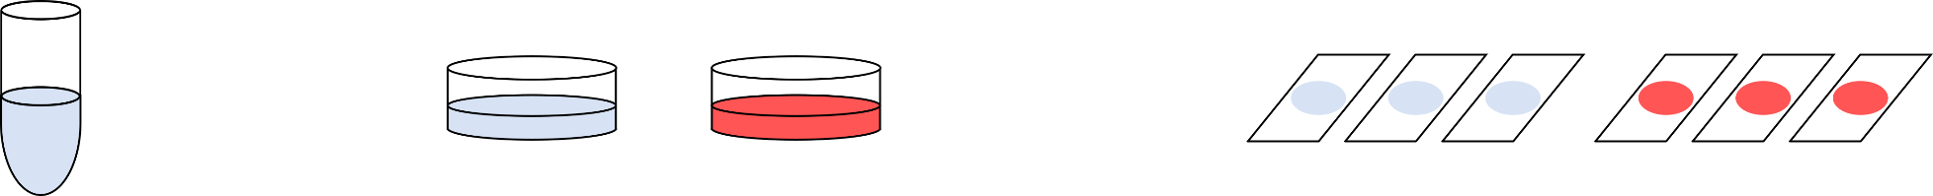

Technical versus biological replicates
Not always easy to tell the difference
Cells, worms, etc. = many ‘individuals’:
What is ‘n’ in cell culture experiments?
Control
Treatment
Glass slides, microarrays,
lanes in gel, wells in plate,
…
Point of Measurements
Vial of frozen cells
Dishes, flasks, wells, …
Cells in culture
Point of Treatment

Slide 16
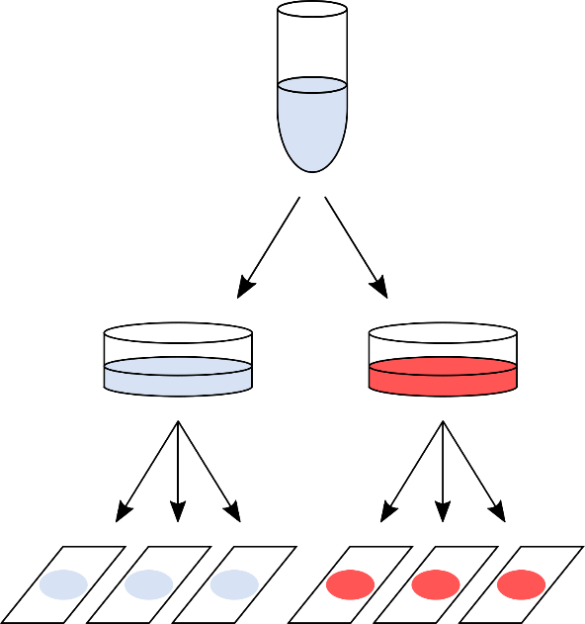
Technical versus biological replicates
Not always easy to tell the difference
Design 1:
One value per glass slide
e.g. cell count
After quantification: 6 values
Sample size: n = 1
no independence between slides
variability = pipetting/measurement error

Slide 17
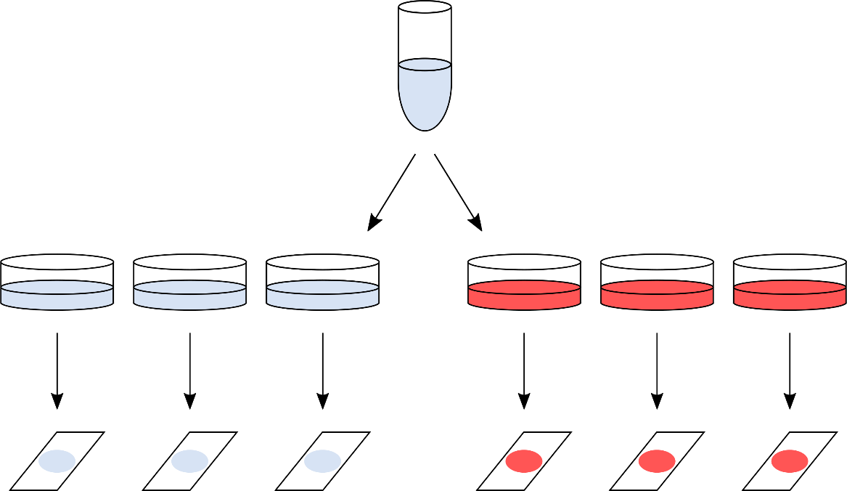
Technical versus biological replicates
Not always easy to tell the difference
Design 2:
Everything processed
on the same day
After quantification: 6 values
Sample size: n = 1
no independence between plates
variability = bit better as sample split higher up in the hierarchy

Slide 18
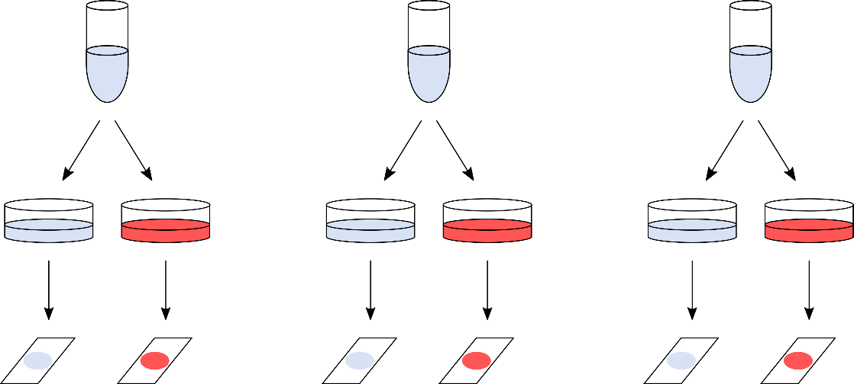
Technical versus biological replicates
Not always easy to tell the difference
Design 3: Often, as good as it can get
Day 1
Day 2
Day 3
After quantification: 6 values
Sample size: n = 3
Whole procedure repeated 3 separate times
3 days are (mostly) independent
Technical variability but at the highest hierarchical level
2 glass slides = paired observations

Slide 19
Technical versus biological replicates
Not always easy to tell the difference
Design 4: The ideal design
person/animal/plant 1
person/animal/plant 2
person/animal/plant 3
After quantification: 6 values
Sample size: n = 3
Real biological replicates

Slide 20



Technical versus biological replicates
Never mix technical and biological replicates
Do not generalise your results beyond what you are able to show
Identify technical and biological replicates
Make the replicates as independent as possible
Consider wider factors, e.g. rarity of samples, cost and accuracy of measurements
How ‘good’ your biological replicates are determines how generalisable your results are
↑ confidence if true biological replicates
↓ confidence if single cell line

Slide 21
Statistical Analysis
Common Sense
Experimental Design
Type of Design
Technical vs. Biological

Slide 22






Experimental Design
Statistical analysis
Think about the statistical analyses before you collect any data
Translate the hypothesis into statistical questions
What data will I collect?
Will I have access to the raw data?
I have been told to do this test/use that template, is that right?
How will it be recorded/produced?
Do I know enough stats to analyse my data?
If not: ask for help!

Slide 23
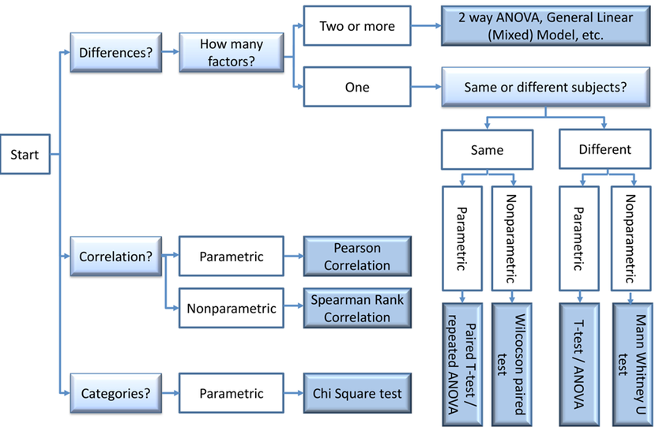
Experimental Design
Statistical analysis

Slide 24

Experimental Design
Exploratory data analysis (EDA)
Purpose of EDA = discovery
Less confidence in results so follow up with confirmatory tests
Confirmatory approaches (hypothesis testing) provide stronger statistical evidence
EDA ≠ “p-hacking” but could be if reported as if confirmatory
Be clear about approach taken – harm comes from misrepresenting processes

Slide 25
Statistical Analysis
Common Sense
Experimental Design
Type of Design
Technical vs. Biological

Slide 26

Experimental Design
Common sense
Design your experiment to be analysable
Imagine how your results will look
Imagine what could go wrong at each step
Accept limitations and account for them (be prepared for follow up experiments, if required)
The gathering of results or carrying out of a procedure is not the end goal
Don’t get fixated on being able to perform a cool technique or experimental protocol
Don’t overcomplicate
Don’t get overwhelmed (ask for help)
Will these results address your hypothesis?

Slide 27
Power Analysis Hayley Carr & Anne Segonds-Pichon v2024-05

Slide 28
Power analysis
Power analysis is about estimating the appropriate sample size.
Question
Data Collection/Storage
Data Exploration
Data Analysis
Results
Experiment
Sample Size
Experimental Design
Power Analysis

Slide 29
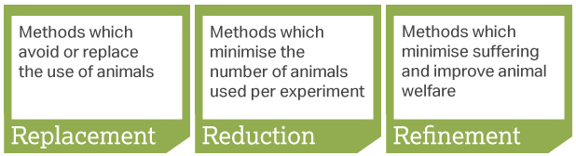
Sample size
Too big: waste of resources
Too small: may miss the effect (p>0.05) + waste of resources
Grants: justification of sample size
Publications: reviewers ask for power calculation evidence
Home office (UK): the 3 Rs: Replacement, Reduction and Refinement
To estimate an appropriate sample size, we need to do a power analysis

Slide 30


Statistical power
In a nutshell: the bigger the experiment (bigger sample size), the bigger the power (more likely to pick up a difference)
Power = probability of detecting an effect, given that the effect is really there
= the probability that a statistical test will reject a false null hypothesis (H0)
To really understand power, we first need to understand some statistical concepts…

Slide 31
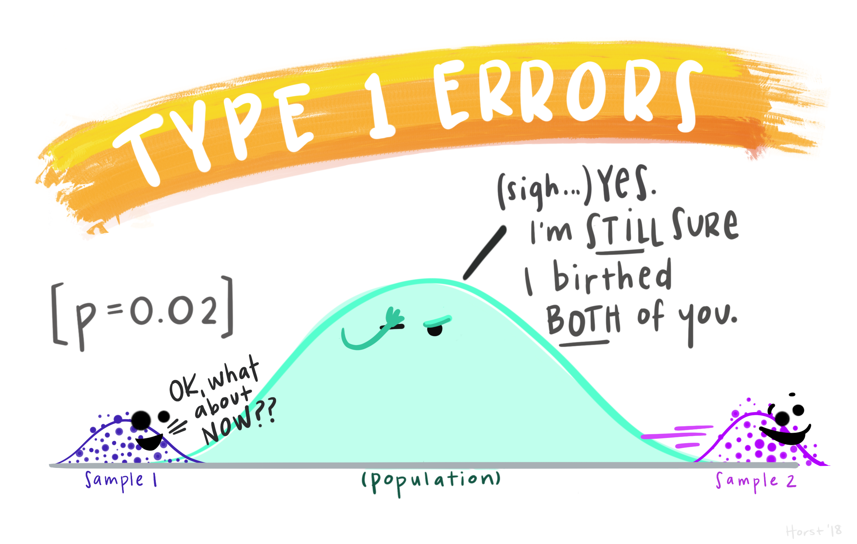
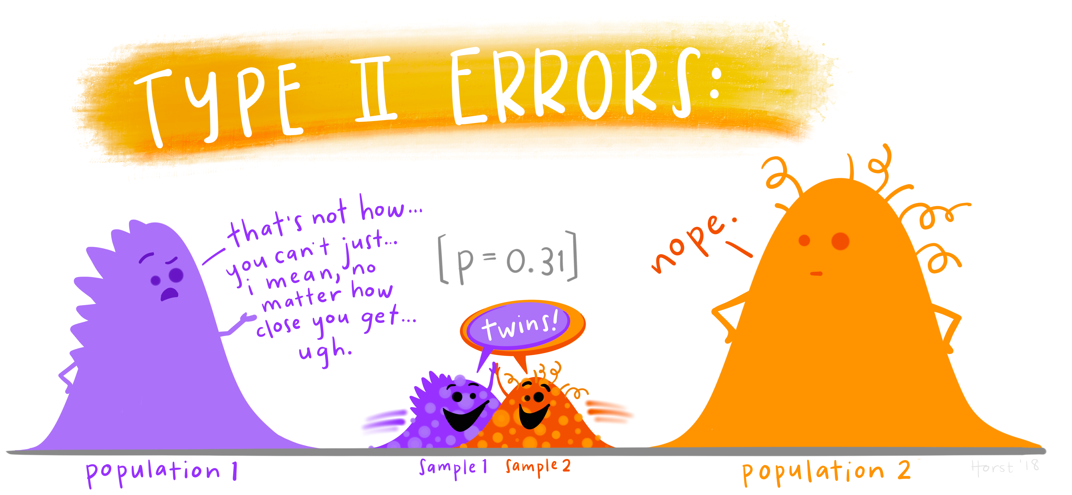
Hypothesis testing
The null hypothesis: H₀ = no effect
The aim of a statistical test is to reject or not H_{0.}
Statistical decision | True state of H₀
 | H₀ True (no effect) | H₀ False (effect)
Reject H₀ | Type I error α False Positive | Correct True Positive
Do not reject H₀ | Correct True Negative | Type II error β False Negative
Properly powered studies minimise this
https://github.com/allisonhorst/stats-illustrations#other-stats-artwork

Slide 32
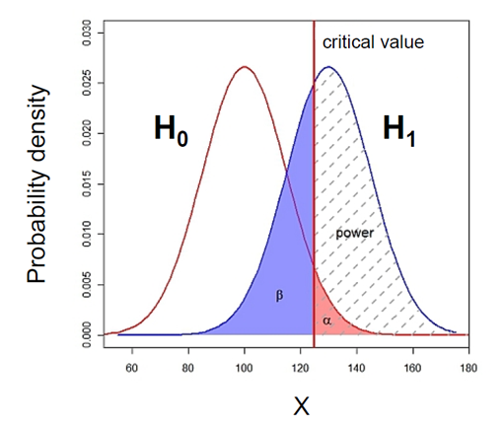
What does Power look like?

Slide 33
What does Power look like? Null and alternative hypotheses
Control
Treatment
Probability that the observed result occurs if H₀ is true
H₀ : Null hypothesis = absence of effect
H₁: Alternative hypothesis = presence of an effect
Statistics is all about rejecting the Null or not.

Slide 34
What does Power look like? Type I error (α)
Type I error is the failure to reject a true H₀
Claiming an effect which is not there.
α : probability of making a Type I error
α : the significance level, usually set at 0.05 or 5%

Slide 35
What does Power look like? Type I error (α) and the p-value
p-value: probability that the observed statistic occurred by chance alone
probability that a difference as big as the one observed could be found even if there is no effect.
Statistical significance: comparison between α (=0.05) and the p-value
p-value < 0.05: there is a significant difference ☺ (reject H₀)
p-value > 0.05: there is no significant difference ☹ (fail to reject H₀)

Slide 36
What does Power look like? Type II error (β) and Power
Area = 1
Power = 1 – β
Type II error (β) is the failure to reject a false H₀
Missing an effect which is really there
β : probability of making a Type II error
Power: Probability of detecting an effect which is really there.
= Probability of rejecting a false H₀
Direct relationship between Power and Type II error: Power = 1 – β

Slide 37

What does Power look like? Power = 80%
General convention: 80% but could be more
Means a true difference will be missed 20% of the time
If power = 0.8 then β = 1- power = 0.2 (20%)
Jacob Cohen (1962):
Type I errors are 4x more serious than Type II errors:
0.05 * 4 = 0.2
Compromise between power and sample size, e.g. for 2 group comparisons:
90% power = +30% sample size
95% power = +60% sample size

Slide 38
The critical value
Critical value
Small difference
Big difference
Not significant: p>0.05
Significant: p<0.05
Critical value = size of difference + sample size + significance level

Slide 39
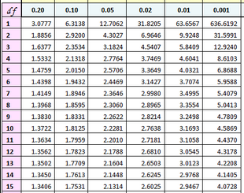
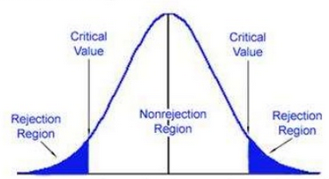
The critical value: size of difference + sample size + significance
Example with the t-test
Significance level
~ Difference
T Distribution
0.95
Diff “big enough”
Degrees of freedom
0.025
0.025
0
t=-2.1448
t=2.1448
Difference “too small”
Example: 2-tailed t-test with n=15 (df=14)
In hypothesis testing:
critical value is compared to the test statistic to determine significance
Example of test statistic: t-value
If test statistic > critical value: statistical significance and rejection of the null hypothesis
Example: t-value > critical t-value

Slide 40
To recap:
The null hypothesis: H₀ = no effect
The aim of a statistical test is to reject or not H_{0.}
Statistical decision | True state of H₀
 | H₀ True (no effect) | H₀ False (effect)
Reject H₀ | Type I error α False Positive | Correct True Positive
Do not reject H₀ | Correct True Negative | Type II error β False Negative
https://github.com/allisonhorst/stats-illustrations#other-stats-artwork

Slide 41
Power analysis
The power analysis depends on the relationship between 6 variables:
the significance level (5%)
the desired power of the experiment (80%)
the alternative hypothesis (i.e. one or two-sided test)
the difference of biological interest
the variability in the data (standard deviation)
the sample size
Effect size

Slide 42
Power analysis
The power analysis depends on the relationship between 6 variables:
the significance level (5%)
the desired power of the experiment (80%)
the alternative hypothesis (i.e. one or two-sided test)
the difference of biological interest
the variability in the data (standard deviation)
the sample size
Effect size

Slide 43
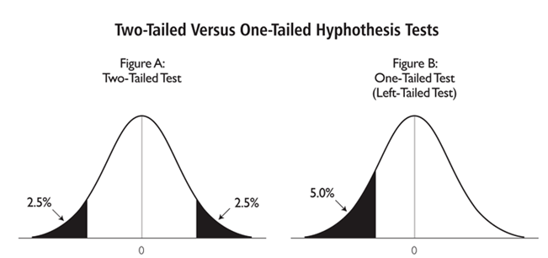
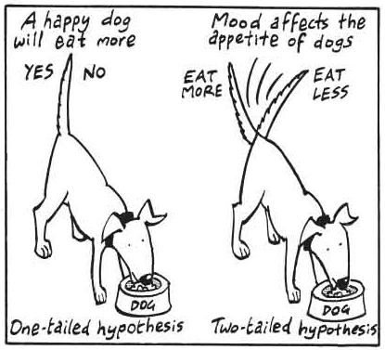
The alternative hypothesis: what is it?
One-tailed or two-tailed test? One-sided or two-sided tests?
Is the question:
Is the there a difference? → Two-tailed
Is it larger than or smaller than? → One-tailed
Can rarely justify the use of a one-tailed test
Two times easier to reach significance with one-tailed than two-tailed → suspicious reviewer!

Slide 44
Power analysis
The power analysis depends on the relationship between 6 variables:
the significance level (5%)
the desired power of the experiment (80%)
the alternative hypothesis (i.e. one or two-sided test)
the difference of biological interest
the variability in the data (standard deviation)
the sample size
Effect size

Slide 45
The difference of biological interest
Determined scientifically (not statistically)
Minimum meaningful effect of biological relevance (Minimum Effect of Interest, MEI)
How to determine it?
Previous research, pilot study
The variability
We need to have an idea of the standard deviation before we start the experiment
How to determine it?
Data from previous research on WT, control or baseline
Effect size
Combination of absolute effect and variability

Slide 46

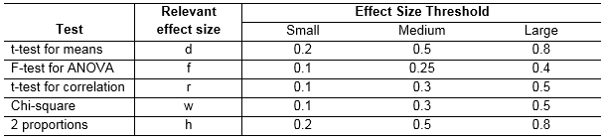
The effect size: how is it calculated?
Depends on the type of difference and the data
Easy example: comparison between 2 means
Jacob Cohen defined small, medium and large effects for different tests – but not recommended
Absolute difference
Variability

Slide 47
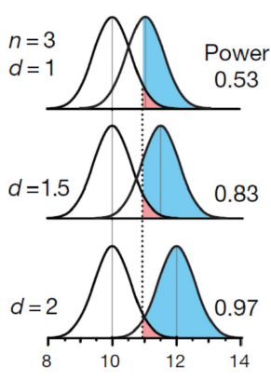
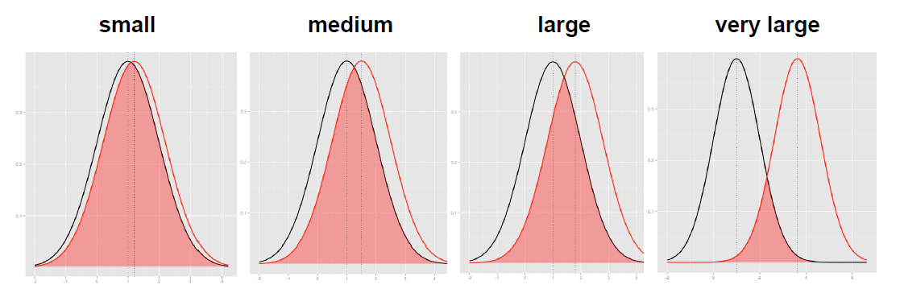
The effect size: how is it calculated?
The absolute difference
The bigger the effect (the absolute difference), the bigger the power
= the bigger the probability of picking up the difference
Absolute difference
http://rpsychologist.com/d3/cohend/

Slide 48
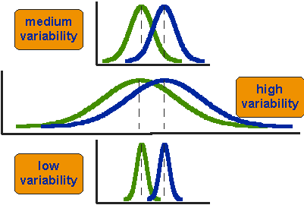
The effect size: how is it calculated?
The standard deviation
The bigger the variability of the data, the smaller the power
Variability
critical value
H₀
H₁

Slide 49
Power analysis
The power analysis depends on the relationship between 6 variables:
the significance level (5%)
the desired power of the experiment (80%)
the alternative hypothesis (i.e. one or two-sided test)
the difference of biological interest
the variability in the data (standard deviation)
the sample size
Effect size

Slide 50
The sample size
Most of the time, the output of a power calculation
In reality it is difficult to reduce the variability in data, or the contrast between means
most effective way of improving power:
increase the sample size
The bigger the sample, the bigger the power
but how does it actually work?

Slide 51

Samples and population
We want to know about whole population
All people, all patients, all mice, all cells…
Not possible to measure whole population
So take a representative sample
Make inferences about the population
Larger samples more likely to be representative of the population

Slide 52
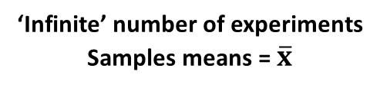
The sample size
‘Infinite’ number of experiments
Samples means = $\overline{x}$
n=3
Small samples (n=3)
Example with 10 experiments
Usually only do one experiment
Sample
n=30
Big samples (n=30)
Population
Sample

Slide 53


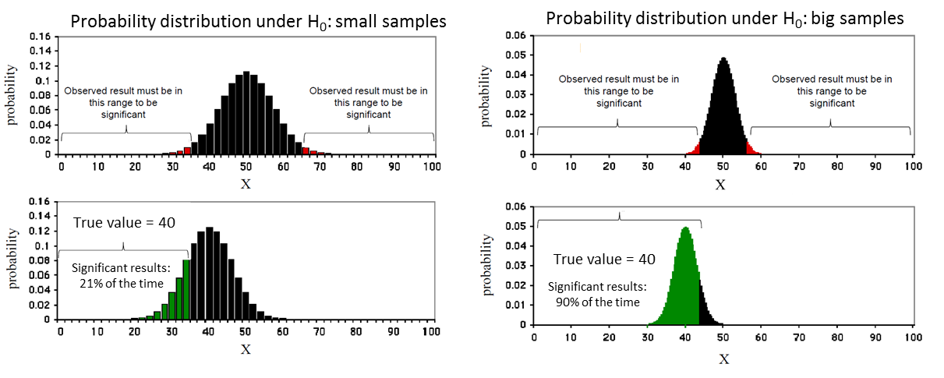
The sample size
Control
Treatment

Slide 54
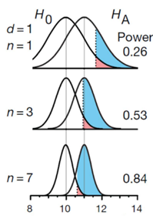
The sample size
Control
Treatment

Slide 55
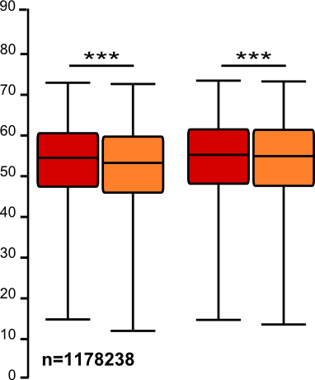
The sample size: the bigger the better?
It takes huge samples to detect tiny differences but tiny samples to detect huge differences
What if the tiny difference is meaningless?
Beware of overpower
Nothing wrong with the stats: it is all about interpretation of the results of the test
Remember the important first step of power analysis:
What is the effect size of biological interest?

Slide 56
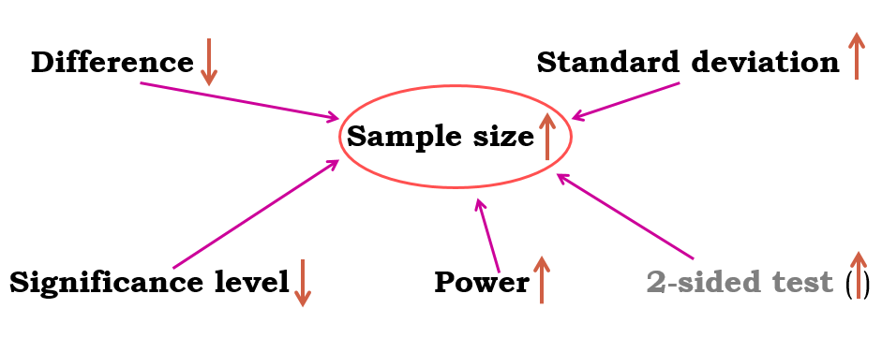
Power analysis
Typical question
What sample size do I need to have a 80% probability (power) to detect this particular effect (difference and standard deviation) at a 5% significance level using a 2-sided test?

Slide 57
Power analysis
Fix any five of the variables, a mathematical relationship is used to estimate the sixth
Difference of biological interest
+ Variability in the data (standard deviation)
+ Desired power of the experiment (80%)
+ Significance level (5%)
+ Alternative hypothesis (i.e. one or two-sided test)
Appropriate sample size

Slide 58
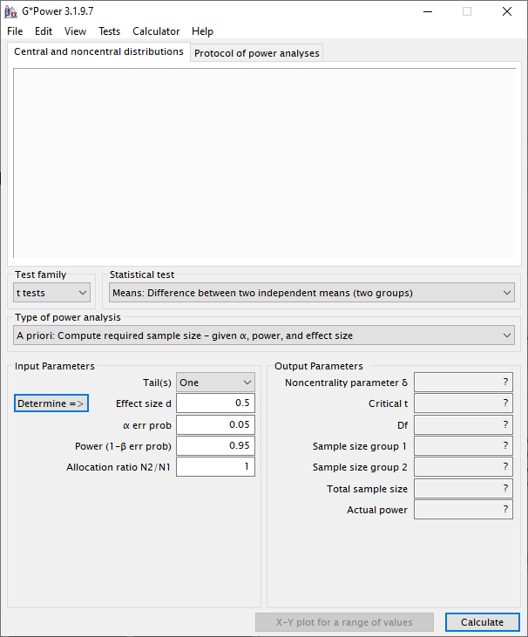
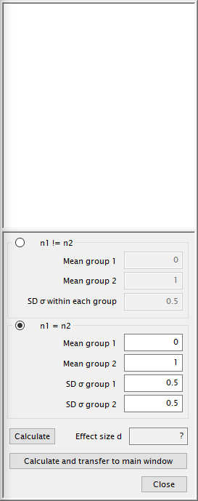
Power analysis
Good news:
there are packages that can do the power analysis for you, providing you have some prior knowledge of the key parameters!
difference + standard deviation = effect size
R
G*Power

Slide 59
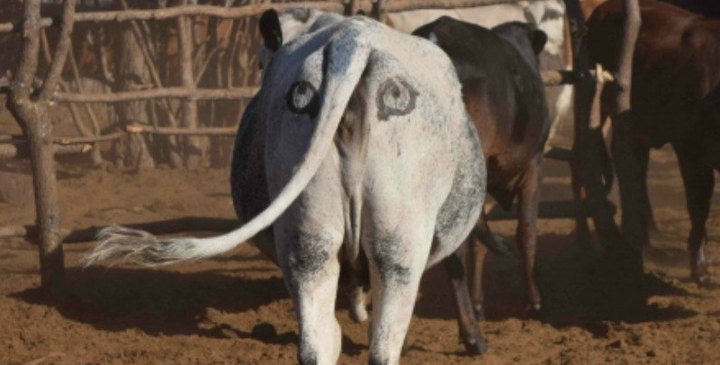
Power Analysis
Comparing 2 proportions (Fisher’s exact test)
Exercise:
Scientists have come up with a solution that may reduce the number of lions being shot by farmers in Africa:
Painting eyes on cows’ bottoms.
Early trials suggest that lions are less likely to attack livestock when they think they’re being watched
Fewer livestock attacks could help farmers and lions co-exist more peacefully.
Pilot study over 6 weeks:
3 out of 39 unpainted cows were killed by lions, none of the 23 painted cows from the same herd were killed.
Tasks:
Do you think the observed effect is meaningful to the extent that such a ‘treatment’ should be applied?
Consider ethics, economics, conservation …
Run a power calculation to find out how many cows should be included in the study.
http://www.sciencealert.com/scientists-are-painting-eyes-on-cows-butts-to-stop-lions-getting-shot

Slide 60
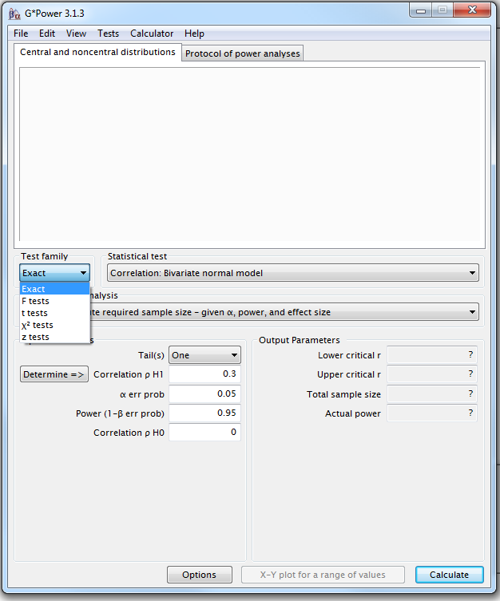
Power Analysis
Comparing 2 proportions
Four steps to Power
Step1: choice of Test family

Slide 61
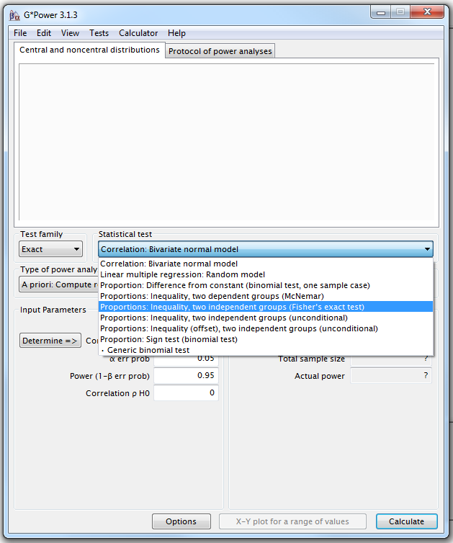
G*Power
Step 2 : choice of Statistical test
Fisher’s exact test or Chi-square for 2x2 tables

Slide 62
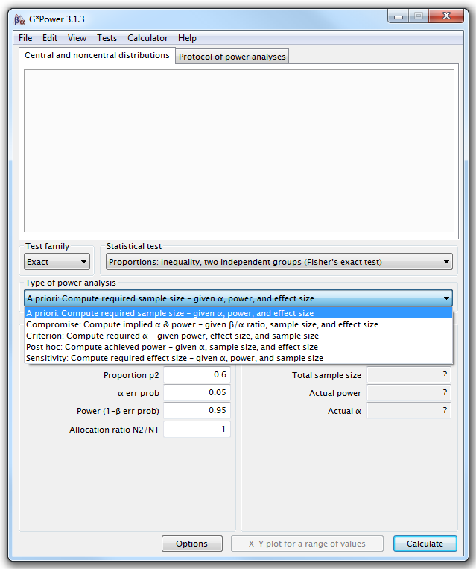
G*Power
Step 3: Type of power analysis

Slide 63
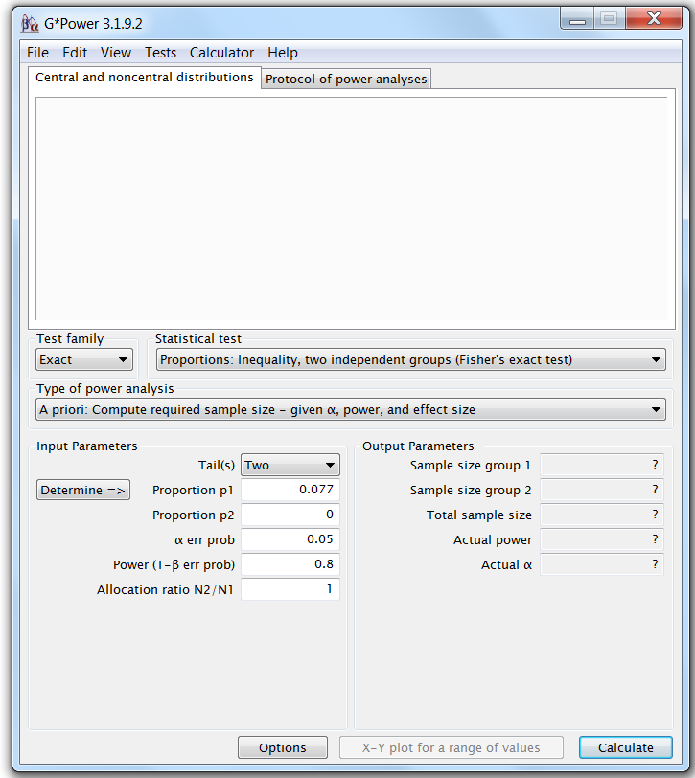
G*Power
Step 4: Choice of Parameters
Tricky bit: need information about the effect size.
Remember to check all parameters!
By default:
Tail(s) = One
Power = 0.95
Example case:
0 cows killed in the painted group 3 out 39 in unpainted

Slide 64
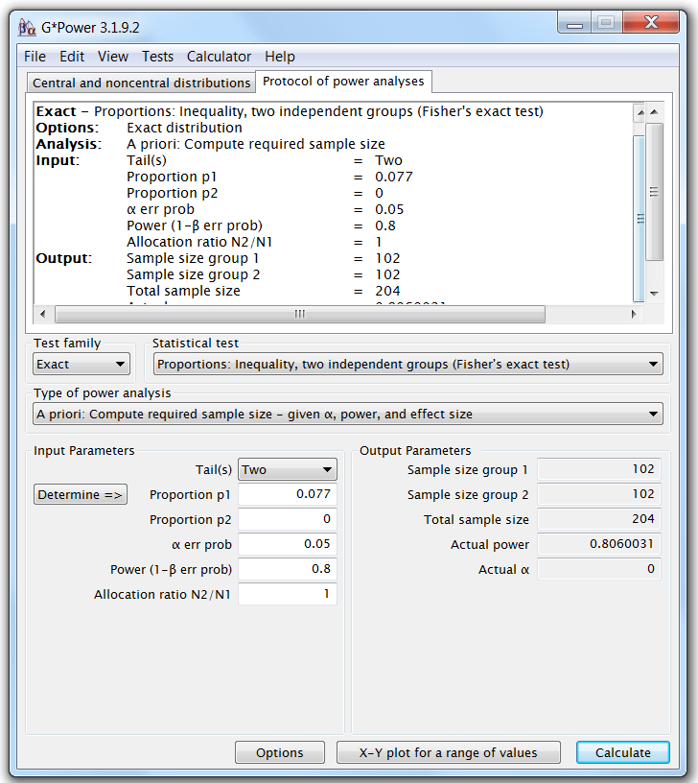
G*Power
Providing the preliminary results are to be trusted, to be able to pick up such a difference between the 2 groups, with a power of 80% and a significance level of 5%, we will need at least 102 cows in each group.

Slide 65
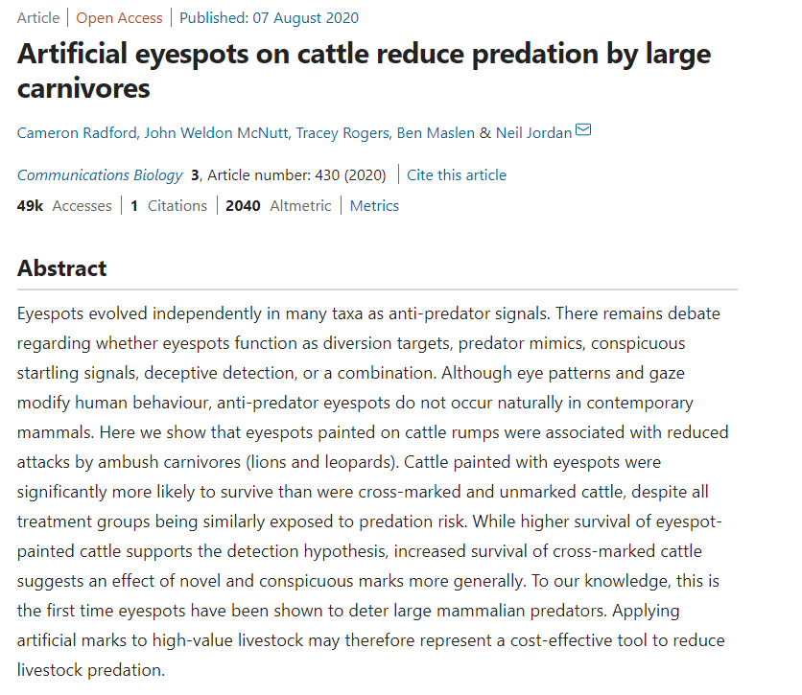
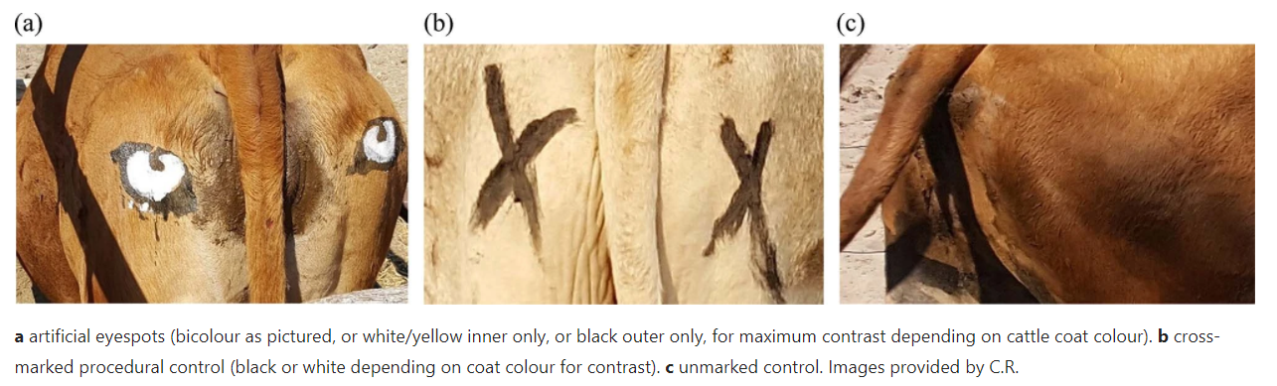
https://www.nature.com/articles/s42003-020-01156-0.pdf

Slide 66
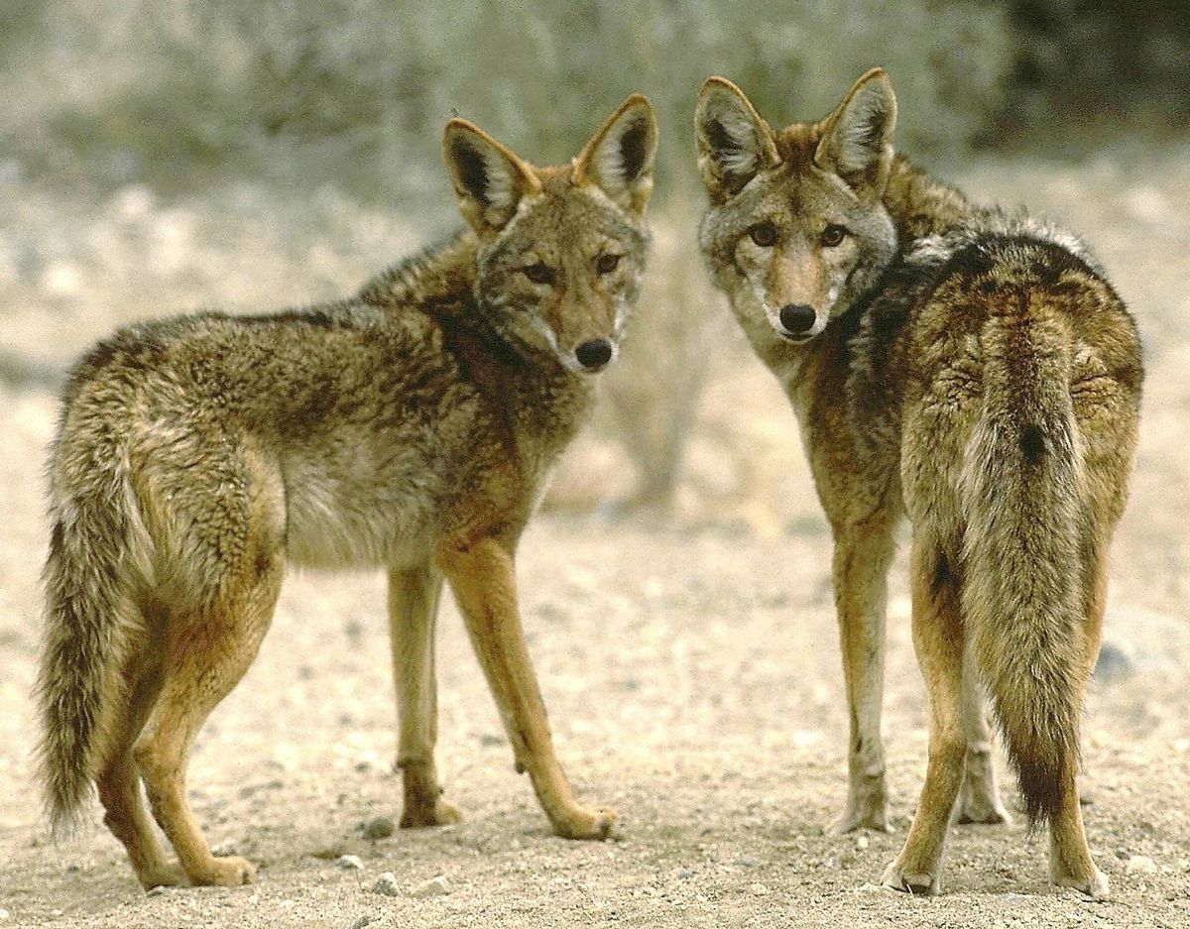
Power Analysis
Comparing 2 means (t-test)
Exercise:
We want to know whether male and female coyotes differ in size
No data from a pilot study but we have found some information in the literature:
In a study run in similar conditions as in the one we intend to run, male coyotes were found to measure: 92cm +/- 7cm (SD)
We expect a 5% difference between the sexes
= smallest biologically meaningful difference
Task:
Run a power calculation to find out how many coyotes should be included in the study

Slide 67
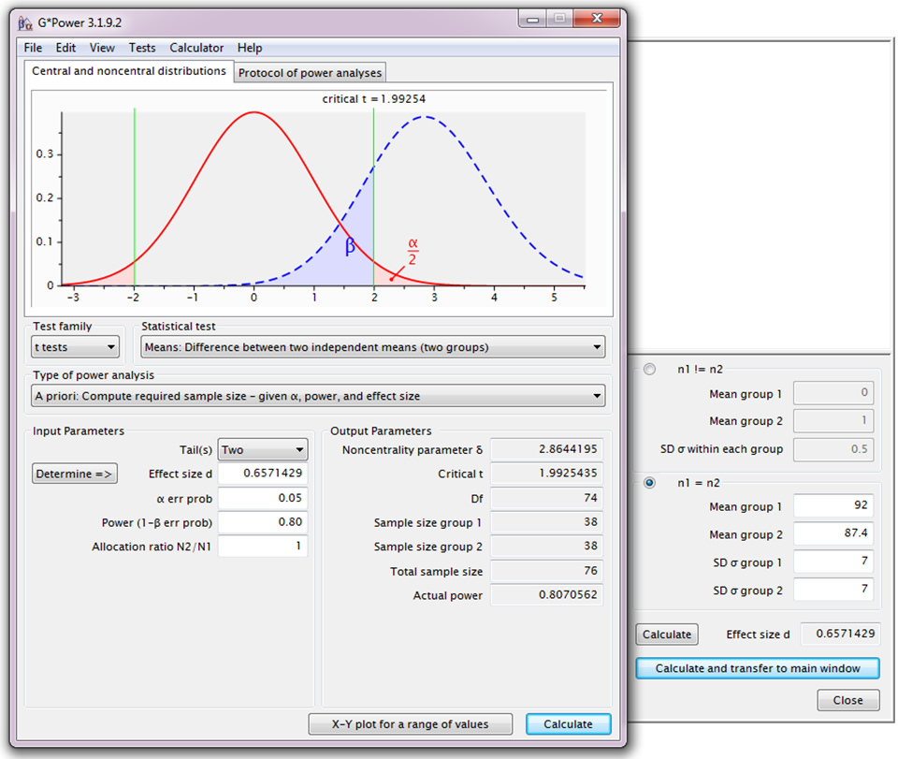
Power Analysis
H₀
H₁

Slide 68
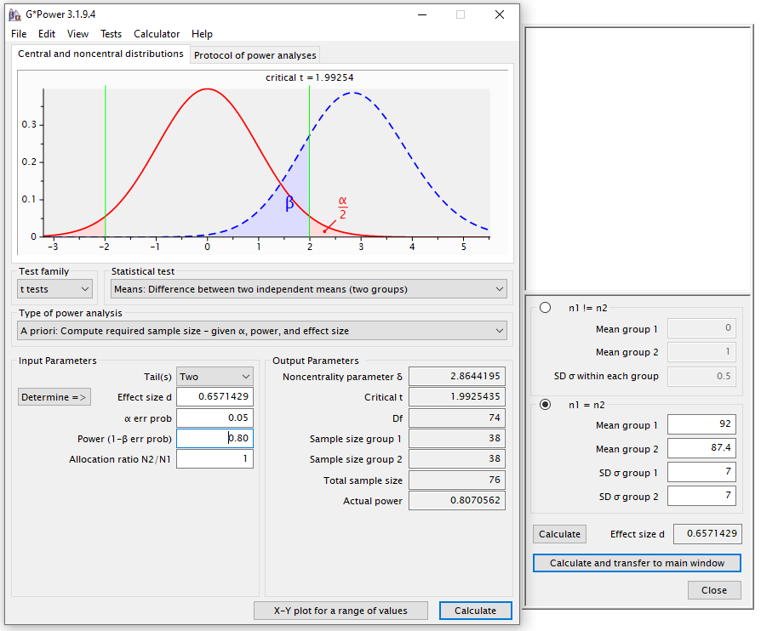
G*Power
Independent t-test
A priori Power analysis
Example case:
From a similar study, male coyotes were found to measure:
92cm+/- 7cm (SD)
You expect a 5% difference between the sexes with similar variability in the female sample
You need a sample size of n=76 (2*38)

Slide 69
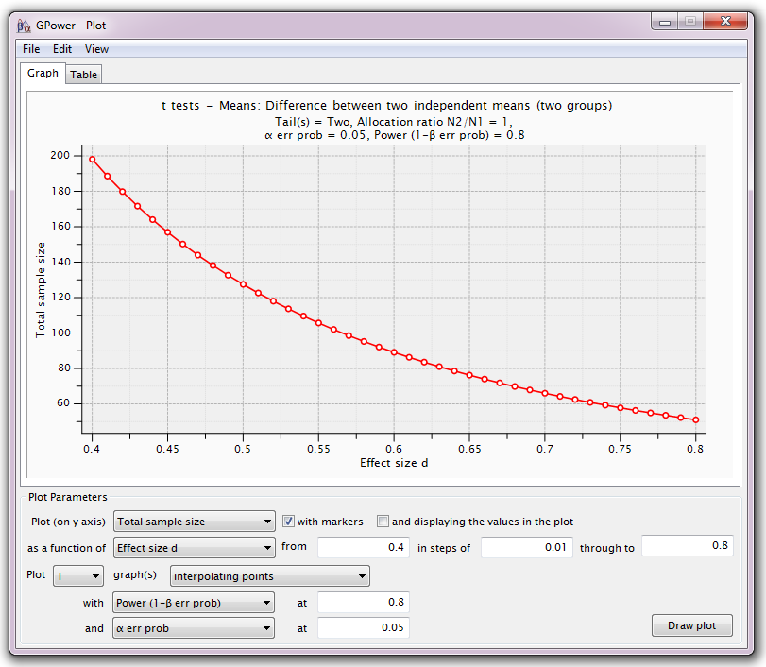
Power Analysis
For a range of sample sizes:

Slide 70
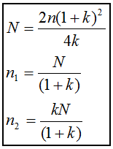
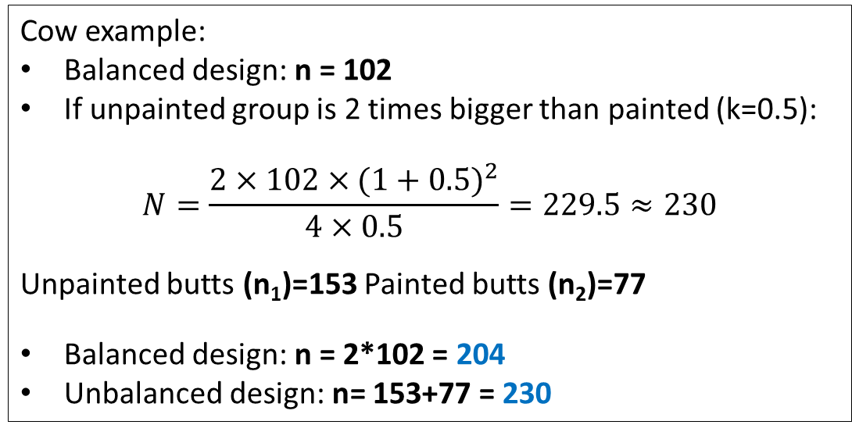
Unequal sample sizes
No simple trade-off – if need 2 groups of 30 → 20 and 40 = decreased power
Unbalanced design = bigger total sample
Solution 1 (old school):
Step 1: power calculation for equal sample size
Step 2: adjustment
Cow example:
Balanced design: n = 102
If unpainted group is 2 times bigger than painted (k=0.5):
$$N=\frac{2×102×{(1+0.5)}^{2}}{4×0.5}=229.5≈230$$
Unpainted butts (n₁)=153 Painted butts (n₂)=77
Balanced design: n = 2*102 = 204
Unbalanced design: n= 153+77 = 230
Where:
N = total sample size in unbalanced design
n = sample size per group in balanced design
n₁ = group 1 size
n₂ = group 2 size
k = ratio n₂/n₁

Slide 71
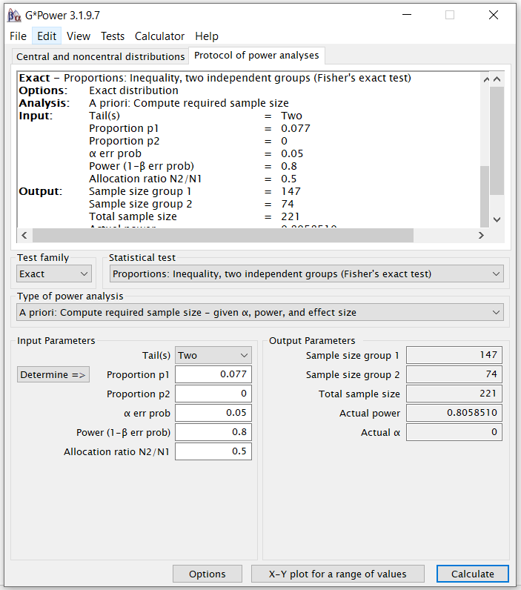
Unequal sample sizes
Solution 2:
Use G*Power
Different methods give slightly different sample sizes:
Using adjustment
Painted (n₁) = 77
Unpainted (n₂) = 153
Total sample = 230
Using G*Power:
Painted (n₂) = 74
Unpainted (n₁) = 147
Total sample = 221
Also consider anything else that might impact final numbers, e.g. if likely to lose some samples during experiment

Slide 72
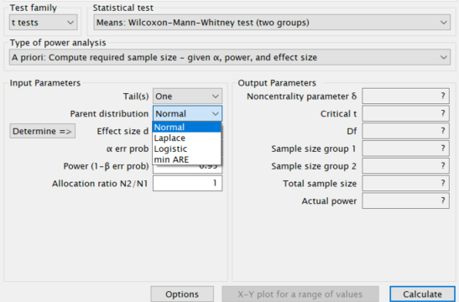
Non-parametric tests
Do not assume data come from a Gaussian/normal distribution
Based on ranking values from low to high
Almost always less powerful
Proper power calculations need to specify which kind of distribution we are dealing with – not easy
Non-parametric usually do not require more than 15% additional subjects compared to parametric
Crude rule of thumb:
Compute sample size required for a parametric test and add 15%

Slide 73
What happens if we ignore the power of a test?
Misinterpretation of the results
Never ever interpret p-values without context!
Significant p-value (<0.05): but what is the difference?
>= smallest meaningful difference: exciting effect
< smallest meaningful difference: essentially a false positive/type 1 error
Too big sample, overpowered – difference has no biological relevance
Not significant p-value (>0.05): but how big was the sample?
Big enough = enough power: no effect
Not big enough = underpowered: potentially a false negative/type 2 error
Too small sample – potentially miss a meaningful difference

Slide 74
Exercise 1

Slide 75
Descriptive Stats and Data Exploration Hayley Carr & Anne Segonds-Pichon v2024-05

Slide 76
Question
Data Collection/Storage
Data Exploration
Data Analysis
Results
Experiment
Sample Size
Experimental Design

Slide 77
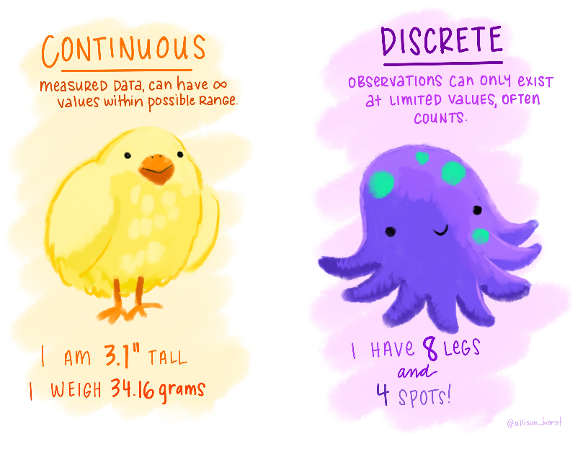
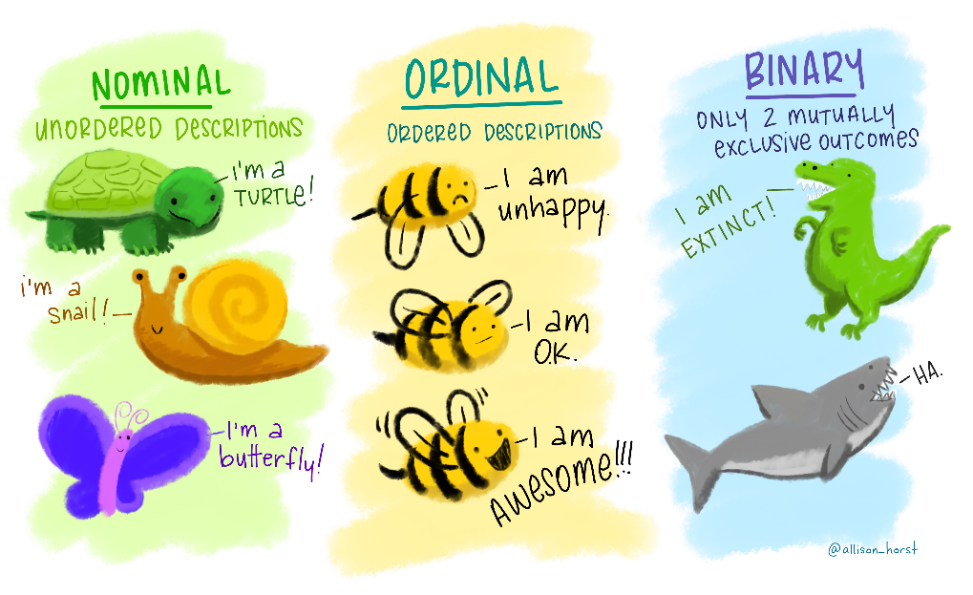
Variable
Quantitative
Qualitative
Nominal
Continuous
Discrete
Ordinal
Binary
https://github.com/allisonhorst/stats-illustrations#other-stats-artwork

Slide 78
Variable
Quantitative
Qualitative
Nominal
Continuous
Discrete
Ordinal
Binary
https://github.com/allisonhorst/stats-illustrations#other-stats-artwork

Slide 79

Quantitative data
They take numerical values (units of measurement)
Discrete: obtained by counting
Example: number of students in a class
values vary by finite specific steps
Continuous: obtained by measuring
Example: height of students in a class
any values – can have decimal places
They can be described by a series of parameters:
Mean, variance, standard deviation, standard error and confidence interval
https://github.com/allisonhorst/stats-illustrations#other-stats-artwork

Slide 80
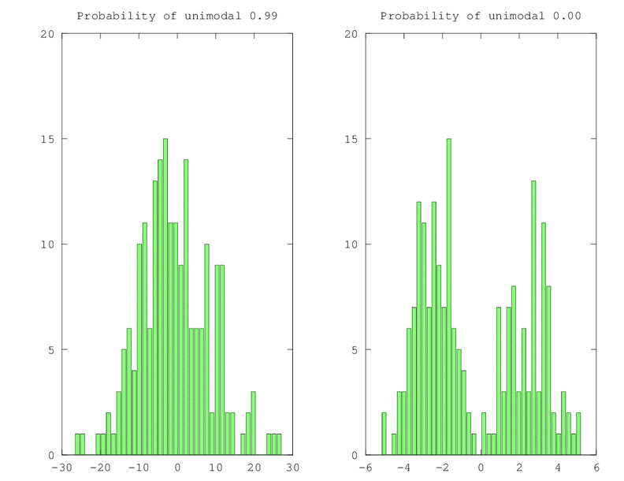

Measures of central tendency Mode and Median
Mode: most commonly occurring value in a distribution
Median: value exactly in the middle of an ordered set of numbers

Slide 81
Measures of central tendency Mean
Definition: average of all values in a column
Example: mean of: 1, 2, 3, 3 and 4 = (1+2+3+3+4)/5 = 2.6
The mean is a model because it summaries the data
How do we know that it is an accurate model?
Difference between the real data and the model created

Slide 82
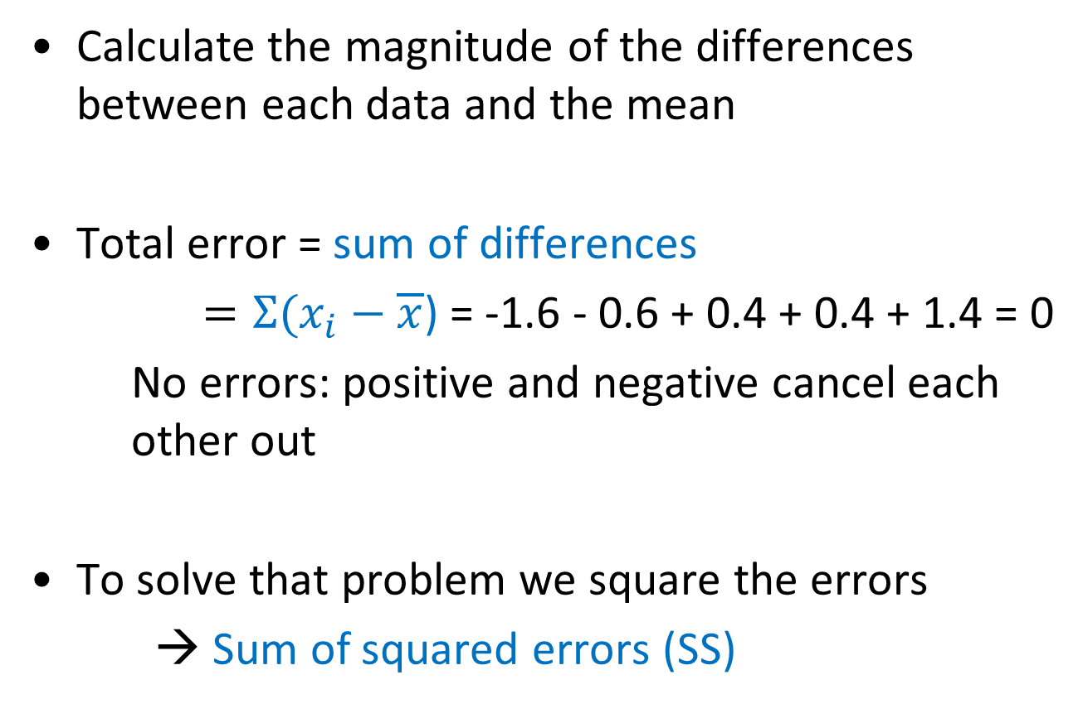
Measures of dispersion
Calculate the magnitude of the differences between each data and the mean
Total error = sum of differences
$=Σ(x_{i}−\overline{x}$) = -1.6 - 0.6 + 0.4 + 0.4 + 1.4 = 0
No errors: positive and negative cancel each other out
To solve that problem we square the errors
→ Sum of squared errors (SS)

Slide 83
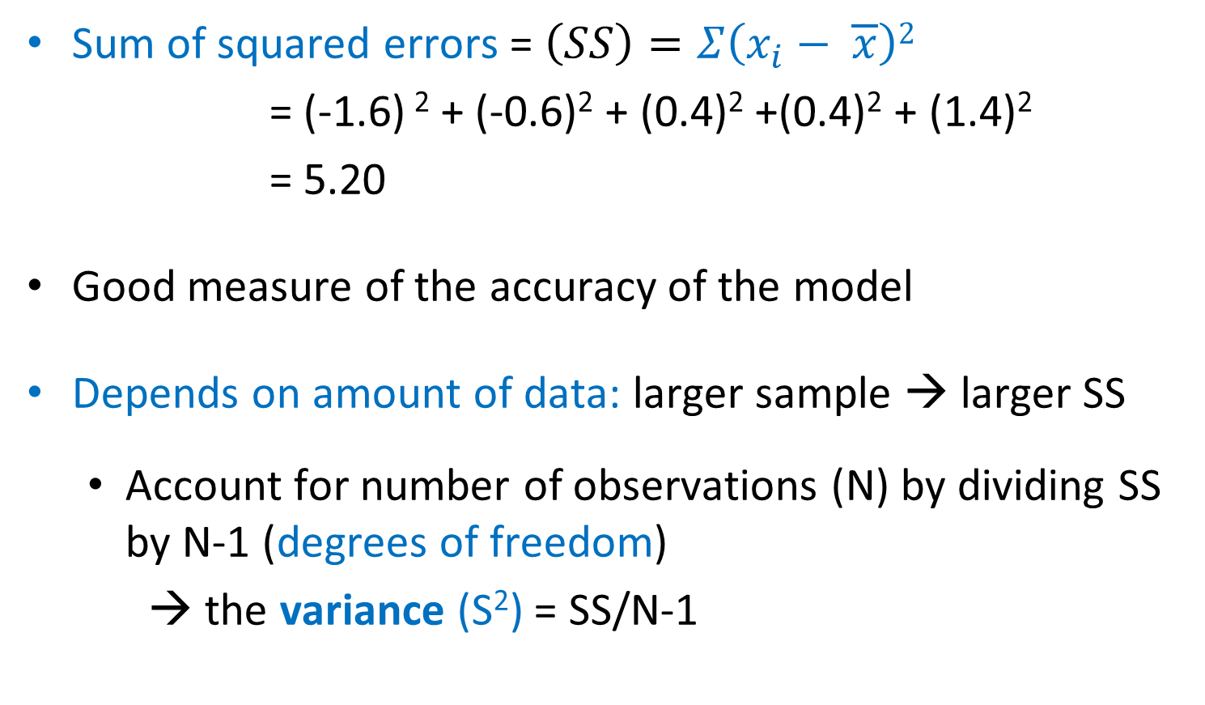
Sum of Squared errors (SS)
Sum of squared errors = $\left(SS\right)=Σ\left(x_{i}− \overline{x}\right)2$
= (-1.6) ² + (-0.6)² + (0.4)² +(0.4)² + (1.4)²
= 5.20
Good measure of the accuracy of the model
Depends on amount of data: larger sample → larger SS
Account for number of observations (N) by dividing SS by N-1 (degrees of freedom)
→ the variance (S²) = SS/N-1

Slide 84
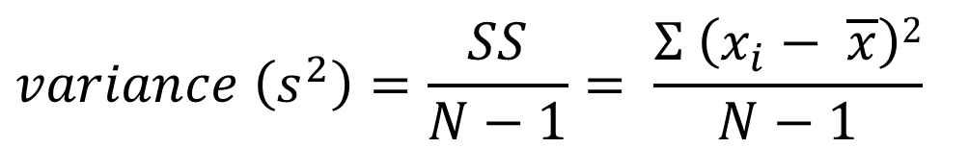
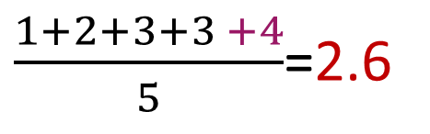

Degrees of freedom
$$variance \left(s^{2}\right)=\frac{SS}{N−1}= \frac{Σ \left(x_{i}− \overline{x}\right)2}{N−1}$$
To calculate the variance, we need the mean
If we know the mean, we do not need all the values in the sample to calculate the variance
Example: Sample: n = 5, Mean ($\overline{x}$) = 2.6
2.6 x 5 – (1+2+3+3) = 4
Once we know the mean, we only need to know the first 4 numbers (N-1) and we can calculate the last number
$\frac{1+2+3+3 +4}{5}$=2.6

Slide 85

Degrees of freedom
The last (n^{th}) value in the sample is no longer independent, is not free.
Because we know the mean, the variance does not depend on all of the values of the sample, only on n-1 of the values
$$variance \left(s^{2}\right)=\frac{SS}{N−1}= \frac{Σ \left(x_{i}− \overline{x}\right)2}{N−1}$$
n – 1 degrees of freedom
Notes:
Example: Dessert analogy:
Imagine your roommate has a sweet tooth, so she’s thrilled to discover that your college cafeteria offers seven dessert options. One week, she decides that she wants to have a different dessert every day.
By deciding to have a different dessert every day, your roommate is imposing a restriction on her dessert choices.
On Monday, she can choose any of the seven desserts. On Tuesday, she can choose any of the six remaining dessert options. On Wednesday, she can choose any of the five remaining options, and so on.
By Sunday, she’s had all the dessert options except one. She doesn’t have any choice to make on Sunday since there’s only one option remaining.
Due to her restriction, your roommate could only choose her dessert on six of the seven days. Her dessert choice was free to vary on these six day. In contrast, her dessert choice on the last day wasn’t free to vary; it depended on her dessert choices of the previous six days.

Slide 86

Variance and standard deviation
$variance \left(s^{2}\right)=\frac{SS}{N−1}= \frac{Σ \left(x_{i}− \overline{x}\right)2}{N−1}= \frac{5.20}{4}=1.3$
Problem with variance: in squared units
Take the square root to get the same unit as the original measure
→ the standard deviation
S.D. = √(SS/N-1) = √(s²) = s $= \sqrt{1.3}=1.14$
SD = a measure of how well the mean represents the data.

Slide 87
Standard deviation
S.D.=0.5
S.D.=3.5
Small S.D.
data close to the mean:
good fit of the data
Large S.D.
data distant from the mean:
not an accurate representation

Slide 88
Standard Deviation (SD) or Standard Error Mean (SEM)?
Smaller error bars
SD
SEM

Slide 89
Standard Deviation
The SD quantifies how much the values vary from one another
→ scatter or spread
Does not change predictably as you acquire more data

Slide 90

Standard Error of the Mean
SEM$=\frac{SD}{\sqrt{N}}$
The SEM quantifies how accurately we know the true mean of the population
Takes into account: SD + sample size
Make inferences about the population
The SEM gets smaller as the sample gets larger
Mean of a large sample likely closer to true mean than mean of a small sample

Slide 91

The SEM and the sample size
n=3
Small samples (n=3)
Theoretical ‘infinite’ number of experiments
Samples means = $\overline{x}$
Sample
n=30
Big samples (n=30)
Population
Sample

Slide 92

SD or SEM ?
Whichever you choose make sure to report it accurately!
If we want to show the variation among values:
→ Report the SD
If we want to show how precisely we have determined the population mean:
→ Report the SEM
Preferably show all data points and the SEM
→ Both variation and precision
Mean + SEM
https://lymielynn.medium.com/a-little-closer-to-cooks-distance-e8cc923a3250

Slide 93


Confidence interval
Range of values that we can be 95% confident contains the true mean of the population
Limits of 95% CI: [Mean - 1.96*SEM; Mean + 1.96*SEM] (SEM = SD/√N)
On average 19/20 experiments include the population mean
Proportion of values
-1.96*SEM Mean +1.96*SEM
On either side of the mean
https://statisticsbyjim.com/hypothesis-testing/confidence-interval/

Slide 94

To recap
The Standard Deviation is descriptive
Just about the sample
The Standard Error and the Confidence Interval are inferential
Sample → General Population
Statistical tests are also inferential

Slide 95
Question
Data Collection/Storage
Data Exploration
Data Analysis
Results
Experiment
Sample Size
Experimental Design

Slide 96

Quantitative data: Scatterplot

Slide 97


Quantitative data: Scatterplot/stripchart
Small sample
Big sample

Slide 98


Quantitative data: Boxplot
‘Extreme’ outliers
‘Normal’ outliers
https://www.researchgate.net/publication/328818609_Outcomes_and_features_of_the_inspection_of_receiver_tubes_ITR_system_for_improved_OM_in_parabolic_trough_plants

Slide 99


Quantitative data: Boxplot or Beanplot (aka Violinplot)
Scatterplot shows individual data
A bean= a ‘batch’ of data
Bimodal
Uniform
Normal
Distributions
Data density mirrored by the shape of the polygon

Slide 100

Quantitative data:
Boxplot and Violinplot and Scatterplot

Slide 101


Quantitative data: Histogram
Big sample
Small sample

Slide 102


Quantitative data: Histogram (distribution)

Slide 103


Data exploration $≠$ plotting data
https://github.com/allisonhorst/stats-illustrations#other-stats-artwork

Slide 104
Plotting is not inherently the same thing as exploring
One experiment: change in the variable of interest between CondA to CondB.
Data plotted as a bar chart.

Slide 105
Plotting is not inherently the same thing as exploring
Five experiments: change in the variable of interest between 3 treatments and a control.
Data plotted as a bar chart.
Comparisons:
Treatments vs. Control
p=0.001
p=0.04
Exp5
Exp4
p=0.32
Exp3
Exp1
Exp2

Slide 106
Plotting is not inherently the same thing as exploring
Five experiments: change in the variable of interest between 3 treatments and a control.
Data plotted as a bar chart.
Comparisons:
Treatments vs. Control
p=0.001
p=0.04
Exp5
Exp4
p=0.32
Exp3
Exp1
Exp2

Slide 107

Plotting is not inherently the same thing as exploring
Four experiments: Before-After treatment effect on a variable of interest.
Hypothesis: Applying a treatment will decrease the levels of the variable of interest.
Data plotted as a bar chart.
Exp2
Exp1
Exp3
Exp4

Slide 108
Data exploration $≠$ plotting data
https://github.com/allisonhorst/stats-illustrations#other-stats-artwork

Slide 109
Key concepts and Assumptions Analysis of Quantitative data Choice of a statistical test Hayley Carr & Anne Segonds-Pichon v2024-05

Slide 110
The null hypothesis and error types
The null hypothesis (H₀): H₀ = no effect
The aim of a statistical test is to reject or not H_{0.}
High specificity = low False Positives = low Type I error
High sensitivity = low False Negatives = low Type II error
Statistical decision | True state of H₀
 | H₀ true (no effect) | H₀ false (effect)
Reject H₀ | Type I error α False positive | Correct True positive
Do not reject H₀ | Correct True negative | Type II error β False negative
https://github.com/allisonhorst/stats-illustrations#other-stats-artwork

Slide 111


Sample
Statistical inference
Population
Difference
Is it meaningful?
Is it real?
Statistical test
Difference
Variation
Result
Is difference big enough?
Sample size
Statistic (t, F, …)
Determined scientifically
Significance

Slide 112
Signal-to-noise ratio
Stats are all about understanding and controlling variation
The ratio of signal to noise determines the significance
Statistical test
Difference
Variation
Sample size
Difference (signal)
Variation (noise)
If the noise (interindividual variation) is low then the signal is detectable
→ statistical significance
Signal
Signal
If the noise is large the same signal will not be detected
→ no statistical significance
Noise
Noise

Slide 113
Choice of a statistical test
There are many statistical tests. Which one we use depends on:
What we want to do
The questions asked
Correct statistical test to answer our questions
What sort of data we have
The type and behaviour
Correct statistical family
There are 2 families of statistical tests:
Parametric tests with 4 assumptions to be met
Non-parametric tests with no or few assumptions and/or for qualitative data

Slide 114

Assumptions of Parametric Data
What sort of data we have
All parametric tests have 4 basic assumptions that must be met for the test to be accurate.
First assumption: Normality
Normal shape, bell shape, Gaussian shape

Slide 115



Assumptions of Parametric Data
What sort of data we have
Frequent departures from normality:
Skewness: lack of symmetry of a distribution
Kurtosis: measure of the degree of ‘peakedness’
Same variance and same skew but differ markedly in kurtosis
Skewness < 0
Skewness = 0
Skewness > 0
More peaked distribution:
kurtosis > 0
Flatter distribution:
kurtosis < 0

Slide 116
Assumptions of Parametric Data
What sort of data we have
Second assumption: Homoscedasticity (Homogeneity in variance)
The variance should not change systematically throughout the data
Third assumption: Interval data (linearity)
The distance between points of the scale should be equal at all parts along the scale
Fourth assumption: Independence
Data from different subjects are independent
Each data point in the sample is independent from all the others = Values corresponding to one subject do not influence the values corresponding to another subject
Important in repeated measures experiments

Slide 117
Non-parametric tests
General principle: original data are transformed into ranks
Not meeting the assumptions for parametric tests is not enough to switch to a non-parametric approach
Data exploration is key:
Outliers?
Possible transformation?
Parametric with corrections?
If outcome is a rank or a score with limited possible values: often non-parametric approach

Slide 118
Choice of a statistical test
Start
Differences?
Correlation?
Categories?
How many factors?
Two or more
One
Two-way ANOVA, General Linear (Mixed) Model, etc.
Same or different subjects?
Same
Parametric
Paired T test/repeated ANOVA
Non-parametric
Wilcoxon paired test
Different
Parametric
Non-parametric
T-test/ANOVA
Mann-Whitney U test
Parametric
Pearson Correlation
Non-parametric
Spearman Rank Correlation
2x2 table
Fisher’s Exact test
>2x2 table
Chi Square test

Slide 119
Choice of a statistical test
Are the mice in group A heavier than those in group B?
Start
Differences?
Correlation?
Categories?
How many factors?
Two or more
One
Two-way ANOVA, General Linear (Mixed) Model, etc.
Same or different subjects?
Same
Parametric
Paired T test/repeated ANOVA
Non-parametric
Wilcoxon paired test
Different
Parametric
Non-parametric
T-test/ANOVA
Mann-Whitney U test
Parametric
Pearson Correlation
Non-parametric
Spearman Rank Correlation
2x2 table
Fisher’s Exact test
>2x2 table
Chi Square test

Slide 120
Analysis of Quantitative data Student’s t-test Hayley Carr & Anne Segonds-Pichon v2023-09

Slide 121

Comparison between 2 groups Student’s t-test
Basic idea:
Comparison between 2 means accounting for variability
Absolute difference vs. variability
Control group mean
Treatment group mean

Slide 122
Variability does matter
Medium variability
High variability
Low variability

Slide 123



Variability does matter

Slide 124


Signal-to-noise ratio
Signal
= statistical significance
Difference (signal)
Noise
Variation (noise)
Signal
= no statistical significance
Noise

Slide 125
Student’s t-test
Signal
=
Difference between group means
Noise
Variability of groups
$$\frac{{\overline{x}}_{1}−{\overline{x}}_{2}}{\sqrt{s^{2}(\frac{1}{n_{1}}+\frac{1}{n_{2}})}}$$
=
Basically the combination of the 2 SEM
=
t-value

Slide 126
Student’s t-test
3 types, depending on experimental design
Independent t-test
Difference between 2 means of one variable for two independent groups
Paired t-test
Difference between two measures of one variable for one group
One-Sample t-test
Difference between the mean of a single variable and a specified constant
One experiment
Control
Treatment
4 different mice
4 different mice
Before
Same mouse
After
Mouse 1
Mouse 2
Mouse 3

Slide 127
Example: coyotes.xlsx
Do male and female coyotes differ in size?
The file contains individual body length of male and female coyotes.
Steps:
Data exploration
Check the assumptions for parametric test
Statistical analysis: Independent t-test

Slide 128

Data exploration
coyotes.xlsx
Do male and female coyotes differ in size?
Load in and explore the data

Slide 129
Exercise: Exploring data - Answers

Slide 130




Checking normality assumption with formal tests
Normality ☑

Slide 131
Checking normality assumption with a QQ plot
Same mean
Same SD
Same sample size
BUT
perfectly normal distribution
= Quantile – Quantile plot
Fake coyotes
Normality ☑
Our coyotes

Slide 132




Student’s t-test with Prism
Males
Females
Male 1
Female 1
Male 2
Female 2
Male 3
Female 3
Could also be
4 independent experiments
Male 4
Female 4
WT 1
KO 1
WT 2
KO 2
Young
Older
WT 3
KO 3
WT 4
KO 4
Normality
Male 1
Length 1
Length 2
Male 2
Length 1
Length 2
Equal variance
Male 3
Length 1
Length 2
Male 4
Length 1
Length 2

Slide 133



Student’s t-test: Residuals
Yet another way to check
it’s the right approach
Have a go!

Slide 134


Independent t-test: Results
Normality ☑
Homogeneity in variance ☑

Slide 135


Independent t-test: Results
The old-fashion way
t = 1.641 < 1.984: not significant
Critical value
What about power?

Slide 136

Independent t-test: Results
Males tend to be longer than females but not significantly so (p=0.1045).

Slide 137



Power analysis
You would need a sample 3 times bigger to reach the accepted power of 80%
But is a 2.3 cm difference between sexes biologically relevant (<3%) ?

Slide 138
Exercise 2

Slide 139
Analysis of Quantitative data One-Way ANOVA Hayley Carr & Anne Segonds-Pichon v2024-05

Slide 140
Analysis of Quantitative data One-Way + Two-Way ANOVA
One-way ANOVA
Independent design
Repeated measures design
Two-way ANOVA (two factors/predictors)
Tests each factor and interactions between them
Independent design
Repeated measures design (time series)

Slide 141
Comparison between more than 2 groups
One factor = One predictor
One-Way ANOVA

Slide 142
Signal-to-noise ratio
Signal
= statistical significance
Difference (signal)
Noise
Variation (noise)
Signal
= no statistical significance
Noise

Slide 143
Analysis of variance: how does it work?
Signal
=
Difference between the means
Noise
Variability in the groups
=
F ratio
If the variance amongst sample means is greater than the error/random variance, then F>1
In an ANOVA, we test whether F is significantly higher than 1 or not

Slide 144
One-Way Analysis of variance
Step 1: Omnibus test
It tells us if there is a difference between the means but not which means are significantly different from which other ones
Step 2: Post-hoc tests
Tell us if there are differences between the group means pairwise
A correction for multiple comparisons will be applied on the p-values
Should only be used when the ANOVA finds a significant effect

Slide 145
Analysis of variance: how does it work?
Source of variation | Sum of Squares | df | Mean Square | F | p-value
Between Groups | 18.1 | 4 | 4.5 | 6.32 | 0.0002
Within Groups | 51.8 | 73 | 0.71
Total | 69.9

Slide 146
Analysis of variance: how does it work?
grand mean
78 differences: $\sum_{1}^{78}{\text{(}{value}_{n}\text{ – }\text{grand} \text{mean}\text{)}2 }$
=
Sum of squared errors
Source of variation | Sum of Squares | df | Mean Square | F | p-value
Between Groups
Within Groups
Total | 69.9

Slide 147
Analysis of variance: how does it work?
grand mean
5 differences: $\sum_{1}^{5}{\text{(}{mean}_{n}\text{ – }\text{grand} \text{mean}\text{)}2 }$
=
Sum of squared errors
Between the groups
Source of variation | Sum of Squares | df | Mean Square | F | p-value
Between Groups | 18.1
Within Groups
Total | 69.9

Slide 148
Analysis of variance: how does it work?
grand mean
group mean
78 differences: $\sum_{1}^{78}{\text{(}\text{value}\text{n}\text{ –} \text{group} \text{mean}\text{)}2}$
=
Sum of squared errors
Within the Groups
Source of variation | Sum of Squares | df | Mean Squares | F | p-value
Between Groups | 18.1
Within Groups | 51.8
Total | 69.9

Slide 149
Analysis of variance: how does it work?
Source of variation | Sum of Squares | df | Mean Squares | F ratio | p-value
Between Groups | 18.1 | k-1
Within Groups | 51.8 | n-k
Total | 69.9
Signal
Noise
df: degree of freedom with df = n-1
n = number of values, k = number of groups
Between groups: df = 4 (k-1)
Within groups: df = 73 (n-k = n₁-1 + … + n₅-1)

Slide 150
Analysis of variance: how does it work?
Source of variation | Sum of Squares | df | Mean Squares | F ratio | p-value
Between Groups | 18.1 | 4 | 4.5
Within Groups | 51.8 | 73 | 0.71
Total | 69.9
Signal
Noise
df: degree of freedom with df = n-1
18.2/4 = 4.5 51.8/73 = 0.71
Mean squares = Sum of Squares / n-1 = Variance!

Slide 151
Analysis of variance: how does it work?
Source of variation | Sum of Squares | df | Mean Squares | F ratio | p-value
Between Groups | 18.1 | 4 | 4.5 | 6.34 | 0.0002
Within Groups | 51.8 | 73 | 0.71
Total | 69.9
Mean squares = Sum of Squares / n-1 = Variance
Variance between the groups
Variance within the groups (individual variability)
4.5
0.71
F ratio =
=
= 6.34

Slide 152
One-Way Analysis of variance
Step 1: Omnibus test
It tells us if there is a difference between the means but not which means are significantly different from which other ones
Step 2: Post-hoc tests
Tell us if there are differences between the group means pairwise
A correction for multiple comparisons will be applied on the p-values
Should only be used when the ANOVA finds a significant effect

Slide 153

Comparison of more than 2 means
Running multiple tests on the same data increases the familywise error rate
= error rate across tests on the same experimental data
One of the basic rules (‘laws’) of probability:
The Multiplicative Rule: The probability of the joint occurrence of 2 or more independent events is the product of the individual probabilities
P(A,B) = P(A) × P(B)
For example:
P(2 heads) = P(head) × P(head) = 0.5 × 0.5 = 0.25

Slide 154
Familywise error rate
Example: All pairwise comparisons between 3 groups A, B and C:
= A-B, A-C and B-C
Probability of making the Type I Error: 5%
→ probability of not making the Type I Error is 95% (= 1 – 0.05)
Multiplicative Rule:
Overall probability of no Type I errors = 0.95*0.95*0.95 = 0.857
Probability of making at least one Type I Error = 1 – 0.857 = 0.143 or 14.3%
Probability has increased from 5% → 14.3%
For comparisons between 5 groups, the familywise error rate is 40% (=1-(0.95)^{n})

Slide 155
Familywise error rate
Solution to increased familywise error rate = correction for multiple comparisons
→ post-hoc tests
Many different approaches:
Different statisticians addressed different issues
e.g. unbalanced design, heterogeneity of variance, liberal vs conservative
Two main ways to address the multiple testing problem:
Familywise Error Rate (FWER) and False Discovery Rate (FDR)
In all cases:
More tests → higher familywise error rate → more stringent correction

Slide 156
Multiple testing problem
Difference between FWER and FDR:
FWER: a p-value of 0.05 implies that 5% of all tests will result in false positives
FDR: an adjusted p-value (or q-value) of 0.05 implies that 5% of significant tests will result in false positives
FWER: Bonferroni: α_{adjust} = 0.05/n comparisons, e.g. 3 comparisons: 0.05/3=0.016
Problem: very conservative leading to loss of power (lots of false negative)
10 comparisons: threshold for significance = 0.05/10 = 0.005
Pairwise comparisons across 20,000 genes = 0.05/20,000 = 2.5x10⁻⁶
FDR: Benjamini-Hochberg: controls the expected proportion of “discoveries” (significant tests) that are false (false positive)
Correction applied only on the significant tests
More power but increased Type I Errors

Slide 157
Repeated measures One-Way ANOVA
A new assumption:
That the variances of the differences between all combinations of related conditions (or group levels) are equal – known as the assumption of sphericity
The Mauchly’s test of sphericity is used to assess whether the assumption of sphericity is met
If the assumption of sphericity is not met, a correction is applied
Often the default as the assumption is seldom met
Most common correction: Greenhouse-Geisser correction

Slide 158
Exercise: One-way ANOVA protein expression.xlsx
Question: is there a difference in protein expression between the 5 cell lines?
1 Plot the data
2 Check the assumptions for parametric test

Slide 160

Parametric tests assumptions

Slide 161


Histogram

Slide 162
Histogram
Auto: bin width = 0.5
Centre 1st = 0
Bin width = 1 Centre 1st = 0.5
Bin width = auto (0.5) Centre 1st = 0.25
Bin width = 2
Centre 1st = 1

Slide 164

Parametric tests assumptions

Slide 165





One-Way ANOVA in Prism
Have a go!

Slide 166

Analysis of variance: Omnibus test
Homogeneity of variance ☑
F=0.6728/0.08282=8.12
Normality ☑

Slide 167

Analysis of variance: Post Hoc tests
Multiple comparisons: Tukey’s correction

Slide 168

Analysis of variance: Post Hoc tests
Multiple comparisons: Bonferroni’s correction

Slide 169
Analysis of variance
Presentation of the results

Slide 170
Exercise 3

Slide 171
Analysis of Quantitative data Two-way ANOVA Hayley Carr & Anne Segonds-Pichon v2023-09

Slide 172
Comparison between more than 2 groups
Two factors = Two predictors
Two-Way ANOVA

Slide 173
Two-way Analysis of Variance (Factorial ANOVA)
Source of variation | Sum of Squares | Df | Mean Square | F | p-value
Variable A * Variable B | 1978 | 2 | 989.1 | F (2, 42) = 11.91 | P < 0.0001
Variable B (Between groups) | 3332 | 2 | 1666 | F (2, 42) = 20.07 | P < 0.0001
Variable A (Between groups) | 168.8 | 1 | 168.8 | F (1, 42) = 2.032 | P = 0.1614
Residuals | 3488 | 42 | 83.04
Source of variation | Sum of Squares | Df | Mean Square | F | p-value
Variable A (Between Groups) | 2.665 | 4 | 0.6663 | 8.42 | <0.0001
Within Groups (Residual) | 5.775 | 73 | 0.0791
Total | 8.44 | 77
One-way ANOVA= 1 predictor variable
2-way ANOVA= 2 predictor variables: A and B
SST
Total variance in the Data
SST
Total variance in the Data
Total
SSM
Variance Explained by the Model
SSR
Unexplained Variance
SSM
Variance Explained by the Model
Between Groups
SSR
Unexplained Variance
Within Groups
SSA
Variance Explained by Variable A
SSB
Variance Explained by Variable B
SSAxB
Variance Explained by the Interaction of A and B

Slide 174
Two-way Analysis of Variance
Interaction plots: Examples
Fake dataset:
2 factors: Genotype (2 levels) and Condition (2 levels)

Slide 175


Two-way Analysis of Variance
Interaction plots: Examples
2 factors: Genotype (2 levels) and Condition (2 levels)
Single Effect
Genotype Effect
Condition Effect

Slide 176


Two-way Analysis of Variance
Interaction plots: Examples
2 factors: Genotype (2 levels) and Condition (2 levels)
Zero or Both Effect
Zero Effect
Both Effect

Slide 177


Two-way Analysis of Variance
Interaction plots: Examples
2 factors: Genotype (2 levels) and Condition (2 levels)
Interaction

Slide 178
Two-way Analysis of Variance
Example: crop.density.csv
Want to know if planting density (1=low density, 2=high density) or fertiliser type (1, 2, or 3) have an impact on crop yield
Three null hypotheses:
No difference in yield for any fertiliser type
No difference in yield for either planting density
Effect of fertiliser type or density on yield does not depend on the effect of the other variable
https://www.scribbr.com/statistics/two-way-anova/

Slide 179



Two-way Analysis of Variance
Excel to Prism

Slide 180
Two-way Analysis of Variance
Main effect of Density
Main effect of Fertiliser
Interaction
between Density and Fertiliser
* Need data in Column format for these graphs

Slide 181






Two-way Analysis of Variance
Have a go!

Slide 182


Two-way Analysis of Variance

Slide 183


Two-way Analysis of Variance

Slide 184

Two-way Analysis of Variance
Quick way to have a look at the interaction

Slide 185
Two-way Analysis of Variance
Quick way to have a look at the interaction

Slide 186
Analysis of Quantitative data Linear and non-linear relationships Hayley Carr & Anne Segonds-Pichon v2024-06

Slide 187
Association between 2 continuous variables
One variable X and One variable Y
One predictor Linear relationship
Correlation and Regression

Slide 188
Signal-to-noise ratio
Signal
= statistical significance
Difference (signal)
Noise
Variation (noise)
Signal
= no statistical significance
Noise

Slide 189
Signal-to-noise ratio and Correlation
Difference (signal)
Variation (noise)
For correlation, signal is similarity of behaviour between variable x and variable y
Similarity
Signal
Coefficient of correlation: r =
=
Variability
Noise
Covariance
Similarity
$$\frac{COV_{xy}}{SD_{x}SD_{y}}$$
r
Variability
Standard Deviation

Slide 190

Correlation
Most widely-used correlation coefficient:
Pearson product-moment correlation coefficient: r
The magnitude and the direction of the relation between 2 variables
Designed to range in value between -1 and +1
Often look for >|0.6|
Coefficient of determination: r²
Gives the proportion of variance in Y that can be explained by X
Helps with the interpretation of r
Basically the effect size
Coefficient (+ve or –ve) | Strength of relationship
0.0 to 0.2 | Negligible
0.2 to 0.4 | Weak
0.4 to 0.7 | Moderate
0.7 to 0.9 | Strong
0.9 to 1.0 | Very strong

Slide 191




Correlation
p = 0.0002
p = 0.04
r = 0.34
r = - 0.83
r² = 0.12
r² = 0.68
Power!!

Slide 192




Coefficient of determination
5 cell lines on protein expression
31%
3%
88%

Slide 193
Coefficient of determination
An illustration: change in sample size
Sample = Power R² does not change but p-value
R² = 3%
R² = 3%
R² = 3%
n=86
n=172
n=258

Slide 194



Coefficient of determination
An illustration: change in variability
Same sample = same power variability R² p-value
R² = 6%
R² = 23%
R² = 71%
n=20
n=20
n=20

Slide 195
Correlation: Assumptions
Pearson correlation is a parametric test for linear relationships
First assumption for parametric test: Normality
Correlation: bivariate Gaussian distribution
Symmetry of the values on either side of the line of best fit.

Slide 196
Correlation and regression
Line of best fit comes from a regression
Correlation: nature and strength of the association
Regression: nature and strength of the association and prediction
Y
x
Correlation = Association
Regression = Prediction
Y = A*X + B

Slide 197

Correlation
treelight.xlsx (conifer)
Amount of light in a tree

Slide 198
Correlation with Prism
Amount of light in a tree

Slide 199



Correlation with Prism
Results
Results
Association
Normality
Strong
Negative
Non-directional
Significant

Slide 200
Correlation with Prism
Amount of light in a tree
r = - 0.85 , p = 0.0003, r² = 72%

Slide 201



Correlation with Prism
(if you also want a line of best fit)
Results
Results
Prediction

Slide 202
Correlation with Prism
Amount of light in a tree
Y = -292.2*X + 5014
r = - 0.85 , p = 0.0003, r² = 72%

Slide 203




Correlation with Prism
(if you also want more options)

Slide 204

Correlation with Prism
(if you also want more options)
Results
Results

Slide 205


Correlation with Prism
If you have more than one group

Slide 206
Exercise 4

Slide 207
Association between 2 continuous variables
One variable X and One variable Y
One predictor Non-linear relationship
Curve fitting

Slide 208


Curve fitting
Dose-response curves
Nonlinear regression
Dose-response experiments typically use 5-10 doses of agonist, equally spaced on a logarithmic scale
Y values are responses
The aim is often to determine the IC50 or the EC50
IC50 (I=Inhibition): concentration of an agonist that provokes a response half way between the maximal (Top) response and the maximally inhibited (Bottom) response
EC50 (E=Effective): concentration that gives half-maximal response

Slide 209

Curve fitting
Example: Inhibition data.xlsx
Step by step analysis and considerations:
1. Choose a Model
2. Choose a Method
3. Compare different conditions

Slide 210

Curve fitting
Example: Inhibition data.xlsx
Step by step analysis and considerations:
1. Choose a Model
not necessary to normalise
should choose it when values defining 0 and 100 are precise
variable slope better if plenty of data points (variable slope or 4 parameters)

Slide 211

Curve fitting
Example: Inhibition data.xlsx
Step by step analysis and considerations:
2. Choose a Method
outliers, fitting method, weighting method and replicates

Slide 212

Curve fitting
Example: Inhibition data.xlsx
Step by step analysis and considerations:
3. Compare different conditions
Diff in parameters
Diff between conditions for one or more parameters
Constraint vs no constraint
Diff between conditions for one or more parameters

Slide 213
Curve fitting
Example: Inhibition data
4. Constrain:
depends on your experiment
depends if your data don’t define the top or the bottom of the curve
5. Initial values:
defaults usually OK unless the fit looks funny
6. Range:
defaults usually OK unless you are not interested in the x-variable full range (i.e. time)
7. Output:
summary table presents same results in a summarised way.
8. Confidence:
calculate and plot confidence intervals

Slide 214

Curve fitting
Example: Inhibition data
9. Diagnostics:
Check for normality
Check Replicates test (heteroscedasticity)
QQ plots
10. Flag:
Only useful if doing lots of curve fits

Slide 215


Curve fitting: Diagnostics
Have a go!

Slide 216








Curve fitting: Results

Slide 217
Curve fitting

Slide 218
Analysis of Quantitative data Non parametric statistics Hayley Carr & Anne Segonds-Pichon v2024-05

Slide 219
Non-parametric tests
General principle: original data are transformed into ranks
Not meeting the assumptions for parametric tests is not enough to switch to a non-parametric approach
Data exploration is key:
Outliers?
Possible transformation?
Parametric with corrections?
If outcome is a rank or a score with limited possible values: often non-parametric approach

Slide 220
Non-parametric tests
General principle: original data are transformed into ranks
Beware of misinterpretation: distribution of the data
Distributions = symmetrical and similar → compares means
Distributions = similar → compares medians
Distributions = not similar → compares distributions (though not always)
A correction is applied when there are ties

Slide 221
Comparison between 2 groups
Non-Parametric data

Slide 222
Comparison between 2 independent groups
Mann-Whitney U test
Non-parametric equivalent of the t-test (and not)
In the case of inequality of variance (violation of the homoscedasticity assumption), the ‘unequal’ version of the t-test is a possibility: Welch’s t-test
For a correct interpretation of the test: Data exploration!
Mann-Whitney U test (Mann–Whitney–Wilcoxon,
Wilcoxon rank-sum test or Wilcoxon–Mann–Whitney)
Wilcoxon: equal sample size
Mann and Whitney: different sample size
Control
Treatment 1
4 different mice
4 different mice

Slide 223

Comparison between 2 independent groups
Mann-Whitney U test
How does the Mann-Whitney U test work?
Real values | Ranks
3 | 1
5 | 2
6 | 3
7 | 4
8 | 5
9 | 6
 | Group 1 | Group 2
 | 2 | 5
 | 4 | 6
 | 1 | 3
Sum | R₁=7 | R₂=14
Group 1 | Group 2
5 | 8
7 | 9
3 | 6
Where:
R = sum of ranks
n = sample size
Statistic of the Mann-Whitney test: U (W)
U₁ = 7-6 = 1 and U₂ = 14-6 = 8
Smallest of the 2 Us: U₁
U1 comparison to critical value + sample size p-value
Control
Treatment 1
4 different mice
4 different mice

Slide 224
Comparison between 2 paired groups
Wilcoxon’s signed-rank test
Same mouse
Before
After
Mouse 1
Non-parametric equivalent of the paired t-test (ish)
Information about the Mann-Whitney test also applies
How does the Wilcoxon’s signed-rank test work?
Mouse 2
2+3=5/2=2.5: average rank
Mouse 3
Before | After | Differences
9 | 3 | -6
7 | 4 | -3
10 | 4 | -6
8 | 5 | -3
5 | 6 | 1
8 | 2 | -6
7 | 7 | 0
9 | 4 | -5
10 | 5 | -5
Abs. Diff. | Ranking | Ranks
0
1 | 1 | 1
3 | 2 | 2.5
3 | 3 | 2.5
5 | 4 | 4.5
5 | 5 | 4.5
6 | 6 | 7
6 | 7 | 7
6 | 8 | 7
 | Negative ranks | Positives ranks
 |  | 1
 | -2.5
 | -2.5
 | -4.5
 | -4.5
 | -7
 | -7
 | -7
Sum | -35 | 1
Statistic of the Wilcoxon’s signed-rank test: Sum of signed ranks = W
Here: W = -35 + 1 = -34
Statistic W + sample size p-value

Slide 225
Comparison between more than 2 groups
One factor
Non-Parametric data

Slide 226
Non-parametric tests
Kruskal-Wallis and Friedman tests
Non-parametric equivalent of the One-Way ANOVA (ish)
Data replaced by ranks
Data exploration
If data represent different distributions: comparison of said distributions
If original data come from similar distributions: comparison of the medians
Kruskal-Wallis: independent measures
Statistic = H
Friedman: repeated measures
Statistic = Q or T1 or FM
Post-hoc test associated with Kruskal-Wallis and Friedman: Dunn’s test
Works pretty much like the Mann-Whitney test

Slide 227
Comparison between more than 2 groups
Independent: Kruskal-Wallis test
Actual values: n=15
Ranks: 15
No | Once | Twice
63 | 0 | 2239
-261 | -652 | 171
-153 | 4724 | 40
-13 | -2 | 1395
965 | 0
 | -86
No | Once | Twice
10 | 7.5 | 14
2 | 1 | 11
3 | 15 | 9
5 | 6 | 13
12 | 7.5
 | 4
32 | 41 | 47
$$H=\left[\frac{12}{n\left(n+1\right)}\sum_{j=1}^{c}{\frac{T_{j}^{2}}{n_{j}}}\right]−3(n+1)$$
$$H=\left[\frac{12}{15\left(15+1\right)}(\frac{{32}^{2}}{5}+\frac{{41}^{2}}{6}+\frac{{47}^{2}}{4})\right]−3\left(15+1\right)=3.868$$
Where:
n = total sample size across all groups
c = number of groups
T_{j} = sum of ranks in the (j^{th}) group
n_{j} = size of the (j^{th}) group
Interpretation of the test: H + degrees of freedom = p-value

Slide 228
Comparison between more than 2 groups
Matched/repeated: Friedman test
Actual values
Ranks
Matched set of values
Violinists | Violin A | Violin B | Violin C
1 | 9 | 7 | 6
2 | 9.5 | 6.5 | 8
3 | 5 | 7 | 4
4 | 7.5 | 7.5 | 6
5 | 9.5 | 5 | 7
6 | 7.5 | 8 | 6.5
7 | 8 | 6 | 6
8 | 7 | 6.5 | 4
9 | 8.5 | 7 | 6.5
10 | 6 | 7 | 3
Violinists | Violin A | Violin B | Violin C
1 | 3 | 2 | 1
2 | 3 | 1 | 2
3 | 2 | 3 | 1
4 | 2.5 | 2.5 | 1
5 | 3 | 1 | 2
6 | 2 | 3 | 1
7 | 3 | 1.5 | 1.5
8 | 3 | 2 | 1
9 | 3 | 2 | 1
10 | 2 | 3 | 1
Sum | R_{A} = 26.5 | R_{B}=21 | R_{C}=12.5
Basic idea: if the sums are very different (here R_{A} R_{B} and R_{C}) the p-value will be small.
$$Q or T1 or FM or F=\left[\frac{12}{N×k×\left(k+1\right)}\right]×{∑R}^{2}−\left[3×N×\left(k+1\right)\right]$$
Where:
N = the number of subjects (violinists)
k = number of groups (violins)
R = sum of ranks in the group (e.g. R_{A})
$$F=\left[\frac{12}{10×3×\left(3+1\right)}\right]×\left[{26.5}^{2}+{21}^{2}+{12.5}^{2}\right]−\left[3×10×\left(3+1\right)\right]$$
$$F=\left[\frac{12}{120}\right]×\left[702.25+441+156.25\right]−120=9.95$$
Interpretation of the test: Q or T1 or FM + df= p-value

Slide 229
Association between 2 continuous variables
Linear relationship
Non-Parametric data

Slide 230
Non-parametric tests
Spearman Correlation Coefficient
Similar concepts as for the other non-parametric tests
ρ (rho) is the equivalent of r and calculated in a similar way
Spearman’s ρ is Pearson’s r applied on ranks
Similarity
$$\frac{COV_{R(x)R(y)}}{SD_{R(x)}SD_{R(y)}}$$
ρ = r_{s}
=
=
Variability

Slide 231
Exercise 5

Slide 232
Analysis of Qualitative data Hayley Carr & Anne Segonds-Pichon v2025-02

Slide 233


Variable
Quantitative
Qualitative
Nominal
Continuous
Discrete
Ordinal
Binary
https://github.com/allisonhorst/stats-illustrations#other-stats-artwork

Slide 234

Qualitative data
Values taken = usually names (also nominal)
e.g. genotypes
Can be numbers but not numerical
e.g. group number = numerical label but not unit of measurement
Qualitative variable with intrinsic order in their categories = ordinal
e.g. low/medium/high
Particular case: qualitative variable with 2 categories: binary or dichotomous
e.g. alive/dead or presence/absence
https://github.com/allisonhorst/stats-illustrations#other-stats-artwork

Slide 235
Comparison between 2 groups
Comparison between 2 proportions
Binary outcome

Slide 236
Chi-square and Fisher’s tests
Chi² is an approximation
Chi² test very easy to calculate by hand but Fisher’s very hard
Often software will not perform a Fisher’s test on tables > 2x2
Fisher’s test more accurate than Chi² test on small samples
Chi² test generally preferable on large samples
Chi² test assumptions:
2x2 table: no expected count <5
Bigger tables: all expected > 1 and no more than 20% < 5

Slide 237
Chi-square test
In a chi-square test, the observed frequencies for two or more groups are compared with expected frequencies by chance
O = Observed frequencies
E = Expected frequencies
$$χ^{2}=\sum{\frac{{(O−E)}^{2}}{E}}$$

Slide 238


Fisher’s exact and Chi² tests
Example: cats and dogs.xlsx
Cats and dogs trained to line dance
2 different rewards: food or affection
Question: Is there a difference between the rewards?
Is there a significant relationship between the 2 variables?
Does the reward significantly affect the likelihood of dancing?
To answer this type of question:
Contingency table
Fisher’s exact or Chi² tests
But first: how many animals do we need?
Power analysis
 | Food | Affection
Dance | ? | ?
No dance | ? | ?

Slide 239
Exercise: Power calculation
Preliminary results from a pilot study: 25% of cats line-danced after having received affection as a reward vs. 70% after having received food
How many cats do we need?

Slide 240

Exercise: Power calculation
Pilot study:
25% of cats line-danced after having received affection as a reward vs. 70% after having received food
Output:
If the values from the pilot study are good predictors and if we use a sample of n=23 for each group, we will achieve a power of 83%

Slide 241
How are the expected frequencies calculated?
Example: expected frequency of cats line dancing after
having received food as a reward
Direct counts approach:
Expected frequency
= (row total)*(column total)/grand total
= 32*32/68 = 15.1
Probability approach: The Multiplicative Rule
Probability of line dancing: 32/68
Probability of receiving food: 32/68
Expected frequency:(32/68)*(32/68)=0.22: 22% of 68 = 15.1
Observed frequencies
 | Food | Affection | Total
Dance | 26 | 6 | 32
No dance | 6 | 30 | 36
Total | 32 | 36 | 68
Expected frequencies
 | Food | Affection
Dance | 15.1 | 16.9
No dance | 16.9 | 19.1

Slide 242
Chi² test
$$χ^{2}=\sum{\frac{{(O−E)}^{2}}{E}}$$
Observed frequencies
Expected frequencies
 | Food | Affection
Dance | 26 | 6
No dance | 6 | 30
 | Food | Affection
Dance | 15.1 | 16.9
No dance | 16.9 | 19.1
Chi² = (26-15.1)²/15.1 + (6-16.9)²/16.9 + (6-16.9)² /16.9 + (30-19.1)²/19.1 = 28.4
Is 28.4 big enough for the test to be significant?

Slide 243


Is 28.4 big enough for the test to be significant?
The old fashion way
Degree of freedom: df
df = (row-1)(col-1)=1
Critical value
χ² = 28.4 > 3.84 so Yes!

Slide 244


Fisher’s exact and Chi² tests with Prism
Classic
effect size
2x2 tables
bigger tables

Slide 245


Fisher’s exact and Chi² tests
Results: Cats
Degree of freedom: df
df = (row-1)(col-1)=1
Odds of dancing on Food group = 26/6
Odds of dancing on Affection group = 6/30
O.R. = ratio of the odds = 26/6/6/30 = 21.7
Odds Ratio = 21.7
If you are a dancing cat, you are almost 22 times more likely to have received food than affection as a reward (p<0.0001).

Slide 246
Exercise 6

Slide 247
Decision trees & resources Hayley Carr

Slide 248
Choosing a test: Flow charts

Slide 249

Start
Differences?
Correlation?
Parametric
Categories?
How many factors?
Two or more
One
2 way ANOVA, General Linear (Mixed) Model, etc.
Same or different subjects?
Parametric
Non-Parametric
Pearson Correlation
Spearman Rank Correlation
Chi Squared Fisher’s exact
Same
Different
Non-Parametric
Parametric
Paired t-test / repeated ANOVA
Wilcoxon paired test
Non-Parametric
Parametric
T-test / ANOVA
Mann Whitney U test
Statistics Decision tree
Anne Segonds-Pichon

Slide 250
Statistics Decision tree
Anne Segonds-Pichon
Start
Differences?
Correlation?
Parametric
Categories?
How many factors?
Two or more
One
2 way ANOVA, General Linear (Mixed) Model, etc.
Same or different subjects?
Parametric
Non-Parametric
Pearson Correlation
Spearman Rank Correlation
Chi Squared test
Same
Different
Non-Parametric
Parametric
Paired t-test / repeated ANOVA
Wilcoxon paired test
Non-Parametric
Parametric
Mann Whitney U test
Student t-test
ANOVA
Is there a difference between males and females coyotes in the body length?
Difference between the 2 conditions
One factor: Sex (2 levels)
2 different samples:
Males and Females
Normality
Homogeneity of variance:
Body length (cm)
That’s the one!

Slide 251
Start
Differences?
Correlation?
Categories?
How many factors?
Two or more
One
Two-way ANOVA, General Linear (Mixed) Model, etc.
Same or different subjects?
Same
Parametric
Paired T test/repeated ANOVA
Non-parametric
Wilcoxon paired test
Different
Parametric
Non-parametric
T-test/ANOVA
Mann-Whitney U test
Parametric
Pearson Correlation
Non-parametric
Spearman Rank Correlation
2x2 table
Fisher’s Exact test
>2x2 table
Chi Square test

Slide 252

Choosing a test: Flow charts

Slide 253

Choosing a test: Flow charts
https://statsandr.com/blog/what-statistical-test-should-i-do/
Notes:
Determine sample size required to detect an effect if one exists with high probability
Sufficient power reduces type II errors (false negatives)
Most ‘thought about’ statistical tests reduce type I errors (false positives)
Type I errors are typically more stringently controlled for – 0.05 significance level, 5% chance of incorrectly accepting the alternate hypothesis
Recommended power = 0.80, 80% chance of detecting the effect, if there is one

Slide 254




Statistics resources
Hayley Carr (i.e. me!):
hayley.carr@babraham.ac.uk
https://www.graphpad.com/guides/prism/latest/statistics/index.htm
https://www.nature.com/collections/qghhqm
Not always the friendliest, but covers lots of relevant topics

Slide 255
Exercise 7

Slide 256



Help us improve!
FEEDBACK FORM
What did you think of this training?
Thanks for letting us know in this short 10 question evaluation form
https://forms.office.com/e/tK16t77Jbd

Slide 257

COURSE DATES
FEEDBACK FORM
Did You Know...
We develop and deliver a wide range of Bioinformatics, Statistics and Scientific Research training courses
bioinformatics.babraham.ac.uk/training.html

