Slide 1


Analysis of Quantitative data
Student’s t-test
Anne Segonds-Pichon v2020-08

Slide 2
Comparison between 2 groups

Slide 3
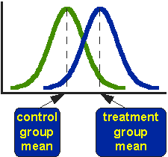
Comparison between 2 groups:
Student’s t-test
Basic idea:
  When we are looking at the differences between scores for 2 groups, we have to judge the difference between their means relative to the spread or variability of their scores.
    Eg: comparison of 2 groups: control and treatment

Slide 4


Variability does matter
Absolute difference
Absolute difference
Scatter plot
Bar chart
Notes:
Smaller variability more likely that the difference is significant case b it’s going to be difficult you nee A LOT of data

Slide 5
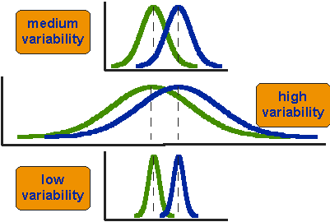
Student’s t-test
Notes:
Smaller variability more likely that the difference is significant case b it’s going to be difficult you nee A LOT of data

Slide 6
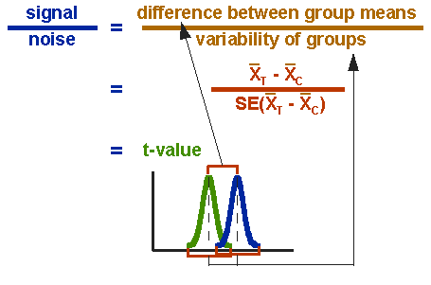
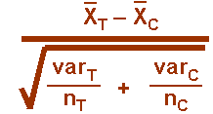
Student’s t-test

Slide 7
~ 4.5 x SEM: p~0.01
~ 2 x SEM: p~0.05
n = 3
~ 2 x SEM: p~0.01
~ 1 x SEM: p~0.05
n = 10

Slide 8
Student’s t-test
  Independent t-test
    Difference between 2 means of one variable for two independent groups
      Example: difference in weight between WT and KO mice
  Paired t-test
    Difference between two measures of one variable for one group:
      Example: before-after measurements
        the second ‘sample’ of values comes from the same subjects (mouse, petri dish …).
      Importance of experimental design!
  One-Sample t-test
    Difference between the mean of a single variable and a specified constant.
Notes:
WT vs mutant, totally independent
Time 0 then treatment and look at time 1: look difference in one group in difference condition

Slide 9
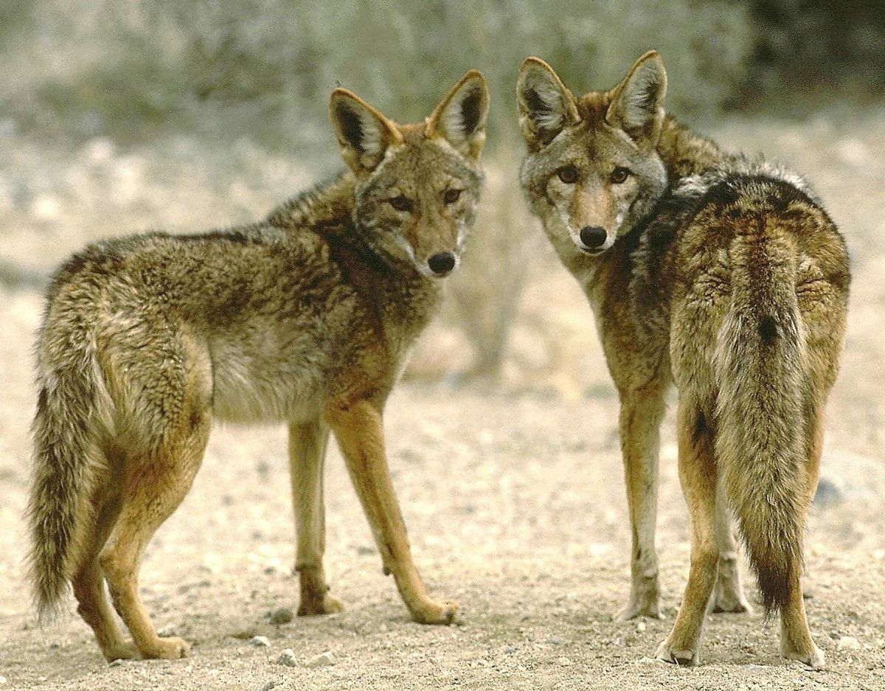
Example: coyotes.xlsx
Question: do male and female coyotes differ in size?
Sample size
Data exploration
Check the assumptions for parametric test
Statistical analysis: Independent t-test

Slide 10
Exercise: Power analysis
Example case:
No data from a pilot study but we have found some information in the literature.
In a study run in similar conditions as in the one we intend to run, male coyotes were found to measure: 92cm+/- 7cm (SD).
We expect a 5% difference between genders.
smallest biologically meaningful difference

Slide 11
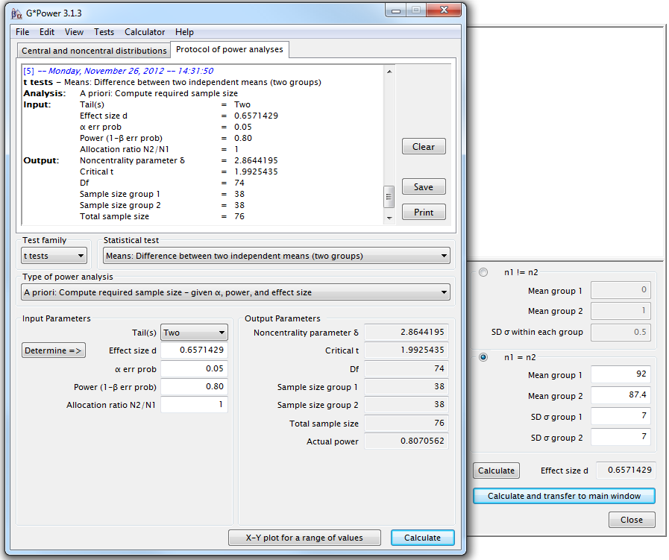
G*Power
Independent t-test
A priori Power analysis
Example case:
You don’t have data from a pilot study but you have found some information in the literature.
In a study run in similar conditions to the one you intend to run, male coyotes were found to measure:
92cm+/- 7cm (SD)
You expect a 5% difference between genders with a similar variability in the female sample.
You need a sample size of n=76 (2*38)

Slide 12
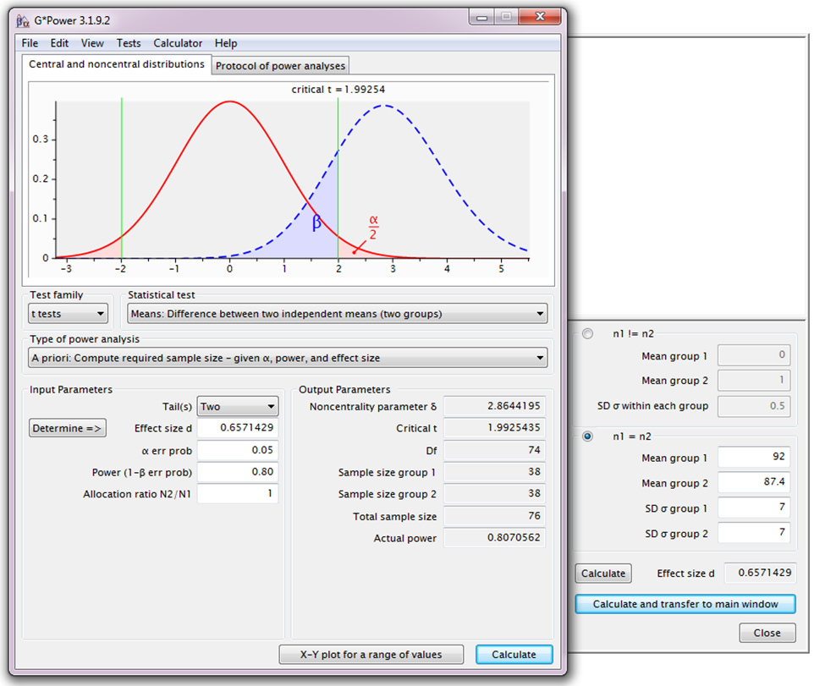
Power Analysis
H₀
H₁

Slide 13
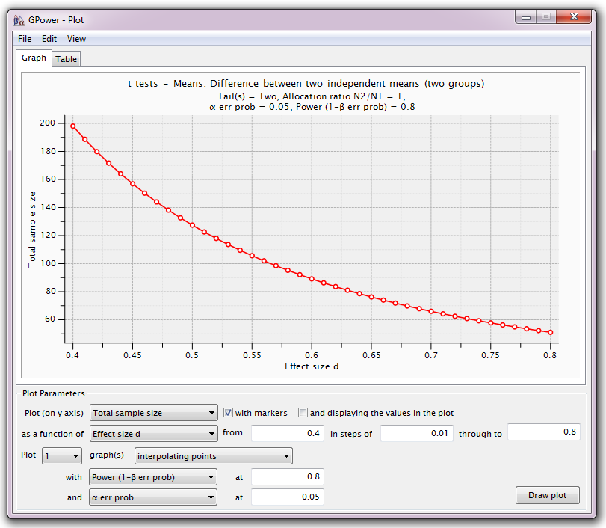
Power Analysis
For a range of sample sizes:

Slide 14

Data exploration $≠$ plotting data

Slide 15
Exercise: Data exploration
coyotes.xlsx
The file contains individual body length of male and female coyotes.
Question: do male and female coyotes differ in size?
  Plot the data as stripchart, boxplot and violinplot

Slide 16
Exercise: Exploring data - Answers

Slide 17
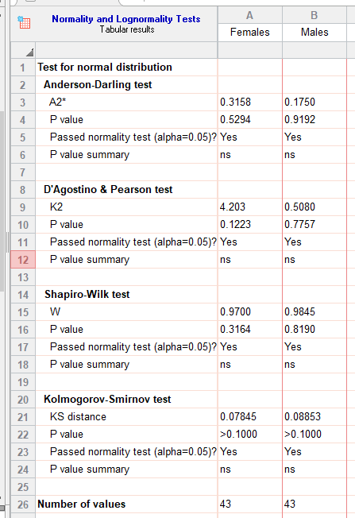
Assumptions for parametric tests
Normality ☑

Slide 18
Normality assumption
Same mean
Same SD
Same sample size
BUT
perfectly normal distribution
= Quantile – Quantile plot
Fake coyotes
Our coyotes

Slide 19
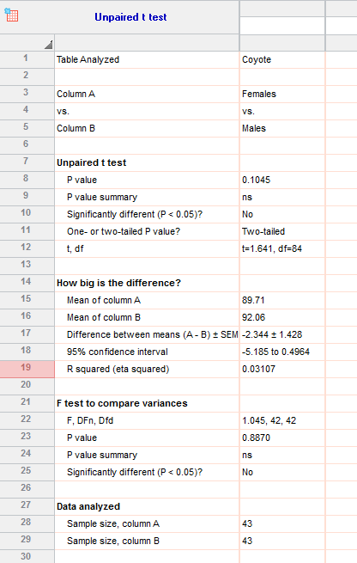
Independent t-test: results
Males tend to be longer than females
but not significantly so (p=0.1045)
Homogeneity in variance ☑

Slide 20
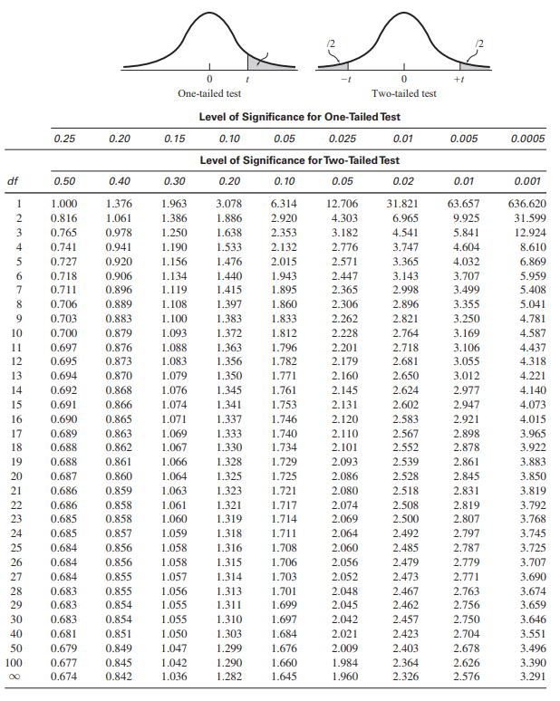
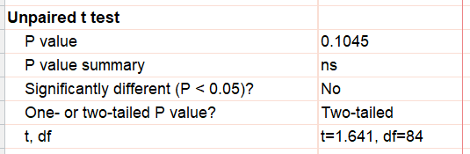
Independent t-test: results
The old-fashion way
t = 1.641 < 1.984: not significant
Critical value
What about power?

Slide 21
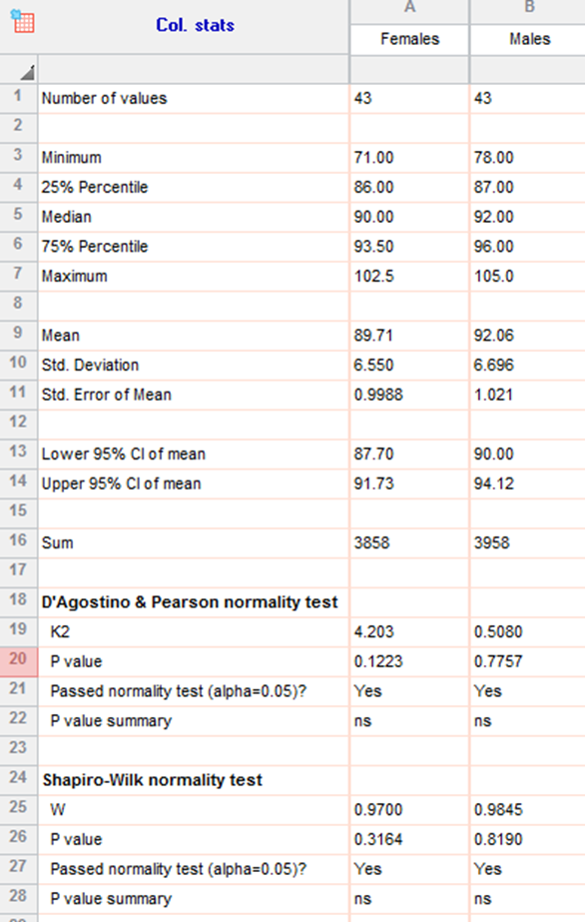
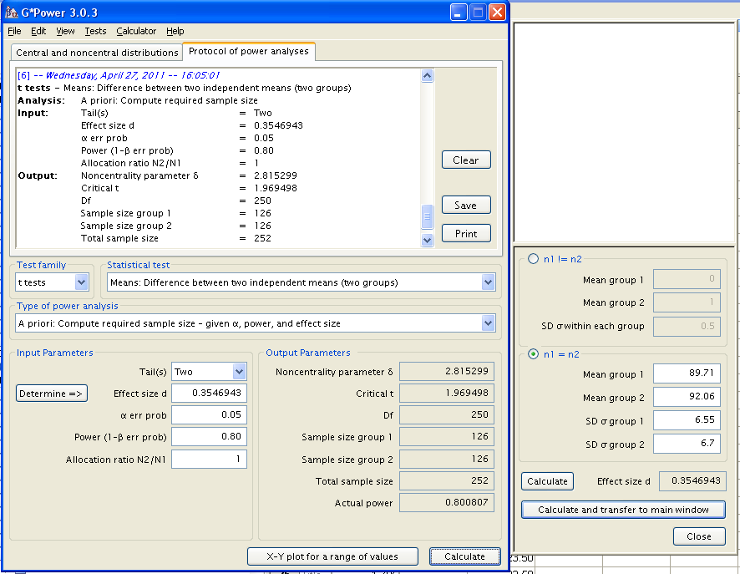
Power analysis
You would need a sample 3 times bigger to reach the accepted power of 80%.
But is a 2.3 cm difference between genders biologically relevant (<3%) ?

Slide 22
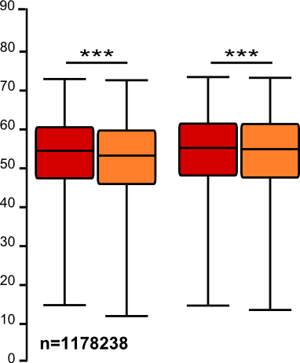
Sample size: the bigger the better?
It takes huge samples to detect tiny differences but tiny samples to detect huge differences.
What if the tiny difference is meaningless?
  Beware of overpower
  Nothing wrong with the stats: it is all about interpretation of the results of the test.
Remember the important first step of power analysis
  What is the effect size of biological interest?

Slide 23
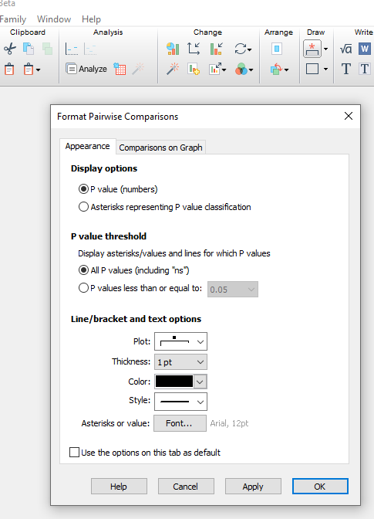
GraphPad Prism 9

Slide 24
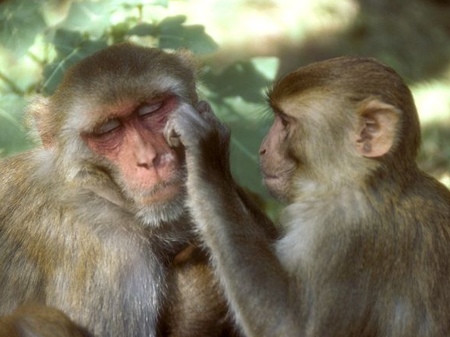
Exercise: Dependent or Paired t-test
working memory.xlsx
A group of rhesus monkeys (n=15) performs a task involving memory after having received a placebo. Their performance is graded on a scale from 0 to 100. They are then asked to perform the same task after having received a dopamine depleting agent.
Is there an effect of treatment on the monkeys' performance?

Slide 25
Exercise: Dependent or Paired t-test
working memory.xlsx
Normaliy ☑

Slide 26
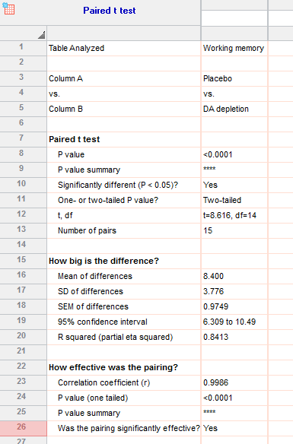
Exercise: Dependent or Paired t-test
working memory.xlsx

Slide 27
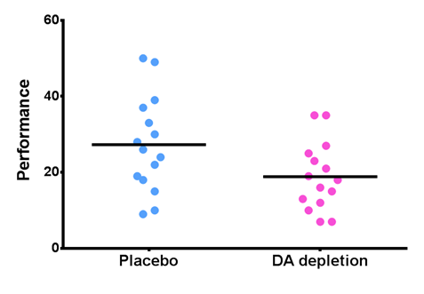
Paired t-test: Results
working memory.xlsx

