Slide 1


Analysis of Quantitative data
One-Way + Two-Way ANOVA
Anne Segonds-Pichon v2020-08

Slide 2
Comparison between more than 2 groups
One factor = One predictor
One-Way ANOVA

Slide 3
Signal-to-noise ratio
Signal
Difference
=
Noise
Variability
Signal
= statistical significance
Noise
Signal
= no statistical significance
Noise

Slide 4
Analysis of variance: how does it work?
Signal
=
Difference between the means
Noise
Variability in the groups
=
F ratio

Slide 5
One-Way Analysis of variance
Step 1: Omnibus test
It tells us if there is a difference between the means but not which means are significantly different from which other ones.
Step 2: Post-hoc tests
They tell us if there are differences between the means pairwise.

Slide 6
Analysis of variance: how does it work?
Source of variation | Sum of Squares | df | Mean Square | F | p-value
Between Groups | 18.1 | 4 | 4.5 | 6.32 | 0.0002
Within Groups | 51.8 | 73 | 0.71
Total | 69.9

Slide 7
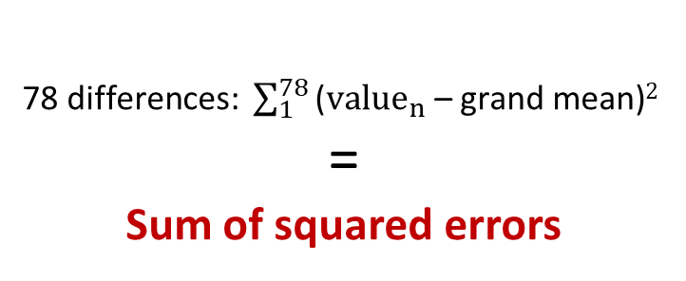
Analysis of variance: how does it work?
grand mean
78 differences: $\sum_{1}^{78}{\text{(}{value}_{n}\text{ – }\text{grand} \text{mean}\text{)}2 }$
=
Sum of squared errors
Source of variation | Sum of Squares | df | Mean Square | F | p-value
Between Groups
Within Groups
Total | 69.9

Slide 8
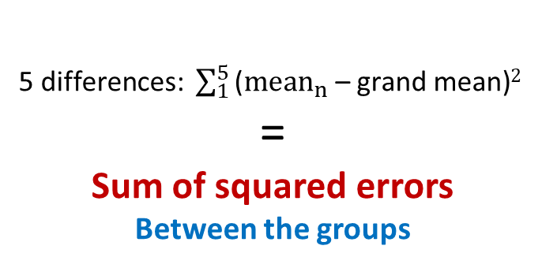
Analysis of variance: how does it work?
grand mean
5 differences: $\sum_{1}^{5}{\text{(}{mean}_{n}\text{ – }\text{grand} \text{mean}\text{)}2 }$
=
Sum of squared errors
Between the groups
Source of variation | Sum of Squares | df | Mean Square | F | p-value
Between Groups | 18.1
Within Groups
Total | 69.9

Slide 9
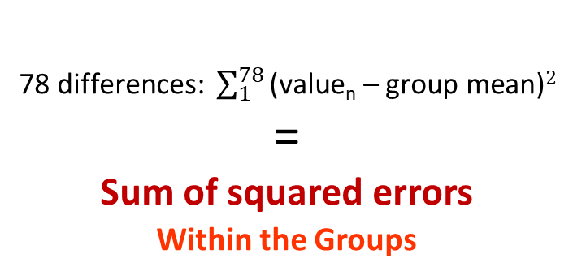
Analysis of variance: how does it work?
grand mean
group mean
78 differences: $\sum_{1}^{78}{\text{(}\text{value}\text{n}\text{ –} \text{group} \text{mean}\text{)}2}$
=
Sum of squared errors
Within the Groups
Source of variation | Sum of Squares | df | Mean Squares | F | p-value
Between Groups | 18.1
Within Groups | 51.8
Total | 69.9

Slide 10
Analysis of variance: how does it work?
Source of variation | Sum of Squares | df | Mean Squares | F ratio | p-value
Between Groups | 18.1 | k-1
Within Groups | 51.8 | n-k
Total | 69.9
Signal
Noise
  df: degree of freedom with df = n-1
  n = number of values, k=number of groups
  Between groups: df = 4 (k-1)
  Within groups: df = 73 (n-k = n₁-1 + … + n₅-1)

Slide 11
Analysis of variance: how does it work?
Source of variation | Sum of Squares | df | Mean Squares | F ratio | p-value
Between Groups | 18.1 | 4 | 4.5
Within Groups | 51.8 | 73 | 0.71
Total | 69.9
Signal
Noise
  df: degree of freedom with df = n-1
  18.2/4 = 4.5 51.8/73 = 0.71
Mean squares = Sum of Squares / n-1 = Variance!

Slide 12
Analysis of variance: how does it work?
Source of variation | Sum of Squares | df | Mean Squares | F ratio | p-value
Between Groups | 18.1 | 4 | 4.5 | 6.34 | 0.0002
Within Groups | 51.8 | 73 | 0.71
Total | 69.9
Mean squares = Sum of Squares / n-1 = Variance
Variance between the groups
Variance within the groups (individual variability)
4.5
0.71
F ratio =
=
= 6.34

Slide 13
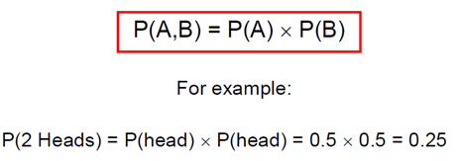
Comparison of more than 2 means
Running multiple tests on the same data increases the familywise error rate.
What is the familywise error rate?
  The error rate across tests conducted on the same experimental data.
One of the basic rules (‘laws’) of probability:
  The Multiplicative Rule: The probability of the joint occurrence of 2 or more independent events is the product of the individual probabilities.
Notes:
Compare many groups to each other, wrong to use multiple t-tests, It increases the error

Slide 14
Familywise error rate
Example: All pairwise comparisons between 3 groups A, B and C:
  A-B, A-C and B-C
Probability of making the Type I Error: 5%
  The probability of not making the Type I Error is 95% (=1 – 0.05)
Multiplicative Rule:
  Overall probability of no Type I errors is: 0.95 * 0.95 * 0.95 = 0.857
So the probability of making at least one Type I Error is 1-0.857 = 0.143 or 14.3%
    The probability has increased from 5% to 14.3%
Comparisons between 5 groups instead of 3, the familywise error rate is 40% (=1-(0.95)^{n})

Slide 15
Familywise error rate
Solution to the increase of familywise error rate: correction for multiple comparisons
  Post-hoc tests
Many different ways to correct for multiple comparisons:
  Different statisticians have designed corrections addressing different issues
    e.g. unbalanced design, heterogeneity of variance, liberal vs conservative
However, they all have one thing in common:
  the more tests, the higher the familywise error rate: the more stringent the correction
Tukey, Bonferroni, Sidak, Benjamini-Hochberg …
  Two ways to address the multiple testing problem
    Familywise Error Rate (FWER) vs. False Discovery Rate (FDR)

Slide 16
Multiple testing problem
FWER: Bonferroni: α_{adjust} = 0.05/n comparisons e.g. 3 comparisons: 0.05/3=0.016
  Problem: very conservative leading to loss of power (lots of false negative)
  10 comparisons: threshold for significance: 0.05/10: 0.005
  Pairwise comparisons across 20.000 genes ☹
FDR: Benjamini-Hochberg: the procedure controls the expected proportion of “discoveries” (significant tests) that are false (false positive).
  Less stringent control of Type I Error than FWER procedures which control the probability of at least one Type I Error
  More power at the cost of increased numbers of Type I Errors.
Difference between FWER and FDR:
  a p-value of 0.05 implies that 5% of all tests will result in false positives.
  a FDR adjusted p-value (or q-value) of 0.05 implies that 5% of significant tests will result in false positives.

Slide 17
One-Way Analysis of variance
Step 1: Omnibus test
It tells us if there is (or not) a difference between the means but not which means are significantly different from which other ones.
Step 2: Post-hoc tests
They tell us if there are (or not) differences between the means pairwise.
A correction for multiple comparisons will be applied on the p-values.
These post hoc tests should only be used when the ANOVA finds a significant effect.

Slide 18
Exercise: One-way ANOVA
protein expression.xlsx
Question: is there a difference in protein expression between the 5 cell lines?
1 Plot the data
2 Check the assumptions for parametric test

Slide 20
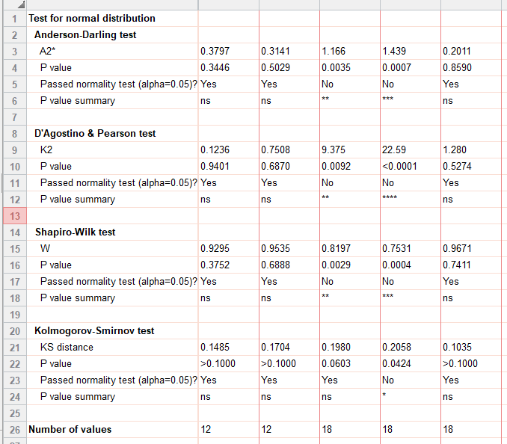
Parametric tests assumptions

Slide 22
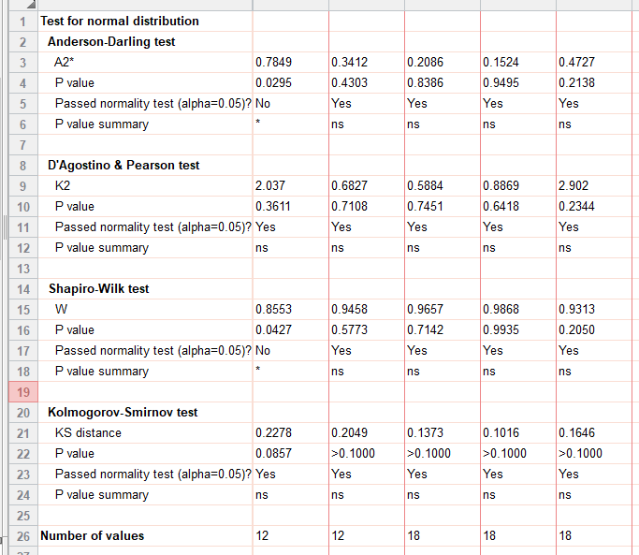
Parametric tests assumptions

Slide 23
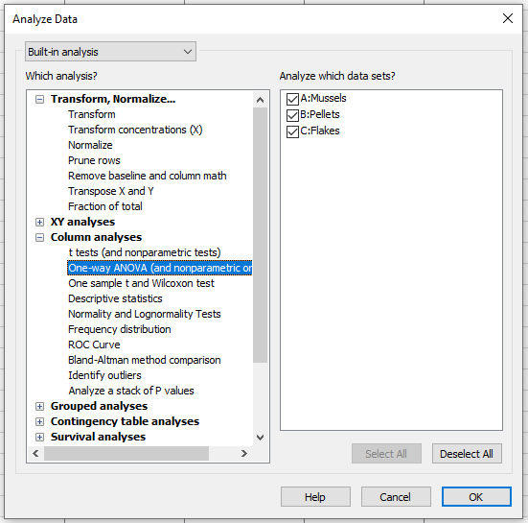
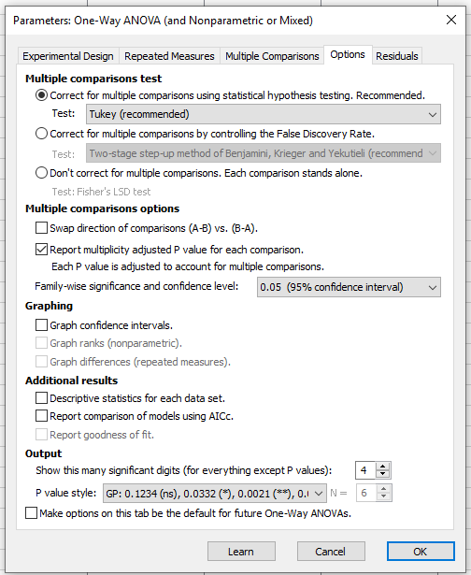
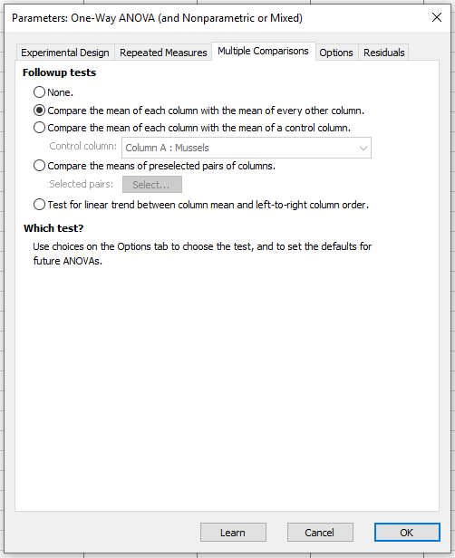
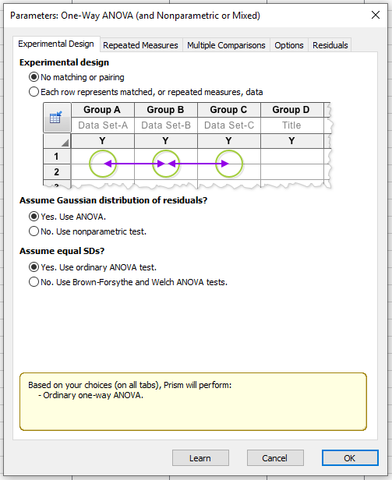
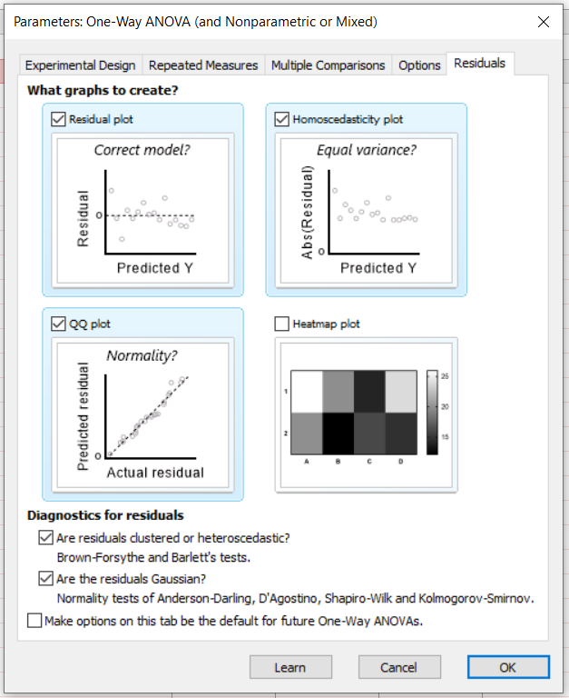

One-Way ANOVA in Prism 8
Have a go!

Slide 24
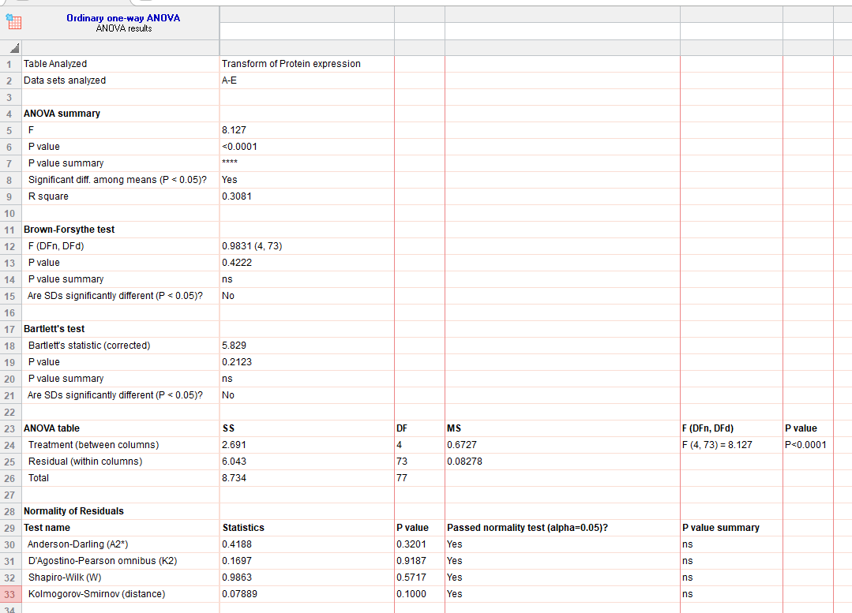
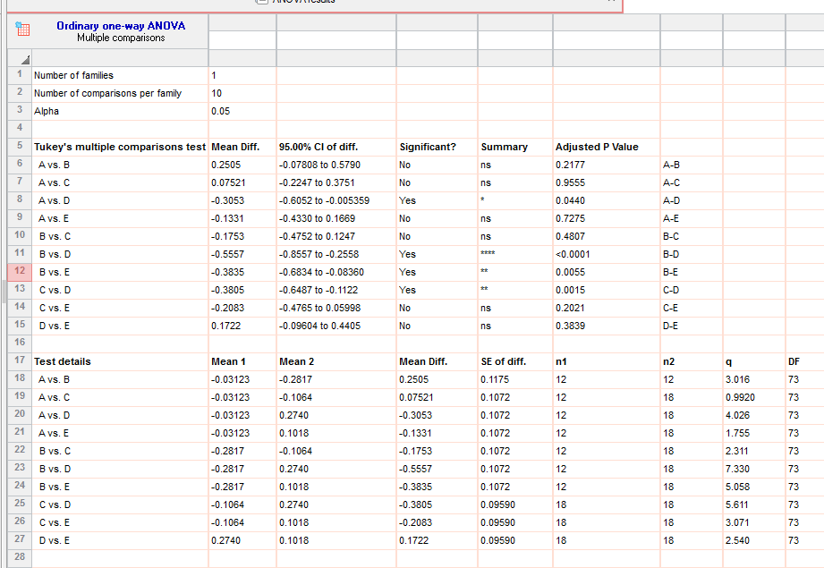
Analysis of variance: results
Homogeneity of variance ☑
F=0.6727/0.08278=8.13
Normality ☑

Slide 25
Analysis of variance: results

Slide 26
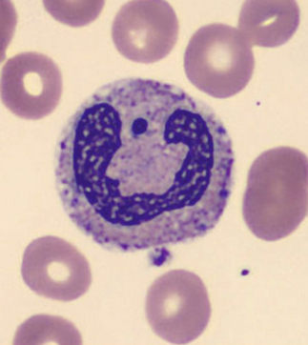
Exercise: Repeated measures ANOVA
neutrophils.xlsx
A researcher is looking at the difference between 4 cell groups. He has run the experiment 5 times. Within each experiment, he has neutrophils from a WT (control), a KO, a KO+Treatment 1 and a KO+Treatment2.
Question: Is there a difference between KO with/without treatment and WT?

Slide 27
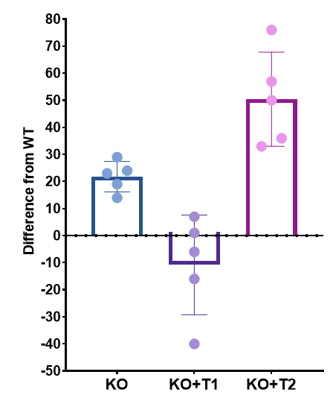
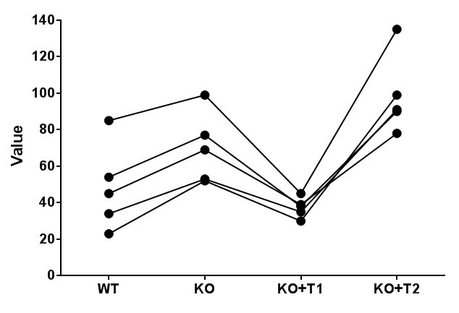
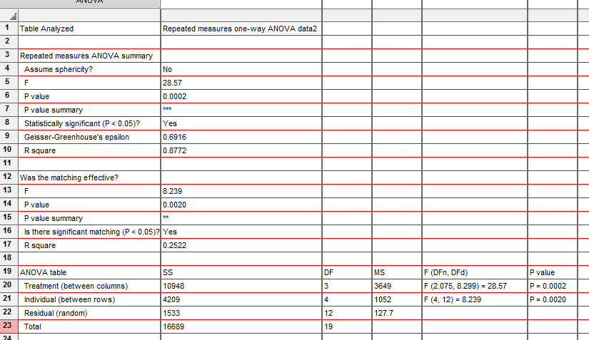
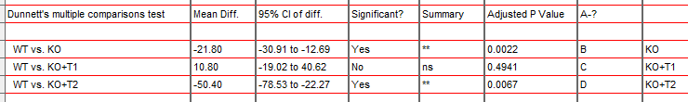
Exercise: Repeated measures ANOVA
neutrophils.xlsx
Answer: There is a significant difference from WT for the first and third groups.

Slide 28
Comparison between more than 2 groups
Two factors = Two predictors
Two-Way ANOVA

Slide 29
Two-way Analysis of Variance
(Factorial ANOVA)
Source of variation | Sum of Squares | Df | Mean Square | F | p-value
Variable A * Variable B | 1978 | 2 | 989.1 | F (2, 42) = 11.91 | P < 0.0001
Variable B (Between groups) | 3332 | 2 | 1666 | F (2, 42) = 20.07 | P < 0.0001
Variable A (Between groups) | 168.8 | 1 | 168.8 | F (1, 42) = 2.032 | P = 0.1614
Residuals | 3488 | 42 | 83.04
Source of variation | Sum of Squares | Df | Mean Square | F | p-value
Variable A (Between Groups) | 2.665 | 4 | 0.6663 | 8.42 | <0.0001
Within Groups (Residual) | 5.775 | 73 | 0.0791
Total | 8.44 | 77
One-way ANOVA= 1 predictor variable
2-way ANOVA= 2 predictor variables: A and B
SST
Total variance in the Data
SST
Total variance in the Data
Total
SSM
Variance Explained by the Model
SSR
Unexplained Variance
SSM
Variance Explained by the Model
Between Groups
SSR
Unexplained Variance
Within Groups
SSA
Variance Explained by Variable A
SSB
Variance Explained by Variable B
SSAxB
Variance Explained by the Interaction of A and B

Slide 30
Two-way Analysis of Variance
Interaction plots: Examples
  Fake dataset:
    2 factors: Genotype (2 levels) and Condition (2 levels)

Slide 31
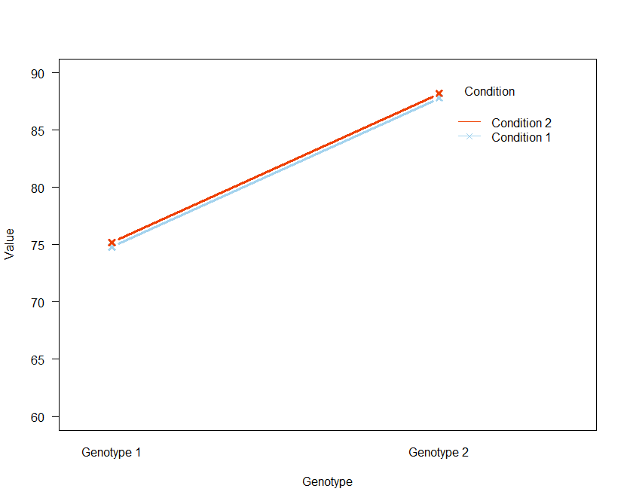
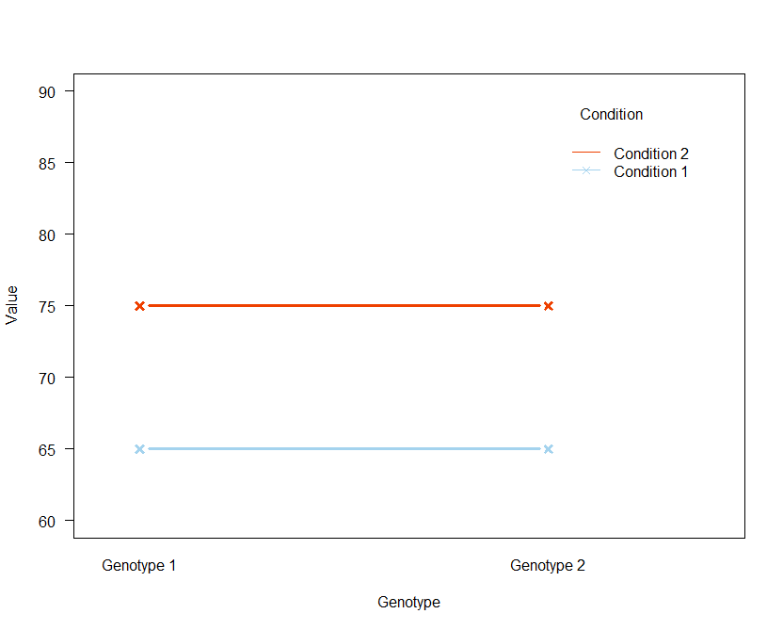
Two-way Analysis of Variance
Interaction plots: Examples
  2 factors: Genotype (2 levels) and Condition (2 levels)
Single Effect
Genotype Effect
Condition Effect

Slide 32
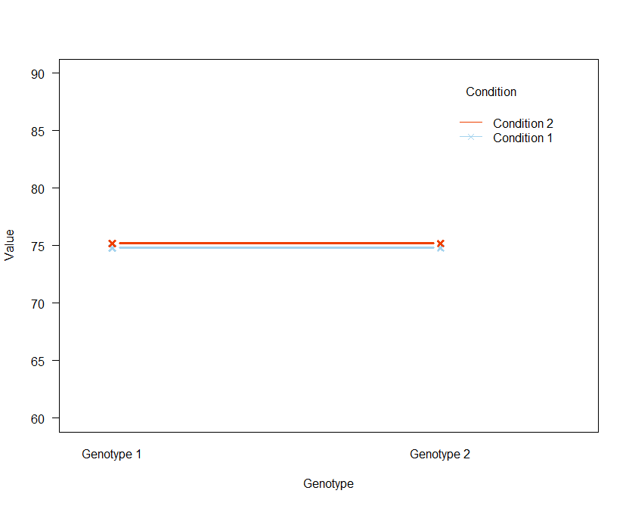
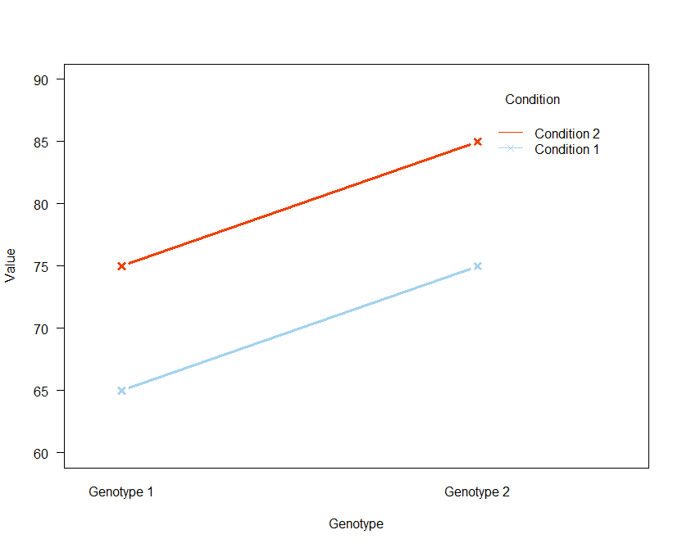
Two-way Analysis of Variance
Interaction plots: Examples
  2 factors: Genotype (2 levels) and Condition (2 levels)
Zero or Both Effect
Zero Effect
Both Effect

Slide 33
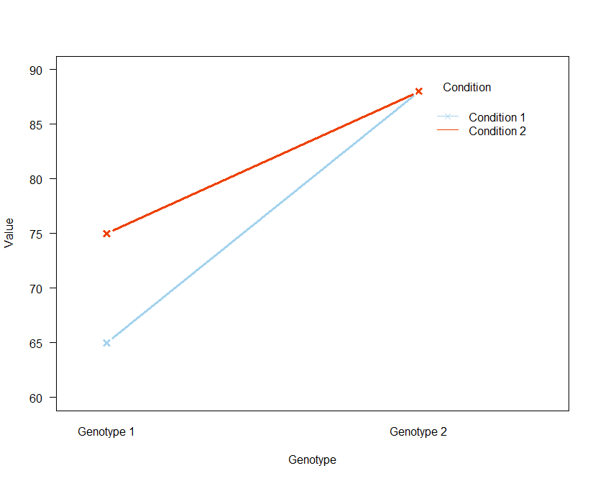
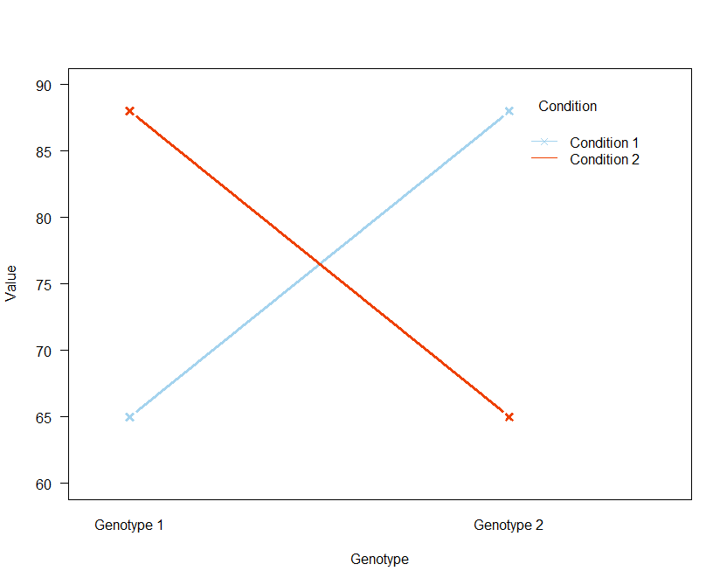
Two-way Analysis of Variance
Interaction plots: Examples
  2 factors: Genotype (2 levels) and Condition (2 levels)
Interaction

Slide 34
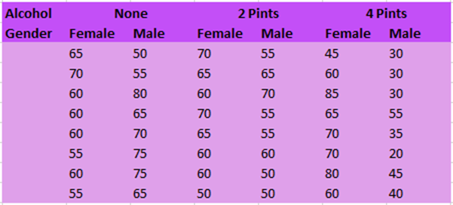
Two-way Analysis of Variance
Example: goggles.xlsx
  The ‘beer-goggle’ effect
    The term refers to finding people more attractive after you’ve had a few beers. Drinking beer provides a warm, friendly sensation, lowers your inhibitions, and helps you relax.
  Study: effects of alcohol on mate selection in night-clubs.
  Pool of independent judges scored the levels of attractiveness of the person that the participant was chatting up at the end of the evening.
  Question: is subjective perception of physical attractiveness affected by alcohol consumption?
    Attractiveness on a scale from 0 to 100

Slide 35
Two-way Analysis of Variance
Interaction
between Alcohol and Gender
Main effect of Alcohol
Main effect of Gender

Slide 36
Two-way Analysis of Variance
With significant interaction (real data)
ANOVA table | SS | DF | MS | F (DFn, DFd) | P value
Interaction | 1978 | 2 | 989.1 | F (2, 42) = 11.91 | < 0.0001
Alcohol Consumption | 3332 | 2 | 1666 | F (2, 42) = 20.07 | < 0.0001
Gender | 168.8 | 1 | 168.8 | F (1, 42) = 2.032 | 0.1614
Residual | 3488 | 42 | 83.04
Without significant interaction (fake data)
ANOVA table | SS | DF | MS | F (DFn, DFd) | P value
Interaction | 7.292 | 2 | 3.646 | F (2, 42) = 0.06872 | 0.9337
Alcohol Consumption | 5026 | 2 | 2513 | F (2, 42) = 47.37 | < 0.0001
Gender | 438.0 | 1 | 438.0 | F (1, 42) = 8.257 | 0.0063
Residual | 2228 | 42 | 53.05

Slide 37
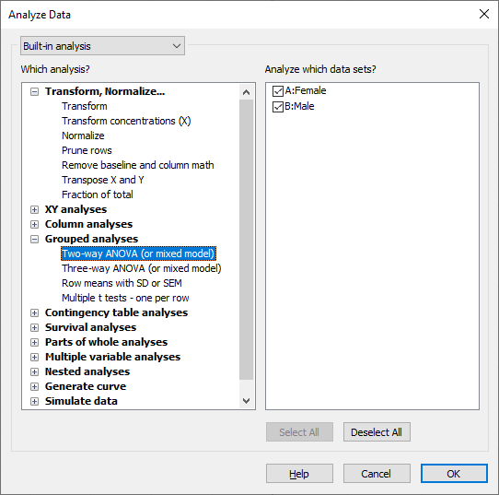
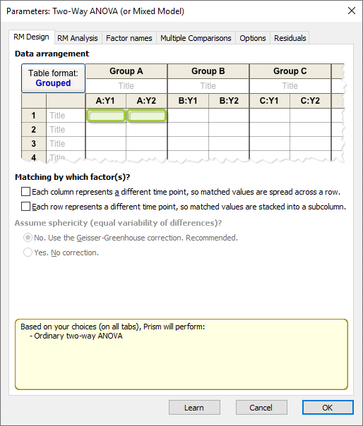
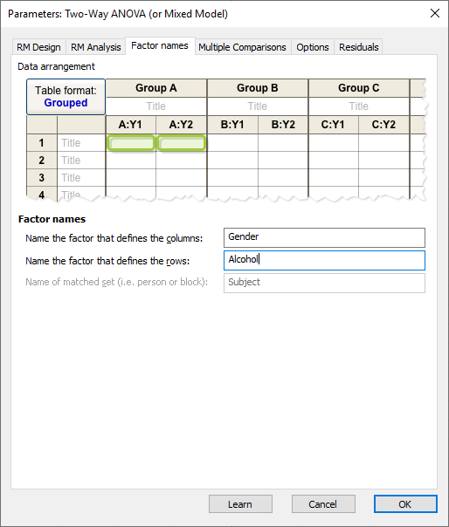
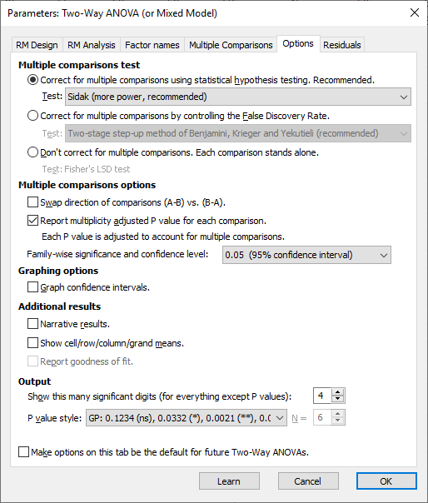
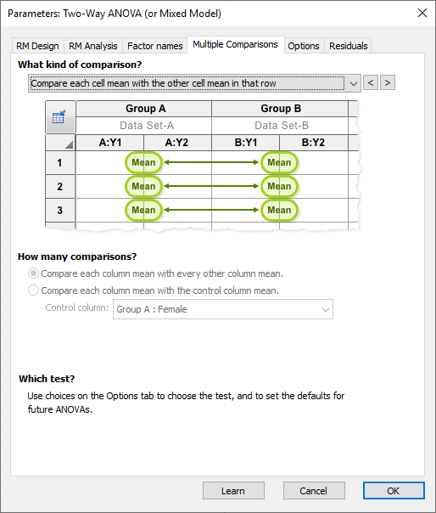
Two-way Analysis of Variance
Have a go!

Slide 38
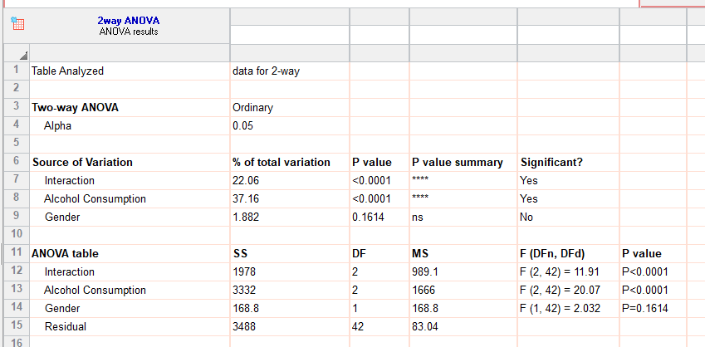
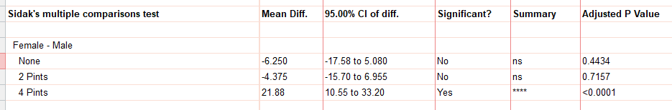
Two-way Analysis of Variance

