Slide 1
Analysis of Quantitative data Non parametric statistics Anne Segonds-Pichon v2020-09

Slide 2
Comparison between 2 groups
Non-Parametric data

Slide 3
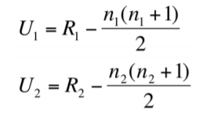
Non-parametric test:
Mann-Whitney = Wilcoxon rank test
Non-parametric equivalent of the t-test (and not).
Not meeting the assumptions for parametric tests is not enough to switch to a non-parametric approach.
Like always, data exploration is key.
How does the Mann-Whitney test work?
Real values | Ranks
3 | 1
5 | 2
6 | 3
7 | 4
8 | 5
9 | 6
 | Group 1 | Group 2
 | 2 | 5
 | 4 | 6
 | 1 | 3
Sum | 7 | 14
Group 1 | Group 2
5 | 8
7 | 9
3 | 6
Statistic of the Mann-Whitney test: U (W)
U₁ = 7-6 = 1 and U₂ = 14-6 = 8
Smallest of the 2 Us: U₁ + sample size p-value
Where:
R = sum of ranks
n = sample size.

Slide 4
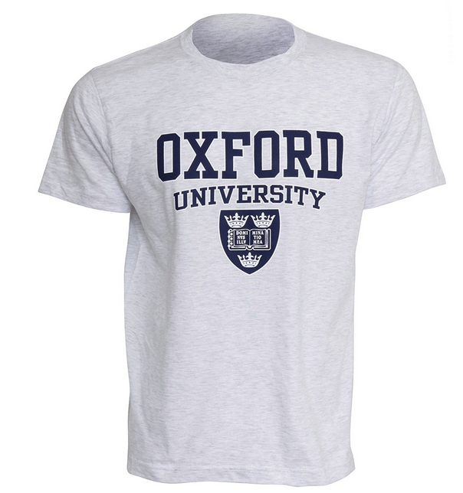
Exercise: smelly T-shirt.xlsx
Hypothesis: Group body odour is less disgusting when associated with an in-group member versus an out-group member.
Study: Two groups of Cambridge University students are presented with one of two smelly, worn T-shirts with university logos.
Question: Can Cambridge students tell the difference between worn smelly T-shirts from Oxford or Cambridge?
Disgust score: 1 to 7, with 7 the most disgusting
Explore the data with an appropriate combination of 2 graphs
Answer the question with a non-parametric approach
What do you think about the design?

Slide 5
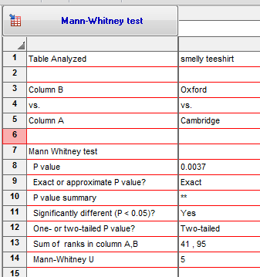
Exercise: smelly T-shirt.xlsx
Question: Can Cambridge students tell the difference between worn smelly T-shirts from Oxford or Cambridge?
Disgust score: 1 to 7, with 7 the most disgusting
Answer:
Cambridge students can tell the difference between Oxford and Cambridge (U = 5, p = 0.0037).
A paired design would have been better.

Slide 6
Non-parametric test:
Wilcoxon’s signed-rank
Non-parametric equivalent of the paired t-test (ish).
How does the test work?
2+3=5/2=2.5: average rank
Before | After | Differences
9 | 3 | -6
7 | 4 | -3
10 | 4 | -6
8 | 5 | -3
5 | 6 | 1
8 | 2 | -6
7 | 7 | 0
9 | 4 | -5
10 | 5 | -5
Abs. Diff. | Ranking | Ranks
0
1 | 1 | 1
3 | 2 | 2.5
3 | 3 | 2.5
5 | 4 | 4.5
5 | 5 | 4.5
6 | 6 | 7
6 | 7 | 7
6 | 8 | 7
 | Negative ranks | Positives ranks
 |  | 1
 | -2.5
 | -2.5
 | -4.5
 | -4.5
 | -7
 | -7
 | -7
Sum | -35 | 1
Statistic of the Wilcoxon’s signed-rank test: Sum of signed ranks = W
Here: W = -35 + 1 = -34
Statistic W + sample size p-value

Slide 7
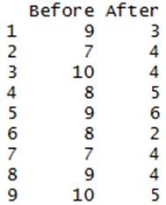
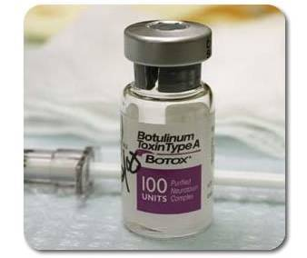
Exercise: botulinum.xlsx
A group of 9 disabled children with muscle spasticity (or extreme muscle tightness limiting movement) in their right upper limb underwent a course of injections with botulinum toxin to reduce spasticity levels.
A neurologist (blinded) assessed levels of spasticity pre- and post-treatment for all 9 children using a 10-point ordinal scale.
Higher ratings indicated higher levels of spasticity.
Question: do botulinum toxin injections reduce muscle spasticity levels?
Score: 1 to 10, with 10 the highest spasticity

Slide 8
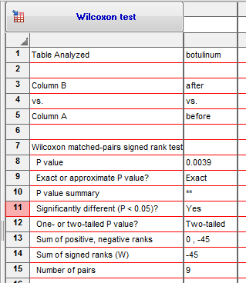
Exercise: botulinum.xlsx
Question: do botulinum toxin injections reduce muscle spasticity levels?
Answer: There was a significant difference pre- and post- treatment in ratings of muscle spasticity (W = -45, p = 0.0039).

Slide 9
Comparison between more than 2 groups
One factor
Non-Parametric data

Slide 10
Kruskal-Wallis and Friedman tests
Non-parametric equivalents of the One-Way ANOVA
Also based on ranks
Kruskal-Wallis: independent measures
Friedman: repeated measures
Statistic associated with Kruskal-Wallis is H
Statistic associated with Friedman is Q or T1 or FM
The statistics have a Chi² distribution
Kruskal-Wallis H = Friedman statistic = One-Way ANOVA F
Post-hoc test associated with Kruskal-Wallis and Friedman: Dunn’s test
The Dunn’s test works pretty much like the Mann-Whitney test.

Slide 11
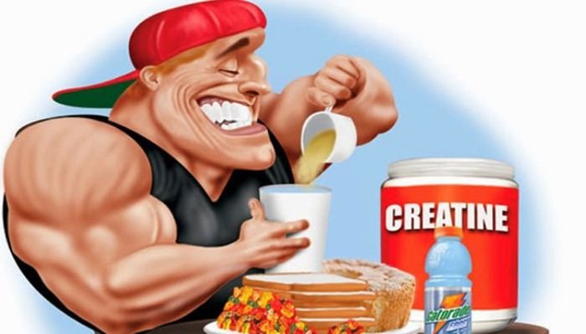
Kruskal-Wallis test: Example
Creatine, a supplement popular among body builders
Three groups: No creatine; Once a day; and Twice a day.
Question: does the average weight gain depend on the creatine group to which people were assigned?

Slide 12
Kruskal-Wallis
Example: creatine.xlsx
Actual values
Ranks
No | Once | Twice
63 | 0 | 2239
-261 | -652 | 171
-153 | 4724 | 40
-13 | -2 | 1395
965 | 0
 | -86
No | Once | Twice
10 | 7.5 | 14
2 | 1 | 11
3 | 15 | 9
5 | 6 | 13
12 | 7.5
 | 4
32 | 41 | 47
$H=\left[\frac{12}{15\left(15+1\right)}(\frac{{32}^{2}}{5}+\frac{{41}^{2}}{6}+\frac{{47}^{2}}{4})\right]$- 3(15+1) = 3.868
Where:
n = sum of sample sizes for all samples,
c = number of samples,
T_{j} = sum of ranks in the j^{th} sample,
n_{j} = size of the j^{th} sample.

Slide 13
Friedman test: Example
An auction house is putting three violins, A, B, and C, up for bidding. Ten violinists are blindfolded are asked to rate the instruments and each player plays the violins in a randomly determined sequence (BCA, ACB, etc.).
After each violin is played, the violinist rates the instrument on a 10-point scale of overall excellence (1=lowest, 10=highest).
Question: which violin is the best according to the 10 violinists?

Slide 14
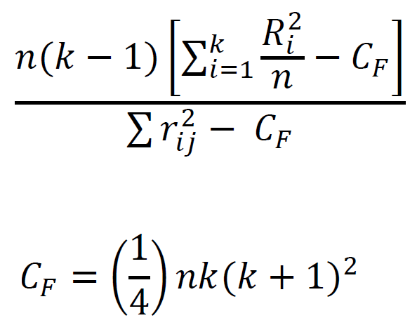
Friedman test
Example: violin.xlsx
Actual values
Ranks
Violinists | Violin A | Violin B | Violin C
1 | 9 | 7 | 6
2 | 9.5 | 6.5 | 8
3 | 5 | 7 | 4
4 | 7.5 | 7.5 | 6
5 | 9.5 | 5 | 7
6 | 7.5 | 8 | 6.5
7 | 8 | 6 | 6
8 | 7 | 6.5 | 4
9 | 8.5 | 7 | 6.5
10 | 6 | 7 | 3
Violinists | Violin A | Violin B | Violin C
1 | 3 | 2 | 1
2 | 3 | 1 | 2
3 | 2 | 3 | 1
4 | 2.5 | 2.5 | 1
5 | 3 | 1 | 2
6 | 2 | 3 | 1
7 | 3 | 1.5 | 1.5
8 | 3 | 2 | 1
9 | 3 | 2 | 1
10 | 2 | 3 | 1
Sum | 77.5 | 67.5 | 57
Q or T1 or FM =
Where:
n = sum of sample sizes for all samples,
k = number of samples,
R_{j} = sum of ranks in the j^{th} sample,
r_{ij} = rank i of the j^{th} sample.

Slide 15
Kruskal-Wallis and Friedman tests
Have a go!
Exercise: creatine.xlsx
Question: does the average weight gain depend on the creatine group to which people were assigned?
Exercise: violin.xlsx
Question: which violin is the best according to the 10 violinists?

Slide 16
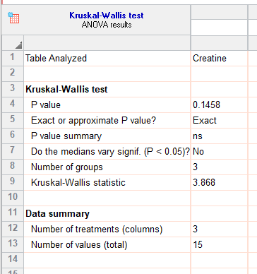
Kruskal-Wallis
Example: creatine.xlsx
Results

Slide 17
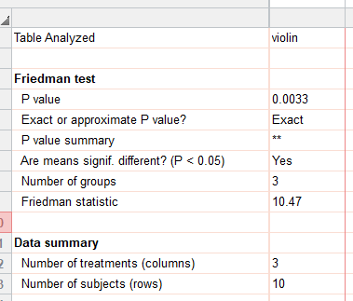
Friedman
Example: violin.xlsx
Results

Slide 18
Association between 2 continuous variables
Linear relationship
Non-Parametric data

Slide 19
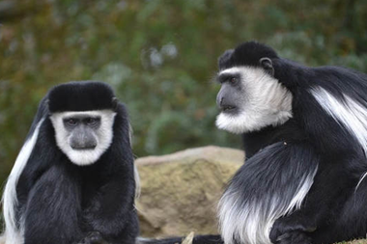
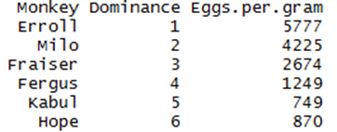
Non-Parametric:
Spearman Correlation Coefficient
Only really useful for ranks (either one or both variables)
ρ (rho) is the equivalent of r and calculated in a similar way
Example: Dominance.xslx
Six male colobus monkeys ranked for dominance
Question: is social dominance associated with parasitism?
Eggs of Trichirus nematode per gram of monkey faeces

Slide 20
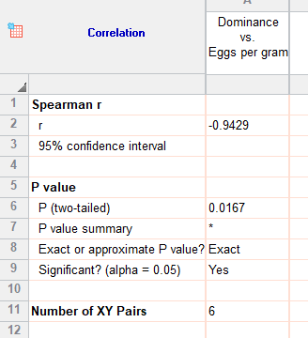
Non-Parametric:
Spearman Correlation Coefficient
Answer: the relationship between dominance and parasitism is significant (ρ = -0.94, p = 0.017) with high ranking males harbouring a heavier burden.

