Slide 1


Analysis of Quantitative data
Introduction
Anne Segonds-Pichon v2020-08

Slide 2
Outline of this section
Assumptions for parametric data
Comparing two means: Student’s t-test
Comparing more than 2 means
  One factor: One-way ANOVA
  Two factors: Two-way ANOVA
Relationship between 2 continuous variables:
  Linear: Correlation
  Non-linear: Curve fitting
  Model diagnostics: Goodness-of-fit
Non-parametric tests

Slide 3
Introduction
Key concepts to always keep in mind
  Null hypothesis and error types
  Statistics inference
  Signal-to-noise ratio

Slide 4
The null hypothesis and the error types
The null hypothesis (H₀): H₀ = no effect
  e.g. no difference between 2 genotypes
The aim of a statistical test is to reject or not H_{0.}
Traditionally, a test or a difference is said to be “significant” if the probability of type I error is: α =< 0.05
High specificity = low False Positives = low Type I error
High sensitivity = low False Negatives = low Type II error
Statistical decision | True state of H₀
 | H₀ True (no effect) | H₀ False (effect)
Reject H₀ | Type I error α False Positive | Correct True Positive
Do not reject H₀ | Correct True Negative | Type II error β False Negative

Slide 5
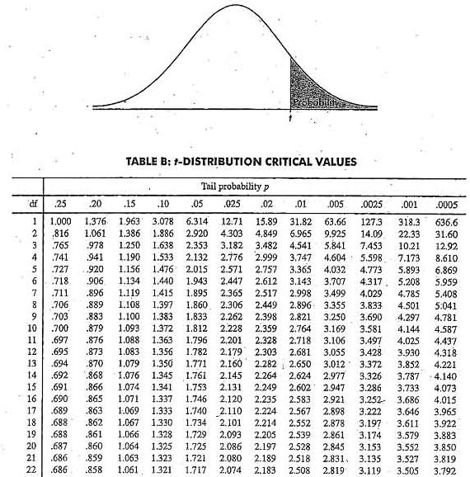
Sample
Statistical inference
Population
Difference
Meaningful?
Yes
Real?
Statistical test
Big enough?
Statistic
e.g. t, F …
=
+ Noise +
Difference
Sample

Slide 6
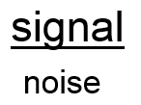
Signal-to-noise ratio
Stats are all about understanding and controlling variation.
signal
noise
signal
noise
Difference
+ Noise
Difference
Noise
If the noise is low then the signal is detectable …
= statistical significance
… but if the noise (i.e. interindividual variation) is large
then the same signal will not be detected
= no statistical significance
In a statistical test, the ratio of signal to noise determines the significance.

Slide 7
Analysis of Quantitative Data
Choose the correct statistical test to answer your question:
  They are 2 types of statistical tests:
    Parametric tests with 4 assumptions to be met by the data,
    Non-parametric tests with no or few assumptions (e.g. Mann-Whitney test) and/or for qualitative data (e.g. Fisher’s exact and χ² tests).

Slide 8
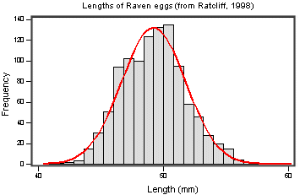
Assumptions of Parametric Data
All parametric tests have 4 basic assumptions that must be met for the test to be accurate.
  First assumption: Normally distributed data
  Normal shape, bell shape, Gaussian shape
    Transformations can be made to make data suitable for parametric analysis.
Notes:
Small sample no worth check for normality
Parametric only when it’s big sample go for non parametric if you are unsure do both the non parametric is more efficient to find a difference
Can ask to run a test if there is a departure from normality

Slide 9
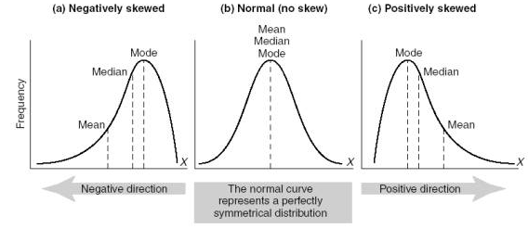

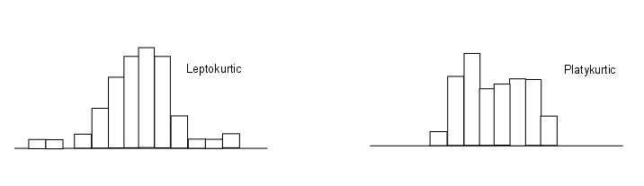
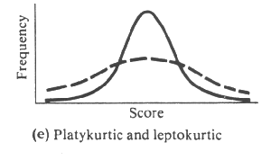
Assumptions of Parametric Data
Frequent departures from normality:
  Skewness: lack of symmetry of a distribution
  Kurtosis: measure of the degree of ‘peakedness’ in the distribution
    The two distributions below have the same variance approximately the same skew, but differ markedly in kurtosis.
Skewness < 0
Skewness = 0
Skewness > 0
More peaked distribution: kurtosis > 0
Flatter distribution: kurtosis < 0
Notes:
Departure from normality +vely skewd most common

Slide 10
Assumptions of Parametric Data
  Second assumption: Homoscedasticity (Homogeneity in variance)
    The variance should not change systematically throughout the data
  Third assumption: Interval data (linearity)
    The distance between points of the scale should be equal at all parts along the scale.
  Fourth assumption: Independence
    Data from different subjects are independent
      Values corresponding to one subject do not influence the values corresponding to another subject.
      Important in repeated measures experiments
Notes:
Variance must be same in the groups or similar
Interval data: in all group ypu measure data in the same way
Independence you have to know if it is or not tests are different in this case

Slide 11
Analysis of Quantitative Data
Is there a difference between my groups regarding the variable I am measuring?
  e.g. are the mice in the group A heavier than those in group B?
    Tests with 2 groups:
      Parametric: Student’s t-test
      Non parametric: Mann-Whitney/Wilcoxon rank sum test
    Tests with more than 2 groups:
      Parametric: Analysis of variance (one-way and two-way ANOVA)
      Non parametric: Kruskal Wallis (one-way ANOVA equivalent)
Is there a relationship between my 2 (continuous) variables?
  e.g. is there a relationship between the daily intake in calories and an increase in body weight?
    Test: Correlation (parametric or non-parametric) and Curve fitting

