Slide 1


Analysis of Qualitative data
Anne Segonds-Pichon v2020-08

Slide 2
Variable
Quantitative
Qualitative
Discrete
Continuous
Nominal
Ordinal
Ratio
Interval

Slide 3
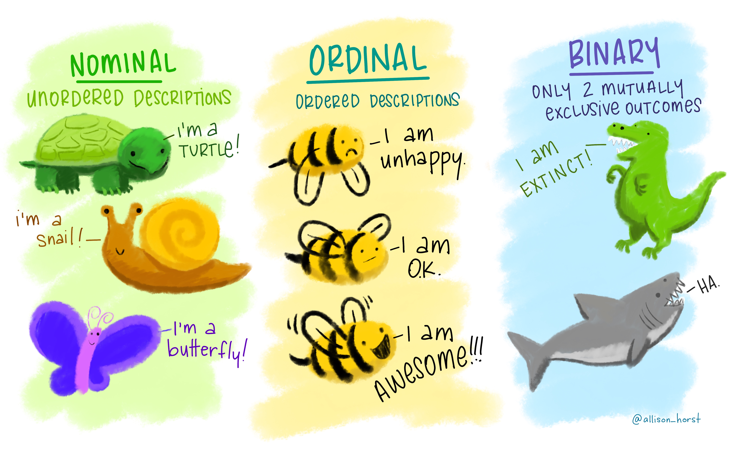
Qualitative data
= not numerical
= values taken = usually names (also nominal)
    e.g. genotypes
Values can be numbers but not numerical
    e.g. group number = numerical label but not unit of measurement
Qualitative variable with intrinsic order in their categories = ordinal
Particular case: qualitative variable with 2 categories: binary or dichotomous
    e.g. alive/dead or presence/absence
https://github.com/allisonhorst/stats-illustrations#other-stats-artwork
Notes:
Can be good or horrible data qualitative data do not use many stats, one is chi square
Cats and dogs, first plot it

Slide 4
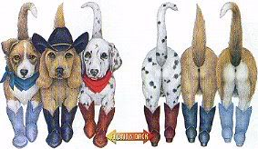
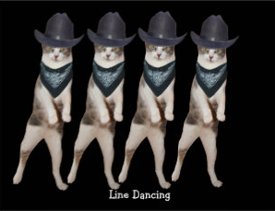
  Fisher’s exact and Chi²
Example: cats and dogs.xlsx
Cats and dogs trained to line dance
2 different rewards: food or affection
Question: Is there a difference between the rewards?
Is there a significant relationship between the 2 variables?
  does the reward significantly affect the likelihood of dancing?
To answer this type of question:
  Contingency table
  Fisher’s exact or Chi² tests
 | Food | Affection
Dance | ? | ?
No dance | ? | ?
But first: how many animals do we need?
Notes:
Is there a difference between the rewards?
Dogs more happy, cats more picky (on demonstration is the other way around, so cats more picky

Slide 5
Exercise: Power calculation
Preliminary results from a pilot study: 25% line-danced after having received affection as a reward vs. 70% after having received food.
  How many cats do we need?

Slide 6
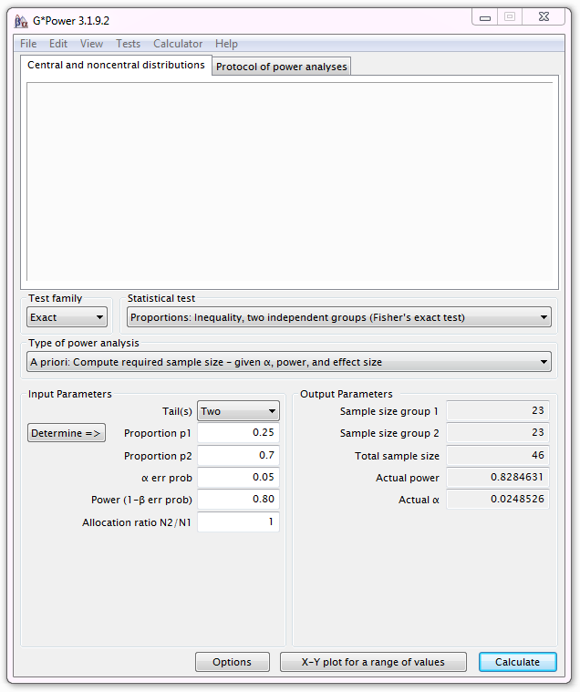
Exercise: Power calculation
Output:
If the values from the pilot study are good predictors and if we use a sample of n=23 for each group, we will achieve a power of 83%.

Slide 7
Chi-square and Fisher’s tests
Chi² test very easy to calculate by hand but Fisher’s very hard
Many software will not perform a Fisher’s test on tables > 2x2
Fisher’s test more accurate than Chi² test on small samples
Chi² test more accurate than Fisher’s test on large samples
Chi² test assumptions:
  2x2 table: no expected count <5
  Bigger tables: all expected > 1 and no more than 20% < 5

Slide 8
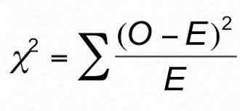
Chi-square test
In a chi-square test, the observed frequencies for two or more groups are compared with expected frequencies by chance.
  O = Observed frequencies
  E = Expected frequencies
Example with ‘cats and dogs’
Notes:
Your frequency, compare the frequencies with the expected ones observed by chance. HOW DIFFERENT IS WHAT I observe from what I expect? THIS DIFFERENCE CAN BE BIG SO SIGNOFICANT OR NOT

Slide 9
  How are the expected frequencies calculated?
Example: expected frequency of cats line dancing
after having received food as a reward.
Direct counts approach:
Expected frequency = (row total)*(column total)/grand total
= 32*32/68 = 15.1
Probability approach: The Multiplicative Rule
Probability of line dancing: 32/68
Probability of receiving food: 32/68
Expected frequency:(32/68)*(32/68)=0.22: 22% of 68 = 15.1
Observed frequencies
 | Food | Affection | Total
Dance | 26 | 6 | 32
No dance | 6 | 30 | 36
Total | 32 | 36 | 68
Expected frequencies
 | Food | Affection
Dance | 15.1 | 16.9
No dance | 16.9 | 19.1
Notes:
Is there a difference between the rewards?
Dogs more happy, cats more picky (on demonstration is the other way around, so cats more picky

Slide 10

Chi² test
Observed frequencies
Expected frequencies
 | Food | Affection
Dance | 26 | 6
No dance | 6 | 30
 | Food | Affection
Dance | 15.1 | 16.9
No dance | 16.9 | 19.1
Chi² = (26-15.1)²/15.1 + (6-16.9)²/16.9 + (6-16.9)² /16.9 + (30-19.1)²/19.1 = 28.4
Is 28.4 big enough for the test to be significant?
Notes:
Distance between expected and observed

Slide 11
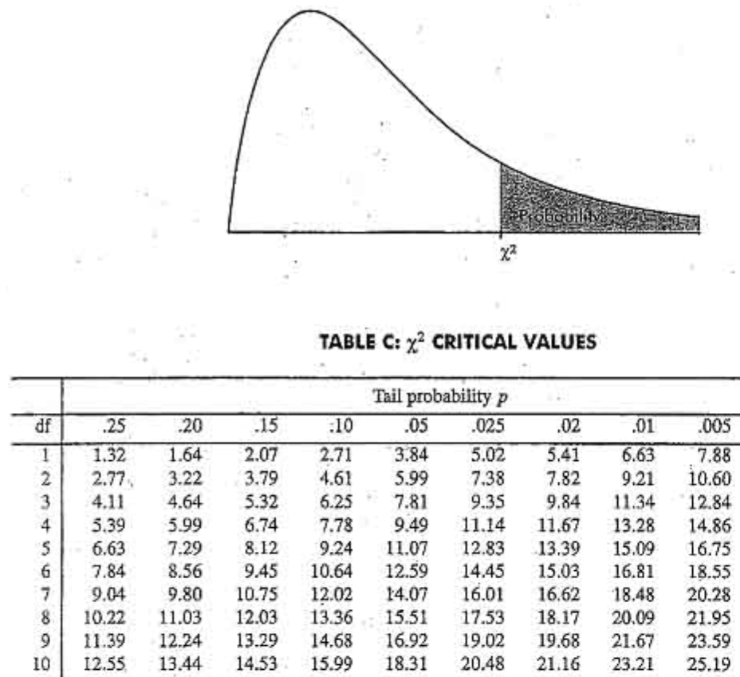
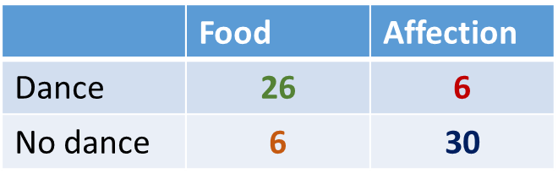
Is 28.4 big enough for the test to be significant?
The old fashion way
Degree of freedom: df
df = (row-1)(col-1)=1
Critical value
χ² = 28.4 > 3.84 so Yes!

Slide 12
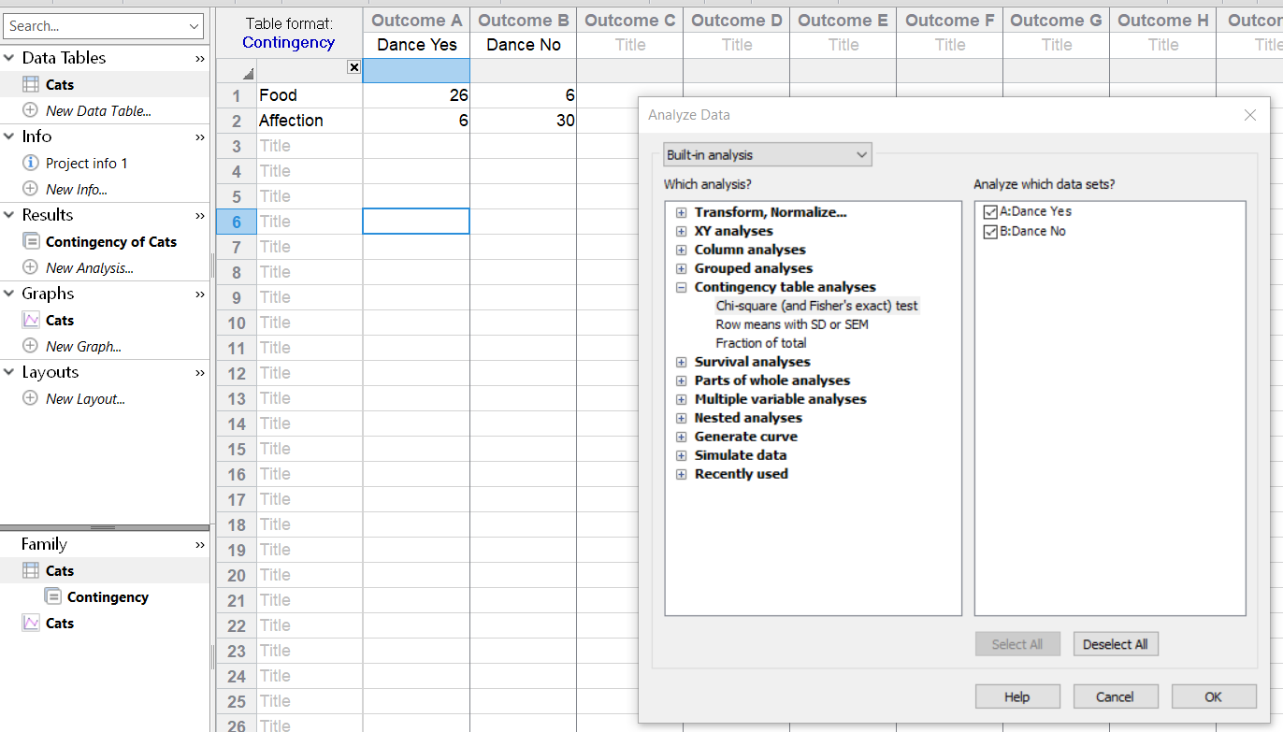
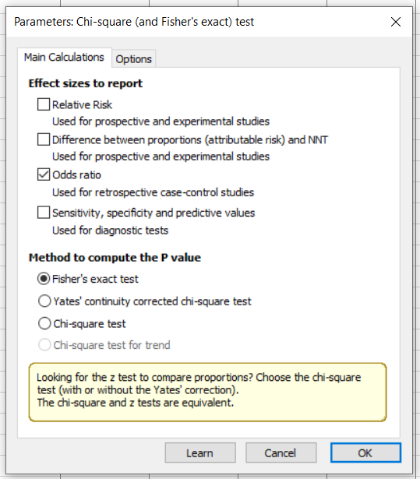
Fisher’s exact and Chi² tests with Prism 8
Classic
effect size
2x2 tables
bigger tables

Slide 13
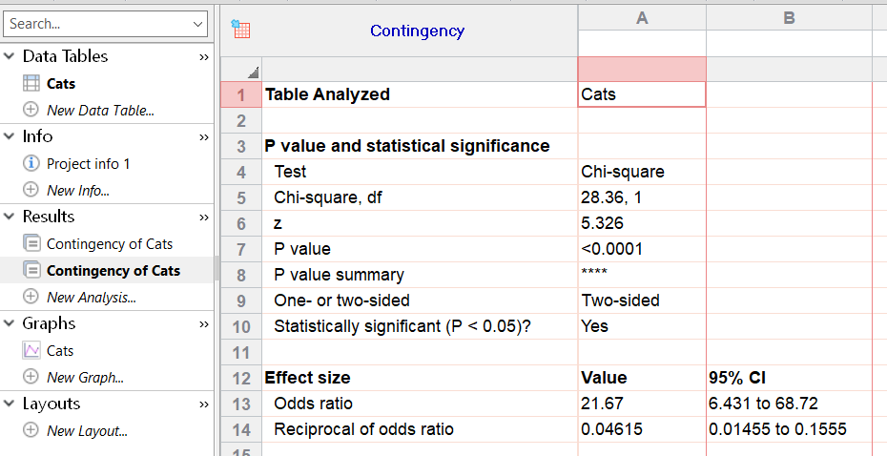
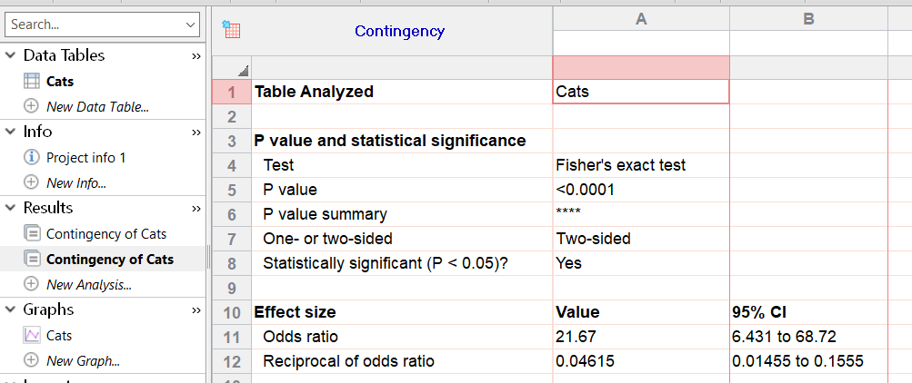
Fisher’s exact and Chi² tests
Results
Odds of dancing on Food group = 26/6
Odds of dancing on Affection group = 6/30
O.R. = ratio of the odds = 26/6/6/30 = 21.7
Odds Ratio = 21.7
If you are a dancing cat, you are almost 22 times more likely to have received food than affection as a reward (p<0.0001).

Slide 14
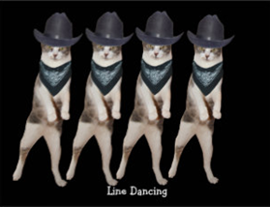
Fisher’s exact and Chi² tests with Prism 8
Beyond significance
Two super important things to keep in mind:
  Qualitative data can be presented as percentages but the tests should always be run on actual counts.
    Power!
  A p-value should always be interpreted in the context of the experiment.
    Power!
Let’s do it with the dogs

Slide 15
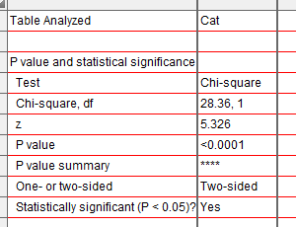
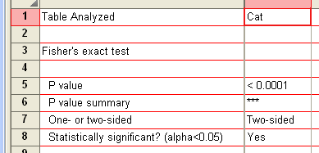
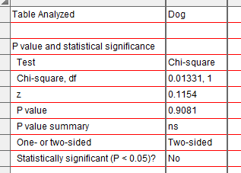
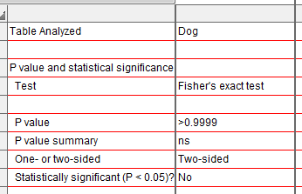
Results for cats and dogs

Slide 16
Fisher’s exact test: results
In our example:
cats are more likely to line dance if they are given food as reward than affection (p<0.0001) whereas dogs don’t mind (p>0.99).

Slide 17
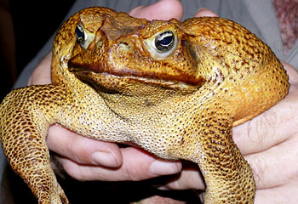
Exercise: Cane toads
 | Infected | Uninfected
Rockhampton | 12 | 8
Bowen | 4 | 16
Mackay | 15 | 5
A researcher decided to check the hypothesis that the proportion of cane toads with intestinal parasites was the same in 3 different areas of Queensland.
From Statistics Explained by Steve McKillup
Question: Is the proportion of cane toads infected by intestinal parasites the same in 3 different areas of Queensland?

Slide 18
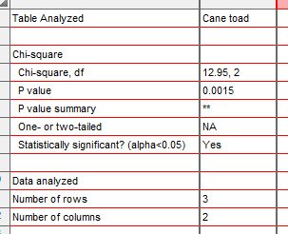
Exercise: Cane toads
Answer:
The proportion of cane toads infected by intestinal parasites varies significantly between the 3 different areas of Queensland (p=0.0015), the animals being more likely to be parasitized in Rockhampton and Mackay than in Bowen.

Slide 19
Exercise: Cane toads
New question:
Is the proportion of infected cane toads different in Bowen than in the other 2 areas?

Slide 20


Exercise: Cane toads
p=0.045
p=0.0024
Bonferroni correction
Is the proportion of infected cane toads different in Bowen than in the other 2 areas? Yes, it is.

