Slide 1
Data Visualisation Exercise
v2018-02
Simon Andrews
Jo Montgomery
simon.andrews@babraham.ac.uk
jo.Montgomery@babraham.ac.uk

Slide 2
Exercise
Look at the following graphs. In each case try to decide
  Is the graph conveying a clear message?
  Does this data benefit from being shown visually?
  Is the representation of the data appropriate?
  Is the amount of data shown appropriate?
  Is the use of colour and other design elements appropriate?

Slide 3
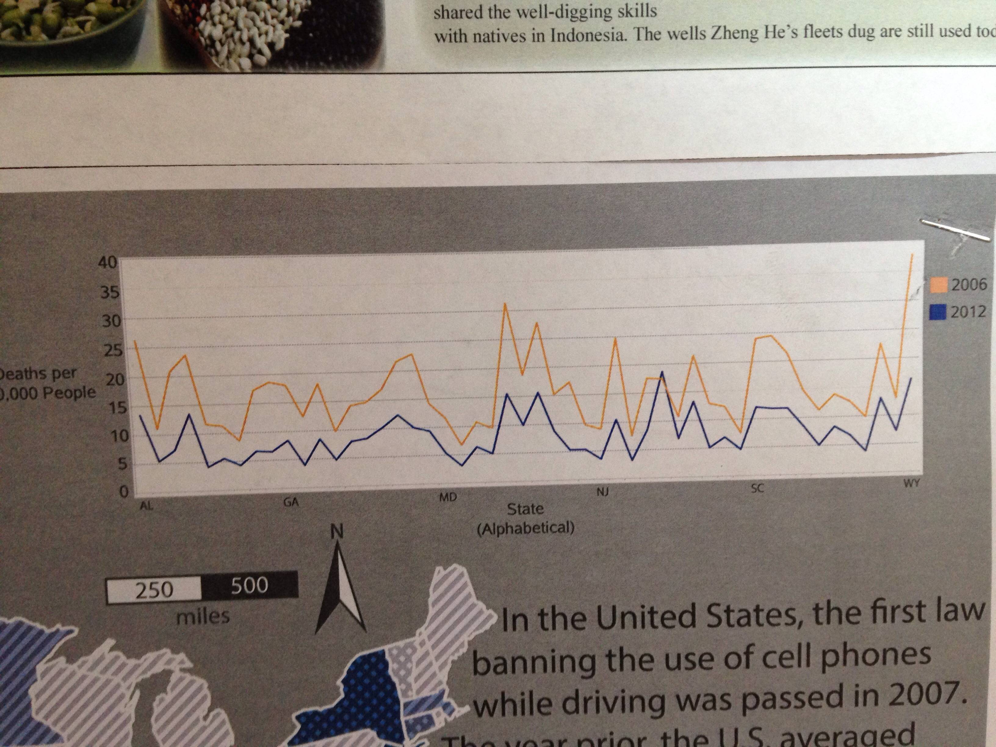

Slide 4
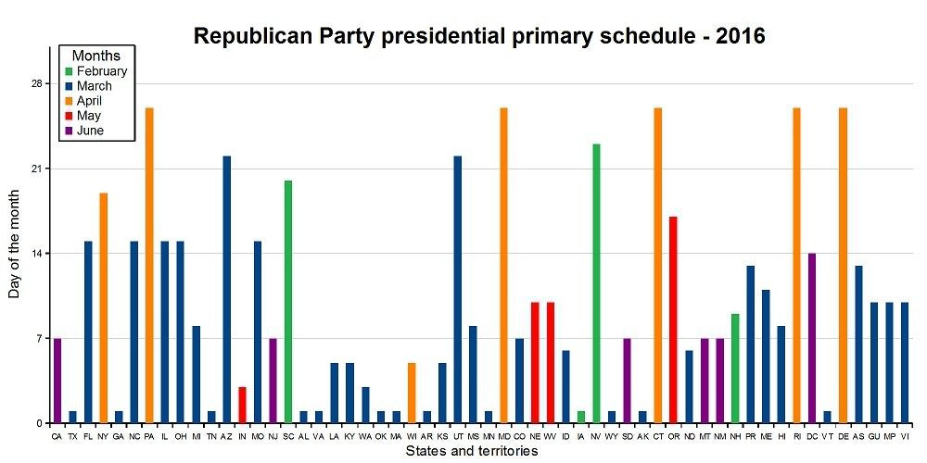

Slide 5
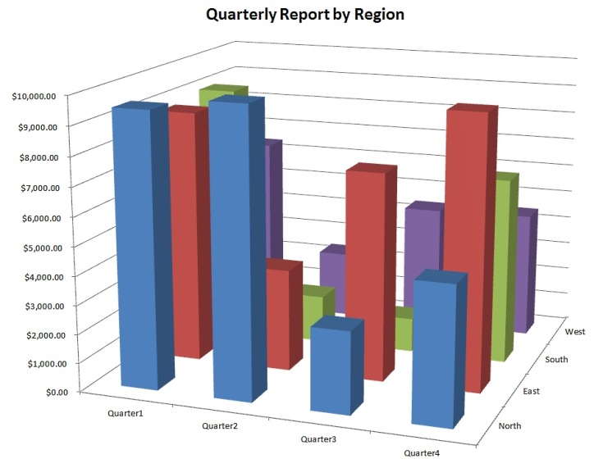

Slide 6
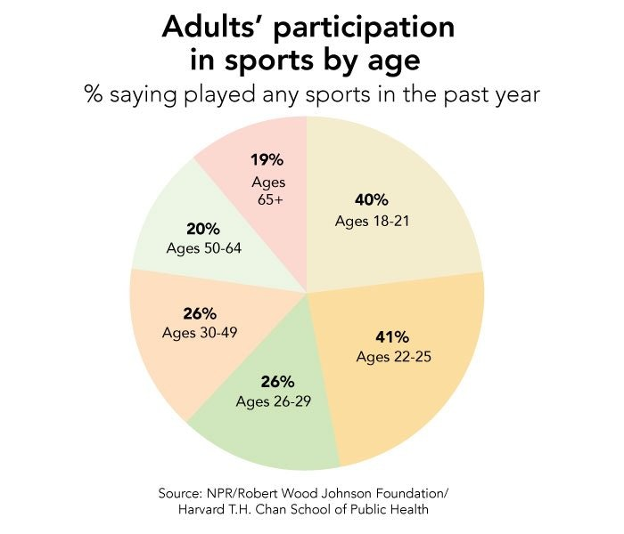

Slide 7
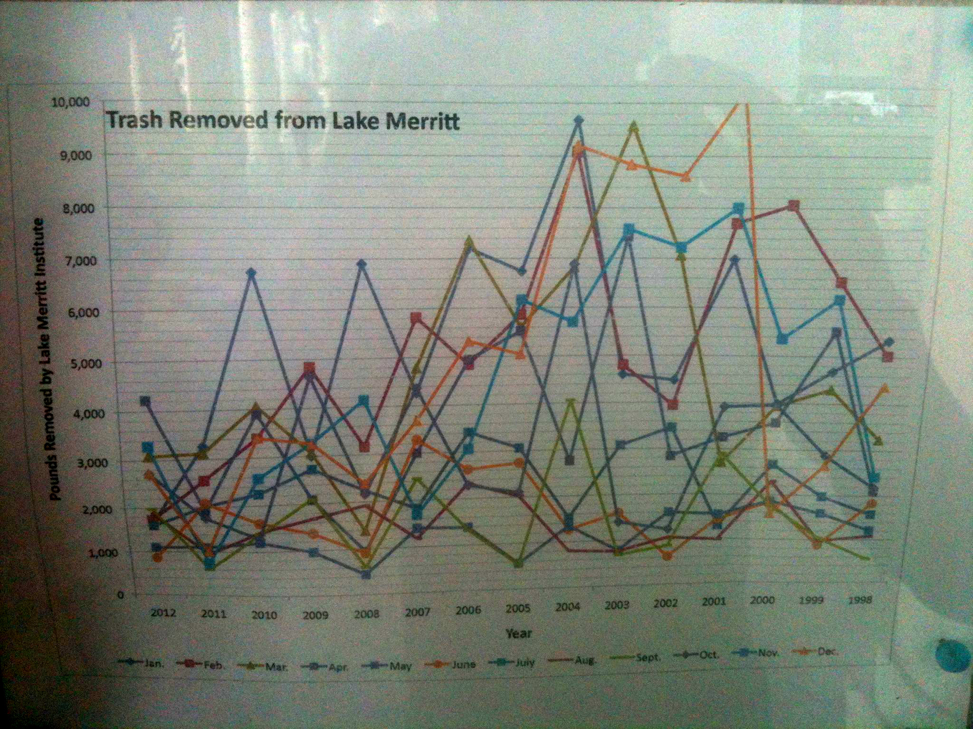

Slide 8
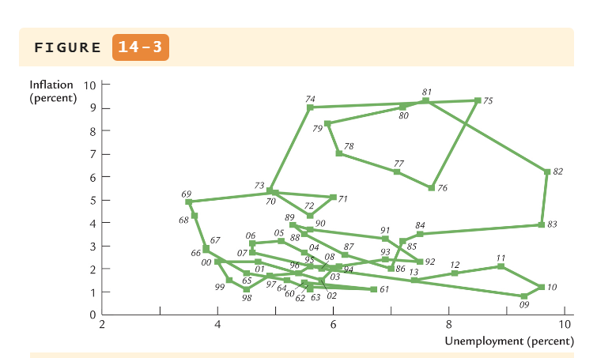

Slide 9
