Slide 1

Submitting to Journals
v2.0
Boo Virk
Boo.Virk@babraham.ac.uk

Slide 2
Preparing for Submission
Initially figures will be assessed by reviewer
At this stage figures do not need to be print quality production
Most reviewers will print figures out on a laser or inkjet printer on normal copy paper
If accepted for publication, high quality figures will be required

Slide 3
Scaling Figures
Vector images can be scaled freely without loss of quality
Bitmap images can be scaled down, but not up

Slide 4
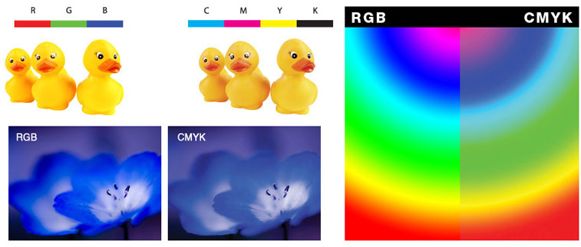
Colour Space
RGB colour - computers
CMYK colour - print
Check what your figures will look like printed out

Slide 5
Basic Steps in Preparation
Determine the final size of the figure
Heights of text, thicknesses of lines
Figure in colour, grayscale or black and white
Resolution
Acceptable File format
  Choose the best one

Slide 6
Journal Guidelines
Most journals have guidelines for initial submission
These differ so it’s worth checking
  Nature: JPEG, 150 dpi, included in the manuscript, fit to column width
  Science: PDF, 150 – 300 dpi, included in manuscript, fit to A4 page
  BMC Biology: Several, 300 dpi, separate from manuscript, fit to A4 page

