Slide 1
Inkscape Tutorial
v2024-05
Simon Andrews
simon.andrews@babraham.ac.uk

Slide 2
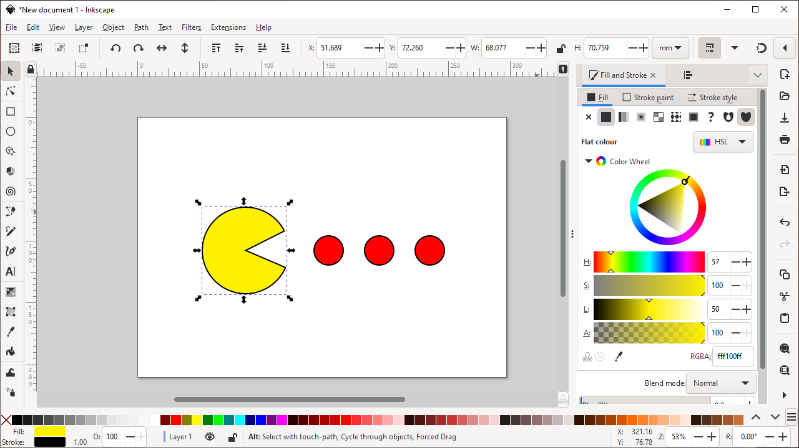
What is Inkscape?
Vector Graphics Editor
Free Software
Cross Platform
Easy to use
Good for:
Compositing
Drawing
Not for:
Bitmap editing
www.inkscape.org

Slide 3
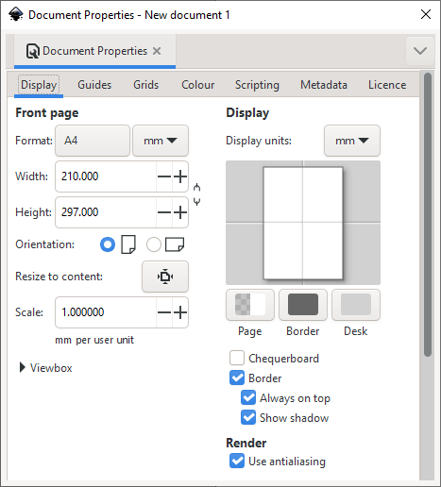
Setting up a canvas
File > Document Properties
Shows page in view
Doesn’t restrict drawing
Useful as a guide

Slide 4
Moving around
Panning
Scroll bars on bottom / right
Scroll up/down, Shift+scroll for left/right
Zooming in / out
Click to zoom in, shift+click to zoom out
Control + Scroll Up/Down to zoom in/out to cursor
Shortcuts
Fit page, drawing, selection in window

Slide 5
The main toolbar
Selection tool
Edit nodes tool
Make rectangles
Make ellipses / arcs
Make polygons / stars
Make 3D boxes
Make spirals
Draw straight lines / curves
Draw freehand lines
Calligraphy tool
Add text

Slide 6
Creating basic shapes
Select tool from toolbar
Click and drag on canvas
Box selects the bounds of the new shape
Colours are remembered from the last shape
Basic options appear in top toolbar
Number of spokes on stars
Rounded corners on rectangles
Circle vs segment vs arc

Slide 7
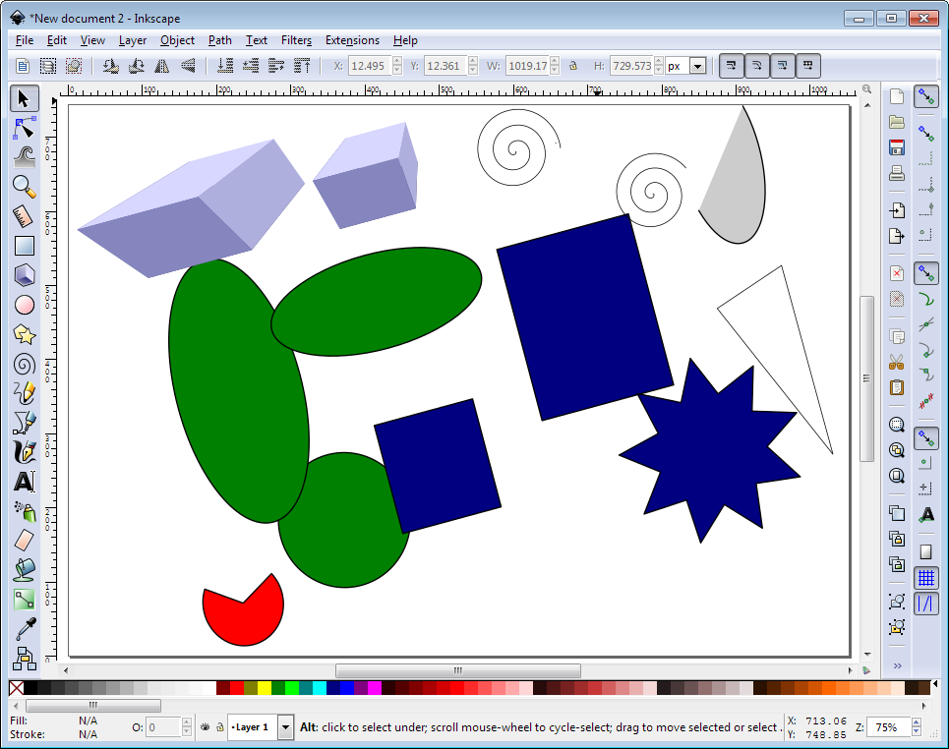
Creating basic shapes

Slide 8
Creating basic shapes
Modifiers – press keys whilst drawing
Control = Constrain height/width ratio
Easiest way to make circles / squares
Shift = grow from centre not edge
Help appears at the bottom of the screen

Slide 9
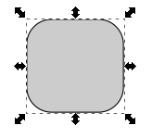
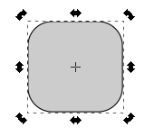
General Transformations
Select the Selection tool
Moving – Click and drag an object
Duplicating – Select object and press Ctrl+D
Resizing / Rotating
Click on object
Click again to change control arrow type
Click and drag arrows to resize / rotate
Resize
Rotate

Slide 10
Transform Shortcuts

Slide 11
Selecting and Grouping
Selecting multiple objects
Drag a box to cover multiple objects
Shift+click to add an object to a selection
Shift+click on a selected object to remove it from the selection
Grouping (Control + G or Object > Group)
Combine multiple objects into a single object
Reversible (Control + shift + G or Object > Ungroup)

Slide 12
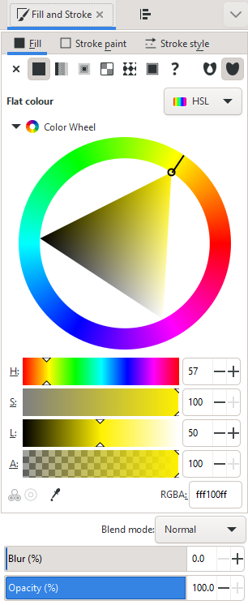
Fill and Stroke (Object > Fill and Stroke)
Fill = Colour/Gradient/Pattern within a shape
Stroke = The line around a shape
Edit
Colours
Opacity

Slide 13
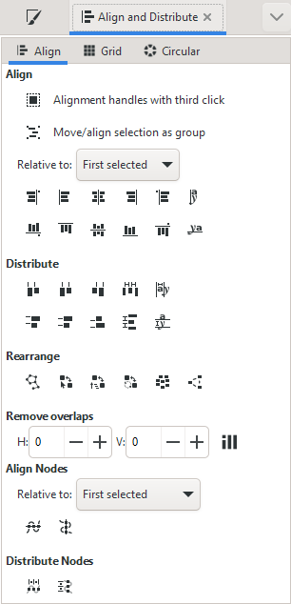
Aligning and Distributing
Object > Align and Distribute
Align = Give objects the same centre/edge position
Distribute = Space objects evenly
Align relative to
First/Last selected object in group
Largest/Smallest object in group
Page
Drawing

Slide 14
Aligning and Distributing
Align top edges
Align centres (horizontal)
Align centres (vertical)
Even spaces between objects

Slide 15
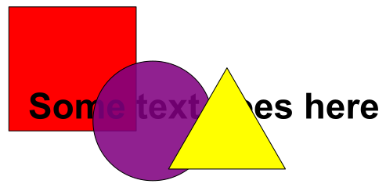
Z axis - Ordering
New objects sit over the top of old objects
Objects obscure those underneath them (except for transparency)

Slide 16
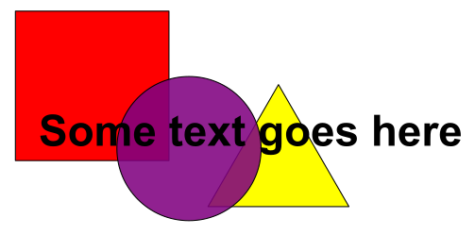
Z-axis Ordering
Send object to bottom of z-stack
Lower object one level
Raise object one level
Bring object to top

Slide 17
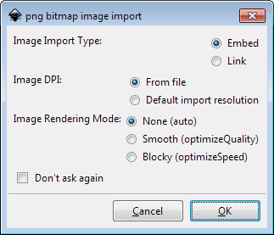
Working with imported pictures
File > Import
PNG, JPEG, SVG, PDF etc.
(Bitmaps) Choose Embed
Copies image into Inkscape
Create single portable file

Slide 18
Working with imported pictures

Slide 19
Adding Text
Use the text tool to add text
Click and type to generate text
Text can be scaled or rotated as any other object
Always hold Ctrl when scaling otherwise the aspect ratio will be messed up

Slide 20
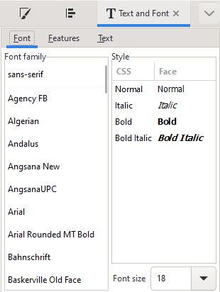
Text options
Text toolbar
Text and font settings
Font (always Arial for scientific figures)
Size
Alignment

Slide 21
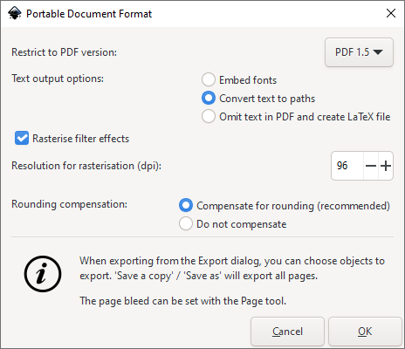
Saving & Exporting
Saving
File > Save (As)
Default is Scalable Vector Graphics (SVG)
Exporting as a Vector
Can export as a PDF
File > Save (As), select PDF

