Slide 1

Scientific Figure Design
v2024-05
Simon Andrews, Anne Segonds-Pichon, Boo Virk, Jo Montgomery
simon.andrews@babraham.ac.uk
jo.montgomery@babraham.ac.uk

Slide 2
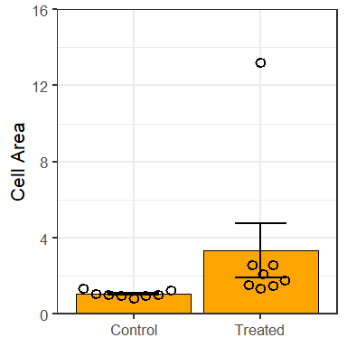
The volume of the cells increased upon treatment
Notes:
Before we start, I’d like you to have a look at this graph; talk to the person next to you about its pitfalls

Slide 3
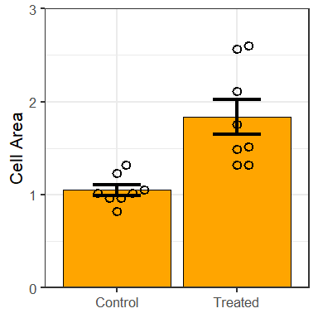
The volume of the cells increased upon treatment
Notes:
Before we start, I’d like you to have a look at this graph; talk to the person next to you about its pitfalls

Slide 4
What this course covers…
Theory of data visualisation
  Why do some figures work better than others?
  Applying theory to common plot types
Ethical data representation
Incorporating principles of graphic design
Practical figure editing and compositing in Inkscape

Slide 5



What this course doesn’t cover…
How to draw graphs in specific programs
http://www.bioinformatics.babraham.ac.uk/training.html

Slide 6
Consider the requirements for a figure
Collect Raw Data
Process and Filter Data
Clean Dataset
Reference Figures
Clean Dataset
Exploratory Analysis
Exploratory Analysis
Exploratory Figures
Generate Conclusion
Generate Conclusion
Illustrative Figures

Slide 7
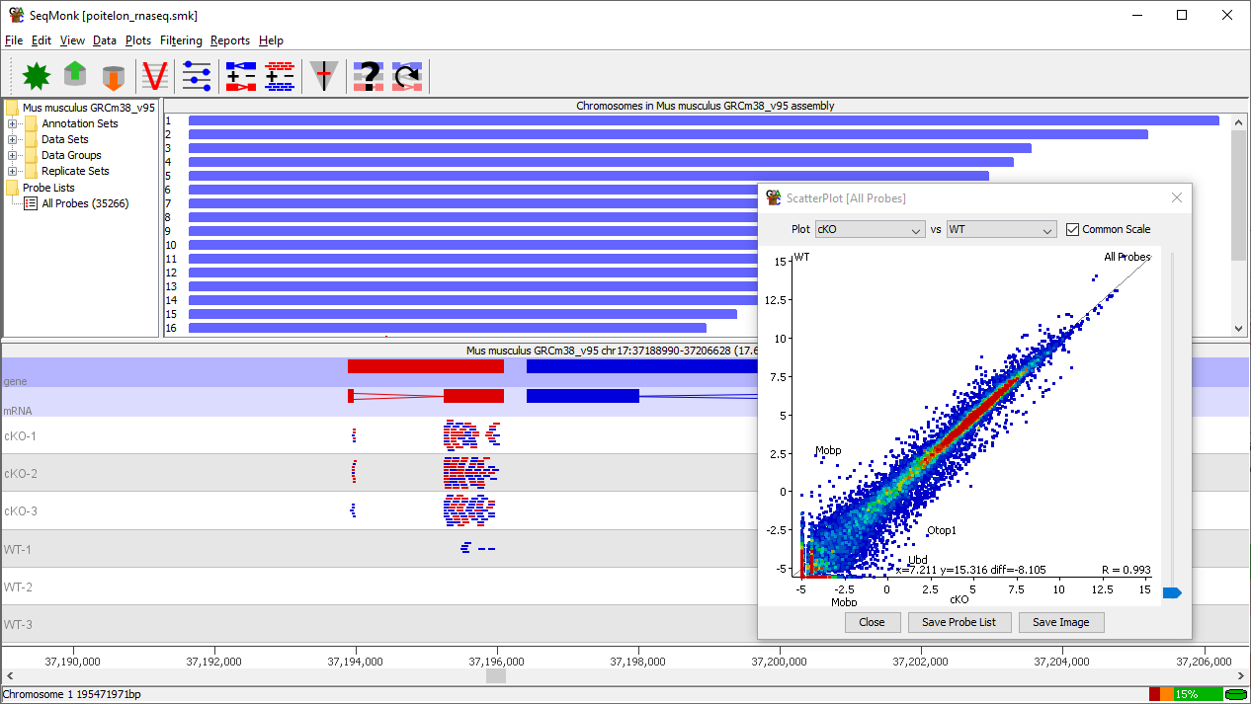
Exploratory figures
Quick!
Complete
Interactive

Slide 8
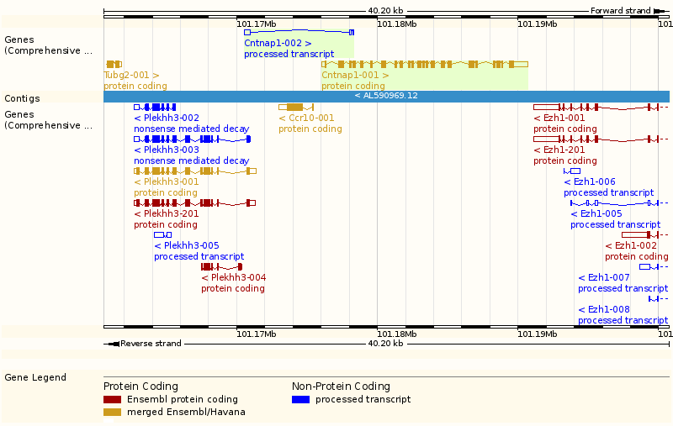
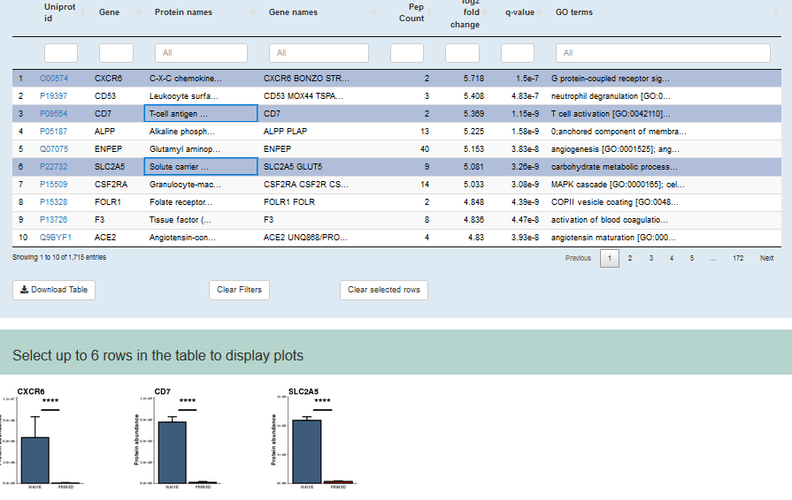
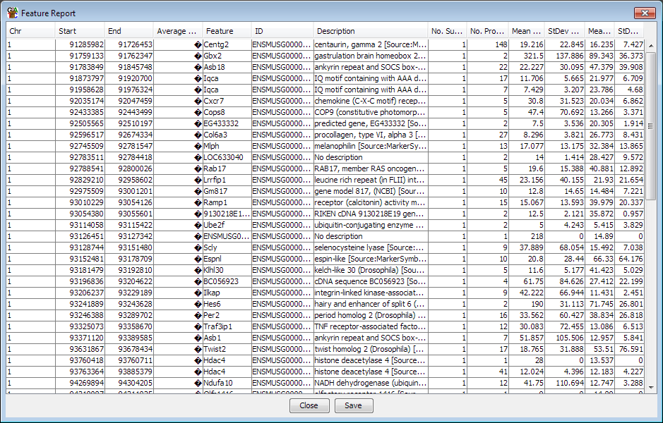
Reference figures
Complete
Flexible

Slide 9
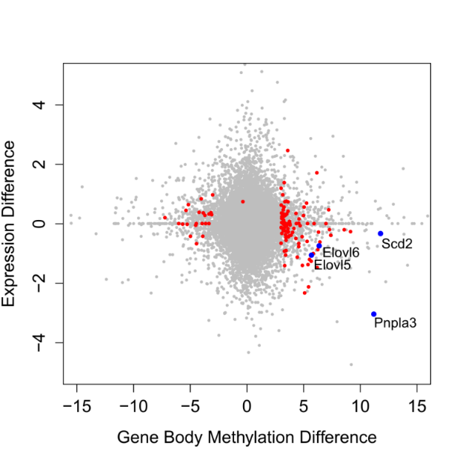
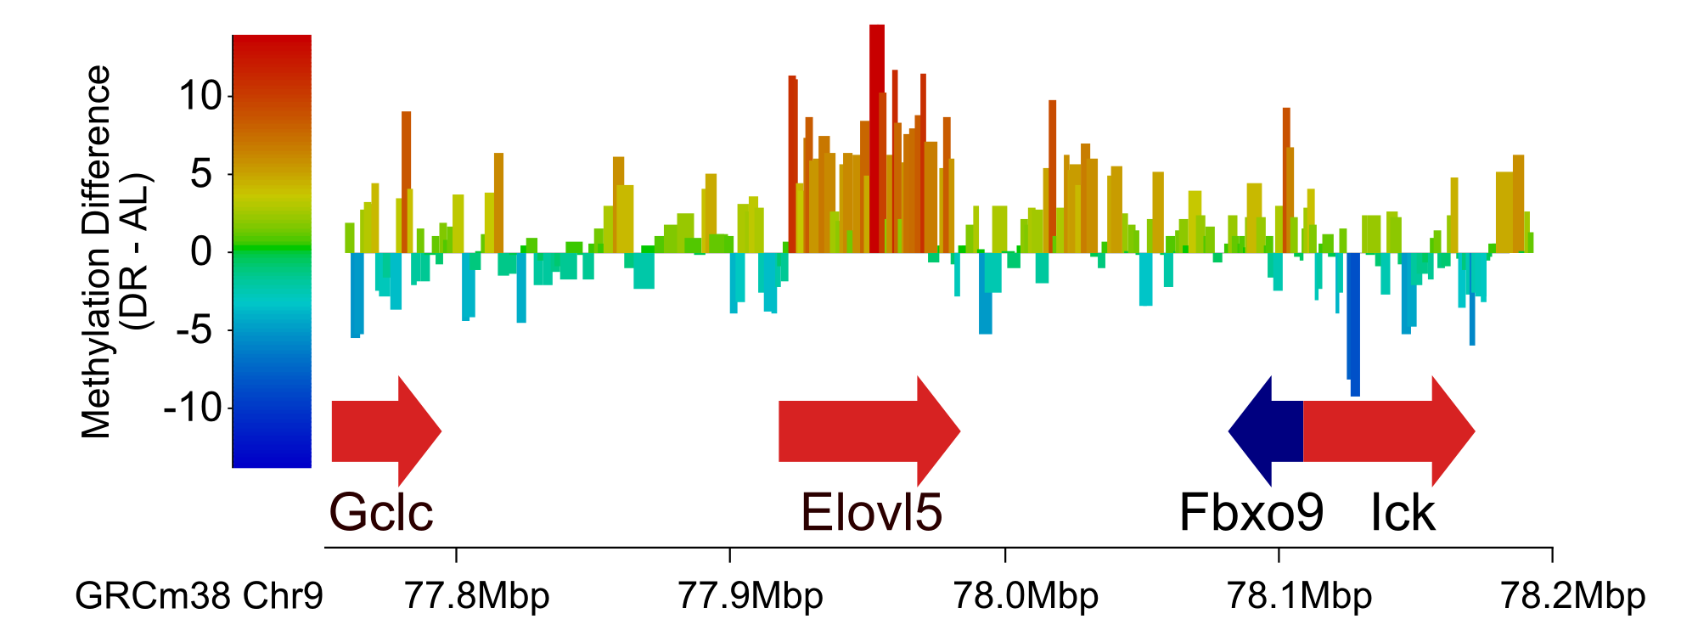
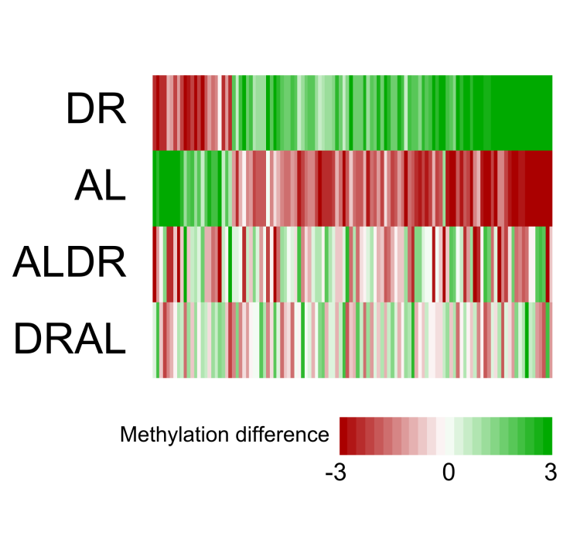
Illustrative figures
Simple
Easy to understand
Well Designed

Slide 10
What makes a good figure?
Has a clear purpose and message
  Helps to tell a story
  Adds to the text, and links to it
Is focused
  Don’t confuse one message with another
Is easy to interpret correctly
  Good data visualisation
  Good design
Is an honest and true reflection of the data

Slide 11
The theory of data visualisation
Simon Andrews, Phil Ewels
simon.andrews@babraham.ac.uk

Slide 13
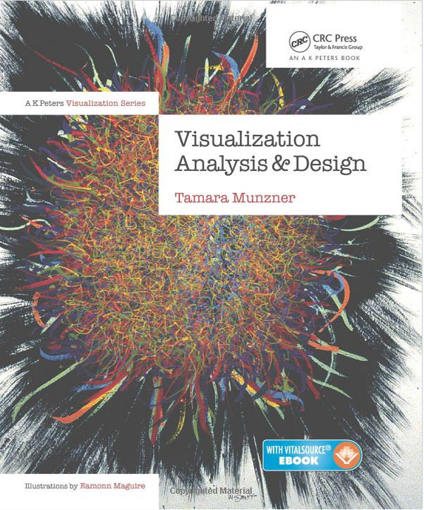
ISBN-10: 1466508914
http://www.cs.ubc.ca/~tmm/talks.html

Slide 14
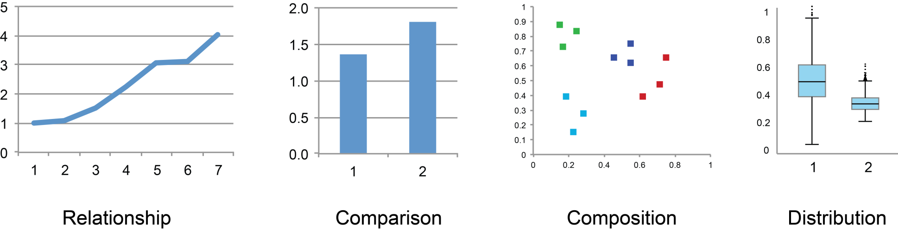
Different representations have common elements

Slide 15
Marks and Channels
Marks
  Geometric primitives
    Lines
    Points
    Areas
  Used to represent data sets
Channels
  Graphical appearance of a mark
    Colour
    Length
    Position
    Angle
  Used to encode data

Slide 16
Figures are a combination of marks and channels
Mark = Circle segment
1 Channel = Angle
Mark = Diamond shape
2 Channels = X position, Y position
Mark = Circle
4 Channels:
X position
Y position
Area
Colour
Mark = Rectangle
2 Channels = X Position, Length of longest side

Slide 17
Golden Rules
Expressiveness
  Match the properties of the data and channel
Effectiveness
  Encode the most important information with the most effective channel

Slide 18
Types of channel
Quantitative
  Position on scale
  Length
  Angle
  Area
  Colour (saturation)
  Colour (lightness)
Qualitative
  Spatial Grouping
  Colour (hue)
  Shape
Quantitative
  Weight
  Length
  Height
  Expression
  Time
  Density
Qualitative
  Treatment
  Genotype
  Batch

Slide 19
Golden Rules
Expressiveness
  Match the properties of the data and channel
Effectiveness
  Encode the most important information with the most effective channel

Slide 20
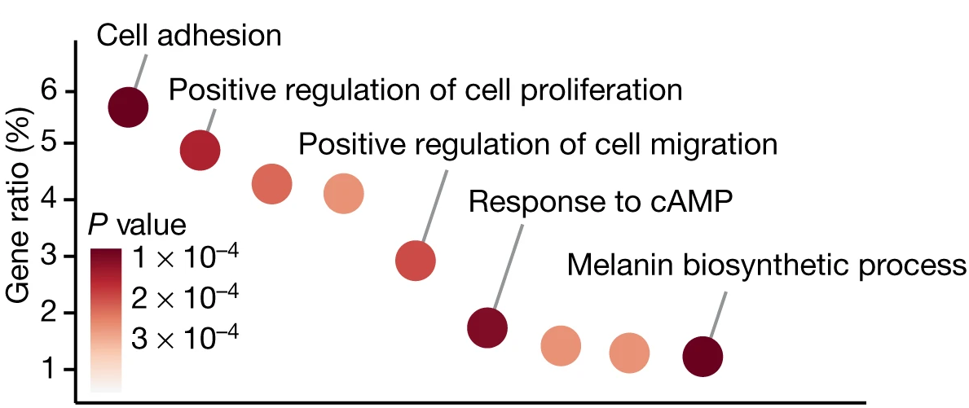
Matching the data and channel

Slide 21
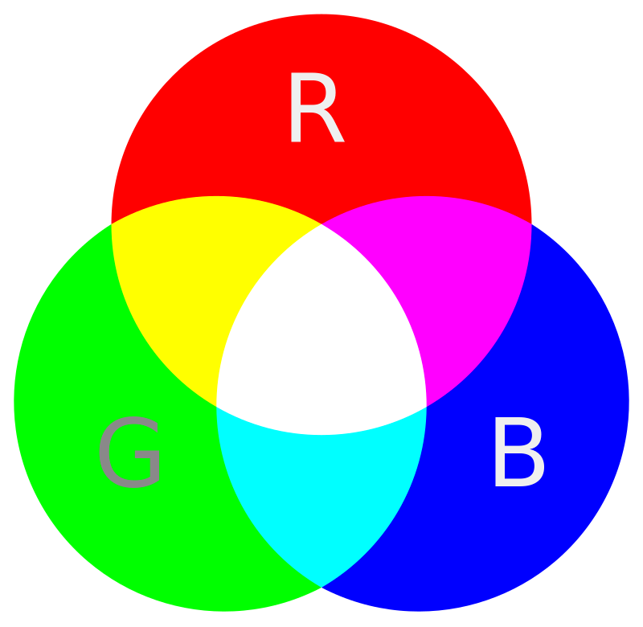
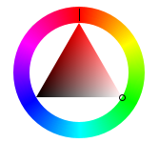
Representing Colour
Only channel to appear in both Qualitative and Quantitative
Technical representations of colour
  Red + Green + Blue (RGB)
  Cyan + Magenta + Yellow + Black (CMYK)
Perceptual representation of colour
  Hue + Saturation + Lightness (HSL)

Slide 22
HSL Representation
Hue = Shade of colour = Qualitative
Saturation = Amount of colour = Quantitative
Lightness = Amount of white = Quantitative
Humans have no innate quantitative perception of hue but we have learned some (cold – hot, rainbow etc.)
Our perception of hue is not linear

Slide 23
Types of colour channel
Quantitative
  Colour (saturation)
  Colour (lightness)
Qualitative
  Colour (hue)
In a single plot you should modify only ONE colour parameter

Slide 24
Golden Rules
Expressiveness
  Match the properties of the data and channel
Effectiveness
  Encode the most important information with the most effective channel

Slide 25
Effectiveness of quantitative channels
2X
4.5X
1.8X
7X
16X

Slide 26
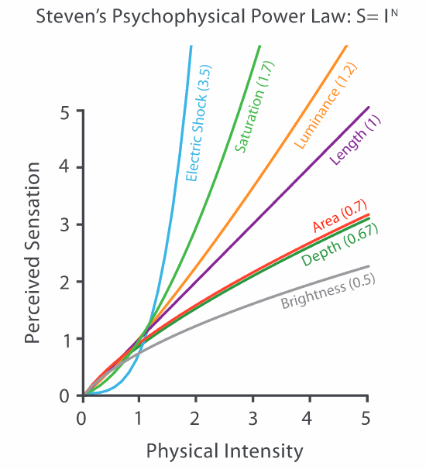
Quantitation Perception

Slide 27
Golden Rules
Effectiveness
  Encode the most important information with the most effective channel
Expressiveness
  Match the properties of the data and channel

Slide 28
Most Quantitative Representations
Good quantitation
Bar chart
Stacked bar chart with common start
Stacked bar chart with different starts
Pie charts
Bubble plots (circular area)
Rectangular area
Colour (luminance)
Colour (saturation)
Poor quantitation

Slide 29
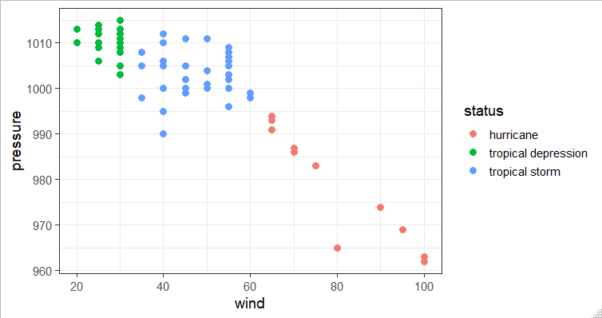
Effectiveness of Qualitative Channels
If you encode categorical data are the differences between categories easy for the user to perceive correctly?

Slide 30
Colour Discrimination
How many colours can you discriminate?

Slide 31
Colour Discrimination
How many colours can you discriminate?

Slide 32
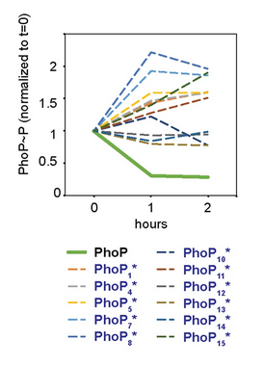
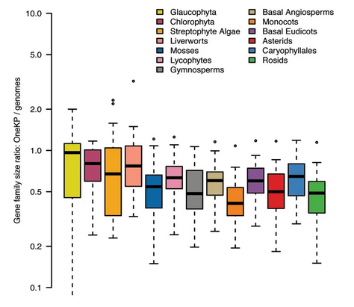
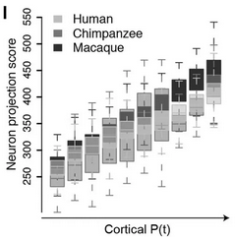
Colour Discrimination

Slide 33
Qualitative Discrimination
How many (fillable) shapes can you discriminate?
Can combine shape with colour, but you need to maintain similar fillable areas

Slide 34
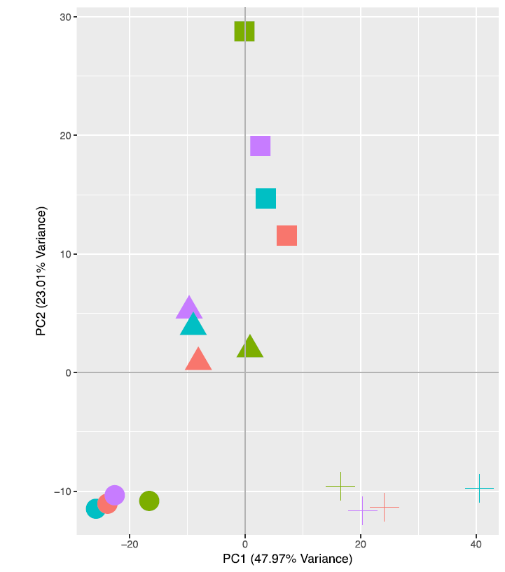
Qualitative Discrimination
You can combine shape with colour, but you need to maintain similar fillable areas

Slide 35
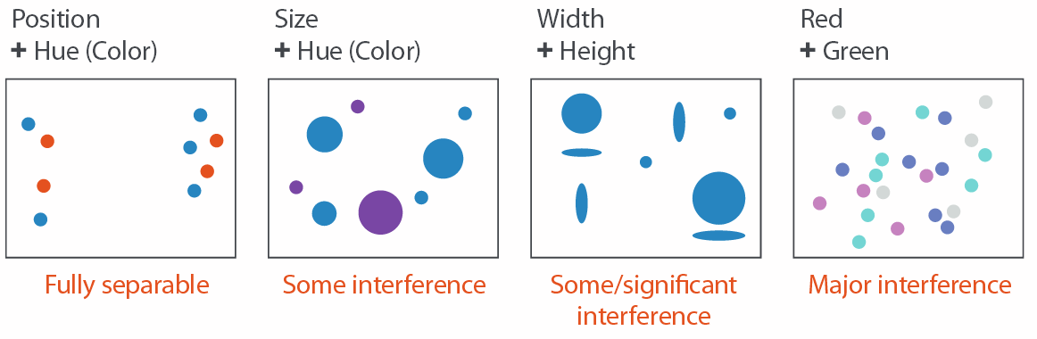
Separability
Adding channels can adversely affect the effectiveness of existing channels
There is no confusion between the two channels
Larger points are easier to discriminate than smaller ones
We tend to focus on the area of the shape rather than the height/width separately
Humans are very bad at separating combined colours

Slide 36
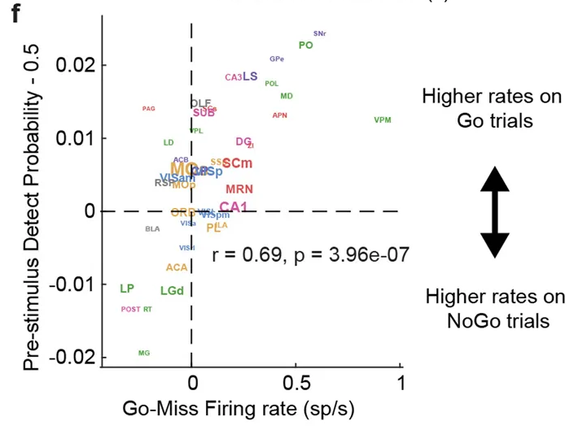
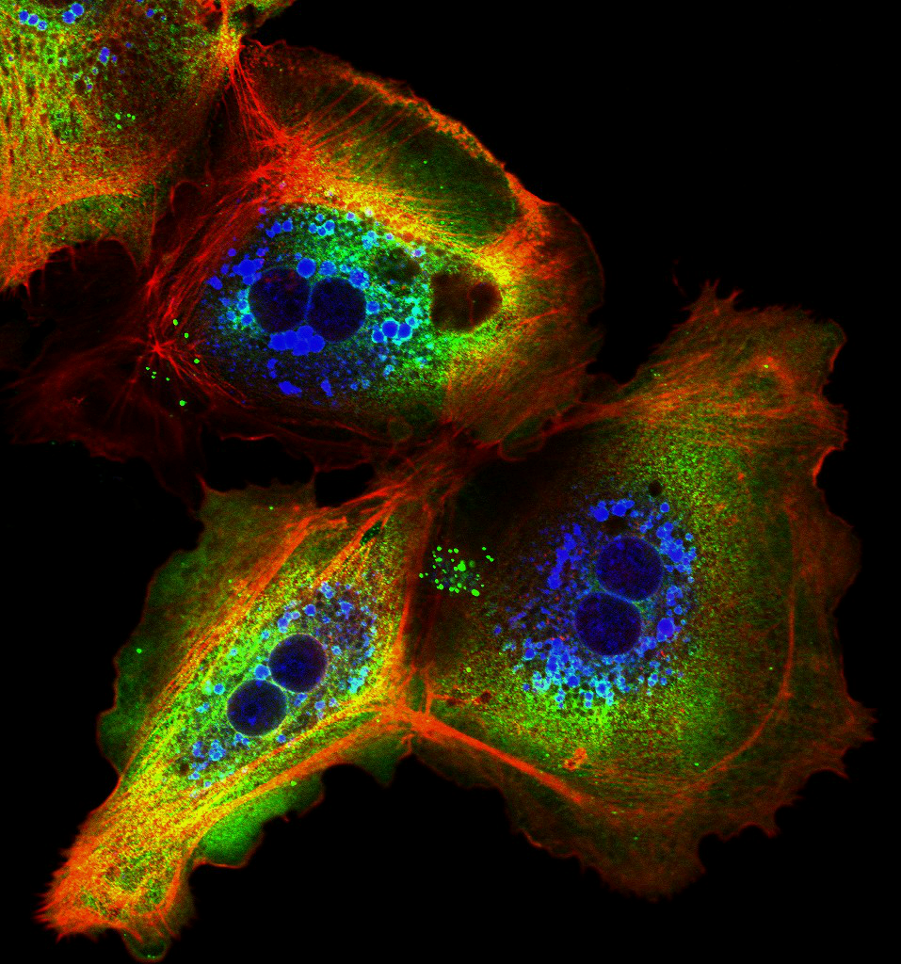
Separability

Slide 37
Other visual cues
How can you modify your plot to improve its ease of interpretation, without changing the basic data representation?

Slide 38
Pop-out
Sometimes you want to draw people's attention to parts of the plot
We can use colours or shapes to trigger a 'popout' reaction
An implicit rather than explicit cue

Slide 39
Popout
(find the red circle)

Slide 40
Popout
Speed of identification is independent of the number of distracting points

Slide 41
Popout
Colour pops out more than shape

Slide 42
Popout
Mixing channels removes the effect
(Find the red circle)

Slide 43
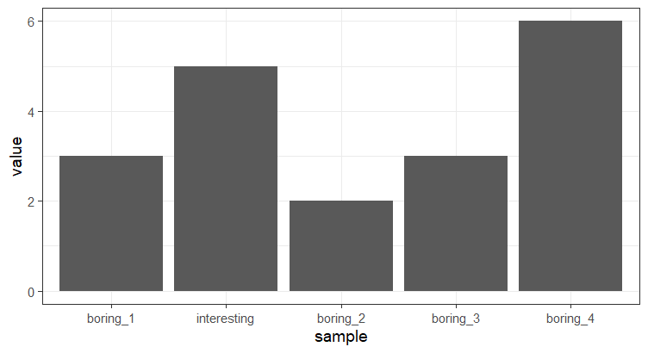
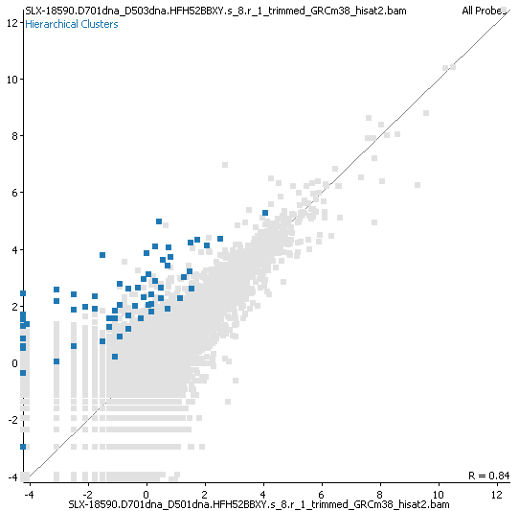
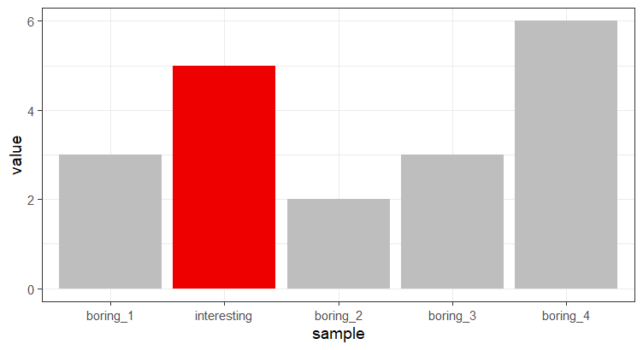
Popout Examples

Slide 44
Other visual clues

Slide 45
Grouping

Slide 46
Other visual clues
Is a monkey heavier than a dog?

Slide 47
Other visual clues
Is a monkey heavier than animal X?

Slide 48
Containment / Linking
Wild Type
Mutant

Slide 49
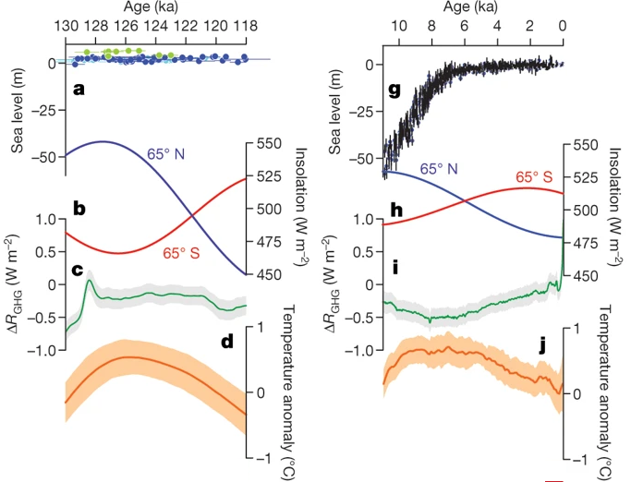
Containment / Linking

Slide 50
How do you know if your figure is working?

Slide 51
Validation
Always try to validate plots you create
You have seen your data too often to get an unbiased view
Show the plot to someone not familiar with the data
  What does this plot tell you?
  Is this the message you wanted to convey?
  If they pick multiple points, do they choose the most important one first?

Slide 52
Exercise
You will be given a series of (not very good) plots to validate. Try to think what message the plot is trying to convey and whether it is doing so effectively.
Work out how you would choose to represent the data if you don’t like the way it’s presented now.

Slide 53
Making effective use of common plot types
Anne Segonds-Pichon
Simon Andrews
Phil Ewels
simon.andrews@babraham.ac.uk

Slide 54
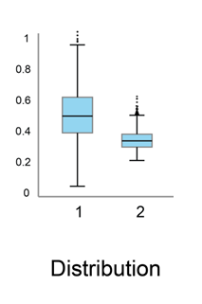
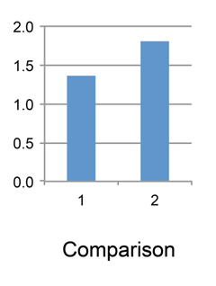
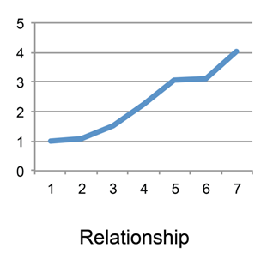
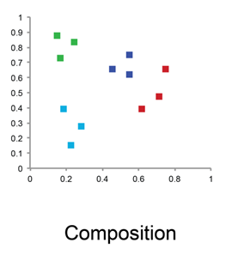
Types of plot
Things you can illustrate

Slide 55
Distributions

Slide 56
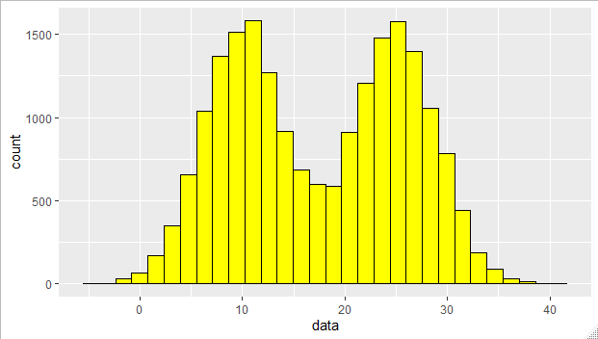
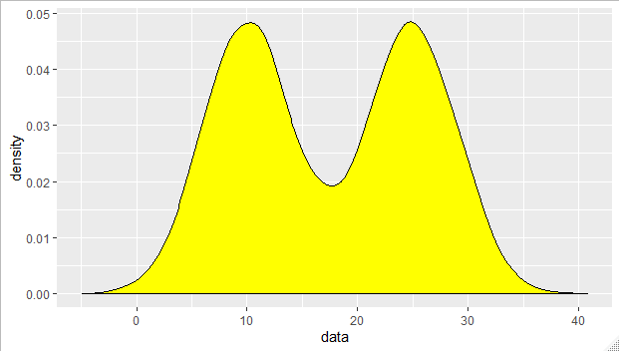
Representing Distributions
Single Samples
Histograms
Density Plots

Slide 57
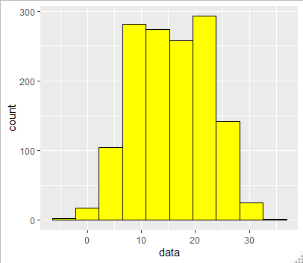
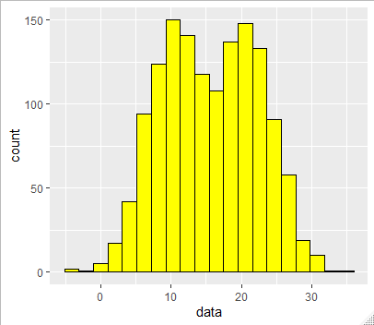
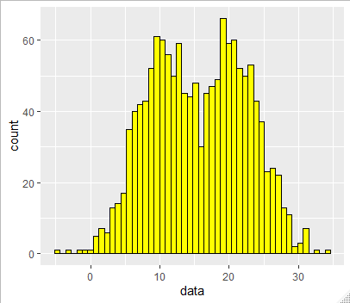
Representing Distributions
Single Samples - Bandwidth

Slide 58
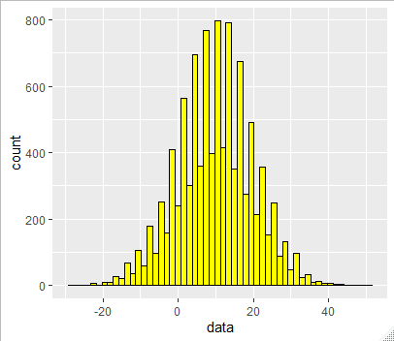
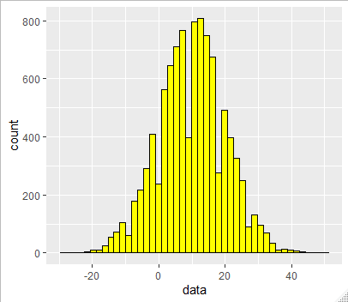
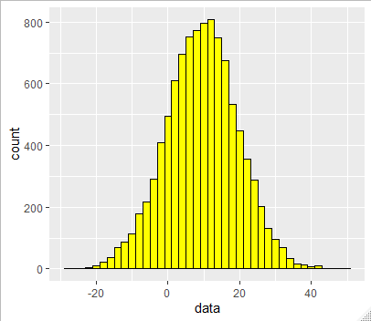
Representing Distributions
Single Samples – Discontinuous data
Plotting Integer Data
1.5
1.8
2

Slide 59
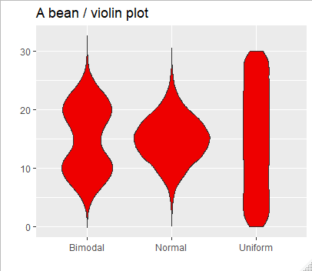
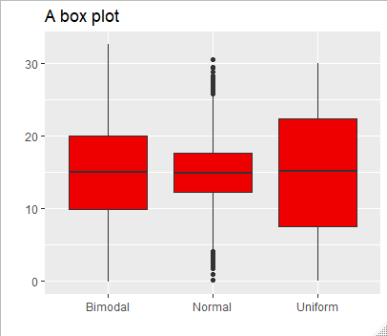
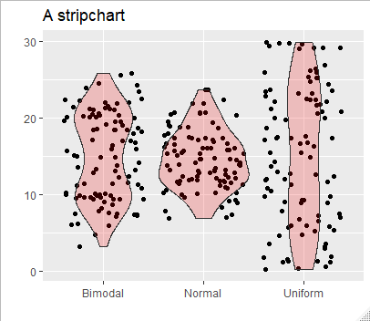
Representing Distributions
Multiple Samples

Slide 60
Comparisons

Slide 61
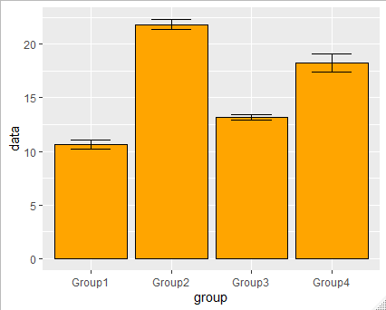
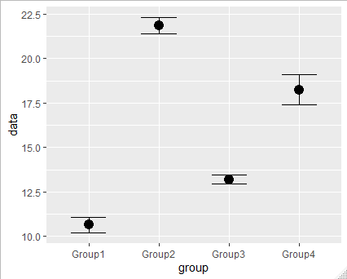
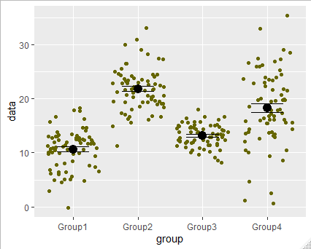
Comparisons

Slide 62
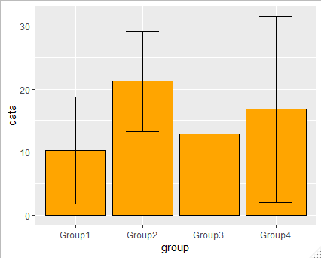
Error Bars
Standard Error of Mean (SEM)
How accurately is the mean calculated
Gets smaller with increased data
Good when comparing means
Standard Deviation (SD)
How well does the mean summarise the data
No systematic change with increased data
Good when comparing variability

Slide 63
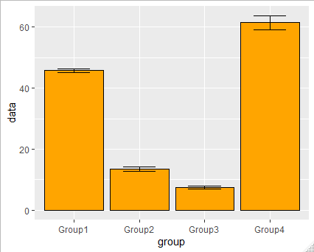
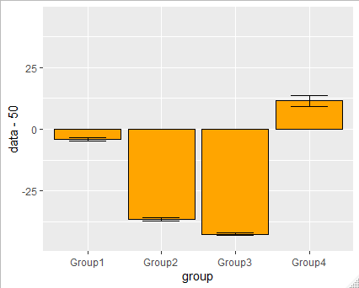

Setting a suitable baseline

Slide 64
Relationships

Slide 65
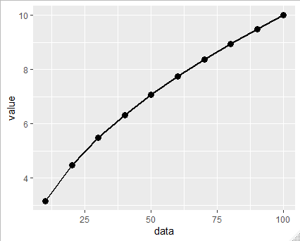
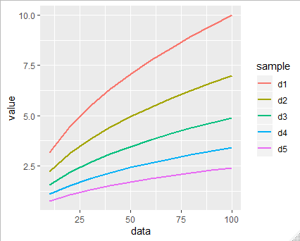

Relationships – Line Graphs

Slide 66



Relationships - Scatterplots

Slide 67
Composition

Slide 68
Pie Charts

Slide 69


Stacked Bar Charts

Slide 70


Heatmaps

Slide 71

Making Heatmaps Effective
Cluster rows and columns
Median centre rows
Diverging symmetrical colour scheme (colourblind friendly)
Clear annotation

Slide 72
Ethics of data representation
Simon Andrews, Anne Segonds-Pichon
simon.andrews@babraham.ac.uk

Slide 73
What is an Ethical data visualisation?
Different ways of being unethical:
  not exploring/getting to know the data well enough
  misusing your chosen graphical representation
  deliberately showing the data in a misleading manner
  choosing the ‘most representative’ image/experiment

Slide 74
Is my plot ethical?
Would a reader come to a different conclusion if they could see the details of the data which were omitted from the plot?

Slide 75


Advertising and politics are built on unethical data representation.
https://venngage.com/blog/misleading-graphs/

Slide 76
Not exploring the data well enough
One experiment, multiple measures, two conditions.

Slide 77
Not exploring the data well enough
Comparisons:
Treatments vs. Control
p=0.001
p=0.04
Exp5
p=0.32
Exp4
Exp3
Exp1
Exp2
Five experiments, single measures, control plus 3 treatments

Slide 78
Choosing the wrong axis/scale
Salaries offered vs date

Slide 79


Choosing the y-axis/scale
Inappropriate use of a log scale

Slide 80


Choosing the y-axis/scale
Logarithmic axis should only be used for:
Logarithmically spaced values
Lognormal data

Slide 81



Image Manipulation
‘Playing’ too much with contrast
“Adjusting the contrast/brightness of a digital image is common practice and is not considered improper if the adjustment is applied to the whole image.
Adjusting the contrast/brightness of only part of an image is improper, however, and this practice can usually be spotted by someone scrutinizing a file.”
Original
Brightness and Contrast Adjusted
Brightness and Contrast Adjusted Too Much:
Oversaturation

Slide 82


Image Manipulation

Slide 83





Image Manipulation can be detected
https://forbetterscience.com

Slide 84
Is my plot ethical?
Would a reader come to a different conclusion if they could see the details of the data which were omitted from the plot?

Slide 85
Practical Design Theory
Boo Virk
Simon Andrews
simon.andrews@babraham.ac.uk

Slide 86
Why does good design matter?
Good design makes a great first impression
Good design makes for effective communication
Good design keeps the reader engaged
Art Palvanov (http://www.palvanov.com/)

Slide 87
Planning
Always look at the guidelines for the journal you're submitting to
  https://www.sciencemag.org/authors/instructions-preparing-initial-manuscript
  https://www.nature.com/nature/for-authors/formatting-guide
  https://www.cell.com/figureguidelines
Huge variation in the amount of detail they provide
Getting things right from the start saves huge amounts of time

Slide 88
General Figure Guidelines
Use distinct colors with comparable visibility and consider colorblind individuals by avoiding the use of red and green for contrast. Recoloring primary data, such as fluorescence images, to color-safe combinations such as green and magenta, turquoise and red, yellow and blue or other accessible color palettes is strongly encouraged. Use of the rainbow color scale should be avoided.
Use solid color for filling objects and avoid hatch patterns.
Avoid background shading.
Figures divided into parts should be labeled with a lower-case, boldface 'a', 'b', etc in the top left-hand corner. Labeling of axes, keys and so on should be in 'sentence case' (first word capitalized only) with no full stop. Units must have a space between the number and the unit, and follow the nomenclature common to your field.
Commas should be used to separate thousands.
Unusual units or abbreviations should be spelled out in full, or defined in the legend.
https://mts-ncomms.nature.com/cgi-bin/main.plex?form_type=display_auth_instructions

Slide 89

Plan out your panels
Plan your panels before starting to draw final figures
Plan to be consistent
  Multiple figures of the same type
  Common colour/shape schemes
  Common fonts and sizing
  Common abbreviations and units
  Common naming of samples / conditions

Slide 90



Slide 91

Alignment: We are sensitive to aligned edges, even when they are separated
Control
200
Treatment A
150
Treatment B
100
50
0
120
Control
100
Control
80
Treatment A
Treatment A
60
Treatment B
Treatment B
40
Dead
20
0
0
1
2
3
4
5
6
Day

Slide 92
Use a grid to help align disparate parts of a figure
200
Control
Treatment A
150
Treatment B
100
50
0
120
Control
Control
100
Treatment A
80
Treatment A
60
Treatment B
Treatment B
40
Dead
20
0
0
1
2
3
4
5
6
Day

Slide 93

Don't make figures too crowded

Slide 94

Don't make figures too crowded

Slide 95


Don't cram too much information onto one figure

Slide 96

Don’t invent your own colour schemes
Colorbrewer2.org

Slide 97
If possible try to consider colour blind readers
Affects 1:12 men and 1:200 women worldwide
“If a submitted manuscript happens to go to three male reviewers of Northern European descent, the chance that at least one will be colour blind is 22 percent.”

Slide 98


See how well your figure works for colour blind people
Gradients are easy to change
Categorical colours are very limited
Basic interpretability in black and white is ideal
Normal colour vision
Protanopia
https://www.color-blindness.com/coblis-color-blindness-simulator/

Slide 99



Try to consider colour blind readers

Slide 100

Only use plain colours as fills
Use a standard colour scheme
Optimise for colour blind people if possible
Keep colours plain

Slide 101
When overlaying information, make sure you have sufficient contrast
Poor contrast
Good contrast
Poor contrast
Good contrast

Slide 102

Add overlays to increase contrast
Poor contrast
Good contrast

Slide 103
Keep text and fonts simple
All fonts for figures should use sans serif fonts
All text in figures should be black or white*
sans-serif
serif
Wild type
Knockout
Wild type
Knockout
* Some journals insist on coloured text. They're wrong, but you can't fight the system

Slide 104


Contrast and text

Slide 105





Keep text horizontal

Slide 106

Keep text horizontal
Numbers are small, text is big
All graphs still work when rotated 90º

Slide 107


Keep text horizontal

Slide 108

Labelling and annotation
Each axis is labelled
Axis scales are appropriate
Quantitative axes have units
Colour scheme is explained
Point shapes are explained
You need enough annotation that the figure is understandable on its own.

Slide 109



Labelling and annotation

Slide 110
Make sure all text is legible at the final printed size
6 point font is the smallest you can comfortably read
(just over 2mm height on paper)

Slide 111

Make sure text is legible

Slide 112


When resizing be aware of what can and cannot have its aspect ratio changed
Things that always need to maintain their aspect ratios:
  Images
  Text
  Circular objects
  Axes with comparable units
X
✓

Slide 113
Checklist
Consistent use of
  Figure types
  Colours / Shapes
  Fonts and Sizes
  Names
Colour
  Uses a standard scheme
  Colourblind friendly (if possible)
All figures are correctly annotated
  Axes labelled with names and units
  Colours and Shapes explained
Text
  Sans serif font
  Large enough to be legible
  Ideally in black or white
  Sufficient contrast to be legible

