Slide 1
Software: the good, the bad and the ugly
Festival of Genomics 2017
Russell Hamilton
rsh46@cam.ac.uk

Slide 2
Software: What’s good, bad and ugly
Bioinformatics Software
All software contains bugs:
Industry Average: “about 15 - 50 errors per 1000 lines of delivered code”
Steve McConnell (author of Code Complete and Software Estimation: Demystifying the Black Art)
Range from spelling mistake in error message to completely incorrect results
Most software will process the input to produce an output without errors or warnings
Never blindly trust software or pipelines
Always test and validate results
Avoid black box software (definition: produces results, but no one knows how)
Software X
W
Y
Z
X

Slide 3
Software: What’s good, bad and ugly
Different classes of bioinformatics software
Class | Examples | Description
Processing | TopHat2, Bowtie2 | Performing computationally intensive task, applying mathematical models
Evaluation | FastQC, BamQC | Deriving QC metrics from output files
Converters | SamToFastq (Picard Tools ) | Simply converting between file formats. Generally stable no regular updates
Pipelines | Galaxy, ClusterFlow | The glue for joining software to create an automated pipeline
Software X
W
Y
Z
X

Slide 4
Software: What’s good, bad and ugly
12 Step Guide for evaluating and selecting bioinformatics software tools
Finding Software to do the job
Has the software been published?
Software Availability
Documentation Availability
Presence on user groups
Installation and Running
Errors and Log Files
Use standard file formats
Evaluating Commercial Software
Bugs in scripts / pipelines to run software
Writing your own software
Using and creating pipelines

Slide 5

Software: What’s good, bad and ugly
1. Finding software to do the job
Identify the required task
Alignment of methylation sequencing data to reference genome
Are there related studies performing similar analysis? Publication / posters / talks
Required features
Must Have
1. INPUT standard FASTQ format files
2. OUTPUT standard BAM alignments
3. OUTPUT Compatible with methylKit
Like to have
1. Perform methylation calls
2. Must make use of multi processors for large
numbers of samples

Slide 6
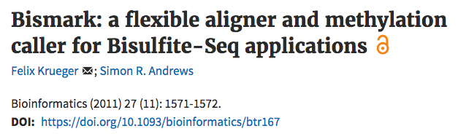

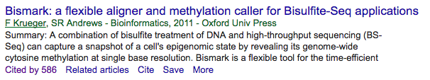
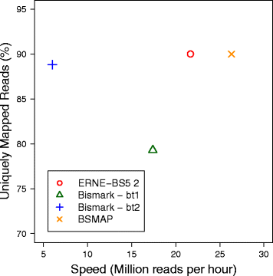
Software: What’s good, bad and ugly
2. Has the software been published?
✓
Published in a peer reviewed journal
As stand alone software or part of study
✓
Cited by other peer reviewed papers
✓
Has the software been benchmarked
(by other people than the authors)
Short read mapping is “generally solved problem”
Informative for run times
BMC Bioinformatics; 2016; 17(Suppl 4):69
DOI: 10.1186/s12859-016-0910-3

Slide 7
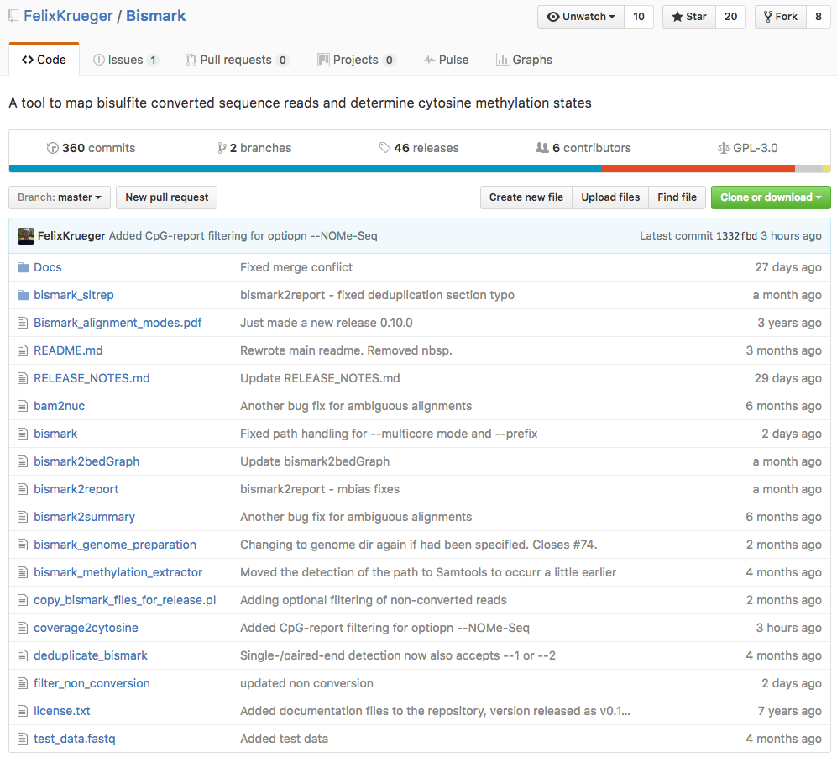
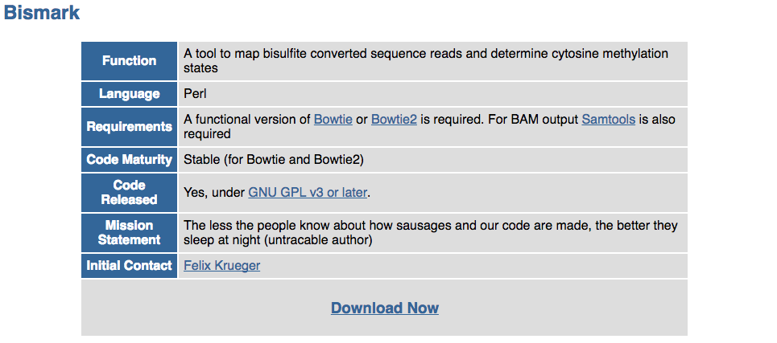
Software: What’s good, bad and ugly
3. Software Availability
✓
Software available for download
Hosted on a recognised software repository
e.g. GitHub, BitBucket, SourceForge
Software regularly updated / bugs fixed / releases
More than one developer (e.g. group account)
Permanent archive of software releases
e.g. zenodo.org, figshare.com
✓
✓
University / Institute / Company Web site
Software is the responsibility of a group not just an individual

Slide 8
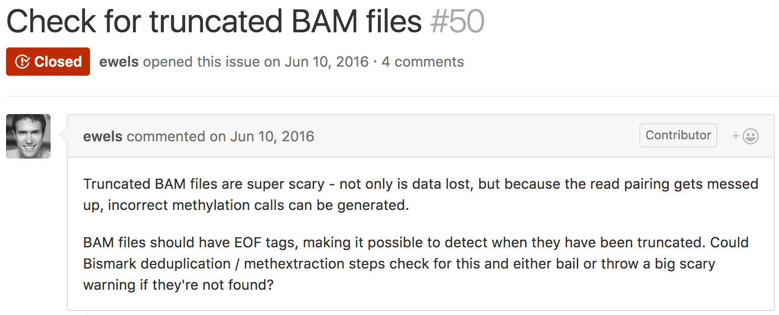
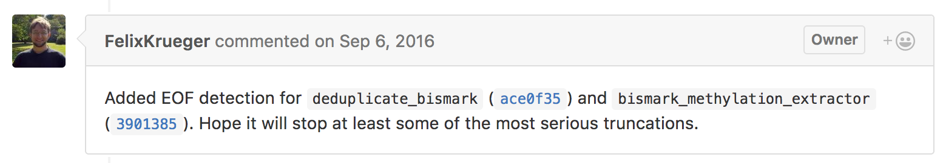
Software: What’s good, bad and ugly
3. Software Availability
✓
Bugs are reported and fixed
New feature requests are added

Slide 9
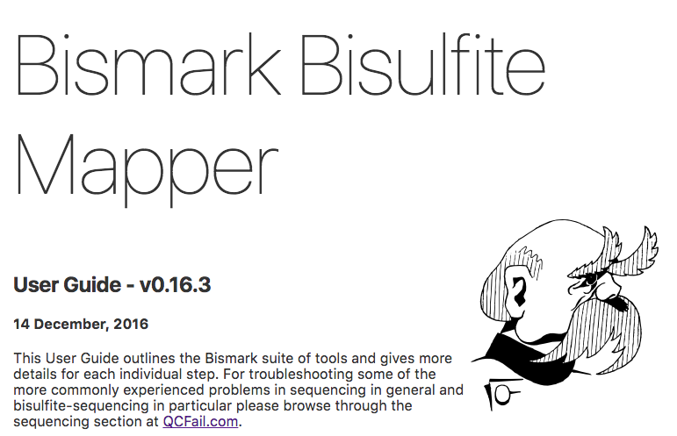
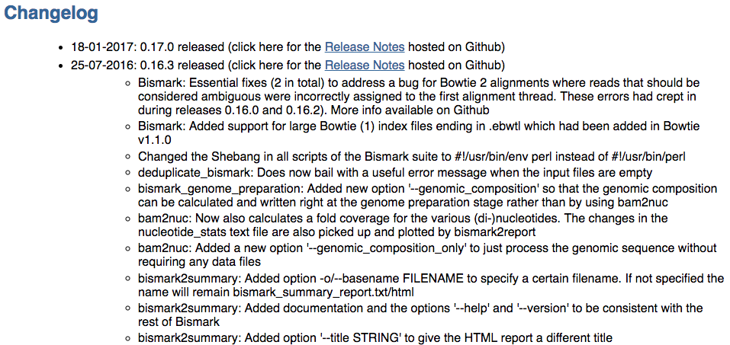
Software: What’s good, bad and ugly
4. Documentation Availability
✓
User Documentation
✓
Release Documentation
Versions – aids reproduceability

Slide 10
Software: What’s good, bad and ugly
4. Documentation Availability
Example: RNA-Seq Differential Gene analysis using DESeq2 Discover limitations
DESeq2 Manual
”The results function without any arguments will automatically perform a contrast of the last level of the last variable in the design formula over the first level.”
Name fileName genotype
WT1 wt1.htseq_counts.txt WT
WT2 wt2.htseq_counts.txt WT
WT3 wt3.htseq_counts.txt WT
KO1.1 ko1.1.htseq_counts.txt KO1
KO1.2 ko1.2.htseq_counts.txt KO1
KO1.3 ko1.3.htseq_counts.txt KO1
KO2.1 ko2.1.htseq_counts.txt KO2
KO2.2 ko2.2.htseq_counts.txt KO2
KO2.3 ko2.3.htseq_counts.txt KO2
KO3.1 ko3.1.htseq_counts.txt KO3
KO3.2 ko3.2.htseq_counts.txt KO3
KO3.3 ko3.3.htseq_counts.txt KO3
WT
KO1
KO2
KO3
WT
X
X
X
KO1
X
X
KO2
X
KO3
count.data <- DESeqDataSetFromMatrix(sampleTable=smplTbl,
design= ~ genotype)
count.data <- DESeq(count.data)
binomial.result <- results(count.data)
binomial.result <- results(count.data, contrast=c(”genotype",”K01",”K02"))
✗
✓

Slide 11
Software: What’s good, bad and ugly
5. Presence on user groups
✓
Evidence for support questions being answered
e.g. FAQ, searchable public support group
http://seqanswers.com
https://www.biostars.org
GitHub Issues
Google Groups
Is there someone near by you can ask for help
Bioinformatics Core Facility
Research group down the corridor

Slide 12
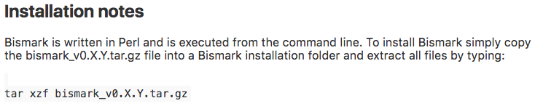
Software: What’s good, bad and ugly
6. Installation and Running
✓
Will run on standard architecture
Docker/Galaxy/BaseSpace
✓
Easy to install
✓
Release versions
$ bismark --version
Bismark - Bisulfite Mapper and Methylation Caller.
Bismark Version: v0.16.3_dev
Copyright 2010-15 Felix Krueger, Babraham Bioinformatics
www.bioinformatics.babraham.ac.uk/projects/
✓
Default parameters
A sensible set of default parameters that are likely to produce a good first pass at the results
✓
Source code available
Binaries can simplify installation

Slide 13
Software: What’s good, bad and ugly
6. Installation and Running
Example: Traceability of results though the steps in the analysis
Intermediate results are excellent check points
✓
Per Gene std.dev
Sample:Sample Correlation
✓
Alignment
✓
✓
Differentially Expressed Genes
BAM
HTSeq-count
counts
DESeq2
✓
✓
Normalised read counts
Sample PCA
✓
✓
MA-Plots
RNA-Seq Differential Gene Expression Analysis

Slide 14
Software: What’s good, bad and ugly
7. Errors and Log Files
Keep and read log files for software run
Warnings
Don’t ignore warnings, they may be telling you something crucial about your data
Errors
Problem severe enough for the program to stop and produce an error

Slide 15
Software: What’s good, bad and ugly
8. Use standard file formats
Bioinformaticians spend an embarrassing amount of time converting between file formats
✓
Standard Input Files
FASTA, FASTQ
Converting between formats could introduce errors
✓
Standard Output Files
BAM
Compatible with downstream tools

Slide 16
Software: What’s good, bad and ugly
9. Evaluating Commercial Software
Should you use commercial software to do RNA-Seq DGE analysis?
Lots of good commercial software available e.g. Partek
Pros | Cons
Graphical Interface – no command line | Run analysis without understanding the steps
Single application for all steps | Harder to trace back step by step
Dedicated Customer Support | Limited user group activity
 | Less transparency (methods / bugs fixed)
 | Expensive
 | License required to reproduce analysis (e.g. reviewers)

Slide 17
Software: What’s good, bad and ugly
10. Bugs in scripts / pipelines to run software
Often written specifically for each analysis or project and are prone to bugs
Examples of accidentally missing out samples
1. Bash Script for running fastQC
for file in *_1.fq.gz;
do
fastqc $file
done
multiqc .
2. RNA-Seq DESeq2 Sample Table
genotype <- data.frame(
‘WT’, ’wt’, ’Wt’, ‘KO1’,’kO1’,’KO1’,
‘KO2’,’Ko2’,’KO2’,‘KO3’,’KO3’,’KO3’)
...
results(dds, contrast=c(”genotype",”WT",”K02"))

Slide 18
Software: What’s good, bad and ugly
11. Utilising dedicated Pipeline tools
The bad and ugly
Home made “glue” scripts for running software can be bug prone
“dark script matter” isn’t reviewed or assesses and rarely released in methods sections
In a 3000 sample study, errors are propagated 3000 times!
The good
Purpose build pipeline tools
Premade pipelines for e.g. RNA-Seq differential gene expression
Job queuing - Load balancing across hardware (laptop to cluster farm)
Log files track a samples progress through pipeline

Slide 19
Software: What’s good, bad and ugly
11. Utilising dedicated Pipeline tools
Interaction via a web browser
Public and private server installs
Many pre-built pipelines
Large user community
https://usegalaxy.org/
Command line interface
Many pre-built pipelines
http://clusterflow.io/
Common
Workflow
Language
A language for building your own pipelines
Utilised by other pipeline tools e.g. NextIO
https://github.com/common-workflow-language

Slide 20

Software: What’s good, bad and ugly
12. Developing your own software
If you are sure a great piece of software doesn’t already exist or can be modified for the task
Developing your own tools gives an appreciation of how difficult it can be
Rule 1: Identify the Missing Pieces
Rule 2: Collect Feedback from Prospective Users
Rule 3: Be Ready for Data Growth
Rule 4: Use Standard Data Formats for Input and Output
Rule 5: Expose Only Mandatory Parameters
Rule 6: Expect Users to Make Mistakes
Rule 7: Provide Logging Information
Rule 8: Get Users Started Quickly
Rule 9: Offer Tutorial Material
Rule 10: Consider the Future of Your Tool

Slide 21
Software: What’s good, bad and ugly
Weighting the evaluation criteria
 | Criteria | Importance | Comments
1 | Finding Software to do the job | +++++ | Use the right tools for the job
2 | Has the software been published? | +++ | New software being released so check for improved methods. Just because its published and well used doesn’t mean it’s still the best
3 | Software Availability | ++ | Openness it a good sign for finding error / bugs / suggesting feature enhancements
4 | Documentation Availability | +++++
5 | Presence on user groups | +++++
6 | Installation and Running | +++
7 | Errors and Log Files | +++++
8 | Use standard file formats | ++++ | Conversions could add sources of error
9 | Evaluating Commercial Software | + | Price Vs Open source software
10 | Bugs in scripts / pipelines to run software | +++++ | Pipelines standardise workflows
11 | Utilising dedicated pipeline tools | +
12 | Writing your own software | + | Don’t re-inventing the wheel

Slide 22
Software: What’s good, bad and ugly
Weighting the evaluation criteria
Compromises for run time vs accuracy/sensitivity
Project A has 3000 samples vs Project B with 12 samples
Method 1: 4 hours per sample 98% accuracy
Method 2: 30 mins per sample 97% accuracy
What would you choose if
Method 1: 4 hours per sample 98% accuracy
Method 3: 15 mins per sample 90% accuracy
Method 1
Method 2
Method 3

Slide 23
Software: What’s good, bad and ugly
Summary
Many ways to evaluate software
  Openness and engagement with users is very important
  - bugs fixed, features added, large user base
  Evaluate features, e.g. run time, against your project requirements
  If you are using pipelines, use purpose build pipelining tools

