Slide 1
Understanding and Validating Experimental Expectations
Festival of Genomics 2017
Simon Andrews
simon.andrews@babraham.ac.uk

Slide 2
Types of Expectation
Nature of samples Human Male Liver
Nature of data RNA-Seq/Genomic
Efficacy of processing Equal losses
Effect of interventions Did they work
Nature of effects Global/Local
Sources of variation Any unexpected

Slide 3
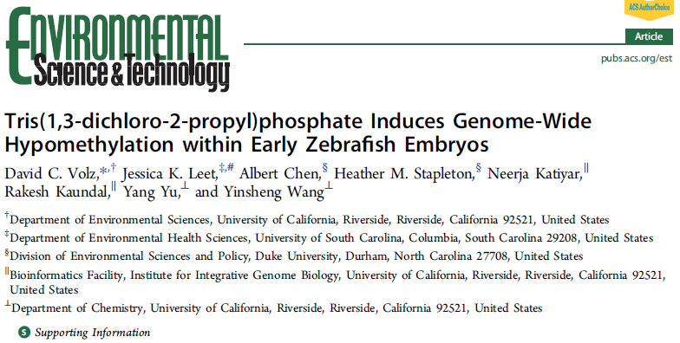
Raw Data Expectation

Slide 4
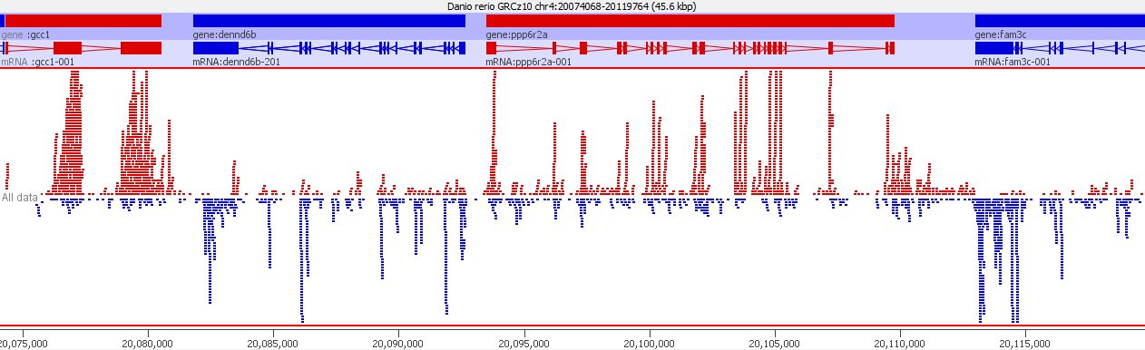
Raw Data Expectations
Bisulphite Sequencing
  Whole genome – all regions equally sampled
  Both strands – no read level strand bias

Slide 5
RNA-Contamination
Calls
Red = meth
Blue = unmeth
Methylation level

Slide 6
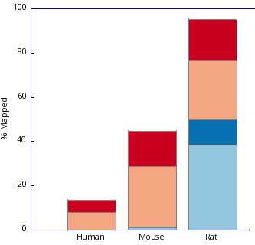
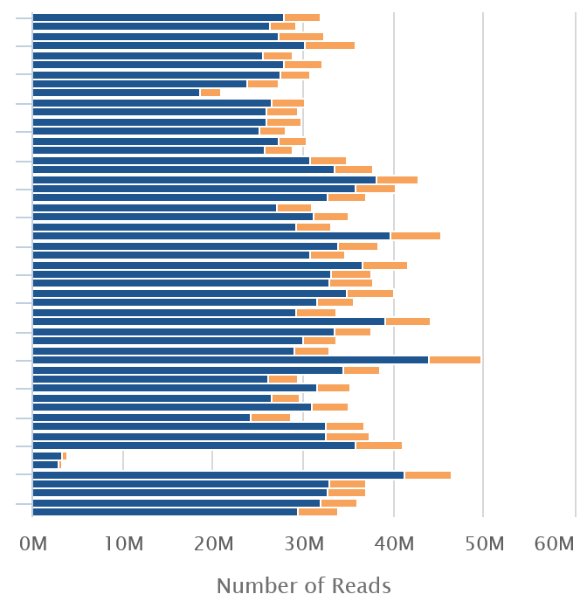

Processing Expectations
(Mouse RNA-Seq)
FastQ Screen
We were really shocked to see that the mouse … cells are actually rat.
We bought them from a company

Slide 7
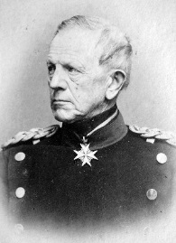
Expectations
Your analysis plan is intrinsically linked to your expectations
analysis
data
“No battle plan survives contact with the enemy.”
Helmuth von Moltke

Slide 8
Gene KO Biological Assumptions
The knockout experimental strategy worked as expected
The reduction in transcript is large enough to achieve a biological effect
The system didn’t find a simple way to compensate

Slide 9
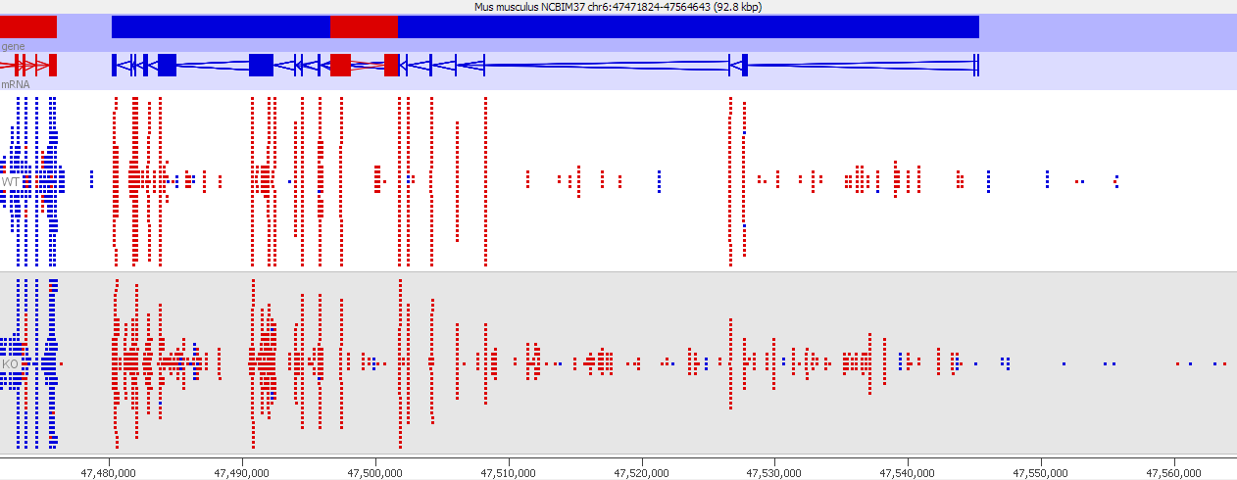
Expected Effects

Slide 10

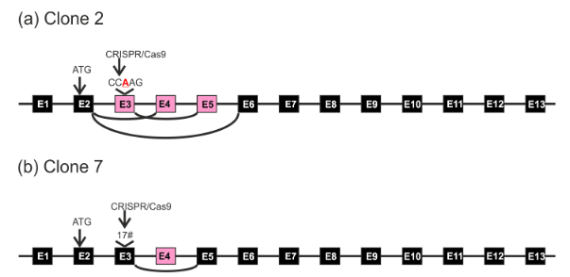
Compensation

Slide 11
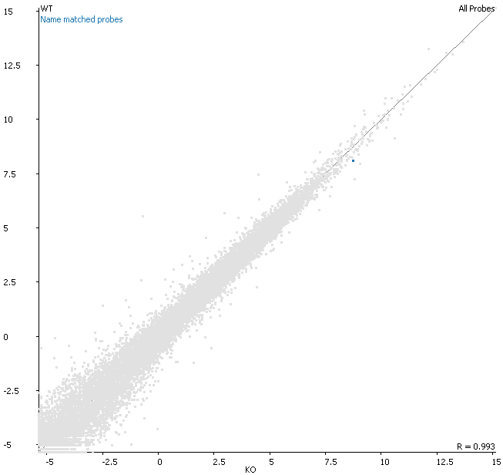
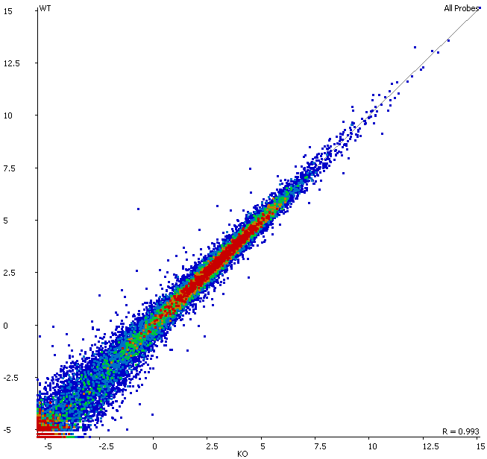
Biological Relevance
Heterozygous gene knockout
Giving very few hits through a standard pipeline

Slide 12
Expected Changes Assumptions
The change will only directly affect a limited subset of genes
Genes which are highly affected by the change will be split between being downregulated and upregulated
The general patterning of transcript expression will not change
The change will be similar in all biological replicates

Slide 13
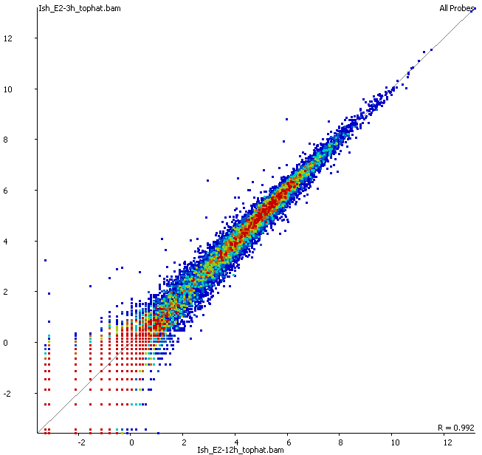
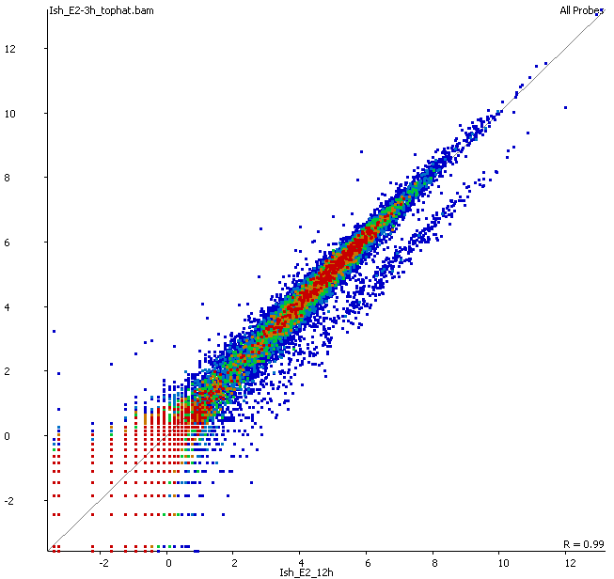
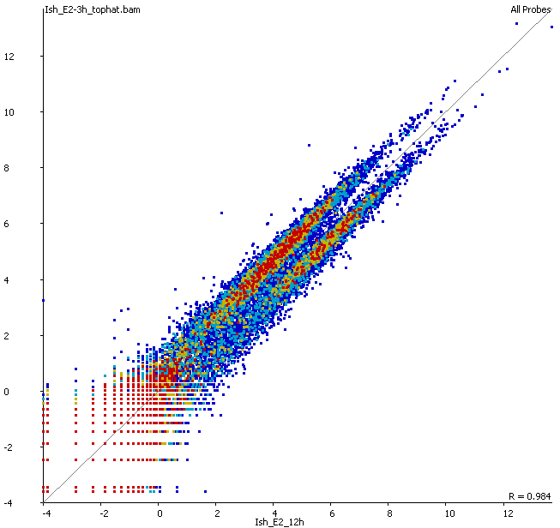
Quantitations come with Assumptions
Standard Log2 Reads per Million Reads of Library Quantitation

Slide 14
Statistics come with Assumptions
T-test
  Data is normally distributed
  Variances are equal
  Replicates are consistent

Slide 15
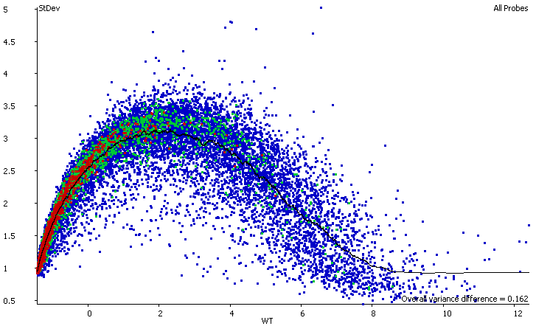
Statistics come with Assumptions
DESeq / EdgeR / BaySeq etc
Use variance information sharing between genes with similar expression levels on the assumption that they will exhibit similar variance

Slide 16
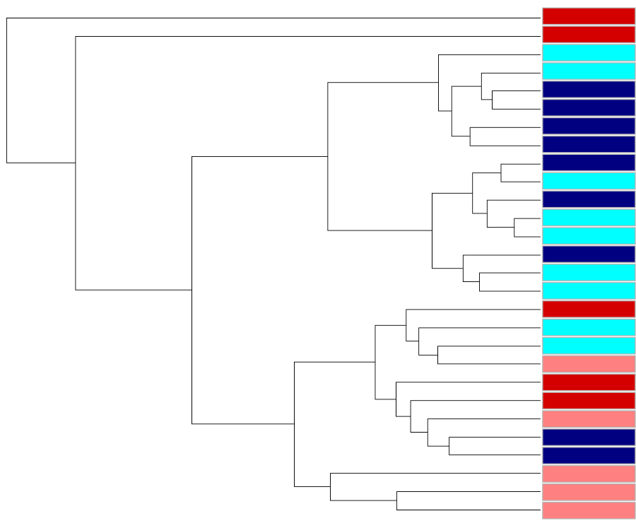
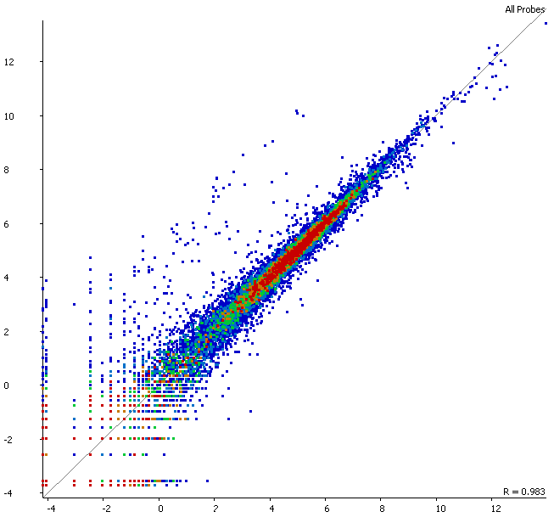
Secondary Signals
Hypertrophic cardiomyopathy (p2e-14)
Cardiac Muscle Contraction (p2e-13)
Troponin Complex (p4e-6)

Slide 17
Make sure you’re asking the right question
Which points change between two conditions?

Slide 18
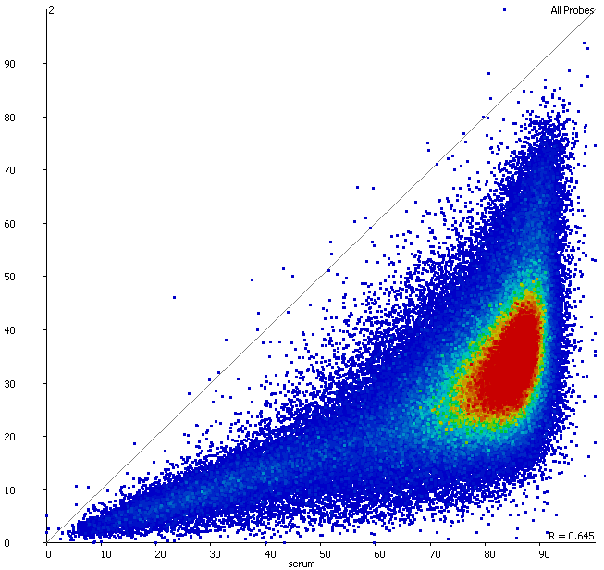
Make sure you’re asking the right question
Which points change more or less than you’d expect?
Which points change between two conditions?

Slide 19
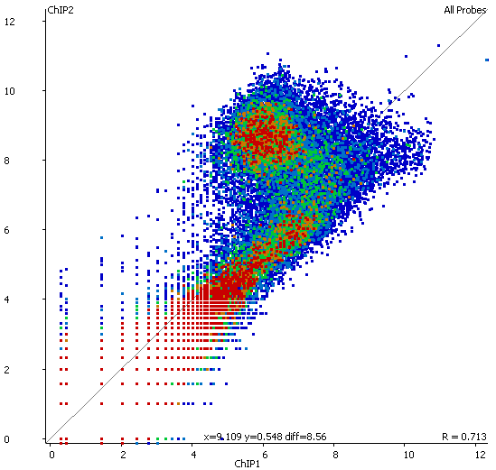
Make sure you’re asking the right question
Which points are in the two groups?
Which points change between two conditions?

Slide 20
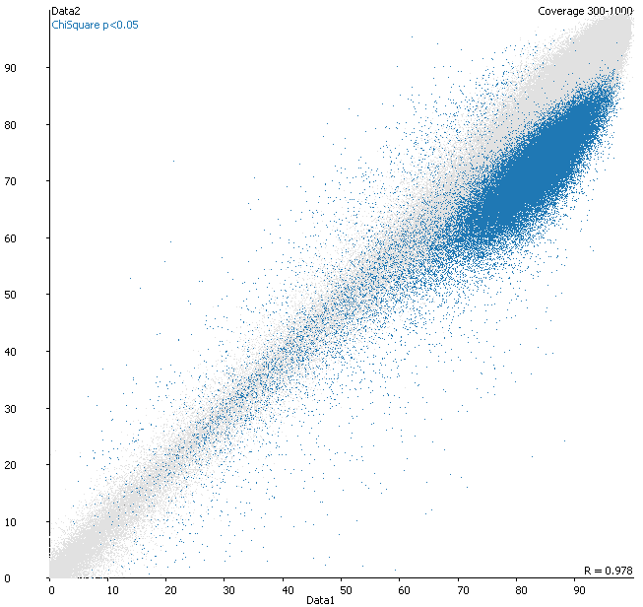
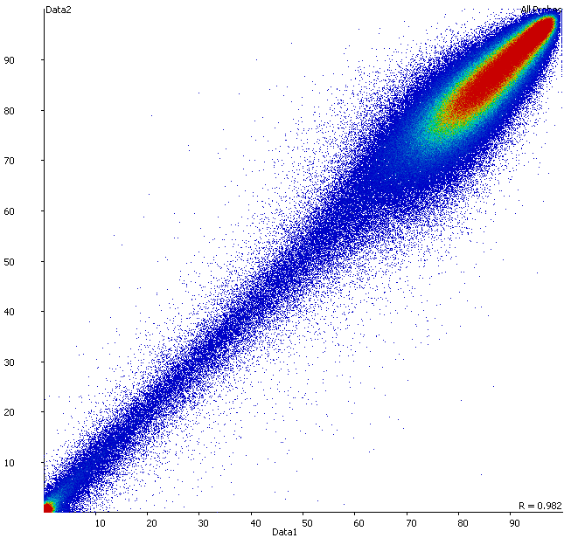
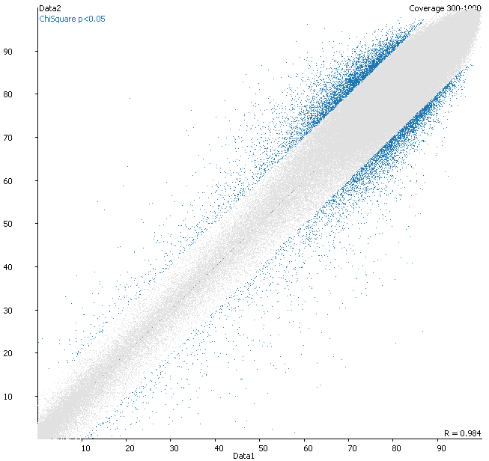
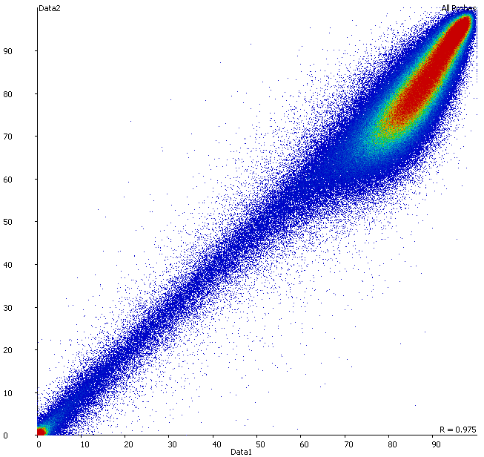
Make sure you’re asking the right question
Which points change between two conditions?

Slide 21
What Should We Validate?
Biological
  Species
  Sex
  Genotype
Processing
  Efficiency
  Types of drop out
  Categorised results
Data
  Genomic distribution
  Expected effects
  Sample clustering
  Overall differences
  Quantitation
  Statistical assumptions

