Slide 1

Networks and Interactions
Laura Biggins, Boo Virk
laura.biggins@babraham.ac.uk
v2017-07

Slide 2
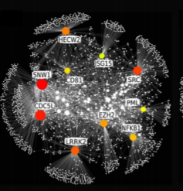
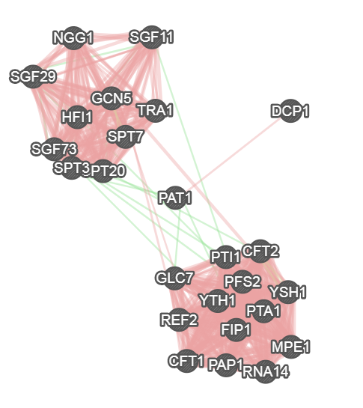
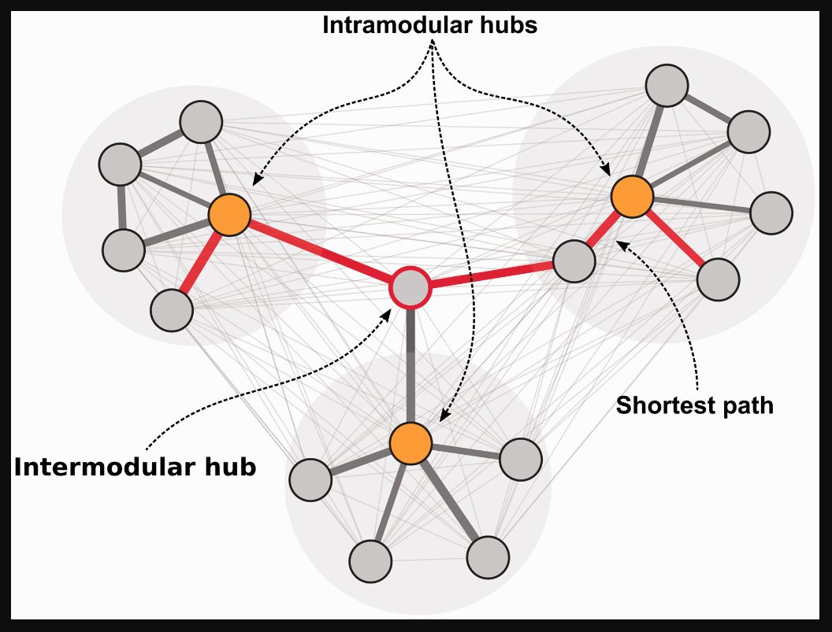
Why Networks?
Biological processes are often controlled by a complex network of molecular interactions
May identify important genes ‘missing’ from analysis
May identify hub and bottleneck genes that are particularly important
Notes:
Limitations of gene ontology – high proportion of computationally derived annotations, relies on these derived sets of genes
Limitations of pathway analysis - > 85% of human Ensembl genes are not mapped to a KEGG pathway.
Tells us lots about what we already know but less about new and unexpected relationships between the genes (or pathways)

Slide 3
Network Analysis: Approach 1
Infer the network directly from the data generated
Algorithms used to generate novel networks
Does not rely on published and curated data
Can find novel interactions
Various algorithms available
Computationally intensive and complex
Beyond the scope of this course

Slide 4
Network Analysis: Approach 2
Use existing experimentally-supported (and computationally derived) interactions and relationships. Overlay data on to these.
A number of user-friendly software tools are available
Simple and fast to perform analysis
Various databases exist of different types of interactions
Relies on published and curated data

Slide 5
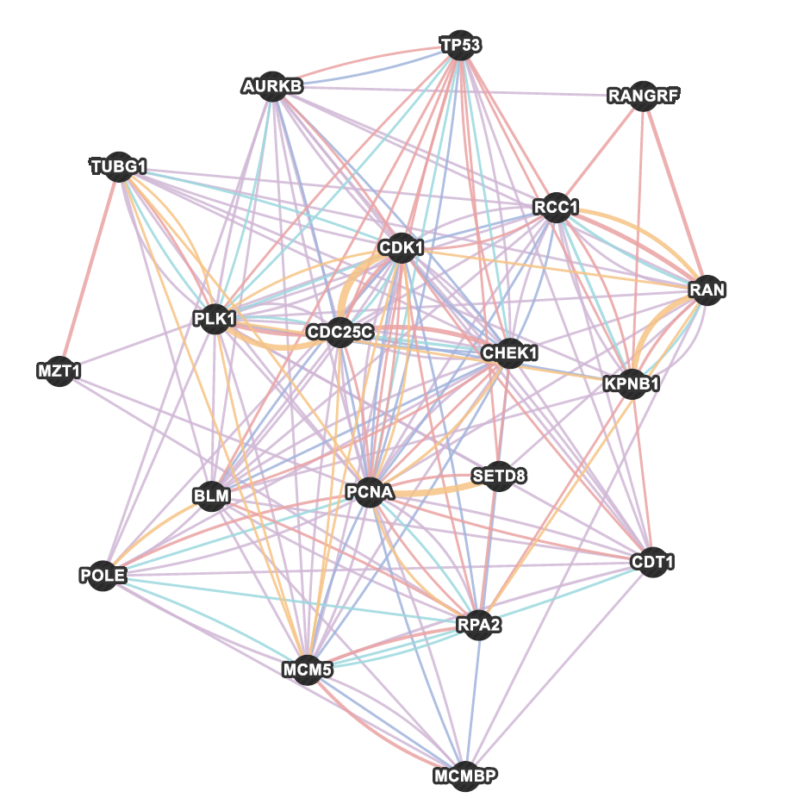
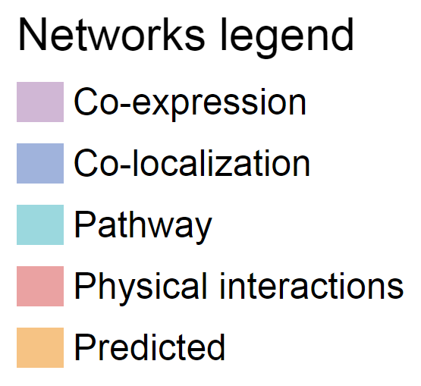
Types of interactions
Multiple sources and types of interaction data

Slide 6
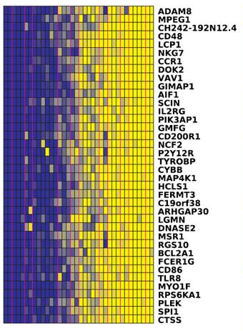
Gene Co-expression
Gene expression data
Two genes are linked if their expression levels were similar across conditions in a gene expression study

Slide 7
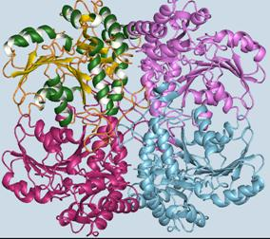
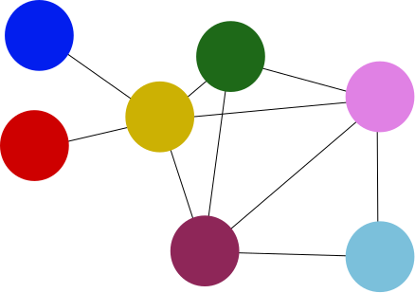
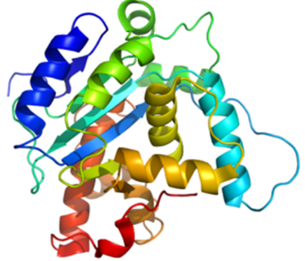
Physical Interaction
Protein-protein interaction (PPI) data
Two gene products linked if found to interact in protein-protein interaction study

Slide 8
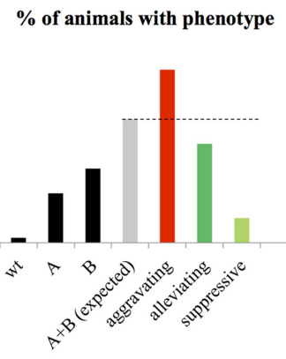
Genetic Interaction
Two genes are functionally associated if the effects of perturbing one gene were found to be modified by perturbations to a second gene
i.e. phenotype of double mutant differs from that expected from each individual mutant

Slide 9
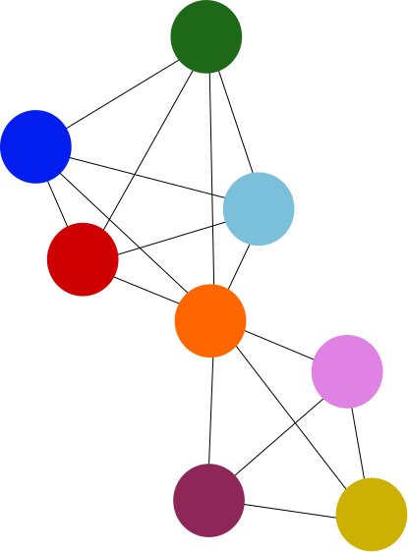


Pathway
Two gene products are linked if they participate in the same reaction within a pathway
Unlike physical networks they don’t have to directly interact

Slide 10
Other Types of Network
Shared protein domain
  Two gene products linked if have the same protein domain
Co-localisation
  Two genes linked if both are expressed in the same tissue, or if their gene products are both identified in same cellular location

Slide 11
Multiple Networks

Slide 12
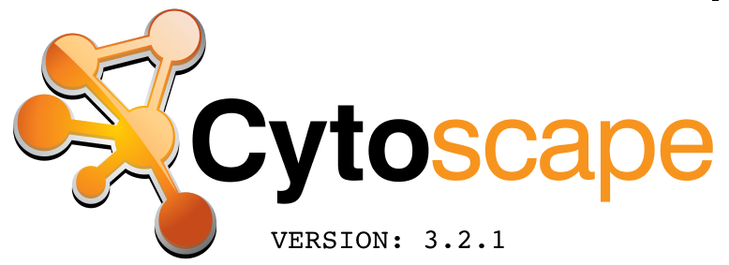

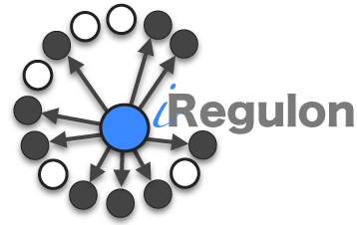



Constructing Networks

Slide 13
http://www.cytoscape.org/
Open source software platform
Lots of functionality
Visualize networks and biological pathways
Integrate networks with annotations, gene expression profiles, etc
Can import, edit and analyse networks
Lots of Apps!
Whole courses dedicated to Cytoscape – not covering it today

Slide 14
Free and easy to use web resources for network analysis
Used in the practical today
http://www.genemania.org/
https://string-db.org/

Slide 15
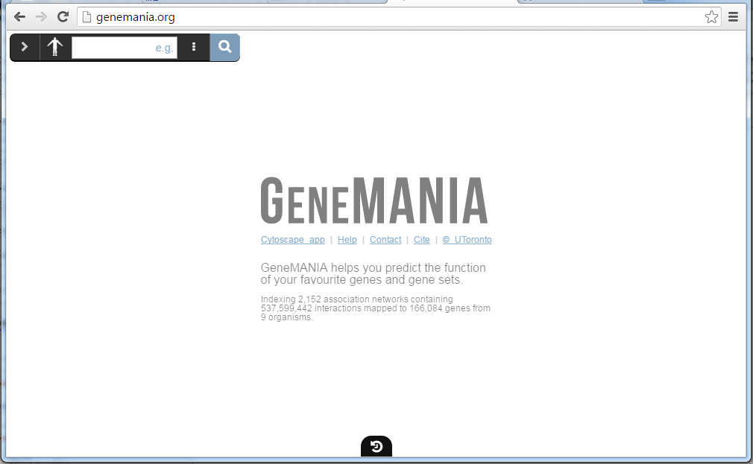
Genemania - demo

Slide 16
  Free to use web resource
    http://string-db.org/
  Direct and indirect associations from 4 sources:
      co-expression
      genomic context,
      high throughput experiments
      published/previous knowledge
  Over 2000 organisms (some more studied than others though)

Slide 17
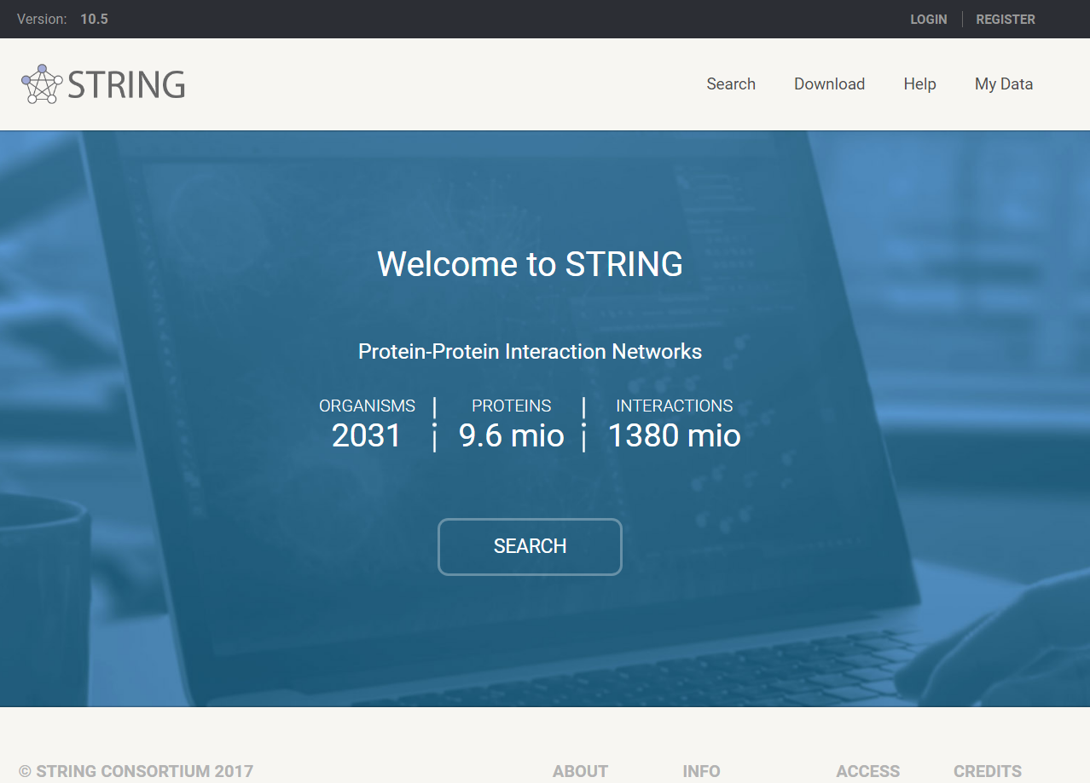

Slide 18
Genemania
String
Association data include:
  Protein interactions, genetic interactions
  pathways, co-expression, co-localization,
9 Organisms available
  human, mouse, rat, worm, fly, zebrafish, E. coli, Arabidopsis, yeast
Overlay functional enrichment information
Precisely control the number of inferred genes
No clustering options
No network stats
Export a report
More protein-centred
Known interactions, predicted interactions, homology etc.
Over 2000 organisms
Overlay functional enrichment information – 1 term at a time
Control the number of inferred genes - bins
Export various types of files
Clustering options
Basic network stats
Export tables and figures
Adjust minimum interaction score

Slide 19
Network Practical
Notes:
Screenshots

