Slide 1

Extracting Biological Information from Gene Lists
Simon Andrews, Laura Biggins, Boo Virk
simon.andrews@babraham.ac.uk
laura.biggins@babraham.ac.uk
v2024-11

Slide 2
Programme
The theory and practice of gene set enrichment
Gene set enrichment practical
Presenting results
Dealing with artefacts and biases
Motif analysis
Motif analysis practical

Slide 3
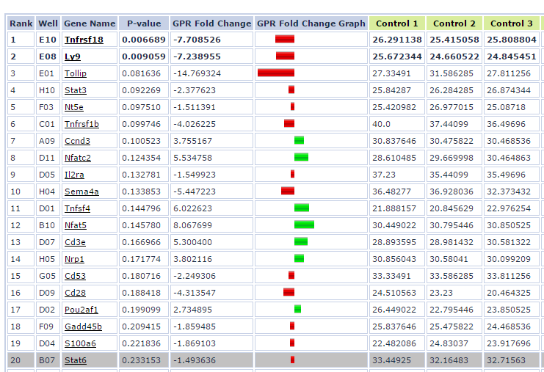
Standard Gene List Output

Slide 4
Descriptions aren’t always informative

Slide 5
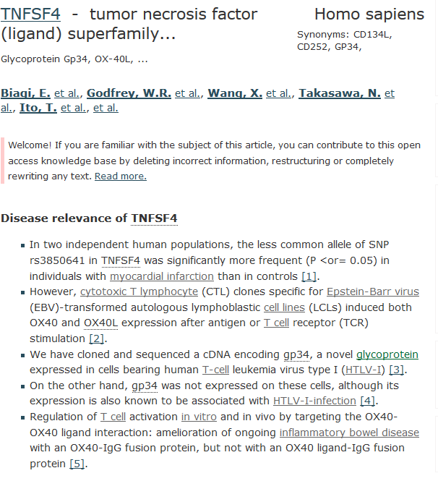
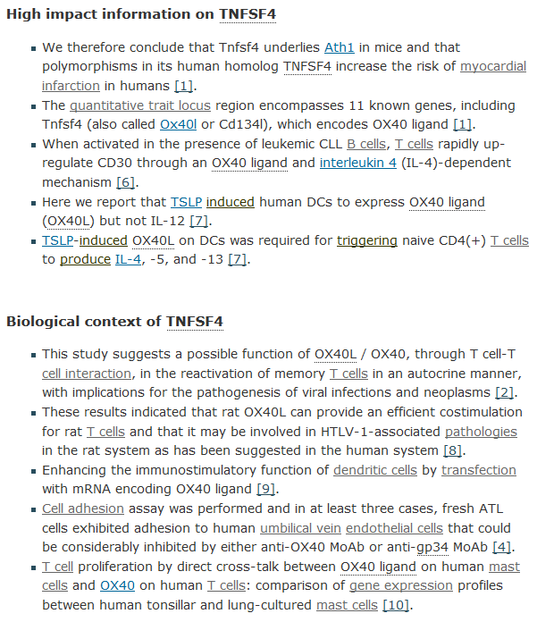



Gene summary sites are useful for single genes

Slide 6
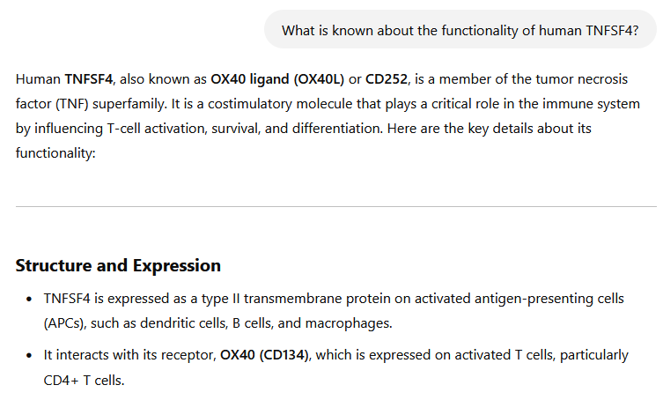
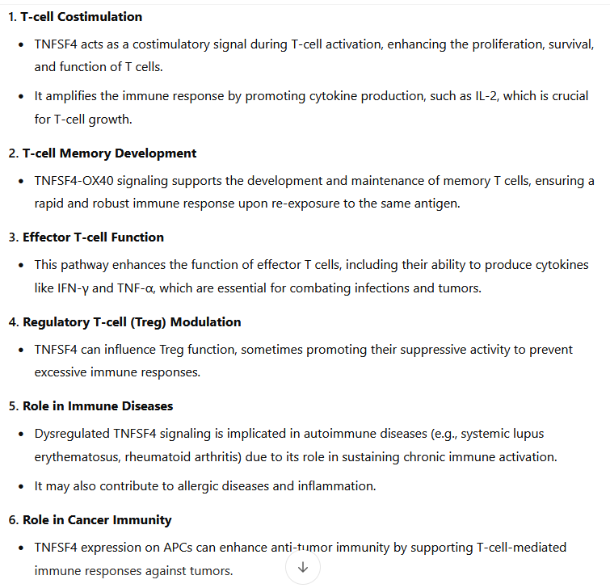

LLMs can be useful if used with caution

Slide 7
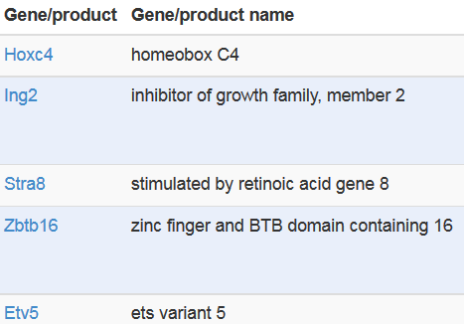
Functional analysis relates hits to existing knowledge
Germ-line stem cell division
The self-renewing division of a germline stem cell to produce a daughter stem cell and a daughter germ cell, which will divide to form the gametes.
Advantages:
Biological insight
Validation of experiment
Generate new hypotheses
Limitations:
You can only discover what is already known
  Novel functionality will be missing
  Existing annotations may be incorrect
  Many species are poorly supported

Slide 8
Functionality is generally annotated on genes
Things to think about
  Converting hits to genes
    Transcripts / Proteins are easy
    Genomic positions may be possible
  Gene nomenclature
    Names change over time
    Gene definitions appear / change
Types of list
  Categorical (hit or not a hit)
  Ordered
  Quantitative
Hits
ABC1
DEF1
GHI1
JKL1
[All non hits]
Ordered
1. DEF1
2. ABC1
3. JKL1
4. GHI1
[All non hits]
Quant
ABC1 = 5.3
DEF1 = 2.1
GHI1 = 7.9
JKL1 = 1.0
MNO1 = 0.4
PQR1 = 5.7
STU1 = 3.8

Slide 9
Comparing your hits to functional gene sets
Germ-line stem cell division
The self-renewing division of a germline stem cell to produce a daughter stem cell and a daughter germ cell, which will divide to form the gametes.
My Hits
A4galt
Atl1
Cdk19
Cdon
Cecr2
Etv5
Flywch1
Gnpda2
Hoxc4
Ing2
Iigp1
Map3k9
Mypop
Rnf6
Serinc1
Stra8
Trp73
Zbtb16
A4galt
Atl1
Cdk19
Cdon
Cecr2
Etv5
Flywch1
Gnpda2
Hoxc4
Ing2
Iigp1
Map3k9
Mypop
Rnf6
Serinc1
Stra8
Trp73
Zbtb16

Slide 10
Nothing is ever straight forward…
Best hit: “DNA Methylation” p<2e-10
name: DNA methylation
datasource: reactome
organism: Human
idtype: hgnc symbol
Genes:
Methyltransferases: DNMT1 DNMT3A DNMT3B DNMT3L
Methyltransferase targeting protein: UHRF1
Histones!!! H2AFB1 H2AFJ H2AFV H2AFX H2AFZ H2BFS H3F3A H3F3B HIST1H2AB HIST1H2AC HIST1H2AD HIST1H2AE HIST1H2AJ HIST1H2BA HIST1H2BB HIST1H2BC HIST1H2BD HIST1H2BE HIST1H2BF HIST1H2BG HIST1H2BH HIST1H2BI HIST1H2BJ HIST1H2BK HIST1H2BL HIST1H2BM HIST1H2BN HIST1H2BO HIST1H3A HIST1H3B HIST1H3C HIST1H3D HIST1H3E HIST1H3F HIST1H3G HIST1H3H HIST1H3I HIST1H3J HIST1H4A HIST1H4B HIST1H4C HIST1H4D HIST1H4E HIST1H4F HIST1H4H HIST1H4I HIST1H4J HIST1H4K HIST1H4L HIST2H2AA3 HIST2H2AA4 HIST2H2AC HIST2H2BE HIST2H3A HIST2H3C HIST2H3D HIST2H4A HIST2H4B HIST3H2BB HIST4H4

Slide 11





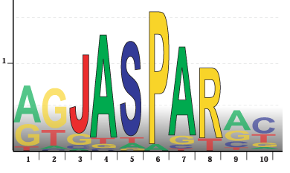

Sources of functional gene lists
Human curated
  Gene Ontology
  Biological Pathways
Domains / Patterns
  Protein functional domains
  Transcription factor regulated
Experimental
  Co-expressed genes
  Interactions
  Hits from other studies

Slide 12
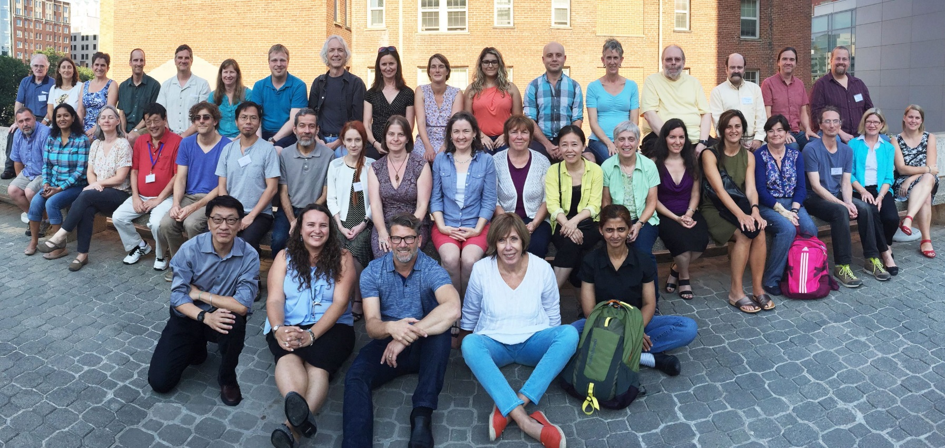
Gene Ontology is a human curated functional database

Slide 13
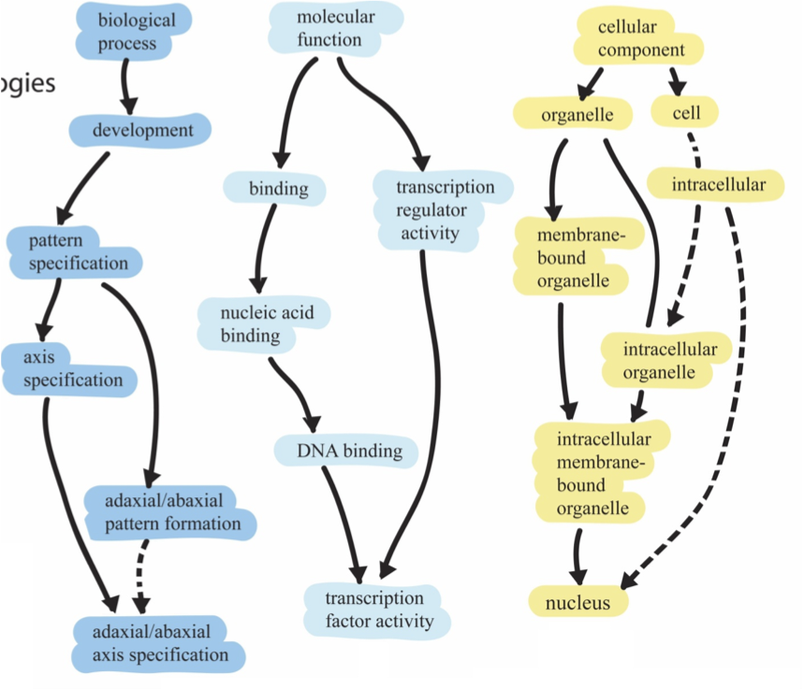
GO has three domains and a hierarchical structure
1
2
3
Root ontology terms
big
general
Parent
small
Child
specific

Slide 14
Genes are specifically placed into each domain
Nanog homeobox
Cellular Component
  GO:0005634 nucleus
  GO:0005654 nucleoplasm
  GO:0005730 nucleolus
Molecular Function
  GO:0003677 DNA binding
  GO:0003700 transcription factor activity
  GO:0003714 transcription corepressor activity
  GO:0005515 protein binding
  GO:0043565 sequence-specific DNA binding
Biological Process
  GO:0001714 endodermal cell fate specification
  GO:0006351 transcription, DNA-templated
  GO:0006355 regulation of transcription, DNA-templated
  GO:0007275 multicellular organism development
  GO:0008283 cell proliferation
  GO:0019827 stem cell population maintenance
  GO:0030154 cell differentiation
  GO:0035019 somatic stem cell population maintenance
  GO:0045595 regulation of cell differentiation
  GO:0045944 positive regulation of transcription from RNA pol2
  GO:1903507 negative regulation of nucleic acid-templated transcription

Slide 15
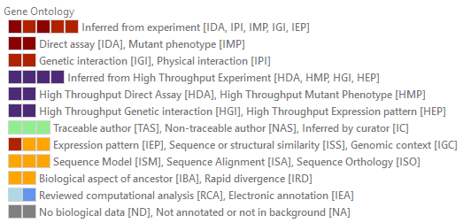
GO Annotations come with evidence
Experimental
  Experiment (EXP)
  Direct Assay (IDA)
  Physical Interaction (IPI)
  Mutant Phenotype (IMP)
Computational
  Sequence Similarity (ISS)
  Sequence Model (ISM)
  Genomic Context (IGC)
  Biological aspect of Ancestor (IBA)
  Key Residues (IKR)
Publications
Curators

Slide 16
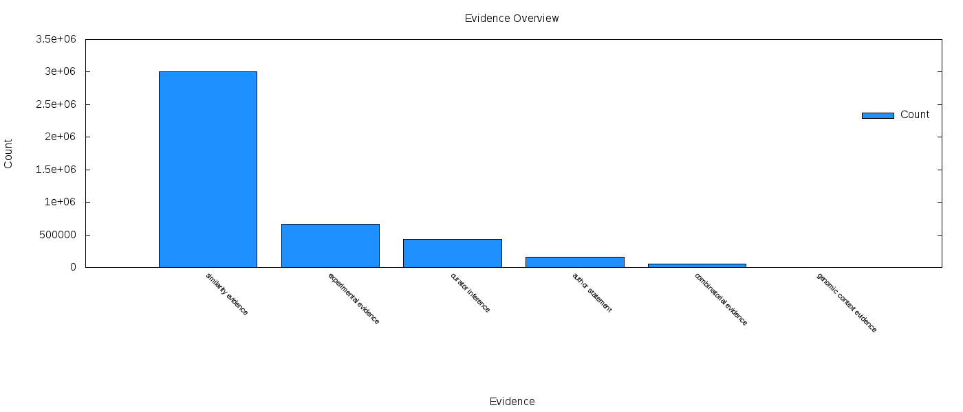
Annotations come with evidence
It looks like something which is annotated
Actual experimental
evidence
Curator
Interpretation
Claimed in a paper
Mixture of sources
Annotated based on where it is in the genome

Slide 17
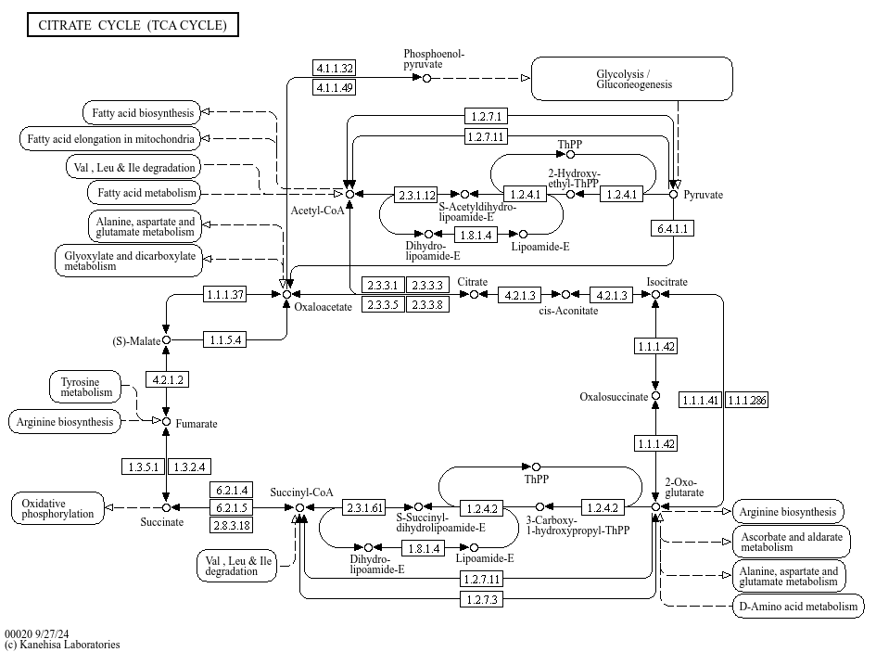

Pathway databases trace metabolic pathways and their regulation

Slide 18
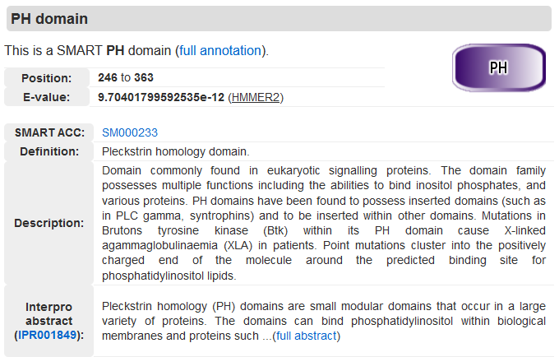

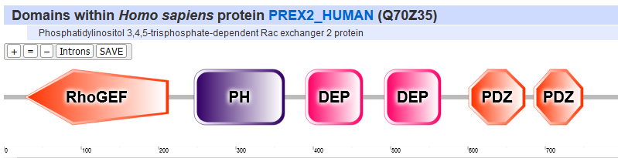
Protein Domain databases annotate functional subdomains within proteins

Slide 19
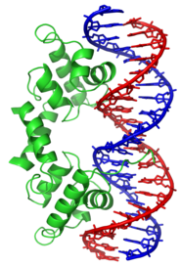



Transcription Factor databases group genes by the motifs in their promoters
Factorbook

Slide 20



Interaction databases map out interactions between genes / proteins
Physical interaction
Genetic interaction
Gene fusions
Literature mentions
Genome neighbourhood

Slide 21
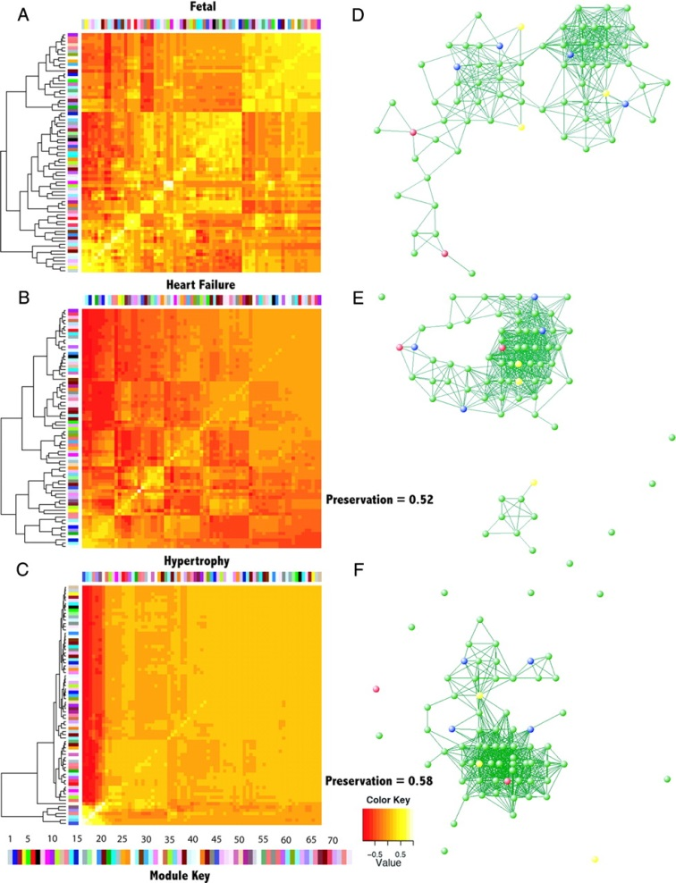



Co-expression databases group genes which are expressed together

Slide 22

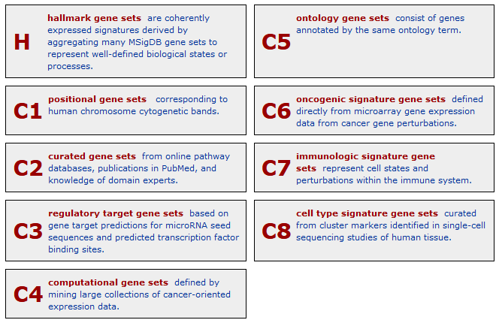
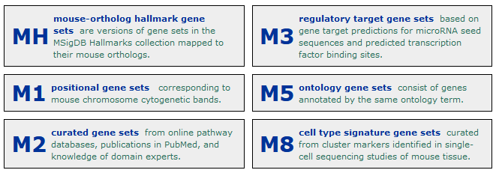
https://www.gsea-msigdb.org/gsea/msigdb

Slide 23
Testing for enriched gene sets

Slide 24
There are two basic ways to test for enrichment
Categorical
  Start from a list of hit genes
  Count overlaps between hit list and functional list
  Find Functional lists where the degree of overlap is statistically unlikely
Quantitative
  Start with all genes
  Associate a value with each gene
  Look for functional sets with unusual distributions of values

Slide 25
Categorical Enrichment Analysis

Slide 26
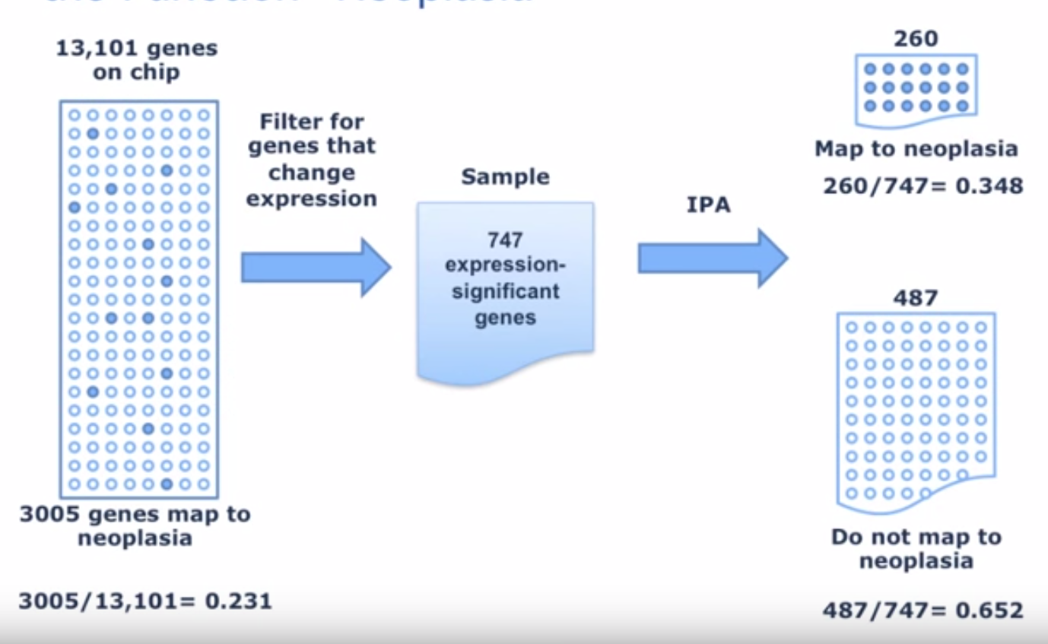

Categorical tests for enrichment
13,101 genes on chip
Related to disease
260/747 = 34.8%
Gene List
 | Gene List | Background
In disease annotated group | 260 | 3005
Not in disease annotated group | 487 | 10096
3005 genes related to disease
3005/13,101=
23.1%
Not related to disease

Slide 27
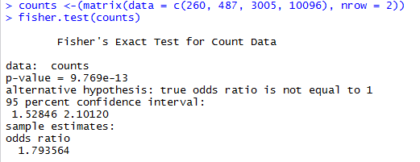
Fisher’s Exact test
 | Gene List | Background | Total
In disease annotated group | 260 E = 176.1 | 3005 E = 3088.8 | 3265
Not in disease annotated group | 487 E = 570.9 | 10096 E = 10012.1 | 10583
Total | 747 | 13101 | 13848
(260/487) / (3005/10096)

Slide 28
Categorical tests are influenced by where you set the cutoff for “interesting” genes
Function X
  3 hits out of 32 in ‘interesting’ list
  Not significant (p=0.07)
Hit1
Hit17
Hit2
Hit18
Hit3
Hit19
Hit4
Hit20
Hit5
Hit21
Hit6
Hit22
Hit7
Hit23
Hit8
Hit24
Hit9
Hit25
Hit10
Hit26
Hit11
Hit27
Hit12
Hit28
Hit13
Hit29
Hit14
Hit30
Hit15
Hit31
Hit16
Hit32

Slide 29
Categorical tests are influenced by where you set the cutoff for “interesting” genes
Function X
  3 hits out of 7 in ‘interesting’ list
  Significant (p=0.02)
Hit1
Hit17
Hit2
Hit18
Hit3
Hit19
Hit4
Hit20
Hit5
Hit21
Hit6
Hit22
Hit7
Hit23
Hit8
Hit24
Hit9
Hit25
Hit10
Hit26
Hit11
Hit27
Hit12
Hit28
Hit13
Hit29
Hit14
Hit30
Hit15
Hit31
Hit16
Hit32

Slide 30
Ordered, but not quantitative lists allow sequential categorical analysis
Function X
  Length=1 p=0.60
  Length=2 p=0.80
  Length=3 p=0.30
  Length=4 p=0.35
  Length=5 p=0.40
  Length=6 p=0.45
  Length=7 p=0.05
  Length=8 p=0.08
  Length=9 p=0.10
Hit1
Hit17
Hit2
Hit18
Hit3
Hit19
Hit4
Hit20
Hit5
Hit21
Hit6
Hit22
Hit7
Hit23
Hit8
Hit24
Hit9
Hit25
Hit10
Hit26
Hit11
Hit27
Hit12
Hit28
Hit13
Hit29
Hit14
Hit30
Hit15
Hit31
Hit16
Hit32

Slide 31
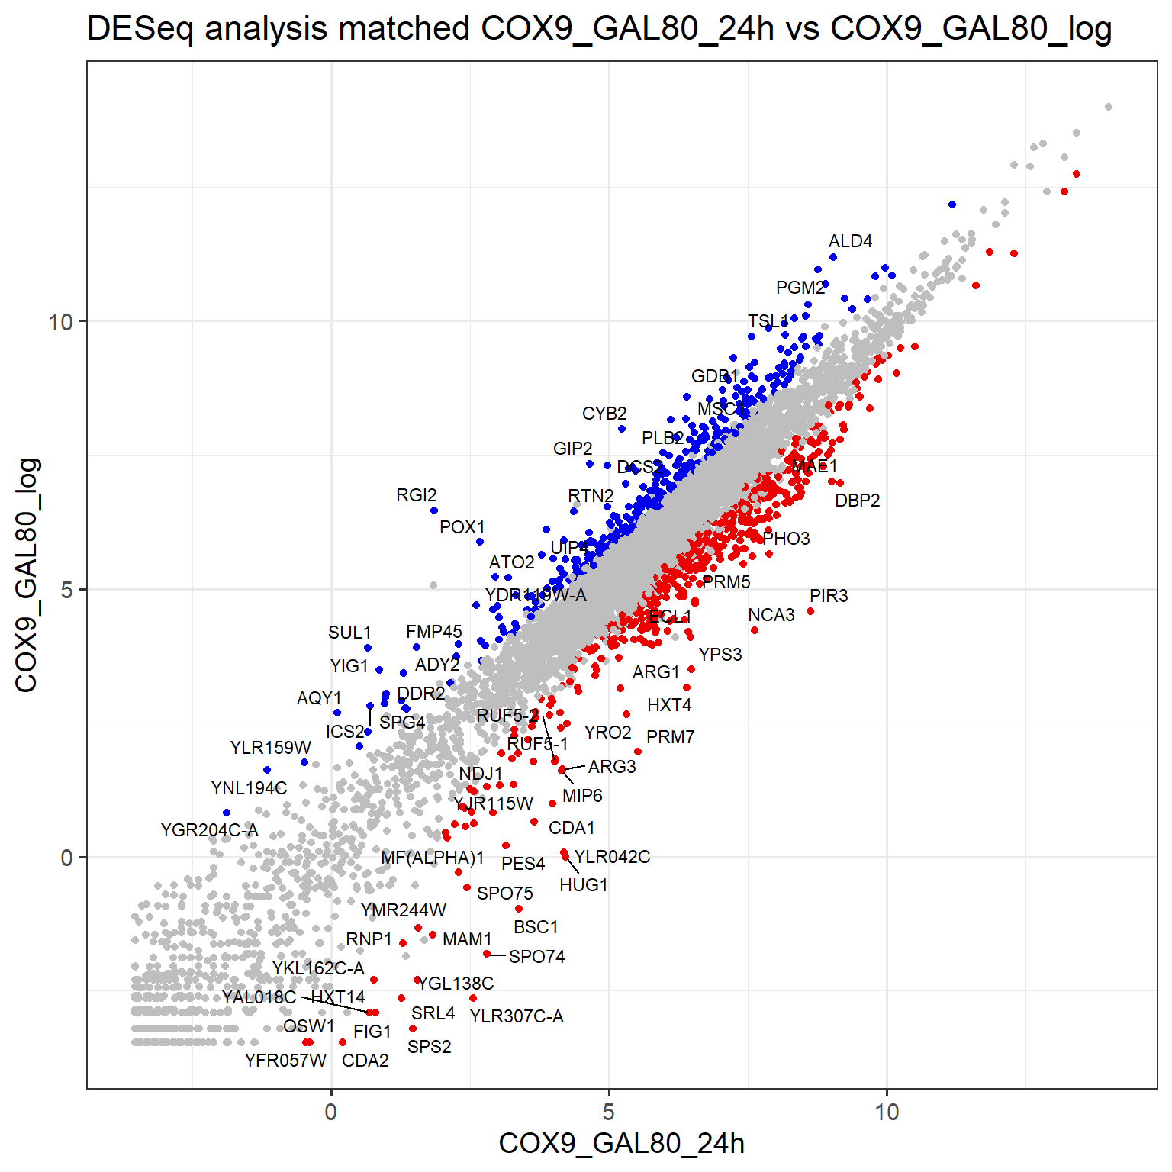
Directional Gene Lists
One search or two?
  One search
    Higher power (more genes)
    Lower enrichment
    Mixed effects (pathways)
  Two searches
    Easier interpretation
    Less power
    Higher enrichment

Slide 32
Quantitative Enrichment Analysis

Slide 33
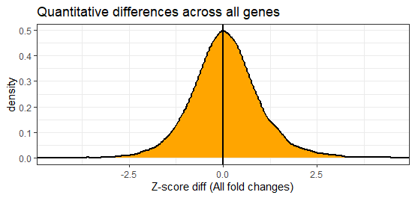
Quantitative comparisons can offer more power
What quantitative value can we use?
  Differential p-value (normally -10 log(p))
  Fold change
  Absolute difference

Slide 34
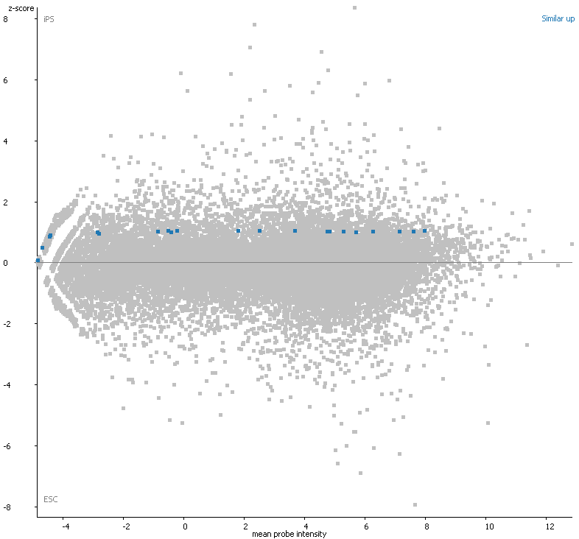
What kind of changes do we expect in an interesting category?
Student’s T-test
Genes in that category all change, and by about the same amount?

Slide 35
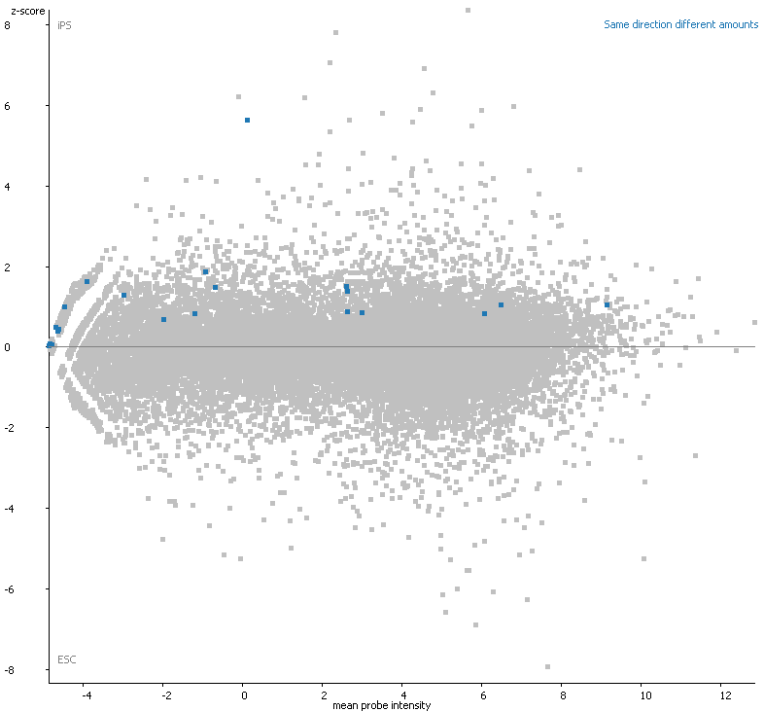
What kind of changes do we expect in an interesting category?
Kolmogorov Smirnov Test
Genes in that category all change in the same direction, but by different amounts?

Slide 36
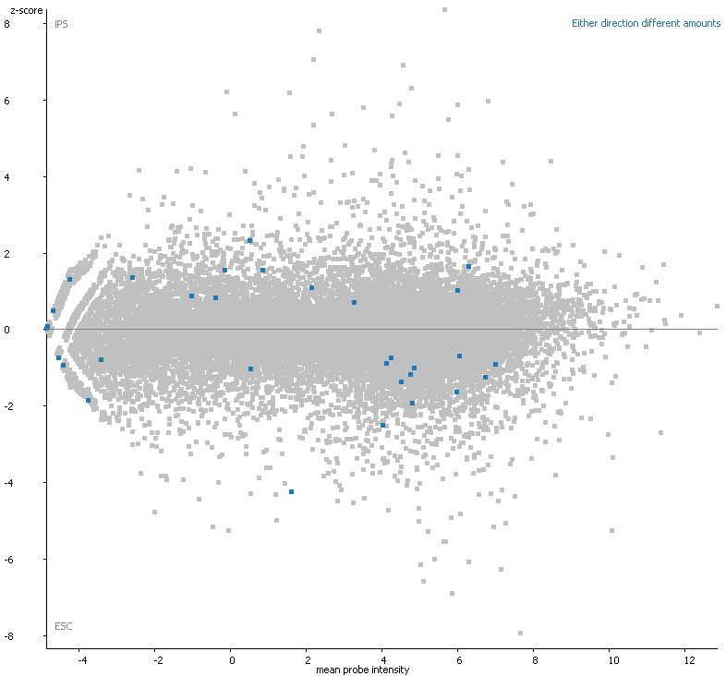
What kind of changes do we expect in an interesting category?
Absolute KS Test
Genes in that category all change in either direction, but by different amounts?

Slide 37
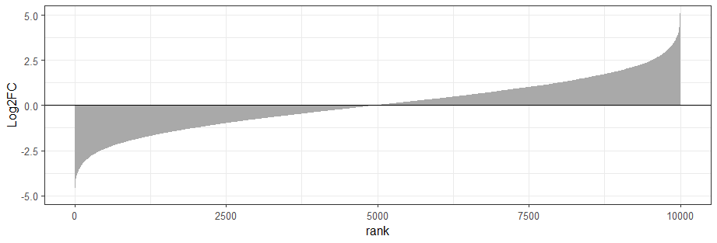
GSEA statistics
Interesting
Boring

Slide 38
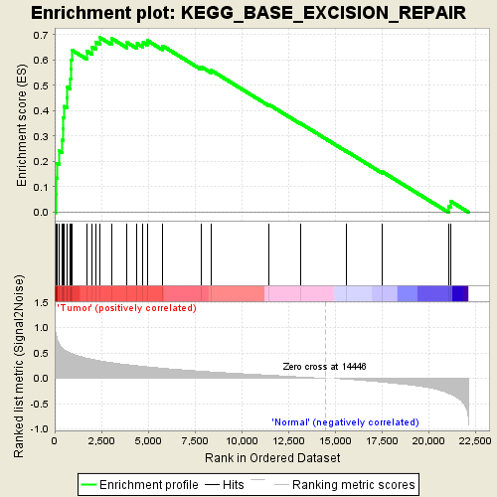
GSEA Statistics
Keep a running total
Start at the highest values
If gene is in the set add value
Otherwise subtract value
Enrichment score is max score
Stats compare ES with randomly shuffled data

Slide 39
Multiple Testing Correction
Original p-value is for one test (one gene set)
Thousands of sets tested in each analysis
Many tools report raw as well as corrected p-values
FALSE POSITIVES
Raw p-values
(no correction)
Benjamini & Hochberg
False Discovery Rate
(FDR)
Bonferroni Corrected
P-value

Slide 40
What do we get back from an enrichment test?
A p-value
  Remember that this reflects not only difference but also variance and power (number of observations)
A difference value
  Enrichment difference (odds ratio)
  Mean quantitative difference
  Remember large differences are easier to obtain with small numbers of observations

Slide 41
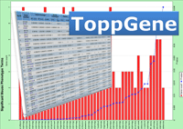


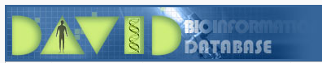



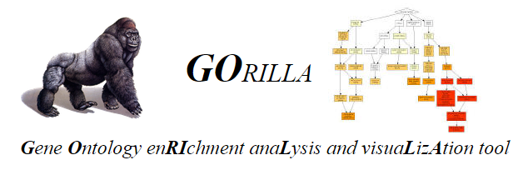


Tools for functional gene list analysis
There are many different tools available, both free and commercial
Popular tools include:

Slide 42
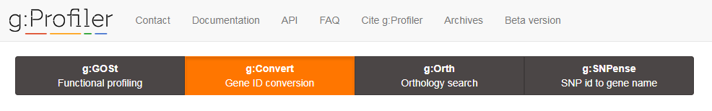
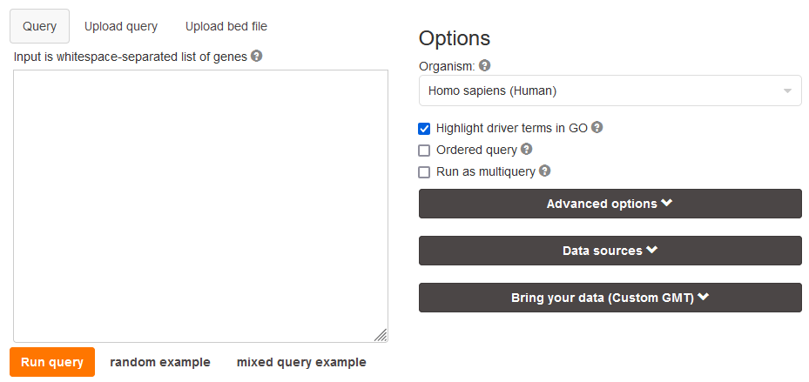
Categorical or ordered statistics
Lots of additional options
Wide species support
Interesting presentation
  Doesn’t scale well to lots of hits

Slide 43
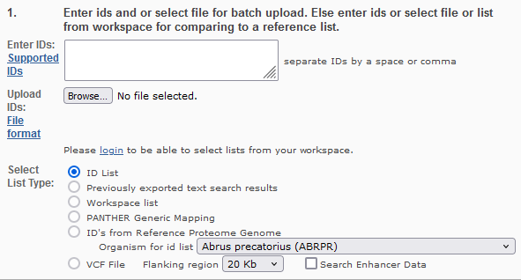
Categorical or Quantitative statistics
Part of Gene Ontology Consortium
  Annotations are up to date
Simple enrichment analysis
Functional lists and categorical break down

Slide 44
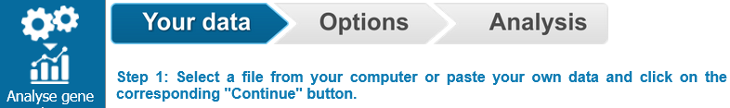
Categorical or quantitative statistics
Pathway focussed
Simple submission interface (no custom background)
Really nice visualisations

Slide 45
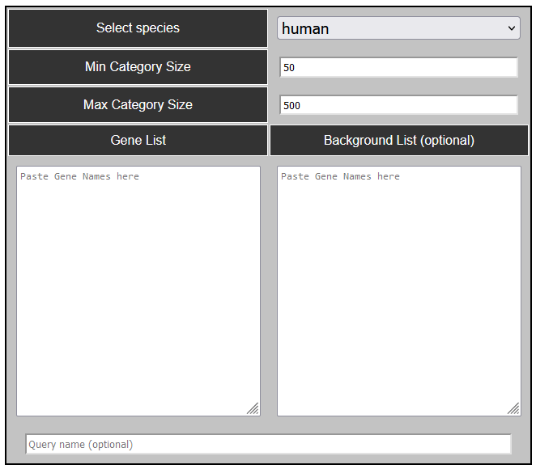
Categorical statistics
Limited species support
Allows custom backgrounds
Uses PathwayCommons gene sets
Innovative detection and presentation of artefacts

Slide 46
Categorical Statistics
Most popular system (mostly historic)
Has been behind the latest annotation
  Was updated again, but now behind once more
Lots of support for different IDs and Species
Configurable gene sets
Simple output presentation

Slide 47
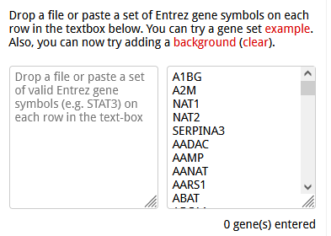
Categorical Statistics
Biggest selection of gene sets
Simple interface, but limited options
  No species information
Simple interactive visualisation
Novel scoring scheme to rank hits

Slide 48
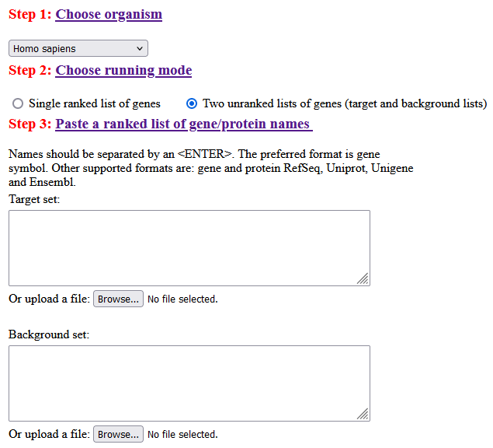
Categorical or ranked analysis
Mostly GO gene list support
Interesting visualisation options

Slide 49
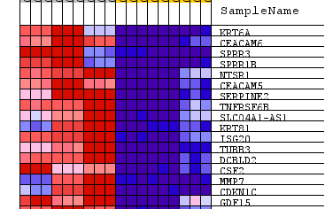
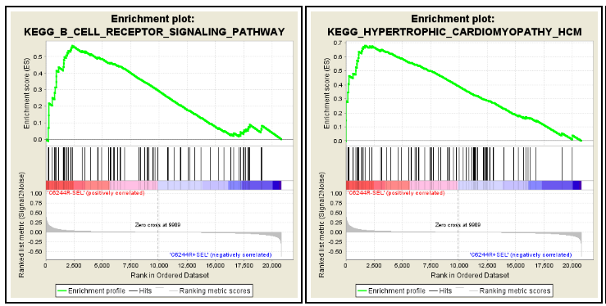
GSEA
Quantitative enrichment
Designed for expression datasets
Local application
Imports tab delimited expression data

Slide 50
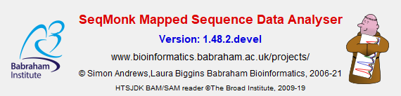
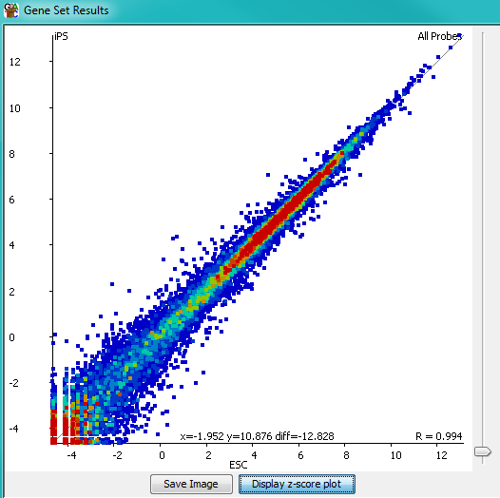
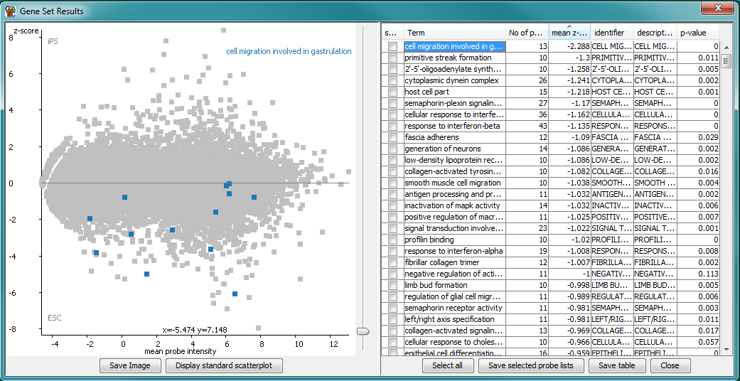
Quantitative enrichment of sequencing datasets
Local Java application

Slide 51
Gene List Practical https://tinyurl.com/exercisetostartat

Slide 52

Exploring and Presenting Results
Simon Andrews, Laura Biggins
simon.andrews@babraham.ac.uk
laura.biggins@babraham.ac.uk

Slide 53
Functional enrichment results
Gene set information
  Gene set name
  Gene set source
  Gene set description
Statistical information
  Raw p-value
  Corrected p-value
  Enrichment value
Count information
  Hit genes in category
  Hit genes outside category
  Background genes in category
  Background genes outside category

Slide 54
Functional enrichment results
Gene set information
  Gene set name
  Gene set source
  Gene set description
Statistical information
  Raw p-value
  Corrected p-value
  Enrichment value
Count information
  Hit genes in category
  Hit genes outside category
  Background genes in category
  Background genes outside category

Slide 55
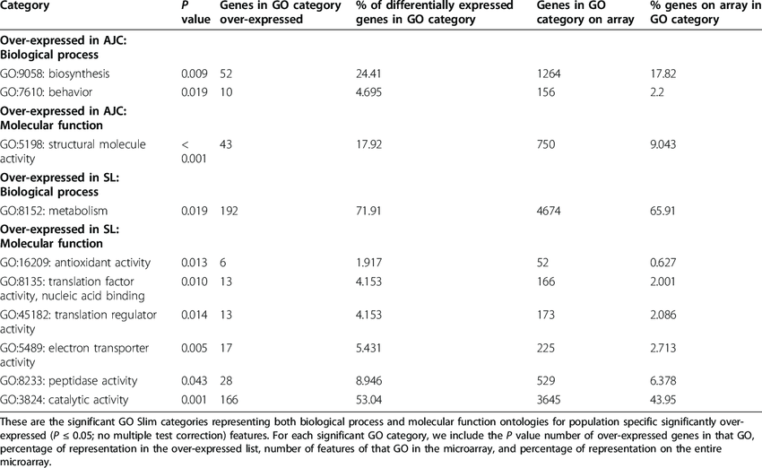
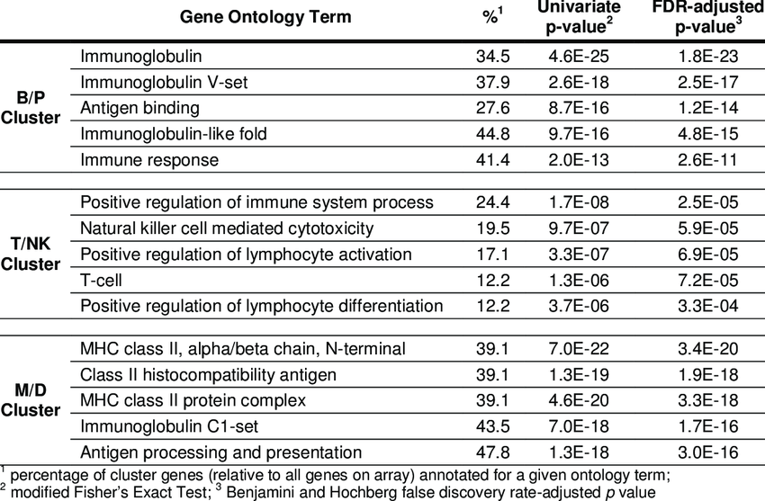
Tables are often enough
Notes:
.

Slide 56
Graphical Representations
Need to add something over a table
  Relationships between multiple result values
  Representation of redundancy between categories
  Relationship to original data
  Context of surrounding pathway

Slide 57
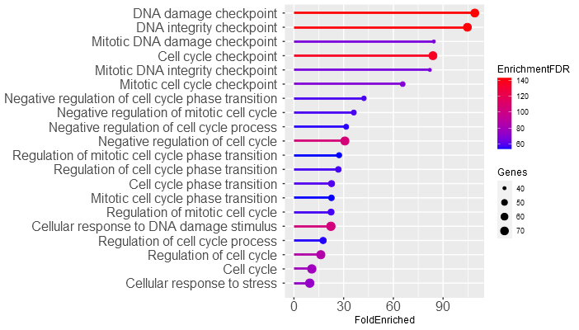
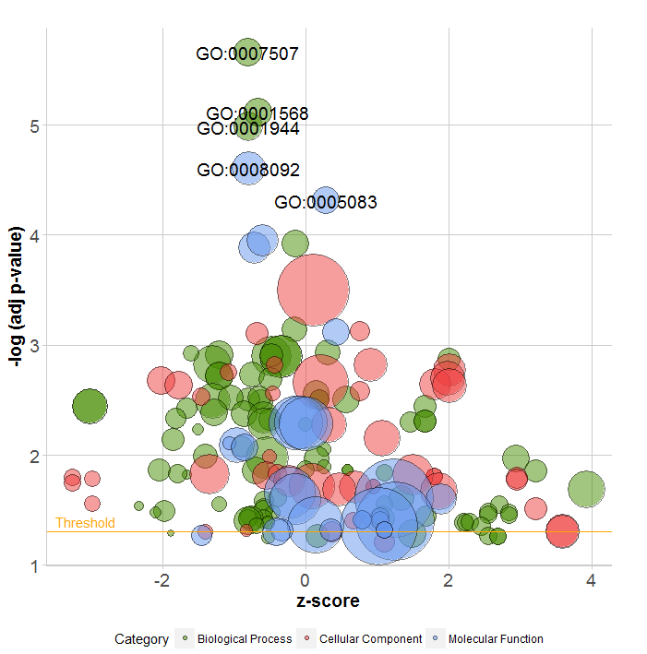

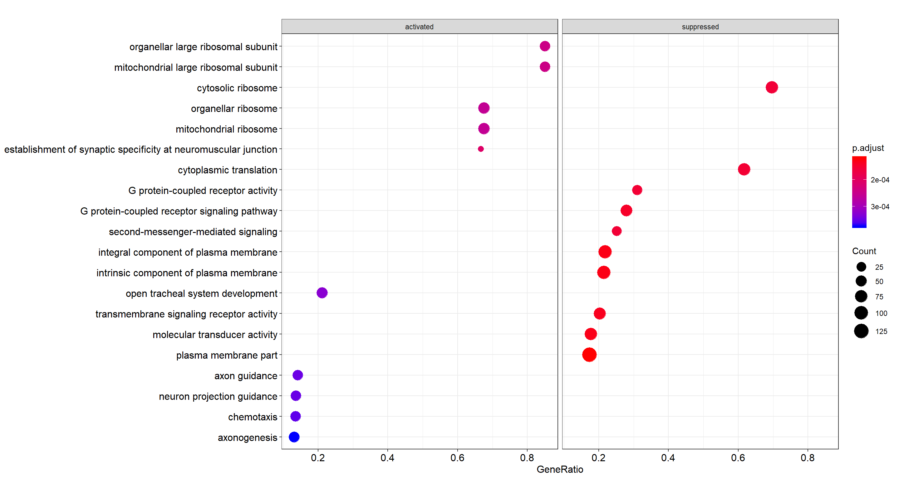

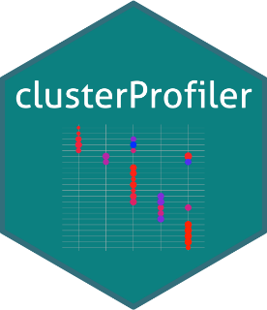
Plotting relationships between values
P-value(corrected)
Enrichment
Size of gene set

Slide 58
Redundancy in gene lists
Gene ontology is hierarchical - a gene is placed in the most specific category and will also appear in all the parent categories
1
2
3
Root ontology terms
general
Parent
Child
specific
Notes:
Parent child redundancy – a gene is placed in the most specific category and will also appear in all the parent categories.

Slide 59
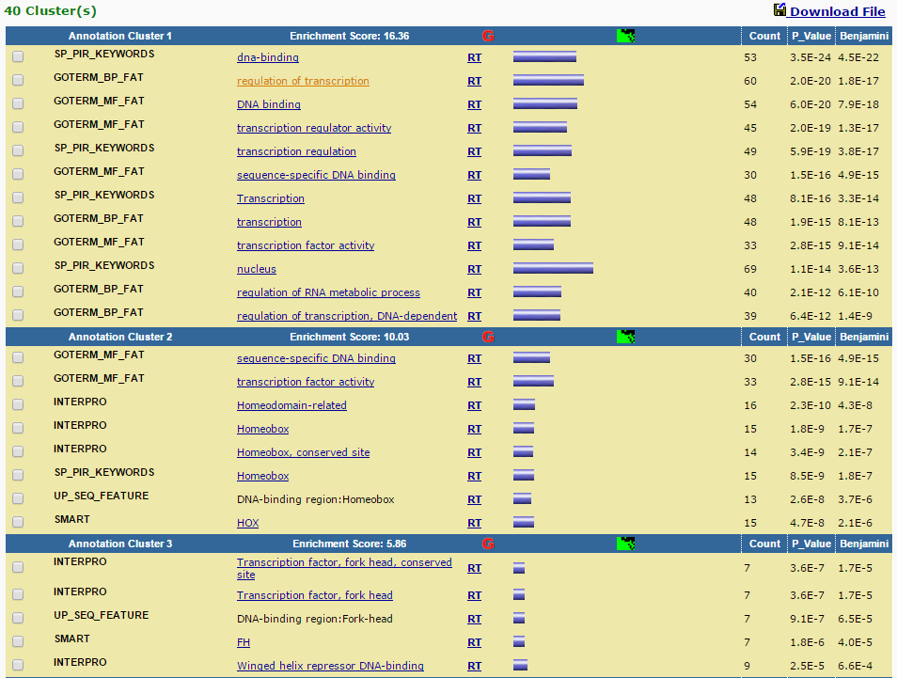
Redundancy: DAVID clustering
Notes:
david clusters by overlapping genes

Slide 60
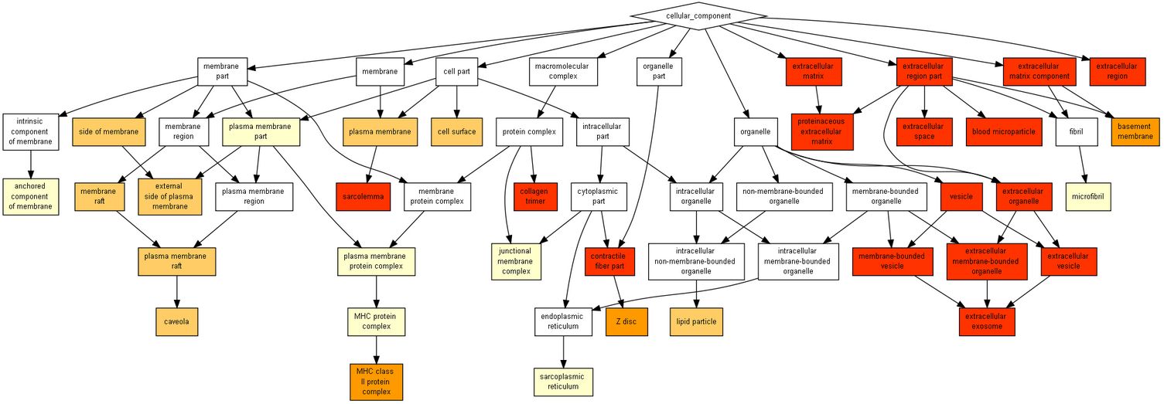
Redundancy: Gorilla GO images
cbl-gorilla.cs.technion.ac.il/
Notes:
Good thing about GOrilla – shows the hierarchy of the GO terms
Also a way of presenting results

Slide 61


Redundancy: Gorilla GO images
cbl-gorilla.cs.technion.ac.il/
Notes:
But – if lots of info, difficult to interpret.
Can see that we don’t just have a neat parent-child relationships

Slide 62




Redundancy: Overlap plots
Notes:
The heatmap - (clustergram as they call it) is quite a nice way of exploring the categories. It has some options to play around with the display
The network may not be available for all gene-set libraries.
Each node represents a term and a link between two nodes means that the two terms have some gene content similarity.
Initially, the network is force directed, but if you drag the node to a fixed position, it will stay there.
Like the other SVG figures, the network can be exported in three image formats.
The grid may not be available for all gene-set libraries.
Each grid square represents a term and is arranged based on its gene-set similarity with other terms. It shows only the top 10 terms sorted by combined score. The brighter the square, the more significant that term is. Clicking on the grid allows you to toggle to an alternate view that colors the grid based on its correlation score with neighbors with white dots representing the significant terms.
The z-score and p-value is a measure of how clustered the top 10 terms are on the grid.

Slide 63


2D Redundancy
Enrichment Analysis Visualisation
(from Enrichr)
https://appyters.maayanlab.cloud/Enrichment_Analysis_Visualizer/
Revigo (from Gorilla)
http://revigo.irb.hr/

Slide 64
Relationship to original data
Quantitative values for genes in category
  Direction and magnitude of change
Look at genes in category which aren’t hits
  Relative numbers
  Supportive changes?

Slide 65


Relationship to original data

Slide 66


Pathways
ShinyGO
Reactome

Slide 67

Pathways: Reactome

Slide 68
Summary
Tables are often sufficient
  Must include name, enrichment, corrected p-value
  Other values are useful, but don’t put in everything
Figures can add extra information
  Plotting multiple metrics
  Illustrating redundancy
  Relating to original data
  Mapping to pathways

Slide 69
Artefacts and Biases in Gene Set Analysis
Simon Andrews, Laura Biggins, Christel Krueger
simon.andrews@babraham.ac.uk
laura.biggins@babraham.ac.uk
christel.krueger@altoslabs.com

Slide 70
What does gene set enrichment test?
Is a functional gene set enriched for genes in my hit list compared to a background set
Are some genes more likely to turn up in the hits for technical reasons?
Are some genes never likely to turn up in the hit list for technical reasons?

Slide 71
Biases
All datasets contain biases
  Technical
  Biological
  Statistical
Biases can lead to incorrect conclusions
We should be trying to spot these
  Some are more obvious than others!

Slide 72


Technical Biases
Simple GC bias from different polymerases in PCR

Slide 73
Statistical Biases
The power to detect a significant effect is based on:
  How big the change is
  How well observed the data is (sample size)
Lists of hits are often biased based on statistical power

Slide 74
RNA-Seq Statistical Biases
What determines whether a gene is identified as
significantly differentially regulated?
  The amount of change (fold change)
  The variability
  How well observed was it
    How much sequencing was done overall?
    How highly expressed was the gene?
    How long was the gene?
    How mappable was the gene?

Slide 75




RNA-Seq Statistical Biases
Unlikely to ever see hits from genes which are
  Lowly expressed
  Short

Slide 76


Biological Biases

Slide 77
Biases Look Like Real Biology

Slide 78


Slide 79


Bias or Biology?
ChIP
Input

Slide 80
What can you do?
Think about whether you’re likely to have expected biases in your experiment.
Look for unexpected biases.
  Sometimes the bias is the interesting biology
Use custom backgrounds during Gene Set Analysis to help minimise bias (if a tool supports it)

Slide 81
Using a background list can make a huge difference
What genes were you likely to see?
  Some are technically impossible
    Membrane proteins in LC-MS
    Small-RNA in RNA-Seq
  Some are much less likely
    Unexpressed or low expressed in RNA-Seq
    Unmappable in ChIP-Seq
    Low CpG content in BS-Seq
Make a list of what you could have seen, and set that as the background.

Slide 82

Expressed Genes
Log2 Read Counts per Gene
26,127 Genes Measured

Slide 83
Expressed Genes
<128 (2^7) reads
per gene
Log2 Read Counts per Gene
10,378 Genes Realistically Measured (40%)

Slide 84
Statistical biases affect gene sets too
Fisher’s test is powered by
  Magnitude of change
  Observation level
Big lists have more power to detect change
Small lists are very difficult to detect
Some tools allow you to exclude the largest gene set categories. We often use categories with between 50 – 500 genes in to get power and specificity
Always look at the enrichment and the p-value when deciding what is interesting

Slide 85
Fold Change and p-value

Slide 86
Other biases: Random Genomic Positions
Relating genomic positions to genes
Find closest gene
  Synapse, Cell Junction, postsynaptic membrane (p=8.9e-12)
  Membrane (p=4.3e-13)
Find overlapping genes
  Plekstrin homology domain (p=1.8e-7)
  Ion transport (p=7.1e-7)
Creating a background list with the same biases as your hit list will alleviate the artefacts.

Slide 87
Stuff which turns up more than it should…
Did a trawl through GEO RNA-Seq datasets
  Downloaded pairs of samples which are supposed to be biological replicates
  Found changing genes
  Ran GO searches
Many gene sets give hits. Some categories turn up very often
  Ribosomal
  Cytoskeleton
  Extracellular
  Secreted
  Translation

Slide 88

www.bioinformatics.babraham.ac.uk/goliath/

Slide 89

www.bioinformatics.babraham.ac.uk/goliath/

Slide 90
Checking for unexpected biases
Do my hits look different from non-hits in factors which should be unrelated
  Sequence composition
  Genomic position
  Gene Length
  Number of splice variants
  etc
If a bias exists then is this the actual link between genes? If not then can I fix this by improving my background list?

Slide 91



www.bioinformatics.babraham.ac.uk/goliath/

Slide 92




Custom backgrounds can make a difference

Slide 93
Custom backgrounds can make a difference
Top hits without correction
Top hits with correction
PLURINETWORK
POSITIVE REGULATION OF VASCULATURE DEVELOPMENT
POSITIVE REGULATION OF ANGIOGENESIS
HALLMARK E2F TARGETS
CHROMOSOME, CENTROMERIC REGION
DNA REPAIR
NEGATIVE REGULATION OF CELLULAR AMIDE METABOLISM
POSITIVE REGULATION OF ENDOTHELIAL CELL MIGRATION
NUCLEAR CHROMOSOME SEGREGATION
PID INTEGRIN1 PATHWAY
POSITIVE REGULATION OF VASCULATURE DEVELOPMENT
POSITIVE REGULATION OF ANGIOGENESIS
PID INTEGRIN1 PATHWAY
BETA1 INTEGRIN CELL SURFACE INTERACTIONS
INTEGRIN BINDING
ASSEMBLY OF COLLAGEN FIBRILS
NABA ECM REGULATORS
POSITIVE REGULATION OF ENDOTHELIAL CELL MIGRATION
RECEPTOR LIGAND ACTIVITY
STRIATED MUSCLE TISSUE DEVELOPMENT

Slide 94
Avoiding Biases
Create a custom background if applicable
  Should contain all genes which *could* have been in your hit list
  May be a compromise, but it's better than nothing
  Will limit which tools you can run
Filter your tested gene sets
  Remove large over powered sets, or sets which are too small to achieve significance (~50 to ~500 is generally about right)
  Check the hit gene sets for matches to known problematic sets

Slide 95
Motif Searching
Simon Andrews
simon.andrews@babraham.ac.uk

Slide 96
Rationale
Hit A
Hit B
Hit C
GGATCC
GGATCC
GGATCC
Prom A
Gene A
Prom B
Gene B
Prom C
Gene C

Slide 97
Basic Questions
Does the sequence around my hits look unusual?
Do specific sequences turn up more often than expected in my hits?
If so, do the sequences look like any known functional sequence?

Slide 98
Basic Workflow
Hit regions
Genes, CDS, Positions, Whatever
Extract Sequences
Check for artefacts
Try to identify enriched sequences
Check for enriched sequences
Check for composition

Slide 99
Deciding what to extract
Hit
Hit
Hit plus context
Fixed width, centred on hit
Gene A
Promoter
Gene Body / CDS
3’ UTR
5’ UTR

Slide 100
Extracting Sequence
From positions
  BEDTools
  Genome Browsers*
  Custom scripts
From features
  Genome Browsers*
  BioMart
*not easily automatable for multiple sequences

Slide 101

BioMart – Selecting Assembly
https://ensembl.org/biomart/martview

Slide 102

BioMart – Specifying features

Slide 103

BioMart – selecting seq region

Slide 104

BioMart – header info

Slide 105

BioMart - exporting

Slide 106
Deciding on a comparison
Shuffled Data
Single Dataset
Dataset 1
Dataset 2
Enrichment
Enrichment
Single Input Set
Double Input Set

Slide 107
Filtering list of hits
Small list
Large list
High specificity
Quick run times
Potentially lower power
Highest hit artefacts
More power
Long run times
More noise
Don’t need all hits to generate motifs
Often better to have a smaller, cleaner sequence set

Slide 108


Artefacts
Hit
LINE
LINE
LINE
LINE
CGI
CGI
CGI
Exclude common repeats
  Simple repeats (poly-A, SerThr repeats etc)
  Complex repeats (retroviral etc)
Check composition
  Analyse compositionally biased regions explicitly

Slide 109





Software
meme-suite.org
xxmotif.genzentrum.lmu.de/
lgsun.grc.nia.nih.gov/CisFinder/
cb.utdallas.edu/cread/
HOMER
homer.salk.edu/homer/motif/

Slide 110

MEME Suite

Slide 111
MEME Motif Discovery
MEME
  Original motif enrichment program
  PWM based motifs
  Long ungapped motifs, sensitive search, slow!
STREME/XSTREME
  Short ungapped discriminatory motifs
    STREME when you expect the motif to be positioned within your sequence (ie ChIP peaks)
    XSTREME when you don't expect the motif to be positioned (eg Promoters)
  Degeneracy based motifs
  Quick!
GLAM2
  Gapped motifs

Slide 112

Main Parameters:
Sequences (multi-fasta)
Expected sites
How many motifs to find
Advanced
Custom background
Negative set
Motif size restriction
NB: Query size limited to 60kb
Local installations don’t have this limit

Slide 113

Good Result

Slide 114

Good Result - Motif

Slide 115

Good Result - Positioning
For ‘peak’ data, expect motifs to be roughly centred. For promoter data there may be no pattern.

Slide 116

Artefactual Result - Composition
MEME tends to favour long compositionally biased motifs
Real motifs can be further down the list

Slide 117

Artefactual Result - Duplication
Multiple transcripts with the same promoter
Overlapping regions

Slide 118

AME – Known motif search
Quicker / easier than de-novo discovery
Limited to characterised binding sites
Can choose from common motif sources
Good place to start

Slide 119




Slide 120

AME Result
No additional detail
Could check for positional bias with CentriMo
Beware similar motifs
from different factors

Slide 121


Slide 122




Slide 123


Slide 124
Motif Searching Exercise

