Slide 1
Categorical Gene Set Practical Results

Slide 2
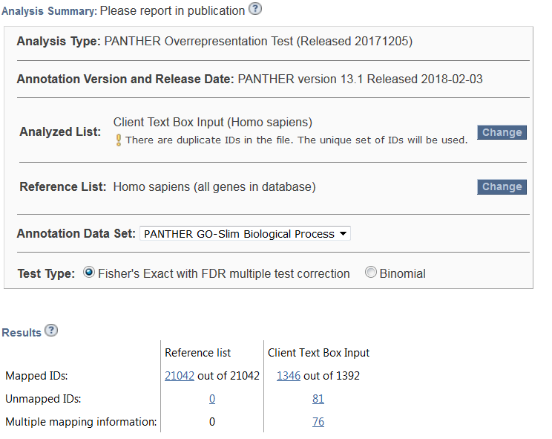
Panther
Notes:
Options to change.
Number of mapped hits

Slide 3
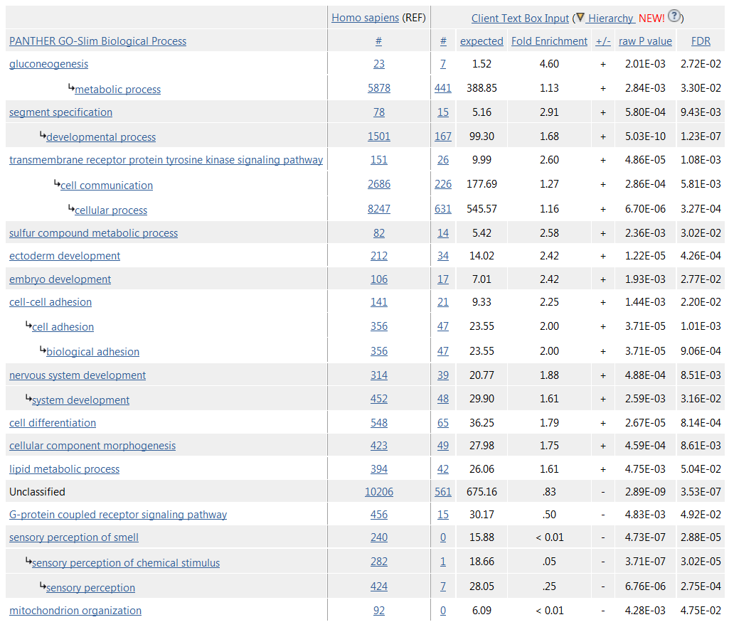
Panther
Notes:
GO Slims results

Slide 4
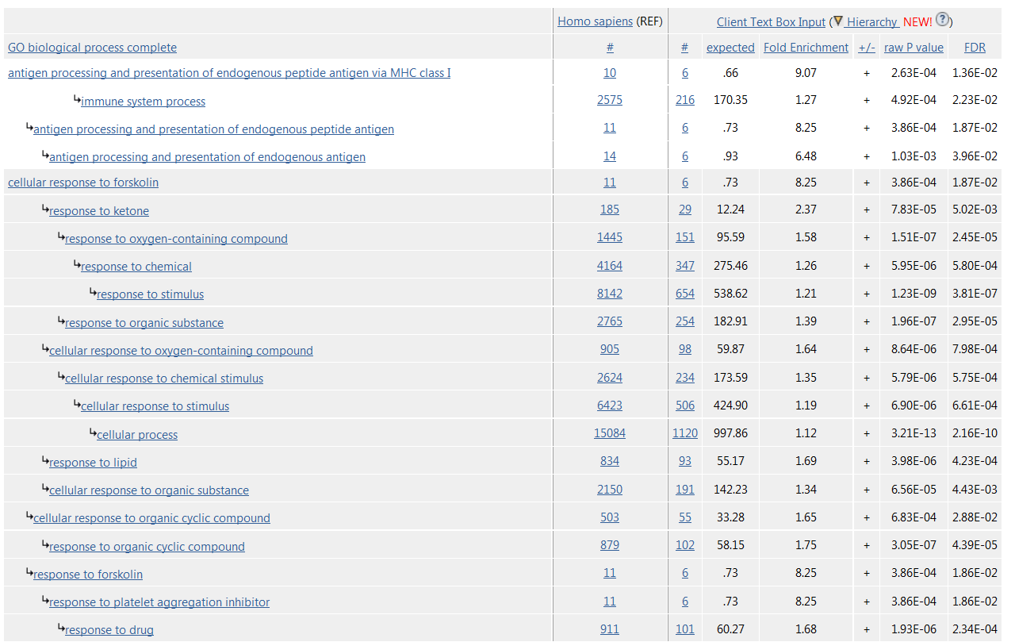
Panther
Notes:
Full GO results

Slide 5
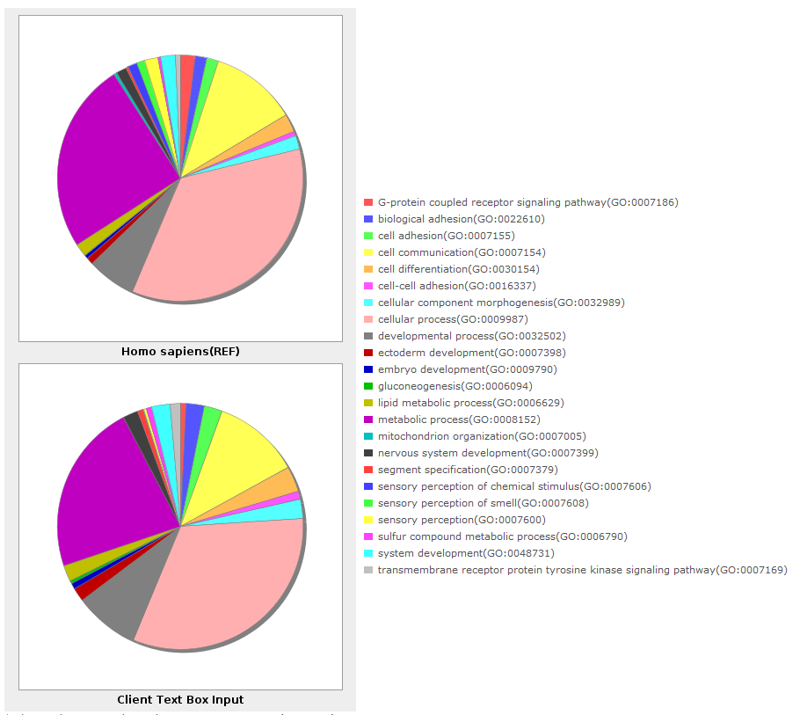
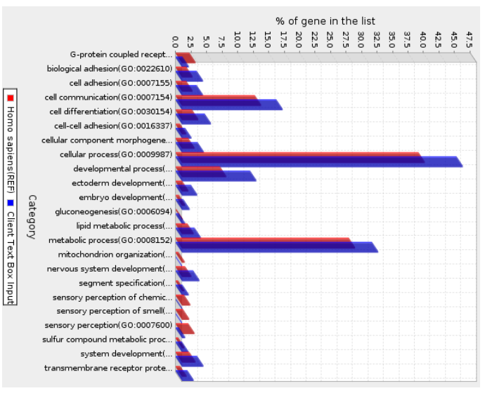
Panther Plots

Slide 6
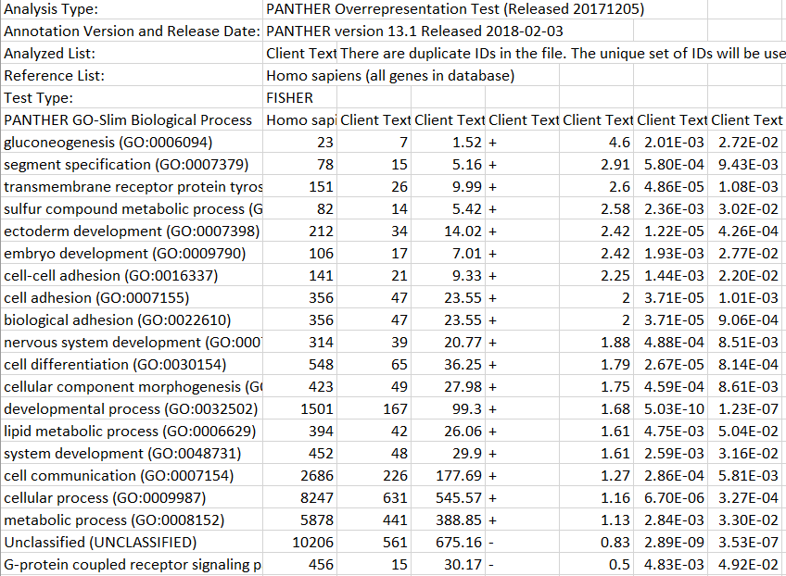
Panther Export
Notes:
Get basic statistics, don’t get the list of genes.

Slide 7
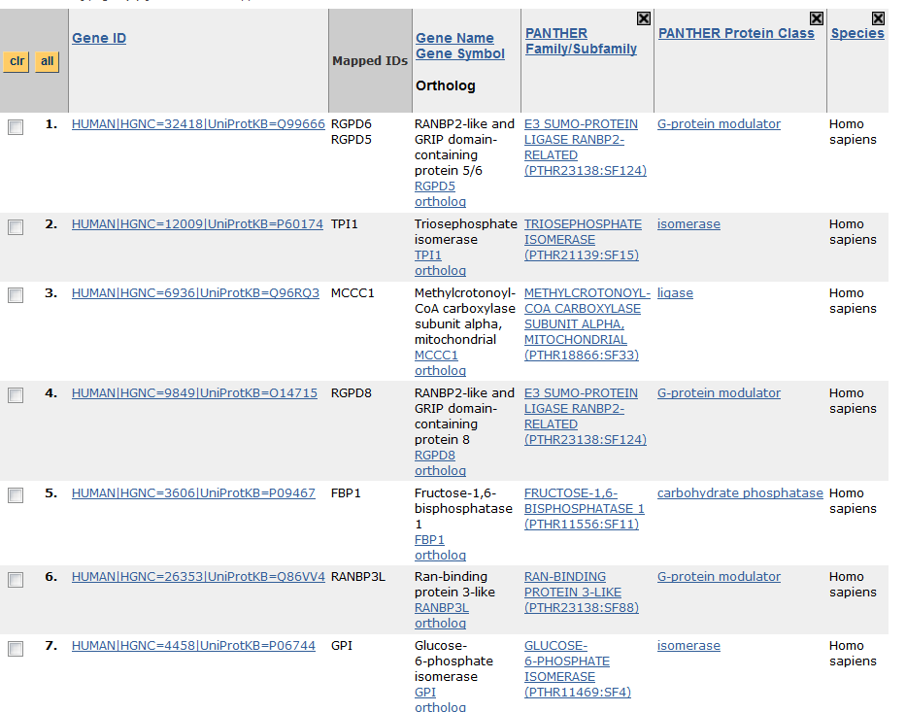
Panther Gene Lists

Slide 8
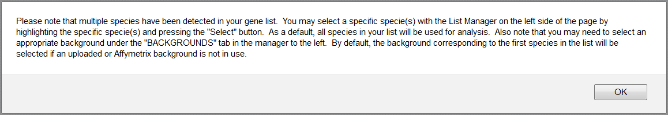
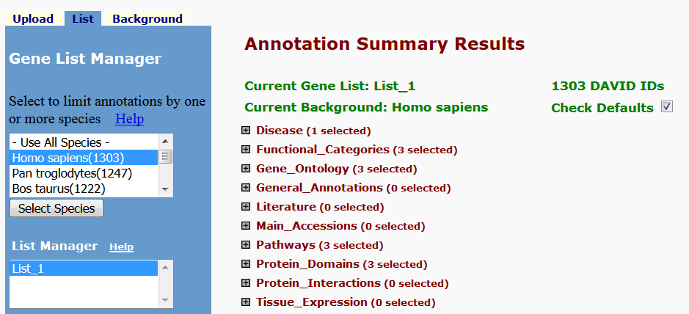
DAVID

Slide 9
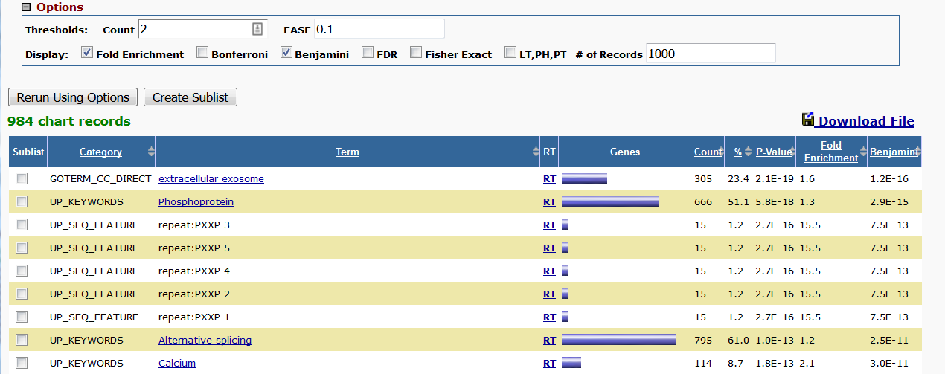
DAVID
Notes:
Had to add the fold enrichment manually.
Can’t see lists of genes here.

Slide 10
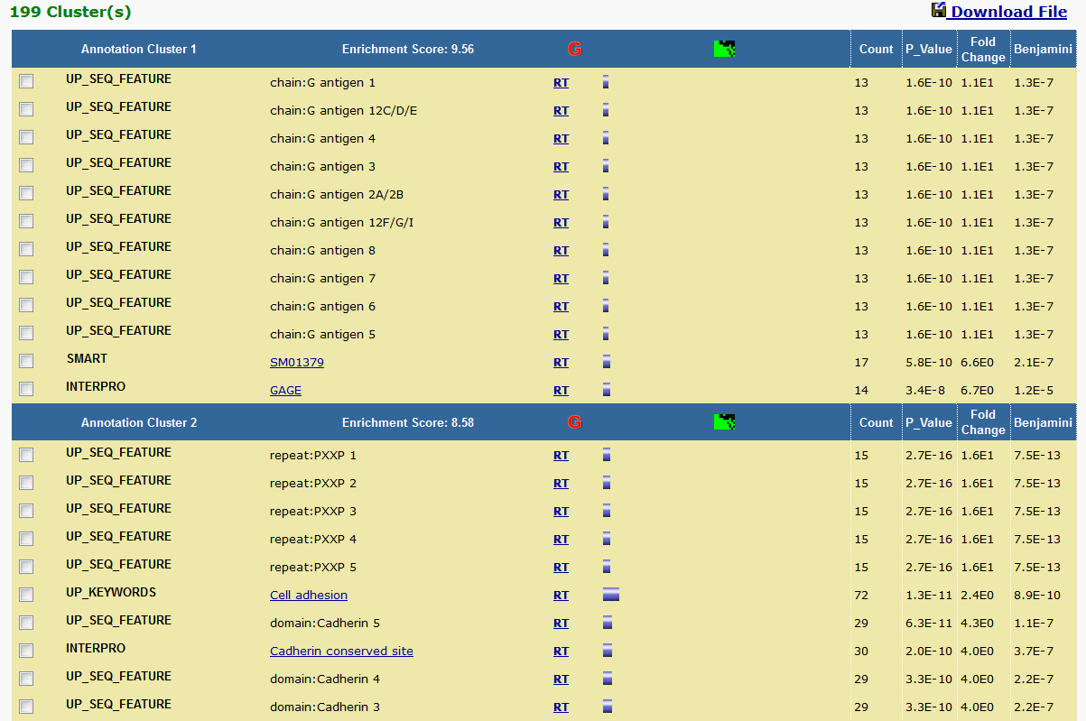
DAVID

Slide 11
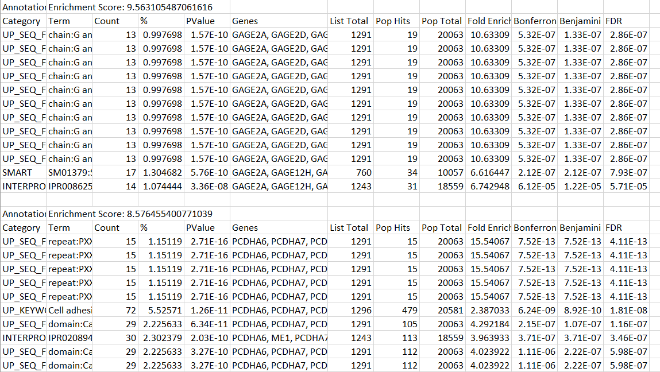
DAVID
Notes:
Lots of detail, including gene names.

Slide 12
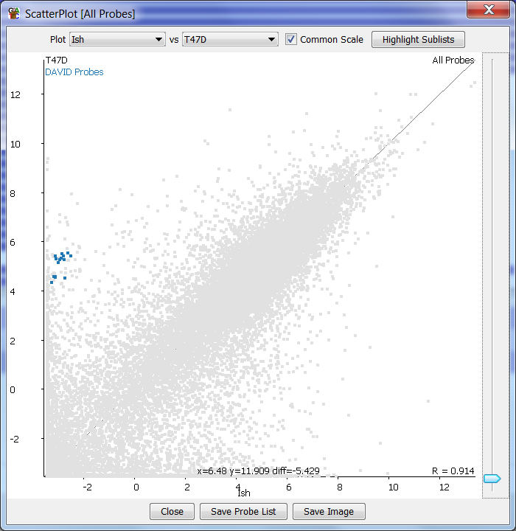
DAVID Validation

Slide 13
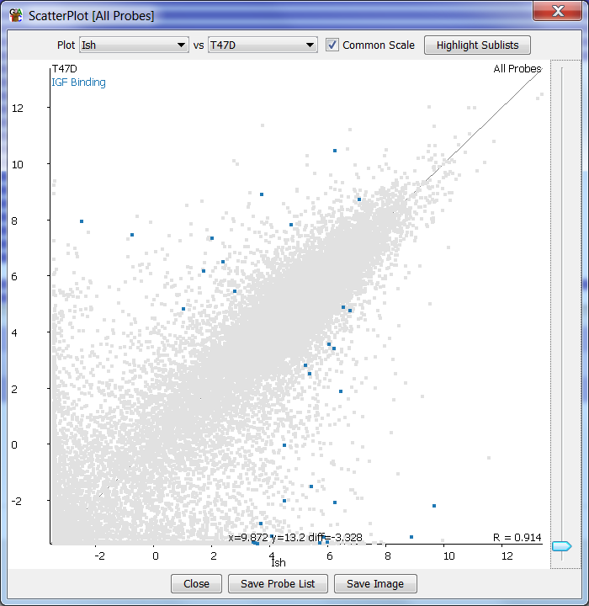
DAVID Validation

Slide 14
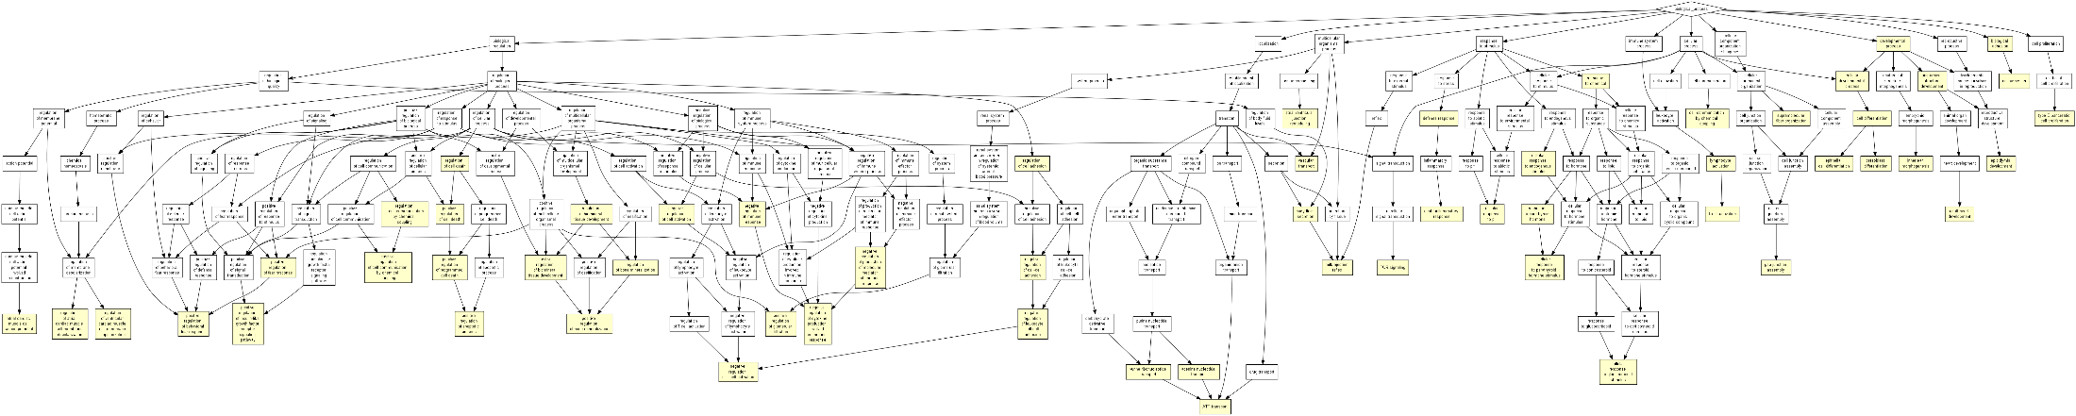
GOrilla

Slide 15
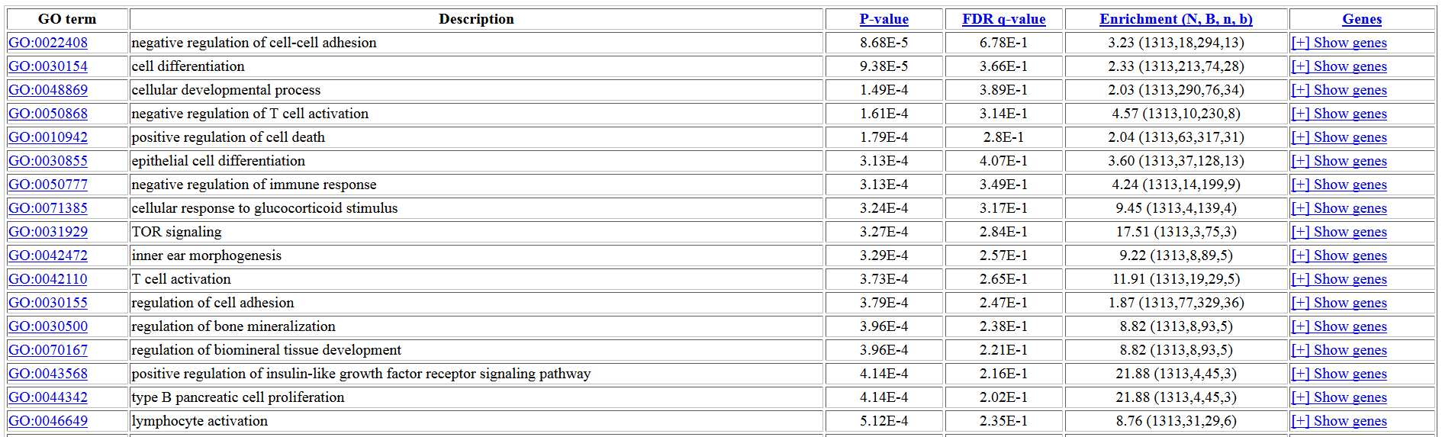
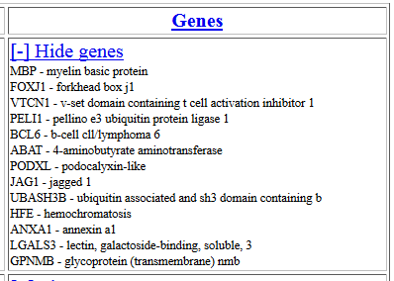
GOrilla

Slide 16
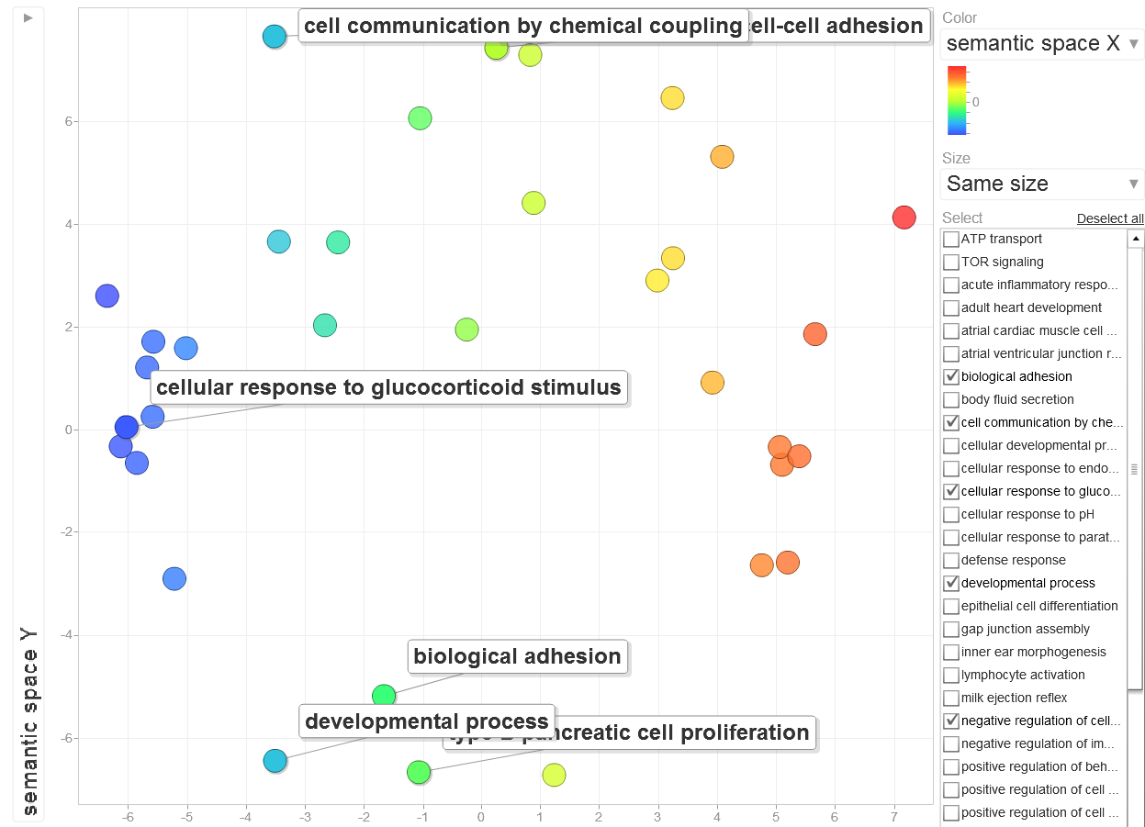
GOrilla - REViGO

Slide 17
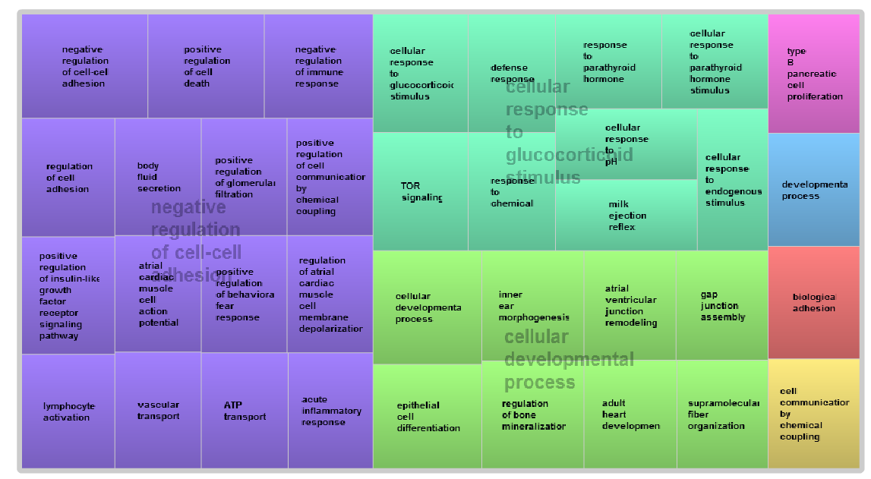
GOrilla - REViGO

Slide 18
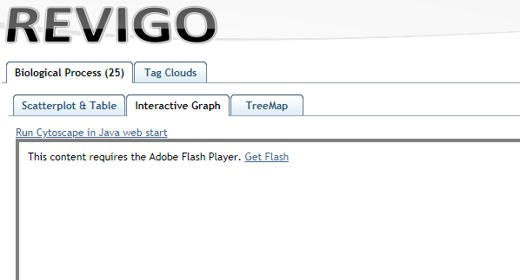
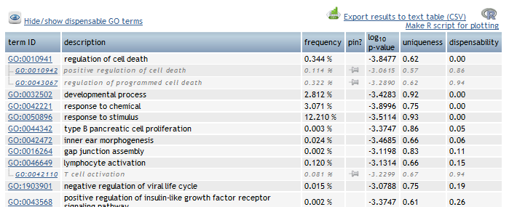

Slide 19
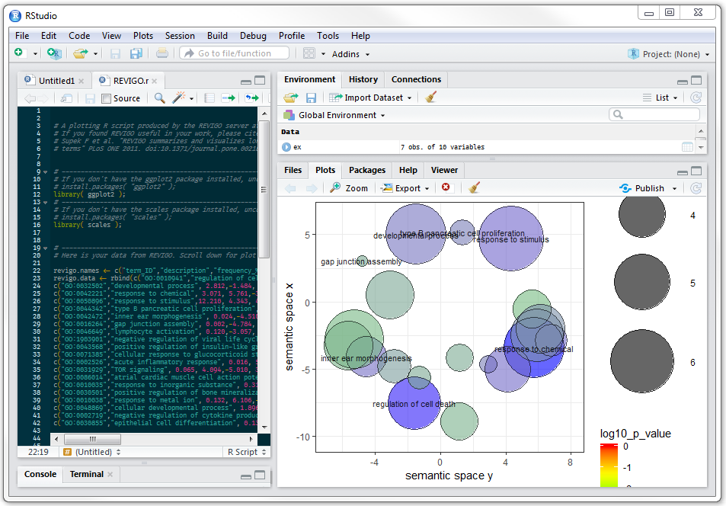

Slide 20
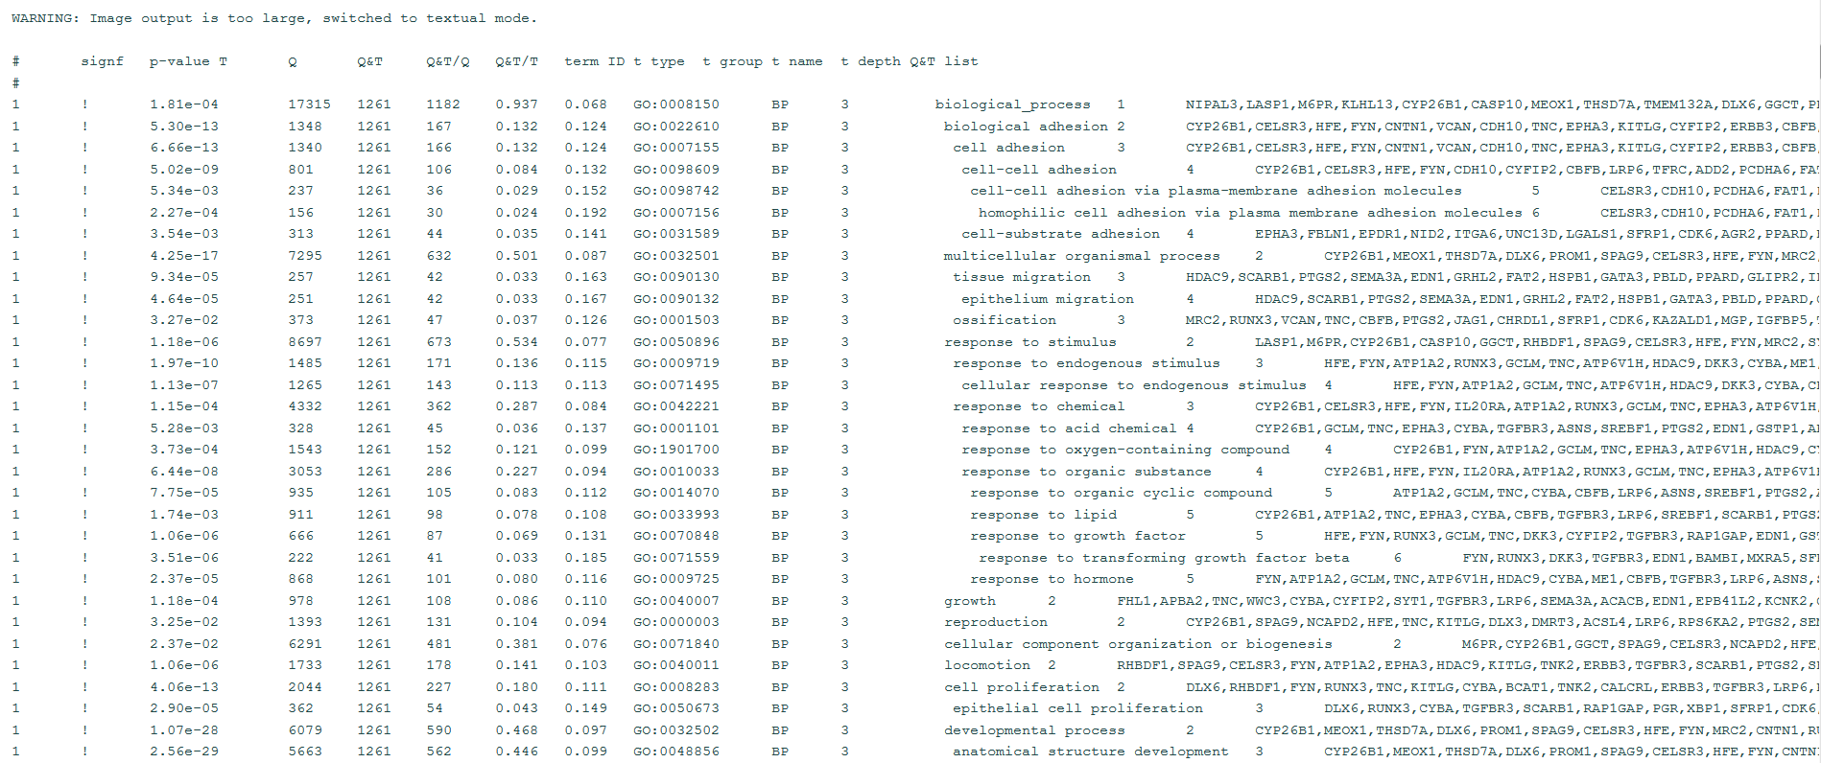
gProfiler

Slide 21
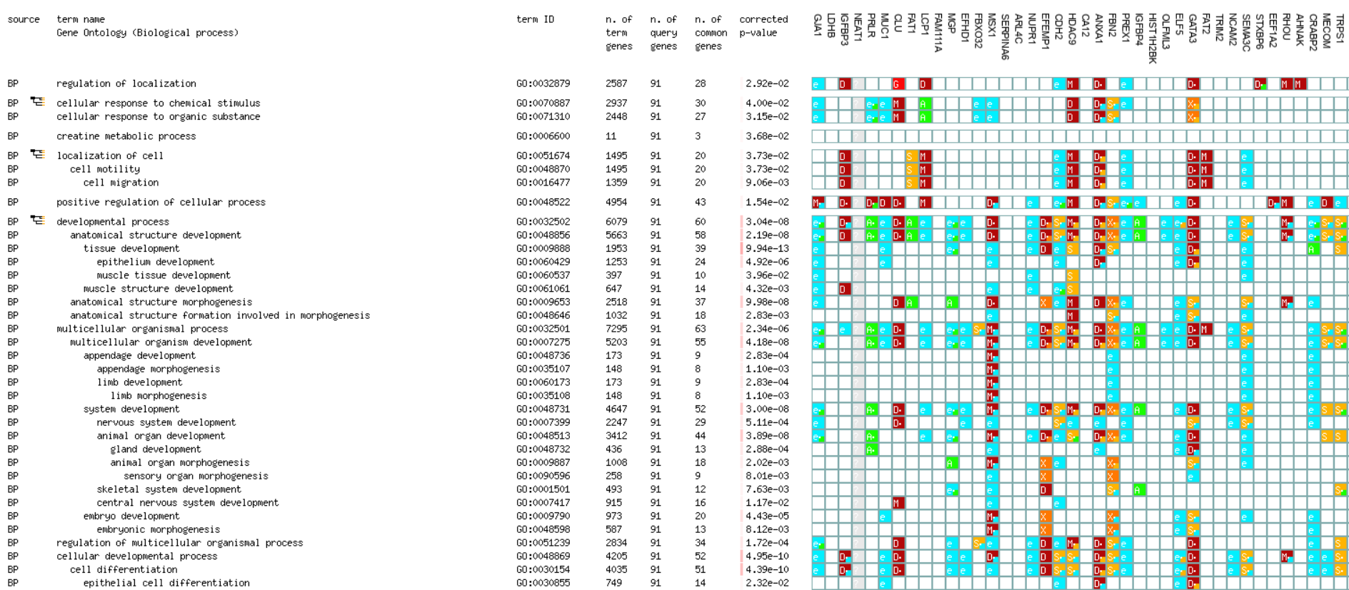
gProfiler

Slide 22
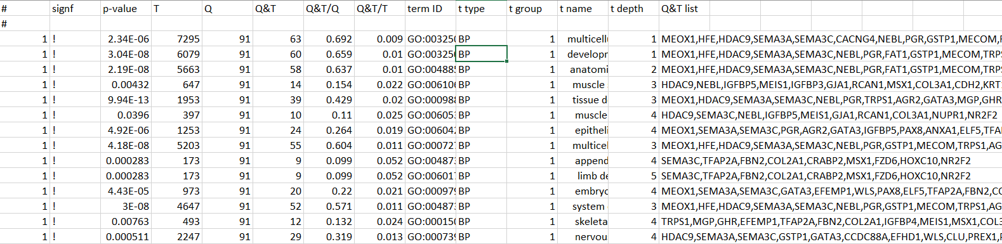
gProfiler

Slide 23
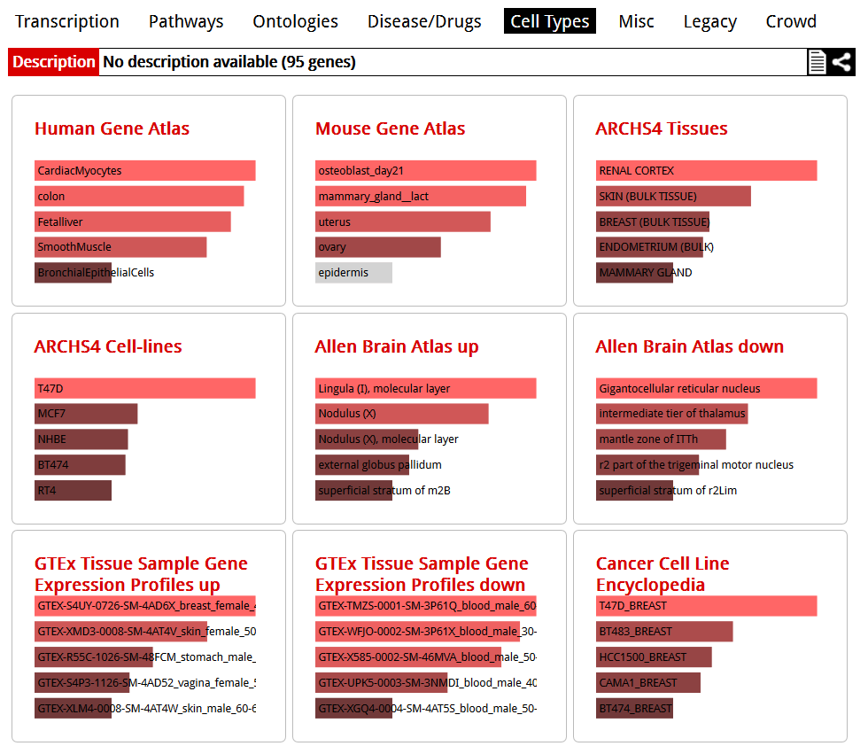
EnrichR

Slide 24
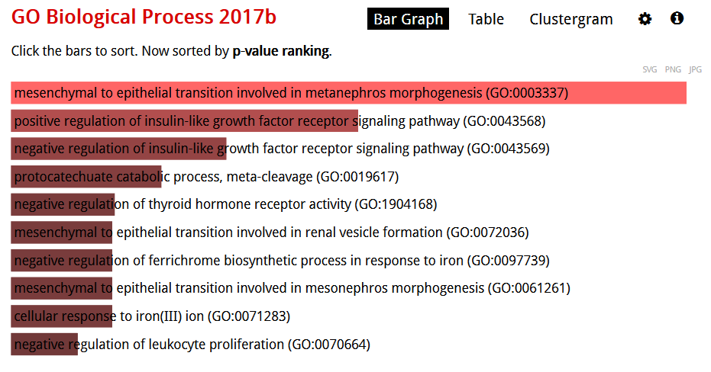
EnrichR

Slide 25
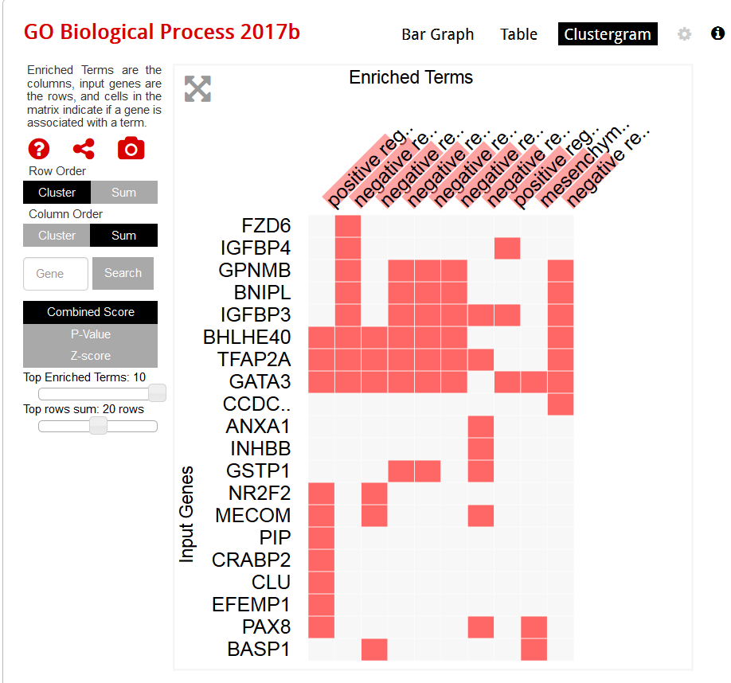
EnrichR
Notes:
Too small! Can’t see enough genes.

Slide 26
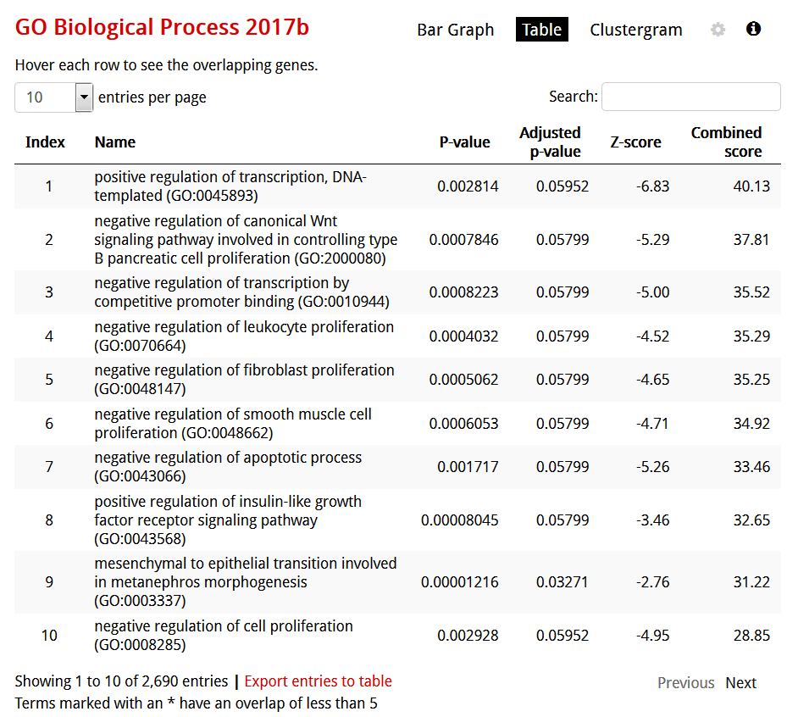
EnrichR

