Slide 1

Motif Searching
Simon Andrews
simon.andrews@babraham.ac.uk
@simon_andrews
V2021-11

Slide 2
Rationale
Hit A
Hit B
Hit C
GGATCC
GGATCC
GGATCC
Prom A
Gene A
Prom B
Gene B
Prom C
Gene C

Slide 3
Basic Questions
Does the sequence around my hits look unusual?
Do specific sequences turn up more often than expected in my hits?
If so, do the sequences look like any known functional sequence?

Slide 4
Basic Workflow
Hit regions
Genes, CDS, Positions, Whatever
Extract Sequences
Check for artefacts
Try to identify enriched sequences
Check for enriched sequences
Check for composition

Slide 5
Deciding what to extract
Hit
Hit
Hit plus context
Fixed width, centred on hit
Gene A
Promoter
Gene Body / CDS
3’ UTR
5’ UTR

Slide 6
Extracting Sequence
From positions
  BEDTools
  Genome Browsers*
  Custom scripts
From features
  Genome Browsers*
  BioMart
*not easily automatable for multiple sequences

Slide 7
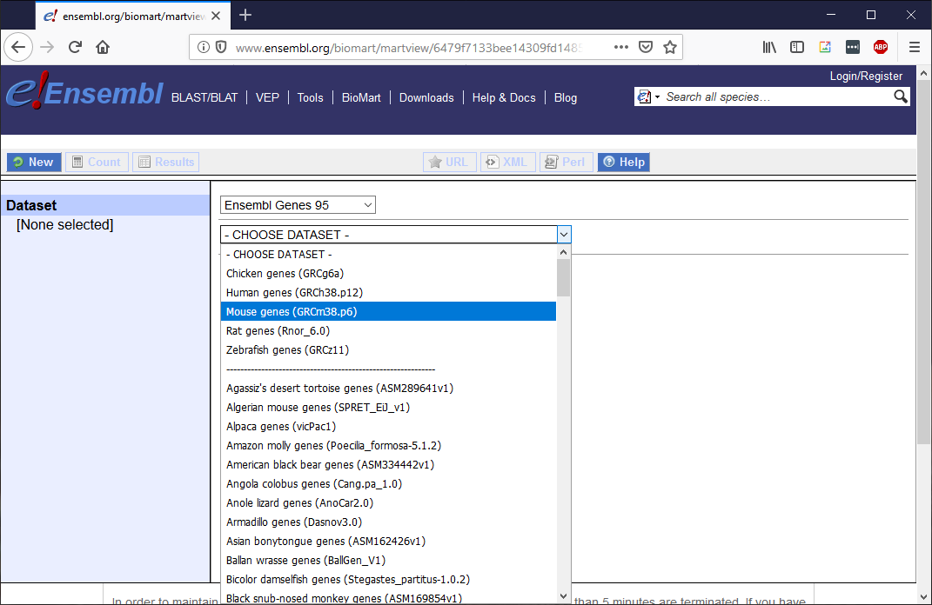
BioMart – Selecting Assembly
https://ensembl.org/biomart/martview

Slide 8
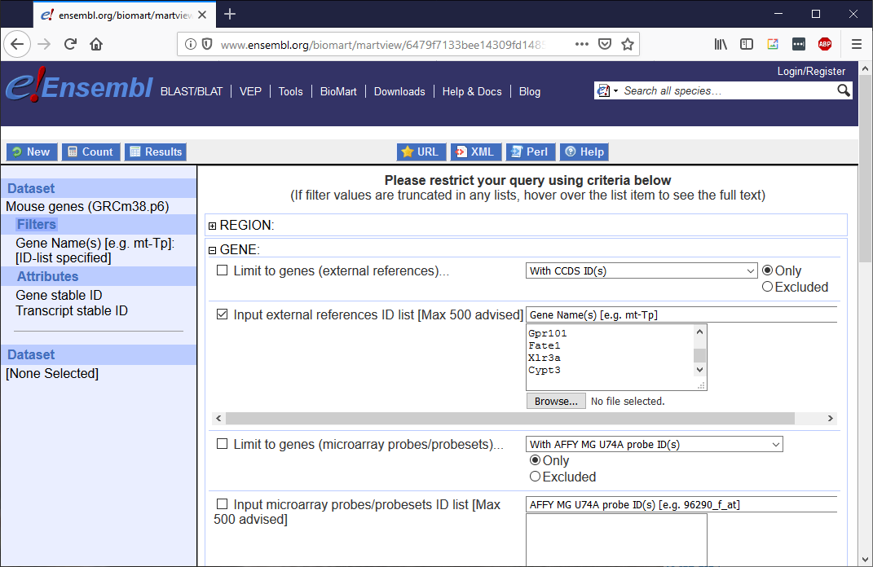
BioMart – Specifying features

Slide 9
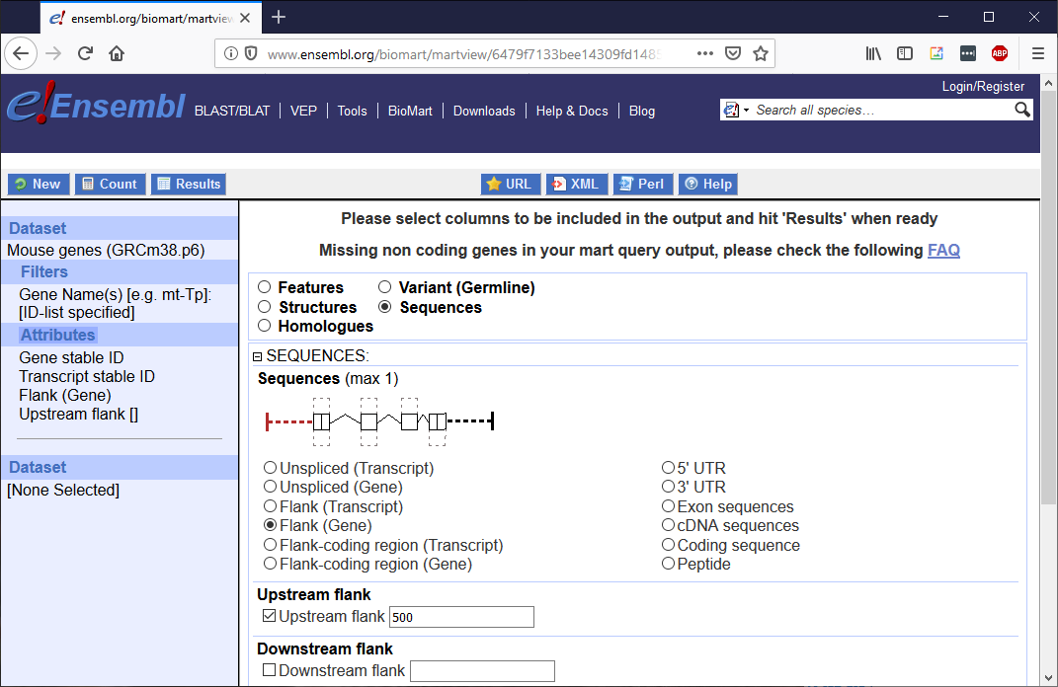
BioMart – selecting seq region

Slide 10
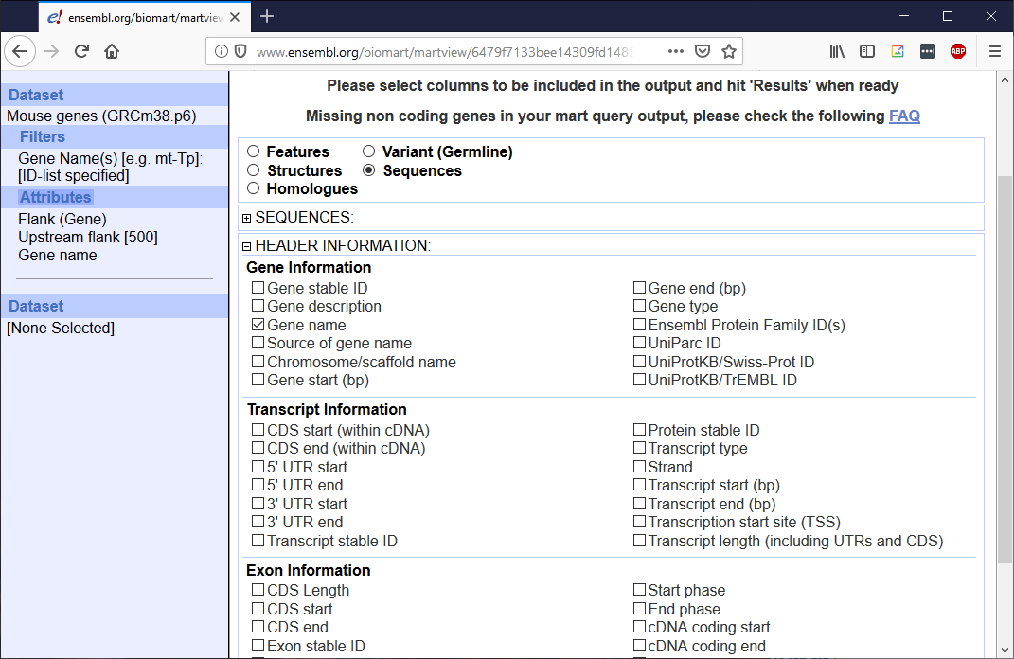
BioMart – header info

Slide 11
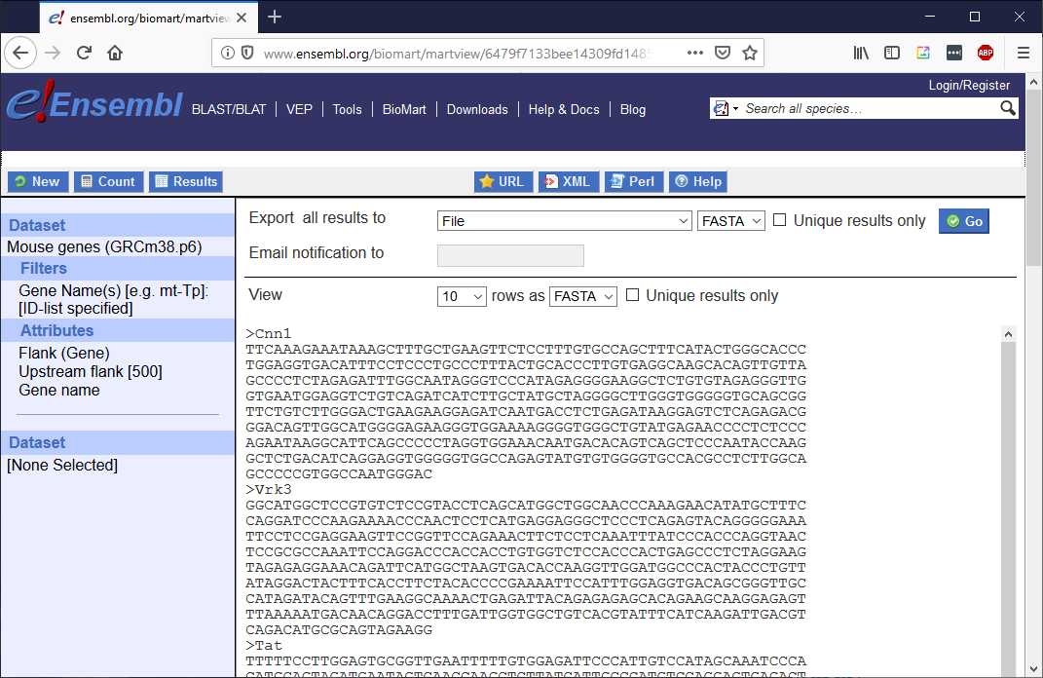
BioMart - exporting

Slide 12
Deciding on a comparison
Genomic
Dataset
Single Dataset
Dataset 1
Dataset 2
Enrichment
Enrichment
Single Input Set
Double Input Set

Slide 13
Filtering list of hits
Small list
Large list
High specificity
Quick run times
Potentially lower power
Highest hit artefacts
More power
Long run times
More noise
Don’t need all hits to generate motif
Often better to have a clean sequence set
Remove sequences which look unusual

Slide 14
Artefacts
Hit
LINE
LINE
LINE
LINE
CGI
CGI
CGI
Exclude common repeats
  Simple repeats (poly-A, SerThr repeats etc)
  Complex repeats (retroviral etc)
  Exclude hits with repeats
  Repeatmasked sequence
Check composition
  Analyse compositionally biased regions explicitly

Slide 15





Software
meme-suite.org
xxmotif.genzentrum.lmu.de/
lgsun.grc.nia.nih.gov/CisFinder/
cb.utdallas.edu/cread/
HOMER
homer.salk.edu/homer/motif/

Slide 16
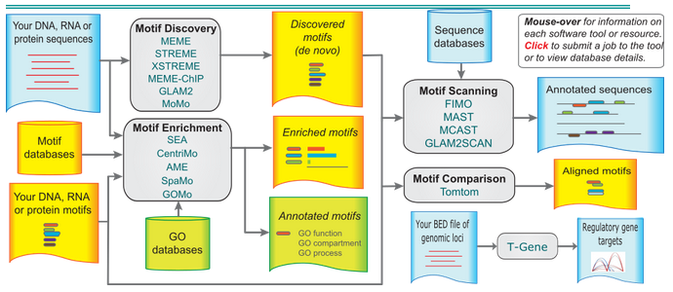
MEME Suite

Slide 17
MEME Motif Discovery
MEME
  Original motif enrichment program
  PWM based motifs
  Long ungapped motifs, sensitive search, slow!
STREME/XSTREME
  Short ungapped discriminatory motifs
    STREME when you expect the motif to be positioned within your sequence (ie ChIP peaks)
    XSTREME when you don't expect the motif to be positioned (eg Promoters)
  Degeneracy based motifs
  Quick!
GLAM2
  Gapped motifs

Slide 18
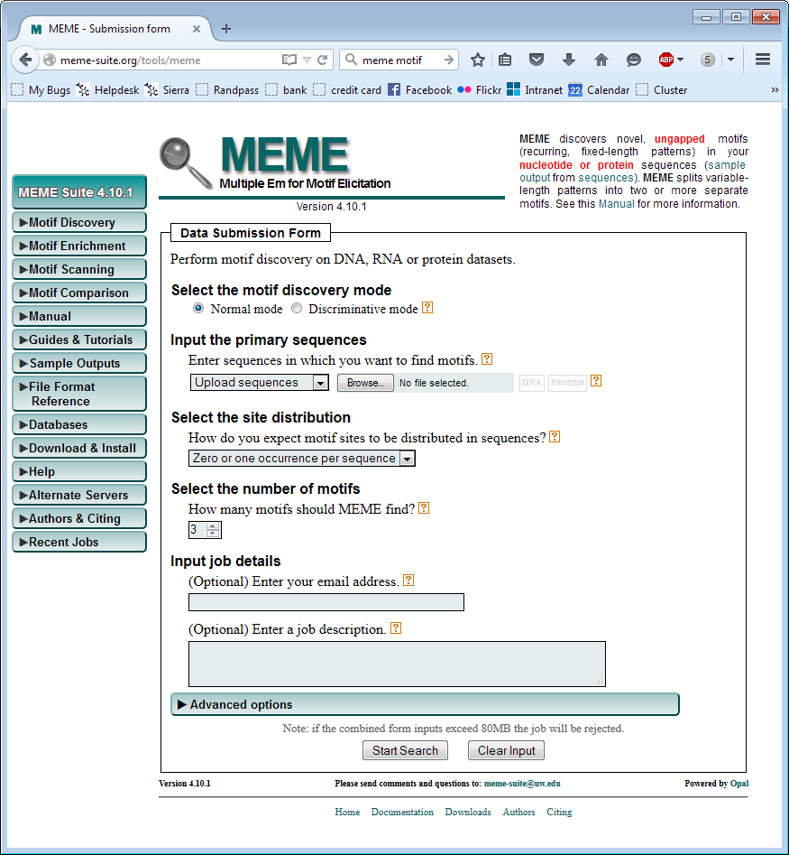
Main Parameters:
Sequences (multi-fasta)
Expected sites
How many motifs to find
Advanced
Custom background
Negative set
Motif size restriction
NB: Query size limited to 60kb
Local installations don’t have this limit

Slide 19
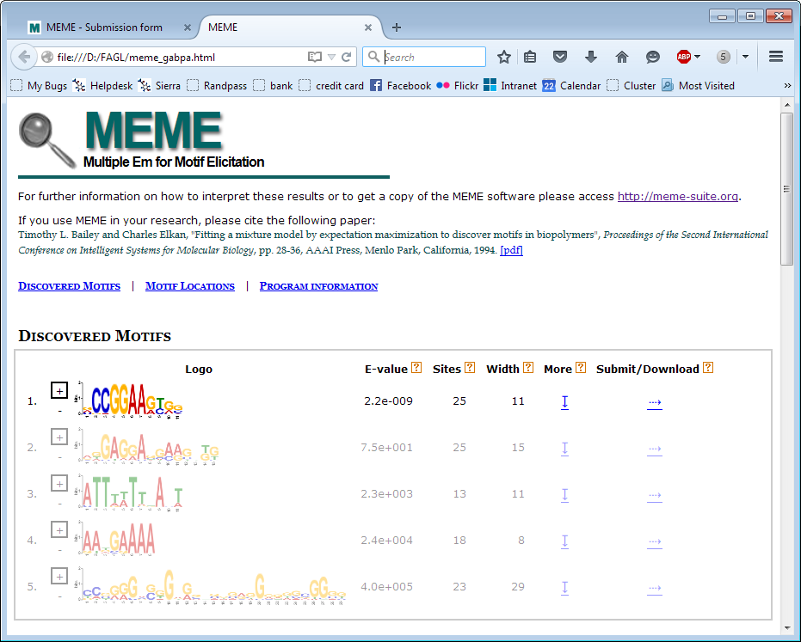
Good Result

Slide 20
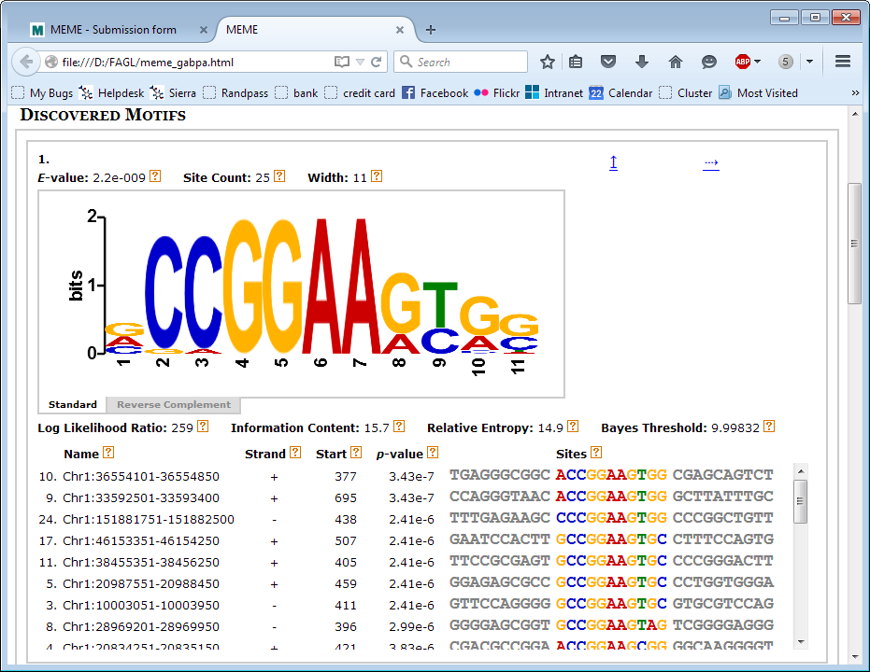
Good Result - Motif

Slide 21
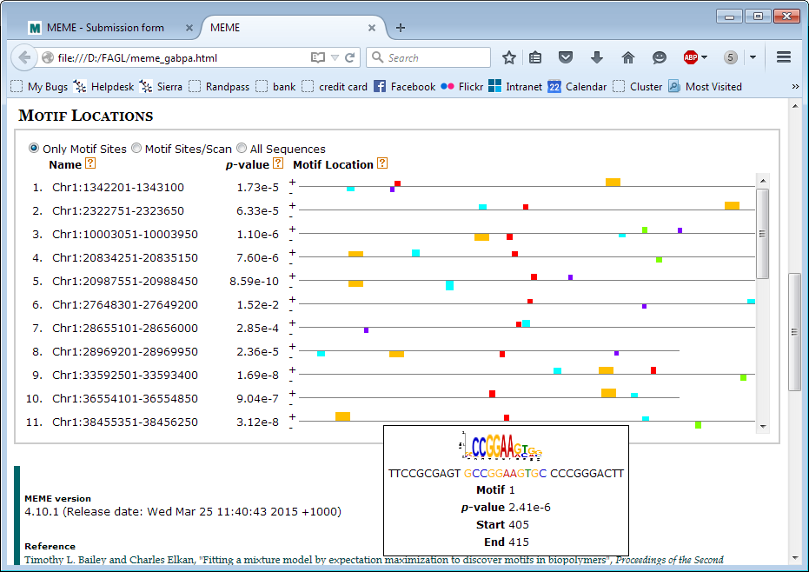
Good Result - Positioning
For ‘peak’ data, expect motifs to be roughly centred. For promoter data there may be no pattern.

Slide 22
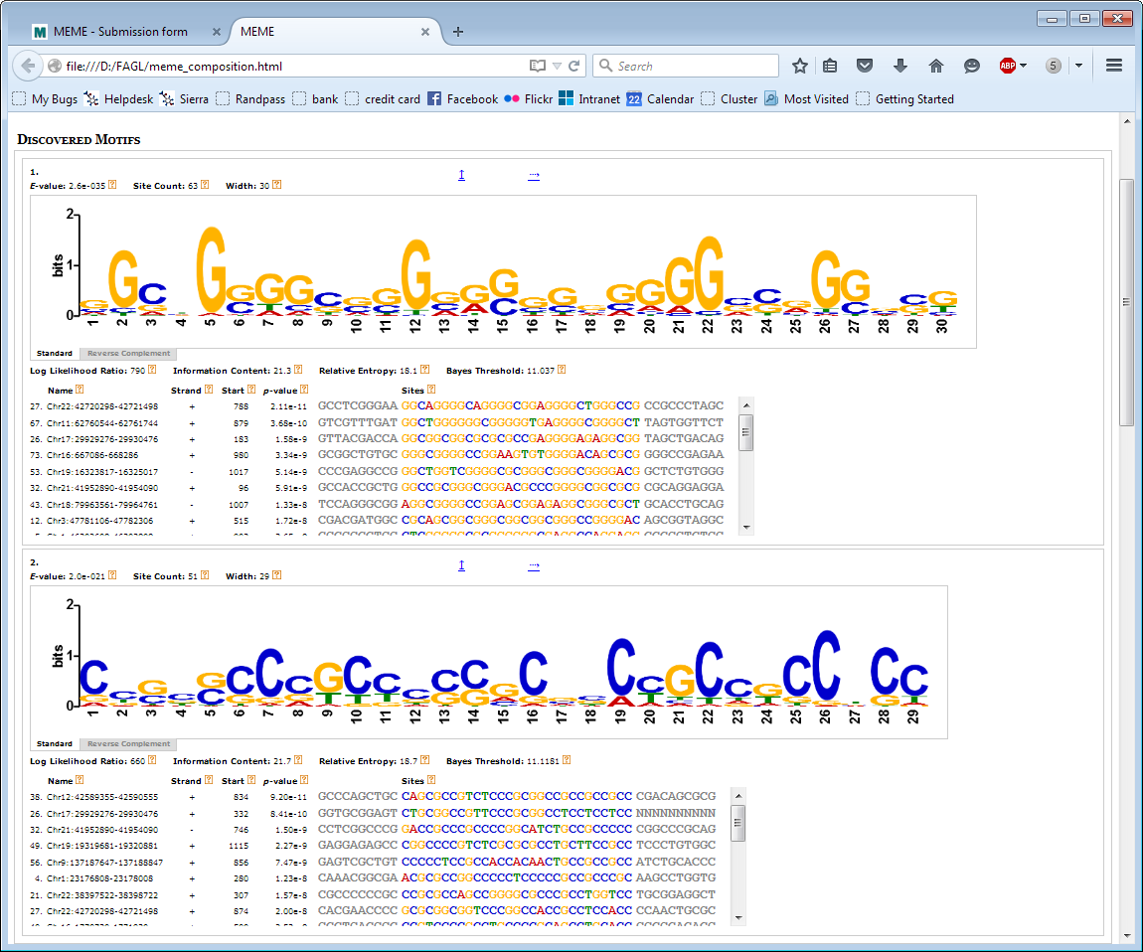
Artefactual Result - Composition
MEME tends to favour long compositionally biased motifs
Real motifs can be further down the list

Slide 23
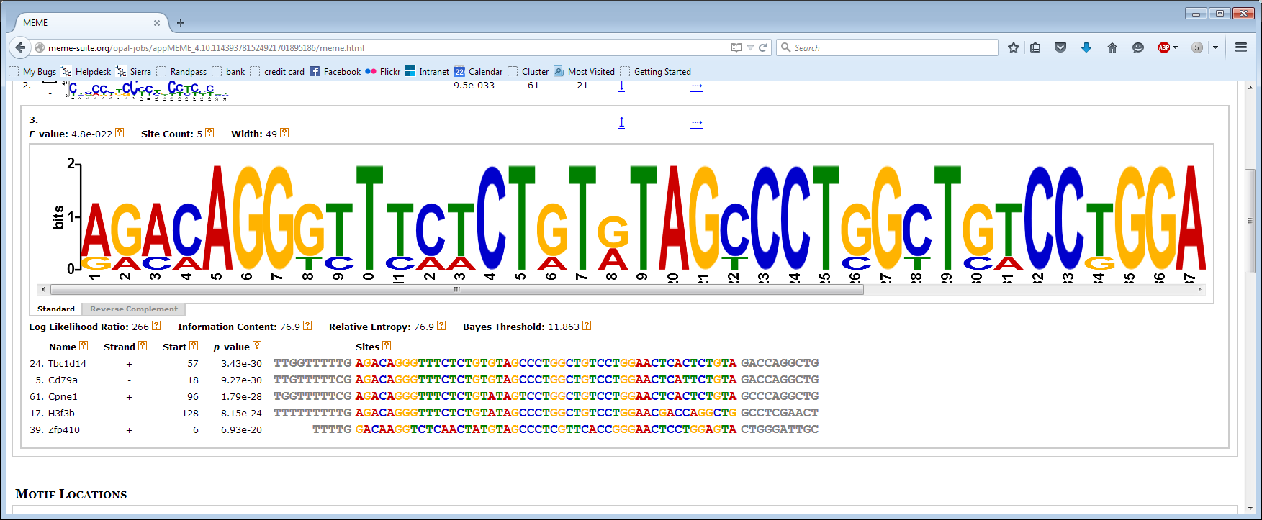
Artefactual Result - Duplication
Multiple transcripts with the same promoter
Overlapping regions

Slide 24
AME – Known motif search
Quicker / easier than de-novo discovery
Limited to characterised binding sites
Can choose from common motif sources
Good place to start

Slide 25
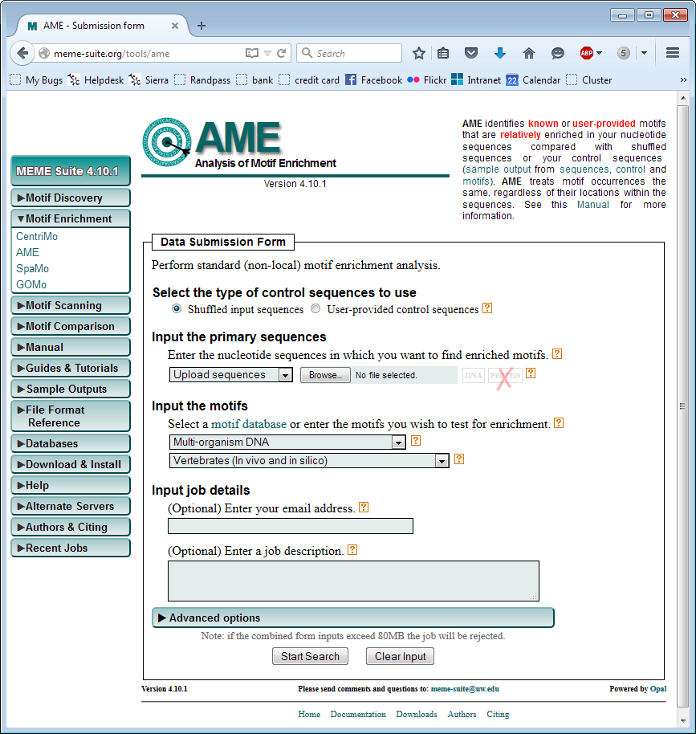
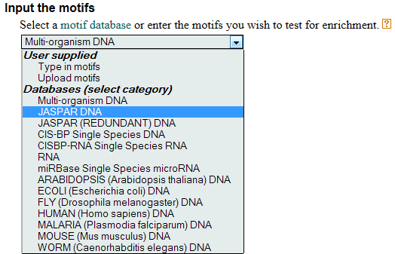
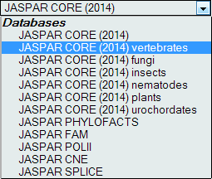

Slide 26
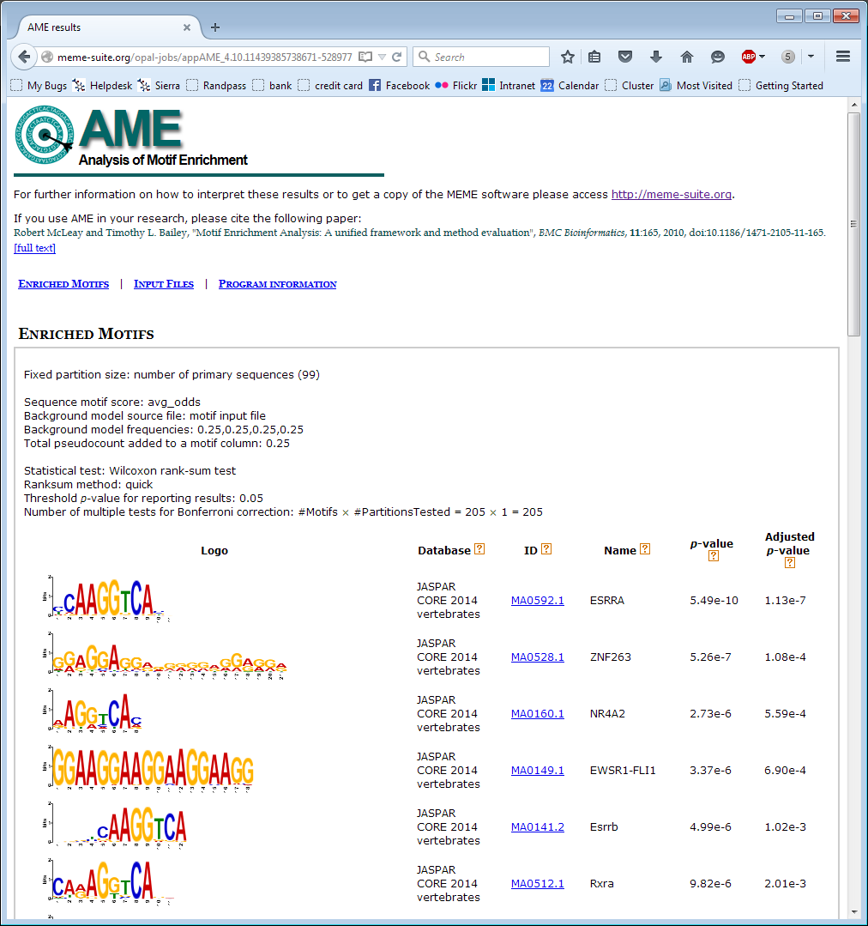
AME Result
No additional detail
Could check for positional
Bias with CentriMo
Beware similar motifs
from different factors

Slide 27
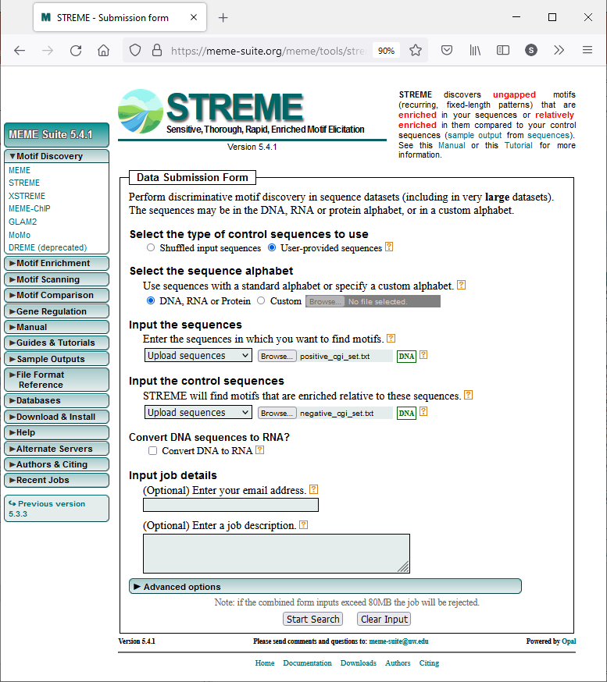

Slide 28
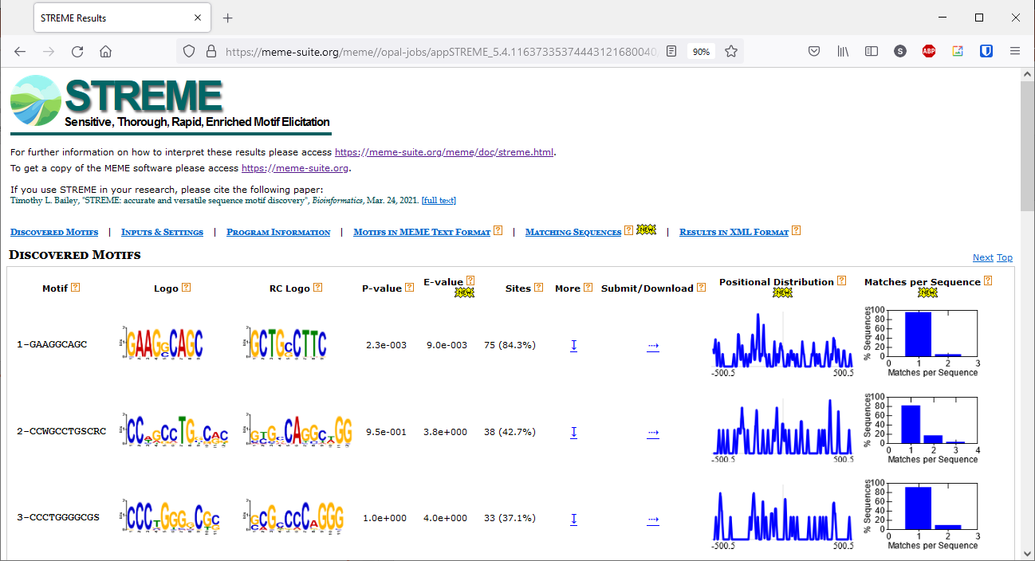
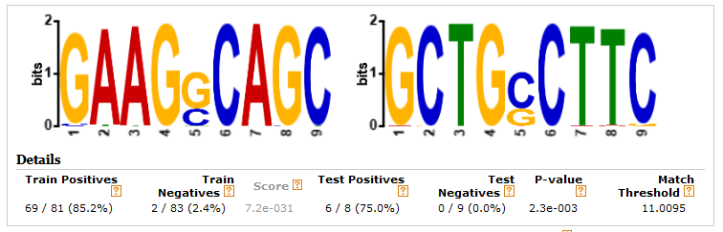
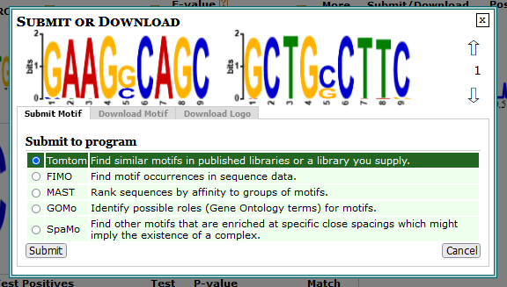

Slide 29
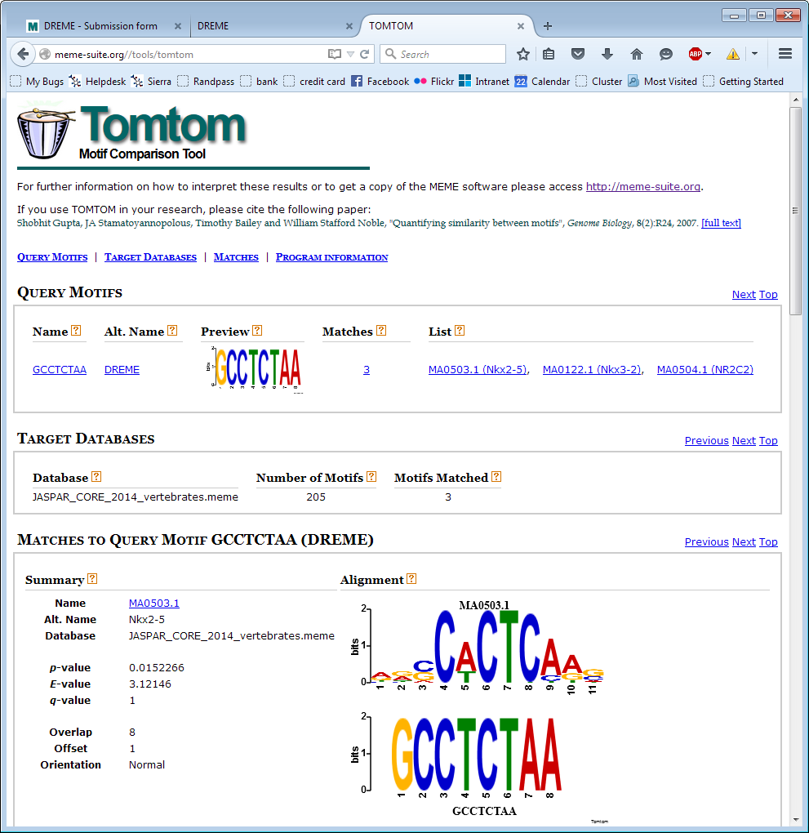

Slide 30
Motif Searching Exercise

