Slide 1

Exploring and Presenting Results
Simon Andrews, Laura Biggins
simon.andrews@babraham.ac.uk
laura.biggins@babraham.ac.uk
v2020-10

Slide 2
Functional enrichment results
Gene set information
  Gene set name
  Gene set source
  Gene set description
Statistical information
  Raw p-value
  Corrected p-value
  Enrichment value
Count information
  Hit genes in category
  Hit genes outside category
  Background genes in category
  Background genes outside category

Slide 3
Functional enrichment results
Gene set information
  Gene set name
  Gene set source
  Gene set description
Statistical information
  Raw p-value
  Corrected p-value
  Enrichment value
Count information
  Hit genes in category
  Hit genes outside category
  Background genes in category
  Background genes outside category

Slide 4
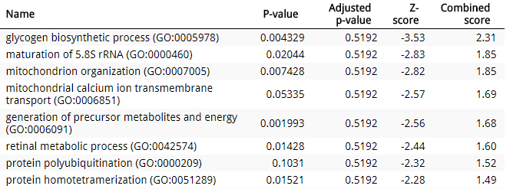
Presenting results
Tables are a natural way to present the key data
Notes:
.

Slide 5
Graphical Representations
Need to add something over a table
  Relationships between multiple result values
  Representation of redundancy between categories
  Relationship to original data
  Context of surrounding pathway

Slide 6
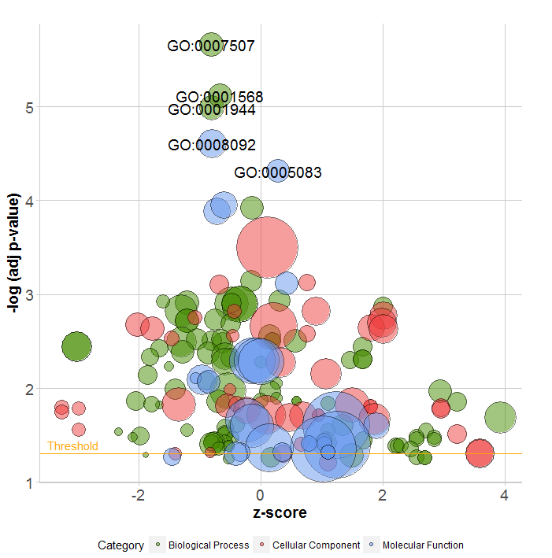

Plotting relationships between values
P-value (y)
Enrichment (x)
Count (radius)
Redundancy (colour)
http://wencke.github.io/

Slide 7
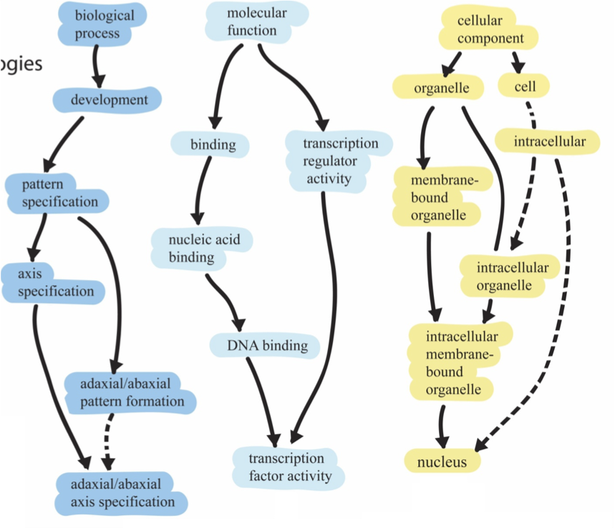
Redundancy in gene lists
Gene ontology is hierarchical - a gene is placed in the most specific category and will also appear in all the parent categories
1
2
3
Root ontology terms
general
Parent
Child
specific
Notes:
Parent child redundancy – a gene is placed in the most specific category and will also appear in all the parent categories.

Slide 8
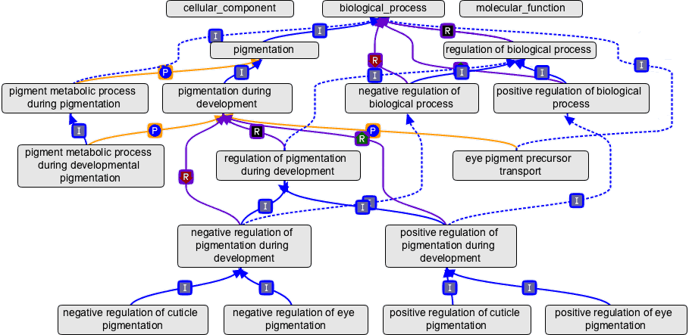
Redundancy in gene lists
Most genes are associated with multiple GO terms
There are many annotation sources, not just gene ontologies
Ontology structure is more complex than just parent-child relationships

Slide 9
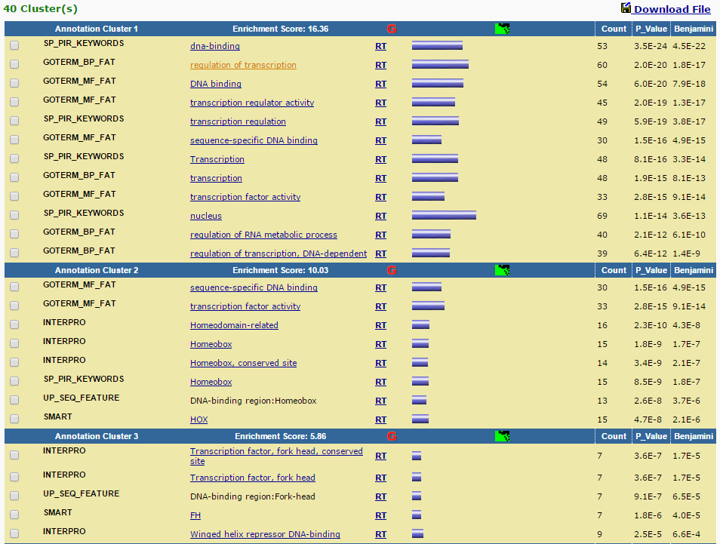
Redundancy: DAVID clustering
Notes:
david clusters by overlapping genes

Slide 10
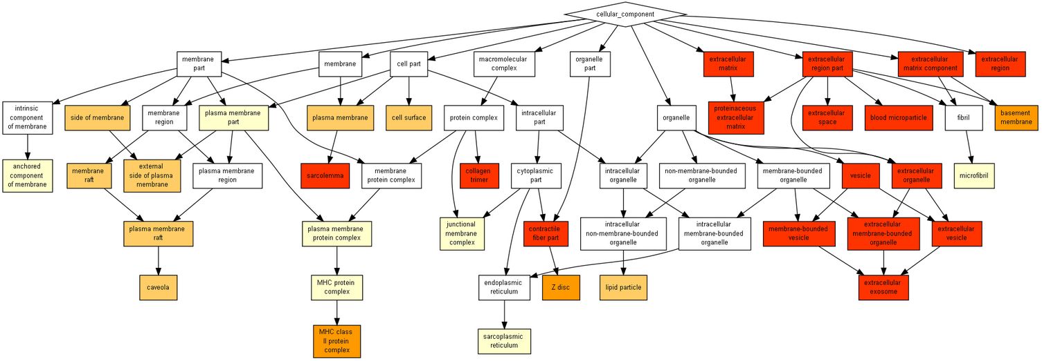
Redundancy: Gorilla GO images
cbl-gorilla.cs.technion.ac.il/
Notes:
Good thing about GOrilla – shows the hierarchy of the GO terms
Also a way of presenting results

Slide 11
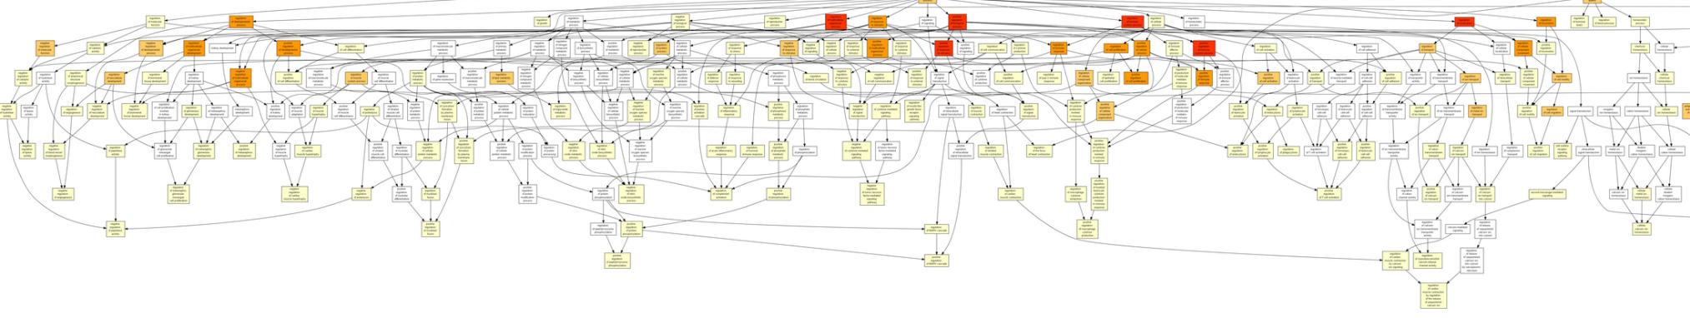
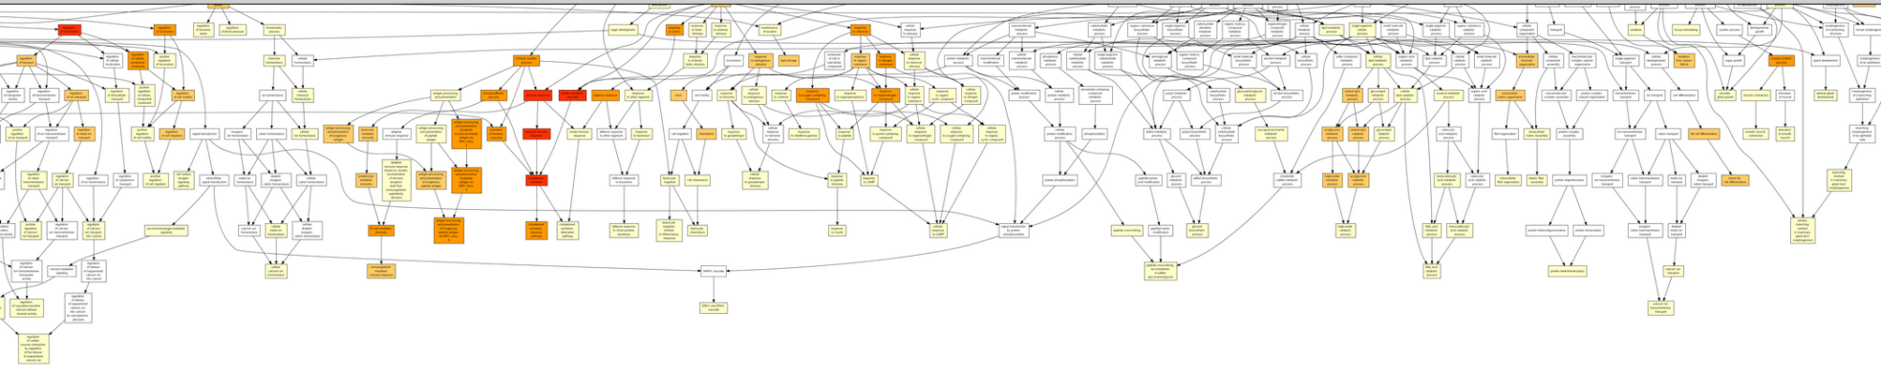
Redundancy: Gorilla GO images
cbl-gorilla.cs.technion.ac.il/
Notes:
But – if lots of info, difficult to interpret.
Can see that we don’t just have a neat parent-child relationships

Slide 12

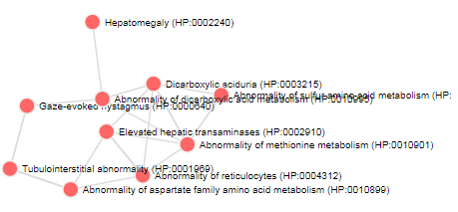
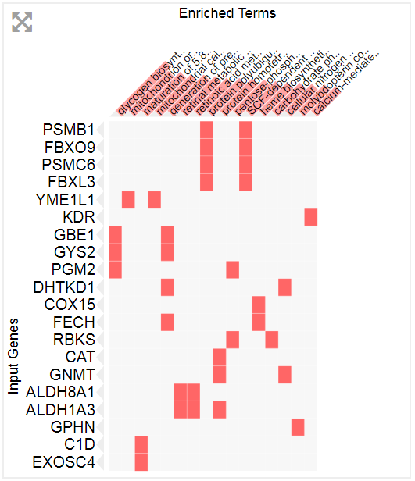
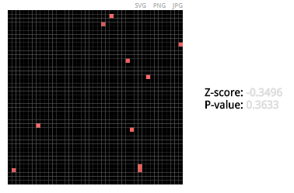
Redundancy: Enrichr overlap plots
Notes:
The heatmap - (clustergram as they call it) is quite a nice way of exploring the categories. It has some options to play around with the display
The network may not be available for all gene-set libraries.
Each node represents a term and a link between two nodes means that the two terms have some gene content similarity.
Initially, the network is force directed, but if you drag the node to a fixed position, it will stay there.
Like the other SVG figures, the network can be exported in three image formats.
The grid may not be available for all gene-set libraries.
Each grid square represents a term and is arranged based on its gene-set similarity with other terms. It shows only the top 10 terms sorted by combined score. The brighter the square, the more significant that term is. Clicking on the grid allows you to toggle to an alternate view that colors the grid based on its correlation score with neighbors with white dots representing the significant terms.
The z-score and p-value is a measure of how clustered the top 10 terms are on the grid.

Slide 13
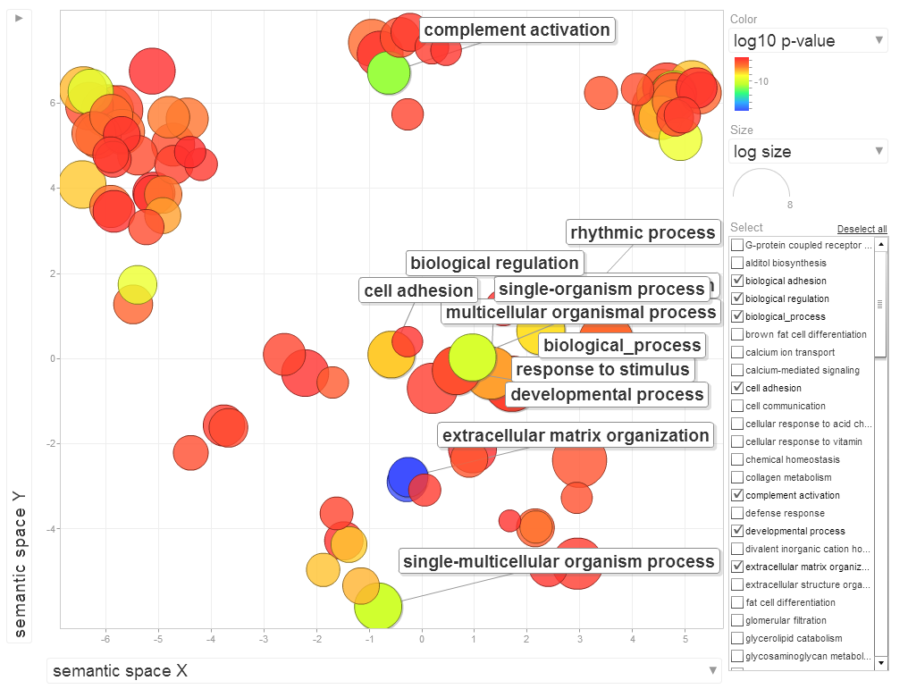
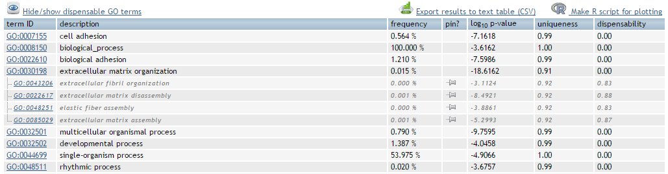
Redundancy: REVIGO (from Gorilla)
http://revigo.irb.hr/

Slide 14
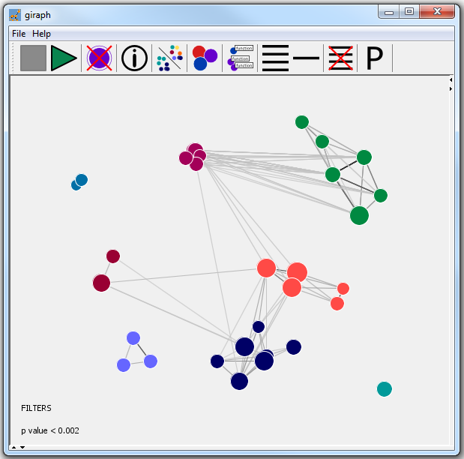
Redundancy: Giraph (via David)
Giraph plot
Proximity of circles is related to the proportion of overlapping genes between categories.
Size of circle represents the number of genes.
https://github.com/laurabiggins/Giraph

Slide 15
Relationship to original data
Quantitative values for genes in category
  Direction and magnitude of change
Look at genes in category which aren’t hits
  Relative numbers
  Supportive changes?

Slide 16
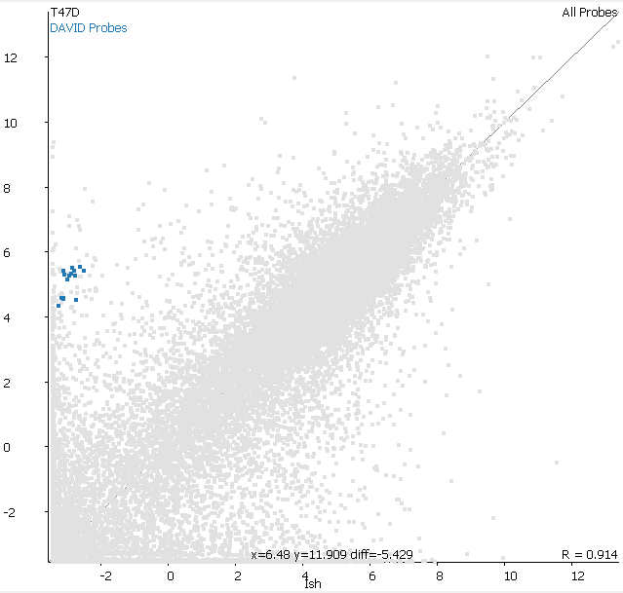
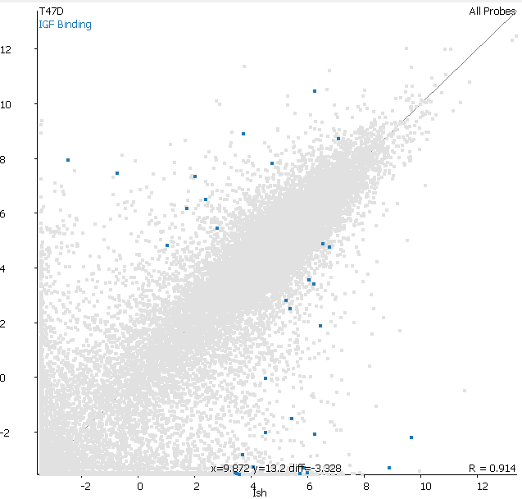
Relationship to original data

Slide 17
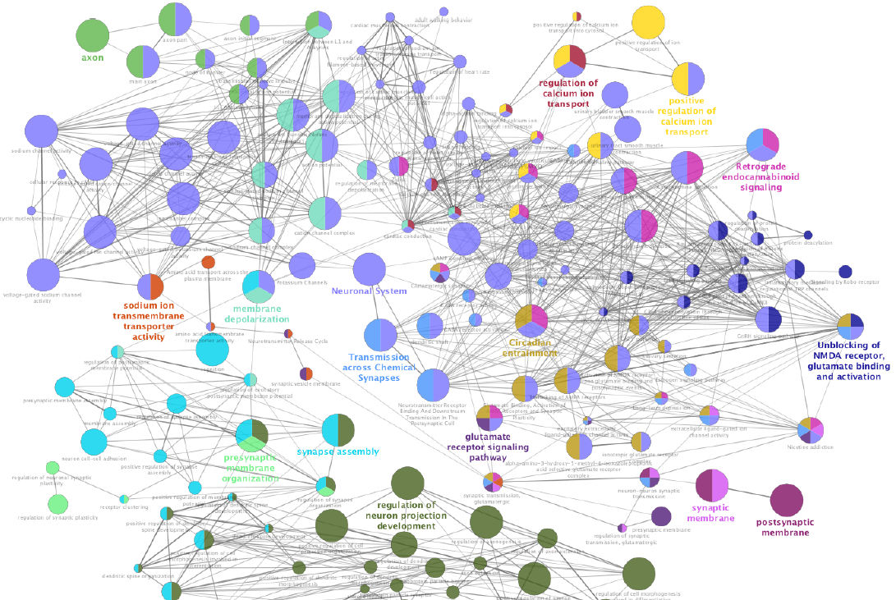

Pathways: ClueGo
App within Cytoscape
ClueGO integrates GO terms as well as pathways
Creates a functionally organized GO/pathway term network

Slide 18
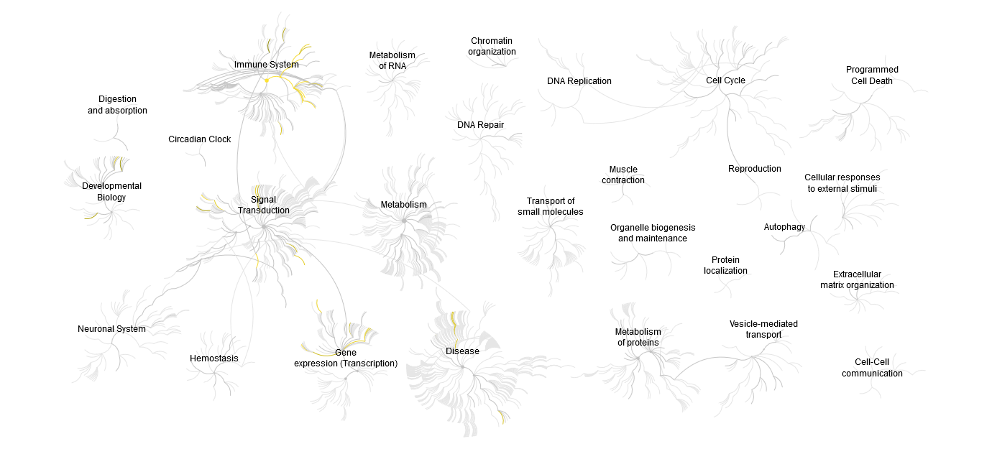
Pathways: Reactome

Slide 19
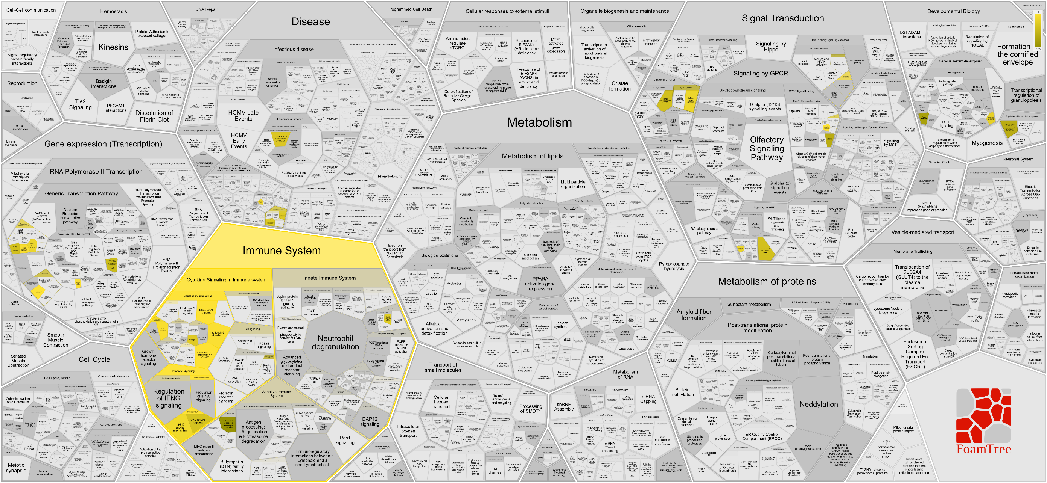
Pathways: Reactome

Slide 20
Summary
Tables are often sufficient
  Must include name, enrichment, corrected p-value
  Other values are useful, but don’t put in everything
Figures can add extra information
  Plotting multiple metrics
  Illustrating redundancy
  Relating to original data
  Mapping to pathways

