Slide 1
Plotting Complex Figures Using R
Simon Andrews
simon.andrews@babraham.ac.uk
v2017-11

Slide 2
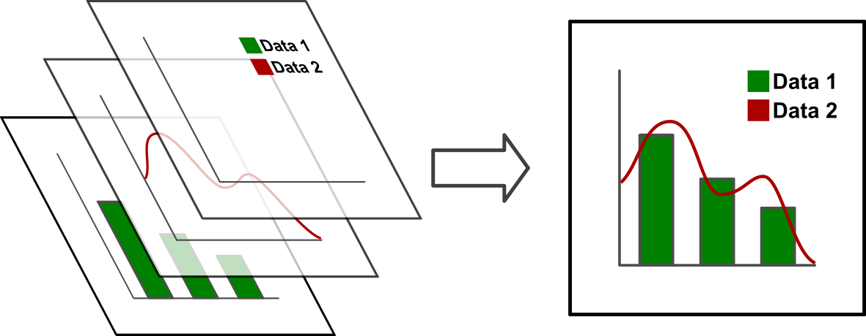
The R Painters Model
Plot area
Base plot
Overlays

Slide 3
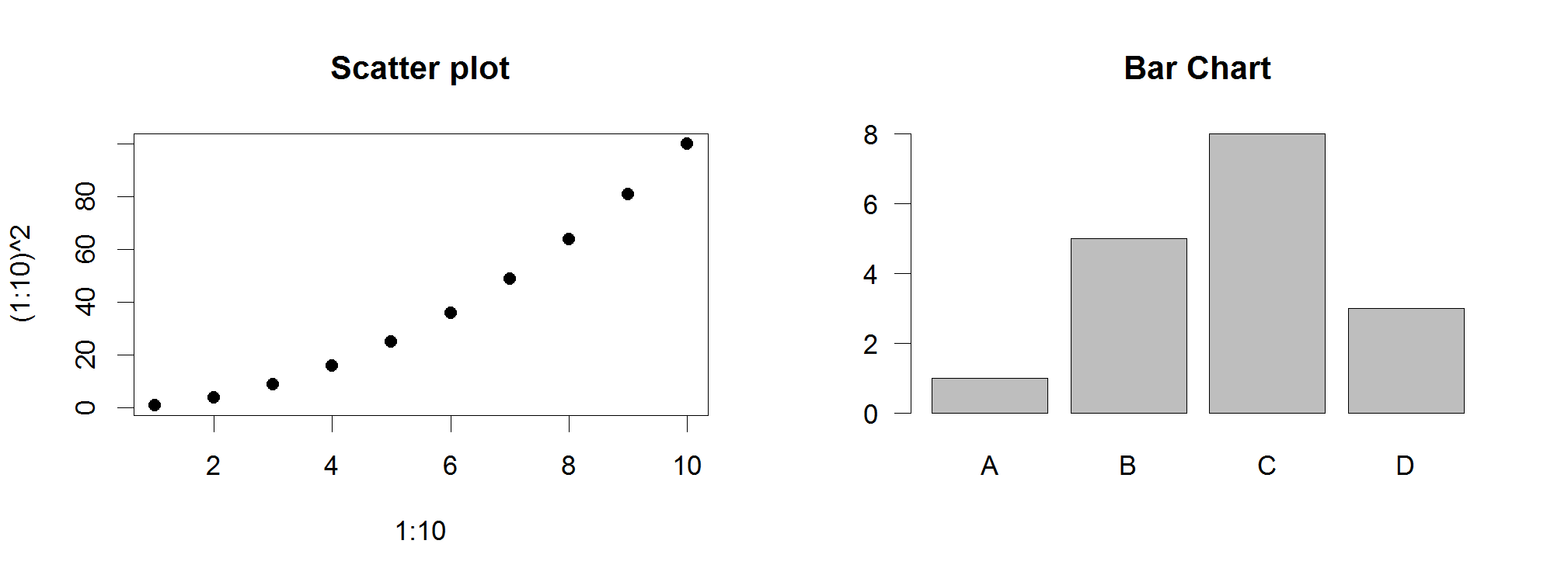
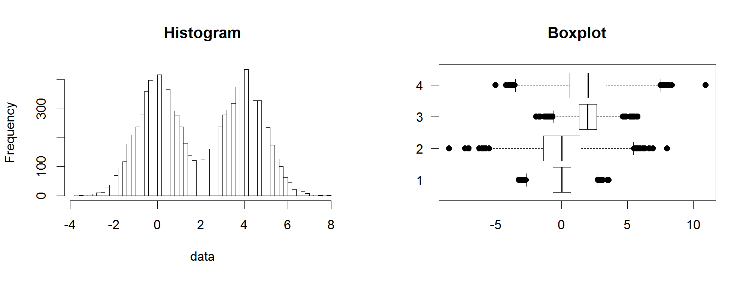
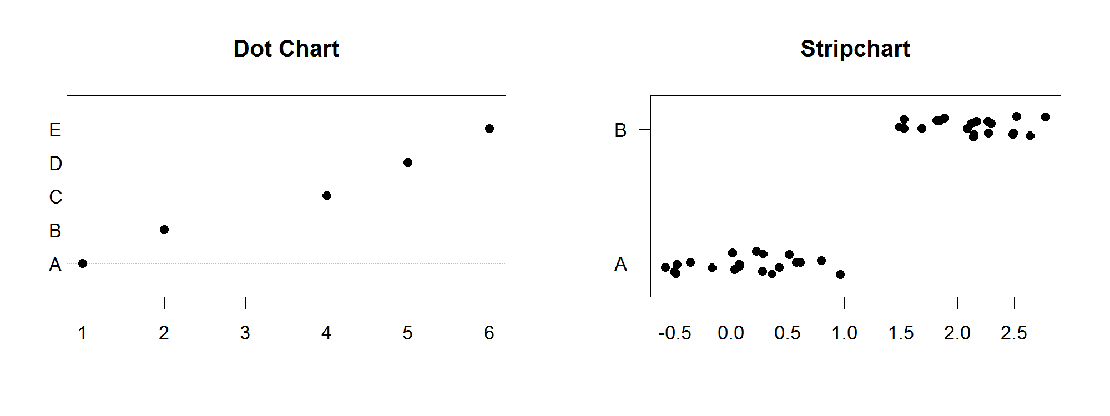
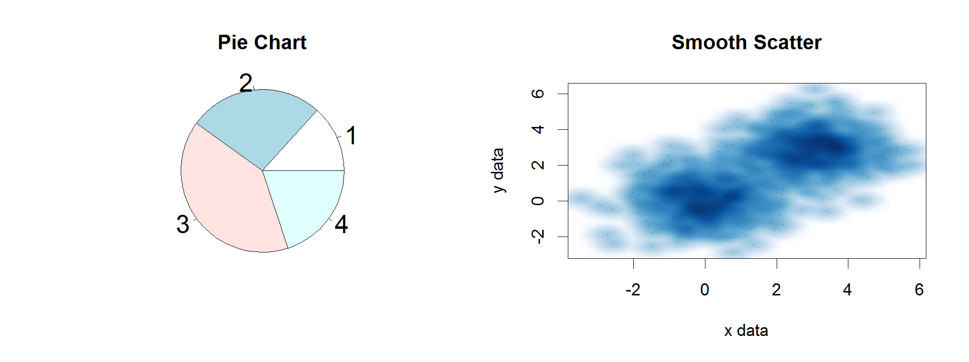
Core Graph Types
Local options to change a specific plot
Global options to affect all graphs

Slide 4
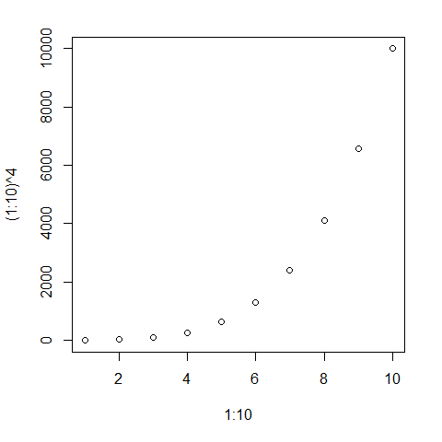
Figures are configured based on the options passed to them
plot(
1:10,(1:10) ^ 4
)

Slide 5
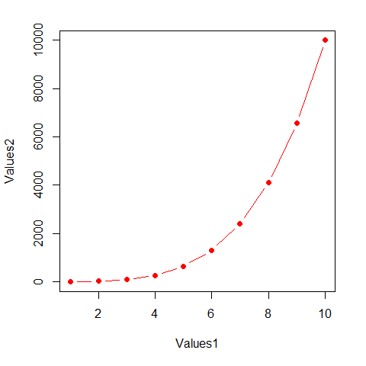
Figures are configured based on the options passed to them
plot(
1:10,(1:10) ^ 4,
pch=19,
type="b",
xlab="Values1",
ylab="Values2",
col="red"
)

Slide 6
Some options are common to many plot types
Axis scales
  xlim c(min,max)
  ylim c(min,max)
Axis labels
  xlab(text)
  ylab(text)
Plot titles
  main(text)
  sub(text)
Plot characters
  pch(number)
  cex(number)

Slide 7
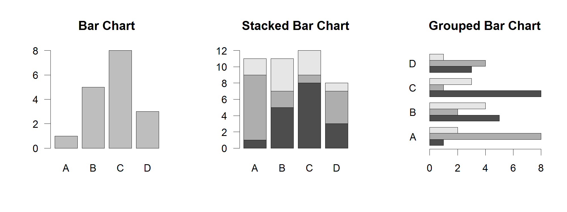
Some options are specific to one graph type (eg barplot)
Options:
  names.arg Bar labels (if not from data)
  horiz=TRUE Plot horizontally
  beside=TRUE Plot multiple series as a group rather than stacked

Slide 8
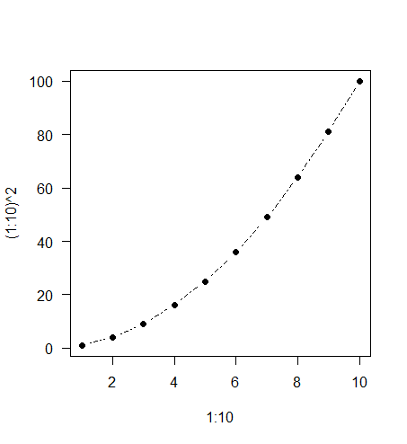
Some options take 'magic' numbers
plot(
1:10,
(1:10)^2,
type="b",
lty=2,
pch=19
)

Slide 9
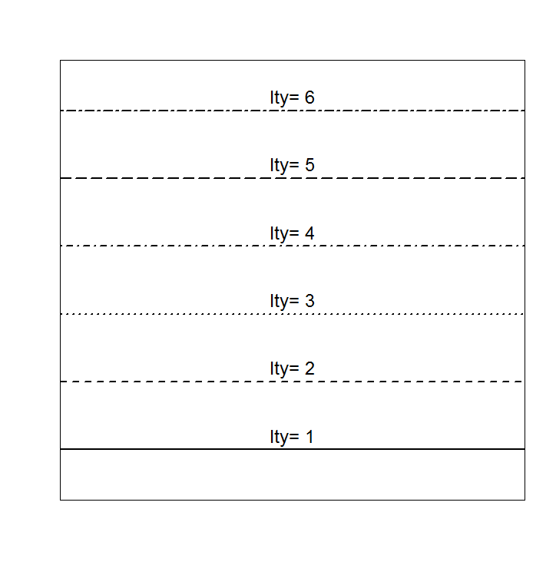
Line types

Slide 10
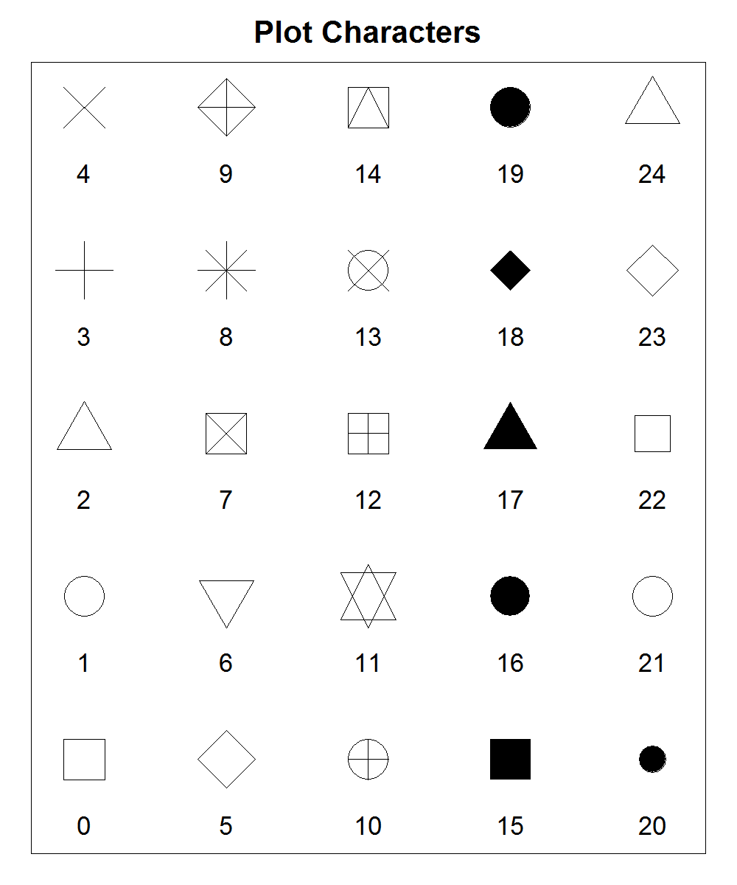
Plot Characters

Slide 11
Controlling plot area options with par

Slide 12
Par
The par function controls global parameters affecting all plots in the current plot area
Changes affect all subsequent plots
Many par options can also be passed to individual plots

Slide 13
Par examples
Reading current value
  par()$cex
Setting a value
  par(cex=1.5) -> old.par
Restoring a value
  par(old.par)
  dev.off()

Slide 14
Par options
Margins
  mai (set margins in inches)
  mar (set margins in number of lines)
  mex (set lines per inch)
  4 element vector (bottom, left, top, right)
Warning
  Error in plot.new() : figure margins too large

Slide 15
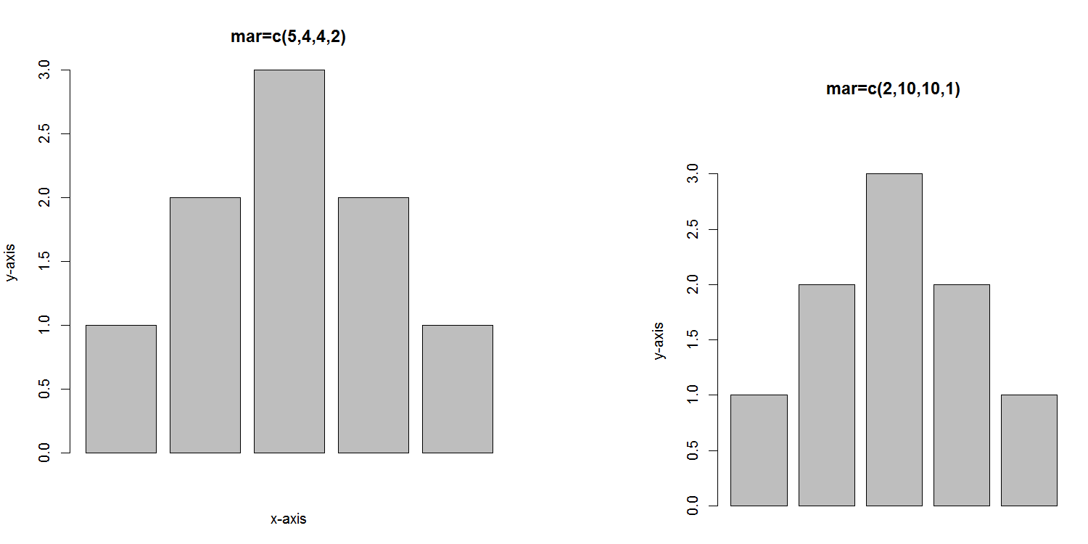

Slide 16
Par options
Fonts and labels
  cex – global char expansion
    cex.axis
    cex.lab
    cex.main
    cex.sub

Slide 17
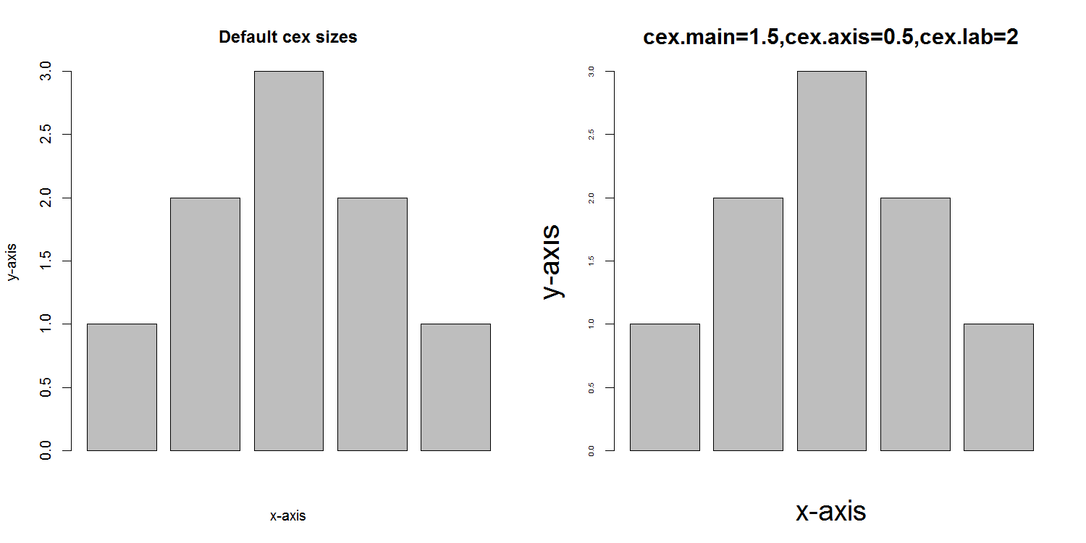

Slide 18
Par options
Font style
  font (font.axis,font.main,font.sub,font.lab)
    1 = Plain text
    2 = Bold text
    3 = Italic text
    4 = Bold italic text
  las (label orientation)
    0 = Parallel to axis
    1 = Horizontal
    2 = Perpendicular
    3 = Vertical

Slide 19
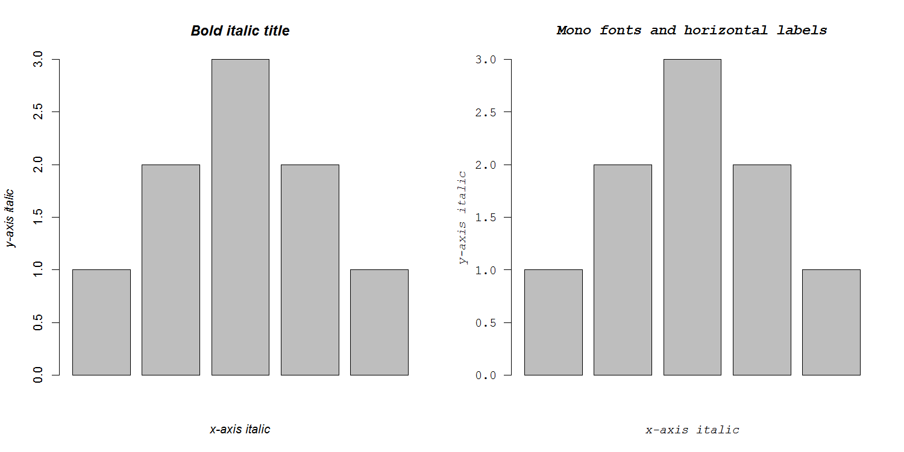

Slide 20
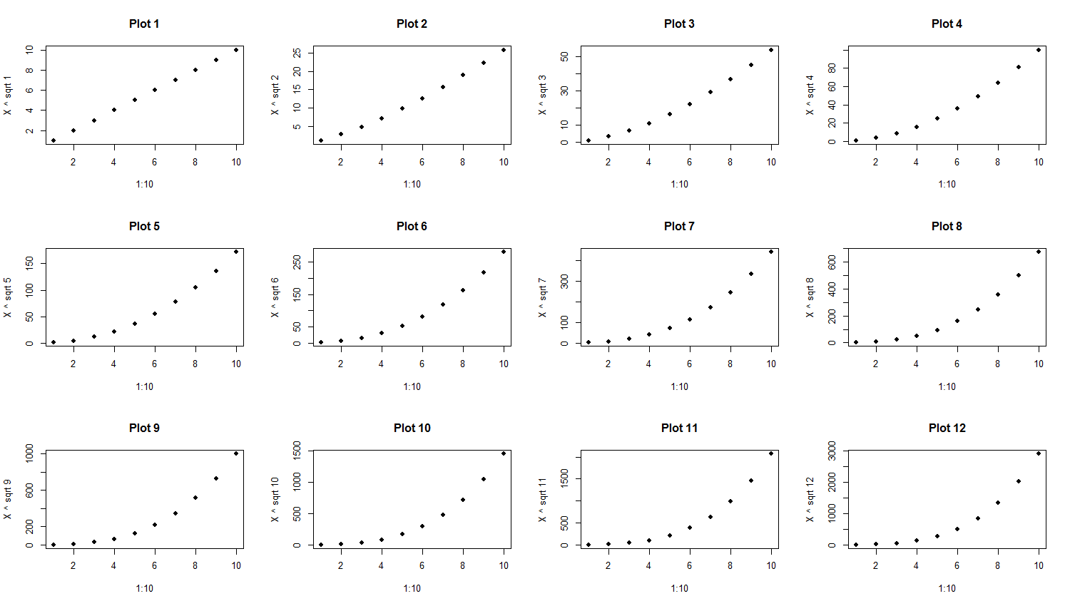
Par options
Multi-panel
  mfrow(rows,cols)
  Not supported by some packages

Slide 21
Exercise 1

Slide 22
Using Colour

Slide 23
Specifying colours
Hexadecimal strings
  #FF0000 (red)
  #0000FF (blue)
  #CC00CC (purple)
Controlled names
  “red” “green” etc.
  colors()

Slide 24
Built in colour schemes
Functions to generate colours
Pass in number of colours to make
Functions:
  rainbow
  heat.colors
  cm.colors
  terrain.colors
  topo.colors

Slide 25
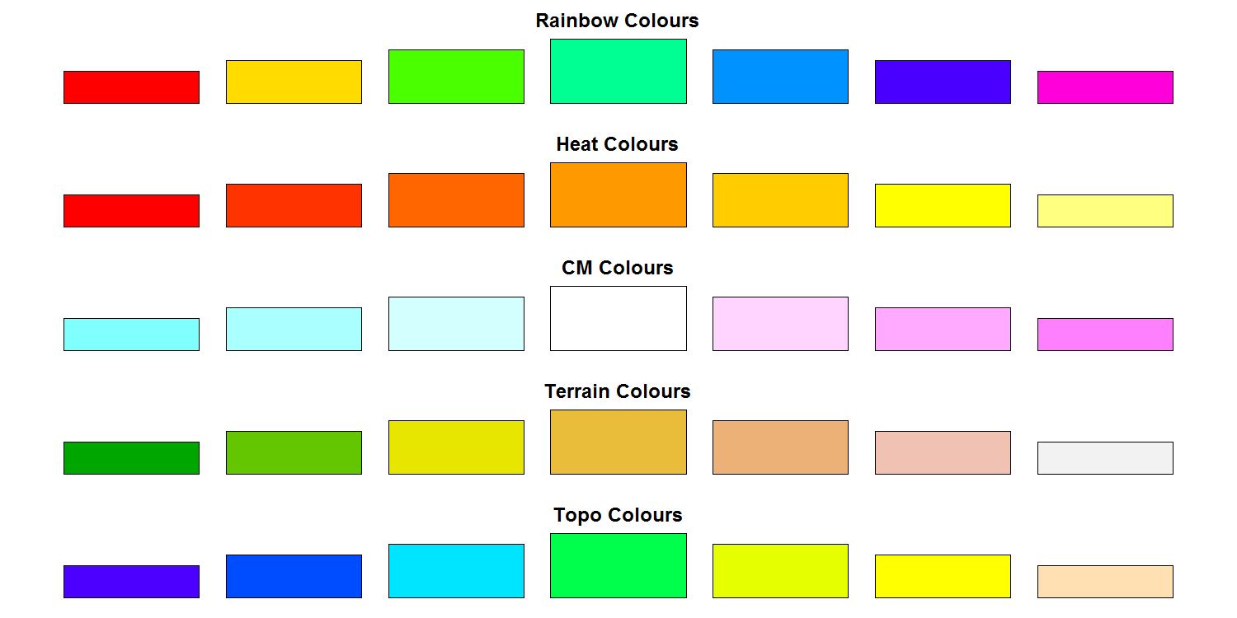

Slide 26
Colour Packages
Color Brewer
  Set of pre-defined, optimised palettes
  library(RColorBrewer)
  brewer.pal(no colours, palette)
ColorRamps
  Create smooth palettes for ramped colour
  Generates a function to make actual colour vectors
  colorRampPalette(c(“red”,”white”,”blue”))
  colorRampPalette(c(“red”,”white”,”blue”))(5)

Slide 27
Applying Colour to Plots
Vector of colours passed to the col parameter
Vector of factors used to divide the data
  Colours taken from palette
  Can read or set using palette function
    palette()
    palette(brewer.pal(9,”Set1”)
    Ordered by levels of factor vector

Slide 28
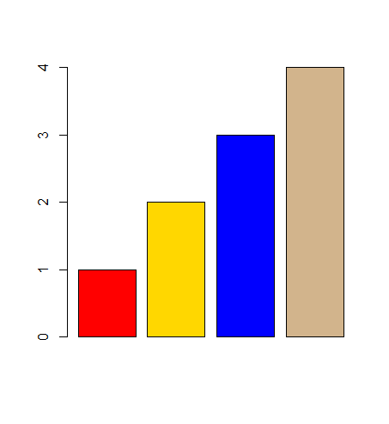
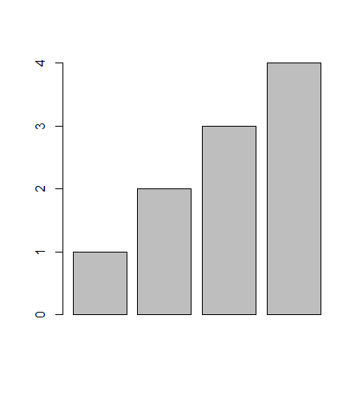
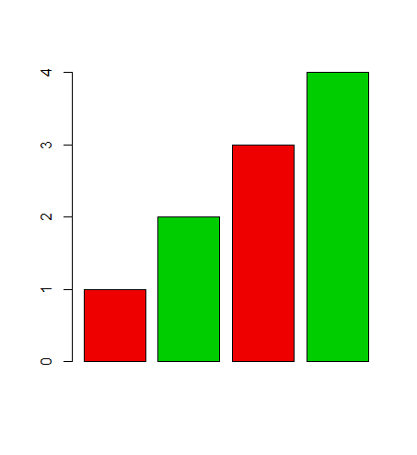
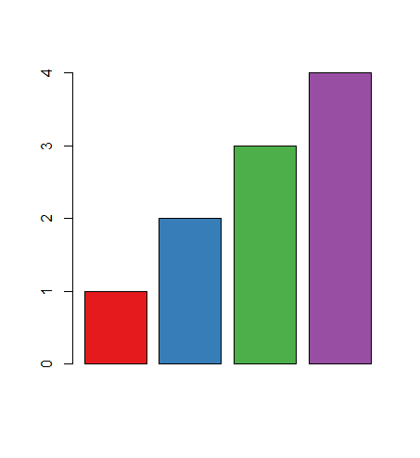
Applying Colour to Plots
barplot(1:4)
barplot(
1:4,
col=c("red","gold","blue","tan")
)
barplot(
1:4,
col=c("red2","green3")
)
library(RColorBrewer)
barplot(
1:4,
col=brewer.pal(4,"Set1")
)

Slide 29
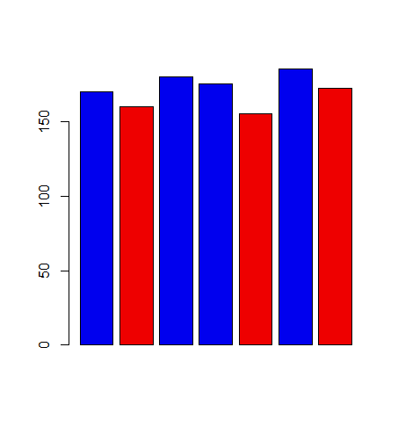
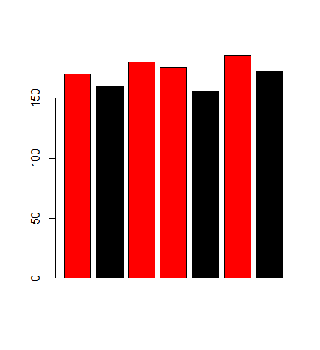
Applying Colour to Plots
barplot(height.data$height,col=height.data$sex)
> height.data
height sex
1 170 M
2 160 F
3 180 M
4 175 M
5 155 F
6 185 M
7 172 F
> palette()
[1] "black" "red" "green3" "blue"
[5] "cyan" "magenta" "yellow" "gray"
> levels(height.data$sex)
[1] "F" "M"
> palette(c("red2","blue2"))

Slide 30
Dynamic use of colour
Colouring by density
  Pass data and palette to densCols
  Vector of colours returned
Colouring by value
  Need function to map values to colours

Slide 31
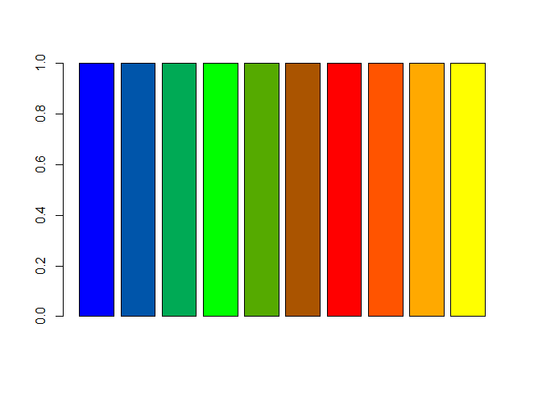
Making colour ramps
> colorRampPalette(c("blue","green","red","yellow"))
function (n)
{
x <- ramp(seq.int(0, 1, length.out = n))
if (ncol(x) == 4L)
rgb(x[, 1L], x[, 2L], x[, 3L], x[, 4L], maxColorValue = 255)
else rgb(x[, 1L], x[, 2L], x[, 3L], maxColorValue = 255)
}
> colorRampPalette(c("blue","green","red","yellow"))(10)
[1] "#0000FF" "#0055AA" "#00AA55" "#00FF00" "#55AA00" "#AA5400" "#FF0000" "#FF5400" "#FFA900" "#FFFF00"
> barplot(
rep(1,10),
col=colorRampPalette(
c("blue","green","red","yellow")
)(10)
)

Slide 32
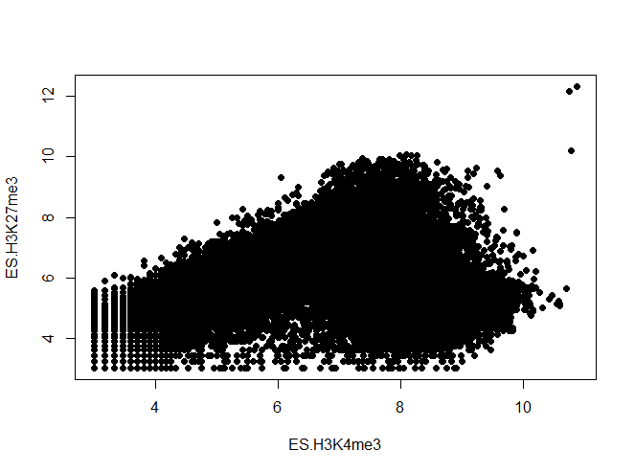
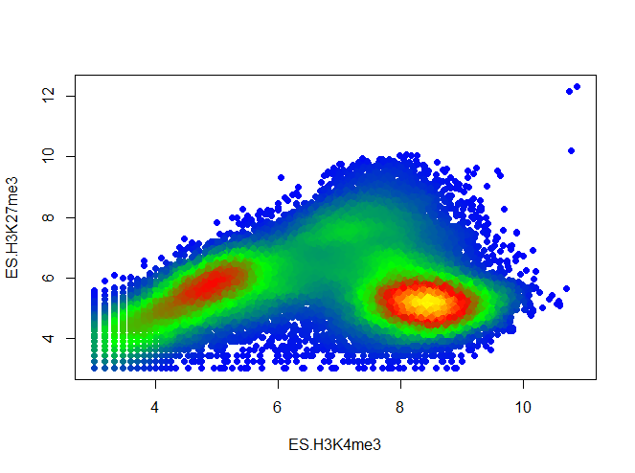
Using colour to plot density
plot(lots.of.data, pch=19)
plot(
lots.of.data,
pch=19,
col=densCols(
lots.of.data,
colramp=colorRampPalette(c(
"blue","green","red","yellow")
)
)
)

Slide 33
Colour Mapping Function
map.colours <- function(values,palette) {
range <- range(values)
proportion <- (values-range[1])/(range[2]-range[1])
index <- round((length(palette)-1)*proportion)+1
return(palette[index])
}

Slide 34
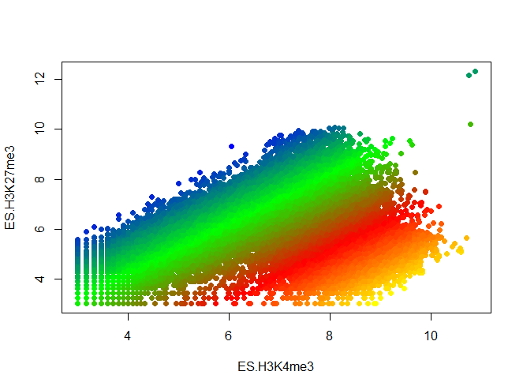
Plotting Quantitative Colour
plot(lots.of.data, pch=19)
plot(
lots.of.data,
pch=19,
col=map.colours(
lots.of.data$K4 - lots.of.data$K27,
colorRampPalette(c(
"blue","green","red","yellow")
)(100)
)
)

Slide 35
Exercise 2

Slide 36
Plot Overlays

Slide 37
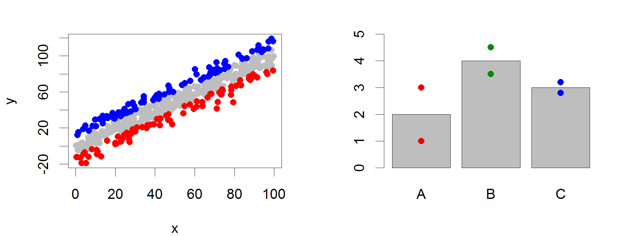
Points
Input: 2 Vectors (x and y positions)
Options:
  pch
  cex

Slide 38
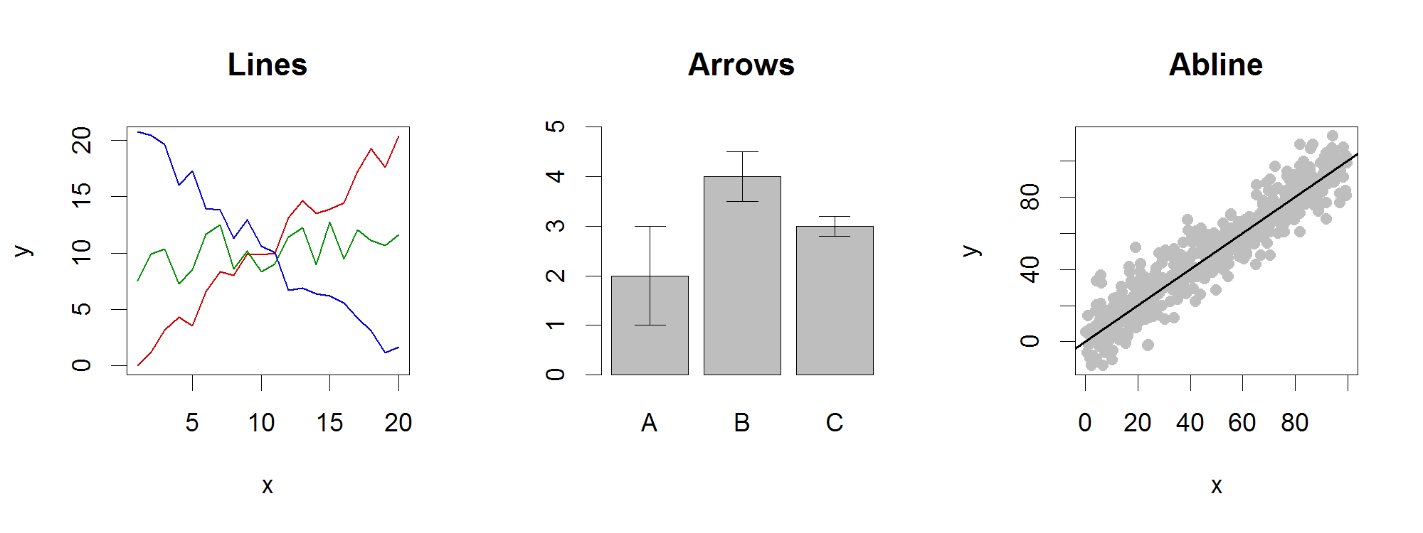
Lines / Arrows / Abline
Input:
  Lines 2 vectors (x and y)
  Arrows 4 vectors (x0,y0,x1,y1)
  Abline Intercept and slope (or correlation object)
Options:
  lwd
  angle (arrows)

Slide 39
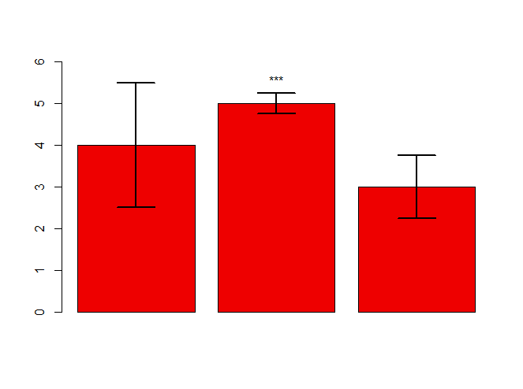
Example multi-layer plot
barplot(
error.data$values,
col="red2",
ylim=(c(0,6))
) -> bar.centres
arrows(
x0=bar.centres,
y0=error.data$values - error.data$sem,
x1=bar.centres,
y1=error.data$values + error.data$sem,
angle=90,
code = 3,
lwd=2
)
text(
bar.centres[2],
y = error.data$values[2] + error.data$sem[2],
labels = "***",
pos=3
)
> error.data
values sem
1 4 1.50
2 5 0.25
3 3 0.75

Slide 40
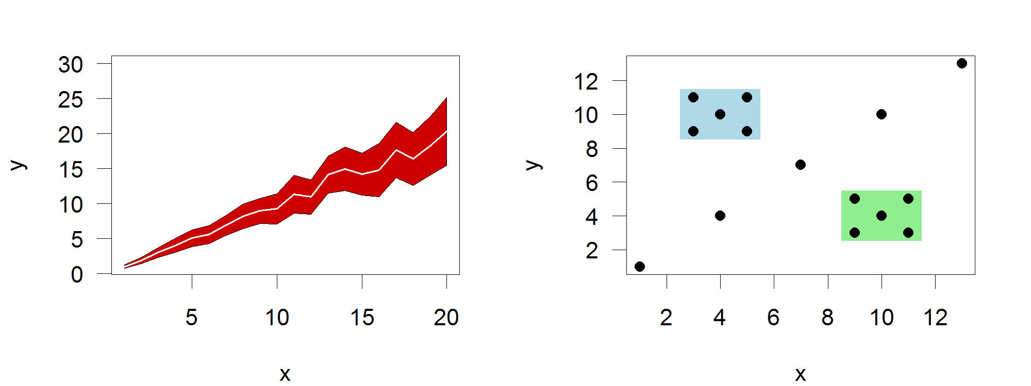
Polygon (shaded areas)
Input:
  2 vectors (x and y) for bounding region
Options:
  col

Slide 41
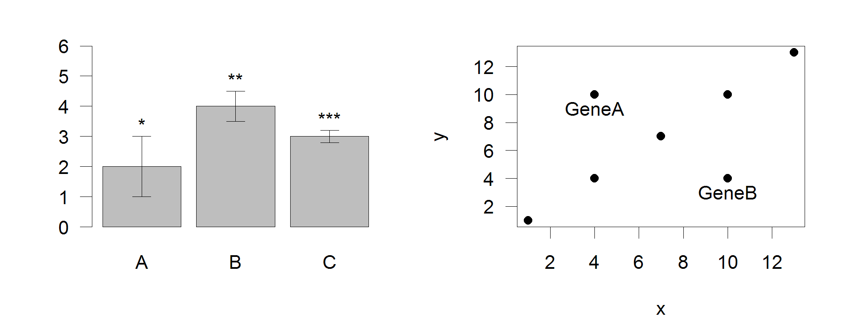
Text (in plot text)
Input:
  Text, x, y
Options:
  adj (x and y offsets)
  pos (auto offset 1=below,2=left,3=above, 4=right)

Slide 42
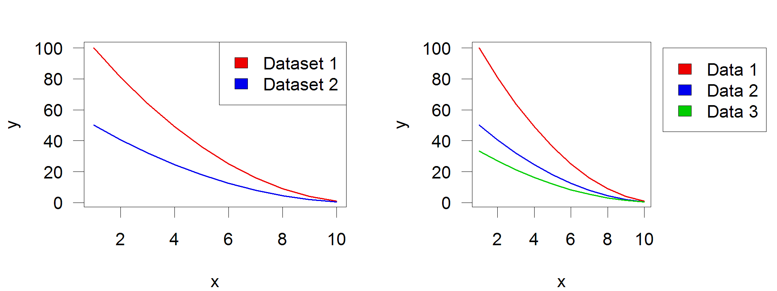
Legend
Input:
  Position (x,y or “topright”,”bottomleft” etc)
  Text labels
Options:
  fill (colours for shaded boxes)
  xpd=NA (draw outside plot area)

Slide 43
Exercise 3

