Slide 1

ChIP-Seq Analysis
Simon Andrews
simon.andrews@babraham.ac.uk
@simon_andrews
v2023-05

Slide 2
What this course covers
The theory of ChIP-Seq
ChIP-Seq library properties
Sequencing, Data processing and QC
Data visualisation and exploration
Types of analysis
  Peak Calling
  Differential Binding

Slide 3
What is ChIP-Seq?
ChIP-Seq is a technology which uses high-throughput sequencing to infer the positions of any mark associated with DNA which can be captured by an antibody.

Slide 4
Types of antibody
Transcription factors / repressors
  nanog, CTCF
Histones and histone modifications
  H3, H3K4me3
DNA modifications
  Methyl-Cytosine, Formyl cytosine
Chromatin remodelling proteins
  BMI1, EZH2
Transcription machinery
  Pol2

Slide 5
How Does ChIP-Seq work
DNA
Cross-link proteins to DNA
DNA
Fragment DNA (sonication, MNase etc)
Capture
Y
Y
Y
Y
Y
Y
Y
Y
Elute
Remove Crosslinks
Size Select
Add Adapters
Sequence

Slide 6
Related Techniques
ATAC-Seq
  Uses transposases to digest exposed DNA to enrich for accessible DNA.
Cut and Tag
  Uses transposases fused to antibodies to find marked, accessible chromatin

Slide 7
What can you sequence?
Y
Y
Y
Y
Y
Y
Y
Y
Y
Y
Y
Y
Y
Y
Y
Y
ChIP Material
Mock (IgG)ChIP Material
Input Material (sonicated / Mnase / H3 etc)

Slide 8
Sequencing for ChIP
Barcode
Adapter
ChIP Fragment
Adapter
Barcode
Read 1
Primer
Adapter
ChIP Fragment
Read 2
Primer
ChIP Fragment
Adapter
Barcode Read

Slide 9
What you end up with

Slide 10
Single End vs Paired End
Insert
Paired
(= >$£€¥)
Read 1
Read 2
Inferred
Read 1
Single
(= Cheaper!)
Inferred

Slide 11
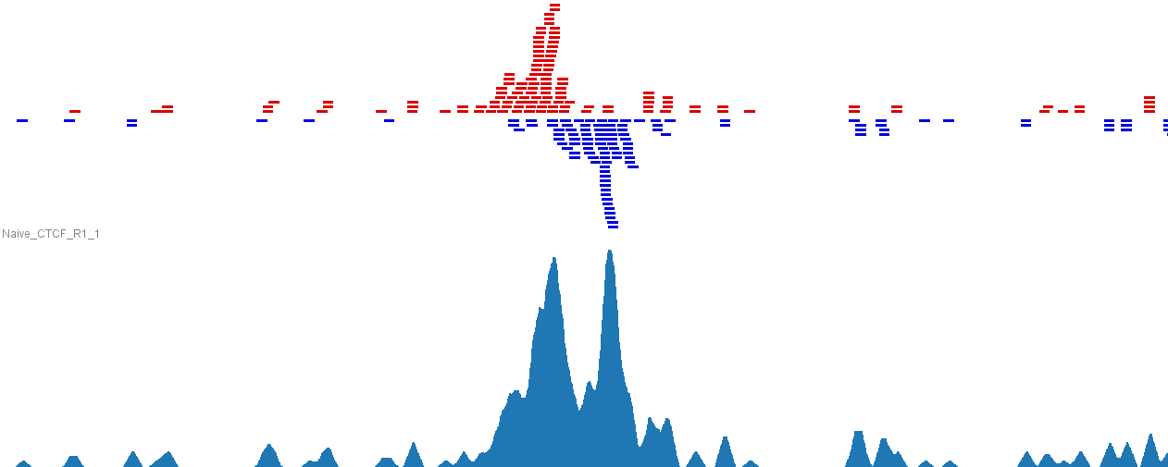
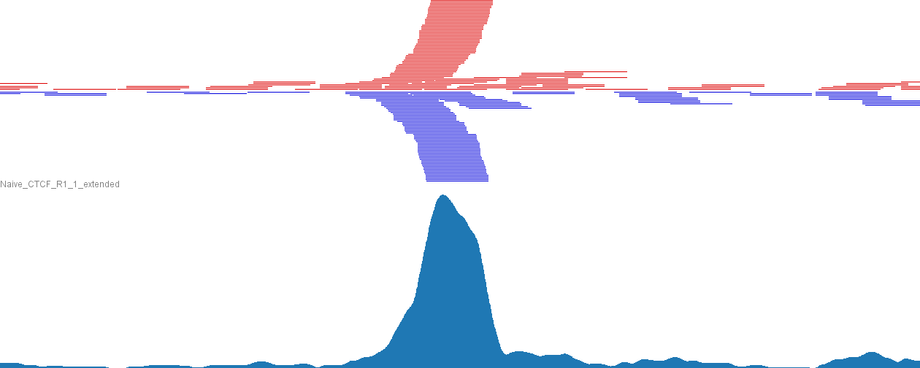
What you end up with
Original
40bp
Reads
Extended
by
250bp

Slide 12
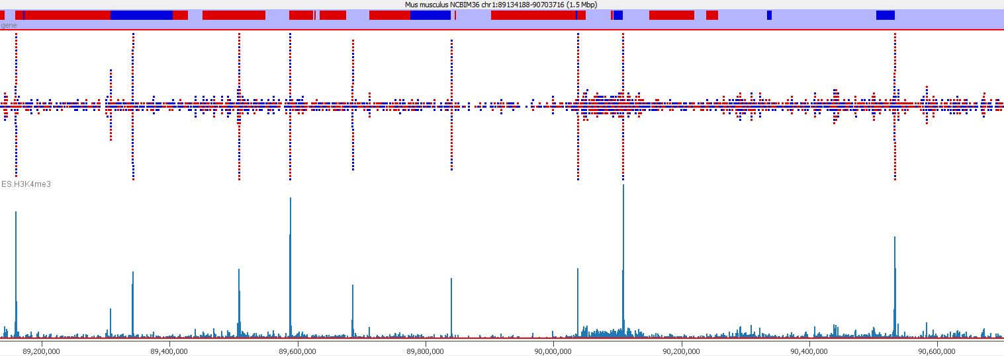
Types of Enrichment
Single points (typical TF, some histone marks)

Slide 13
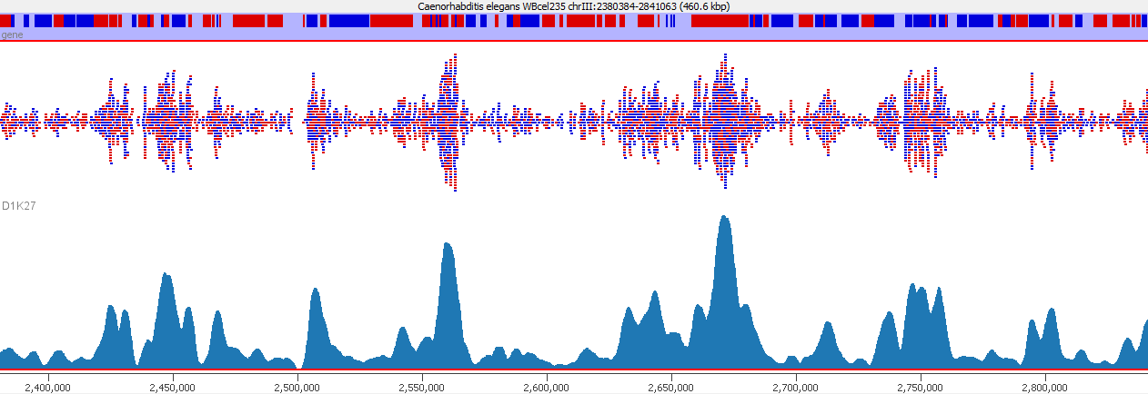
Types of Enrichment
Broad Regions (some histone marks, PolII)

Slide 14
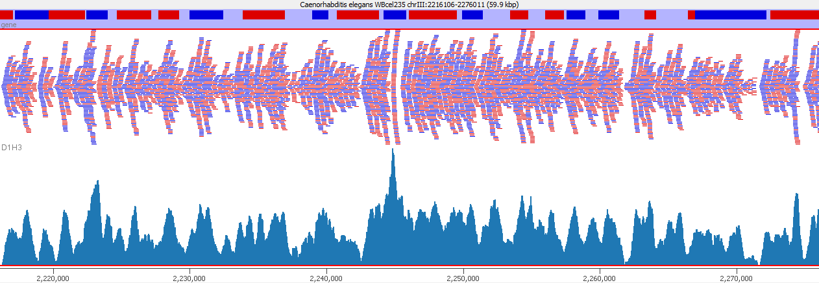
Types of Enrichment
Virtually everywhere (h3)

Slide 15
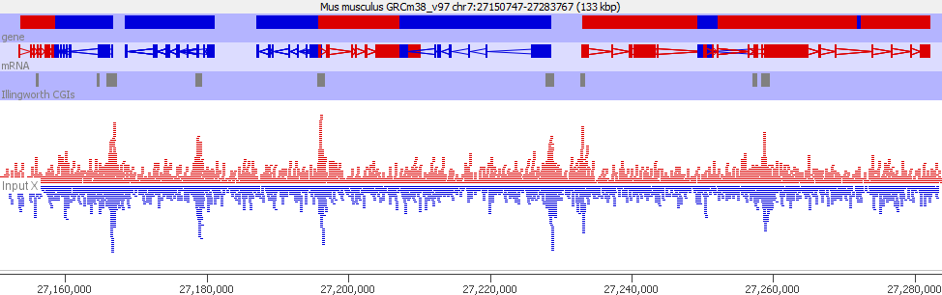
Types of Enrichment
Artefactual (GC in this case)

Slide 16
What are you actually measuring?
ChIP Seq measures RELATIVE enrichment
  Region A has twice as much signal as Region B
Without some external calibration, NOTHING in ChIP-Seq gives an ABSOLUTE measure.

Slide 17



What can affect enrichment?
Starting
More Sites
Poorer Signal

Slide 18
What sort of questions can you answer?
Where is this mark present?
  General - it's in promoters, gene bodies etc.
  Specific - it's at these loci
How does this mark change when I do XXX?
  Categorical: A peak disappears
  Quantitative: The enrichment of a locus changes

Slide 19
ChIP-Seq Data
Processing and QC

Slide 20
A typical ChIP Library
Barcode
Adapter
ChIP Fragment
Adapter
Barcode
Potential technical problems
  Adapter contamination
  PCR Duplication
Potential biological problems
  Lack of enrichment
  Other selection biases

Slide 21
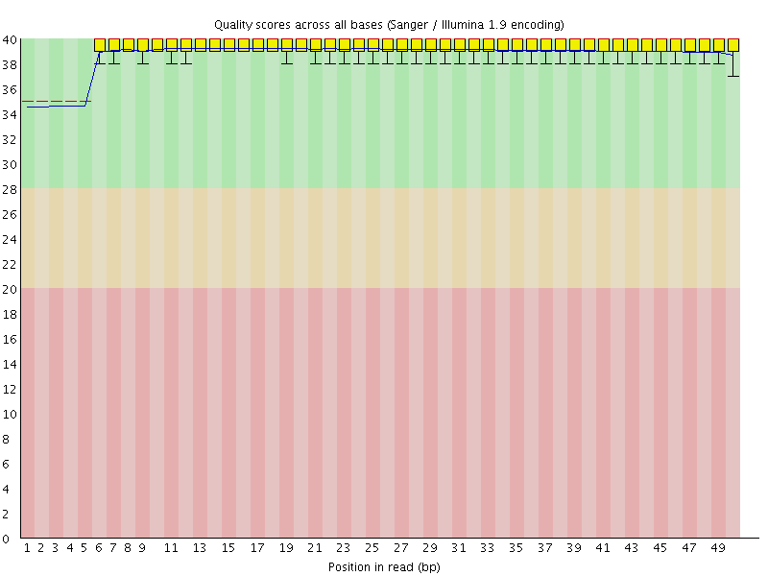
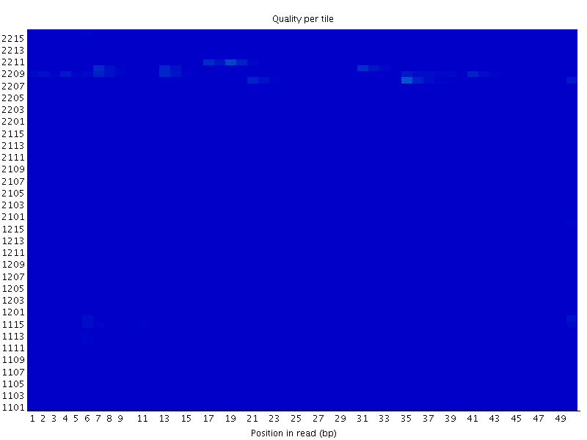
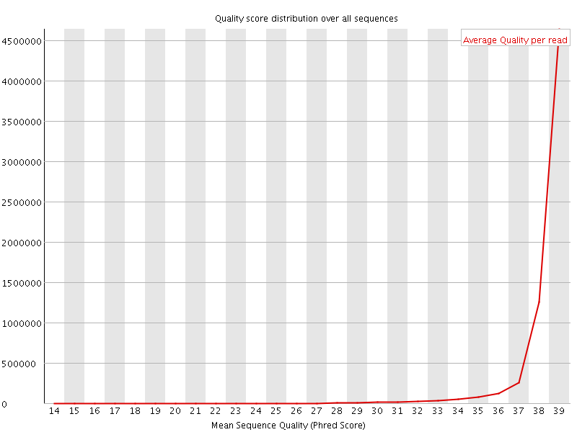

QC of raw sequence
Base Call Quality

Slide 22
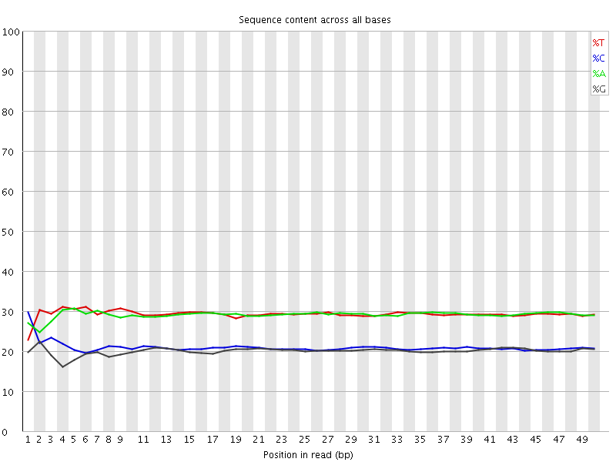
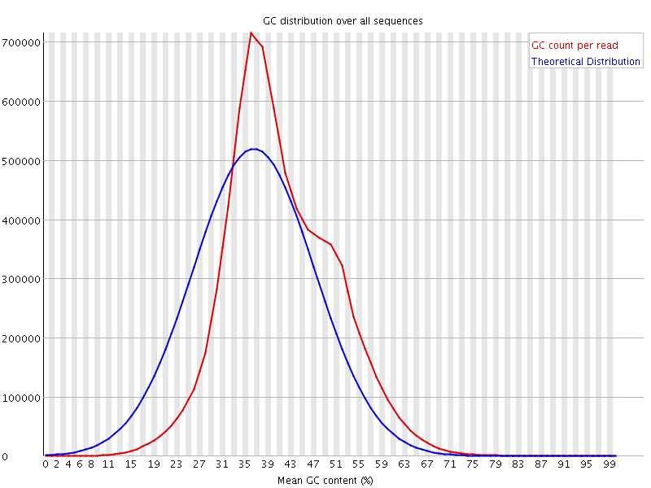
QC of raw sequence
Sequence Composition

Slide 23
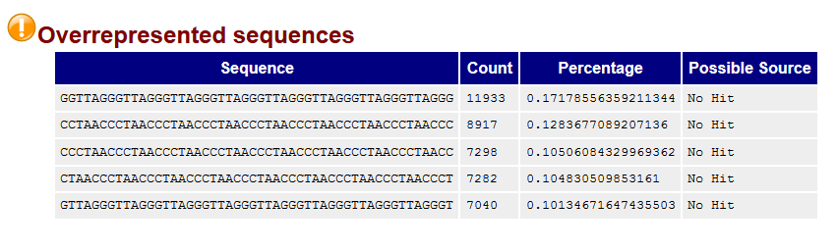
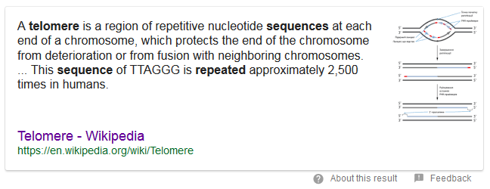
QC of raw sequence
Sequence Composition

Slide 24
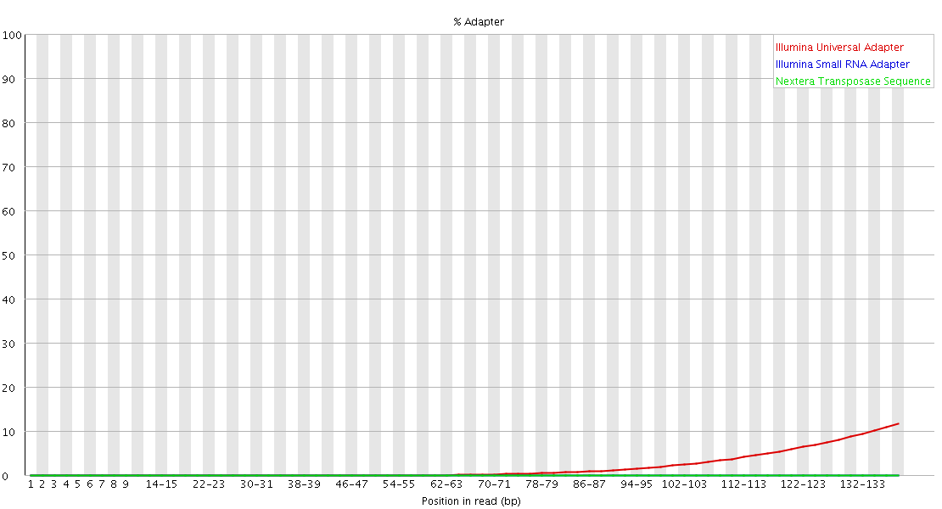
QC of raw sequence
Adapter Contamination
Barcode
Adapter
ChIP Fragment
Adapter
Barcode
Read
Trim Galore!
Quality and Adapter Trimming

Slide 25
Mapping ChIP Data
All regions should be linear genomic stretches
Standard genomic aligners are fine
  Bowtie2 http://bowtie-bio.sourceforge.net/bowtie2/
  BWA http://bio-bwa.sourceforge.net/

Slide 26
Example Bowtie2 Mapping
Create Genome Index (once - slow!)
Map a single FastQ file
bowtie2-build yeast_genome.fa yeast_index
bowtie2 \
-x yeast_index \
-U data.fastq.gz \
| samtools view \
-bS \
-o data.bam

Slide 27
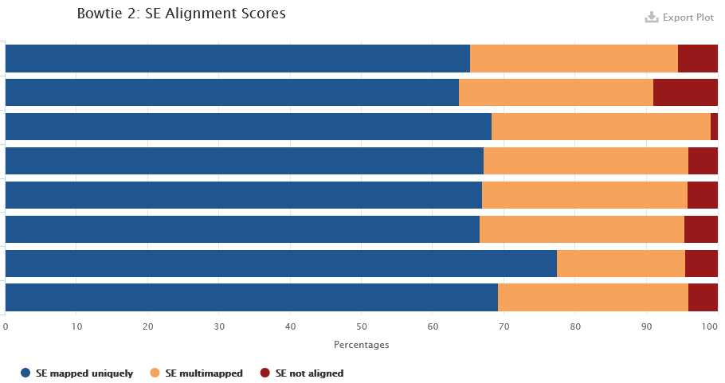

Post Alignment QC
Mapping Statistics
41523294 reads; of these:
41523294 (100.00%) were unpaired; of these:
1851792 (4.46%) aligned 0 times
32175322 (77.49%) aligned exactly 1 time
7496180 (18.05%) aligned >1 times
95.54% overall alignment rate

Slide 28
Post Alignment Processing
MAPQ Filtering
ChIP-Seq relates sequences to positions in a reference genome
You need to be confident that the reported position is correct
Filtering on MAPQ value (likelihood of reported position being incorrect) is an easy way to do this
MAPQ filtering should be performed in most cases
samtools view -q 20 -b -o filtered.bam data.bam

Slide 29
Standard Processing Workflow
Mapping Stats
Mapping Stats
Mapping Stats
Trim
Galore
SAM
Tools
FastQ File
Trimmed FQ File
BAM File
Filtered BAM
FastQ File
Trimmed FQ File
Bowtie
BWA
BAM File
Filtered BAM
FastQ File
Trimmed FQ File
BAM File
Filtered BAM
FastQC
FastQC
FastQC Report
FastQC Report
MultiQC Report
Visualisation and Assessment
FastQC Report
FastQC Report
FastQC Report
FastQC Report

Slide 30
Data Processing Exercise

Slide 31
Running programs in Linux
Open a shell (text based OS interface)
Type the name of the program you want to run
  Add on any options the program needs
  Press return - the program will run
  When the program ends control will return to the shell
Run the next program!

Slide 32
Running programs
babraham@babraham-VirtualBox:~$ ls
Desktop Documents Downloads examples.desktop Music Pictures Public Templates Videos
babraham@babraham-VirtualBox:~$
Command prompt - you can't enter a command unless you can see this
The command we're going to run (ls in this case, to list files)
The output of the command - just text in this case

Slide 33
The structure of a unix command
ls -ltd --reverse Downloads/ Desktop/ Documents/
Program
name
Switches
Data
(normally files)
Each option or section is separated by spaces. Options or files with spaces in must be put in quotes.

Slide 34
Command line switches
Change the behaviour of the program
Come in two flavours (each option often has both types available)
  Minus plus single letter (eg -x -c -z)
  Two minuses plus a word (eg --extract --gzip)
Some take an additional value
  -f somfile.txt (specify a filename)
  --width=30 (specify a value)

Slide 35


Specifying file paths
home
simon
Data
big_data.fq.gz
Specify names from whichever directory you are currently in
  If I'm in /home/simon
  Data/big_data.fq.gz
    is the same as /home/simon/Data/big_data.fq.gz
Move to the directory with the data and just use file names
  cd Data
  big_data.fq.gz

Slide 36
Command line completion
Most errors in commands are typing errors in either program names or file paths
Shells (ie BASH) can help with this by offering to complete path names for you
Command line completion is achieved by typing a partial path and then pressing the TAB key (to the left of Q)

Slide 37
Command line completion
List of files / folders:
Desktop
Documents
Downloads
Music
Public
Published
Templates
Videos
T [TAB] → Templates
P [TAB] → Publi
Do [TAB] → [beep]
Do [TAB] [TAB] → Documents Downloads
Doc [TAB] → Documents
You should ALWAYS use TAB completion to fill in paths for
locations which exist so you can't make typing mistakes
(it obviously won't work for output files though)

Slide 38
Debugging Tips
Be wary of anything which finishes suspiciously quickly!
Look for errors before asking for help. They will either be
  The last piece of text before the program exited
  The first piece of text produced after it started (followed by the help file)
Programs which are stuck can be cancelled with Control+C

Slide 39
Some useful commands
cd mydir Change directory to mydir
ls -ltrh List files in the current directory, show details and put the newest files at the bottom
less x.txt View the x.txt text file
Return = down one line
Space = down one page
q = quit

Slide 40
Data Processing Exercise

Slide 41
Exploring and Understanding ChIP-Seq data

Slide 42
Some Basic Questions
Is there any enrichment?
  What is the size / patterning of enrichment?
How well are my controls behaving?
What is the best way to quantitate this data?
Are there any technical artefacts?

Slide 43
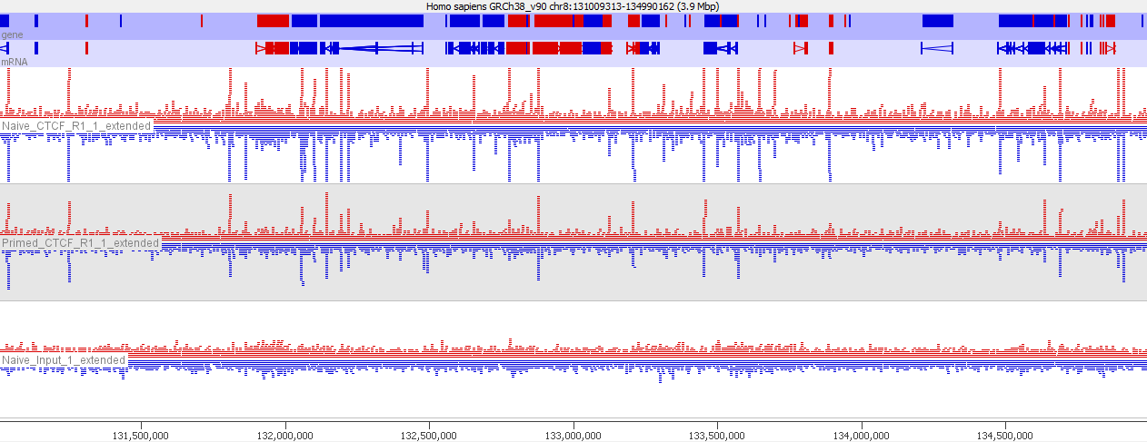
Start with a visual inspection
Is there any enrichment?
What is the size / patterning of enrichment?
How well are my controls behaving?

Slide 44
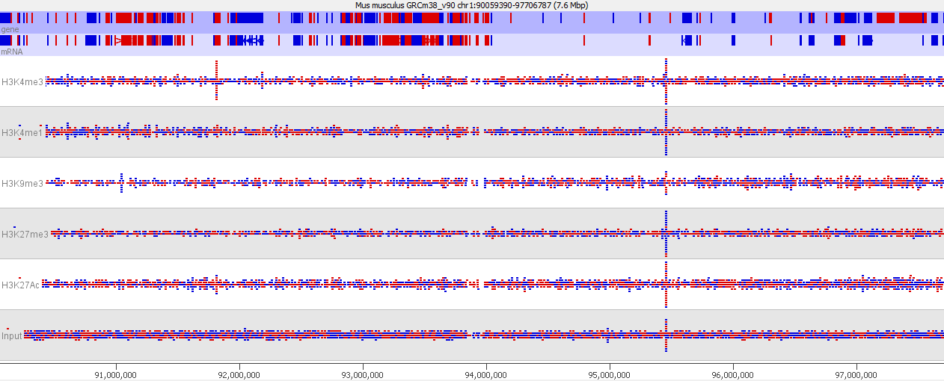
Start with a visual inspection
Is there any enrichment?
What is the size / patterning of enrichment?
How well are my controls behaving?

Slide 45
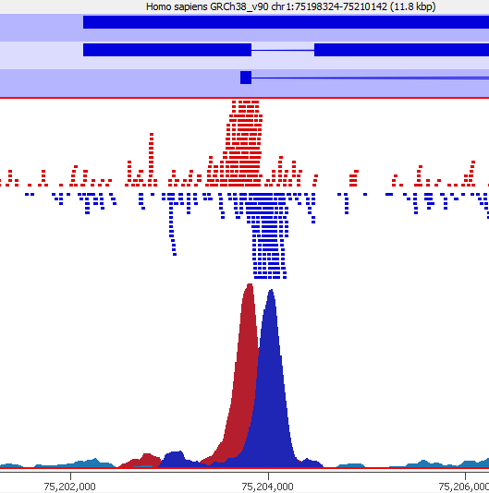
Extending reads if necessary
For point enrichment, insert size is roughly peak width/2
Peak Width

Slide 46
Examine Controls
IgG or other Mock IP
  Good result is no material at all
  Not worth sequencing. Reads are only informative if the ChIP hasn't worked.
  May be justified for Cut and Run where there is no real input
Input material (sonicated / Mnase etc)
  Genomic library - everywhere equally
  Technical issues can cause variation

Slide 47
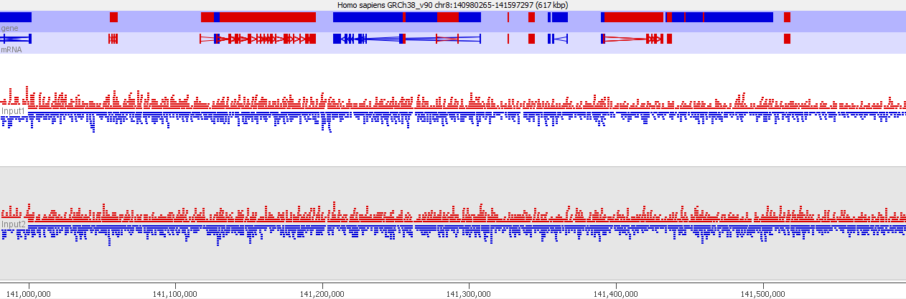
Examine Controls
Does the coverage look even
If there are multiple inputs to do they look similar

Slide 48
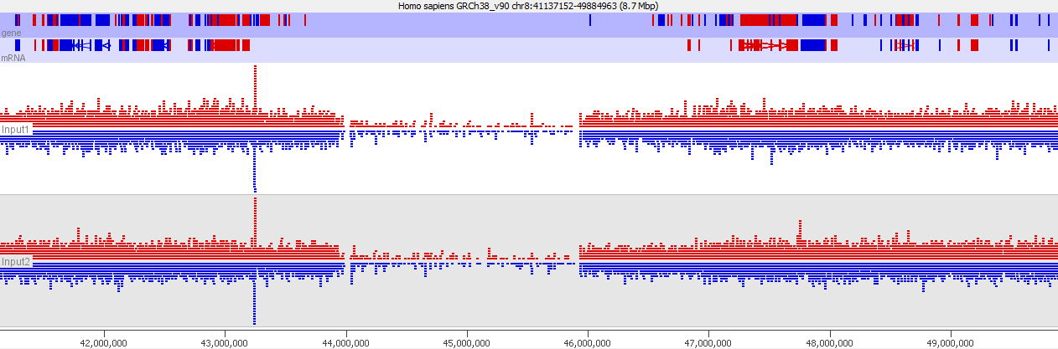
Examine Controls

Slide 49
Why do controls misbehave?
Low coverage
  Repetitive unmappable regions
  Holes in the assembly
High coverage
  Mismapped reads from outside the assembly
Biases
  GC content
  Segmental Duplication
Blacklist these regions and remove them from the analysis (ignore hits within these regions)
Input normalisation might help, but requires further examination

Slide 50
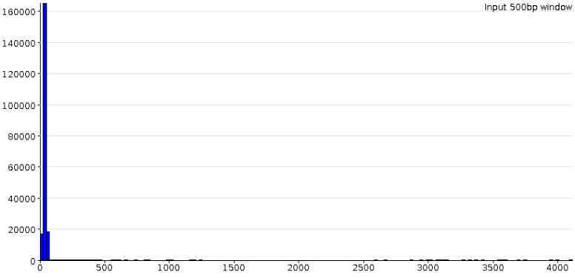
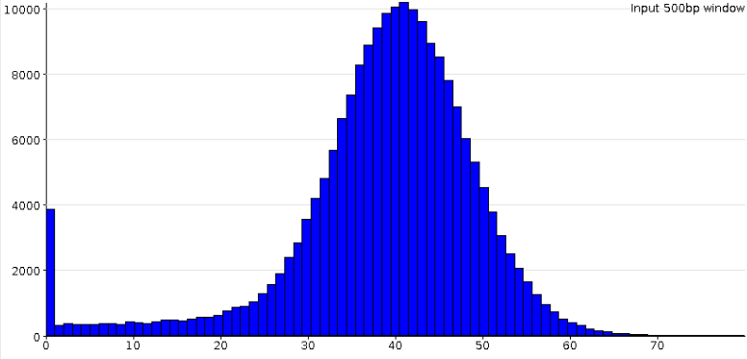
Making Blacklists
Look at distribution of Input counts
  Set limits on unusually high/low values
  Remove regions outside those limits

Slide 51
Comparison of samples

Slide 52
Initial Quantitation
Always start with a simple unbiased quantitation (not focussed on features/peaks)
Tiled measures over the whole genome
  Use approximate insert size as window size
  Something around 500bp is normally sensible
Linear read count quantitation corrected for total library size

Slide 53
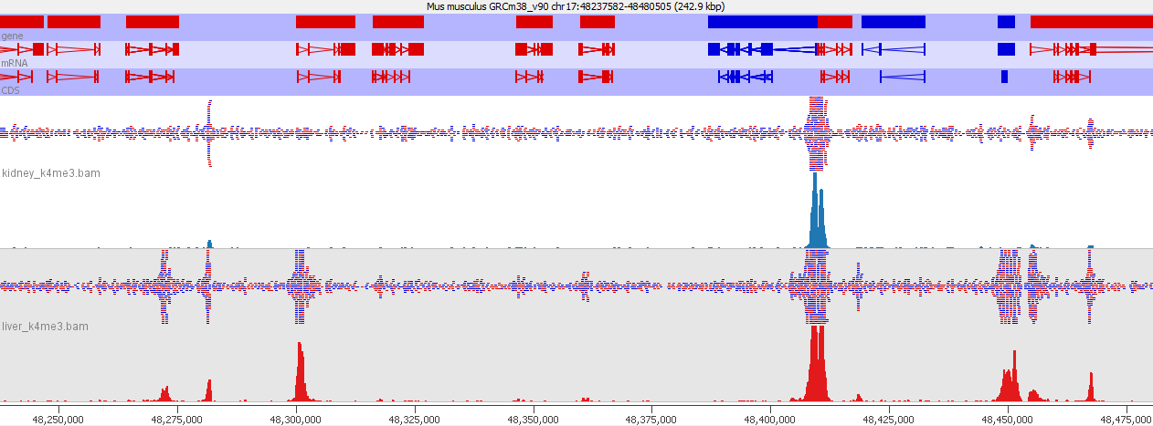
Compare samples
Visual comparison against raw data
Similar apparent overall enrichment
Any obvious differences?

Slide 54
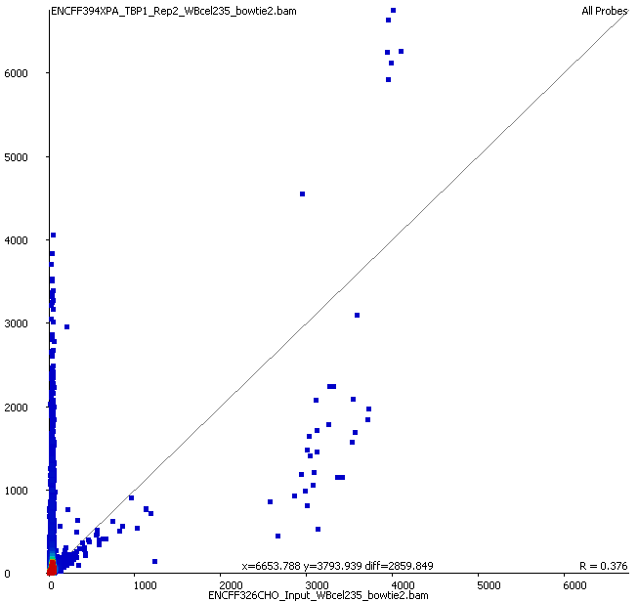
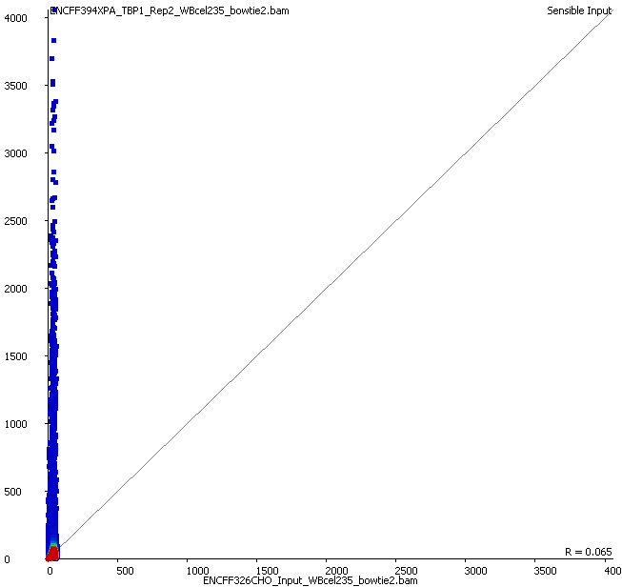
Compare samples
Scatterplot input vs ChIP
Raw
Filtered

Slide 55

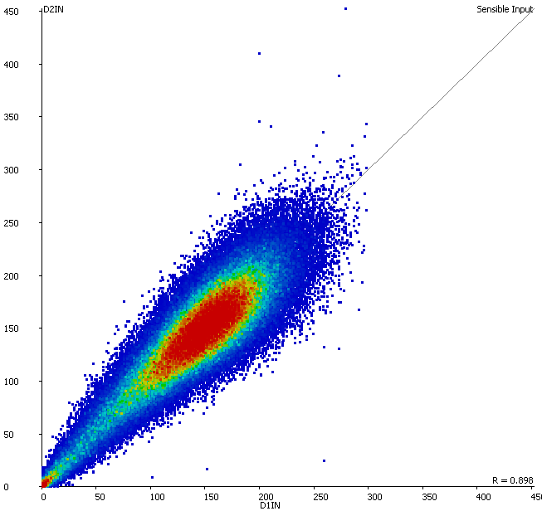

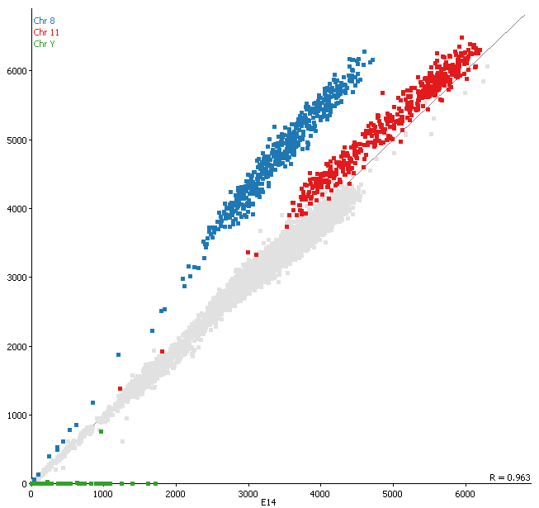
Compare samples
Scatterplot input vs input
Chr 8
Chr 11
Chr Y
Any suggestion of differential biases in inputs
Can we merge them to use as a common input

Slide 56
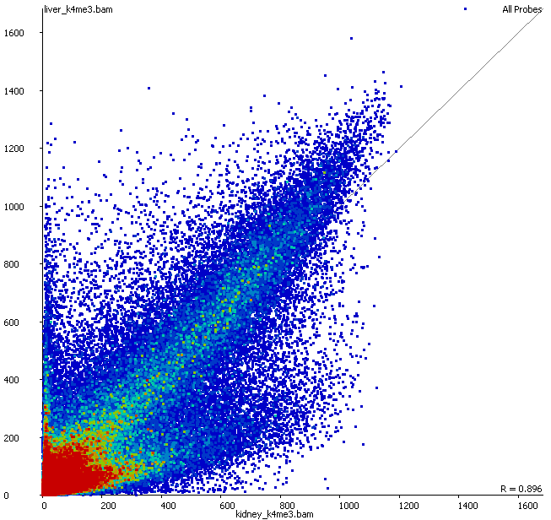
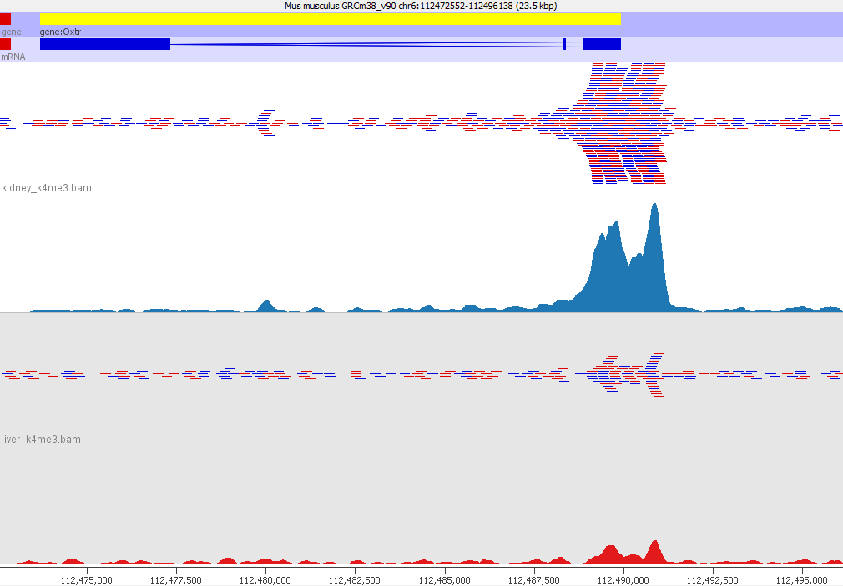
Compare samples
Scatterplot ChIP vs ChIP
Look at examples for different parts of the plot
Look for outgroups (differentially enriched)
Compare level of enrichment (compare to diagonal)

Slide 57
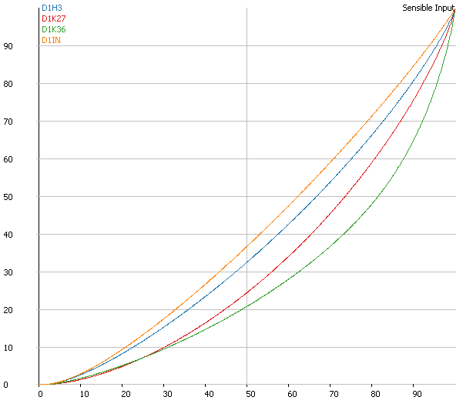
Compare samples
Summarise distributions
QQPlot
  Percentile though measures(x) vs Percentile through total quantitation (y)
  Perfect input is on the diagonal
  More enrichment moves the curve down and right
  How flat is your input? How consistent are the ChIPs?

Slide 58
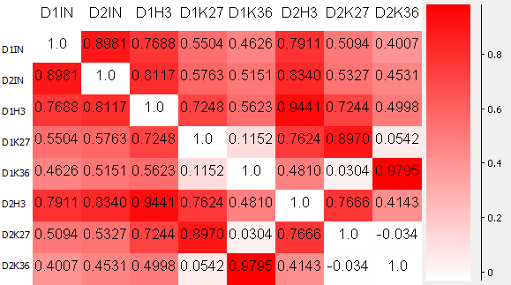
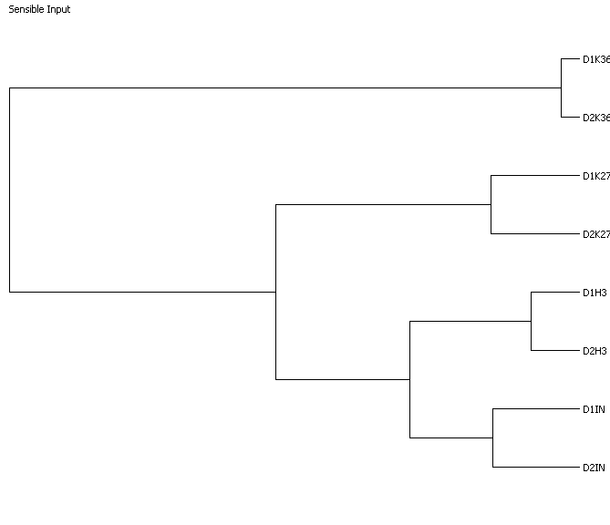
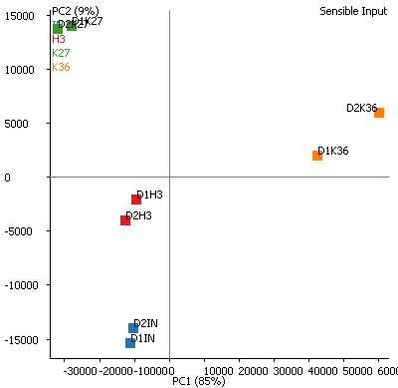
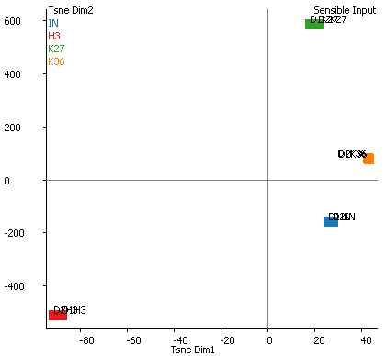
Compare samples
Higher level clustering
Correlation Matrix
Correlation Tree
tSNE Plot
PCA Plot

Slide 59
Associate enrichment with features

Slide 60
Trend Plots
Graphical way to look at overall enrichment relative to positions in features
  Gene bodies
  Promoters
  CpG islands
May influence how we later quantitate and analyse the data
  Analyse per feature
  Look for exceptions to the general rule

Slide 61
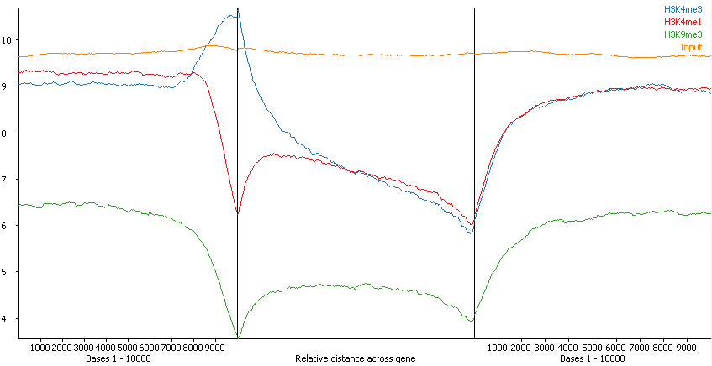
Trend Plot Example
Overall average
Says nothing about the number / proportion of features affected

Slide 62
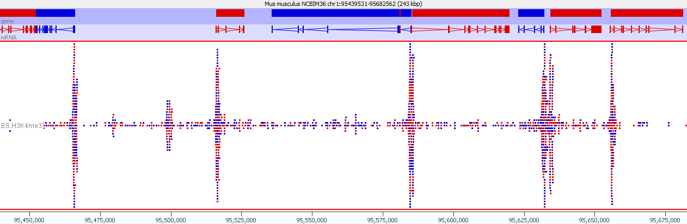
Check trend plot results against data
TSS
TSS
TSS
TSS
TSS

Slide 63
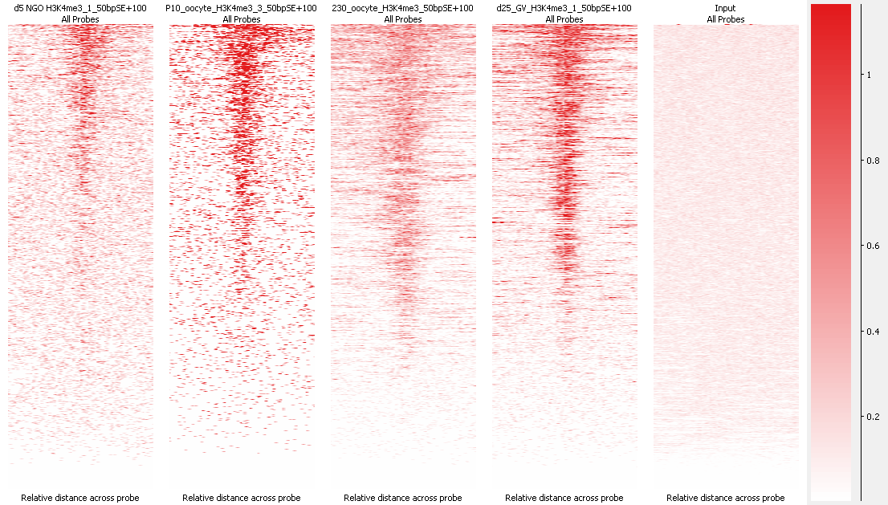
Aligned Probes Plots give more detail
Information per feature instance
Comparison of equivalent features in different marks/samples

Slide 64
After exploration you should...
Know whether your ChIP is really enriched
Know the nature / shape of the enrichment
Know whether your controls behave well
Know whether you're likely to have differential enrichment
Know if you will need additional normalisation
Know the best strategy to measure your data

Slide 65
Data Exploration Exercise

Slide 66
Analysing ChIP-Seq Data

Slide 67
Steps in Analysis
Define enriched regions
  Based around features
  De-novo peak prediction
Quantitate
  Corrections and Normalisation
Compare
  Categorical
  Quantitative

Slide 68
Defining Regions - Should I peak call?
Choices
  Make measurements around features (promoters / genes / CpG islands etc)
  Make measurements around enriched regions (peaks)
Can I use features?
  Do you see a strong and complete linkage between enrichment and the type of feature you want to use?
  If not, then you should peak call

Slide 69
How MACS Works
Optimise the starting data
Build a background model
Test sliding windows
Report
Apply per-site adjustment
macs2 callpeak --broad -t chip.bam -c input.bam

Slide 70
Optimise the starting data
Correct the for/rev offset
Deduplicate

Slide 71
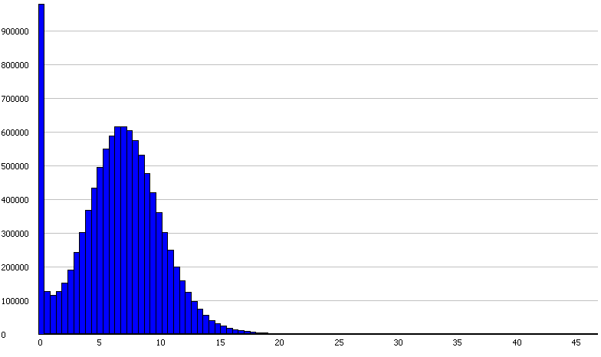
Build a background model
Lambda value
Observed

Slide 72
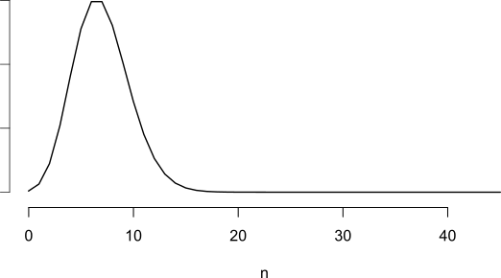
Build a background model
Lambda value
Critical p-value (n=18)
Model

Slide 73
Build a background model
Lambda value
Critical p-value (n=18)
Observed + Model

Slide 74
Test Sliding Windows
Generally use half of the library fragment size
Windows whose count exceeds the critical value are kept
Merge adjacent windows over the critical value to form peaks
Generates candidate (not final) peak set

Slide 75
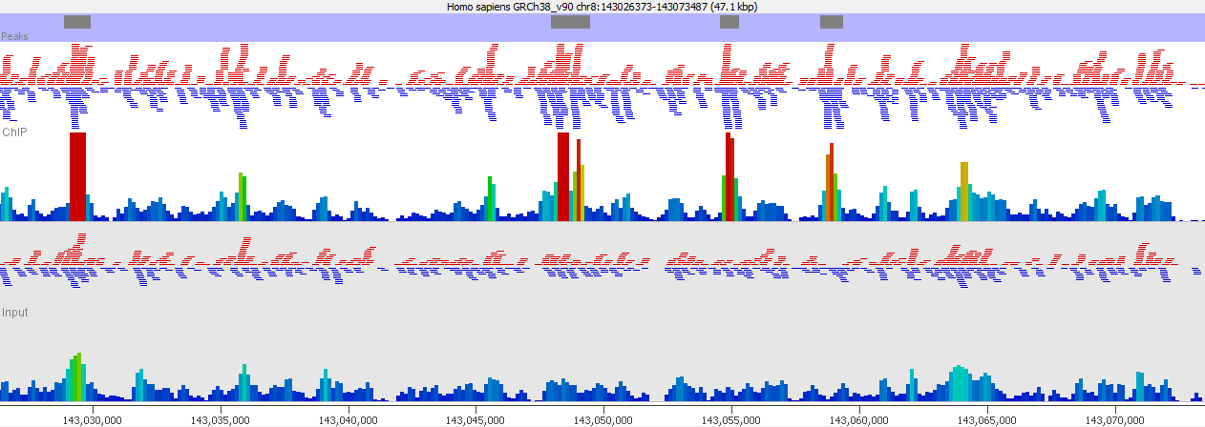
Correct for local variation
Critical value
Generate localised model if input density
is higher than the global value
Most pessimistic p-value is kept

Slide 76
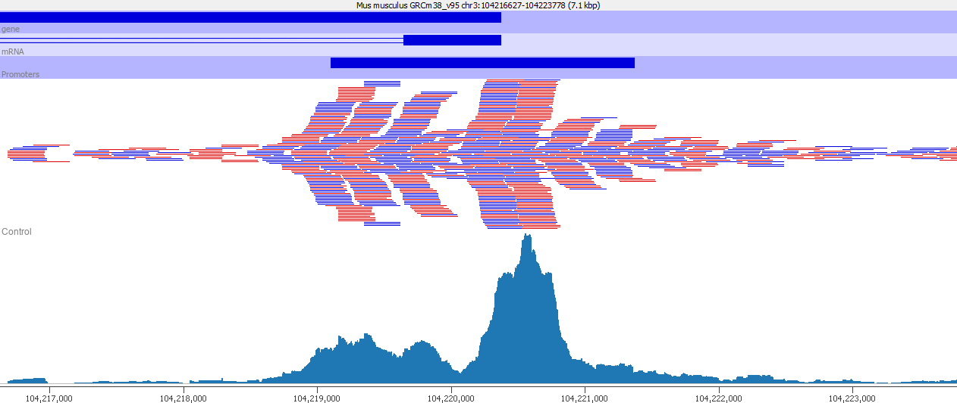
Broad Peaks
Added in MACS2 – suitable where larger regions with variable enrichment exist
Uses two thresholds for enrichment

Slide 77
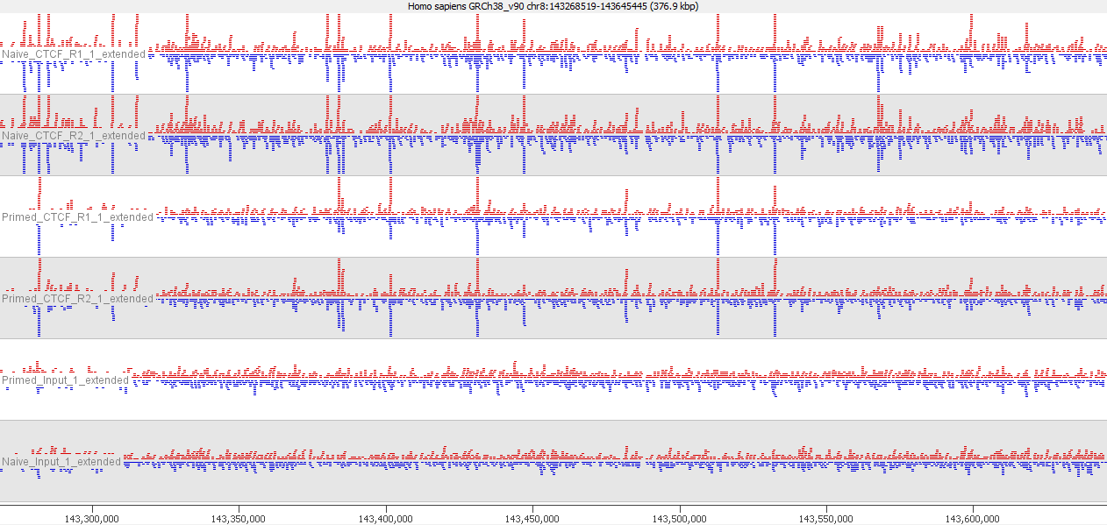
How should you apply peak callers
Multiple ChIPs (over multiple conditions)
Multiple Inputs

Slide 78
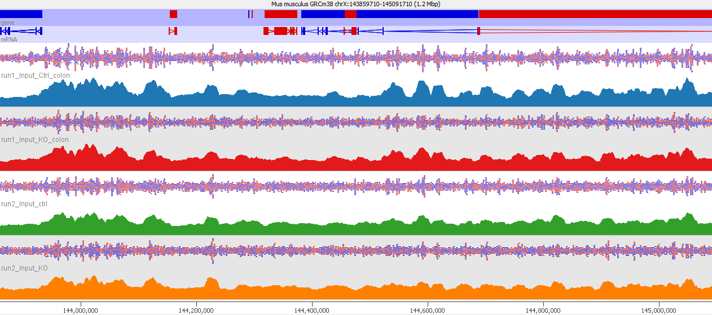
Multiple Inputs
Input variability is generally consistent
  Mapability
  Genome Assembly
  Fragmentation biases
Unless you see substantial variability between inputs it’s better to combine them into a single reference input sample

Slide 79
Multiple ChIPs
BAM Files
Peak Sets
WT ChIP 1
WT ChIP 1
+
WT ChIP 2
+
KO ChIP 1
+
KO ChIP 2
Peaks
WT ChIP 1
+
WT ChIP 2
+
KO ChIP 1
+
KO ChIP 2
WT ChIP 2
KO ChIP 1
KO ChIP 2

Slide 80
Multiple ChIPs
BAM Files
Peak Sets
WT ChIP 1
WT Peaks 1
WT Peaks 1
And
WT Peaks 2
WT Peaks 1
And
WT Peaks 2
Or
KO Peaks 1
And
KO Peaks 2
WT ChIP 2
WT Peaks 2
KO ChIP 1
KO Peaks 1
KO Peaks 1
And
KO Peaks 2
KO ChIP 2
KO Peaks 2

Slide 81
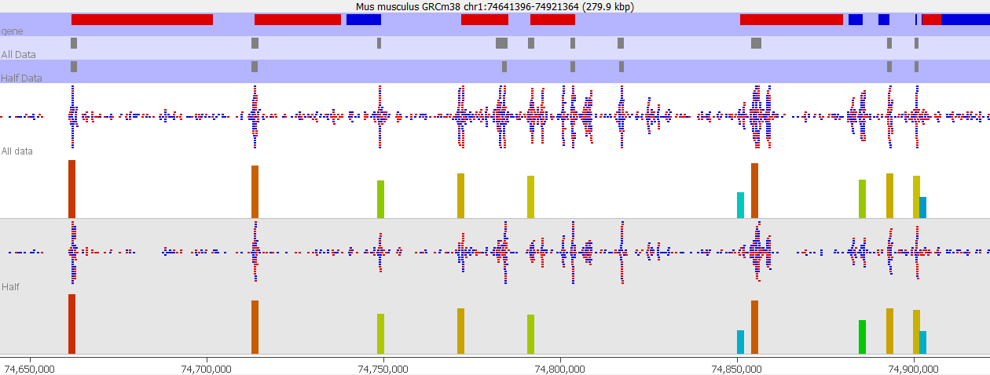
Why isn't a peak called
Fewer peaks are called by just sub-sampling the same data

Slide 82
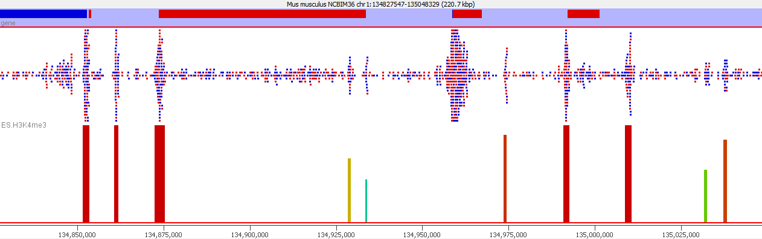
Why isn't a peak called
With no input the region around the peak is used to model the background. Broader peaks can be missed
For ATAC data (no input) you should skip the rescoring step
(--nomodel)

Slide 83
Reporting on Peak sets
Don’t make claims based solely on the number of peaks (“there were more WT peaks than KO peaks” for example)
Don’t make claims based on regions being peaks in 1 set but not another (there were 465 peaks which were specific to KO)
It is OK to make statements about overlap (there were 794 peaks which were common to WT and KO)
You have to address differential enrichment problems quantitatively

Slide 84
Quantitating ChIP data for analysis
Quantitation of ChIP is not a simple problem
Can start with something simple but in many cases you will need to refine this
Globally corrected log counts are a good place to start

Slide 85
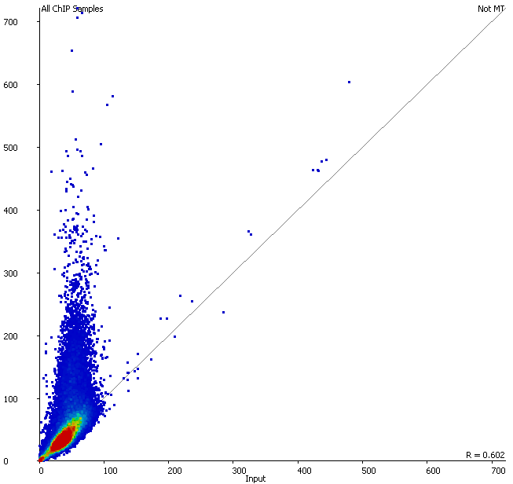
Should I normalise to input?
Only consider input normalisation if:
  You have substantial variation in the coverage of your input (excluding outliers)
  Your ChIP signal is correlated with the input level

Slide 86
Why not just always do "fold over input"?
Region | Input | ChIP | ChIP/Input
Region A | 5 | 200 | 40
Region B | 2 | 200 | 100
Inputs are generally poorly measured
  Poor coverage compared to ChIP
Fold change values are more influenced by input than ChIP
Biases in the input are smaller than enrichment power of the antibody

Slide 87
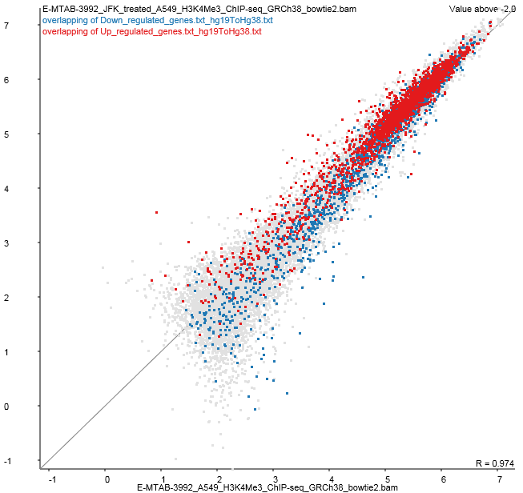
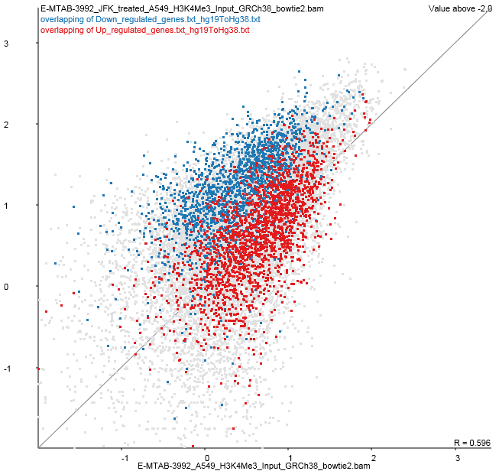
Hits with increased enrichment
Hits with decreased enrichment

Slide 88
Evaluating and Normalising Enrichment
Good Enrichment
Worse Enrichment
Similar Enrichment
Small Difference
Large Difference

Slide 89
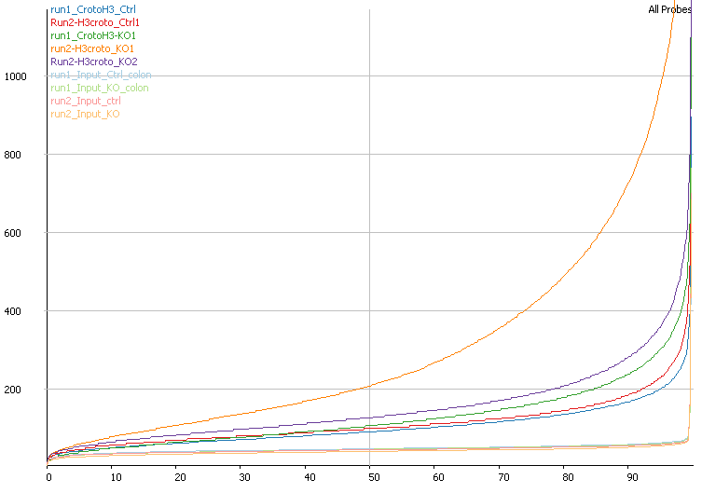
Evaluating and Normalising Enrichment
Normalised Read Count
Percentile through data

Slide 90
Normalising Enrichment
Size Factor
Single point of comparison
Works well for small differences
Insufficient for large differences
Allows the use of count based stats
Small Difference
Large Difference
Enrichment
Two points of comparison
Corrects for larger differences
Not directly compatible with count based stats
Large Difference
Quantile
Forces distributions to be identical
Corrects any differences, easy to apply
Small Difference

Slide 91
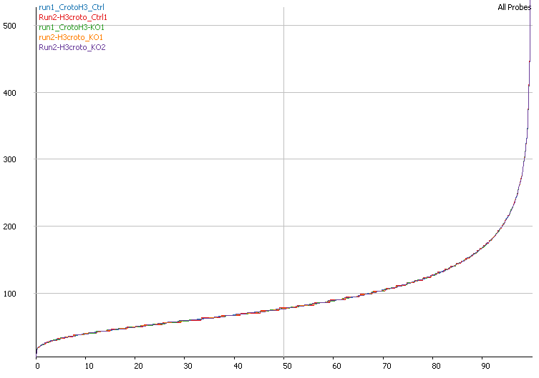


Normalising Enrichment

Slide 92


Checking Normalisation
Before Normalisation
After Normalisation

Slide 93


Look for systematic enrichment changes
(real biology!!)
Use replicates to build a case for a biological rather than technical difference

Slide 94
Differential enrichment analysis
Needs to be quantitative
Needs to operate on non-deduplicated data
Two statistical options
  Count based stats on raw uncorrected counts
    DESeq
    EdgeR
  Continuous quantitation stats on normalised enrichment values
    LIMMA

Slide 95
Which statistic to pick?
If enrichment is roughly similar
  Raw counts, then DESeq/EdgeR
If there are large differences in enrichment
  Enrichment normalisation
  LIMMA statistics

Slide 96
Visualisation of hits
Map onto scatterplot for simple verification
Normally makes sense to use log transformed counts
Look at the data underneath candidates you make specific claims about

Slide 97

Hit validation
Look whether hits make sense
Look at points which change but were not selected
Log scale should be used
Keep the context of non-hits

Slide 98


Hit validation
Directionality
Most ChIP enrichments are not strand-specific
Should expect to see enrichment on both strands

Slide 99

Hit validation
Heatmap
You should be able to see consistency between replicates

Slide 100
Data Analysis Exercise

Slide 101
Experimental Design

Slide 102
Experimental Design Considerations
All normal rules apply
  Think about sources of variation
  Don't confound variables
  Think about what batch effects might exist
Test your antibody well before starting
  By far the biggest factor in success
  Good performance on Western / in-situ is not a guarantee, but it's a good start

Slide 103
Experimental Design Considerations
Number of replicates
  Lots of studies use 2 replicates
  Fine for just finding binding sites (motif analysis)
  Not really enough for differential binding
    Huge reliance on 'information sharing'
    No accurate measurement of variance per peak
    Potentially over-predicts differential binding
  Should think about likely levels of variability and make replicates to match

Slide 104
Experimental Design Considerations
Amount of sequencing
  Can be difficult to predict
  Depends on
    Genome size
    Proportion of genome which is enriched
    Efficiency of enrichment
  ENCODE standard is ~20M reads per sample
    Can get away with fewer (K4me3 for example)
    Will need more for some marks (H3 for example)
    Sequencing depth will affect ability to detect changes

Slide 105
Experimental Design Considerations
Type of sequencing
  Single end is fine for most applications
    ATAC-Seq can require paired end for some analyses
  Moderate read length is required
    Can map anywhere in the genome
    50bp is probably OK. 100bp would be preferable

Slide 106
Downstream Analyses

Slide 107
Composition / Motif Analysis
Composition
  Good place to start, can provide either biological or technical insight
  See if hits (up vs down) cluster based on the underlying sequence composition
Motifs
  Great for defining putative binding sites
  Interesting to do sensitivity check
  Can do differential motif calling (for hit/non-hit)

Slide 108

Compter - composition analysis
www.bioinformatics.babraham.ac.uk/projects/compter

Slide 109


MEME - Motif Analysis

Slide 110
Gene Ontology / Pathway
Be careful how you relate hits to genes
  Really need to have a global link between peak positions and genes
  Random positions will give significant GO hits if you just use closest/overlapping genes

