Slide 1

Analysing Single-Cell RNA-Seq with R
v2024-10
(Seurat v5)
Simon Andrews
simon.andrews@babraham.ac.uk

Slide 2

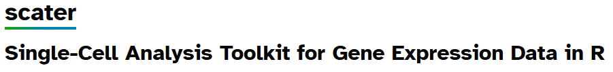
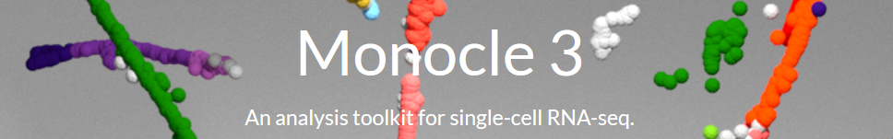



Major scRNA Package Systems
https://satijalab.org/seurat/
https://bioconductor.org/packages/release/bioc/html/scater.html
https://cole-trapnell-lab.github.io/monocle3/
https://scanpy.readthedocs.io/en/stable/

Slide 3
What do they provide?
Data Structure for modelling scRNA-Seq
  Counts
  Normalisations
  Metadata
  Clusters
Convenience methods
  Data parsing
  Data access
  Simple transformations

Slide 4
What do they provide?
Implementations of common methods
  Data Normalisation
  Dimensionality reduction
    PCA
    tSNE
    UMAP
Plotting
  Projections
  QC
  Standard graphs (scatterplots, violin plots, stripcharts)

Slide 5
What do they provide?
Statistics
  Enriched genes
  Differential expression
Novel functionality
  Seurat
    Feature anchors to match datasets
  Monocle
    Trajectory mapping

Slide 6
Seurat
Probably the most popular choice
  Well supported and frequently updated
Easy data model to work with
  Documentation is good too
Lots of built in functionality
  Easy to extend to build your own
Lots of nice examples on their web pages

Slide 7
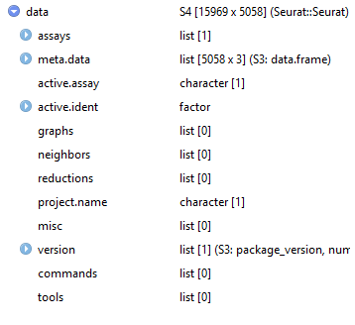
Seurat Data Structure
Single object holds all data
  Build from text table or 10X output (feature matrix h5 or raw matrix)
Seurat Object
Assays
Raw counts
Normalised Quantitation
Metadata
Experimental Conditions
QC Metrics
Clusters
Embeddings
Nearest Neighbours
Dimension Reductions
Variable Features
Variable Gene List

Slide 8
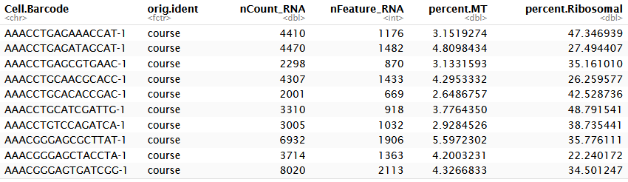
Seurat Metadata
QC
Conditions
Clusters
  data[[]]
  data$nCount_RNA
  new_data -> data$new_metric

Slide 9
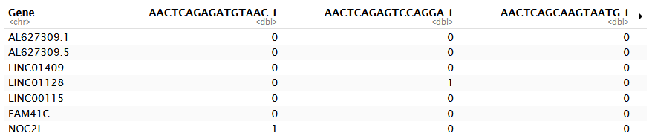
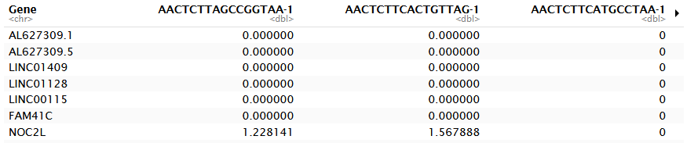
Seurat Quantitative Data
> LayerData(data, layer="counts")
> LayerData(data, layer="data")

Slide 10
Seurat Dimensionality Reductions
> Embeddings(data,reduction = "pca")
PC_1 PC_2 PC_3
GAGAAACCAT-1 -4.135099 -8.7585629 0.004920869
GAGATAGCAT-1 10.279728 0.8451562 0.287589575
GAGCGTGAAC-1 -6.002598 4.9504875 -3.022266598
GCAACGCACC-1 10.610838 0.4030928 0.165408128
GCATCGATTG-1 -5.581052 -0.4542359 5.166186308
> Loadings(data, reduction="pca")
PC_1 PC_2 PC_3
IGLC3 -0.01326925 -0.07255036 -0.017863727
IGLC1 -0.01039493 -0.05451957 -0.008700478
IGLC2 -0.01569606 -0.08276587 -0.021715297
IGKC -0.02226017 -0.12668741 -0.038651318
S100A9 0.11325462 0.01836318 0.013403732
> Embeddings(data,reduction = "tsne")
tSNE_1 tSNE_2
AAACCTGAGAGTGAGA-1 14.182877 -12.592458
AAACCTGAGCGAAGGG-1 -24.612876 5.739248
AAACCTGAGCGTCTAT-1 21.212219 4.717356
AAACCTGAGCTACCTA-1 5.228508 21.568443
AAACCTGAGCTCCCAG-1 18.923168 6.299075

Slide 11
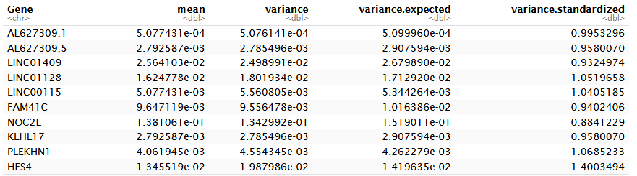
Variable Gene Information
> HVFInfo(data)

Slide 12
Seurat Methods
Data Parsing
  Read10X
  Read10X_h5*
  CreateSeuratObject
Data Normalisation
  NormalizeData
  ScaleData
Graphics
  Violin Plot – metadata or expression (VlnPlot)
  Feature plot (FeatureScatter)
  Projection Plot (DimPlot, DimHeatmap)
Dimension reduction
  RunPCA
  RunTSNE
  RunUMAP
Statistics
  Select Variable Genes FindVariableFeatures
  Build nearest neighbour graph FindNeighbors
  Build graph based cell clusters FindClusters
  Find genes to classify clusters (multiple tests) FindMarkers
*Requires installing the hdf5r package

Slide 13
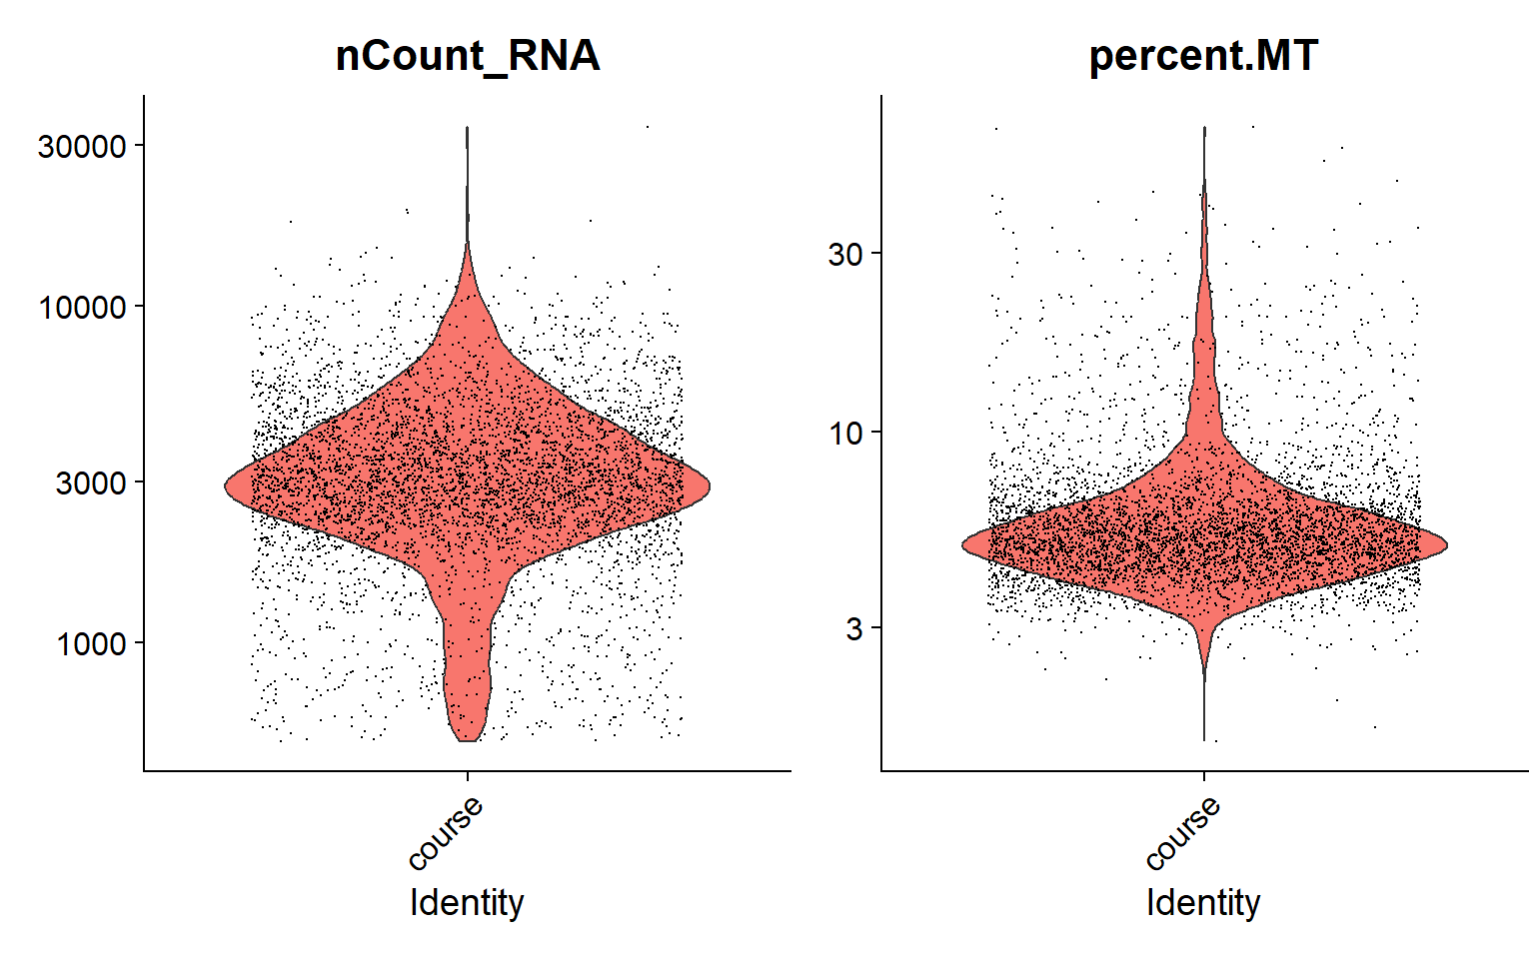
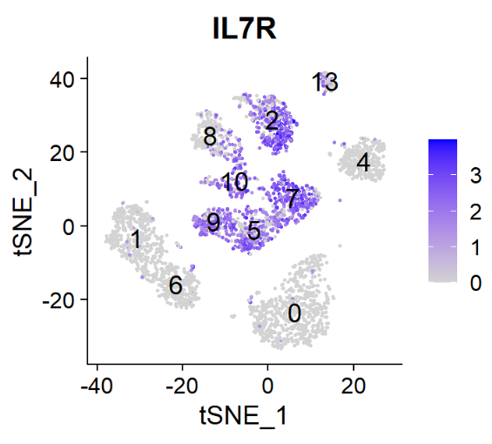
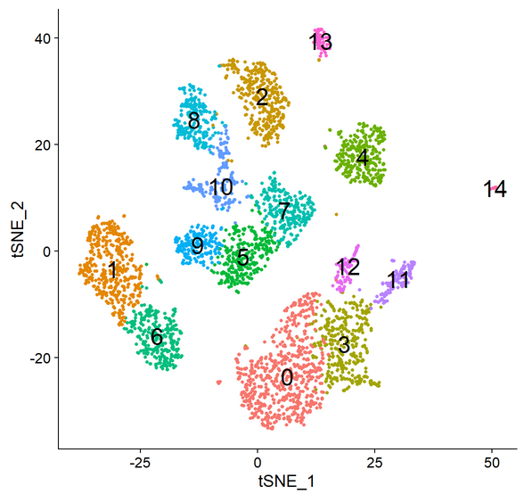
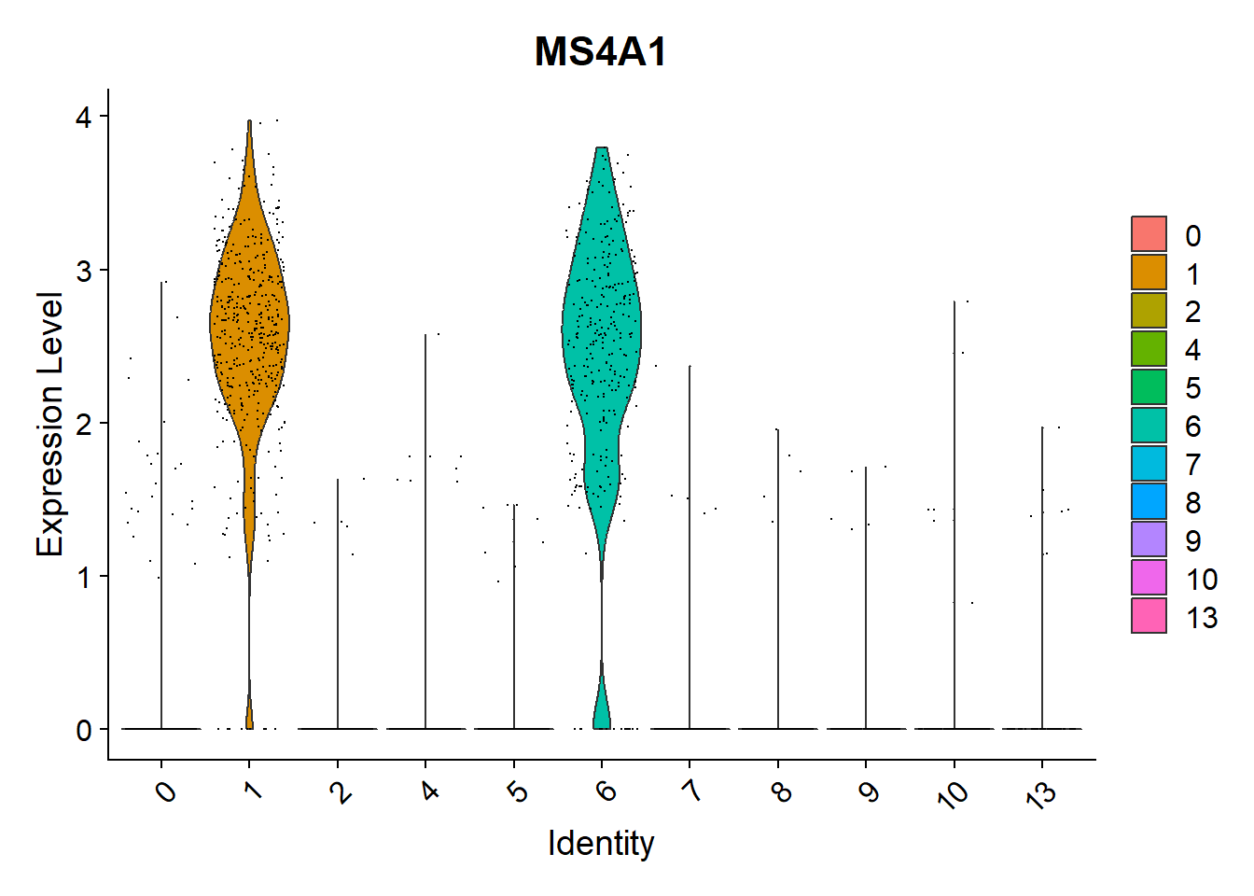
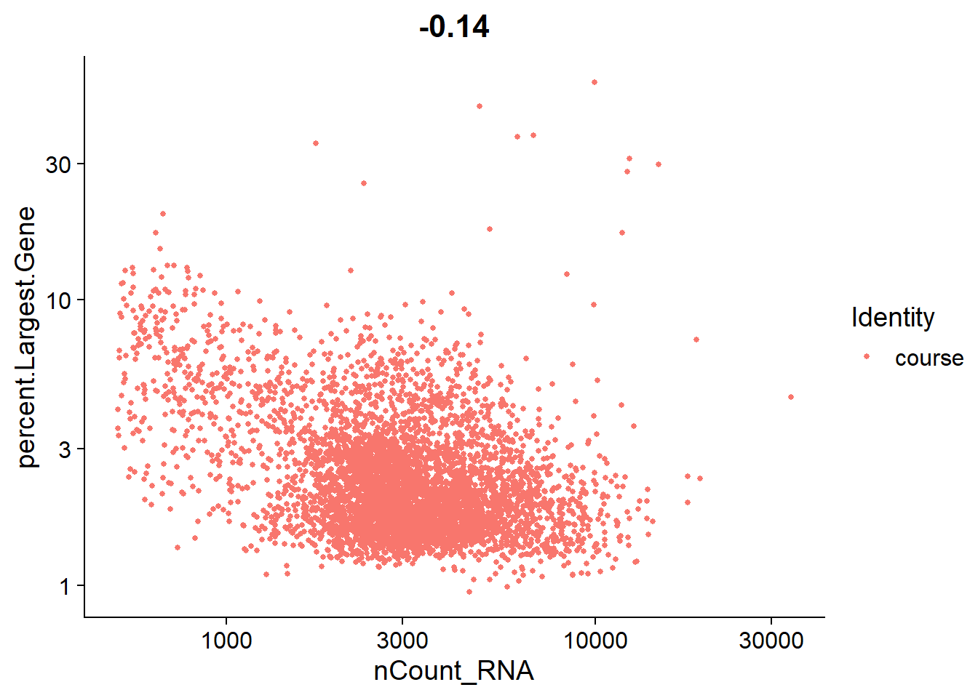
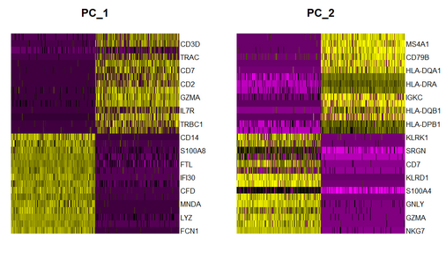
Seurat Graphs
FeaturePlot
VlnPlot
DimPlot
DimHeatmap
FeatureScatter

Slide 14
Example 10X Seurat Workflow

Slide 15
Example Seurat Workflow
Read Data
Calculate QC Metrics
Filter cells and genes
Normalise and scale counts
Find Variable Genes
Identify Cluster Markers
Define Clusters
(Normalise Runs)
Run tSNE / UMAP
Run PCA and select PCs

Slide 16
Reading Data
Read10X_h5("filtered_feature_bc_matrix.h5") -> data
CreateSeuratObject(
counts=data,
project="course",
) -> data
> data
An object of class Seurat
17136 features across 3939 samples within 1 assay
Active assay: RNA (17136 features, 500 variable features)
3 layers present: counts, data, scale.data
2 dimensional reductions calculated: pca, tsne

Slide 17
QC – What problems are likely?
Lysed cells
Dead or dying cells
Empty GEMs
Double (or more) occupied GEMs
Cells in different cell cycle stages

Slide 18
Lysed Cells
Outer membrane is ruptured – cytoplasmic RNAs leak out
  Loss of mature RNA, increase in pre-mRNA
  Lower overall counts/features
  Increase in nuclear RNAs
    MALAT1 is an easy marker to use
  Increase in Membrane associated transcripts

Slide 19
Dead or Dying Cells
Cells undergoing apoptosis have very different transcriptomes
  Lower total RNA production
  Huge upregulation of mitochondrial transcription

Slide 20
Empty GEMs
GEMs containing no cell will still produce some sequence
  Background RNA in the flow medium
  Will be worse with higher numbers of lysed cells
Total amount of signal will be greatly reduced
Will often cluster together

Slide 21
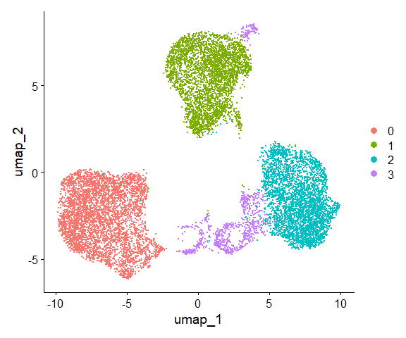
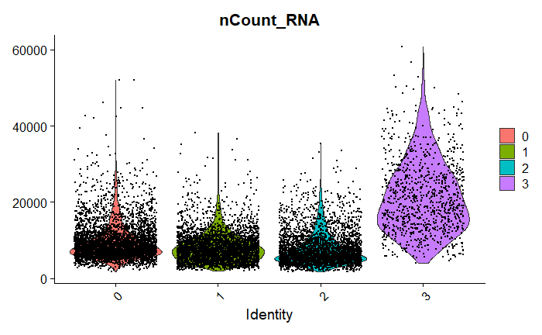
Double occupied GEMs
Will get a mixed signal from two different cells
Not as obvious a signal as empty GEMs
  More UMIs/Features per cell
  Intermediate clustering

Slide 22
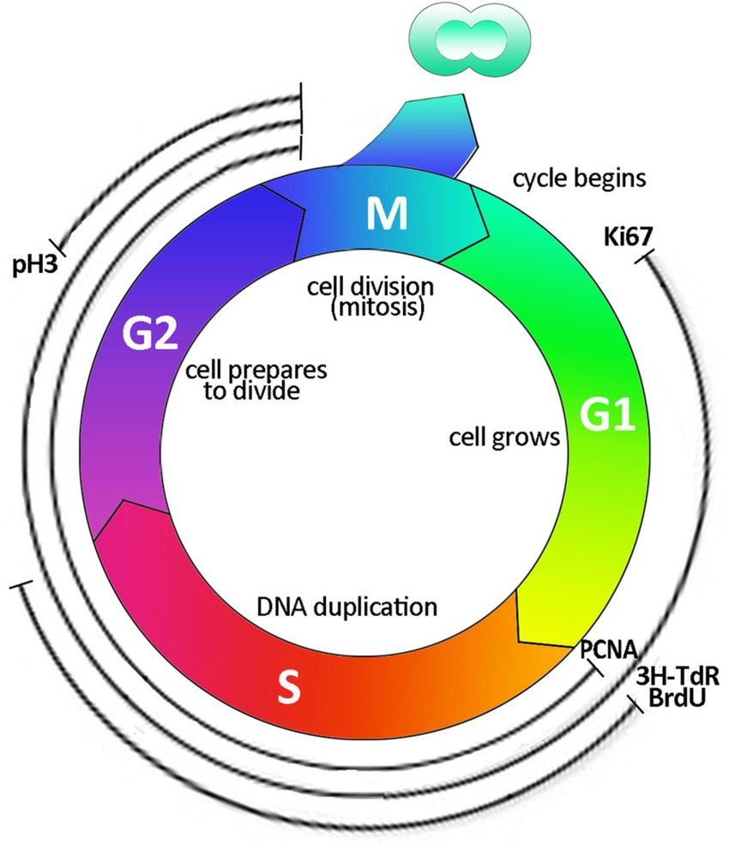
Cell Cycle Variation
Cells in different stages of the cell cycle have quite different expression profiles
  Use genes which classify different phases to classify cells in different phases
  Exclude unusual cells
  Attempt to include cell cycle as a factor during quantitation / differential expression
Lombardi, et al. (2015). 10.1093/ndt/gfv262.

Slide 23
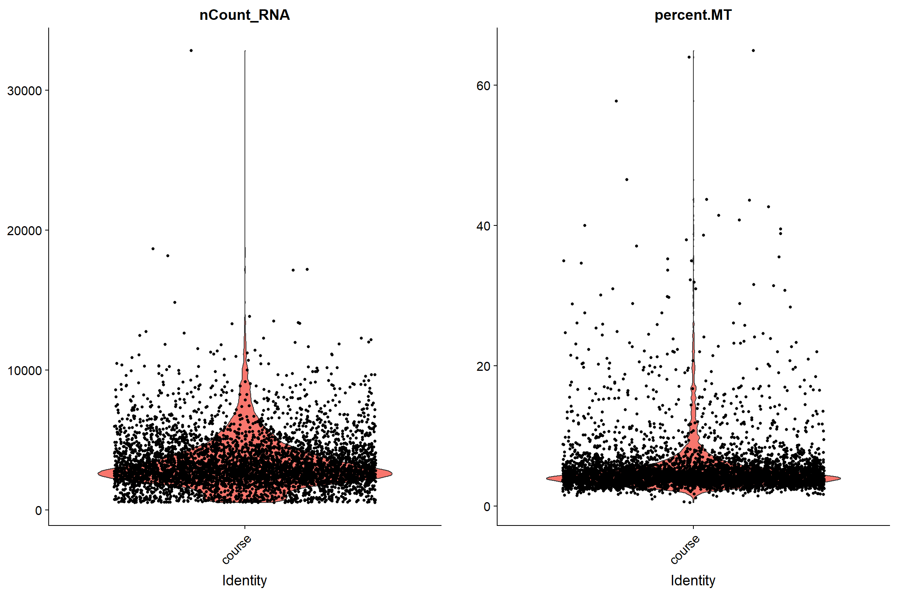
QC and Cell Filtering
Standard QC Measures
  Number of observed genes per cell
  Number of reads per cell
  Relationship between the two
Calculated QC Measures
  Amount of mitochondrial reads
  Amount of ribosomal reads
  Marker genes (eg MALAT1)
  Cell cycle

Slide 24
Custom QC Metrics
PercentageFeatureSet(
data,
pattern="^MT-“
) -> data$percent.MT
apply(
LayerData(data, layer="counts"),
2,
function(x)(100*max(x))/sum(x)
) -> data$Percent.Largest.Gene

Slide 25
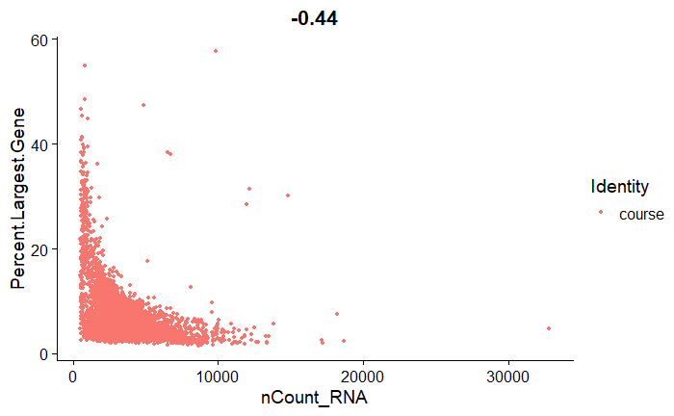
QC and Cell Filtering
VlnPlot(
data, features=c("nCount_RNA","percent.MT"),
log=TRUE
)
FeatureScatter(
data,
feature1 = "nCount_RNA",
feature2 = "Percent.Largest.Gene“
)

Slide 26
Applying Filters
subset(
data,
nFeature_RNA>750 &
nFeature_RNA < 2000 &
percent.MT < 10 &
Percent.Largest.Gene < 20
) -> data

Slide 27
Count Normalisation and Scaling
Raw counts are biased by total reads per cell
Counts are more stable on a log scale
Standard normalisation is just log reads per 10,000 reads
For PCA counts scale each gene's expression to a z-score
  Can also use this step to try to regress out unwanted effects

Slide 28
Count Normalisation and Scaling
NormalizeData(
data,
normalization.method = "lognormalize"
) -> data
ScaleData(
data,
features=rownames(data)
) -> data

Slide 29
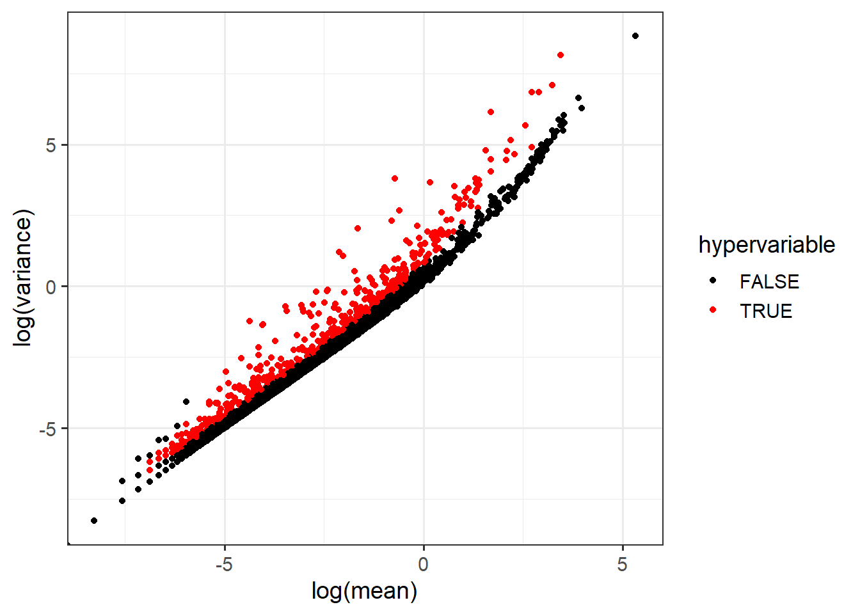
Variable Feature Selection
Selects a subset of genes to use for downstream analysis
Identify genes with an unusual amount of variability
Link the variability with the expression level to find variation which is high in the context of the expression level
Keep only the most variable genes
FindVariableFeatures(
data,
selection.method = "vst",
nfeatures=500
) -> data

Slide 30
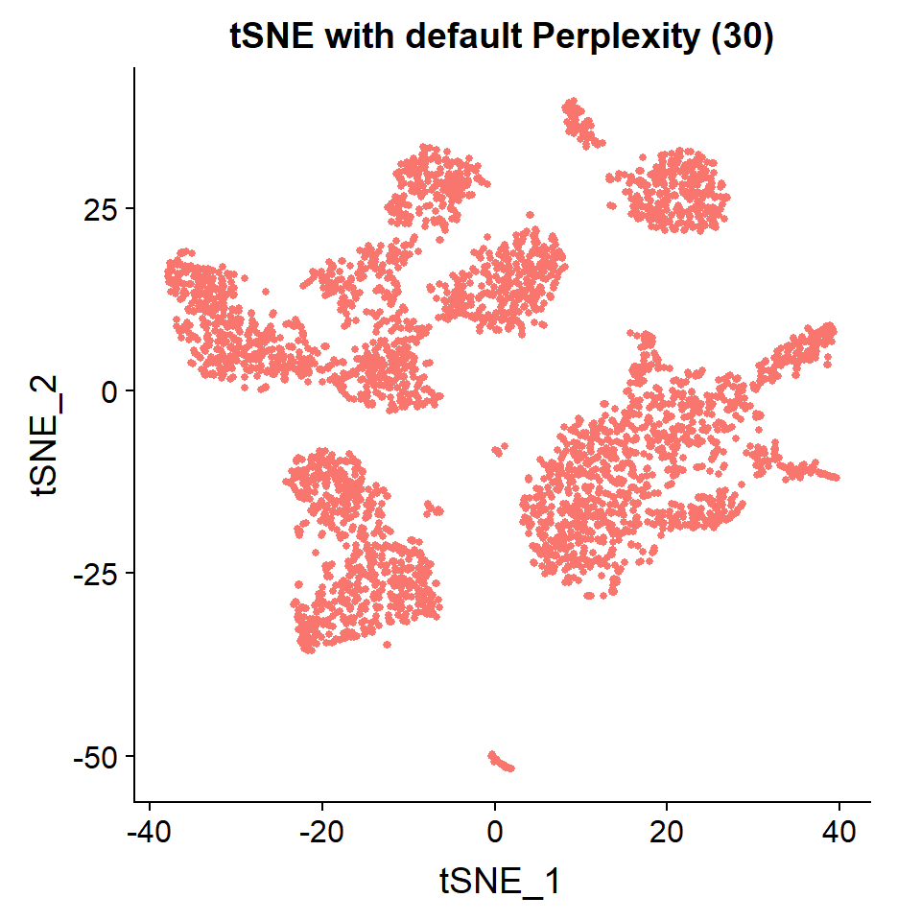
Dimensionality Reduction
Start with PCA on the normalised, filtered (both cells and genes), scaled data
Scree / Elbow plot to decide how many PCs are informative
Pass only the interesting PCs to subsequent tSNE or UMAP reduction to get down to 2 dimensions

Slide 31
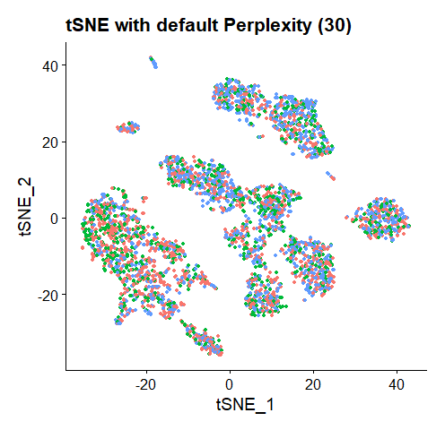
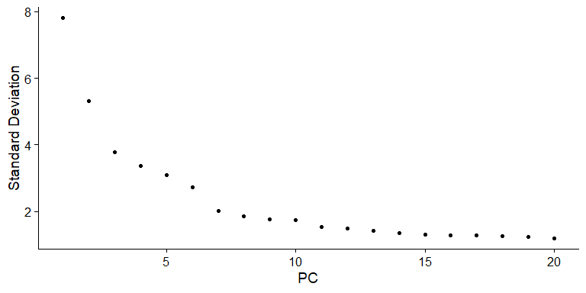
Dimensionality Reduction
RunPCA(
data,
features=VariableFeatures(data)
) -> data
RunTSNE(
data,
dims=1:15,
seed.use = saved.seed,
perplexity=30
) -> data

Slide 32
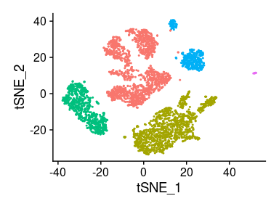
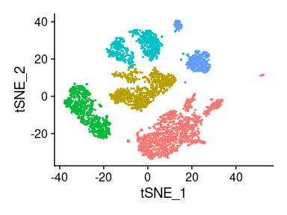
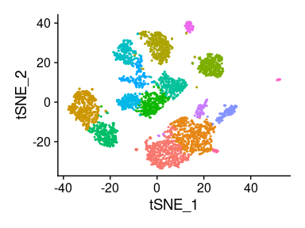
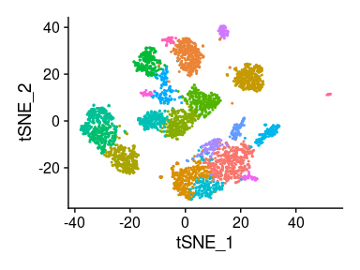
Defining clusters
Construct nearest neighbour graph
  Constructed from PCA
  Same dimensions as tSNE/UMAP
Find clusters
  All cells are classified
  Graph Based (Louvain) Clustering
  Resolution (0.01 - 5) defines granularity
FindNeighbors(
data,
dims=1:15
) -> data
FindClusters(
data,
resolution = 0.5
) -> data

Slide 33
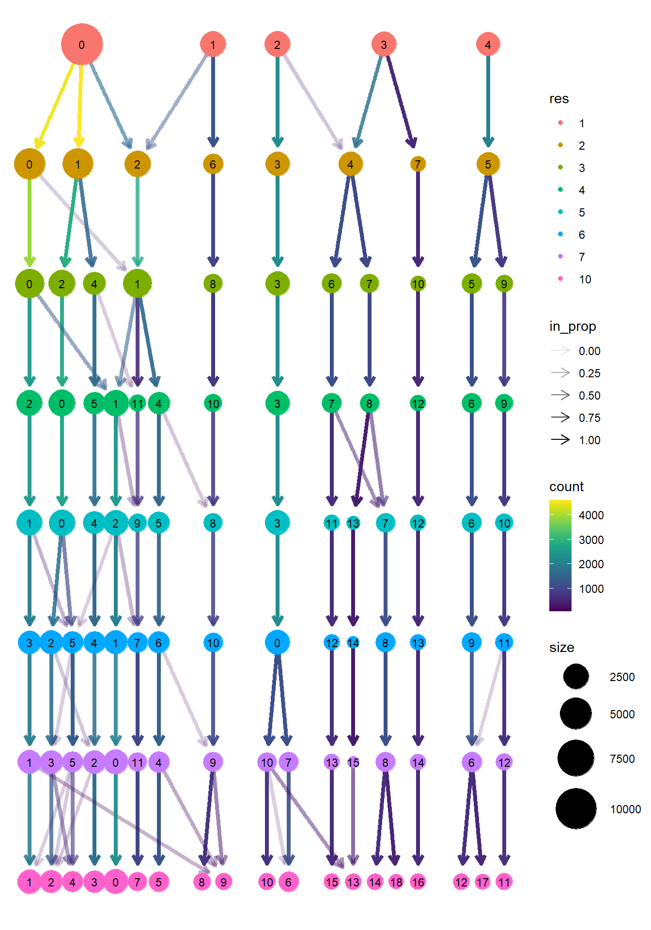
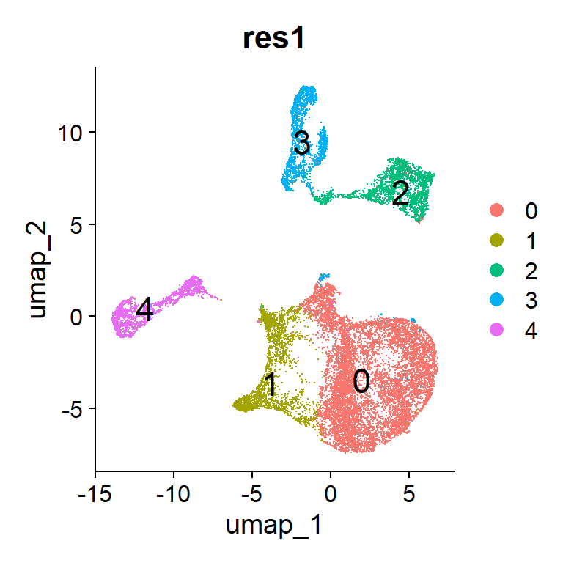
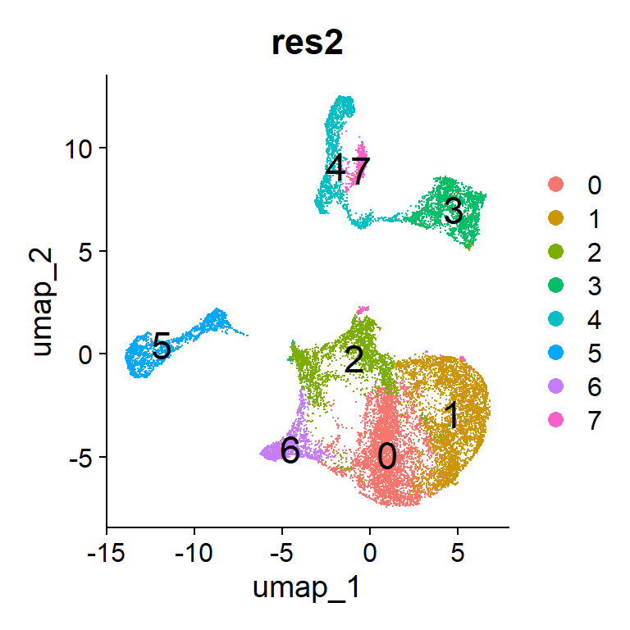
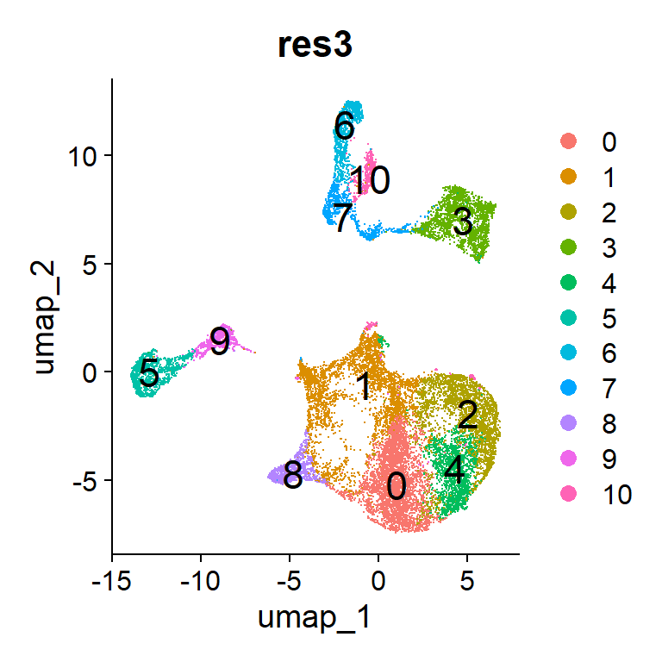
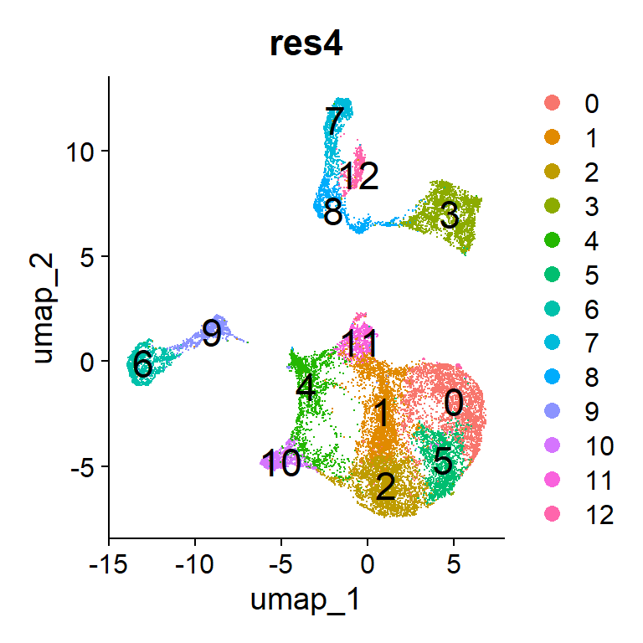
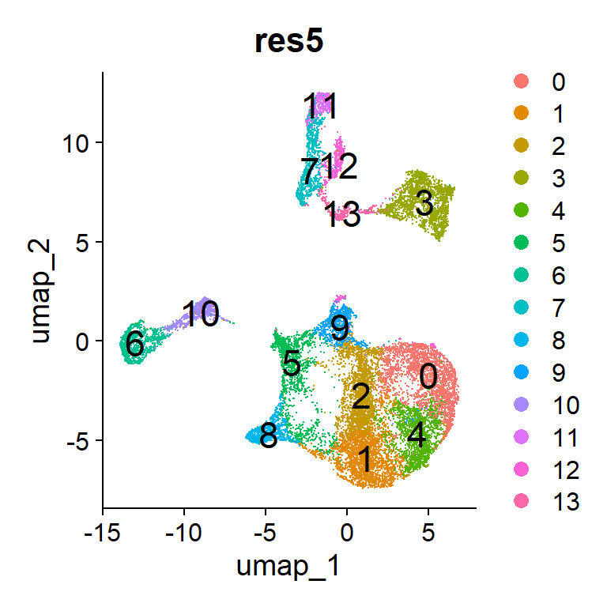
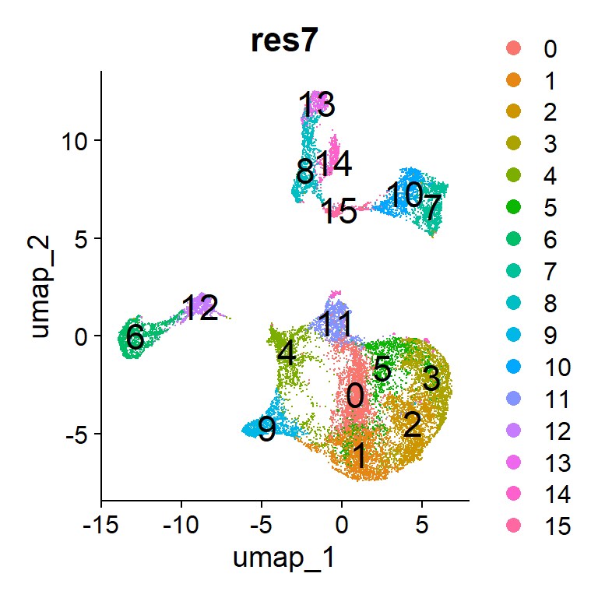
Clustree to see effect of resolution
https://github.com/lazappi/clustree

Slide 34
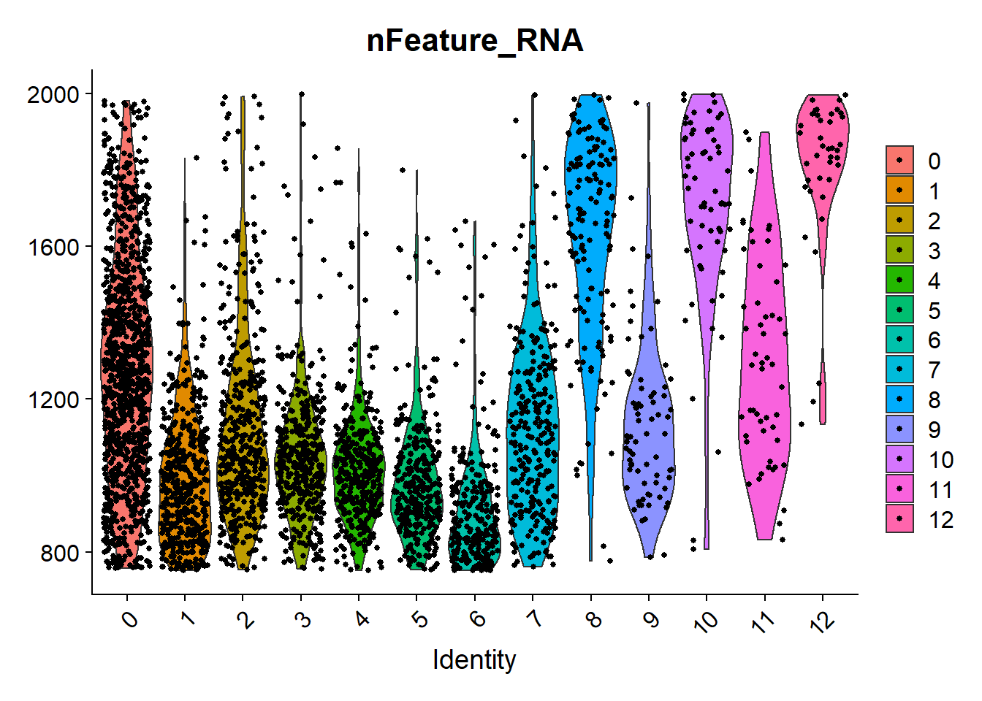
Comparing Properties of Clusters
VlnPlot(data,features="nFeature_RNA")
We want to know that clusters are occurring because of biological changes, not technical differences
We plot QC metrics for clusters
  Read/Gene counts
  Mitochondrion
  MALAT1
Can remove suspect clusters
subset(data, !Seurat_clusters %in% c(8,10,12)) -> data

Slide 35
Statistical Analysis
Sample A
Sample B
1
1
3
2
3
2
4
4
Cluster 1 vs Clusters [2,3,4]
Cluster 1 vs Cluster 3
Cluster A1 vs Cluster B1

Slide 36
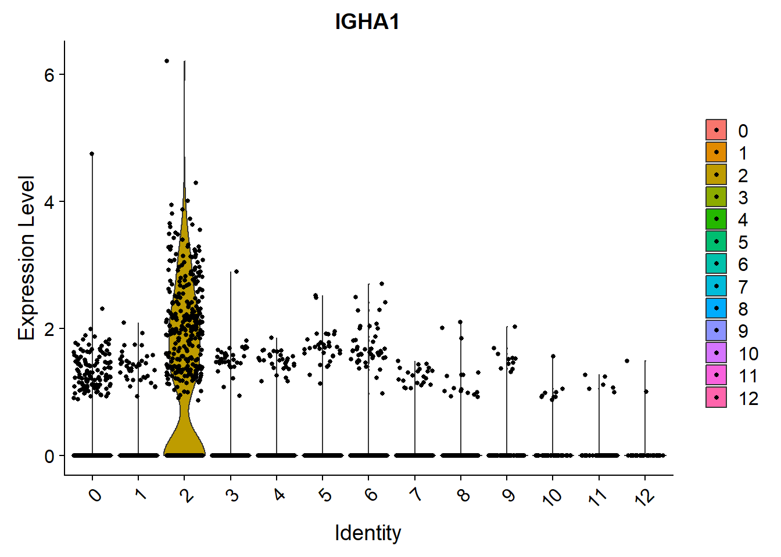
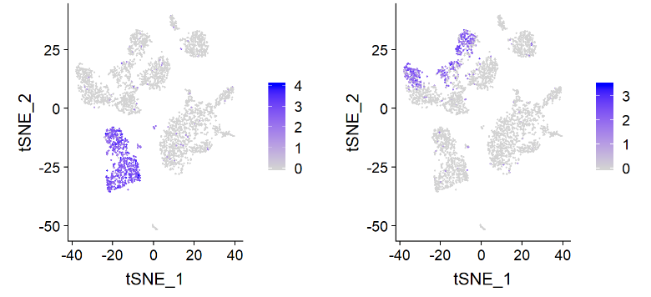
Statistical analysis of differences between clusters
Non-parametric
  Wilcox rank sum test
Parametric
  T-test
  Negative binomial (eg DESeq)
Classification
  ROC analysis
Specialised
  MAST
FindMarkers(
data,
ident.1 = 2,
ident.2 = 6,
test.use = "roc",
only.pos = TRUE
)

Slide 37
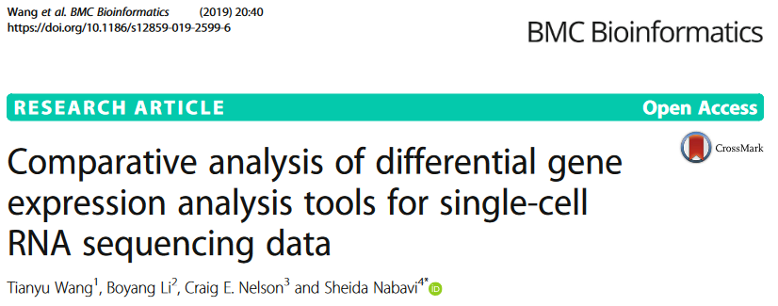
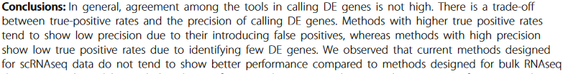

Slide 38

Automated Cell Assignment
Can automatically assign cell identities to clusters
Need a source of marker genes
  Result of a previous run/experiment
  Publicly available data (https://azimuth.hubmapconsortium.org/)
Many packages to do this
  SCINA has worked well for us
  Azimuth built into Seurat

Slide 39
Integrating Multiple Runs
When multiple runs are combined (eg Unstim and Stim), the batch differences between the runs can overwhelm the biological differences
Raw comparisons can therefore miss changes between what are actually matched subgroups

Slide 40
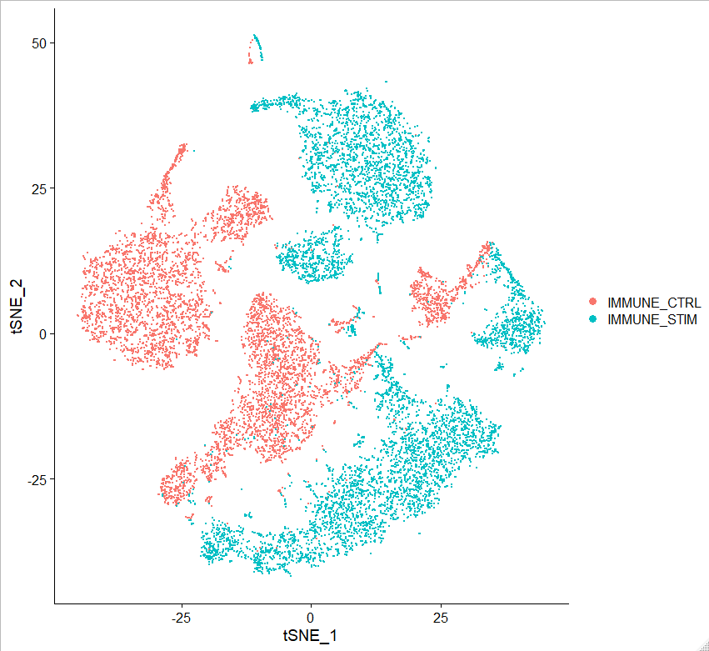
Raw merged runs
Two PBMC populations run at different times
tSNE spread coloured by library
Little to no overlap between cell populations

Slide 41
Integrating Runs
Split the layers based on the metadata
Rerun Normalisation, Variable Features, Scaling, PCA
Create a new integrated layer
split(data[["RNA"]], f = data$Batch) -> data[["RNA"]]
IntegrateLayers(
object = data, method = RPCAIntegration,
orig.reduction = "pca", new.reduction ="integrated.rpca",
verbose = FALSE
) -> data

Slide 42
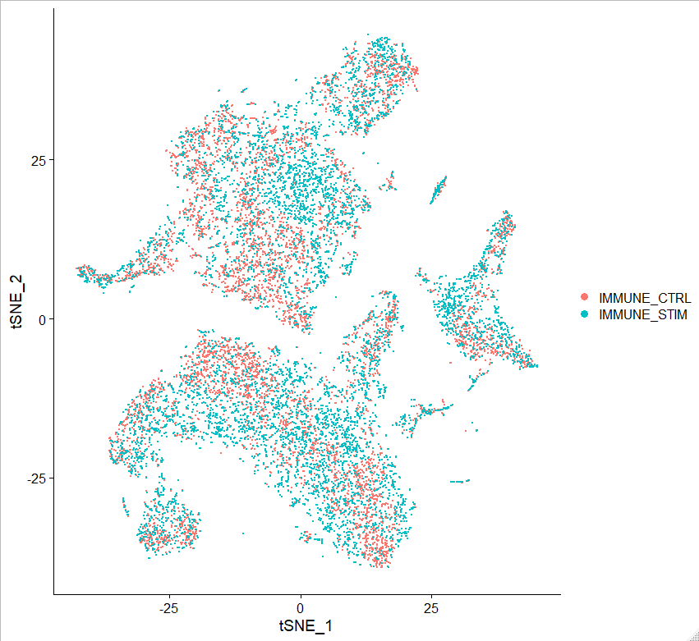
Integrating Runs
Raw
Anchored

Slide 43
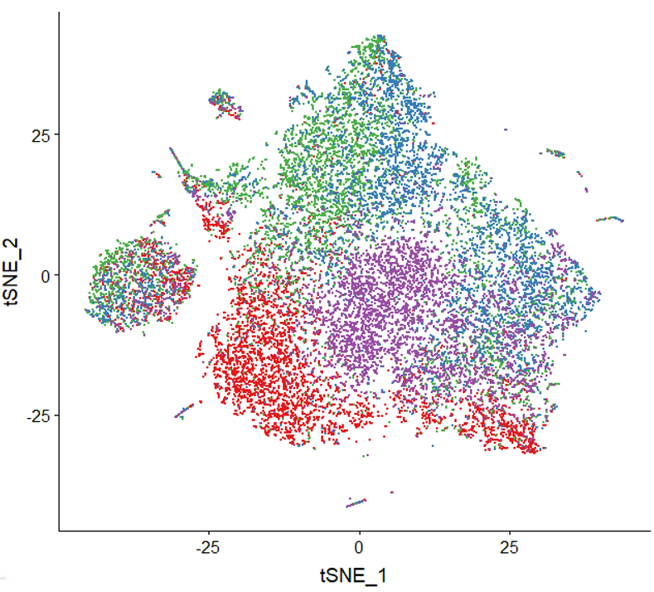
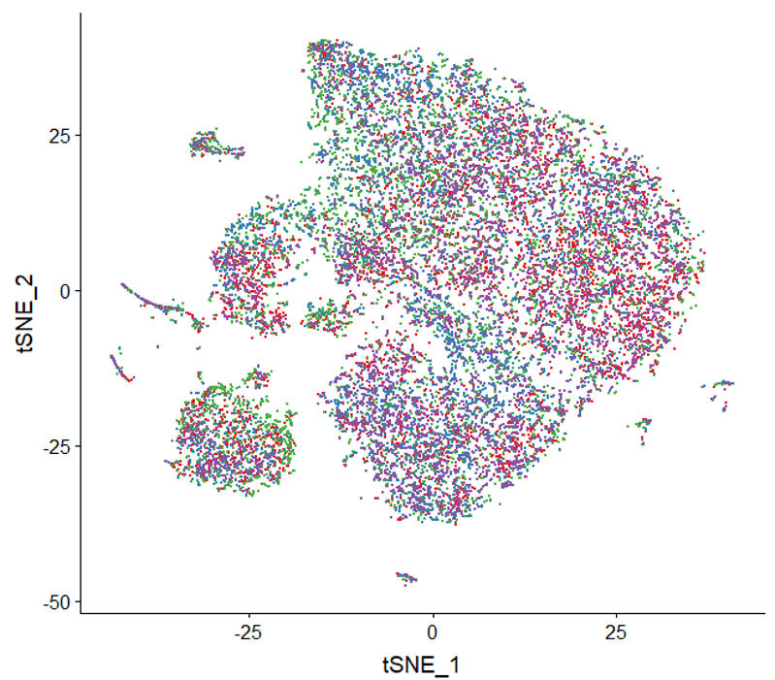
Over-Integration

Slide 44
Exercise – Using Seurat to analyse 10X data

