Slide 1

Analysing 10X Single Cell RNA-Seq Data
v2019-06
Simon Andrews
simon.andrews@babraham.ac.uk

Slide 2
Course Outline
How 10X single cell RNA-Seq works
Evaluating CellRanger QC
  [Exercise] Looking at CellRanger QC reports
Dimensionality Reduction (PCA and tSNE)
  [Exercise] Using the Loupe cell browser
  [Exercise] Analysing data in R using Seurat

Slide 3
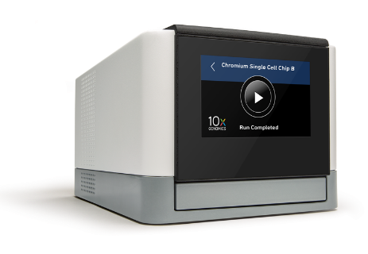
How 10X RNA-Seq Works
RT Reagents
Oil
Cells
Barcoded Beads
Gel Beads in Emulsion (GEMs)

Slide 4
How 10X RNA-Seq Works
Oligo dT
Cell barcode (same within GEM)
UMI (all different)
Priming site

Slide 5
How 10X RNA-Seq Works
AAAAAGATTCGTAGTGCTGATGCT...
Reverse Transcription
Mix RNAs
and Cells
Oligo dT
Cell barcode (same within GEM)
UMI (all different)
Priming site
Illumina Library Prep

Slide 6
How 10X RNA-Seq Works
Read 1
Read 3
Illumina
Adapter
UMI
Cell Barcode
3’ RNA Insert
Illumina
Adapter
Sample Barcode
Read 2
Sample level barcode – same for all cells and RNAs in a library
Cell level barcode (16bp) – same for all RNAs in a cell
UMI (10bp) – unique for one RNA in one cell

Slide 7
10X Produces Barcode Counts
Sample WT
Sample KO
Cell WT A
Cell WT B
Cell WT C
Cell KO A
Cell KO B
Cell KO C
UMI
UMI
UMI
UMI
UMI
UMI
UMI
UMI
UMI
UMI
UMI
UMI
UMI
UMI
UMI
UMI
UMI
UMI
UMI
UMI
UMI
UMI
UMI
UMI
UMI
UMI
UMI
UMI
UMI
UMI
UMI
UMI
UMI
UMI
UMI
UMI
UMI
UMIs are finally related to genes to get per-gene counts

Slide 8
The 10X Software Suite
Chromium
Controller
Cell
Ranger
Loupe
Browser
Runs the chromium system for creating GEMs
Pipeline for mapping, filtering, QC and quantitation of libraries
Desktop software for visualisation and analysis of single cell data.

Slide 9
Cell Ranger
Barcode Extraction and filtering
  Identifies cell level barcodes
Mapping to reference
  Uses STAR aligner
Generate count table
  UMIs per gene in each cell
Dimensionality Reduction
  PCA and tSNE
Clustering
  K-means and Graph Based

Slide 10
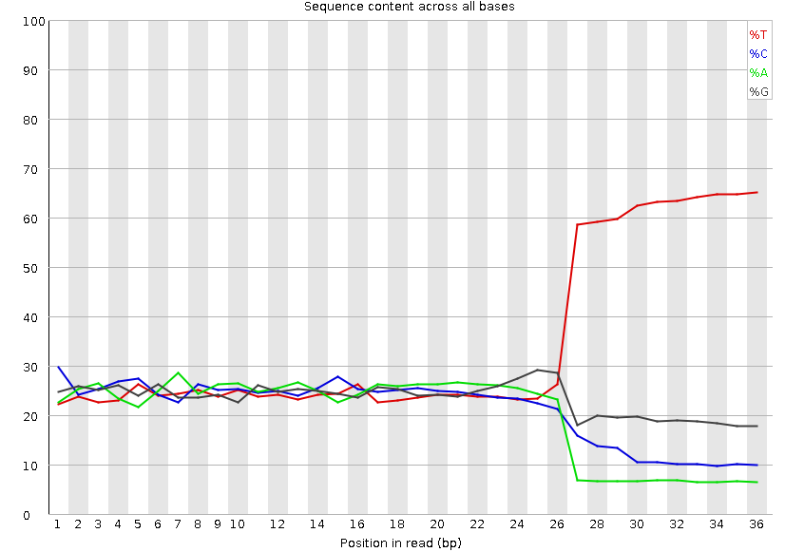
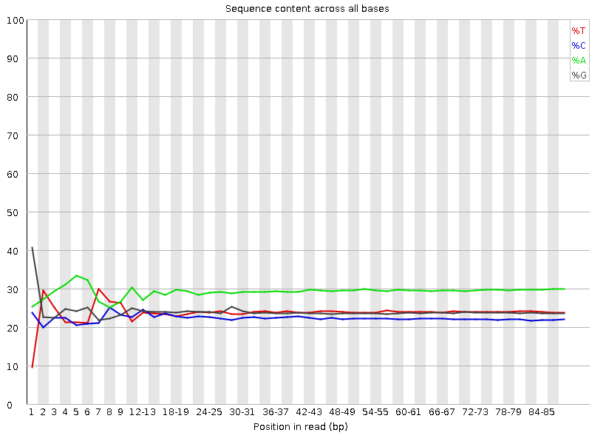
CellRanger Commands
scrALI001_S1_L001_I1_001.fastq.gz
scrALI001_S1_L001_R1_001.fastq.gz
scrALI001_S1_L001_R2_001.fastq.gz
I1
  Index file. All identical (or one of 4) at Babraham
R1
  Barcode reads
    16bp cell level barcode
    10bp UMI
R2
  3’ RNA-seq read

Slide 11
CellRanger Commands
CellRanger Count (quantitates a single run)
$ cellranger count --id=COURSE \
--transcriptome=/bi/apps/cellranger/references/GRCh38/ \
--fastqs=/bi/home/andrewss/10X/ \
--localcores=8 \
--localmem=32
CellRanger aggr (merges multiple runs)
$ cellranger aggr --id=MERGED \
--csv=merge_me.csv \
--normalize=mapped

Slide 12
Output files generated
web_summary.html - Web format QC report
filtered_features_bc_matrix
  barcodes.tsv.gz - cell level barcodes seen in this sample
  features.tsv.gz - list of quantitated features (usually Ensembl genes)
  matrix.mtx.gz - (sparse) matrix of counts for cells and features
possorted_genome_bam.bam - BAM file of mapped reads
molecule_info.h5 – Details of the cell barcodes – used for merging
cloupe.cloupe - Analysis data for Loupe Cell browser

Slide 13
Evaluating CellRanger Output
Look at barcode splitting report
  Check sample level barcodes
Look at web_summary.html file
  Check number of cells
  Check quality of data
  Check coverage per cell
  Check library diversity

Slide 14
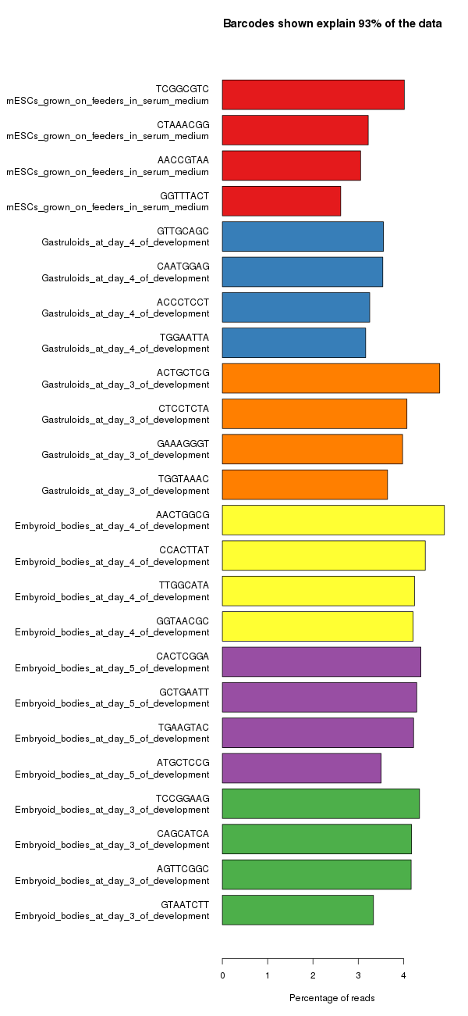
Sample Level Barcodes
Only present if multiple libraries mixed in a lane
Get standard barcode split report, but with 4 barcodes used per sample
Even coverage within and between libraries

Slide 15
CellRanger Reports
HTML report – comes with each sample and aggregated group of samples
Gives some basic metrics to judge the quality of the samples and spot any issues in the data or processing

Slide 16
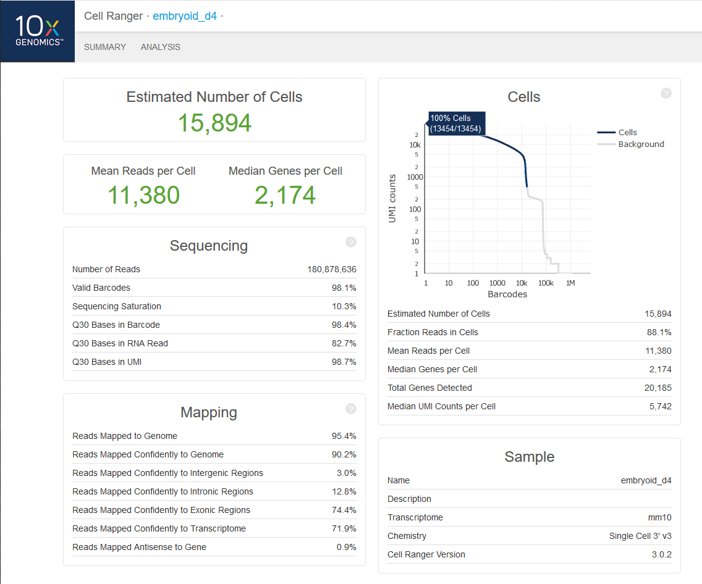

Slide 17
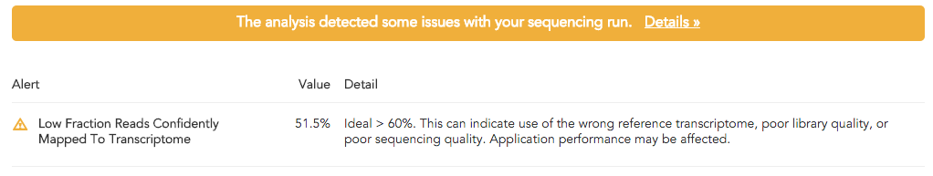
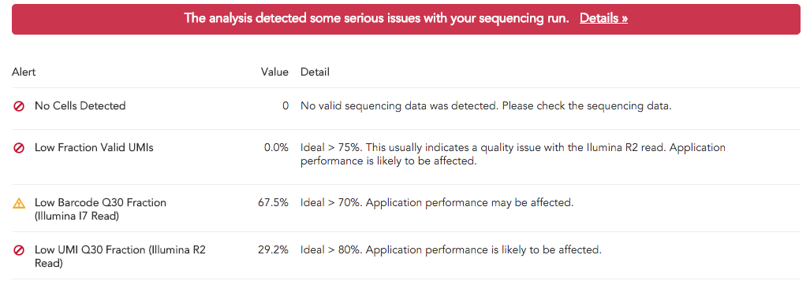
Errors and Warnings

Slide 18
How many cells do you have?
Cell number is determined from the number of cell barcodes with ‘reasonable’ numbers of observations
Need to separate signal from background – real cell associated barcodes vs noise from empty GEMs and mis-called sequences
Changing the thresholds used can give very different predictions for cell numbers

Slide 19
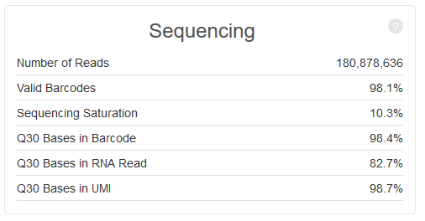
How many cells do you have?
Start by looking at the quality of the base calls in the barcodes
Bad calls will lead to inaccurate cell assignments

Slide 20
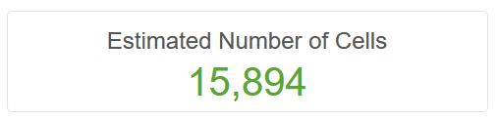
How many cells do you have?
Start by looking at the quality of the base calls in the barcodes
Bad calls will lead to inaccurate cell assignments

Slide 21
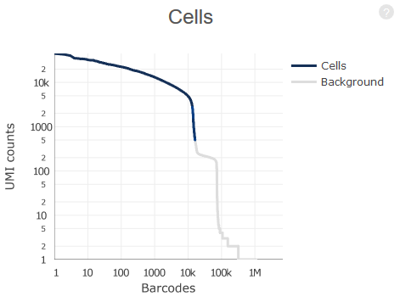
How many cells do you have
Plot of UMIs (reads) per cell vs number of cells
Blue region was called as valid cells
Grey region is considered noise
Both axes are log scale!!!

Slide 22
How many cells do you have
5000 reads per cell. 10k cells
500 reads per cell. 15k cells
CellRanger v3 uses a liberal cutoff to define cells. This was designed to accommodate (normally cancer) samples where cells might have wildly different amounts of RNA. It will include large numbers of cells with small numbers of UMIs. If this doesn’t apply to your sample then this will over-predict valid cells.

Slide 23
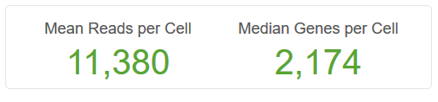
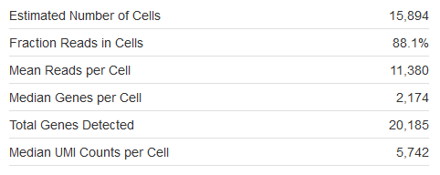
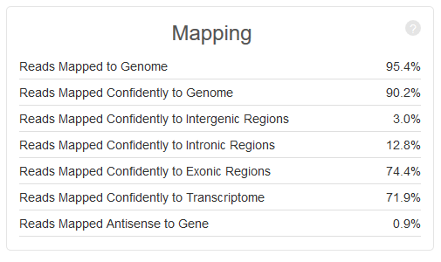
How much data do you have per cell?
Reads should map well
Check reads are mostly in transcripts
Means and medians can be misleading when cells are variable

Slide 24
How much data do you have per cell?
Some details about mapping
  Reads should map to the 3’ end of transcripts (oligo dT selection)
  Reads count as exonic if 50% of them overlaps an exon
  Multi-mapped reads which only hit one exon are considered to be uniquely mapped
  Reads associate with genes based on overlap and direction
  Only confident (unique) transcriptome reads are used for analysis

Slide 25
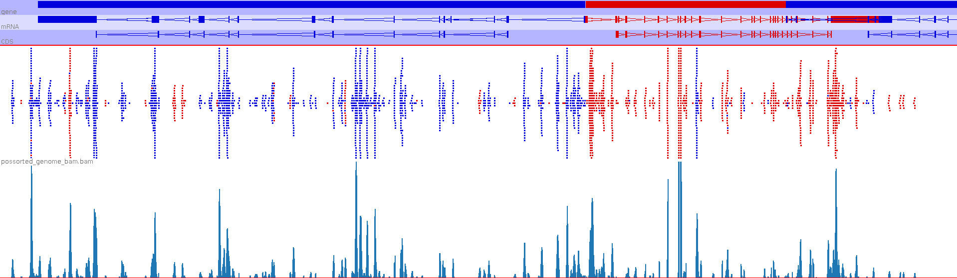

Slide 26
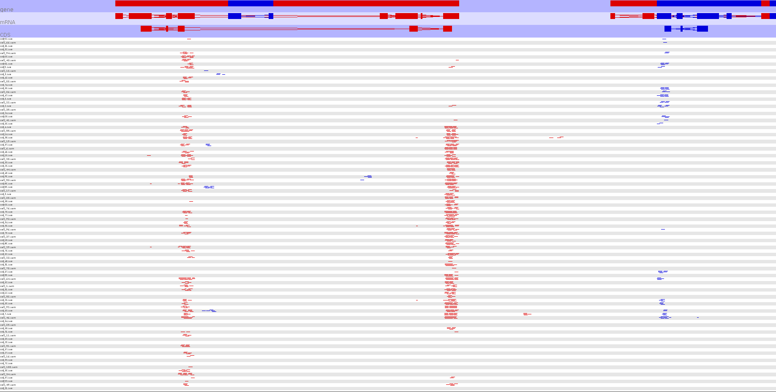

Slide 27
How much data do you have per cell?
Difficult to generalise how much data to create/expect
  Depends on cell type, genome and other factors
In general though, sensible numbers would be:
  Reads per cell ~10,000
  Genes per cell 2000 - 3000

Slide 28
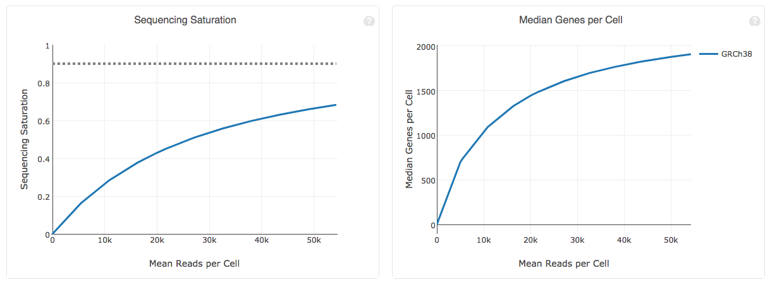
How deeply sequenced is your library

Slide 29
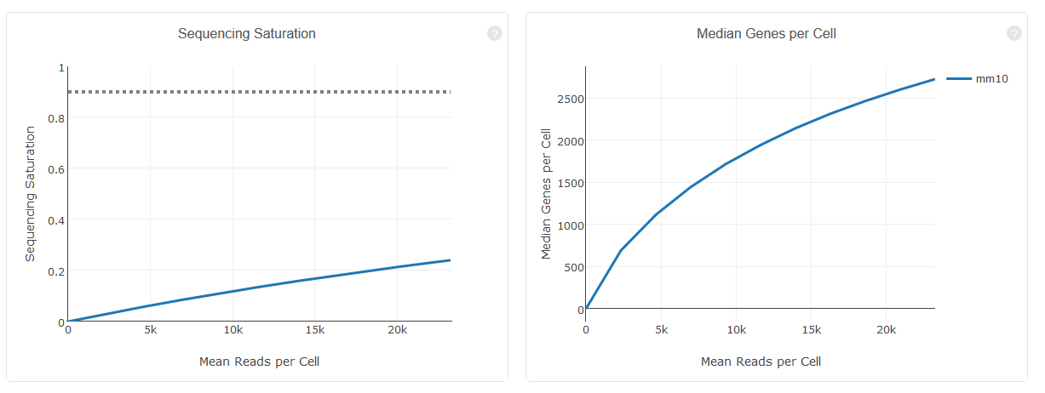
How deeply sequenced is your library

Slide 30
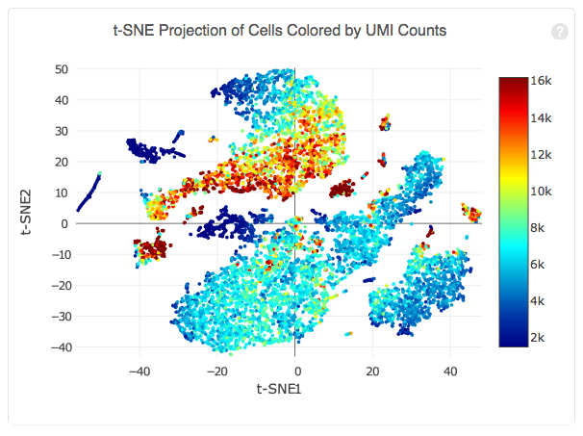
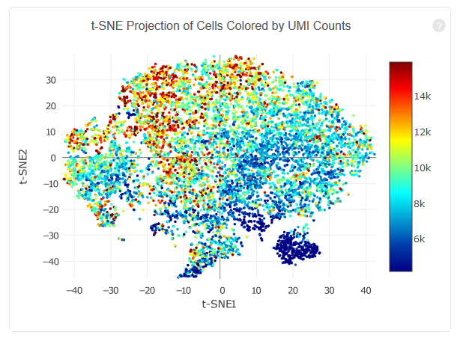
Is coverage variation affecting your data?

Slide 31
Exercise – Evaluating CellRanger Reports
Look at the selection of CellRanger reports to get an idea for the metrics they provide
The data we’re going to use for the rest of the day is in “course_web_summary.html”, do you see any problems which would concern us with this data at this stage?

Slide 32
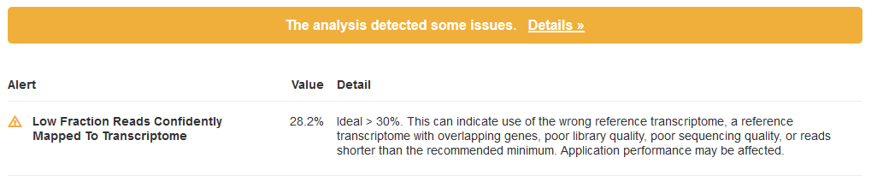
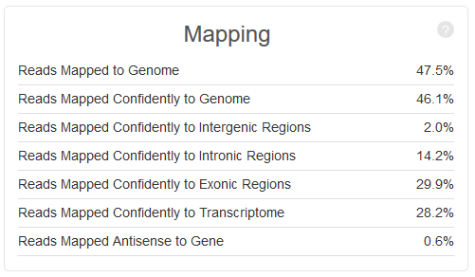
Course Data CellRanger QC
Actual Problem
Value Reported

Slide 33
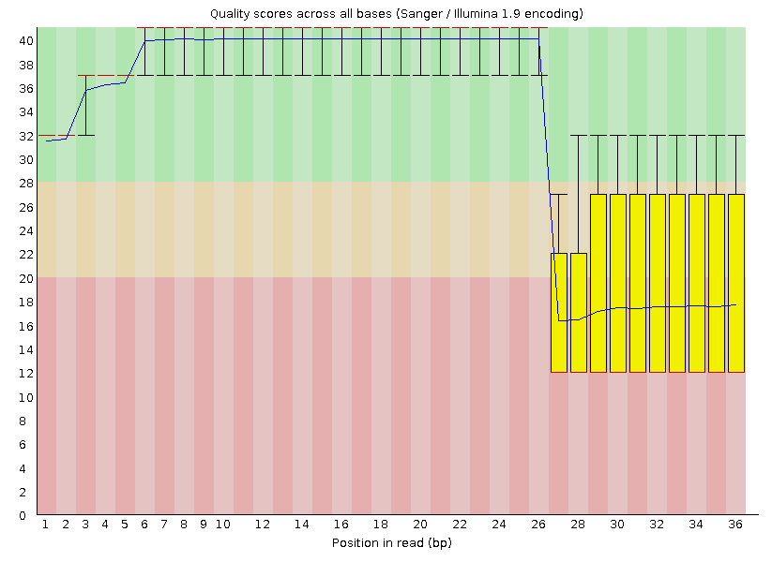
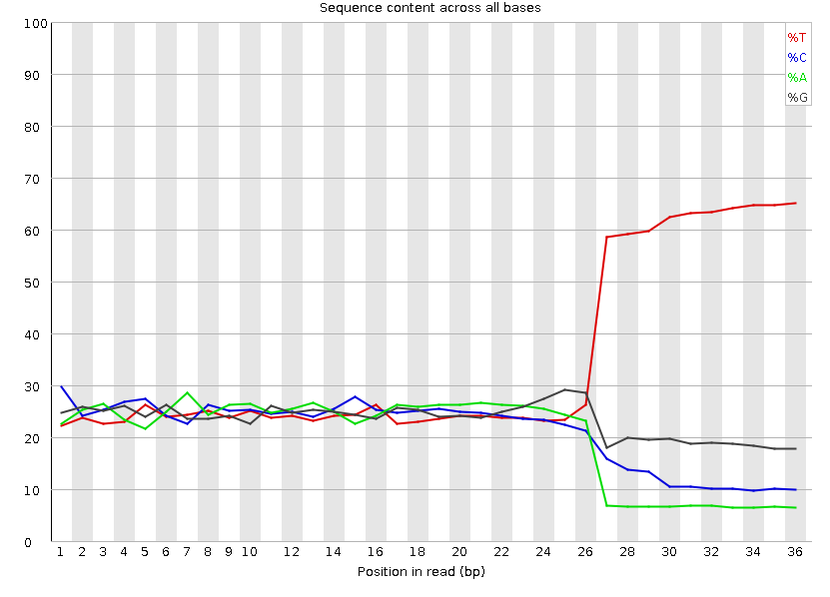
Course Data QC – Read1 (Barcodes)

Slide 34
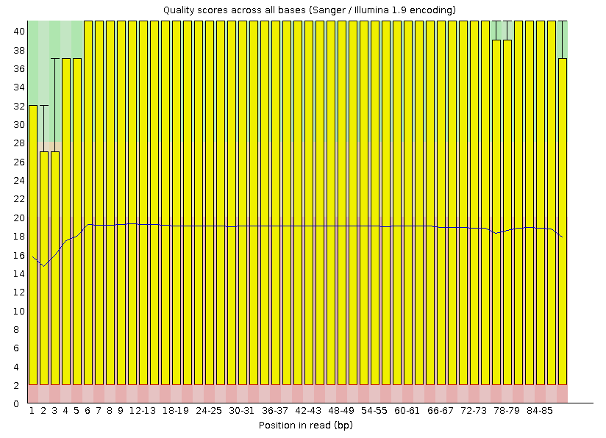
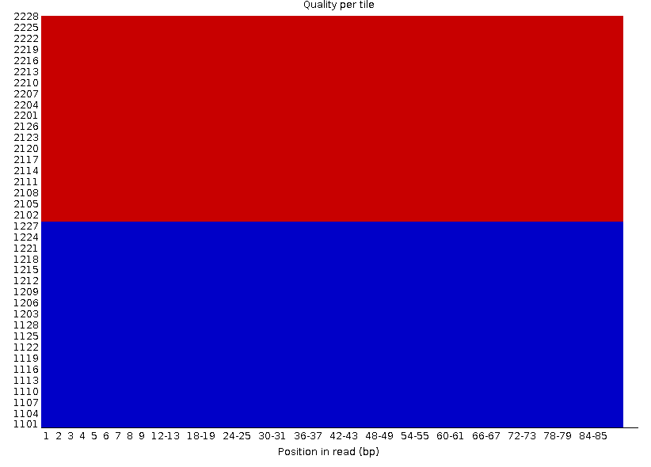
Course Data QC – Read2 (RNA)

