Slide 1
Quality Control for Sequencing Experiments
v2023-04
Simon Andrews, Sarah Inglesfield
simon.andrews@babraham.ac.uk
sarah.inglesfield@babraham.ac.uk

Slide 2
Support service for bioinformatics
Academic – Babraham Institute
Commercial – Consultancy
Support BI Sequencing Facility
MiSeq/ HiSeq/ NextSeq-based sequencing service
Data Management / Processing / Analysis

Slide 3
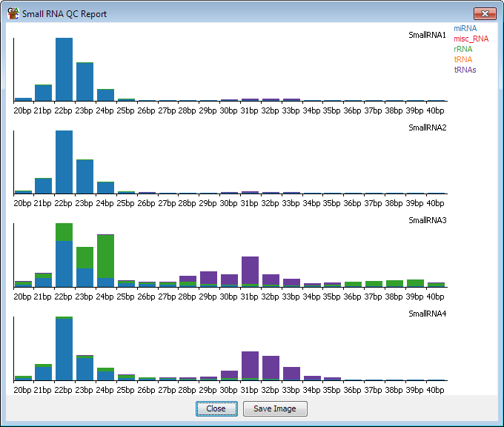
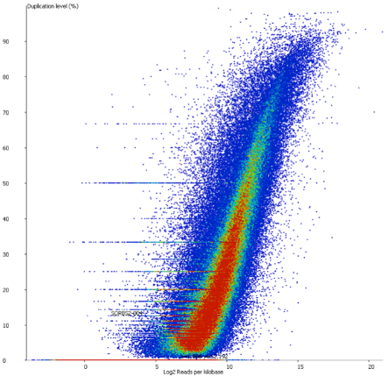
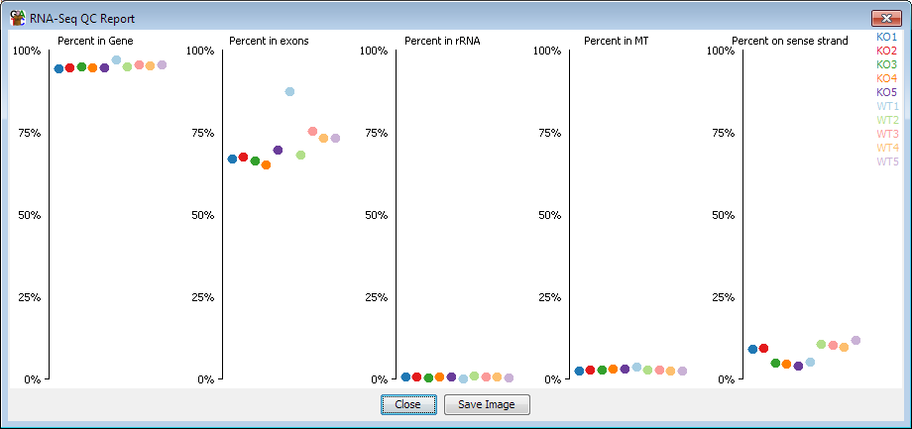
Interests in QC
QC packages
Application specific QC
Data visualisation QC
Notes:
Developed QC for in-house sequencing
Developed QC packages
FastQC
BamQC
FastQ Screen
Developed application specific QC
Bismark (bisulphite methylation)
HiCUP (Hi-C genome structure)
Developed data visualisation QC
SeqMonk (generic sequencing visualisation / analysis)
RNA-Seq QC
Small RNA QC
Duplication QC

Slide 4
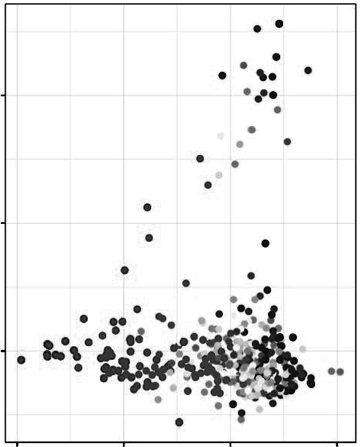
An example of why QC is important…
Single Cell RNA-Seq
Each dot is a cell
An outgroup is clearly visible
What is it?
PC2
PC1

Slide 5
Genes for PC2 (85 total)
Gene Description
Arhgef4 Rho guanine nucleotide exchange factor (GEF) 4
Cflar CASP8 and FADD-like apoptosis regulator
Als2 amyotrophic lateral sclerosis 2 (juvenile) homolog (human)
Cxcr2 chemokine (C-X-C motif) receptor 2
Col4a3 collagen, type IV, alpha 3
Sag retinal S-antigen
Gpr35 G protein-coupled receptor 35
Acmsd amino carboxymuconate semialdehyde decarboxylase
Qsox1 quiescin Q6 sulfhydryl oxidase 1
9430070O13Rik RIKEN cDNA 9430070O13 gene
Mrps14 mitochondrial ribosomal protein S14
Scyl3 SCY1-like 3 (S. cerevisiae)
Ildr2 immunoglobulin-like domain containing receptor 2
Atp1a2 ATPase, Na+/K+ transporting, alpha 2 polypeptide
Slamf8 SLAM family member 8
Wdr38 WD repeat domain 38
Exd1 exonuclease 3'-5' domain containing 1
Serf2 small EDRK-rich factor 2

Slide 6
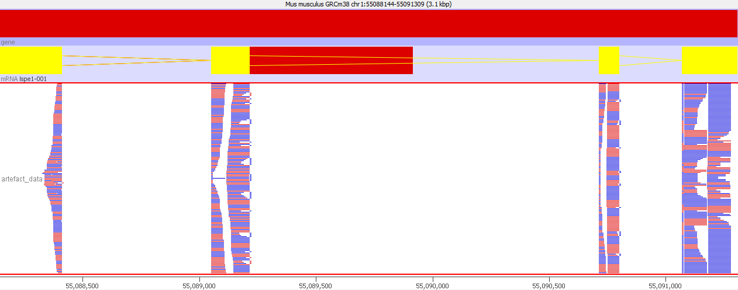
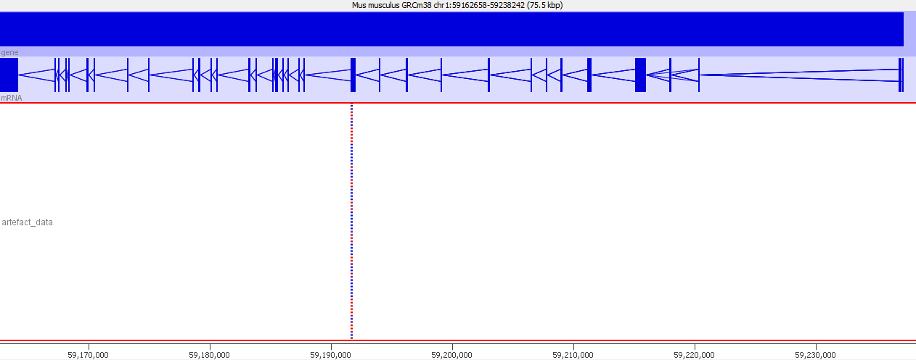
Coverage of Raw Data
Normal Gene
PCA Gene

Slide 7
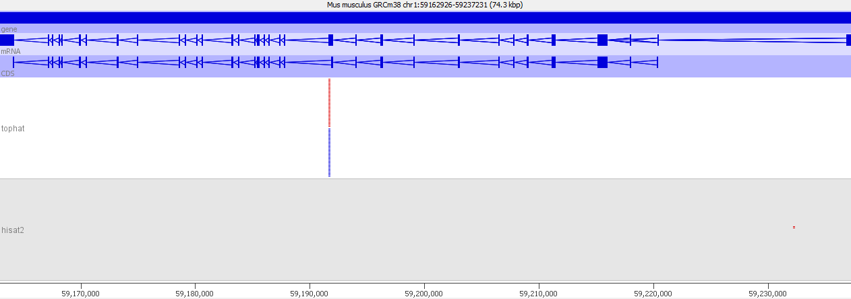
Using a different read mapper…
PC2
Conclusion: The separation in the original graph was a technical artefact of no biological interest. If we'd published this it would have mislead others. Even if we find it we've wasted some time and effort.
PC1

Slide 8
What is the point of QC?
Technical problems don't cause pipelines to fail
Technical problems don't prevent hits being generated
Technical hits often look biologically real
Unexpected, interesting effects can easily be missed
Finding problems through follow-on work is slow and expensive!
QC saves you time and effort! (and money)

Slide 9
Course Structure
How does Illumina Sequencing work?
What can QC tell us?
QC Software
Universal metrics
Library Dependent metrics
Consistency
Putting QC into Practice

Slide 10
How Does Illumina Sequencing Work?

Slide 11
Illumina Sequencing: An Overview
Library Generation
Attach to Flow Cell
Sequence by Synthesis (SBS)
Sequencing Reads
DNAP

Slide 12
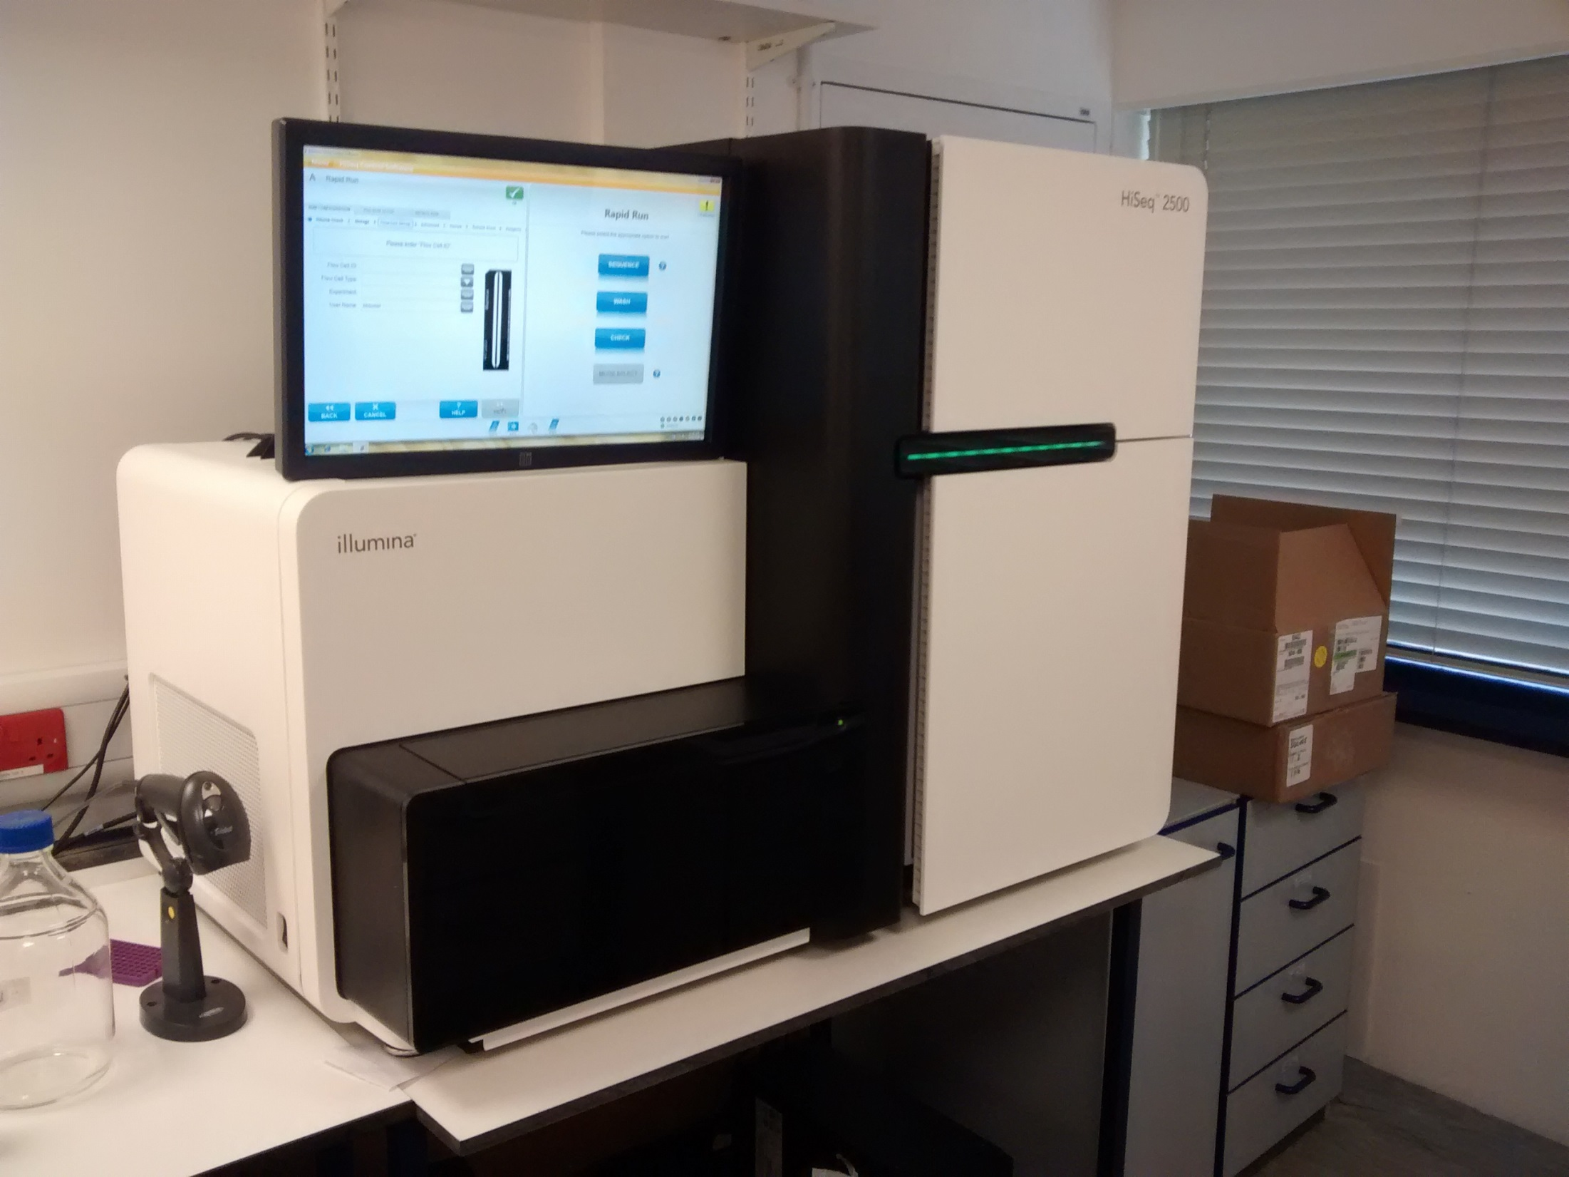
Microscope
Fridge
Pumps
Compartment

Slide 13
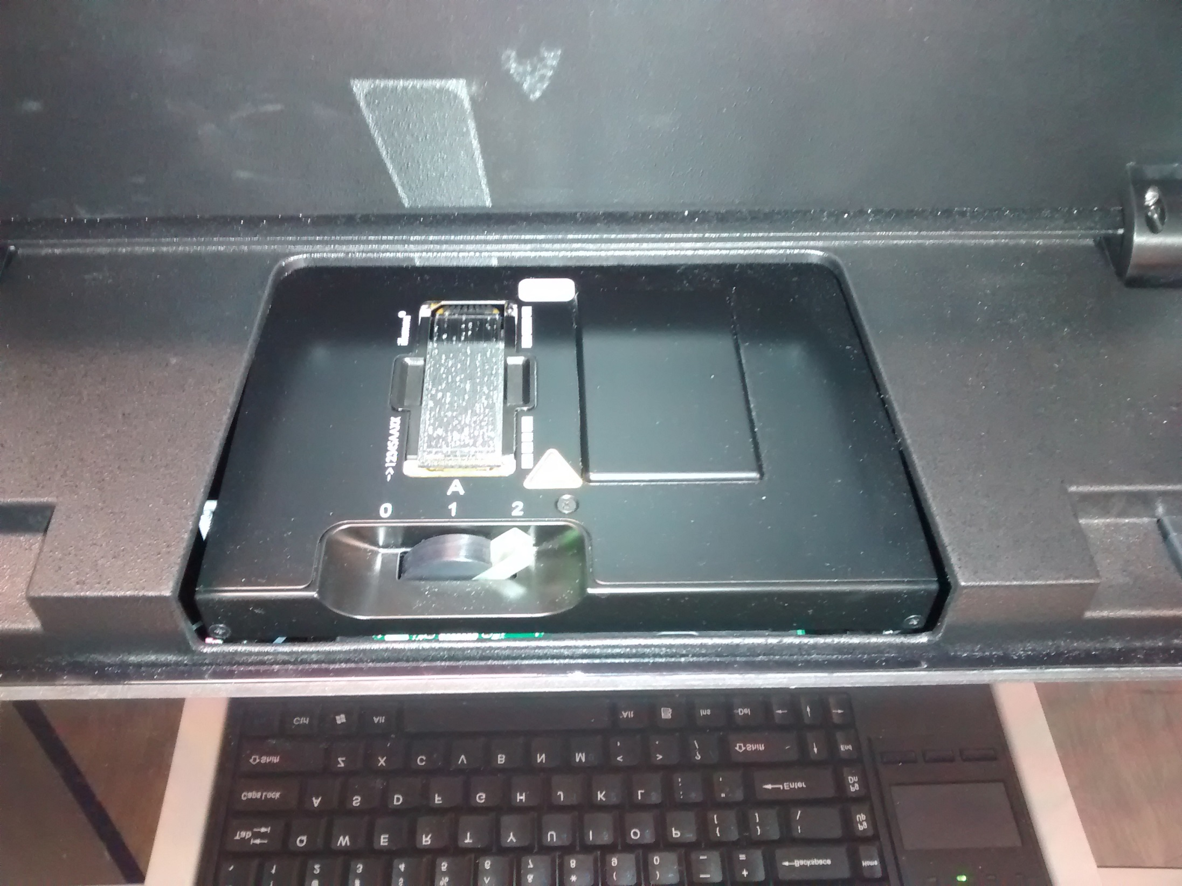
Flow Cell

Slide 14
Illumina Sequencing: An Overview
Library Generation
Attach to Flow Cell
Sequence by Synthesis (SBS)
Sequencing Reads
DNAP

Slide 15
SBS For a Single Molecule
T
A
G
C
G A T T C A G

Slide 16
SBS For a Single Molecule
C
G A T T C A G

Slide 17
SBS For a Single Molecule
T
A
G
C
C
G A T T C A G
1 Cycle

Slide 18
SBS For a Single Molecule
C
T
A
A
G
T
C
ect...
G A T T C A G
5 Cycles
3 Cycles
2 Cycles
4 Cycles
... Read length
6 Cycles
7 Cycles

Slide 19
Comparing Chemistry
Signal
Image
Base Call
4 Channel Chemistry
2 Channel Chemistry
1 Channel Chemistry
T
C
A
G
T
C
A
G
T
C
A
G
T
C
A
G
Notes:
1 channel chemistry isn’t very common – used by the iSeq™ 100 System

Slide 20
Comparing Chemistry
Signal
4 Channel
T | C | A | G
2 Channel
T | C | A |  | G
1 Channel
T | C | A | G
Image
Base Call
No Signal is interpreted as G

Slide 21
Detecting a Signal
One Molecule isn’t Enough
Cycle 3
Amplify to generate Cluster
Cycle 2
Cycle 1
Multiple Clusters on a Flow Cell

Slide 22
Flow Cell Imaging
Image
Flow out
Lanes
Flow in
Tiles
Swaths
Flow Cell
Image
Glass Slide

Slide 23
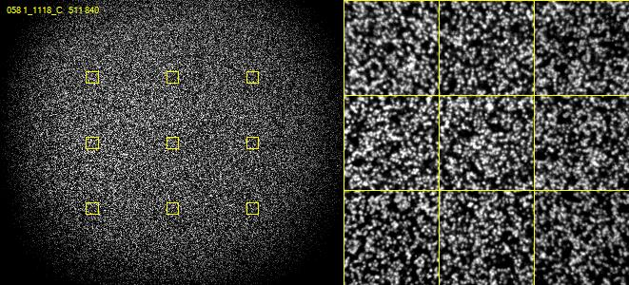
Real Illumina Sequence Data

Slide 24
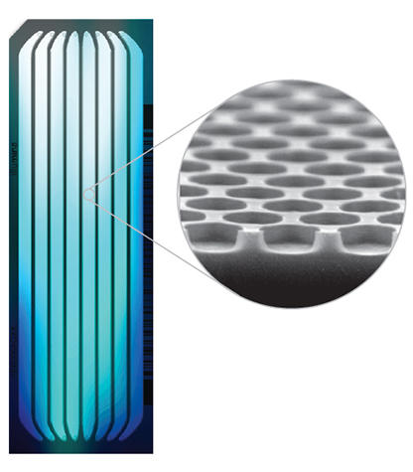
Creating Clusters
Non Patterned Flow Cell
Patterned Flow Cell
Random Clusters
Pre-defined Clusters
Notes:
Flow cell is coated with a lawn of oligo primers complementary to adapter region of fragment strand
Patterned allows greater density

Slide 25
Creating Clusters: Patterned Flow Cells
Single molecule attaches in a nano well
Recombinase Polymerase
Bridge Amplification
Cluster of identical (ish) molecules created in a nanowell
Amplification is faster than seeding
Notes:
Key difference is the flow cell and the chemistry
Rather than a random lawn of primers the primers are located in nanowells – can be more densely packed
Then the actual amplification is slightly different – uses what Illumina term Exclusion amplification chemistry
Essentially Recombinase Polymerase Amplification – allows amplification to proceed without thermal/chemical melting
This amplification is quick and faster than the seeding rate
In part because seeding is controlled by electric field which also helps direct molecules to wells
So overall very similar and this is the approach of newer sequencers
Limited density less data
http://enseqlopedia.com/2016/12/index-mis-assignment-between-samples-on-hiseq-4000-and-x-ten/

Slide 26
Good and Bad things about clusters
Good
Bad
Generates large signal
Is robust to random mistakes
Needs a small amount of starting material
Bridging limits length
Molecules in a cluster get out of sync
2 bases added
No bases added
Reaction stalls
Can get mixed signals if clusters overlap (non-patterned)
Can get re-seeding (patterned)
Can get index hopping (patterned)

Slide 27
Different sequencers, same chemistry
Sequencer | Number of lanes | Reads per lane | Max read length | Dyes
iSeq 100 | 1 | ~4 million | 150bp | 1
MiniSeq | 1 | ~7 million | 150bp | 2
MiSeq | 1 | ~20 million | 300bp | 4
NextSeq | 1 | ~400 million | 150bp | 2
HiSeq 2xxx | 16 | ~200 million | 150bp | 4
HiSeq 4xxx | 16 | ~300 million | 150bp | 4
NovaSeq | 8 | ~2.5 billion | 150bp | 2

Slide 28
Illumina Sequencing: An Overview
Library Generation
Attach to Flow Cell
Sequence by Synthesis (SBS)
Sequencing Reads
DNAP

Slide 29
What Reads Do You Get
Barcode
Adapter
Insert
Adapter
Barcode
Read 1
Primer
Single End Run
(one fastq file)
Adapter
Insert
Read 2
Primer
Paired End Run
(two fastq files)
Insert
Adapter
Used to separate libraries – often don't see the fastq file
Barcode Read

Slide 30
FastQ Format Data
@HWUSI-EAS611:34:6669YAAXX:1:1:5069:1159 1:N:0:
TCGATAATACCGTTTTTTTCCGTTTGATGTTGATACCATT
+
IIHIIHIIIIIIIIIIIIIIIIIIIIIIIHIIIIHIIIII
@HWUSI-EAS611:34:6669YAAXX:1:1:5243:1158 1:N:0:
TATCTGTAGATTTCACAGACTCAAATGTAAATATGCAGAG
+
DF=DBD<BBFGGGGGGGBD@GGGD4@CA3CGG>DDD:D,B
@HWUSI-EAS611:34:6669YAAXX:1:1:5266:1162 1:N:0:
GGAGGAAGTATCACTTCCTTGCCTGCCTCCTCTGGGGCCT
+
:GBGGGGGGGGGDGGDEDGGDGGGGDHHDHGHHGBGG:GG

Slide 31
A single FastQ Entry
@HWUSI-EAS611:34:6669YAAXX:1:1:5266:1162 1:N:0:
GGAGGAAGTATCACTTCCTTGCCTGCCTCCTCTGGGGCCT
+
:GBGGGGGGGGGDGGDEDGGDGGGGDHHDHGHHGBGG:GG
Header - starts with @
Base calls (can include N or IUPAC codes)
Mid-line - starts with + usually empty
Quality scores (= Phred Scores)
Notes:
Must start with a unique identifier (up to first space)
Can often have substructure
Per base signal:noise assessment
ASCII encoded Phred score

Slide 32
Illumina Header Sections
@HWUSI-EAS611:34:6669YAAXX:5:1:5069:1159 1:N:0:
Starts with @ (required by fastq spec)
Instrument ID (HWUSI-EAS611)
Run number (34)
Flowcell ID (6669YAAXX)
Lane (5)
Tile (1)
X-position (5069)
Y-position (1159)
[space]
Read number (1)
Was filtered (Y/N) (N) - You wouldn't normally see the Ys
Control number (0 = no control)
Sample number (only if demultiplexed using Illumina's software)

Slide 33
Phred Scores
Start from (p) - the probability that the reported call is incorrect
Initial transformation to a Phred score - positive integer from floating point
Phred = -10 * (int)log₁₀(p)
p=0.1 Phred = 10
p=0.01 Phred = 20
p=0.001 Phred = 30

Slide 34
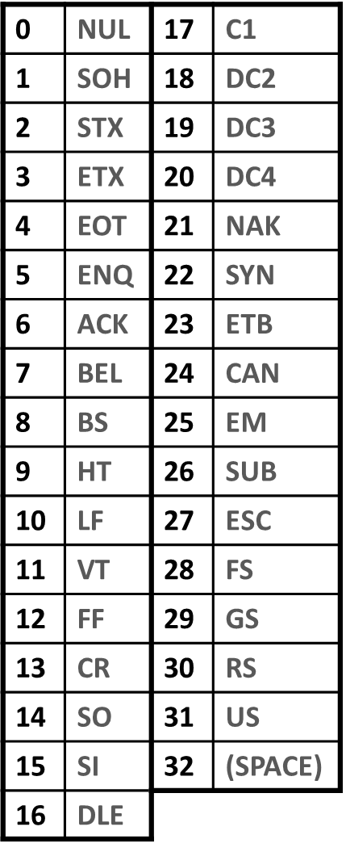
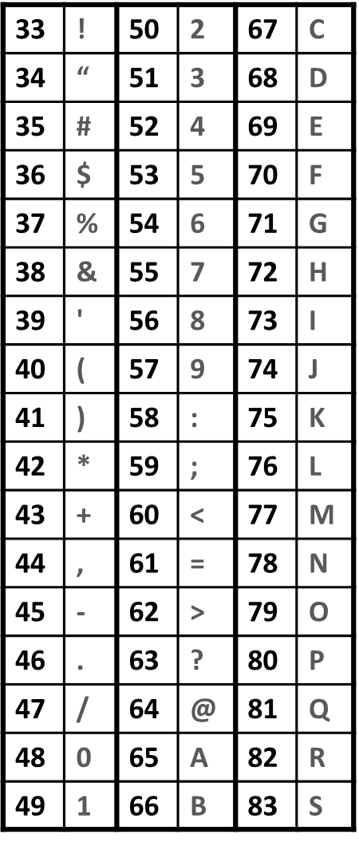
Phred Score Encoding
Translation of Phred score to single ASCII letter
Based on standard ASCII table
Can't translate directly
low values are non-printing
Encode with Sanger System*
Phred+33
*Historically also had Illumina = Phred+64

Slide 35
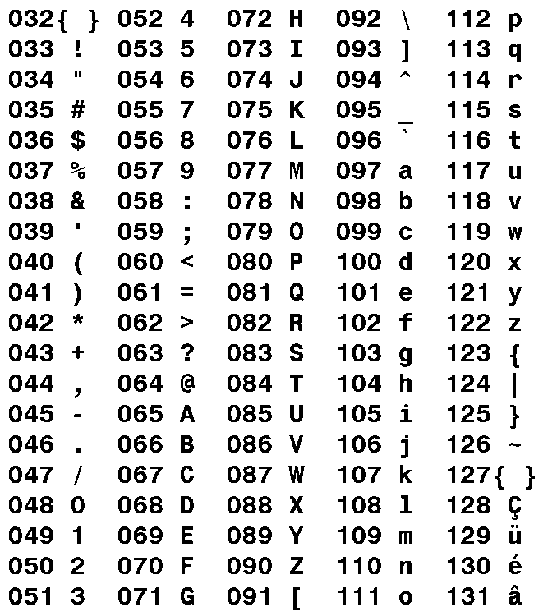
Phred score encoding
:GBGGGGGGGGGDGGDEDGGDGGGGDHHDHGHHGBGG:GG
: = ASCII 58
Phred33 encoding so Phred = 25
p = 10^^{(25/-10)}
p = 0.003

Slide 36
Phred score encoding
:GBGGGGGGGGGDGGDEDGGDGGGGDHHDHGHHGBGG:GG
Symbol | ASCII | Phred | Probability of miscall
: | 58 | 25 | p = 10^{^(25/-10)} = 0.003
G | 71 | ? | ?
BETTER
or
WORSE

Slide 37
Phred score encoding
:GBGGGGGGGGGDGGDEDGGDGGGGDHHDHGHHGBGG:GG
Symbol | ASCII | Phred | Probability of miscall
: | 58 | 25 | p = 10^{^(25/-10)} = 0.003
G | 71 | 38 | p = 10^^{(38/-10)} = 0.00016
BETTER

Slide 38
Phred score encoding
:GBGGGGGGGGGDGGDEDGGDGGGGDHHDHGHHGBGG:GG
Symbol | ASCII | Phred | Probability of miscall
G | 71 | 38 | p = 10^^{(38/-10)} = 0.00016
B | 66 | ? | ?
BETTER
or
WORSE

Slide 39
Phred score encoding
:GBGGGGGGGGGDGGDEDGGDGGGGDHHDHGHHGBGG:GG
Symbol | ASCII | Phred | Probability of miscall
G | 71 | 38 | p = 10^^{(38/-10)} = 0.00016
B | 66 | 33 | p = 10^^{(33/-10)} = 0.0005
WORSE

Slide 40
Aligned Data – BAM files
Expanded file containing alignment data as well as everything in the fastq file
Two sections
Header (list of reference seqs and how the file was created)
Alignments (details of the alignments and sequences)
Need special programs to read, normally 'samtools'

Slide 41
BAM Header
[andrewss@headstone Sample_lane1]$ samtools view -H lane1000_TTAGGC_test_L001_R1_GRCm38_hisat2.bam
@HD VN:1.0 SO:unsorted
@SQ SN:1 LN:195471971
@SQ SN:10 LN:130694993
@SQ SN:11 LN:122082543
@SQ SN:12 LN:120129022
@SQ SN:13 LN:120421639
…etc…
@PG ID:hisat2 PN:hisat2 VN:2.1.0 CL:"/bi/apps/hisat2/2.1.0/hisat2-align-s --wrapper basic-0 --dta --sp 1000,1000 -p 7 -t --phred33-quals -x /bi/scratch/Genomes/Mouse/GRCm38/Mus_musculus.GRCm38 --known-splicesite-infile /bi/scratch/Genomes/Mouse/GRCm38/Mus_musculus.GRCm38.90.hisat2_splices.txt -U /tmp/17469.unp"

Slide 42
BAM Alignments
[andrewss@headstone Sample_lane1]$ samtools view lane6045_TTAGGC_Col4_contr_L001_R1_trimmed_GRCm38_hisat2.bam | less
HWI-D00436:394:CBGLBANXX:1:1101:1222:1861 16 chr18 57944851 60 50M * 0 0 AAAAGATCTCTTGATTTAGAATTTTCTCTCAAATGTGAGGGACTTTTATN GGGGGGGGGGGGGGGGGGGGGGGGGGGGGGGGGGGGGGGGGGGGGBA<=# AS:i:-2 XN:i:0 XM:i:1 XO:i:0 XG:i:0 NM:i:1 MD:Z:49G0 YT:Z:UU NH:i:1
Sections
Sequence name HWI-D00436:394:CBGLBANXX:1:1101:1222:1861
Alignment Flags 16
Reference sequence name chr18
Start position 5794485
Mapping Quality (Phred) 60
Alignment (CIGAR) string 50M
Paired sequence name *
Paired sequence position 0
Total insert length 0
Called Bases AAAAGATCTCTTGATTTAGAATTTTCTCTCAAATGTGAGGGACTTTTATN
Base Quality String (Phred 33) GGGGGGGGGGGGGGGGGGGGGGGGGGGGGGGGGGGGGGGGGGGGGBA<=#
Other Tags

Slide 43
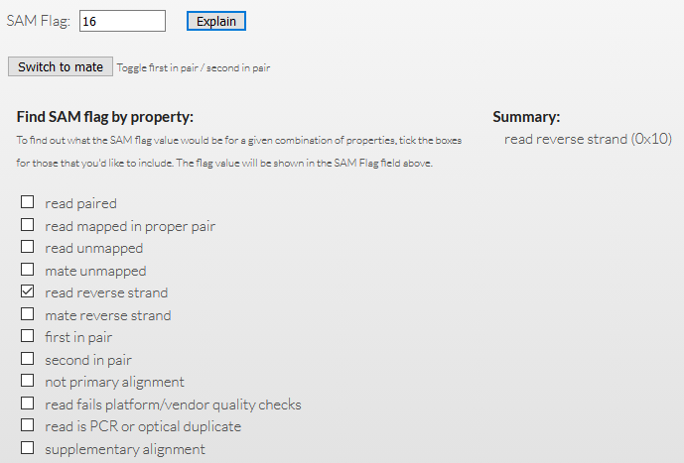
BAM Flags
A 12-bit binary number with a set of TRUE/FALSE values
Sequence is paired end
All reads from this template are aligned
This read didn't align
The paired read didn't align
The read aligned in the reverse orientation
The paired read aligned in the reverse orientiation
This is the first read
This is the second read
This is not the best alignment for this read
This read failed upstream QC
This read is a duplicate
This is part of a chimeric alignment
https://broadinstitute.github.io/picard/explain-flags.html

Slide 44
What can QC tell us?

Slide 45
QC metrics can we work with
Per Base Quality Scores
Library composition
Base level
Sequence Level
Known sequences
Mapping statistics
Downstream Quantitation Values

Slide 46
Context is Key for QC
Expectations
Observations
Critical Analysis
Understanding & Confidence
QC should be about what you expect and what you see
Notes:
Therefore some aspects of QC are highly context dependent

Slide 47
Context is Key for QC
Expectations
Individual Library:
Universal
Library Dependent
Replicate Libraries:
Consistency

Slide 48
Some Software Packages for Sequence QC

Slide 49
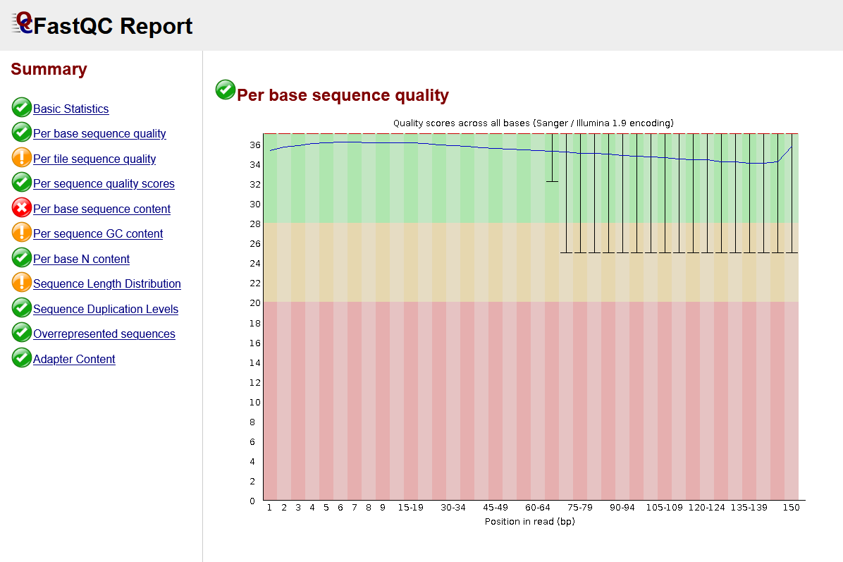
FastQC
Reads raw fastq files
Performs multiple checks
Pass/warn/fail
Compares to genomic library
HTML Report
https://www.bioinformatics.babraham.ac.uk/projects/fastqc/

Slide 50
FastQ Screen
Reads fastq files
Maps against a range of species / contaminants
Identifies unexpected sequences in your library
https://www.bioinformatics.babraham.ac.uk/projects/fastq_screen/

Slide 51
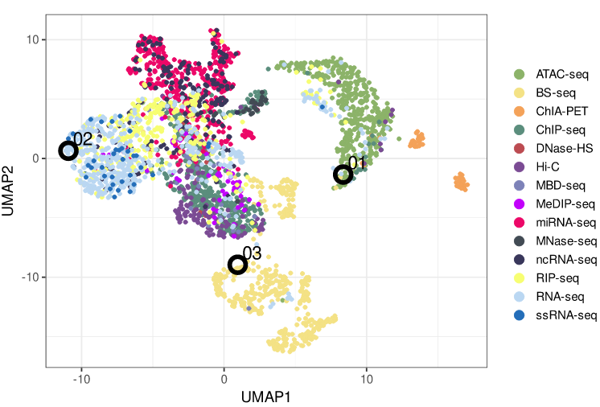
Librarian
Reads FastQ files
Looks at the base composition
Predict library type
Under development
https://github.com/DesmondWillowbrook/Librarian

Slide 52
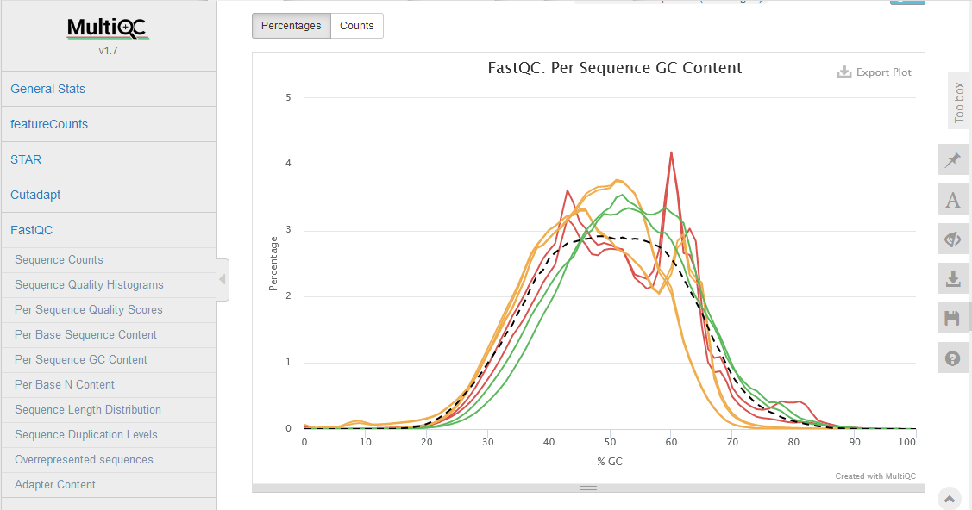
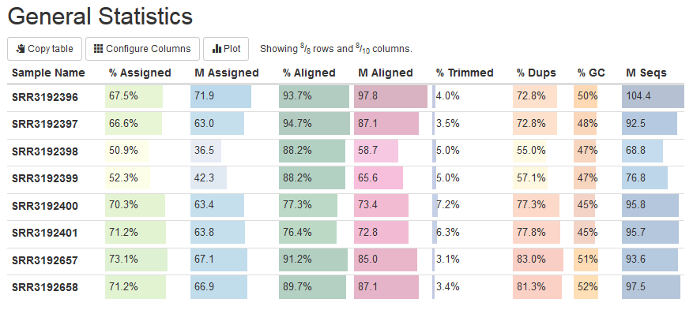
MultiQC
Aggregates QC information from multiple samples
Large number of programs supported
Combined HTML report
https://multiqc.info/

Slide 53
Assessing Universal Metrics

Slide 54
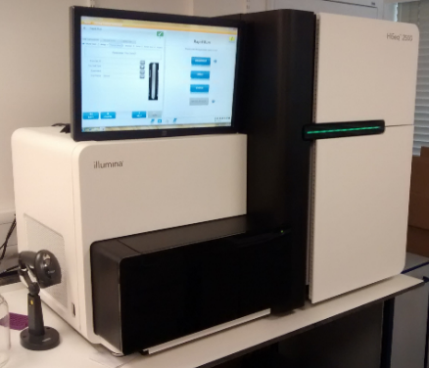
Universal QC Metrics
Demultiplexing
Base Call Quality
Adapter Content
Mapping Quality

Slide 55
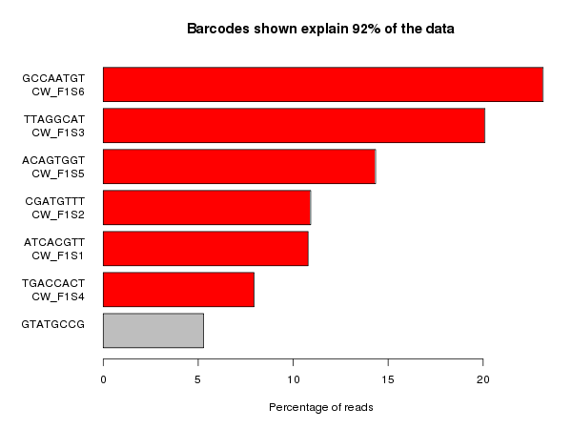
Demultiplexing: Barcode Sequences
Barcode
Adapter
Insert
Adapter
Barcode

Slide 56
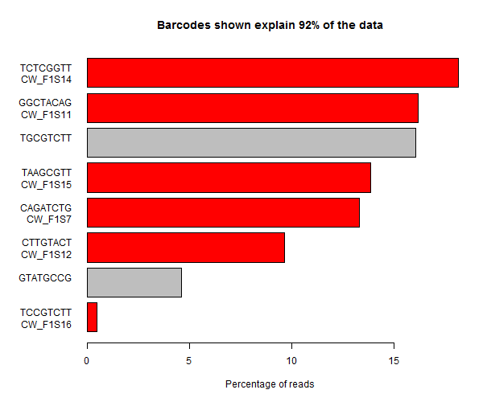
Demultiplexing: Barcode Sequences

Slide 57
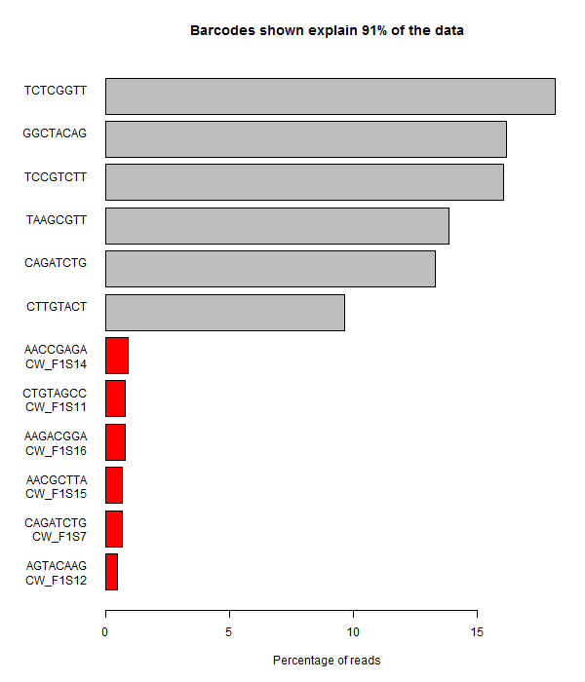
Demultiplexing: Barcode Sequences

Slide 58
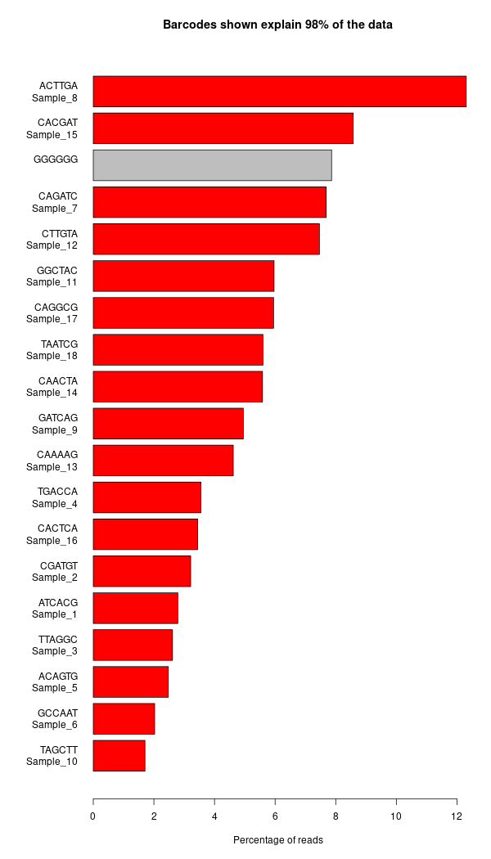
Demultiplexing: Barcode Sequences

Slide 59
Base Call Qualities – Per Cycle
Phred Score
Read Position / Cycles of Chemistry

Slide 60
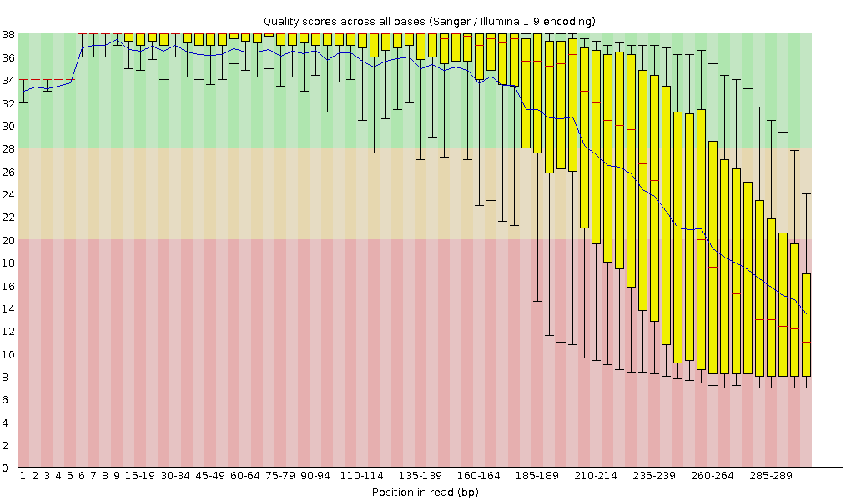
Base Call Qualities – Per Cycle
Phred Score
Read Position / Cycles of Chemistry

Slide 61
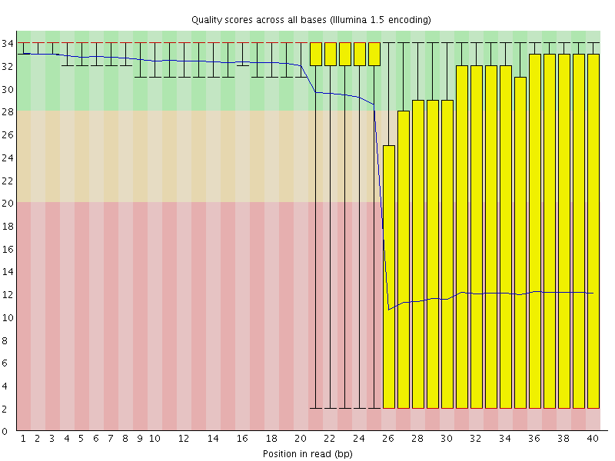
Base Call Qualities – Per Cycle

Slide 62
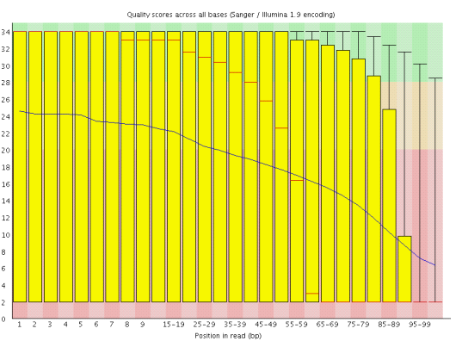
Diagnosing Poor Base Call Qualities
Not everything is bad
Can see identify why some parts are bad and others aren't?
May help to fix future runs

Slide 63
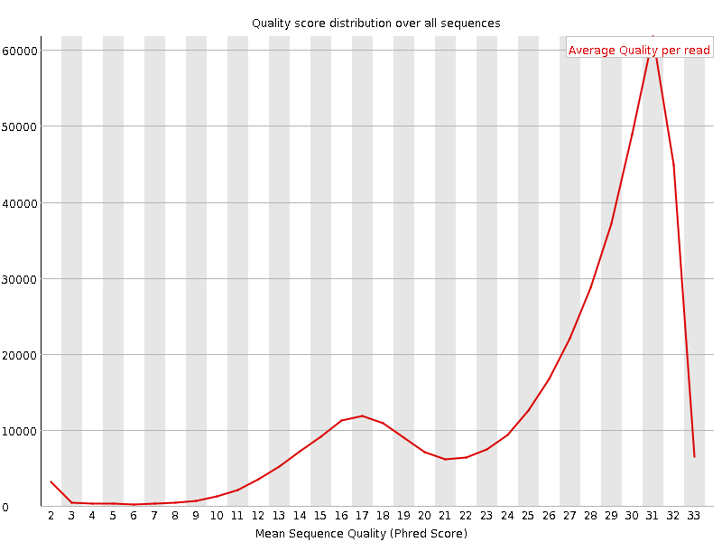
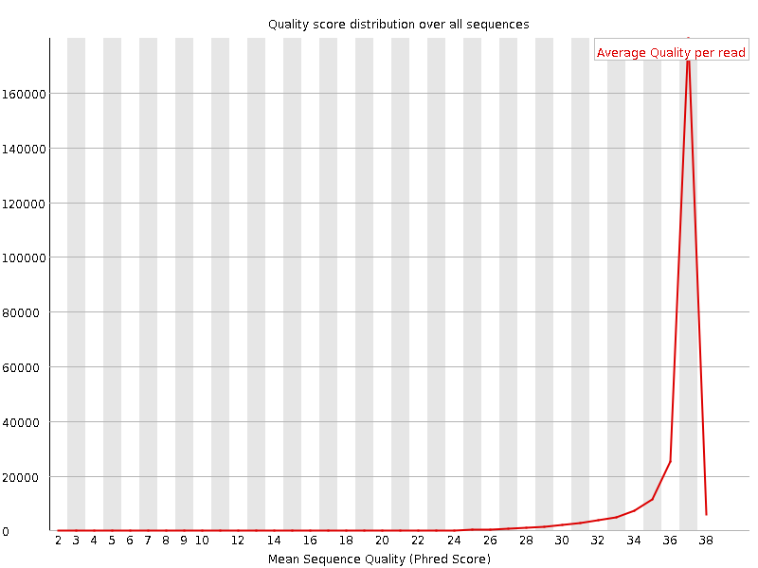
Per-Read Quality
Are all reads equally affected?
Is there a subset of reads which are always poor whilst others are good?

Slide 64
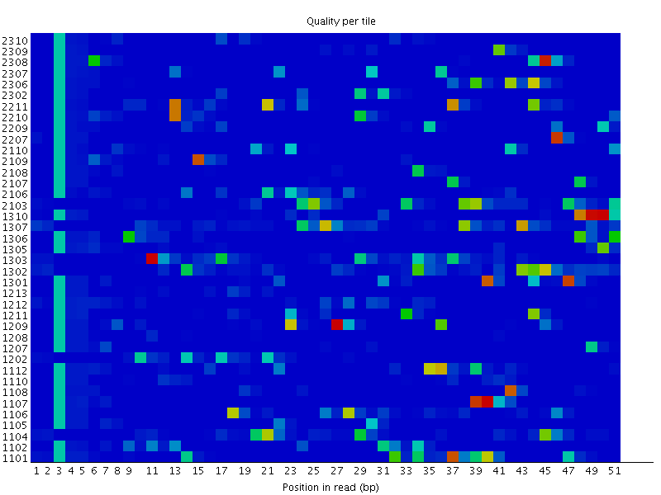
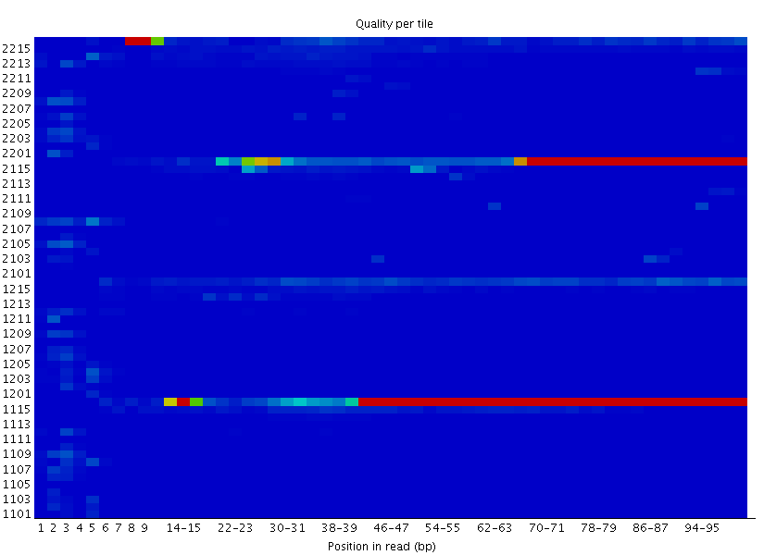
Positional Quality
Random Patterning
Tiles
Lanes
Top
Bottom
Position Specific
Patterning

Slide 65
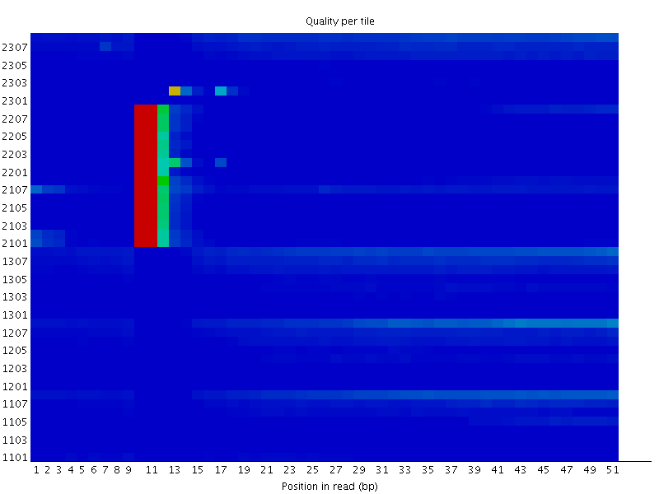
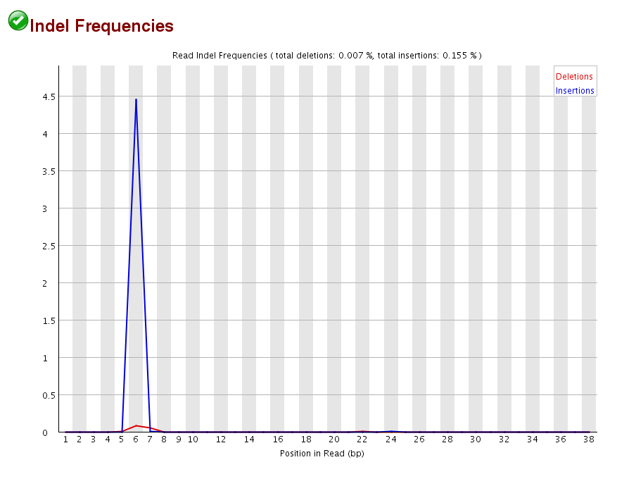
Positional Quality

Slide 66
Read-through Adapters
Read 1
Primer
Adapter
Insert
Adapter
Read 1
Primer
Adapter
Insert
Adapter

Slide 67
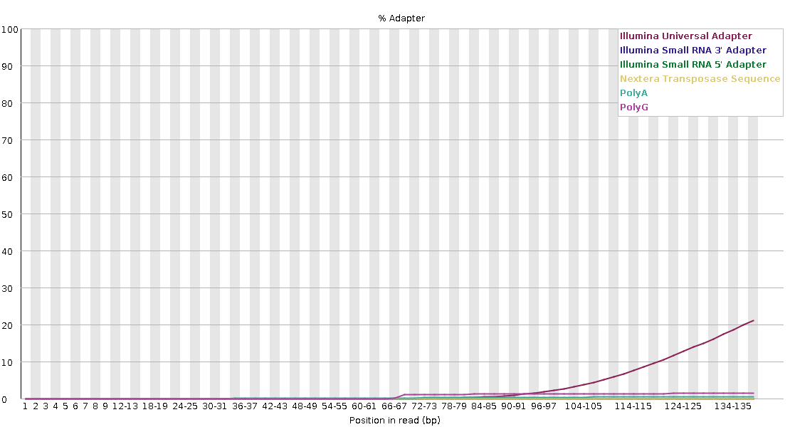
Measuring Read-though Adapters
Read 1
Primer
Adapter
Insert
Adapter

Slide 68
Clean-Up Options
Trimming 3’ end:
Remove adapter read through
Remove poor quality bases
Read 1
Primer
Adapter
Insert
Adapter
Some quality issues may need to also remove specific reads
Despite issues may still be good enough for what is needed e.g. mapping

Slide 69
Mapping Statistics
Time loading forward index: 00:01:10
Time loading reference: 00:00:05
Multiseed full-index search: 00:20:47
24548251 reads; of these:
24548251 (100.00%) were paired; of these:
1472534 (6.00%) aligned concordantly 0 times
21491188 (87.55%) aligned concordantly exactly 1 time
1584529 (6.45%) aligned concordantly >1 times
94.00% overall alignment rate
Time searching: 00:20:52
Overall time: 00:22:02
If many reads do not map to the expected genome…
…Where do they come from?

Slide 70
Library Screening
Map your reads against a range of reference genomes
Classify matches as: unique to one species & single or multiple mapping
Notes:
Any species you normally work with
Common lab contaminants (E coli and Human)
Artificial sequences (adapters, vectors)
Known problematic sequences (rRNA)

Slide 71
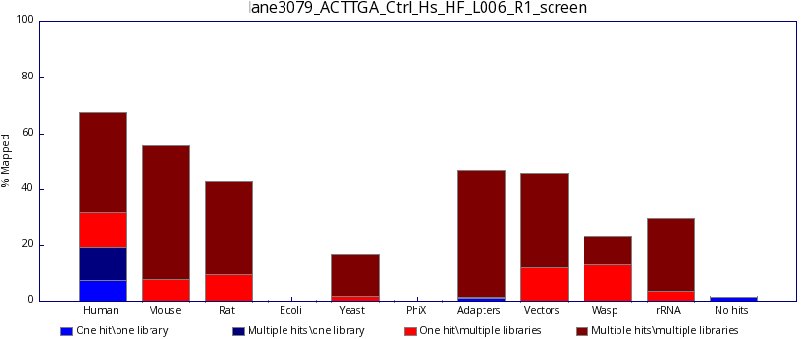
Library Screening

Slide 72
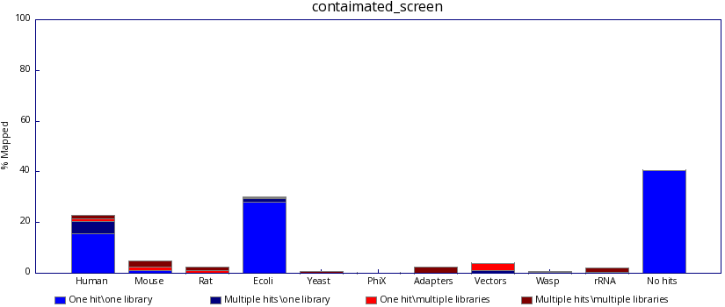
Library Screening

Slide 73
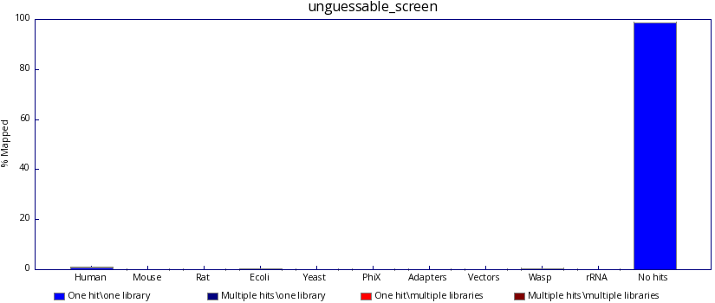
Library Screening

Slide 74
Assessing Library Dependent Metrics

Slide 75
Library Dependent QC Metrics
FastQC expects a Genomic Library: Do you?
Some QC metrics will be influenced by what you are sequencing
Concern or Expected?
GC Content
Base Composition
Duplication
Notes:
FastQC was built for standard genomic libraries, therefore it expects a standard genomic library
You Might not!

Slide 76
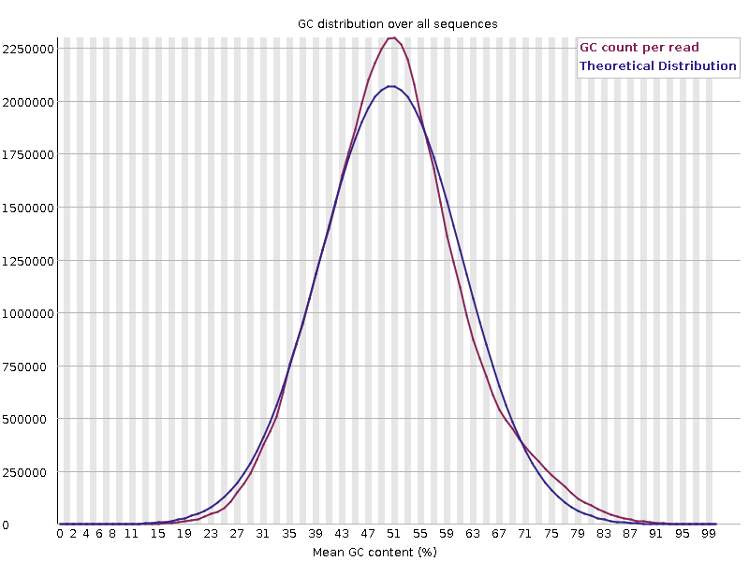
Library GC Content
Generic summary of library composition at a read level
Expect a normally distributed set of values centred on the overall GC content
Notes:
SRR14760809_GSM5363752_ATAC-seq_Tet1_KO_Replicate_#3_Mus_musculus_ATAC-seq_1.fastq.gz

Slide 77
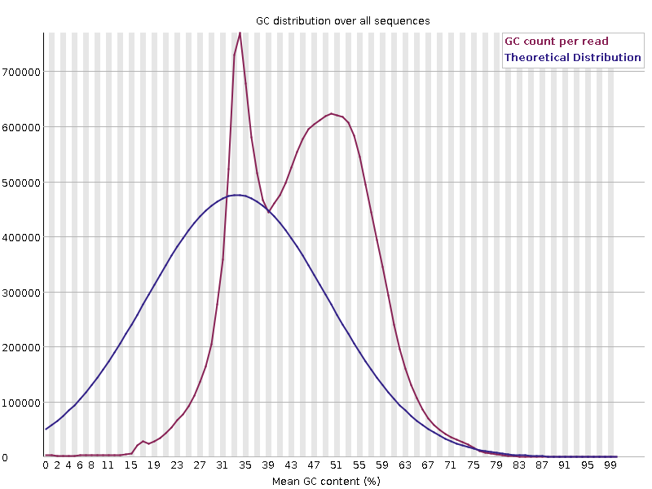
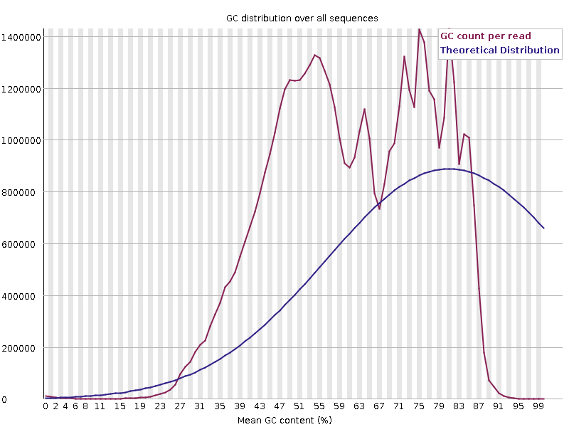
Sharp Peaks in GC
Concern or Expected
Specific Contamination with single sequence or closely related sequences
Artificial sequences, ribosomal RNA, contaminants
Notes:
file:///C:/Users/inglesfs/Downloads/SRR2089635_GSM1811753_WT_MII_oocyte_1_RNA-seq_Mus_musculus_RNA-Seq_2_val_2_fastqc.html#M5
(alternative single peak enriched with GC from: file:///C:/Users/inglesfs/Downloads/SRR6491539_GSM2891677_prpa_TOP1_INP_2_1_Homo_sapiens_ChIP-Seq_1_fastqc.html#M5)
From Masui_2023 file:///C:/Users/inglesfs/Downloads/SRR18752205_GSM6043804_Control_Eed_EPC._rep2_Mus_musculus_RNA-Seq_1_fastqc.html#M9
(looking at total RNA so ribosomal material makes sense here!)

Slide 78
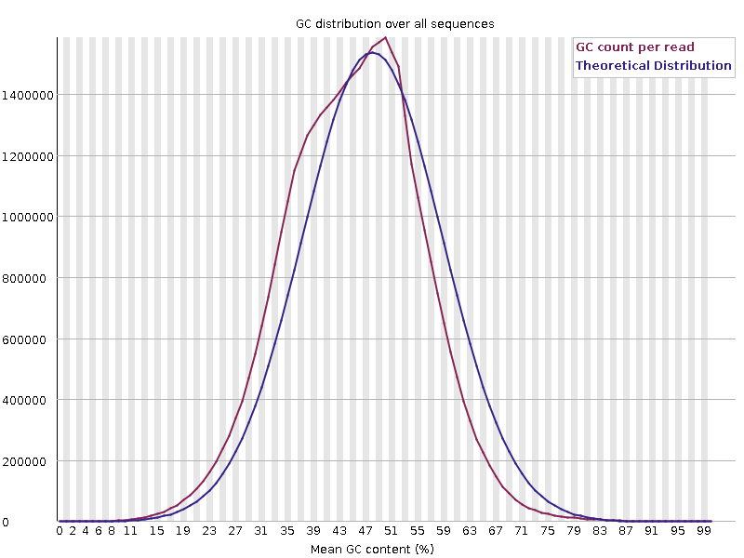
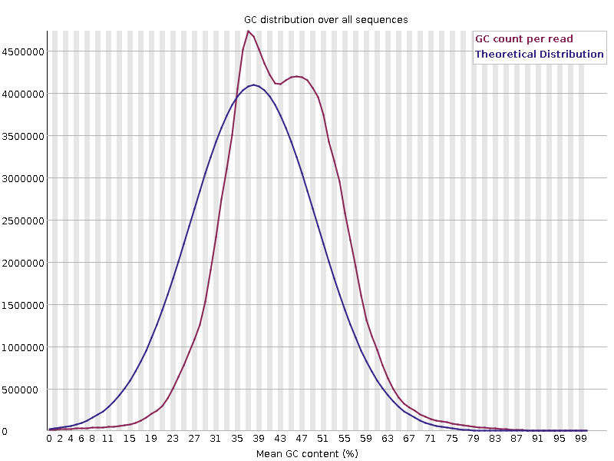
Broader Peaks in GC
Concern or Expected
Mouse
Drosophila
H3K4me1 ChIP: enrich for regions rich in GC
More extensive mixture of reads with different GC content
Notes:
Sample 4777 Sierra
lane2_Ub119_58_TCCGTCTT_L002_3536STDY7827645_R1_trimmed.fq.gz
Mouse sample with a drosophila spike-in (only around 1.5%)
Right: Feeney_2016 SRR3217295_GSM2084579_H3K4me1_pre-B_ChIP-seq_Mus_musculus_ChIP-Seq_trimmed.fq.gz

Slide 79
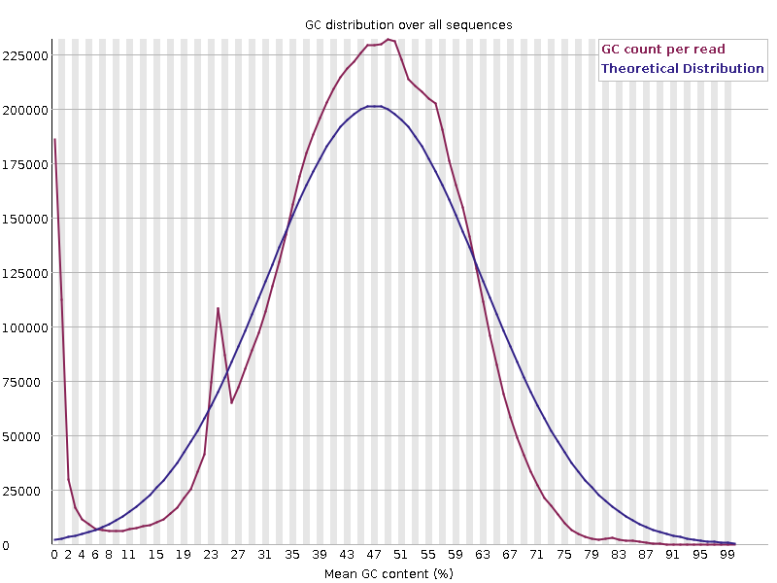
GC Skew
Concern or Expected
PolyA’s
PolyG’s
More extensive subset of reads with extreme differences in GC
Notes:
Left
file:///C:/Users/inglesfs/Downloads/SRR2240620_GSM1868818_EPI4.1_Homo_sapiens_RNA-Seq_1_val_1_fastqc%20(1).html#M5
(alternatives: file:///C:/Users/inglesfs/Downloads/SRR5476919_GSM2587220_E7.0_ExE_rep2_RNA_Mus_musculus_RNA-Seq_1_fastqc.html#M5)
Right This is an example of artificial GC enrichment due to polyG sequences
FromDorighi_2017 SRR5466763_GSM2586555_Input_DNA_WT_Mus_musculus_ChIP-Seq_1_trimmed.fq.gz

Slide 80
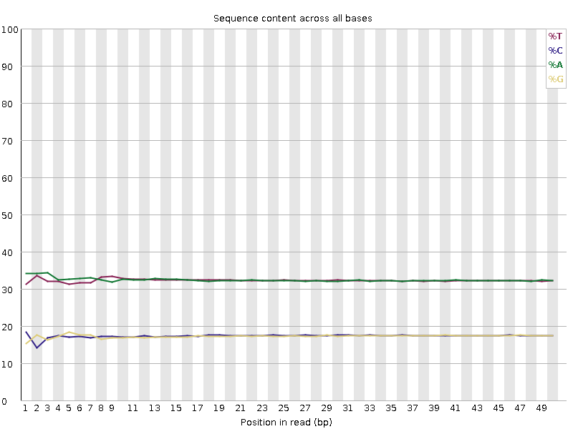
Library Base Composition
For every chemistry cycle we can look at the number of ATGC we call
For Libraries with random start positions the composition should be the same for all cycles
Notes:
Balance between GATC can vary
GC content of the species (GC separates from AT)
Systematic biases per library type
GC separate to AT
Lines mostly flat
So if you don’t see this can indicate some biases in the sequences you get back, but is that inherently a bad thing – well it depends on what you see vs what you expect
file:///C:/Users/inglesfs/Downloads/arrest_M-CDK_inhibited_rep6_SRR7533474_1_fastqc.html#M4

Slide 81
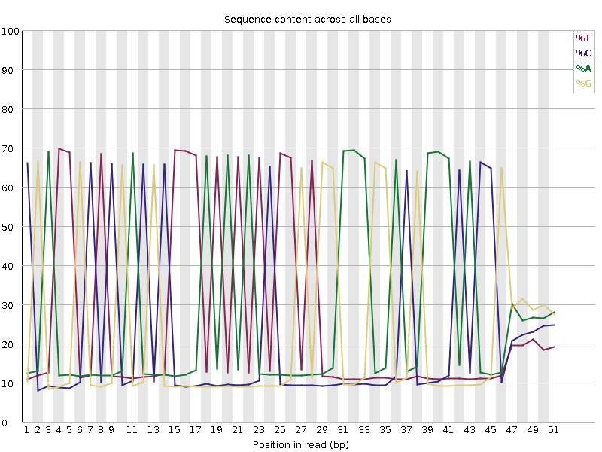
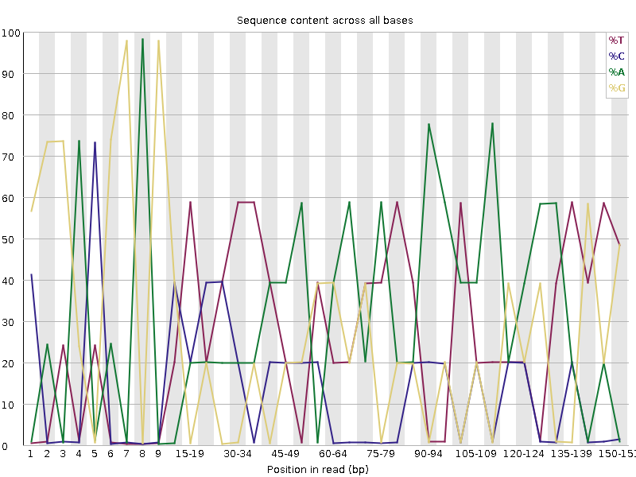
Bias Composition Throughout
Concern or Expected
Wrong Sequence
Amplicon
Proportional biases of bases at specific positions:
Very low diversity
Notes:
Left: Sample 5891 CRISPRa_gRNA_plasmid_library – technical error, sequenced primer before the variable sequence
Right: Sample 4135 lineage Cas9 4days Nextera amplicon
https://www.bioinformatics.babraham.ac.uk/sierra/sierra.pl/lane5716_AGGCAGAA_AAGGAGTA_E03_L001_R1_val_1_fastqc.html?action=send_file&lane_id=5716&path=%2Fdata%2Fprivate%2Fsierra%2Fdata%2F170802_M02293_0292_000000000-AU96R%2FUnaligned%2FProject_000000000-AU96R%2FSample_lane1%2Flane5716_AGGCAGAA_AAGGAGTA_E03_L001_R1_val_1_fastqc.html#M4

Slide 82
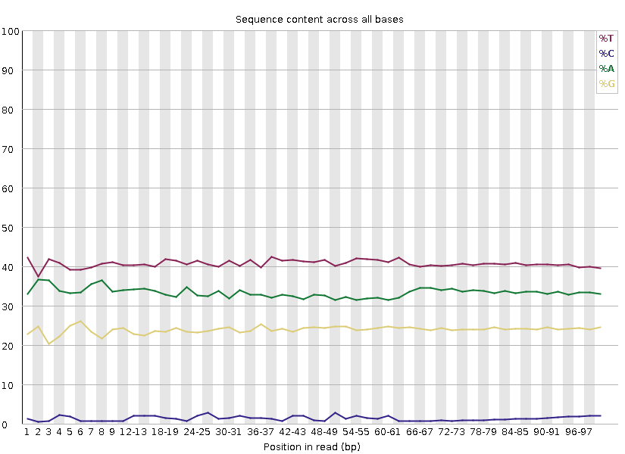
Bias Composition Throughout
Concern or Expected
WGBS
Consistent disproportional expression of bases
Notes:
http://bioinfdev.babraham.ac.uk/labrador/download_file.php?fn=Guo_2014/QC/SRR1295942_WGBS_human_ICM_lane1_1_val_1_fastqc.html

Slide 83
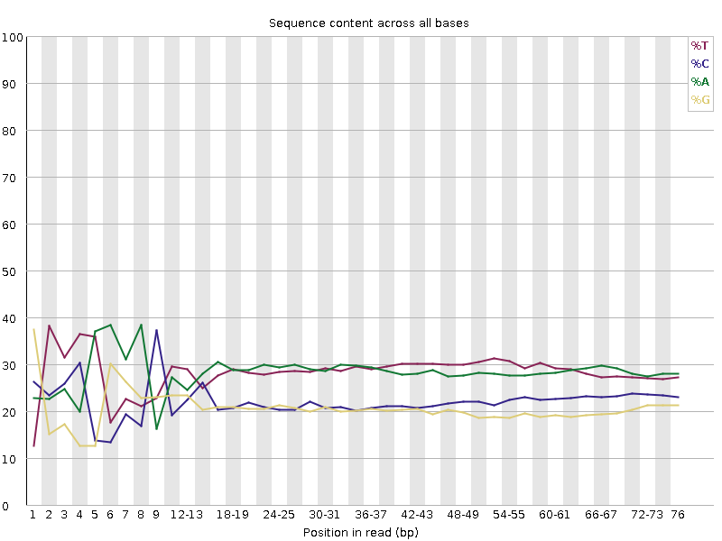
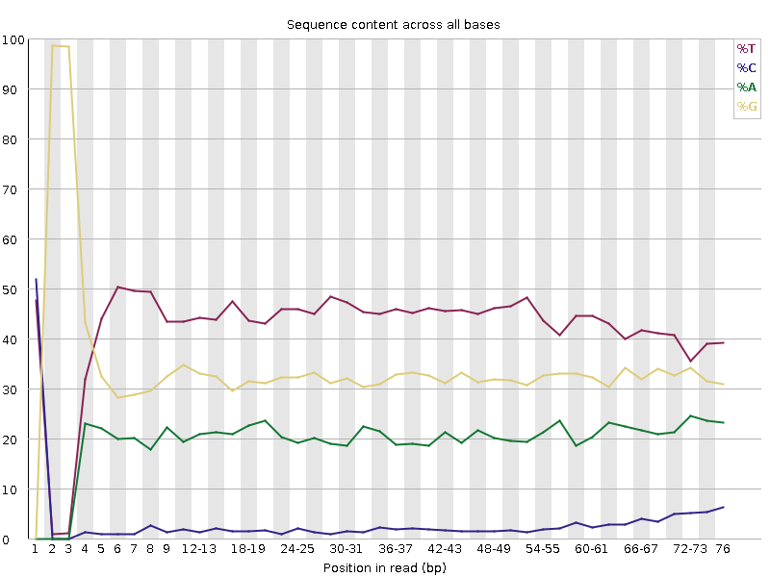
Bias Composition at 5’ end
Concern or Expected
ATAC – Transposases
RRBS – Restriction Start Site
Proportional biases of bases at the start of a read: A preferred start site
Notes:
ATAC: file:///C:/Users/inglesfs/Downloads/SRR10347760_GSM4140579_MuSC_d0_Young_bulkATACseq_Rep2_Mus_musculus_ATAC-seq_1_fastqc.html#M4
RRBS: file:///C:/Users/inglesfs/Downloads/SRR1544466_RRBS_E7_5_1_val_1_fastqc.html#M4

Slide 84
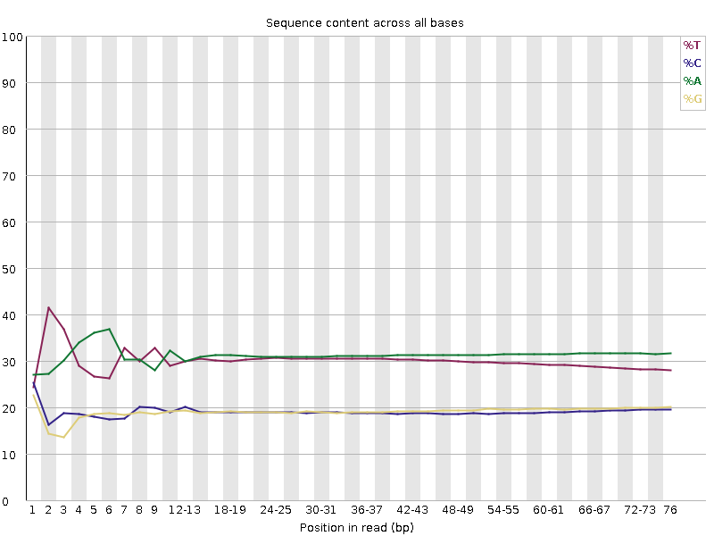
Bias Composition at 3’ end
Concern or Expected
Proportional biases of bases at the end of a read: consistent closing sequence
Notes:
https://www.bioinformatics.babraham.ac.uk/sierra/sierra.pl/lane8413_ATGAGC_2-JH1724-Log_L001_R1_fastqc.html?action=send_file&lane_id=8413&path=%2Fdata%2Fprivate%2Fsierra%2Fdata%2F230306_NB501547_0028_AHGLMTBGXM%2FUnaligned%2FProject_NextSeq%2FSample_lane1%2Flane8413_ATGAGC_2-JH1724-Log_L001_R1_fastqc.html#M4
lane8413_ATGAGC_2-JH1724-Log_L001_R1_fastqc.html

Slide 85
Bias Composition at 3’ end
Concern or Expected
Proportional biases of bases at the end of a read: consistent closing sequence
Bioinformatics processing can also influence QC metrics!
Notes:
https://www.bioinformatics.babraham.ac.uk/sierra/sierra.pl/lane8413_ATGAGC_2-JH1724-Log_L001_R1_trimmed_fastqc.html?action=send_file&lane_id=8413&path=%2Fdata%2Fprivate%2Fsierra%2Fdata%2F230306_NB501547_0028_AHGLMTBGXM%2FUnaligned%2FProject_NextSeq%2FSample_lane1%2Flane8413_ATGAGC_2-JH1724-Log_L001_R1_trimmed_fastqc.html#M4

Slide 86
Duplication
How frequently the exact same sequence appears in your library
For WGS expect most sequences to be unique

Slide 87
Duplication
If the exact same sequence appears more than once it could be…
Technical:
Coincidental:
ATCCGAGCTATTCGGCGAGCTCGCCAGTTACG
ATCCGAGCTATTCGGCGAGCTCGCCAGTTACG
ATCCGAGCTATTCGGCGAGCTCGCCAGTTACG
ATCCGAGCTATTCGGCGAGCTCGCCAGTTACG
ATCCGAGCTATTCGGCGAGCTCGCCAGTTACG
ATCCGAGCTATTCGGCGAGCTCGCCAGTTACG
PCR duplicates
Deep sequencing
Highly present sequences
Restricted diversity libraries
Notes:
The sequences come from different biological molecules and the duplication is coincidental
Deep sequencing
Highly present sequences (repeats for example)
Restricted diversity libraries (amplicon sequencing, restricted libraries)
The sequences come from the same biological and the duplication is technical
PCR duplicates

Slide 88
Duplication
Concern or Expected
RNA-Seq
Amplicon
BUT could have technical duplication with expected coincidental duplication!
Notes:
Some Libraries we expect coincidental duplication….
Modest duplication: RNAseq - file:///C:/Users/inglesfs/Downloads/SRR14760800_GSM5363743_RNA-seq_Tet1_KO_Replicate_R3_Mus_musculus_RNA-Seq_1_val_1_fastqc.html#M8
Extreme duplication: Amplicon Bisulphite seq - https://www.bioinformatics.babraham.ac.uk/sierra/sierra.pl/UHRF1chr1_L001_R2_val_2_fastqc.html?action=send_file&lane_id=8398&path=%2Fdata%2Fprivate%2Fsierra%2Fdata%2F230214_M02293_0001_AMPLICONBS%2FUnaligned%2FProject_Sanger%2FSample_lane1%2FUHRF1chr1_L001_R2_val_2_fastqc.html#M8

Slide 89
Overrepresented Sequences
Extreme duplication
The exact same sequence is a significant proportion of the whole library (which might not be duplicated overall)
Poly Sequences
Specific Sequences
Notes:
Normally comes from artificial sequences (primers, adapters, vectors etc)
Can search a database of known sequences to find matches

Slide 90
Sources of Poly Sequences
PolyN – Quality too poor to make any calls
PolyG – Empty space in 2 colour chemistry, can be technically “high quality” calls
Notes:
PolyN = Xie_2013_2 SRR304956_Reference_Epigenome_ChIP-Seq_Analysis_of_H3K27ac_in_BMP4_Trophoblast_Cells_1.fastq.gz
PolyG = Dorighi_2017 SRR5466763_GSM2586555_Input_DNA_WT_Mus_musculus_ChIP-Seq_1_trimmed.fq.gz

Slide 91
Sources of Poly Sequences
PolyA (or PolyT) – Common in RNA-Seq
Notes:
From http://bioinfdev.babraham.ac.uk/labrador/download_file.php?fn=Blakeley_2015/QC/SRR2240620_GSM1868818_EPI4.1_Homo_sapiens_RNA-Seq_1_val_1_fastqc.html
(alternative: file:///C:/Users/inglesfs/Downloads/SRR3337287_2-cell_embryo_RNA-seq_20cells_rep2_1_fastqc.html#M9)
Jiang_2023 file:///C:/Users/inglesfs/Downloads/SRR12439945_GSM4725073_mouse_placental_cells_E09.5_Mus_musculus_RNA-Seq_2_fastqc.html#M10

Slide 92
Overrepresented Specific Sequences
Normally artificial sequences (primers, adapters, vectors etc)
Can search a database of known sequences to find matches
Example of an Adapter dimer:
Barcode
Adapter
Insert
Adapter
Barcode
Barcode
Adapter
Adapter
Barcode

Slide 93
Overrepresented Specific Sequences
Other potential sources…
Ribosomal
Contaminant
Notes:
Ribosomal from (same as GC earlier, mouse total RNA)
file:///C:/Users/inglesfs/Downloads/SRR18752205_GSM6043804_Control_Eed_EPC._rep2_Mus_musculus_RNA-Seq_1_fastqc.html#M9
Ecoli from file:///C:/Users/inglesfs/Downloads/SRR11517364_GSM4471316_lung2_RNA_Homo_sapiens_RNA-Seq_1_val_1_fastqc.html#M9
(also see Ecoli in this sample in fastq screen, should be mouse)
Phage from Shcherbina_2020
file:///C:/Users/inglesfs/Downloads/SRR10347759_GSM4140578_MuSC_d0_Young_bulkATACseq_Rep1_Mus_musculus_ATAC-seq_1_val_1_fastqc.html#M9

Slide 94
Overrepresented Specific Sequences
Which of these libraries would you expect to flag with overrepresented specific sequences?
Whole Genome Bisulfite Library
Amplicon Library
RNAseq Library
Notes:
Amplicon
Sample 4135 lineage Cas9 4days Nextera amplicon
https://www.bioinformatics.babraham.ac.uk/sierra/sierra.pl/lane5716_AGGCAGAA_AAGGAGTA_E03_L001_R1_val_1_fastqc.html?action=send_file&lane_id=5716&path=%2Fdata%2Fprivate%2Fsierra%2Fdata%2F170802_M02293_0292_000000000-AU96R%2FUnaligned%2FProject_000000000-AU96R%2FSample_lane1%2Flane5716_AGGCAGAA_AAGGAGTA_E03_L001_R1_val_1_fastqc.html#M4
Also
Libraries focused on small RNAs
Long non coding RNAs
Ribosomal RNAs

Slide 95
Overrepresented Specific Sequences
Which of these libraries would you expect to flag with overrepresented sequences?
Notes:
Amplicon
Sample 4135 lineage Cas9 4days Nextera amplicon
https://www.bioinformatics.babraham.ac.uk/sierra/sierra.pl/lane5716_AGGCAGAA_AAGGAGTA_E03_L001_R1_val_1_fastqc.html?action=send_file&lane_id=5716&path=%2Fdata%2Fprivate%2Fsierra%2Fdata%2F170802_M02293_0292_000000000-AU96R%2FUnaligned%2FProject_000000000-AU96R%2FSample_lane1%2Flane5716_AGGCAGAA_AAGGAGTA_E03_L001_R1_val_1_fastqc.html#M4
Also
Libraries focused on small RNAs
Long non coding RNAs
Ribosomal RNAs

Slide 96
Assessing Consistency

Slide 97
Aggregated Statistics
Individual QC reports are useful but helpful to have a wider picture
Sample 1
Sample 2
Aggregate and plot range of QC stats together
https://multiqc.info/modules/
Notes:
Aggregate and plot range of QC stats together
Individual QC reports are useful but can be difficult to interpret without context
Help us spot local QC problems
We can aggregate and plot a range of QC statistics to make this easier
The simplest way to spot a local QC problem is that one sample doesn't look like the rest

Slide 98
Sample1
Sample2
Sample3
Sample4
Sample5
Sample6
6 Samples, 24 files:
Paired end
Pre/post trimming

Slide 99
Aggregated Mapping Stats
Identify local QC problems by spotting samples that behave differently
FastQ Screen
Notes:
The simplest way to spot a local QC problem is that one sample doesn't look like the rest
Olivia?

Slide 100
Putting QC into Practice

Slide 101
Expectations and Observations are Key
Can you tell if these libraries are any good?
Notes:
You can’t tell without the bigger picture, need the context of the library type / experiment
Also need to actually look at the underlying data
We also need the bigger picture, not just fastqc other stats about the library too
First one is a chip input (untrimmed)
Second one is RNA-seq
Third one is Repeat Amplicon Bisulphite

Slide 102
QC In A Nut-Shell
Expectations
Observations
Critical Analysis
Understanding & Confidence
Good Science ☺

Slide 104
Exercise: Assess the Quality of Public Sequencing Datasets
Consider Expectations
Review Observations
Fastq File
QC Metrics:
FastQC
RNA-Seq
ChIP-Seq
Trimmed Fastq File
QC Metrics:
FastQC
FastQ Screen
WGBS
ATAC-Seq
Aligned File
e.g. bam file
QC Metrics:
Aligner programme dependent QC stats
e.g. mapping statistics

