Slide 1
Inkscape Tutorial
v2023-02
Simon Andrews
simon.andrews@babraham.ac.uk

Slide 2
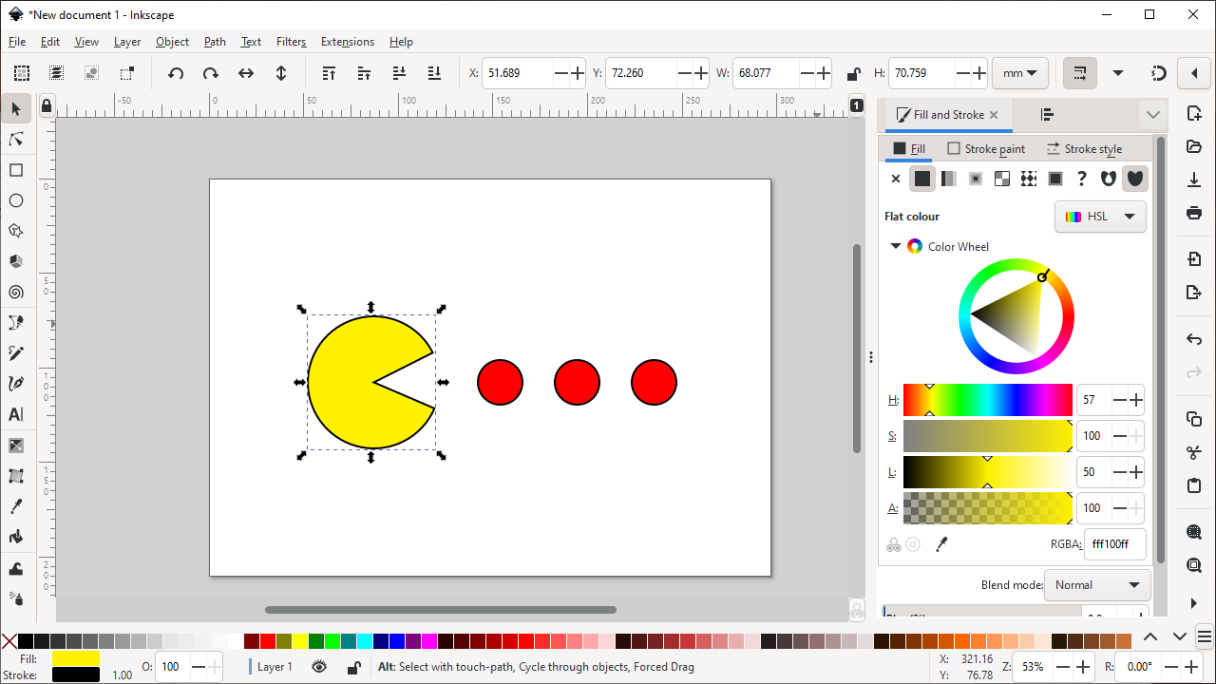
What is Inkscape?
Vector Graphics Editor
Free Software
Cross Platform
Easy to use
Good for:
Compositing
Drawing
Not for:
Bitmap editing
www.inkscape.org

Slide 3
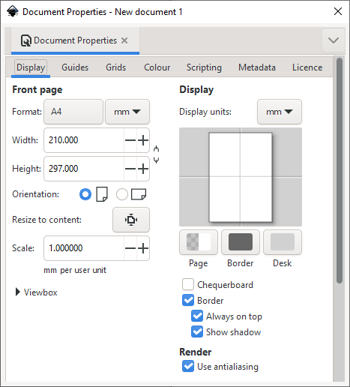
Setting up a canvas
File > Document Properties
Shows page in view
Doesn’t restrict drawing
Useful as a guide

Slide 4
Moving around
Panning
Scroll bars on bottom / right
Scroll up/down, Shift+scroll for left/right
Zooming in / out
Click to zoom in, shift+click to zoom out
Control + Scroll Up/Down to zoom in/out to cursor
Shortcuts
Fit page, drawing, selection in window

Slide 5
The main toolbar
Selection tool
Edit nodes tool
Make rectangles
Make ellipses / arcs
Make polygons / stars
Make 3D boxes
Make spirals
Draw straight lines / curves
Draw freehand lines
Calligraphy tool
Add text

Slide 6
Creating basic shapes
Select tool from toolbar
Click and drag on canvas
Box selects the bounds of the new shape
Colours are remembered from the last shape
Basic options appear in top toolbar
Number of spokes on stars
Rounded corners on rectangles
Circle vs segment vs arc

Slide 7
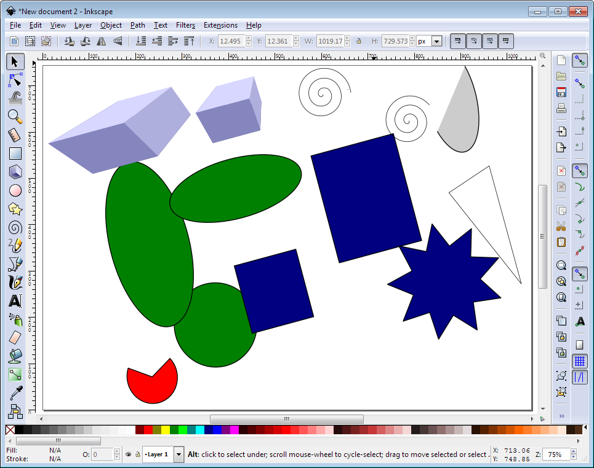
Creating basic shapes

Slide 8
Creating basic shapes
Modifiers – press keys whilst drawing
Control = Constrain height/width ratio
Easiest way to make circles / squares
Shift = grow from centre not edge
Help appears at the bottom of the screen

Slide 9
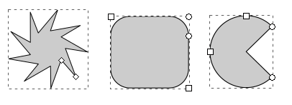
Control nodes
Use the Edit Nodes tool
Two types of control points, squares and circles
Squares generally change the size of the shape
Circles change the appearance

Slide 10
General Transformations
Select the Selection tool
Moving – Click and drag an object
Duplicating – Select object and press Ctrl+D
Resizing / Rotating
Click on object
Click again to change control arrow type
Click and drag arrows to resize / rotate

Slide 11
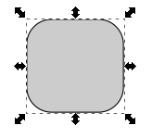
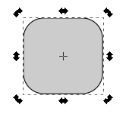
Resize / Rotate
Resize
Rotate
Can use shift/control keyboard modifiers as before
For rotation you can move the crosshair to change the centre of rotation

Slide 12
Transform Shortcuts
Rotate 90 degrees anticlockwise
Rotate 90 degrees clockwise
Mirror object around the vertical axis
Mirror object around the horizontal axis

Slide 13
Selecting and Grouping
Selecting multiple objects
Drag a box to cover multiple objects
Shift+click to add an object to a selection
Shift+click on a selected object to remove it from the selection
Grouping
Combine multiple objects into a single object
Reversible

Slide 14
Grouping
Select Multiple Objects
Object > Group (Control+G)
Multiple Levels
Object > Ungroup (Control+Shift+G)

Slide 15
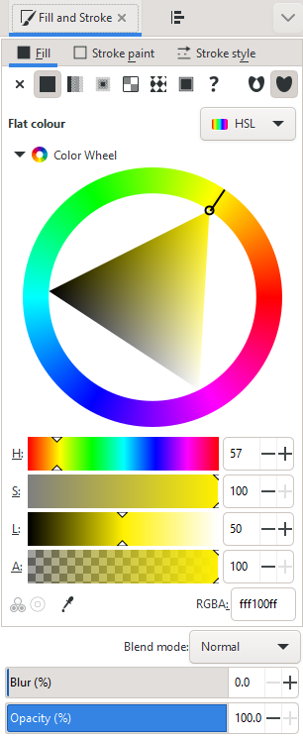
Fill and Stroke
Fill = Colour/Gradient/Pattern within a shape
Stroke = The line around a shape
Object > Fill and Stroke (Shift+Ctrl+F)
Edit
Colours
Opacity
Blur

Slide 16
Opacity / Blur
Applies to whole object
Separate from alpha in colours
Works on all Objects

Slide 17
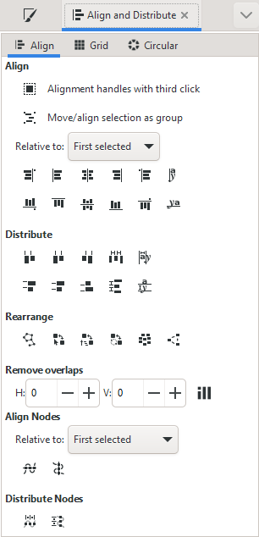
Aligning and Distributing
Object > Align and Distribute
Align = Give objects the same centre/edge position
Distribute = Space objects evenly
Align relative to
First/Last selected object in group
Largest/Smallest object in group
Page
Drawing

Slide 18
Aligning and Distributing
Align top edges
Align centres (horizontal)
Align centres (vertical)
Even spaces between objects

Slide 19
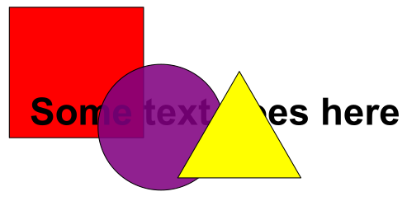
Z axis - Ordering
New objects sit over the top of old objects
Objects obscure those underneath them (except for transparency)

Slide 20
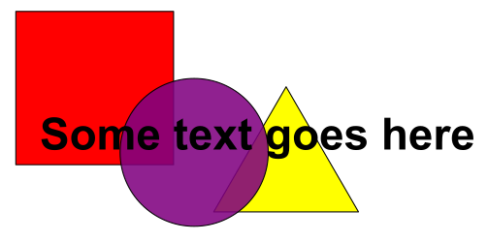
Z-axis Ordering
Send object to bottom of z-stack
Lower object one level
Raise object one level
Bring object to top

Slide 21
Working with bitmaps (photos)
Inkscape can include bitmaps in images
Appear as objects alongside vector objects
Can’t edit the images
Can’t increase the resolution of the image
Transparency (from PNG etc) is preserved
File > Import
PNG, JPEG, SVG, PDF etc. etc.

Slide 22
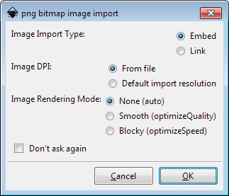
Working with bitmaps (photos)
Embed
Large file sizes
No updating image
Portable file
Link
Small file sizes
Need to keep original
Can update original
Can’t (easily) move file

Slide 23
Creating and Editing Paths
Created using freehand or line tool
Can convert other objects to become a path
Paths are composed of nodes and segments
There are different types of node and segment

Slide 24
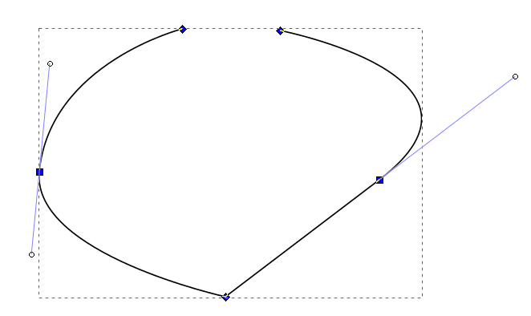
Nodes and Segments
3
3
Segment types
Lines (1)
Curves (2)
Node types
End (3)
Corner (4)
Smooth (5)
Normal
Symmetric
Auto
2
2
5
1
2
4

Slide 25
Editing nodes
Use nodes toolbar to add, remove or convert nodes or segments
Select nodes or segments to make their handles visible
Drag handles to change the arc of curves

Slide 26
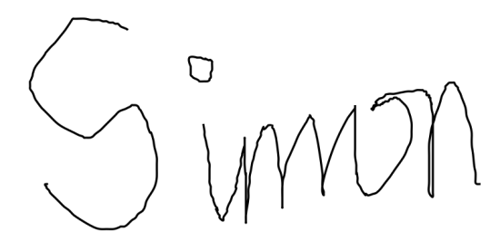
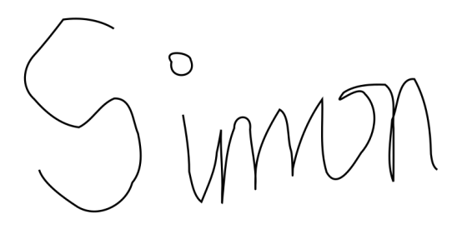
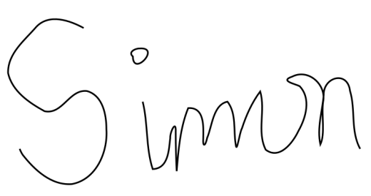
Freehand drawing
Freehand drawings tend to have large numbers of nodes, and be quite messy
Can use simplification (Path > Simplify, Ctl+L)
Can finally edit nodes on the simplified version

Slide 27
Combining paths
Often want to add or subtract objects from each other
Have to do this as paths (Path > Object to Path)
Lots of options for joining paths together

Slide 28
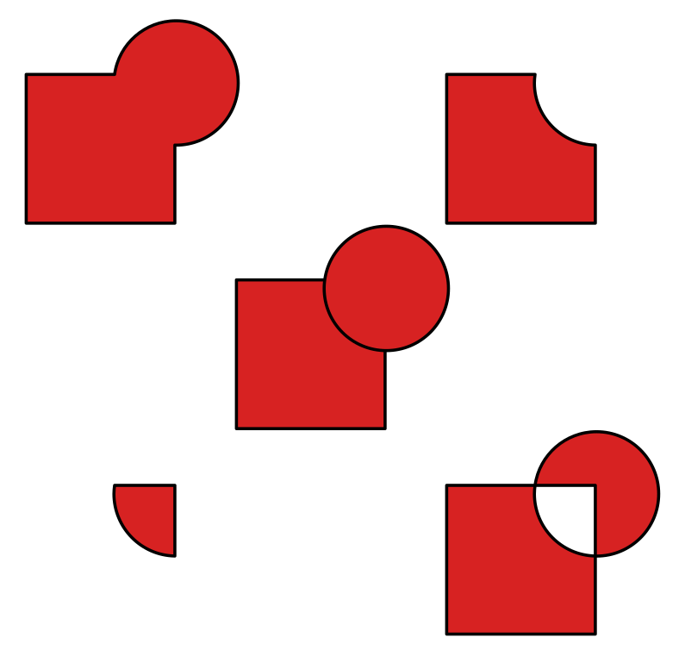
Combining Paths
Union
Difference
Intersection
Exclusion

Slide 29
Adding Text
Use the text tool to add text.
Click and type to generate text
Text can be scaled or rotated as any other object
Always hold Ctrl when scaling otherwise the aspect ratio will be messed up

Slide 30
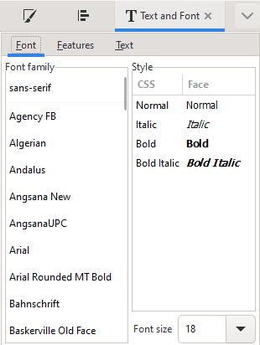
Text options
Text toolbar
Text and font settings
Font
Alignment
Spacing

Slide 31
Saving
Saving
File > Save (As)
Default is Scalable Vector Graphics (SVG)
Adds custom extensions to SVG standard
Can select plain SVG for maximum compatibility
Can compress SVG (svgz) for disk space saving

Slide 32
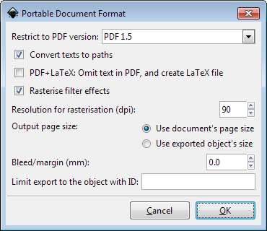
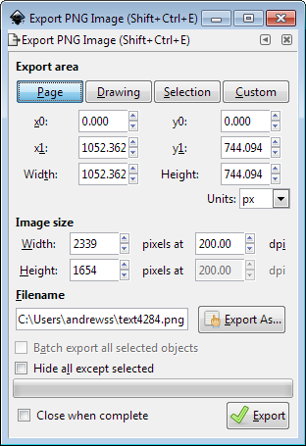
Exporting
Vector
Can export as a PDF
File > Save (As), select PDF
Bitmap
Can render high quality PNGs
File > Export PNG Image

